Slide 1
Test stand for superconducting magnets cooled with cryocoolers and development of cryogenic PHP at PSI
Michal Duda, Carolin Zoller :: Magnet Section :: Paul Scherrer Institute
4th Superconducting Magnet Test Facility Workshop
25/04/2023

Slide 2
Outline
Introduction PSI, Magnet Section and CHART
Cryogen Free Test stand WNLA/010
Cold tests results
Planned upgrade
Upcoming projects
Michal
Carolin

Slide 3
Paul Scherrer Institute (PSI)
Largest research institute for natural and engineering sciences within Switzerland
Three main fields of research: matter and materials, energy and the environment and human health
Develops, builds and operates complex large research facilities
Employs 2100 people
~2500 visiting scientists using facilities for experiments
Part of the ETH Domain that also includes ETH Zurich and EPFL Lausanne
Financed by the federal Government

Slide 4
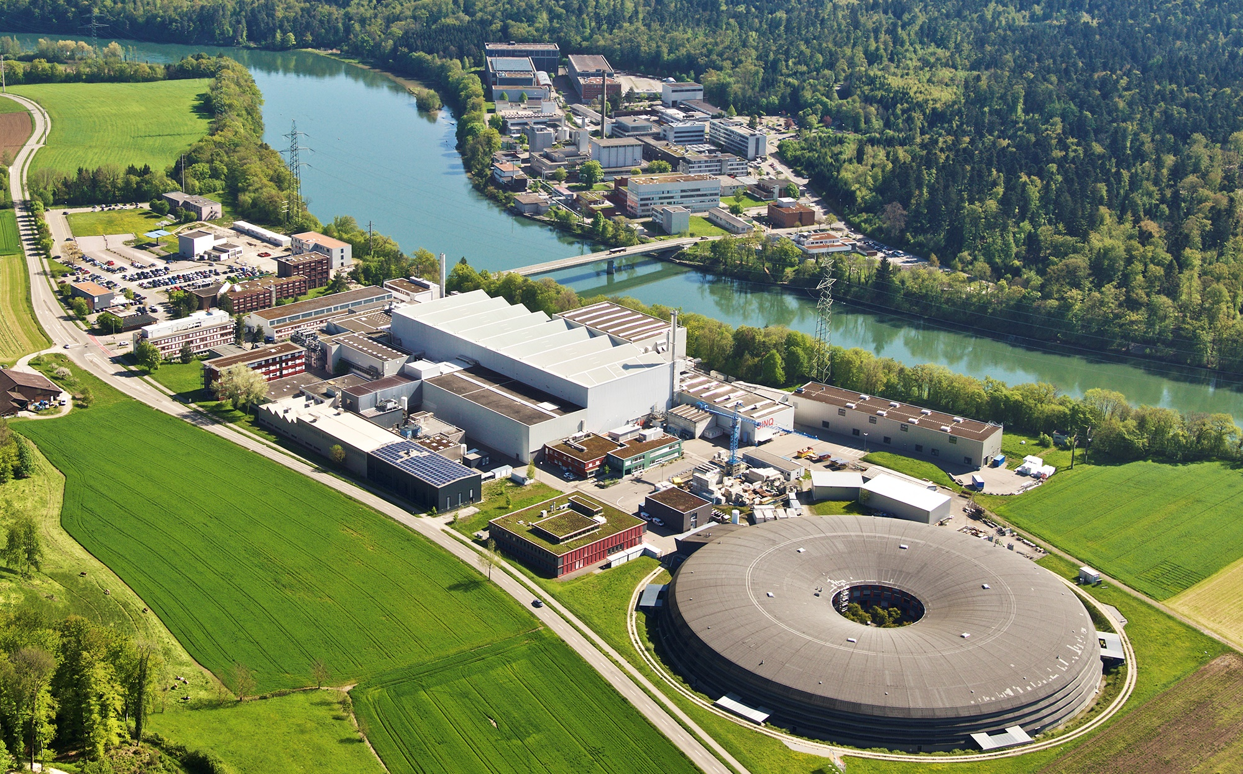
Paul Scherrer Institute (PSI)
⬅ Basel
Germany ⬆
Aarau/Bern ⬇
Zurich ➔
Material sciences
Nanotechnology
Radiochemistry
Hotlab
Radiopharmacy
PSI East
Biology
ESI Platform
SwissFEL
Particle physics
Energy research
Proton accelerator
Neutron source
Muon source
Proton therapy
PSI West
Synchrotron Light Source (SLS)
Notes:
This is a bird’s-eye view of PSI.
As you can see, we cover a broad range of research areas :
from materials research and energy research to nanotechnology and biology.
On the western side of the river Aare, you can see our three current large research facilities: the Synchrotron Light Source SLS, the Neutron Spallation Source SINQ and the Muon Source SµS. The Center for Proton Therapy for the treatment of specific cancers is located in-between.
Our fourth large research facility, SwissFEL, is currently under construction in the forest on the eastern side.
PSI runs these facilities not only for its own use, but also for any researchers from academia and industry from Switzerland and abroad.

Slide 5
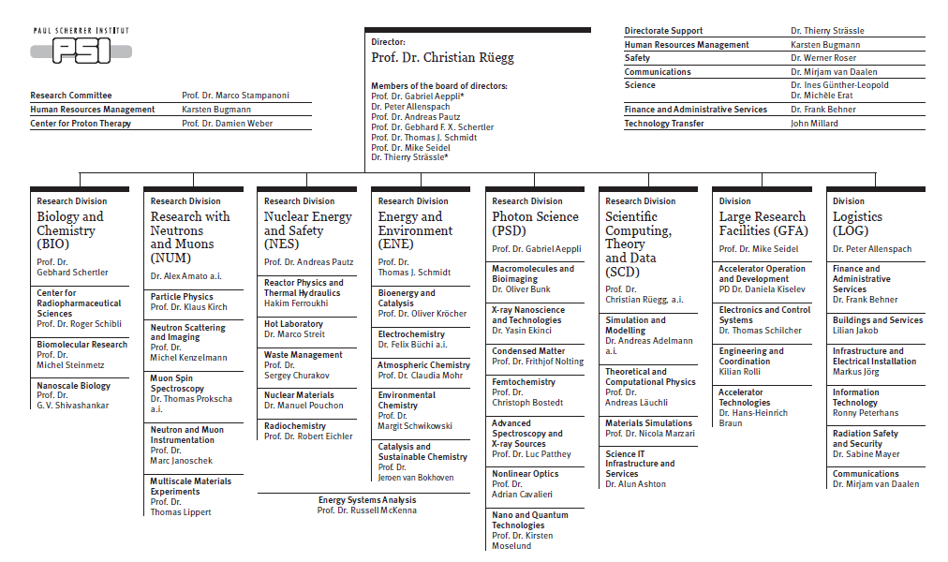
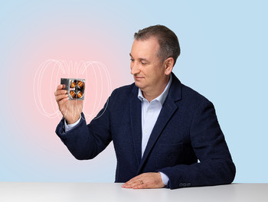
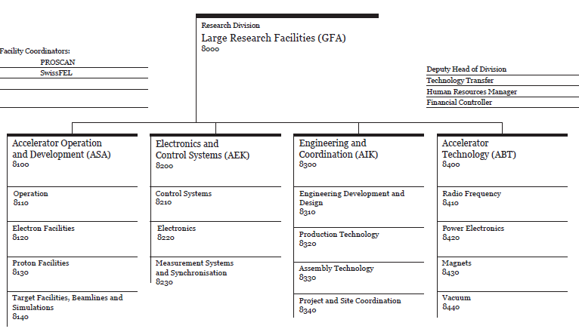
Magnet section at PSI
Stéphane Sanfilippo
head of the Magnet Section
23 section members

Slide 6
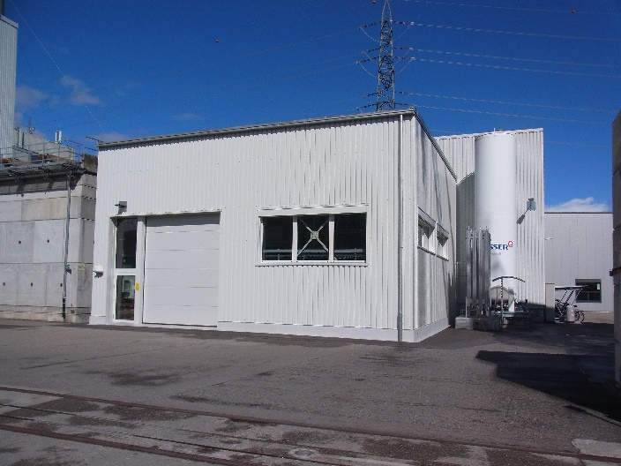
Magnet infrastructure at PSI
Construction SC magnets
CHART
Construction and test NC magnets and PM
SC magnets
teststand
Office

Slide 7
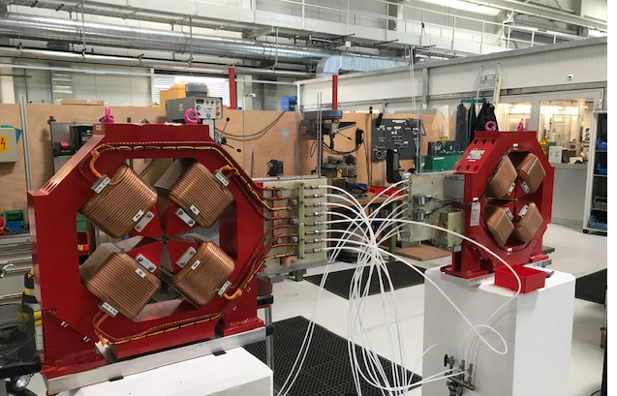
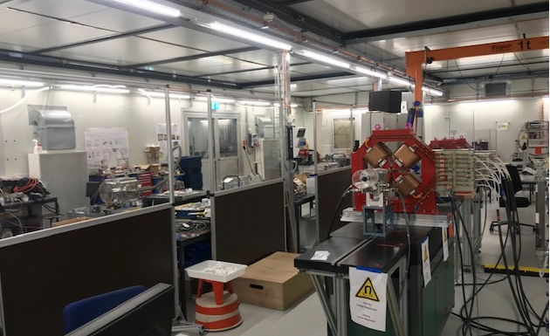
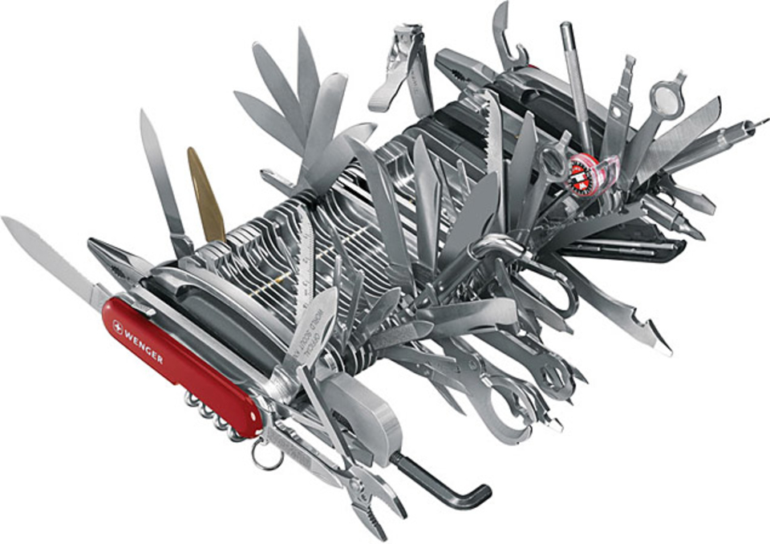
Magnet section activities
activities centered around the magnets (PM, EM, SC) needed for existing and planned accelerator facilities at PSI
magnetic and mechanical design, the construction, procurement and/or assembly of the magnets
qualify the magnetic specifications with measurements and data analysis
maintain and repair existing magnet assemblies at PSI
maintain and develop magnetic measurement systems
promote collaboration and support in our field of expertise
Construction and test EM and PM

Slide 8

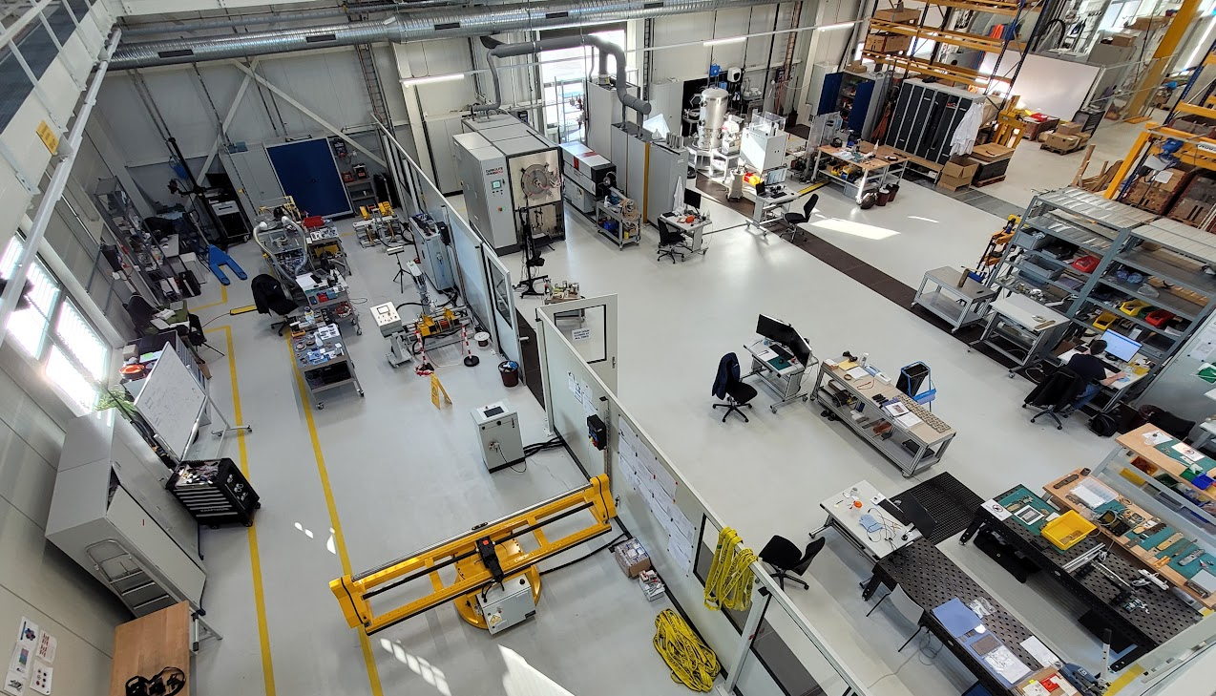
CHART @ PSI
“Swiss Accelerator Research and Technology – CHART” is a Swiss research network with PSI as a host institute and CERN, EPFL, ETHZ, and UniGE as additional members (http://chart.ch)
Strand / Tape
LTS/HTS conductor R&D, Characterization
Cable
Rutherford / Roebel production
Magnet Design
FCC-hh / HE-LHC conceptual and technical
Coil Manufacturing
Nb3Sn and HTS coils
Mechanical Assembly
Mechanical loading
Testing
LTS and HTS magnet tests
Heat treatment
Impregnation
  CHART MagDev @ PSI
  creates sc magnet development infrastructure
  LTS (Nb3Sn) technology development for the international high-field magnet project
  NI HTS (REBCO) coil program
  HTS (REBCO) superbend demonstrator
  bulk-HTS (REBCO) undulators
  HTS capture solenoid for a positron source
3D Scanning
HTS winding
Storage
LTS re-reeler
Instrumentation
Loading / Assembly
LTS winding

Slide 9
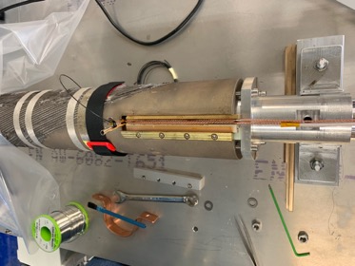
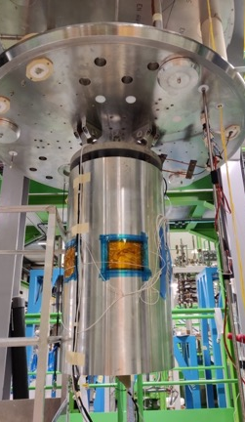
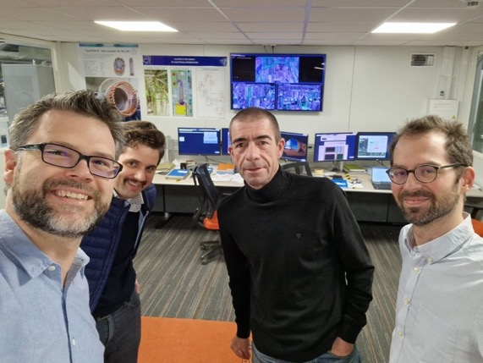
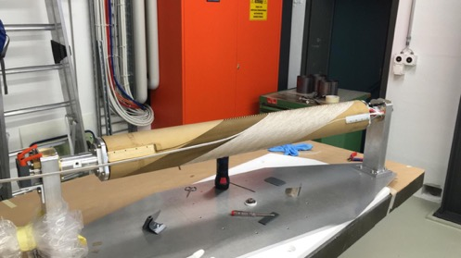
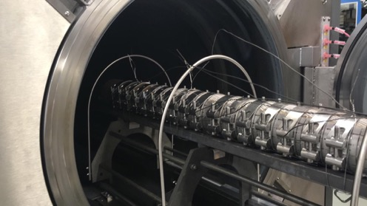
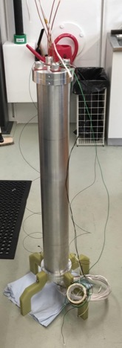
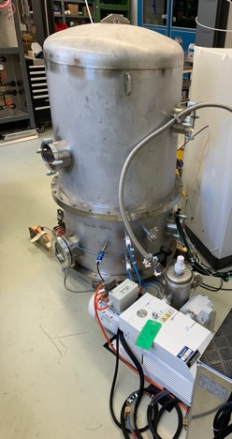
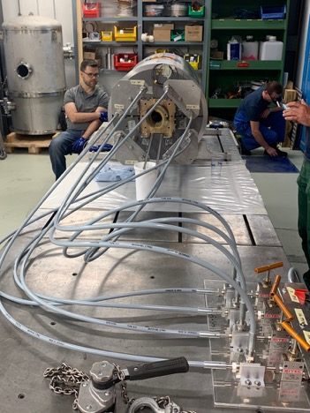
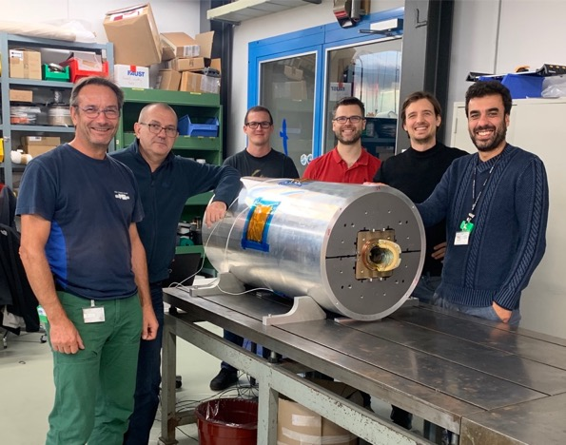
CD1 magnet Nb3Sn CCT dipole
Courtesy of Franco Mangiarotti
It reached 10.1 T in the bore at 94% of Iss at 1.9 K; 9.9 T and 100% of Iss at 4.5 K
Courtesy of Michael Daly
Courtesy of Giuseppe Montenero

Slide 10
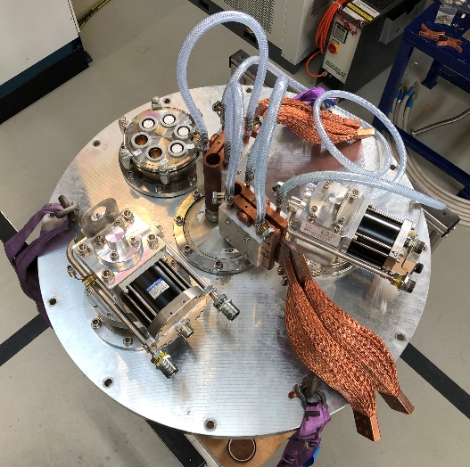
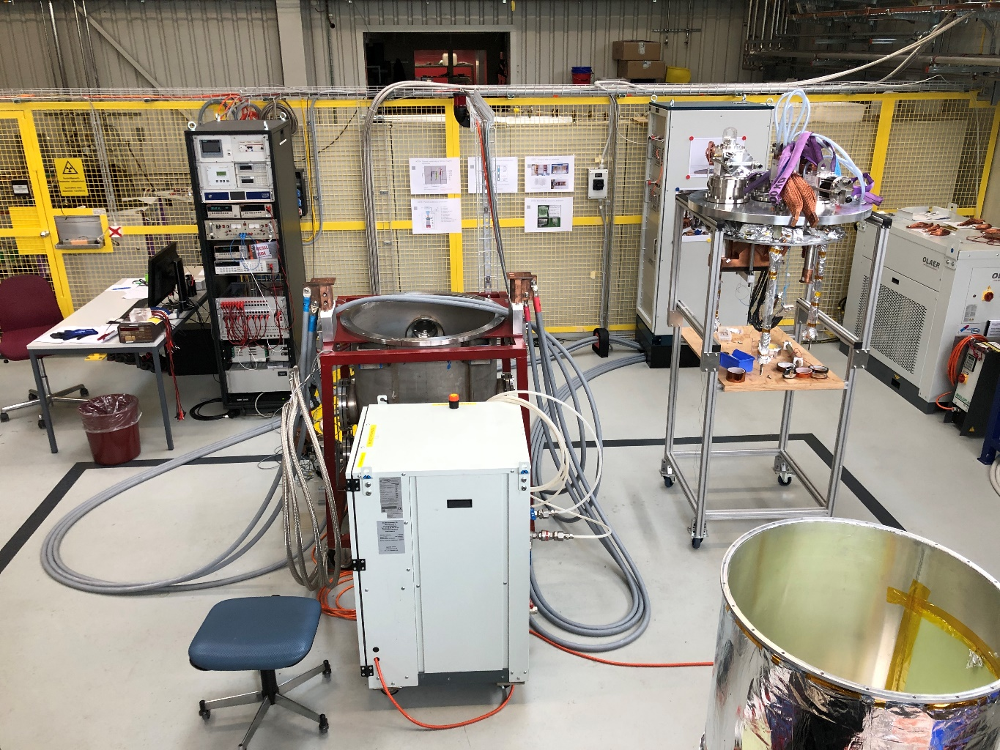
Cryogen free test stand
2kA ±10V power converter
Cryostat insert with two cryocoolers
Electronic rack
vacuum control/monitoring
temperature control/monitoring
voltage signals recording
quench detection system
Cooling with 2 cryocoolers
  RDK-415D – two stages
  RDK-500B – single stage
DAQ
  2 nanovolt channels
  64 high precision channels
  64 fast sampling channels
FPGA based quench detection system with interlock and safety matrix
(CERN uQDS with PSI modification)
10+ cernox temp sensors
5+ hall probes matrix (calibrated at various temperatures up to 20T)
Vacuum vessel with pumps
Powering cables (500A single cable)
Water chiller
Radiation shield with MLI

Slide 11
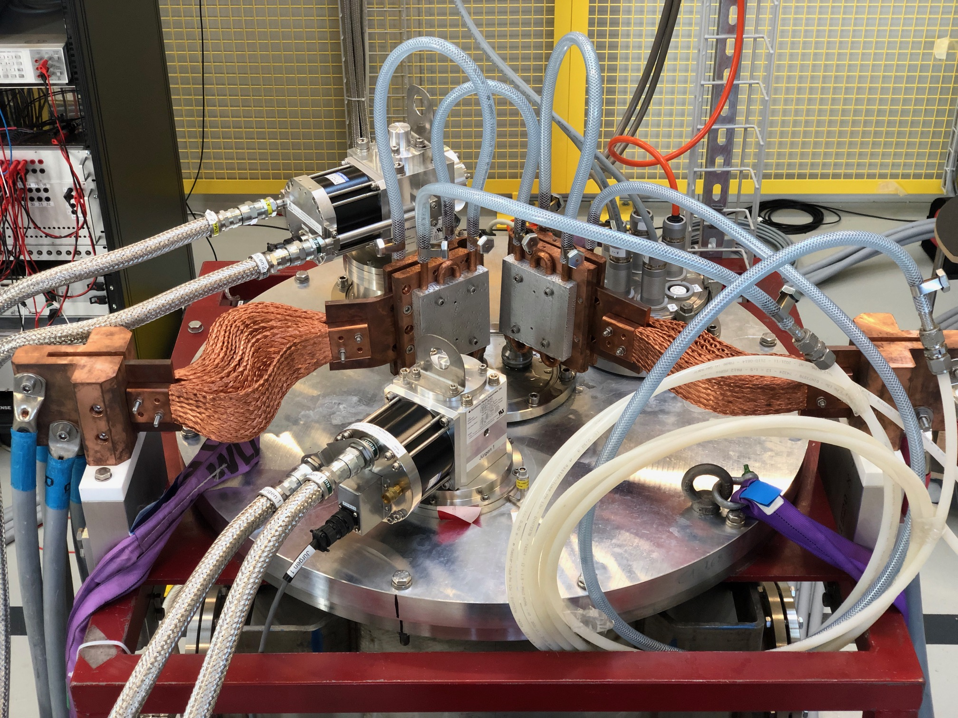
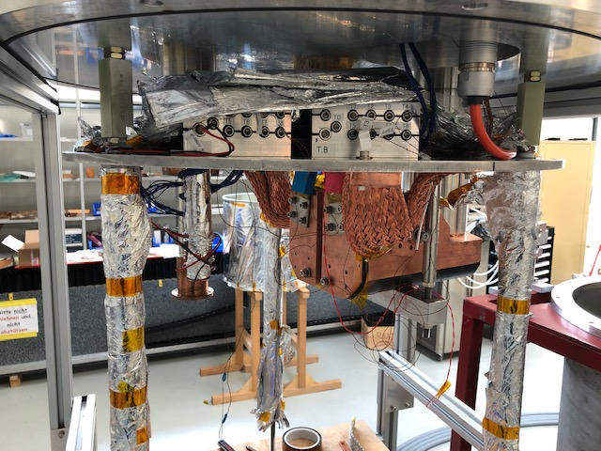
Cryogen free test stand insert
Electronic wires feedthroughs
Cryocooler RDK-500B
Water cooled copper leads
Instrumentation terminals
Flexible current leads
Cryocooler RDK-415D
Radiation shield
V taps connectors
Copper current leads terminals

Slide 12
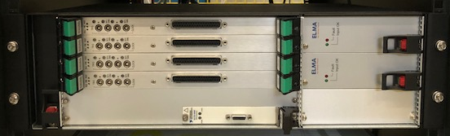
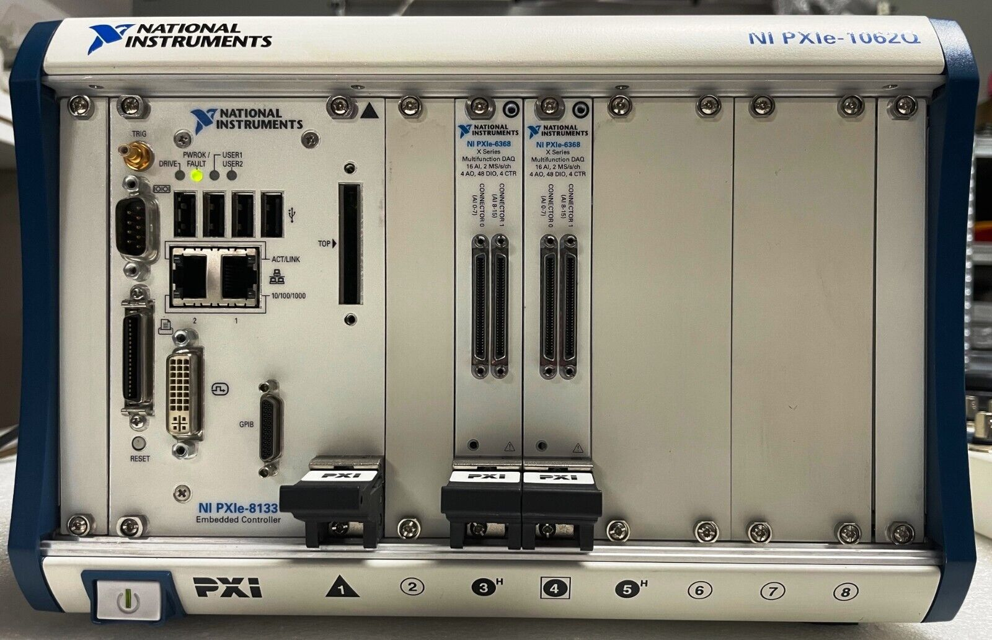
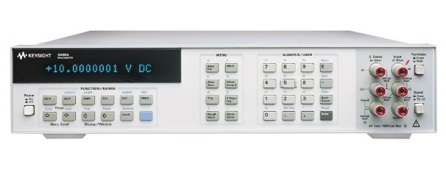
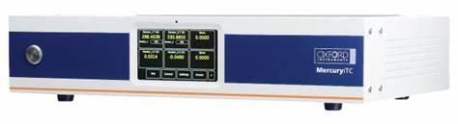
Cryogen free test stand DAQ
64 channels high frequency (200 kS/s) DAQ NI based INCAA custom system
64 channels high precision DAQ NI PXI system
CERN uQDS system with ‘swiss knife’ firmware
nanovoltmeters
under commissioning
mechanical switch (~4 ms ot) with varistor
temperature PID controller

Slide 13
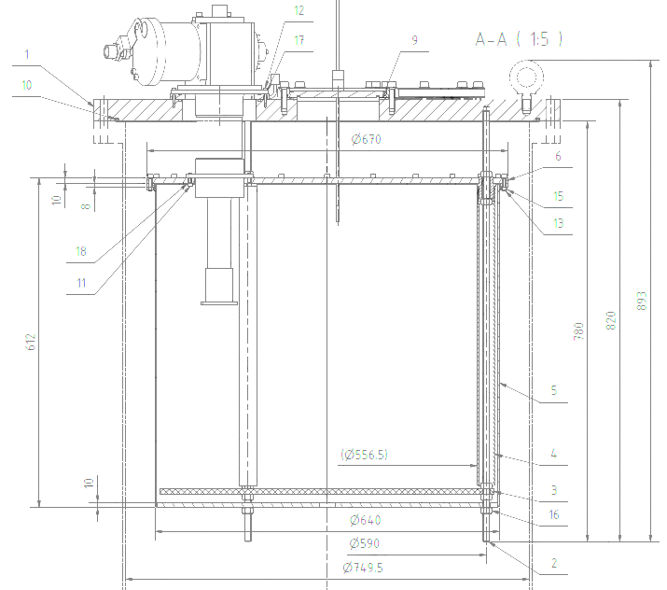
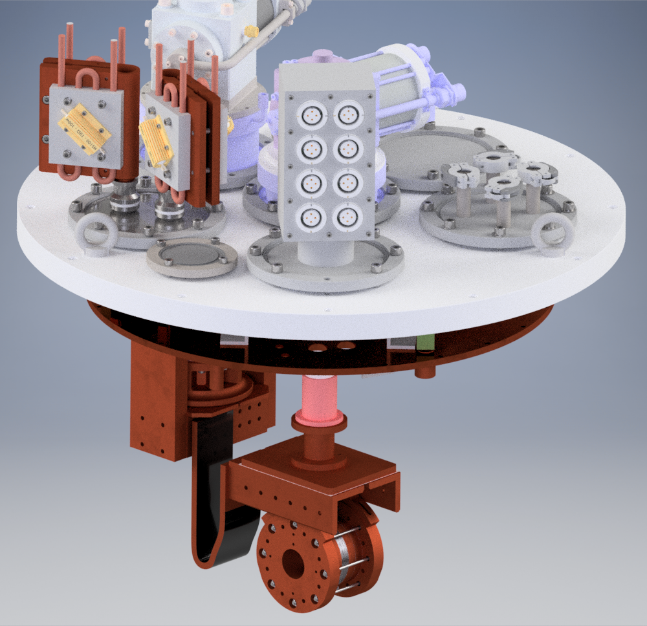
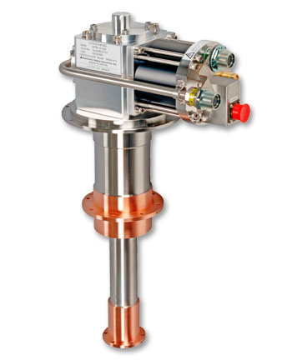
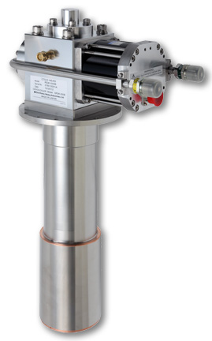
Key parameters
vacuum vessel made of 316L non-magnetic stainless steel installed on non-magnetic floor
useful volume inside the radiation shield : 630 mm diameter, 590 mm height (can be extended to 1000 mm)
custom made conduction cooled flexible copper and HTS leads optimized for 2000 A
cooled by two cryocoolers
  RDK-415D – samples/coils (1.5 W @ 4.2 K and 35 W @ 50 K)
  RDK-500B – current leads (160 W @ 70 K)
cooling time <12h
variable temperatures operation
ongoing upgrade

Slide 14
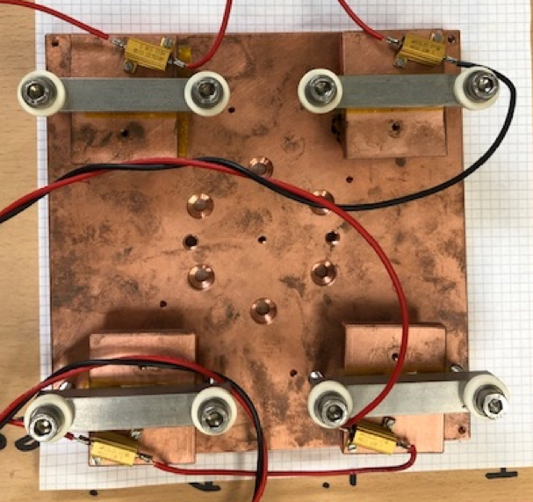
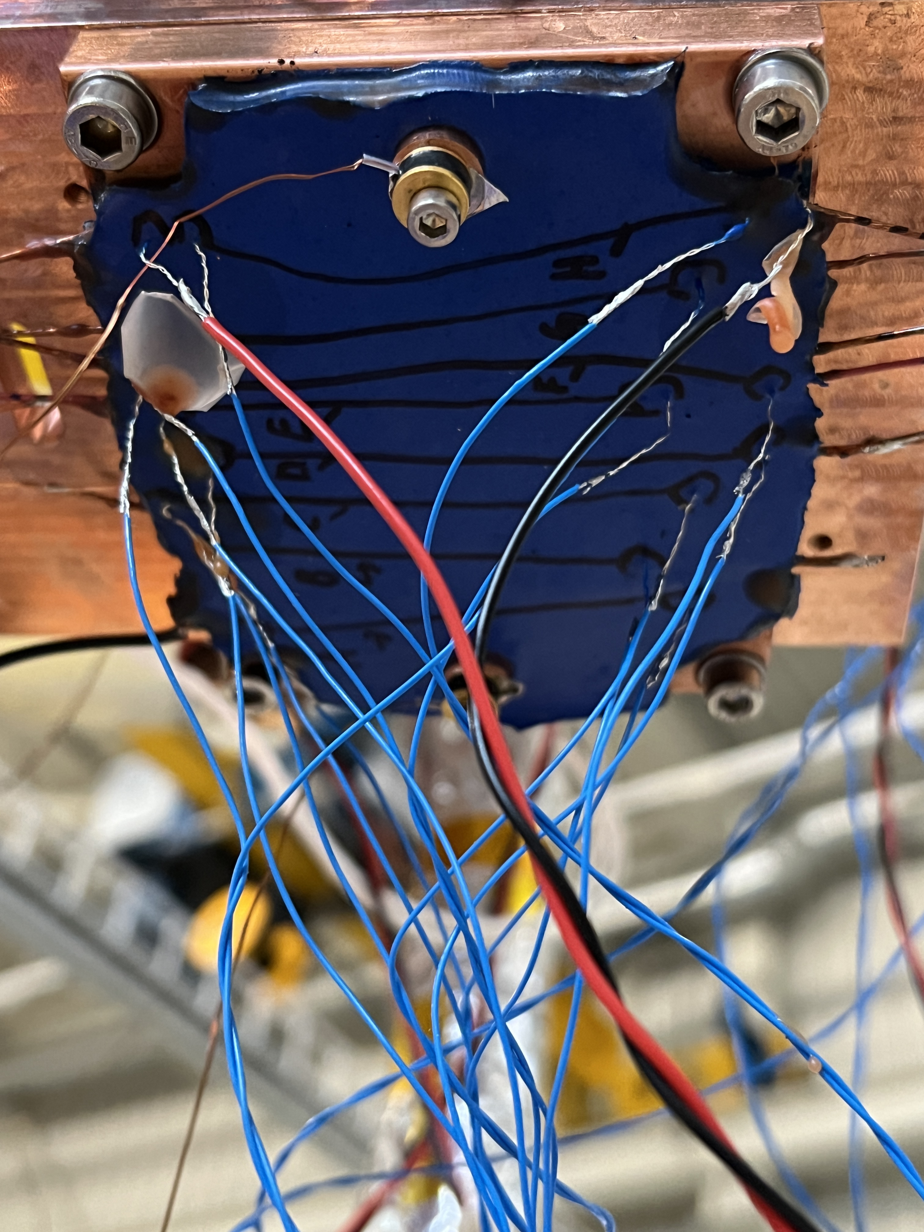
Test station capabilities various temperature tests
Thermal conductivity of different types of insulated joints
Strands in this measurement had undergone different heat treatments. During the heating cycle, they were exposed to varying amounts of oxygen at different temperatures

Slide 15
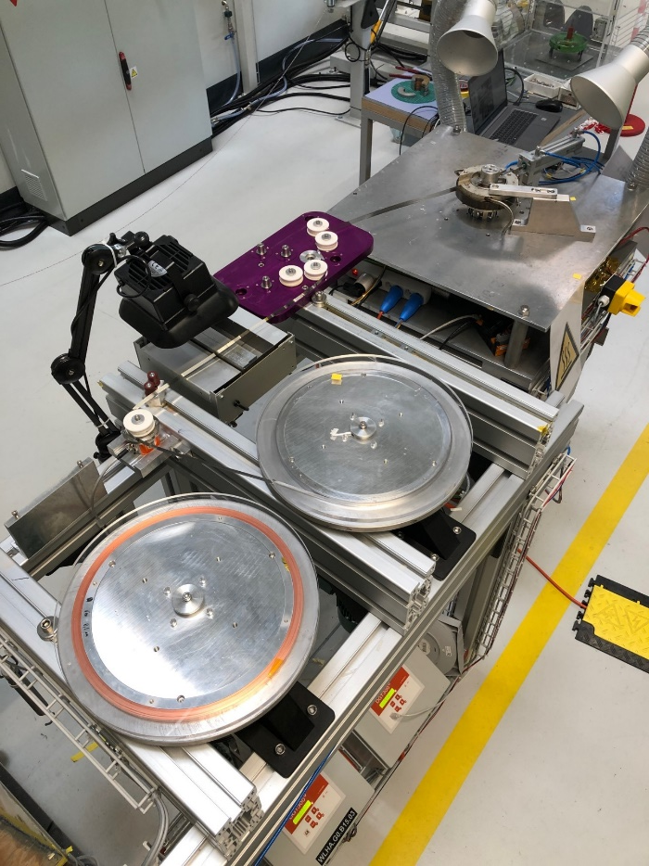
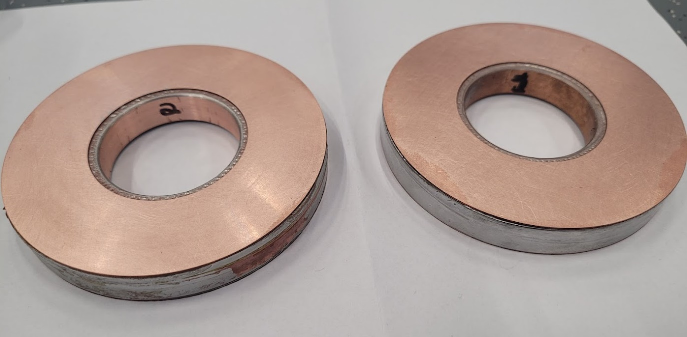
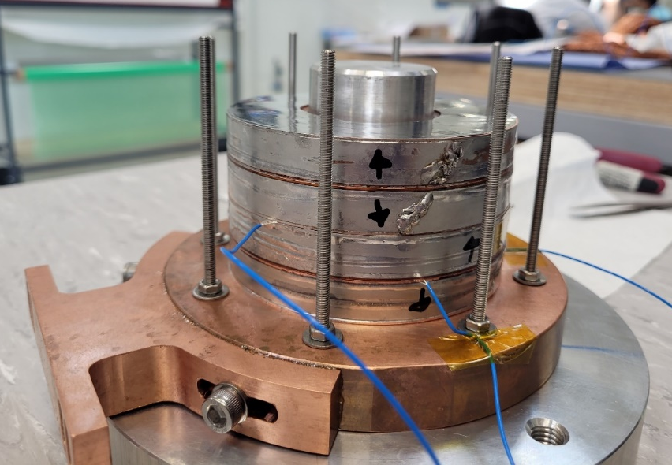
NI coils winding and soldering
winding setup for one or two tapes with individual tension control
automatic application of soldering flux on each tap
possibility of soldering the coil as it is wound
4 coils manufactured using different winding and soldering techniques
winding table
Stacked, single layer pancakes
Axial joints
4 coils, 12 mm SuperOx tape
Solder-potted coils
r_i 25 mm
r_o 50 mm
# turns: 2 x 170
SC length: 2 x 49 m
voltage taps
hall sensors matrix
Manufacturing 2 days!

Slide 16
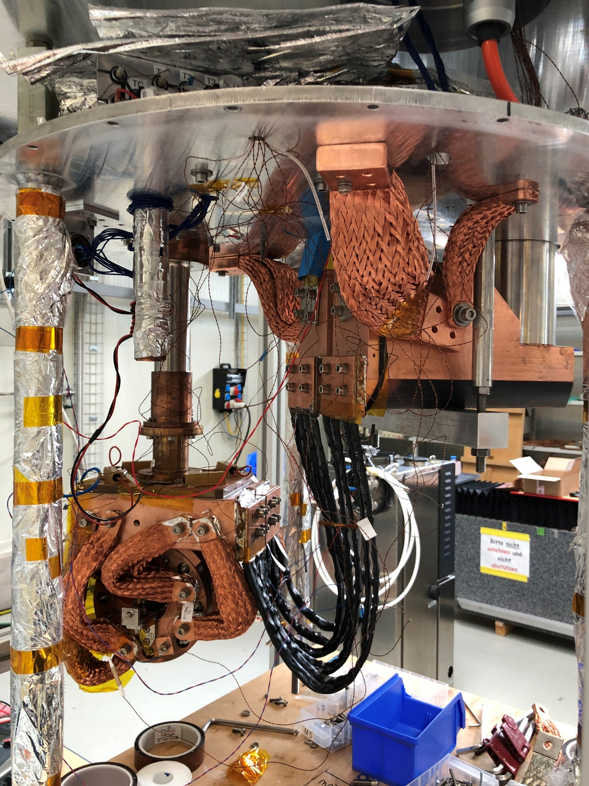
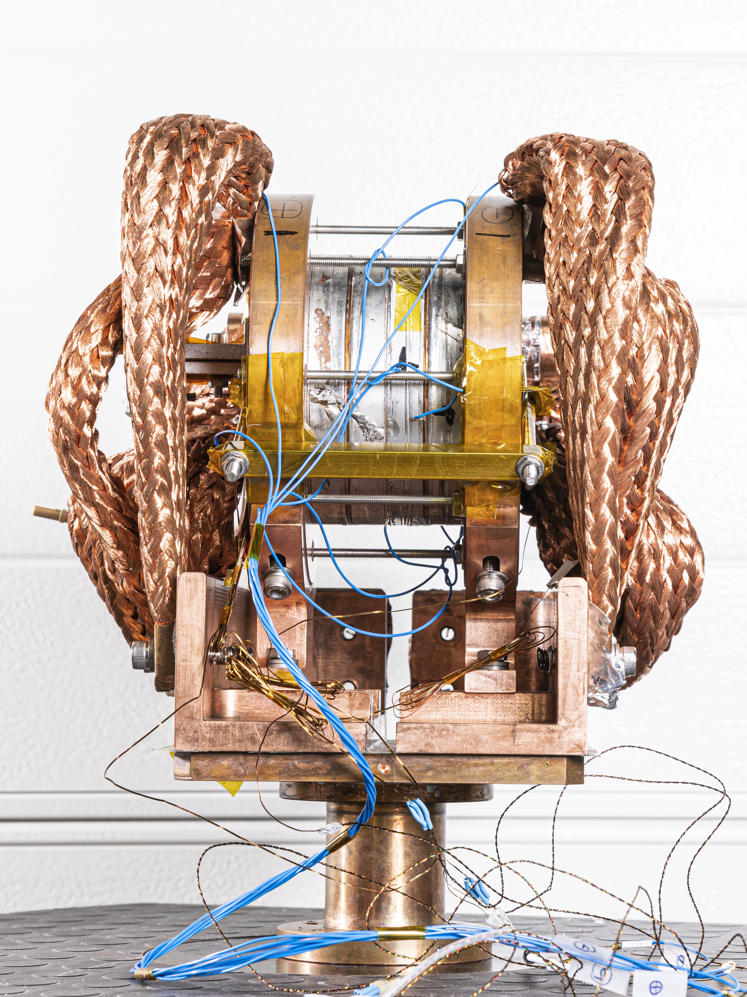


Technology Solenoid Program Milestone
Stack of 4 NI HTS pancake coils solenoid, built at PSI and using licensed Tokamak Energy Ltd technology.
radiation shield
thermal connectors
MEDUSA
2nd cryocooler
1st cryocooler 4K coldhead
Cu leads
stack of 4 NI HTS coils with thermal/current connectors
HTS leads
Flag of Sicily

Slide 17
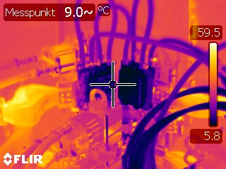
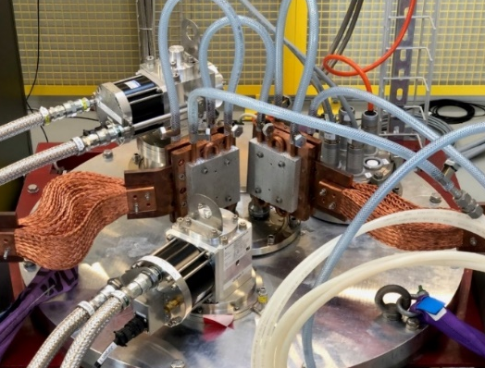
Medusa 2 kA powering results
A B C D
current
2 kA 3h
0-A:
fast ramp up with 1 A/s
coils temp regulated by external heaters
A-B:
slower ramp up with 0.2 A/s to stabilize coils temperature
B-C:
2 kA 3h plateau
temperature of Cu-HTS leads joint increasing because of joule heating
coils temperature stable at 12 K
C-D:
slow ramp down with 0.5 A/s
78 K
HTS leads temp
coils temp
12 K
superconductivity discovery at PSI
external
heater OFF
heating while
current
discharge

Slide 18
Medusa 2 kA powering results
A B C D
current
0-A:
fast ramp up with 1 A/s
voltage over coils increasing because of current radial path
A-B:
slower ramp up with 0.2 A/s to stabilize coils voltage increase
B-C:
2 kA 3h plateau
coils voltage decreasing because of current redistribution
field is increasing – not reaching saturation
C-D:
slow ramp down with 0.5 A/s to avoid quench back
2 kA 3h
coils voltage
1.6 mV
over 4 coils
~800 nohm
18.2 T
field

Slide 19
Quench event
1.99kA
0.2A/s
0.1A/s
0.5A/s
2A/s
0.5A/s
5A/s
1A/s
35K
28K
25K
21K
10A/s
temp sensor
detachment
coils 2&3?
external heater OFF
2min
5min

Slide 20
Quench event
How to detect and protect NI HTS coils?
bad contact heating too much
c4 voltage rise

Slide 21
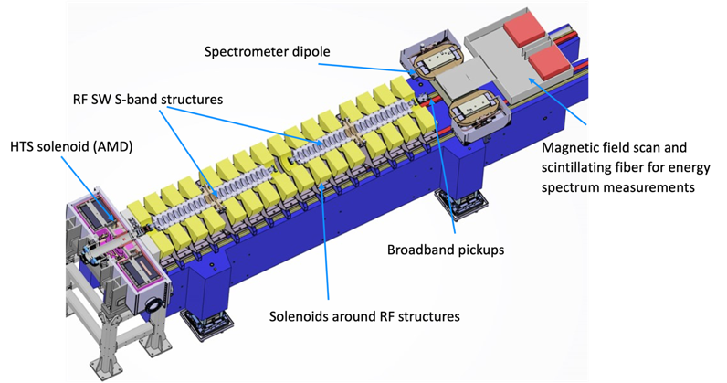
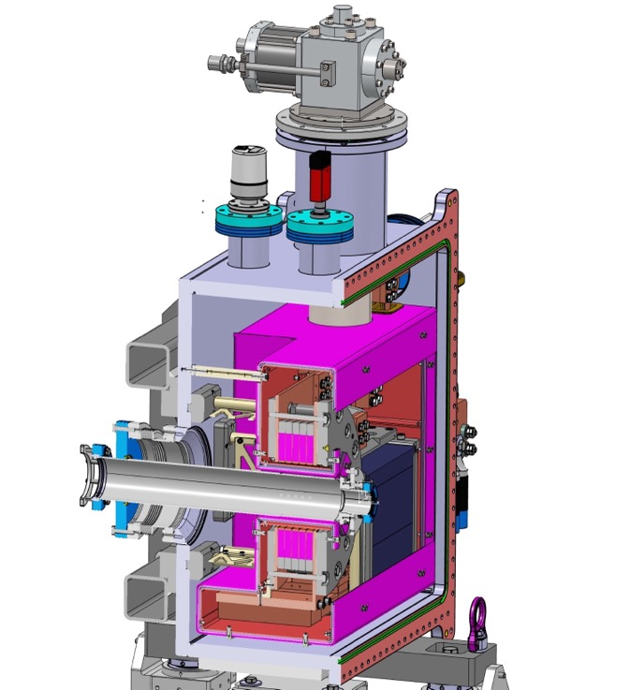
P³ FCCee Injector Study PSI Positron Production
15 K conduction-cooling
5 coils from 12 mm ReBCO
Coil diameter | 122 mm inner 219 mm outer
Stored energy | 331 kJ
Operating current | 1.17 kA
Charging constant | 11 hours
HTS NI target solenoid, to demonstrate high-yield positron source concept
  stable DC operation,
  high thermal conduction due to solder impregnation to extract heat deposited in coils,
  radiation robustness due to absence of insulators.
Manufacturing Q3’23-Q2’24
Experiment at PSI’s SwissFEL 2025/26
target
Solid-state (Pb)
thermal buffer
15 T in 72 mm warm bore
21 T on conductor
Courtesy J. Kosse, T. Michlmayr, H. Rodrigues

Slide 22
Summary part one
PSI new approach for superconducting materials and small demonstrator magnets test stand: cryogen free
  variable temperatures (3 – 100+ K)
  flexibility of tested items:
    enabling technologies (impregnations, thermal conductivity, etc.)
    wire/cables/tapes characterization (RRR, Tc, etc.)
    small magnets demonstrators (LTS and HTS)
  energy consumption optimization
Max operating current 2 kA (+-10 V)
Quench detection system based on FPGA electronic
Protection by fast mechanical switch and dump varistor (1 kV)
Plans for future:
  optimize cooling paths for existing insert
  mm anti-cryostat
  new cryostat 10 kA
  superconducting transformer powering

Slide 23
Outline
Introduction PSI, Magnet Section and CHART
Cryogen Free Test stand WNLA/010
Cold tests results
Planned upgrade
Upcoming projects
Michal
Carolin

Slide 24
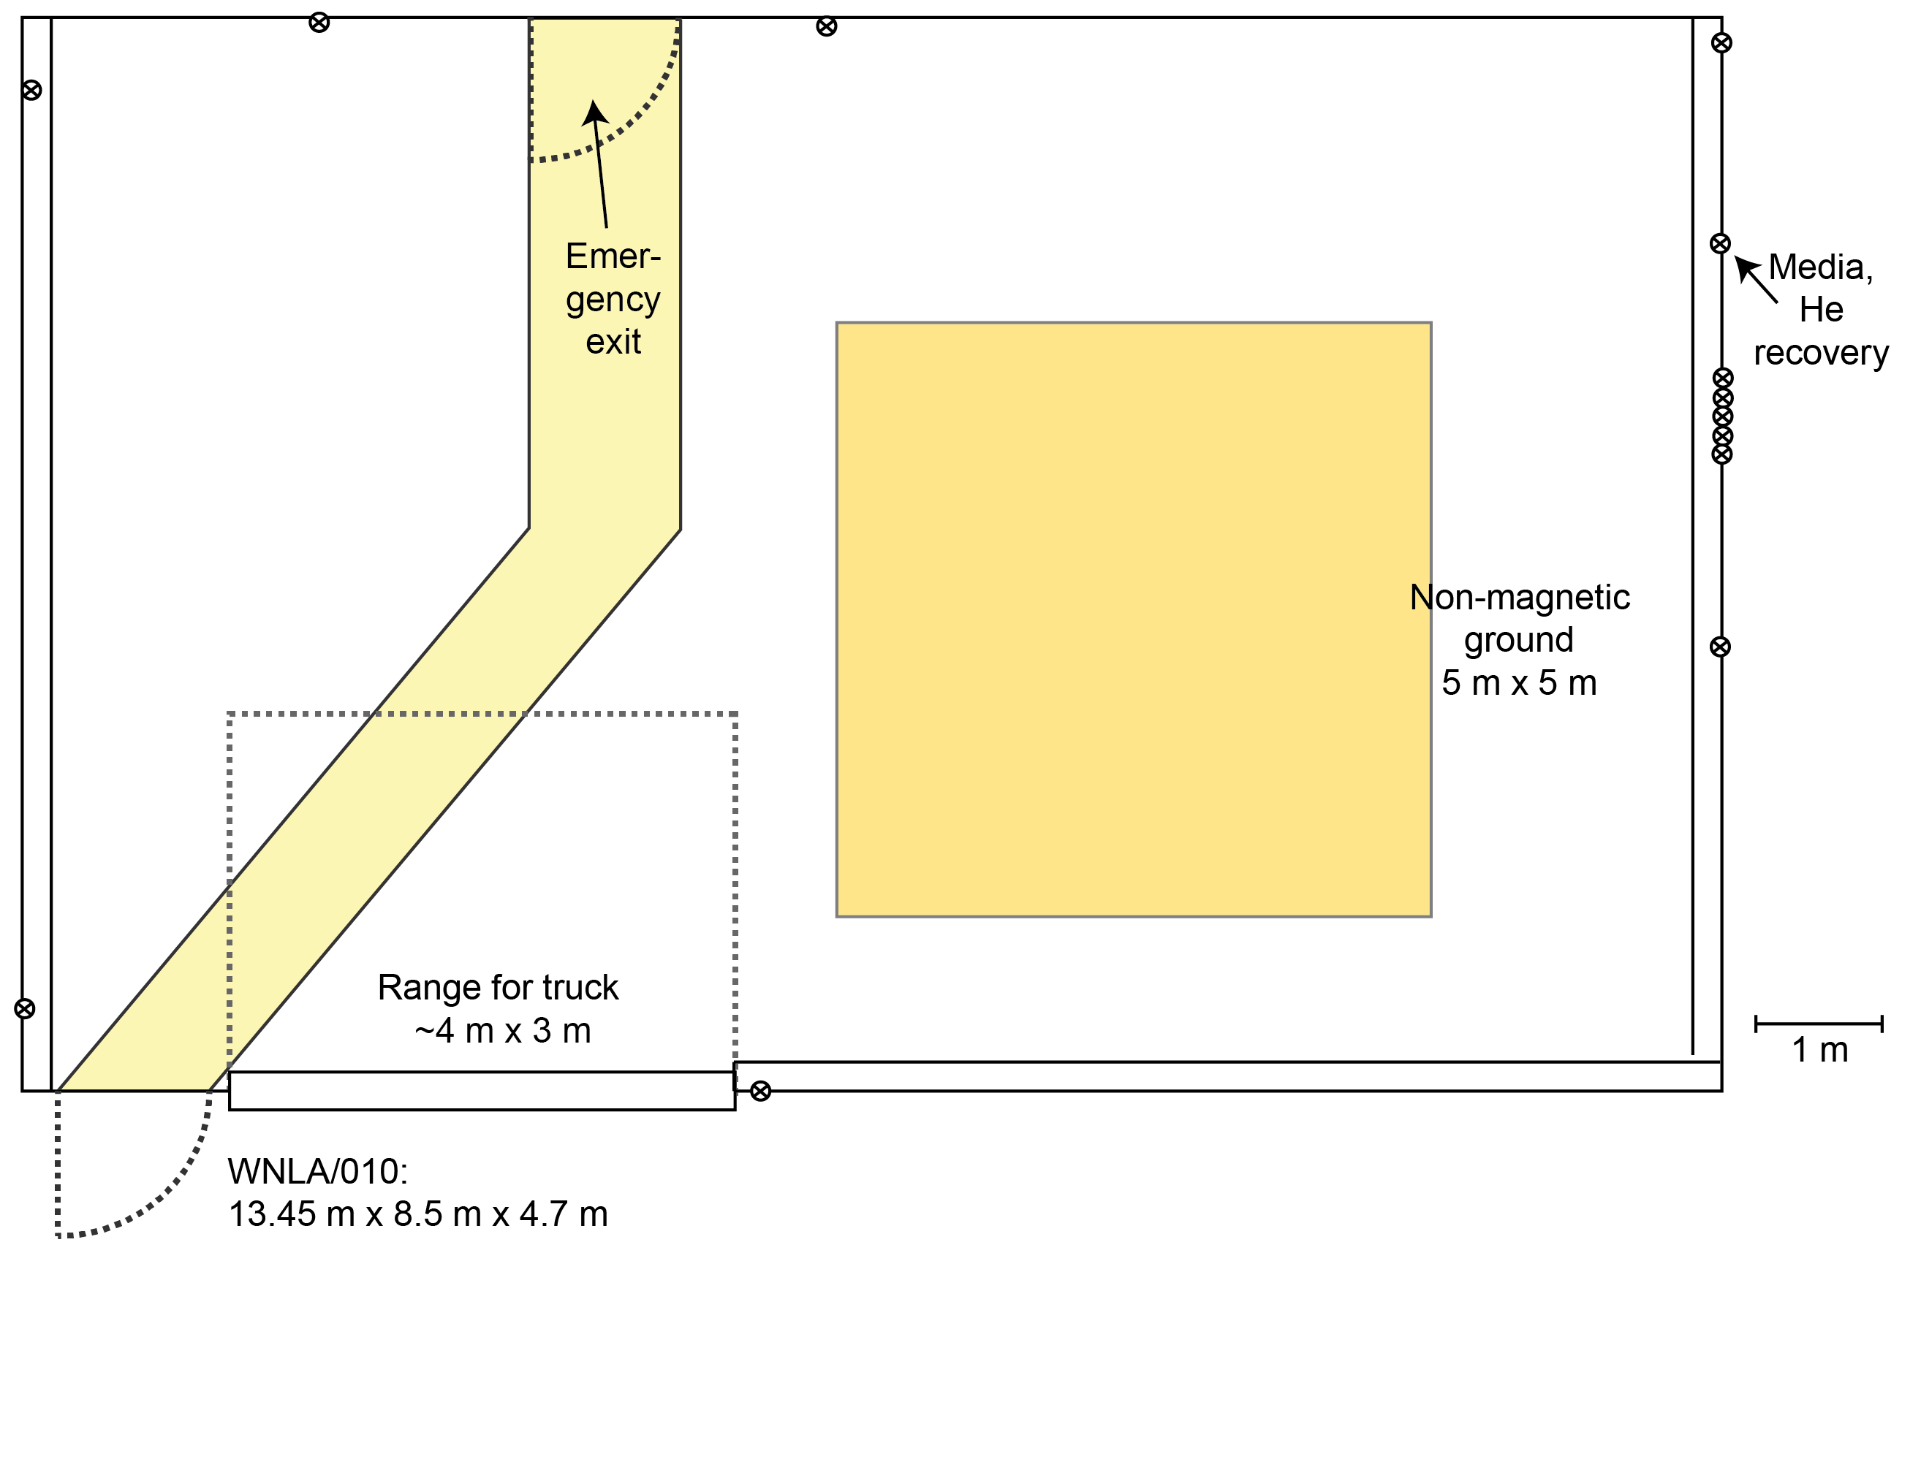
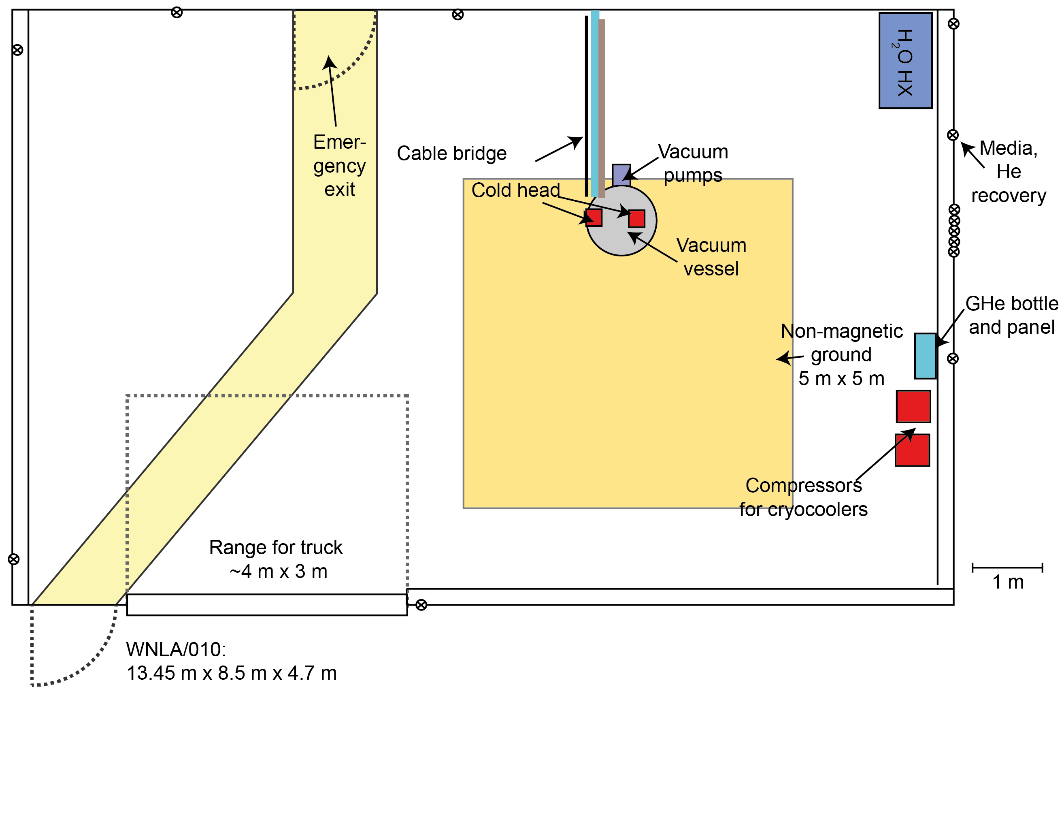
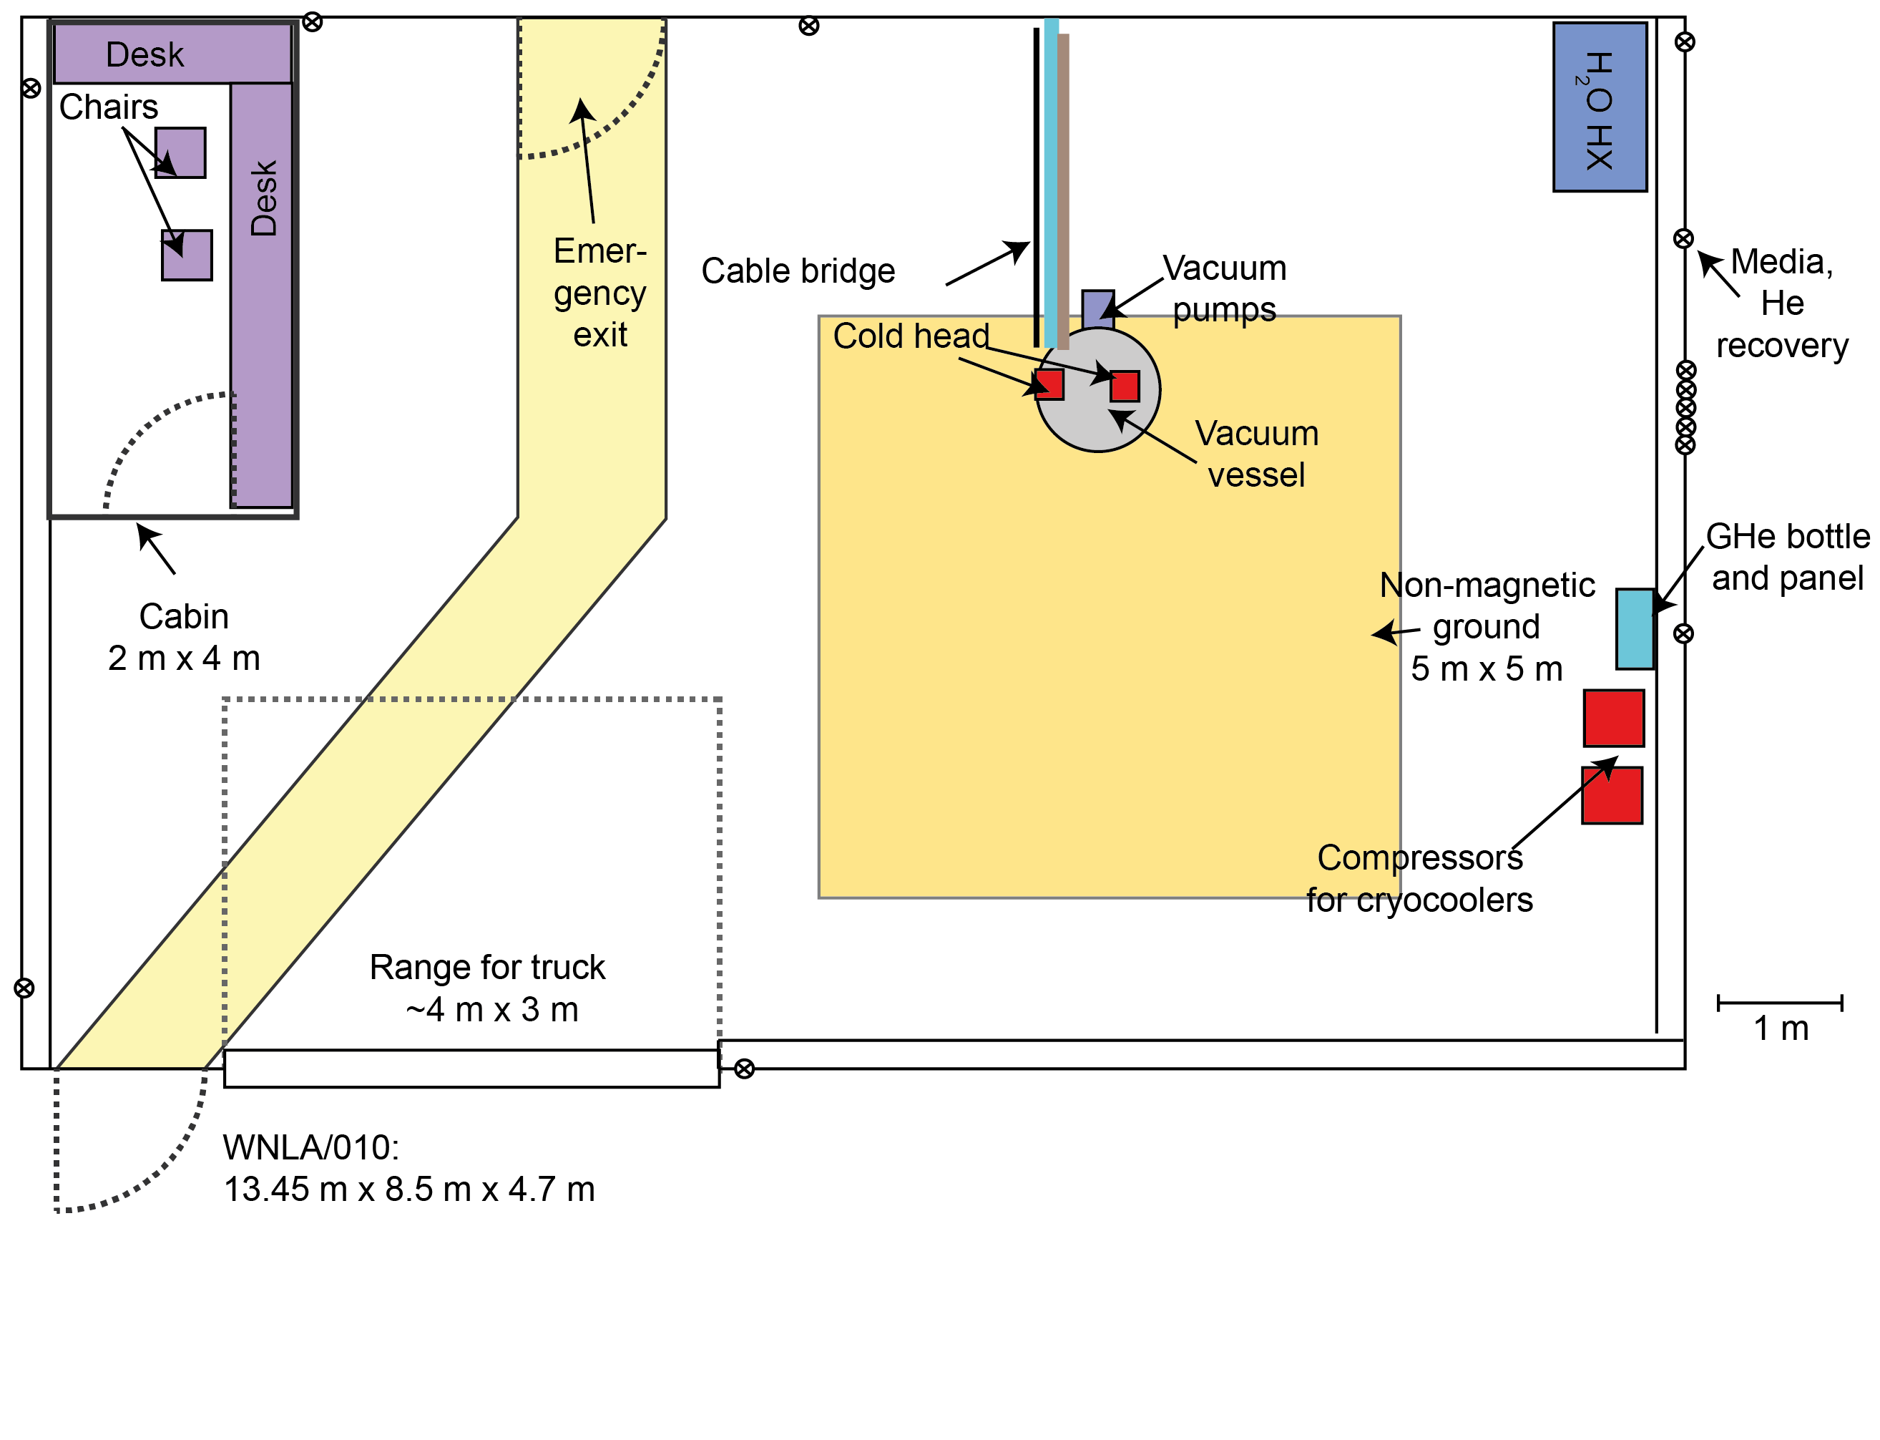
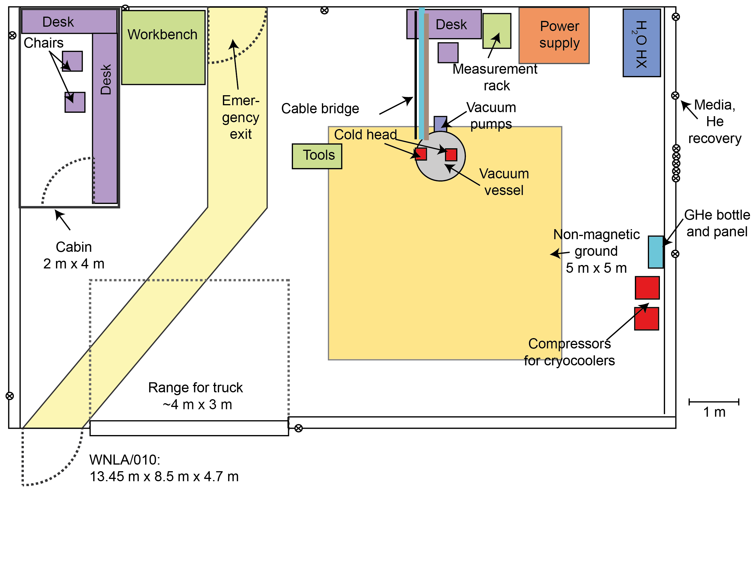
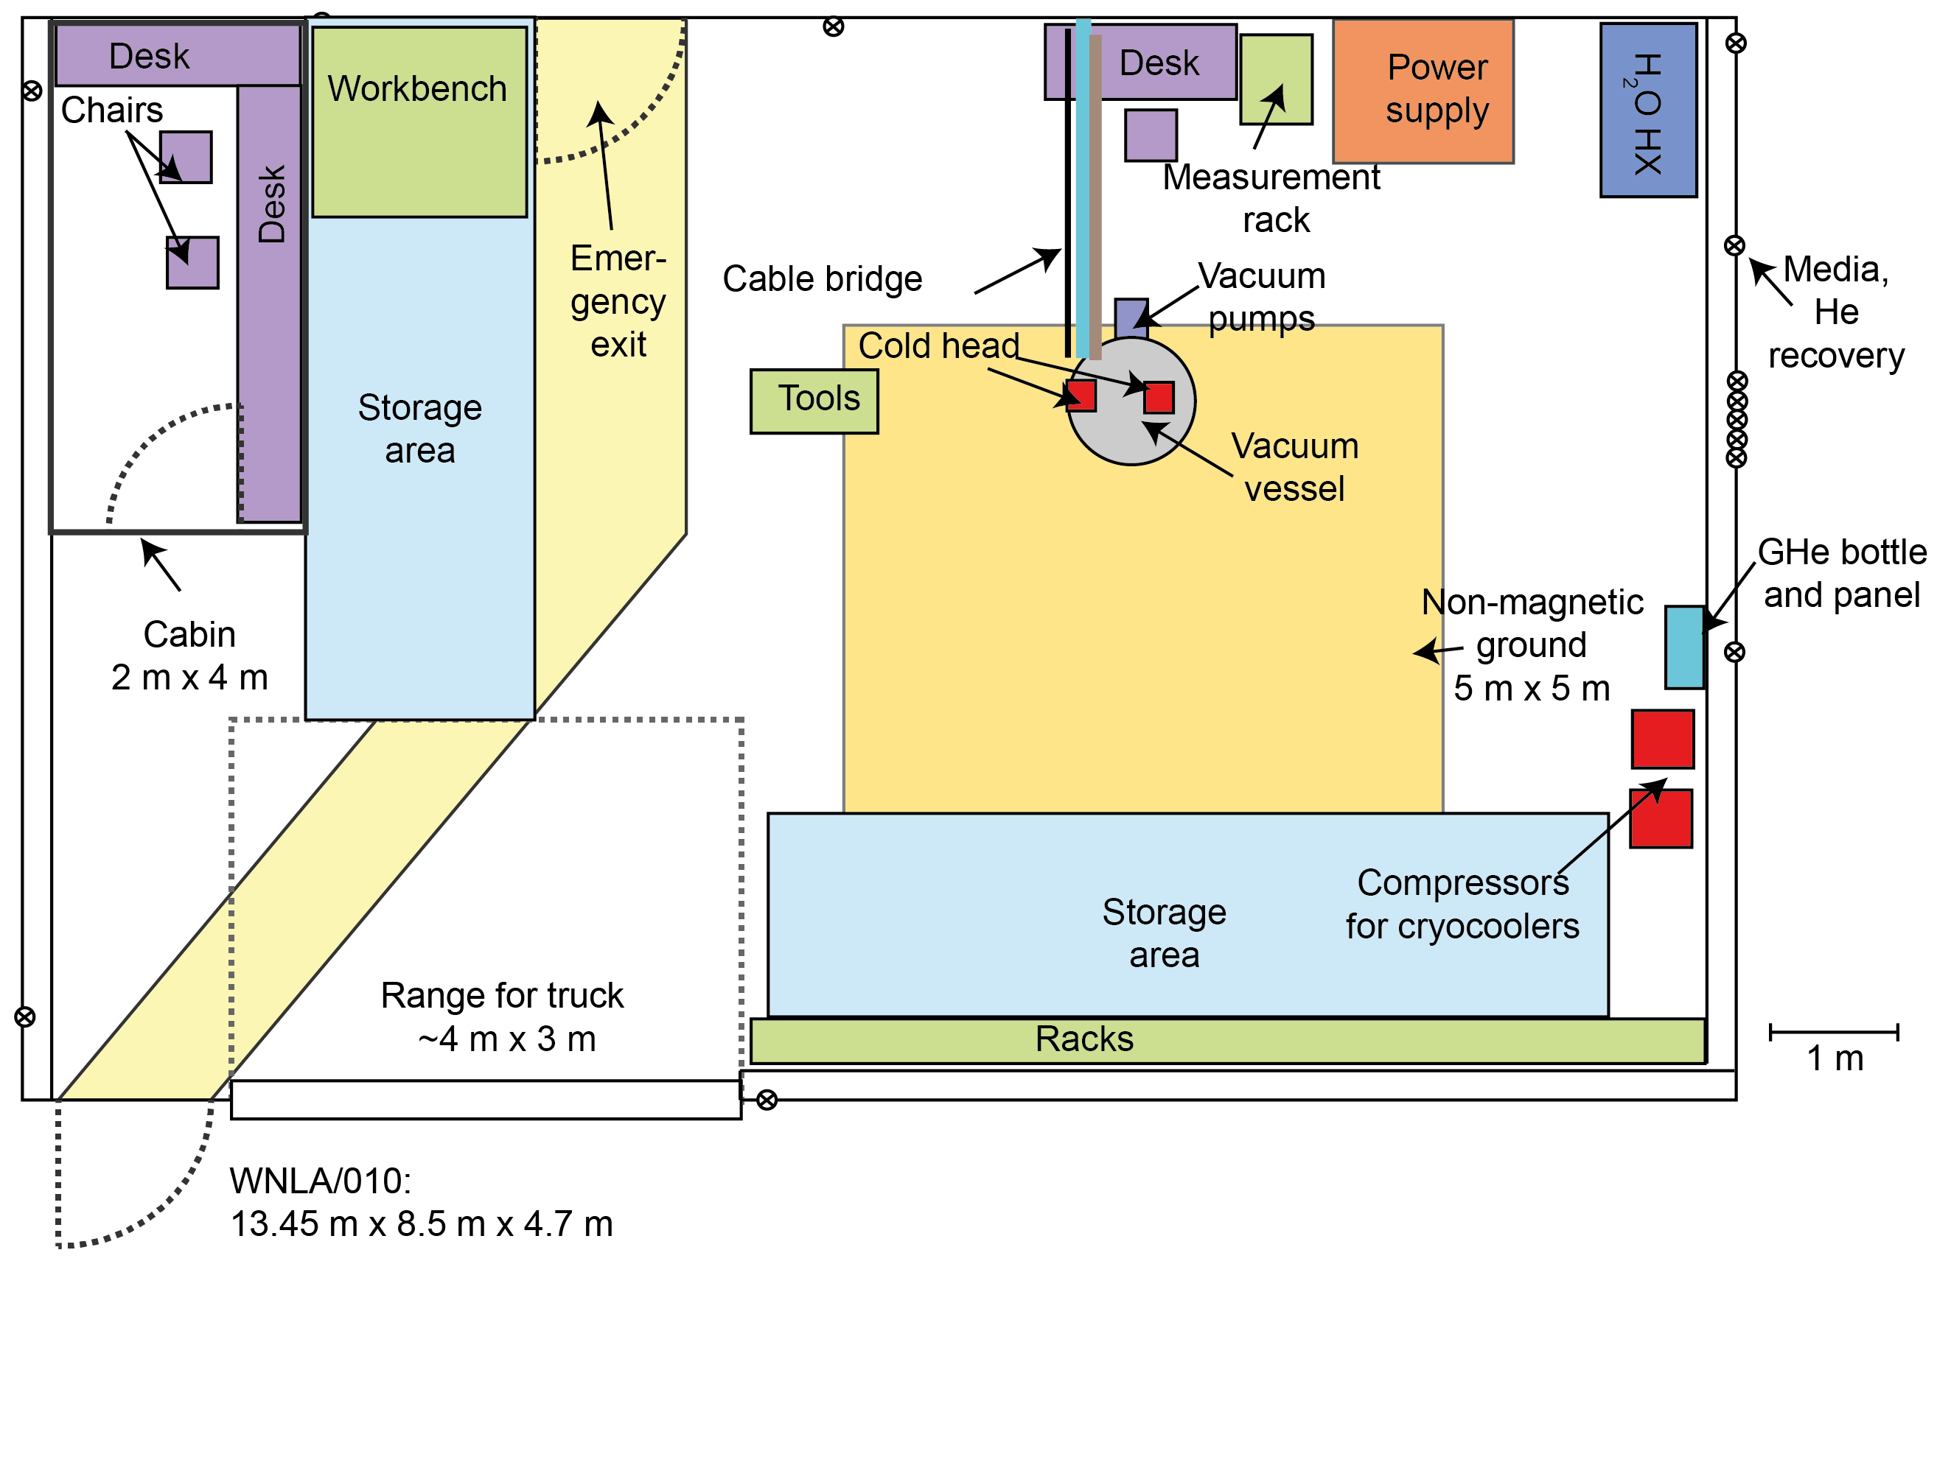
Test stand - now

Slide 25
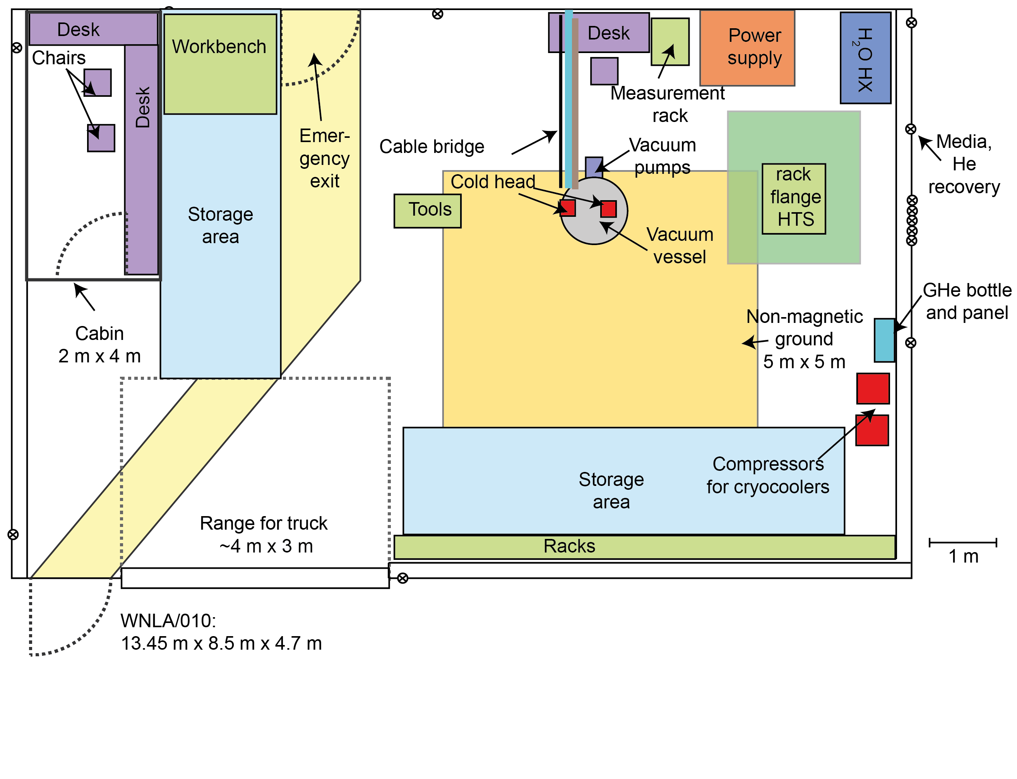
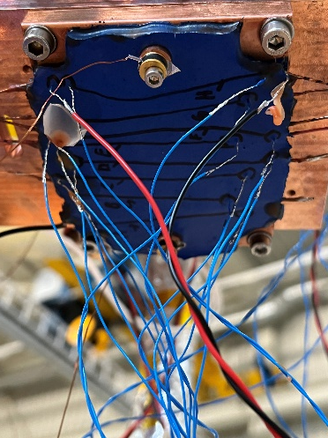


Test stand - now
Space! Noise!
RRR, thermal conductivity, etc.
michal.duda@psi.ch

Slide 26
Test stand – (re-)move parts
Space! Noise!

Slide 27
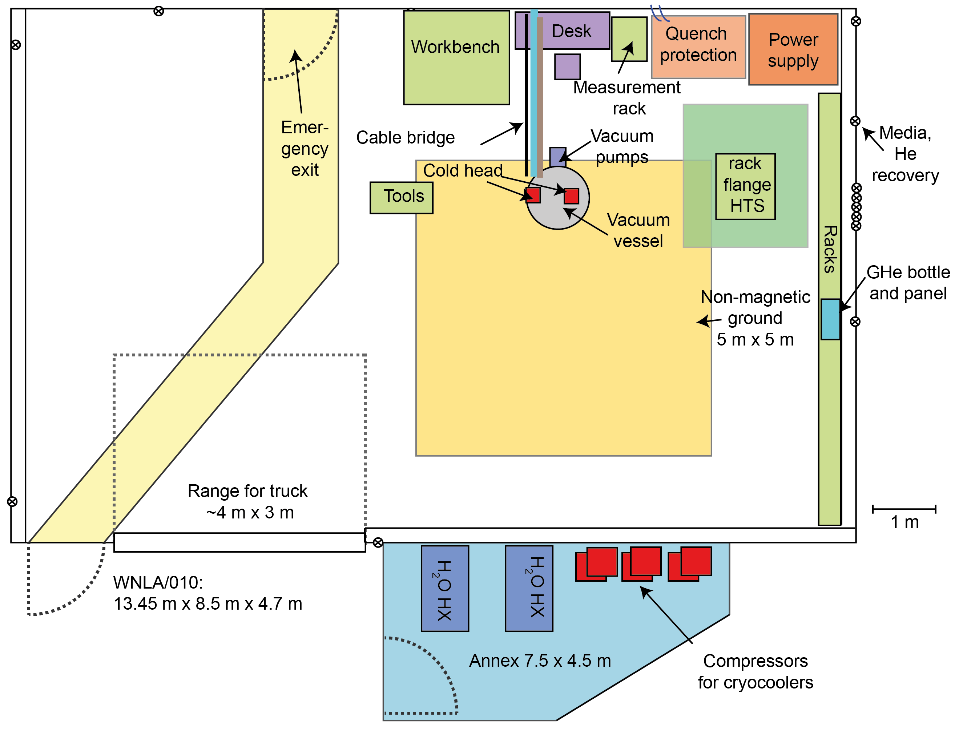
Test stand – planned annex for noisy components

Slide 28
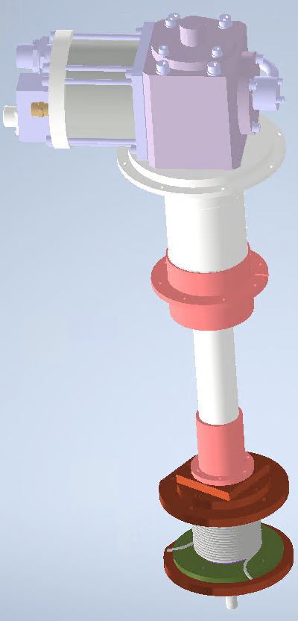


Test stand – new projects from 2023
Innovation Fostering in Accelerator Science and Technology (I.FAST)
+ Team
https://ifast-project.eu/home
rebecca.riccioli@psi.ch
Page 28

Slide 29



Test stand – new projects from 2023
FCCee Injector Study: P³ (PSI
Positron Production)
N. Vallis, “PSI The P³ experiment: a Positron Source Demonstrator for FCC-ee”, 2022
+ Team
jaap.kosse@psi.ch

Slide 30



Test stand – new projects from 2023
Superconducting superbends for SLS2
+ Team
C. Calzolaio et al. “Design of a Superconducting Longitudinal Gradient Bend Magnet for the SLS Upgrade”, 2016
ciro.calzolaio@psi.ch

Slide 31



Test stand – new projects from 2023
HTS undulator for SLS2
Zhang et al., “Fully-staggered-array bulk Re-Ba-Cu-O short-period undulator: large-scale 3D electromagnetic modelling and design optimization using A-V and H-formulation methods”, 2021
+ Team
marco.calvi@psi.ch

Slide 32



Test stand – new projects from 2023
From 2025:
test stand for sc. LTS and HTS magnets for CHART
https://chart.ch/
bernhard.auchmann@psi.ch
+ Team

Slide 33






Test stand – new projects from 2023
Development of cryogenic pulsating heat pipes (PHP)
+ Team
Jiao, A. et al, “Experimental investigation of cryogenic oscillating heat pipes”, 2009
carolin.zoller@psi.ch

Slide 34






Cooling of sc. magnet without LHe bath
Challenge: Transport heat efficiently from sc. component to cryocooler
Cryocooler
Current leads
60 kg copper block
Nitrogen PHP in Laboratory
(Jiao et al., https://doi.org/10.1016/j.ijheatmasstransfer.2009.03.013.)
Test 2 kA current leads
$→$ Replace of conventional copper thermal links with pulsating heat pipes (PHP) filled with cryogenic fluid

Slide 35





Thermal conductivity of PHP for cryogenic application
References listed in annex of this presentation
Helium PHP for LTS application
Neon PHP (theoretically also hydrogen and nitrogen PHP) for HTS application

Slide 36
Summary
Magnet infrastructure at PSI for permanent, electro- and superconducting magnets
Trend for new projects to use sc. magnets cooled with cryocoolers (saving energy)
Test stand for cryocooled sc. magnets at PSI continuously evolved since 2018
Ongoing upgrade of test stand for new projects, e.g. P³, LTS superbend and HTS undulator for SLS2
Cryogenic pulsating heat pipes (PHP) promising alternative to copper connection between sc. magnet and crycooler

Slide 37
Wir schaffen Wissen – heute für morgen
We create knowledge today – for use tomorrow
Thank you for your interest.

Slide 38
References Saclay, France
[1] | Bonnet F, Gully P, Nikolayev V. Development and test of a cryogenic pulsating heat pipe and a pre-cooling system. In: Advances in cryogenic engineering, vol. 1434; 2012. p. 607–14.
[2] | Romain Bruce, Maria Barba, Antoine Bonelli, Bertrand Baudouy, Thermal performance of a meter-scale horizontal nitrogen Pulsating Heat Pipe, Cryogenics, Volume 93, July 2018, Pages 66-74
[3] | Barba, M., Bruce, R., Bouchet, F., Bonelli, A. & Baudouy, B. Thermal Study of a one-meter long Neon Cryogenic Pulsating Heat Pipe. IOP Conf. Series: Materials Science and Engineering 502 (2019). (doi.org/10.1088/1757-899X/502/1/012152)
[4] | Bruce, R., Barba, M., Bouchet, F., Bonelli, A. & Baudouy, B. Transient thermal behavior of a neon Pulsating Heat Pipe (PHP). IEE Transactions on Applied Superconductivity, Volume 29, Issue 5 (2019). (doi.org/10.1109/TASC.2019.2902978)
[5] | Maria Barba, Romain Bruce, Florent Bouchet, Antoine Bonelli, Bertrand Baudouy, Effect of the thermo-physical properties of the working fluid on the performance of a 1-m long cryogenic horizontal pulsating heat pipe, International Journal of Heat and Mass Transfer, Volume 187, 2022, 122458, https://doi.org/10.1016/j.ijheatmasstransfer.2021.122458.

Slide 39
References Missouri and Wisconsin, USA
[6] | Fonseca LD, Miller F, Pfotenhauer J. Design and operation of a cryogenic nitrogen pulsating heat pipe. In: Advances in cryogenic engineering, vol. 101; 201
[7] | Luis Diego Fonseca, Franklin Miller, and John Pfotenhauer, "A helium based pulsating heat pipe for superconducting magnets", AIP Conference Proceedings 1573, 28-35 (2014) https://doi.org/10.1063/1.4860679
[8] | Luis Diego Fonseca, John Pfotenhauer, Franklin Miller, Results of a three evaporator cryogenic helium Pulsating Heat Pipe, International Journal of Heat and Mass Transfer, Volume 120, 2018, Pages 1275-1286, ISSN 0017-9310, https://doi.org/10.1016/j.ijheatmasstransfer.2017.12.108.
[9] | Luis Diego Fonseca, John Pfotenhauer, Franklin Miller, Short communication: Thermal performance of a cryogenic helium pulsating heat pipe with three evaporator sections, International Journal of Heat and Mass Transfer, Volume 123, 2018, Pages 655-656, ISSN 0017-9310, https://doi.org/10.1016/j.ijheatmasstransfer.2018.03.013.
[10] | Jiao AJ, Ma HB, Critser JK. Experimental investigation of cryogenic oscillating heat pipes. Int J Heat Mass Transf 2009; 52(15–16):3504–9.

Slide 40
References Toki, Japan
[11] | Mito T., Natsume K., Yanagi N., Tamura H., Tamada T., Shikimachi K., Hirano N., Nagaya S., Development of highly effective cooling technology for a superconducting magnet using cryogenic OHP (2010) IEEE Transactions on Applied Superconductivity, 20 (3), art. no. 5433248, pp. 2023 - 2026, DOI: 10.1109/TASC.2010.2043724
[12] | K. Natsume et al., "Development of Cryogenic Oscillating Heat Pipe as a New Device for Indirect/Conduction Cooled Superconducting Magnets," in IEEE Transactions on Applied Superconductivity, vol. 22, no. 3, pp. 4703904-4703904, June 2012, Art no. 4703904, doi: 10.1109/TASC.2012.2185029.
[13] | Mito T., Natsume K., Yanagi N., Tamura H., Tamada T., Shikimachi K., Hirano N., Nagaya S. Achievement of high heat removal characteristics of superconducting magnets with imbedded oscillating heat pipes (2011) IEEE Transactions on Applied Superconductivity, 21 (3 PART 2), art. no. 5699953, pp. 2470 – 2473, DOI: 10.1109/TASC.2010.2100356
[14] | Kyohei Natsume, Toshiyuki Mito, Nagato Yanagi, Hitoshi Tamura, Tsutomu Tamada, Koji Shikimachi, Naoki Hirano, Shigeo Nagaya, Heat transfer performance of cryogenic oscillating heat pipes for effective cooling of superconducting magnets, Cryogenics, Volume 51, Issue 6, 2011, Pages 309-314, ISSN 0011-2275, https://doi.org/10.1016/j.cryogenics.2010.07.001.
[15] | Mito T, Natsume K, Yanagi N, Tamura H, Tamada T, Shikimachi K, et al. Development of highly effective cooling technology for a superconducting magnet using cryogenic OHP. IEEE Trans Appl Supercond 2010;20(3):2023–6.
[16] | Mito T, Natsume K, Yanagi N, Tamura H, Terazaki Y. Enhancement of thermal properties of HTS magnets using built-in cryogenic oscillating heat pipes. IEEE Trans Appl Supercond 2013;23(3):4602905.

Slide 41
References Beijing, China
[17] | Qing Liang, Yi Li, Qiuliang Wang, Experimental investigation on the performance of a neon cryogenic oscillating heat pipe, Cryogenics, Volume 84, 2017, Pages 7-12, ISSN 0011-2275, https://doi.org/10.1016/j.cryogenics.2017.03.004.
[18] | Liang, Q., Li, Y., & Wang, Q. (2017). Cryogenic oscillating heat pipe for conduction-cooled superconducting magnets. IEEE Transactions on Applied Superconductivity, 28(3), 1-5.
[19] | Qing Liang, Yi Li, Qiuliang Wang, Effects of filling ratio and condenser temperature on the thermal performance of a neon cryogenic oscillating heat pipe, Cryogenics, Volume 89, 2018, Pages 102-106, ISSN 0011-2275, https://doi.org/10.1016/j.cryogenics.2017.12.002.
[20] | Q. Liang , Y. Li , Q. Wang , Study on a neon cryogenic oscillating heat pipe with long heat transport distance, Heat Mass Transf. 54 (2018) 1721–1727 .
[21] | Deng HR, Liu YM, Ma RF, Han DY, Gan ZH, Pfotenhauer JM. Experimental investigation on a pulsating heat pipe with hydrogen. In: Advances in cryogenic engineering, vol. 101; 2015.
[22] | Dong Xu, Laifeng Li, Huiming Liu, Experimental investigation on the thermal performance of helium based cryogenic pulsating heat pipe, Experimental Thermal and Fluid Science, Volume 70, 2016, Pages 61-68, ISSN 0894-1777, https://doi.org/10.1016/j.expthermflusci.2015.08.024.
[23] | M. Li, L. Li, D. Xu, Effect of number of turns and configurations on the heat transfer performance of helium cryogenic pulsating heat pipe, Cryogenics, Volume 96, December 2018, Pages 159-165.
[24] | Monan Li, Laifeng Li, Dong Xu, Effect of filling ratio and orientation on the performance of a multiple turns helium pulsating heat pipe, Cryogenics, Volume 100, 2019, Pages 62-68, ISSN 0011-2275, https://doi.org/10.1016/j.cryogenics.2019.04.006.
[25] | Bingkun Lyu, Dong Xu, Wei Wang, Jijun Xin, Yaran Shi, Zhichun Fang, Chuanjun Huang, Rongjin Huang, Laifeng Li, Experimental investigation of a serial-parallel configuration helium pulsating heat pipe, Cryogenics, Volume 131, 2023, 103668, ISSN 0011-2275, https://doi.org/10.1016/j.cryogenics.2023.103668.

Slide 42




Superconducting Conductors Tests for gantry and energy saving applications
Experimental campaign to test three different superconductors as possible candidates for future superconducting magnets at PSI
Conductors to be tested
Main goals: Working on simplified geometries to study and compare the dynamic behavior of the conductors, i.e. AC losses, field quality and cryocooler efficiency in ramping regime.
Experimental campaign steps :
Wet winding tests with dummy samples to test the winding procedure and to verify the insulating capacity;
Setup testing on reduced lengths of MgB2, NbTi and HTS tape;
Real conductors winding and testing + comparison with simulations.
rebecca.riccioli@psi.ch

Slide 43




Upgrade of SLS
SLS2.0
x 35
Brilliance
Phase 1
Phase 2
Notes:
Canted Cosine Teta → Canted Cosine Theta

Slide 44


SLS2.0 Magnets ; the challenges
High number of magnets n (Emittance decreasing with 1/n³)
High field, field gradients (~n^{1.8-2.4}), sextupole strengths (~n³)
Dense packing of magnets (Cross-talk effects)
Short magnet bores (radius ~1/n^{1.5-2})
Combined function magnets
Tight tolerances (field quality 0.01….0.1 %; aligment below 30 micrometers)
Three types of magnets (electro/permanent/superconducting)
Tight schedule for the design, production and measurements
H&V steerers
Bend (1.35T)
Reverse bend
Triplet
SOQ
7BA arc-A. Streun

Slide 45



SLS2.0 Phase 2 - 5 T superbends
ciro.calzolaio@psi.ch
Unique type for the 2 SC superbends
Operating fields between 3T and 5 T
2 pairs of Nb-Ti coils
2 power supplies (200 A) , 2 current leads
two 2-stages cryocoolers
Close yoke with remote vacuum chamber
Closed shape

Slide 46
5 T superbends- main components
ciro.calzolaio@psi.ch
Gifford-McMahon cryocoolers
 | Main magnet components
1 | 2 cryocolers RDK-415D
2 | 50 K Cu thermal shield
3 | Liquid Helium vessel (~15 l)
4 | Filling + venting pipes
5 | Thermal connections
6 | Current leads (Cu+HTS)
7 | Suspension straps
8 | Armco Yoke
50 K thermal connection
LHe vessel (~15 l)
~8 hours autonomy in case of cryocooler’s failure
Current
lead
4 K thermal connection
Vacuum chamber
anchoring
ARMCO
yoke
Suspension straps (x8)

Slide 47











SLS2.0- Phase 2: HTS Bulk Undulator
Marco Calvi for the Insertion Device Group
marco.calvi@psi.ch
Bulk HTS sample : Cambridge
Ø : 30 mm; Thickness : 4 mm
10 mm period, 4 mm gap, 2 T
Tmag~10 K
Nb₃Sn solenoid (10T): Fermilab
B (z) for a prototype
(FC @ 10T to 0)

Slide 48

SPEC
Active length : 1.0 m
Total length : < 2m
period length : 10 mm
magnetic gap : 4.0mm
B₀ ∼ 2
Cryocoolers
HTS temp 10K
LTS temp 4.0K
The Meter Long Prototype
48

Slide 49


