Slide 1
EPFL test facility at PSI
H. Bajas
April 25th, 2023

Slide 2
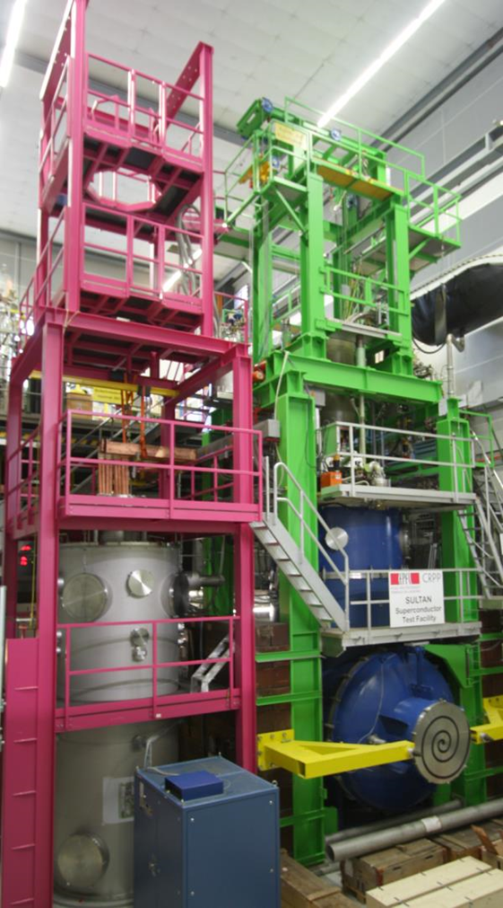
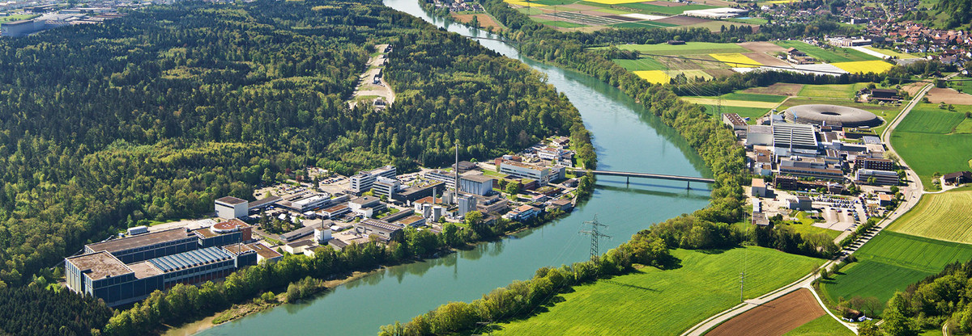
Introduction
Ecole Polytechnique Fédérale de Lausanne (EPFL)
  Swiss Plasma Center (SPC)
    Superconducting Group (SG)
Hosted by the Paul Scherrer Institute (PSI)
Led by Kamil Sedlak (after Pierluigi Bruzzone)
7 post-docs, 8 technicians, 3 PhD students

Slide 3
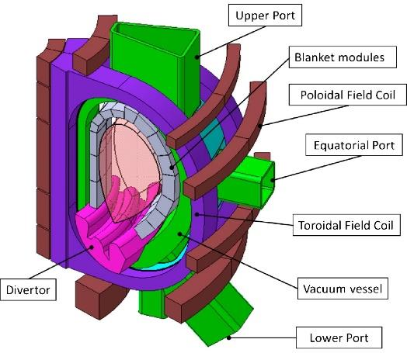
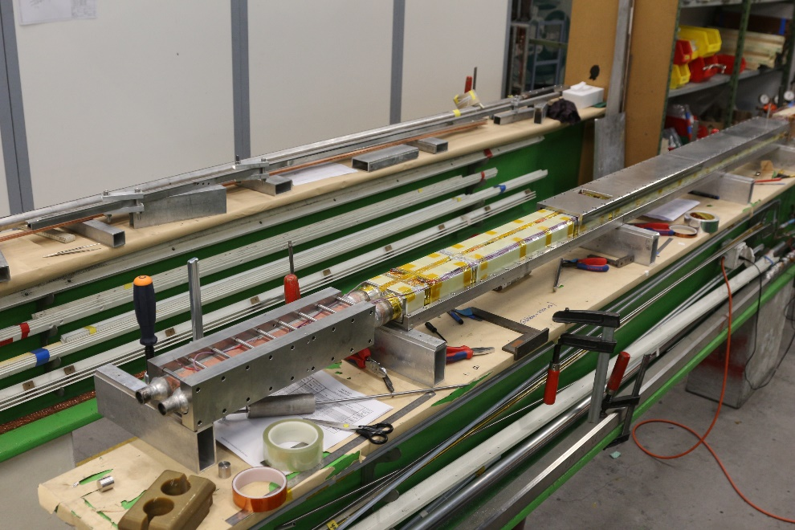
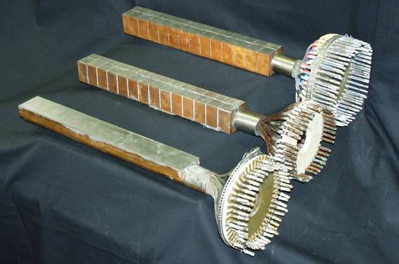
Introduction
What are our main activities?
  Running the SULTAN test facility
  Assembling, Integrating and Testing SULTAN samples
  Leading Designs and R&D programs for fusion technologies

Slide 4
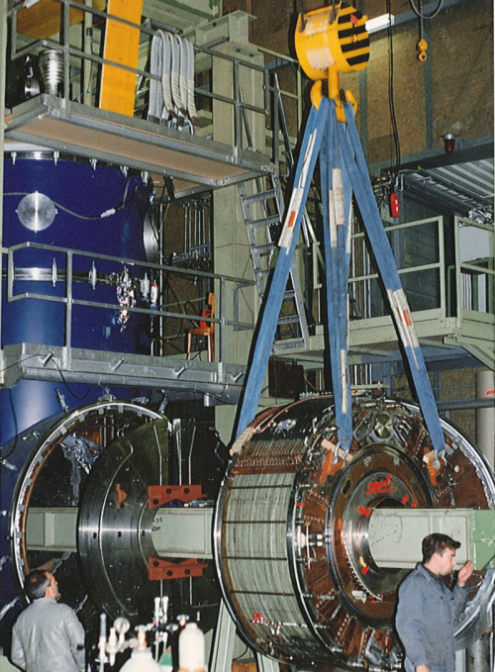
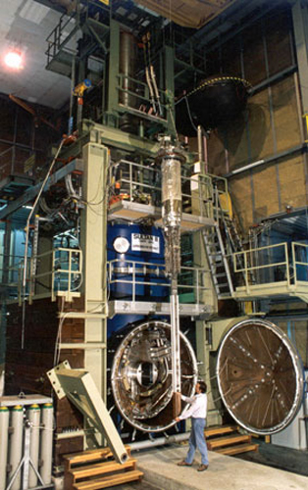
The SULTAN test facility
SULTAN assembly
EDIPO & SULTAN
Insert
Sample

Slide 5
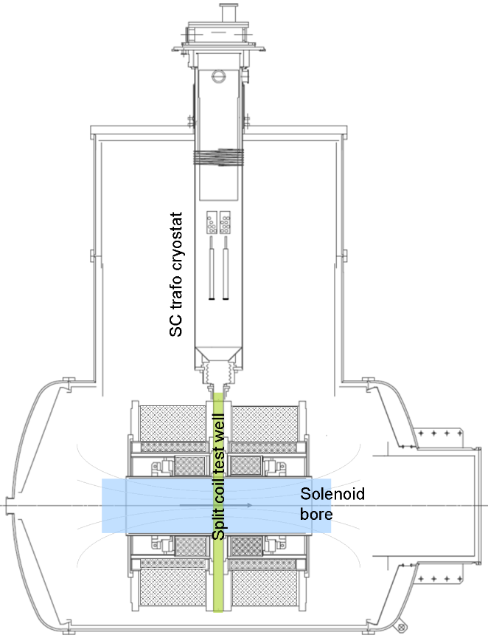
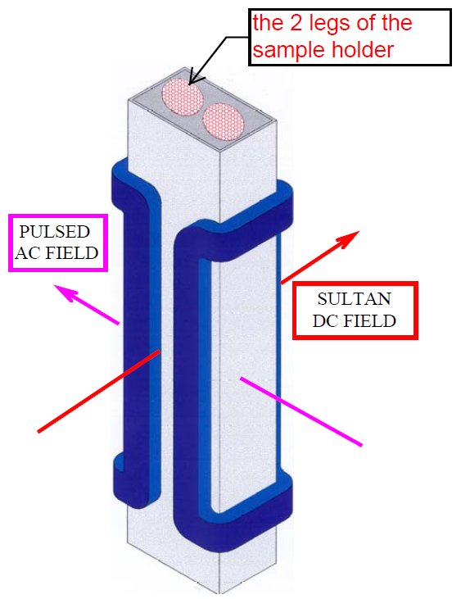
The SULTAN test facility
Since 1984, the SULTAN test facility is the largest worldwide device
to test forced flow, high current superconductors. It offers:
  Helium Refrigerator 1.5 kW at 4.5 K
  Three sets of coils, Nb₃Sn/NbTi with individual power supply
  DC background field up to 11 T in a 580 mm diameter split solenoid
  94x144 mm² test well
  450 mm High Field Region
  DC current for test sample ± 100 kA
  Supercritical Helium at 10 bar, 4.5 K-50 K, up to 20 g/s
  Superimposed steady state ac field, up to ± 0.4 T, 0.01 to 6 Hz
  Superimposed pulsed field, up to 3 T amplitude, 140 ms period

Slide 6
Recent Upgrades of the test facility
Heat Exchanger
For HTS conductor testing above 20 K, the heat flux between the HTS sample under test and the NbTi transformer needs to be limited to ≈10 W per leg by means of an HTS adapter connecting them. The intermediate temperature He is supplied by a tube-in-tube heat exchanger (HEX). The HEX ensures that the He is returned with a temperature of less than 20 K to the refrigerator

Slide 7
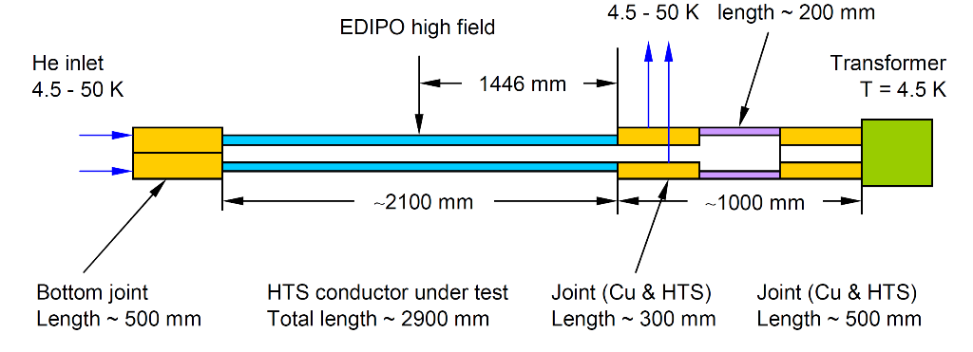
Recent Upgrades of the test facility
HTS adaptor

Slide 8
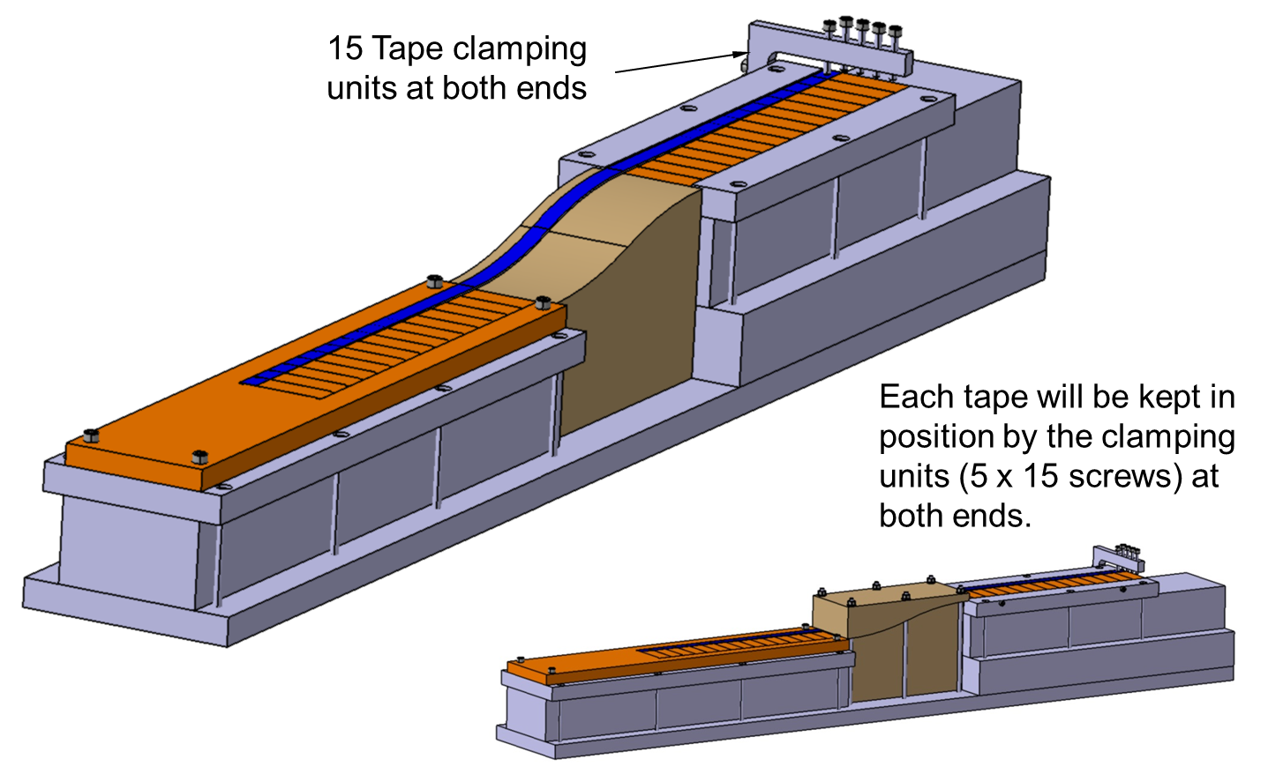
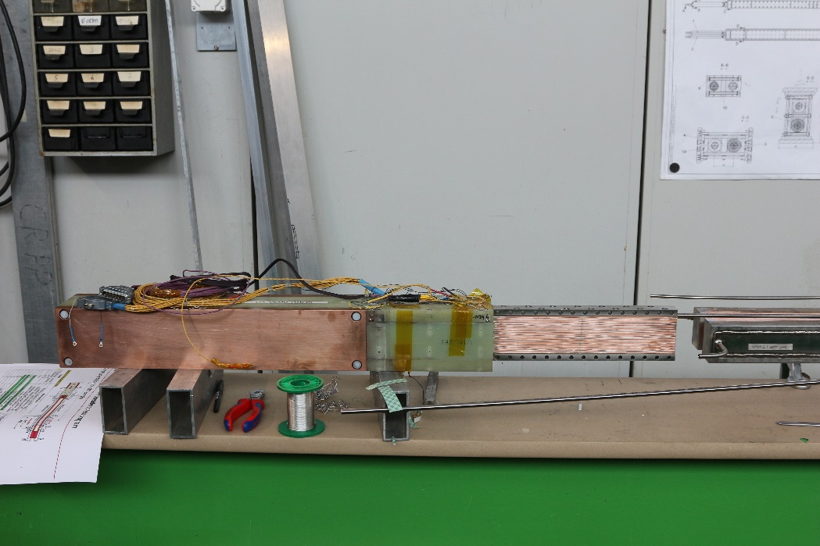
Recent Upgrades of the test facility
HTS adaptor:

Slide 9
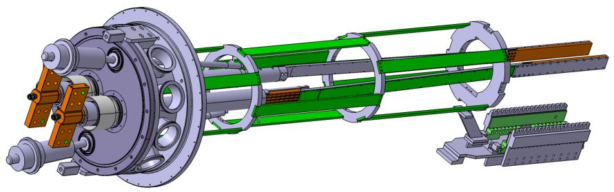
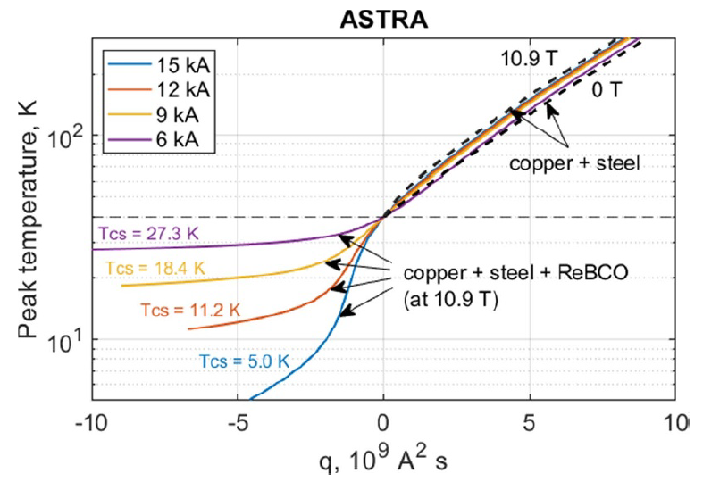
Recent Upgrades of the test facility
The Quench Experiment:
  Test of sub-size (HTS) conductors in SULTAN
  Power supply: 15 kA, 10 V.
  Allows us to preserve current when there is a big resistance in the sample during a quench, which would not be possible with superconducting transformer
  Temperature range in the quenched region: 4.5 –250 K
  Test of sub-size (HTS) conductors in SULTAN
Quench sample holder
https://doi.org/10.1088/1361-6668/acb17b

Slide 10
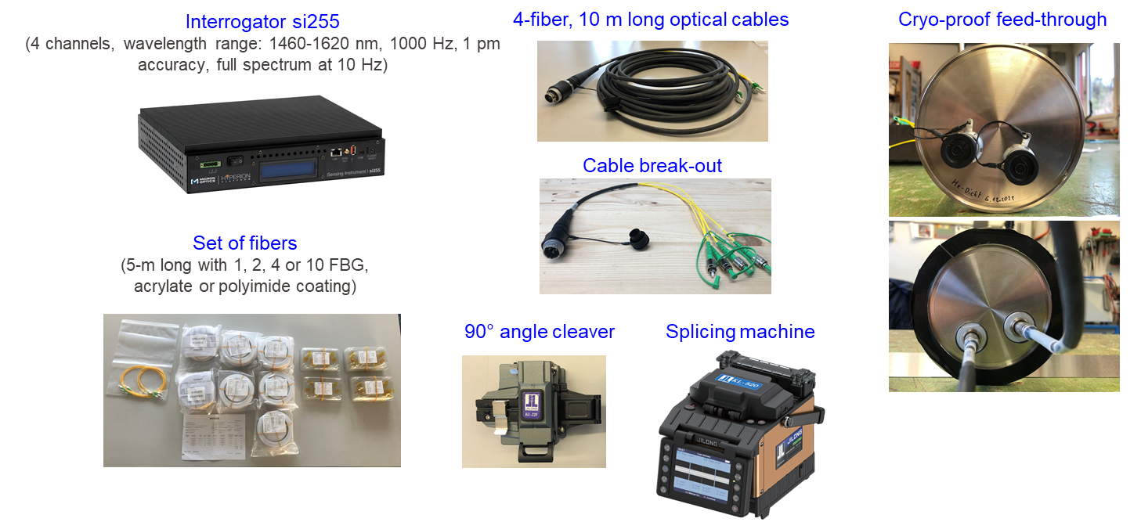
Recent Upgrades of the test facility
Optical Equipment for SULTAN

Slide 11
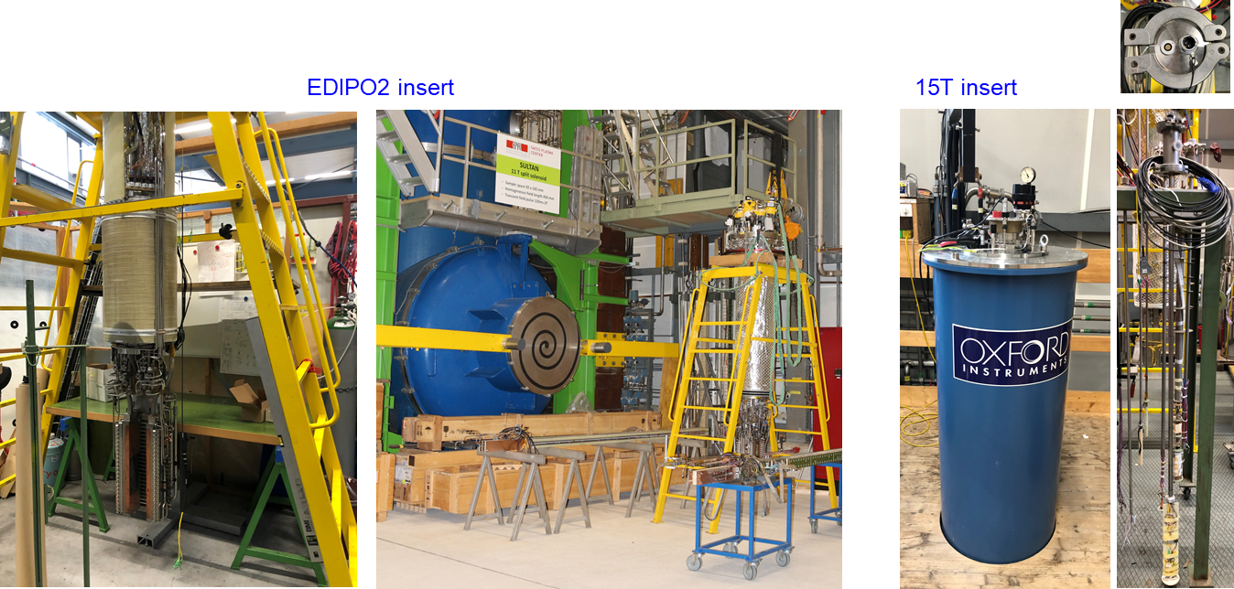
Recent Upgrades of the test facility
Optical Equipment for SULTAN

Slide 12
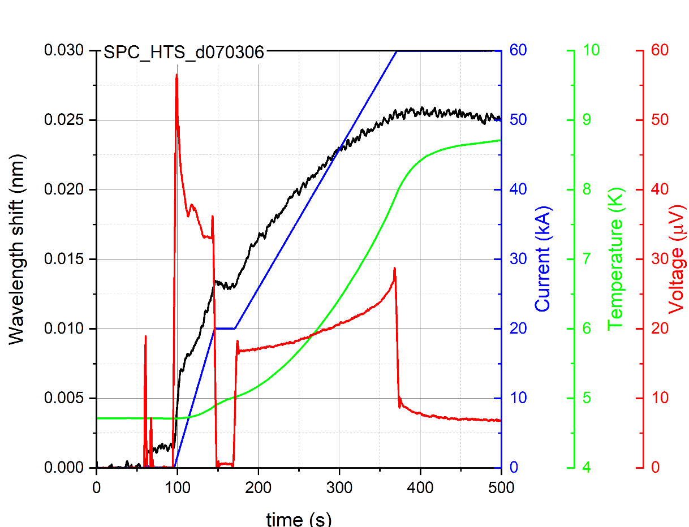
Recent Upgrades of the test facility
Optical Equipment for SULTAN
  The different inserts have been equipped with necessary read-out system
  Integration of optical signals into common data monitoring system
  (Labview program development)

Slide 13
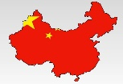
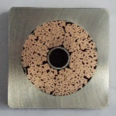
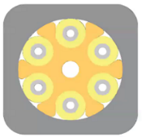
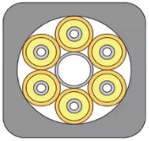
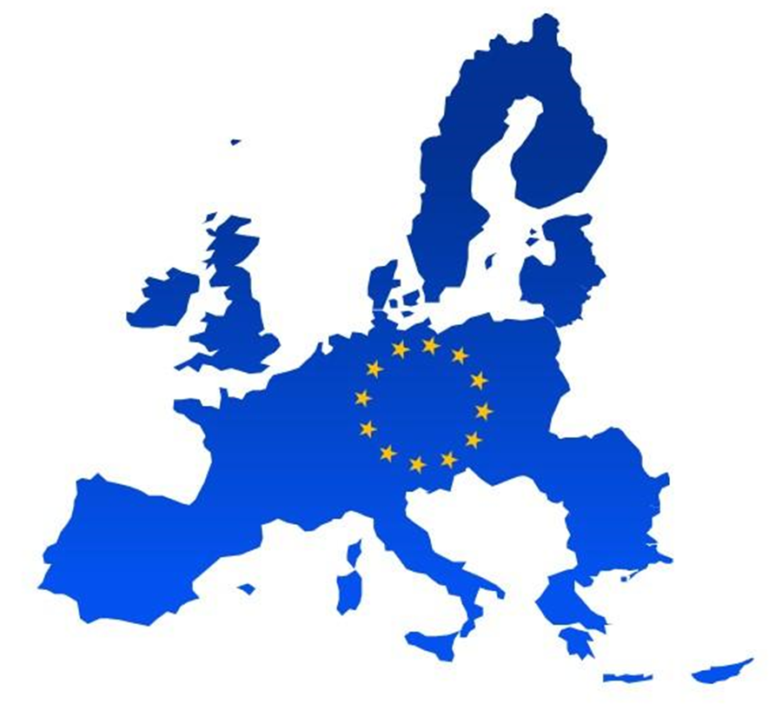
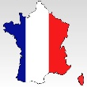
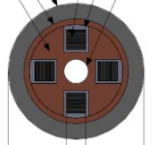
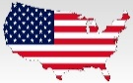

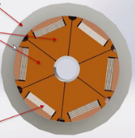

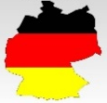
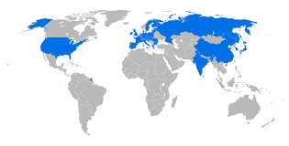
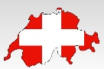
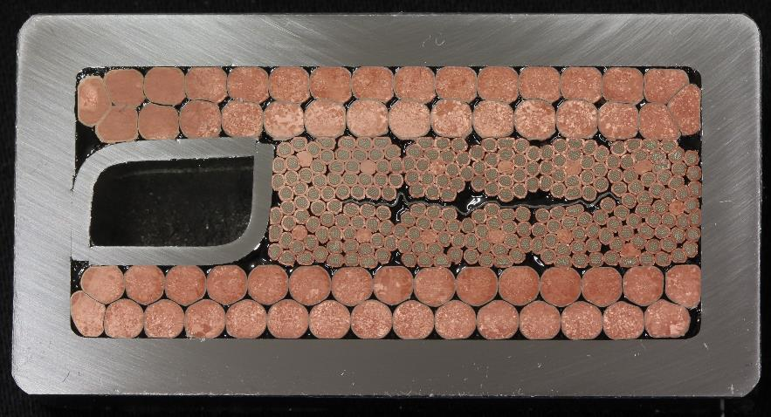
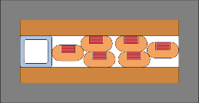
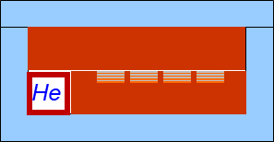
What is a SULTAN sample test ?
To deal with worldwide laboratories superconducting cables
  ASIPP
  CERN
  CEA
  CFS
  ENEA
  KIT
  ITER
  SPC
  NbTi, Nb₃Sn (CICC), HTS (CORC)
  Nb₃Sn internal joint
  Nb₃Sn (CICC)
  HTS (Viper)
  NbTi, Nb₃Sn, HTS (SECAS)
  HTS (CroCo)
  NbTi, Nb₃Sn (CICC)
  Nb₃Sn (R&W), HTS (ASTRA & NTNT)
Notes:
For fusion but not only
CroCo: Cross Conductor
NTNT monolithic non-transposed non-twisted condcutor

Slide 14
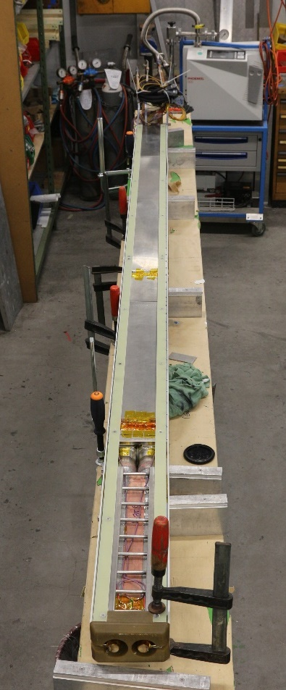
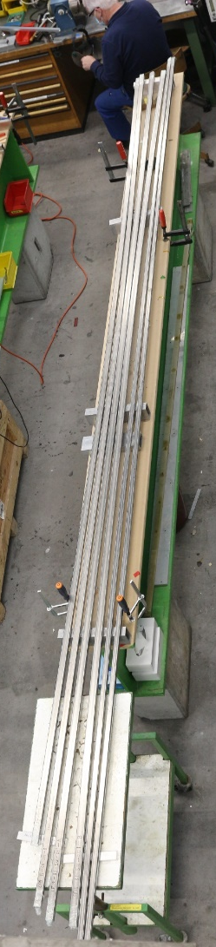
What is a SULTAN sample test ?
To prepare the sample for integration
From out of the box
to
SULTAN Sample
Notes:
For fusion but not only
CroCo: Cross Conductor
NTNT monolithic non-transposed non-twisted condcutor

Slide 15
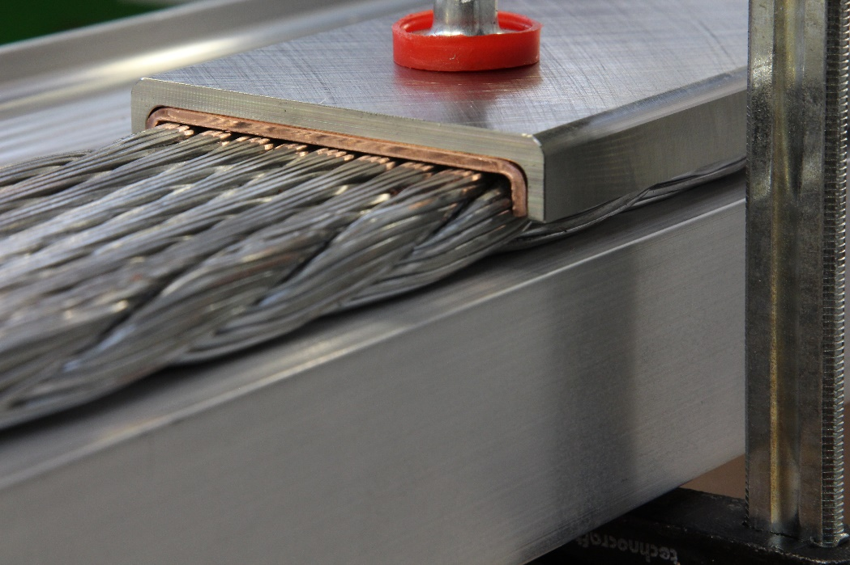
What is a SULTAN sample test ?
To perform the Jacketing and Welding (when necessary)
Notes:
For fusion but not only
CroCo: Cross Conductor
NTNT monolithic non-transposed non-twisted condcutor

Slide 16
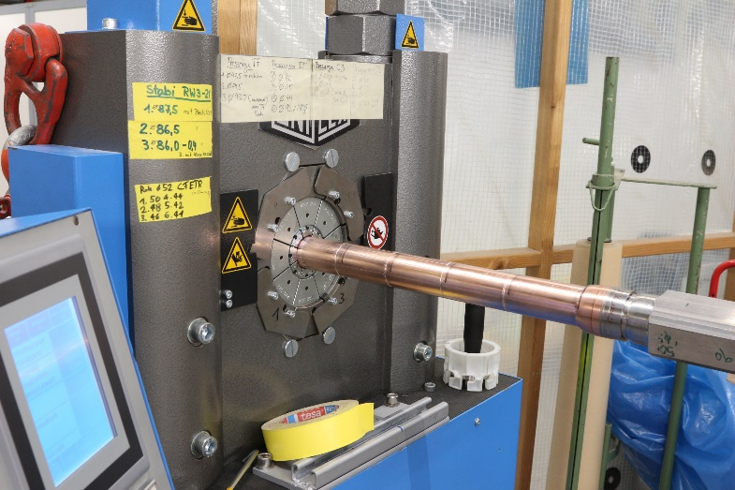
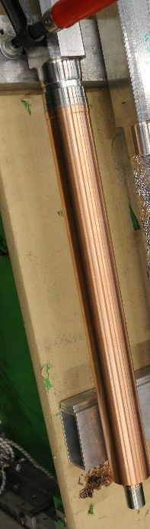
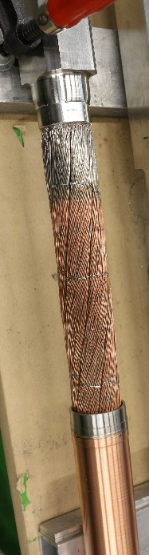
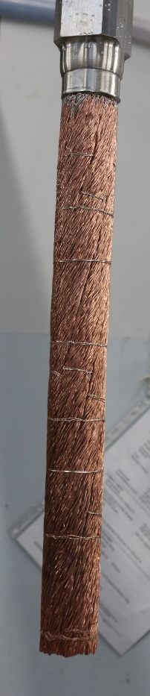
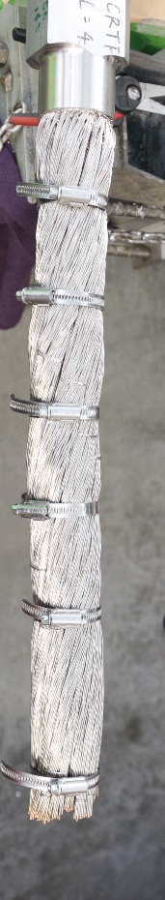
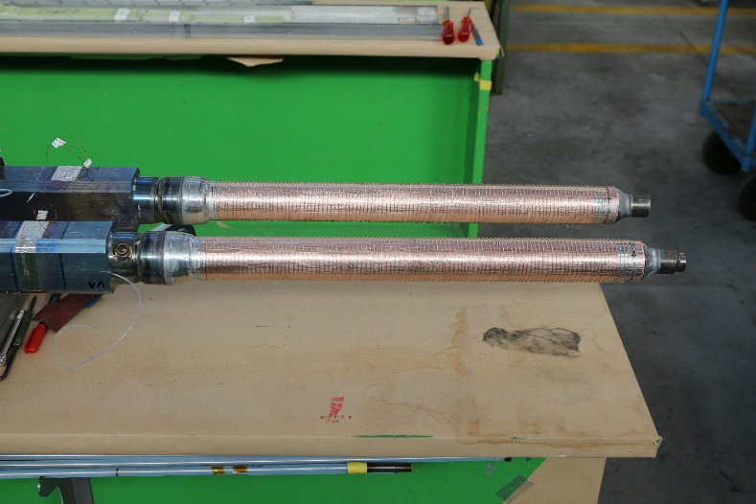
What is a SULTAN sample test ?
To manufacture the conductor terminations
Notes:
For fusion but not only
CroCo: Cross Conductor
NTNT monolithic non-transposed non-twisted condcutor

Slide 17
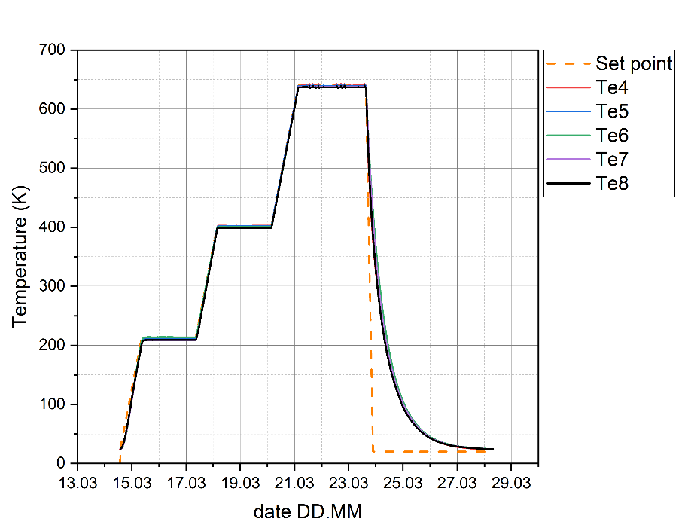
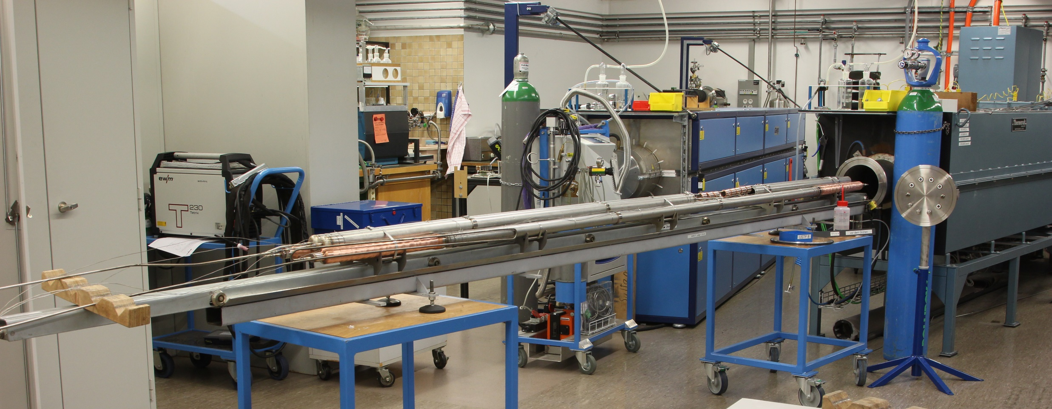
What is a SULTAN sample test ?
To react the sample
  Heat treatment (3 furnaces)
Notes:
For fusion but not only
CroCo: Cross Conductor
NTNT monolithic non-transposed non-twisted condcutor

Slide 18
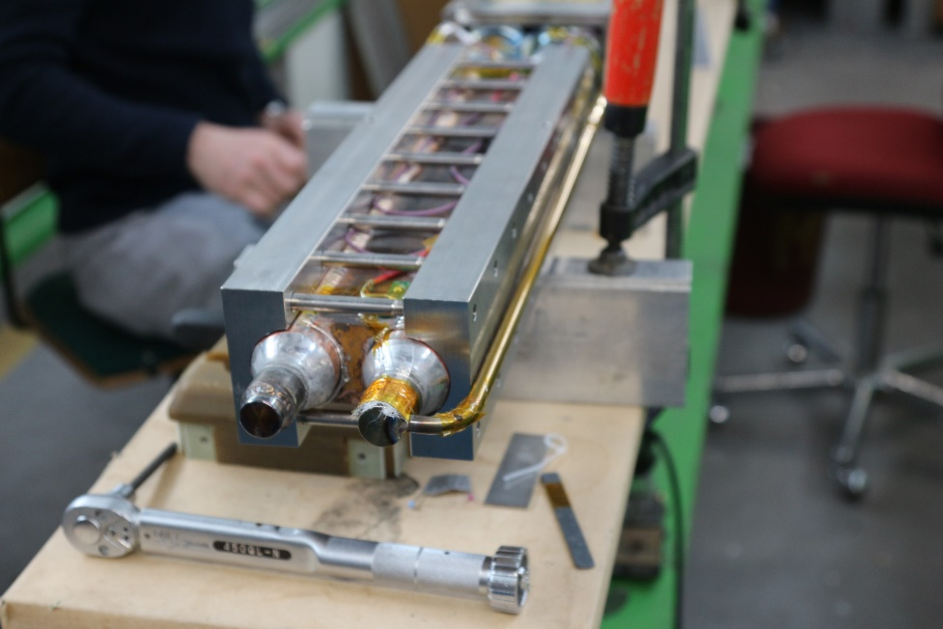
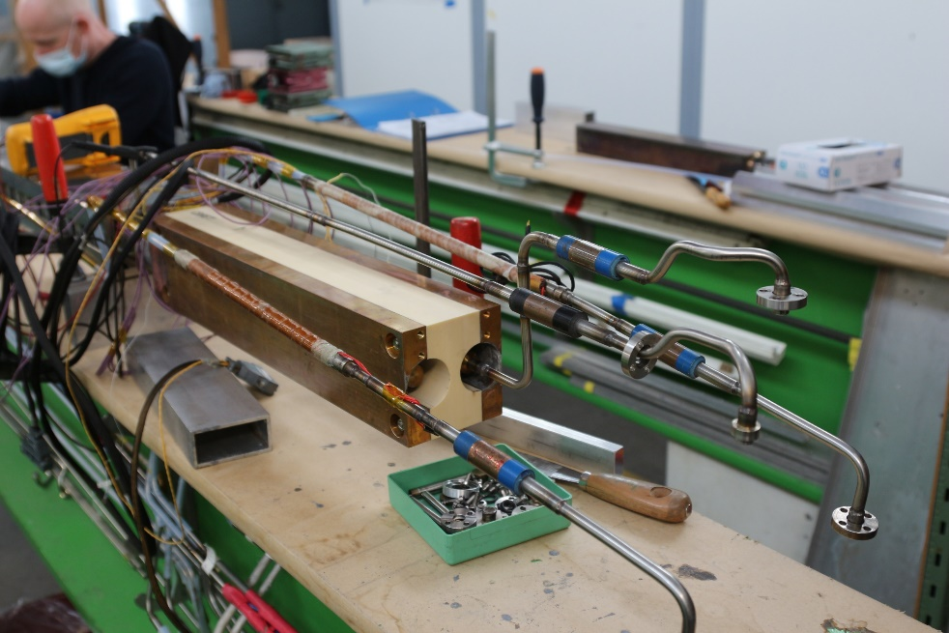
What is a SULTAN sample test ?
To manufacture the conductor terminations
Bottom joint
Upper terminals
Notes:
For fusion but not only
CroCo: Cross Conductor
NTNT monolithic non-transposed non-twisted condcutor

Slide 19
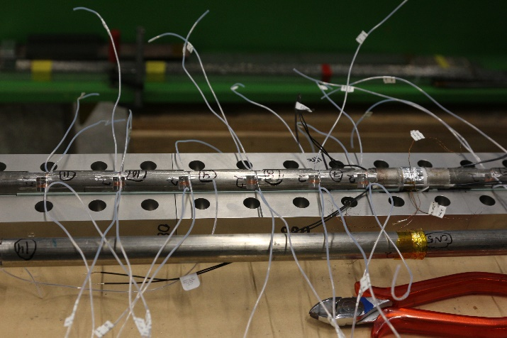
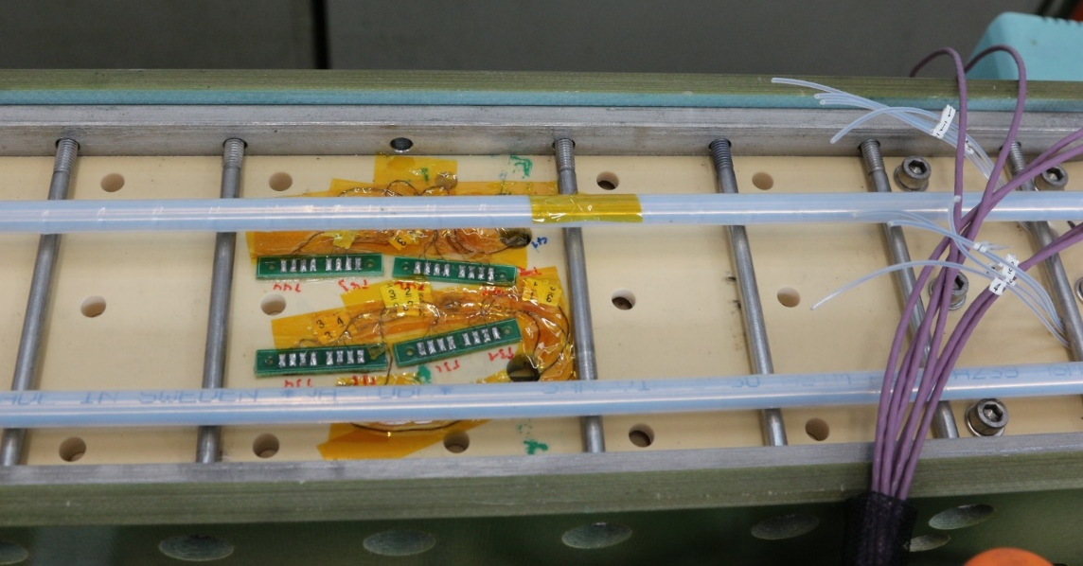
What is a SULTAN sample test ?
To install the instrumentations (voltage taps, CERNOX, fiber, spot heater)
Notes:
For fusion but not only
CroCo: Cross Conductor
NTNT monolithic non-transposed non-twisted condcutor

Slide 20
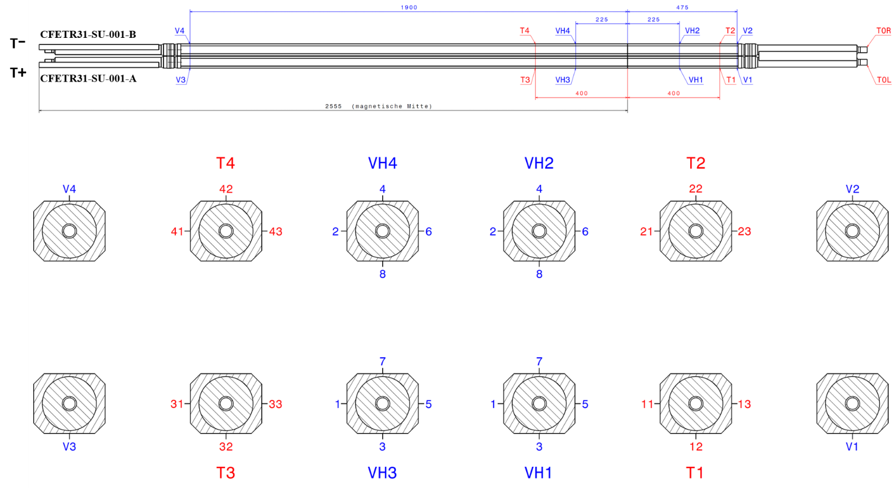
What is a SULTAN sample test ?
To install the instrumentations (voltage taps, CERNOX, fiber, spot heater)
Notes:
For fusion but not only
CroCo: Cross Conductor
NTNT monolithic non-transposed non-twisted condcutor

Slide 21
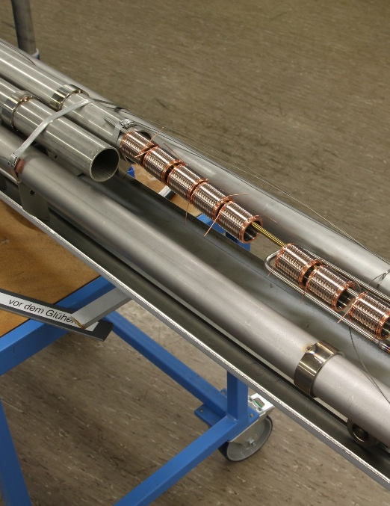
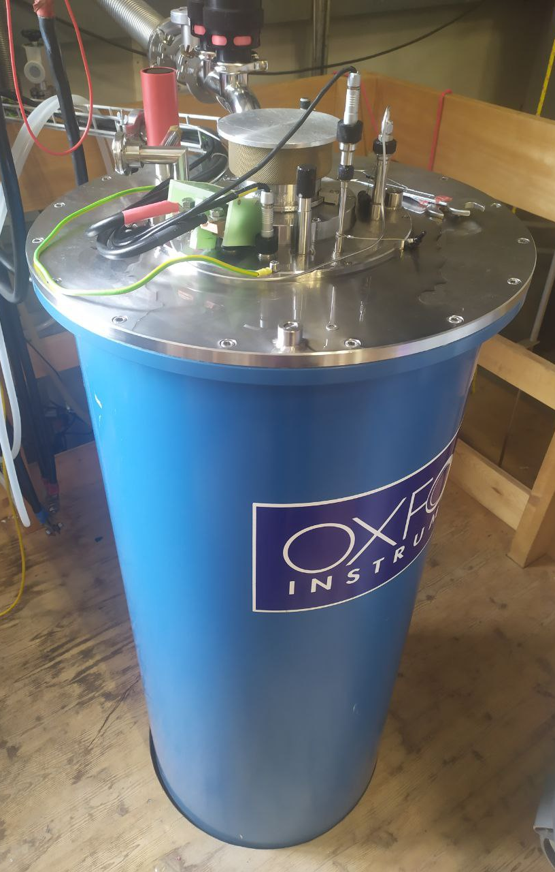


What is a SULTAN sample test ?
To prepare the witness sample
  Reacted together with SULTAN sample (short samples on ITER barrel)
  Strands performance evaluation in the 15T/2kA solenoid test stand
Notes:
For fusion but not only
CroCo: Cross Conductor
NTNT monolithic non-transposed non-twisted condcutor

Slide 22
What is a SULTAN sample test ?
What do we measure in SULTAN?
  Conductor performances
    V-T curve that yields to the current sharing temperature: T_{cs}
    V-I curve that yields to the critical current : I_{c}
    evolution with Lorentz force cyclic loading: I_{c}, T_{cs} vs. nb. of cycles
  Transient behavior (Tokamak pulsed mode operation)
    AC loss and Minimum Quench Energy
  Quench behavior: propagation, hot spot temperature
  Flux jump and mechanical disturbances
Notes:
For fusion but not only
CroCo: Cross Conductor
NTNT monolithic non-transposed non-twisted condcutor

Slide 23
What is a SULTAN sample test ?
Reporting and data sharing
  The sample assembly report and the test report are the final deliverable of every test campaign
  The data are stored and shared via ftp to the customer
  Archiving
Notes:
For fusion but not only
CroCo: Cross Conductor
NTNT monolithic non-transposed non-twisted condcutor

Slide 24


On-going R&D program in the group
Nb₃Sn React-and-Wind conductor for DEMO reactor
  Cross-section design
RW1
RW2-Rutherford
RW2
RW3
Notes:
For fusion but not only
CroCo: Cross Conductor
NTNT monolithic non-transposed non-twisted condcutor

Slide 25

On-going R&D program in the group
Nb₃Sn React-and-Wind conductor for DEMO reactor
  Cross-section design
    The RW2 conductor reached higher performance than ITER TF conductors, even though the cross-section of Nb₃Sn in RW2 was only 56% of that in ITER TF
Notes:
For fusion but not only
CroCo: Cross Conductor
NTNT monolithic non-transposed non-twisted condcutor

Slide 26


On-going R&D program in the group
Nb₃Sn React-and-Wind conductor for DEMO reactor
  Bending tolerance test
S-bent sample:
Cable bent before heat treatment then straightened
Cable bent to three different bending radii and re-straightened
(R_{HT} ≈ 7000 mm → ε_{fin} ≈ 0.06%)
    Bending radii:
      RW3B1: Reference → R = ∞;
      RW3B2: R = 4514 mm → ε = ±0.09%;
      RW3B5: R = 2125 mm → ε = ±0.2%;
      RW3B4: R = 1417 mm → ε = ±0.3%.
Notes:
For fusion but not only
CroCo: Cross Conductor
NTNT monolithic non-transposed non-twisted condcutor

Slide 27

On-going R&D program in the group
Nb₃Sn React-and-Wind conductor for DEMO reactor
  Diffusion-bonded joint
Electric arc spray process with Copper
(a) Cable prepared with Al clamps and bars;
(b) after 1st stage sandblasting;
(c) after clamps removal and 2nd sandblasting stage;
(d) after being sprayed with Cu;
(e) after milling all sides.
Notes:
For fusion but not only
CroCo: Cross Conductor
NTNT monolithic non-transposed non-twisted condcutor

Slide 28


On-going R&D program in the group
Nb₃Sn React-and-Wind conductor for DEMO reactor
  Diffusion-bonded joint
Inductive heating process
good performance (R<0.8 nΩ at 8T and 66 kA)
RW3 cable in between the inductive heating coils.
A 25 MPa pressure is applied to the conductor.
Heating using 53 kHz, 6 kW up to 650°C for 2 h.
The heating process is done in N2 atmosphere.
Notes:
For fusion but not only
CroCo: Cross Conductor
NTNT monolithic non-transposed non-twisted condcutor

Slide 29



On-going R&D program in the group
Nb₃Sn React-and-Wind conductor for DEMO reactor
  Strain distribution in Nb₃Sn conductor
    Measurement of the cable susceptibility as a function of temperature in VTI
    Pressure increased in steps before each measurement
Notes:
For fusion but not only
CroCo: Cross Conductor
NTNT monolithic non-transposed non-twisted condcutor

Slide 30





On-going R&D program in the group
HTS conductor for DEMO reactor
  HTS tapes stacks in various configuration
The first HTS conductor design at SPC (~2016):
Conductor performance was initially good, but degraded during the test campaign due to electromagnetic load. I_{c} degradation during cycling was mainly found at the edges of the conductor.
ASTRA conductor concept for DEMO CS
Monolithic Non-transposed non-twisted conductor
Nikolay Bykovskiy
(NTNT)
Davide Uglietti
Simplest tape arrangement
Good for slowly, seldom charged magnets
Critical bending radius < 1 m
Cable design:
  Roebel cabling
  Jacket pre-compression
  Separate cooling channel
  Cable space impregnation
https://doi.org/10.1109/TASC.2022.3153248
Field
Force
Current
He
Both non-twisted concepts (ASTRA and NTNT) were first presented and motivated in https://doi.org/10.1016/j.cryogenics.2020.103118. The common strategy was: 1. Keeping gaps and empty spaces as small as possible. 2. Filling with a stiff material: solder or water/DMSO.
Notes:
For fusion but not only
CroCo: Cross Conductor
NTNT monolithic non-transposed non-twisted condcutor

Slide 31

On-going R&D program in the group
HTS conductor for DEMO reactor
  HTS tape characterization
Notes:
For fusion but not only
CroCo: Cross Conductor
NTNT monolithic non-transposed non-twisted condcutor

Slide 32


On-going R&D program in the group
New Quench Detection Systems
  Superconducting Quench Detection
https://doi.org/10.1088/1361-6668/acb17b
Notes:
For fusion but not only
CroCo: Cross Conductor
NTNT monolithic non-transposed non-twisted condcutor

Slide 33

On-going R&D program in the group
New Quench Detection Systems
  Fiber Optic Sensor Quench detection
  Schematics of the instrumentation
    3 fibers to be integrated (close to conductor and outside the steel jacket)
      2 fibers with 10 FBGs and 1 fiber with 4-FBG
Notes:
For fusion but not only
CroCo: Cross Conductor
NTNT monolithic non-transposed non-twisted condcutor

Slide 34

On-going R&D program in the group
New Quench Detection Systems
  Fiber Optic Sensor Quench detection
  Strain free vs. embedded
Notes:
For fusion but not only
CroCo: Cross Conductor
NTNT monolithic non-transposed non-twisted condcutor

Slide 35

On-going R&D program in the group
New Quench Detection Systems
  Fiber Optic Sensor Quench detection
  Root, protection
  and splice of the fiber
Notes:
For fusion but not only
CroCo: Cross Conductor
NTNT monolithic non-transposed non-twisted condcutor

Slide 36


On-going R&D program in the group
New Quench Detection Systems
  Fiber Optic Sensor Quench detection
  Successful integration in SULTAN sample and cryogenics tests.
Notes:
For fusion but not only
CroCo: Cross Conductor
NTNT monolithic non-transposed non-twisted condcutor

Slide 37


On-going R&D program in the group
Instrumentation
  Fiber Optic Sensor Optimization for cryogenics temperature monitoring
Notes:
For fusion but not only
CroCo: Cross Conductor
NTNT monolithic non-transposed non-twisted condcutor

Slide 38
Scopes
Design and built of the EDIPO2 magnet.
R&W Nb₃Sn conductor development and bending test.
Testing of superconducting samples, mainly for fusion
Design and R&D of EUROfusion DEMO
  Fiber integration in tokamak (long distance, exit, etc…)
  Fiber used as thermometer and quench detection system
  Superconducting switch
  Non-Insulated coils
Notes:
For fusion but not only
CroCo: Cross Conductor
NTNT monolithic non-transposed non-twisted condcutor

Slide 39

On-going R&D program in the group
Instrumentation
  Fiber Optic Sensor Optimization for cryogenics temperature monitoring
Notes:
For fusion but not only
CroCo: Cross Conductor
NTNT monolithic non-transposed non-twisted condcutor

