Slide 1
LASA test facility
Marco Statera, LASA

Slide 2

Outline da rifare
LASA cryogenic system
SC cavities test facility
SC magnets test area
  Highligths of HL-LHC HOC production and test
  Next tests, from high field to ion therapy
conclusion

Slide 3
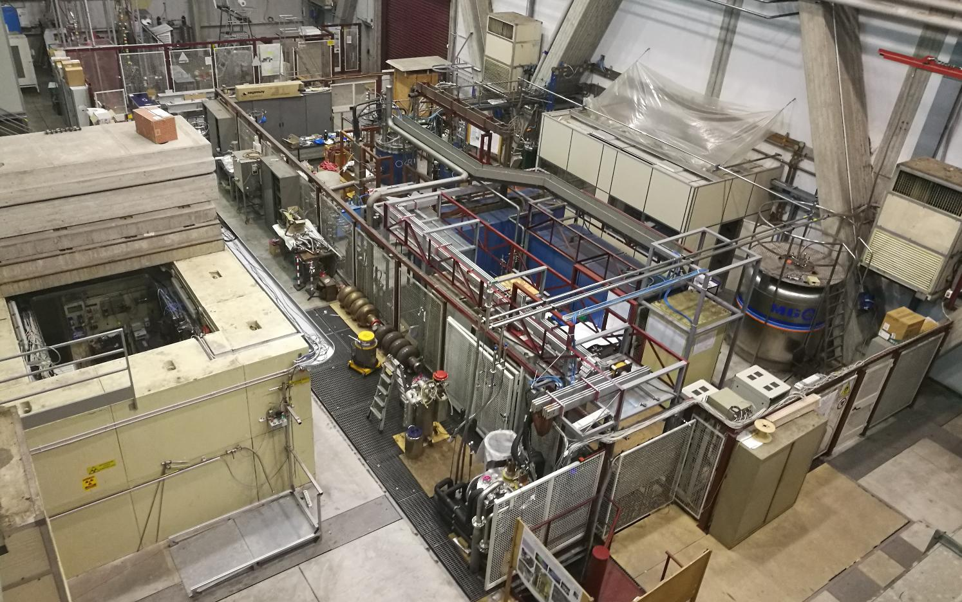
LASA overview
high field solenoids
Neutron test area
30 kA line
SC cavities
Test area
power supplies
fast DAQ and slow control
vertical cryostats
10 kA line

Slide 4
Cryoplant layout
DISCORAP and
hilumi cryostat
3000l
450 l dewar
HL-LHC HOC
tested
a
DISCORAP
constraints
100 Nm³/h compressors
100 m³ recovery balloon
operation 1-2 k h/year

Slide 5
Cryoplant Upgrades
SC magnets
HL-LHC correctors
HTS @ variable T
SC cavities
HeII refiller
procurement ongoing
He liquefier
New machine
Bidding started in 2022
warm helium automation
Ready for installation
2023

Slide 6
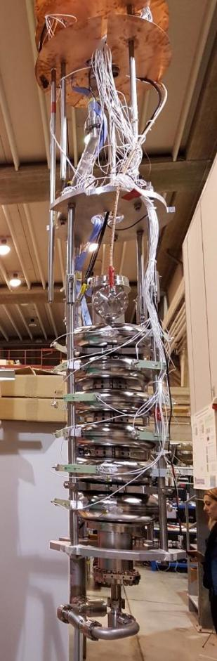
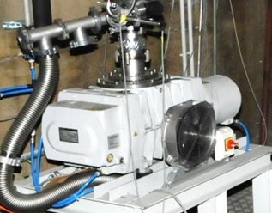
SC Cavities Testing Facility
Bunker with vertical cryostat, f 700 mm, 4500 mm depth, can hold large SC cavities as 500 MHz
Sub-cooling system for superfluid helium, up to 1.5 K. Cooling power 41 W a 2.0 K
2 Cold inserts for cavity testing
RF generators: 700 MHz, 1.3 and 3.9 GHz
  European Spallation Source – ESS
  Proton Improvement Plan II – PIP-II FNAL
Associated infrastructures
ISO4 clean room (9 m²)
High Pressure Rinsing facility
Slow pumping Slow venting system
UP water production plant (100 l/h)
Courtesy of R. Paparella

Slide 7
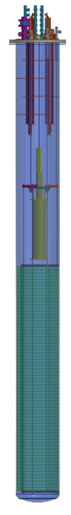

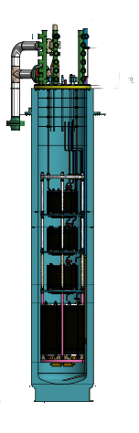
SC Magnet Test Area
MAGIX
D 480 mm
h 1200 mm
4.2 K and 2.17 K
500 A
Small Magnets test cryostat
  HO correctors protoypes
    6P MCSXFP (MCSXF/MCSSXF)
    8P MCOXFP (MCOXF/MCOSXF)
    10P MCDXFP (MCDXF/MCDSXF)
High Current Test Station
  DISCORAP and HTS magnets
  HO correctors
  HiLumi HO correctors series
DISCORAP
D 695 mm
h 7200 mm
4.2 K
10 kA
HiLumi
D 515 mm
H 2950 mm
4.2 K
500 A

Slide 8
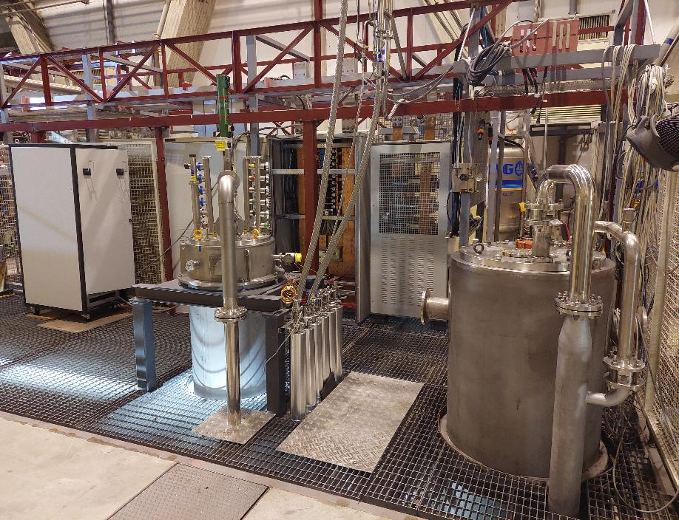
Cryostat updated installation
10kA IGBT switch
(30K A in construction)
10kA line
Hilumi cryostat was inserted into dicorap for the series mesurements
DISCORAP and Hilumi cryostat may operate indipendently (not in parallel)
New PC - line – fast switch 25-30 kA
Procurement ongoing
MM
hilumi
discorap

Slide 9

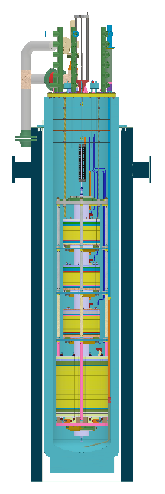
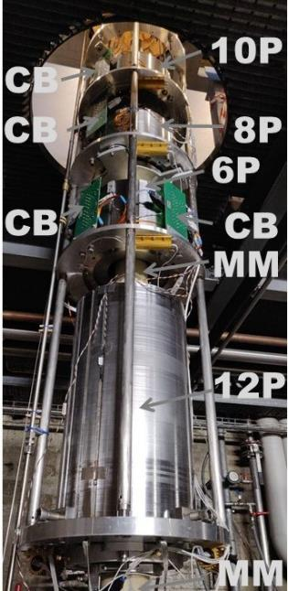
The test station at LASA
Four HO correctors cooled at 4.2 K
  Each magnet powerd individually
  Magetic Measurements
Power converter 600 A
  Dump resistance 1 W or 1.5 W
  IGBT polarity switch by LASA
  IGBT for quench protection
Field probe for the series by CERN
  Each magnet measured individually
  No cross talk
  Integration and commisioning by LASA

Slide 10
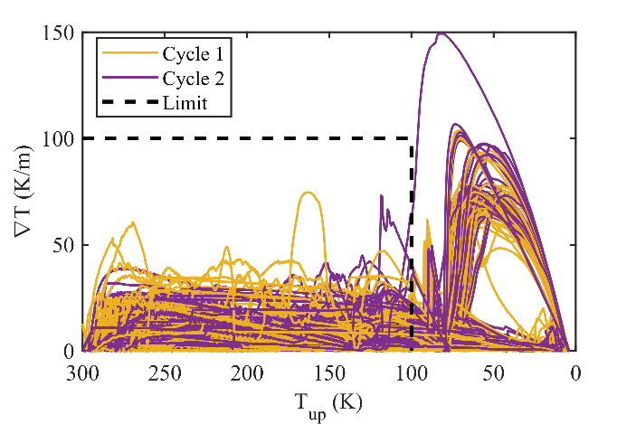
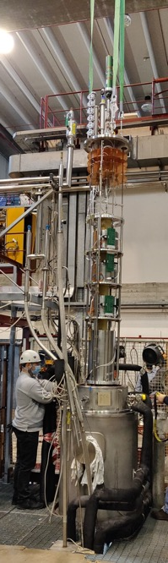
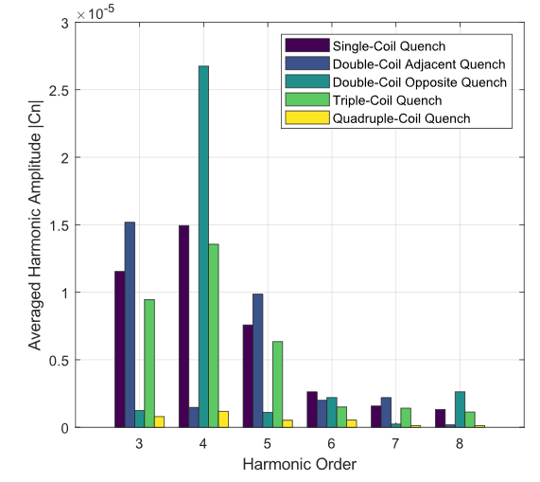
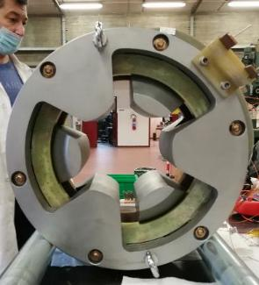
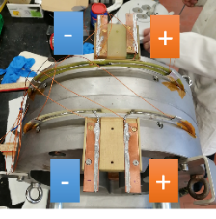
HL-HOC test
54 series magnets tested and delivered to CERN
Powering (M. prioli)
  Training (both polarities)
  Endurance test 1h at ultimate
Magnetic field measurement by CERN
(E. De Matteis, S. Mariotto)
  Field integral 1% to 3% wrt simulations
  Field integral reproducibility <0.1%
  Field quality high reproducibility
  Transfer function very good agreement with simulations, high reproducibility
Quenched coil recostruction via Magnetic Measurements (S. Mariotto)
Roud Coil Superconducting Magnet
2 MgB₂ coils
Reached 230 A (1.5 I_{nom})
By R. Valente

Slide 11
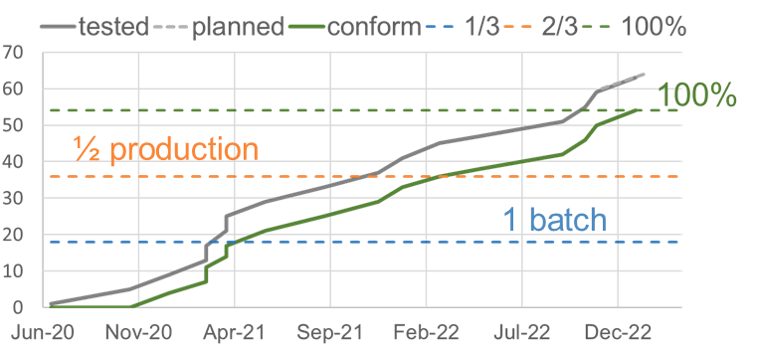
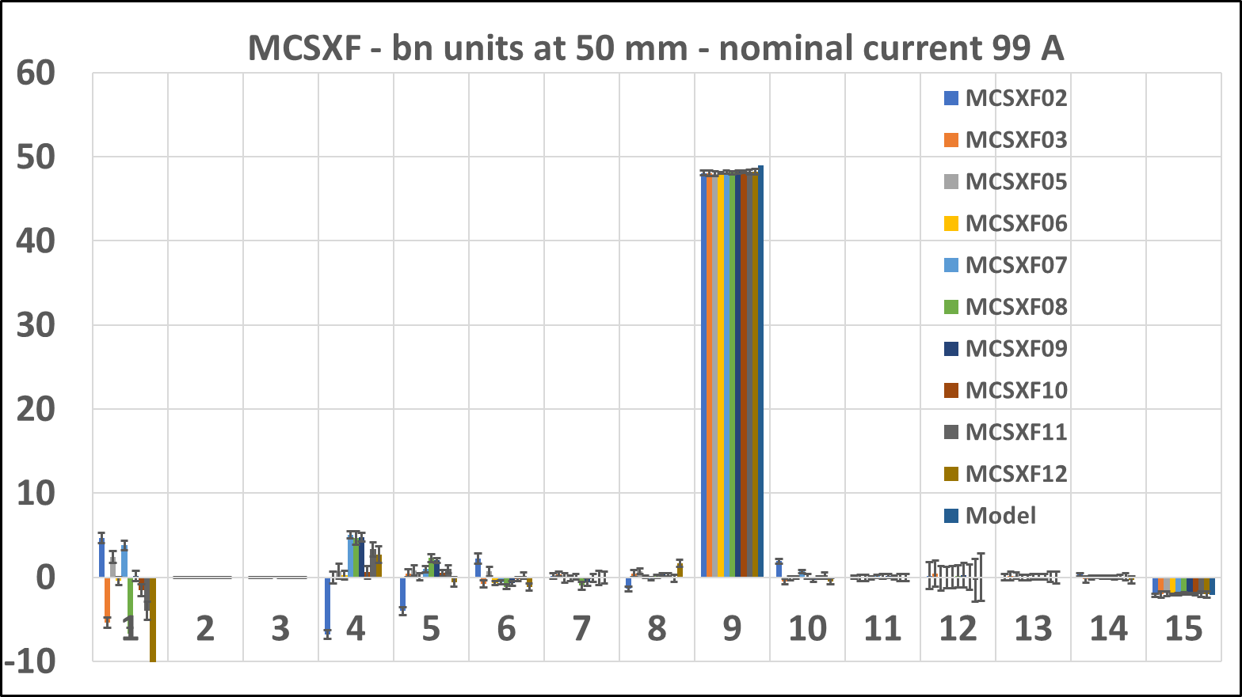
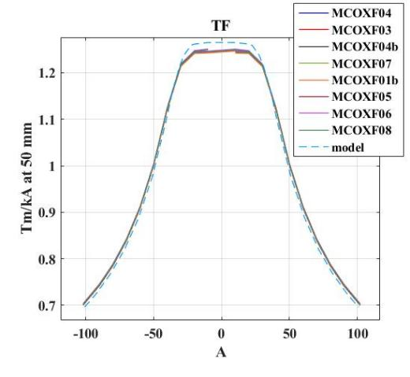
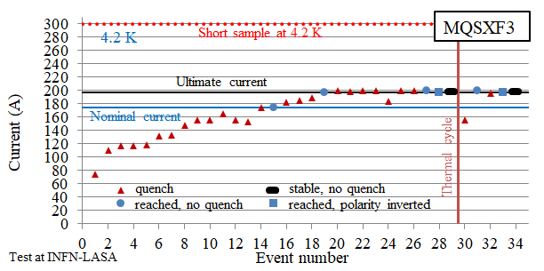
Selected results
2 ½ years of measurements at LASA
Calculated
Field quality of the 6P family
Transfer function of the 8P family
Training history and quench memory

Slide 12
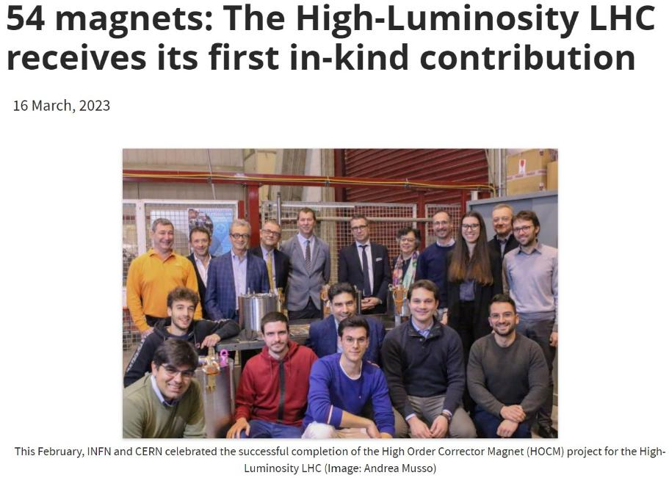

End of production
First series production and first measurement of a series production of accelerator magnets
End of production has been celebrated on Feb 17th
https://indico.cern.ch/event/1254316/
https://hilumilhc.web.cern.ch/article/54-magnets-high-luminosity-lhc-receives-its-first-kind-contribution

Slide 13
Next magnets to be tested at LASA
In the next two years we are testing different magnets,
exploring superconductors, configurations and technologies
Cosin theta high field dipole FalconD
Canted cosin theta magnets (straight and curved) for R&D and applications
HTS test coils (R&D for IRIS and MuColl)

Slide 14


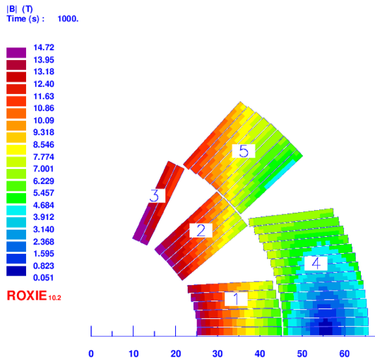
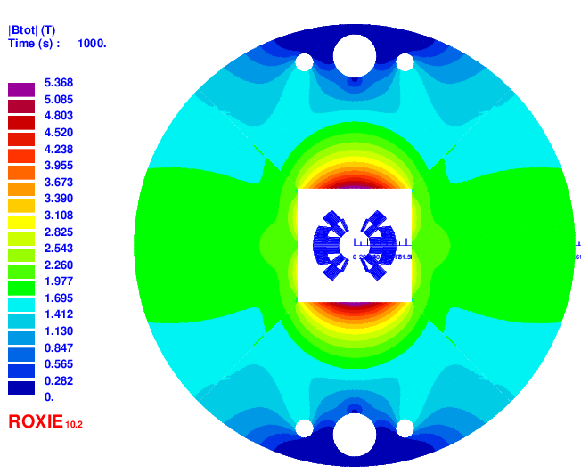
FalconD
INFN activity, co-founded by CERN, to develop a Nb₃Sn cos-theta dipole demostrator for 14 T (2 m long)
Magnet Parameter | Value
Bore field (T) | 14
Operation on Load Line | 86% (block 3)
Current (A) | 22975
J_{cu} (A/mm²) | 1540
Cable Parameter | Value
Cu/SC | 1
Strand number | 2x19
Strand diameter (mm) | 1
Height (mm) | 20
Inner width (mm) | 1.72
Outer width (mm) | 1.895
Keystone angle | 0.5°
Twist pitch (mm) | 100

Slide 15
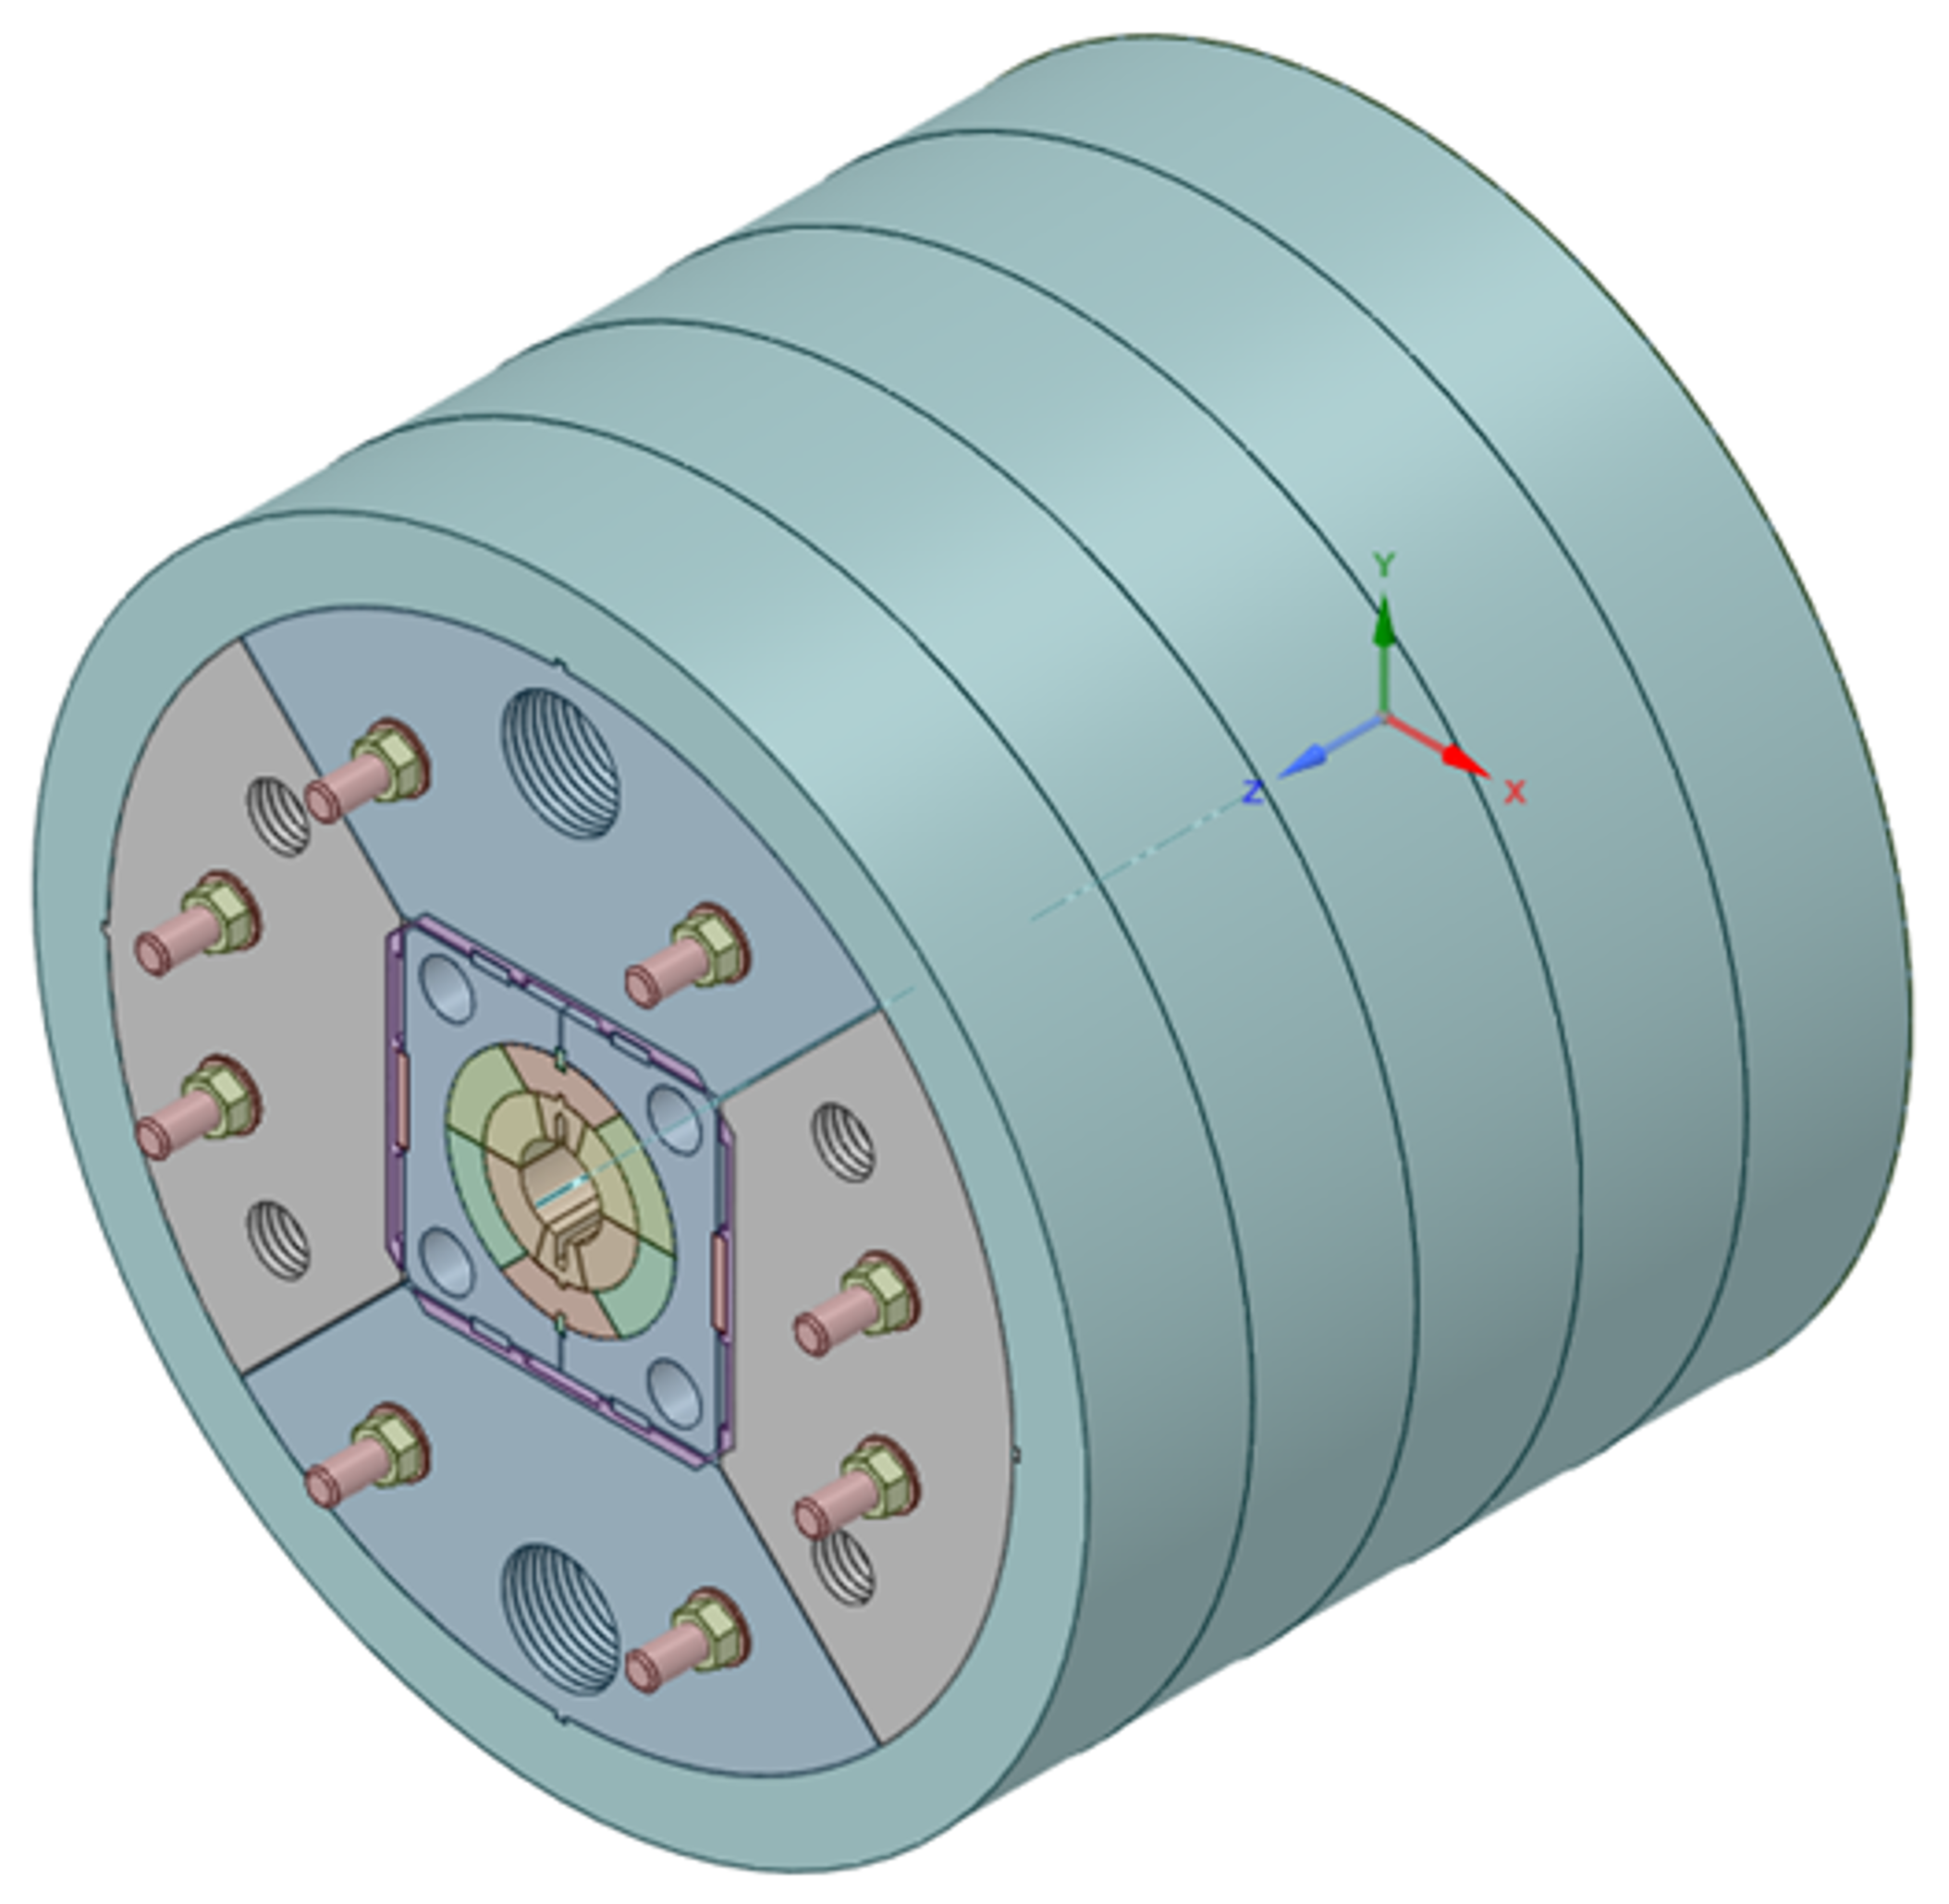
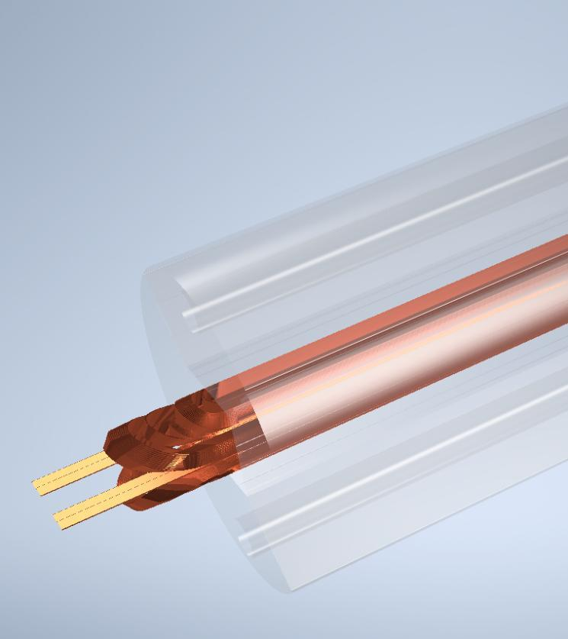
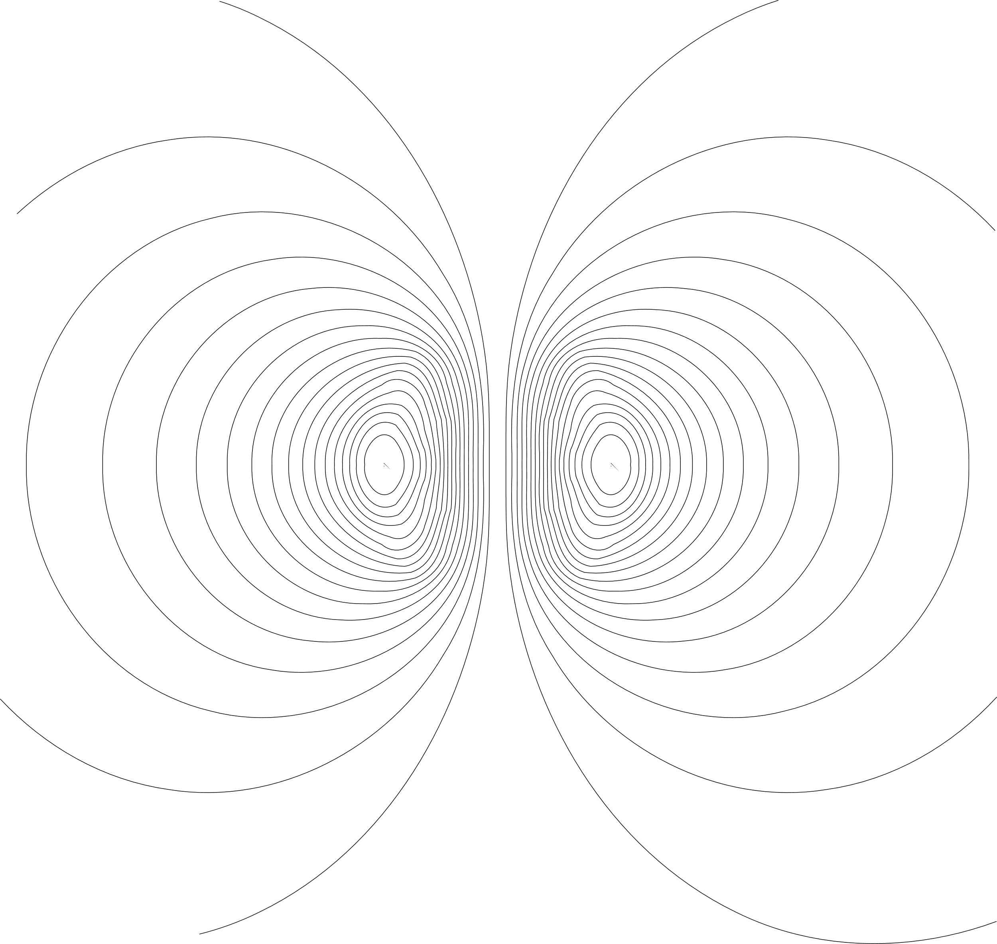
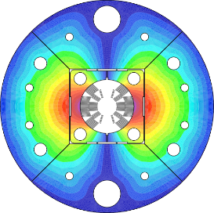
FalconD
Coils in production at ASG Superconductors
Assembly at LASA
Test at 4.2 K at LASA

Slide 16


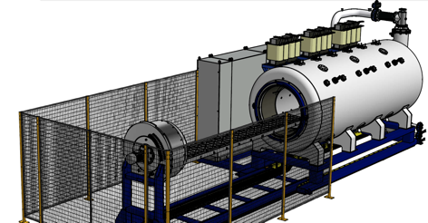




INFN-LASA activity on FCC
This activity requested an investment to procure a furnace for Nb₃Sn reaction
This new important new competences in high field dipole assembly and test, together with the “in house” special toolings, is a step for producing high field magnets at LASA
Geometry and load: | 3 m
Commissioning | OK
Installation area | 9 x 3.5 m
Length (uniform Temp/total) | 3 m
Max. operation temperature | 900°C
Temperature uniformity | ±3°C
Circulation fan / turbulent flow | 1 Fan/vertical axis
Process atmosphere | Argon
Vacuum level | 10⁻² hPa
Oxygen monitoring | down to 1 ppm

Slide 17


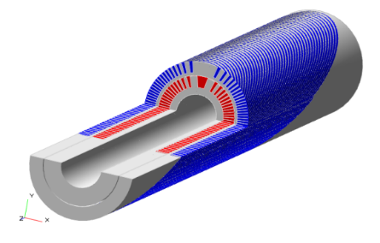

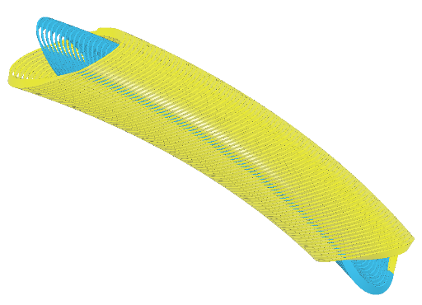

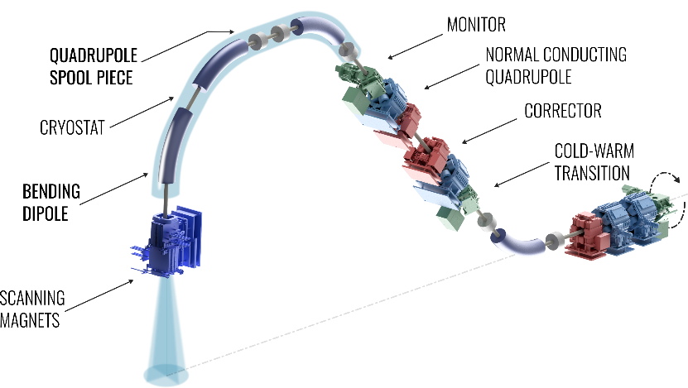
European Projects on SC magnet design for Gantry & Co¹
WP8 - Superconducting magnet design
Institutes/Companies Partners
CURVED Canted Cosine Theta with R = 1.65 m (Ion gantry-oriented) B= 4 T, 4.7 K, 0.4 T/s
Courtesy of Tengming Shen
Main advantages:
Reduction of weight
(300 → 50 ÷100 tons)
  Reduce the number of magnets (B = 3→4 T)
Footprint and cost reduction
  Gantry cost is about 25% of facility cost;
  Total cost of facility is about 200-250 Meuro (50 Meuro for the gantry);
Power consumption (SC vs NC magnets);
Reduction of size:
  Compact gantry → less civil construction.
6 m
15 m

Slide 18


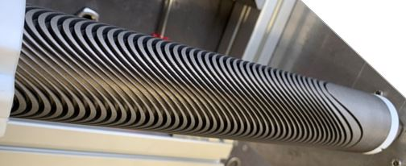

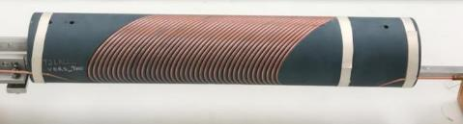
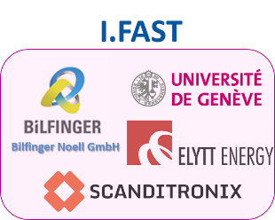
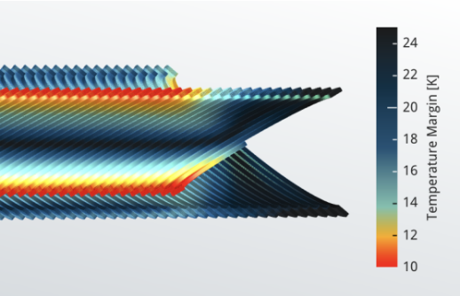
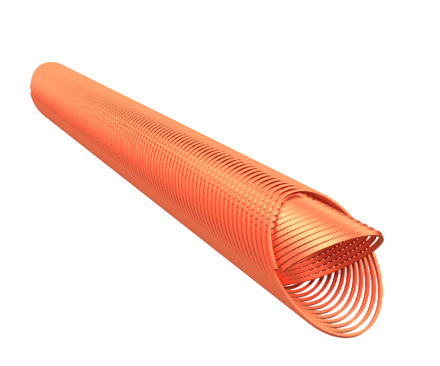
European Projects on SC magnet design for Gantry & Co¹
WP8 - Innovative Superconducting magnets
Institutes/Companies Partners
exploring Canted Cosine Theta with HTS and combined function! Labs → Industry (two demonstrators)
B = 4 T, 20 K, 0.4 T/s
Outer layer
Courtesy of Xiaorong Wang
¹L. Rossi et al., "A European Collaboration to Investigate Superconducting Magnets for Next Generation Heavy Ion Therapy," in IEEE Transactions on Applied Superconductivity, vol. 32, no. 4, pp. 1-7, June 2022, Art no. 4400207, doi: 10.1109/TASC.2022.3147433.

Slide 19
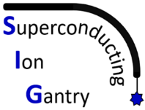




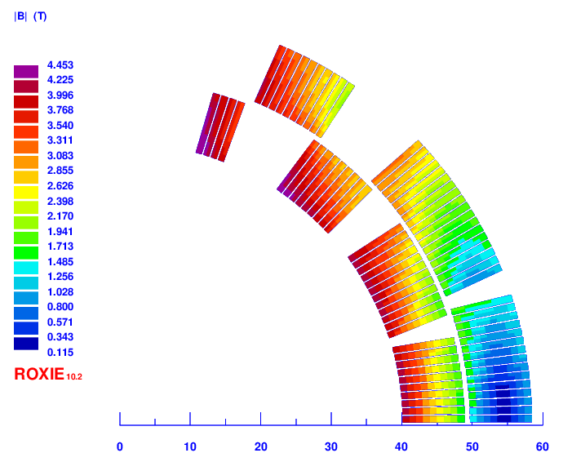
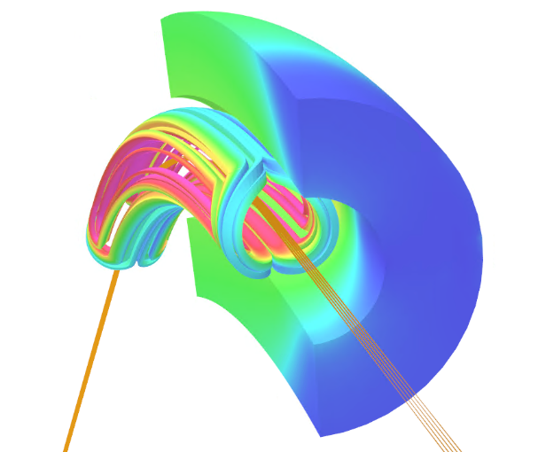
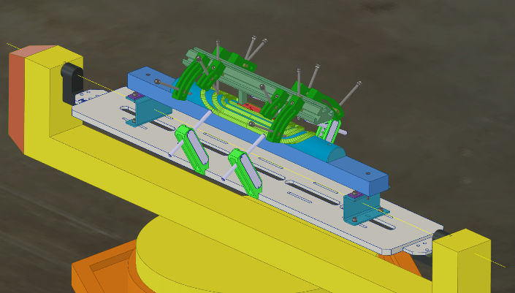
SIG project
SIG is an international collaboration among
Technology incubator for heavy ion gantry
Curved superconducting magnet demonstrator (R = 1.65 m) 4 T central field
Test coil assembly design ongoing
2D magnetic field
3D model and particle tracking

Slide 20
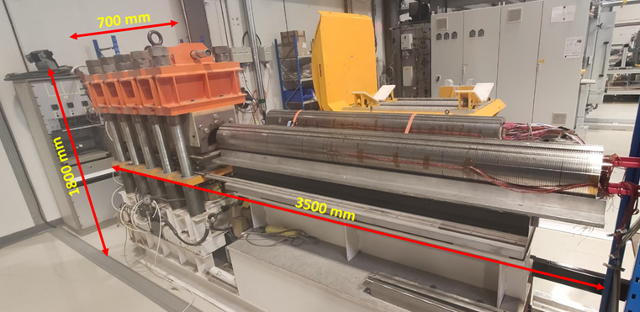
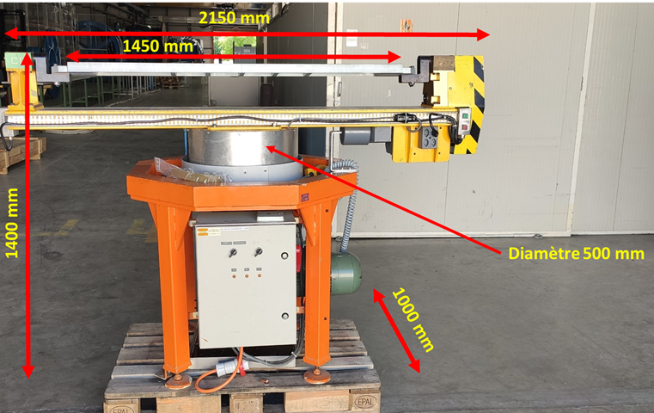
Special tooling
CERN provided some key tooling for magnet construction on loan (5 years, renewable) to LASA
Installed in the workshop & assembly area
Collaring press for costheta straight magnets
Winding machine for Rutherford cable

Slide 21

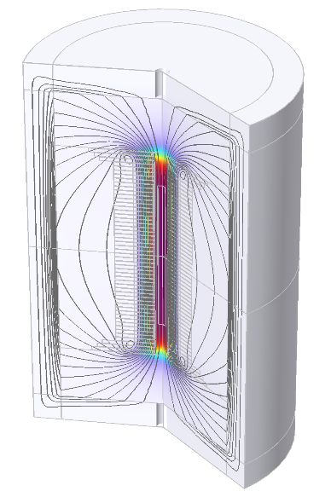
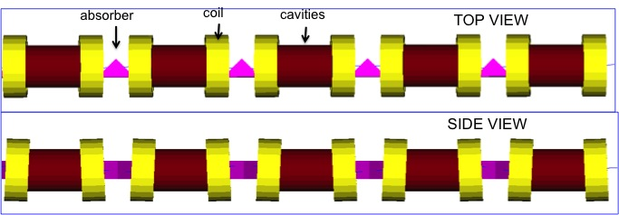
HTS R&D
Test HTS coils in the framework of MuColl WP7.2
CERN-EP, LNCMI, PSI, Univ. Geneva, INFN LASA, Univ. Milan, Univ. Southampton, Univ. Twente, CEA
Target solenoid
1.5 m 20 T 2MW
Muon coolig
1km 2 T to14 T
Final cooling
8.5 m – 40 T or 60 T
40 T NI
B. Bordini, CERN

Slide 22
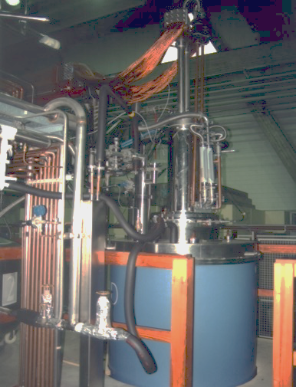
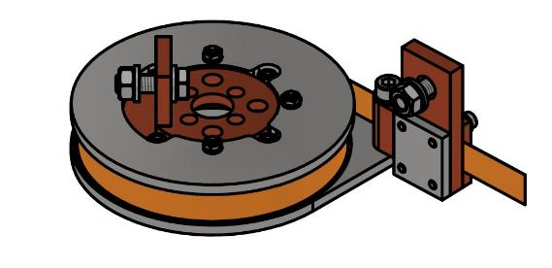
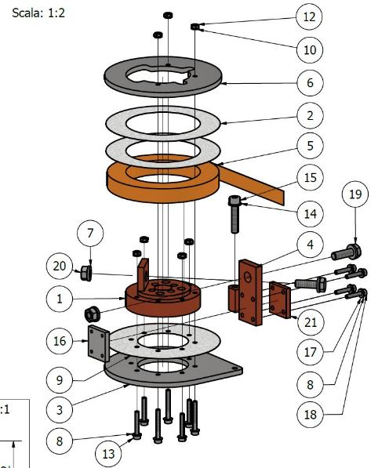
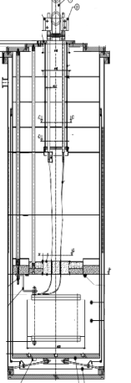

Test of small coils
R&D testing small coils (in self field or up to 8T)
NI-partial insulated – impregnated
New cooling system 20-50K
Closed loop He
(IRIS)
NI-partial insulated –
impregnated
MAGIX
D 480 mm
h 1200 mm
4.2 K and 2.17 K
500 A
8 T field by solemi1
(refurbished by IRIS)
S, Sorti, LASA

Slide 23
Conclusion
Updates on the activity of the LASA magnet test station
Updating cryoplant
  New liquifier procurement started
End of production and test of the HiLumi HO correctors
  54 HO corrector series magnets delivered to CERN
  First magnet in kind contribution to be finalized
Overview of the next magnets to be tested at LASA
  Furnace for Nb3Sn reaction for a high field Nb3Sn demonstrator, FalconD
  Assembly and first test at LASA of the FalconD short model
  Canted and cos-theta magnets for heavy ion hadroterapy
  HTS R&D coils for IRIS and MuColl solenoids

Slide 24
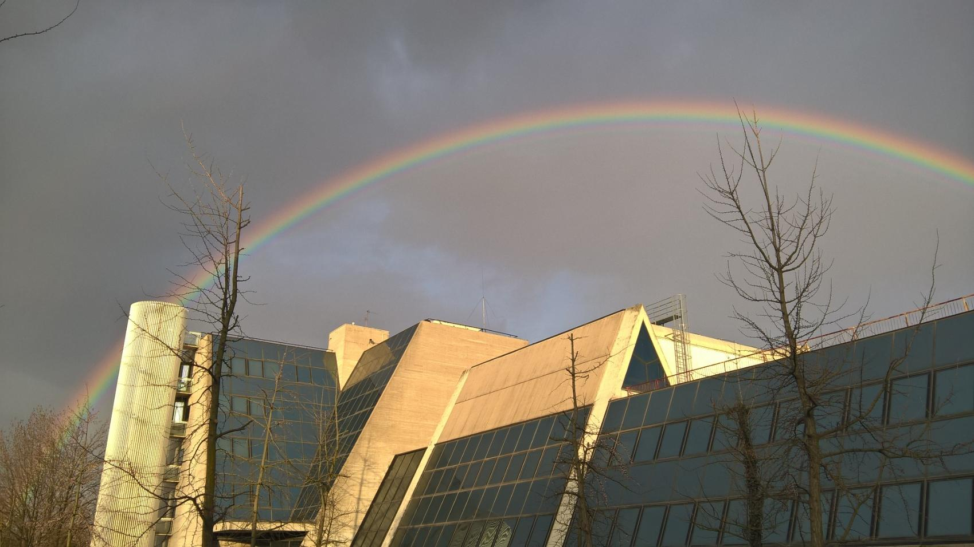
THANK YOU
Ph. by G. Fornasier
LASA team: F. Broggi, S. Mariotto, A. Paccalini, D. Pedrini, A. Leone, M. Quadrio, A. Pasini, M. Prioli, M. Sorbi, M. Statera, M. Todero,

Slide 25







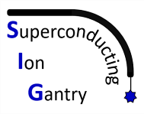

Outline
Struttura magneti LASA
Progetti attuali:
Correttori HL-LHC
FalconD
HITRIplus
I.Fast
SIG CALL CSN5
PNRR (?)

Slide 26
Outline
Struttura magneti LASA
Progetti attuali:
Correttori HL-LHC
FalconD
HITRIplus
I.Fast
SIG CALL CSN5
PNRR (?)

Slide 27
High Magnetic Field Laboratory
The High Magnetic Field Laboratory has the capability to provide magnetic field for research purposes, and to develop and test magnet prototypes
Research Magnets
SOLEMI 1: solenoid NbTi
8 T, 535 mm room temperature bore
SOLEMI 2+3: solenoid Nb₃Sn
15 T, 100 mm cold bore @ 4.2/2.2 K
75 mm cold bore in gas flow 2-300 K
Solenoid NbTi + Nb₃Sn
13.5 T, 50 mm cold bore @ 4.2/2.2 K
Cryocooler-operated magnet
8 T, 75 mm cold bore cryogen-free
Resistive Dipole
1 T, 120 mm room temperature gap
SOLEMI 1

Slide 28
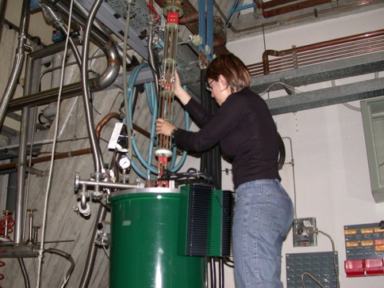
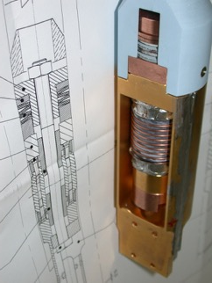
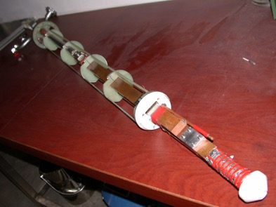
Test Station for Superconducting Wire Characterization
Critical current measurement of S.C. wires
  Facilities to test superconducting wires
  Back-ground magnetic field up 15 T
  Temperature variable from 1.9 K to 50 K
  Iper-stabilized power supply 3000 A, 6 V
  (battery bank to cancel ripple noise)
  Several supports for many types of conductor
  New impulse on the activity for Nb₃Sn with ABSTRACT CSN5

Slide 29

Test Station for long magnets LTS and HTS
LHe Cryostats
  φ 690 mm, 6500 mm depth a rather unique feature
  φ 515 mm, 3300 mm depth for medium-size
  φ 480 mm, 1200 mm depth for small-medium size
  other smaller cryostat
Power Supplies
  3 x Power supply up to 10 kA, 6 V
  (i.e. up 30 kA – 6 V or 10 kA – 18 V)
  2 x Power supply up to 1.2 kA, 36 V
  1 x Power supply up to 500 A, 125 V
  1 x Power supply up to 600 A, 15 V, IGBT based polarity switch
  1 x Power supply up to 2 kA, 4 V
  (low noise, battery based)
Magnet Protection System including discharge resistor, switch, Quench Detection Electronics
  10kA IGBT fast switch <1 ms to open
Strategic tooling for high field programs

Slide 30



Cryogenic test availability
SMTT
D 480 mm
h 1200 mm
4.2 K and 2.17 K
500 A
Small Magnets Test Cryostat (SMTT)
  HO correctors protoypes
    6P MCSXFP
    8P MCOXFP
    10P MCDXFP
High Current Test Station (DISCORAP)
  DISCORAP and HTS magnets
HiLumi Correctors series (HOC)
  All HO correctors series
DISCORAP
D 695 mm
h 7200 mm
4.2 K
10 kA
HiLumi HOC
D 515 mm
H 2950 mm
4.2 K
500 A

Slide 31
Outline
Struttura magneti LASA
Progetti attuali:
Correttori HL-LHC
FalconD
HITRIplus
I.Fast
SIG CALL CSN5
PNRR (?)

Slide 32









HL-LHC : High Order Correctors
INFN LASA
In kind contribution
Design, construction and test of the 5 different prototypes
CERN 453 k€ – INFN 453 k€
Series production of 54 High Order correctors. 6 families of magnets
CERN 2881 k€– INFN 2981 k€
3 new low beta sections:
Singola beampipe diametro 150 mm
Fascio ~ μm nel punto di interazione
~70 m
ATLAS
CMS
Magnets specification and challenges
NbTi superconducting coils
superferric design (first time in LHC)
150 mm bore
60% margin @ 1.9 K
200 mm - 600 mm length
Radiation hardndess: 15 MGy
OD320
a2
OD460
a3 b3
MgB₂ demonstrator accelerator magnet Sextupole round coil
«THE FIRST HL-LHC COMPONENT IS READY»
CERN Bulletin Issue n. 11-12, March 2016
a4 b4
a6 b6
a5 b5

Slide 33






HL-LHC : High Order Correctors - Produzione
Principali sfide
Super-ferrici NbTi
(prima volta in un acceleratore)
Piccola serie
Margine 60% @ 1.9 K
Resistenza a radiazione: 15 MGy
Integrazione (interfacce meccaniche ed elettriche)
Sistema qualità
Produzione di serie 54 magneti SAES Rial Vacuum (Pr)
Produzione bobine SAES Getter (Lainate, MI) terminata
Fine della produzione Nov 2021
Fine test LASA Estate 2022
Consegna CERN 2022
TEST at LASA
Curva di apprendimento Produzione bobine
MCTXF1
Funzione di Trasferimento
Assemblaggio prima massa fredda Set. 21

Slide 34
Outline
Struttura magneti LASA
Progetti attuali:
Correttori HL-LHC
FalconD
HITRIplus
I.Fast
SIG CALL CSN5
PNRR (?)

Slide 35





INFN-LASA activity on FCC
INFN (LASA &Genova) has developed the study of the 16 T Nb₃Sn superconducting dipole (in FCC Conceptual Design Report)
2D Design completed (EuroCirCol program 2015-2019)
After the study, new agreement CERN-INFN to build a first model of dipole FalconD
Nb₃Sn coil cross section
Field quality
Cold mass cross section
Mechanical study (Genova)

Slide 36



INFN-LASA activity on FCC - FalconD
INFN LASA/Genova full responsible of design/construction
Construction of SC coils in industry (ASG - Genova)
Cold mass assembly at LASA (from 2022, with support from CERN for «bladder & key technology»)
Possible functional test at 20 kA at LASA (from 2023, to have rapid answer on the assembly results)
To pave the road of FCC, INFN and CERN have signed an agreement for the construction of a 12-14 T, 2-m-long model (FalconD)
Magnet Parameter | Value
Bore field (T) | 12-14 T
Operation on Load Line | 86-91%
Current (A) | 22975
J_{cu} (A/mm²) | 1540
Cable Parameter | Value
Cu/SC | 1
Strand number | 2x20
Strand diameter (mm) | 1
Height (mm) | 20
Inner width (mm) | 1.72
Outer width (mm) | 1.895
Keystone angle | 0.5°
Twist pitch (mm) | 100

Slide 37
INFN-LASA activity on FCC
This activity requested an investment to procure a furnace for Nb₃Sn reaction
This new important new competences in high field dipole assembly and test, together with the “in house” special toolings, will push our Laboratory as a main partner of CERN for FCC programs and in general for developing of high field magnets
Geometry and load: | 3 m
Commissioning | end 2021
Installation area | 9 x 3.5 m
Length (uniform Temp/total) | 3 m
Max. operation temperature | 900°C
Temperature uniformity | ±3°C
Circulation fan / turbulent flow | 1 Fan/vertical axis
Process atmosphere | Argon
Vacuum level | 10⁻² hPa
Oxygen monitoring | down to 1 ppm

Slide 38


Future: the European HFM (High Field Magnet) program
The Update of the Eu. Strategy for PP approved by CERN Council (and all Institutes) states as first priority for accelerator R&D:
The community is devoting most budget of the accelerator R&D (for PP) to this aim in 2021-2027
CERN: 75 MCHF (include 25 of old engagement like Falcon-D)
INFN: can get a quota if puts matching fund (like Falcon-D)
INFN-LASA, INFN-Ge, INFN-Na, INF-LNS + Unimi, Unibo, Units, Polito, CNR -SPIN-GE → SIMAP (gamba italiana di HFM)
12 T post Falcon-D
Studio
16 T
20 T insert
I_{c}, cond. thermica

Slide 39
Outline
Struttura magneti LASA
Progetti attuali:
Correttori HL-LHC
FalconD
HITRIplus
I.Fast
SIG CALL CSN5
PNRR (?)

Slide 40


I.Fast HITRIplus
I.FAST
Programma R&D EU per gli acceleratori
Scopo favorire l’innovazione tecnologica: esplorare SC HTS e nuovi layout dei magneti per adroterapia con l’industria
Diretto da CERN; MI-LASA coordina il lato INFN
WP8 Magneti Superconduttivi Innovativi: coordinato da INFN-MI-LASA
HITRIplus (Hitri+)
Studio di una nuova facility per terapia con ioni : SEEIIST (ma non solo)
Diretto da CNAO; Mi-LASA coordina il lato INFN
WP8 on Magnet Design: coordinato da INFN-MI-LASA
Prima applicazione di CCT oltre HL-LHC
CCT curvi - Cosine Theta superconduttivi
Cryogen free
BISCOTTO: lavoro preparatorio INFN

Slide 41


Dimostratore CCT per adroterapia
Campo 4.5 T
Lunghezza 1 m
Bore 75 mm
By E De Matteis

Slide 42
Outline
Struttura magneti LASA
Progetti attuali:
Correttori HL-LHC
FalconD
HITRIplus
I.Fast
SIG CALL CSN5
PNRR (?)

Slide 43


SIG – dati principali
Area di ricerca: Acceleratori & detectors - Interdisciplinare
Responsabile nazionale: Lucio Rossi (INFN-MI-Lasa)
Altri principali responsabili: R. Musenich (resp. INFN-GE), R. Sacchi (resp. INFN-TO), S. Giordanengo (TO, WP4 Leader), E. Fiorina (TO, WP5 Leader), L Sabbatini (resp. INFN-LNF e WP3 Leader)
Durata: 3 anni 2022-2024; Budget: 1 M€ (+ 600 k€ Fondi Esterni : CNAO e CERN)
Personale: 603.6 p-m (50.3 FTE-y): 144 p-m (12 FTE-y) AR inclusi nel budget SIG.
E’ pienamente nello scopo CSN5
Acceleratori di particelle
Rivelatori di particelle
Elettronica e software
Applicazioni interdisciplinari della tecnologia INFN
By L. Rossi

Slide 44





International collaboration: CERN-CNAO-INFN-MedAustron for an advanced ion SC Gantry
Dimostratore
Based on novel CURVED SC dipole of 4- 5 T
(Twice the HIMAC-Toshiba state-of-the-art gantry!)
Light maneuverable and cost-effective with infrastructure
Fast and compact scanning magnets
Pure dipole field SIG demonstrator
Final design: Dip+Quad = combined funtion
By L. Rossi

Slide 45
Outline
Struttura magneti LASA
Progetti attuali:
Correttori HL-LHC
FalconD
HITRIplus
I.Fast
SIG CALL CSN5
PNRR (?)

Slide 46

PNRR
Linea trasporto corrente 1GW
  MgB₂
  GHe – LH2
Magneti per gantry
  4-5 T
  Curvi
  CCT o CT
  Combinati
Magneti ad alto campo
Magneti HTS +20T
INFN
CNAO, CNR, ENEA, RSE
Università di Genova, Università Milano Statale, Università di Salerno
CHI
confidential
COSA
PNRR (2026) Vs Fondi complementari (2028)
Bandi Bando non EU
Consorzio Consorzio o
Associazione temporanea di scopo
Gare semplificate Gare standard

Slide 47



Coclusioni
Correttori HL-LHC
FalconD
HITRIplus
I.Fast
SIG CALL CSN5
PNRR (?)
Grazie
per l’attenzione

