Slide 1
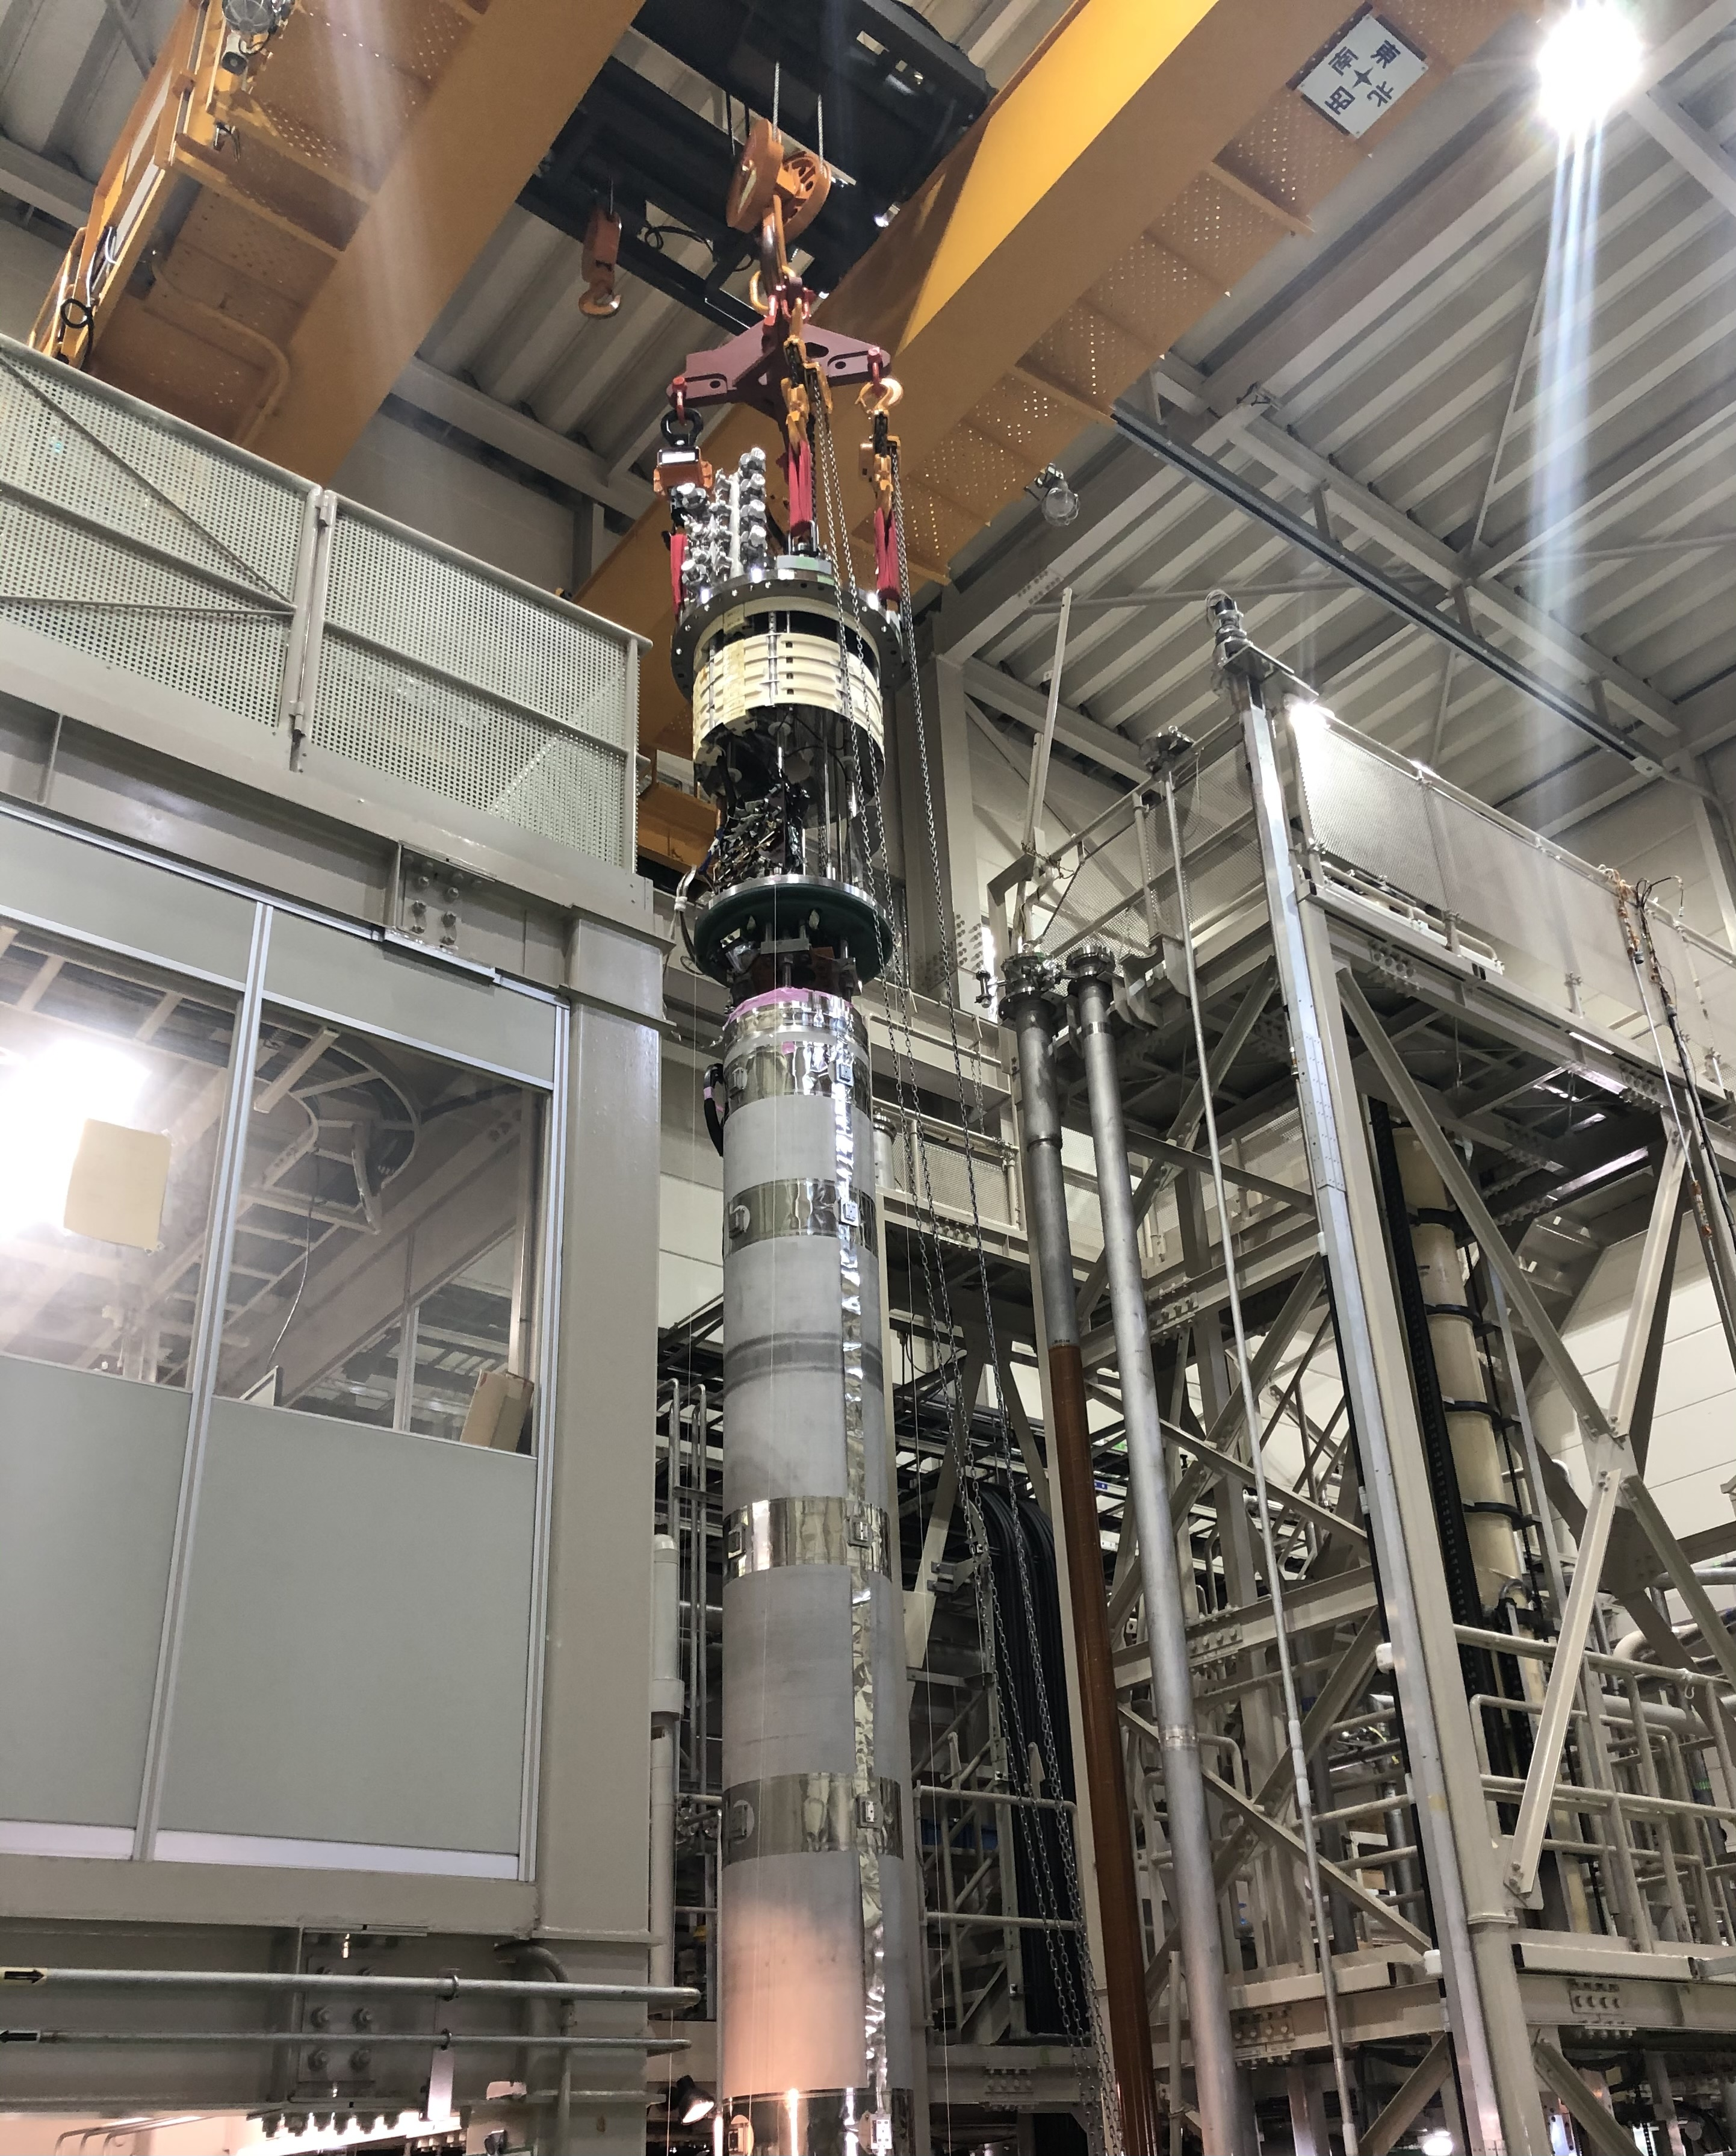
KEK test facility
Kento SUZUKI (KEK)
on behalf of the CERN-KEK collaboration
4th Superconducting Magnet Test Facility Workshop – 25th April 2023

Slide 2
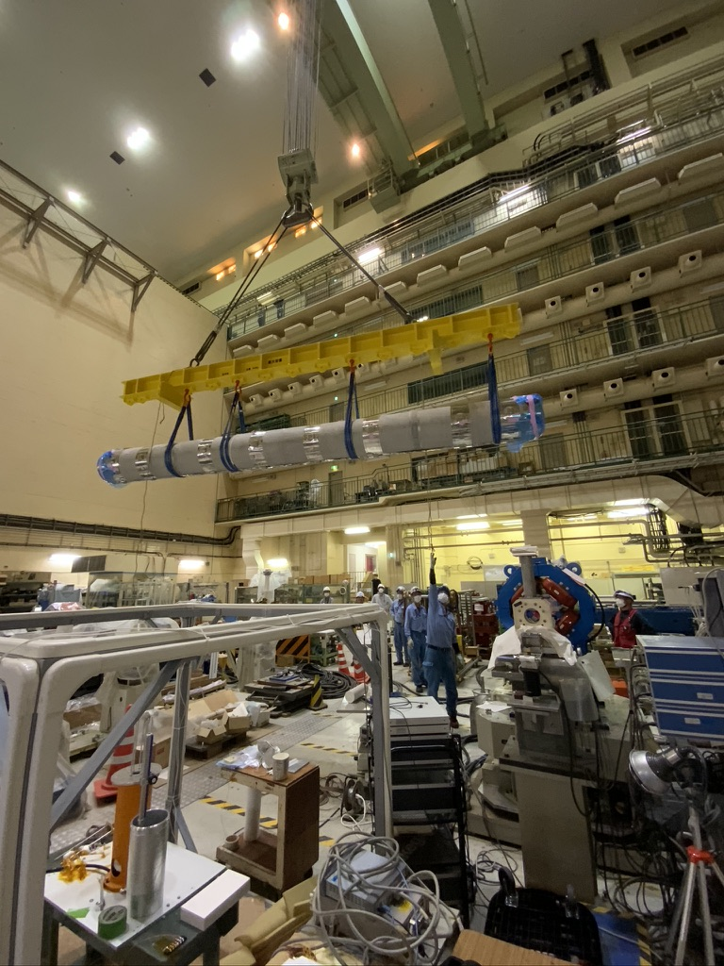
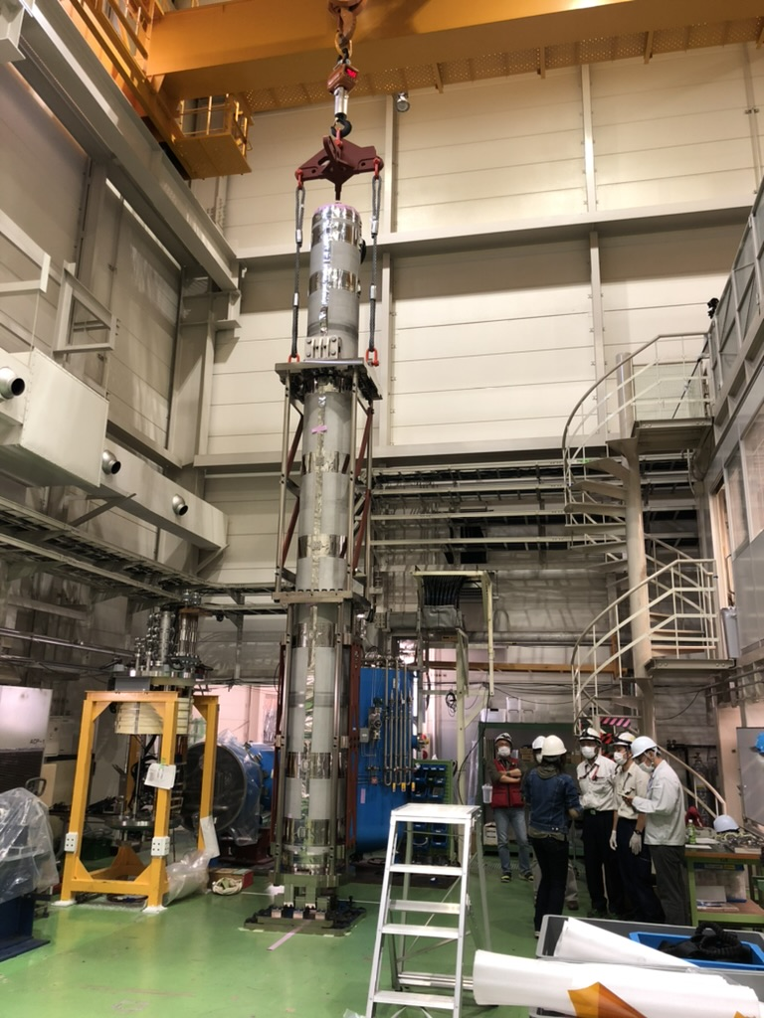
Not reported today…
Mt. Tsukuba (877m)
Test stand at
Cryogenics Science Center
Super KEKB (e⁻ + e⁺)
Nikko
Experimental Hall
for single stretched wire measurement

Slide 3
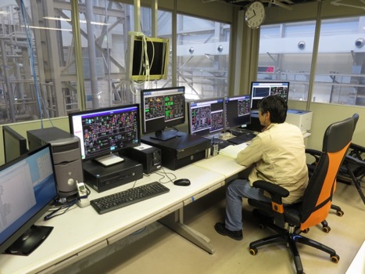
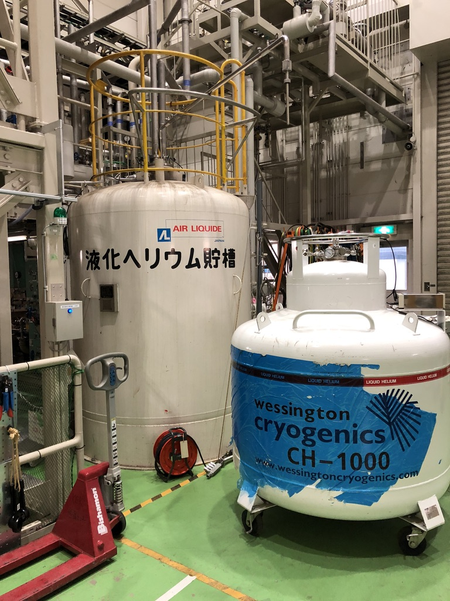
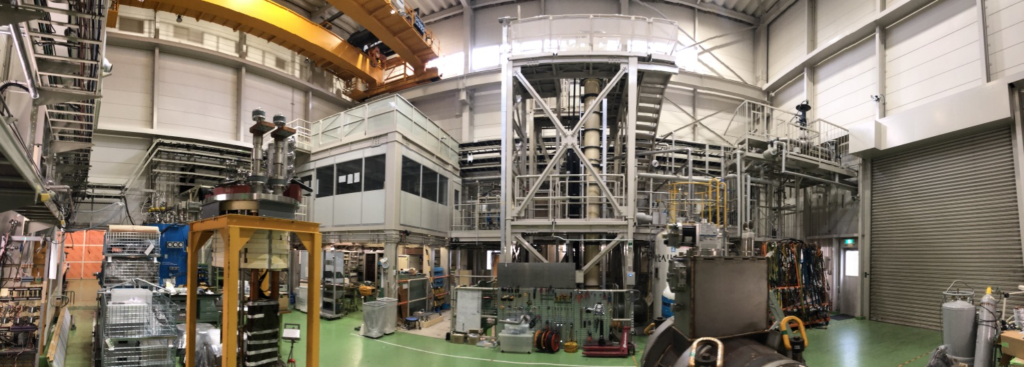
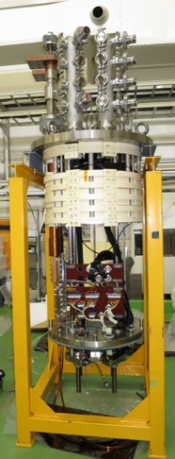
KEK Cryogenic Science Center (CSC)
20 t crane
MBXF header
Control room
Liquefier
(2400 L dewer)
9 m deep cryostat
Previous reports can be found at :
  1st workshop
    https://indico.cern.ch/event/507584/contributions/2027926/attachments/1289830/1920459/20160613KEKTestStand_NakamotoFinal.pdf
  2nd workshop
    https://indico.cern.ch/event/704235/contributions/2931999/attachments/1651165/2640917/20180508KEKD1_TestStandWSFinal.pdf
  3rd workshop
    https://indico.uu.se/event/596/contributions/999/

Slide 4
News Since the Last Workshop (2019)
Reception of the first full-scale prototype of D1
  MBXFP (magnet) tested in 2021
    Vertical powering test
    Horizontal magnetic field measurement
  LMBXFP (cold mass) tested in 2022
    Horizontal magnetic field measurement
Reception of the first series magnet of D1
  MBXF1 (magnet) IS BEING TESTED NOW
    Horizontal magnetic field measurement
    Vertical powering test ← NOW

Slide 5
Japanese contributions to the HL-LHC

Slide 6
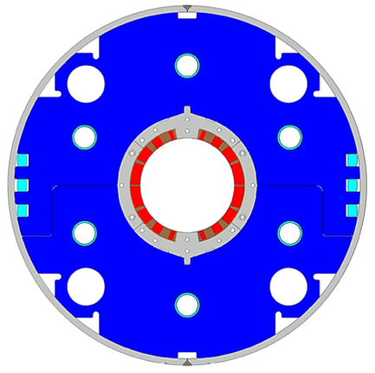
D1 magnets magnet production
Beam separation dipole (D1) by KEK
  Design study of D1 for HL-LHC within the framework of the CERN-KEK collaboration since 2011.
  150 mm single aperture, 35 Tm (5.6 T x 6.3 m), Nb-Ti technology.
  Development 2-m long model magnets (3 units) at KEK
Deliverables for HL-LHC
  1 full-scale prototype cold mass (LMBXFP)
  6 series cold masses (LMBXF1-6)
7 units x 7-m long cold masses

Slide 7
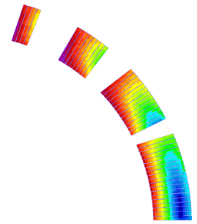
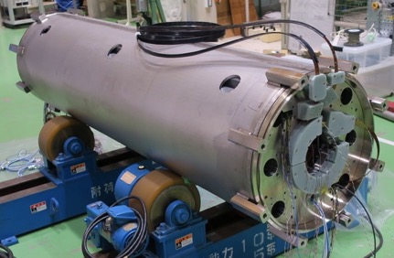
Design parameters
GFRP
wedge
Collar
Shell
 | prototype, series production (7m)
Coil aperture | 150 mm
Field integral | 35 T m
Field (3D) | Nominal: 5.60 T, Ultimate: 6.04 T
Peak field (3D) | Nominal: 6.58 T, Ultimate: 7.14 T
Current | Nominal : 12.11 kA, Ultimate 13.23 kA
Operating temperature | 1.9 K
Field quality | <10⁻⁴ w.r.t B₁ (R_{ref}=50 mm)
Load line ratio (3D) | Nominal: 76.5%, Ultimate: 83.1% at 1.9 K
Differential inductance | Nominal: 4.0 mH/m
Conductor | Nb-Ti: LHC-MB outer cable
Stored energy | Nominal: 340 kJ/m
Magnetic length | 6.26 m
Coil mech. length | 6.58 m
Magnet mech. length | 6.73 m
Heat load | 135 W (Magnet total) 2 mW/cm³ (Coil peak) > 25 MGy
Radiation dose
Nb-Ti/Cu coil
Yoke
QPH
Insulation
Brass shoe
4
8
12 ton
13
4 blocks
44 turns
19
Three 2 m model magnets were developed at KEK.

Slide 8
Preparation for Reception Tests of the D1 prototype
- May 2021

Slide 9
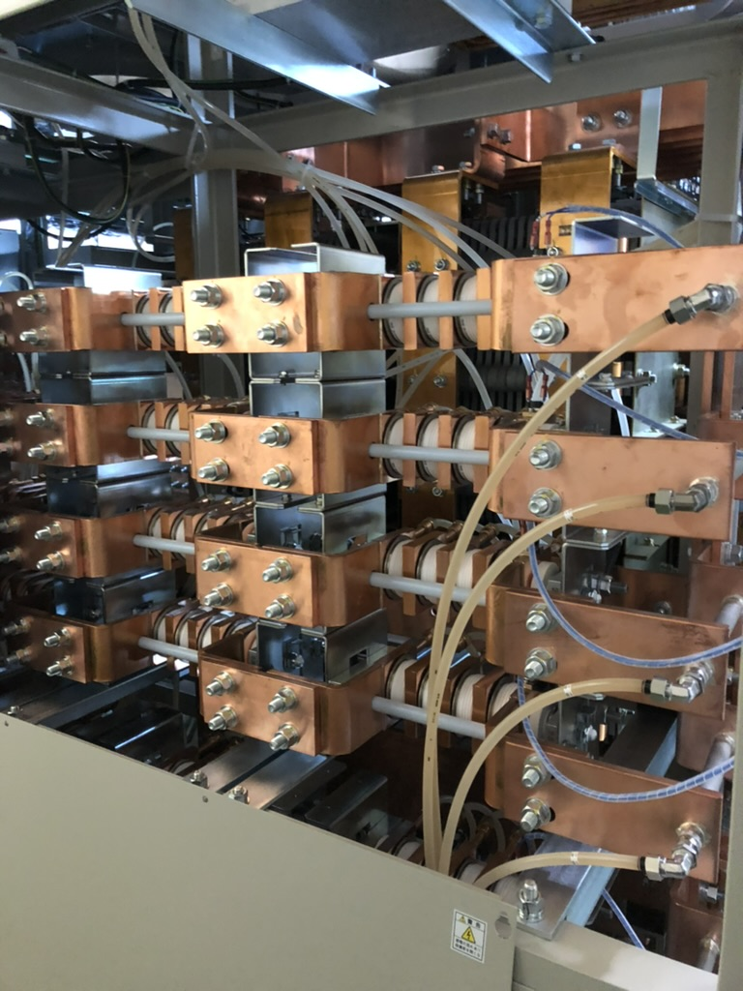
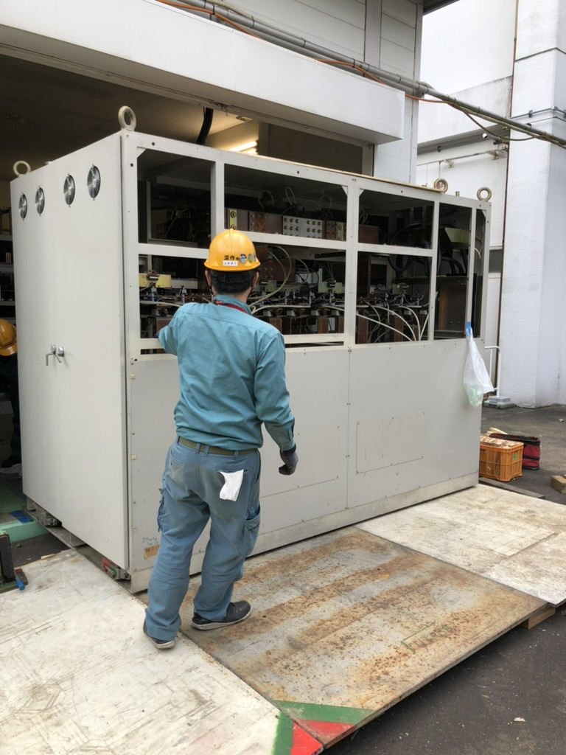
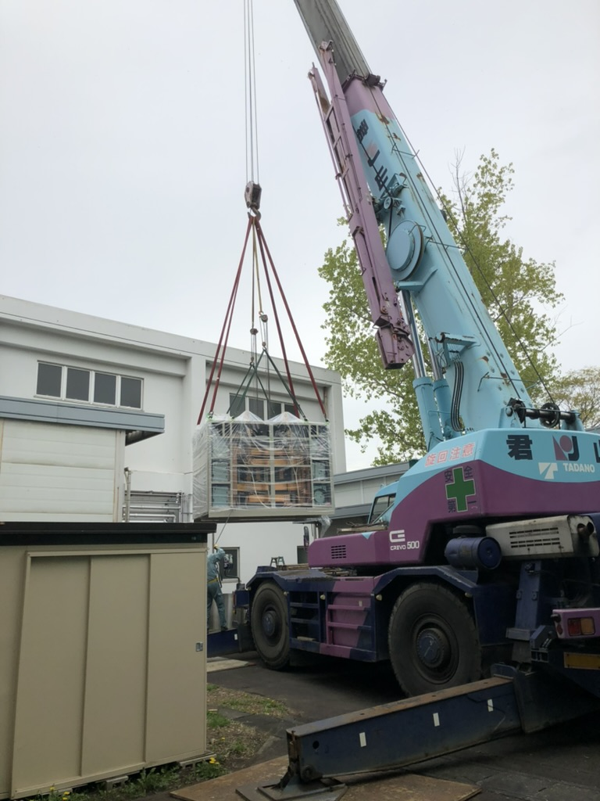
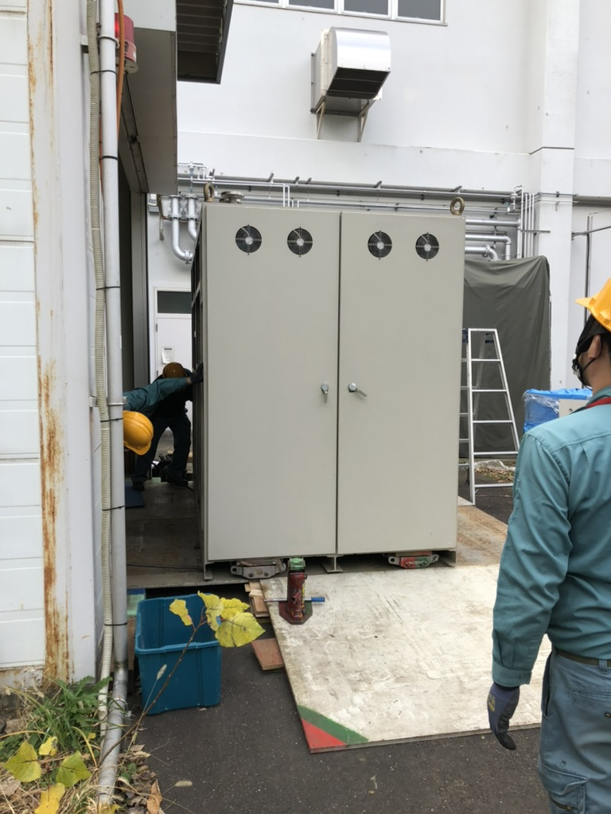
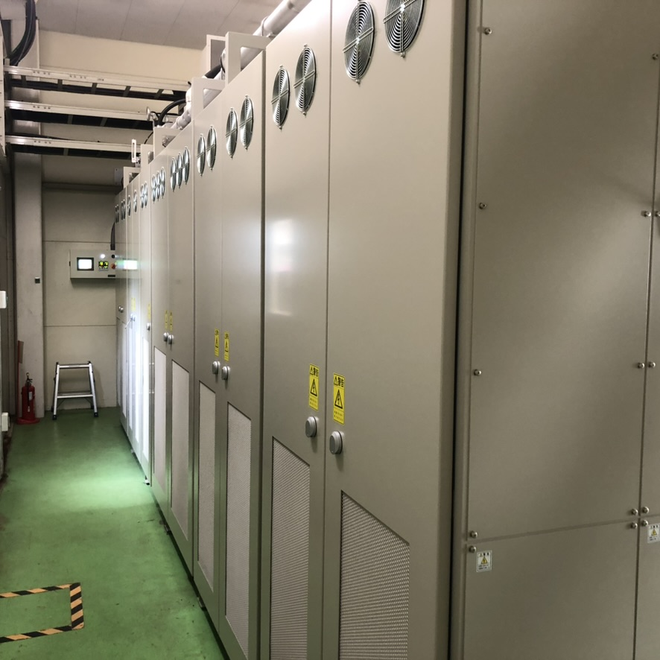
New Power Converter (15kA) Installation
2020 Nov.
2021 Apr.
The old converter had operated since 1992 until the test of D1 model magnets (20 years !)
The new converter was installed before the first full-scale D1 prototype, in Apr. 2021

Slide 10
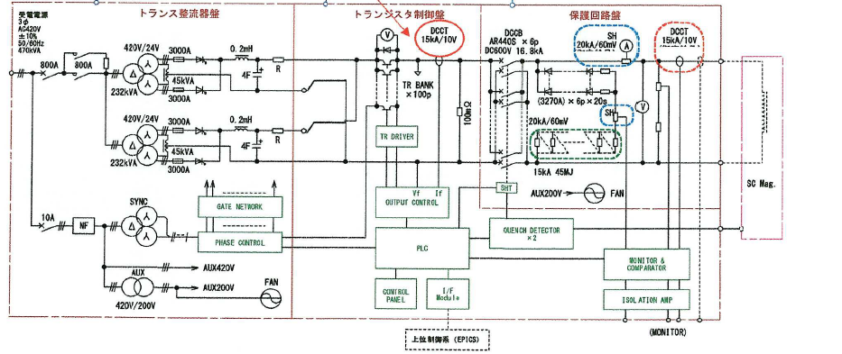
The New Powering Circuit
Rectifier section
(Transformer and Thyristor)
Protection circuit
Regulator
Load (D1)
AC420V,
470kVA
Operating current range: 0 - 15 kA ( 0 – 15 V)
Stability : 10⁻⁴ / hour (10⁻⁵ /min)
PLC controller w/ EPICS Interface

Slide 11
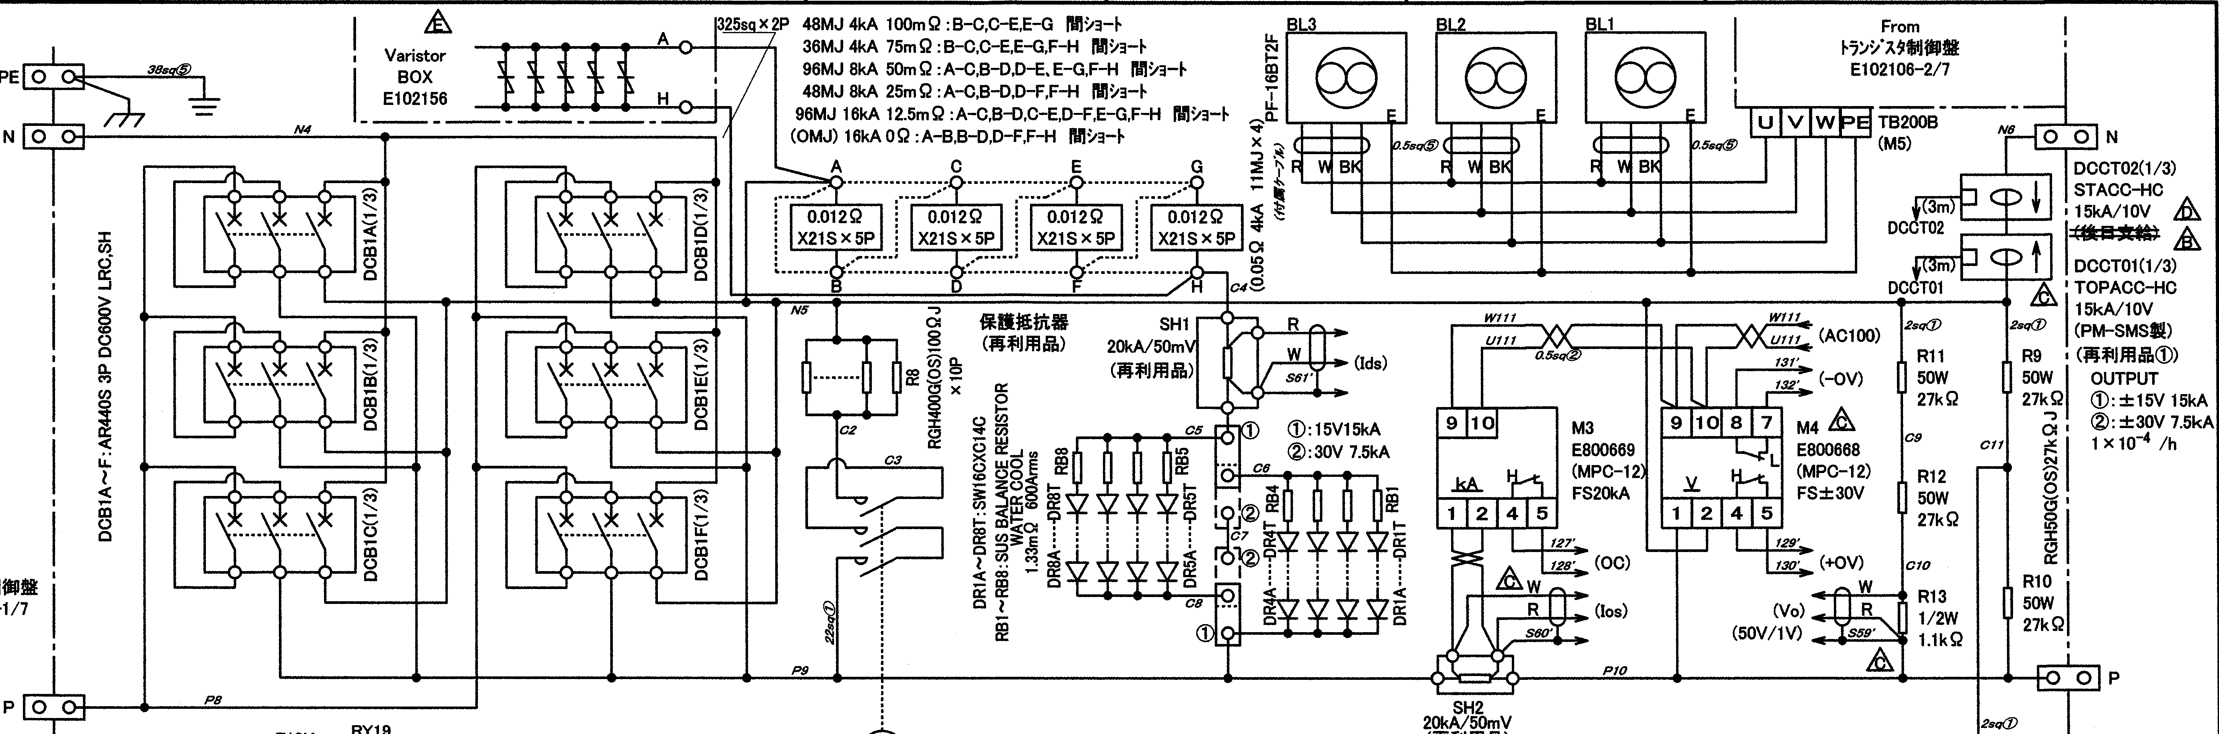
Energy Extraction System
Dump resistor
DCCB
DCCTx2
D1
Re-use the dump resistor (12.5 m, 25m, 50m, 75m, and 100mOhm)
Two DCCTs (Phoenix Mechano Ltd.) for monitoring transport current
Protection switch : Electro-mechanical switch (DCCB: 6 parallel units)
  Rated voltage limit : 600 VDC
  Rated current limit : 4 kA per each unit
  Switching delay : 17.3 ms

Slide 12
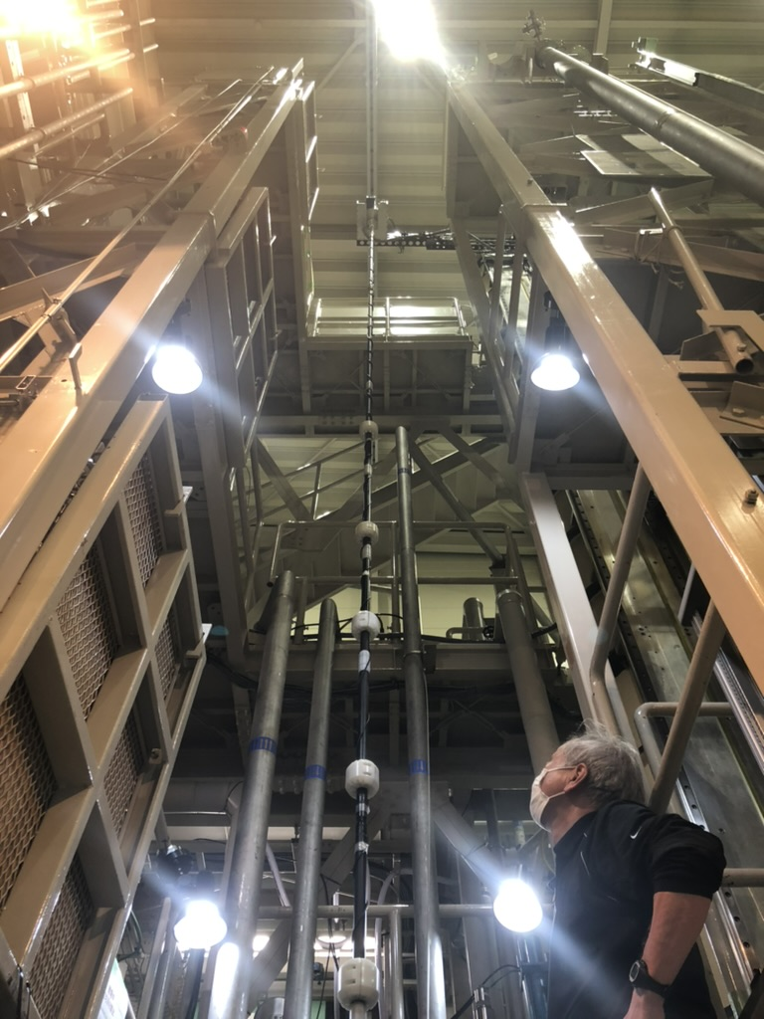
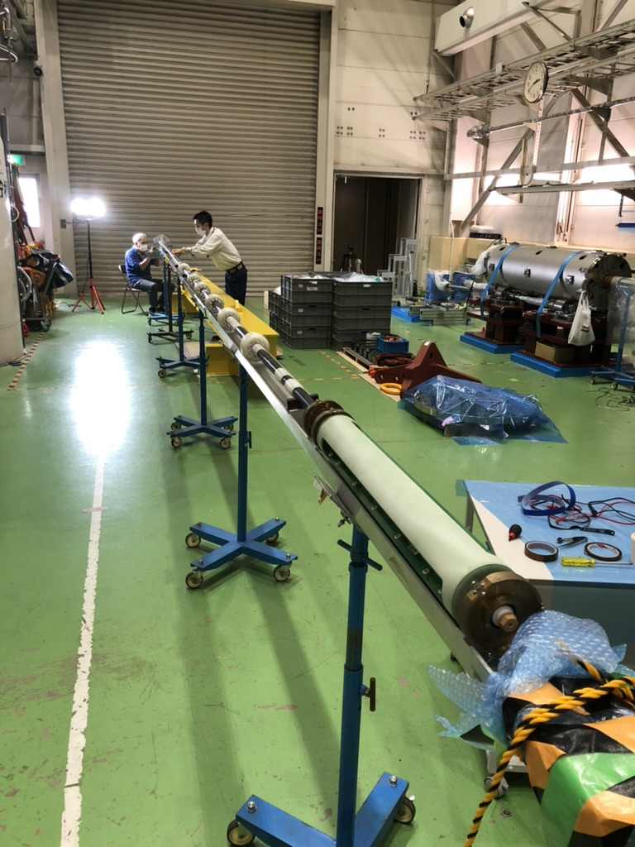
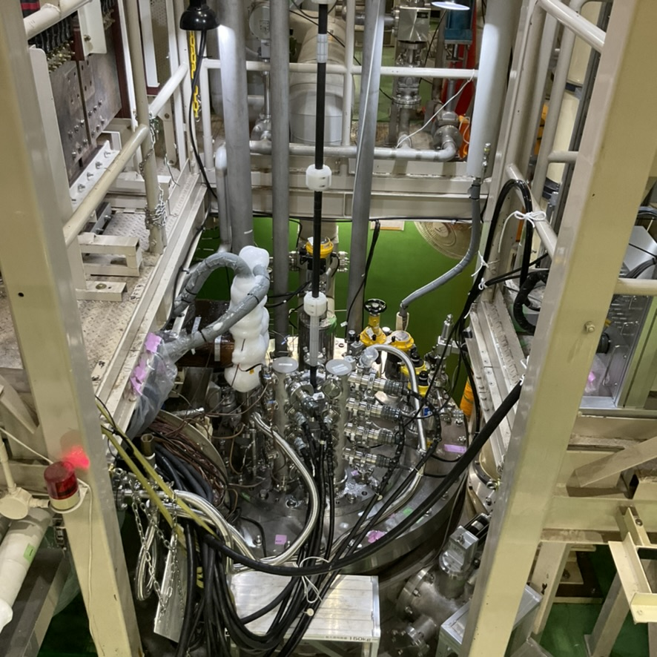
Vertical Magnetic Measurement System
Short1 (50)
Short2 (50)
Long (500)
Shaft extension work
2021 May
New PCB design
  Two short coils for coil-end field inspection
  Long coil for the field integral measurement
Shaft extension
  Attached a 1.7m-long extension to enlarge the measurement coverage for the full scale (7m-long) magnet

Slide 13
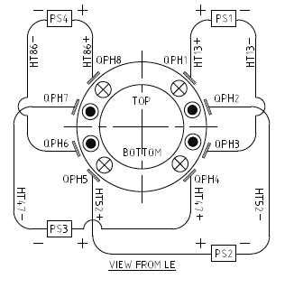
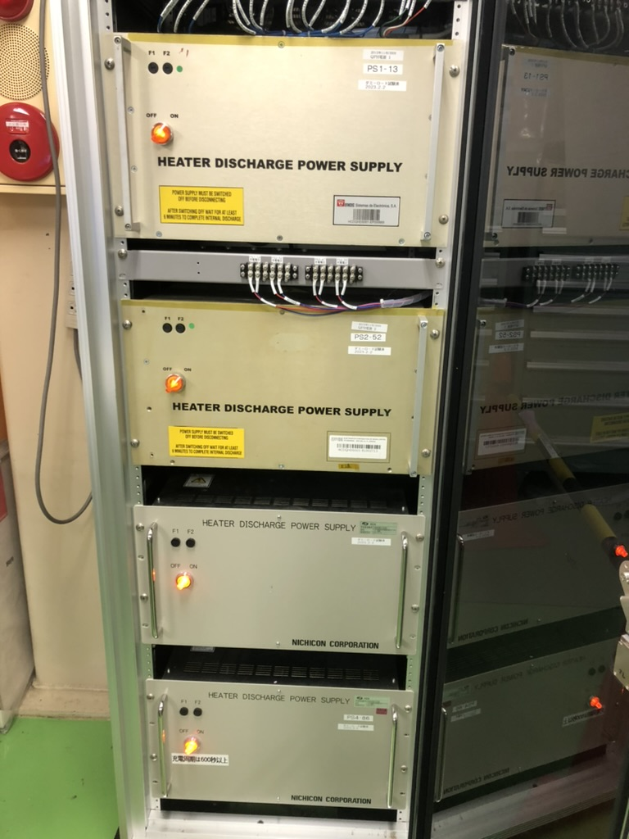
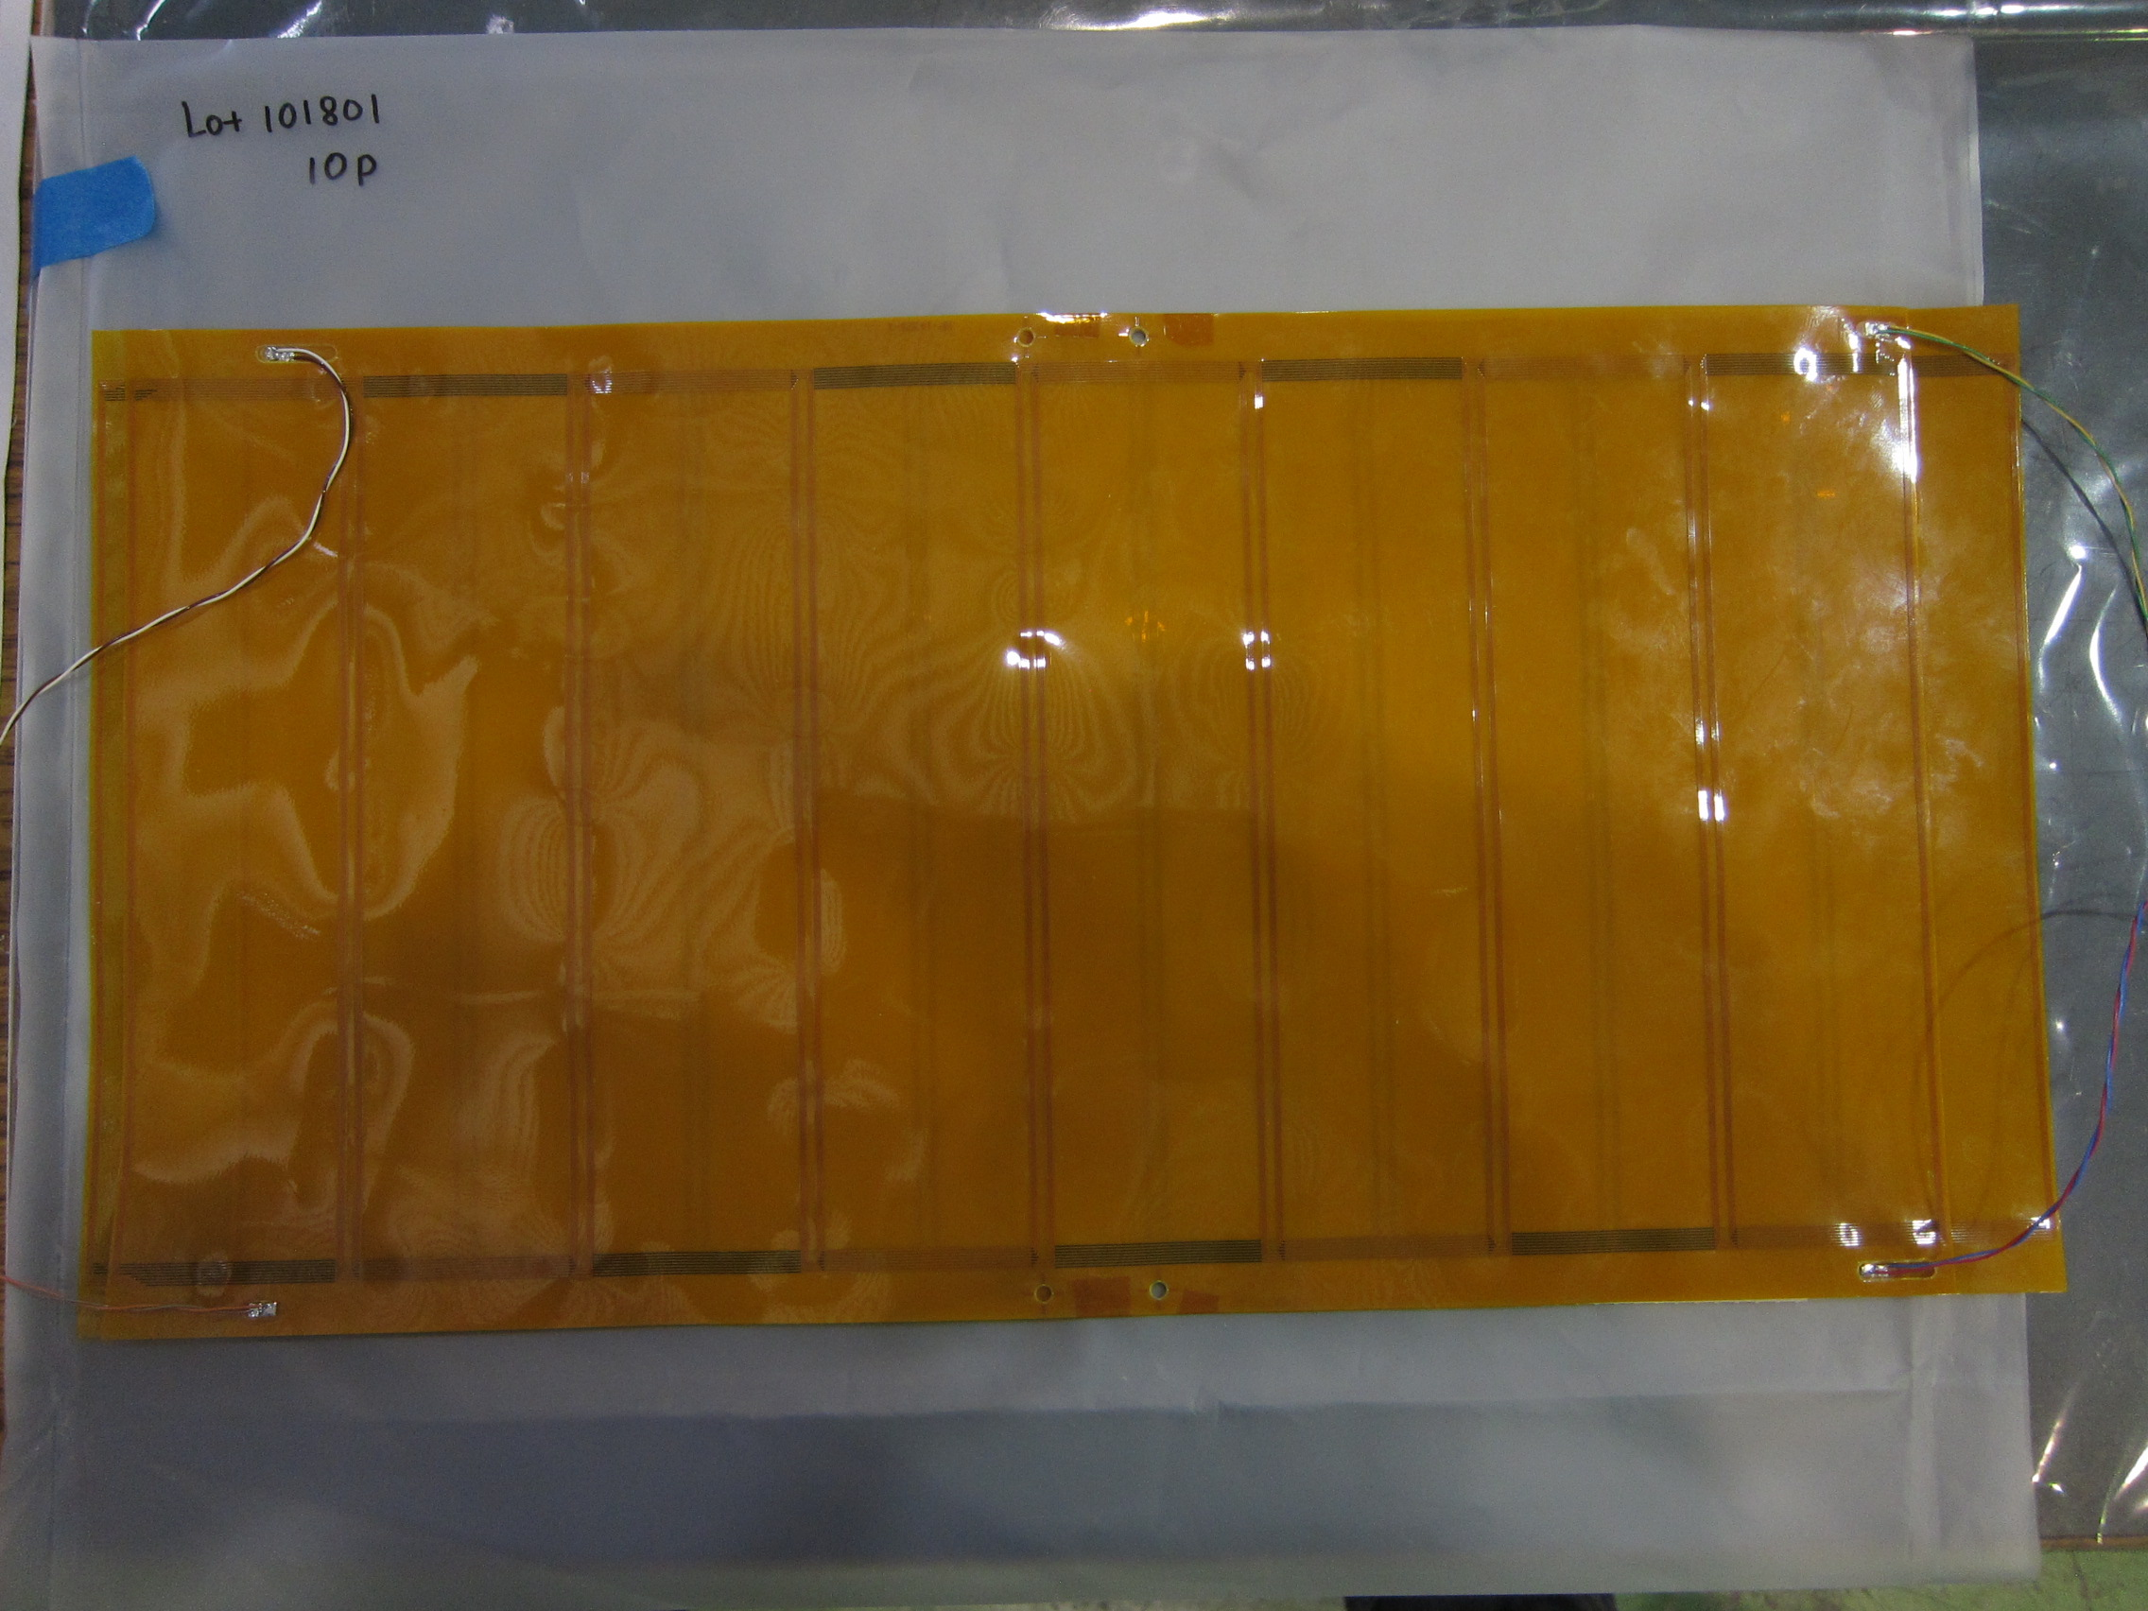
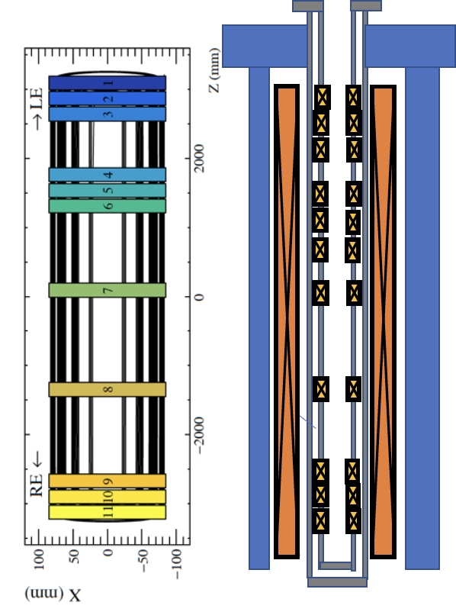
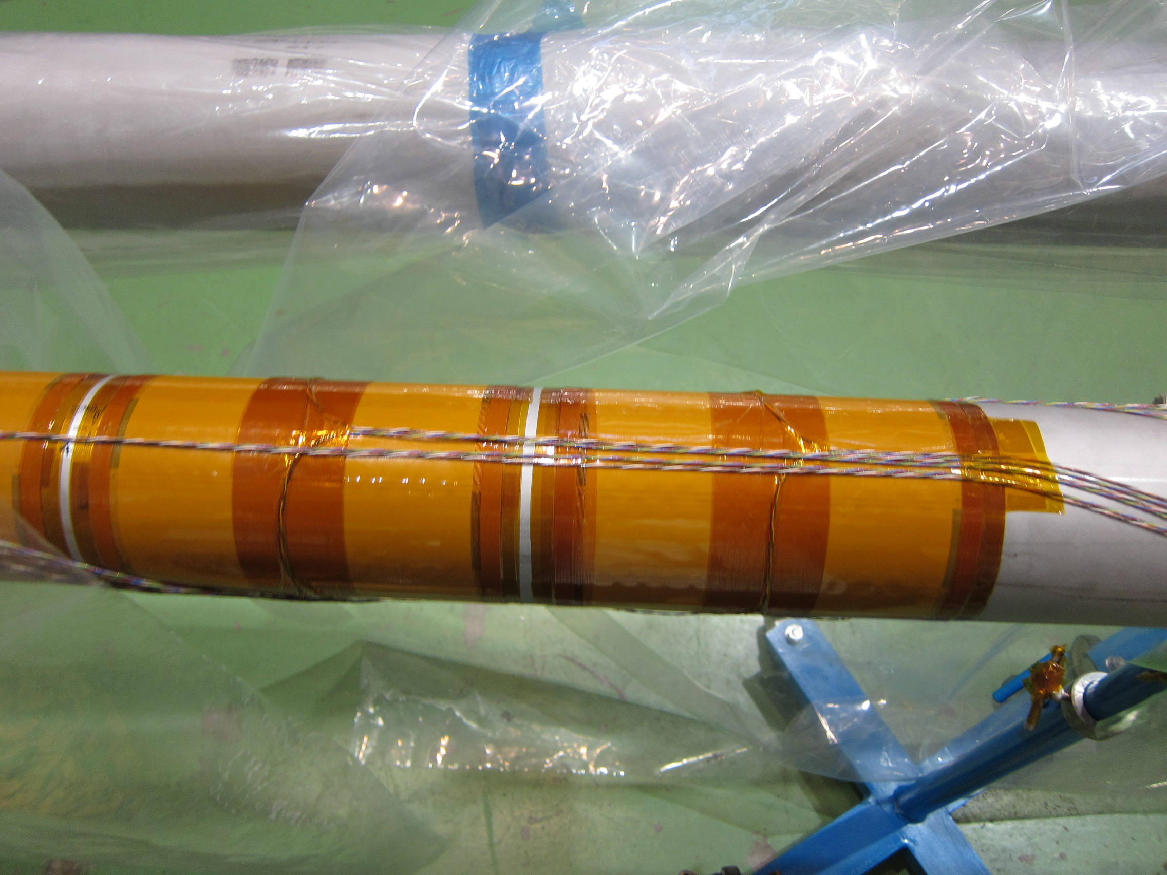
Quench protection and diagnostics
QPH circuit
Quench antenna
Nichicon
Protection baseline : 8 QPH strips + 25 mOhm (48 MJ) as energy extraction
  New QPH power supplies (7.05 mF) from Nichicon Co.,Ltd.
Quench localization : 11 antennas made by flexible printed circuits (FPB)
  Wrapped round the warm bore tube and installed to the vacuum-insulation space

Slide 14
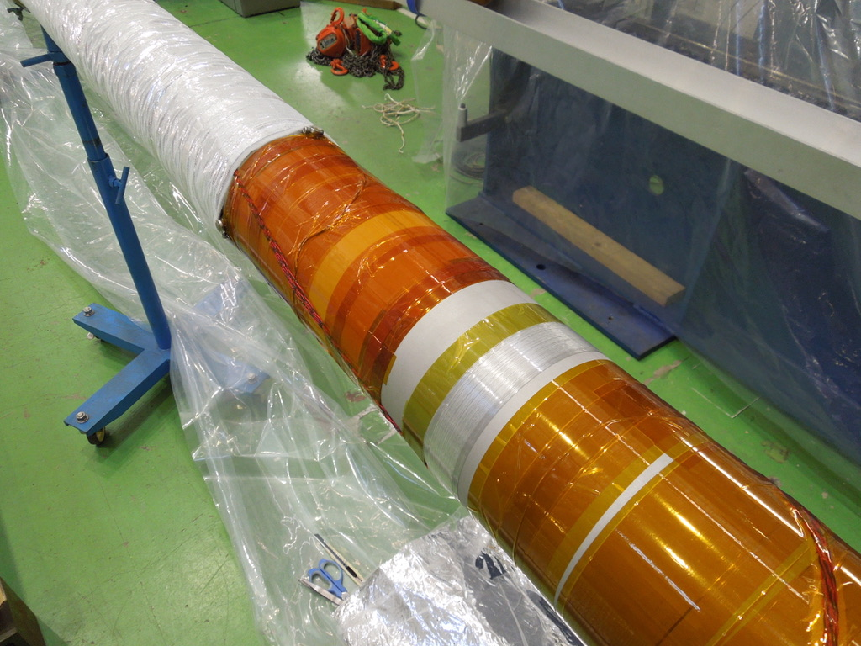
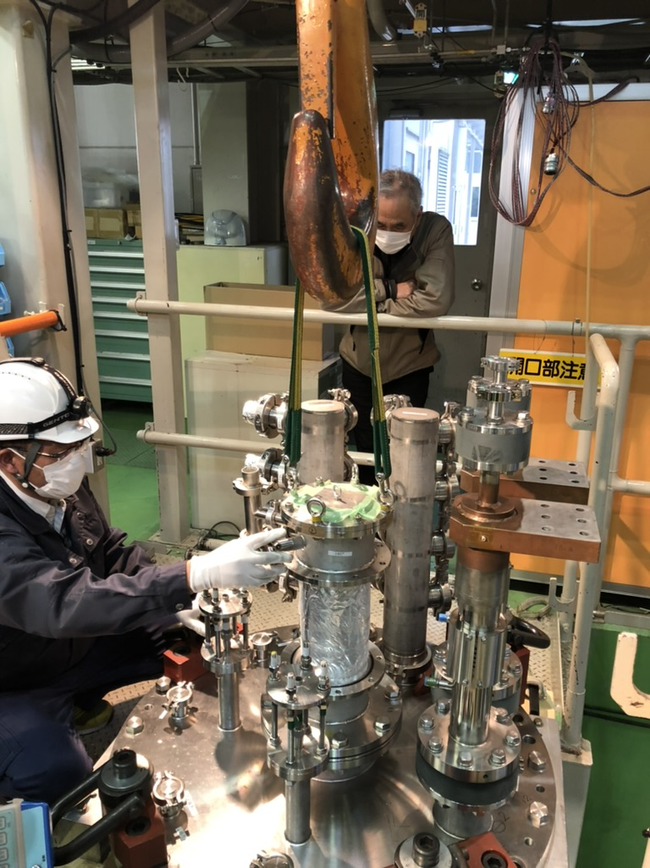
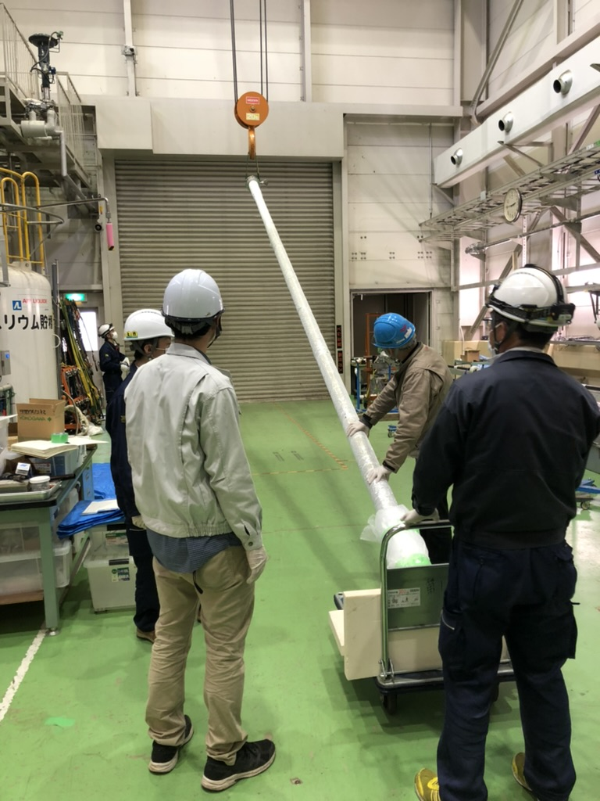
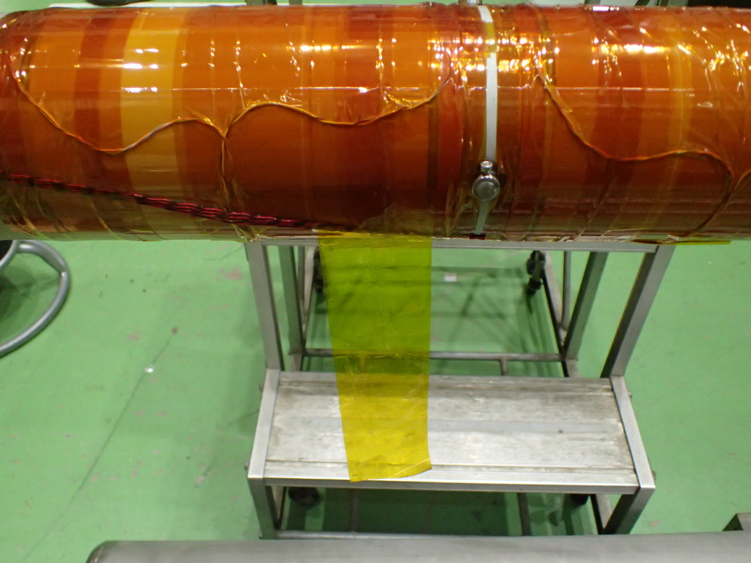
Visual Inspection of Quench Antennas
2020 Feb.
Unwrap super-insulation films
Extraction of
the warm bore tube
Thanks to the overhaul we could find insulation damage in one of the signal cables

Slide 15
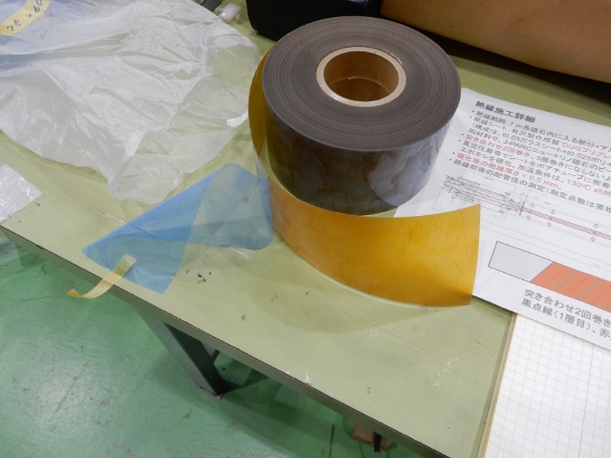
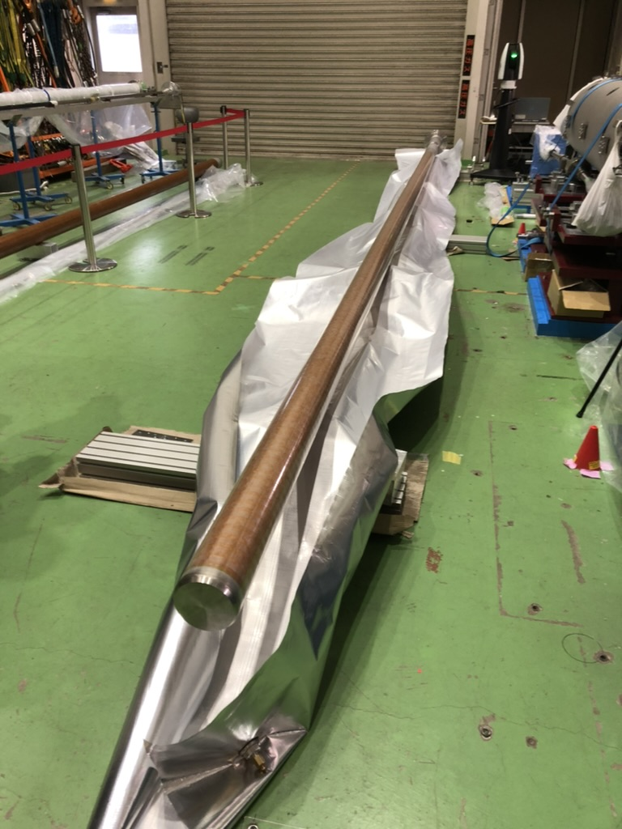
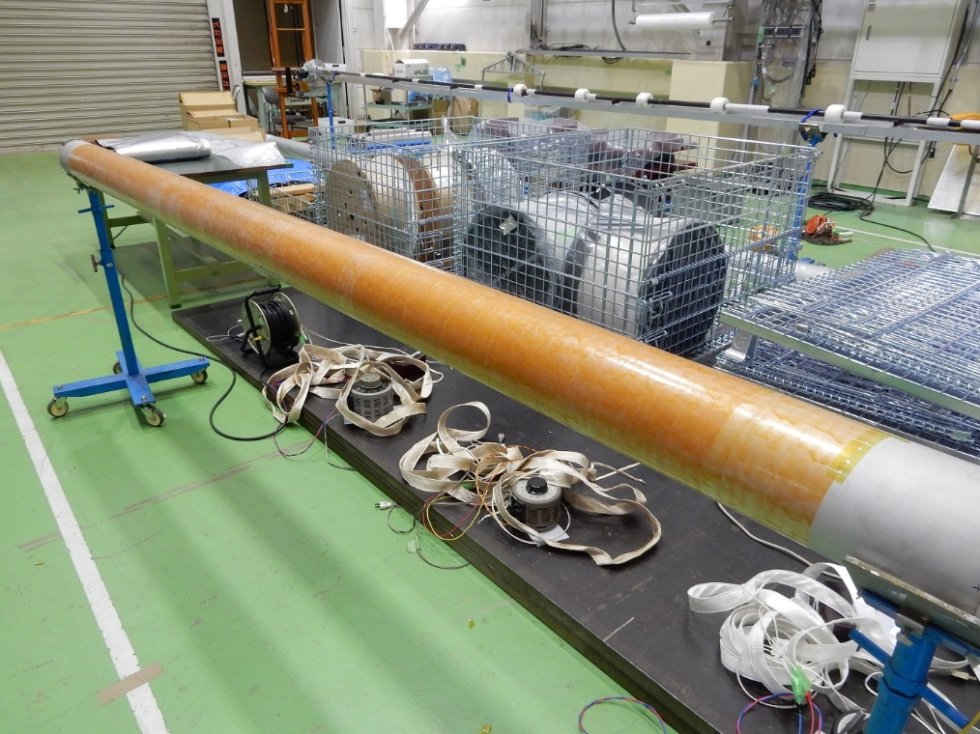
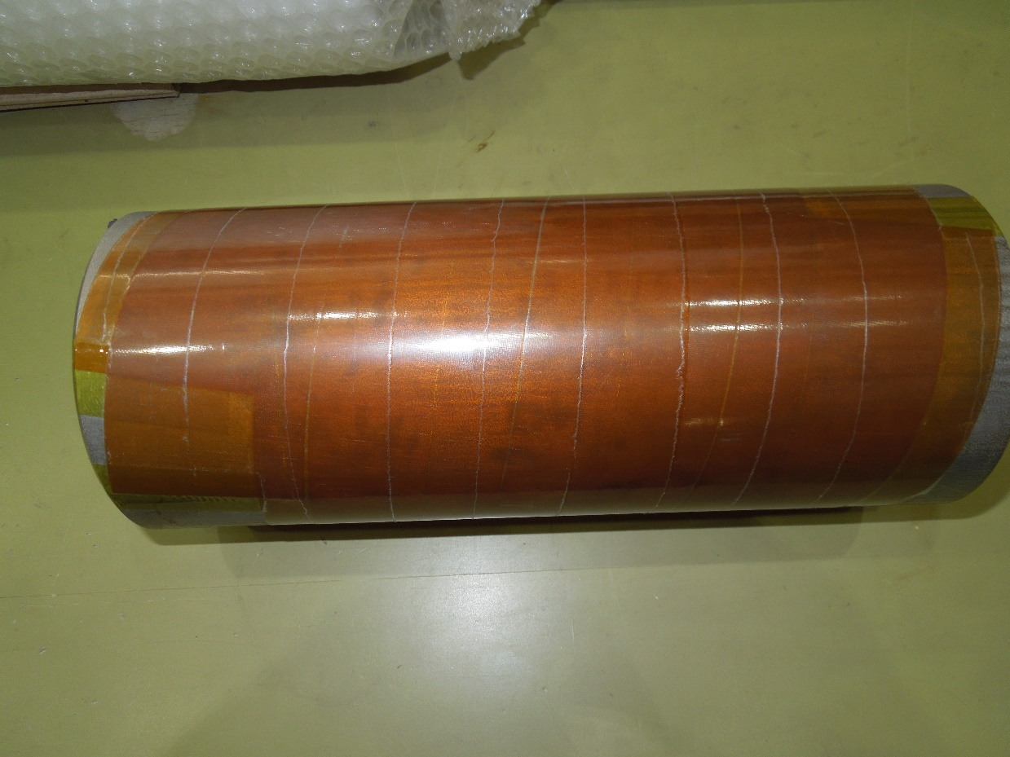
Cold Bore Tube Insulation
GKG tape
(Arisawa Co.,Ltd)
Short-scale wrapping test
3m-long pipe wrapping test
CBT
Insulation w/ GKG sheet ( Glass t0.05 + Polyimide t0.02 + Glass t0.05)
R&D was started from testing w/ short-scale stainless-steel pipe
A series of tests was successfully done
  Adopted to the cold bore tube (CBT)

Slide 16
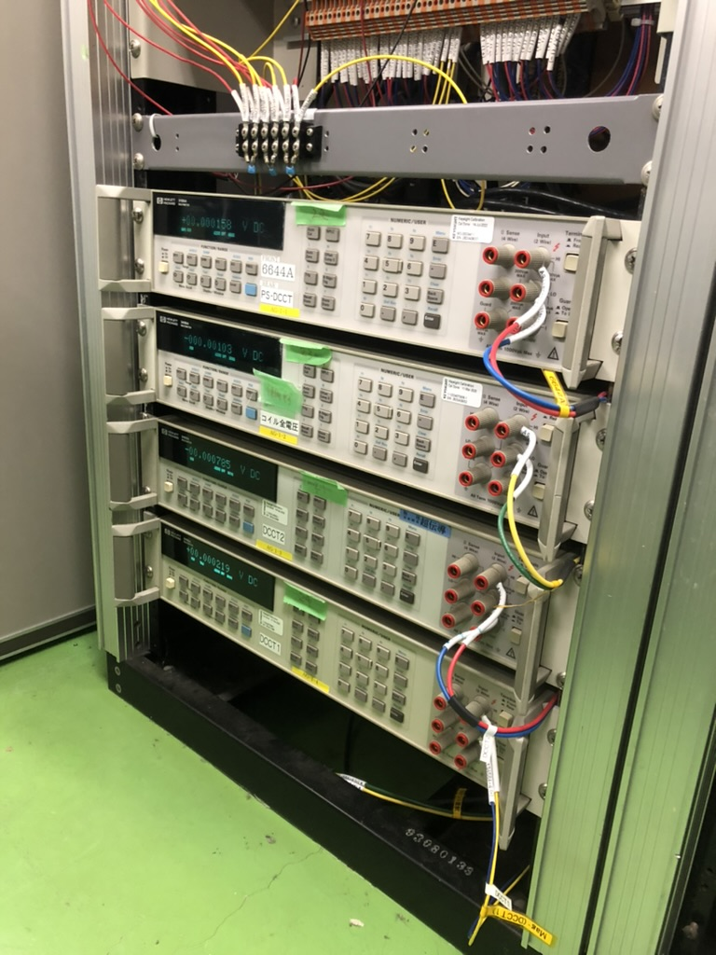
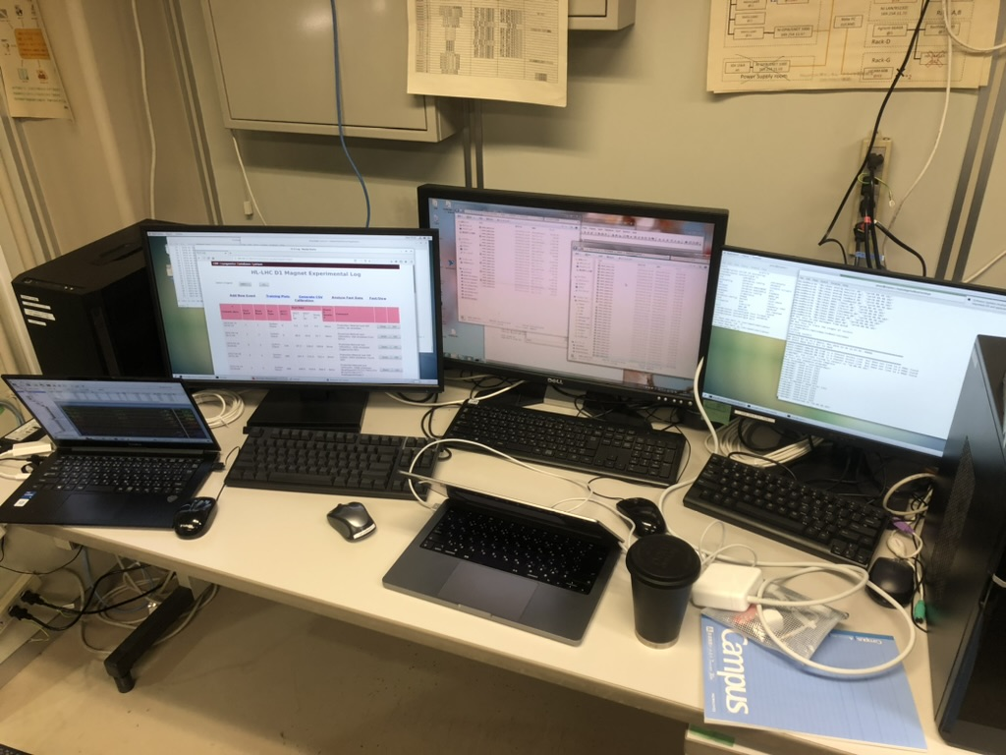
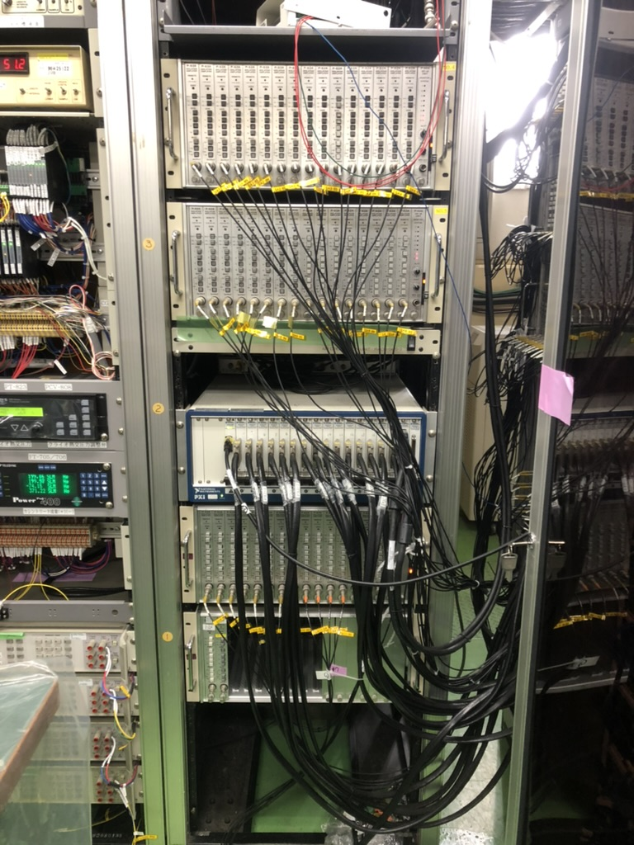
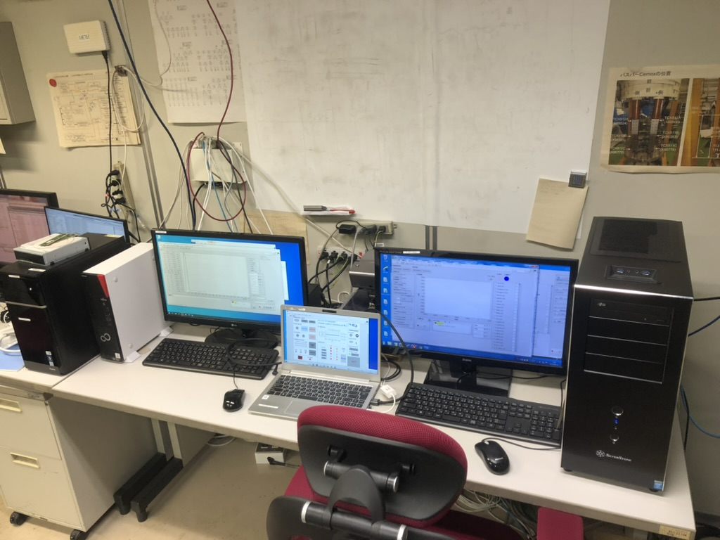
Data acquisition and control
DAQ machines
  Same as ones for the model magnet
  Fast DAQ: 10 kHz sampling ADC units (PXI-6143, 16 bit x 8 ch x 15 slots)
  Slow DAQ: HP 3458A (8^{1/2} digits multimeter)
  LabVIEW interface
15kA power converter controller
  EPICS Input/Output controller (IOC) for PLC
  Operator interface (OPI) was prepared using a LabVIEW software
MySQL-based database for logging and archiving events
Database
server
EPICS IOC
Vertical MM
controller
Slow DAQ:
PXI system
Slow DAQ
Fast DAQ
EPICS OPI
Fast DAQ:
PXI system

Slide 17
Testing MBXFP
June – Sep. 2021

Slide 18
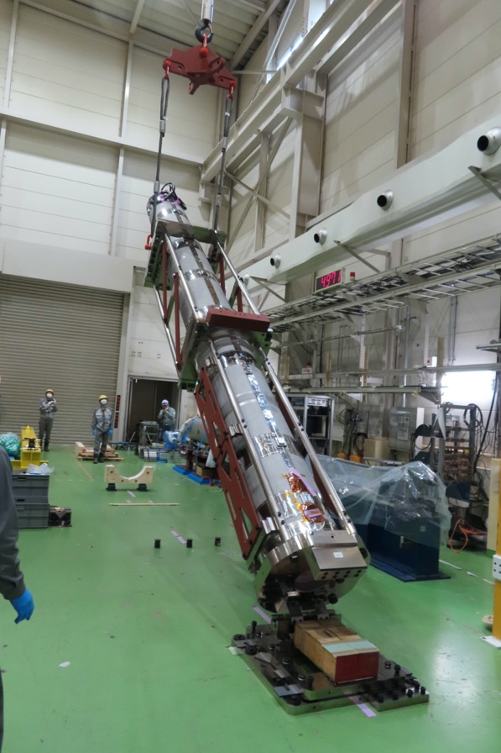
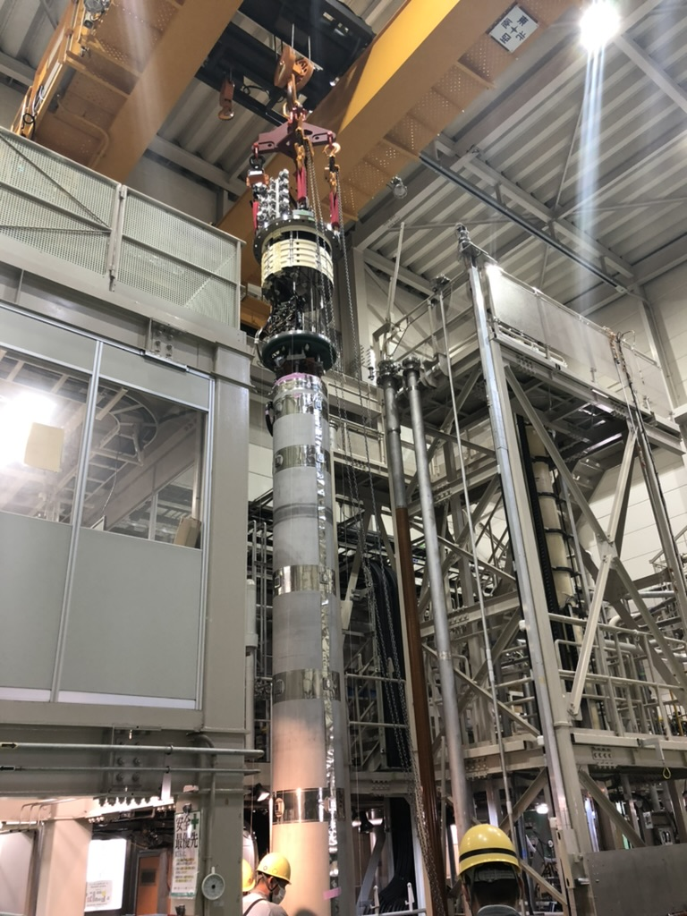
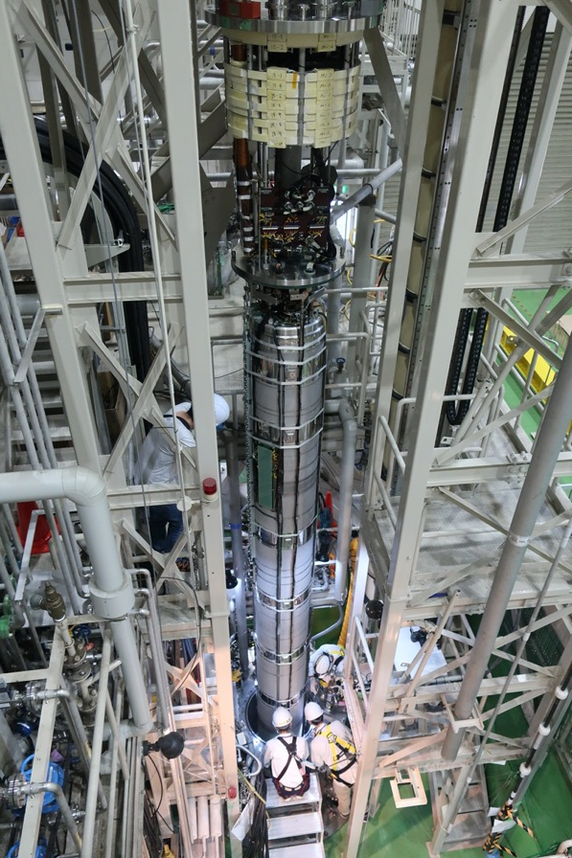
MBXFP Installation to the Vertical Cryostat
a
2021 May-June

Slide 19
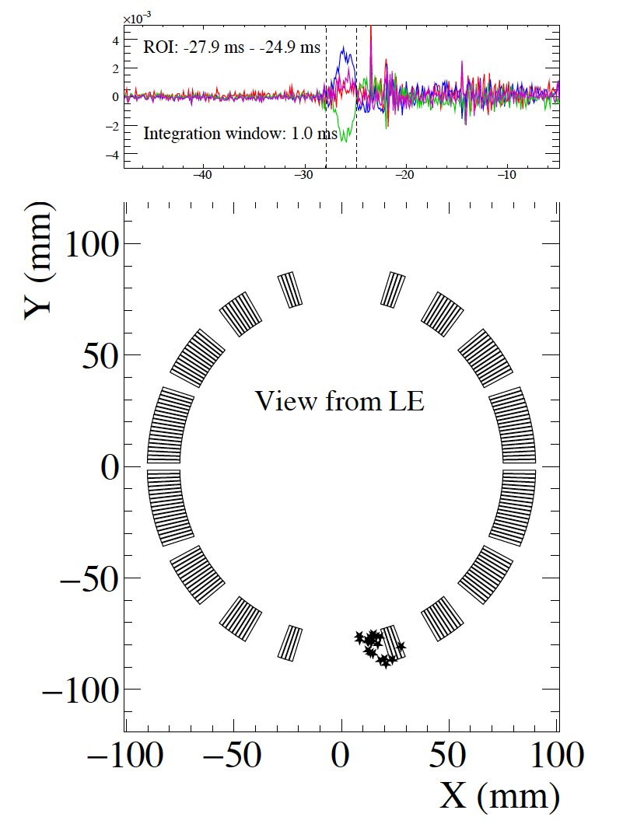
Vertical Cold Test Results
Prototype
Ex.) quench localization
by quench antennas
(units)
 | Field Integral at 12.1 kA
 | Calculation |  | Meas.
 | CERN H-Cryo. | KEK V-Cryo. | KEK V-Cryo.
b₃ | -0.5 | -6.5 | -12.7
b₅ | 4.9 | 4.8 | 6.5
b₇ | 0.3 | 0.3 | 0.5
b₉ | 0.5 | 0.5 | 0.8
b₁₁ | -0.2 | -0.2 | -0.2
b₁₃ | -0.8 | -0.8 | -1.0
b₁₅ | -1.3 | -1.3 | -1.4
Training behavior
Good performance was confirmed
Field quality
Some discrepancies observed in b₃ and b₅.
  Larger discrepancy observed in b₃ integral comes from the coil ends.
A fine tuning of the coil cross section for series production magnets.

Slide 20
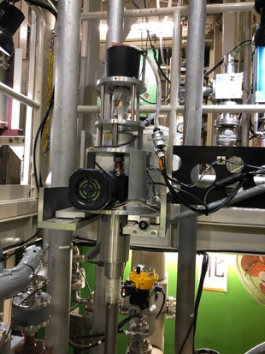
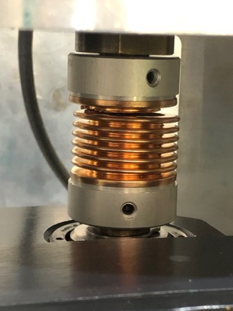
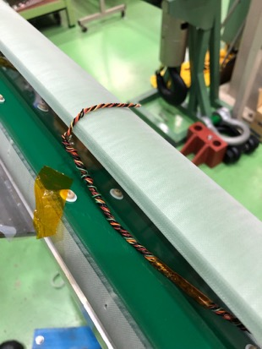
Incident Happened to the Vertical MM System
2021 June
One of the couplings of the rotating shaft was broken during the magnetic measurement before the training
  Caused by an axial mis-alignment (> 0.2 mm tolerance)
Suspended the measurement, extracted the shaft and performed a recovery work

Slide 21
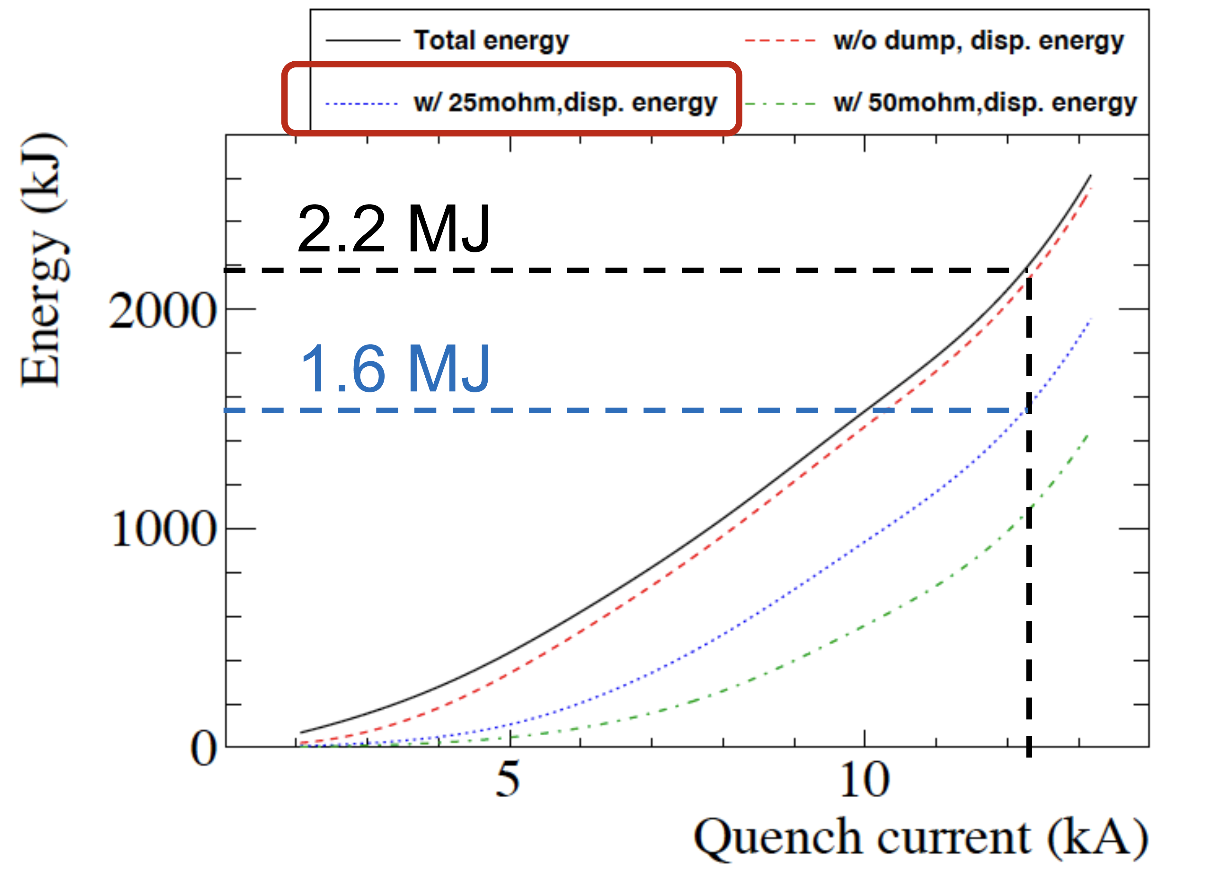
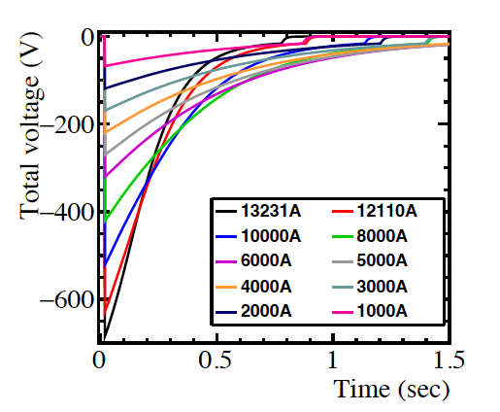
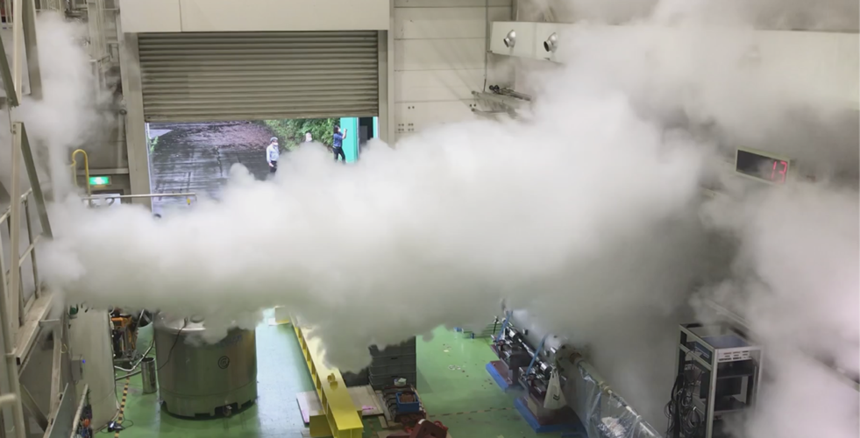
Operating Current Limitation
Simulation
2021 July,
Quench at 12.2 kA
Stored energy : 2.2 MJ
Simulation
Quench training around 12 kA w/ protection of QPH & 25 mOhm dump resistor
  Energy dissipated inside the magnet : ~1.6 MJ
  Amount of He gas evaporated exceeds the limit of our He recovery system
Higher resistance (50 mOhm) could reduce the dissipation energy but it could exceed our DCCB voltage limit (=600V) at 12 kA
We were not able to perform trainings up to the ultimate current (13.231 kA)

Slide 22
Toward Test for the Series Magnet
2022 June -

Slide 23
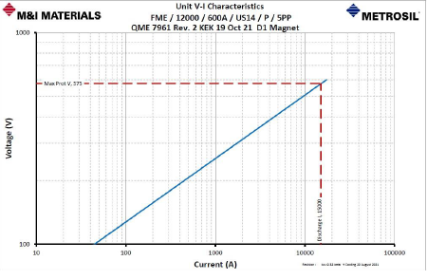
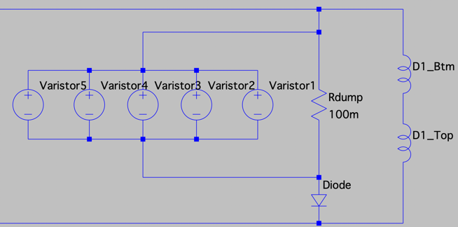
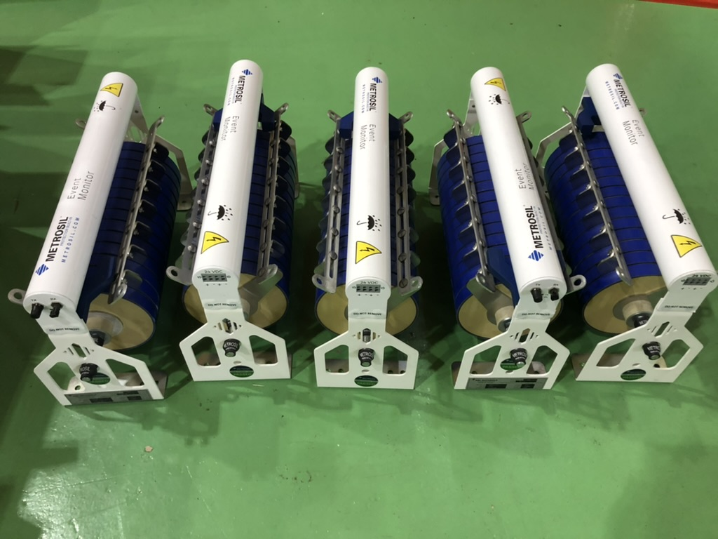

New EE system: Non-linear resistor (Varistor)
1000
Voltage (V)
Dump
$$V=C×I^{β}$$
100
10
100
1000
10000
Current (A)
Metrosil®
Decided to install an non-linear resistor, so called “varistor” from Metrosil®
Energy extraction : >5 MJ
(β,C) was designed so that we could operate up to 15 kA
The system was installed so that it can coexist with the original dump resistor

Slide 24

New EE system: Non-linear resistor (Varistor)
Safety limit
Circuit voltage below
600V even at 15 kA
Safety limit
Dissipation energy below 1.6 MJ at 13.23 kA
Metrosil®
Decided to install an non-linear resistor, so called “varistor” from Metrosil®
Energy extraction : >5 MJ
(β,C) was designed so that we could operate up to 15 kA
The system was installed so that it can coexist with the original dump resistor

Slide 25




Varistor Monitoring System
The 5-parallel circuit scheme raises concern about “current imbalance” due to the different characteristics including non-linear parameters of (C, β)
  Rogowski coils (CWT15LF, PEM Ltd.) were installed to monitor branch current during quench
  The signal (V∝dI/dT) goes through RC integrators and digitized with a sampling rate of 100k-1M Hz
Electronical characteristics has a dependence on temperature
  Status of varistor is also monitored with “Event Monitor” at every surging event

Slide 26




Additional Helium Gas Storage Bag
Limitation of helium gas recovery at quenches of MBXFP1.
Present capacity: 280 m³ (#2: 80 m³, #4: 200m³)
Helium gas at 13.23 kA w/ Varistors: 294 m³ (prediction)
A new Helium gasbag installation (#4b, 40 m³)
  Total capacity: 320 m³ > 294 m³
  #4b Gasbag to be installed next to #4 Gasbag in the same tent warehouse
NEW #4b gasbag 40 m³

Slide 27


Upgrade of pumping system for 1.9 K cooling
Mechanical
booster pump
Dry pump
GXS750/2600 made by Edwards
Existing pumping system
The layout of the new pumping system
Acceptance test
• The current pumping system for 1.9 K cooling is almost 25 years old. An update of the pumping system is planned.
• Five unit pumps with a dry and mechanical booster pump and their chillers have been procured.
• The operating parameters of each pump such as rotating speed, temperature, current, and power can be monitored
via ethernet communication.
• The similar performance in all the unit pumps has been confirmed in the acceptance test.
• Replacement work is scheduled this fall.

Slide 28
Summary
Since the last workshop in 2019, we have prepared the reception of the full-scale D1 magnet and successfully operated the powering tests even in difficult phases of the COVID-19 pandemic
  Replacement /repair works for the 15kA power converter, MM system, 1.9 K pumping system,…
We also have found that some updates were necessary for coming tests for the series D1 magnets to enable the ultimate current training
  Installation of the New EE system
  Installation of the new gas storage bag
Now the powering test of the first series D1 magnet (MBXF1) is ongoing !!
  Results will be released soon.

Slide 29
Thank you

Slide 30
Supplement

Slide 31

Non-linear resistor : Varistor
Non-linear characteristics in the VI curve
β<0.5:
  I needs to be increased more than fourfold to double V
    Lower terminal voltage at shutoff
  Smaller current → higher voltage when compared to an usual linear resistor
    Fast decay
Our demand:
  V_{terminal} < 575 V at 15 kA (voltage drops at the diodes are taken into account )
    ← beta = 0.3 and C=32.01
  Energy extraction up to 2.6 MJ
    ←Capable of extracting >5MJ
$$V=C×I^{β}$$

