Slide 1
GSI test facility at CERN
Antonella Chiuchiolo
On behalf of GSI/CERN collaboration
4th Workshop on Superconducting Magnet Test Facility
24th – 25th April, Paestum (Italy)

Slide 2
Outline
The Super-FRS­ and the Super-FRS­ magnets overview
CERN test facility
Achievements and improvements
Status and future
Conclusions

Slide 3
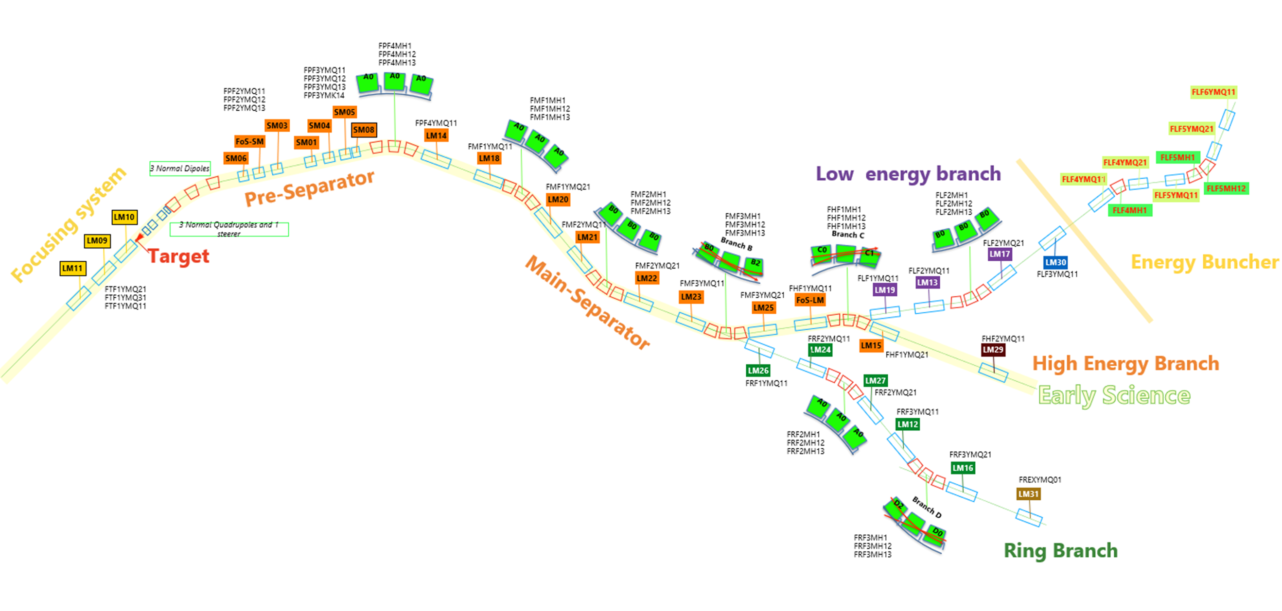
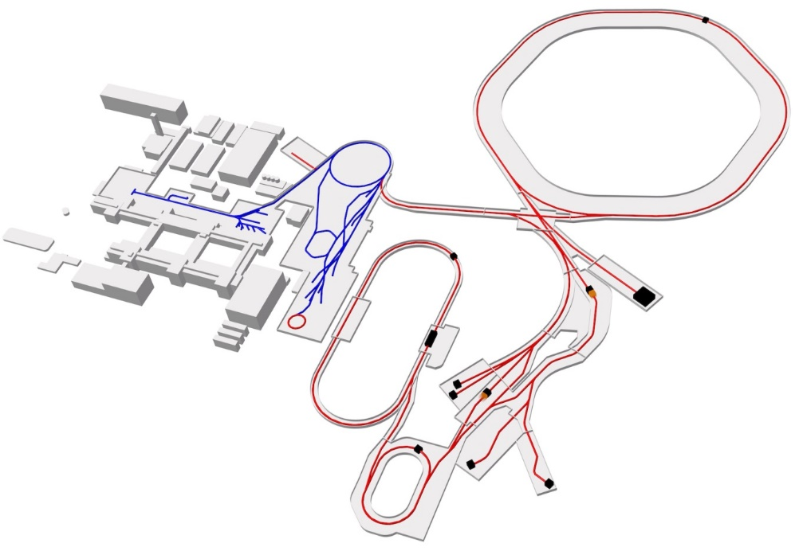
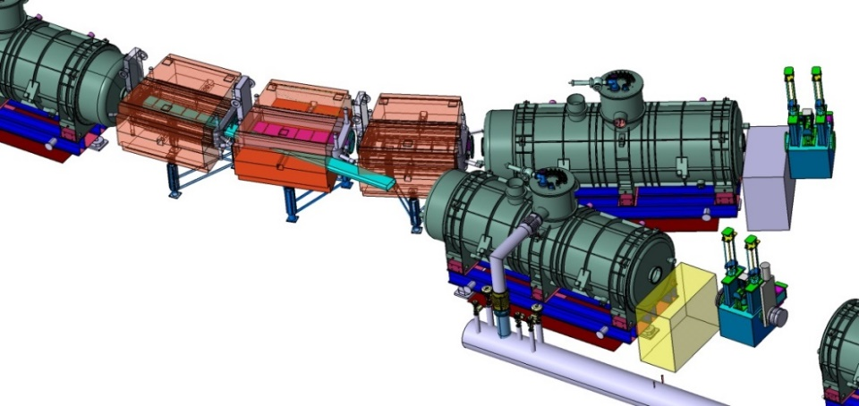
Super-FRS­ magnets overview
Super-conducting FRagment Separator at FAIR facility
SIS18
SIS100
Super-FRS
Dipole
Multiplet

Slide 4
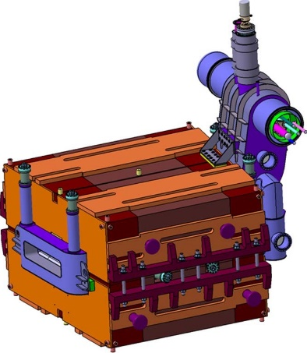
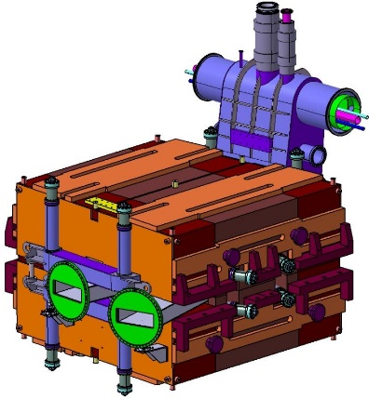
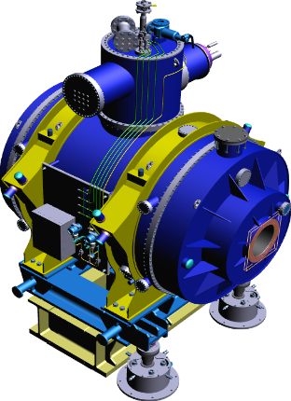
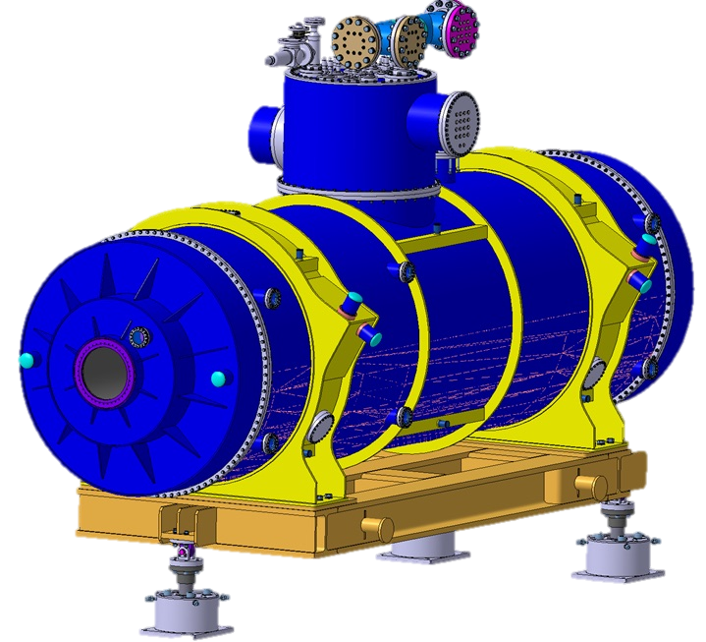
Super-FRS magnets overview
 | Type 3 dipole (9.75°) | Type 2 dipole (11°) | Branch dipole | Short quadrupole | Long quadrupole | Sextupole | Steerer Dipole | Octupole embedded in SQ
Number of magnets | 18 | 3 | 3 | 44 | 34 | 41 | 14 | 42
Magnet type | super ferric | super ferric | super ferric | super ferric | super ferric | superferric | cosine-Theta | cosine-Theta
 | warm iron | warm iron | warm iron | cold iron | cold iron | cold iron | cold iron | cold iron
Aperture [mm] | 170 x 794 | 170 x 794 | 170 x 794 | 380 | 380 | 380 | 380 | 380
Integrated gmax [Tm/m^n-1] | 3.4 | 3.84 | 3.4 | 8 | 11.5 | 20 | 0.1 | 84
Max. current [A] | 260 | 260 | 308 | 330 | 330 | 320 | 308 | 176
Inductance [H] | 23 | 26 | 23 | 30 | 42 | 1.04 | 0.07 | 0.1
Stored Energy [MJ] | 0.5 | 0.5 | 0.5 | 0.77 | 1.1 | 0.037 | 0.0026 | 0.0013
 |  |  |  | Integrated into 32 multiplets of 24 different configurations
Length [m] | 3.0 | 3.3 | 3.0 | From 2.7 to 7
Heigth [m] | 3.2/4.4 | 3.2/4.4 | 3.2/4.4 | 4.3 (feet included)
Weight [ton] | 52 | 55 | 49 | From 27 to 65
LHe volume [m³] | 0.05 | 0.05 | 0.05 | From 0.9 to 1.35
56 modules: in total 199 magnets
Standard Dipole
Branch Dipole
Short Multiplet (SM)
Long Multiplet (LM)

Slide 5
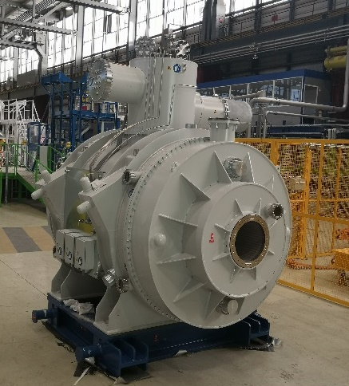
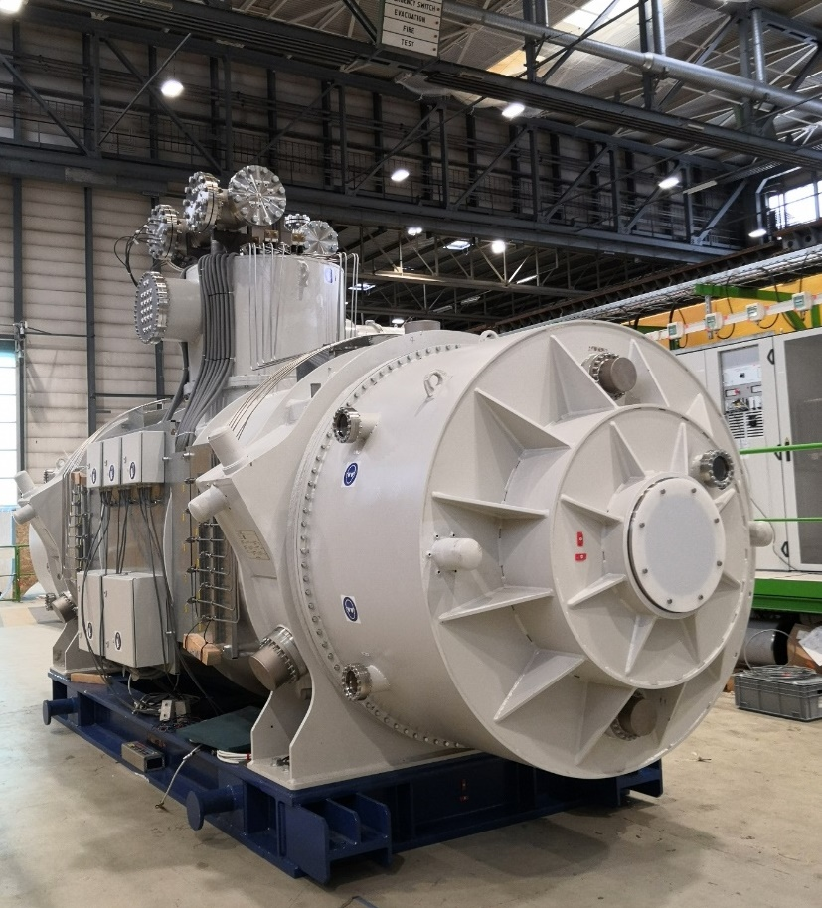
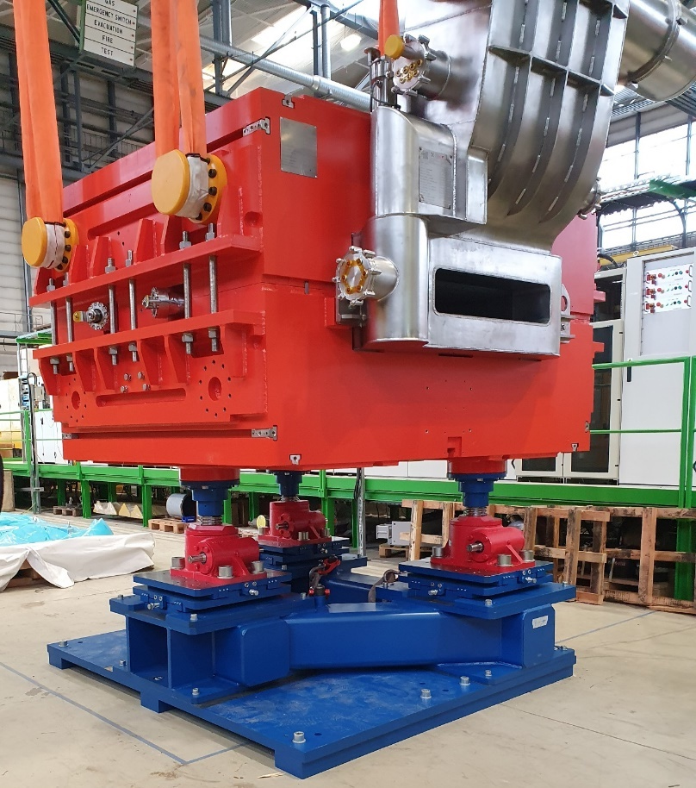
Super-FRS magnets overview
4 m
Standard Dipole
Short Multiplet (SM)
Long Multiplet (LM)

Slide 6
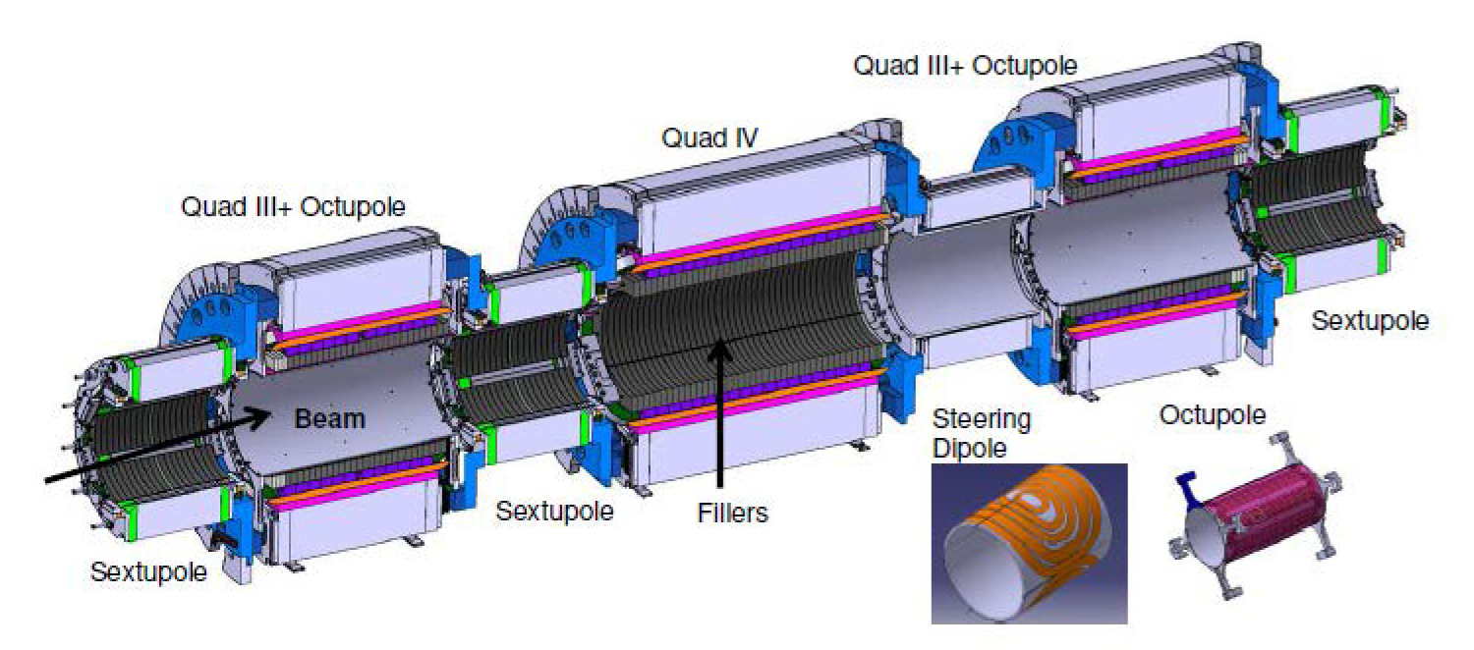
Super-FRS magnets overview
Short Quadrupole + Oct
Long Quadrupole
Short Quadrupole + Oct
Sextupole
Steering dipole
Sextupole
Sextupole
Example of 9 magnets assembly
Long Multiplet (LM)

Slide 7
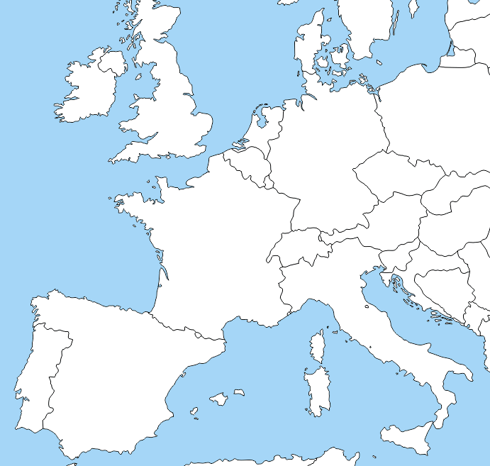







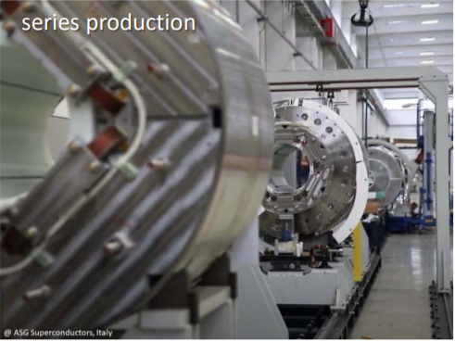
Collaboration
  Spain
  Dipoles production
  Germany
  Production follow up
  Pre – Assembly
  Installation
  Operation
  Italy
  Multiplets production
  France
  Technical follow-up of the Dipole production (CEA/Saclay In-kind contribution)
  Switzerland
  Magnets qualification (Site Acceptance Tests)
  CERN

Slide 8
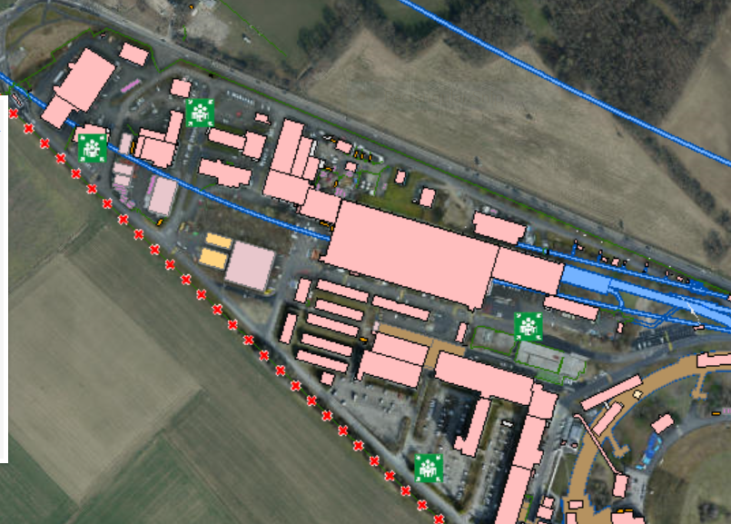
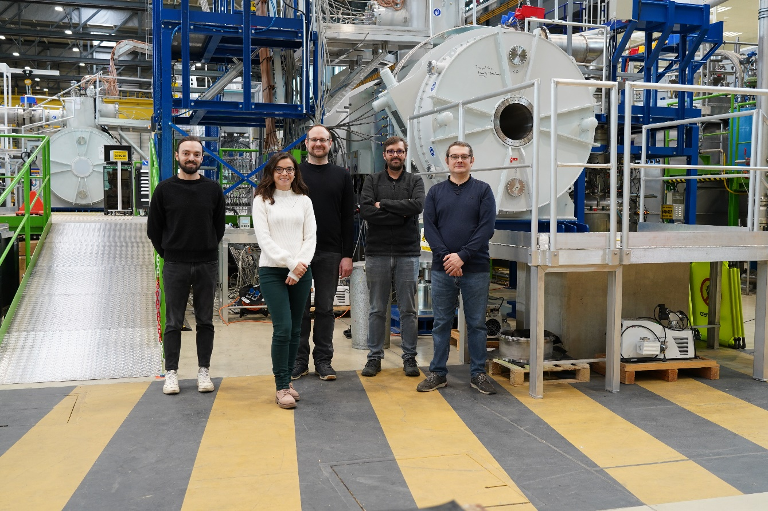
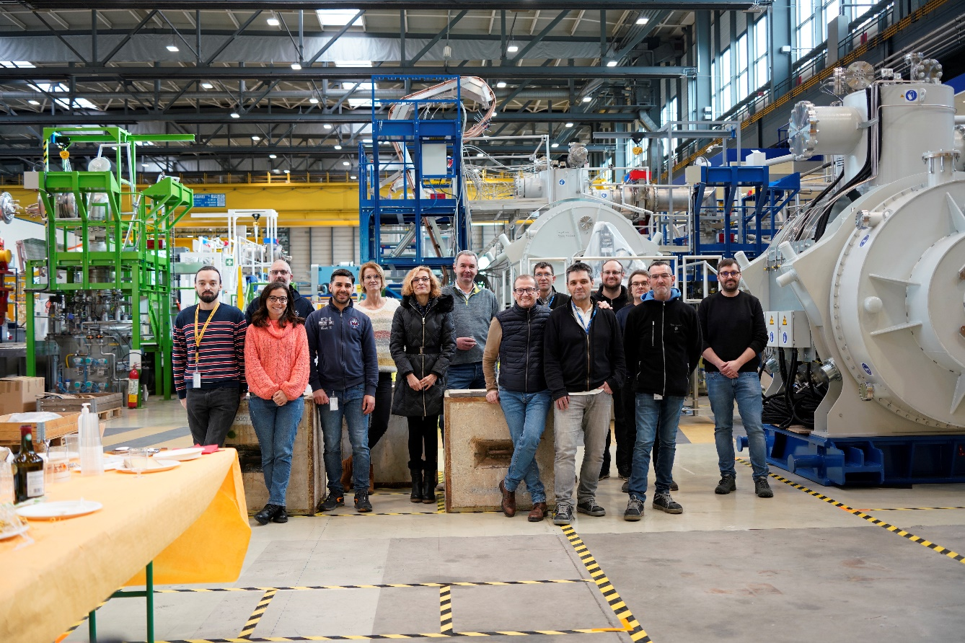
Collaboration
CERN’s building 180
180
GSI testing team
and CERN teams
2010- 2012
CERN/GSI collaboration agreement
2012-2018
Facility construction (CERN contribution)
2019
First of series short multiplet delivery at CERN: beginning of the tests and facility commissioning
Timeline
Resources
5 GSI members on site
responsible of test plan, testing and magnet acceptance, interfaces
CERN members
TE (CRG, RAS, MSC, MPE), EN (HE, MME), SY (EPC), BE(GM)
Guarantee the functionality of the facility, cryo operation, space, safety, handling, welding, FSU

Slide 9
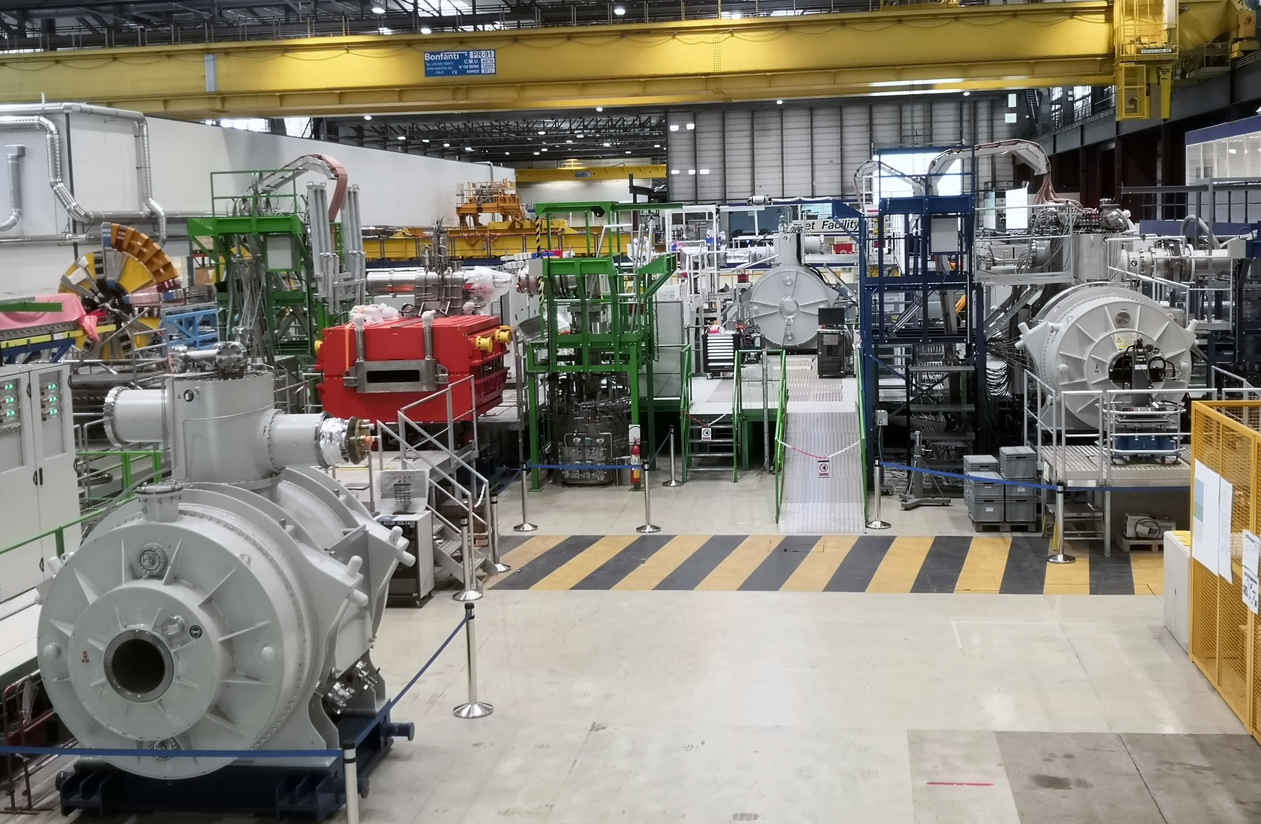
CERN test facility overview

Slide 10

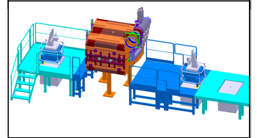
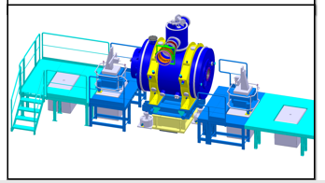
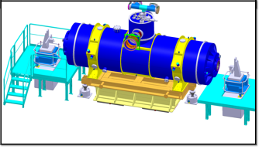
CERN test facility overview
INFRASTRUCTURE
3 test benches
Modular Test benches
  Blue, green, white
  Platforms configurations compatible with dipole and multiplets for the 3 benches
TB3
TB2
TB1

Slide 11
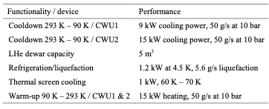
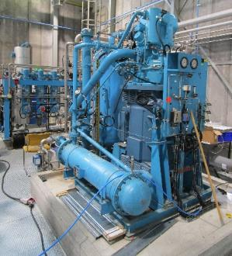
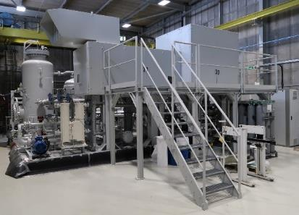
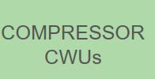
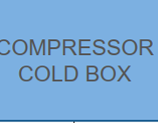
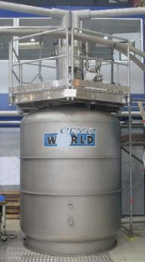
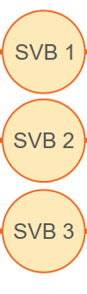
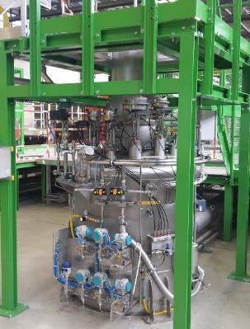
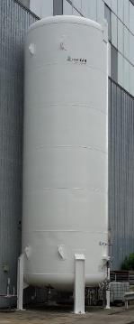
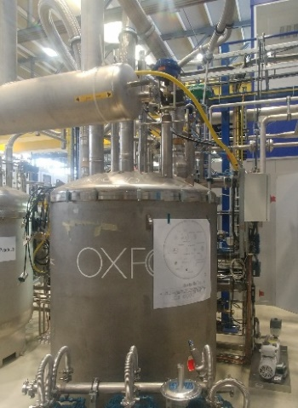
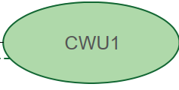
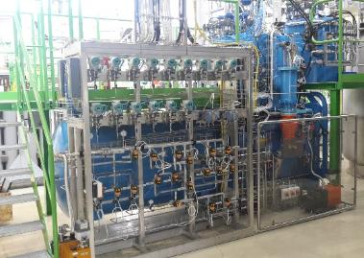

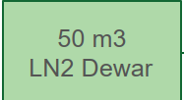
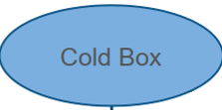
CERN test facility overview
INFRASTRUCTURE
3 test benches
3 cryogenic distribution systems
Cryogenic main sub-systems
  2 x Pre-cooling system
  LHe system
  3 x Cryogenic distribution system
Operation conditions required:
4.5 K, 1.3 bar cold mass, 16 bar thermal shield
50 g/s at 17 bar
150 g/s at 18 bar
Commissioned and fully operational
Consolidation works on-going
Courtesy of G. Rolando (TE-CRG-ME)

Slide 12
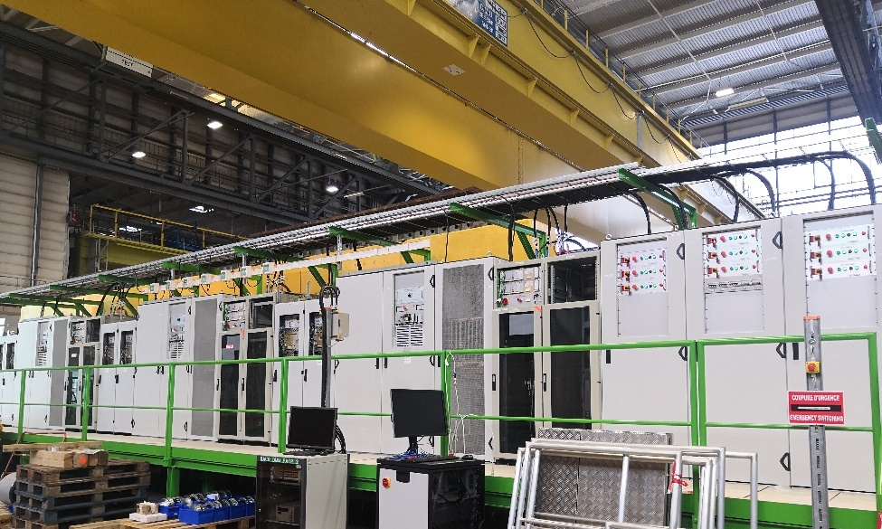
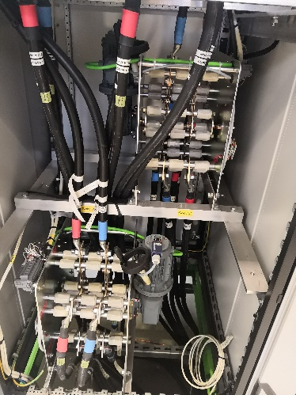
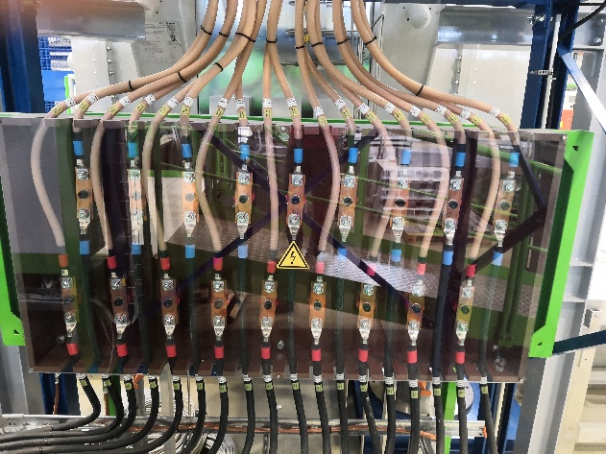
CERN test facility overview
INFRASTRUCTURE
3 test benches
3 cryogenic distribution systems
9 power converters circuits
3 energy extraction systems
78 DC powering cables, with a combined total length of about 2900 m
Power converters and energy extraction
3 x [±500A/±120V] for the main circuits
6 x [±600A/±40V] for the corrector circuits
3 x EE system with 2.8 Ohm resistance for the quadrupoles
9 x load switched interlocked
Commissioned and fully operational
Power converters and EE systems
Power cables
Load switches

Slide 13
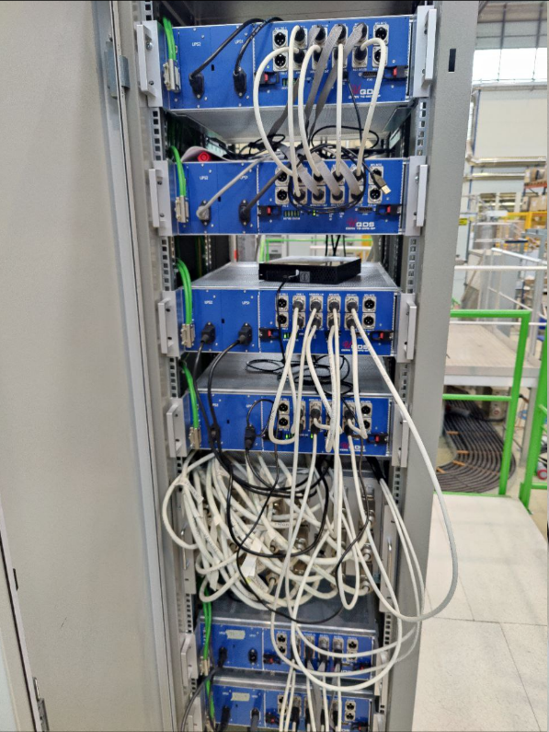
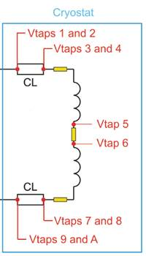
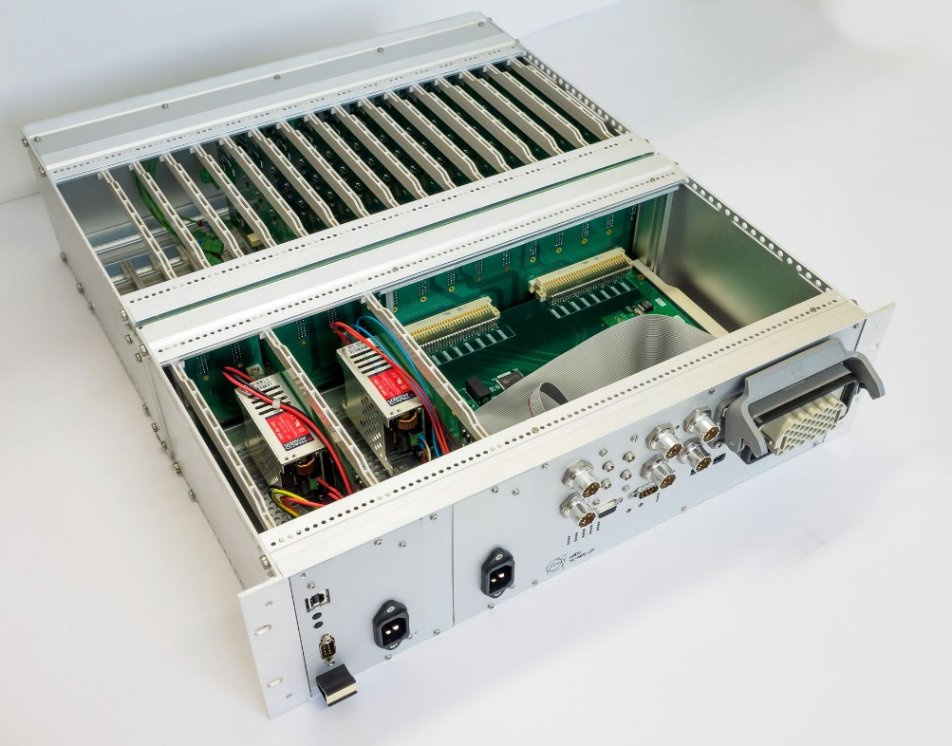
CERN test facility overview
INFRASTRUCTURE
3 test benches
3 cryogenic distribution systems
9 power converters circuits
3 energy extraction systems
78 DC powering cables, with a combined total length of about 2900 m
18 CERN uQDS systems
Magnets Quench protection
TB1 Commissioned and operational
18 x Universal Quench Detection Systems units
(3+3 redundant per bench )
TB2 and TB3 commissioning to be completed with 9 magnets configuration

Slide 14
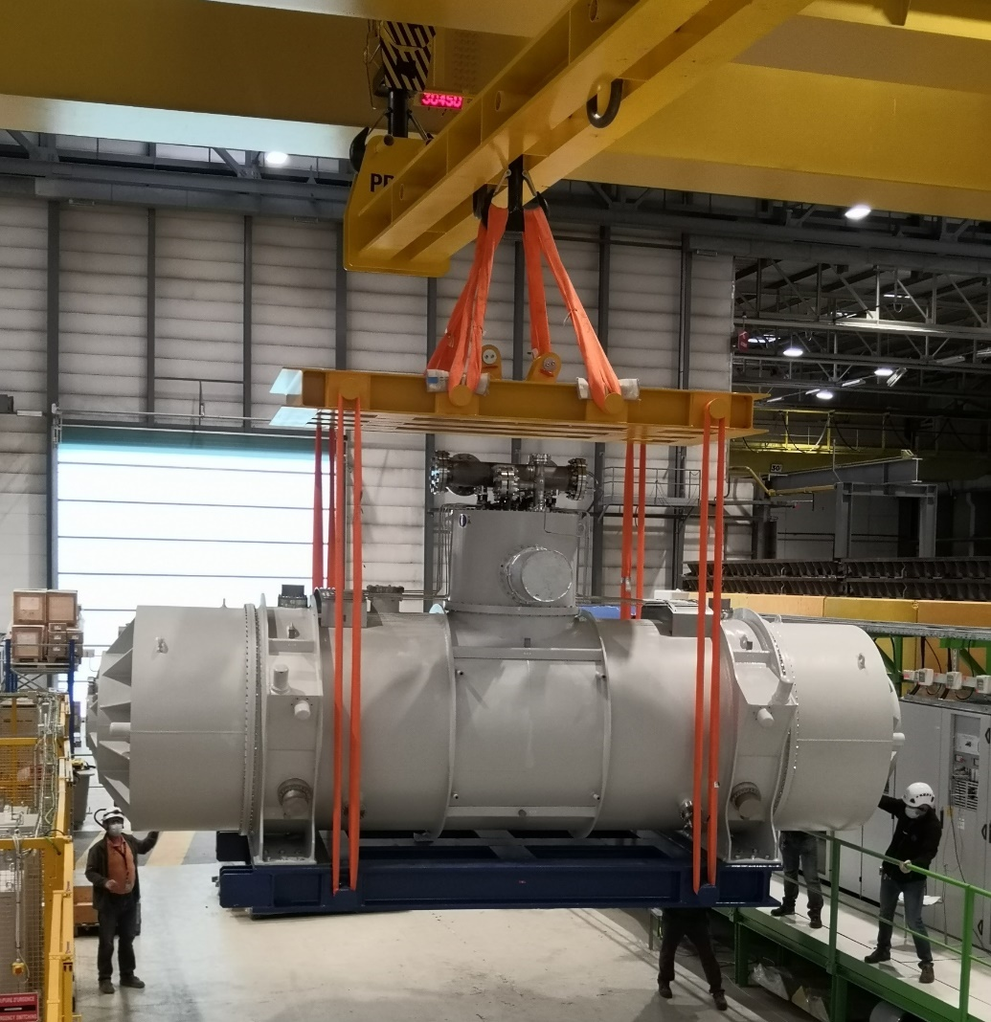
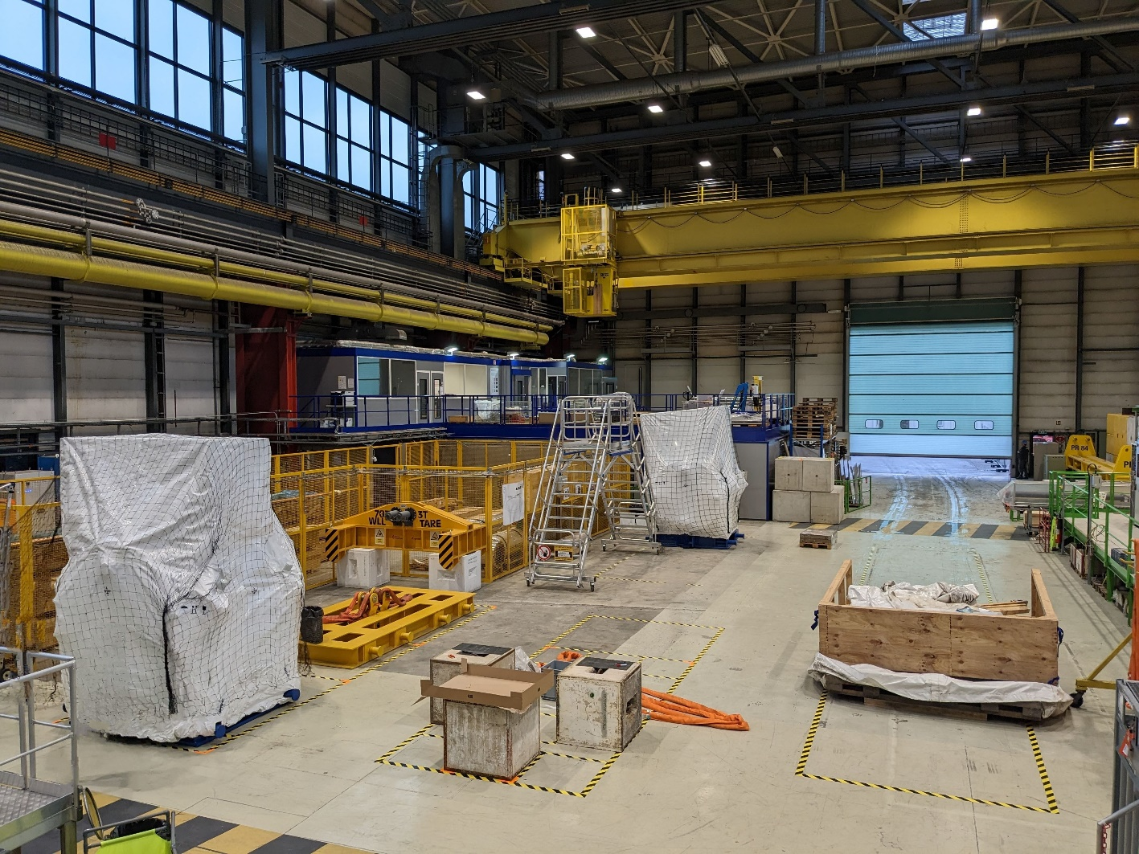
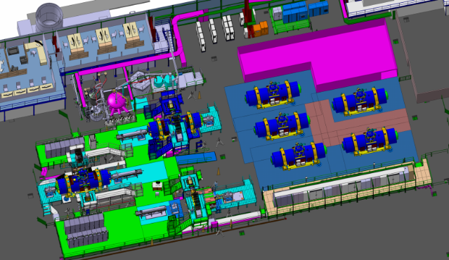
CERN test facility overview
INFRASTRUCTURE
3 test benches
3 cryogenic distribution systems
9 power converters circuits
3 energy extraction systems
78 DC powering cables, with a combined total length of about 2900 m
18 CERN uQDS systems
2 over-head cranes
Preparation Area
Handling and transport
40T and 60T cranes to be coupled for modules > 58 tons
3 x different lifting tools for short, long multiplet and dipoles
5 x spaces in the preparation area for reception/ test at warm/ handling/ purging/ intervention/ packaging/ shipment
In/out
3
1
5
Feet installation
2
4

Slide 15
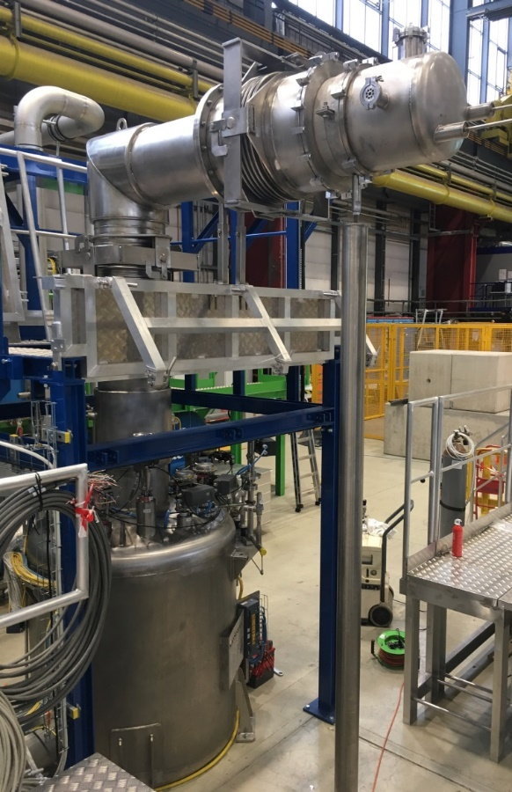
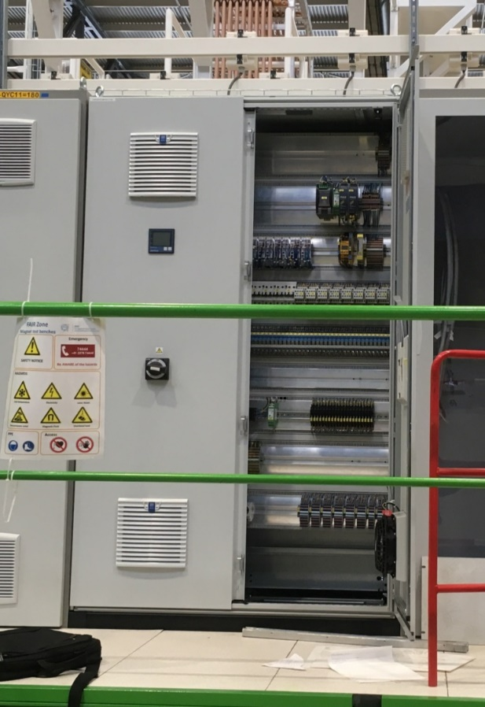
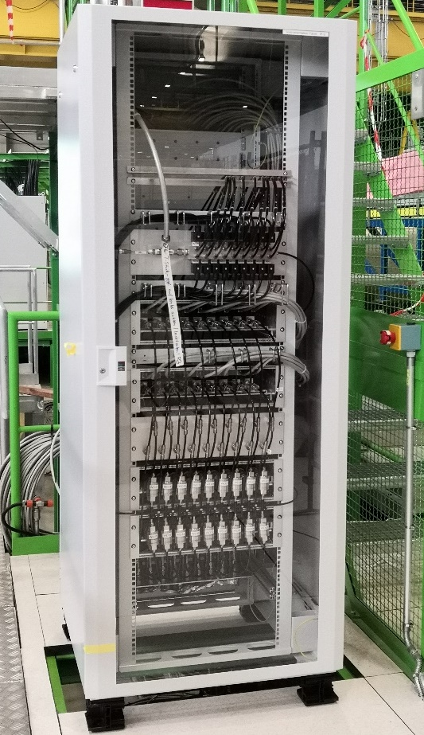
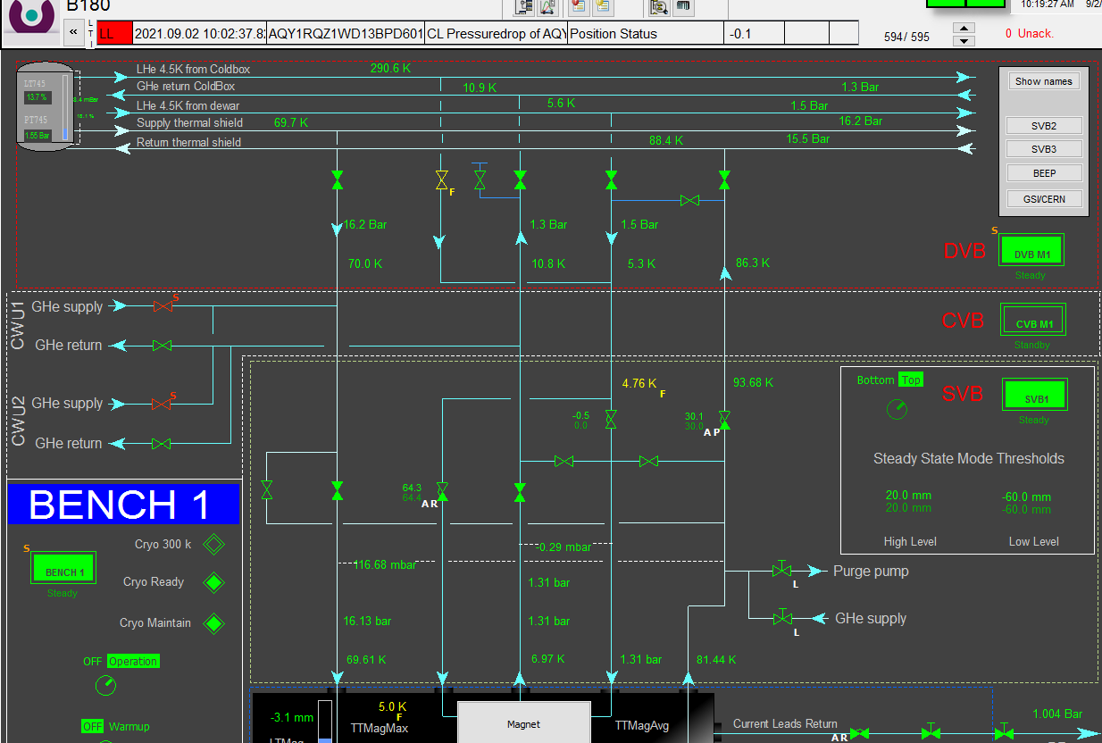
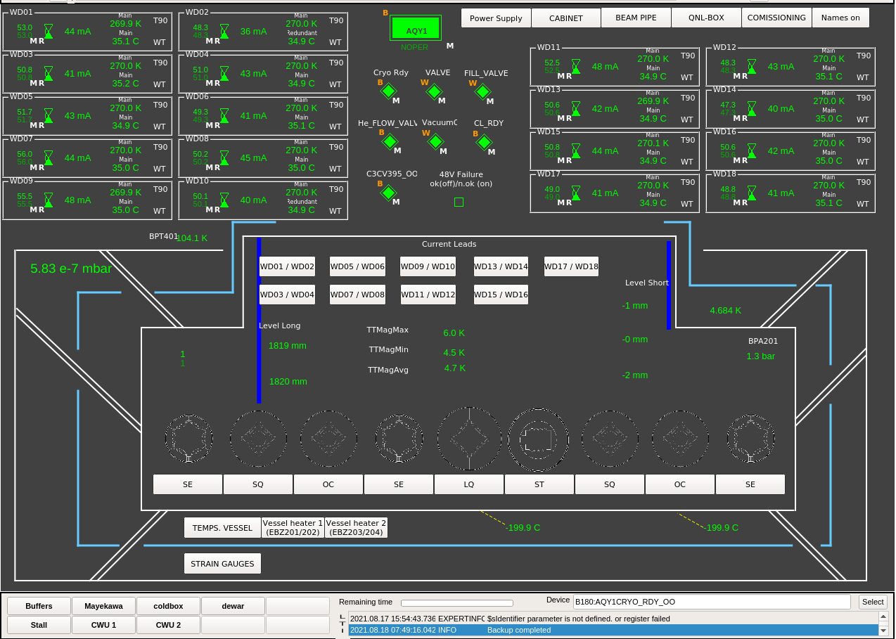
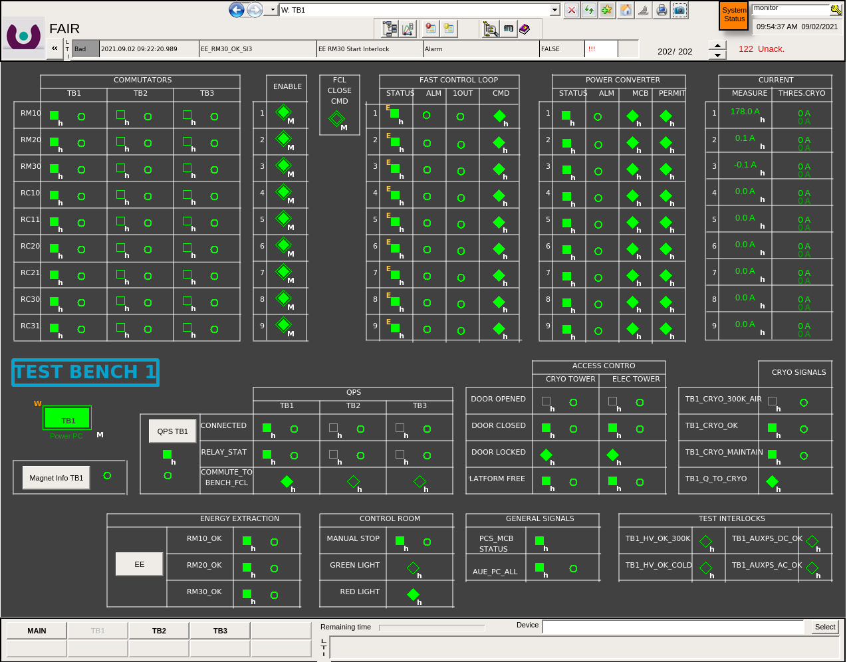
Facility interfaces
GSI Jumper line (x3))
Commissioned and fully operational
CRYO PLC
Satellite valve box
(CERN)
GSI Electrical Cabinet (x3)
GSI current leads panel (x3)
sensors monitoring (pressure, temperature, liquid He level)
insulation vacuum monitoring
current leads cooling control
interlocks
for all different magnets configurations
SAFETY PLC
Commissioned and fully operational
Consolidation works
GSI Magnets control software

Slide 16
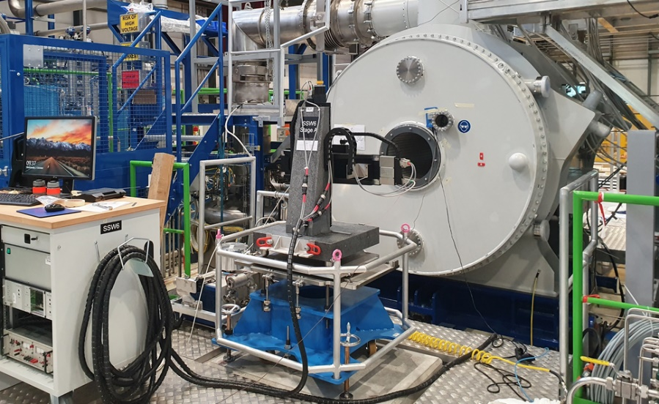



Instrumentation
Integral field and field quality measurements extended program for the First Of Series (FOS)
  Dipoles: Translating fluxmeter, Single Stretched Wire (SSW)
    additional local map with a 3D hall probe mapper
  Multiplets: Rotating coils (RC), Single Stretched Wire
Standard program for the Series
  Integral measurements with SSW
  In case of not acceptable divergences: fluxmeter (for dipoles) or rotating coil (for multiplets)
Commissioned and fully operational
Translating fluxmeter
3D mapper
Stretched Wire
Rotating coil

Slide 17


Achievements and improvements
  Parallel operation of 3 benches achieved (1CD//1WU//1cold test) for a total of 50 g/s
Example cooldown duration: 13 days for a LM (4 magnets)
Parallel operation
Phase 1 :
283 K- 80 K
30 g/s
16 bar
ΔT = 40 K over the cold mass
Phase 2 :
80 K – 4.2 K
1.3 bar
Filling
from 8 to 17 days depending on the module

Slide 18


Achievements and improvements
  9 parallel magnets powering in machine configuration without quenches
  Up to 70 different cross talk powering configurations (for the FoS only)
First parallel powering of 9 magnets in the FoS LM

Slide 19



Achievements and improvements
  Infrastructure:
          Cold box bypass to limit disturbances during connection when another bench is used for powering tests
          GN2 distribution line near benches and transport area
  Software:
              automatic valves control for HV and heat load tests
              automatic switching cryo operation modes (GSI SCADA)
Courtesy of T. Dupont (TE-CRG-ML)
HV & Heat load test commands
GN2 distribution lines

Slide 20





Status and future
INCOMING
TESTING
OUTGOING
FoS SM | 02.2019 | 2 magnets – 4 cooldowns | 03.2022 GSI
FoS LM | 11.2020 | 9 magnets – 2 cooldowns | 09.2022 GSI
FoS Dipole D3 | 02.2021 |  | 01.2022 Elytt
SM08 | 12.2021 | 2 magnets - 1 cooldown | 11.2022 GSI
FoS Dipole D2 | 01.2022 | 1 magnet - 2 cooldowns | 03.2023 Elytt
SM01 | 03.2022 | 2 magnets – 2 cooldowns | 01.2023 GSI
LM09 | 10.2022 | 3 magnets- tested
LM11 | 01.2023 | 4 magnets- under tests
SM06 | 12.2022 | 3 magnets- tested
Since 2019 - 8 modules (26 magnets) tested including 3 FoS with extended testing programs and thermal cycles

Slide 21

Status and future
2023
2024
2025
2026
2027
3 benches:
(blue, green, white)
Energy
Buncher
To be tested for Early Science (end 2025): 27 modules including 2 FoS
To be tested for the full Super –FRS (end 2026) - 48 modules including 2 FoS
Energy buncher not in the present agreement

Slide 22
Conclusions
GSI facility at CERN is commissioned and operational
Consolidation works on going to improve the cross-talk performances of the cryo infrastructure
Full commissioning of quench detection systems will be only possible with the series testing
8 modules tested for a total of 26 magnets including 3 FoS with extended testing programs
Facility is not yet at the full capacity rate

Slide 23
Thank you for your attention

