Slide 1
Facilities for sc Magnet Testing at GSI
A. Szwangruber et al.
4th Workshop on Superconducting Magnet Test Facility, 24-26 April 2023, Paestum

Slide 2
Outlook
GSI Helmholtz Centre
FAIR Project, SIS100 and Super-FRS
Cryogenic test facilities at GSI
Prototype Test Facility (PTF)
Series Test Facility (STF)
SIS100 series components testing
SIS100 string test
Upcoming challenges

Slide 3
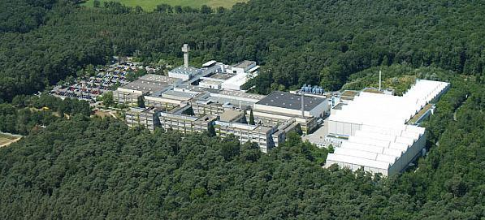
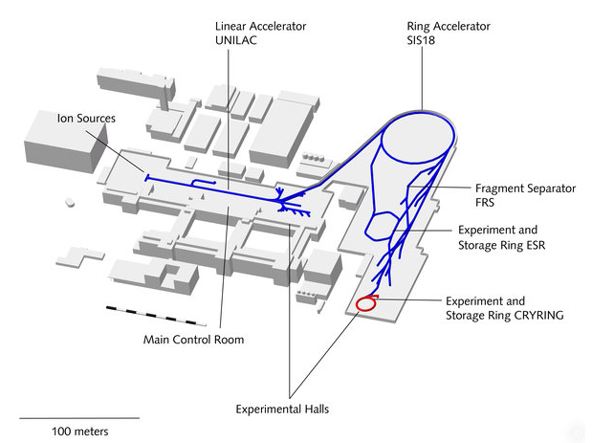
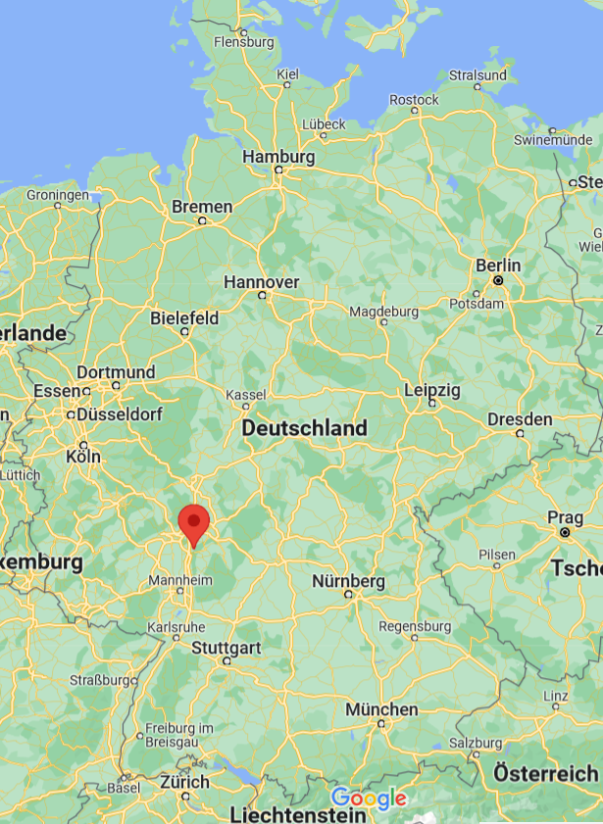
GSI – Helmholtz Center for heavy Ion research
Linear accelerator UNILAC
Synchrotron SIS18
GSI campus , Location Darmstadt, Germany (courtesy of GSI)
GSI research program
nuclear physics
atomic physics
application-oriented research
  materials research
  plasma physics
  biophysics
  nuclear medicine
core facility
new part

Slide 4
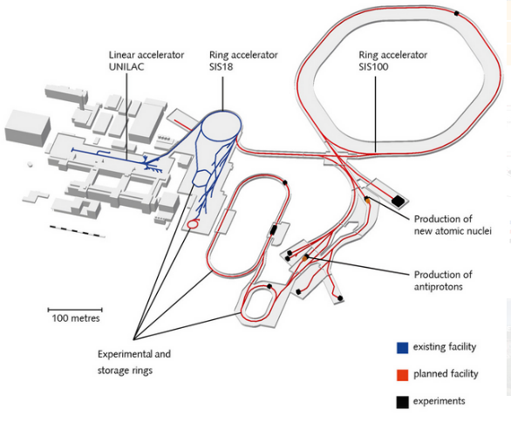











Facility for Antiproton and Ion Research (FAIR)
International project
High intensity ion and antiproton beams for experiments in nuclear, atomic, plasma physics and material science
Super FRS
Performance of FAIR compare to existing GSI facility
Primary beam intensities: ×100
Secondary beam intensities: ×10000
Primary beam energies for U²⁸⁺: ×10
Antiproton production

Slide 5
Facility for Antiproton and Ion Research (FAIR)
SIS100 Synchrotron
SIS100
heavy ion synchrotron
beam rigidity 100 [Tm]
fast cycling machine (2T, 4T/s)
415 fast-ramped sc magnets
Ions from H to U²⁸⁺
high intensity beam for experiments
Super FRS
Super FRS
sc Fragment Separator
magnetic spectrometer for study of exotic particles

Slide 6
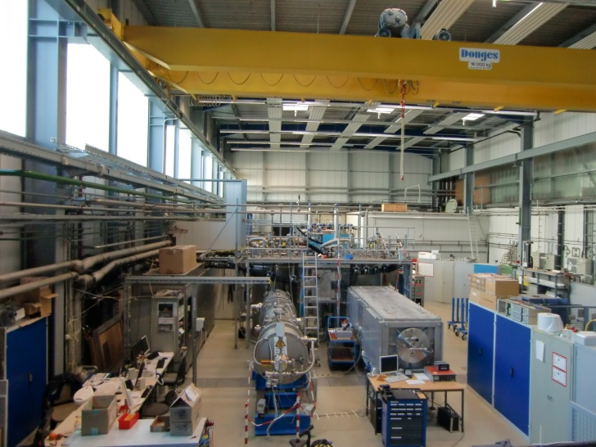
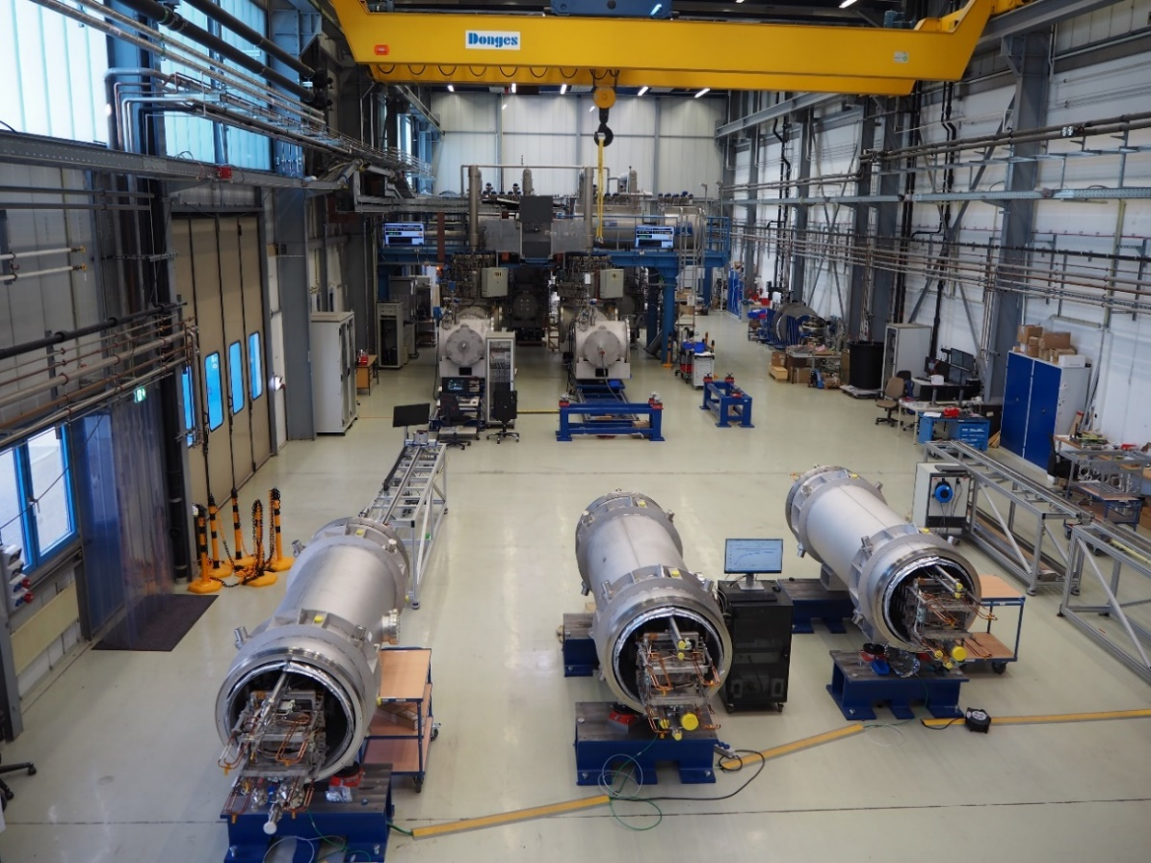
GSI Test Facilities
courtesy C.Schröder (GSI-CRY)
Prototype Test Facility (PTF)
in operation since 2005
Series Test Facility (STF)
in operation since 2017

Slide 7
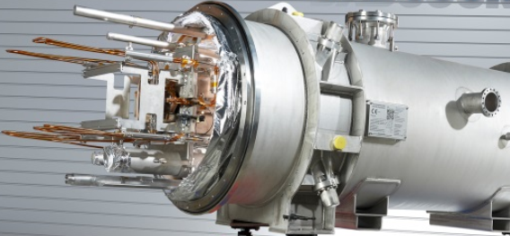
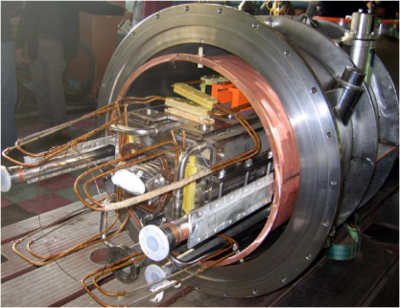
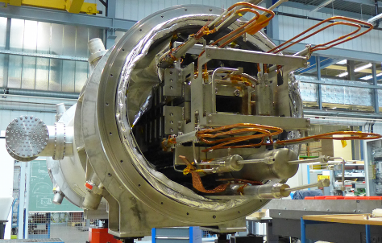
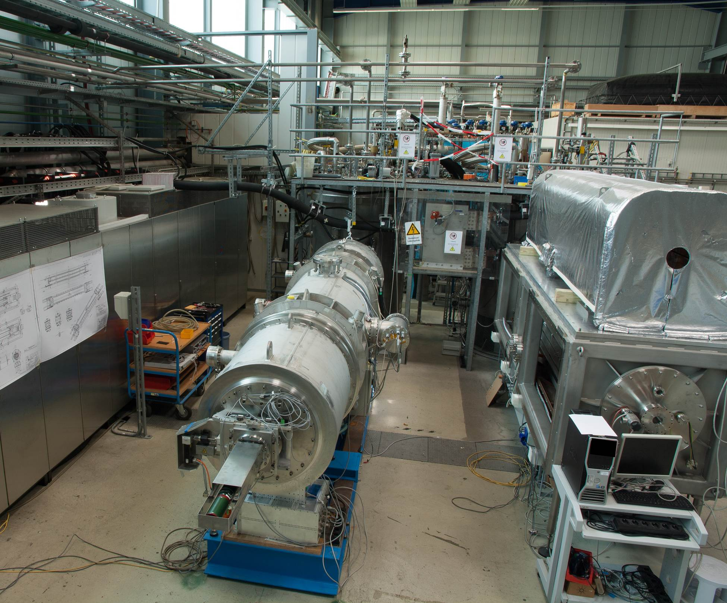
Prototype Test Facility (PTF):
Applications
SIS100 dipole prototypes
current leads
beam pipes
long term powering tests on SIS100 dipole
S2LD
courtesy Bilfinger Noell
FoSD
courtesy Bilfinger Noell
C2LD
Infrastructure
Testing area ~ 200m²
Two test benches:
    TB1 - testing of SIS100 prototype dipoles in own cryostats
    TB2 – universal cryostat for testing of small cryogenic components
Cryogenic infrastructure
Power supply and magnet protection system
FB1
FB2
PS
universal cryostat
FoS Dipole
2013 - Refurbishment of the test facility for testing of FoS Dipole for SIS100
PTF with FoS Dipole under testing

Slide 8
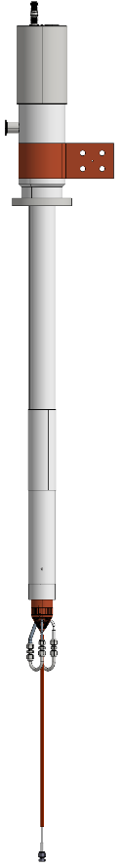
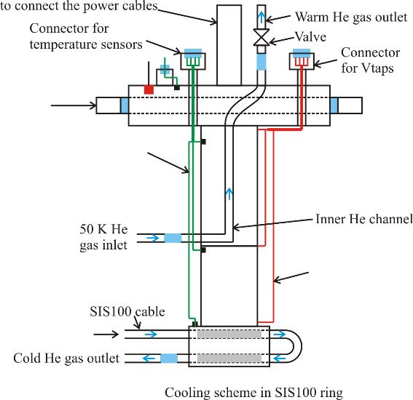
Prototype Test Facility (PTF):
Cryo plant:
Cooling power @ 4.5 K | 300 W
He circulation pump | 60 - 200 g/s
Helium liquefaction rate | 2 g/s
Helium inventory @ 300 K | 300 m³
Max. power consumption | 250 kW
Cryogenic layout:
Current Leads 14kA DC (HTS)
300 K
Feed Box 2 (FB2)
Universal cryostat
Cryo Plant
Distribution box
Feed Box 1 (FB1)
Magnet in its own cryostat
Recooler
PS
Quench detection
INCAA system from CERN
Analog bridge and single-ended input cards with mechanical potentiometers
20 channels available
Local PC (offline) with LabVIEW 7 based software
in 2021, the unused KIT system from STF replaced INCAA
50 K
Power converter
Max. Load Current | 20 kA
Load Voltage | 22 V / 66 V
Current stability | 10⁻⁴
Max. ramp rate | 30 kA/s
Cycle frequency | 1 Hz
HTS section
5.8 K
Nuclotron cable
4.8 K
courtesy C. Roux (GSI-SCM)

Slide 9
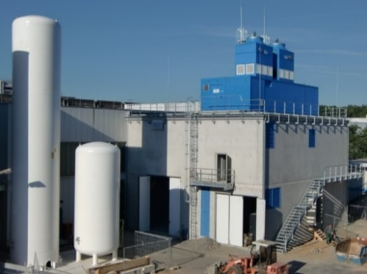
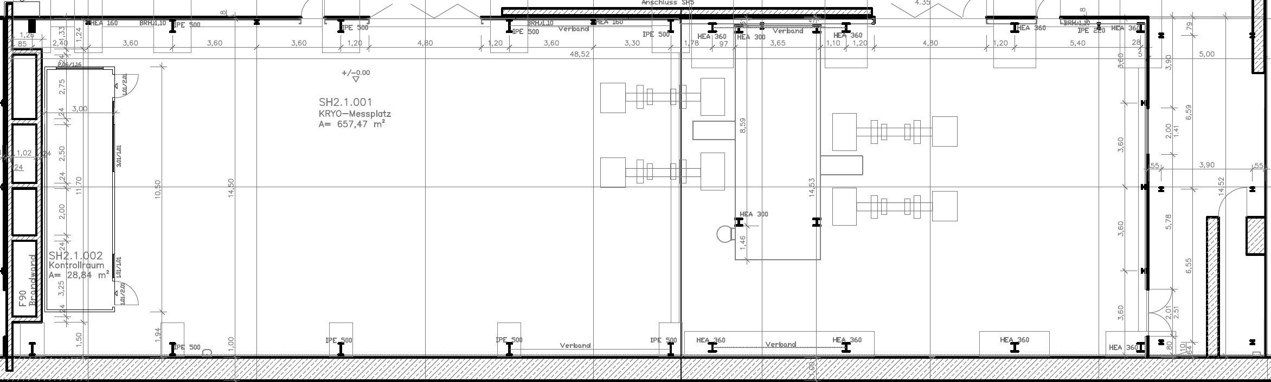
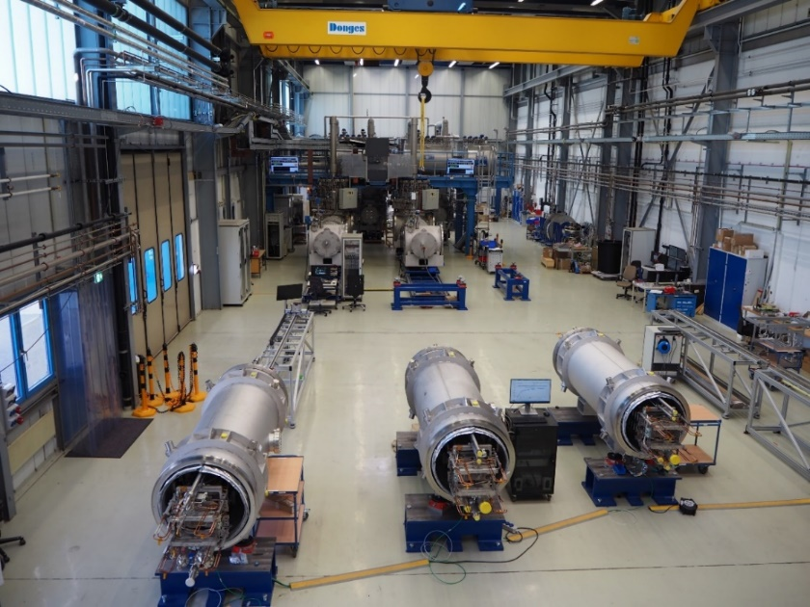
Series Test Facility (STF):
Applications
Infrastructure
2012 – 2014
planning & procurement
2014 – 2017
installation &commissioning
series dipole
main current lead
local cryogenic components
string test
Total area 678 m²
4 test benches for 4 K testing
6 test benches for 300 K testing
calibration bench for MFMS
CRYO and 2x20 kA power converters in the annex building
SIS100
courtesy C.Schröder (GSI-CRY)
Driveway for trucks
FB1
FB2
FB3
control room
FB4
calibration chain for MFMS
Preparation benches

Slide 10
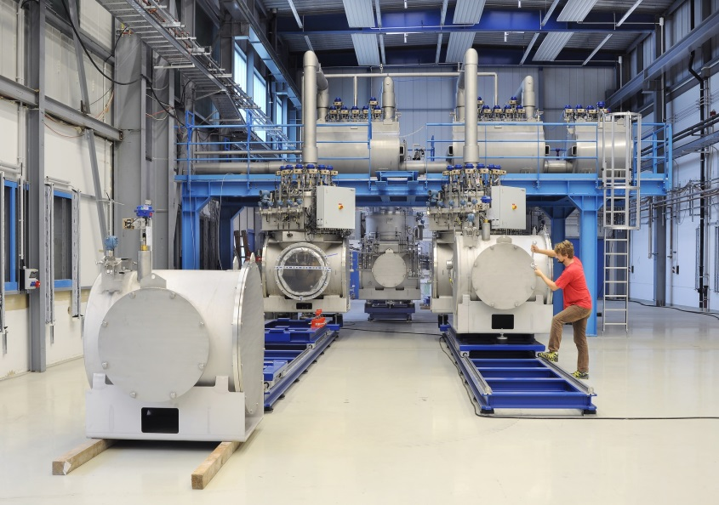
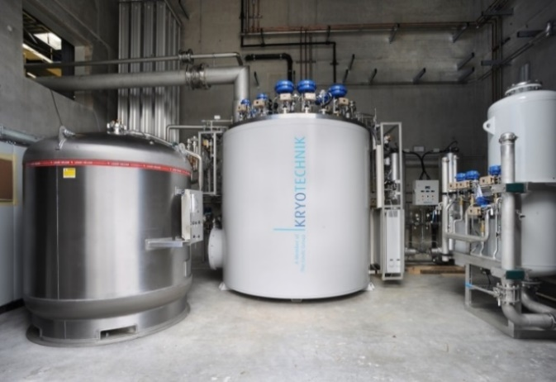

STF: Cryogenic Infrastructure
Cryoplant:
Cooling power @ 4.5 K | 700 W
Cooling power @ 50 K – 80 K | 2000 W
Helium liquefication rate | 6 g/s
Helium inventory @ 300 K | 1000 m³
Helium inventory @ cold | up to 3000 l
Max. power consumption | 434 kW
Distribution system and feed boxes
Independent operation of test benches.
He sub-cooling in feed boxes
courtesy C.Schröder (GSI-CRY)
Installation and commissioning 2014 - 2015
courtesy C.Schröder (GSI-CRY)

Slide 11
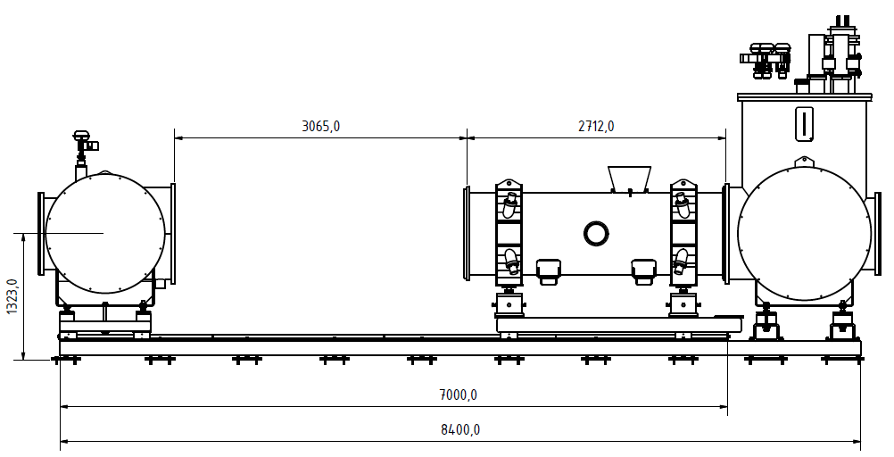
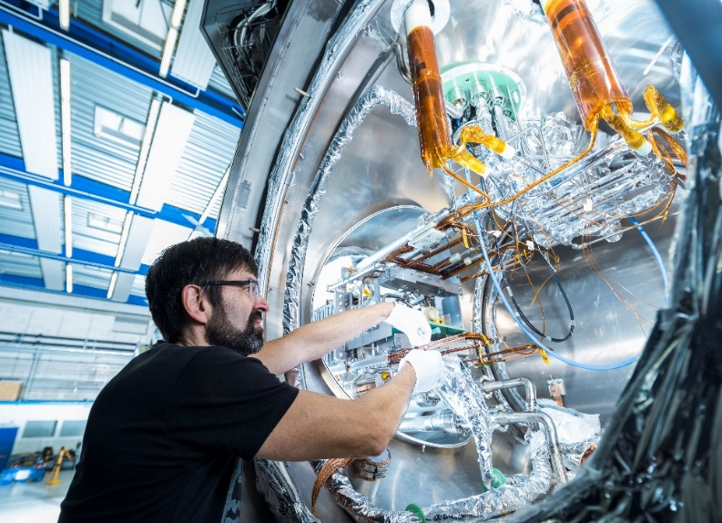
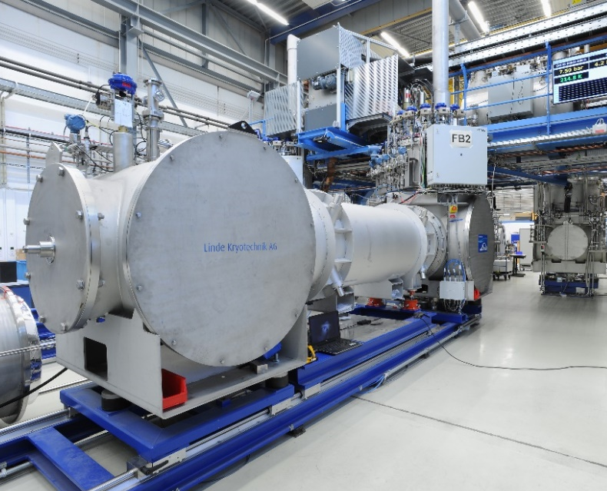
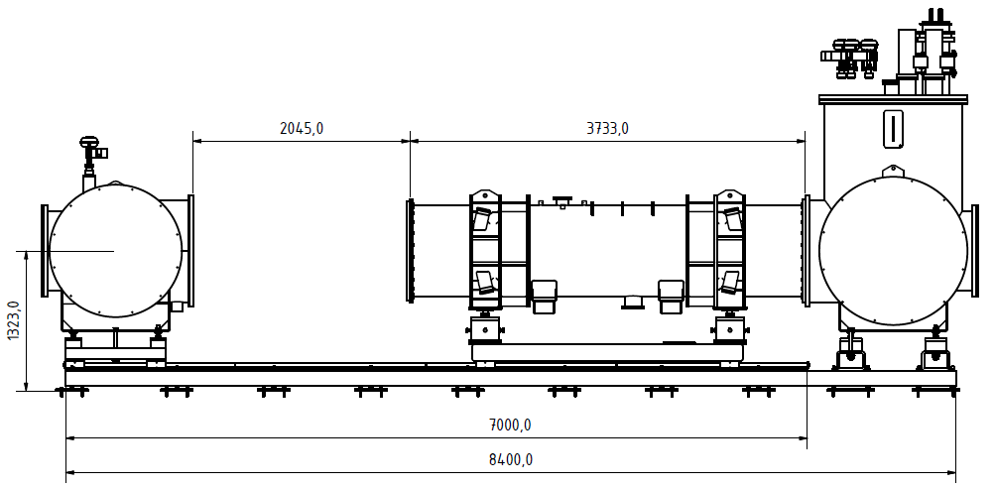
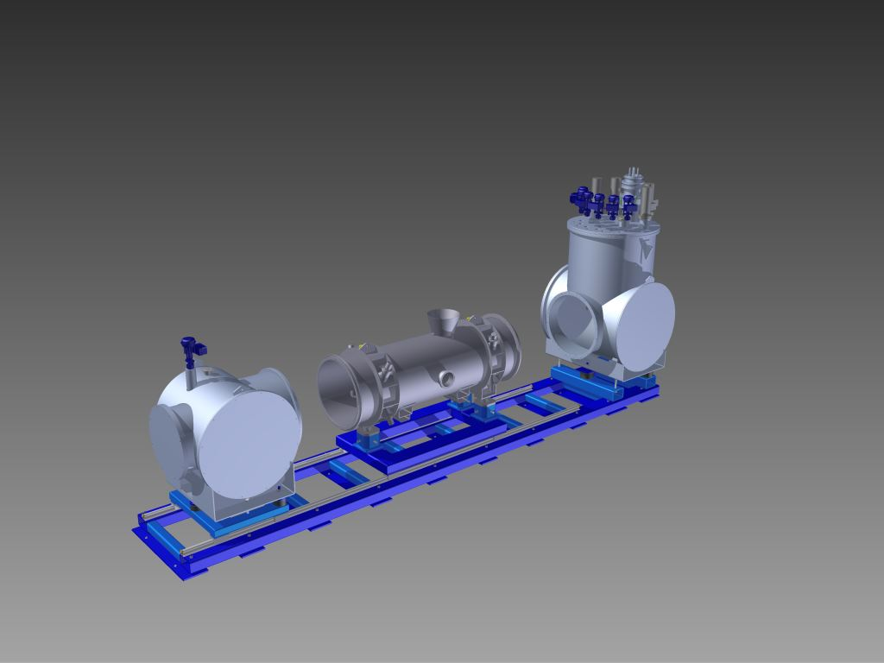
STF Test Benches
Mechanics:
rail system
bellow free - easy mounting of the module to the feed and end box
good access to hydraulic and electrical connections
module positioning: ±0.1 mm horizontal, ±1 mrad
operation with SIS100 dipole and Quadrupole doublet modules
Image: J. Hosan/GSI Helmholtzzentrum für Schwerionenforschung GmbH
Test bench with SIS100 dipole
Feedbox
Feedbox
Endbox
Cryo-module
Test bench with SIS100 quadrupole doublet
SIS100 dipole at test bench
courtesy C.Schröder (GSI-CRY)

Slide 12

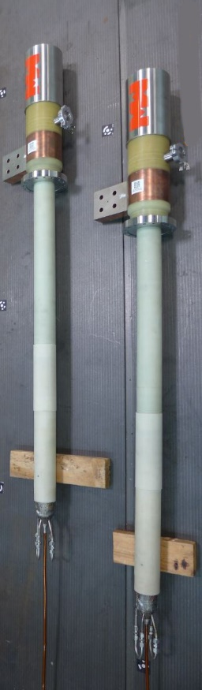
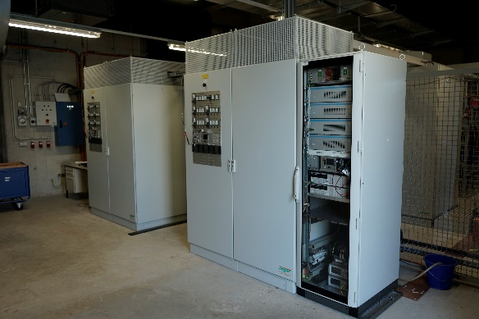
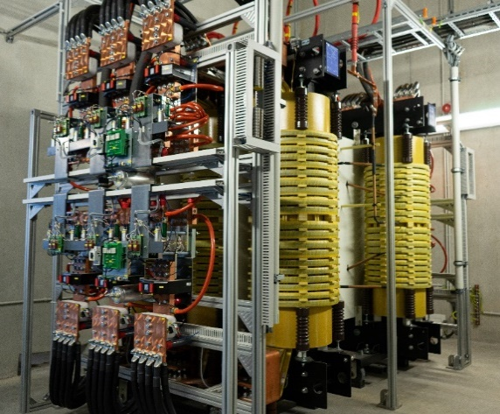
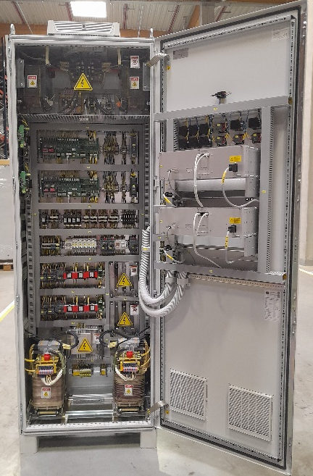
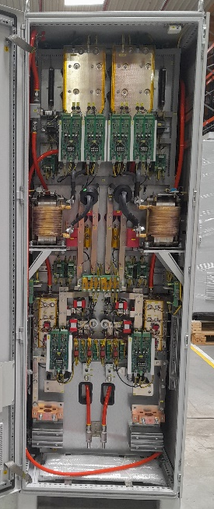
STF: Power Link
Annex building for CRYO & PC
Current Leads 14kA DC (HTS)
Power converters for sc -corrector magnets
amount | 6
Max. Load Current | 300 A
Load Voltage | 50 V / 65 V
Max. ramp rate | 1300 kA/s
Cycle frequency | 2 Hz
Main power converters
amount | 2
Max. Load Current | 20 kA
Load Voltage | 22 V / 66 V
Max. ramp rate | 30 kA/s
Cycle frequency | 1 Hz
Power converters (20kA, 66V)
Trafos for 22 / 66 V operation
Installation and commissioning 2015 – 2017
courtesy V.Plyusnin(GSI-EPS)

Slide 13
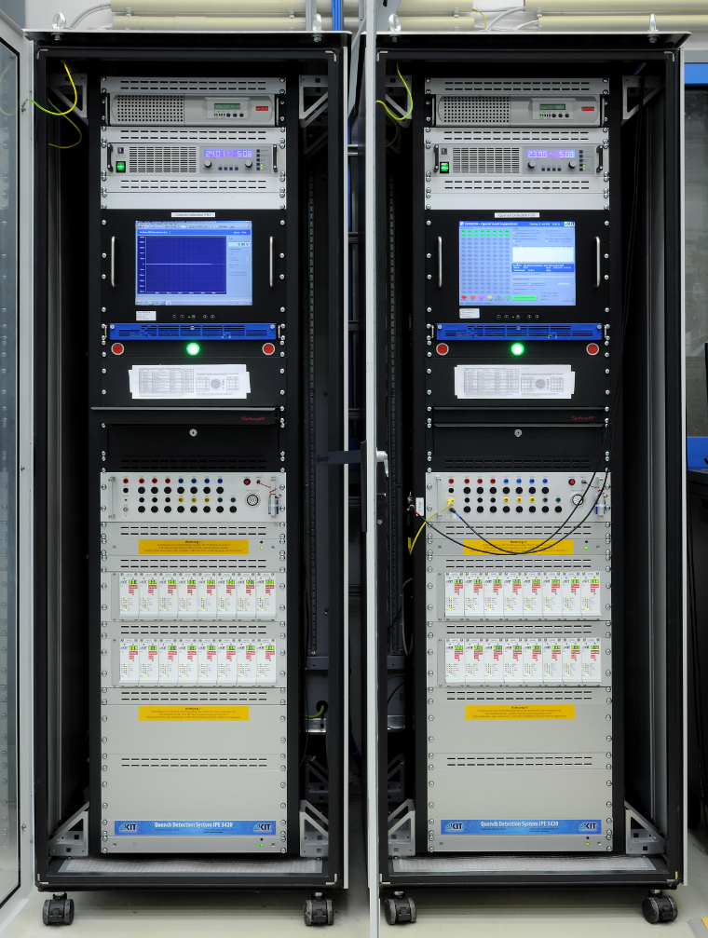
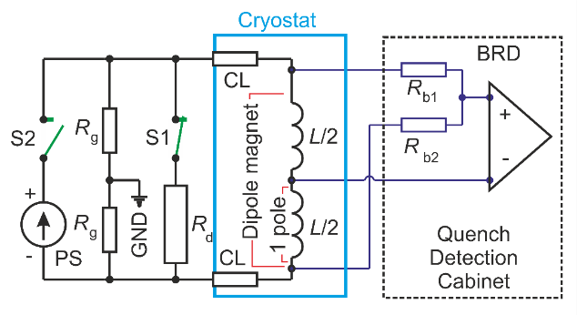
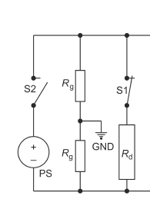
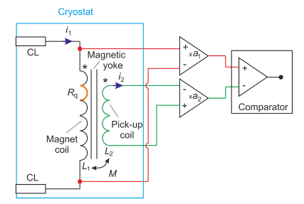
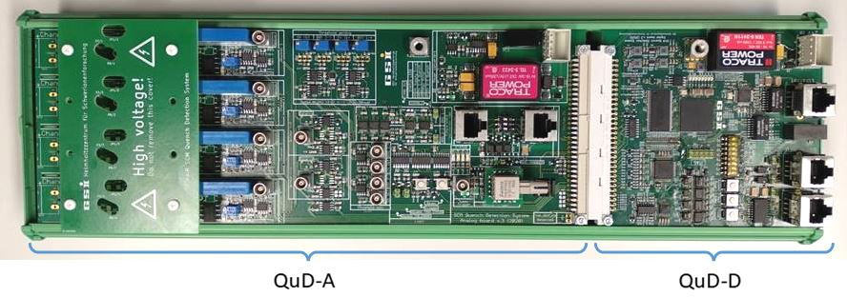
STF: Quench Detection
Main magnets (dipole, quadrupole)
Corrector magnets
Classical balance bridges
Mutual inductance-based Detector (MID)
dipole / quadrupole magnet
available 16 channels per FB
configurable as bridge (e.g. for coils) or single-ended input (e.g. for current leads)
error voltages between 10 and 1250 mV
digital filtering instead of validation time
the balancing potentiometer is digital
analog trigger line to the related power converter
post mortem recording: 4 s before and 4 s after the trigger event
industrial PC (RS-485 communication) and UPS
QuD-A – analogue electronics
QuD-B – digital electronics (FPGA)
one detector per single corrector magnet which monitors the coil incl. bus-bars and local current leads
data streaming and post mortem available
local adjustment of symmetry, balance, offset and threshold
Ethernet communication
remote threshold adjustment
fixed validation time ~ 5 ms
optical and electrical trigger output
Commercial electronics developed by KIT/Germany
FAIR quench
detection system
monitoring & trigger
control & communication
courtesy P. Szwangruber (GSI-SCM)

Slide 14
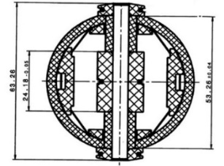
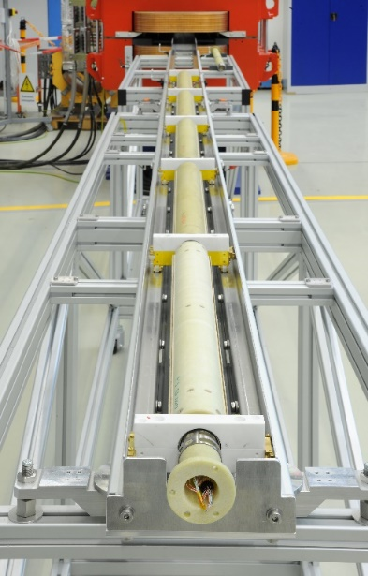
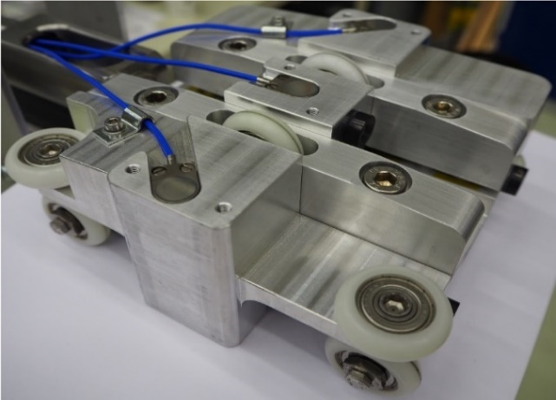
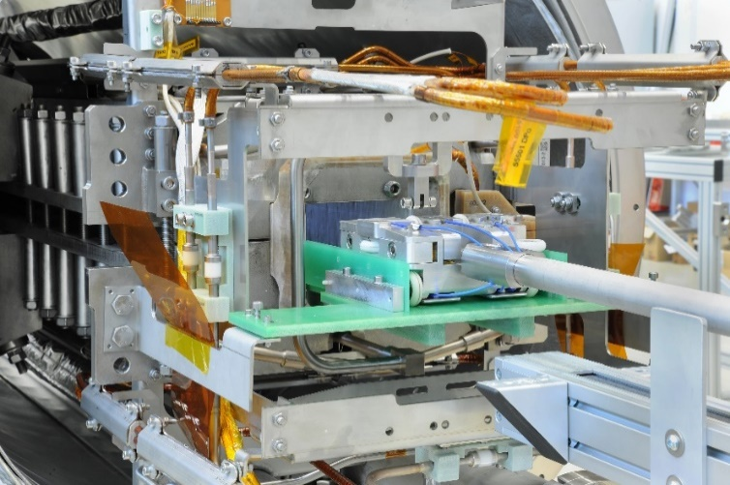
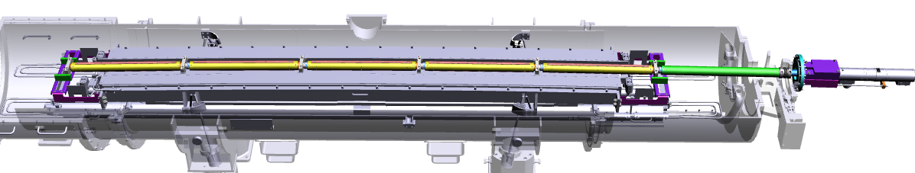
  Special equipment for qualification of sc components
High precision gap height measurements
Magnetic field measurements
measurement of the gap height with precision of 15 µm (absolute), < ± 3 µm (relative)
parallelism of the pole shoes
6 capacitive sensors on the carriage (3 on the top, 3 on the bottom)
linear encoder for reproducible positioning of the carriage along the magnet
sits for retroreflectors → measurement of the yoke’s sag and twist if combined with a laser tracker
rotating coil technique
  integral filed strength
  higher order harmonics
5 measuring heads – tangential coils
3 pick up coils per head, 600 mm length
effective surface 1.67 m²
R_{ref} = 30 mm
rotated ferro-fluidic feedthrough for transferring the rotational motion from the motor unit at atmospheric side to the measuring probe in vacuum @ 4.5 K
63.26
Cross section of the measuring head
4
2
Field measurements in vacuum @ 4.5 K
courtesy G.Otto (GSI)
Measuring probe at the calibration bench
1
3
motor unit
courtesy G.Otto (GSI)
ferro-fluidic feedthrougth
1 – carriage, 2 – capacitive sensors, 3 – wheels,
4 – holder for spherically mounted retroreflectors.
Insertion of the measuring carriage in to the
gap of the SIS100 dipole.
The measuring probe is designed and built in collaboration with CERN collaboration agreement K1727/DG
1 carriage, 2 capacitive sensors, 3 wheels,
4 holder for spherically mounted retroreflectors.
Insertion of the meassuring carriage in to the gap of the SIS100 dipole.

Slide 15
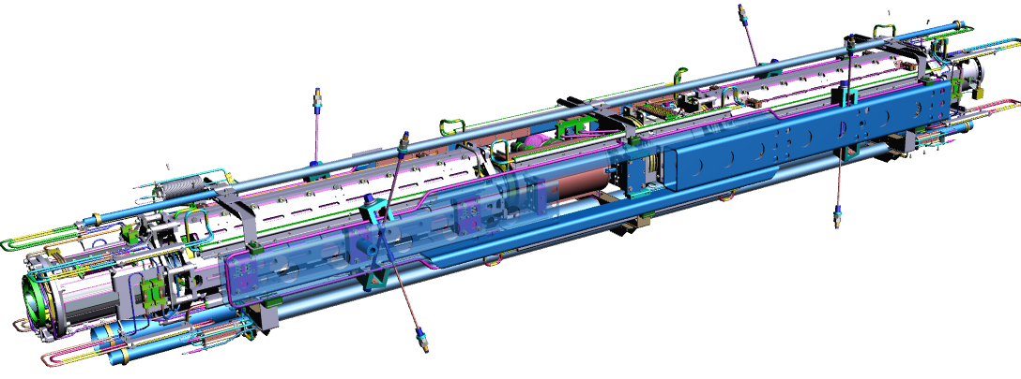
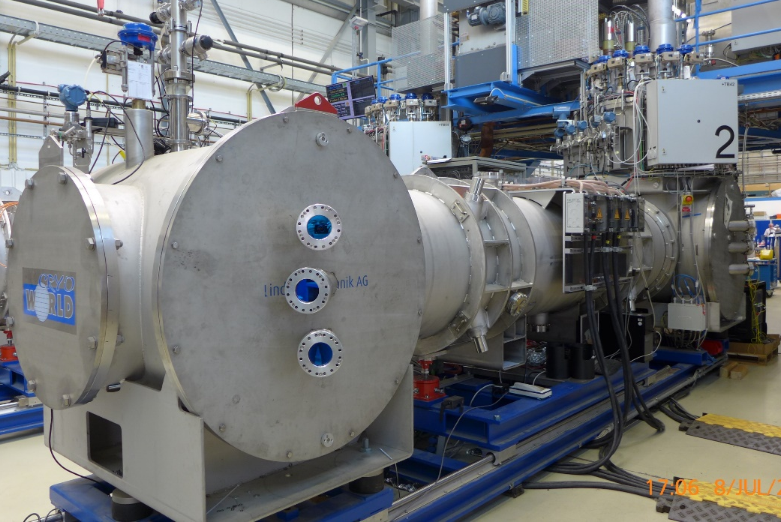
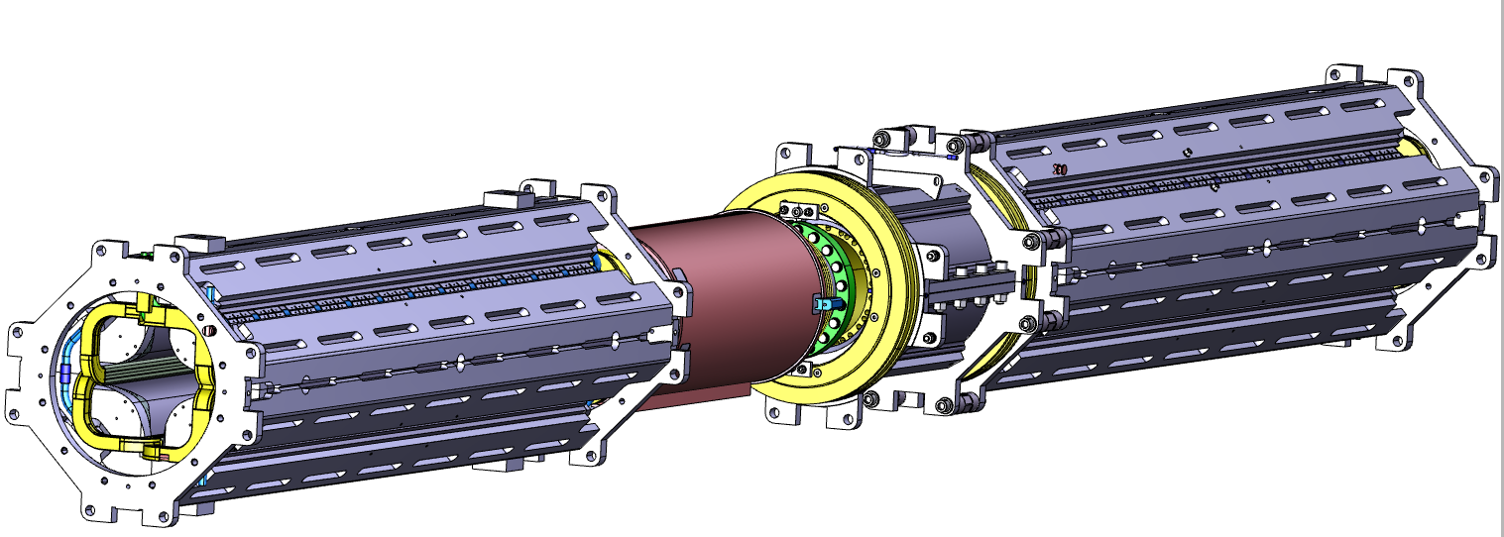
  Special equipment for qualification of sc components
Measurements of the cold mass position stability
quad. focus.
cryo collimator
steerer
Surveying of the cold mass of SIS100 Quadrupole Doublet Module during thermal cycles (300 K → 4 K → 300 K)
7 view ports - DN100 flanges with coated optical glasses (ᴓ110mm ±5mm, thickness 15mm ±0,2mm, parallelism <0,01mm)
1.5’’ spherically mounted retroreflectors (Metrology Works) + pin nests
Laser Tracker - Leica AT40x or AT960/930
quad defocus.
suspension system
5158 mm
sextupole
Cold mass of the Quadrupole Doublet Module (QDM)
Z
Beam
5
X
6
B
1
8
Y
2
A
7
4
3
Quadrupole module for SIS100 at a test bench
Reference points on the cold mass of the Quadrupole Doublet Module (QDM)

Slide 16
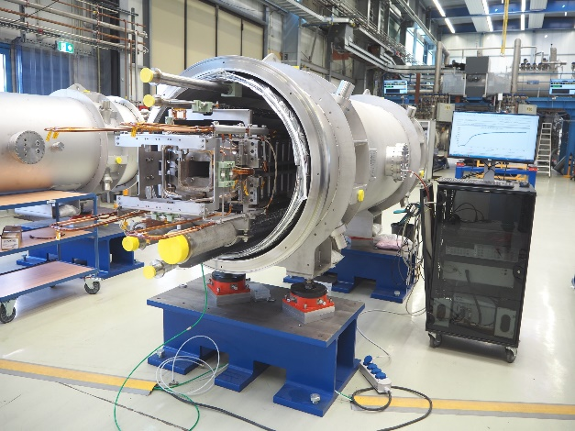
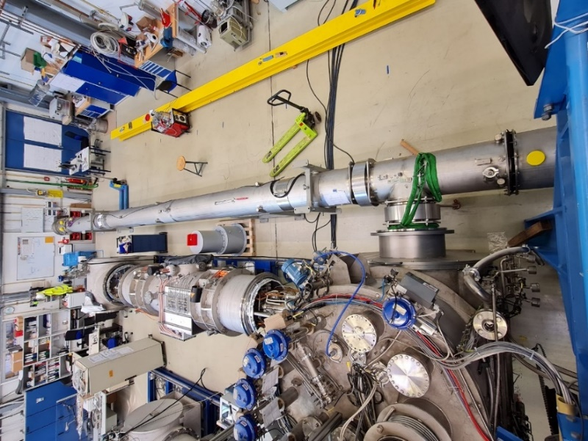
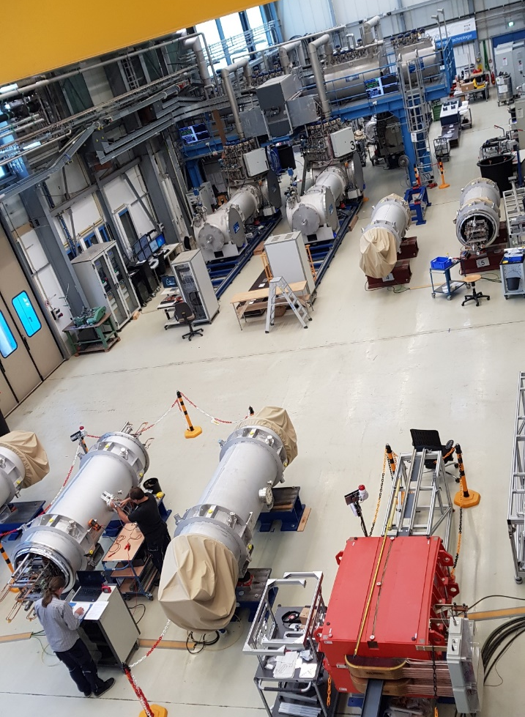
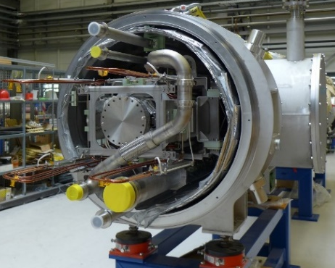
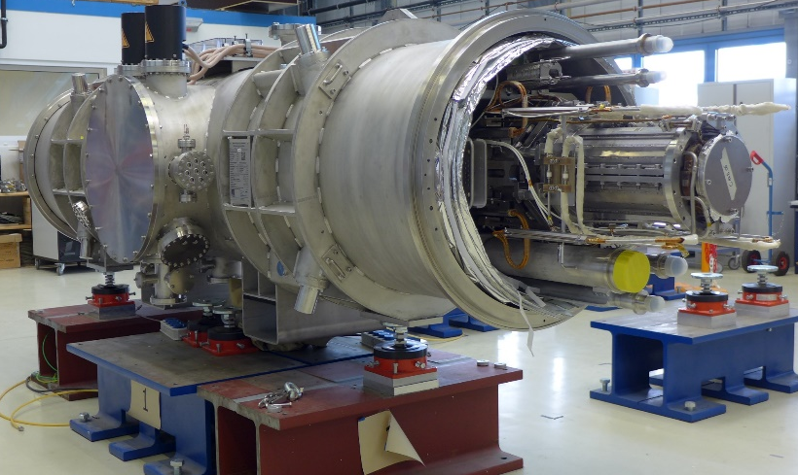
SIS100 series components testing at STF
Dipole modules - 110 pcs. Q4/2017- Q2/2021
ByPass Line 3 pcs. 2018-2021
STF during the pick of operation with SIS100 dipole modules
courtesy B.Streicher (GSI-CRY)
Missing dipole 12 pcs. Q3/2021- Q3/2022
QDMs: FoS QDM + # of QDMs Q4/2019 - ...
courtesy C. Schröder (GSI-CRY)

Slide 17
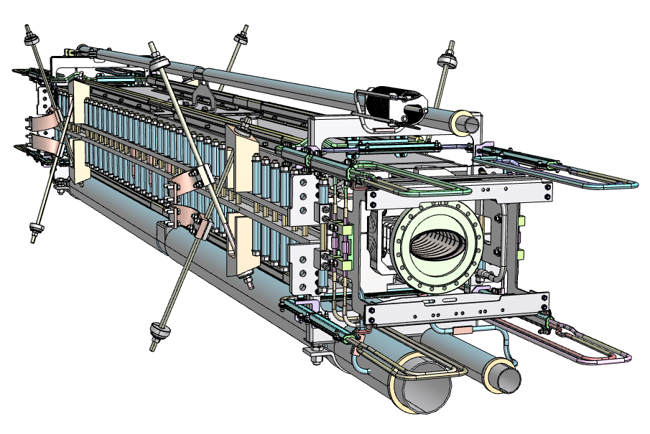
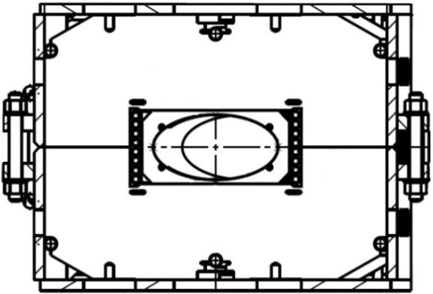
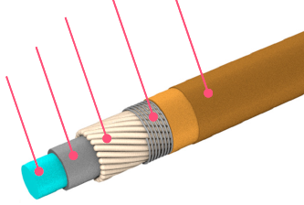
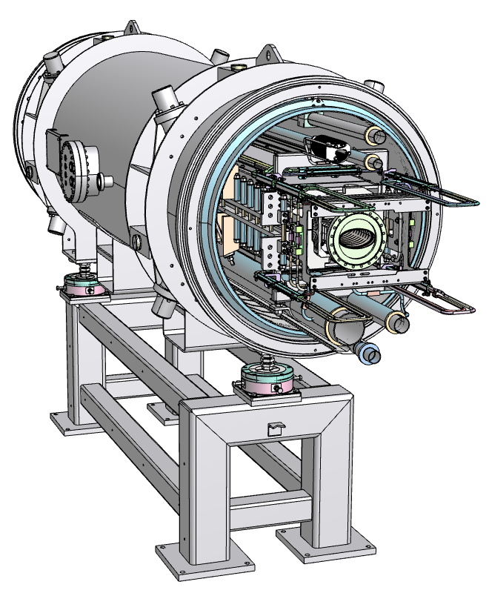
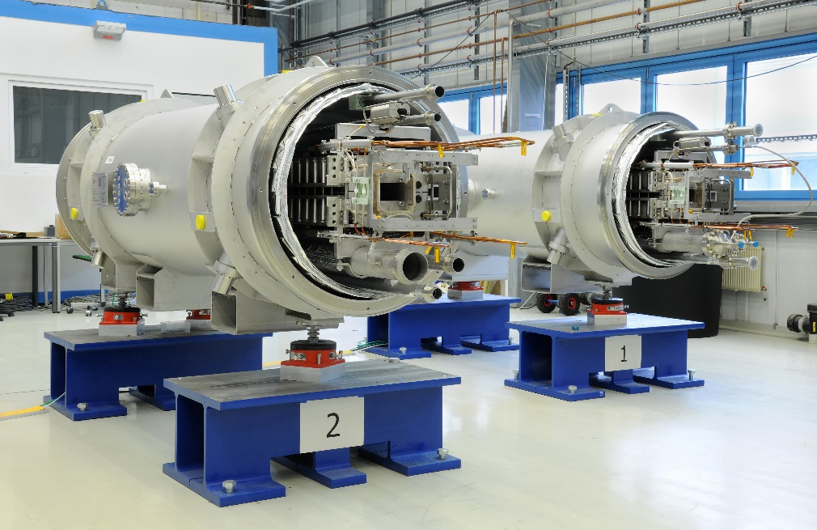
SIS100 Dipole Magnets: Magnet Design
Magnet cross section
sc-cable Nuclotron type
Main principles
Super ferric Window-frame, curved SC coil – 4 turn per pole Low AC loss Nuclotron-type cable (NbTi with CuMn inter-filament matrix) Cooling with 2-phase He (forced flow)
fixation wire CrNi
sc wire NbTi
Kapton
266 mm
68
cooling tube
2 phase He
140.1 mm
≈ 3000 mm
Cold mass
with beam chamber
350 mm
Main parameters
Effective length L_{eff} | m | 3.062
Usable aperture | mm x mm | 60 x 120
Bending angle | deg. | 1 1/3
Bending radius | m | 52.632
Nominal field | T | 1.9
Field homogeneity ∆B/B_{main} x10⁴ | units | < ± 6
Ramp rate | T/s | 4 @1Hz
Number of the magnets in SIS100 |  | 108 + 1
~ 260 mm
Cryo-dipole module
courtesy G.Otto (GSI)

Slide 18




SIS100 Dipole Magnets: Site Acceptance Tests (SAT)
SAT sequence
110 Dipole tested Sept. 2017 – Mai 2021
Operators – 1.5 shift 5 days a week
CRYO 24/7
Continuous operation also during pandemic
Incoming tests @ 300 K
  visual inspection
  geometry
  instrumentation
  electrical insulation
  pressure, leaks and mass flow rate
Mounting on the test bench
Cool down
Tests @ 4.5 K
  electrical integrity
  magnet training
  inductance
  magnetic field
  static and AC losses
warming up and dismounting
Outgoing tests @ 300 K
~ 30 parameters/SAT
~ 100 steps/SAT
SAT duration ~ 5 weeks/module
series testing completed

Slide 19

SIS100 Series Dipole Magnets: Training Performance
Current | [kA]
Nominal (I_{n}) | 13.2
Acceptance criterion (110 % I_{n}) | 14.5
Power converter limit | 16.9
Theoretical cable limit | 17.8
nominal
current
acceptance
criterion
power
converter
limit
Excellent quench performance: 80%, 97%, 99% out of 111 tested magnets exceeded the I_{n} at the 1st, 2nd and 3rd training quench, respectively
high mechanical stability of the coil: during training, often the quench origin was migrating from lower to upper half-coil
All tested magnets exceeded the 110% I_{n} within the training campaign (1-9 successive quenches)
65% of tested magnets withstood an applied current of 16.9 kA (power converter interlock) without quenching
No significant degradation between successive quenches
Very stable DC and AC (2-28 kA/s) operation of the all tested magnets
courtesy P. Szwangruber (GSI-SCM)

Slide 20








SIS100 Dipole Magnets: Test Results
Integral field
Field homogeneity
  acceptance criteria:
  measured on 90 magnets:
  ~ 20 times better than required
acceptance criteria:
$${∆BL}/{BL}≤ {4×10}^{−3}$$
with $BL= \int{B\left(l\right)dl}$
$\sum_{n}{C_{n}/B_{1}}$ < ± 6 units @ $R_{ref}$ = 30mm
$B\left(z=x+iy\right)=\sum_{n}{C_{n}{\left(\frac{z}{R_{ref}}\right)}^{n−1}}$
$C_{n}{=B}_{n}+{iA}_{n}$
$${∆BL}/{BL}=2.3×{10}^{−4}$$
courtesy F. Kaether (GSI-SCM)

Slide 21

The Team for SIS100 Dipole Testing
Testing SIS100 Series Dipole completed Mai 2021
GSI departments
SCM, CRY, QUA, TRI, EN-MG, EPS, VAC, BB, RHV
Support on demand – MEWE, KB, ENG

Slide 22

Quadrupole Doublet Modules (QDM) for SIS100
Main design principles
Quadrupole Unit
QDM - Assembly of 2 Quadrupole units, UHV, beam diagnostic components on one commongirder in a common cryostat
sc-bus bars
quad + steerer
quad focus.
Quadrupole unit - Assembly of one quadrupole magnet + 1 or 2 corrector magnets
steerer
cryo collimator
Cold mass of QDM
quad defocus.
Quadrupole magnet – superferric, 27.7 T/m²
Chromaticity sexstupole – superferric, 232 T/m³
chr. sextupole
Steering magnet – cos θ dipoles, nested
suspension system
Multipole correctors – cos θ, nested: B2, A3, B4
5158 mm
Cooling with 2-phase He (forced flow)
Nuclotron type sc- cable
QDM
Special magnets:
low current quad (inj., extr.)
γ_{t}-jump quad

Slide 23



Quadrupole Doublet Modules for SIS100
Arc section modules (5 types)
54 modules
part of the SIS100 arc sections
Straight section modules (two types)
17 modules
stand alone module in between two warm sections of SIS100
Arc termination modules (two types)
10 modules
US- / DS- termination of an arc section of SIS100
Injection, Extraction modules
2 modules
US-, DS- terminations of the sector 5 in SIS100

Slide 24

Quadrupole Doublet Modules for SIS100
Production and Testing strategie for QD-units and QDMs
QD unit production and testing JINR, Dubna, RU
QDM components besides magnets:
  cryostat QingdaoBachmann, CN
  girder BilfingerNoell, DE
  beam chamber (series) RI, DE
  cryocatcher Pfeiffer Vacuum, DE
  BPM Kyocera (Friatec), DE
  LCLs ILK, DE
  cryopump ILK, DE
  roughing CWT Pfeifer Vacuum, DE
QDM integration BilfingerNoell, DE
QDM testing INFN Salerno, IT
GSI, DE
courtesy C. Roux (GSI-SCM)

Slide 25


Testing of First of Series QDM for SIS100
Delivery to STF November 2019
Extensive tests for design evaluation
position stability of the cold mass
functionality of HTS Local Current Leads
hydraulic resistance and cooling of the module
UHV performance @ 4K
Site Acceptance tests
Instrumentation check
Electrical integrity of current circuits
Integrity of installed instrumentation
Alignment and survey of the cold mass
Leak tightnes:
  He-headers
  UHV system
Magnet training
Powering of the main quadrupole and corrector magnets
Static and dynamic heat load
courtesy G.Otto (GSI)
6 thermal cycles performed over 8 months
courtesy C. Schröder (GSI-CRY)

Slide 26



FoS QDM: Position stability of the cold mass in thermal cycles
Beam
5
Z
X
6
B
8
1
Y
2
A
7
4
3
Comparison cold – cold measurements
Comparison warm – cold measurements
Reproducibility of the cold mass position @ 4K better 0.1 mm
Displacement of the cold mass 4K vs. 300K negligible
courtesy P. Aguar Bartolome (GSI-SCM)

Slide 27




FoS QDM: Quench Study
Training during cold testing FoS QDM
Training without quenching:
  QD, F2, Chrom.Sextup (CV) and Steerer Vertical (SV)
Stable operation of QD, F2, and CV at nominal current and ramp rates
SV successfully operated at nominal current and ramp rates when powered individually
SH - operation at nominal current at reqired ramp rates not possible due to quenching
Simultaneous operation of SH and SV critical, coils causes quenching
Ultimate current
Nominal current
FoS SH
Training during cold testing of single units
Studies on Steerer coil performed.
Reason for quenching identified and resolved.
Mechanical reinforcement of steerer coil heads was improved for series modules
courtesy JINR Dubna, P. Aguar Bartolome (GSI-SCM)
Quench history QD magnet
Quench history F2 magnet
Quench history Steerer magnet

Slide 28



FoS QDM: Evaluation of UHV system @ 4K
Power cycle for UHV evaluation
Magnet | Ramp Rate [A/s] | I_{mn} / $I_{max}$ [A] | $t_{cycle}$ [s]
F2 / QD | 17000 / -13300 | 1300 / 7700 | 0.9913
SV | ±515 | 10 / 250 | 0.999
CV | ±550 | 10 / 250 | 1.007
beam direction
Temperature of the UHV components and pressure in the UHV system during long term ramping
Rest gas spectrum for UHV system during long tearm ramping
T_{max} < 12 K no desorption of H₂ from UHV chamber walls
No UHV pressure increase during magnet ramping
No He detected No cold leaks in UHV
courtesy P. Aguar Bartolome (GSI-SCM)

Slide 29

FoS QDM: Summary of the testing campaign at GSI
Conclusion:
    FoS QDM 2.5 was subjected to an intense test program over 8 months and 6 thermal cycles
    The design was proven to be suitable (cooling time, stability, heat load, vacuum…)
    non conformities detected during testing have been subjected for comprehensive analysis. Reason of faults understood, mitigation for the series production done.
    Series production of QDMs released
Next steps:
    FoS QDM 2.5 was sent to the INFN (Salerno) for commisioning of the new test facility for series QDM testing - THOR
    Part of the SIS100 String test
Oct. 2020 FoS QDM left GSI to THOR
courtesy P. Aguar Bartolome (GSI-SCM)

Slide 30


Testing of series QDMs at STF
Start of testing October 2021
Test program
Extended tests for further design evaluation. Impact of thermal cycling on:
    cold mass stability
    UHV system
    Local Current Leads
Extended SAT program (including power tests on main magnets)
QDMs and QD units on the preparation bench
5 QDMs received
3 QDMs cold tested, 4th under cold tests
3 QDMs need reworking due to non conformities → send back to the integrator company.
Common issues for reworking - electrical insulation of LCLs. Reason understood mitigation measures implemented.
Quadrupole module for SIS100 at a test bench

Slide 31





Testing of Missing Dipole Modules (MDMs) at STF
Missing Dipole Module
beam pipe
sc busbar
Modules without magnetic system
12 modules in SIS100
Location – first and last IO cell of an arc section
Man functions of MDMs
Continuity
of the cryostat system of the SIS100 arc sections
of UHV of the beam pipe system,
of SC electrical supply systems (Bus Bars) for main dipole and quadrupole circuits
of cooling circuit in the SIS100 arc sections
provide spill-valves for over-pressure safety.
Connecting the 4K-He-supply line for beam pipe cooling with the common return line.
cold mass of MDM
MDM without overpressure valves
MDM with overpressure valves
He header
Testing campaign Aug. 2021 – Jul. 2022
Modules successfully tested and accepted for installation in SIS100

Slide 32

SIS100 String Test: Work in Progress at STF
Motivation:
Objectives:
verification of different interfaces and interconnections regarding fitting and mountability
preparation for installation, commissioning and operation of SIS100
preparation of work instructions for the machine installation (cooperation of SCM, CRY, UHV, TRI, ENG, TEL,FSB, approval through WPLs, SPL SIS100)
choosing appropriate tools for installation in the tunnel
mechanical stability of interconnections
insulation vacuum stability and performance of the UHV components
cooling down behaviour, functionality of parallel cooling channels and local cryo-components
electrical issues – cross-talk between live circuits, degradation of insulation resistance
testing of new quench detectors and cabling
testing of the slow control system

Slide 33


SIS100 String Test:
String layout at STF
PC1 (66V)
PC2 (22V)
transport gate
FB 1
FB2
DM
End
box
Beam direction
Intercon-nection box
FB 3
BPL
FB 4
End Box STF
End box*
DM #11
(with VC)
Transfer Line
FoS QDM 2.5
EC
QDM
DM
DM
DM #26
DM #16
End box 3
FoS BPL
End Cap 1.E
~19,4 m
Configuration of the modules identical to the SIS100 tunnel

Slide 34




SIS100 String Test:
Most critical interconnections
Transfer line, new endbox
courtesy C. Schröder (GSI-CRY)
courtesy C. Schröder (GSI-CRY)
Installation status 2021 – BPL connected to the Feed box via transfer line and SIS100 Dipole
courtesy C. Schröder (GSI-CRY)
Installation status 2023 – positioning of the components on the blue line, check for interface fitting, evaluation of tooling for different installation steps

Slide 35
Required upgrade of the GSI test facility for testing of SIS100 Quadrupole Units
Upcoming challenges at STF
MF-MS for quadrupole and corrector qualifying
  Rotating coil probe:
  integral field Gradient
  higher order harmonics
SSW / VSW - magnetic axis of main quadrupoles, roll angle
Calibration bench – available at NC magnets
Anticryostat
Test cryostat - if usage of the standard QDM cryostat not feasible
Preparation / mounting benches - if installation of QD units into the test cryostat at STF

Slide 36
Thank you for your attention !

