Slide 1
FNAL test facility
Superconducting Magnet Test Facility Workshop
Apr 24 – 28, 2023, Paestum
Maria Baldini, C. Boffo, G. Chlachidze, S. Feher, J. Di Marco, S. Krave, S. Stoynev

Slide 2
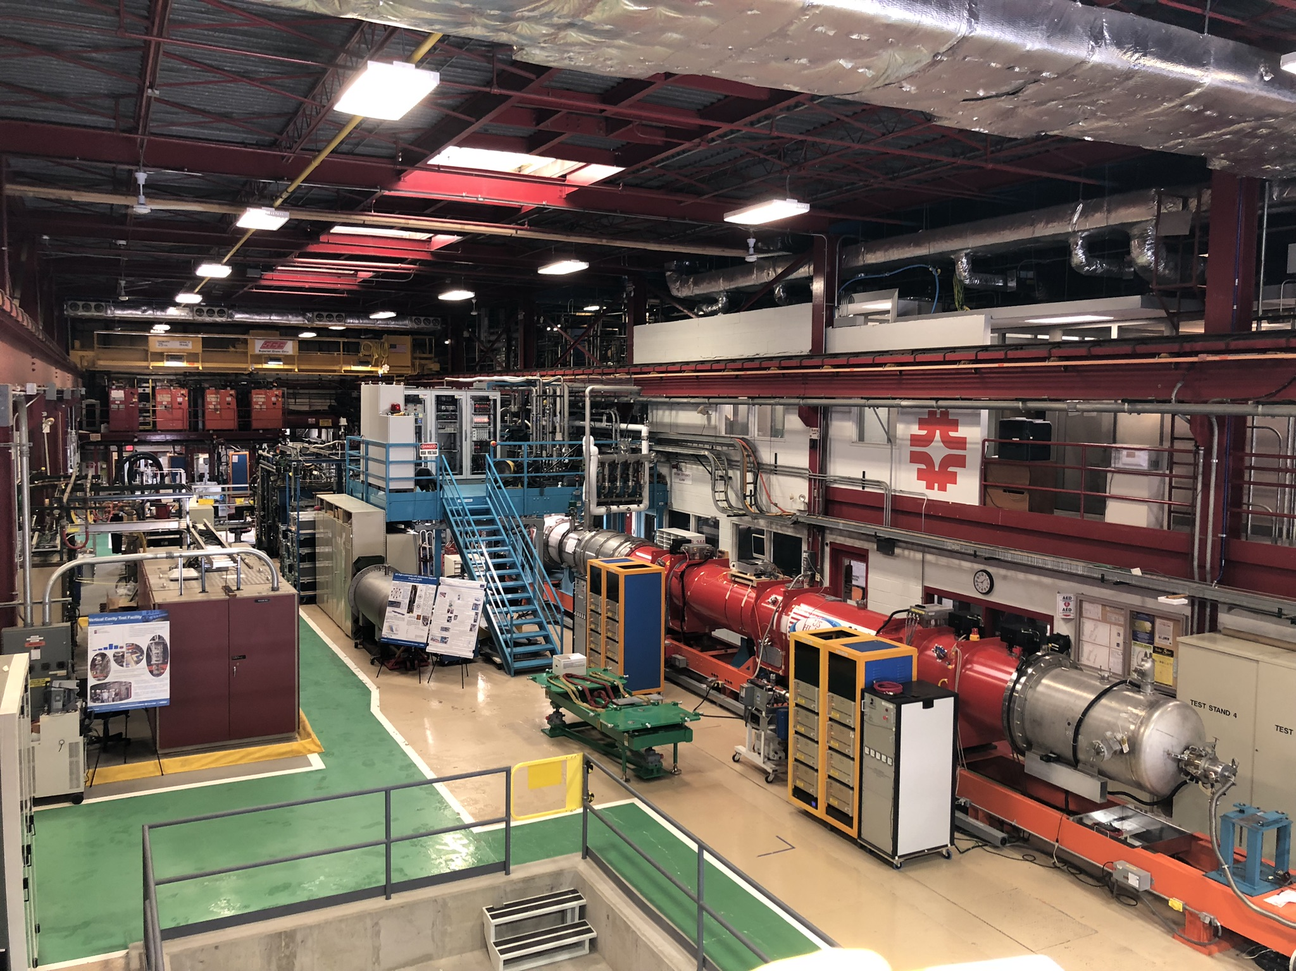
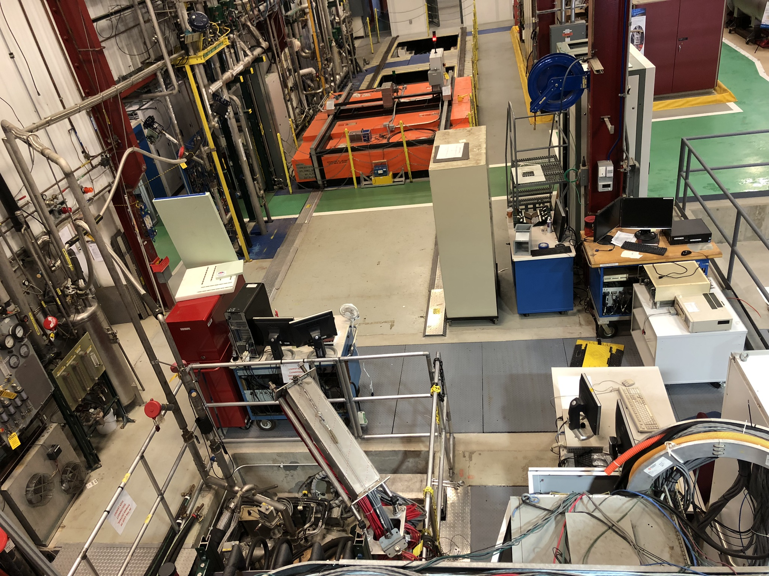
Test facility overview at FNAL
Vertical magnet test facility (VMTF): 4 m deep, 0.65 m diameter
Stand 3 for 1 m long, 0.4 m diameter magnets and testing HTS current leads up to 10 kA
3 cryostats at VCTF, each 4 m deep, 0.7 m diameter (used for cavity testing)
Stand 4: One horizontal cryostat
Stand 7: conduction cooled low cost facility
Stand 3
Stand 4
VCTF
HF-VMTF
Stand 7
Lifting and Handling tools:
Two 25-top cranes used in synchronized mode.
two 10-ton cranes
VMTF

Slide 3
Outline
Vertical magnet test facility (VMTF): diagnostic improvements
Stand 7
Stand 4

Slide 4
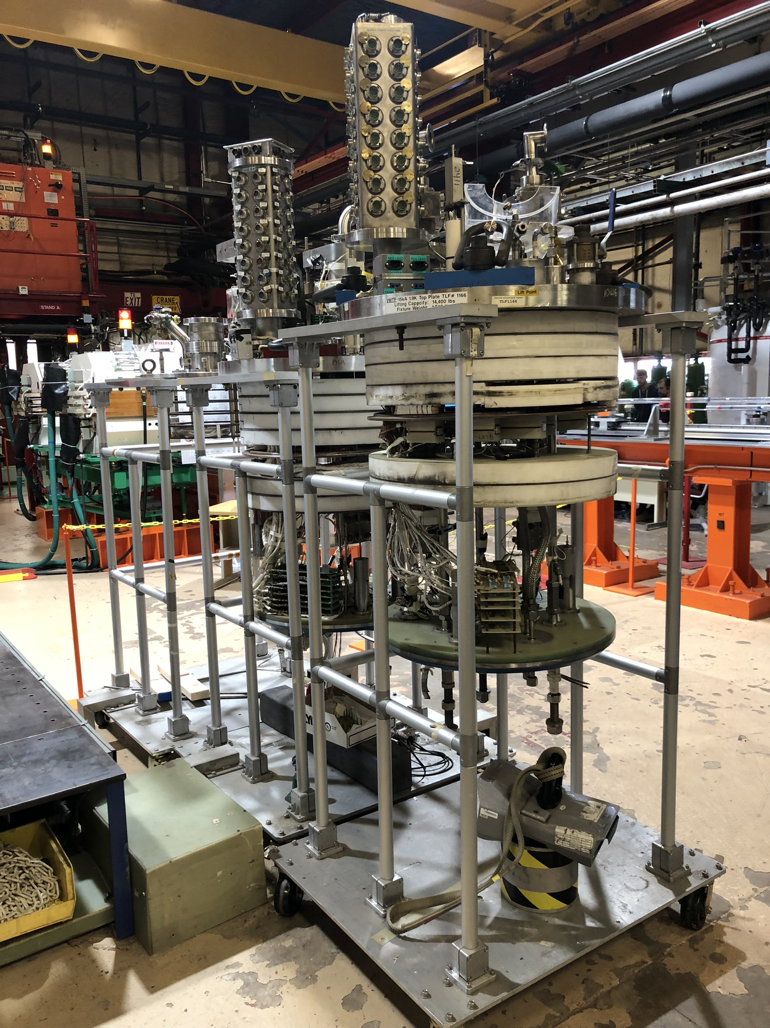
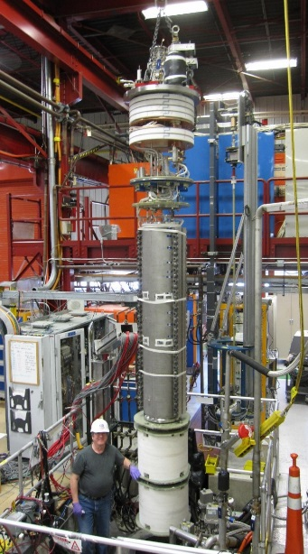
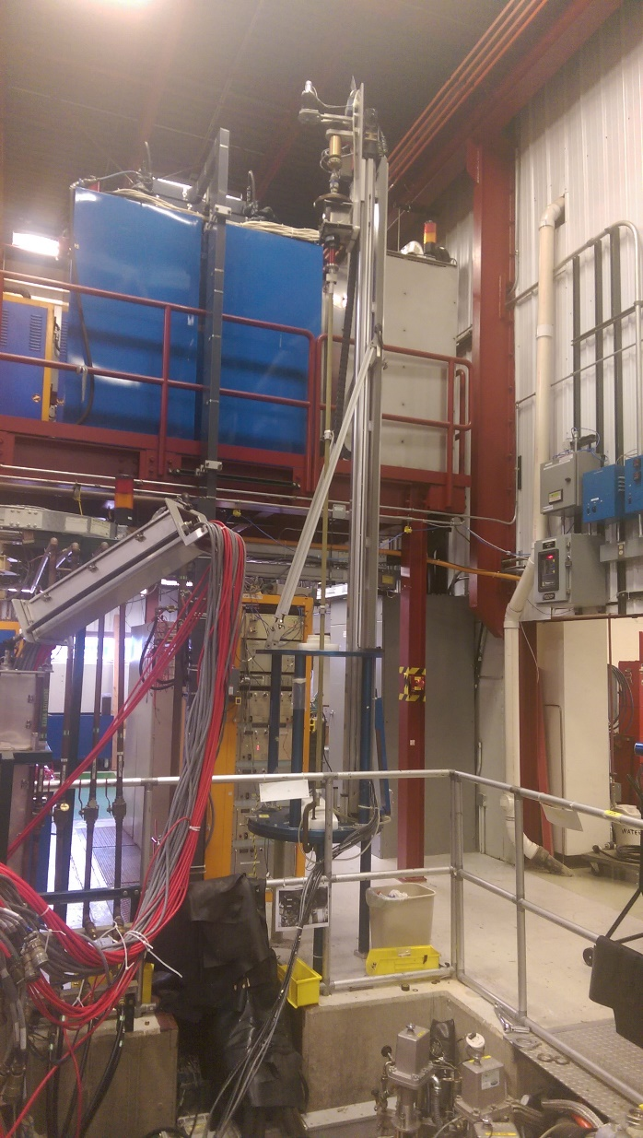
Vertical magnet test facility: VMTF
Operating temperature: 1.8-4.5 K
15000 A 30000 A
top heads
Cooling phases:
300 to 4.5 K
4.5 to 1.8 K
N. Of signals:
104: voltage taps (QA)
63: strain gauges
16: strip heaters
13: QA
6: temperature
Detection system: AQD, DQD and a 3rd one upgraded system FPGA based
Probe for magnetic measurements

Slide 5
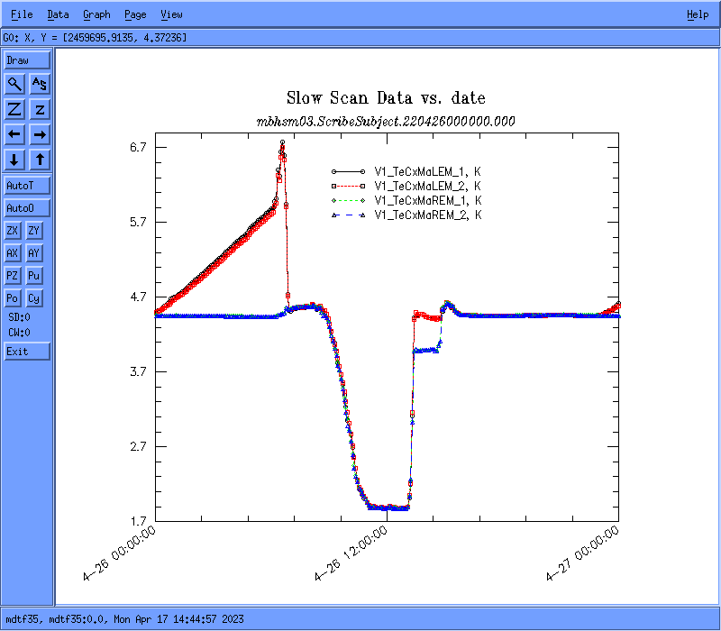
Data acquisition system
Quench characterization: 8 kHz 1 sec before and after the quench
FVT (fixed VT), CVT (configurable VT) signals: strain gauge s/sample
Slow scan min/sample
AUP short model quadrupole: 1 hr to cold down to 1.9 K after quench

Slide 6
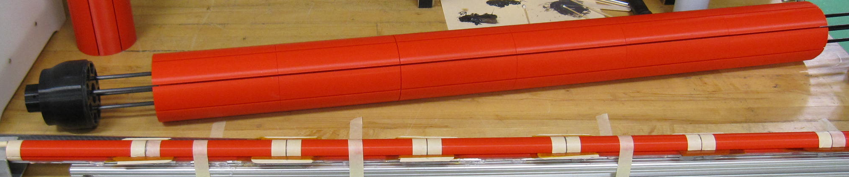
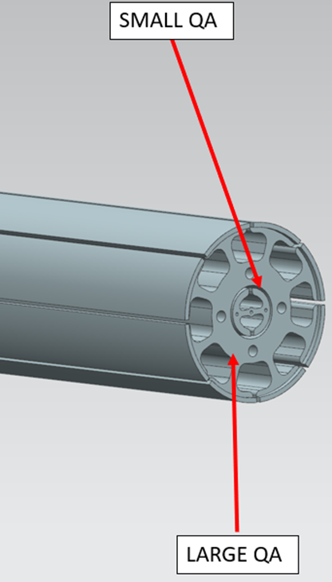
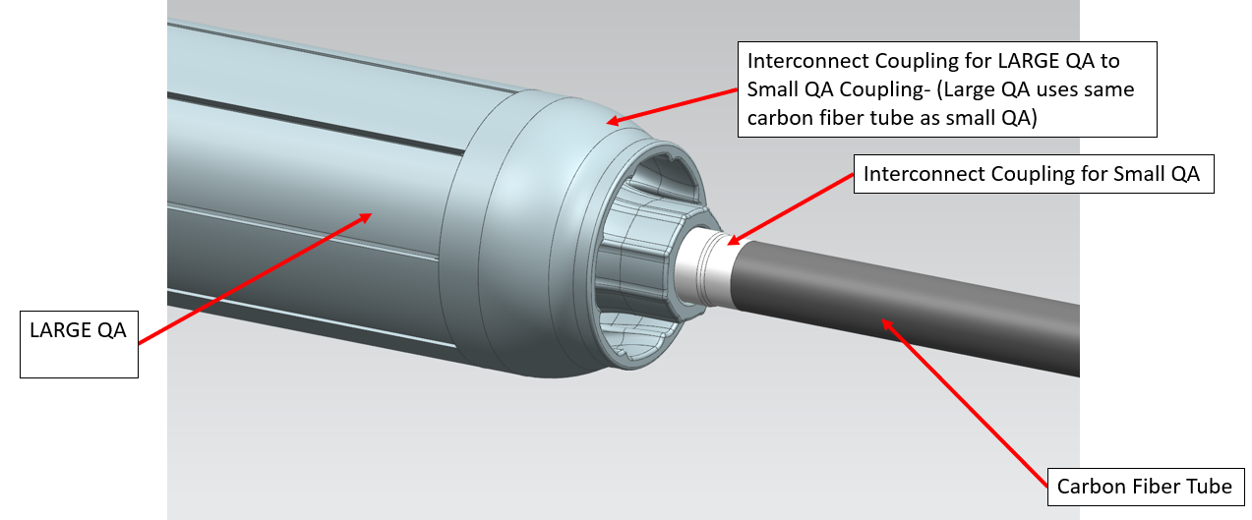
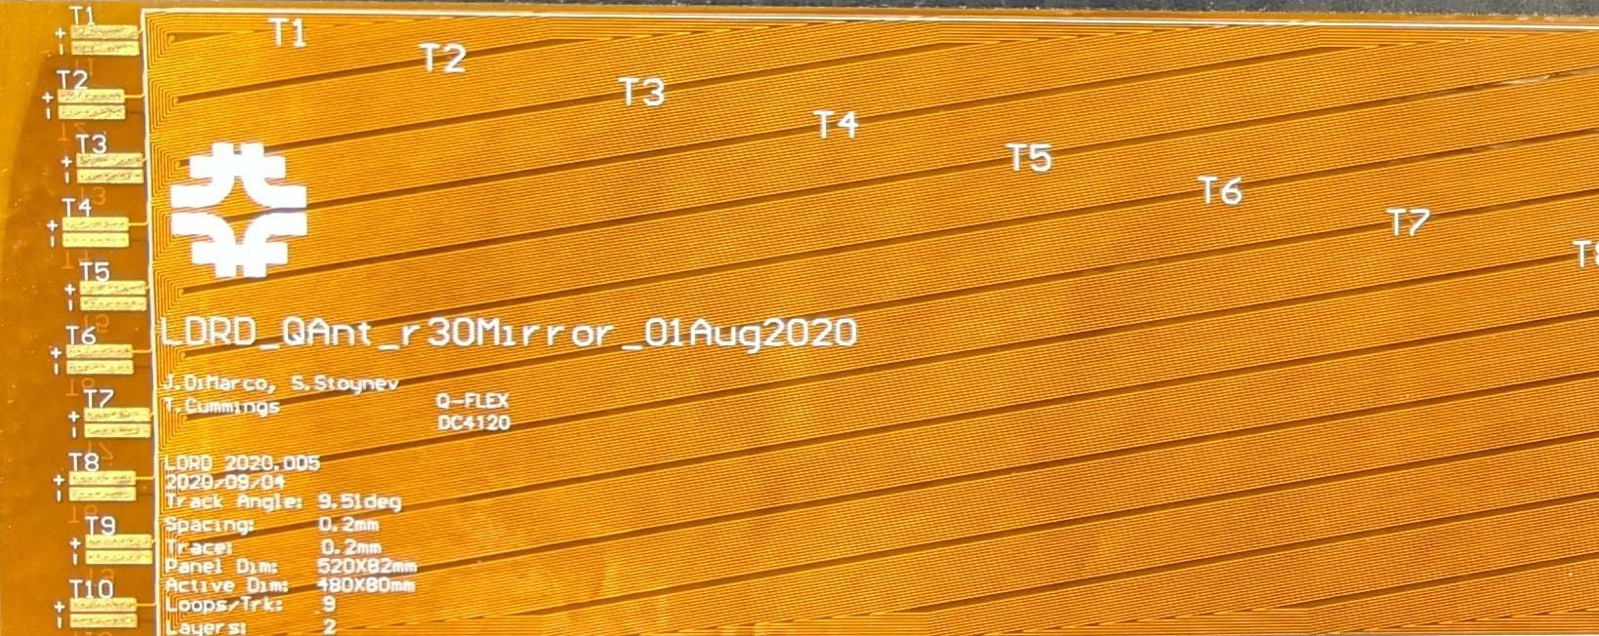
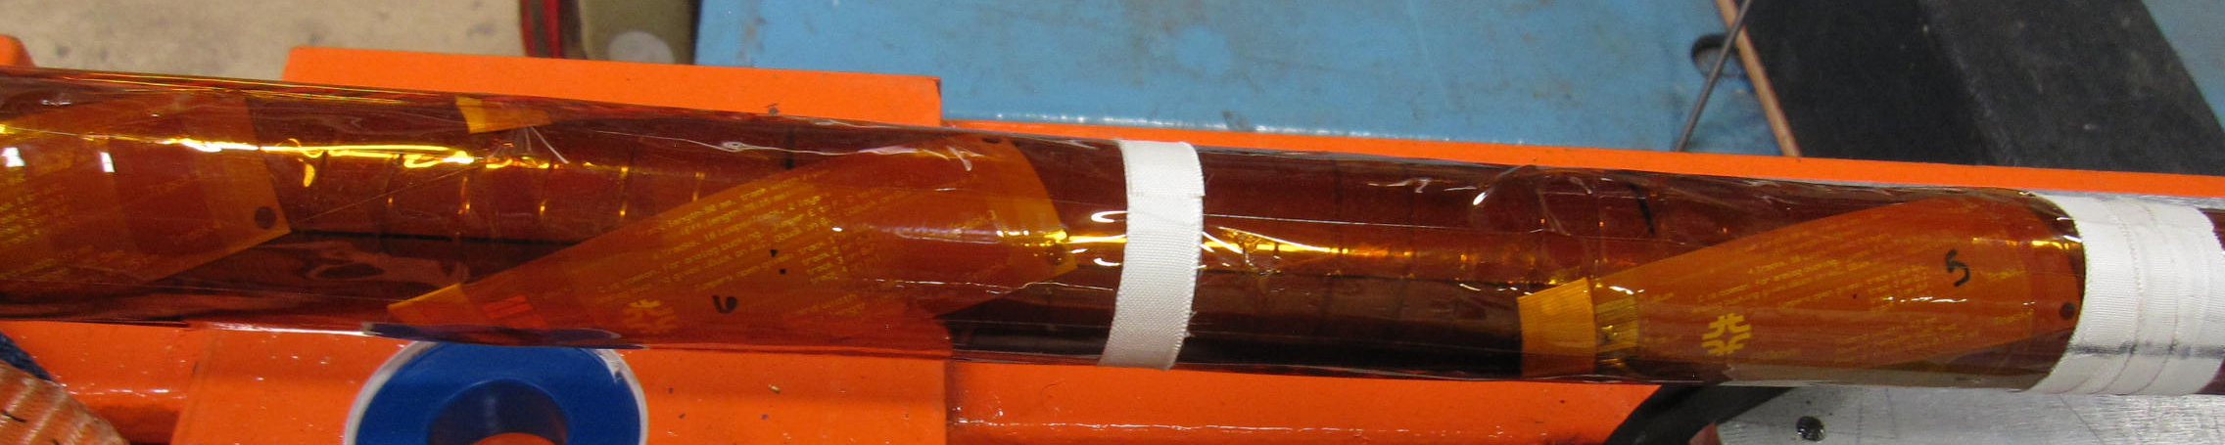
VMTF diagnostic improvements: quench antenna (J. Di Marco, S. Stoynev)
SMALL QA
INTERCONNECT COUPLING FOR LARGE QA TO SMALL QA COUPLING
A dual-diameter warm bore QA support was developed to allow flex-QA arrays to be positioned precisely and channels neatly taken out of the bore. Fine-grained arrays of flex-QA were fabricated.
Sample rate 100 KHz
A “warm” test stand has been also fabricated to replicate/model cold flex antenna data.
CARBON FIBER TUBE
LARGE QA
Details on Joe DiMarco talk on April 28

Slide 7
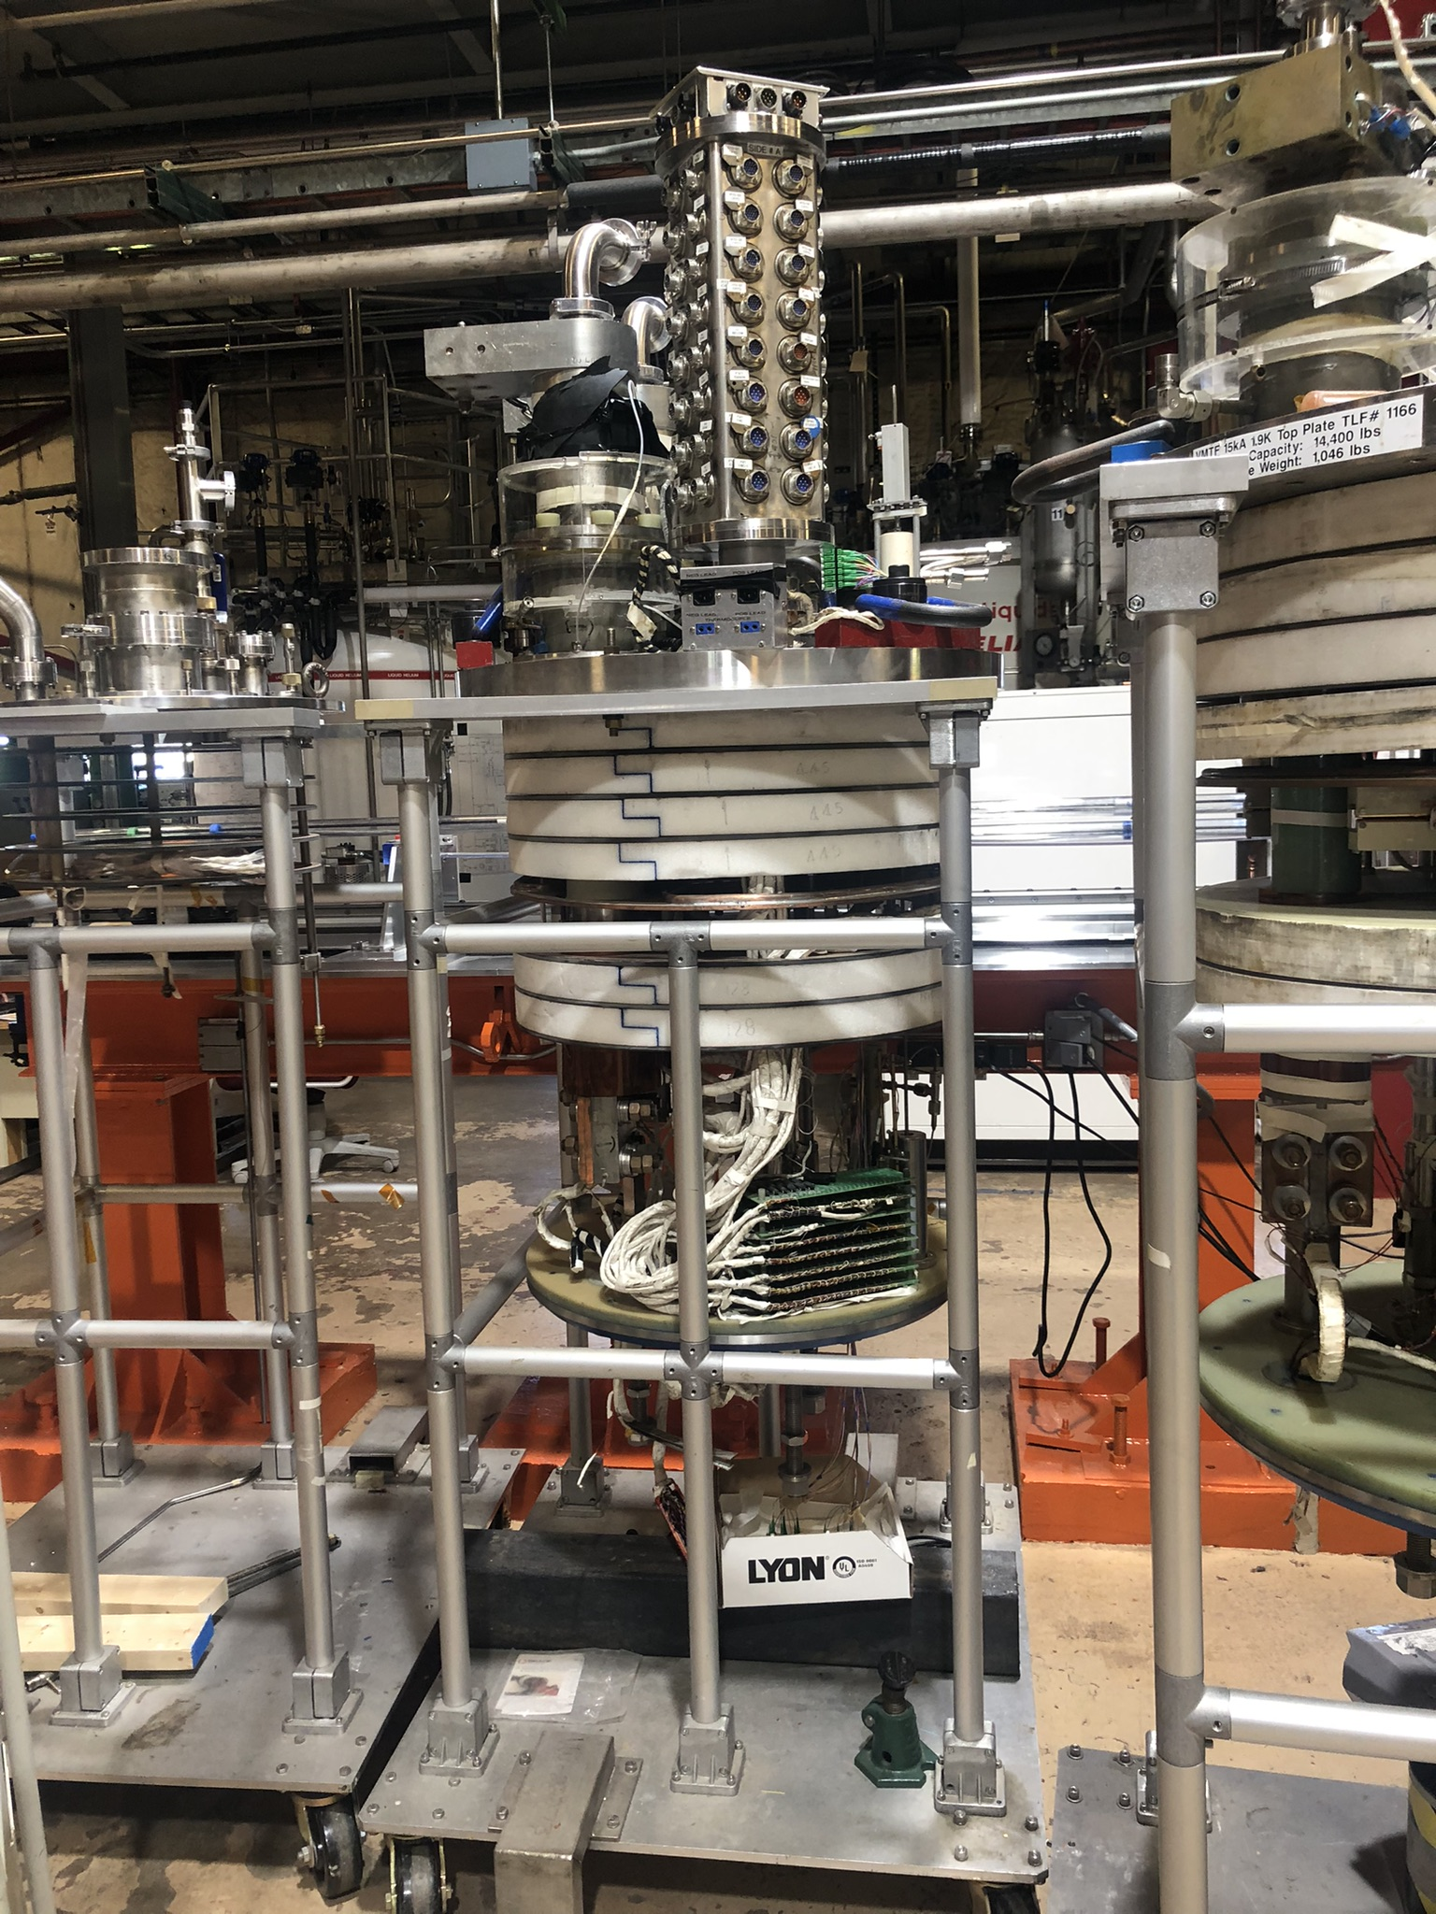
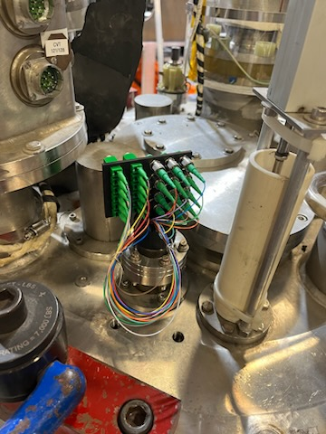
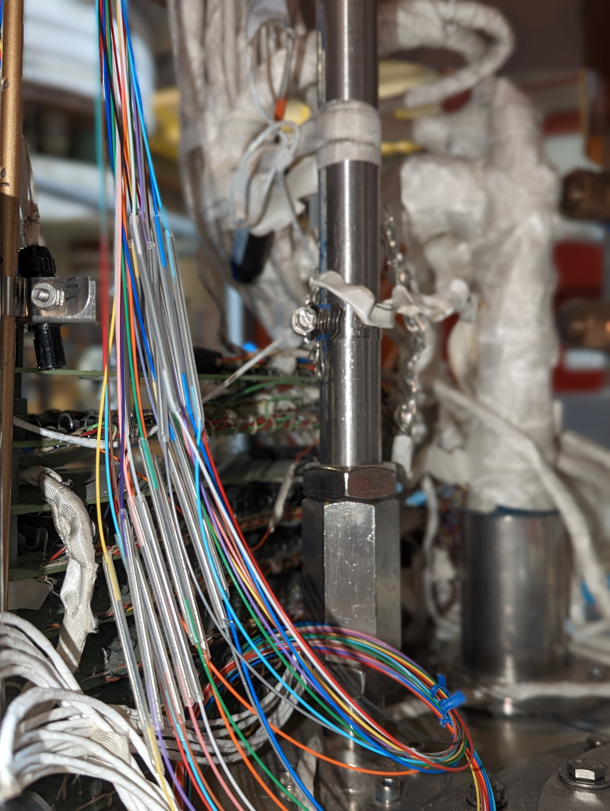
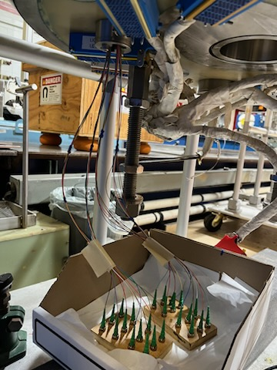
VMTF diagnostic improvements: Fiber optic diagnostic (M. Baldini, S. Krave)
Distributed and FBG fibers:
2 interrogators (16 channels)
FBG up to 1KHz
Rayleigh up to 250Hz
Implemented solution: use of pigtail cables spliced below the lambda plate
Details on M. Baldini and S. Krave talks on April 27

Slide 8
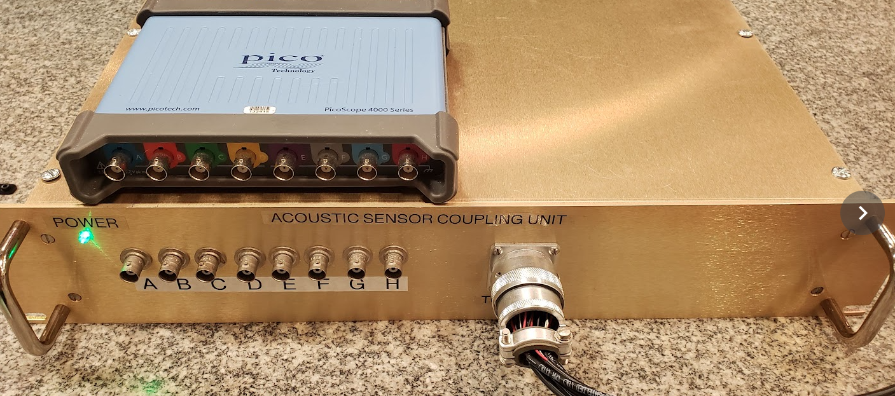
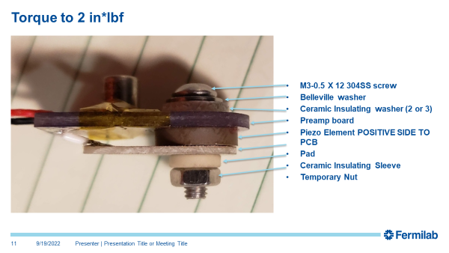
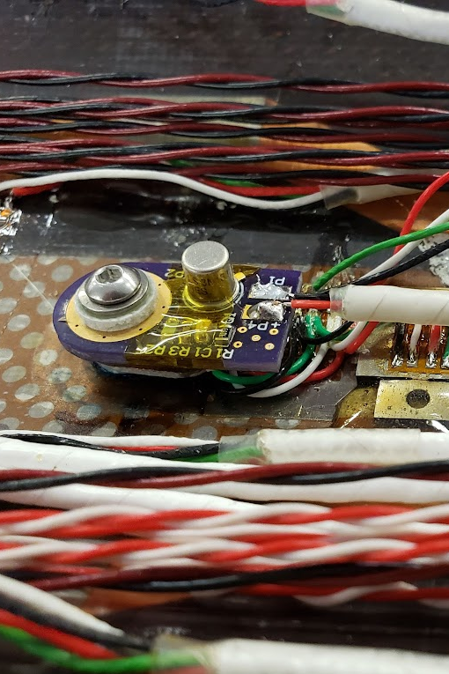
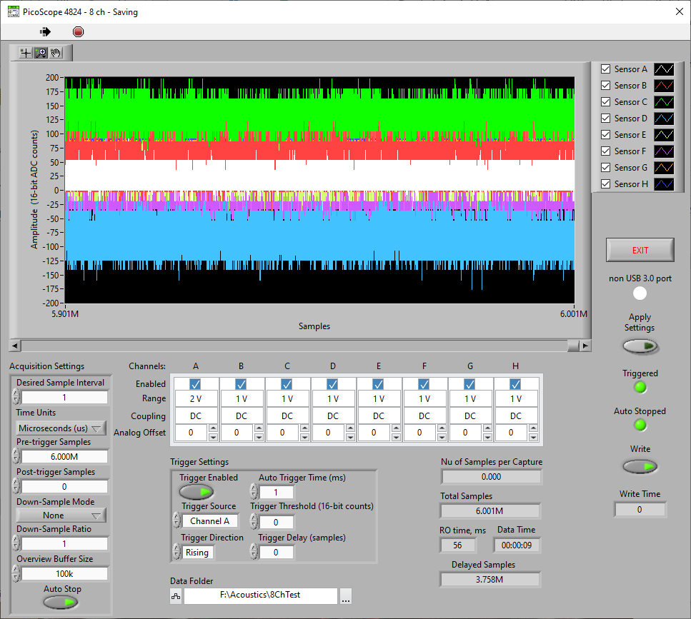
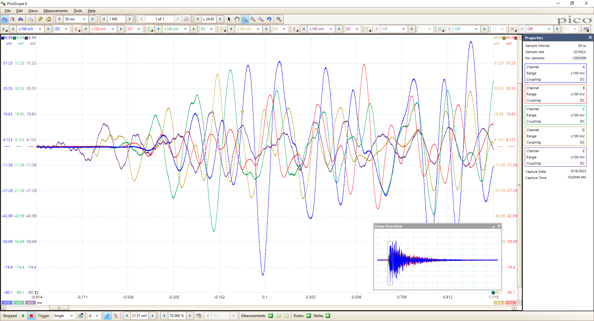
VMTF diagnostic improvements: acoustic sensors (S. Krave)
Acoustics DAQ
  8 Ch
  Up to 2MS/s 12 bit, used at 1MS/s
  600 MPoints record length
Coupling Box Rebuilt for better noise performance
Sensors and box based on design by Maxim (LBNL).
Coupling box and USB scope
Preliminary Checkout completed. Reduction in noise floor with new box from~100mV to ~1mV
AE sensor
Picoscope labview app

Slide 9
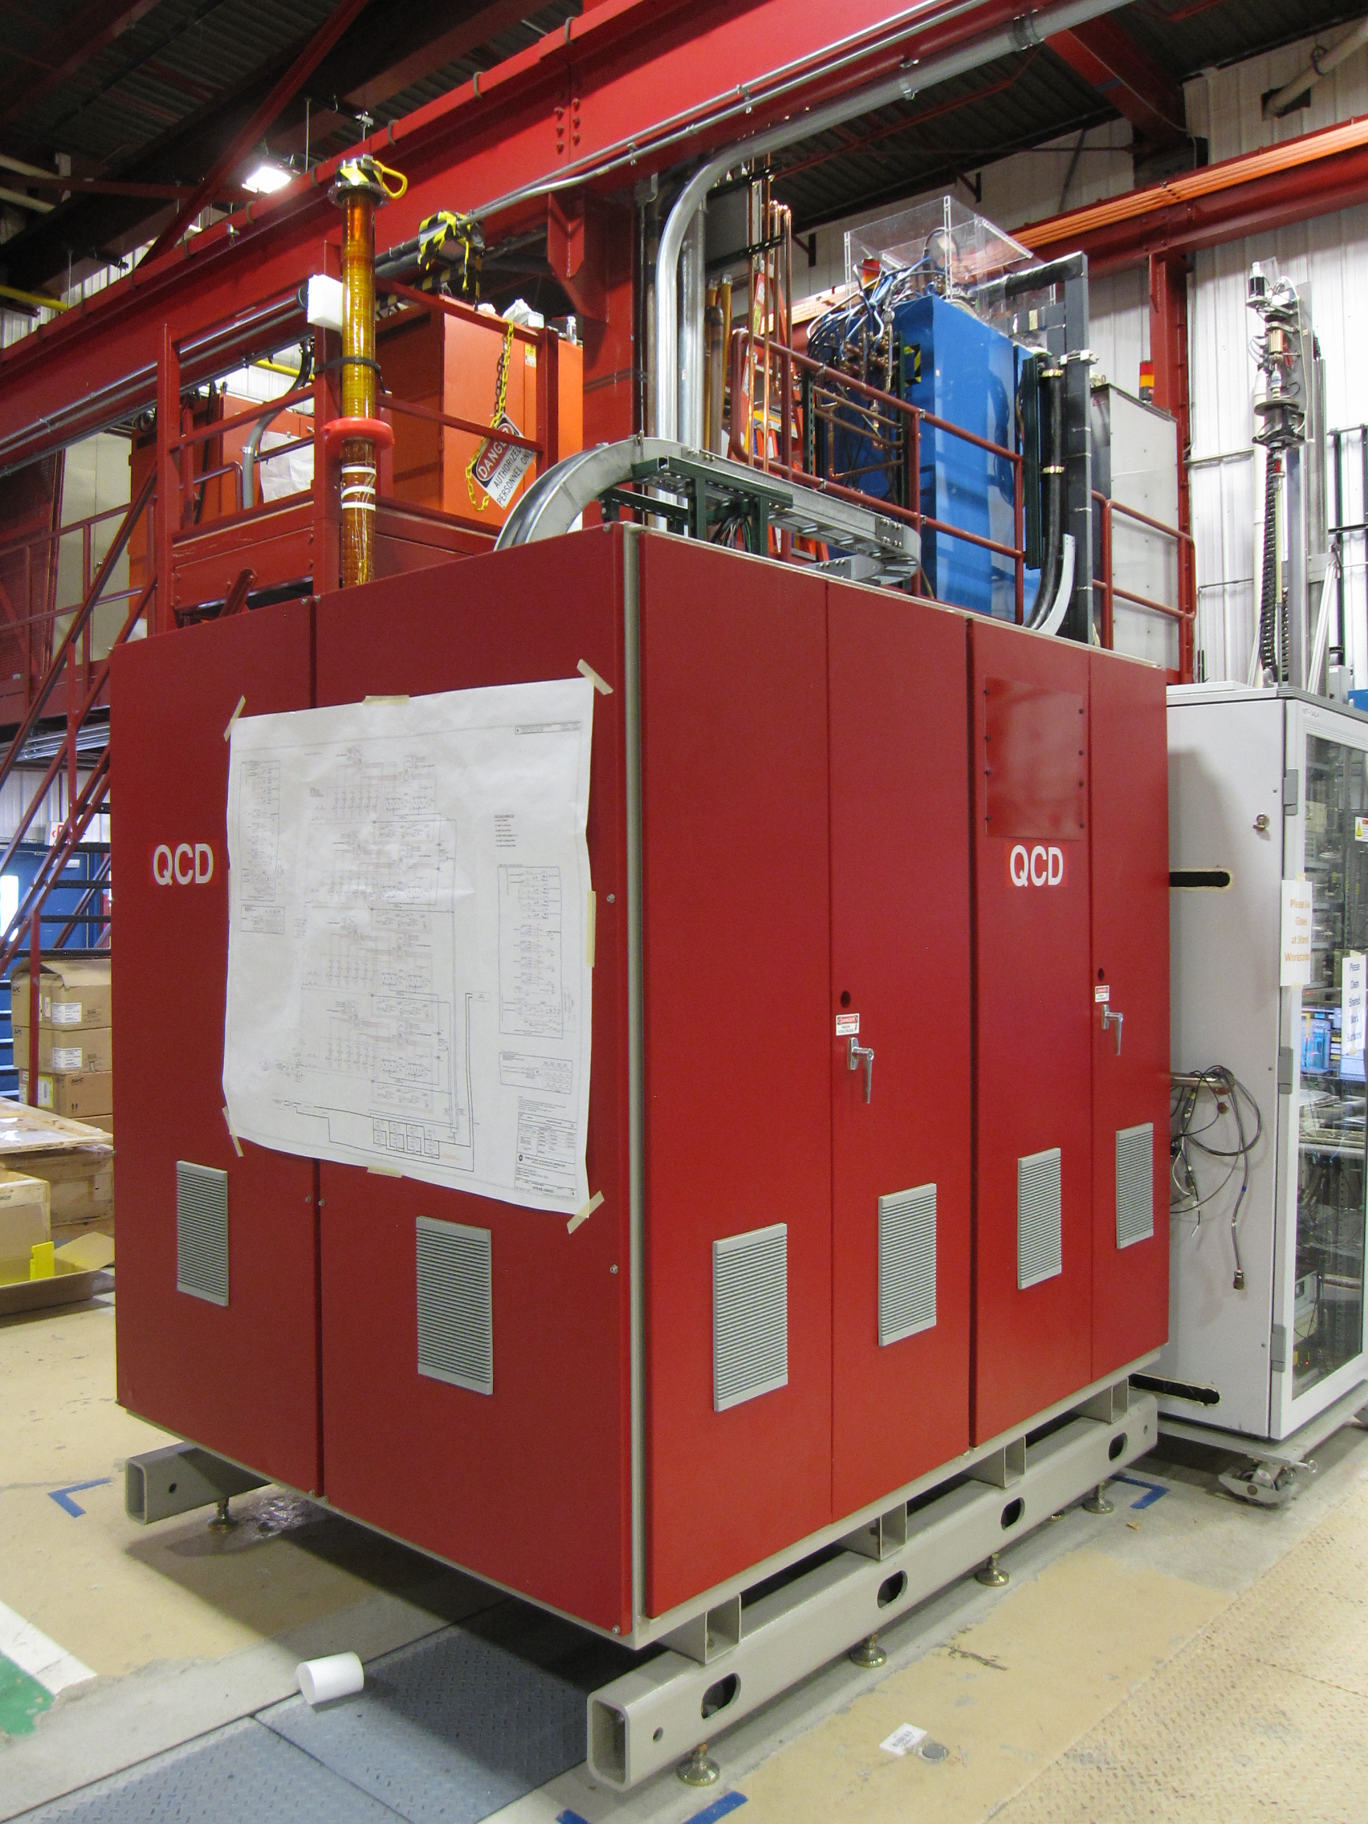
Quench Current-boosting device: QCD (S. Stoynev)
  Capacitor based device
    400 mF, up to 1 kV (200 kW)
Details on S. Stoynev talks

Slide 10
Outline
Vertical magnet test facility (VMTF)
Stand 7
Stand 4

Slide 11
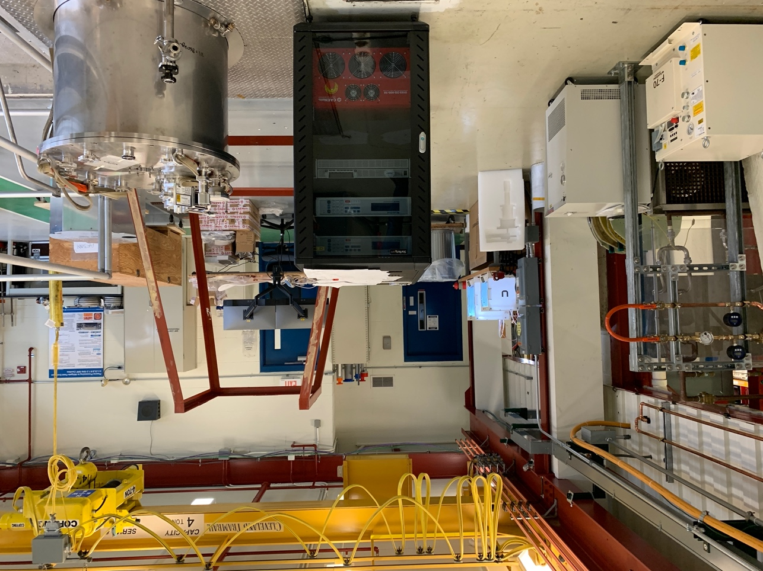
Conduction Cooled Low Cost Test Stand (C. Boffo)
Test Stand designed to support both SC magnet and SRF in conduction cooling
800A – 10V power supply with 4 channel quench detection system
Up to 5 pairs of HTS current leads
Quickly dismountable aluminum thermal shield
Notes:
1.8 W GM or 1.5 W PT Cryocooler

Slide 12
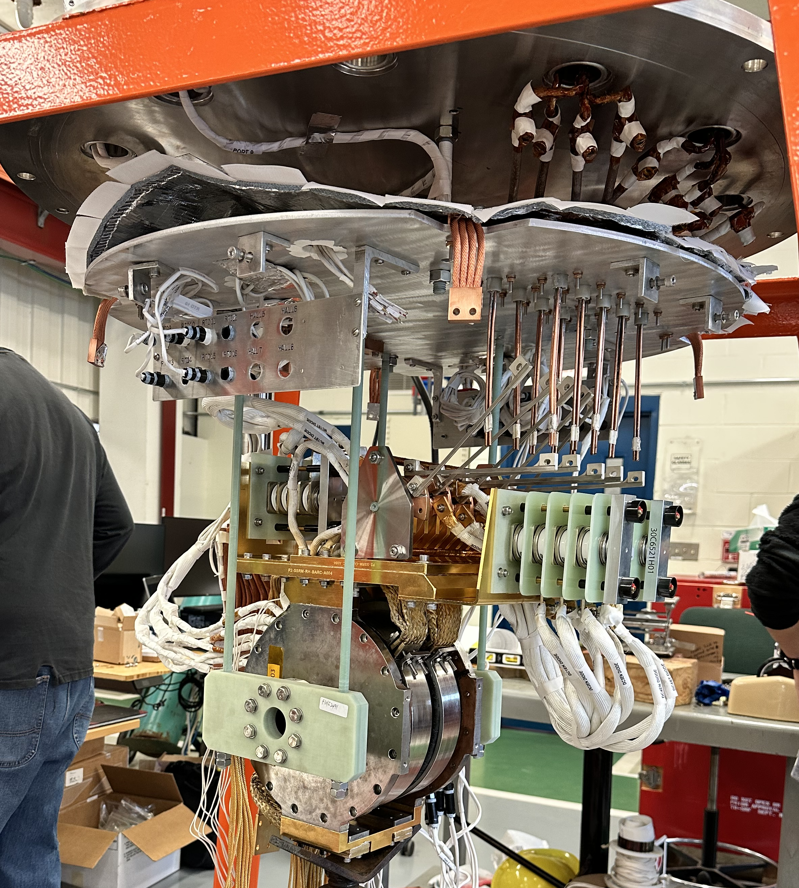
Conduction Cooled Low Cost Test Stand (C. Boffo)
PIP-II SSR Focusing Lens
Test of focusing lenses for PIP-II
Test of 12T solenoid for the PSI HTS undulator
Test of NbTi superconducting undulators
In the future HTS and Nb3Sn SRF cavities

Slide 13
Outline
Vertical magnet test facility (VMTF)
Stand 7
Stand 4

Slide 14
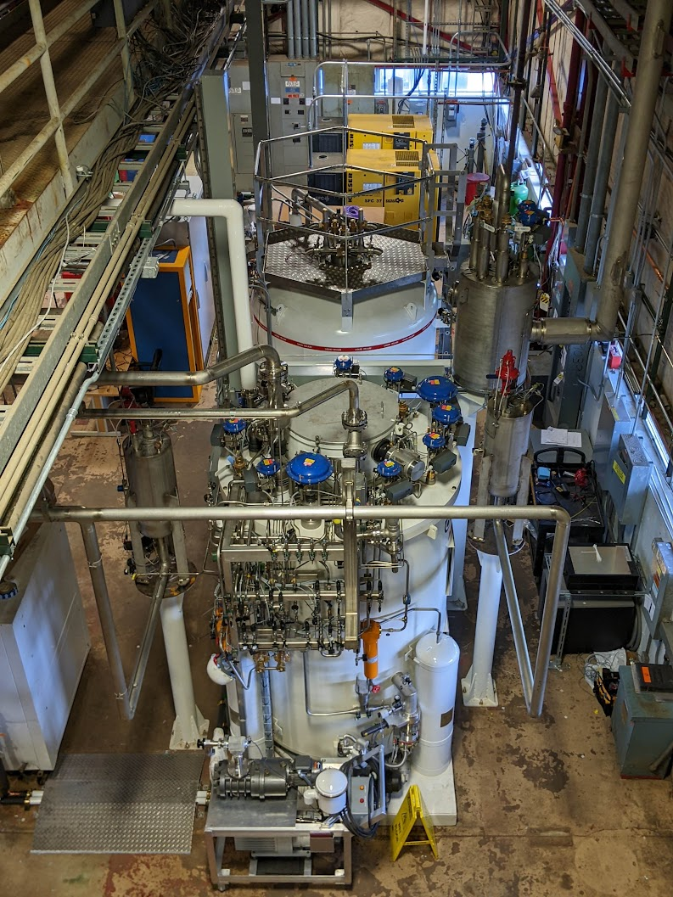
Cryogenic system improvements
A new cryogenic distribution system (CDS) connecting the new IB1 Coldbox to the IB1 test stand infrastructure was successfully commissioned this month.
LHe make rate is ~600 L/hr
Total liquid storage volume is 14000 L.
New Helium compressor skids
Process control system rebuilt
Simultaneous testing activities at both the horizontal magnet test stand and the VTS SRF test stand.

Slide 15
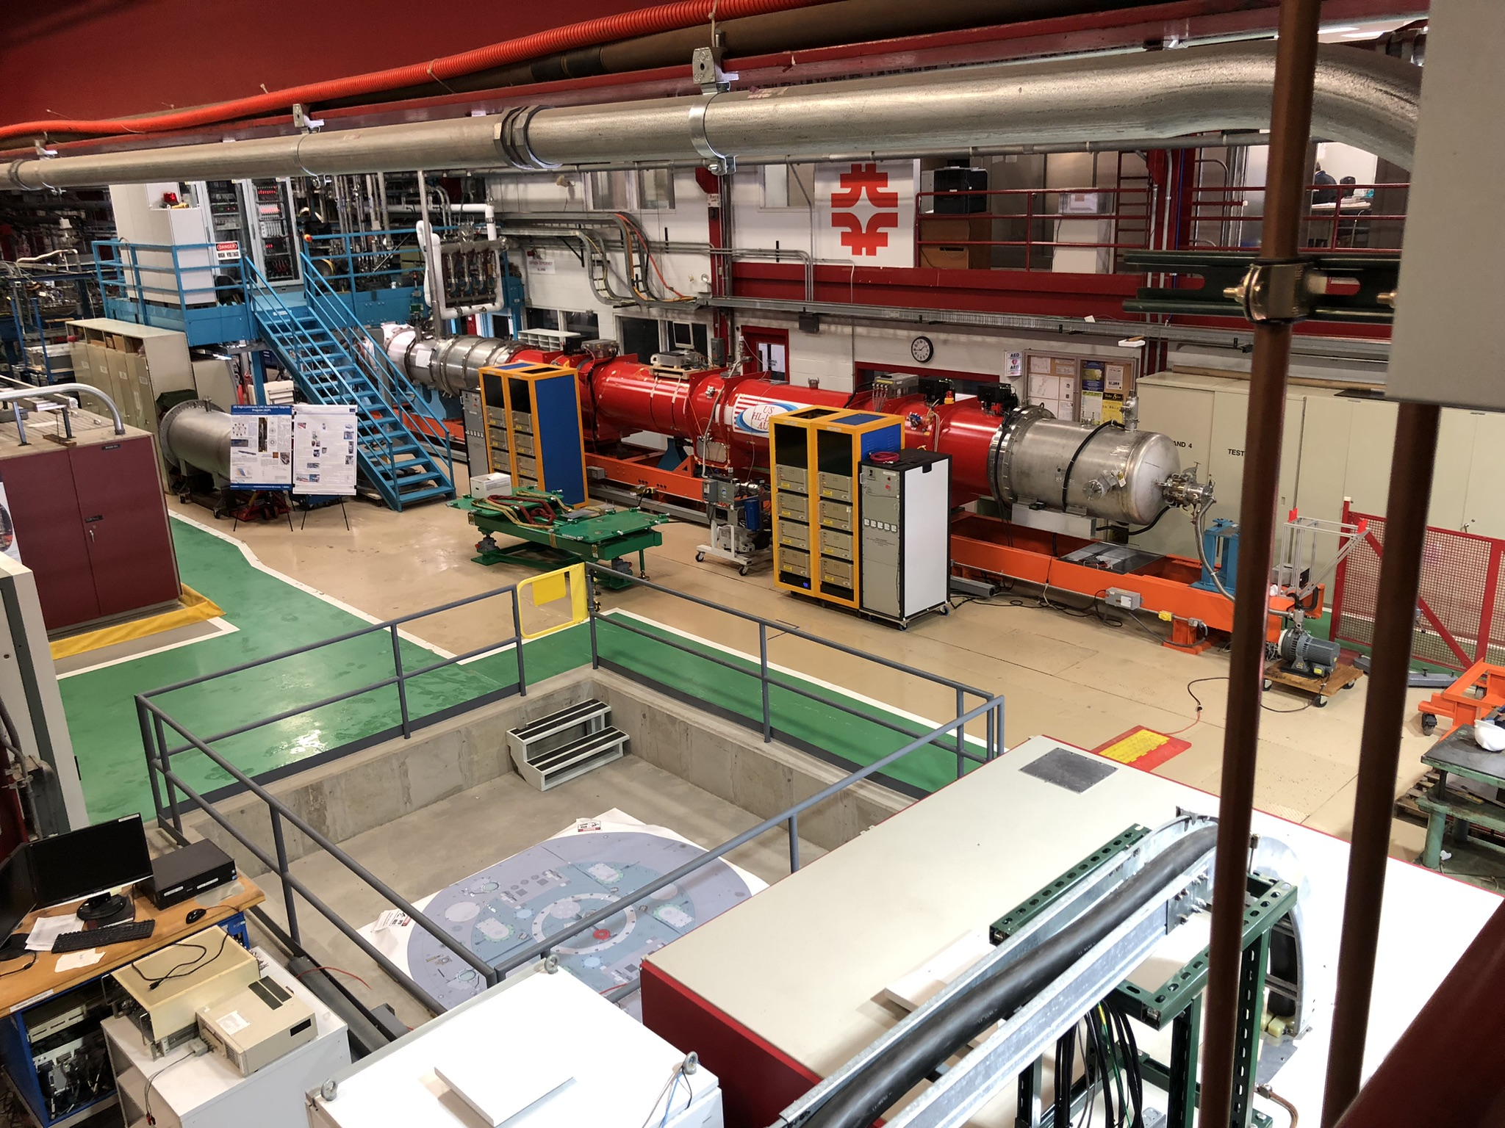
Fermilab Horizontal Test stand (G. Chlachidze, S. Feher)
It was previously was used for testing the existing LHC inner-triplet quadrupoles in 2001-2006. The refurbishment and new fabrication of test stand components was necessary to meet the HL-LHC cryo-assembly design and test requirements.
Old process controls and magnet protection and monitoring systems also were upgraded

Slide 16
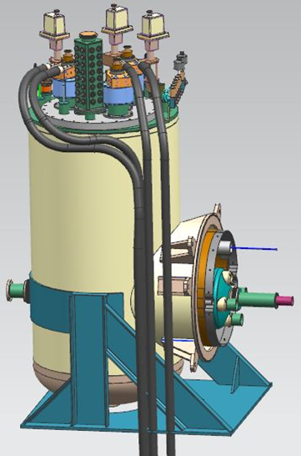
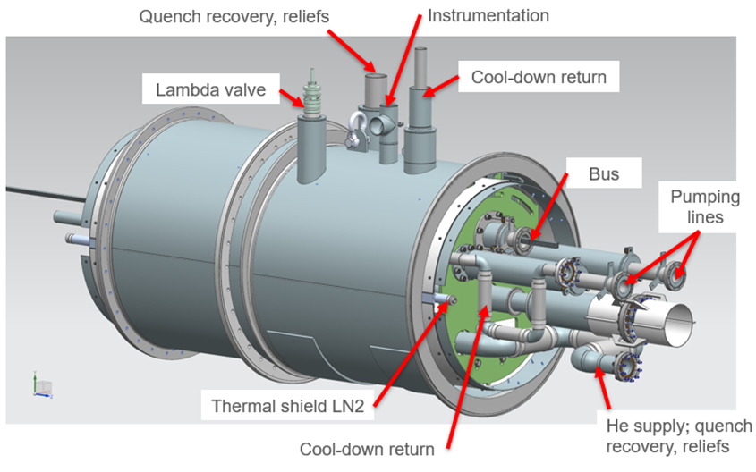
Fermilab Horizontal Test stand: new adapter box
Interface between the existing cryogenic feed box and the new HL-LHC cryo-assemblies. The adapter box adapts the piping locations of the feed box to match the piping layout of the new cryo-assemblies.
Use of the old components, including the cryogenic feed box, the feedbox insert with vapor-cooled power flags, instrumentation trees.

Slide 17
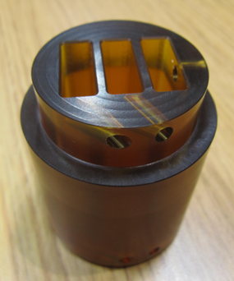
New location of the lambda plug
The adapter box: separation between the 4.5K and 1.9K temperature levels.
Lambda plug location was moved from the Feed box to the Feed box-Adapter box interconnect
New Lambda plug (Ultem 1000 and and stainless steel (SS) housing) is designed to accommodate three superconducting busses.
Moving the 1.9K boundary from the Feed box to the interconnect:
reduces the 1.9K volume and liquid He usage, shorted pump-down time
reproduce LHC tunnel conditions with high pressure (up to 17 bar) after the quench.

Slide 18
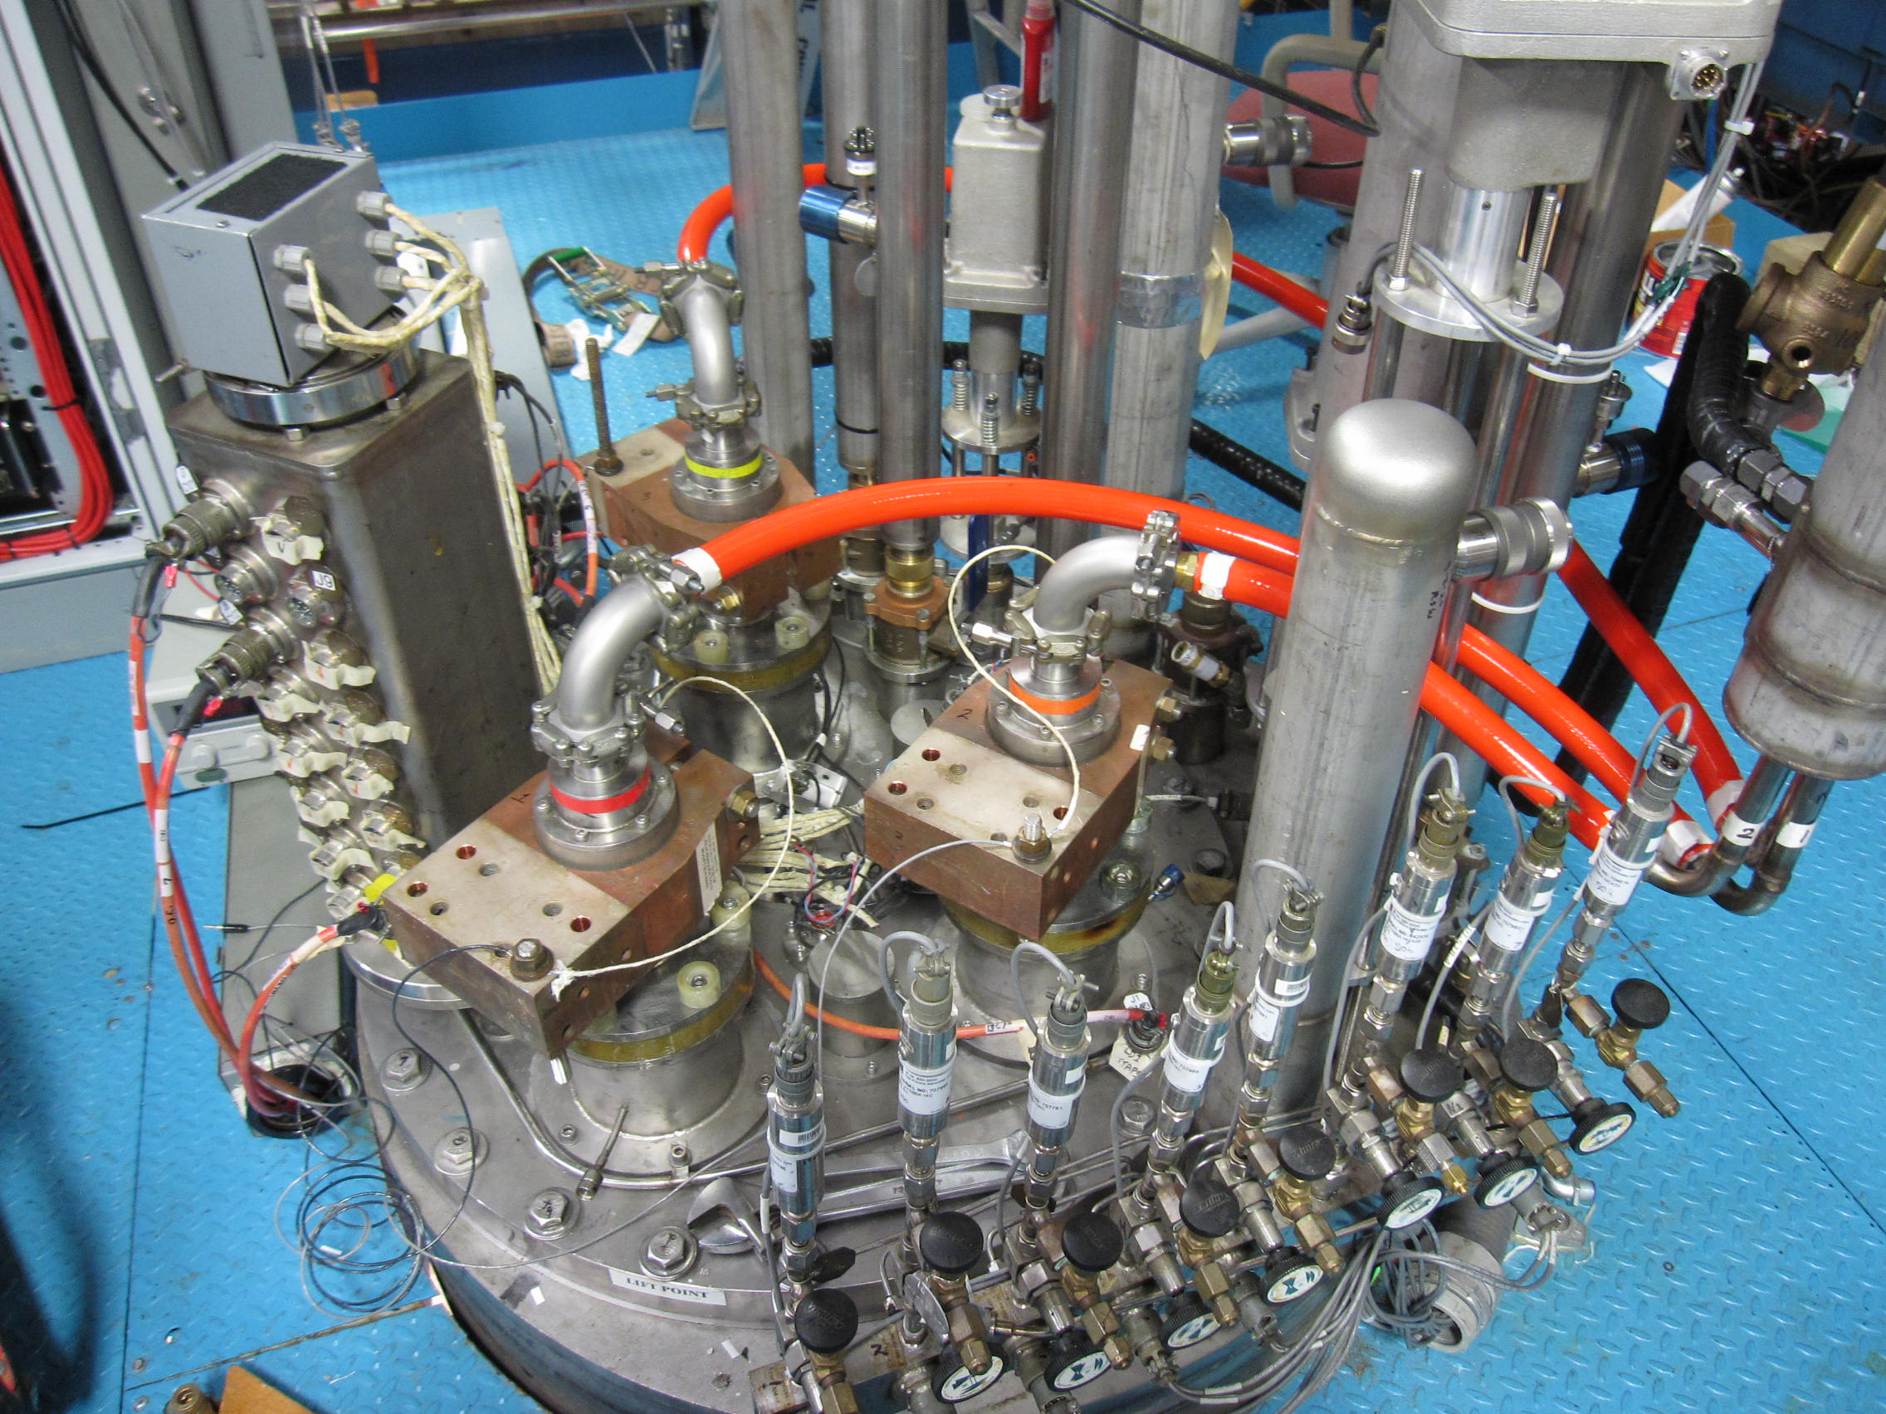
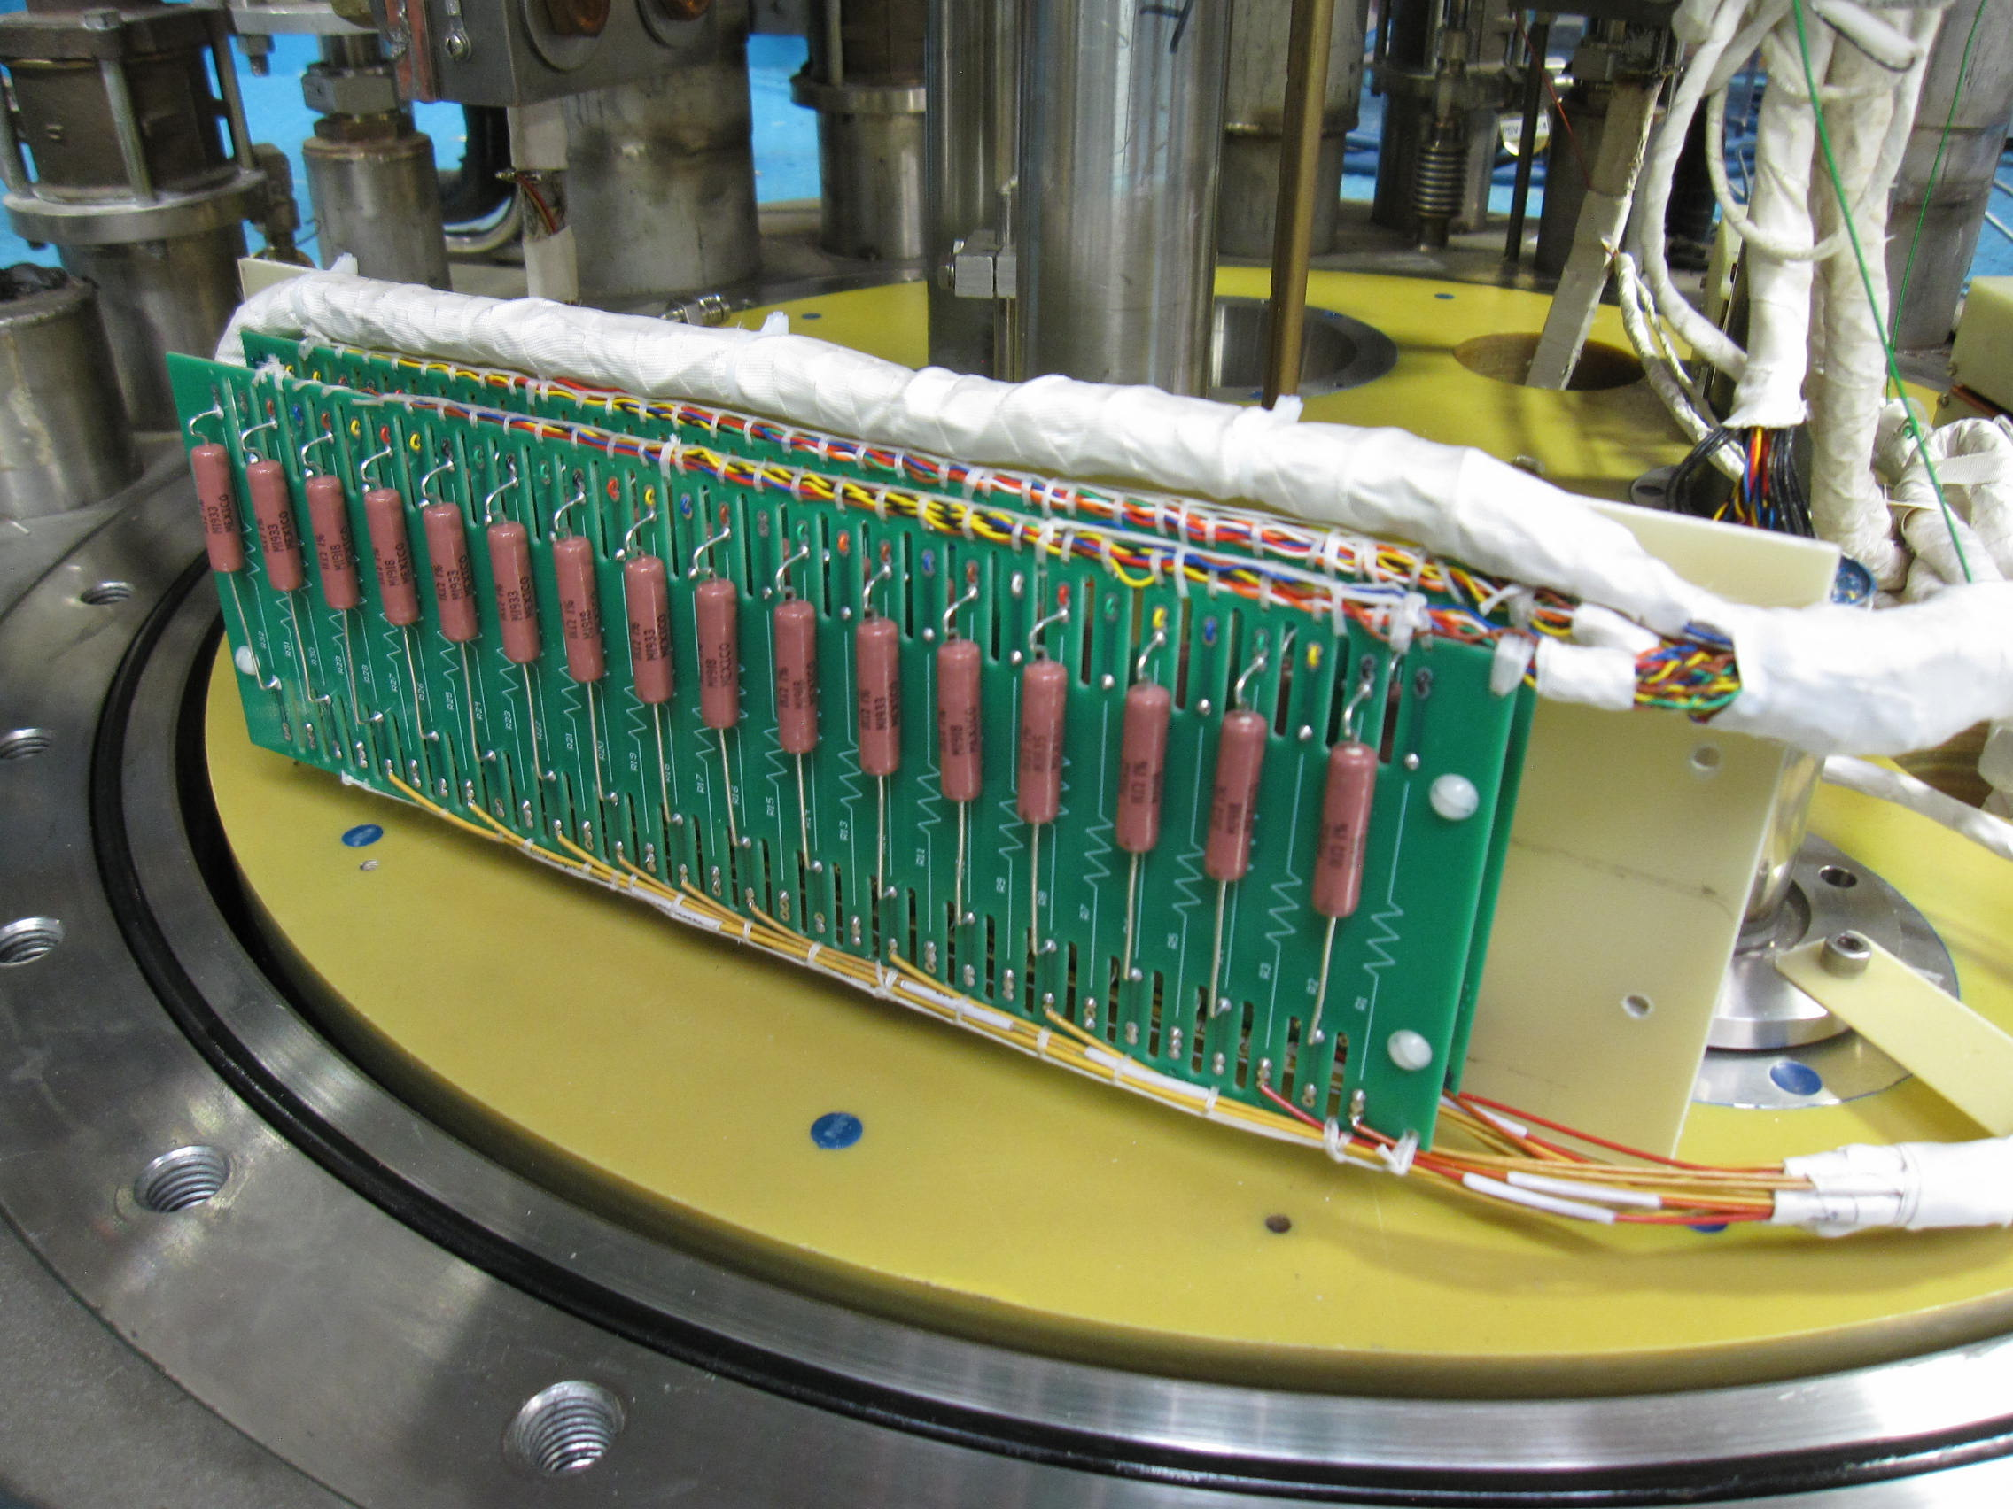
FEED BOX INSERT
Low conductivity water (LCW) system for cooling the solid copper bus and the flexible power leads was fully refurbished to provide an adequate water flow (4 times larger).
The old Feed box insert is used for horizontal cryo-assembly testing. Three vapor cooled power leads will allow testing of two magnets in the cryo-assembly individually or together connected in series. Copper flags were silver-plated for a better connection with the flexible leads. New current limiting resistors were installed.

Slide 19
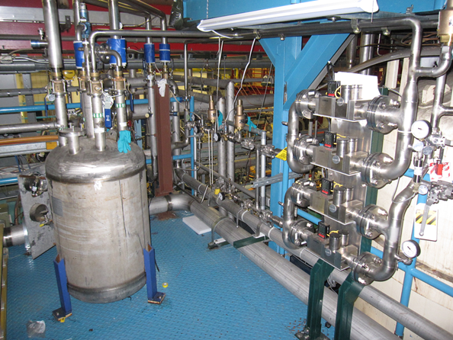
Controlled cooldown
To prevent excessive stresses in the magnet structure during the cool-down and warm-up:
maximum temperature difference of 50K between the ends of the cold mass.
The temperature gradient during cool-down and warm-up in the tunnel is expected to be less than this upper limit.
Controlled cooldown is accomplished in two stages:
For cool-down from 300K to 80K, He gas is cooled in a liquid nitrogen bath and then mixed with the 300K helium to achieve the required cold mass supply temperature.
Below 80 K: 80K helium gas is mixed with the 4.5K liquid helium

Slide 20
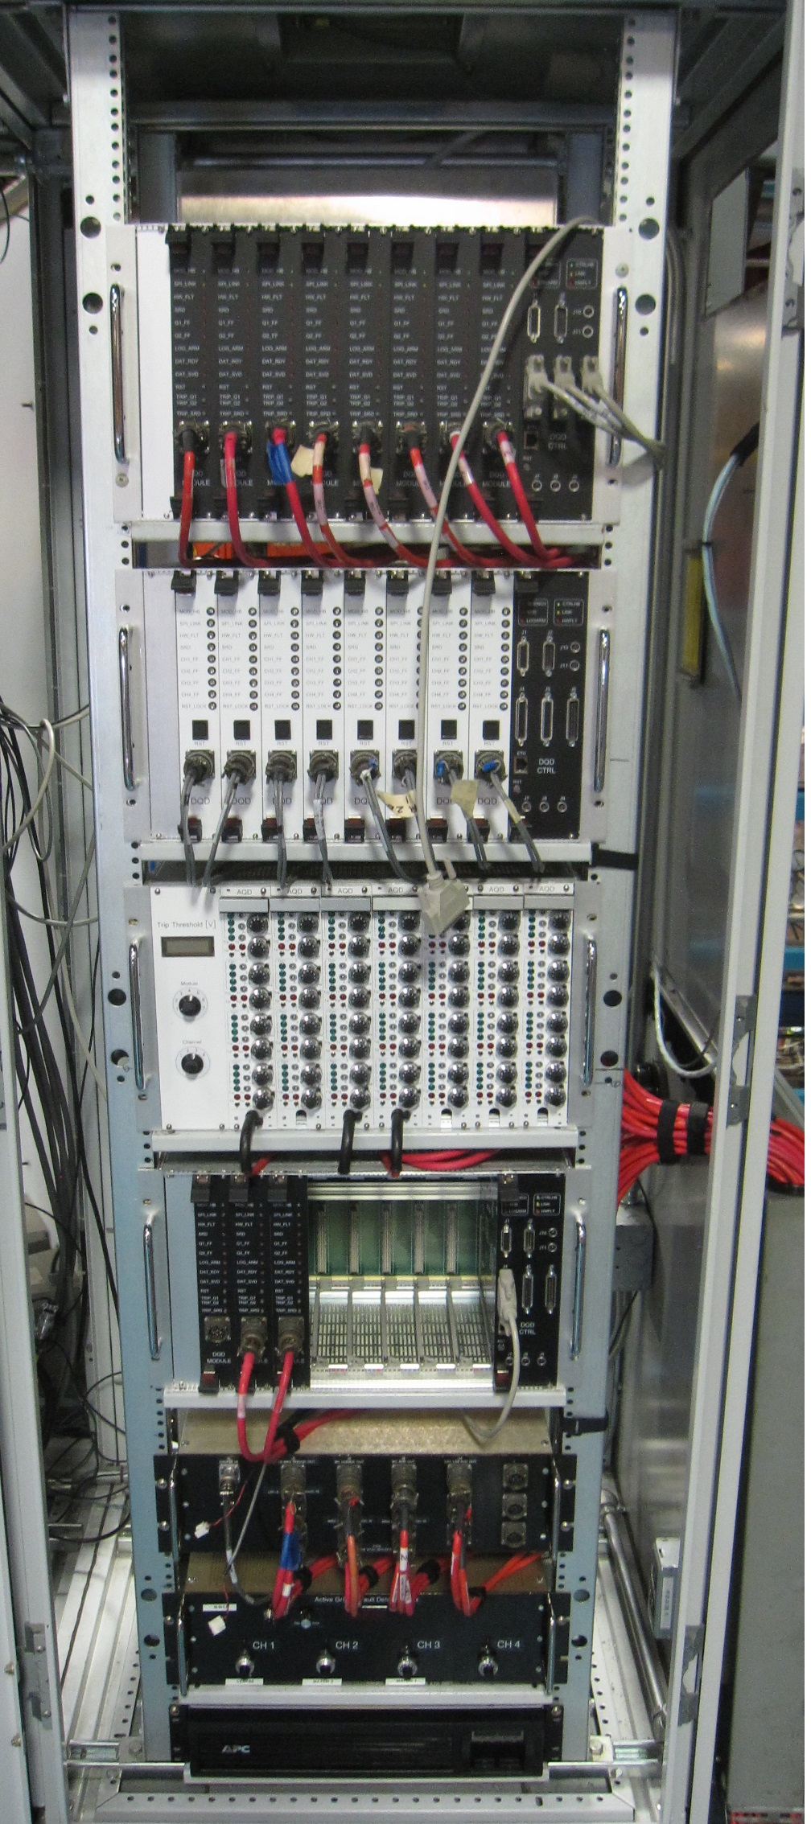
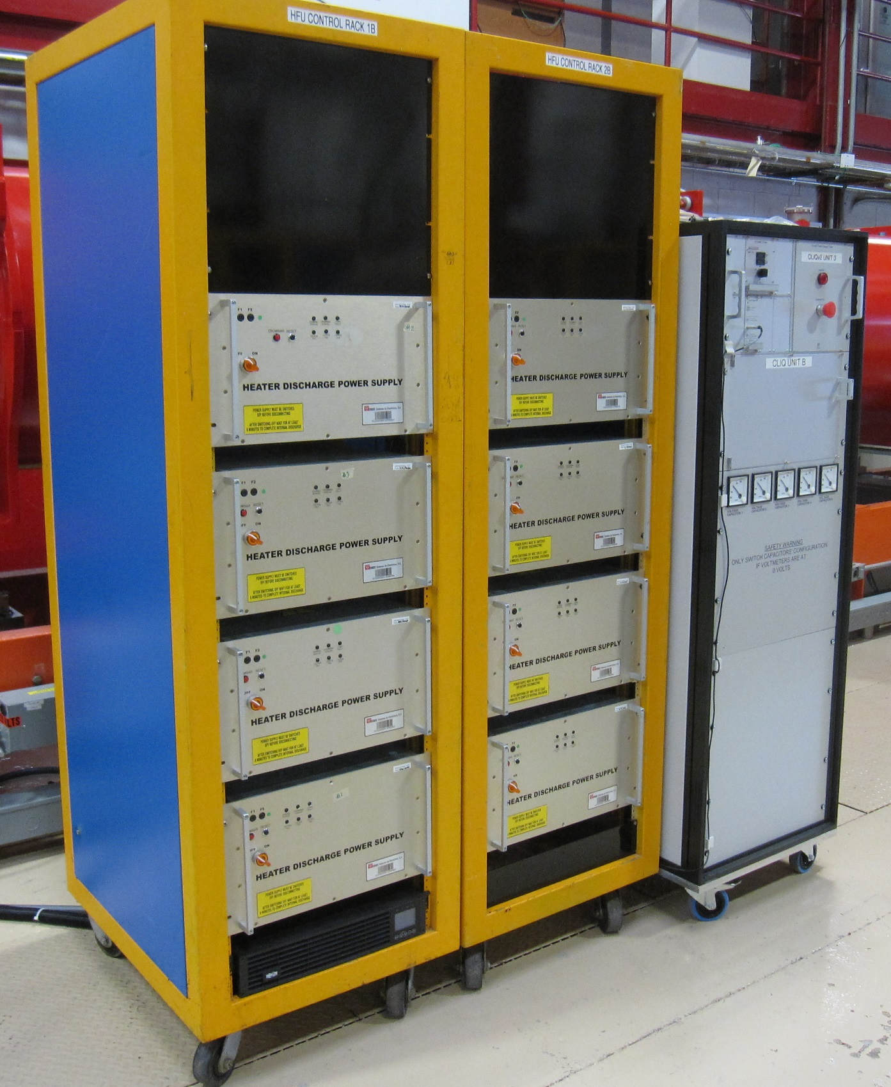
Quench Protection and Monitoring
Tier-1 is a primary FPGA based Digital Quench Detection system,
Tier-2 - secondary Analog QD system, and
Tier 3 - Quench controls and Data Management system by National Instrument Cryo: user interface
High reliability is achieved with two independent and fully redundant systems: Digital primary and Analog secondary quench detection.
The goal is to provide magnet protection at Fermilab as close as possible to the operating conditions at CERN:
Coupling Loss Induced Quench (CLIQ)manufactured by the same vendor both for CERN and Fermilab
HFU provided by CERN

Slide 21
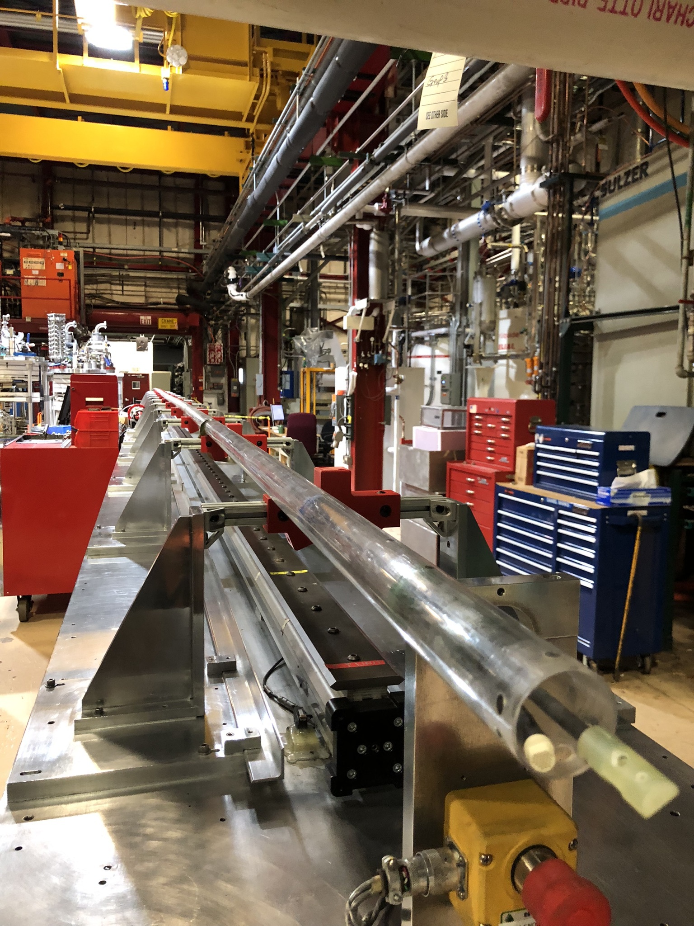
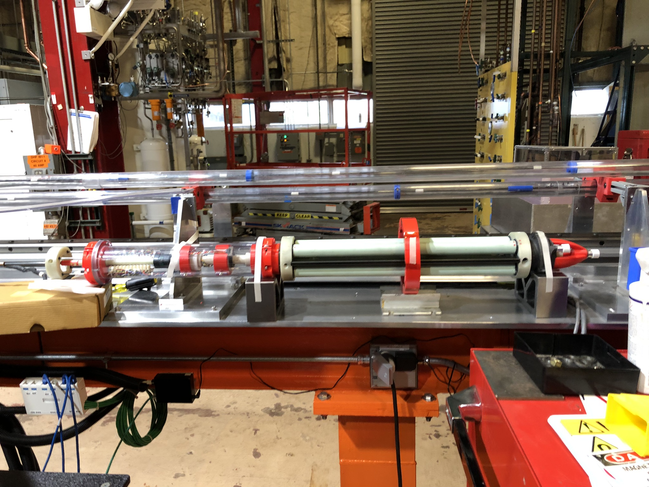
Magnetic measurement system
Fermilab developed Printed Circuit Board (PCB) based magnetic measurement probe.
Those probes are successfully used at LBNL (Berkeley) and BNL (Brookhaven) for magnetic measurements during assembly and testing of the magnets.
For accurate measurements of the local magnetic center and field angles we need to know the measurement probe location and orientation with high precision.
The Leica Absolute Tracker AT960 will be used for precise location of the probe.
Details on Joe DiMarco talk on April 28

Slide 22
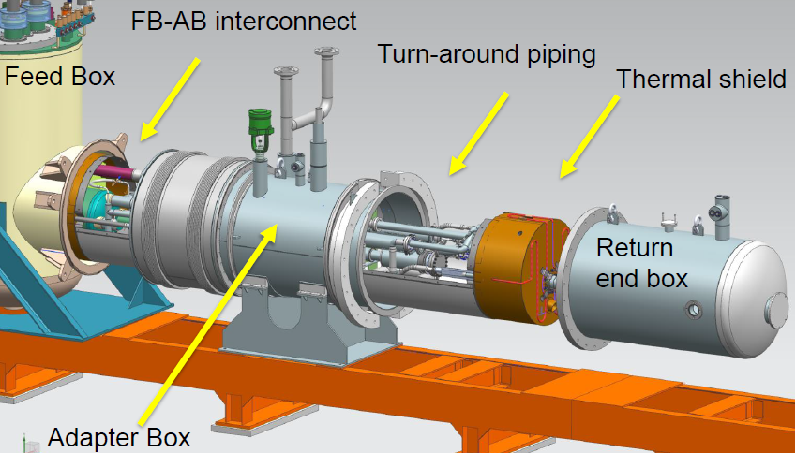
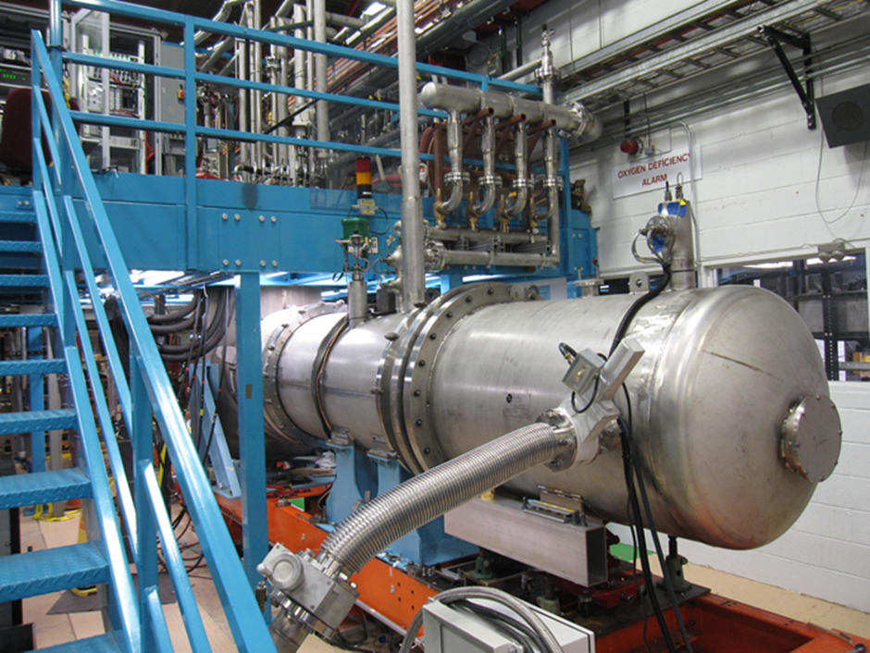
Zero Magnet Test
Major cryo-mechanical and electrical upgrades at Fermilab’s horizontal test stand were verified during the shorted bus (zero-magnet) test in October-December 2020.

Slide 23
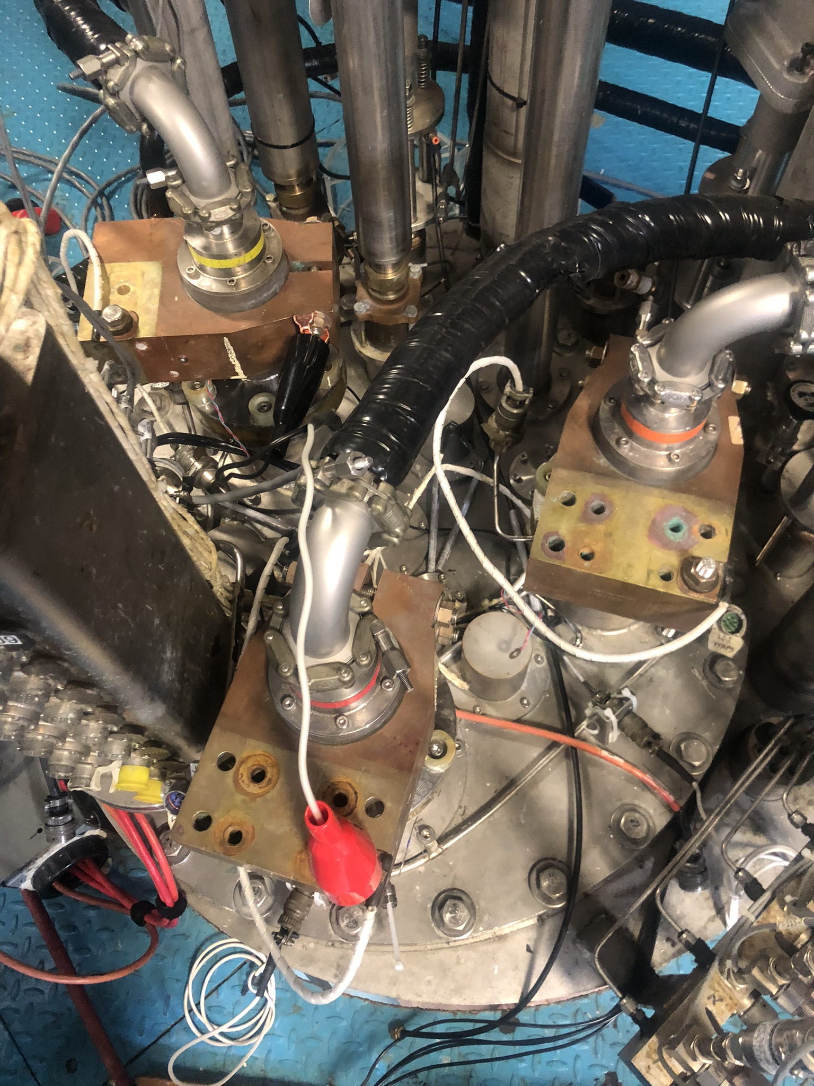
Stand 4 commissioning
Functionality of the upgraded systems
new piping
the cooldown return relief manifold
new adapter box and interconnects.
The insulating vacuum reached ~ 10⁻⁷ Torr.
Return end piping pressurized up to 17 bar
Controlled cooldown from room temperature to 4.5 K
Main vapor-cooled power leads were verified up to 18500 A.
The middle power lead achieved 17600 A, demonstrating sufficient margin for testing the HL-LHC cryo-assemblies at the nominal operating current of 16230 A.
Notes:
demonstrating acceptable vacuum sealing of the lambda plug and interconnects.
Foto delle power lead

Slide 24
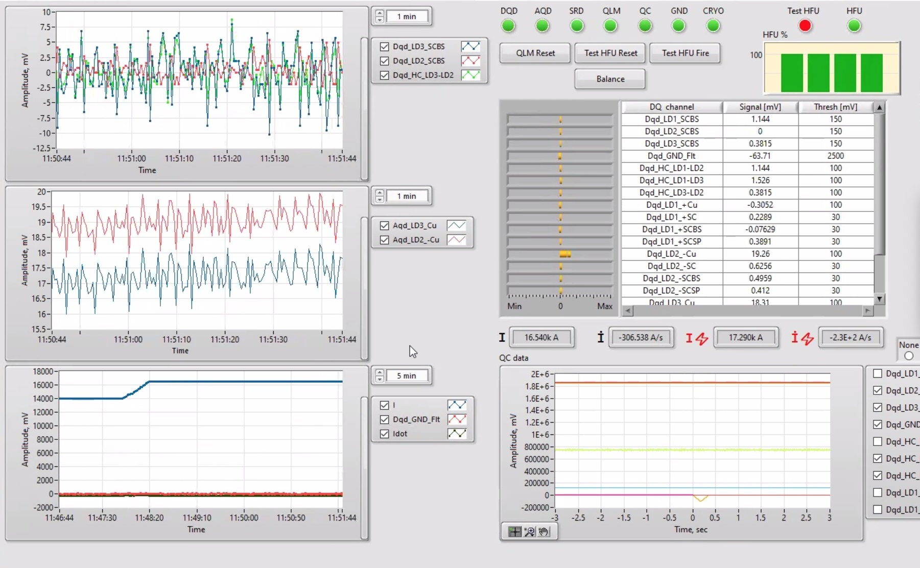
Stand 4 commissioning
New Quench Protection and Monitoring system was tested.
A real quench was detected in the middle power lead.
Holding current test was performed at 16500 A.
The new process controls system operation with additional automation capabilities also was successfully demonstrated.

Slide 25
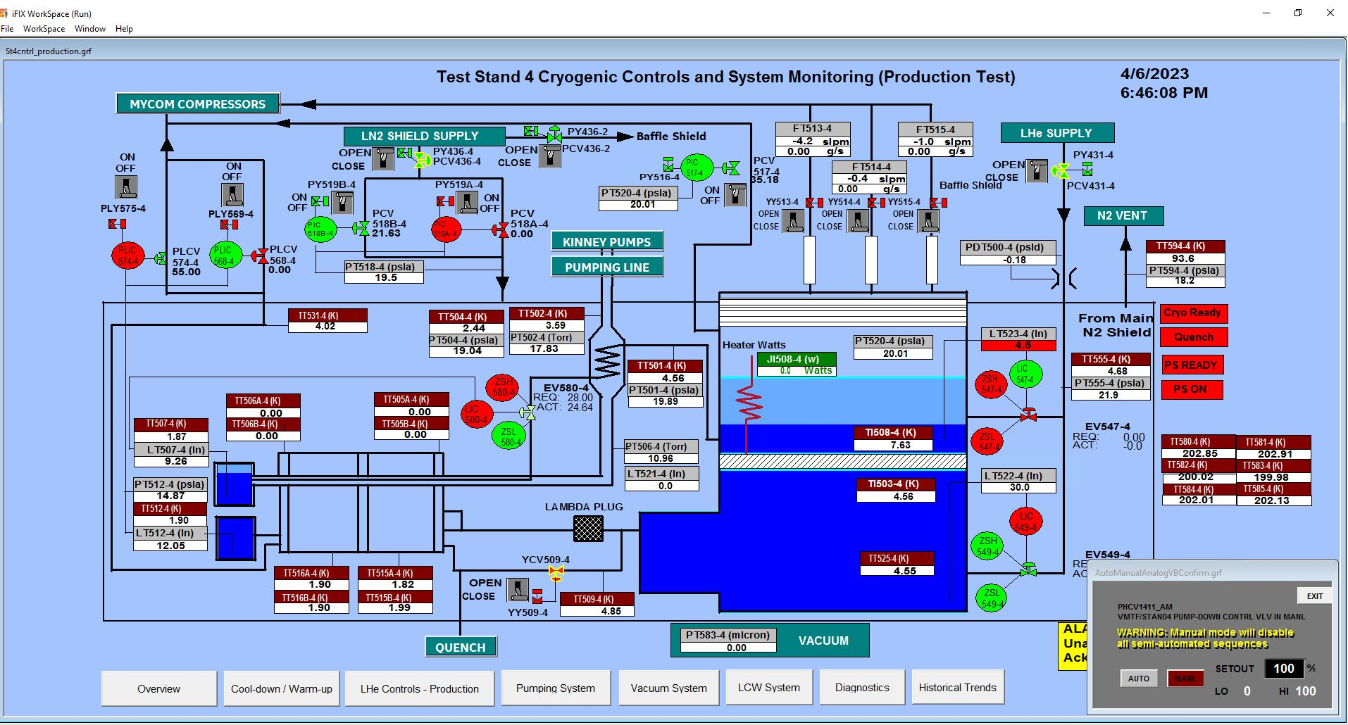
1.9 K on April 6

Slide 26
Conclusions
Fermilab has 30K A magnet vertical test facility
      Several LARP-HL-LHC R&D short quadrupole magnets were tested
      15T and several mirror magnets
Several new diagnostic capabilities have been implemented over the last 5 years
Future plans: synchronize/ improve the diagnostic systems
Conduction Cooled Low Cost test stand
    to support both SC magnet and SRF in conduction cooling
    12T solenoid for the PSI HTS undulator and in the future HTS and Nb3Sn SRF

Slide 27
Conclusions
Fermilab’s horizontal magnet test stand is operating again.
The facility was refurbished and upgraded to meet the design and test requirements for the High-Luminosity LHC low-beta quadrupole magnets.
    automated controlled cool-down and warm-up
    New location of the lambda plug
    Vapor cooled main power leads were verified at currents up to 18500 A.
    New Quench Protection and Monitoring system was successfully used during this test.
Test of the first pre-series cryo-assembly is ongoing
    Successful cooldown to 1.9 K

