Slide 1
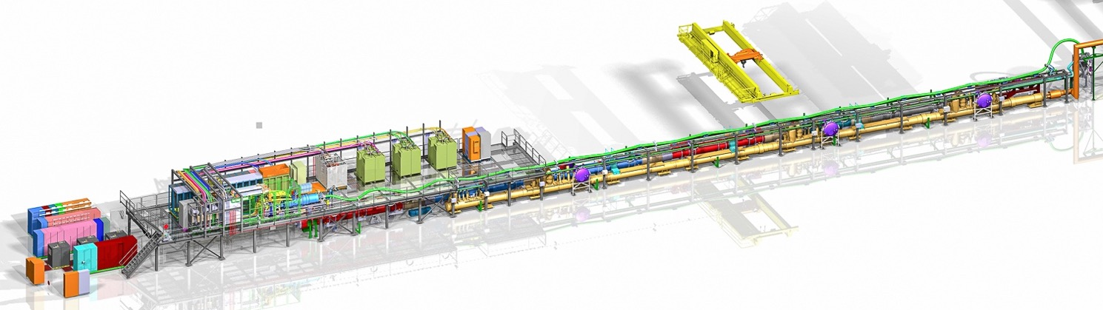

HL-LHC IT String and unique and temporary test stand @ CERN
M. Bajko TE-MPE-SF/HL-LHC WP16
On behalf of the SF section and WP16 team
Integration by. A. Kosmicki
4th SMTF and 2nd IDSM Workshop in Paestum, April 2023

Slide 2
OUTLINE
INTRODUCTION: HL-LHC
HL-LHC IT STRING TEST STAND SCOPE
HL-LHC IT STRING TEST STAND DESCRIPTION
STATUS- PERSPECTIVES
  STRING Integration and Installation
  STRING Validation Program
  STRING Safety
Schedule and Resources
Conclusions-Summary

Slide 3
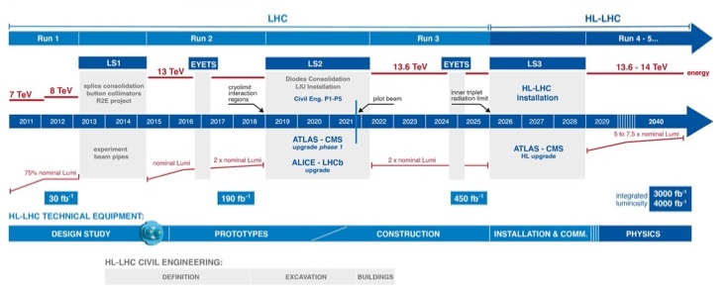
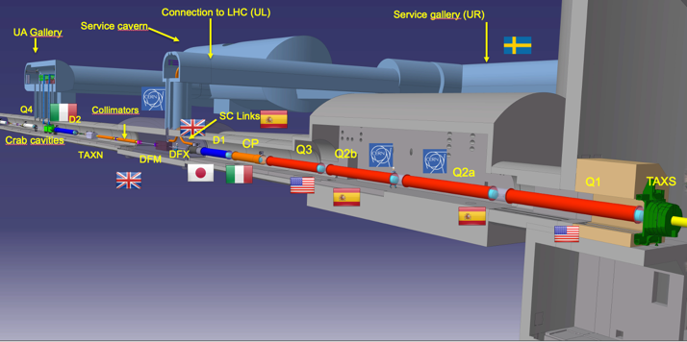
HL-LHC
The High-Luminosity LHC project aims at increasing the integrated LHC luminosity by an order of magnitude, and enabling LHC operation till the early 2040s.
The overall schedule for the HL-LHC installation. With the official project budget implementation in 2016, the project is currently at about the mid-point of the implementation phase.

Slide 4
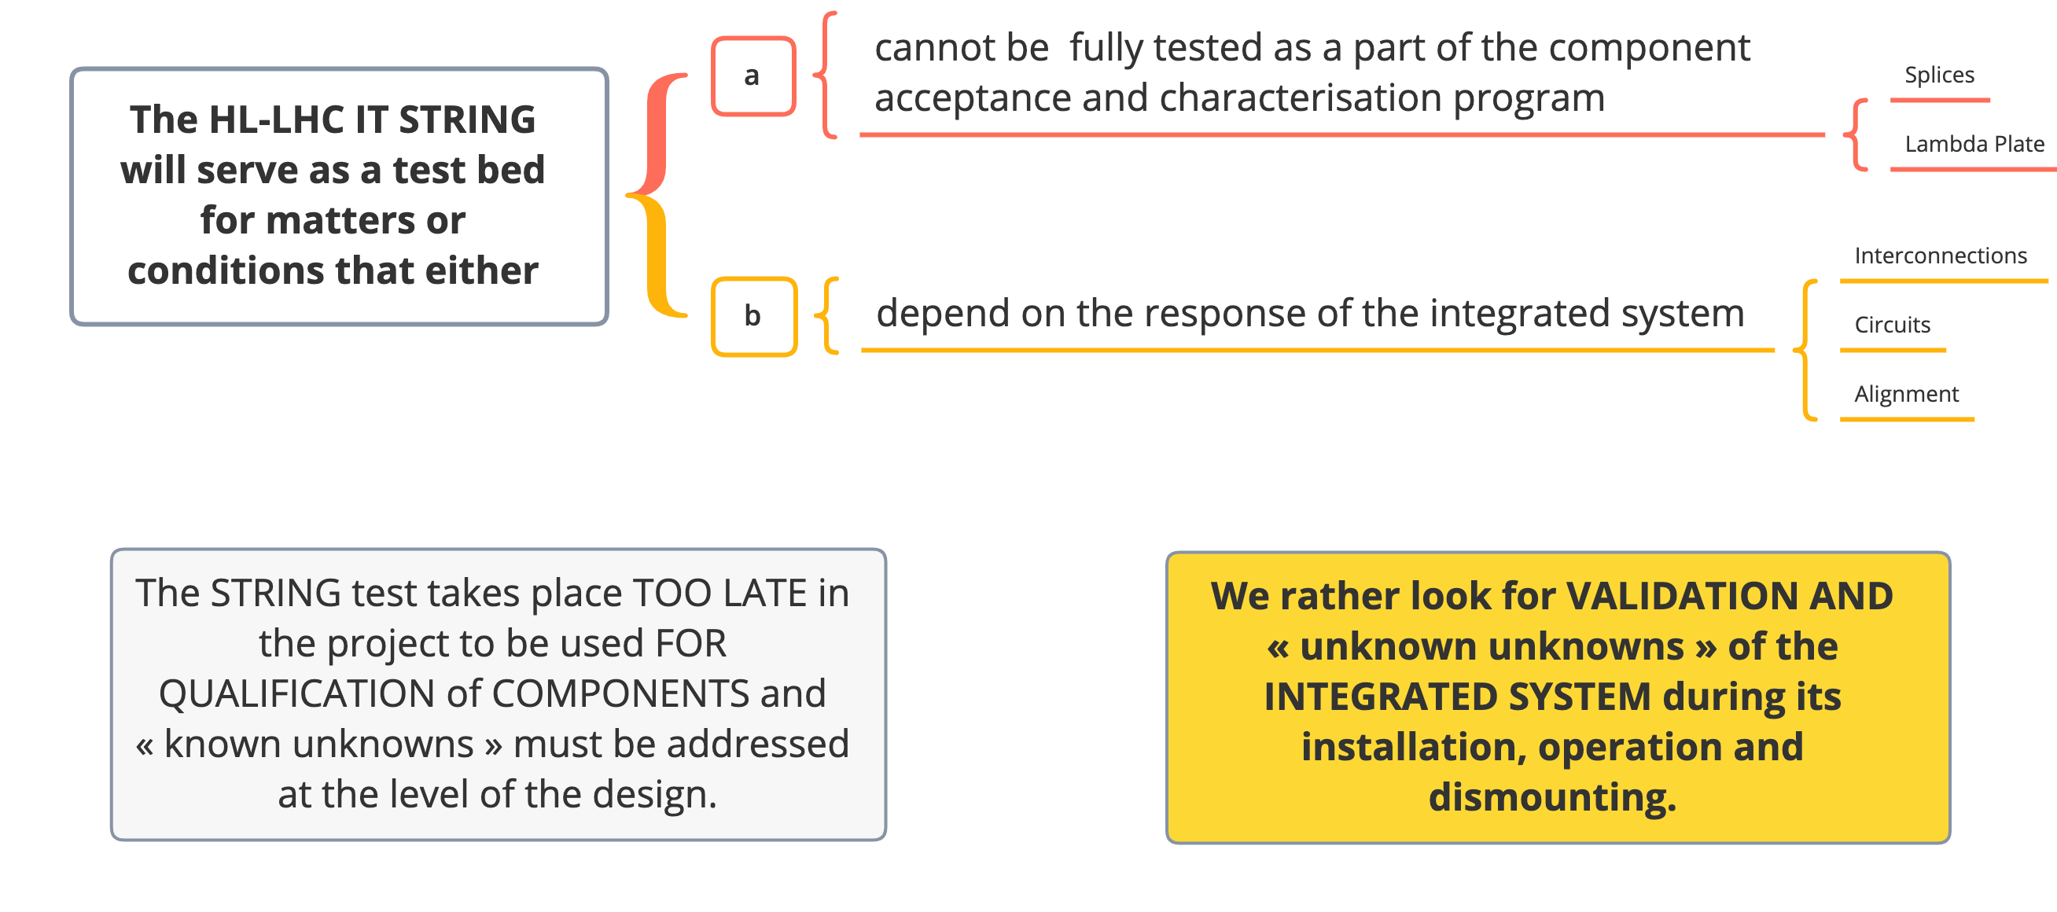
The HL-LHC IT STRING an unique and temporary test stand @ CERN

Slide 5
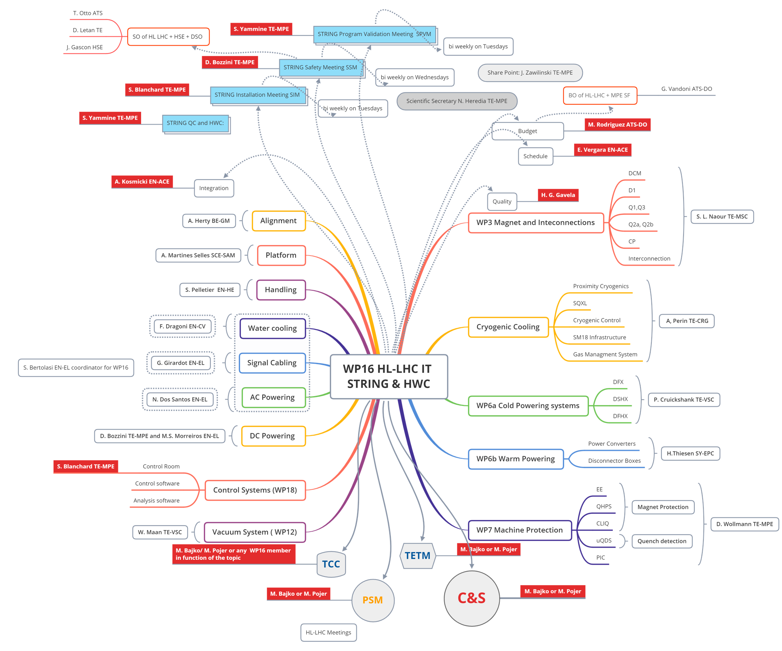

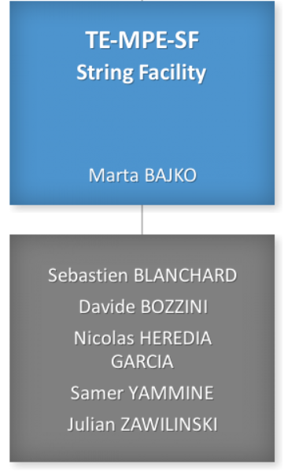

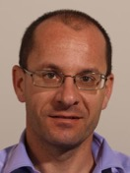


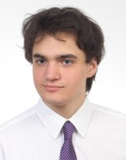





HL-LHC IT STRING organization
Alvaro SANTIAGO FERRER
Planning
Budget
Integration
Co-WPL
https://espace.cern.ch/HiLumi/WP16/SitePages/Home.aspx

Slide 6
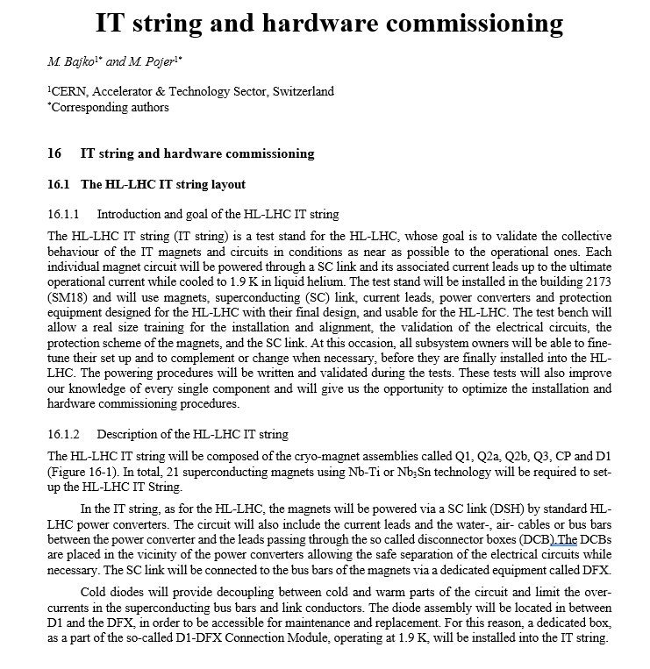
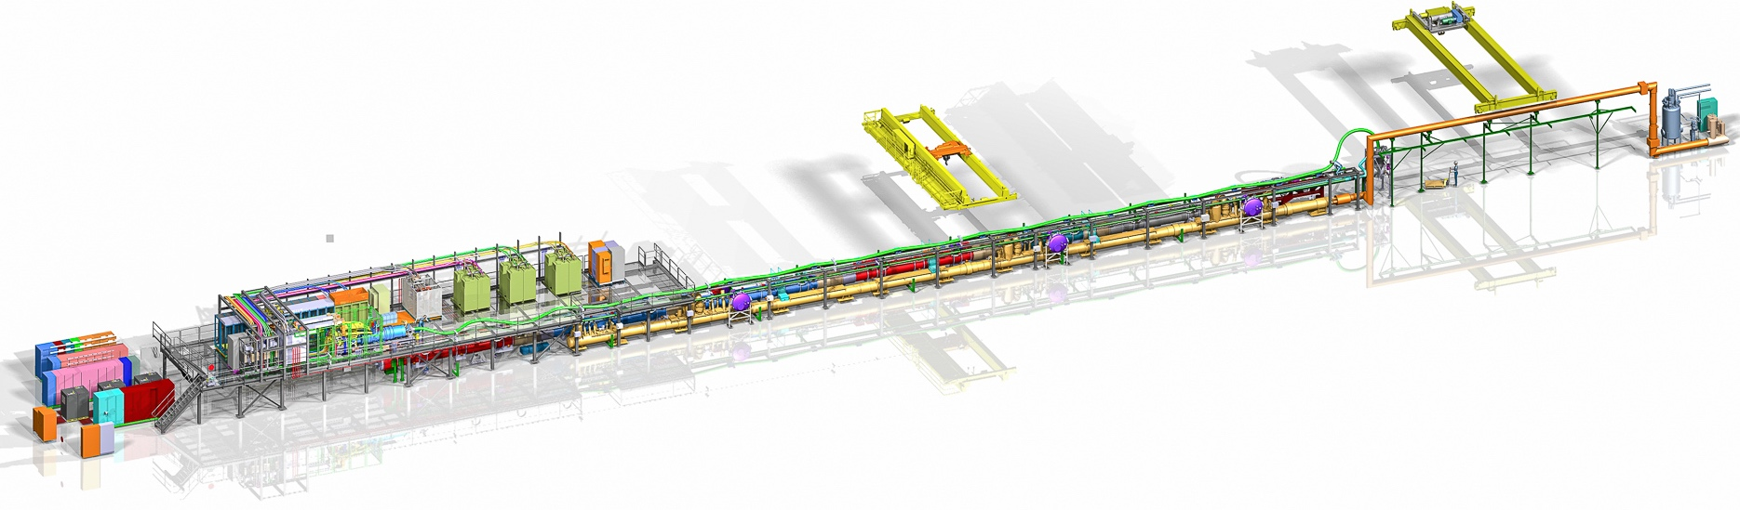
The HL-LHC IT STRING Scope
The scope of the IT STRING is to represent, as best as reasonably achievable in a surface building, the various operation modes to STUDY and VALIDATE the COLLECTIVE BEHAVIOUR of the different systems of the HL-LHC’s IT zone (magnets, magnet protection, cryogenics of the magnets and of the superconducting link, magnet powering, vacuum, alignment, interconnections between magnets, and the superconducting link itself).
Ref. HL-LHC IT STRING Scope https://edms.cern.ch/document/1693312/1
The HL-LHC IT STRING will deliver the first complete experience of installing and operating the HL-LHC IT zone

Slide 7
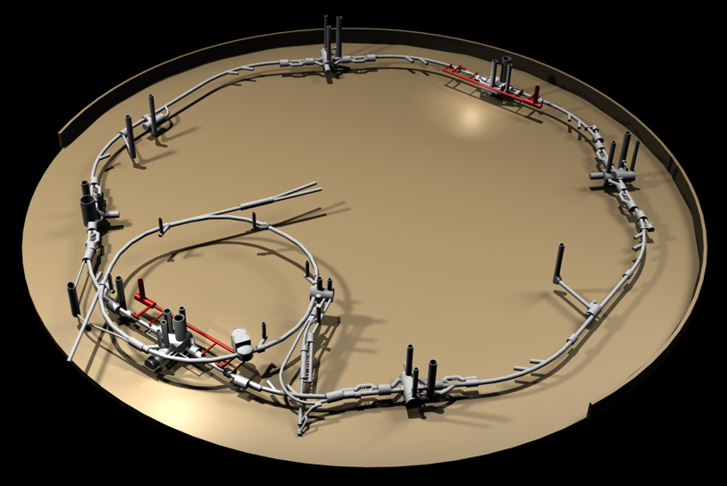
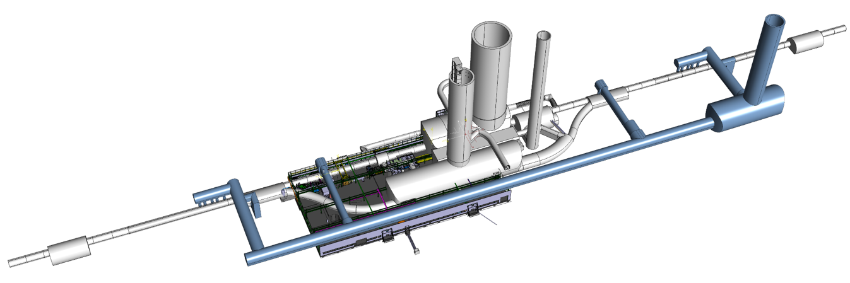
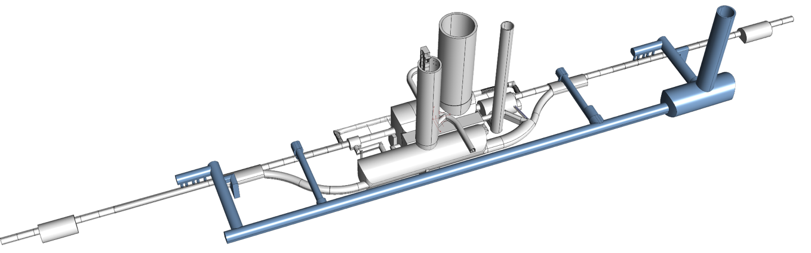
HL-LHC IT STRING a reproduction of HL-LHC P5L
P4
P5
P5
P3
P2
HL-LHC
P6
P5R
SPS
P7
P1
P5L
P8

Slide 8
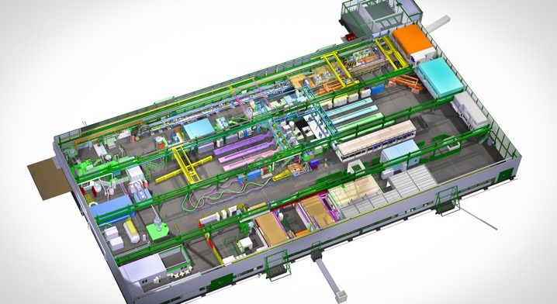
HL-LHC IT STRING in the SM18
STRING area
Horizontal benches for cryo magnets
Magnet test cryostats
Cryogenic infrastructure
SC link system test bench
RF test zone

Slide 9
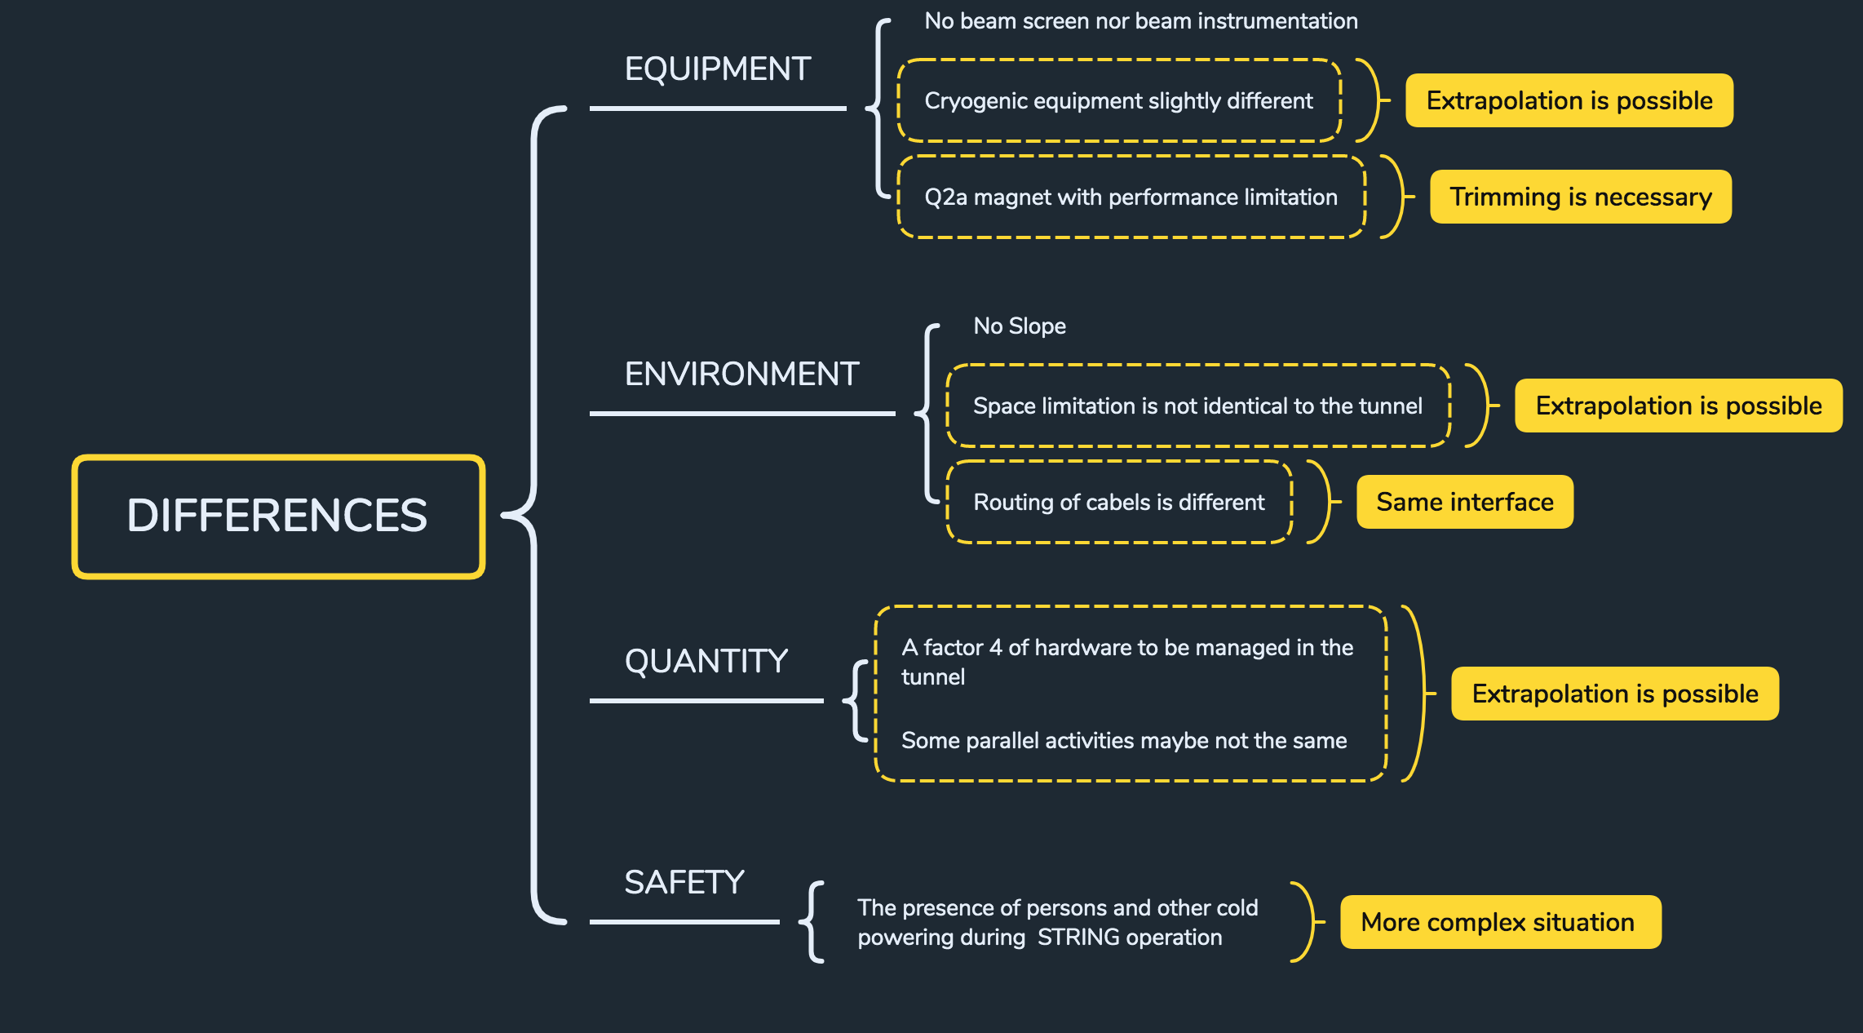
DIFFERENCES BETWEEN THE IT STRING AND HL-LHC

Slide 10
THE MAJOR COMPONENTS OF THE IT STRING
Integration done by. A. Kosmicki

Slide 11
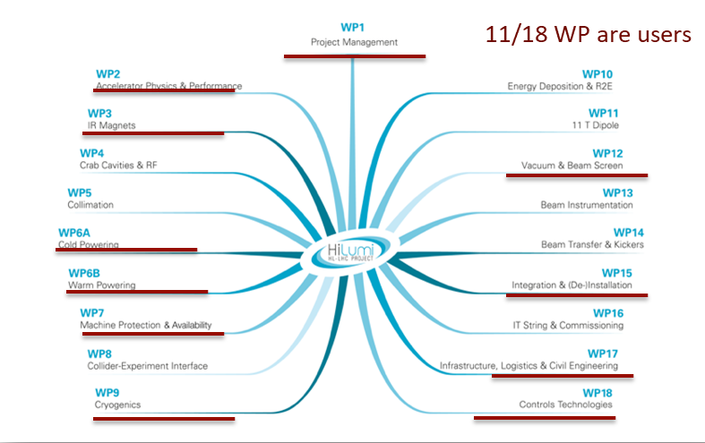
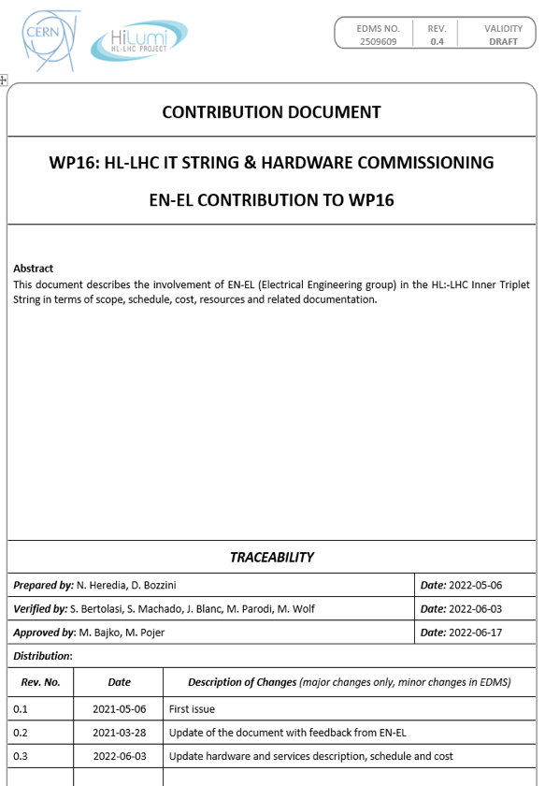
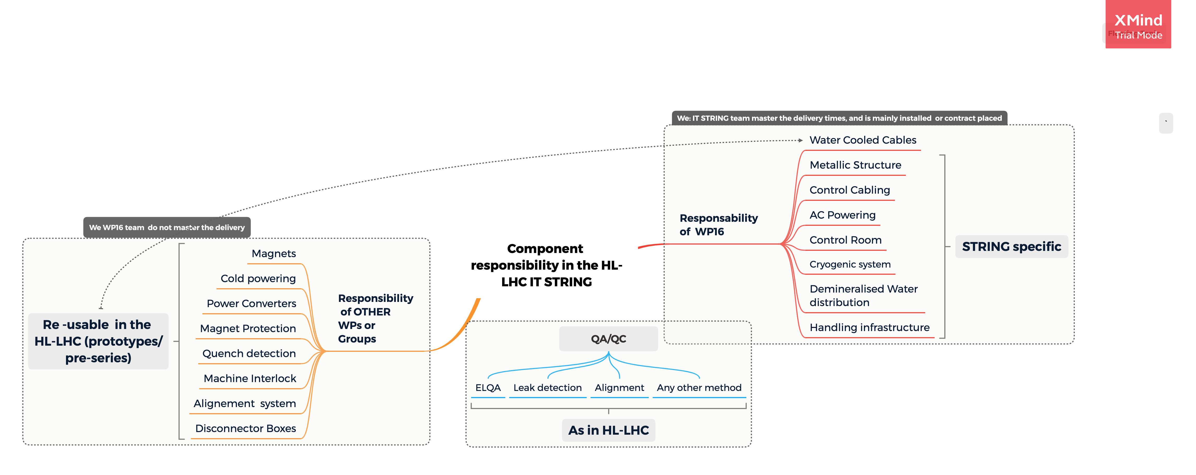
COMPONENT RESPONSIBILITIES OF THE IT STRING
The interfaces fall the responsibility of various WPs. The String -being an early activity mirroring the installation of the HL-HLC - facilitates the discovery of grey zones.
WP16 contract with the different users or contributors

Slide 12
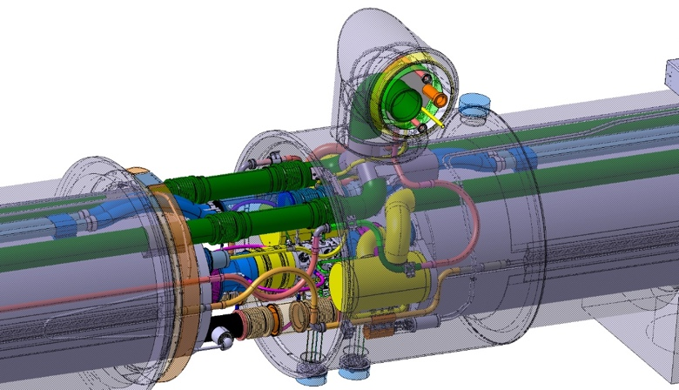
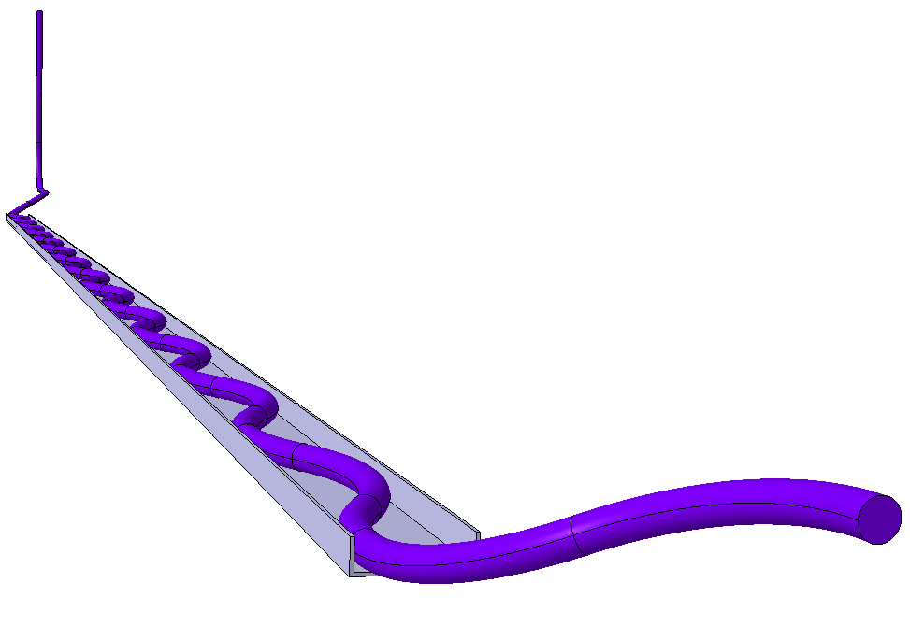
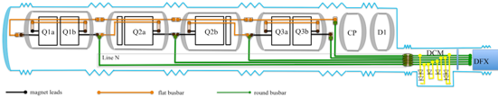
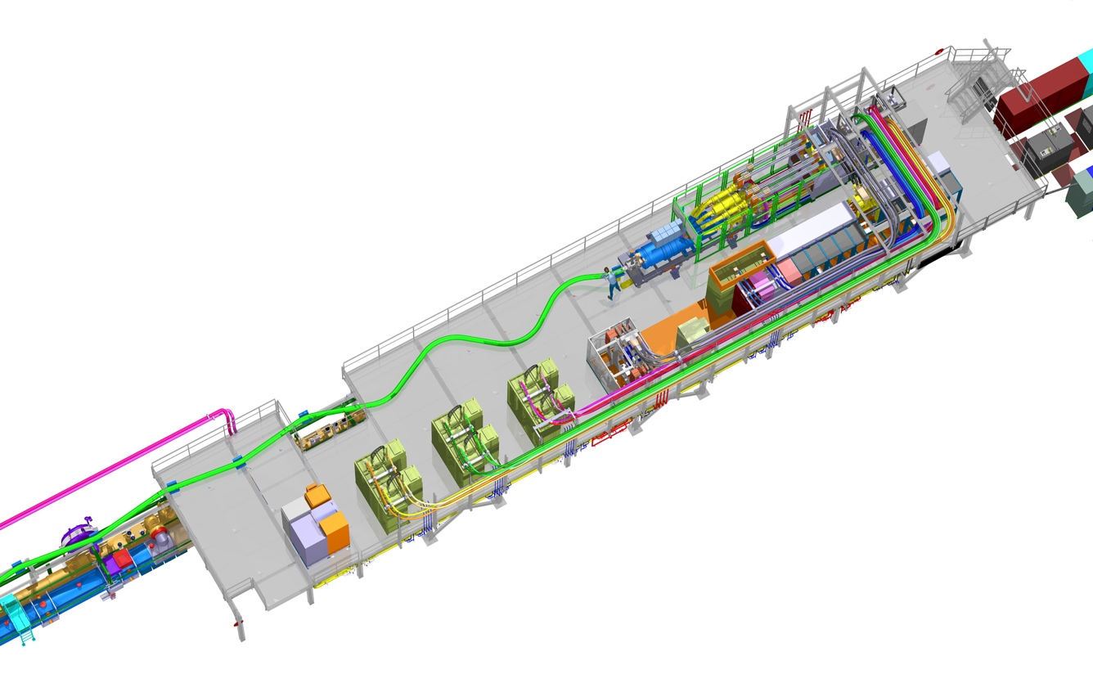
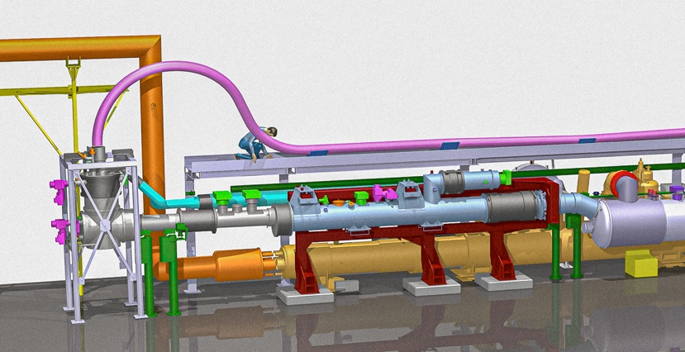
LEARNING DURING INSTALLATION?
This is the first time that the individually-tested magnets will be interconnected, following the procedures which h had been defined for the new HL-LHC inner triplet
D1
CP
Q3
Q2b
Q2a
Q1
Validation of the procedures, the time duration and of the space requirements for the installation/ Mainly regarding the interconnection of the Magnets, (including the splices), the QXL and the N line.
Validation of the assembly procedures of of the DFX and its interconnection with the DCM.
Validation of the routing of the SC link, also of the WCC
DFHX
DCM
D1
Ex. of Sc Link for the D2 at P5L draft proposal in July ‘21 by M. Gonzalez de la Aleja
Validation of the handling of the SC link system: of the conjoined DFHX and SC link together.
Water-Cooling distribution in two possible configurations.
DFX

Slide 13
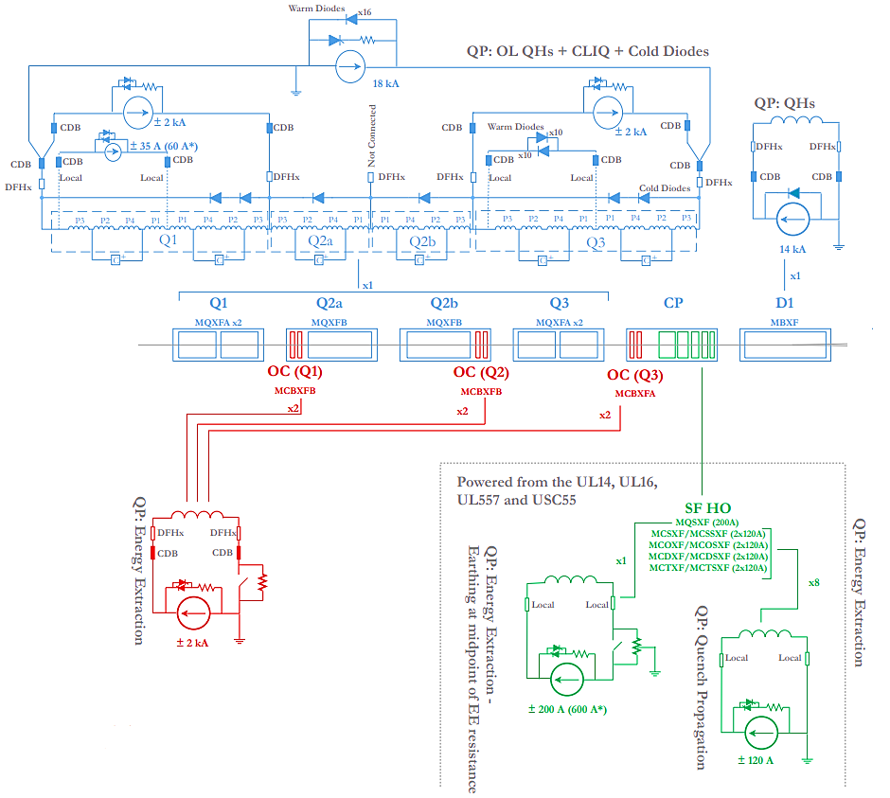
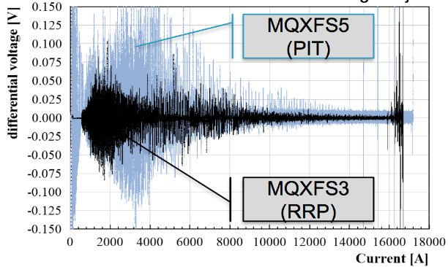



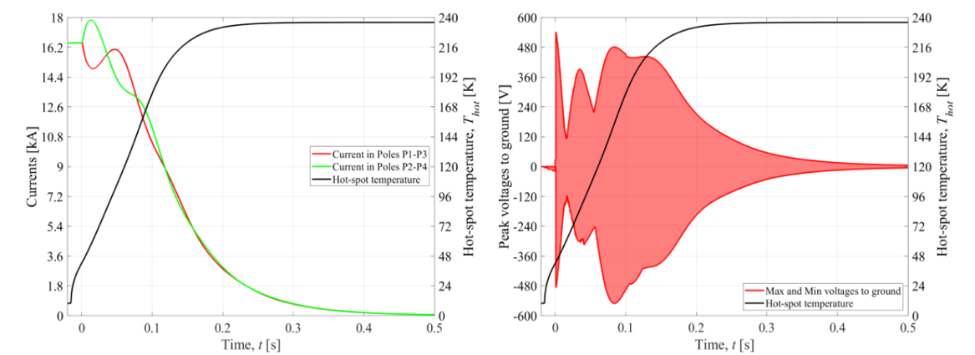
LEARNING DURING STRING HWC AND OPERATION
Ex. Validation of the new POWERING AND PROTECTION STRATEGIES
Define thresholds and validate the quench detection considering cross-talk among circuits and flux jumps, in order to increase the availability and reduce the amount of false triggers in both HWC and in the operation while keeping a suitable quench detection scheme.
VALIDATE the new powering scheme:
ex. new decoupling algorithm parameters for the circuit nested control and the new FGC parameters for the HL-LHC IT circuits.
Ground to Cold mass transfer function validation (vibration measurements)
Flux jumps
Validate the protection strategy combining CLIQ and QH
Validate the energy extraction with the new technology
Ex. of flux jumps recorded during individual model magnet test
Validate the Interlock system for machine protection.
Check how the SYSTEMS TOGETHER can be commissioned…(also including WCC performance, CV circuitry, cryogenics etc
Validate the new hardware, software and procedure for the HL-LHC ElQA

Slide 14
STRING INTEGRATION AND INSTALLATION

Slide 15
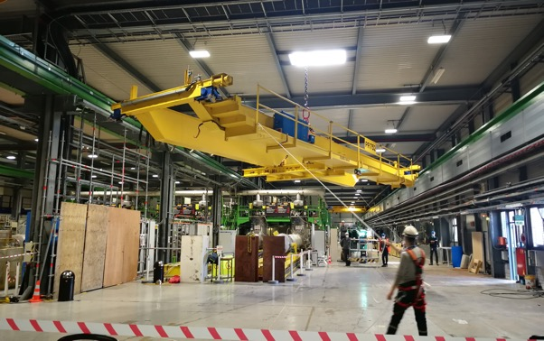
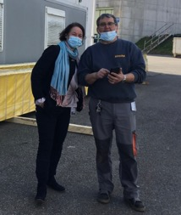
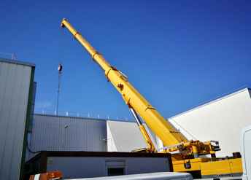
STATUS IN PICTURES: OVERHEAD CRANE
COMPLETED
necessary for the Cold powering system installation
New overhead crane installation
@ reception

Slide 16
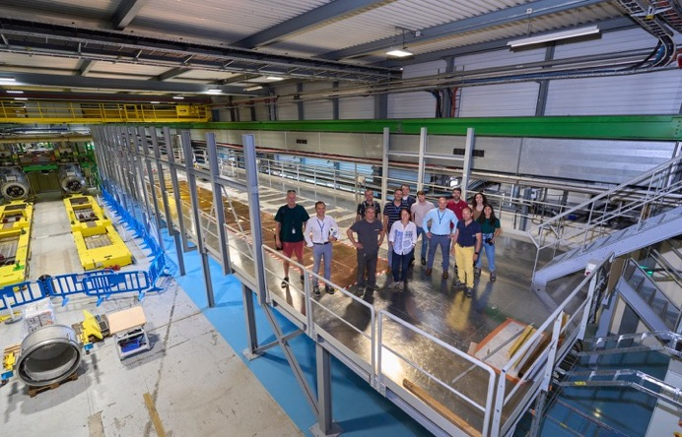
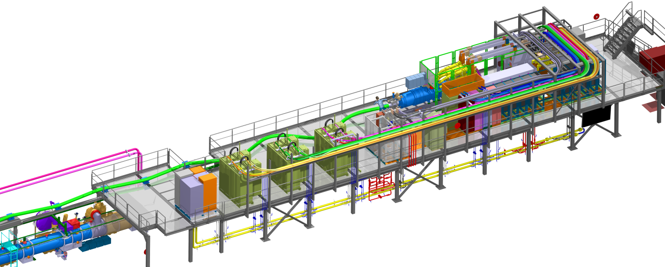
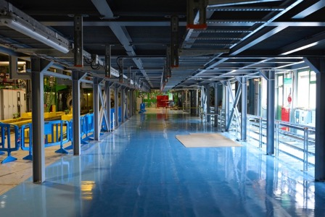
STATUS IN PICTURES: METALLIC STRUCTURE
COMPLETED
for the installation of the powering elements
On top of the metallic structure
Under the metallic structure

Slide 17
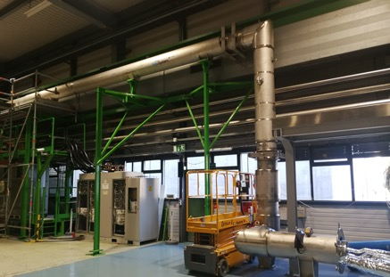
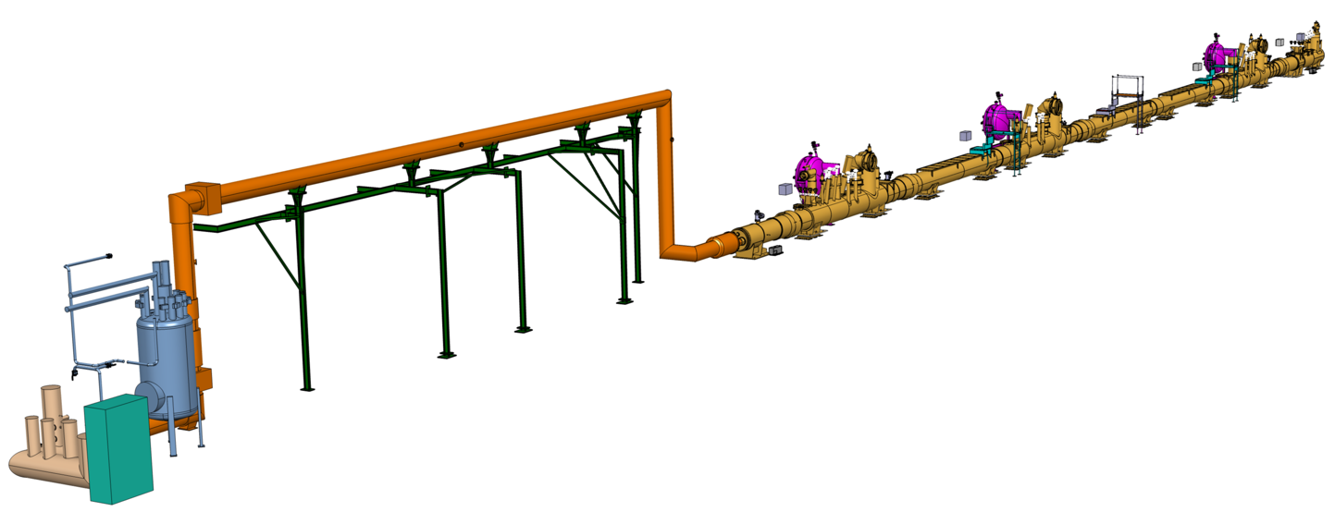
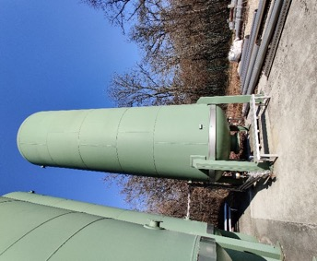
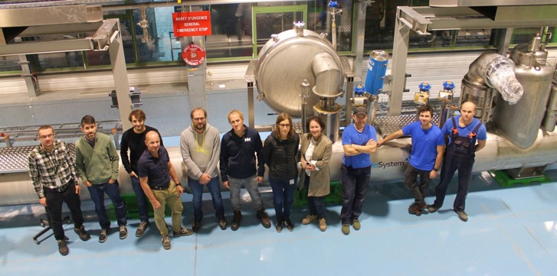
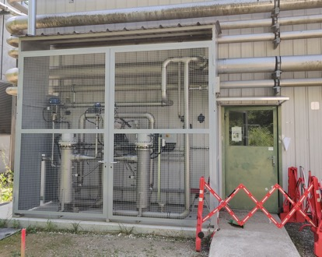
STATUS IN PICTURES: CRYOGENICS
COMPLETED
HWC of the system before connected to magnets and cold powering planned this summer
WQB
Proximity cryogenics
SQXL with TE-CRG ,
KrioSystem and String team

Slide 18
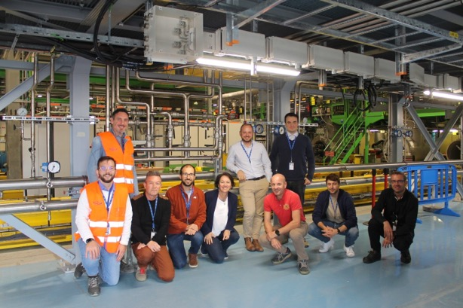
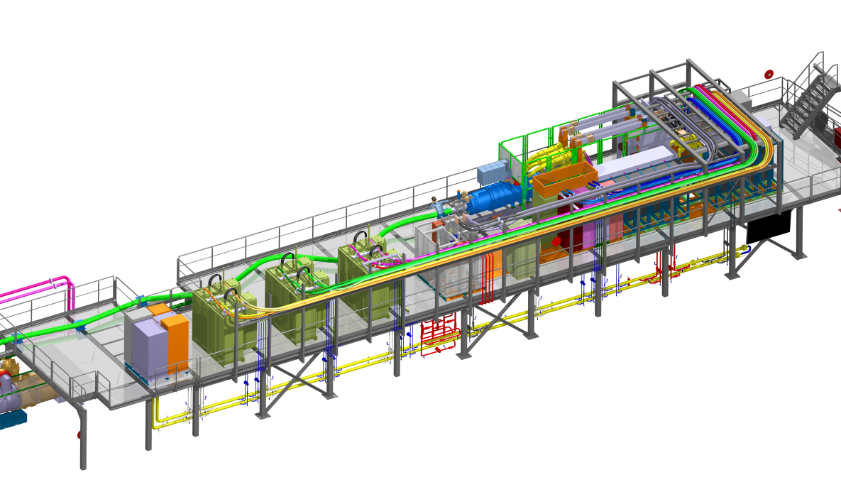
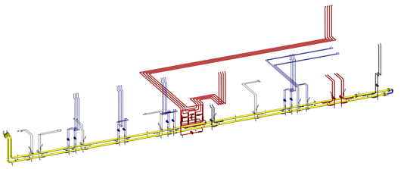
STATUS IN PICTURES: DEMINERALISED WATER
COMPLETED 95%
including a system allowing to make comparative test of series or parallel distribution
Demineralised water distribution with EN-CV and STRING team

Slide 19
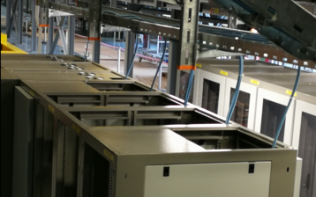
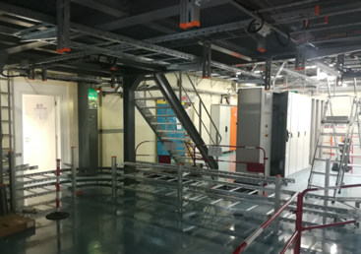
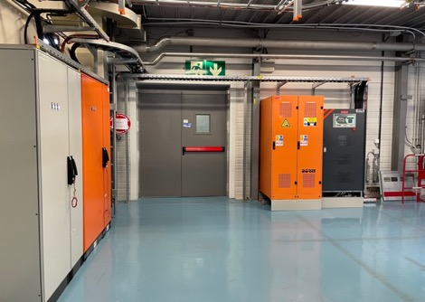
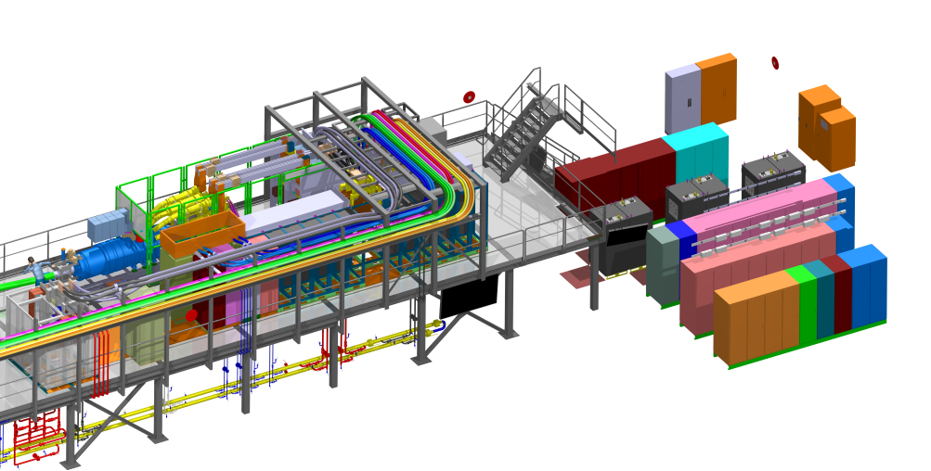
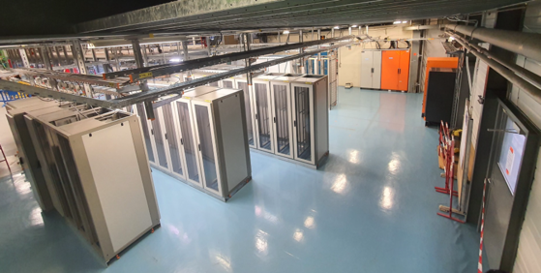
STATUS IN PICTURES: OTHER INFRASTRUCTURES
AC, DC & Signal cable trays (Rack area)
Ethernet network
UPS Switch Board
Batteries
UPS Controller Rack
COMPLETED to 75%
Racks

Slide 20
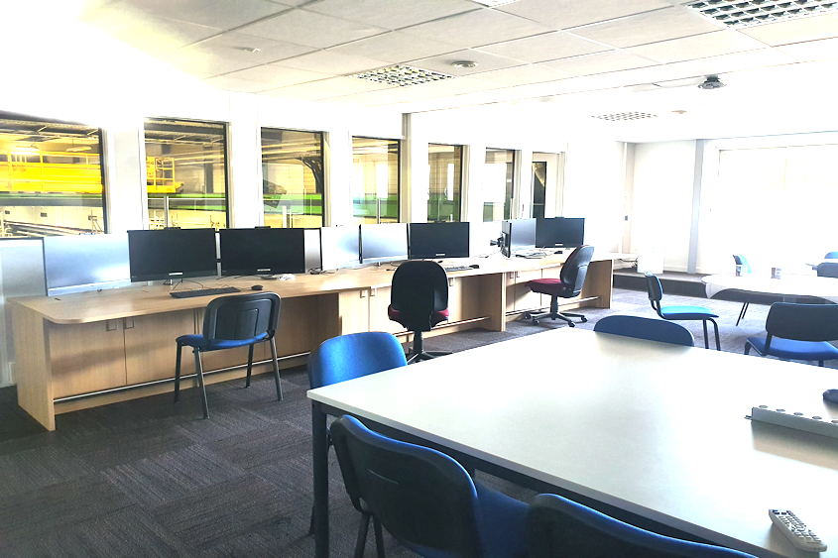
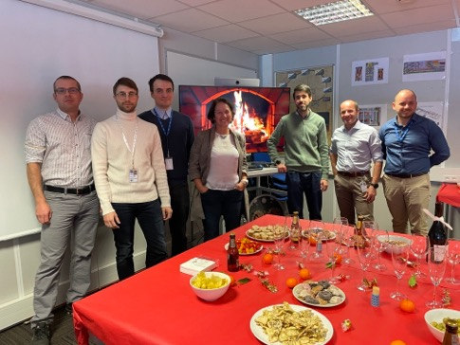
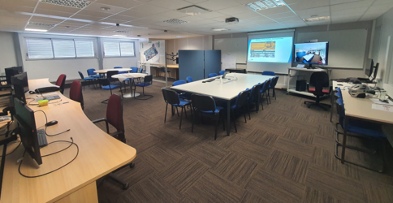
STATUS IN PICTURES: STRING CONTROL ROOM
COMPLETED 95%,
ready to perform the IT STRING Validation Program.
Control layers strategy is made and work is planned for 2023.
Xmass drink Dec 2022
New control room, with space for meetings and every day work

Slide 21
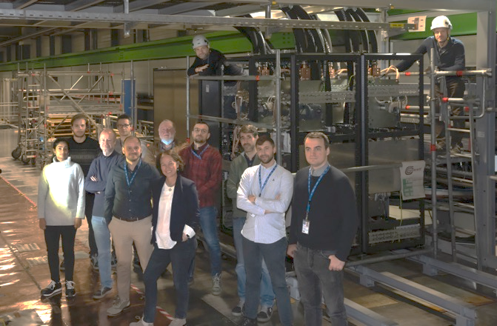
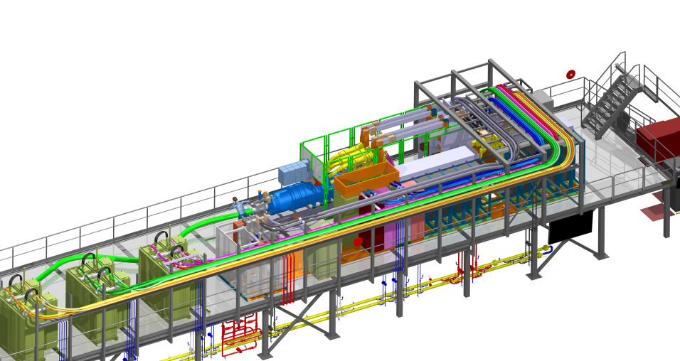

STATUS IN PICTURES: CDB INSTALLATION
COMPLETED
the CDBs were the first equipment belonging to a HL-LHC WP (the WP6b) installed into the STRING
CDB installed in the STRING with SY-EPC and STRING team
CDBs at reception

Slide 22



STATUS IN PICTURES: WCC INSTALLATION
WCC positioned on the CDB side
https://videos.cern.ch/record/2297271
COMPLETED 85%
positioned and connected to the CDBs.

Slide 23


STATUS IN PICTURES: EE INSTALLATION
STARTED
The EE belonging to WP7 racks are installed on the platform
EE racks installed in the STRING with TE-MPE, WP7 and STRING team

Slide 24



STATUS IN PICTURES: PC INSTALLATION
COMPLETED
The PC belonging to WP6b are delivered to the STRING platform
PC racks installed in the STRING with SY-EPC, WP6b

Slide 25
STRING VALIDATION PROGRAM

Slide 26
WP16
HL-LHC IT STRING and HL-LHC HWC
The HL-LHC IT STRING will serve as a test bed [….]. The HL-LHC IT STRING should therefore validate operational modes […] in view of the hardware commissioning and operation periods in the HL-LHC era. […]
The HARDWARE COMMISSIONING phase should extend its activity to all equipment that will be installed in the insertion regions [..].
The hardware commissioning (HWC) activity will focus on the preparation and execution of detailed procedures […] including their individual system tests and a short circuit test campaign, […] consolidated operational tools obtaining the final validation of the superconducting circuits.
Extract from the Mandate of the WP16

Slide 27






From String Validation Program Phases to HL-LHC HWC
HL-LHC IT STRING Validation Program Document
(Goals and Methods)
LHC-XMS-ES-0020, EDMS no. 2664290
First implementations of the HL-LHC procedures fully inspired from LHC procedures of similar circuits and time for optimisation
Final version of HL-LHC procedures ready for validate for the HL-LHCHWC
LS3
HL-LHC HWC
LHC HWC Procedures
HL-LHC HWC Procedures

Slide 28
THE IT STRING VALIDATION PROGRAM
Fully approved the admonition that present NCR of components will limit the powering to below nominal with 200 A.

Slide 29
STRING SAFETY

Slide 30

IT STRING – SAFETY
We consider six main safety sections covering the entire IT String life cycle
Roles and responsibilities
Design safety
Applicable standards, norms, rules and regulations
IT String life cycle
Design / integration
On-site construction and coactivities
Installation and assembly
SM18
environment
Construction
Assembly
Functional and dysfunctional analysis
Commissioning and operation
Anticipate/identify what can go wrong. Safe operation
Operation
Dismantling

Slide 31
IT String Safety – Roles and responsibilities*
TE DL Miguel Jimenez
TE-MPE GL Felix Rodriguez Mateos
TE-MPE-SF SL Marta Bajko
TE DSO Delphine Delrieux-Letant
IT String TSO Davide Bozzini
HL-LHC PSO Thomas Otto
IT String HSE Carlos Gascon
EROS Emanuel Paulat
Line
Management
Responsibility
role
TE DL
TE DSO
Advisory
& supporting
role
TE-MPE GL
IT String TSO
TE-MPE-SF SL
HL-LHC PSO
Roles and responsibilities
EROS
IT String
Magnet test benches
DL Department Leader
GL Group Leader
SL Section Leader
DSO Departmental Safety Officer
TSO Territorial Safety Officer
PSO Project Safety Officer
HSE Health, Safety & Environmental
EROS Engineering Referent for Operational Safety
IT String HSE
RF Test benches
SM18 TSO
SM18
Technical infrastructures
* According to SR-SO ‘’Responsibilities and organizational structure in matters of safety at CERN’’

Slide 32



IT STRING ACCESSIBILITY
During commissioning and operation
High
1 – Forbidden area
According to raccomandations of ‘’Electrical failure modes of the Inner Triplet in SM18’’ – EDMS 2575427’’
2 – Controlled area
Fenced and access-controlled
Facilitate activities in the neighbouring areas
3 – Extended area
Including clusters A, D, G, H and transit areas
To grant safety during first high-energy powering tests and quenches
Energy thresholds and types of tests to be determined
Whenever and wherever needed (under study)
Patrolling before powering
CCTV in IT String control room
Powering tests performed outside normal working hours
1
2
3
Individual system
commissioning
and first powering
Energy / current level
SM18
environment
Low
0
50
150
≈1000
High
Distance [cm]
Test program once all
systems are commissioned
1
2
Commissioning and operation
Energy / current level
Low
0
50
150
≈1000
Threshold to be determined
Distance [cm]
3
3
3
1 & 2 forbidden and controlled areas
3 Extended area (proposal)
Mezzanine
1 and 2
String of magnets
1/2
1/2
3

Slide 33


PERSPECTIVES : IMPLEMENTATION OF ACCESS
  Technical feasibility of fixed fences has been confirmed
  3D integration proposal available
  Technical note is ongoing
  Submittal of proposal for approval including associated budget done November 2022
SM18
environment
Evacuation path from control room and mezzanine
Doors for access and evacuation from control room and mezzanine

Slide 34
STRING SCHEDULE and RESOURCES

Slide 35

Present Hl-LHC IT STRING SCHEDULE
The critical path is sill driven by the delivery of the last cryo-magnet to the String.
The next critical item is the Sc link system delivery and installation.
There is now a clear overlap between the STRING operation and LS3.

Slide 36

RESOURCES & RESOURCE
DISTRIBUTION IN TIME
Extract of the resources from the IT STRING planning specifically during critical periods is sent to the line management for mitigation action.

Slide 37
STRING OPERATIONAL SCHEME and RESOURCES

Slide 38

OPERATION SCHEME

Slide 39
OPERATION RESOURCES
From String Validation Program Phases to HL-LHC HWC
LS3
SM18 Individual magnet test
HL-LHC IT STRING
LS3
(HL)
LHC HWC
HL-LHC OP
Resources trained at SM18 on individual magnet test operation (TE-MSC )
Shared resources between SM18 individual magnet test operation ( TE-MSC ) and STRING team (TE-MPE)
Shared resources between LHC Operation ( BE-OP) and STRING team (TE-MPE)
LHC Operation ( BE-OP)
Synergy with magnet testing team trained for magnets and SM18 environment
Synergy with LHC operation team trained on STRING for HWC participation
Not Wp16
Wp16
LS3

Slide 40
Conclusions-Summary
THE HL-LHC IT STRING is a temporary test stand for the HL-LHC Project
STRING Integration and Installation
  Infrastructure advanced following the schedule. The 2023 perspectives are the warm and cold powering installation, IST and SCT
STRING Validation Program
  HL-LHC IT STRNG test program approved. Work started on the HL-LHC HWC procedures ( as part of the WP16 mandate) , starting with the circuits used in the HL-LHC IT STRING, to be finalised together with the HL-LHC like software and control layers in 2023. Responsibilities and road map defined.
STRING Safety
  Responsibilities defined, safety is followed following the different subjects ( 6 legs). Today we plan to implement the approved access strategy and follow up strictly the safety instructions during the installation (and later operation) phase .
Schedule and Resources
  Today there are two critical overlaps ( EYETS 23/24 and LS3) that may imply the needs of common resources but mothing would impede collecting information from the test stand before the HL-LHC IT zones are installed in the LHC tunnel.

