Slide 1

CERN Superconducting Magnet Test Facility
Gerard Willering
24 April 2024
4th Superconducting Magnet Test Stand Workshop
https://agenda.infn.it/event/32061/
For the team:
Franco Mangiarotti, Jerome Feuvrier, Gaëlle Ninet, Patrick Viret, Olivier Ditsch, Guillaume Pichon, Stian Juberg, Filip Kosowski, Deepak Paudel, Ruben Keijzer, Dimitris Dardanis
Marco Buzio, Lucio Fiscarelli, Carlo Petrone, Stephan Russenschuck
Thanks to support from Fred, Yannick, Jean-Luc, Fred, Raph, Maxime, Abdelhay, Bertrand

Slide 2
Purpose CERN SM18 Superconducting Magnet Test Facility
Qualification of magnets before installation in the LHC/HL-LHC
  Mostly on horizontal test benches
Prototype and model magnet testing, corrector magnet qualification
  Mostly on vertical test benches
Test bed for enabling technology
  Power converters, data acquisition systems, quench detection systems, protection systems like CLIQ, energy extraction, etc.

Slide 3
SM18 building layout
HL-LHC string test facility: See talk Marta Bajko
HL-LHC String test
Vertical benches
Horizontal benches
Superconding RF cavities
Cryogenics
Building shared between:
- Cryogenics installation Frédéric Ferrand
- RF cavities testing: not represented
- HL-LHC string: Marta Bajko
- Magnet test benches: This presentation

Slide 4
Magnet test facility timeline
~2000: 12 horizontal test benches for LHC magnet testing
~2010: Vertical benches created with 3 cryostats + 1 cryogenic feedbox
~2017: Cluster D + HFM vertical cryostats ready
2019-2022: Modification Cluster F2 started for SC link + powering circuits for F1
2023-2024: Shuffling modules on 4 test benches
For a historical view, see also https://indico.cern.ch/event/978830/

Slide 5
SM18 Main cryogenic circuits
1.9 K
String test facility
4.5 K
80 – 300 K
12 g/s pumping (1)
RF cavities test benches
1.9 K
Added to RF and Magnet bench pumping capacity when String does not require pumping
1.9 K
4.5 K
24 g/s cold box
80 – 300 K
4.5 K
Horizontal Magnet test benches
A1, A2, B1, B2, C1, C2, E1, E2, F1, F2
Backup possibility
1.9 K
4.5 K
80 – 300 K
35 g/s cold box
Lhe dewar 25 m³
(Temporary replaced by 10 m³)
4.5 K
4.5 K
Vertical magnet test benches
12 g/s pumping (2)
1.9 K
1.9 K
Long
Siegtal
4.5 K
LN₂ –> GHe heat exchanger, ~80 g/s at 80 K
1.9 K
HFM
Cluster D
4.5 K
80 – 300 K
80 – 300 K
4.5 K
VTC
‘Feedbox’
Not available at CERN: cryocooler test station with magnet powering option.
LHe+GHe mixer
4.5 to 80 K
300 K GHe
Cryogenic operation by TE-CRG section,
see presentation Frederic Ferrand on helium availability.

Slide 6
Horizontal test benches
Qualification of magnets before installation in the LHC/HL-LHC

Slide 7
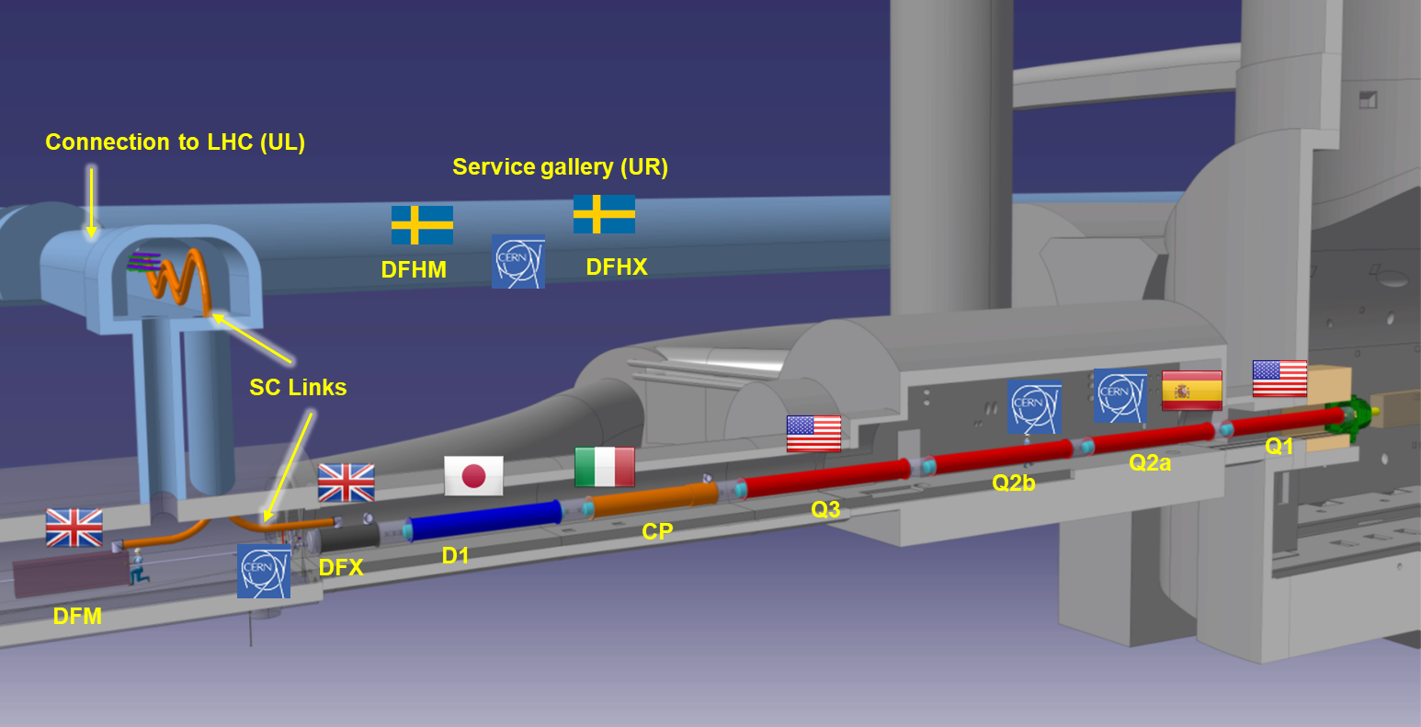
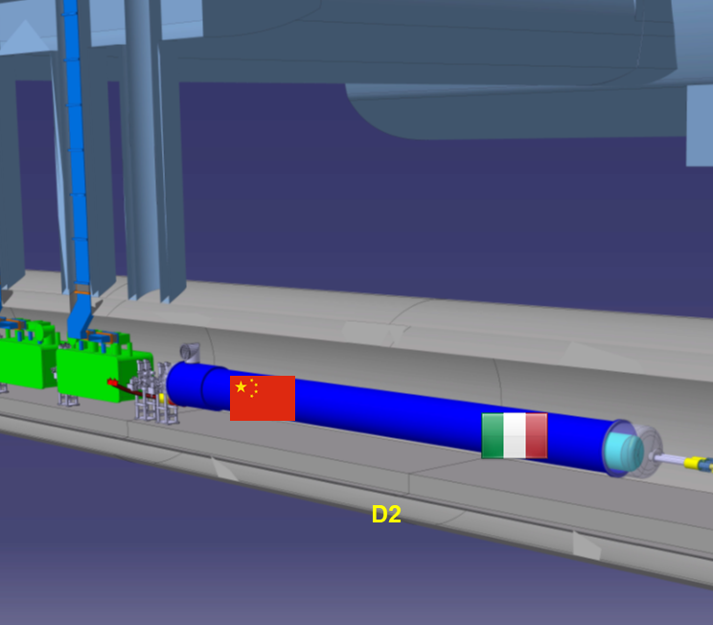
Getting ready for the HL-LHC
New set of magnets around two interaction points
4 times Q1, Q2a, Q2b, Q3, CP, D1, SC link, SC-link, D2 + spares to be tested and installed in the coming years.

Slide 8
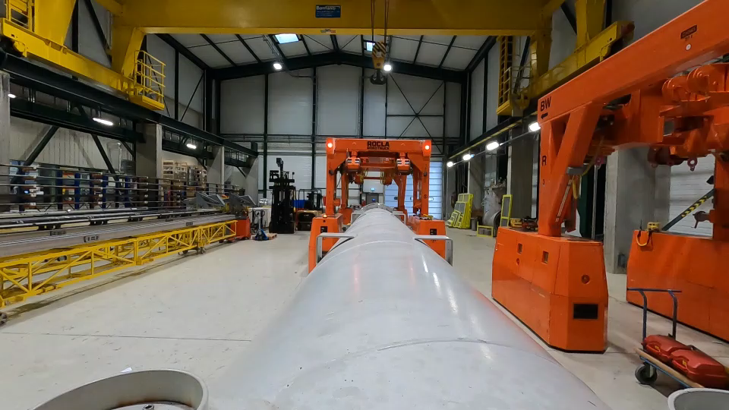
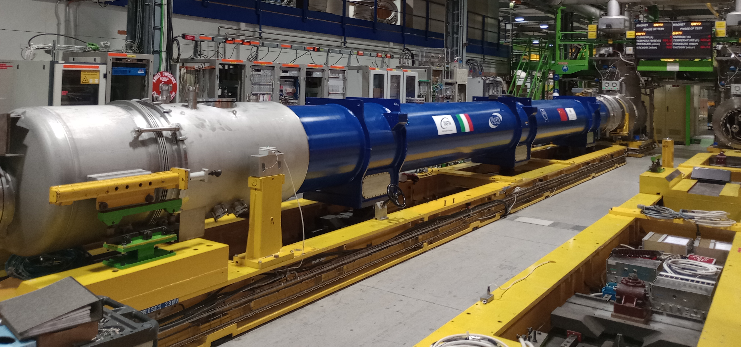
Horizontal test benches
Placement of an MQXF magnet on the horizontal test bench
D2 prototype – 15 meter long first full assembly for HL-LHC currently in test.
On horizontal test benches in the next 3-4 years:
Qualification for the HL-LHC for
~ 40 full magnet assemblies
~ 10 SC link systems
Horizontal benches are not used much for collaborations, since they are used for full magnet assemblies in their final cryostat.

Slide 9
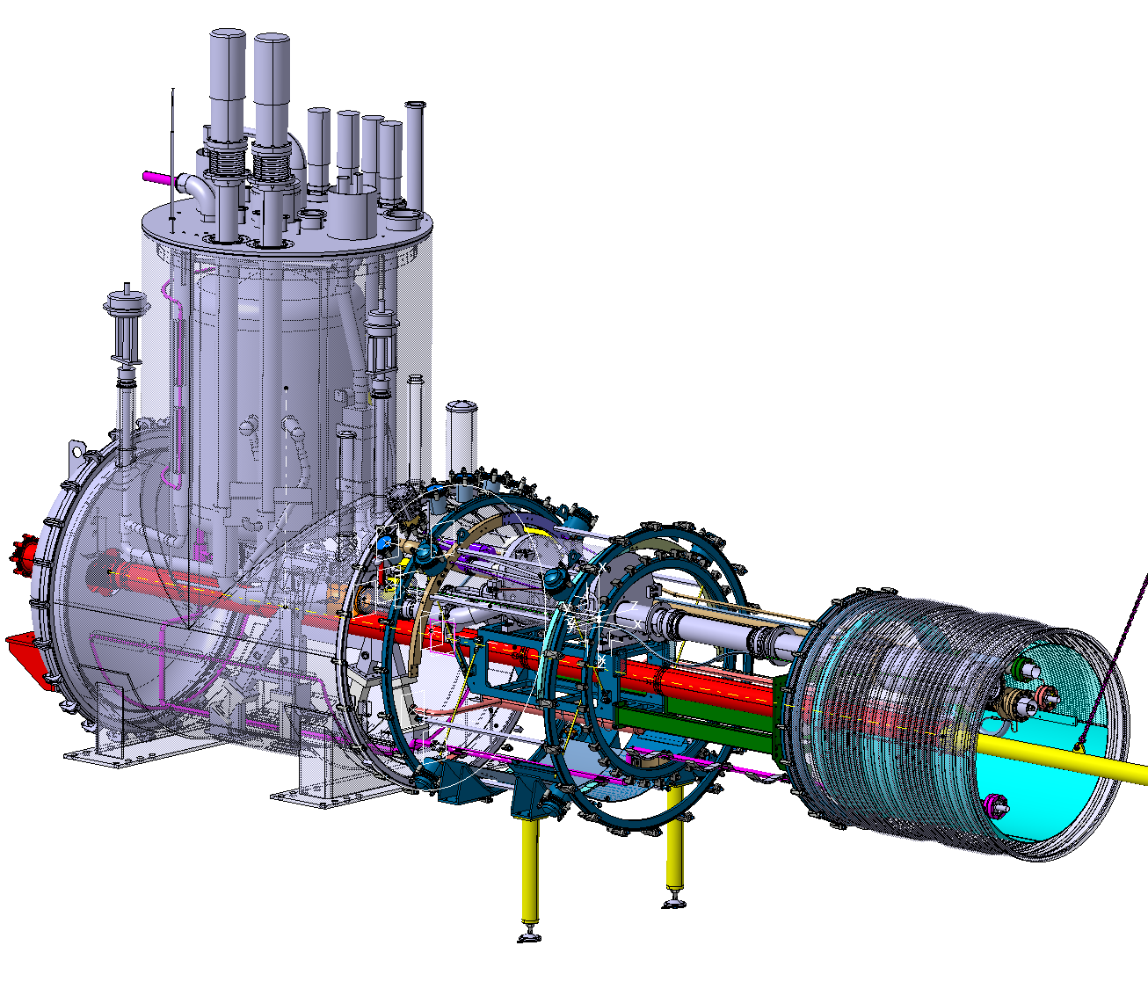
Horizontal test benches
Main upgrades:
Additional temperature probes for delta T control during 80-300 K HeGas cooled/heating phases for Nb₃Sn magnets. (since ~2018)
Shuffling module to facilitate HL-LHC 4.5 K operation and magnet connection
New anti-cryostats for 105 mm and 150 mm aperture magnets.
Cryogenic feed box or CFB
(~20 years)
Anti-cryostat
(1 per aperture)
Shuffling module
(new in 2023)
Courtesy
Arnaud Vande Craen
Olivier Pirotte (present at workshop)
Carlos Solano Eizaguirre
Image from: link

Slide 10
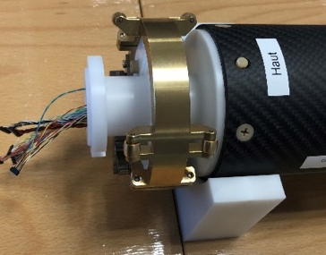
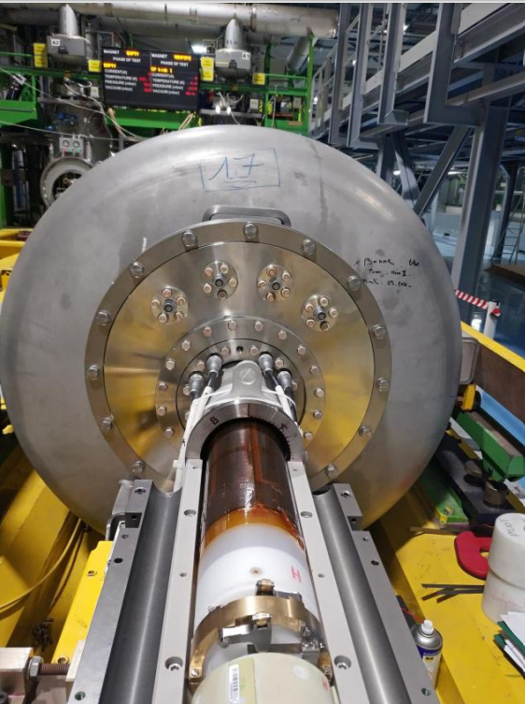
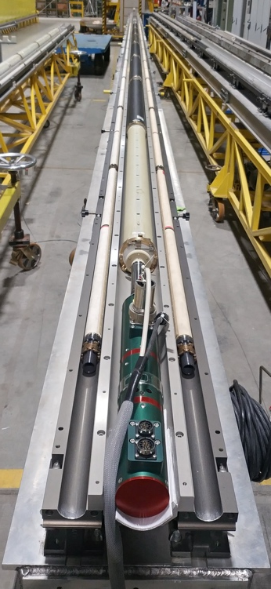
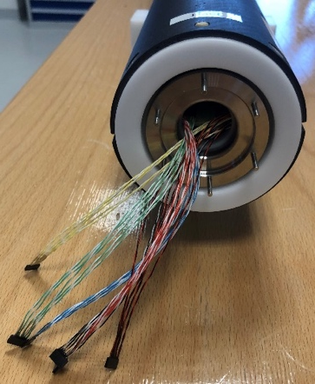
Magnetic measurements
New rotating magnetic measurement shafts for MQXF magnets with carbon tubes.
New type of Quench Antenna with flexible PCB technology, measuring ‘harmonics’.
See presentations Stephan Russenschuck (Thursday) and Lucio Fiscarelli (Friday)

Slide 11
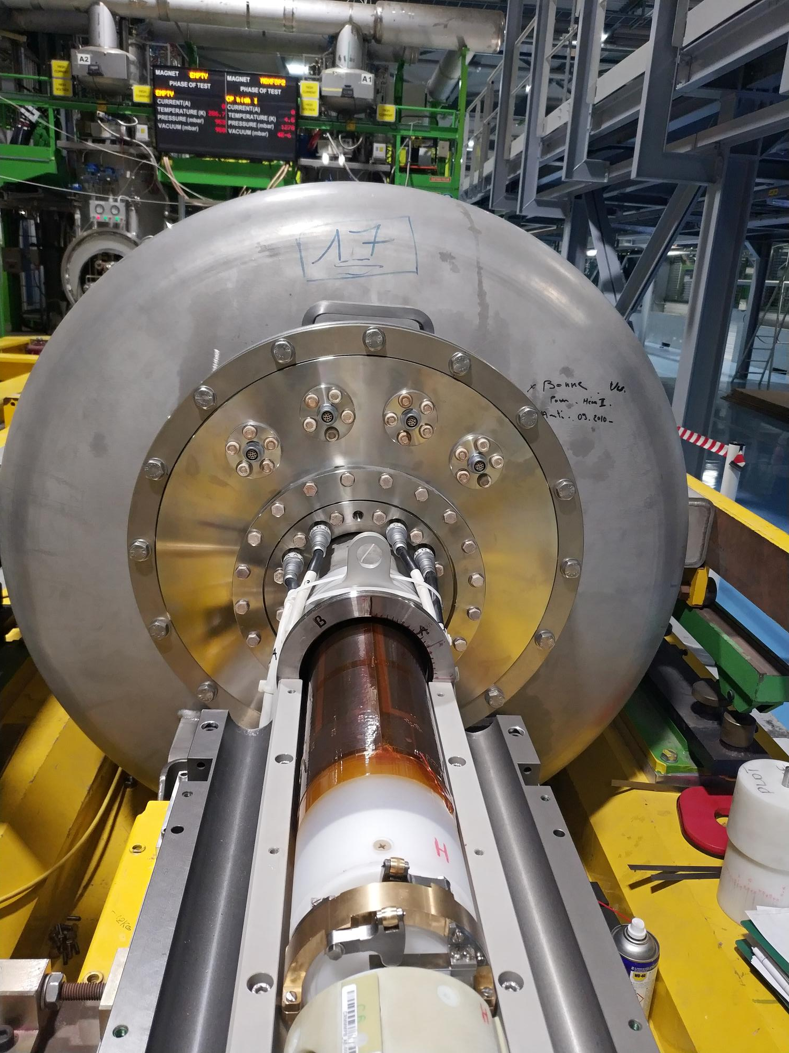
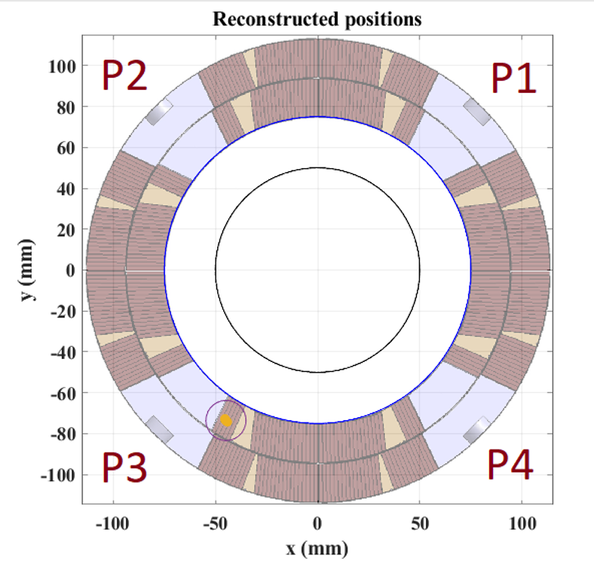
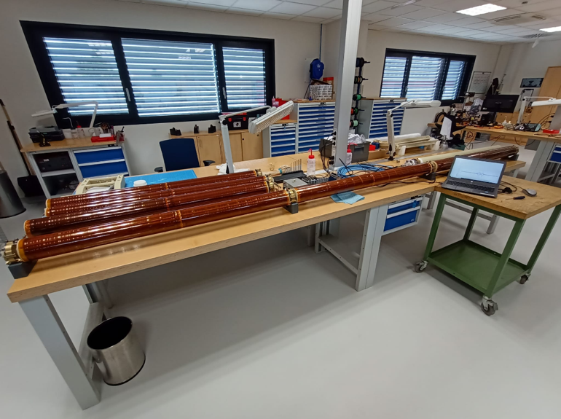
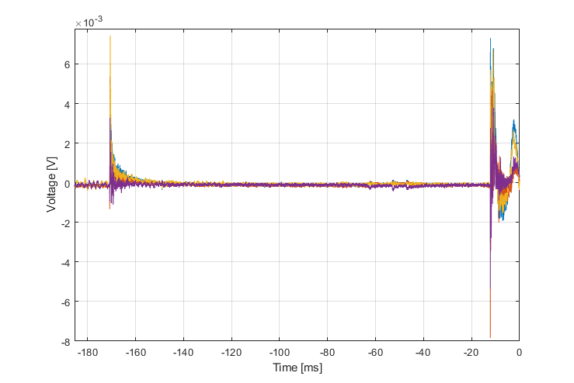
Instrumentation
Team expertise and development on most instrumentation types.
Example: Quench localization using flex PCB - B3,A3,B4,A4 sensitivity, 12 segments on 6 shaft = 48 channels
See presentation Lucio Fiscarelli

Slide 12
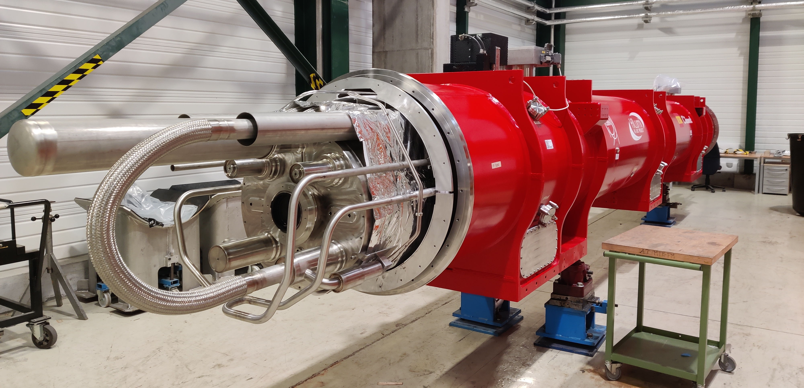
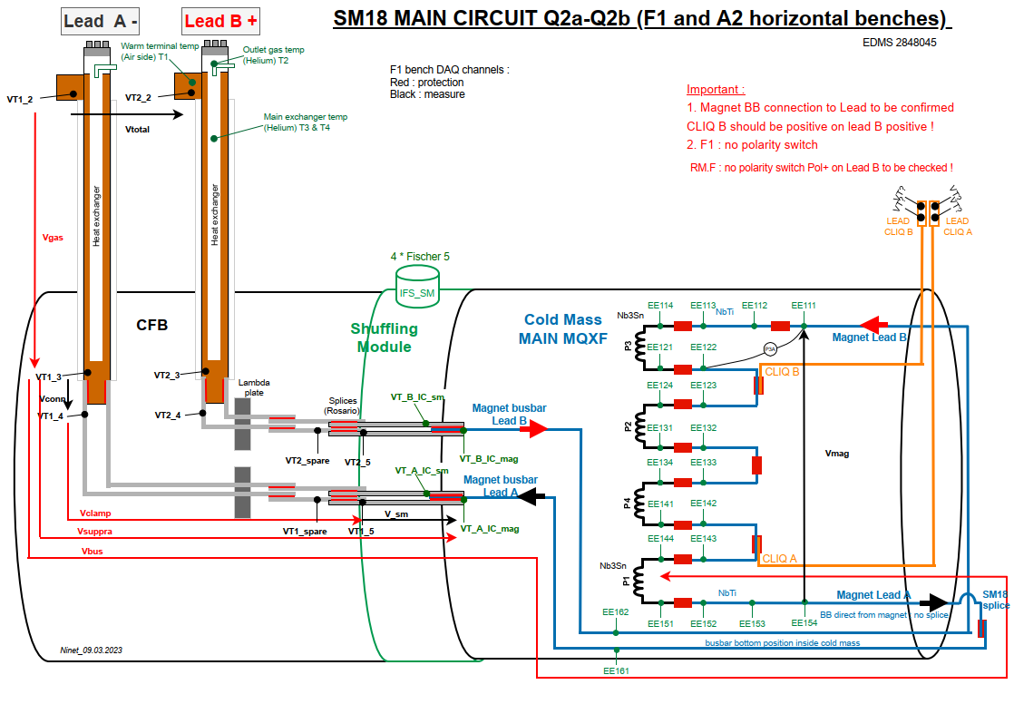
Horizontal test benches
Electrical connection scheme:
Main powering circuits connected through the ends.
Up to 120 A circuits on the cryostat side
Instrumentation connected on top of the magnet, including QH, voltage taps, CLIQ, fiber optics, etc.
Courtesy Gaëlle Ninet

Slide 13
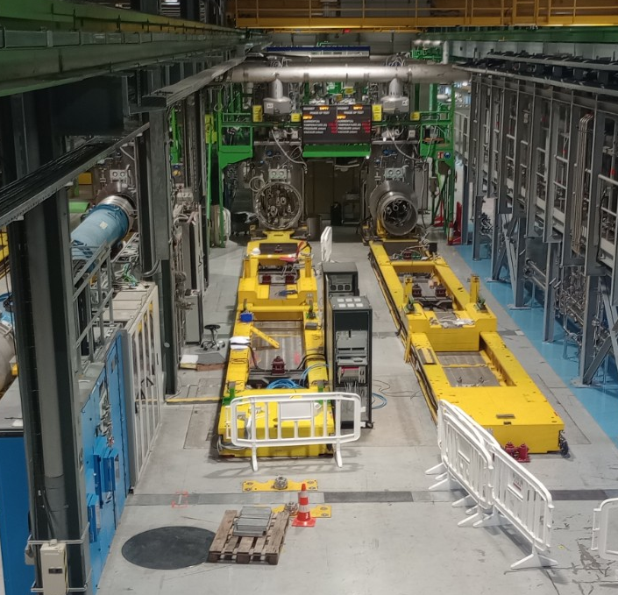
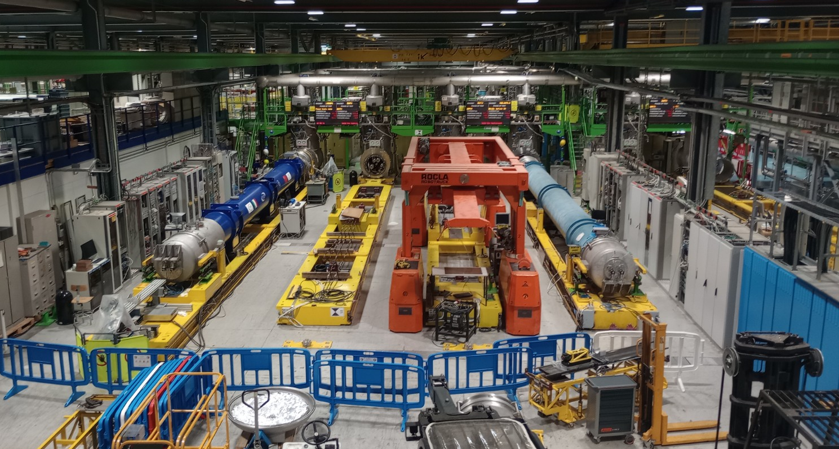
Bench compatibility
Each bench optimized for 1 type of magnet:
A1: MQXF test cryostat (18 kA)
A2: Corrector package + Q3 (20 kA + 2*2 kA + 120 A circuits)
B1: LHC MB and MQ (13 kA + 2*600 A)
B2: D1 (13 kA)
C1: 11T (13 kA + 2*600 A)
C2: D2 (13 kA + 2*600 A)
E1: spare
E2: spare (shaft storage)
F1: Q2 (18 kA + 2*2 kA)
F2: SC link (18 kA + 13 kA + 2*2 kA)

Slide 14
Vertical test benches
Prototype and model magnet testing, corrector magnet qualification

Slide 15
Vertical test benches
5 cryostats
Variable temperature
Cluster D
Long
HFM
Siegtal

Slide 16

Important contributions from experienced mechanics and transport team.
https://www.youtube.com/watch?v=w1jdZHvl_-w

Slide 17
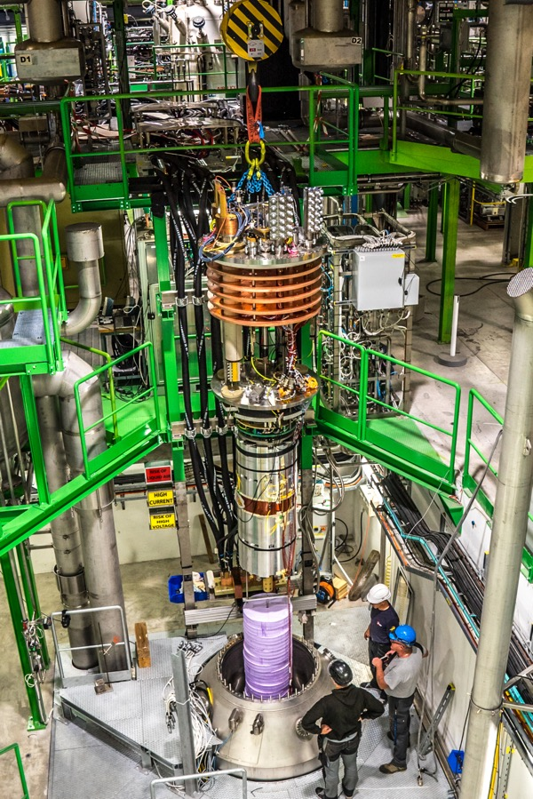
Cluster D cryostat
Longest vertical cryostat ~5.2 meter useful length
0.8 m diameter
30 kA power supply + EE
Two 2 kA power supplies + EE
Test at 4.5 K and 1.9 K
Precooling and warming up between 80 and 300 K with controlled Ghe temperature.
Currently limited to 2.5 meter long magnets: rotation tower in production for 5.2 meter long magnets.

Slide 18
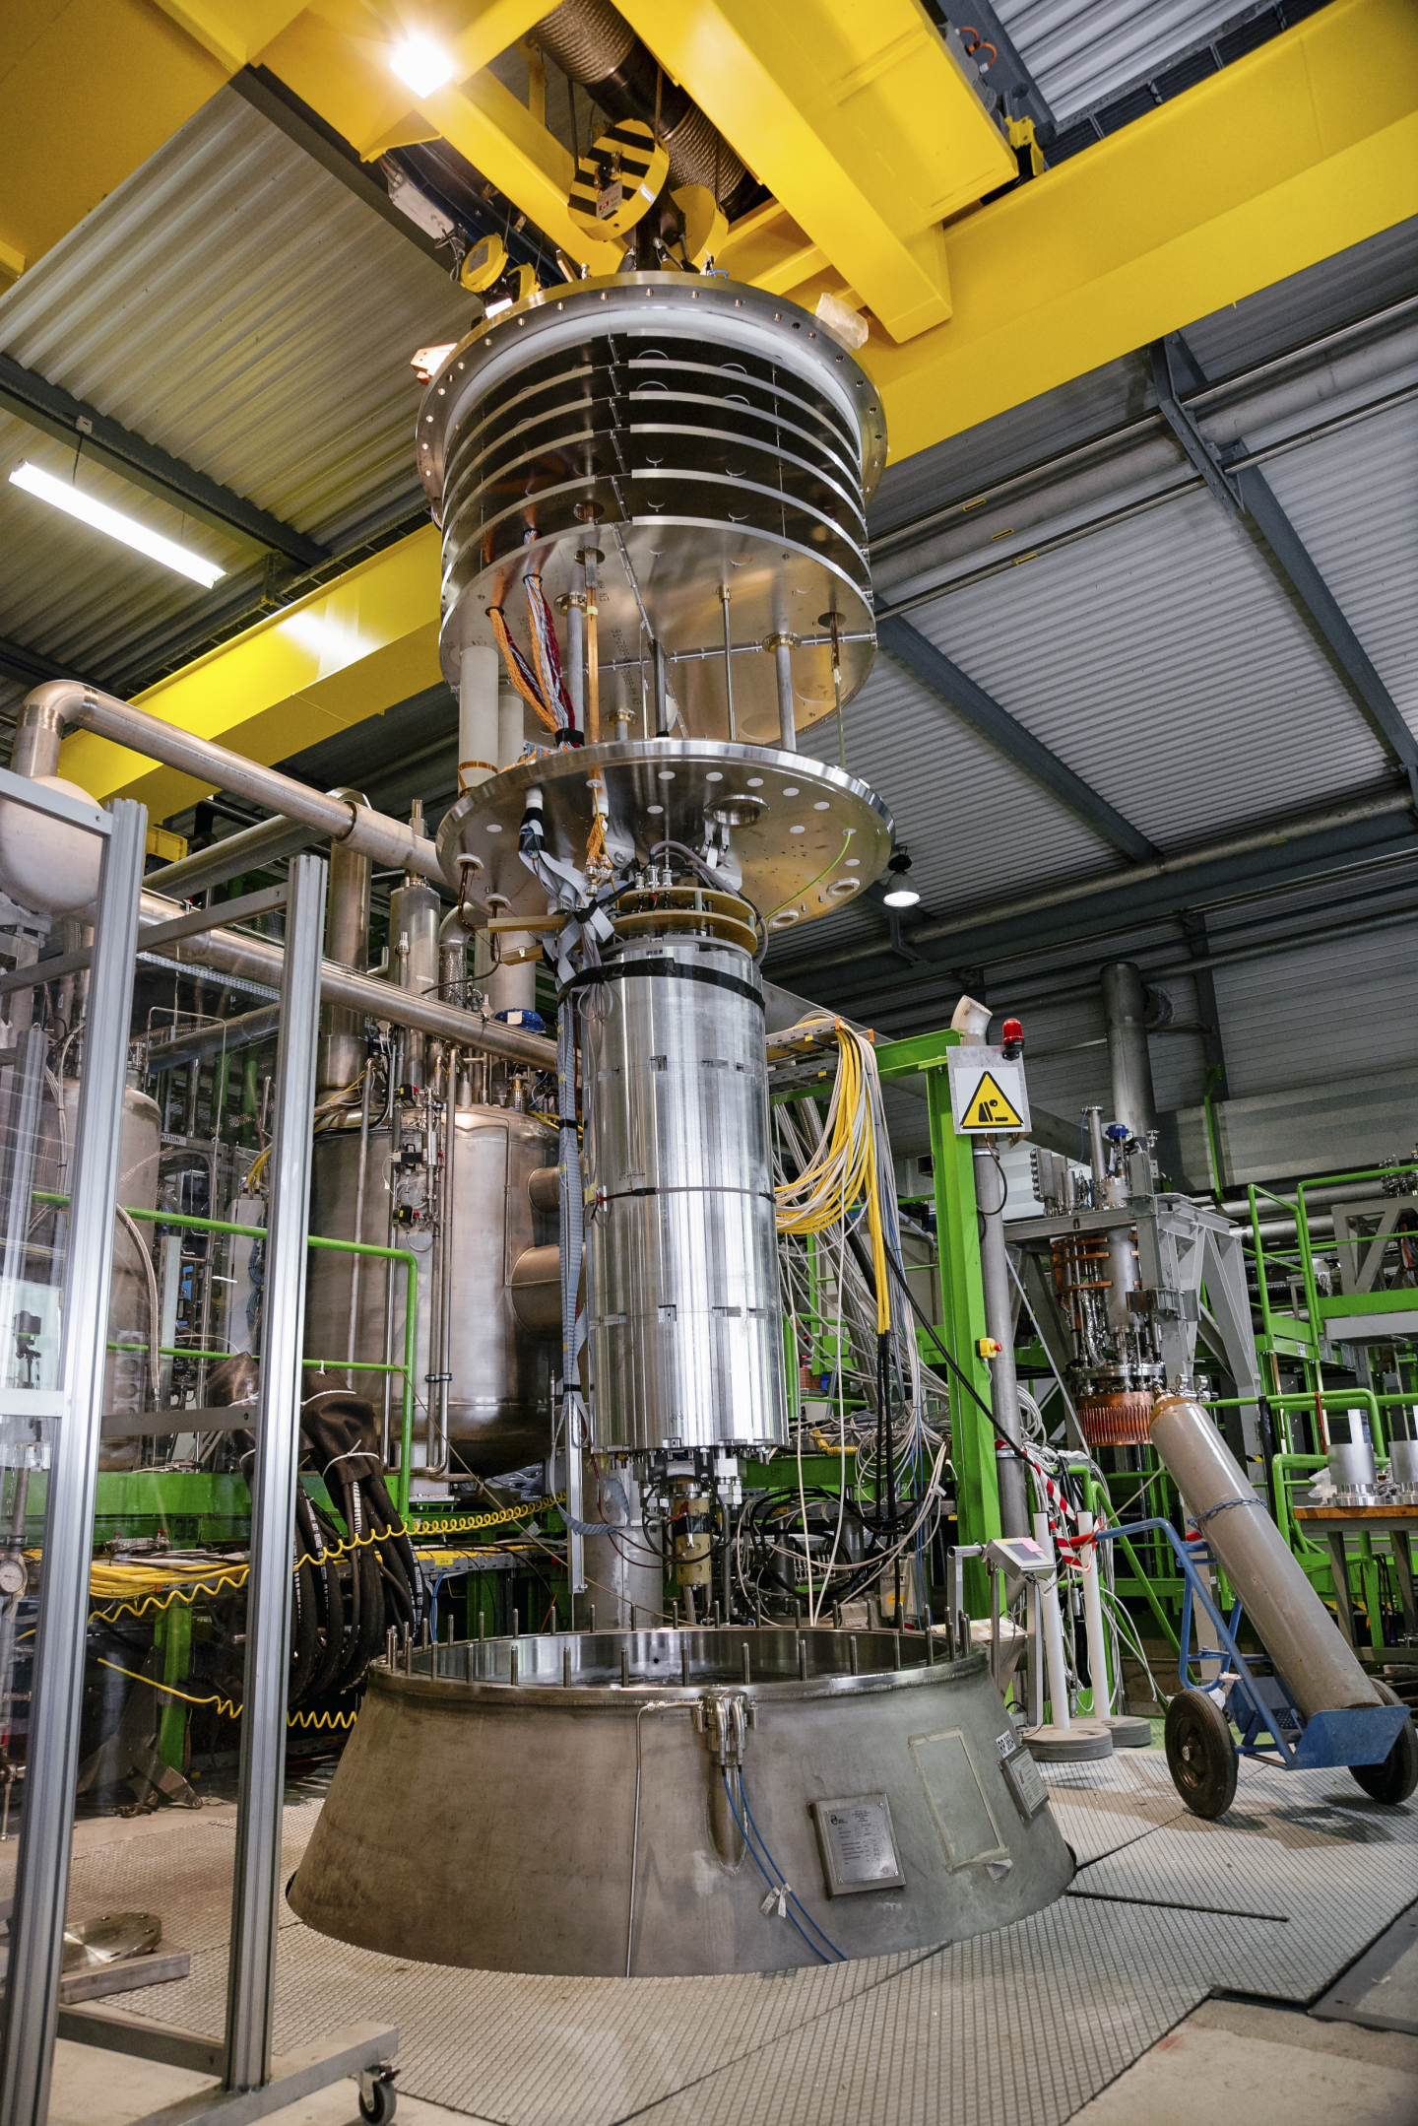
HFM cryostat
Widest vertical cryostat
~2.5 meter useful length
1.5 m diameter
20 kA power supply + 10 kA power supply for inserts
Possibility for 120 A and 600 A PCs.
Precooling and warming up between 80 and 300 K with controlled Ghe temperature.
1.9 K and 4.5 K operation.
Possibility to use a 150 mm aperture MBXFS dipole magnet as background magnet for HTS inserts (5.6 T at 1.9 K, 5.1 T at 4.5 K).

Slide 19
Variable Temperature Cryostat
4.5 K Lhe
4.5 K – 300 K GHe
Up to 20 kA power supply
Typically used for
Cold diode tests
HTS coils
1.2 meter useful length
0.5 meter diameter
Siegtal Cryostat
4.5 K and 1.9 K LHe
Up to 20 kA power supply
1.2 meter useful length
0.8 meter diameter
Long Cryostat
4.5 K and 1.9 K LHe
Up to 20 kA power supply
4.0 meter useful length
0.6 meter diameter

Slide 20
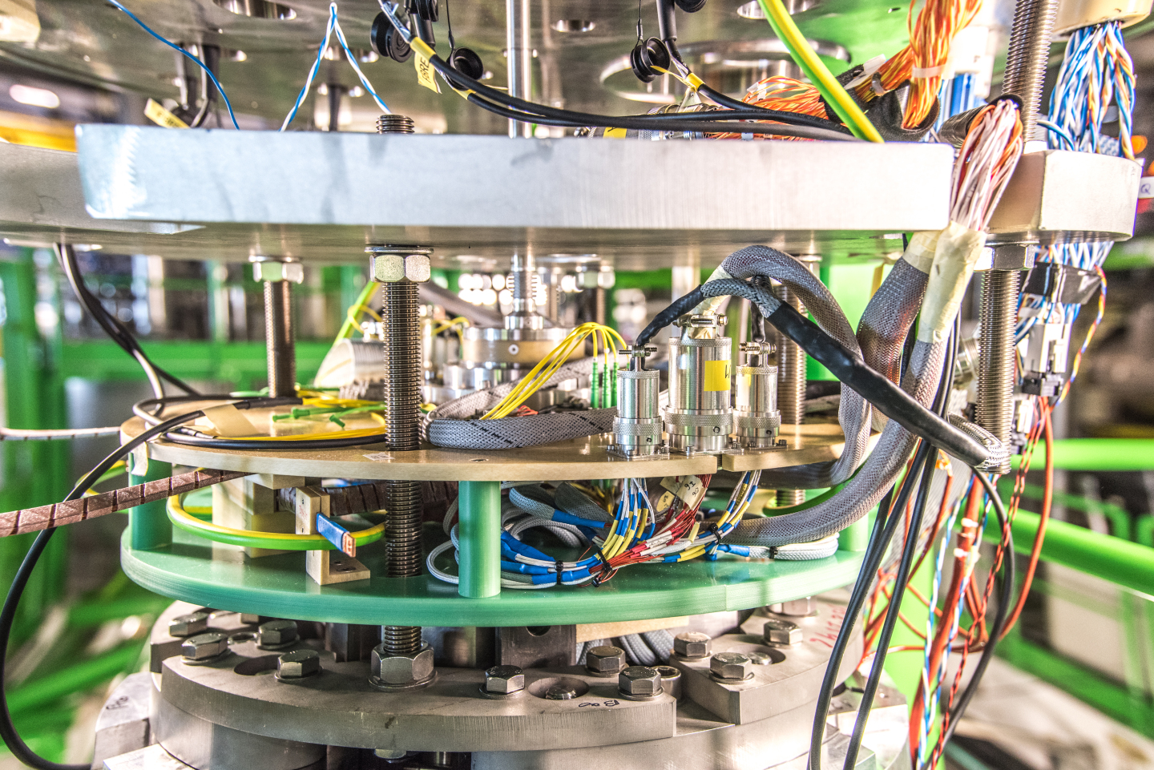
Instrumentation for all vertical benches
Instrumentation feed throughs for all cryostats
Hundreds of wires for voltage taps and strain gauges
Fiber optics feedthrough
Cold rotating magnetic measurement shafts
Quench antenna pickup coils
Typically 2 of the 5 vertical cryostats are in parallel operation with typically around 30 magnets tested each year.

Slide 21
Test bed for and use of enabling technology
Power converters, data acquisition systems, quench detection systems, protection systems like CLIQ, energy extraction, etc.

Slide 22
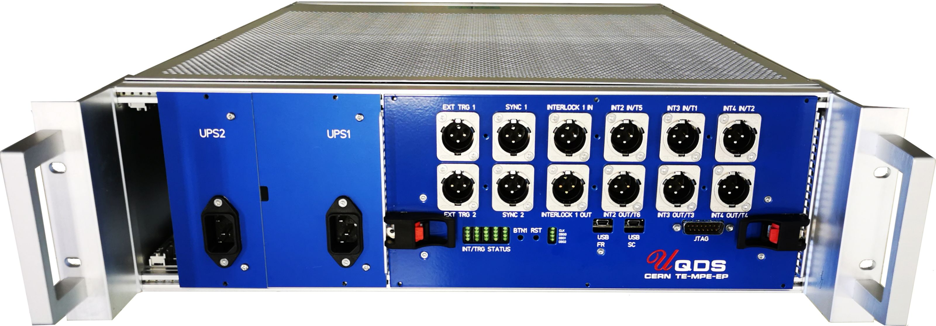
Quench detection systems
PotAim analogue system, on all benches, except F
‘legacy’ system, protection all SC components on all benches
Direct channel threshold setting for splices and leads quench detection
3-wire differential amplifying channels for coil quench detection
Current dependent thresholds (max two ranges)
uQDS
16 channels, FPGA based system, ready for (HL)-LHC
Large flexibility in number of current dependent thresholds
Coil voltage comparison of any combination of the 16 input channels
L*dI/dt compensation
Used as additional system on all benches for Nb₃Sn magnet quench detection
Used as only system for Cluster F
Thanks to Jens Steckert, Jelena Spasic, Guzmán Martin Garcia et al.

Slide 23
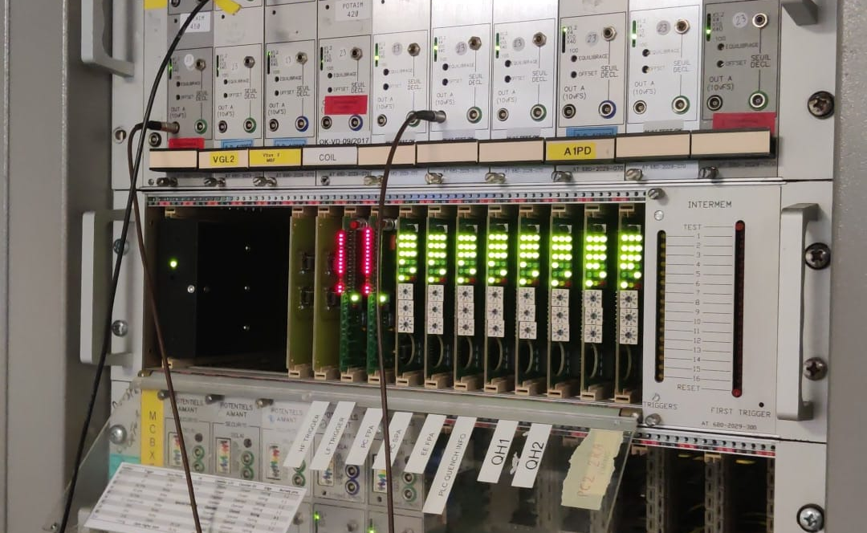
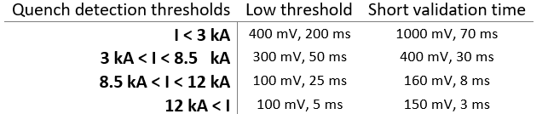
Triggering and interlocks
Main challenge:
Maximum flexibility protection interlocks and trigger options for high throughput and large variety of magnets.
Minimizing risk induced by flexibility.
Triggering by security matrix:
Activation and de-activation of separate systems
Individual trigger delay for various systems (QH, CLIQ, EE, etc.)
Table: Example of settings for an MQXF Nb₃Sn magnet

Slide 24
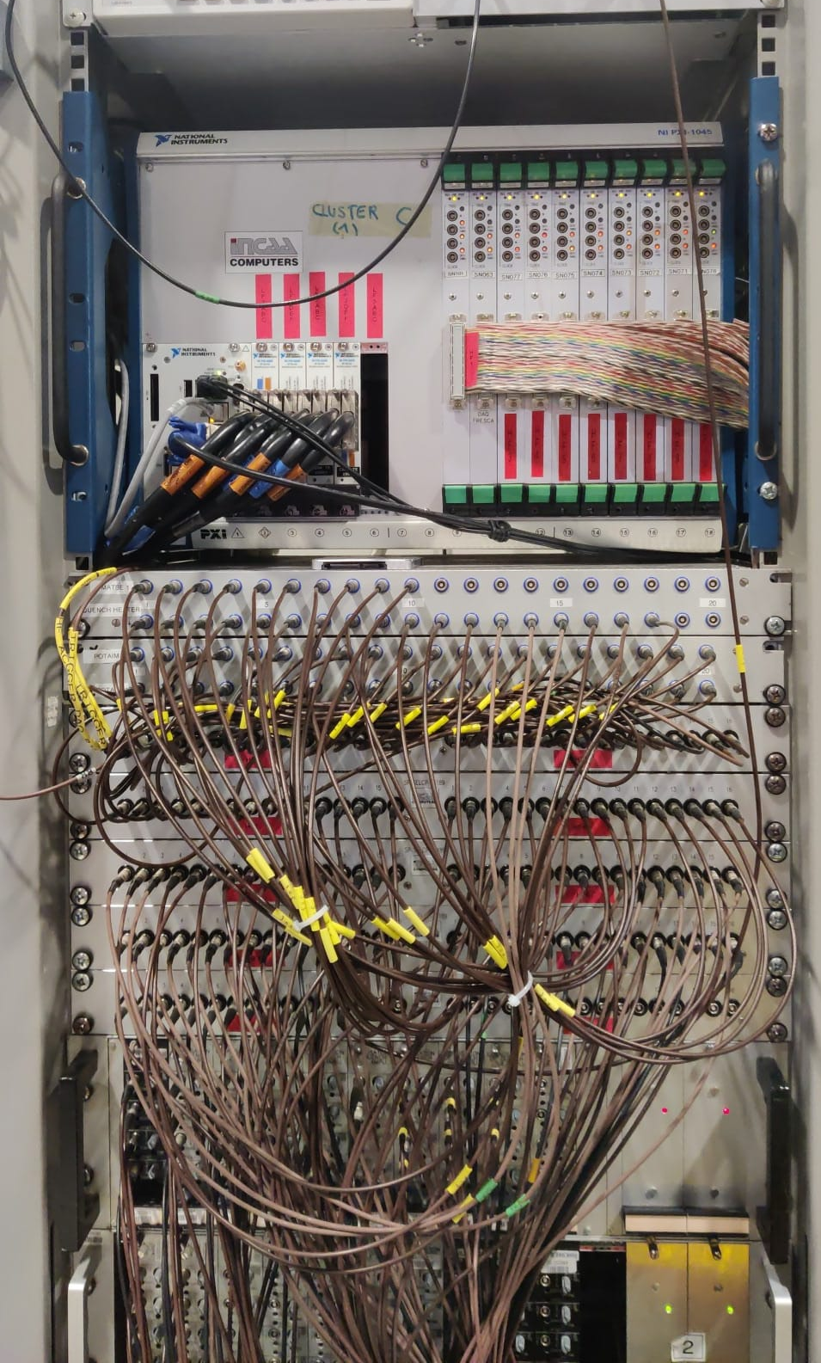
Data acquisition systems
High frequency triggered data files >50 kHz for quench analysis
Cluster F: DAQ is done by the new uQDS system, 16 channel per crate, up to 20 crates.
Already in use in other test facilities (Freia, GSI at CERN)
Additional software development ongoing for parameter configuration and threshold settings.
For all other benches:
>160 channels using legacy analogue amplifiers and up to date NI-DAQ system

Slide 25
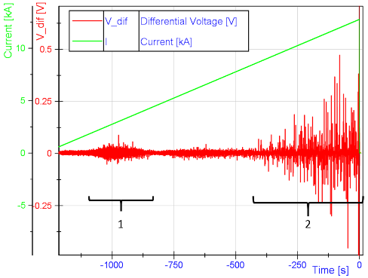
Data acquisition systems
High frequency long acquisition ≥ 50 kHz for >20 minutes
uQDS DAQ system, can be deployed on all benches
Medium frequency ≤ 10 kHz for >20 minutes
> 160 channels using the NI-DAQ system
Flux Jumps
Movements
Important for flux jump and motion detection. Few channels needed for magnet voltages, many channels for quench antenna.

Slide 26
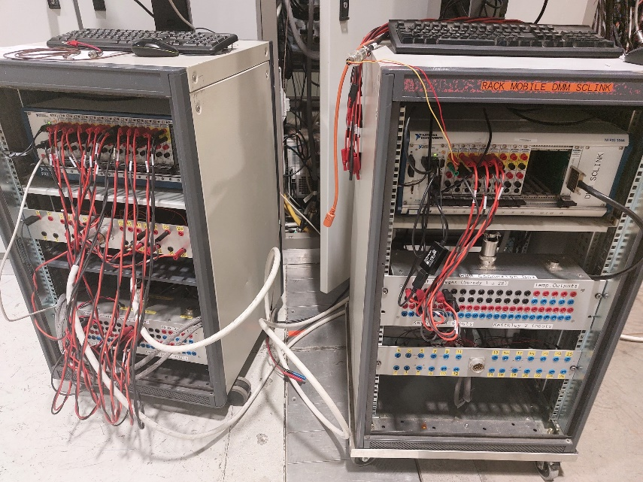
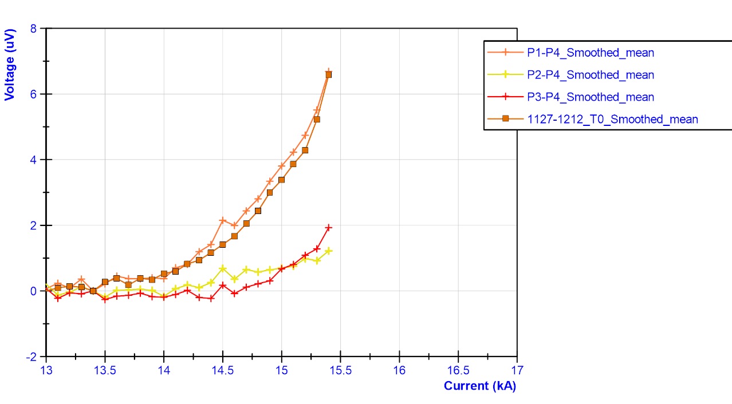
Data acquisition systems
Low frequency triggered data files ~ 2 Hz
NI 7.5 digit DMM system – 16 channels per bench, some mobile racks.
V-I measurements have become very important for Nb₃Sn magnets.
‘Easy’: precision measurement of a short voltage segment (single splice)
‘Real challenge’: Precision measurement (V-I or splice) when an inductive coil is included in the signal.
See presentation Ruben Keijzer

Slide 27
Energy Extraction systems
Horizontal benches:
Not used on main circuit, since EE on magnets with L/R_{EE} >> L/R_{magnet} is not very effective and also not used in the LHC.
EE available on 2 kA corrector magnets on HL-LHC Q2 and CP magnets (1 kV, 150 mΩ, IGBT based)
EE on 600 A circuit for the D2 corrector magnet (2*150 mΩ, 2*600 V, Vacuum-type switch)
Vertical benches
30 kA cluster D with IGBT based switch (2 times 15 kA)
2*2 kA cluster D with IGBT based switch
20 kA PC with 1 kV thyristor based switch
10 kA PC with IGBT based switch (for HFM) s
Resistors are used in standard configuration. Varistors have been used for some tests.
Thanks to Bozhidar Panev, Gert-Jan Coelingh, Mirko Pojer, et al.

Slide 28
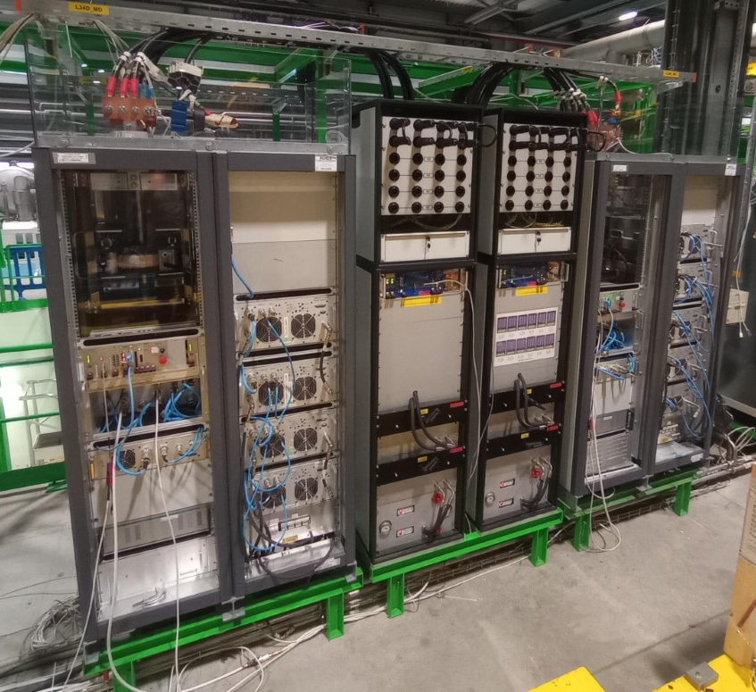
Power converters
In the image:
2*2 kA power supplies including their energy extraction systems.
Important for testing:
Low noise
High precision
Synchronization between converters
Reliability
Power converters tested for use in the LHC.
Thanks to the power converter team with Hugues Thiessen, Vicente Herrero,

Slide 29
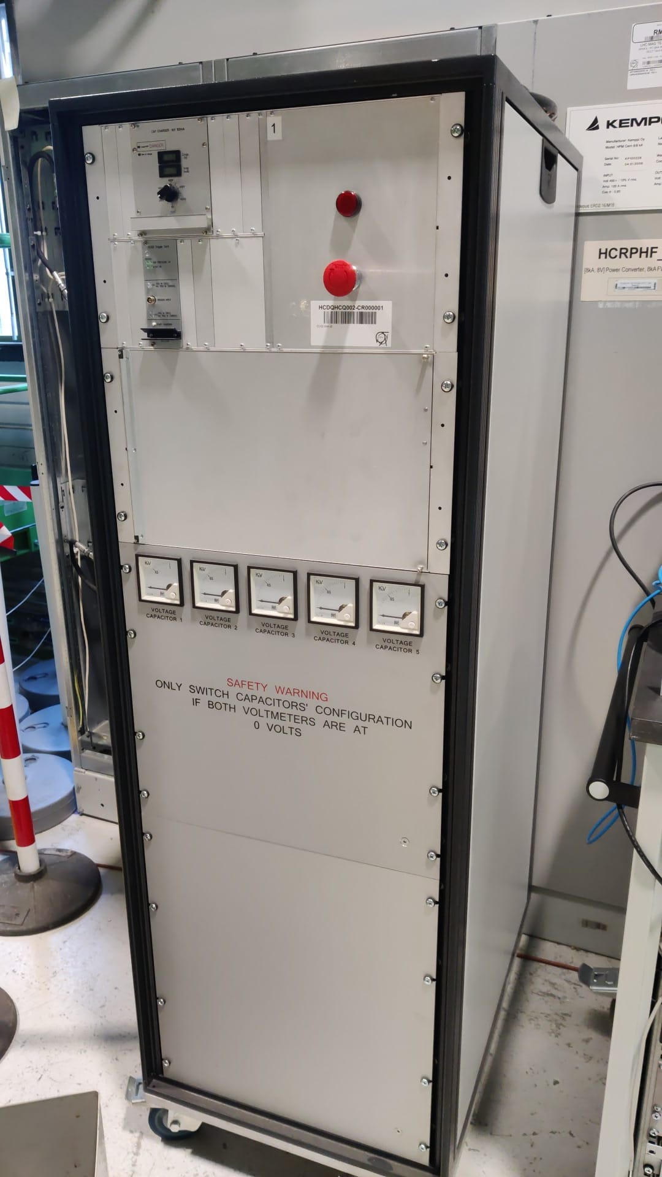
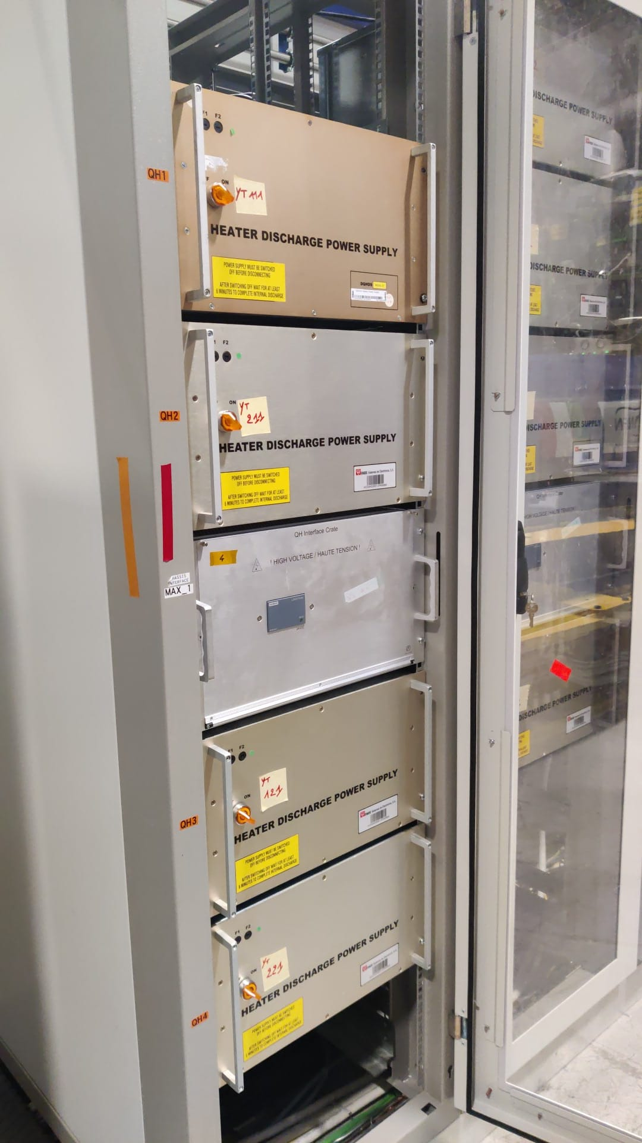
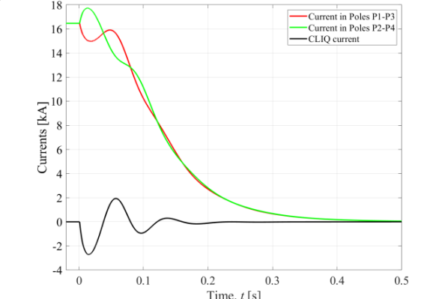
Quench heater and CLIQ discharge units
Quench heater power supplies in fixed racks on horizontal and vertical benches
Mobile CLIQ discharge units are used on horizontal and vertical benches
Thanks to team of Mirko Pojer, et al.

Slide 30
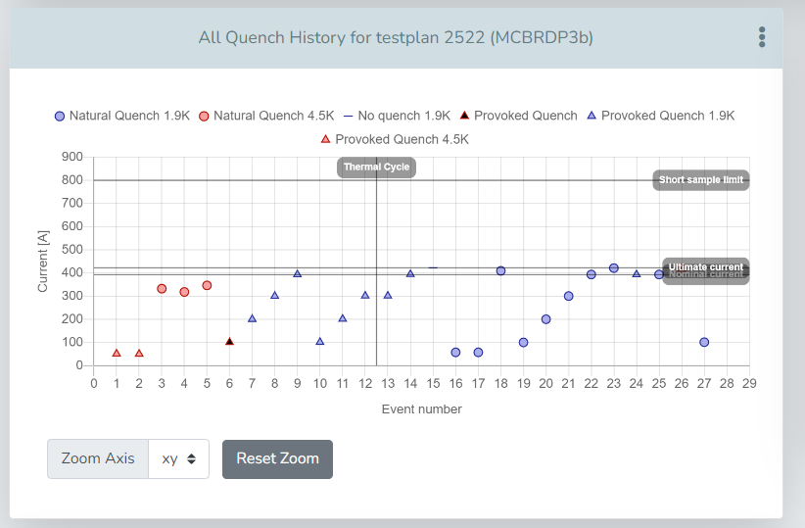


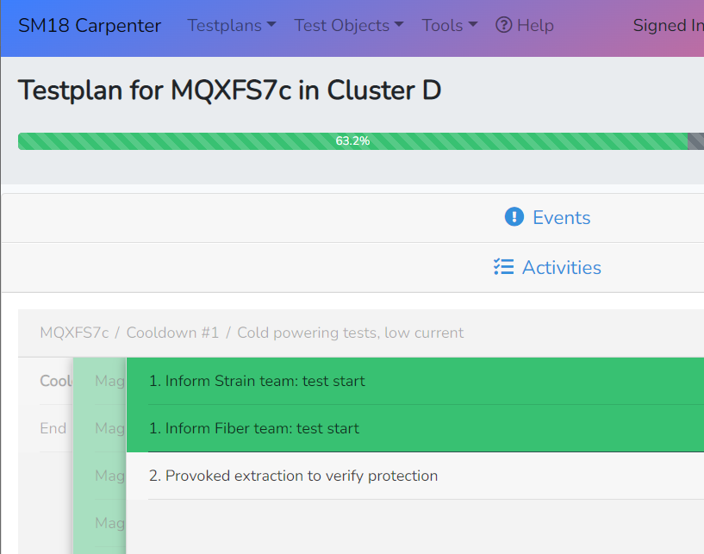
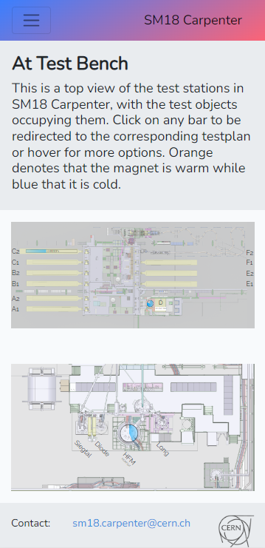
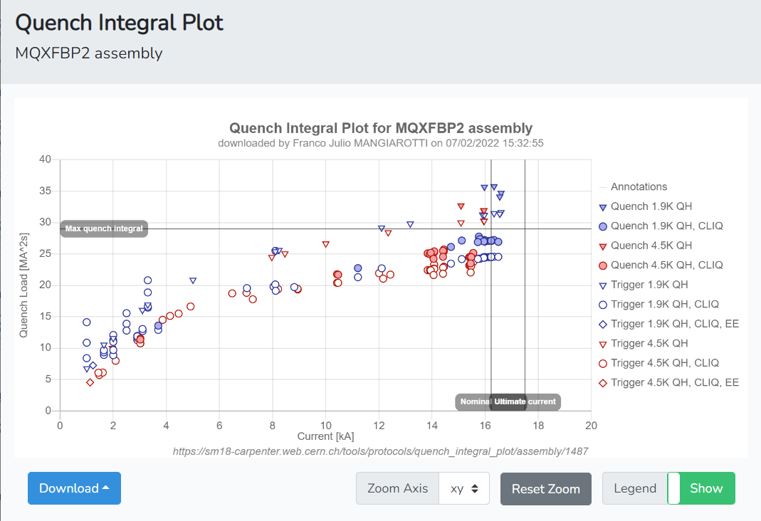
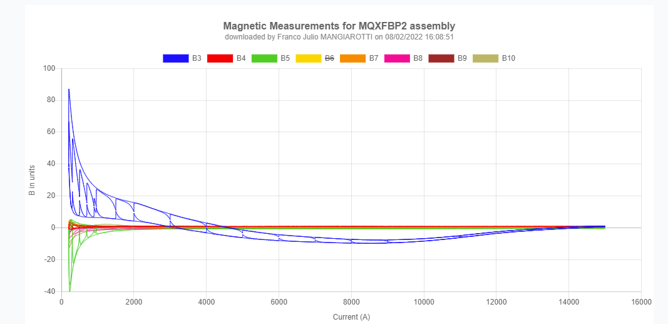
Test plan, test follow up and databases
Carpenter test follow up software fully developed, linked to database, automated protocols for test result plots
See more information here: https://indico.cern.ch/event/1125261/
30

Slide 31
Collaborations and opportunities
In the past years, many magnets have been tested for (mostly European) collaborating institutes in collaboration frameworks, for example the 'Transnational access' within the ARIES framework.
Part of CERN's mission is to: "unite people from all over the world to push the frontiers of science and technology, for the benefit of all." Collaboration requests are welcome, both for superconducting magnet testing and expertise in test technology.
We work on a Knowledge Transfer collaboration contract template, which could open the door for commercial partners.
Many examples of win-win situations in collaborations, both for testing as for development of technology and methods.
  Technology and knowledge transfer to Freia magnet test station
  Magnetic measurement technology for STAARQ at CEA Saclay
  GSI super-FRS test station, based at CERN, but with GSI staff
  New collaboration with Uppsala on warm insert for magnetic measurements both at CERN and in Uppsala

Slide 32
Conclusion: Testing in the CERN SM18 test facility
9 horizontal test benches in preparation for HL-LHC series magnets and 1 for SC-link testing
5 Vertical benches, operational for HL-LHC series tests, model and prototype testing. Ready for NbTi, Nb₃Sn, HTS, diodes, leads, etc.
Strong support available from other teams with enabling technology: PC, EE, QDS, QH+CLIQ discharge systems, DAQ software, databases, test follow up, etc.
Experienced and responsible team in place to handle all upgrades and high test throughput
Key to success:
Collaborative effort thoughout CERN departments and beyond
Team !!!
Knowledge, Instrumentation, Diagnostics

Slide 33
Thank you

