Slide 1
The SIS100 QDM
Site Acceptance Tests
@THor
G. Avallone, D. D'Agostino, A. Ferrentino, U. Gambardella, G. Iannone, M. Imran,
E. Leo, A. Saggese, C. Severino, F. Severino

Slide 2

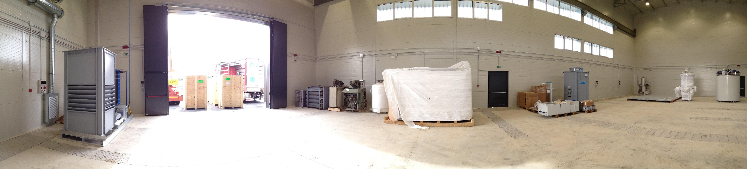
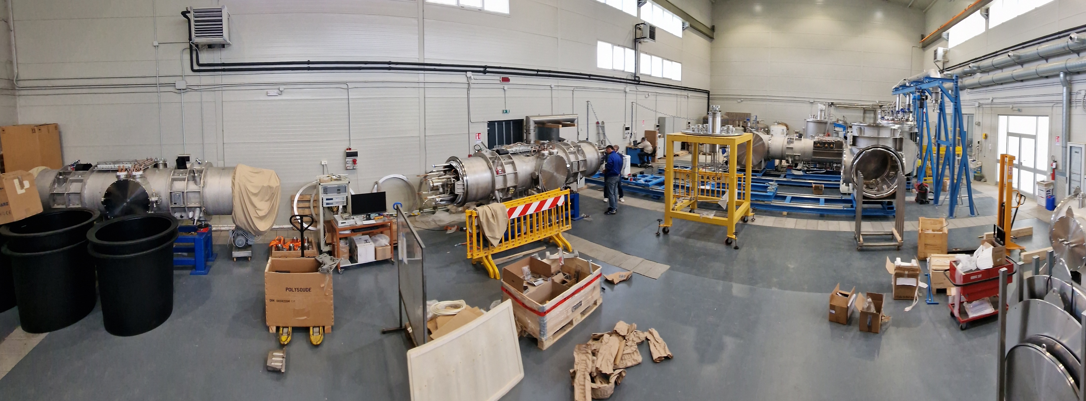
Outline of the talk
Introduction and brief history
The test stand, acquired and developed instruments
Test results
Problems occurred and their mitigation
Conclusion

Slide 3
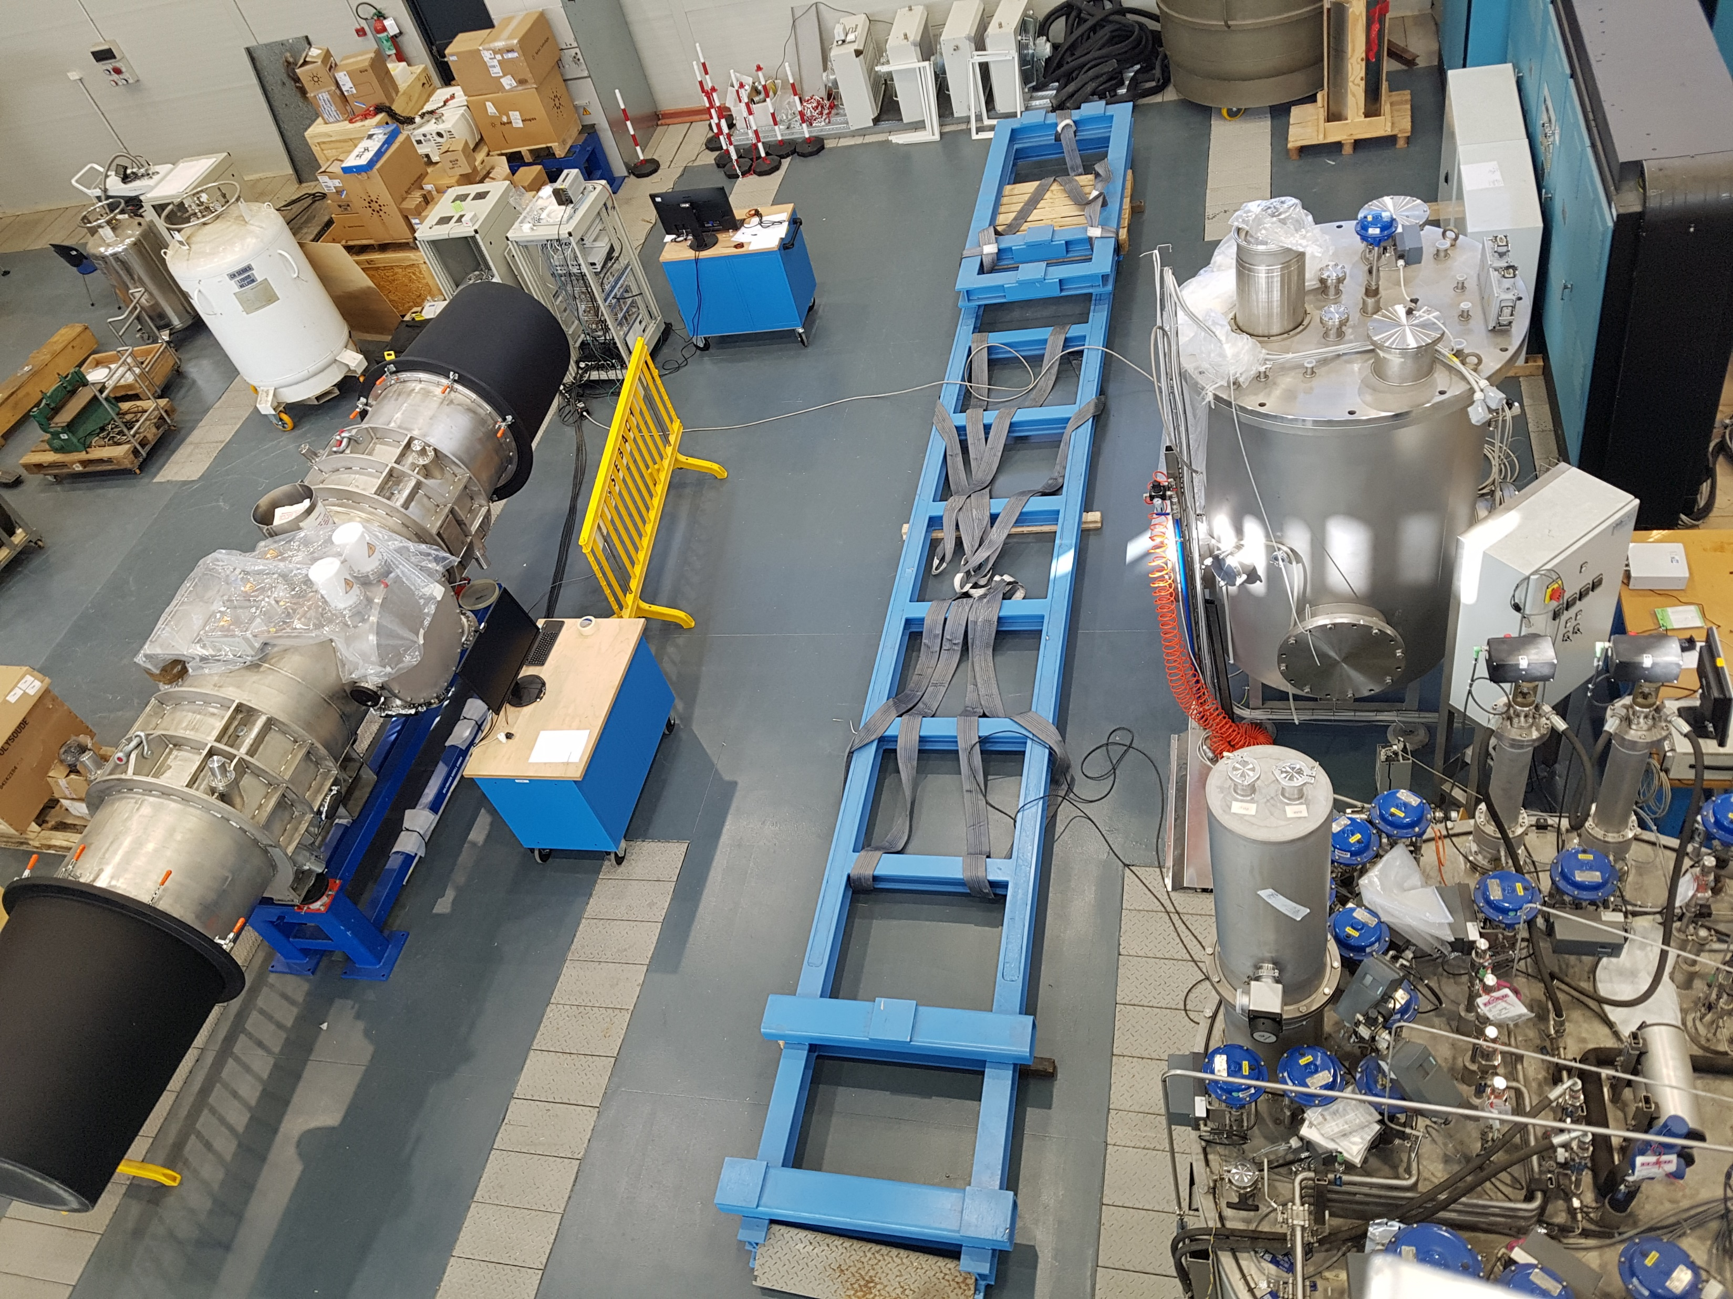
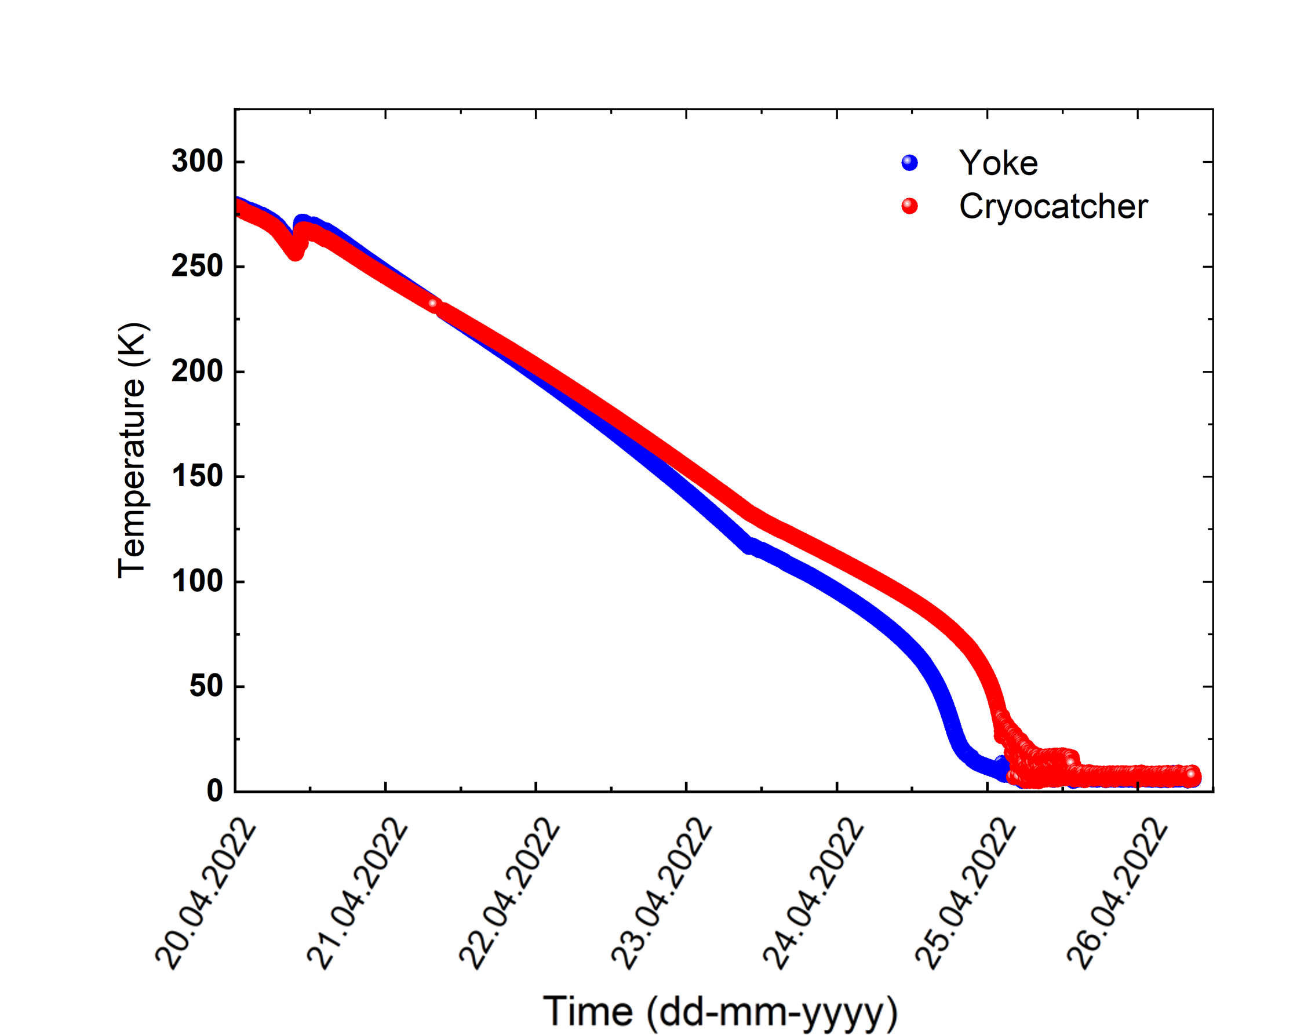

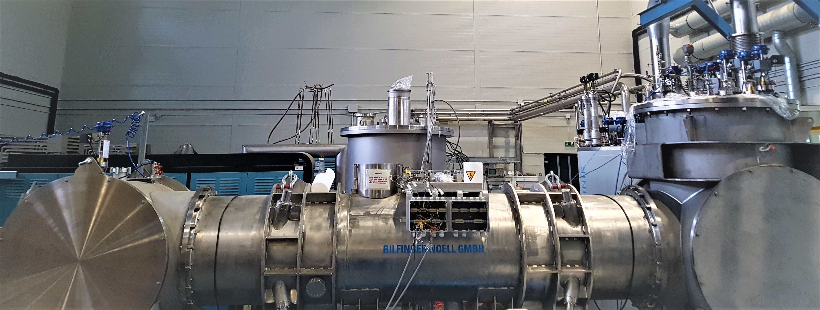
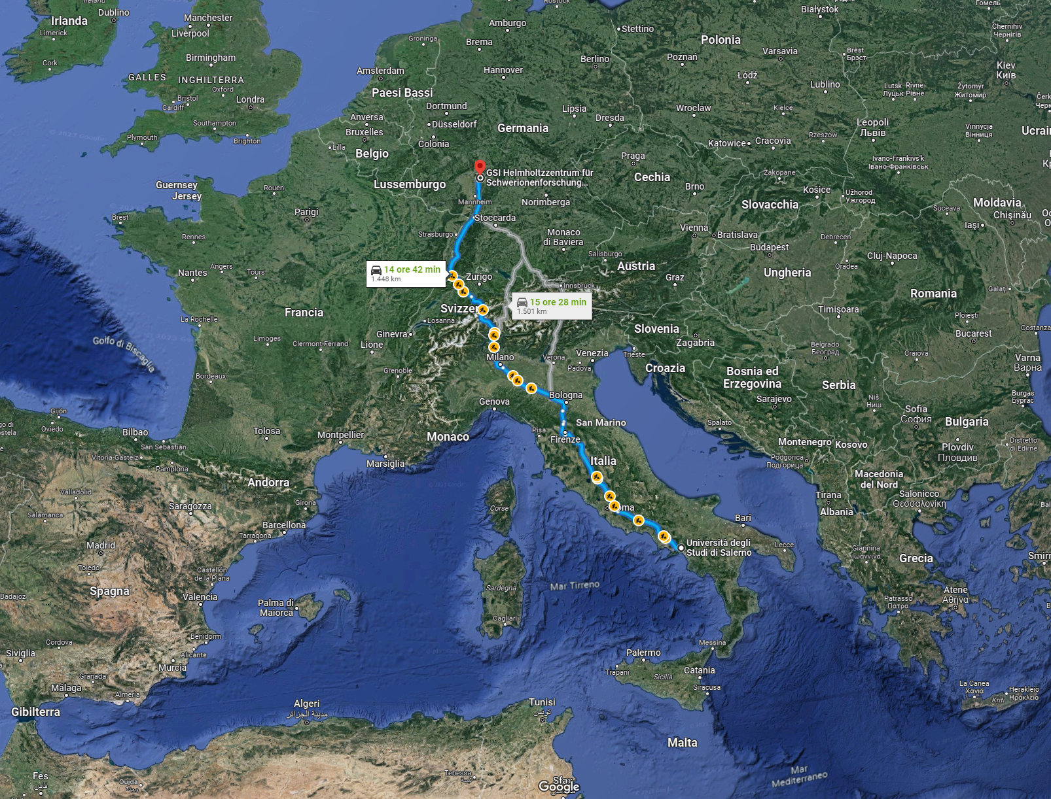


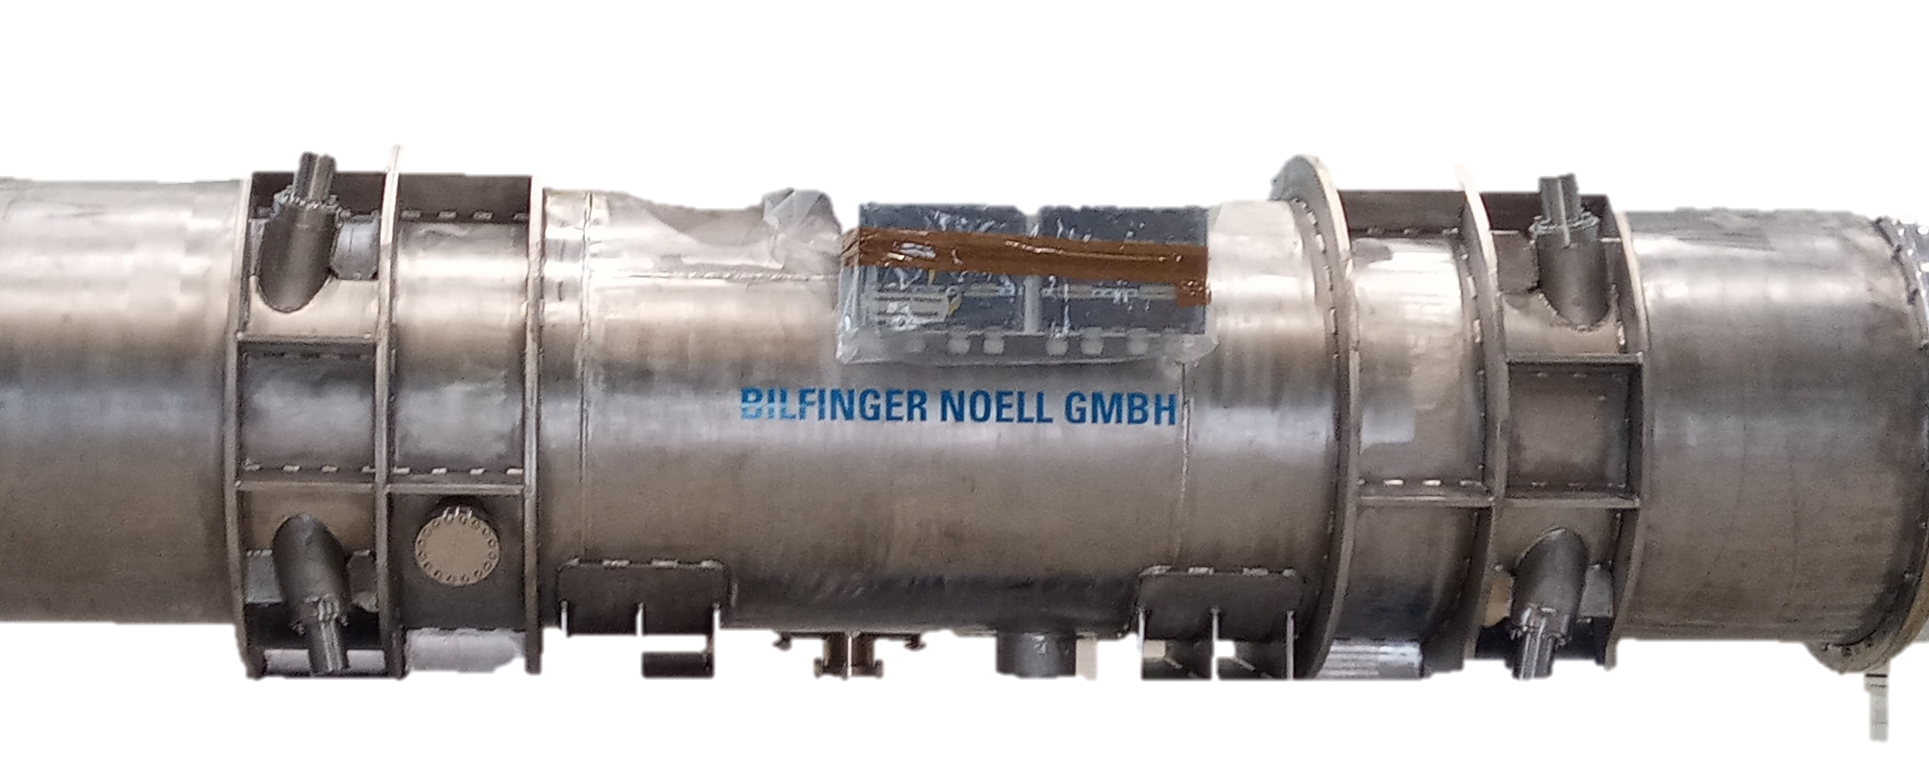

The development history
The idea of developing test lines for superconducting QDM of SIS100 raised since 2017, when the production of these quadrupoles was at prototype stage.
INFN started funding the setting up of the facility well in advance with respect to the official agreement, trusting this project.
GSI looked at the Salerno facility as a good opportunity, despite of the actual problems (distance, logistic, etc…).
The MoU between INFN/GSI was signed 2° half of 2019, followed by a MoU between UniSA/GSI at beginning of 2020.
On 2021 the first test line was assembled in the laboratory (by working during the pandemic).
On May 2022 we succeded to cooldown at 4.7K the FoS QDM in Salerno.

Slide 4
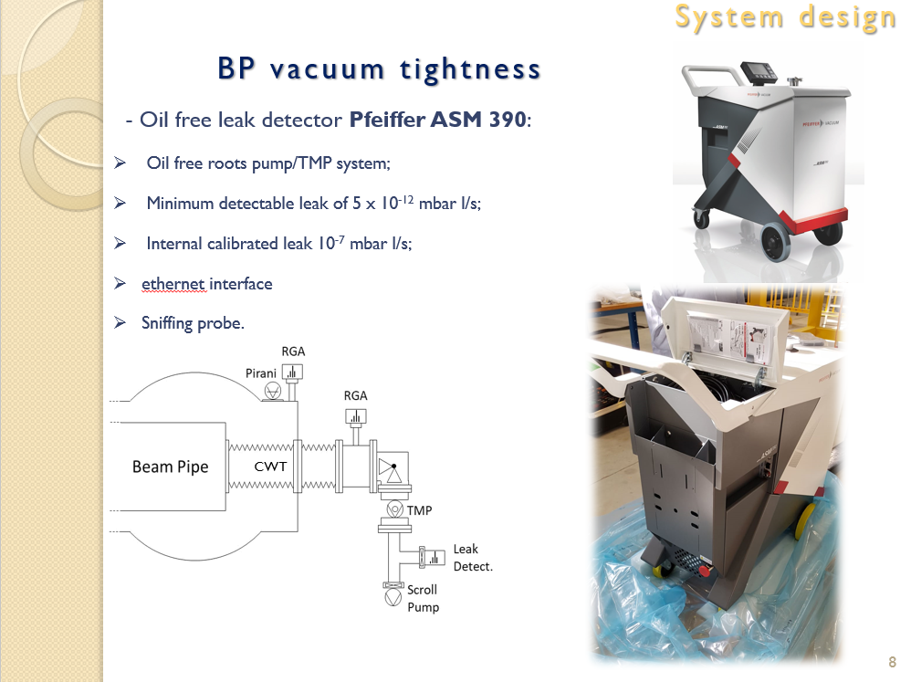
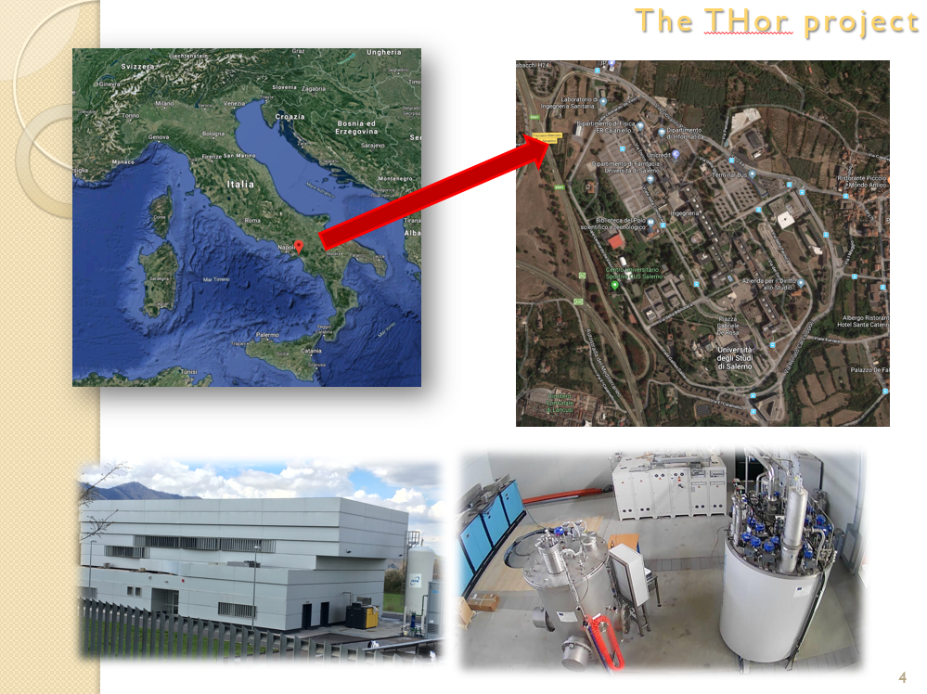
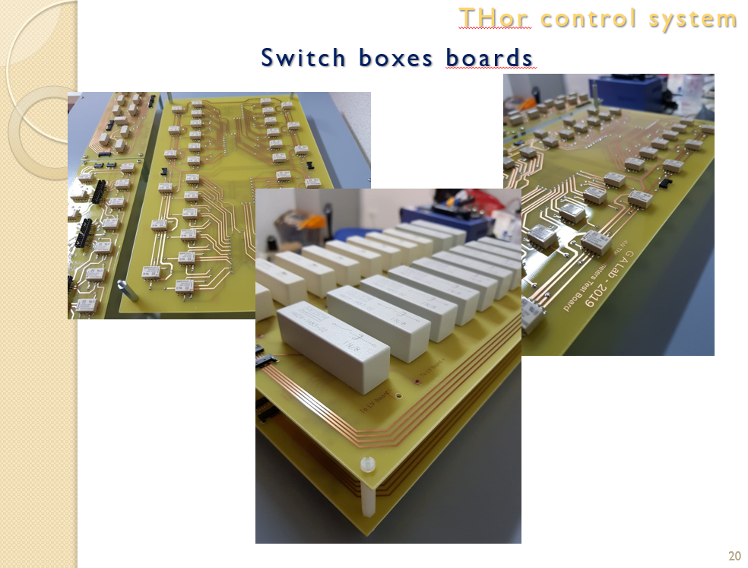
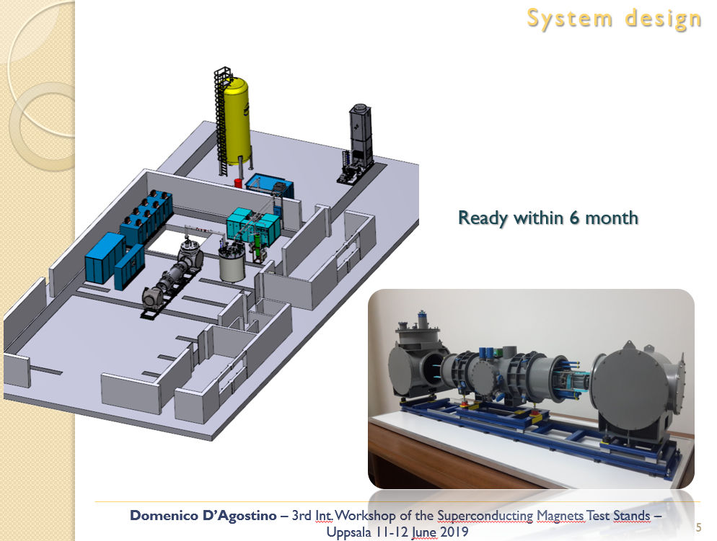
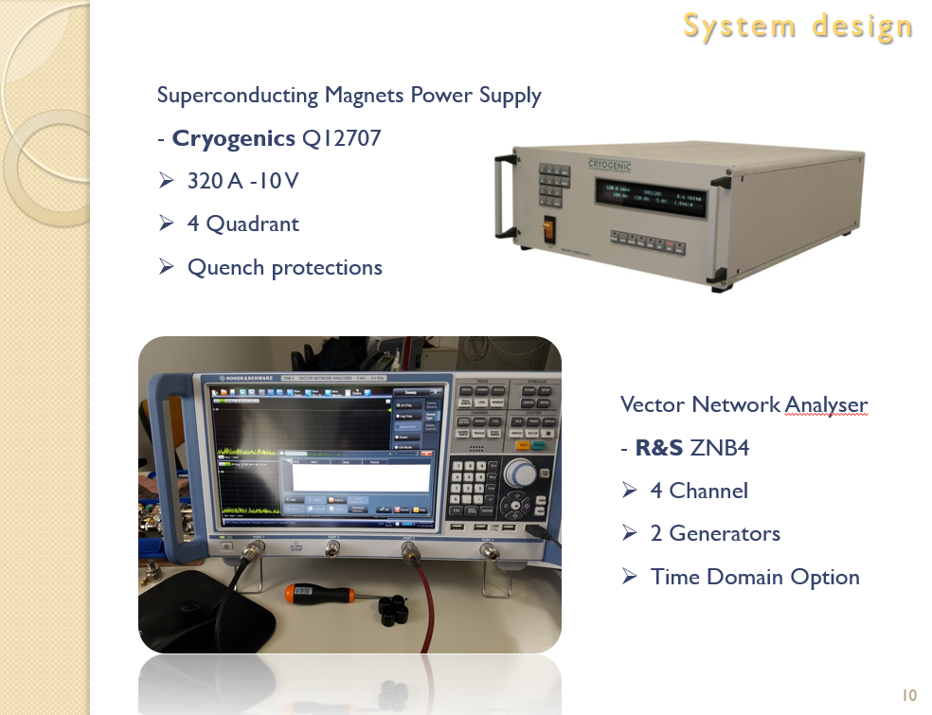

Last update
PRESENTED AT
3rd WSMTS

Slide 5
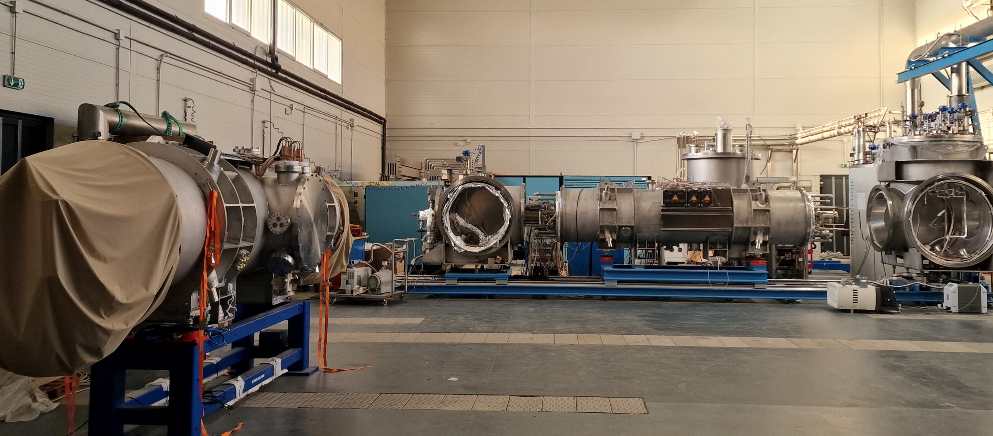
The Test Facility

Slide 6
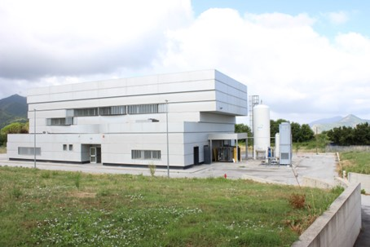
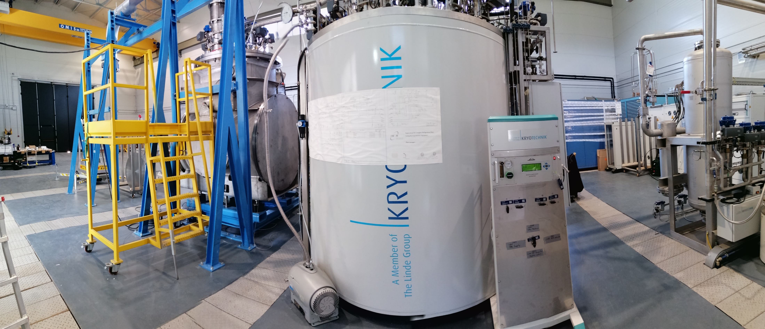
INFN THOR Test Facility: infrastructure
450 m² working area plus control room and workshop (40 m² each);
External Helium gas tank (30 m³ @ 14 bar) and precooling liquid Nitrogen tank (3000 l);
Kaeser compressor (70 g/s @ 10 bar);
Cooling tower (20 m³/h of water at 25°C, 300 kW);
Cold Box supercritical He (3-7 bar, 200 W @ 4.5 K + 500 W @ 60 K w/o precooling);
Power converter DC/AC (20 kA, +25 V/-20 V or 10 kA, 50 V/-40 V).

Slide 7
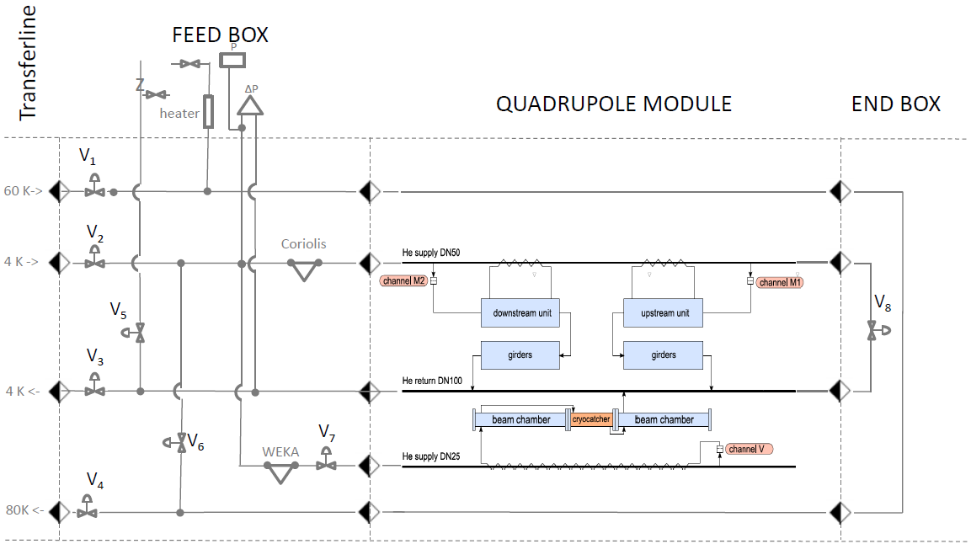
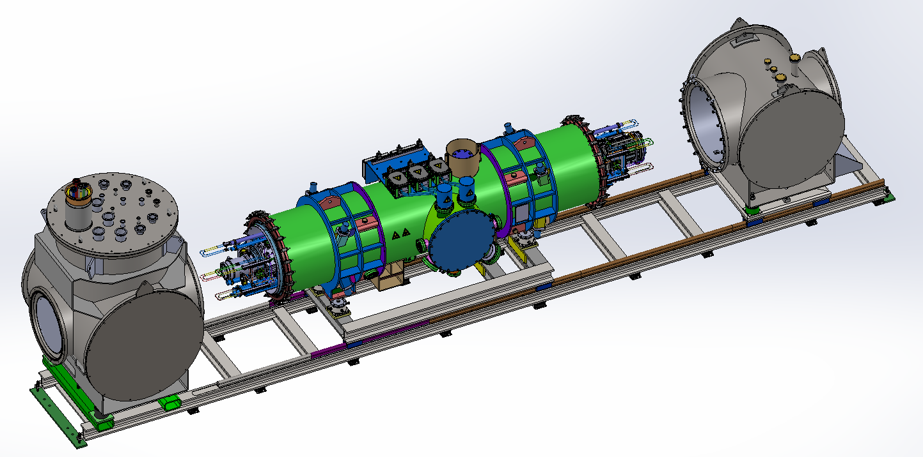
QDM connection to FB and EB

Slide 8
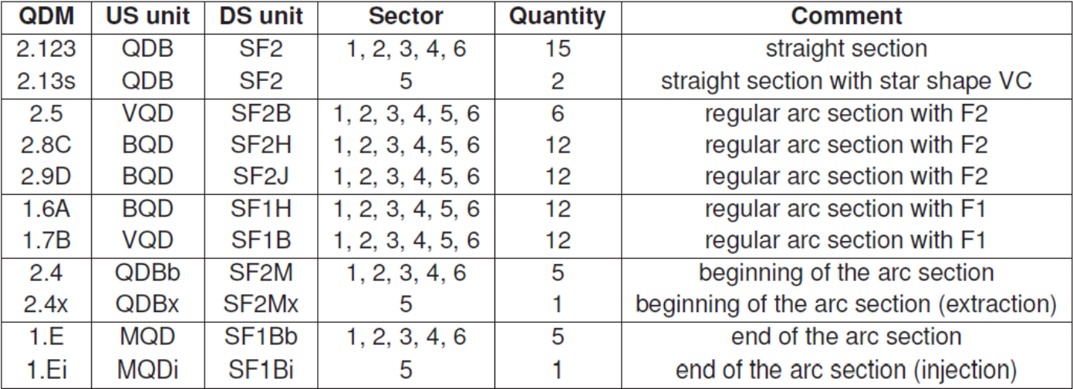
11 types of modules to be tested
Overall, 83 QDMs to be tested (81 at THOR and 2 at STF, according to original plan)

Slide 9
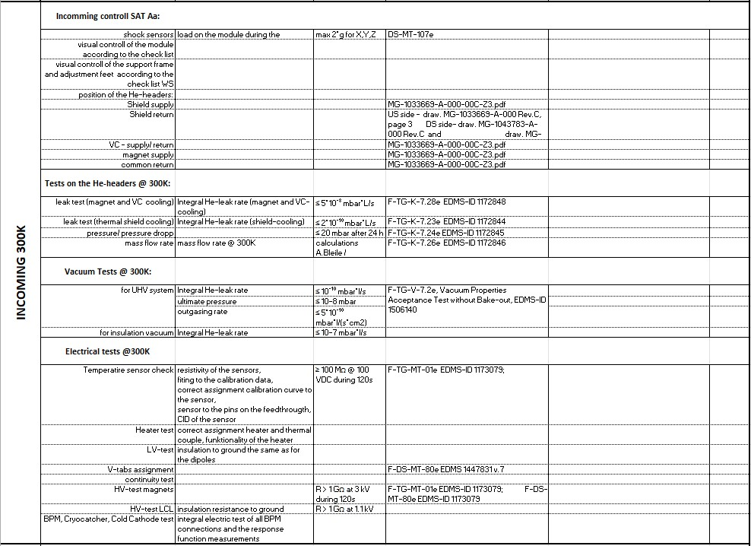
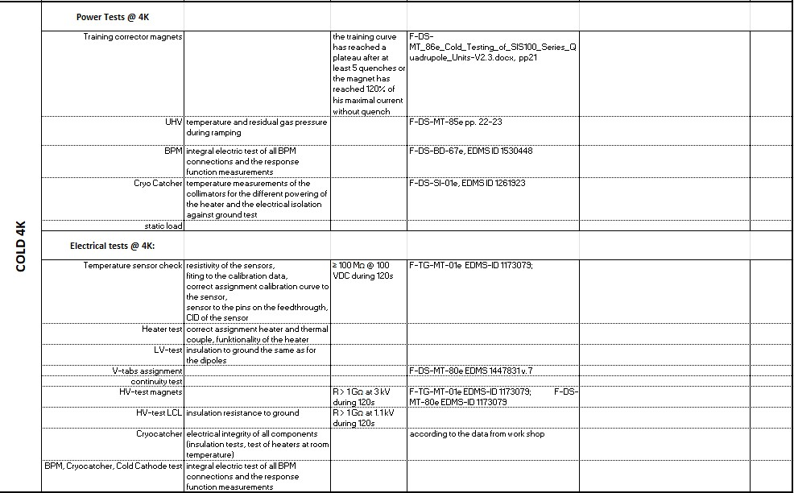
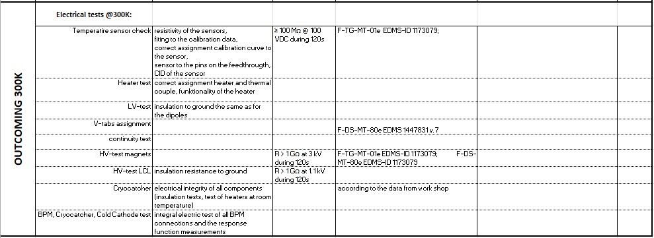
QDM test list
Shock meters reading
Visual inspection
Pressure and flow test of pipes
Test on BPM, Cryo Collimator and CC
Continuity test
HV bus bar isolation test
HV LCL isolation test
LV isolation test
Heat load
Corrector magnets powering
UHV leak check (for the beam pipe)
Insulation vacuum leak check
Functionality of sensors and heaters

Slide 10
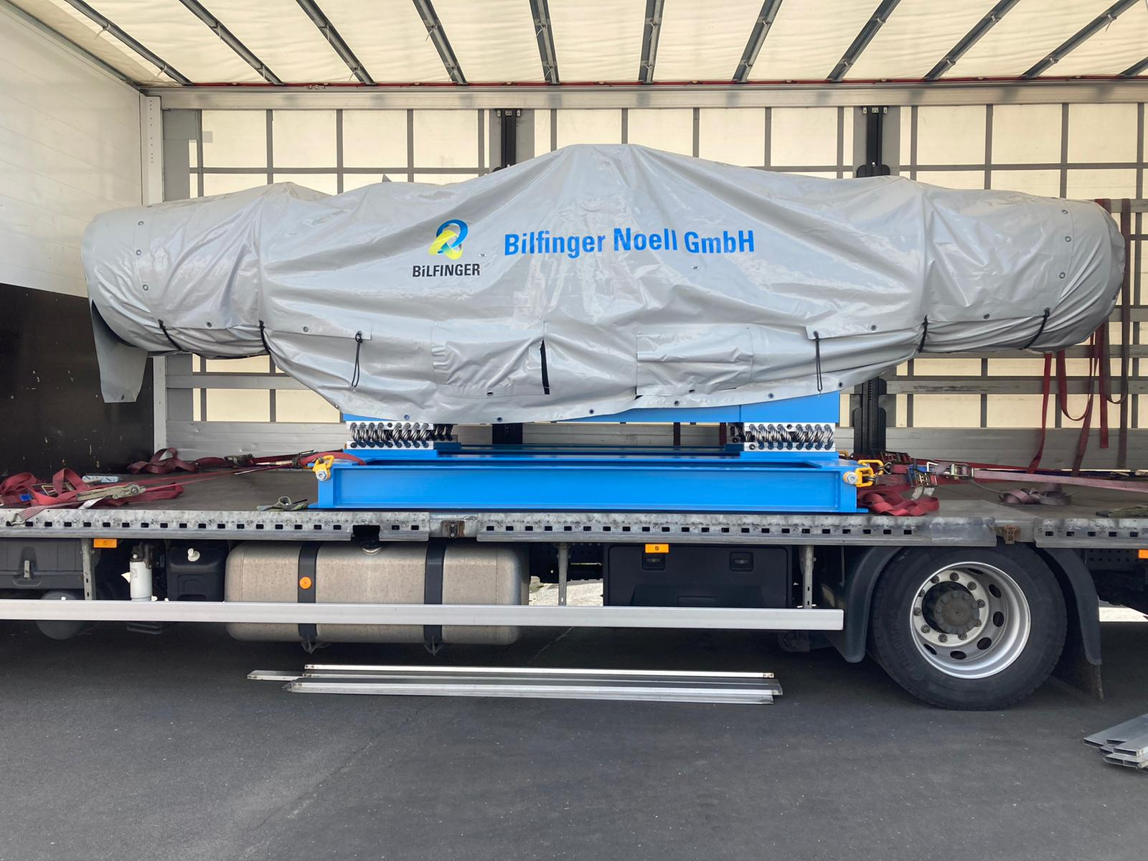
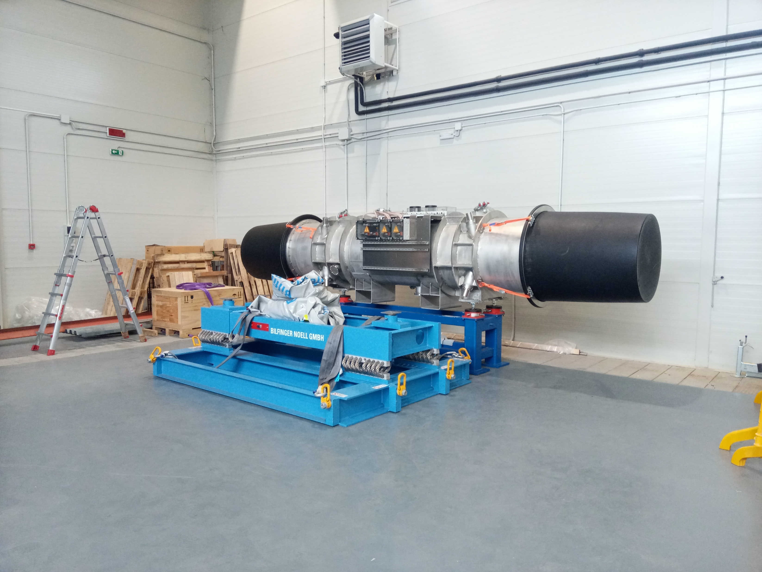
QDM arrival and incoming checks
Arrival of the QDM type 2.5 short CID 27-6

Slide 11
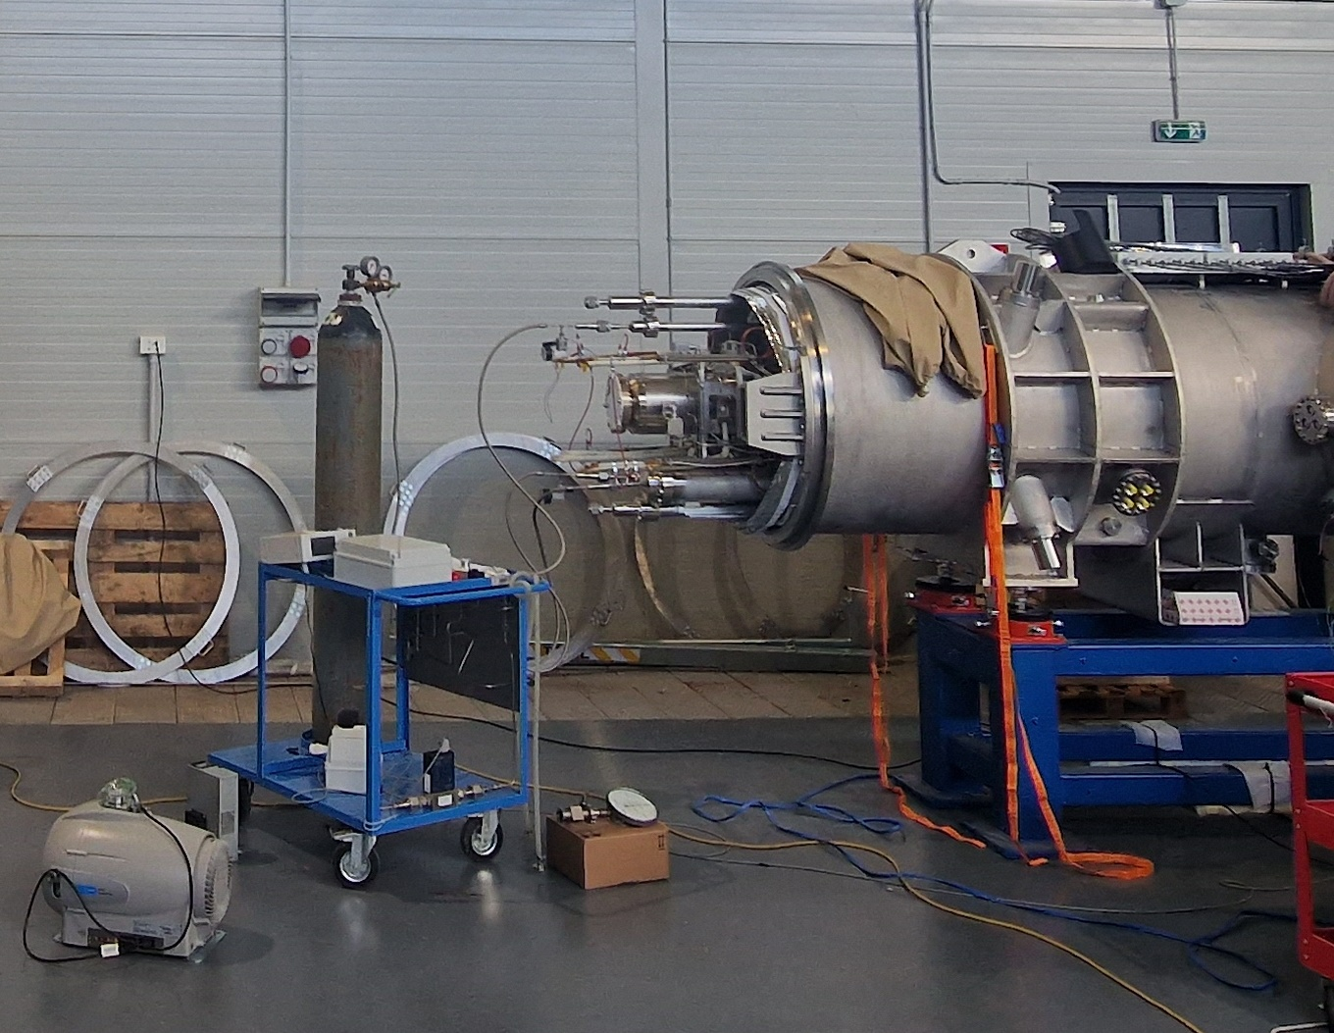
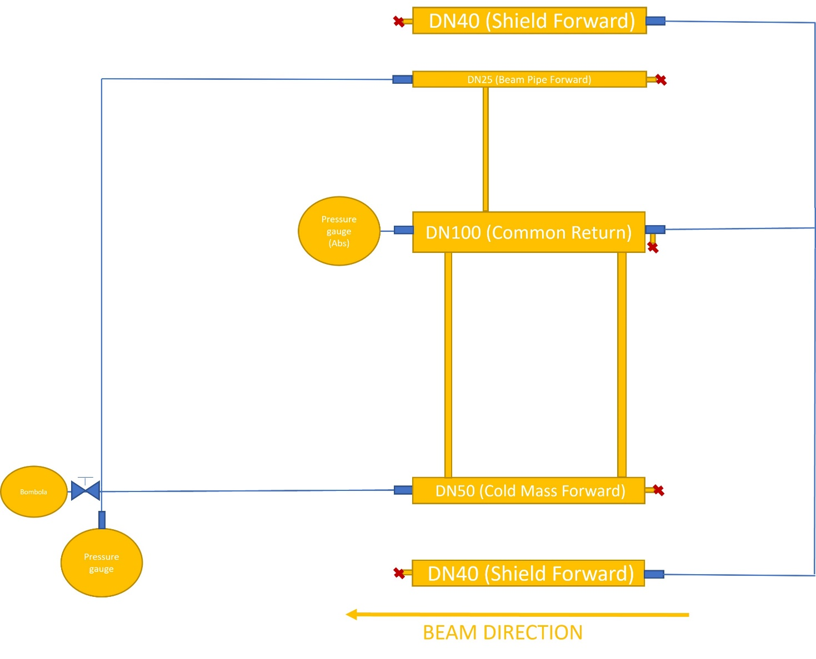
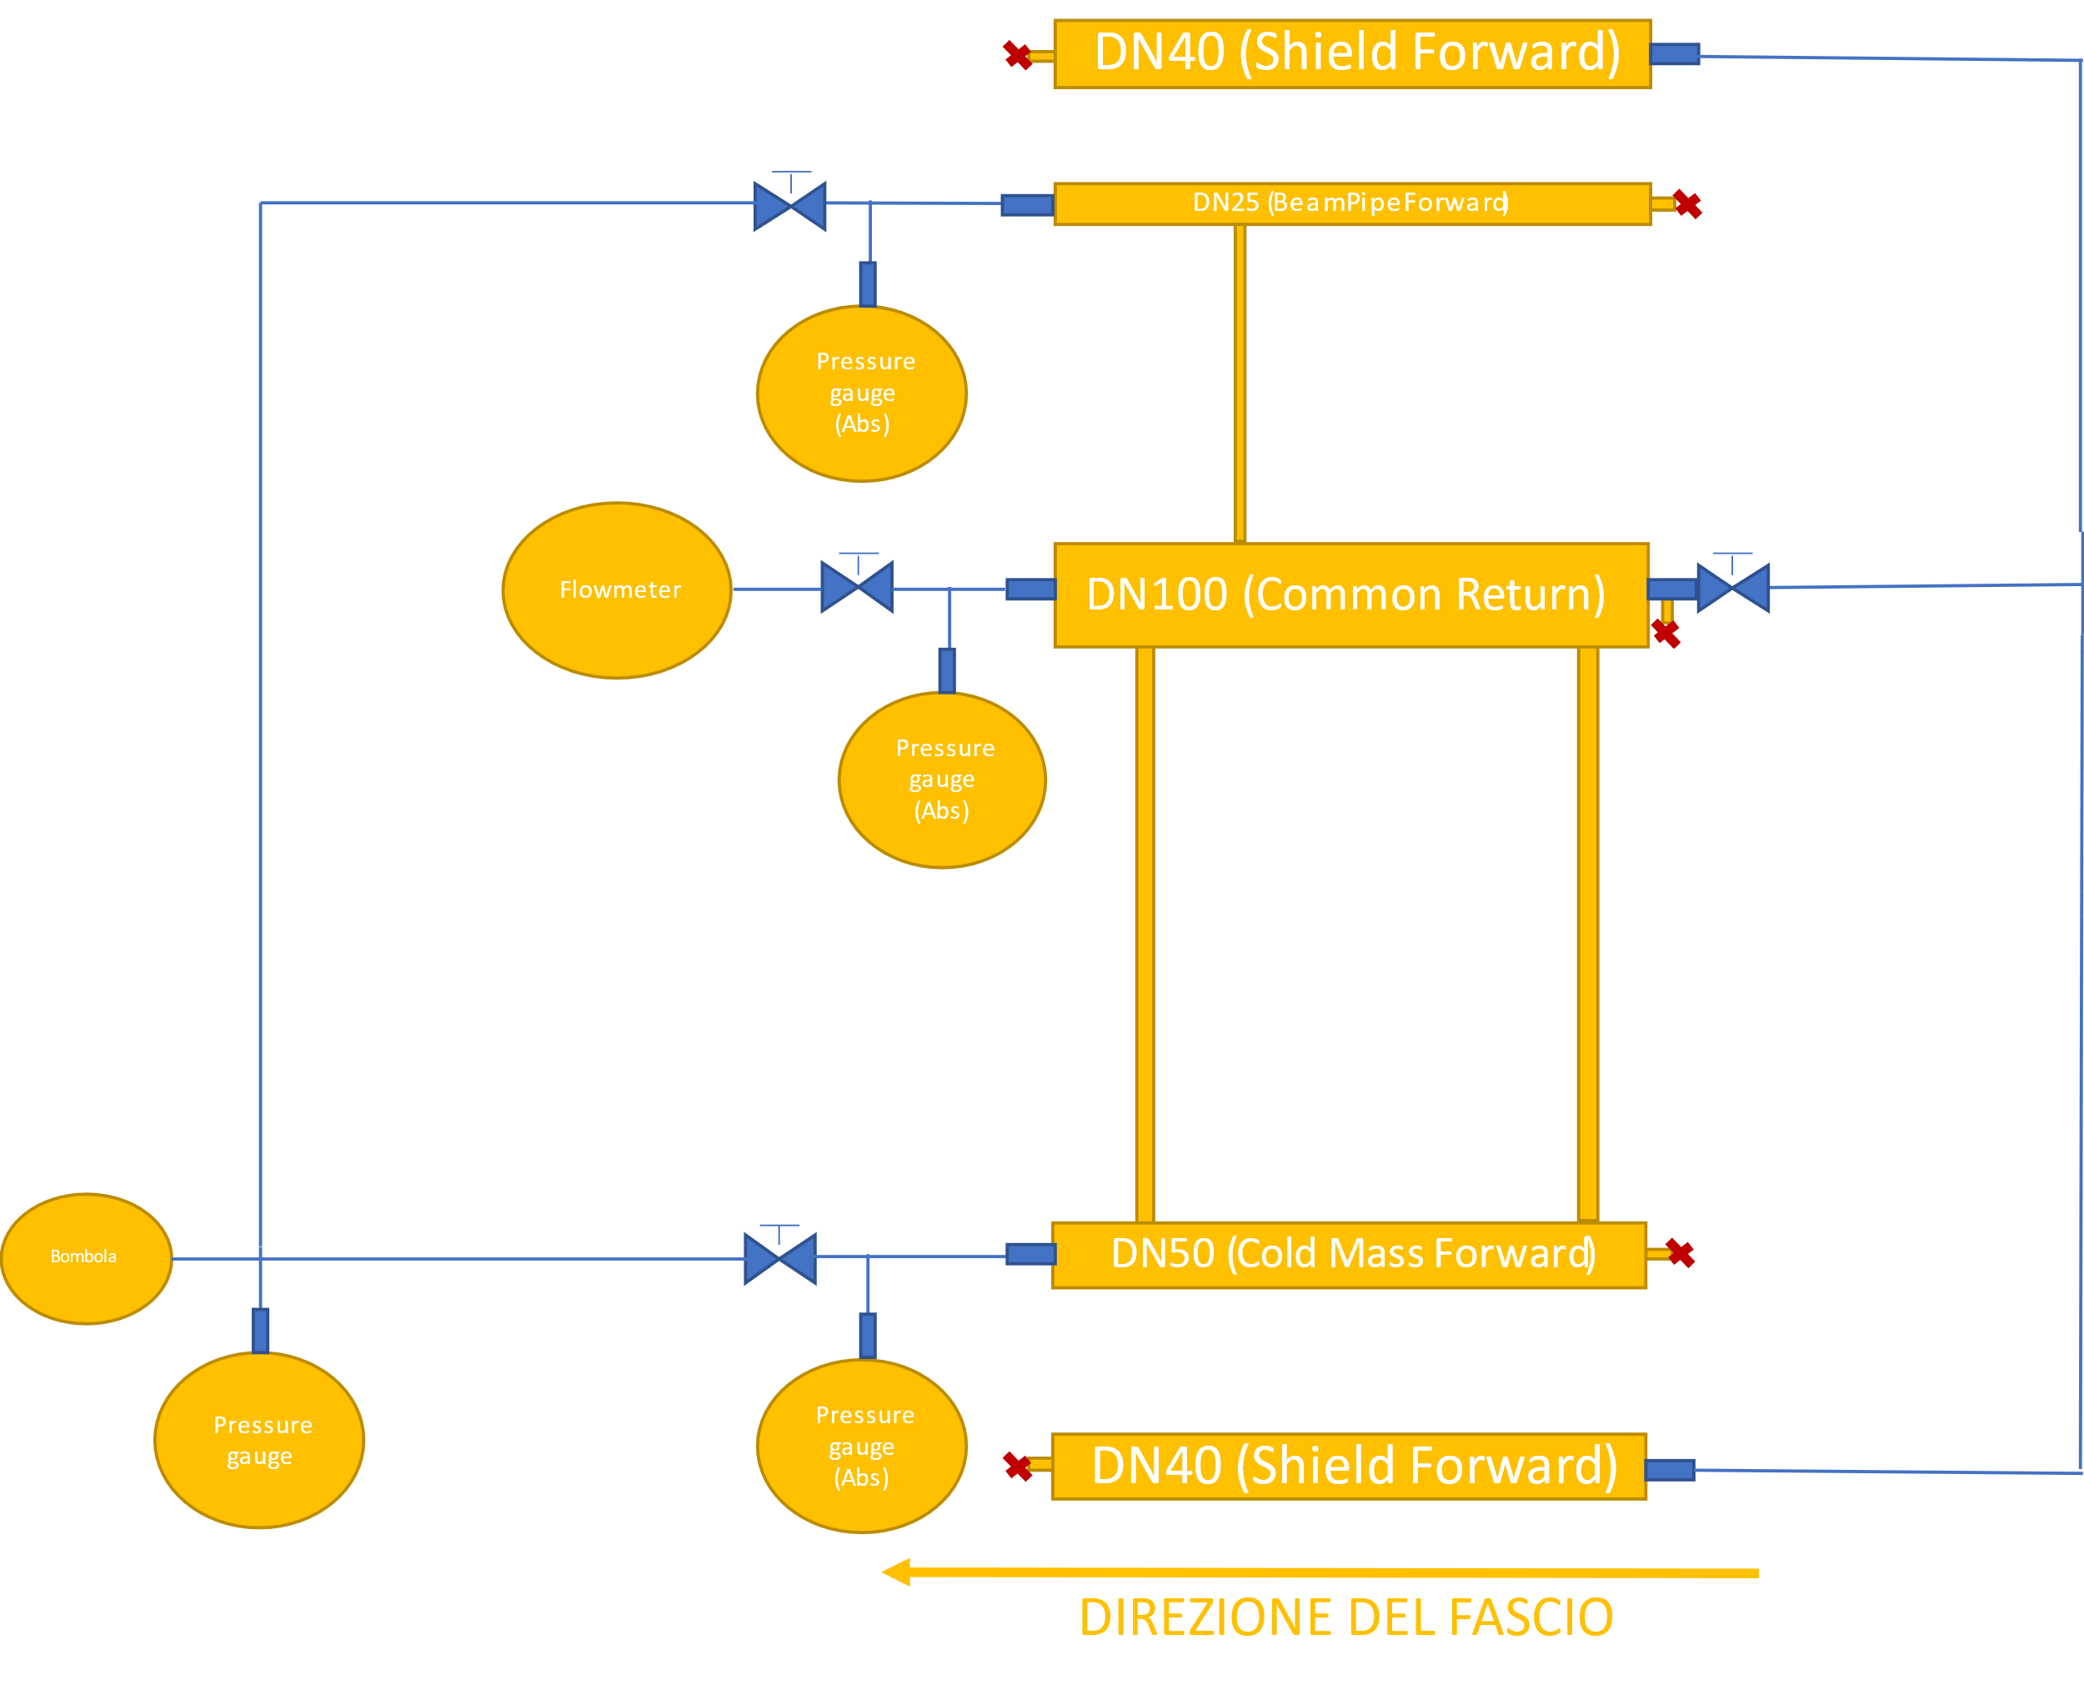
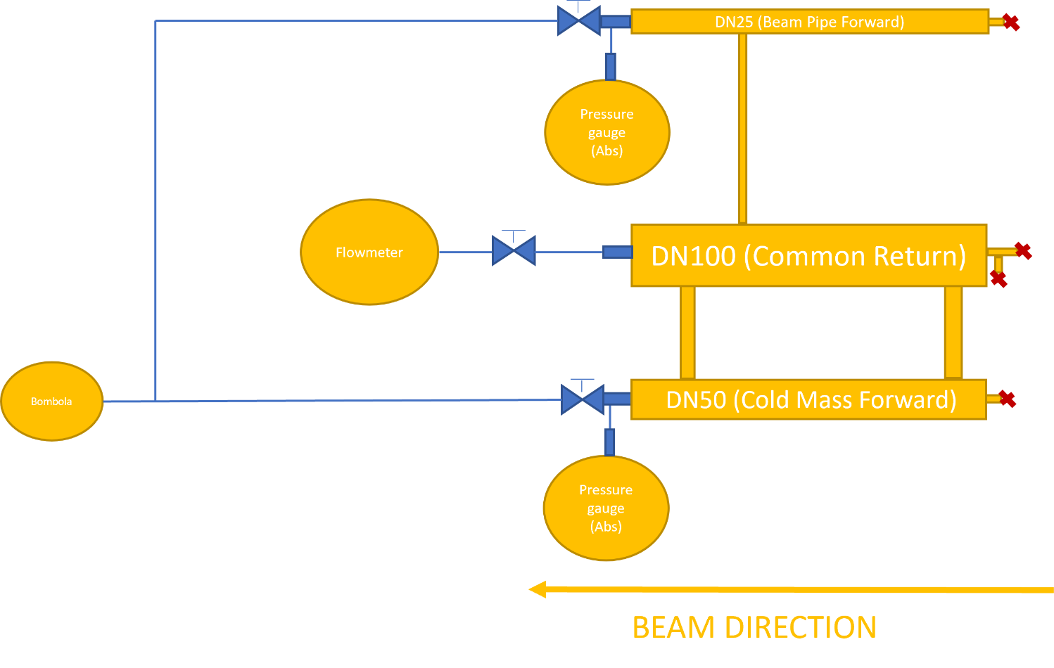
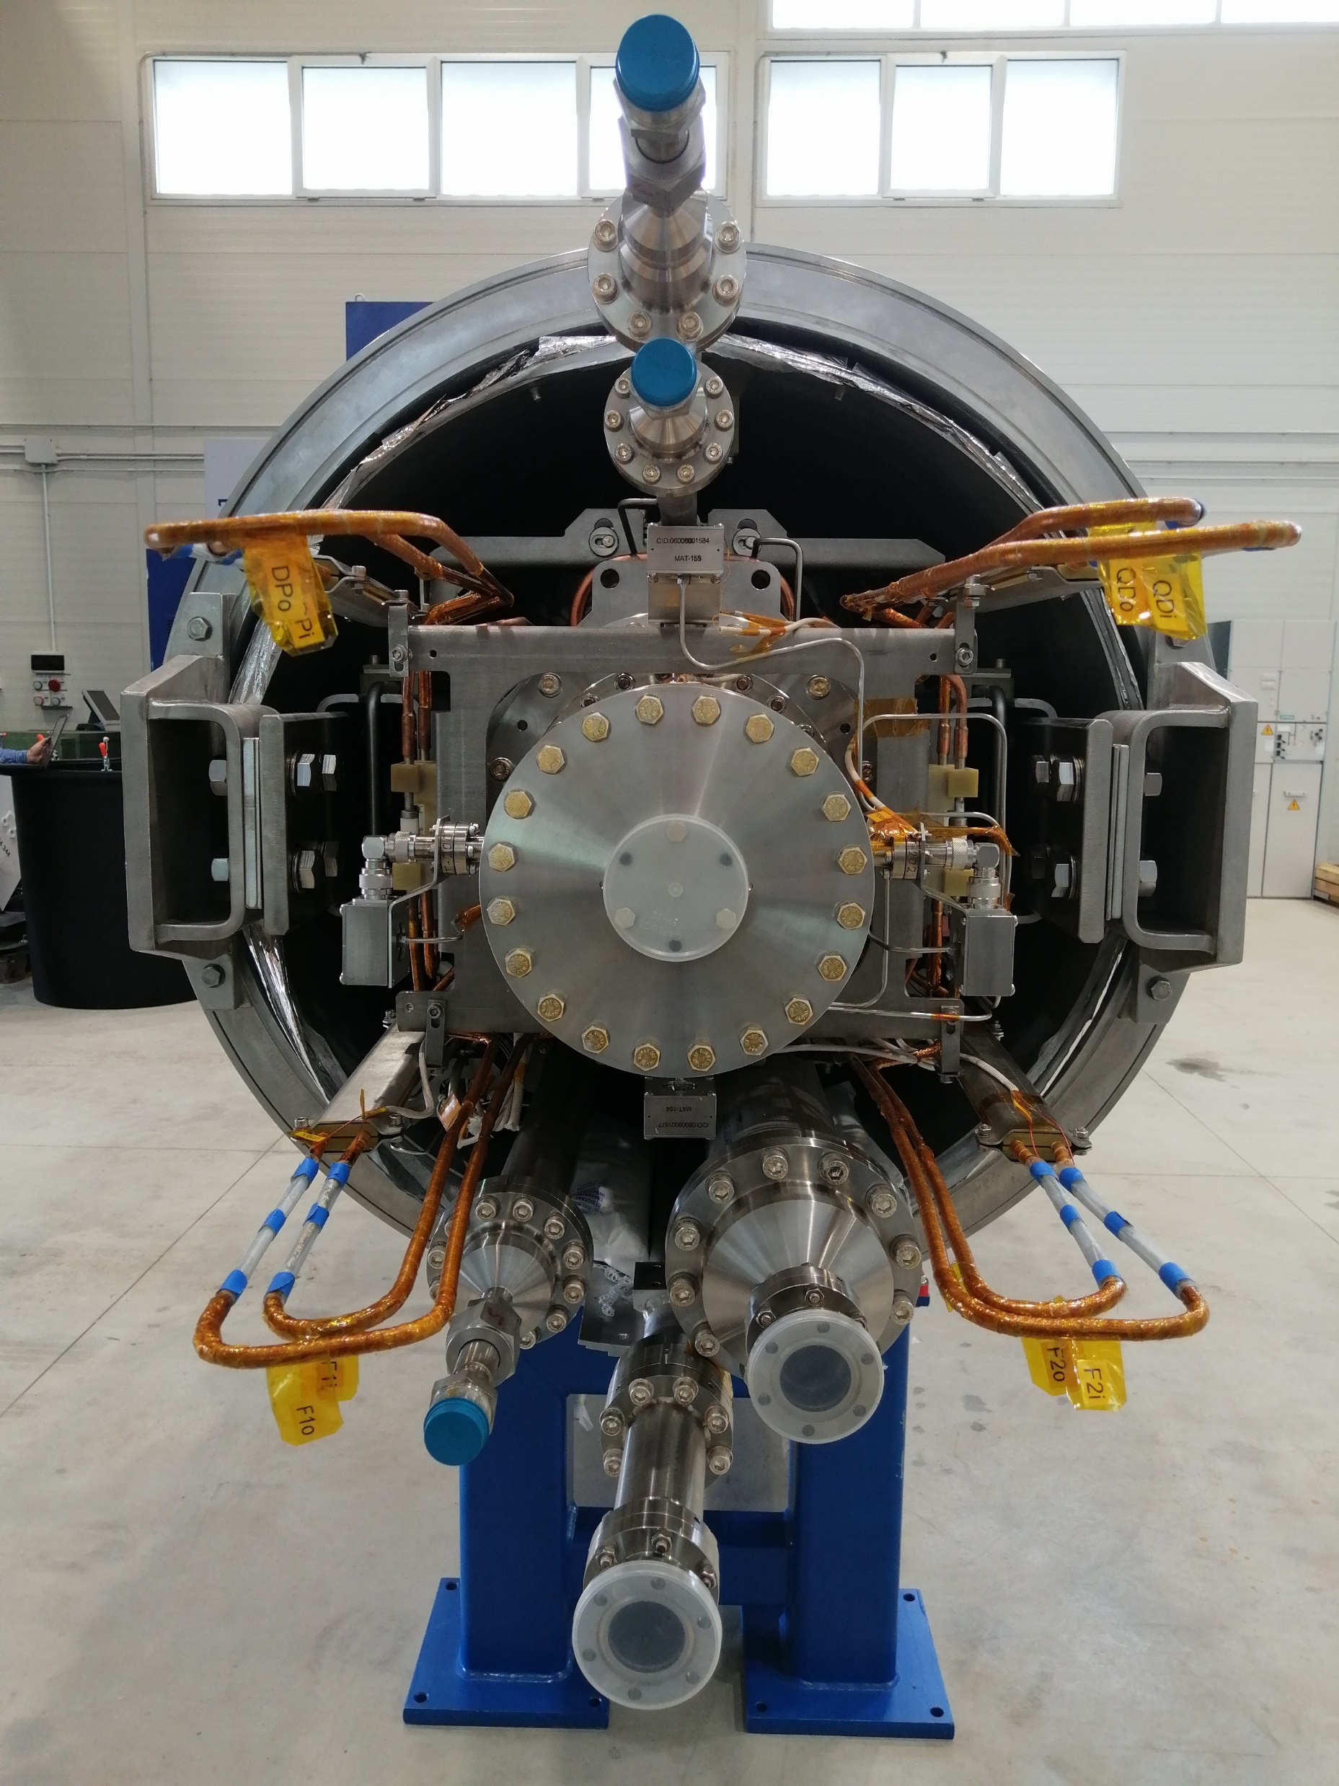
Leak, pressure and flow test of cooling pipes
Pressure leak test
Mass flow test
Time | P[mbar] | T [°C]
17:30 25/07 | 20030 | 26.5
10:05 26/07 | 19890 | 26.2
15:22 26/07 | 19869 | 25.0
17:30 26/07 | 19877 | 25.6
ΔP [bar] | T [°C] | Mass flow [g/s]
8 | 25.8 °C | 0.3942
7 |  | 0.351
6 |  | 0.3024
5 |  | 0.2484
4 |  | 0.2052
3 |  | 0.1674
2 |  | 0.1188
1 |  | 0.0648
Cold Mass Restrictor
Acceptance <200 mbar drop
ΔP [bar] | T [°C] | Mass flow [g/s]
8 | 25.8 °C | 0.1458
7 |  | 0.1296
6 |  | 0.1134
5 |  | 0.1026
4 |  | 0.0972
3 |  | 0.081
2 |  | 0.081
1 |  | 0.0756
Beam Pipe Restrictor
Results of the test on QDM type 2.5 short CID 27-6

Slide 12
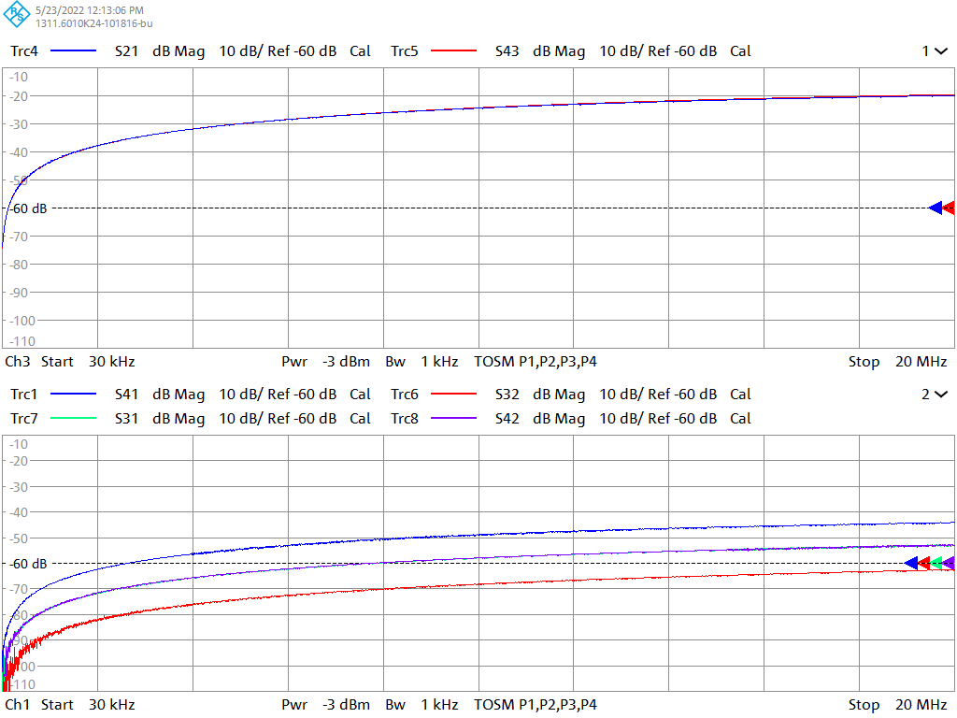
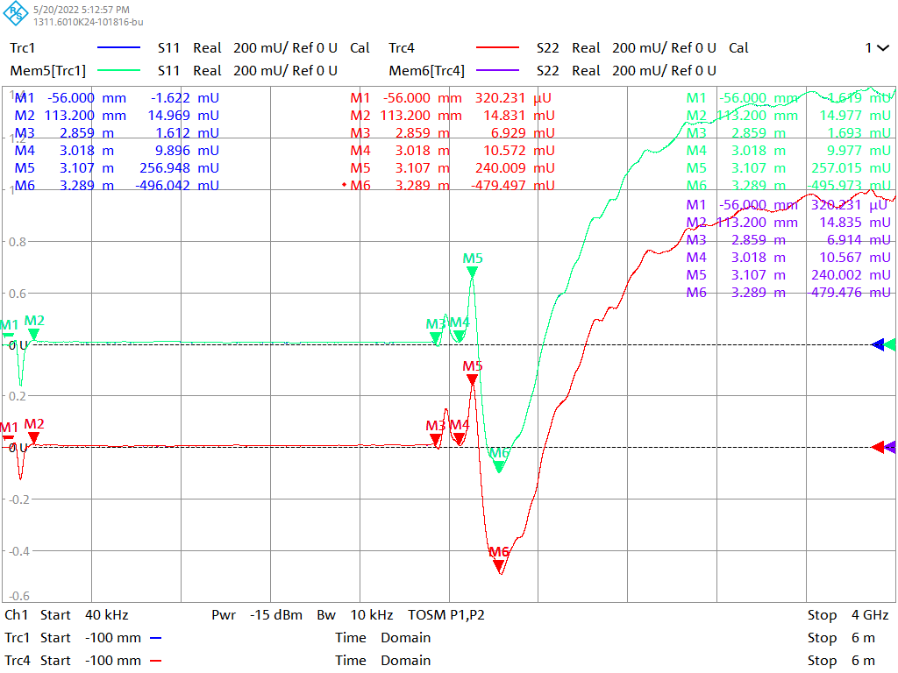
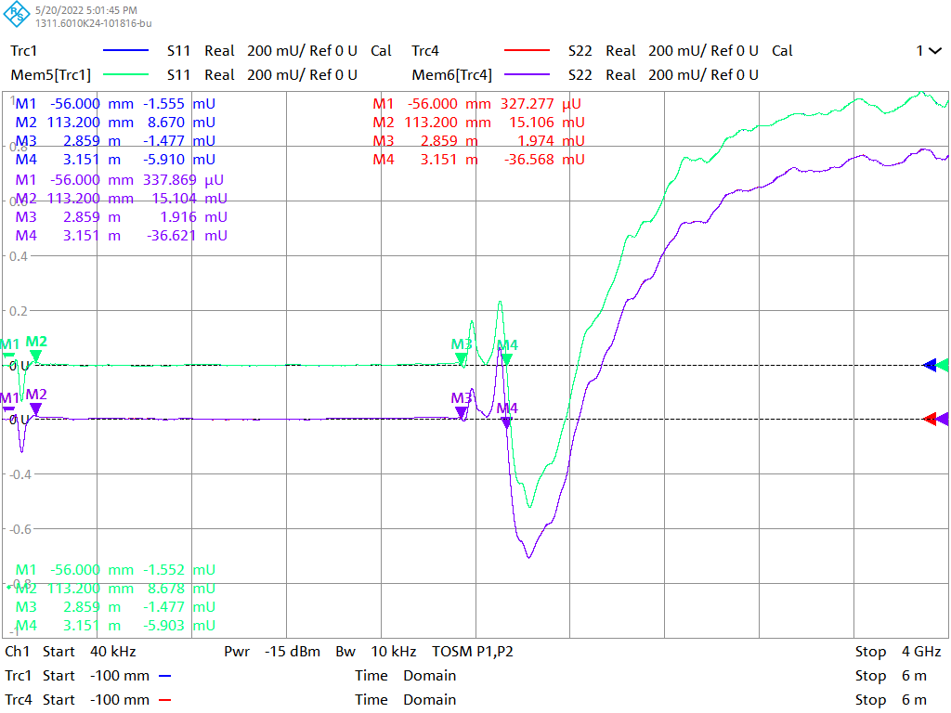
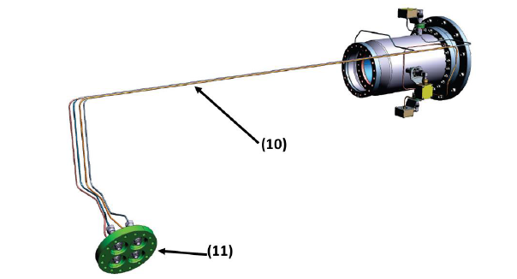
Beam instrumentation integrity
Beam Position Monitor test protocol
Nomenclature
AU | → | 1
IN | → | 2
OB | → | 3
UN | → | 4
Nomenclature
OB | → | 1
UN | → | 2
Nomenclature
AU | → | 1
IN | → | 2
Results of the test on QDM type 2.5 short CID 27-6

Slide 13
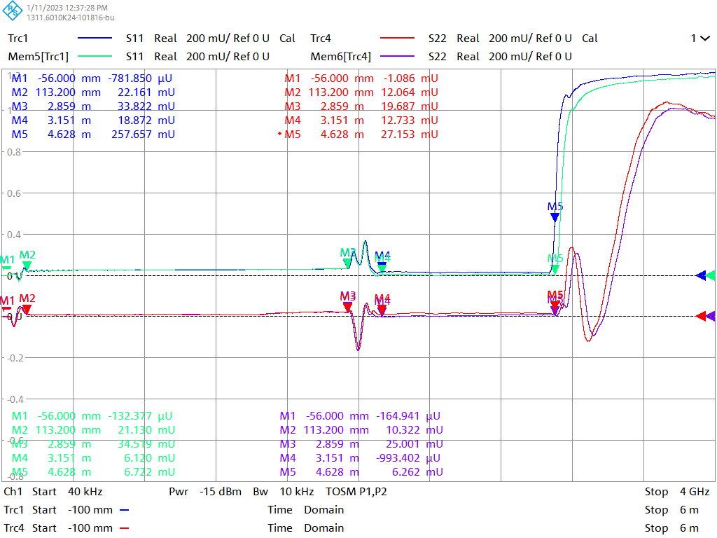
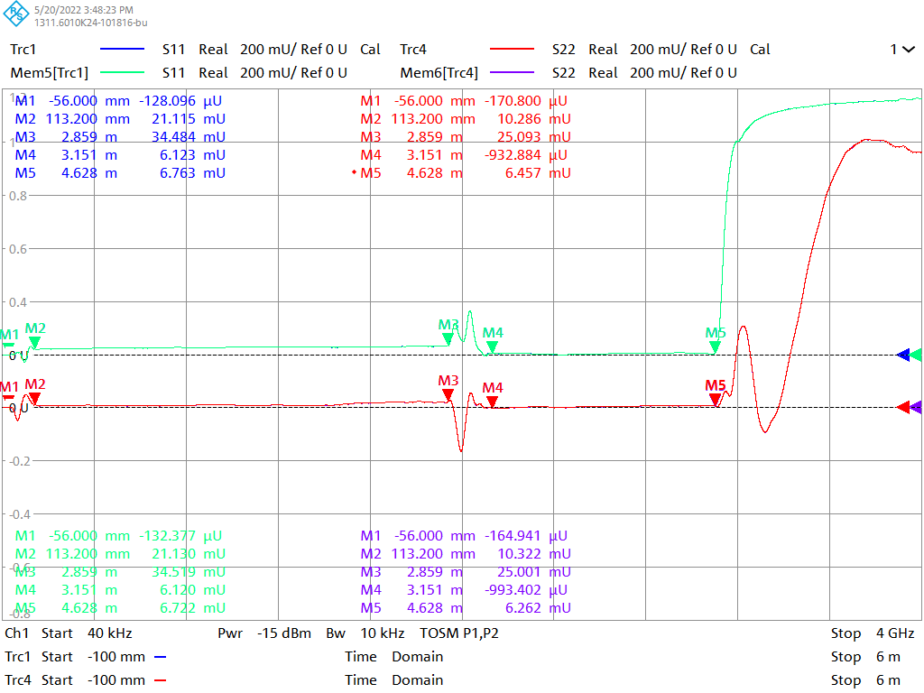
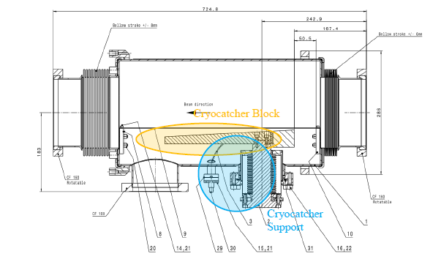
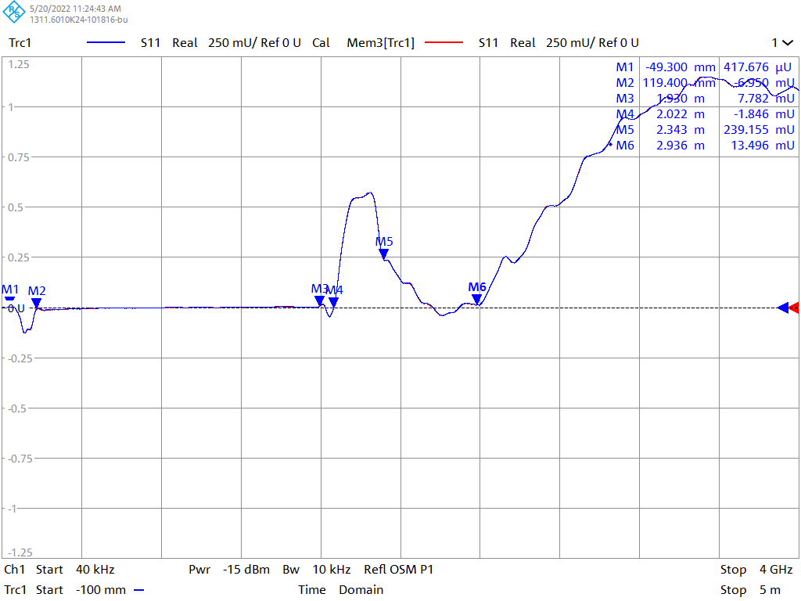
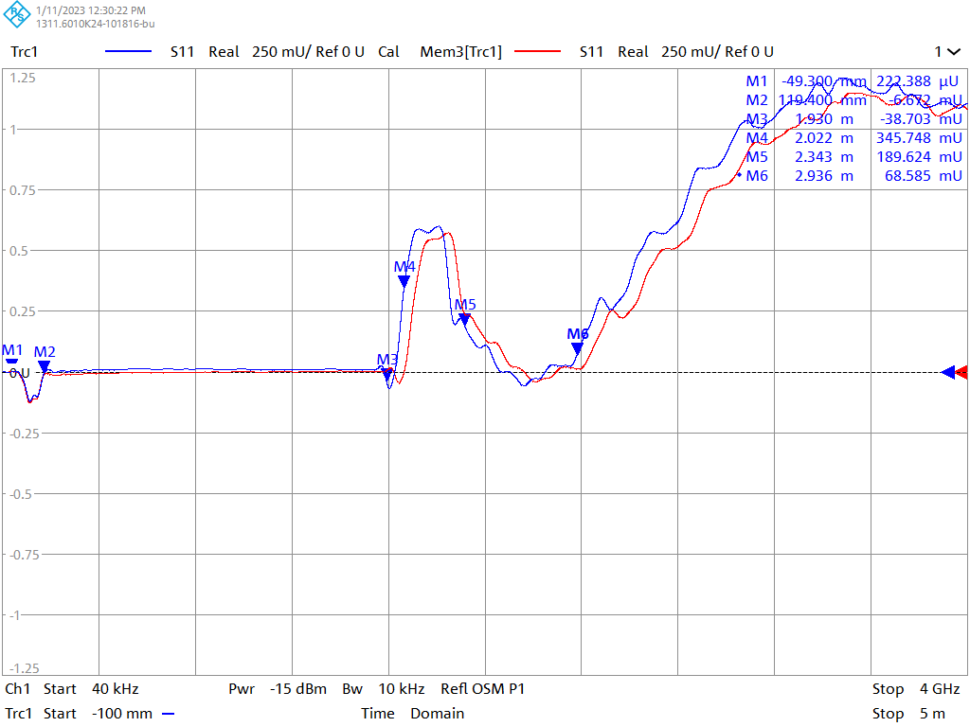
Beam instrumentation integrity
Cryo-collimator integrity
Cold Cathode integrity
Warm – Cold comparison
Cryo-collimator
Cold Cathode
Results of the test on QDM type 2.5 short CID 27-6

Slide 14
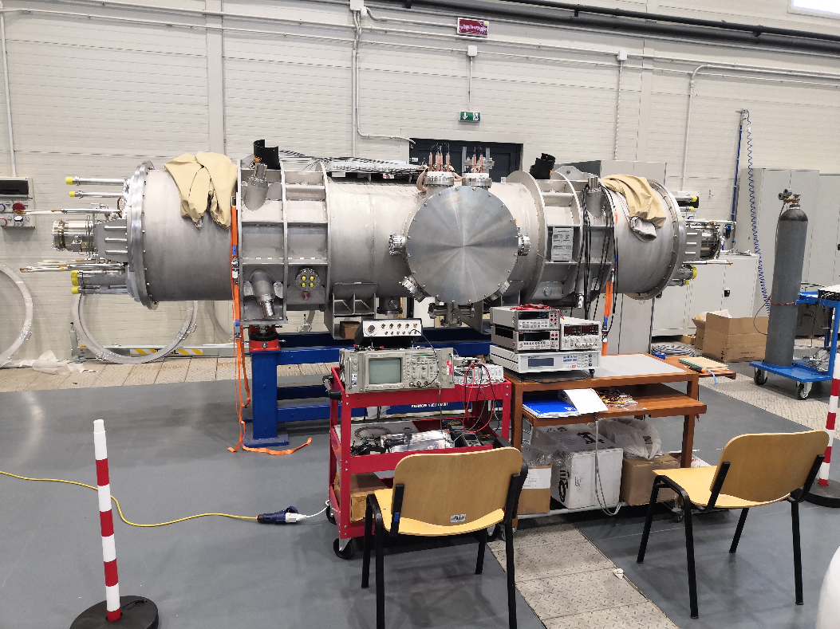
Electrical tests
Continuity test on QD main magnet
V-tap nomenclature (Socket – Pin – Voltage tap) | Voltage (mV)
 | Readouts | Expected values
SBQ – Pin 1 – VBQ4 | 0.393 | 67.570
SQD – Pin 1 – N.C. | Floating | Floating
SQD – Pin 5 – VQD1 | 230.950 | 278.477
SQD – Pin 4 – VQD2 | 230.940 | 278.451
SQD – Pin 3 – VQD3 | 502.600 | 547.956
SQD – Pin 2 – VQD4 | 502.610 | 547.953
SQD – Pin 7 – VQD5 | 771.650 | 815.487
SQD – Pin 6 – VQD6 | 771.650 | 815.490
SBQ – Pin 2 – VBQ3 | 781.820 | 825.077
Continuity test on CV corrector magnet
V-tap nomenclature (Socket – Pin – Voltage tap) | Voltage (V)
 | Readouts | Expected values
SCS – Pin 4 – VC14 | 0.000016 | 0.003370
SCS – Pin 5 – VC13 | 0.000015 | 0.003370
SCS – Pin 14 – VC12 | 0.000110 | 0.003460
SCS – Pin 15 – VC11 | 0.000110 | 0.003461
SCS – Pin 16 – VC10 | 0.000528 | 0.003818
SCS – Pin 17 – VC09 | 0.000528 | 0.003818
SCS – Pin 18 – VC08 | 7.525 | 7.529
SCS – Pin 19 – VC07 | 8.099 | 8.103
SCS – Pin 8 – VC06 | 15.629 | 15.625
SCS – Pin 9 – VC05 | 15.629 | 15.625
SCS – Pin 10 – VC04 | 15.631 | 15.628
SCS – Pin 11 – VC03 | 15.631 | 15.628
SCS – Pin 12 – VC02 | 15.631 | 15.629
SCS – Pin 13 – VC01 | 15.632 | 15.630
SCS – Pin 1 – N.C. | Floating | Floating
Results of the test on QDM type 1.7B short CID 44-3

Slide 15
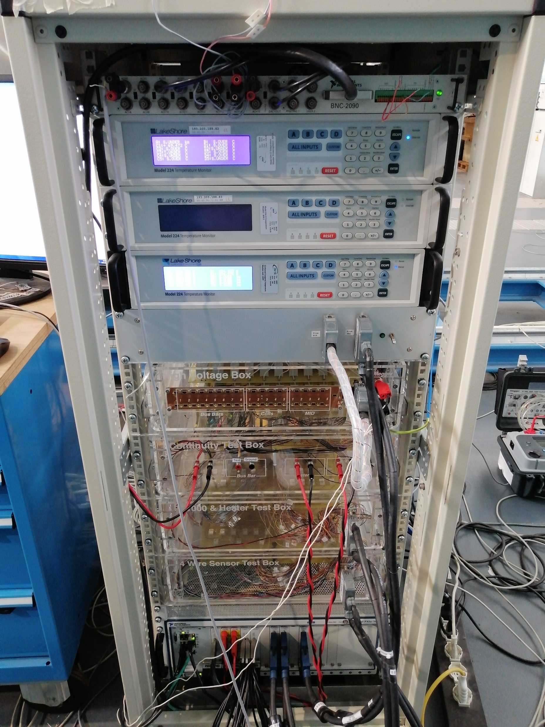
Electrical tests
Low Voltage test on T-sensors (50 V) and heaters (100V)
High Voltage test on bus-bars (600 V, 1500 V, 3000 V)
Voltage (V) | Bus-Bar | @ 5 s |  | @ 30 s |  | @ 60 s |  | @ 120 s
 |  | R_{I} (GΩ) | I_{L} (nA) | R_{I} (GΩ) | I_{L} (nA) | R_{I} (GΩ) | I_{L} (nA) | R_{I} (GΩ) | I_{L} (nA)
3000 | DPi | 2.2 | 1413.0 | 10.6 | 288.8 | 11.3 | 270.9 | 11.5 | 265.4
3000 | Dpo | 2.2 | 1395.0 | 9.7 | 316.4 | 10.3 | 297.8 | 10.4 | 294.4
3000 | F1i | 2.2 | 1386.7 | 7.9 | 387.5 | 8.4 | 364.8 | 8.6 | 356.3
3000 | F1o | 2.2 | 1409.9 | 7.2 | 424.9 | 7.7 | 398.0 | 8.0 | 383.3
3000 | F2i | 2.3 | 1335.2 | 9.2 | 333.7 | 9.8 | 312.4 | 10.0 | 304.9
3000 | F2o | 1.1 | 2745.9 | 5.1 | 601.8 | 5.5 | 555.1 | 5.9 | 518.3
3000 | QDi | 2.3 | 1314.5 | 15.0 | 203.7 | 15.5 | 197.7 | 16.0 | 191.3
3000 | QDo | 1.5 | 2069.2 | 10.9 | 280.5 | 12.4 | 246.3 | 13.4 | 227.9
Feedthrough | Voltage (V) @ 60 s | Sensor | R_{I} (GΩ) | I_{L} (nA)
CLSHP | 50 V | HT01 | 6.528 | 7.114
CLSHP (redundant) | 50 V | HT02 | 6.793 | 6.842
CLSHN | 50 V | HT03 | 6.225 | 7.478
CLSHN (redundant) | 50 V | HT04 | 7.017 | 6.623
CLSVP | 50 V | HT05 | 6.868 | 6.756
CLSVP (redundant) | 50 V | HT06 | 6.523 | 7.113
CLSVN | 50 V | HT07 | 6.755 | 6.864
CLSVN (redundant) | 50 V | HT08 | 7.275 | 6.373
CLCSP | 50 V | HT09 | 7.010 | 6.616
CLCSP (redundant) | 50 V | HT10 | 7.212 | 6.421
CLCSN | 50 V | HT11 | 7.362 | 6.310
CLCSN (redundant) | 50 V | HT12 | 7.707 | 6.000
CLSHP | 100 V | HL01 | 7.541 | 12.918
CLSHP (redundant) | 100 V | HL02 | 7.348 | 13.258
CLSHN | 100 V | HL03 | 6.712 | 14.512
CLSHN (redundant) | 100 V | HL04 | 7.417 | 13.123
CLSVP | 100 V | HL05 | 7.336 | 13.276
CLSVP (redundant) | 100 V | HL06 | 6.734 | 14.464
CLSVN | 100 V | HL07 | 7.063 | 13.795
CLSVN (redundant) | 100 V | HL08 | 7.839 | 12.417
CLCSP | 100 V | HL09 | 7.613 | 12.790
CLCSP (redundant) | 100 V | HL10 | 7.758 | 12.545
CLCSN | 100 V | HL11 | 5.268 | 18.475
CLCSN (redundant) | 100 V | HL12 | 5.033 | 19.360
Insulation resistance ≥ 1 GΩ and Leakage current ≤ 3 µA
High Voltage test on correctors (200 V, 500 V, 1100 V)
Voltage (V) | Corrector | @ 60 s |  | @ 120 s
 |  | RI (GΩ) | IL (nA) | RI (GΩ) | IL (nA)
1100 | SCS-Coil | 4.0 | 280.2 | 4.6 | 244.9
1100 | SCS-MID | 8.0 | 139.2 | 8.8 | 127.7
1100 | SSH-Coil | 1.2 | 964.7 | 1.3 | 861.0
1100 | SSH-MID | 6.0 | 186.1 | 6.4 | 175.7
1100 | SSV-Coil | 2.8 | 394.2 | 3.2 | 349.1
1100 | SSV-MID | 7.3 | 152.8 | 7.9 | 140.9
Insulation resistance ≥ 0.1 GΩ and Leakage current ≤ 0.5-1 µA
Results of the test on QDM type 2.5 short CID 27-6
Insulation resistance ≥ 1 GΩ and Leakage current ≤ 1.1 µA

Slide 16
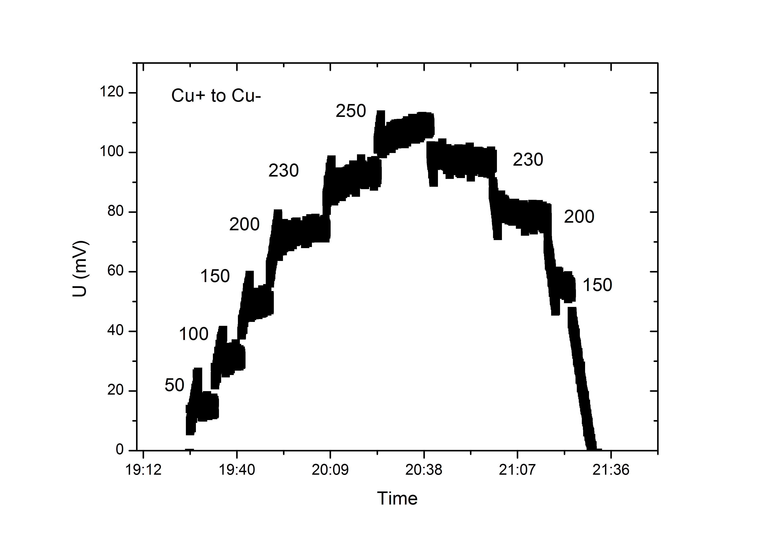
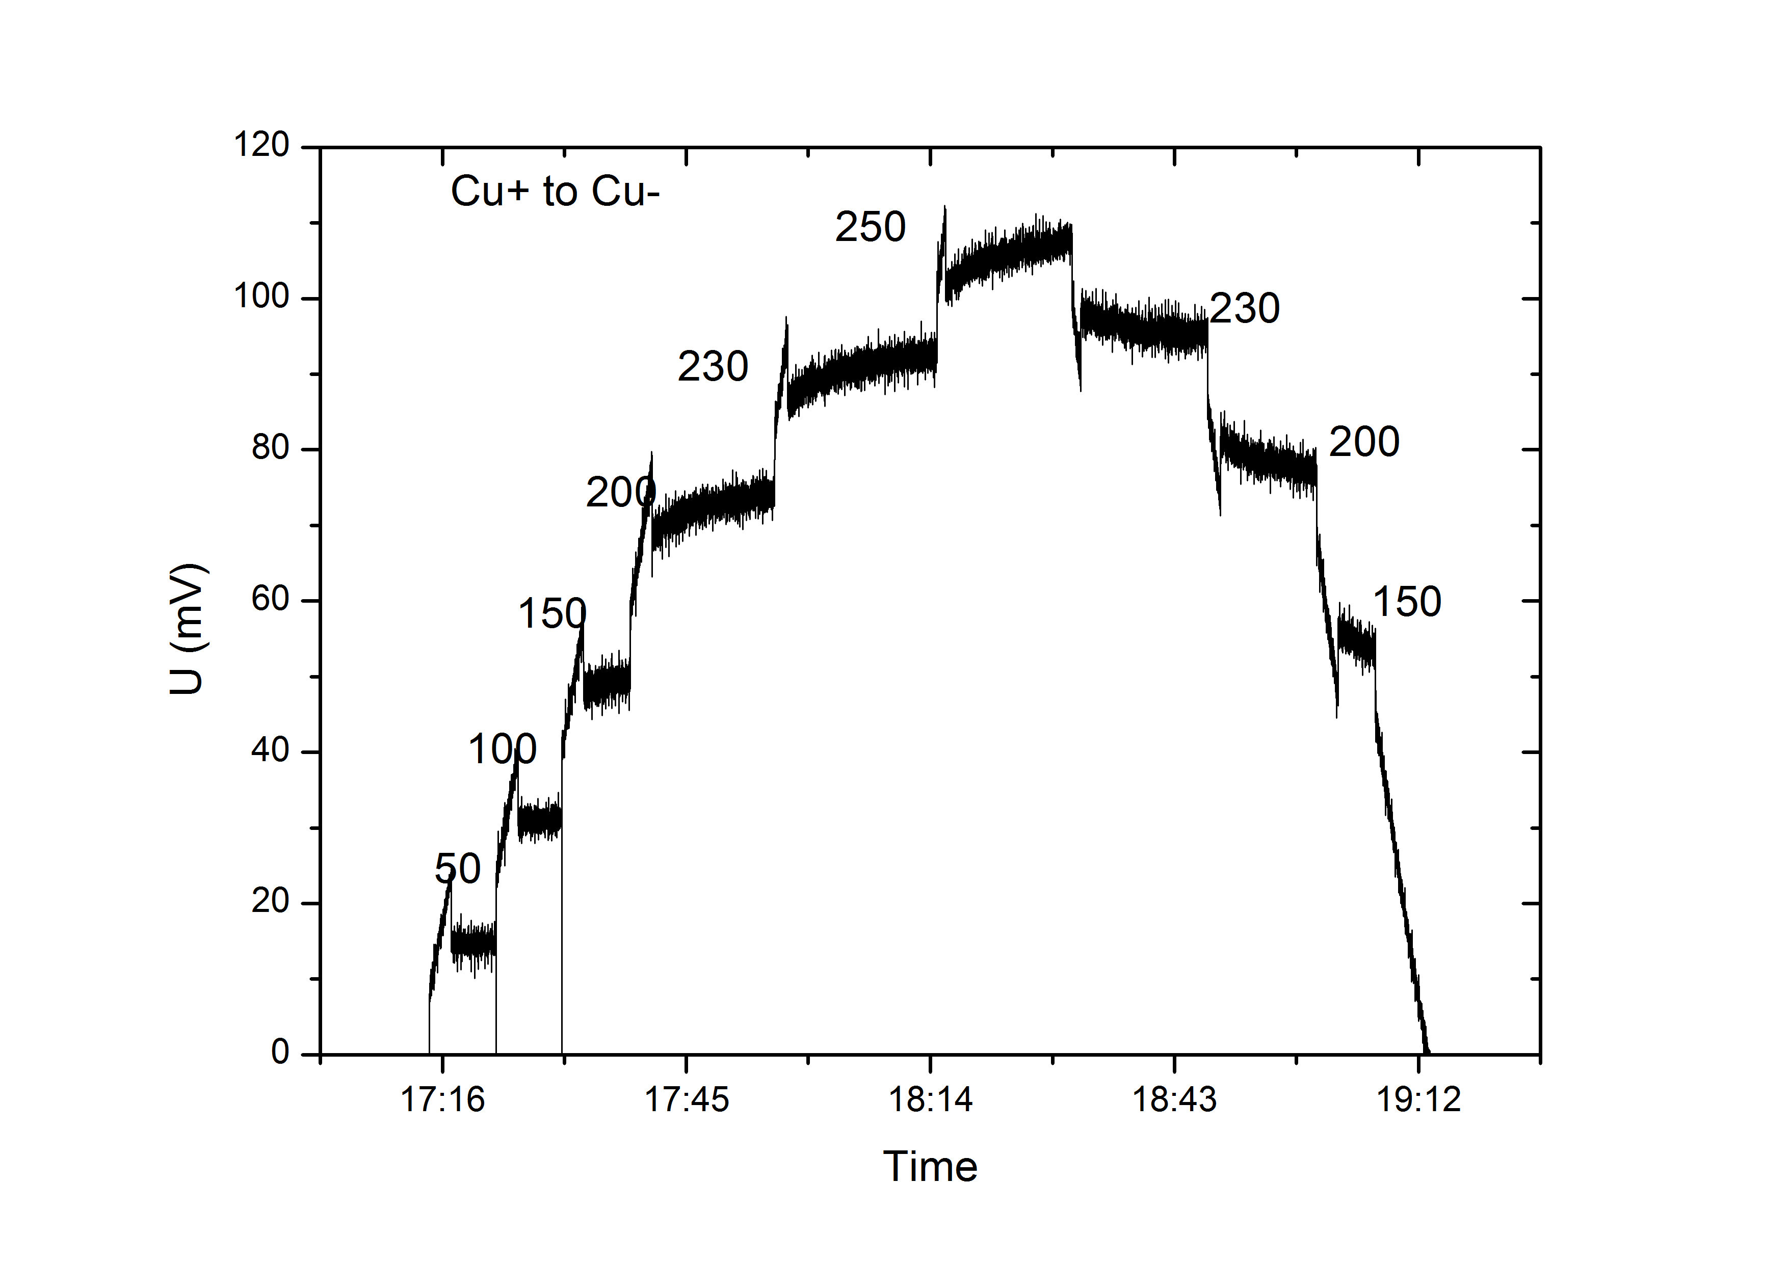
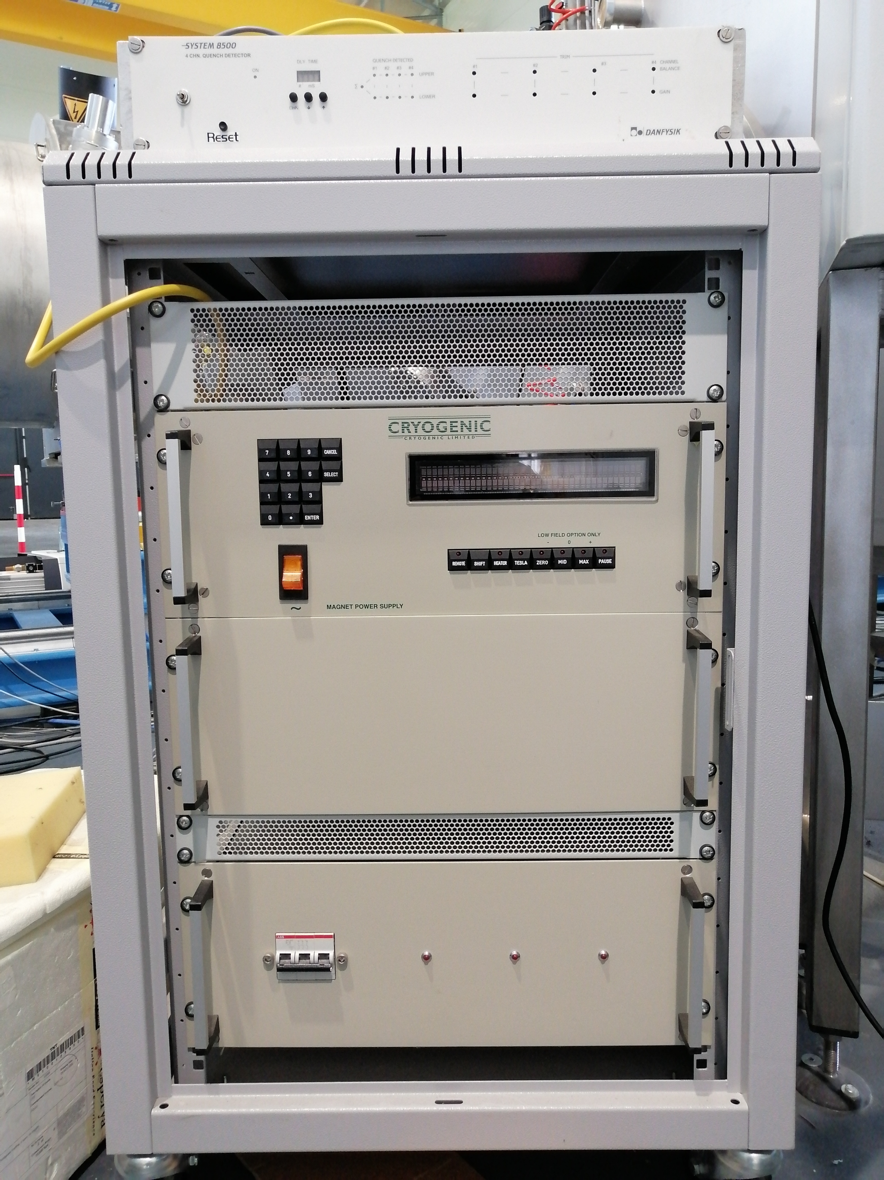
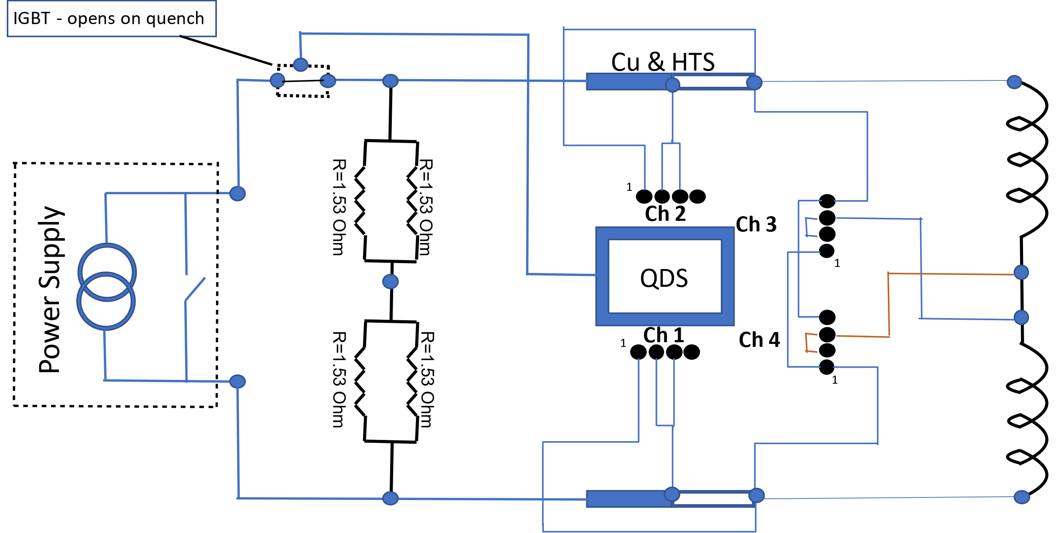
Corrector magnets powering
Protection Scheme
Steerer Horizontal
Steerer Vertical
Results of the test on QDM type 2.5 short CID 27-6

Slide 17
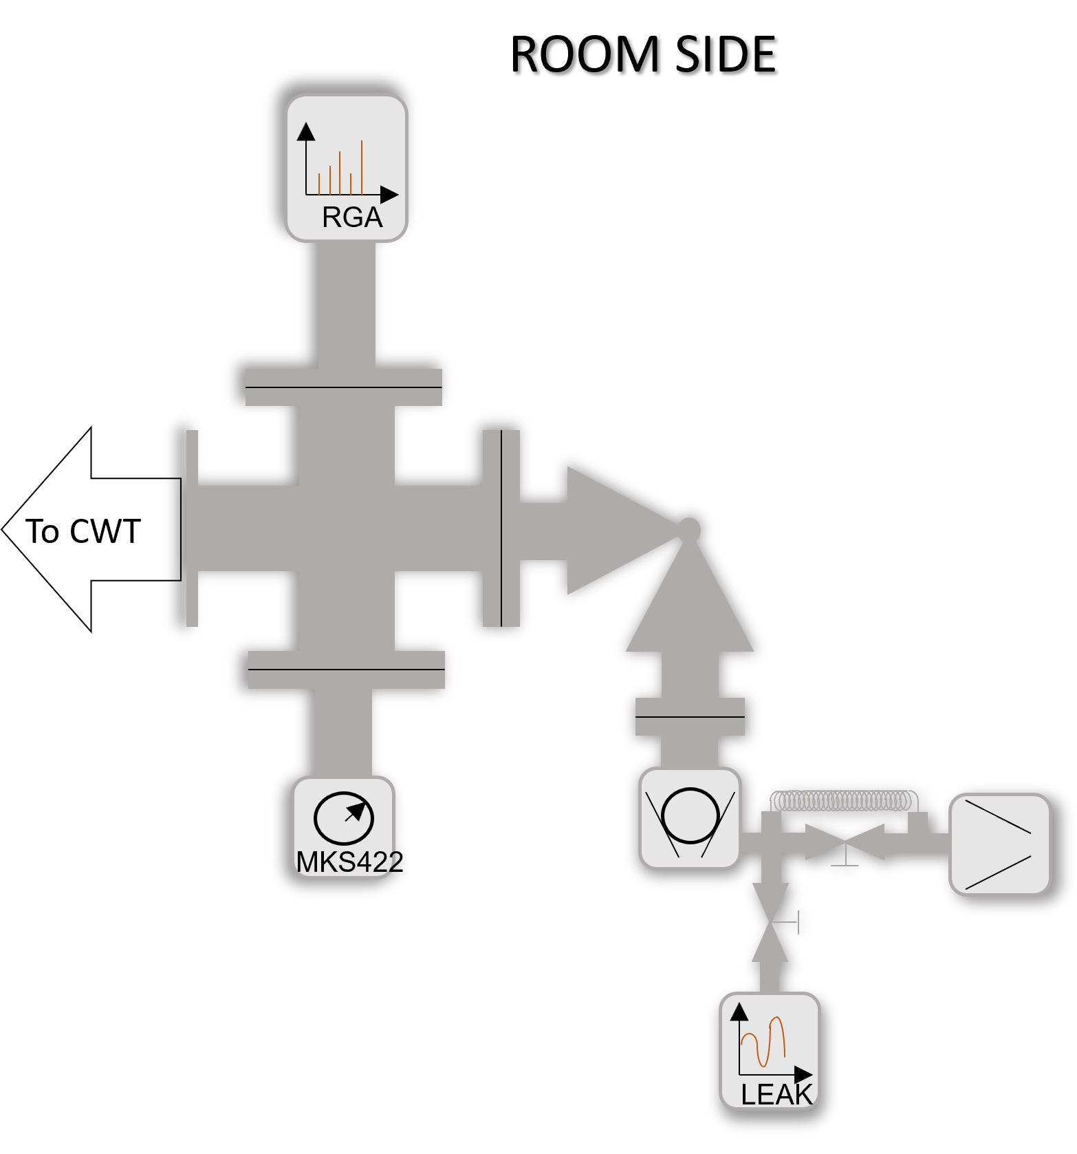
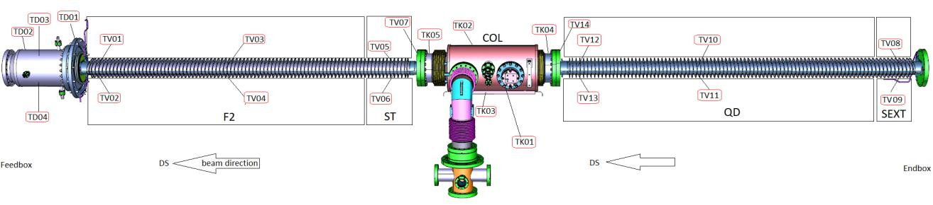
UHV leak check
Beam pipe assembly
Test equipment

Slide 18
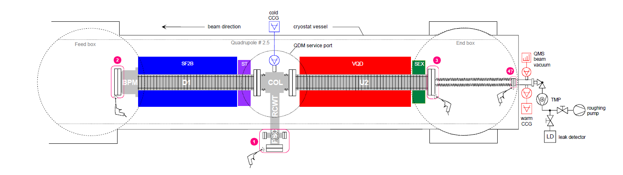
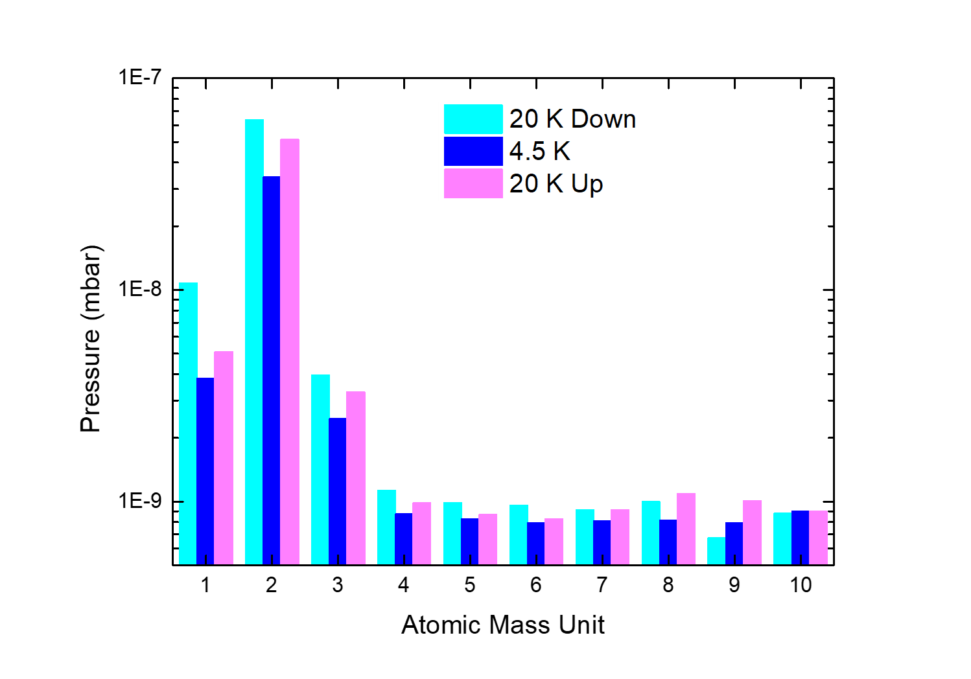
Cold leak check
Warm leak check
Acceptance criteria maximum leak <1x10⁻¹⁰ mbar l/s

Slide 19
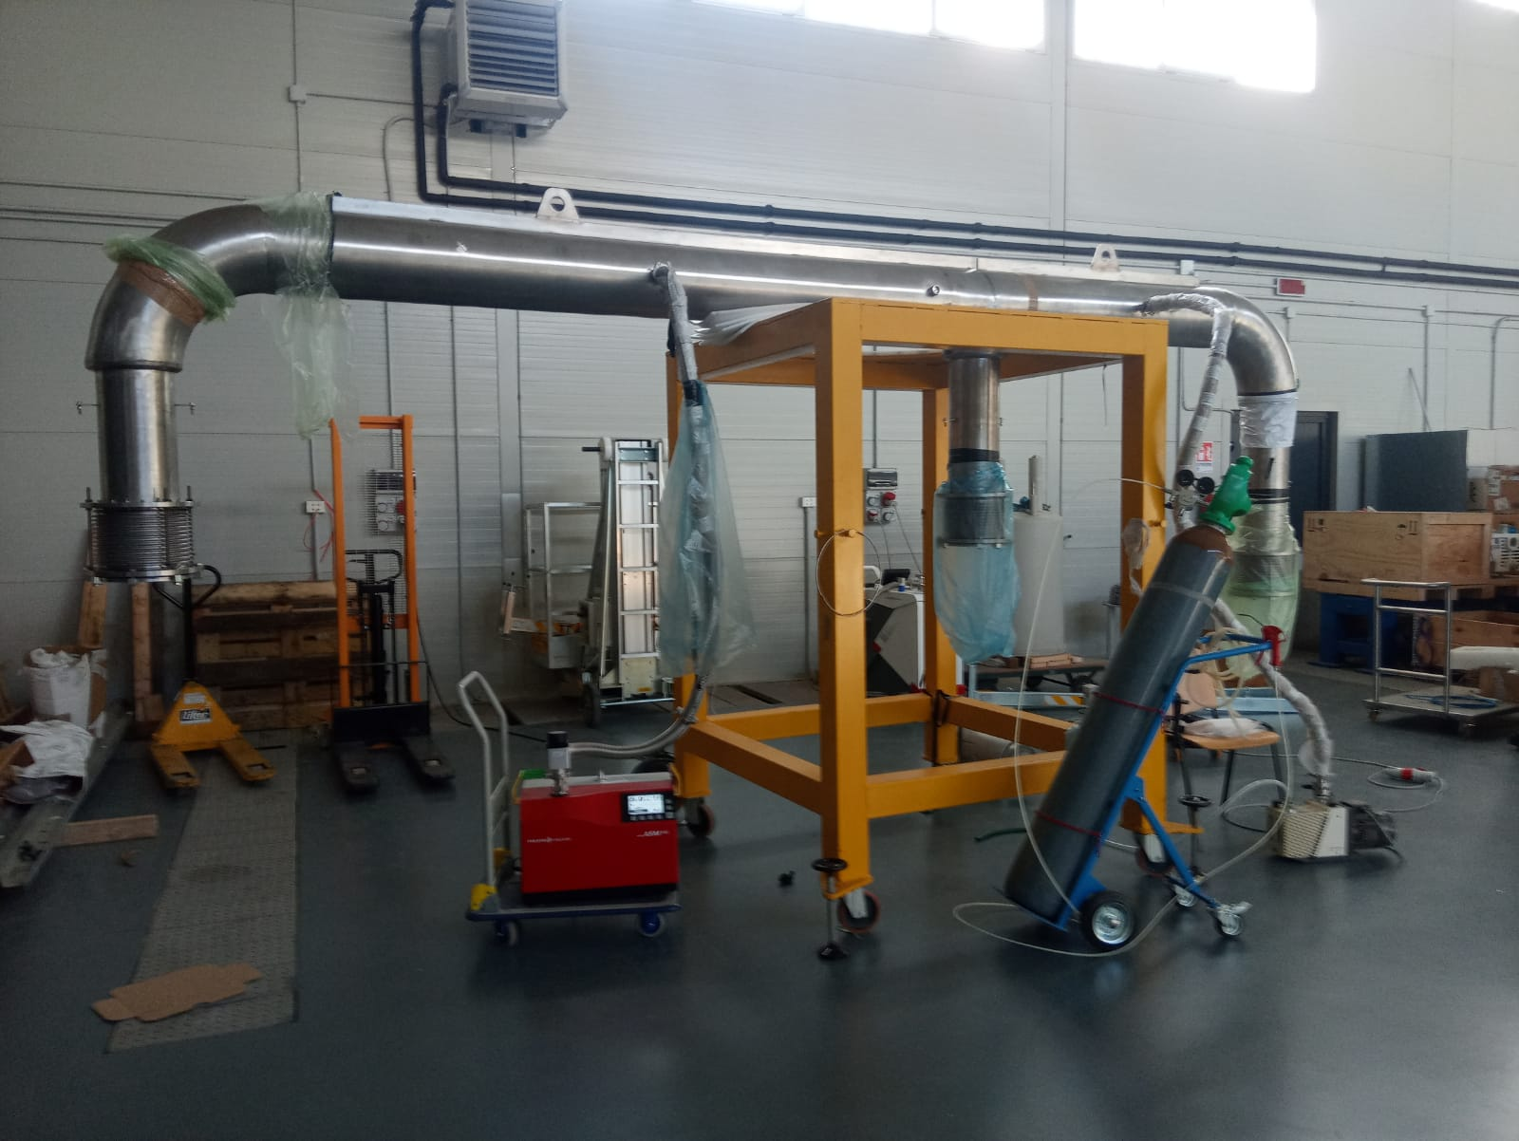
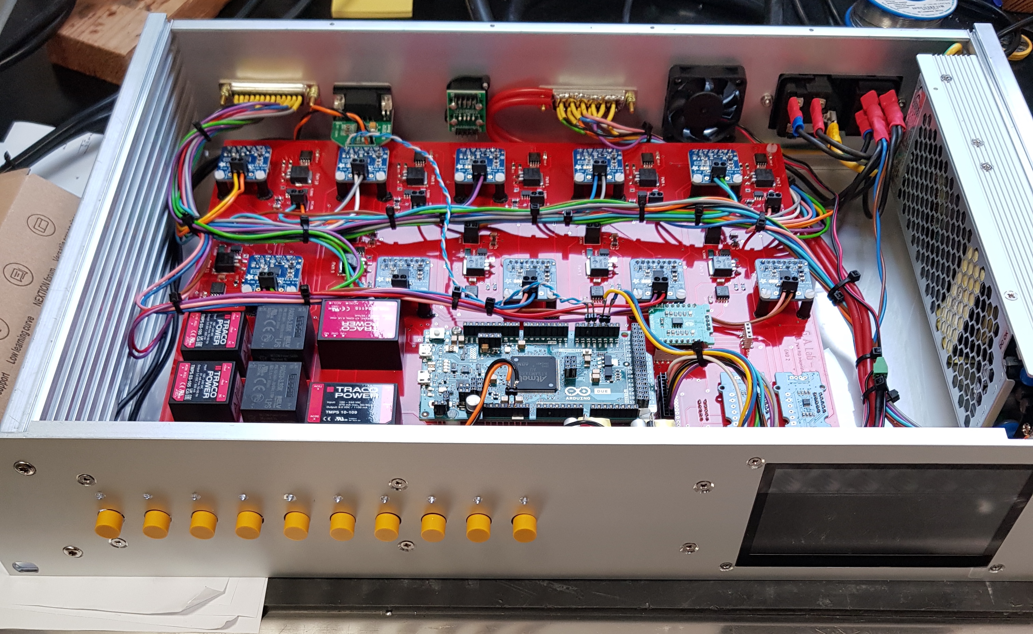
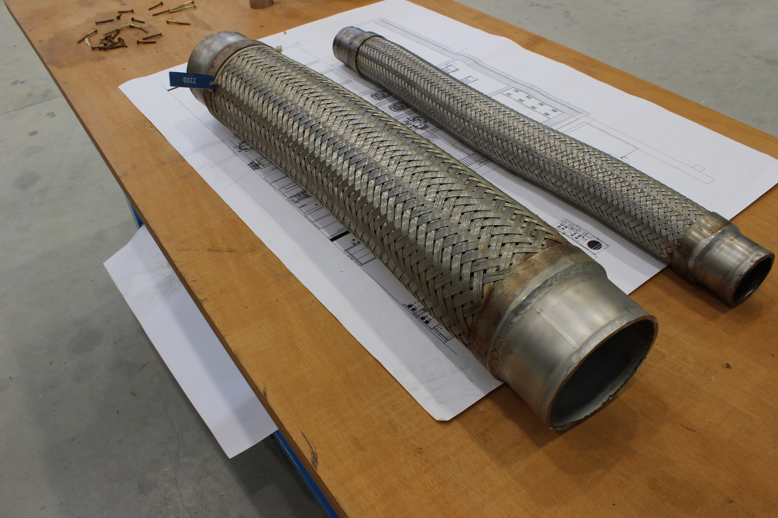

Problems and mitigation
Limy cooling tower heat exchanger
Leaky transfer line
Uncontrollable LCL heater controller
Leaky dampers on He lines
Power grid faults
We are experiencing continuous power grid faults; they are few ms long but able to trigger the cold box compressor protection system;
We are procuring filters and uninterruptible power supply systems for compressor and cold box acessories.
Heat exchanger has been opened and cleaned;
A second heat exchanger has been procured to be mounted in parallel to the first. It will be used in case of new cleaning procedure on the first eschanger, allowing to continue tests.
Substituted with a in house designed, prduced and tested controller
Substituted 2 times
Transfer line has been reworked

Slide 20

Overview of THOR activities
Completed
Set up and commissioning of THOR first test line;
First pump down and cool down successfully achieved on FoS;
Full thermal cycle on two QDMs type 2.5 (FoS and #27);
Full test sequence on two QDMs type 2.5 (FoS and #27);
Incoming tests on two QDMs type 1.7B (42 and 44);
Third module redy to be cooled down (44);
THOR second test line just delivered;
Possible under discussion
Alignment tests on Helium header pipes (either using a mechanical template to be provided by GSI or using laser tracking techniques;
AC powering of corrector magnets (using new power converters provided by GSI after proper training);

Slide 21
Conclusion
The joining of INFN and UniSA to the FAIR/GSI program lead to the development of a strong activity in applied superconductivity. The installation and the operation of relevant infrastructure for operation in this field opens perspectives to the development of research to the host institutions, which are also already reflected in the new PNRR programs.

Slide 22

Salvador Dali – Melting Watch
Thank you for your time!

