Slide 1
US MDP Program – Challenges and Plans for Test Infrastructure
Soren Prestemon
US Magnet Development Program
Lawrence Berkeley National Laboratory

Slide 2
Outline
The Magnet Development Program vision and goals, & priorities of the current Roadmaps
Context in the broader US High Energy Physics community
Our involvement in the international community
Leveraging synergistic activities
Test infrastructure and driving questions
Summary

Slide 3
Recap of our MDP vision and goals
Focus on the four primary goals identified in the the original MDP Plan
  Explore the performance limits of Nb₃Sn accelerator magnets, with a focus on minimizing the required operating margin and significantly reducing or eliminating training
  Develop and demonstrate an HTS accelerator magnet with a self-field of 5T or greater, compatible with operation in a hybrid HTS/LTS magnet for fields beyond 16T
  Investigate fundamental aspects of magnet design and technology that can lead to substantial performance improvements and magnet cost reduction
  Pursue Nb₃Sn and HTS conductor R&D with clear targets to increase performance and reduce the cost of accelerator magnets
Further develop and integrate the teams across the partner laboratories and Universities for maximum value and effectiveness to the program
Identify and nurture cross-cutting / synergistic activities with other programs to more rapidly advance progress towards our goals

Slide 4
Program roadmap – 2020 Detailed Plan
Strategic priorities for the current plan:
  Probing stress management structures
  Hybrid HTS/LTS designs
  Understanding and impacting the disturbance-spectrum
  Advancing both LTS and HTS conductors, optimized for HEP applications
  The new element 20T Hybrid Magnet Design & Comparative Analysis, is making good progress, preparing for future program goals
  Expect to fold into magnet arena at next CM
There is growing schedule disconnect
  Driven primarily by funding + our interest in maintaining a broad program
=> Need to focus towards key hybrid magnets

Slide 5
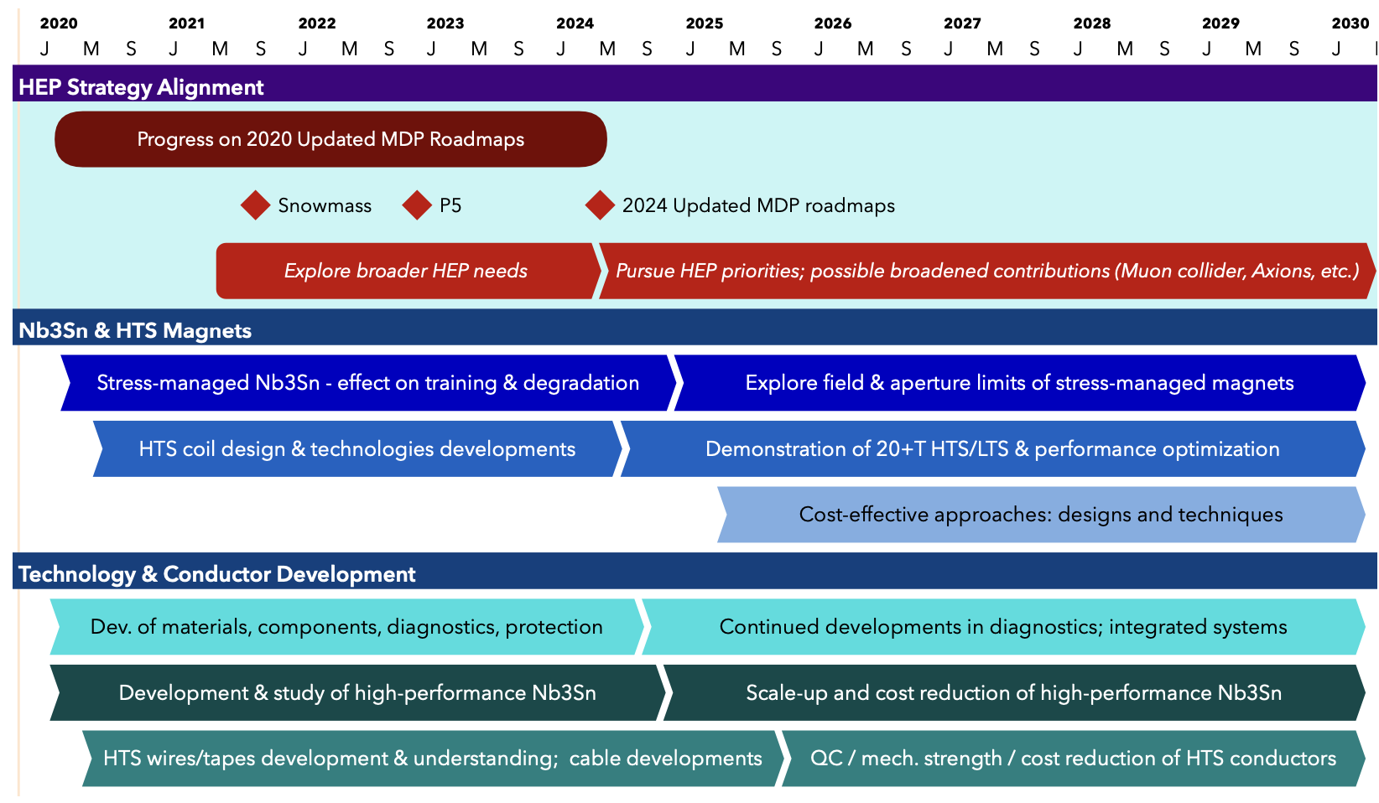
US MDP 2020 roadmaps – long range
Continue alignment with physics community needs
Focus on “stress-management” as well as hybrid HTS/LTS magnet technology
Continue to invest in the “science of magnets” and in improved conductors

Slide 6
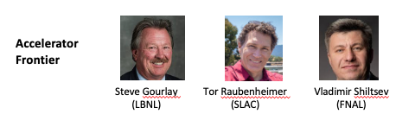
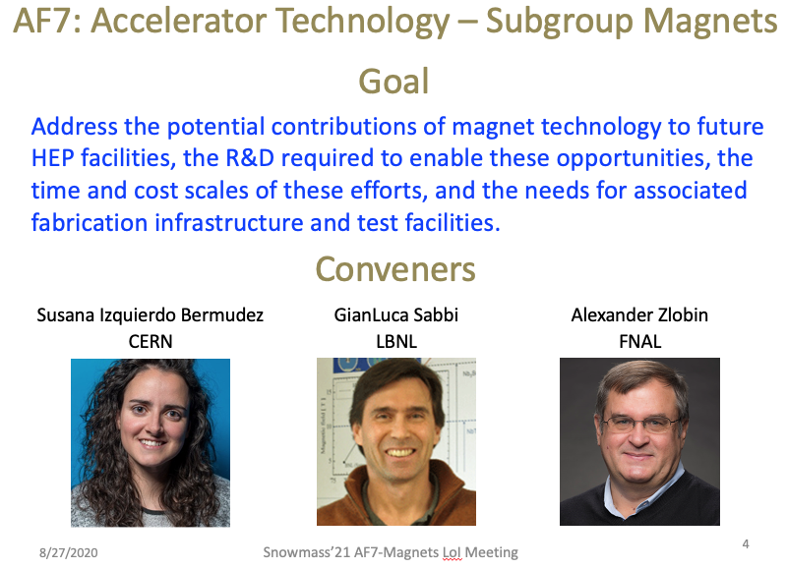
Our context in the US HEP Community
The US MDP resides under DOE-OHEP General Accelerator R&D
  Viewed as Long-term R&D – strength of DOE-OHEP, that has led to longstanding international leadership in the field
The ”Snowmass” HEP community planning exercise is completed
  Strong presence of MDP staff!
  Whitepapers submitted and discussed in Seattle
  The Snowmass process, and the follow-on P5 (Particle Physics Projects Prioritization Panel) report, will provide critical input for an update to MDP roadmaps circa 2024

Slide 7
We have ongoing efforts to contribute to P5 deliberations
Snowmass has concluded, and the P5 is underway
  Two MDP TAC members are on P5
    Amalia Ballarino & Mark Palmer
  One DOE Steering Council rep for MDP is on P5
    Tor Raubenheimer
P5 is holding townhalls – opportunity for input
  Presentations planned on Wed., May 3rd:
    FCC-ee/FCC-hh
      Planning panel led by Tor, Vladimir, Andy
      Magnet contributions from Kathleen, Steve, Soren
    Muon Collider
      Planning panel led by Sergo Jindariani, Diktys Stratakis (Fermilab)
      Magnet contributions from Steve, Giorgio, Soren
    Magnet technology for future colliders
      Soren

Slide 8

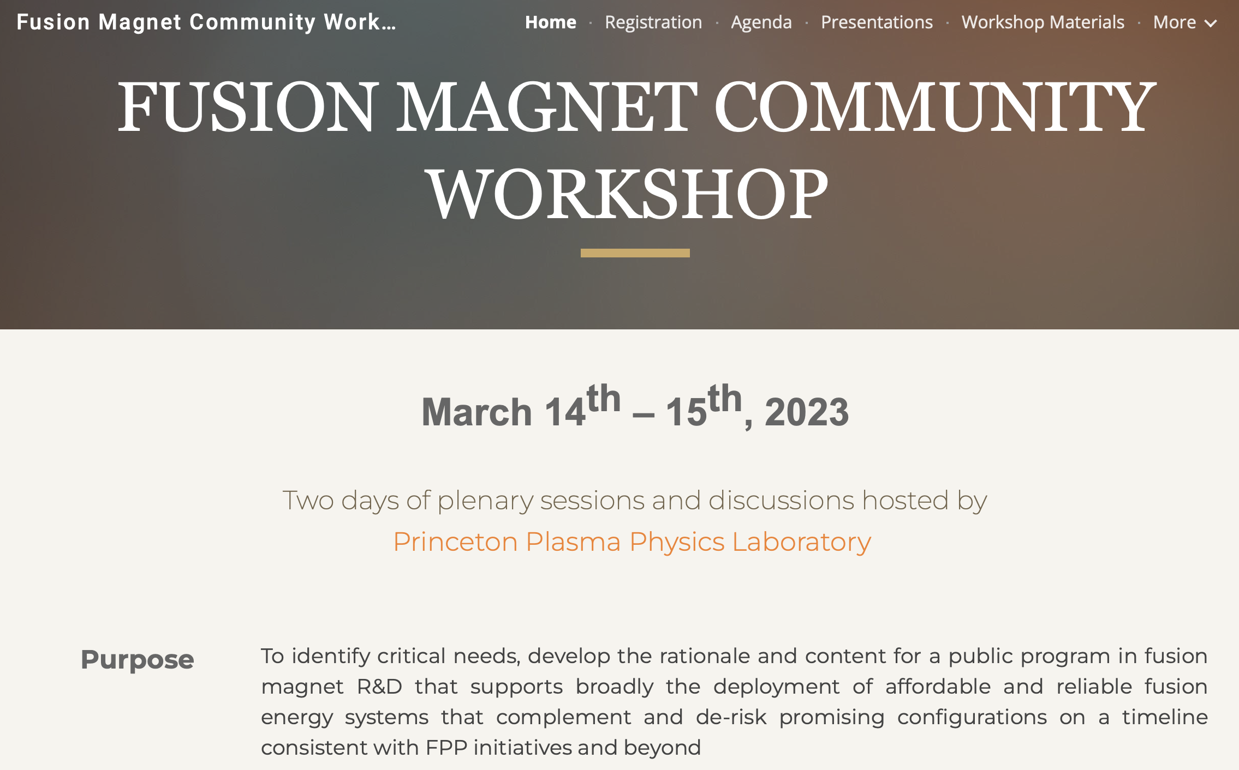
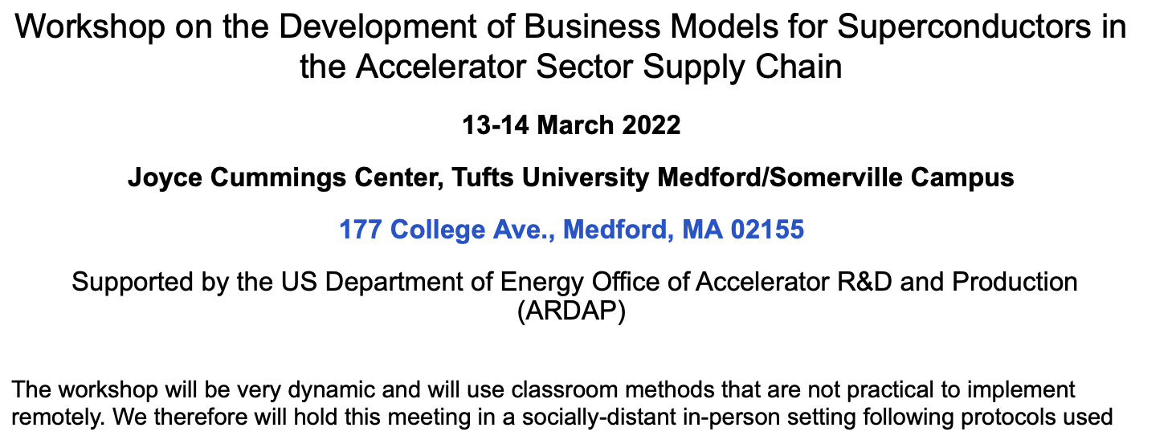
Our visibility in the International Community is strong… and important!
Strong Conference and workshop contributions, e.g.
  ASC 2022
    ~35 presentations/posters from MDP staff
More than 200 publications by MDP staff on MDP-related research since 2016 (>50 in the last year!)

Slide 9
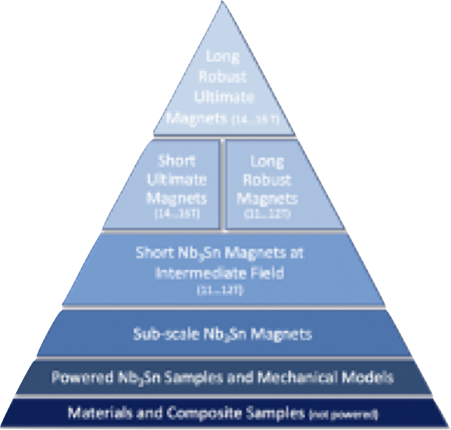
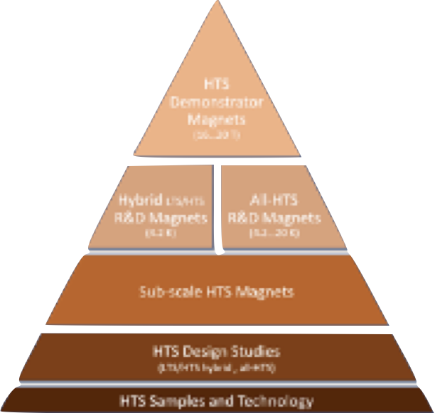
MDP plays an important role in the international context
European HFM–major elements similar to US MDP
  http://arxiv.org/abs/2201.07895
  Use of multi-lab teams, similar structure
  Key role of rapid-turnaround development platforms e.g. subscale magnets
  Funding target (5y): 112.9 MCHF + 478.5 FTEy
Intent is to have MOU with CERN that enables/encompasses work with HFM partner labs
  CERN contact Andrzej Siemko
Continue to build collaborations that are mutually beneficial
  We want to be seen as partners-of-choice
  Always keep DOE-OHEP / MDP goals in mind

Slide 10
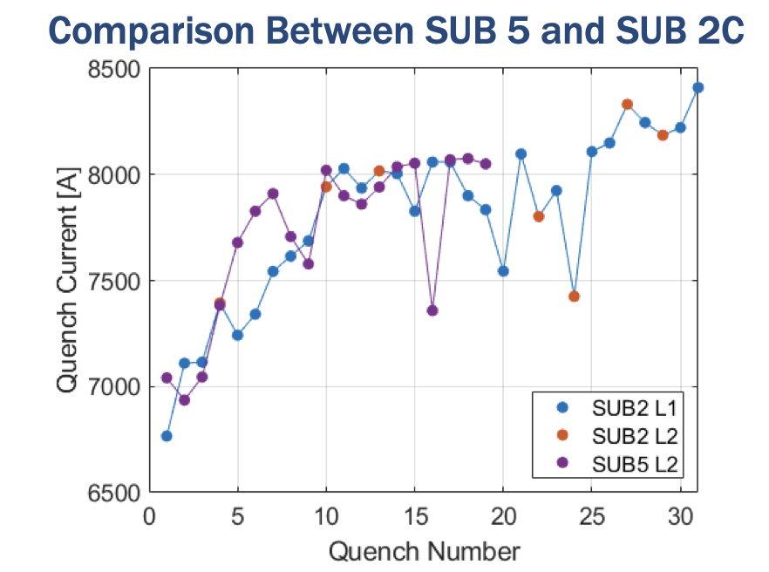
Example of collaborative magnet R&D: magnet impregnations
MDP has been exploring impregnation material alternatives
PSI developed a rapid-turn around testing capability (“BOX”) to explore training
  Wax and Stycast appeared to show dramatically better training behavior
MDP applied wax to an inner layer of a sub-scale CCT magnet
  Test exhibited no training in wax-impregnated layer (also after thermal cycle)
  Validation with new subscale magnet (utilizing wax solely) is underway

Slide 11
Leveraging synergistic activities
We have various SBIRs, ARPA-E, Fusion & INFUSE, etc. projects underway
  From an MDP perspective:
    These are encouraged, but as much as possible through the lens of MDP
      Be strategic, e.g. look for synergies between MDP needs and industry interests
      Use these public-private partnerships to forge relationships, identify strong partners
      Build relation of trust, insist on sufficient access to data for honest assessment
    It is sometimes difficult, but… be ready to say “no” if the “fit” is not right
  Continue to partner with DOE in identifying effective SBIR topics
There are many “relevant” DOE funding opportunities this year
  Early Career Research Proposals
    A few submitted from MDP staff this year
ARDAP, HEP, Fusion
  Proposals developing/submitted to support…
    AI/ML applied to magnets and materials
    Conductor development
    Radiation damage
    …
  Balance “alignment” and “complementarity” with MDP
  Such proposals are strongest when teams across labs and universities come together with common interest and unique expertise and/or facilities

Slide 12
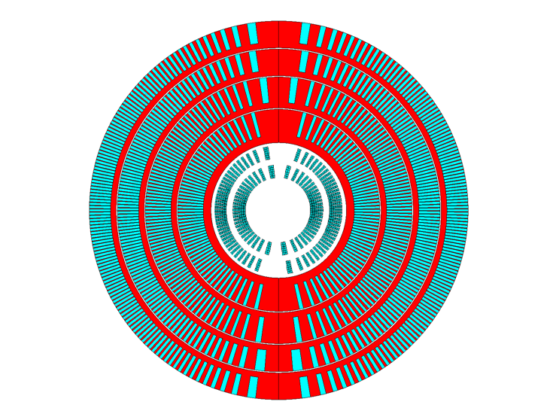
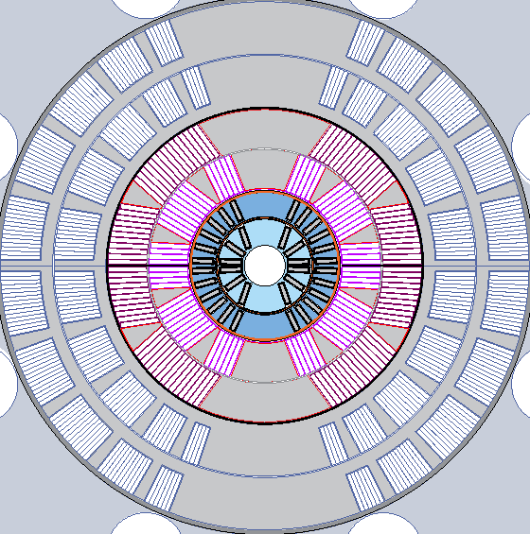
Strategic priorities for the current plan impact test infrastructure needs
  Probing stress management structures
  Hybrid HTS/LTS designs
  Understanding and impacting the disturbance-spectrum
  Advancing both LTS and HTS conductors, optimized for HEP applications
Powered independently
20 T B_{bore} at short sample
Bi2212 SMCT (1-2 T)
  2-layers, ID/OD: ~20-50 mm
  To be tested in SMCT+MDPCT1-inner in 2025
    16-18 T field range
Needs:
two ~15-20kA PS + header
Independent extractions
CLIQ + heaters
4.2K (.9K preferred)

Slide 13
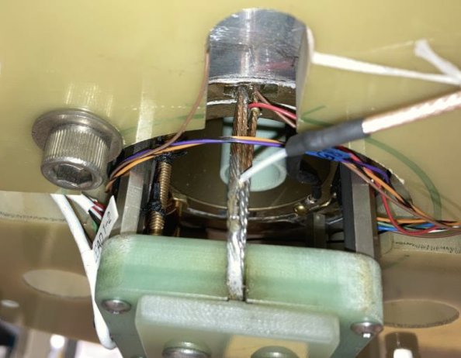
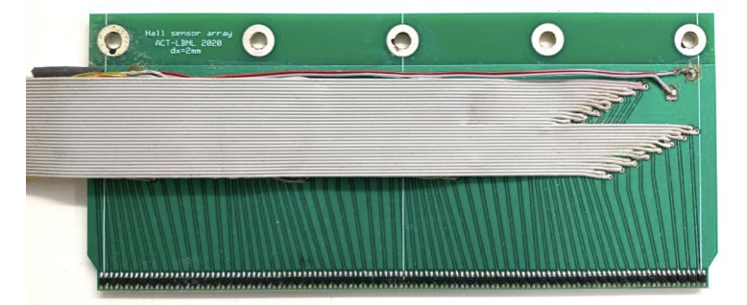
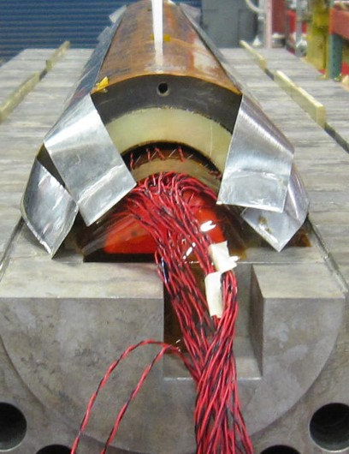
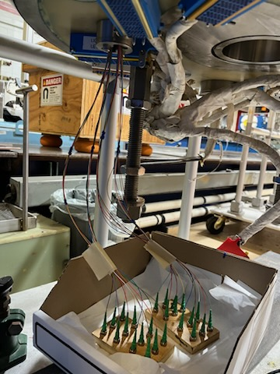
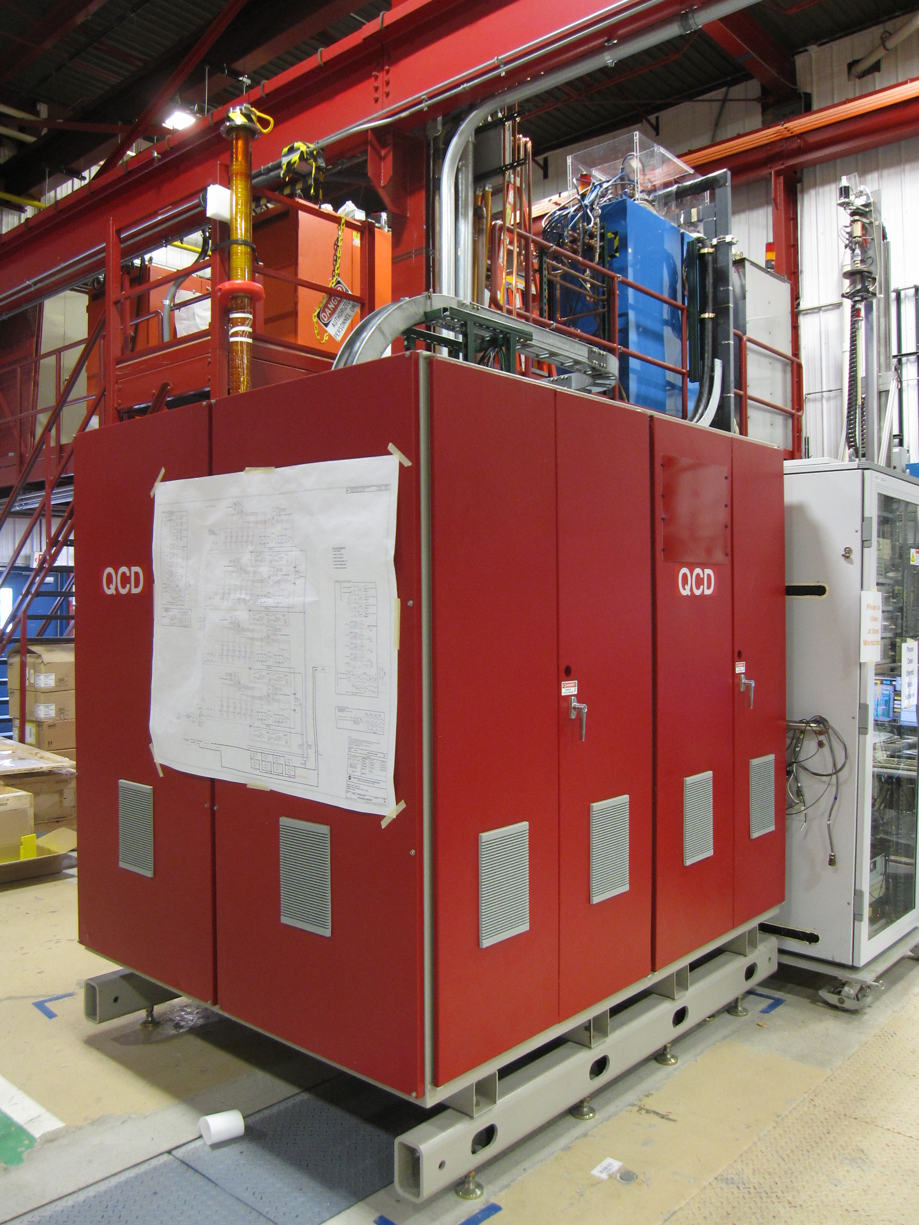
Strategic priorities for the current plan impact test infrastructure needs
  Probing stress management structures
  Hybrid HTS/LTS designs
  Understanding and impacting the disturbance-spectrum
  Advancing both LTS and HTS conductors, optimized for HEP applications
Hall probe arrays
Time domain reflectometry
Novel quench antennae
Fiber-optics
Quench current-boosting
Needs:
diagnostic feedthrus
        - Voltage-based
        - fiberoptics
“high-voltage” feedthrus for CLIQ, QCD
Flexibility!

Slide 14
Questions related to forces and training
  What is the nature of accelerator magnet training? Can we reduce or eliminate it?
  How do we best define operating margin for Nb₃Sn and HTS accelerator magnets, and to what degree can and should it be minimized?
  Can we control the disturbance spectrum and engineer a magnet response to reduce operating margin and enhance reliable performance?
  What are the mechanical limits and possible stress-management approaches for Nb₃Sn, HTS, and 20 T hybrid LTS/HTS magnets, and do they have defined mechanical limits?
  Do hybrid designs benefit from the best features of LTS and HTS, or inherit the difficulties of both material technologies?

Slide 15
MDP timeline for hybrid magnets
CCT5/BIN5c hybrid
~9-10T
Test late 2023
FNAL Bi2212 SMCT (1-2 T)
2-layers, ID/OD: ~20-50 mm
Test in SMCT+MDPCT1-inner in 2025
LBNL Bi-CCT1(3-5 T)
  2-layers, ID/OD 40/95mm
  To be tested in CCT6 in 2026
LBNL STAR CCT S1 (~1-2 T)2-layers, ID/OD: 50-77 mm, ~9T
Test in CCT5 in 2024-2025
FNAL SBIR COMB
4-layers, 5-7T (standalone)
Test in SMCT 2025
LBNL Bi-CCT2(4-7 T)
2-layers, ID/OD 40/115mm
To be tested in CCT6 in 2026/27
FNAL CORC COMB
(~5 T, stand-alone with iron)
  2-layers, ID/OD: 100-120 mm
  Test in CCT6/SMCT in 2025
LBNL C4 CCT
~16T
Test in CCT6

Slide 16
Test Facility challenges associated with advanced magnet R&D
Stress-managed structures are “naturally” compatible with conductor grading
Advances in superconductors continues to increase J_{e}
  Both of these pose challenges to magnet protection
  Need fast detection, switching, and possibly variable extraction resistance
HTS magnets have slow quench propagation
Large enthalpy margin makes traditional quench protection schemes “clumsy”
Indications are that HTS can be easily degraded
  => Calls for sensitive, redundant detection of quench precursors
  Paradigm should focus on energy control without irreversible quench onset

Slide 17
Additional test infrastructure needs
In-situ mechanics evaluation:
  Direct ultrasonic imaging
  Photo-Acoustic Scanning
Cryo-electronics:
  Expect continued, and accelerated, development and implementation of cryo-electronics
    Benefits detection, data analysis, and data extraction
Rutherford cable testing:
  Transverse pressure tests (FNAL, Twente; also BNL, NHMFL)
    Nb3Sn – continued interest in further evaluating reversible and irreversible regimes
    Bi2212 – meager, “old” data – strong need to characterize degradation limits
  Extracted strands Bi2212
    Impact of cabling on transport current remains unclear (leakage; connectivity)
Custom ”subscale magnet testing”
  Rapid turn-around testing of magnet-relevant experiments

Slide 18
FNAL magnet test infrastructure
FNAL has excellent longstanding magnet production and R&D testing capabilities
  1.9K, current and data acquisition systems, etc.
New capabilities under development: HTS Cable Test Facility
    Large (~1.2m diameter) cryostat
    Header with 2x20kA Power Supplies and associated header
    Will host a 15T dipole magnet and variable temperature insert for cable testing
See George Velev for further details on FNAL test facility capabilities

Slide 19
LBNL magnet test infrastructure
LBNL has longstanding magnet R&D testing capabilities
  4.2K, current and data acquisition systems, etc.
  Significant experience with HTS R&D magnet testing
New capabilities underway:
  Procuring a new liquefier for enhanced cooling capability (still 4.2K)
  New header in design/fabrication for hybrid magnet testing
  2nd 25kA power supply in hand; installation planning underway
See Reed Teyber for further details on LBNL test facility capabilities

Slide 20
BNL magnet test infrastructure
BNL has longstanding magnet production and R&D testing capabilities
  1.9K, current and data acquisition systems, etc.
  Significant experience with HTS R&D magnet testing
  ~10T common coil available for testing of “inserts”
New capabilities underway:
  2nd high current power supply in hand; connections, header underway
See Anis Ben Yahia for further details on BNL test facility capabilities

Slide 21
NHMFL magnet test infrastructure
Longstanding, significant experience in operating magnets for users
Strong experience in magnet R&D development and testing (solenoids)
Significant experience in HTS magnet development and testing
See Dan Davis for further details on BNL test facility capabilities

Slide 22
Summary
Test infrastructure is a critical part of magnet development and delivery
  Groups need to acquire and analyze test data to be effective
  Complementarity of test facility capabilities leverages investments
Magnet R&D benefits from test infrastructure that is flexible/adaptable
  Need to incorporate new concepts, adapt to new paradigms

