Slide 1
High Field Magnet R&D Programme Hosted at CERN
Challenges and Plans for Test Infrastructures
Andrzej Siemko, CERN

Slide 2
Outline
Short overview of the HFM R&D programme and consortium
Focus areas for the LTS high-field magnets
  State-of-the-art LTS superconductors and magnet technology
  Main challenges facing the development of LTS high-field magnets
  R&D Strategy and Main Focus Areas
Focus Areas for the HTS high-field magnets
  State-of-the-art HTS superconductors and magnet technology
  Main challenges facing the development of HTS high-field magnets
  R&D Strategy and Main Focus Areas
Focus Areas for the test infrastructures, measurements and diagnostics
Key mid-term deliverables until the next update of European Strategy for Particle Physics
Final remarks

Slide 3
HFM Programme – broad goals
The EU Accelerator R&D Roadmap identifies main objectives for the High Field Magnet Programme:
  OBJECTIVE 1:
    Design and demonstrate a full-size Nb3Sn accelerator magnet to proof the maturity of the most advanced technologies today, based on the HL-LHC design, i.e., 12 T magnets, and applying all the lessons learned from the US LHC Accelerator Research programme (LARP), the US High-Luminosity LHC Accelerator Upgrade project (AUP) and the HL-LHC project
  OBJECTIVE 2:
    Explore the limitations of the LTS state-of-the-art technology and push Nb3Sn magnet technology to its practical limits in terms of ultimate performance, towards the 16 T target targeted by the FCC-hh
  OBJECTIVE 3:
    Explore the capabilities and limitations of state-of-the-art HTS and magnet technology based on these superconductors. Demonstrate the suitability of HTS
  Create a European Research Network involving CERN and National Labs

Slide 4











HFM R&D consortium
(present main contributors)

Slide 5
HFM R&D consortium and organisational structure
The organizational structure comprises the following bodies:
  HFM Programme Governance
      HFM Steering Board
      Collaboration Board
      HFM Technical Advisory Committee
  HFM Programme Executive Structure
      HFM Technical Coordination Board
      Project Office
      Structure of R&D Lines with Work Package breakdown

Slide 6
HFM Programme Executive Structure
Governance
Executive Structure

Slide 7
Outline
Short overview of the HFM R&D programme and consortium
Focus areas for the LTS high-field magnets
  State-of-the-art LTS superconductors and magnet technology
  Main challenges facing the development of LTS high-field magnets
  R&D Strategy and Main Focus Areas
Focus Areas for the HTS high-field magnets
  State-of-the-art HTS superconductors and magnet technology
  Main challenges facing the development of HTS high-field magnets
  R&D Strategy and Main Focus Areas
Focus Areas for the test infrastructures, measurements and diagnostics
Key mid-term deliverables until the next update of European Strategy for Particle Physics
Final remarks

Slide 8
Focus areas for the LTS magnet technology
Demonstrator of the maturity of state-of-the-art Nb₃Sn technology
“12 Tesla Robust Dipole”
So far, no full-size dipole magnet using Nb₃Sn technology has been built
In order to demonstrate the maturity of the most advanced technologies today applying all the lessons learned from the US LARP, the US AUP and the HL-LHC project and to investigate the physical and technological effects related to the length of the magnets, an accelerator-size magnet demonstrator will be built towards a production scale through robust design, industrial manufacturing processes and cost reduction, taking HL-LHC as a benchmark, i.e., 12 T
12 Tesla
Robust
Accelerator-size demonstrator of maturity of Nb₃Sn technologies, including improved manufacturability through collaboration with industrial partners
Reaching 14+T with this 12 T robust technology will be aided by increased J_{c} and improved mechanical properties of Nb₃Sn conductor

Slide 9
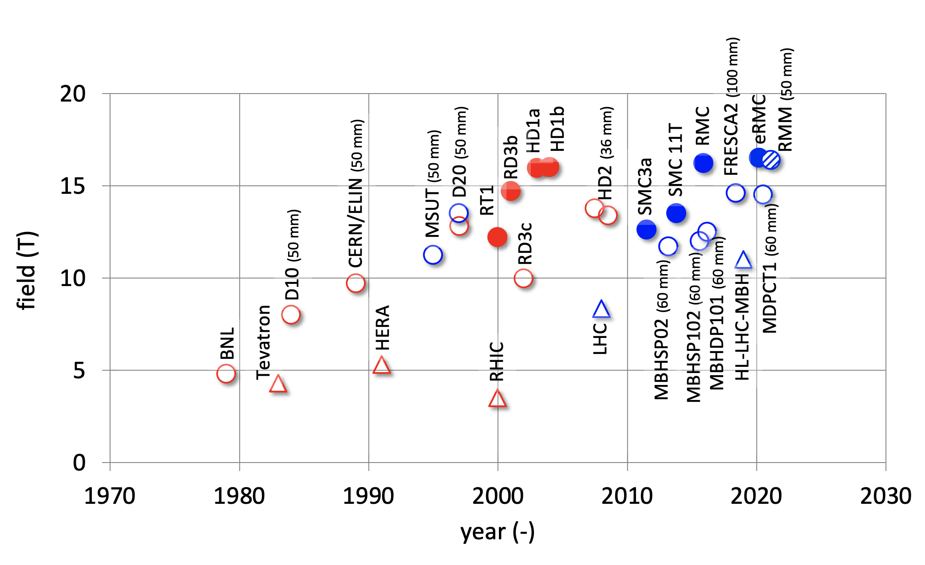
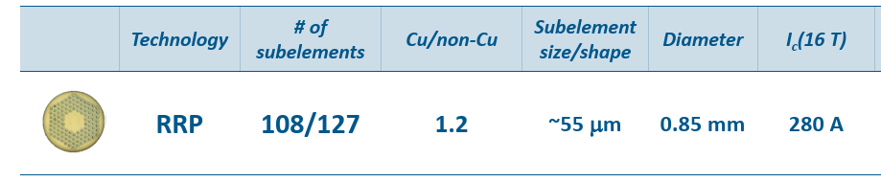
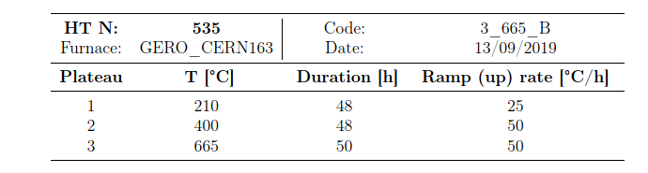
State-of-the-art LTS superconductors and magnet technology
State-of-the-art of Nb₃Sn magnet performance
Upper limit of Nb₃Sn
technology (~16 T)
Present state-of-the-art
(short models ~13-14 T)
Courtesy of L. Bottura
State-of-the-art Nb₃Sn conductor (HL-LHC)
Heat treatment
Courtesy of S. Hopkins

Slide 10
Main challenges facing the development of future 14+ Tesla LTS high-field magnets
Nb₃Sn Conductors
Present limitations of Nb₃Sn technology are linked to:
  conductor stress/strain sensitivity and degradation
  thermomechanical behaviour and degradation of magnet performance
σ_{irr} = 145–175 MPa
I_{c}/I_{c0} @ 150 MPa
→ 16 % - 28 %

Slide 11
R&D Strategy and Focus Areas for the LTS high-field 14+ T magnets
Nb₃Sn Conductors and magnets: pushing towards ultimate performance
Stress/strain sensitivity and degradation of Nb₃Sn conductors to be overcome by one of the two development paths:
Nb₃Sn Conductor
R&D
New Nb₃Sn wire structures with improved mechanical robustness
Higher Jc (increased margins)
Industrialization of improved superconductor
Novel Magnet Structures
Magnet structures need to be adapted through stress management to cope with performance limitations due to Nb₃Sn stress/strain sensitivity and thermomechanical behaviour

Slide 12
R&D Strategy and Focus Areas for the LTS high-field magnets
Nb₃Sn Magnets: 14+T Feasibility Studies
  Exploratory phase, multiple magnet-development of various magnet structures at CERN and national laboratories
  Approaches range from evolutionary, based on LARP/HL-LHC technology to departures from evolutionary to beyond state-od-the-art magnet structures
  1st priority: performance and (sufficient) robustness.
  2nd priority: maximum robustness and reduced cost.
Evolutionary
technology R&D
cos theta (see 12 T Robust);
Exploratory phase of magnet structure R&D
block coil;
common coil
Beyond
state-of-the-art
Magnet structures adapted to stress/strain sensitivity limitations
stress managed version of either coil variant aimed at reduced coil stresses, at cost of lower efficiency

Slide 13
Outline
Short overview of the HFM R&D programme and consortium
Focus areas for the LTS high-field magnets
  State-of-the-art LTS superconductors and magnet technology
  Main challenges facing the development of LTS high-field magnets
  R&D Strategy and Main Focus Areas
Focus Areas for the HTS high-field magnets
  State-of-the-art HTS superconductors and magnet technology
  Main challenges facing the development of HTS high-field magnets
  R&D Strategy and Main Focus Areas
Focus Areas for the test infrastructures, measurements and diagnostics
Key mid-term deliverables until the next update of European Strategy for Particle Physics
Final remarks

Slide 14
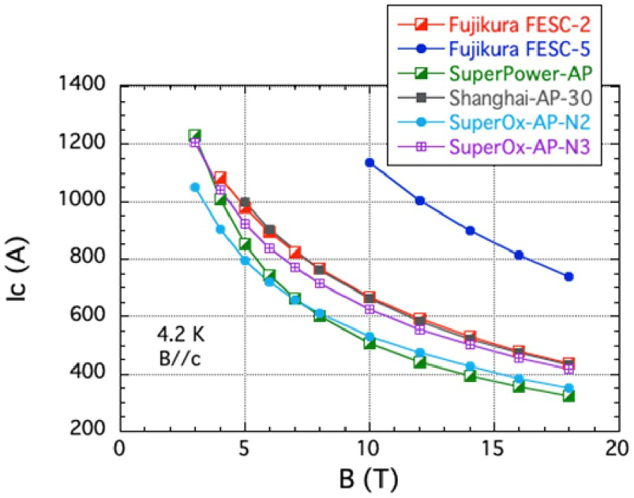
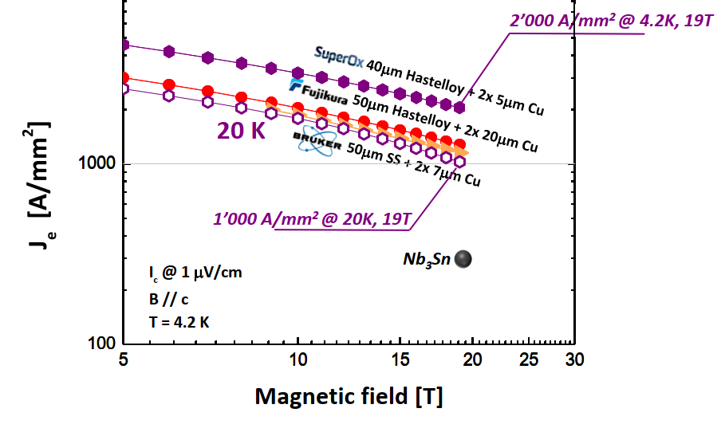
REBCO: State of the Art
REBCO (ReBa₂Cu₃O_{7-x},) is a potential enabling technology for magnets beyond 16 T
For REBCO coated conductor (‘tape’), core technology established, including APCs.
Distinct challenges from Nb₃Sn:
  J_{c} is sufficient for most application requirements, J_{e} (4.2 K, 20 T) > 1000 A/mm², but anisotropic, and J_{c}(B,T,θ) is strongly supplier-dependent, according to technology, composition and APCs.
  Production yield and piece lengths (< 1 km) still relatively low, contributing to high cost
  Long-length uniformity of performance, geometry, electrical resistances etc. requires further development
Critical current (I_{c}) in magnetic field (B) perpendicular to substrate at 4.2 K for selected commercial tapes
Tsuchiya et al., Supercond. Sci. Technol. 34 (2021) 105005
Engineering current density (J_{e}) in magnetic field perpendicular to substrate for selected conductors (C. Senatore, UNIGE)
Courtesy of S. Hopkins
Notes:
Also this slide is very well known to the US-MDP community.

Slide 15
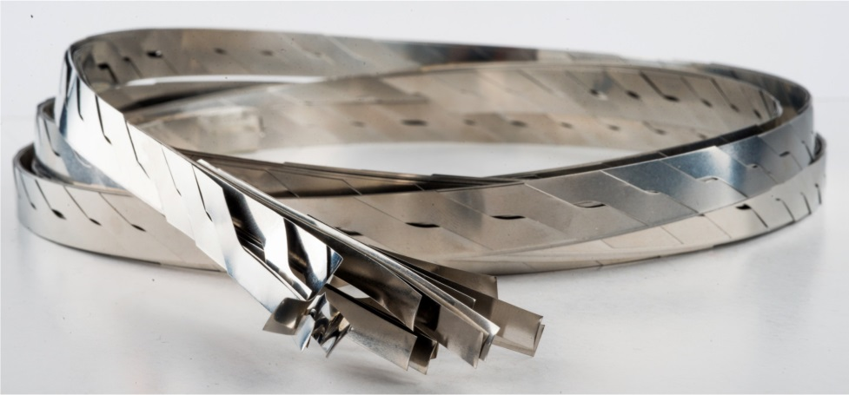
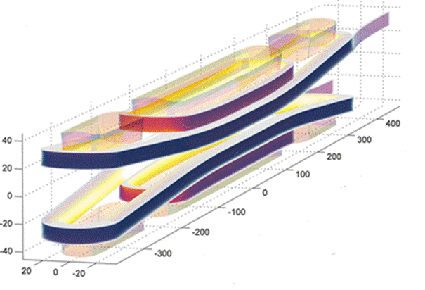
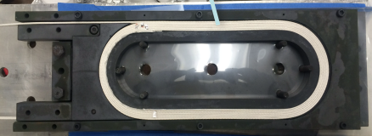
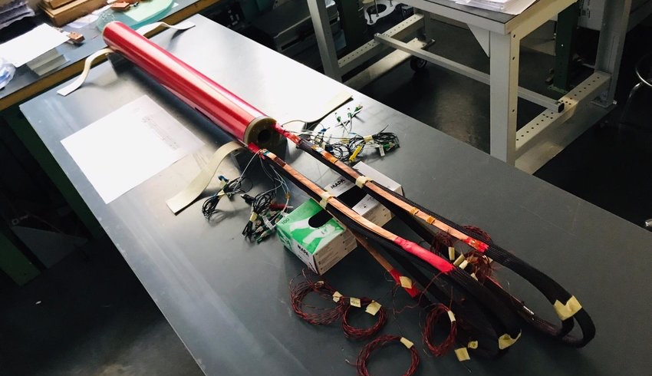
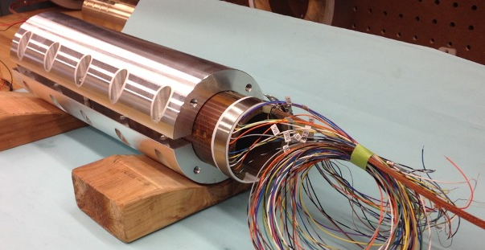
State-of-the-art HTS superconductors and magnet technology
So far only a few accelerator magnet coils have been made with ReBCO tapes and Bi-2212 cables and only the first hybrid dipole demonstrators, such as 13+5 T at CERN and 12.3 T at BNL
CERN design of HTS 5 T insert magnet for 13 T Nb₃Sn background field
LBNL – Bi-2212 coils
Courtesy of G. Kirby, J. Van Nugteren
Courtesy of L. Garcia Fajardo, T. Shen
Notes:
All examples here are ReBCO. Why mention Bi-2212?
Second bullet not a full sentence.

Slide 16
Main challenges facing the development of future HTS high-field magnets
HTS Conductors
Present main limitations of HTS technology are linked to:
  ReBCO conductor shear stress sensitivity and degradation
  Large magnetization of ReBCO conductors. Tape conductor shape (rather than multifilamentary round wire) creates field errors that may be too large for accelerator magnets
  Uniformity of ReBCO cables along the length and lot to lot
  Limited length of ReBCO tapes and cables
  Limited ability to bend at small radii of ReBCO conductors, forcing specific, not very effective structures of magnet coil ends allowing for large bend radii
  Quench protection of accelerator size magnets made with ReBCO and Bi-2212 HTS coils with high current and stored energy densities but low quench propagation velocity
  Bi-2212 conductor stress/strain sensitivity and degradation
  Very complex Reaction Heat Treatment for Bi-2212
  Bi-2212 leaks
  …

Slide 17
R&D Strategy and Focus Areas for the HTS high-field magnets
HTS Conductors and Magnet Technology
  The broader HTS magnet technology, including cable design, coil design, joints, quench detection and magnet protection remains at an early stage of development
  Main focus area is demonstration of the suitability of state-of-the-art HTS conductors for accelerator magnets, providing a proof-of-principle of HTS magnet technology beyond the range of Nb₃Sn
HTS Conductors
Improvement of ReBCO conductor for low magnetisation demand in accelerator magnets
Development of alternative HTS superconductors
Development of practical HTS cables
HTS Magnets
Development of stand-alone HTS demonstrator magnets
Subscale tests in background field and development of hybrid HFMs

Slide 18
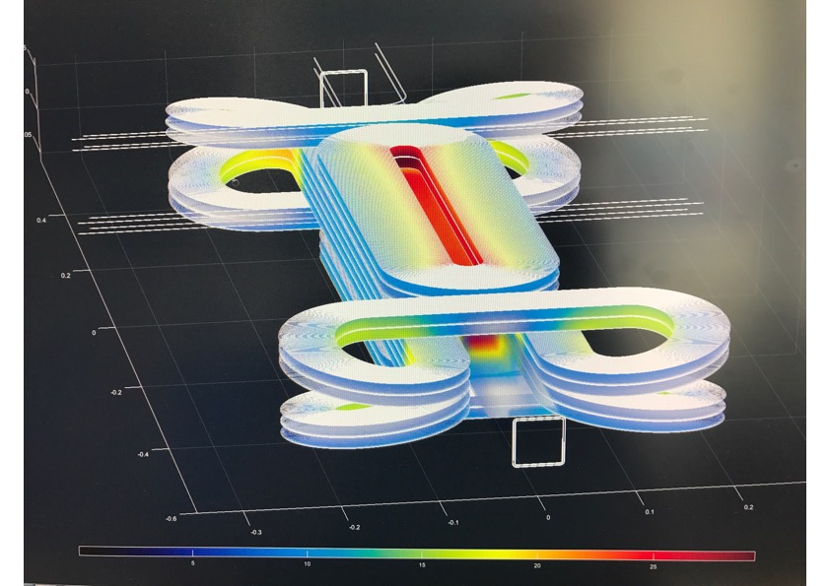
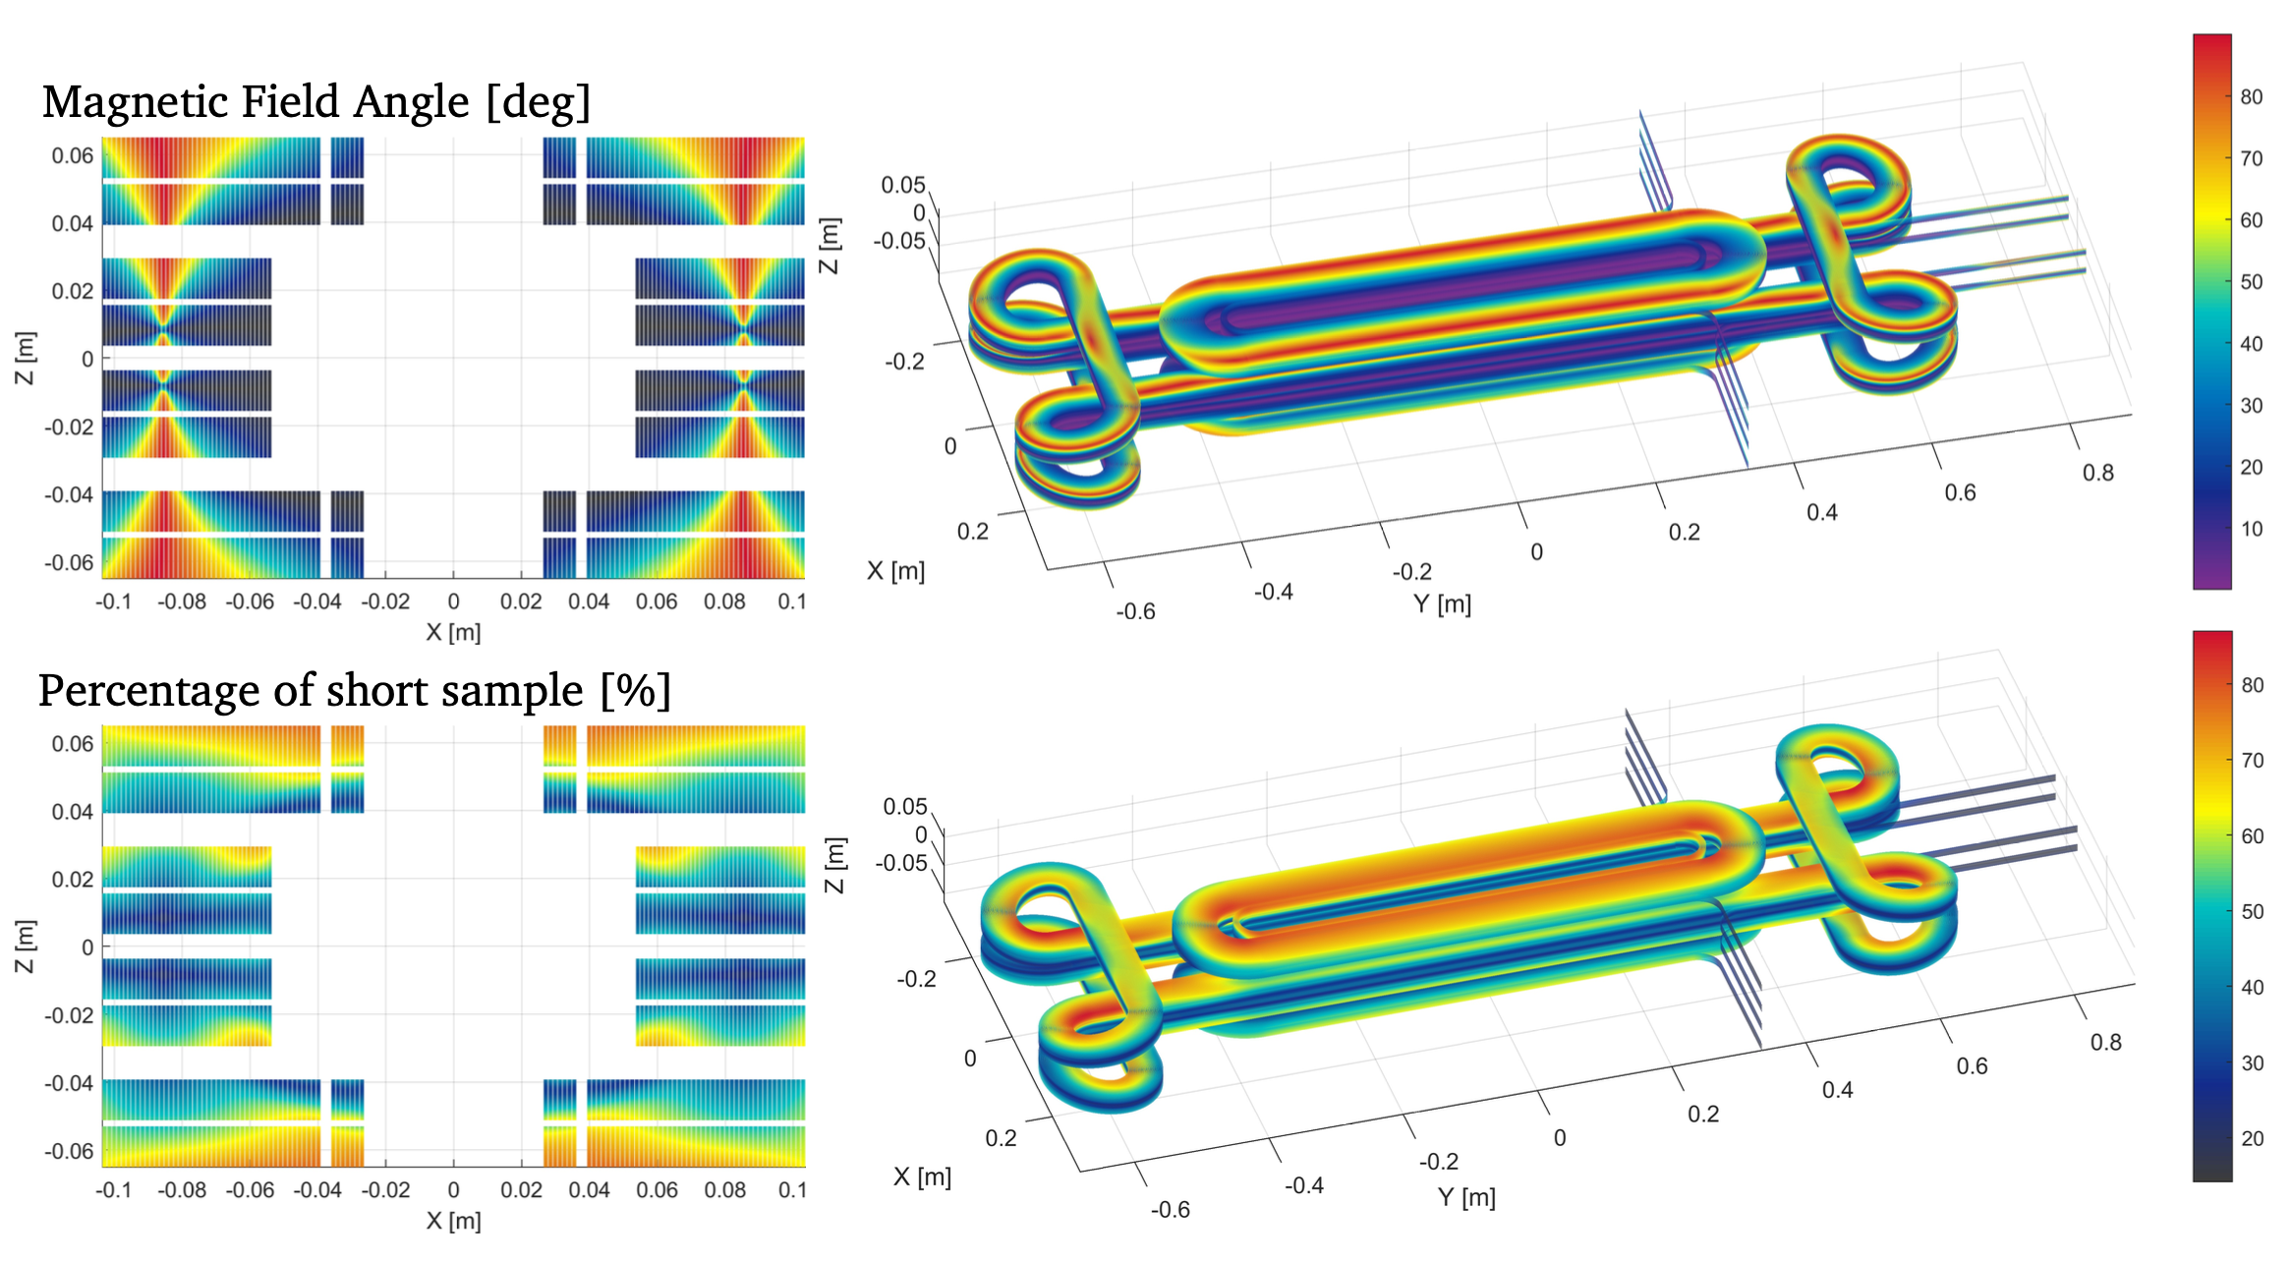
HTS is the only path beyond 16 Tesla
Using present HTS conductors now vs. waiting for better ones in the future is under deliberation
Conceptual design of HTS magnets using existing state-of-the-art conductors is ongoing within HFM Programme
Courtesy of G. Kirby
Notes:
What does ‘better’ mean? Do we have a choice? We must start with what we have. Maybe mention which labs are starting to work on the topic (CERN, CEA, PSI, INFN)

Slide 19
Outline
Short overview of the HFM R&D programme and consortium
Focus areas for the LTS high-field magnets
  State-of-the-art LTS superconductors and magnet technology
  Main challenges facing the development of LTS high-field magnets
  R&D Strategy and Main Focus Areas
Focus Areas for the HTS high-field magnets
  State-of-the-art HTS superconductors and magnet technology
  Main challenges facing the development of HTS high-field magnets
  R&D Strategy and Main Focus Areas
Focus Areas for the test infrastructures, measurements and diagnostics
Key mid-term deliverables until the next update of European Strategy for Particle Physics
Final remarks

Slide 20
HFM - Challenges and Plans for Test Infrastructures
Main HFM Programme needs
HFM R&D programme will require the development of new infrastructures related to both superconducting cables and magnets
Infrastructures
Magnet test infrastructures for the HFM programme
Infrastructures for conductors and characterisation
Infrastructures for building demonstrators, short magnet models and full-scale prototypes
Novel instrumentation, diagnostics and measurement equipment

Slide 21
Status of existing at CERN infrastructure for testing HFM model magnets
Vertical cryostats at CERN in SM18:
Cryostat | Cluster D | Siegtal | Diode | HFM | Long
Diameter [mm] | 0.9 | 0.75 | 0.5 | 1.5 | 0.6
Useful depth [m] | 5.5 | 1.45 | 1.4 | 2.34 | 3.45
Operation Temperature [K] | 1.9, 4.5 | 1.9, 4.5 | 4.5 -- 80 | 1.9, 4.5 | 1.9, 4.5
Main power converter | 30 kA with dump (1 kV) | 20 kA with dump (1 kV)
Auxiliary power converter | 2 x 2kA with dump (1 kV) | 2 x 600 A with dump (500 V)
Courtesy of F. Mangiarotti
A satisfactory basic infrastructure is believed to exist at CERN for testing HFM demonstrators and short models.

Slide 22
Status of existing infrastructure for testing HFM demonstrators and model magnets
Horizontal test benches at CERN in SM18:
Several types of horizontal test benches for full cryo-magnets will be available in SM18 after completion of the HL-LHC test campaign
  max. current 20 kA, 1.9 or 4.5 K

Slide 23
Status of existing infrastructure for testing HFM demonstrators and model magnets
Required upgrades and improvements:
Anti-cryostat for vertical cryostats to allow more detailed diagnostics such as Z-scans and QA/MM exchange
Horizontal test cryostat and matching modules to be defined in the future to meet the emerging needs

Slide 24
New testing needs for the HFM programme
New test stand for testing thermomechanical behaviour of mechanical magnet models
  Liquid nitrogen cryostat without powering
  Equipped with Digital Tween technology, representing a mechanical model updated from real-time data with simulations and machine learning to help guide design decisions
New test stand (originally planed within HL-LHC) for current leads, tests of HTS cables and splices
  Study of requirements for the HTS and development plan to be defined in 2023

Slide 25
New testing needs for the HFM programme
New test stand for testing HTS insert coils in LTS dipole background field (hybrid magnet configuration)
  Phase 1: 6 T background field using HL-LHC D1 short model
  Phase 2: 14 T background field (to be developed as separate project by HFM WP3.4)
  Option to test the HTS coils/magnet in the elevated temperature range (10-20 K) while maintaining the background field magnet in liquid helium

Slide 26
New testing needs for the HFM programme
New 20 T LTS/HTS conductor critical current test station:
  Magnet system including cryostat, protection system and power supply featuring vertical field direction with maximum field of 20T
  Free bore diameter: 100 mm
  Field homogeneity better than 1% in a cylinder of 85 mm diameter and 200 mm height
  200 mT stray field limit from magnet center at 0.5 m (target)
  Cryostat of up to 2.5 m height and 1.2 m diameter
Upgrade of existing Ic test stations: (B→15-17 T), upgrade of VSM and magnetization measurements of wires, tapes and cables, upgrade of inter-strand/inter-tape contact resistance measurements

Slide 27
New testing needs for the HFM programme
Cryogenic Laboratory test stands for HFM measurements and novel cryogenic cooling modes
  Dedicated thermal conductivity, diffusivity and specific heat test stand
  Upgrade of thermal expansion/contraction test stand
  Upgrade of Superfluid He permeability test stand
  Upgrade of test stand for heat extraction measurement of coil packs
  Upgrade of variable temperature range test stand for HTS coils and splices
  Test stand for demonstrator of reduced helium content cooling variants including conduction-cooling

Slide 28
New measurements and diagnostics needs for the HFM programme
Instrumentation for the HFM Nb₃Sn magnets
  Dedicated anti-cryostats, positioning system, rotating coils and quench antennas for measurement of the 12 T short models at ambient and cryogenic temperatures
  Dedicated anti-cryostats, positioning system, rotating coils and quench antennas for measurement of the 12 T long prototype at ambient and cryogenic temperatures
  Adaptation of instruments for measurements of the 14+ T short models at ambient and cryogenic temperatures
Instrumentation for the HFM HTS magnets (needs and strategy are under definition)
  Instrumentation such as Hall probes and printed-circuit pickup coils for the HTS racetrack coils without bore
  Specific magnetic measurement sensor
  Advanced sensors for quench localization
  Novel sensors for quench detection

Slide 29
New measurements and diagnostics needs for the HFM programme
General-purpose infrastructures for measurements and diagnostics
  Facility for characterization and calibration of sensors at ambient and cryogenic temperatures
  Advanced data acquisition system for small-amplitude signals
  Advanced data acquisition system with on-line processing
Instruments and sensors for mechanical measurements
  Instruments and sensors for mechanical measurements of magnets at ambient and cryogenic temperatures
  Upgrade of the existing E-modulus measurement stand for Nb₃Sn race-tack coils
  New “10 stack” measuring stand for mechanical properties

Slide 30

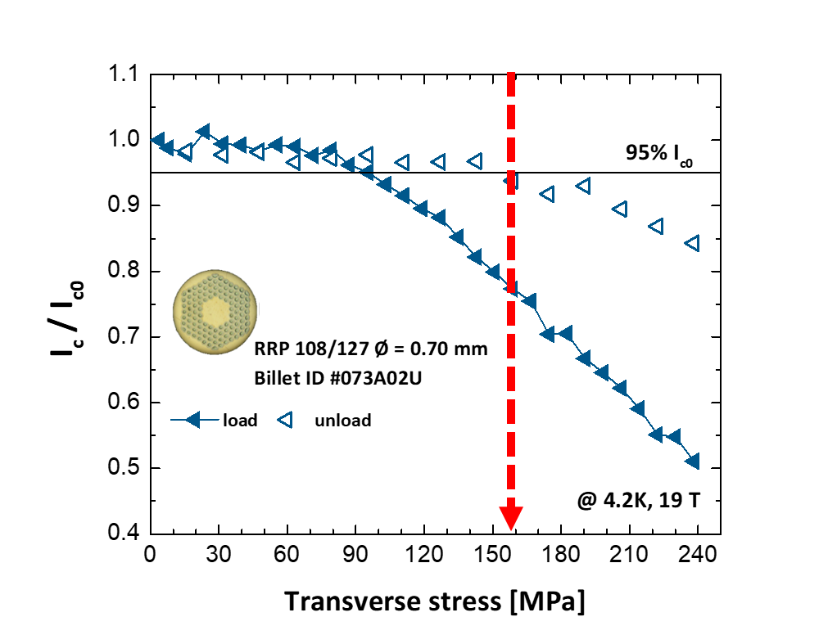
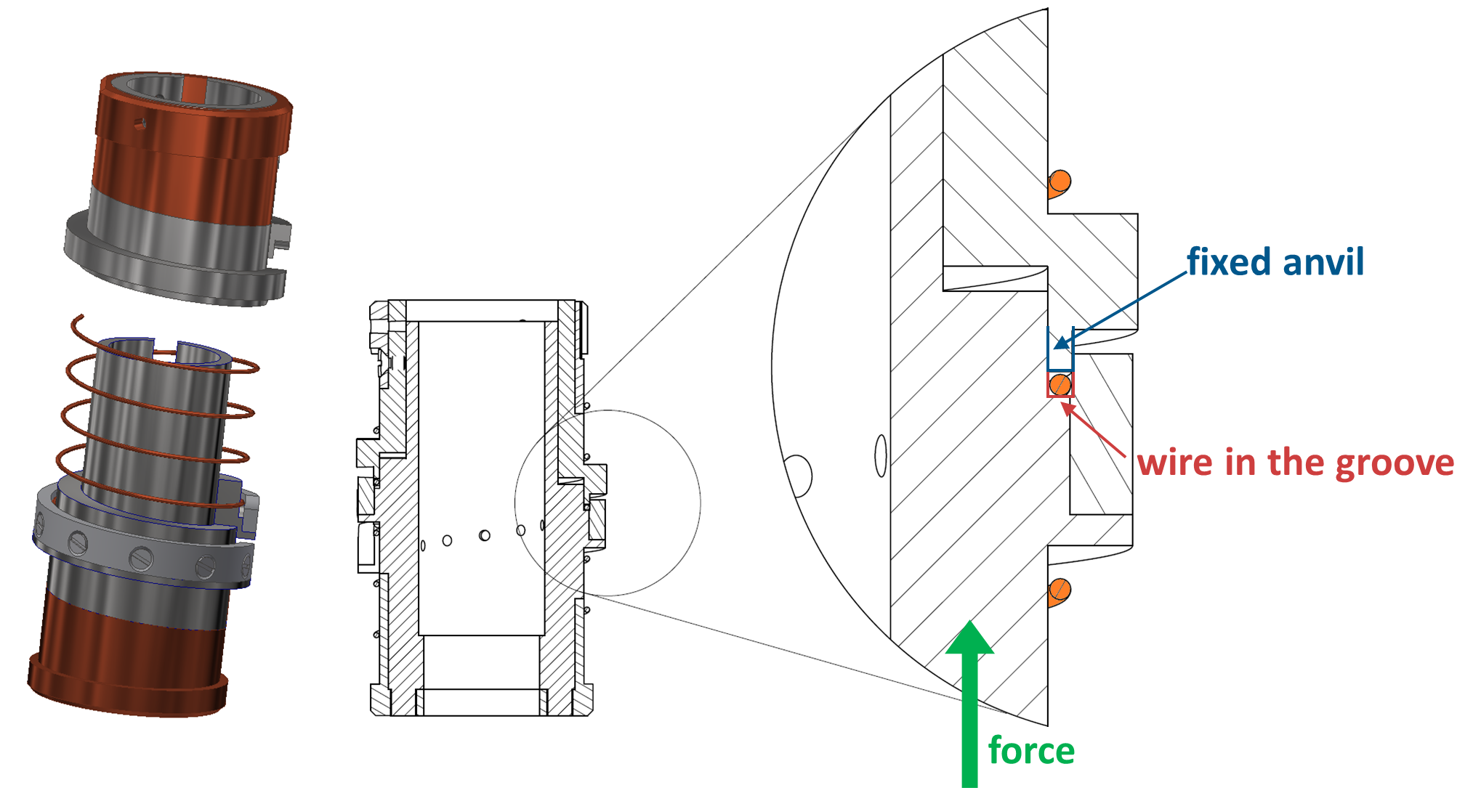
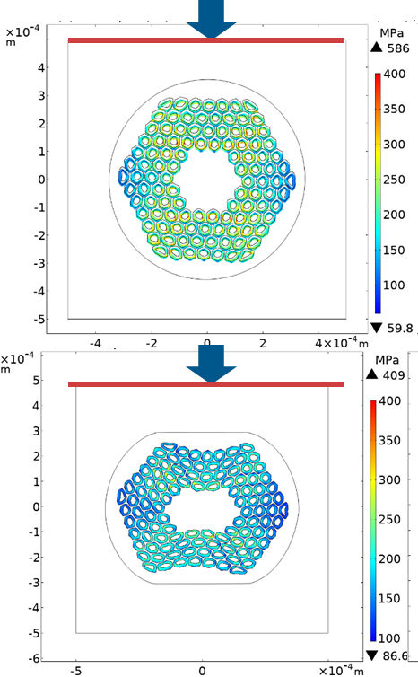
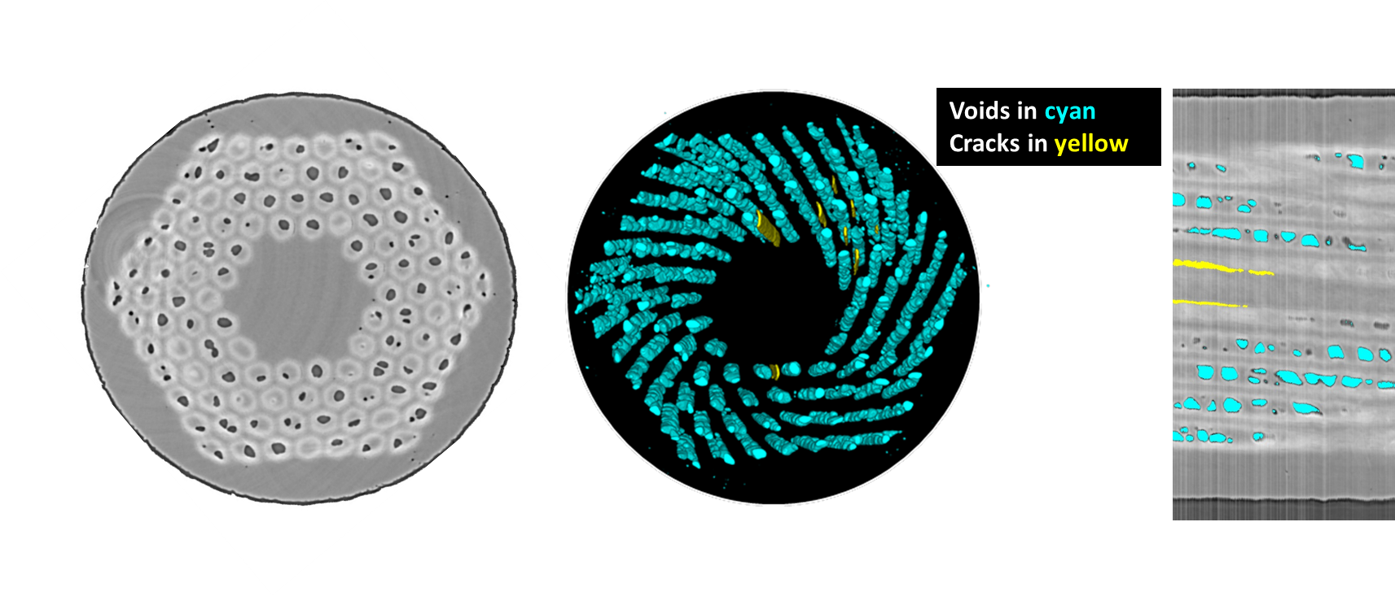
Ongoing work examples: Advanced Characterizations of Superconductors
Assessing the mechanisms behind the permanent reduction of I_{c}
FE simulations to investigate the role of plastic deformation and residual stresses in the irreversible loss of critical current under transverse load, in collaboration with PSI
A comprehensive campaign of electromechanical tests on different wire types to gain knowledge on several practical aspects for magnet operations
Machine learning applied to X-ray tomography as a new tool to analyze crack formation and propagation in Nb₃Sn wires, in collaboration with ESRF
Courtesy of C. Senatore
Notes:
UNIGE is one of the few laboratories specialized in testing the electromechanical properties of technical superconductors under conditions relevant for magnet design. Recently, they developed a new tool to investigate the internal features of Nb3Sn superconducting wires, combining X-ray tomographic data with an unsupervised machine-learning algorithm, with a view to providing new insights to enhance the electro-mechanical performance of the wires. The tool is ideal for characterizing quantitatively the distribution and morphology of the components of superconducting wires, with a particular focus on the voids that are generated during the heat treatment necessary to form the Nb3Sn superconducting phase. Voids can be detrimental for the electro-mechanical performance as they act as stress concentrators. This tool paves the way for novel wire design, assisted by detailed Finite Element Models (FEM) at sub-element level, with the final goal being further optimization of wire properties relevant for use in future accelerator magnets.

Slide 31
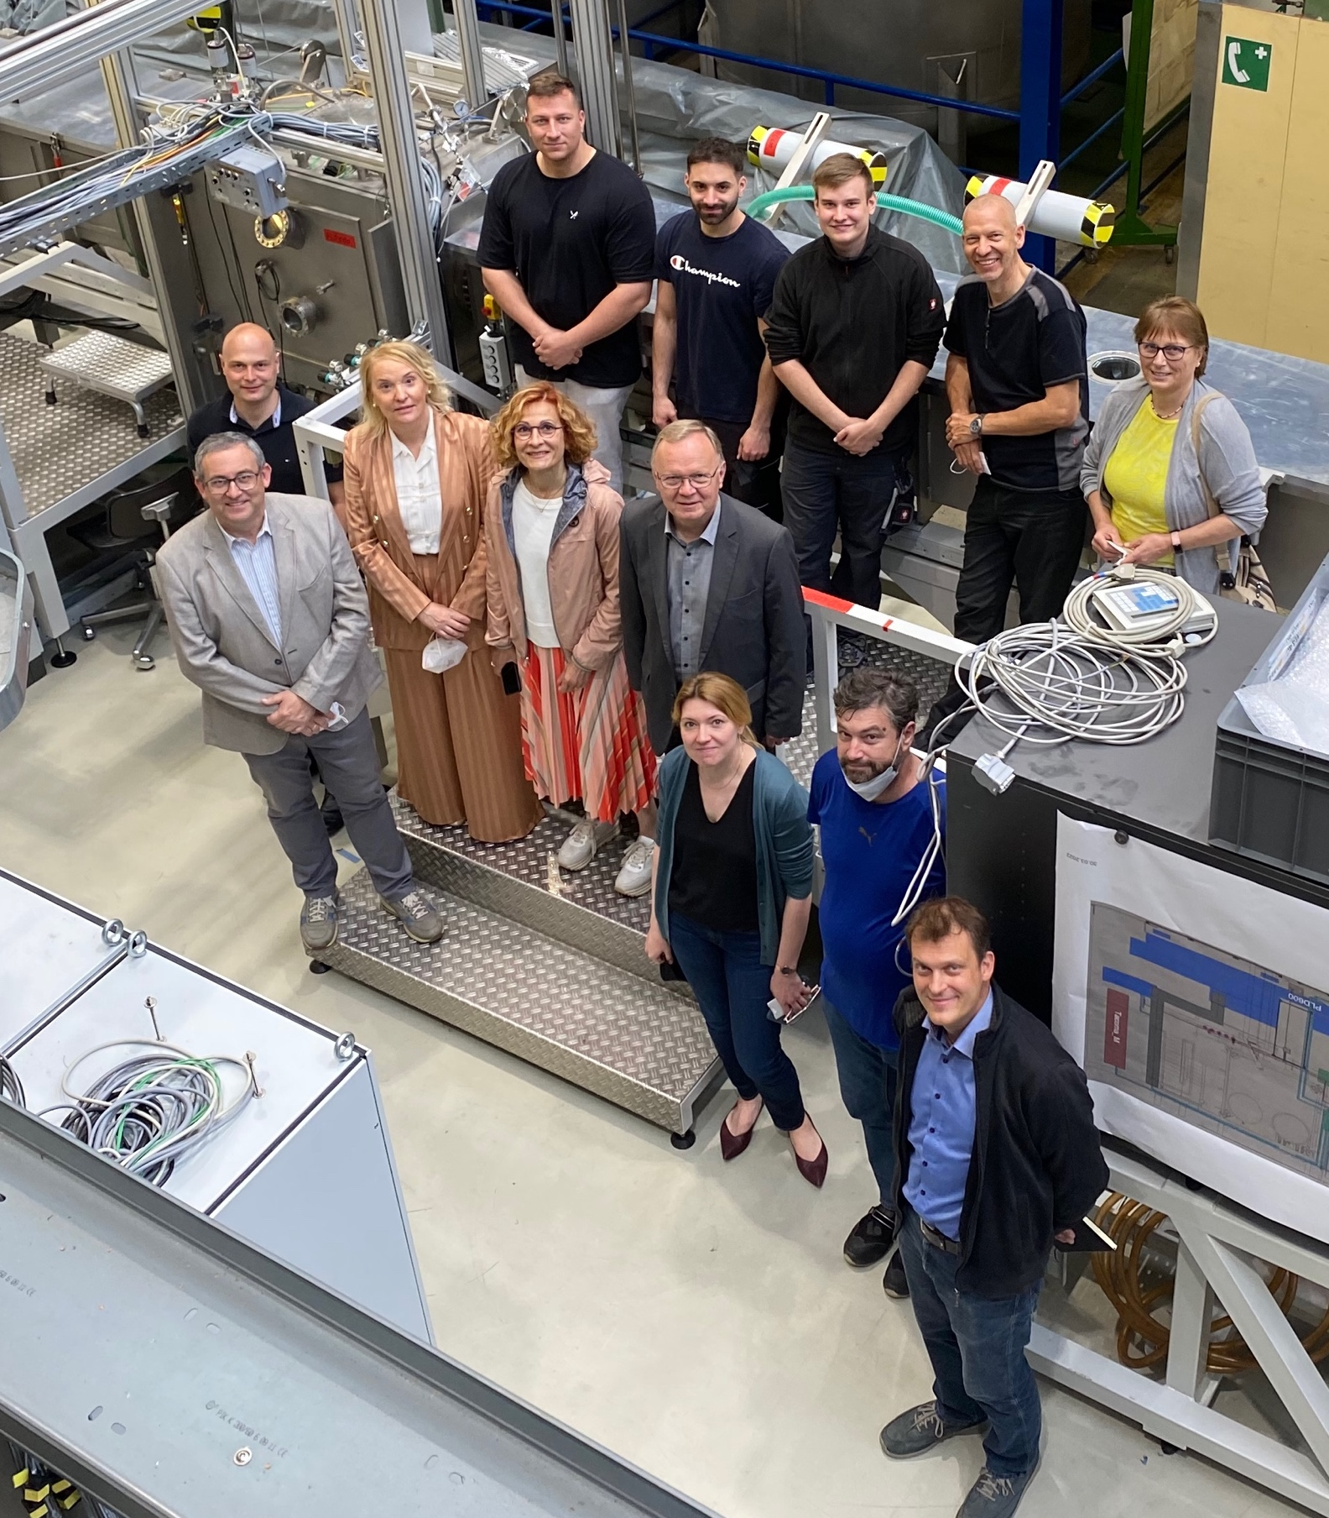
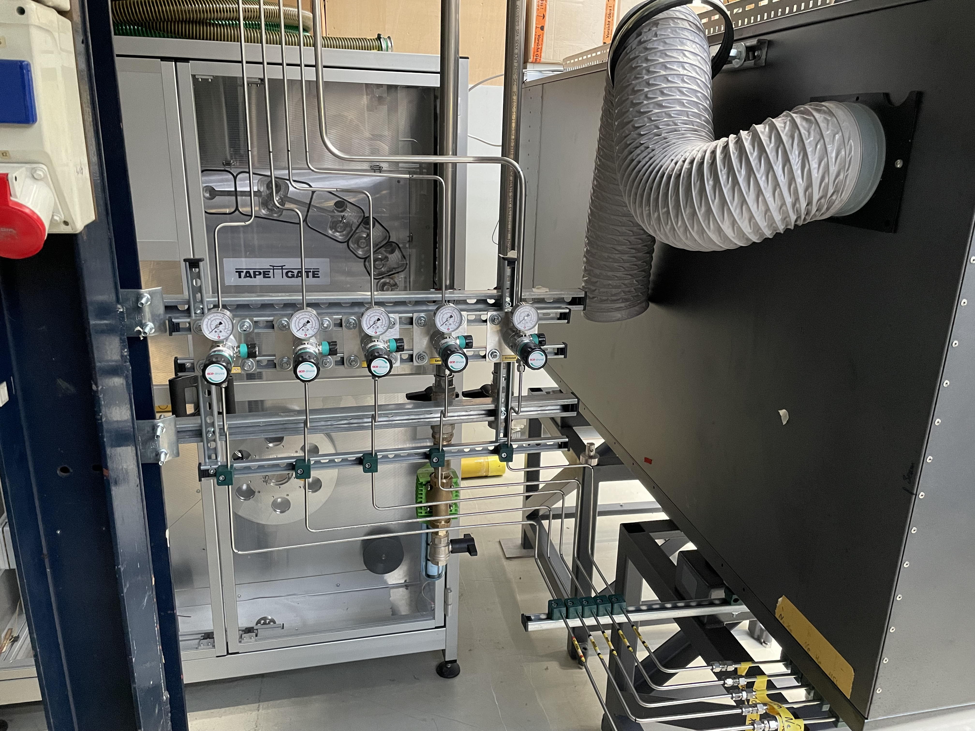
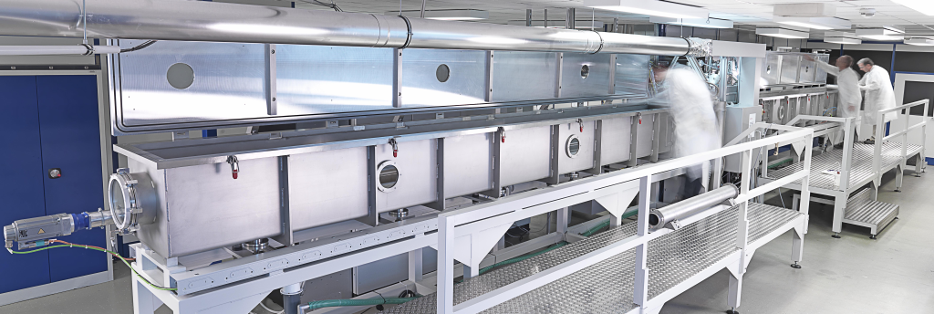
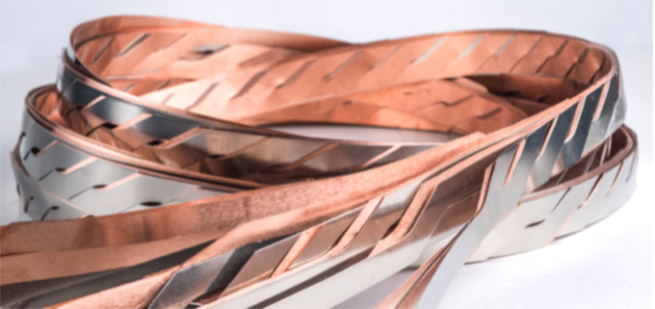

Ongoing work examples: KIT-CERN Collaboration on Coated Conductors
KC⁴ mission
Development of tailored HTS-tapes for magnet and energy applications
  Company independent
  Special tape architectures for R&D
  Tape length up to 100m to meet
  demonstrator needs
Commissioning of CC deposition equipment
  PLD setup adapted to local lab requirements
  Short sample (10m batches)
  synthesis just started
Courtesy of B. Holzapfel
Notes:
Mention that US has such independent tape R&D, producing, e.g., tape for STAR conductor.

Slide 32
Outline
Short overview of the HFM R&D programme and consortium
Focus areas for the LTS high-field magnets
  State-of-the-art LTS superconductors and magnet technology
  Main challenges facing the development of LTS high-field magnets
  R&D Strategy and Main Focus Areas
Focus Areas for the HTS high-field magnets
  State-of-the-art HTS superconductors and magnet technology
  Main challenges facing the development of HTS high-field magnets
  R&D Strategy and Main Focus Areas
Focus Areas for the test infrastructures, measurements and diagnostics
Key mid-term deliverables until the next update of European Strategy for Particle Physics
Final remarks

Slide 33
Summary of main deliverables during 2023-2026 as an input to the next update of ESPP (LTS)
Development of new HFM grade Nb₃Sn conductor with target Jc of 1500 A/mm2 @ 16 T and enhanced mechanical properties
Demonstration of the maturity of Nb₃Sn technology for collider-scale production through 12 T robust dipole magnet design, including industrial processes and cost reduction:
  INFN – 12 T FalconD single aperture short dipole model
  CERN – 12 T Robust twin aperture short dipole model (either collared coils or bladder and key)
Demonstrators of the Nb₃Sn potential above 14 T:
  CEA – FD single aperture 14 T graded conductor block coil demonstrator (no aperture)
  CERN – 14+T block coil demonstrator with coil stress management (targeting 16 T)
  CIEMAT – 14 T common coil demonstrator
  PSI – 14+ T common coil demonstrator with coil stress management (targeting 16 T)

Slide 34
Summary of main deliverables during 2023-2026 as an input to the next update of ESPP (HTS)
Exploration and demonstration of suitability of state-of-the-art HTS conductors for building accelerator magnets
  KIT – accelerator magnet grade REBCO prototype tapes with optimized magnetization and mechanical properties
  CERN – development of practical HTS cables
  CEA – development of MI racetrack coil demonstrator
  PSI – development of insulated soldered tape-stack racetrack demonstrator with stress management.
  CERN – development of dielectric-insulated racetrack coil demonstrator
The target objectives are defined and challenges to reach them are shared with EU national labs

Slide 35
Final Remarks
The CERN hosted HFM programme, is a technology focussed R&D mission aimed at developing the next generation of accelerator magnets for future colliders
The conductor and magnet technology challenges faced by HFM will be many and significant, in particular requiring a decisive advancement beyond the state of the art to make the next generation magnets possible.
The development of required new test infrastructures will require innovations, and exploration of emerging technologies, especially for the instrumentation and measurement equipment needs
Fostering and profiting from collaborations with EU national laboratories is an essential part of the HFM programme as well as linking to ongoing worldwide efforts, particularly in the US and Japan
We intend to accelerate the R&D effort of the HFM programme, focusing on milestones to be achieved by the next ESPP update

Slide 36
Thank you for your attention!
We should remember that testing and measurements are the ways to quantify our understanding!

