Slide 1
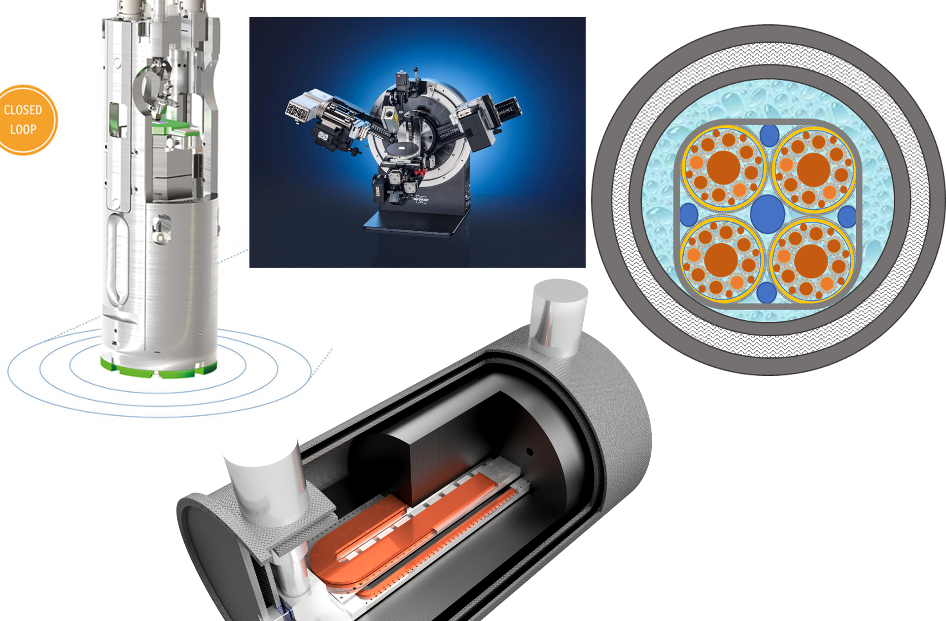
Applied Superconductivity in Italy. Challenges and plans for test infrastructures
IRIS
Marco Statera
INFN – sezione di Milano
Laboratorio LASA
24 April 2022

Slide 2
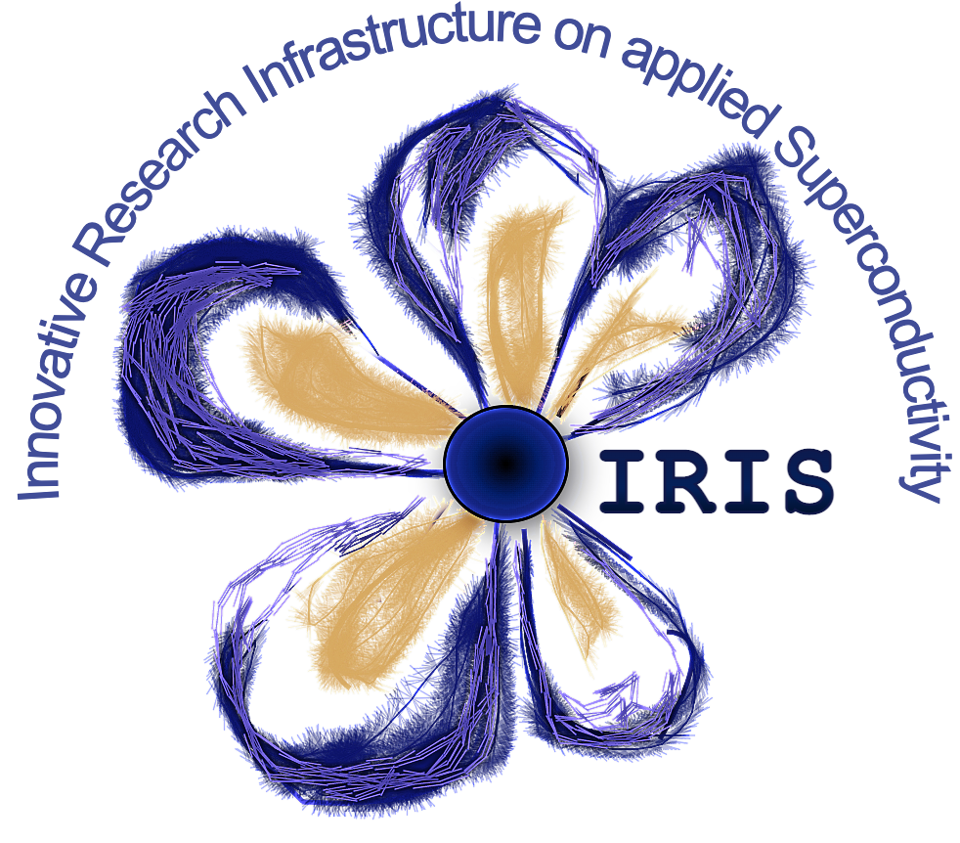
outline
IRIS - Innovative Research Infrastructure on applied Superconductivity
Motivation, scope and genesis of the project
IRIS structure and highligths from sites
Planning and where we are

Slide 3
Preamble
The evolution of the project until its present form
In 2020 till summer 2021 the idea was to present a program devoted to develop Applied Superconductivity (AS) mainly for HEP future collider (FCC-hh)
Then in summer 2021 the accent was to couple the technology development for Accelerators with societal application of AS:
  Medical (Gantry and synchrotrons for heavy ion particle treatment with CNAO)
  Green Energy: a very low dissipation SC line for power transmission (CERN)
Then from November 2021 the program had to be posted as RESEARCH INFRASTRUCTURE
  We lost the medical (CNAO cannot be partner…) even if we keep as technology spinoff
  The LASA laboratory of INFN-Milano had to be the “Hub” as the only present national R.I.
  We rescued the community of EMHFL that in Italy has no national R.I. → Univ. Salento (Lecce)
  We decide to keep two large technology demonstrator, to be developed in the frame of the project.

Slide 4
Preamble 2
Response to a call by the Ministry for Research under the “Recovery Funds” (PNRR)
To form a new distributed infrastructure in applied superconductivity (AS) in Italy by mutualizing existing infrastructures, competences, skills and by expanding them with new laboratories
6 poles for the new or renewed infrastructures: Frascati (INFN), Genova (INFN, CNR-Spin, Unige), Milano (INFN, Unimi – LASA lab), Napoli (Unina), Salento (Unisalento) e Salerno (INFN e Unisa)
  LASA (Miano) is the hub and coordinates the activity

Slide 5
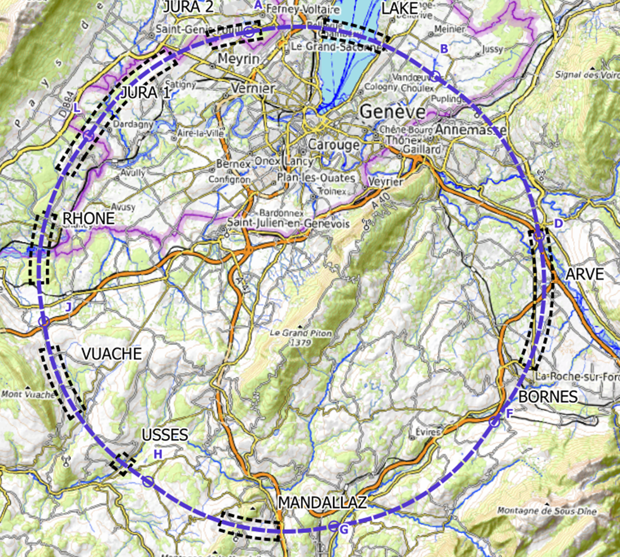
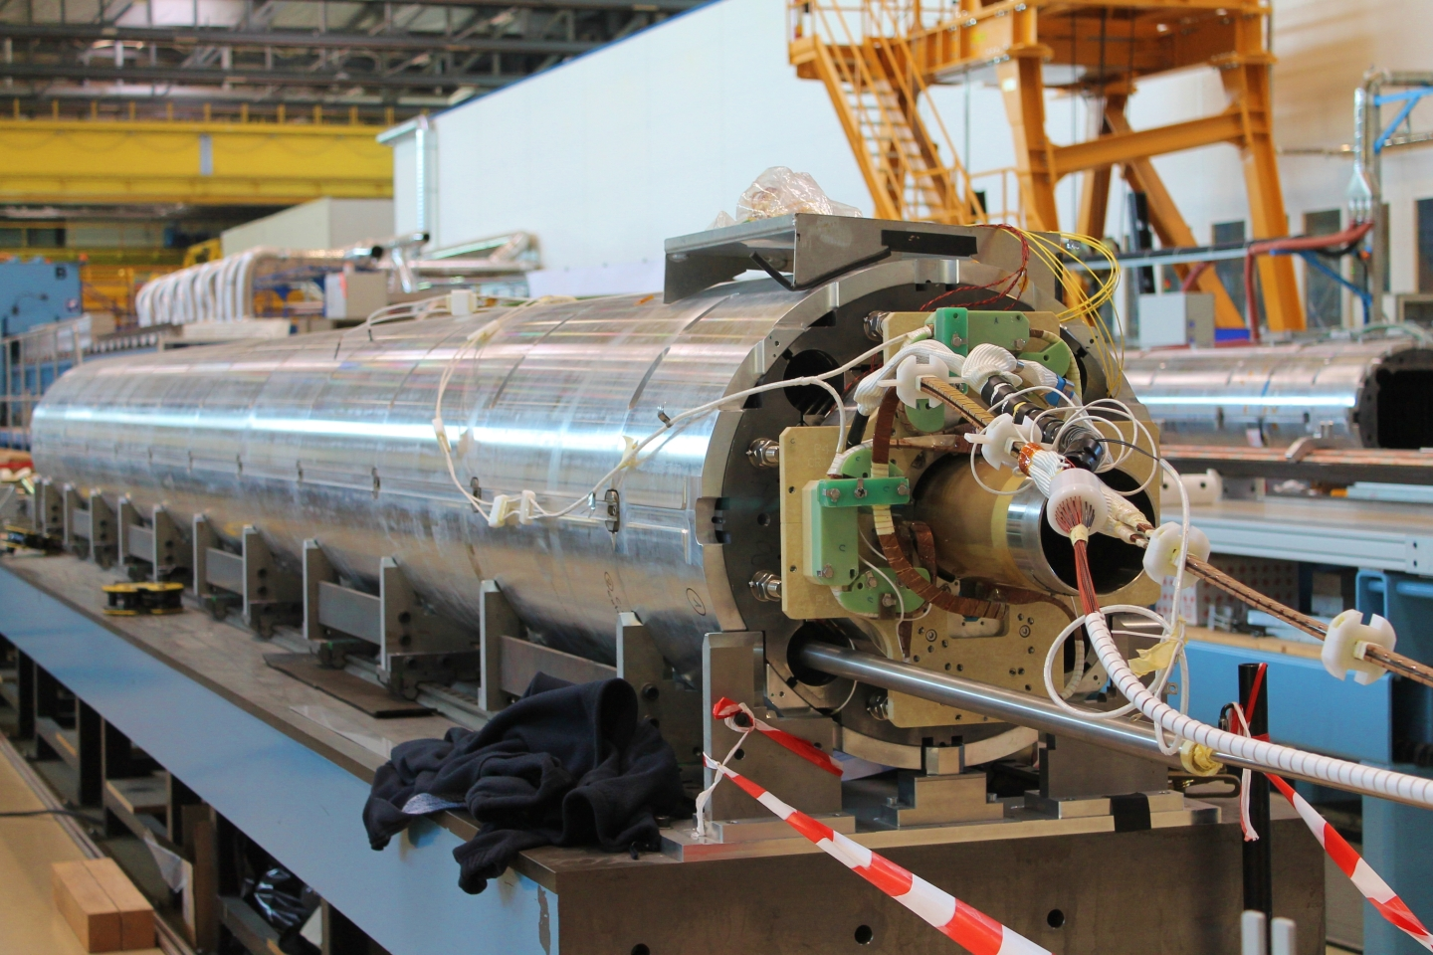
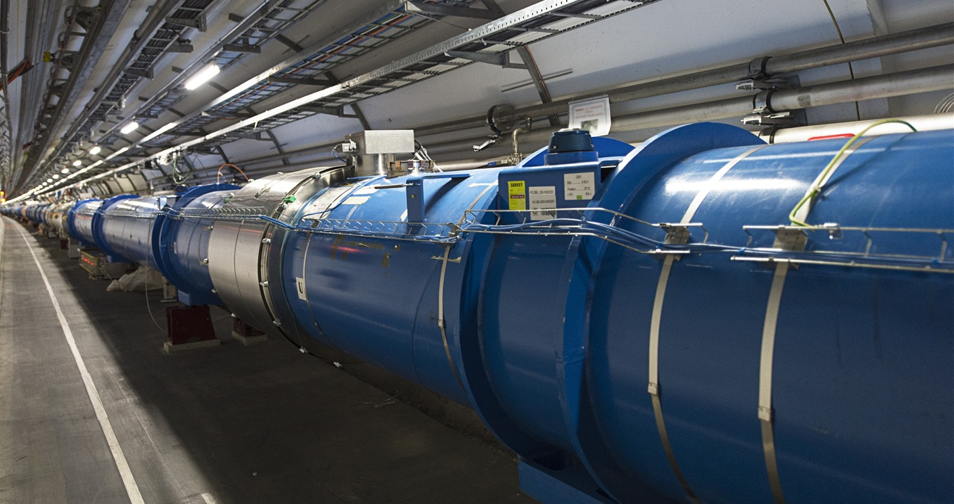
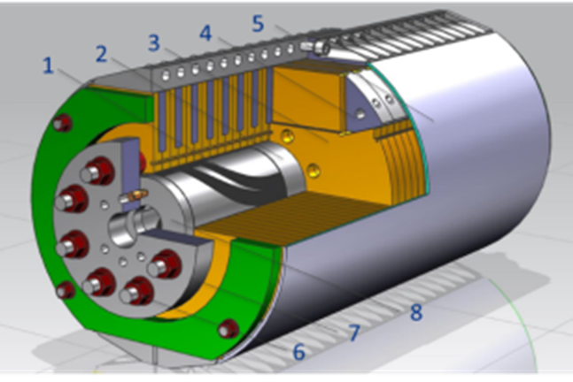
IRIS scope -1
Fundamental Physics instrumentation
Superconductivity has been instrumental for the discovery of the Higgs boson and its development will be critical for future accelerators and we need of adequate infrastructure to sustain this.
LHC dipoles (8 T) in the tunnel
HiLumi MQXF quad (12 T)
FCC (12-16 T)

Slide 6
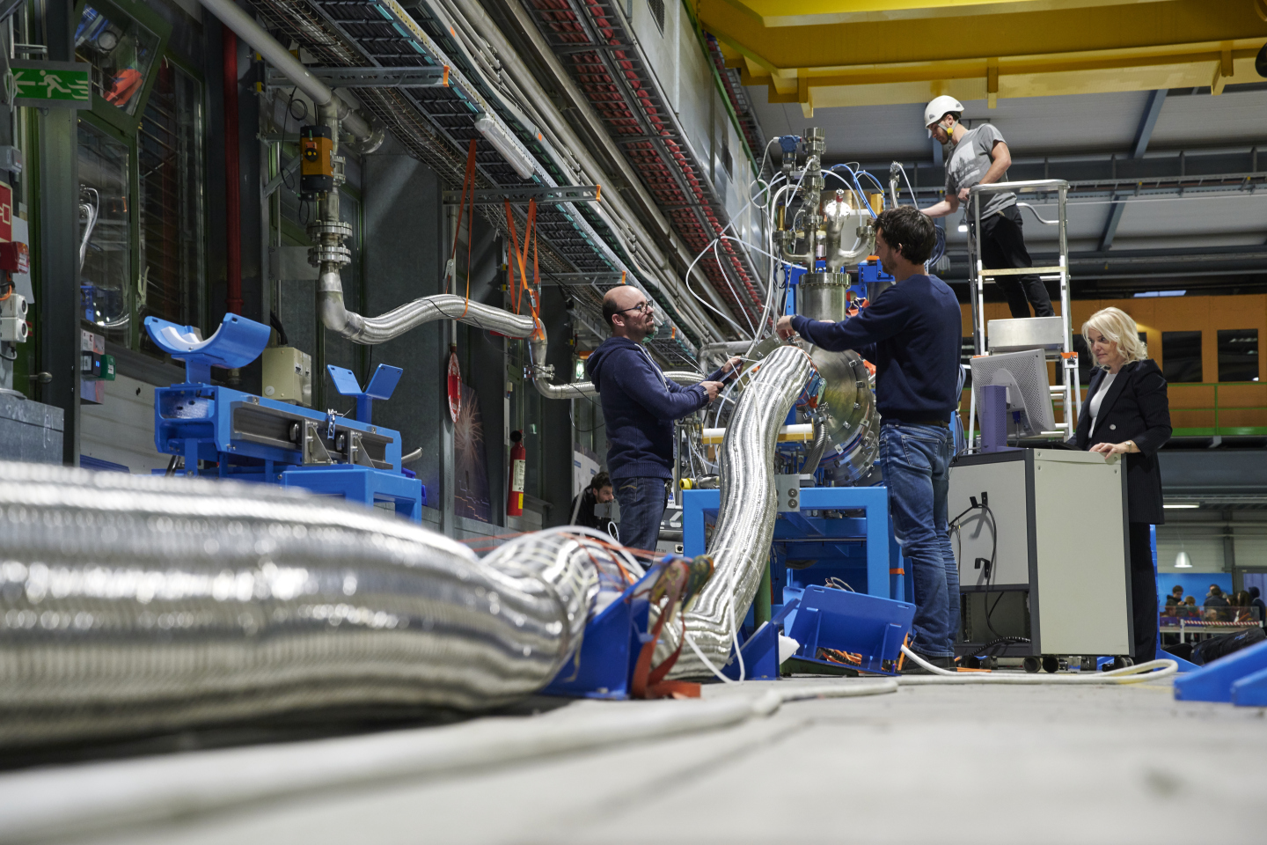
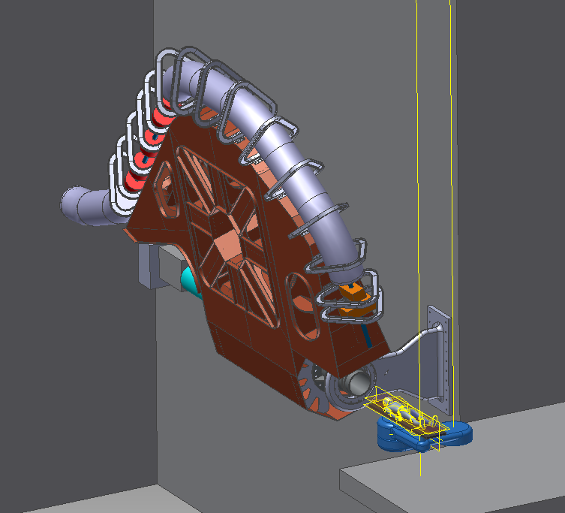
IRIS scope -2
Societal Applications
Green Energy and Medical
Green : energy transport at zero emission and energy saving magnets.
  important for society but also for the sustainability of our research infrastructure
Medical: Superconductivity could play a key role in heavy ion therapy by enabling a rotatable gantry
Courtesy A. Ballarino - CERN
Courtesy M. Pullia (CNAO –Italy)

Slide 7
IRIS ULTIMATE GOAL: contribute to Fundamental Physics instrumentation (particle accelerators for post-LHC era) and to Societal Applications for green energy and medicine.
Superconductivity has been instrumental for the discovery of the Higgs boson and its development will be critical for future accelerators and we need of adequate infrastructure to sustain this. But the infrastructure will be devoted also to societal applications. In the domain of energy will be fundamental for a future green economy but also will allow a step toward sustainable infrastructure for fundamental physics.
Method:
  clustering applied physicists with material scientists and magnet engineers. Therefore, we have also teams working on basic science and materials
  forming a new distributed infrastructure in applied superconductivity (AS) in Italy by mutualizing existing infrastructures, competences, skills and by expanding them with new laboratories
Industry are not allowed to be partner, rather they must be contractors.

Slide 8
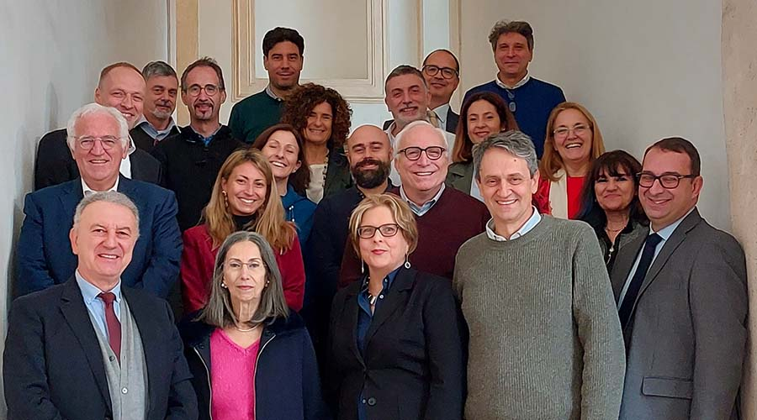
IRIS timeline
Avviso MUR n. 3264 del 28-12-2022
Application on 25 February 2022
Negotiation phase with MUR: 10 June 2022
(resubmission new proposal : 17 June 2022 with 20% budget cut)
Decree of approval: n. 124 of 21.06.2022
Start date of the project: 1 November 2022
End of project: 28 February 2025
→ 6 months extension to 30 October 2025 (mentioned in the call)
IRIS KoM, Rome Nov 2022

Slide 9
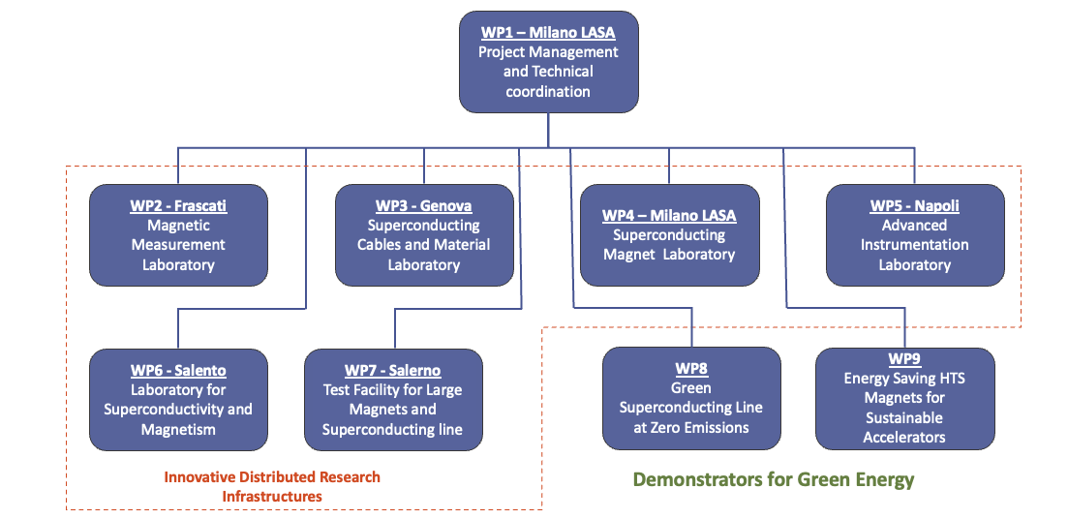
IRIS Structure
PI Pierluigi Campana (INFN G.E.)
TC Lucio Rossi (INFN LASA)
IM Beniamino Di Girolamo (INFN LASA)

Slide 10
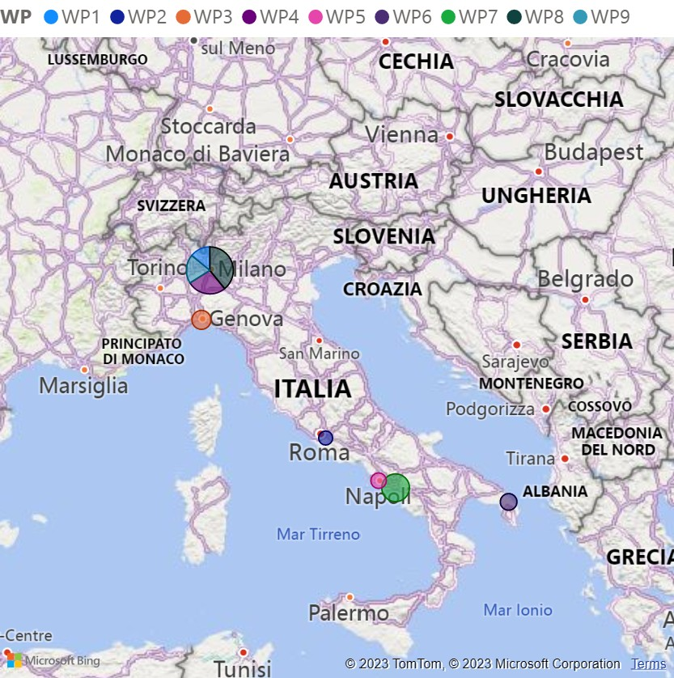

Distributed facility
The challenge
60 ME (including taxes)
Geographical distribution 45% North 55% South
36 FT positions (50% academic) 5 PhD
End of project: 28 February 2025 +6 Months

Slide 11
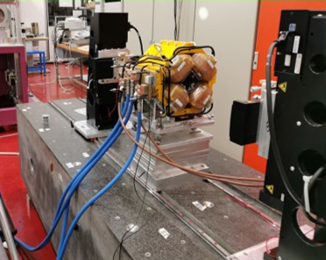
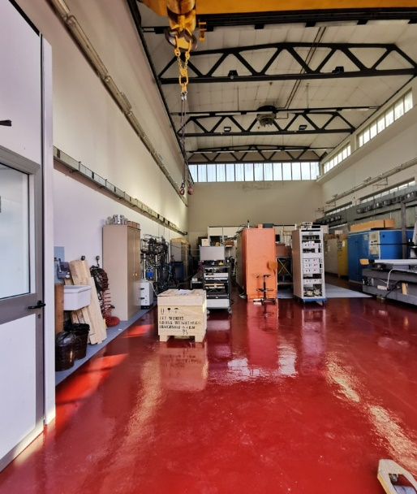
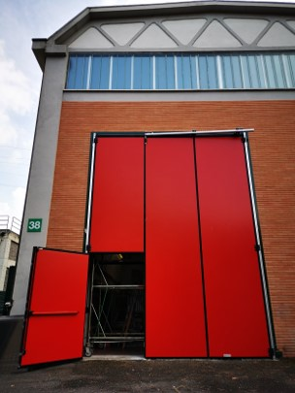
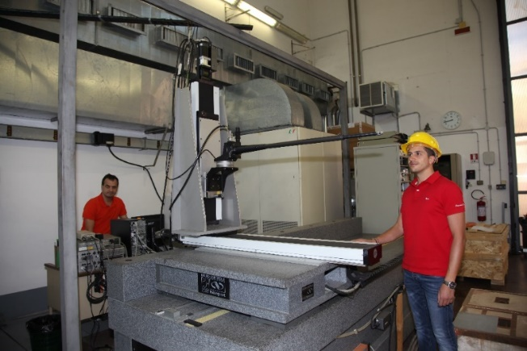
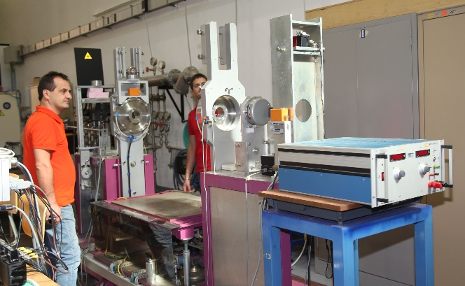
WP2 – Frascati INFN-LNF
Magnetic Measurements Laboratory @ LNF
The INFN-LNF magnetic measurements laboratory, about 200 m², with 15 T crane has already :
a Hall effect digital teslameter with a 5-axes movement device on a granite bench;
a stretched wire bench for integral measurements of fields and mechanical fiducialization;
a rotating coil multipole measurement system; an NMR teslameter.
Several other ancillary instruments are available, such as gaussmeters, integrators, etc…
Stretched wire bench
Hall probe mounted on the coordinatometer
Rotating coil bench

Slide 12
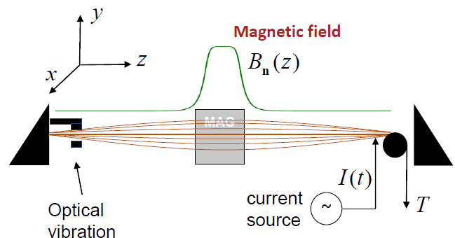
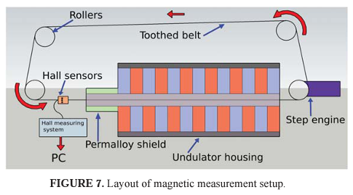
Vibrating wire Magnetic Measurement
New instruments

Slide 13
WP3 – Genova INFN, CNR-SPIN, UNIGE-DIFI
Collaboration among the three Insitutes has been formalized (ante-IRIS) with a new Joint Research Lab : LabCoR
INFN
  Characterization of very high current cable
  Design of SC magest for accelerators and Detectors
  Industrial Folow-ip of the SC magnets Construction
  R&D on future Magnets
CNR-SPIN
  Study of SC material for application
  Development of SC wires
UniGe – Phsics Dept.
  Research on SC material

Slide 14
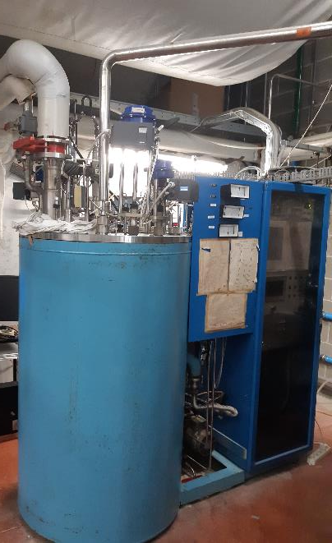
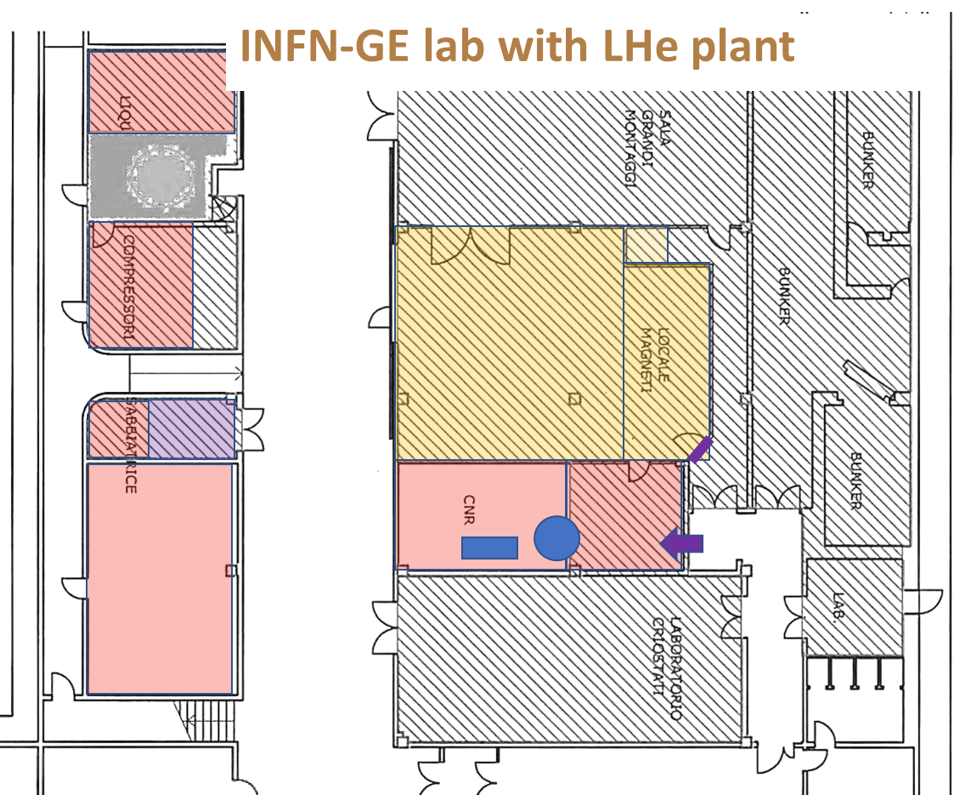
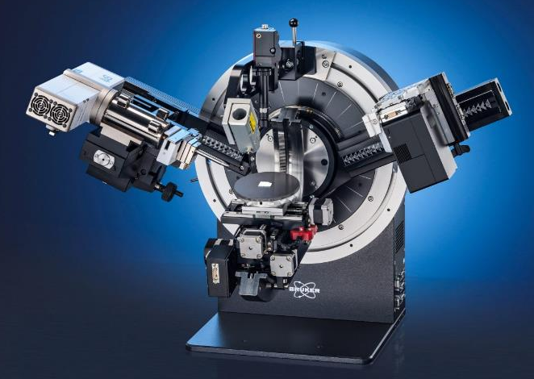
WP3 – Genova – continue INFN, CNR-SPIN, UNIGE-DIFI
Scope
Renewal and better efficiency of the LHe plant
Renewal of part of the existing laboratory
Purchase and commissioning of new modern equipment
Training of new researchers
Research on SC material
Study of SC material for application
Development of SC wires
Characterization of very high current cable
X ray difrattometer

Slide 15
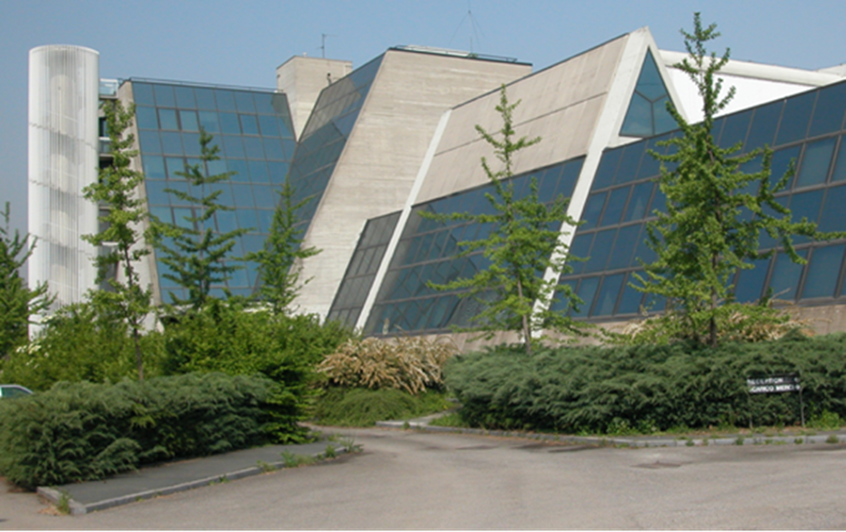
WP4 – Milano LASA - INFN-Milano, UNIMI-DIFI
Laboratorio Acceleratori & Superconduttività Applicata
  SC magnets and SRF cavities
Also photocathodes and other activities (BriXino, radionuclides studies)
(old) LHe plant to be renewed in the next 2 years
About 25 people active in applied superconductivity
It is “only” a building, not an Institution: it belongs to Unimi, co-managed by INFN-Milano and Unimi-DIFI
It is National R.I. as INFN infrastructure (in the list of PNIR as medium priority)

Slide 16
Main activity WP4 Milano LASA
Re-vamping of the exiting equipment in the main hall for SC magnet test
  (INFN) Revamping of the existing SC magnet test facility (for bare magnets) up top 20+ kA
  (INFN) Addition of VTI for magnet tests, new power lines, etc…
(DIFI) New building for a Superconducting Magnet Laboratory open to other labs and Industry to support new projects (FCC, MuCol, other) and novel ideas
(DIFI) Metal AD equipment to support prototypal activity
(INFN) A complete set of new equipment for manufacturing small/medium size SC magnet

Slide 17
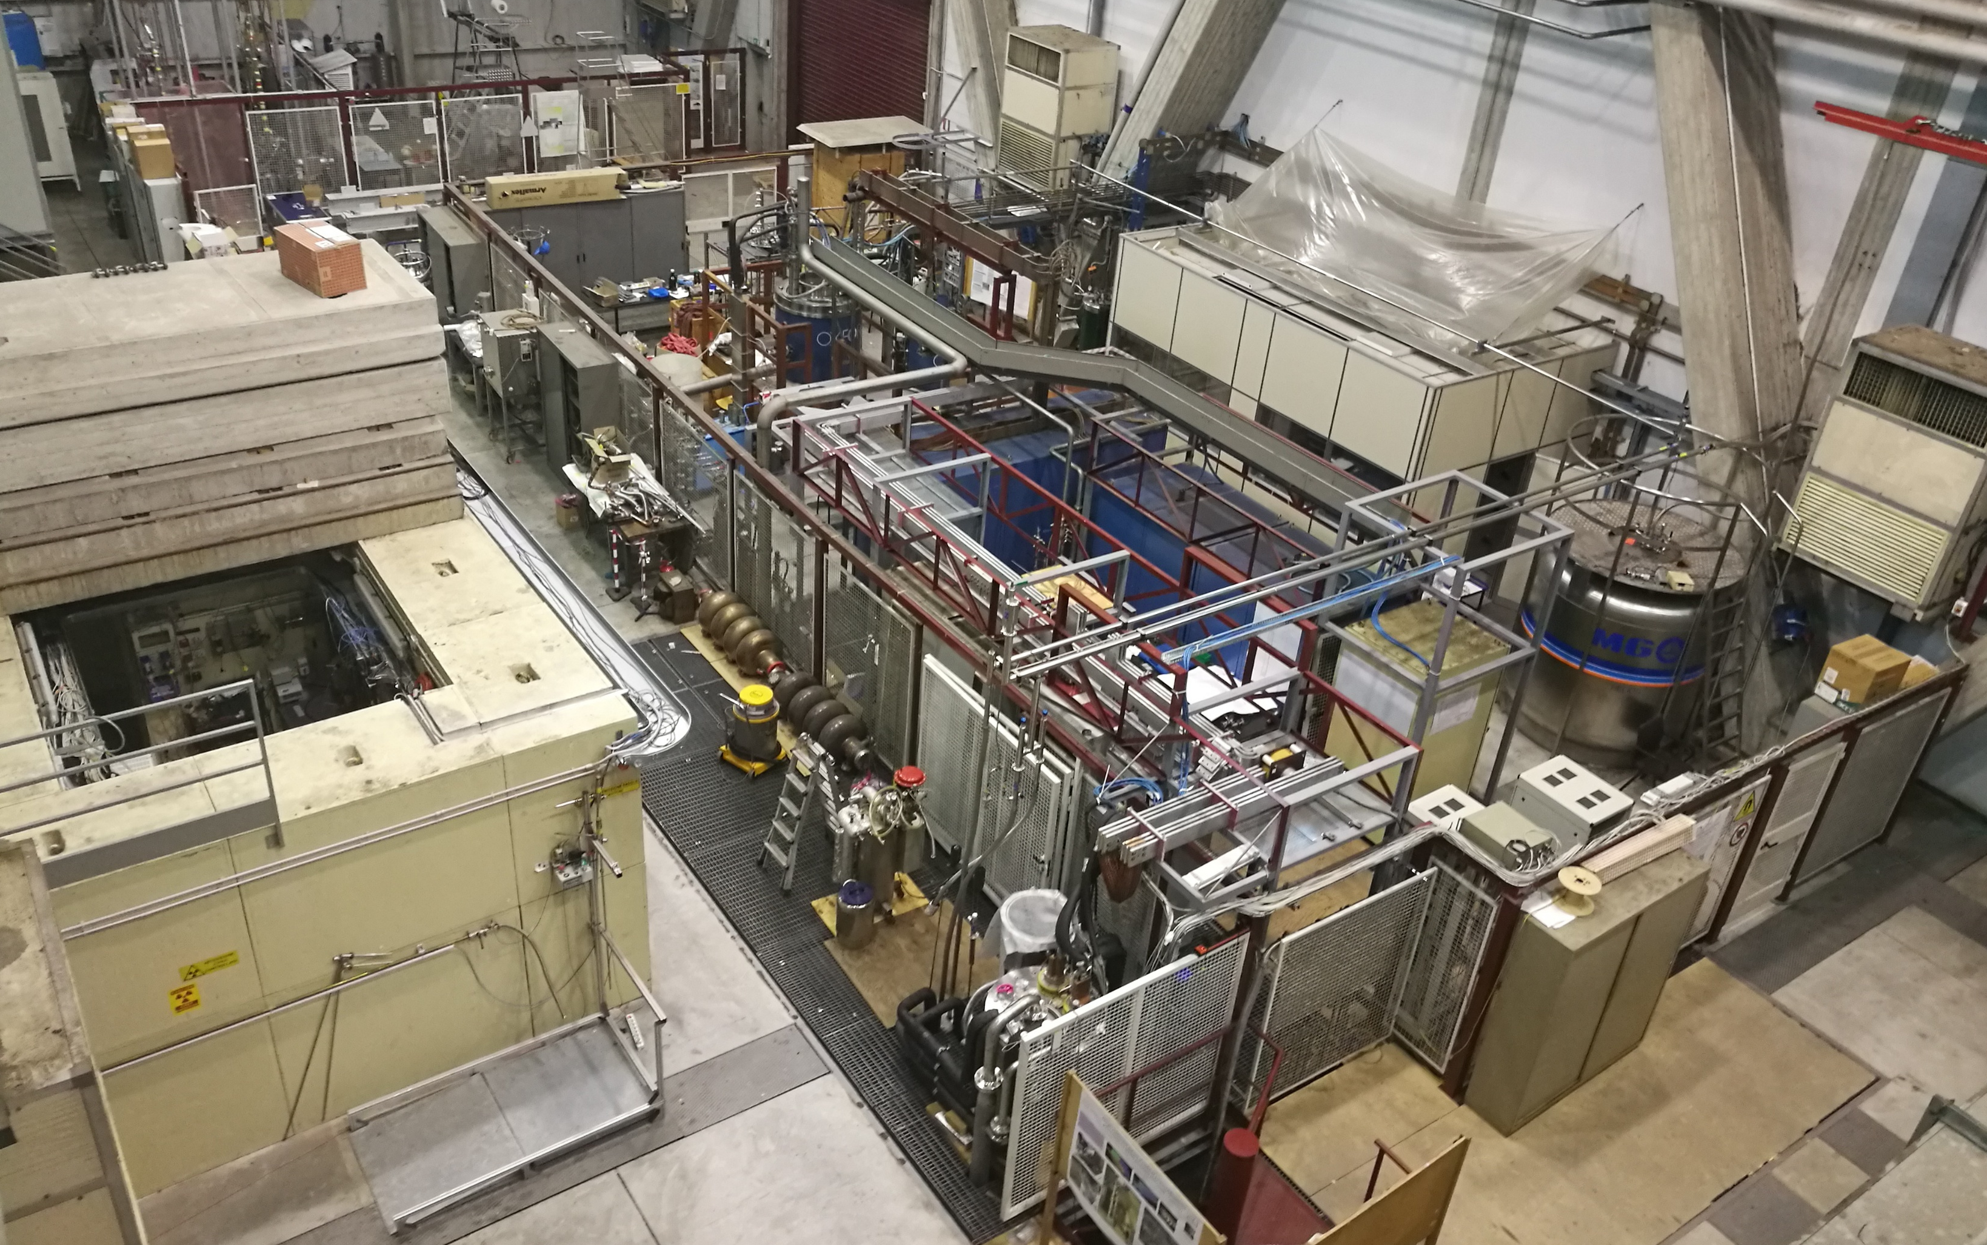
LASA overview
high field solenoids
Neutron test area
30 kA line
SC cavities
Test area
aaa
power supplies
Discorap SIS300
HL-LHC High Order Correctors
fast DAQ and slow control
vertical cryostats
10 kA line

Slide 18
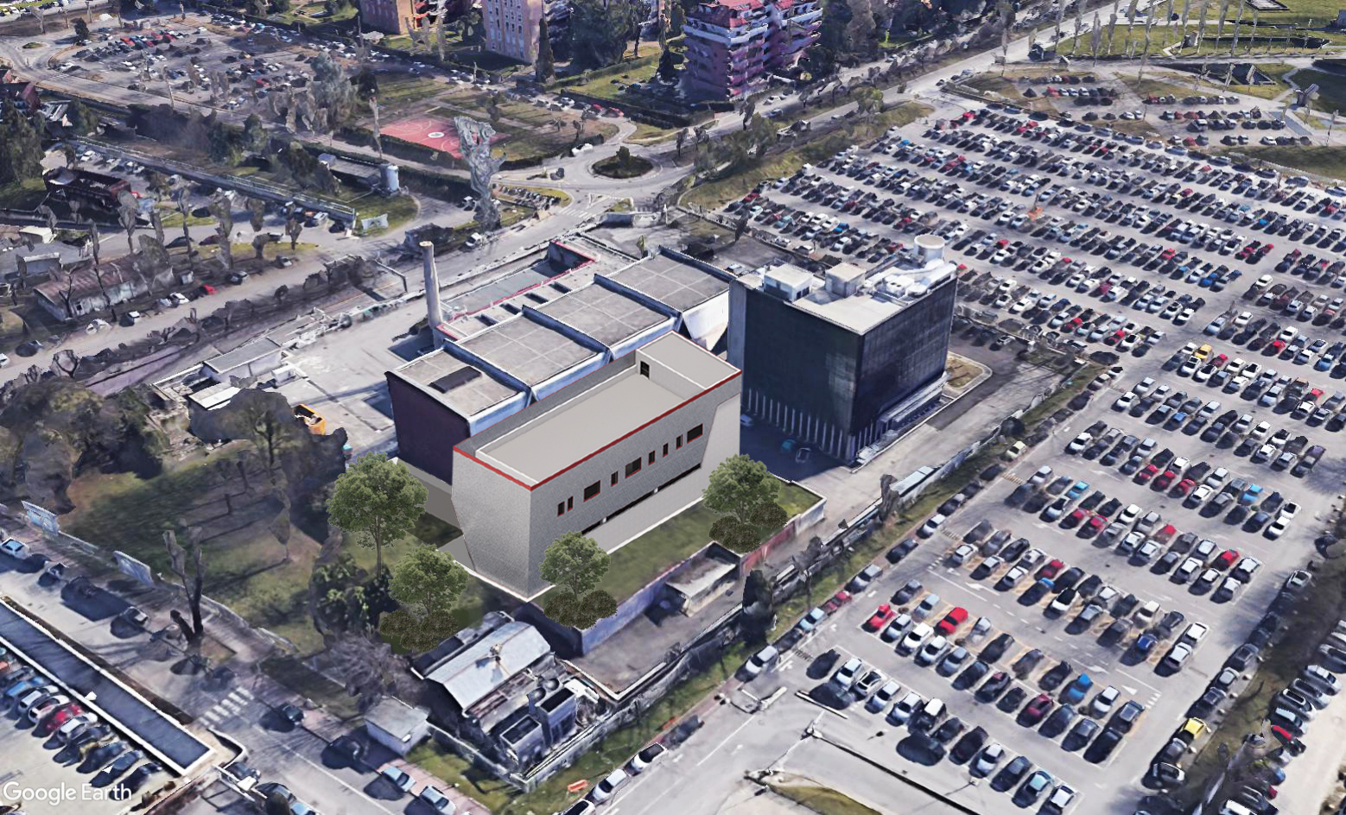
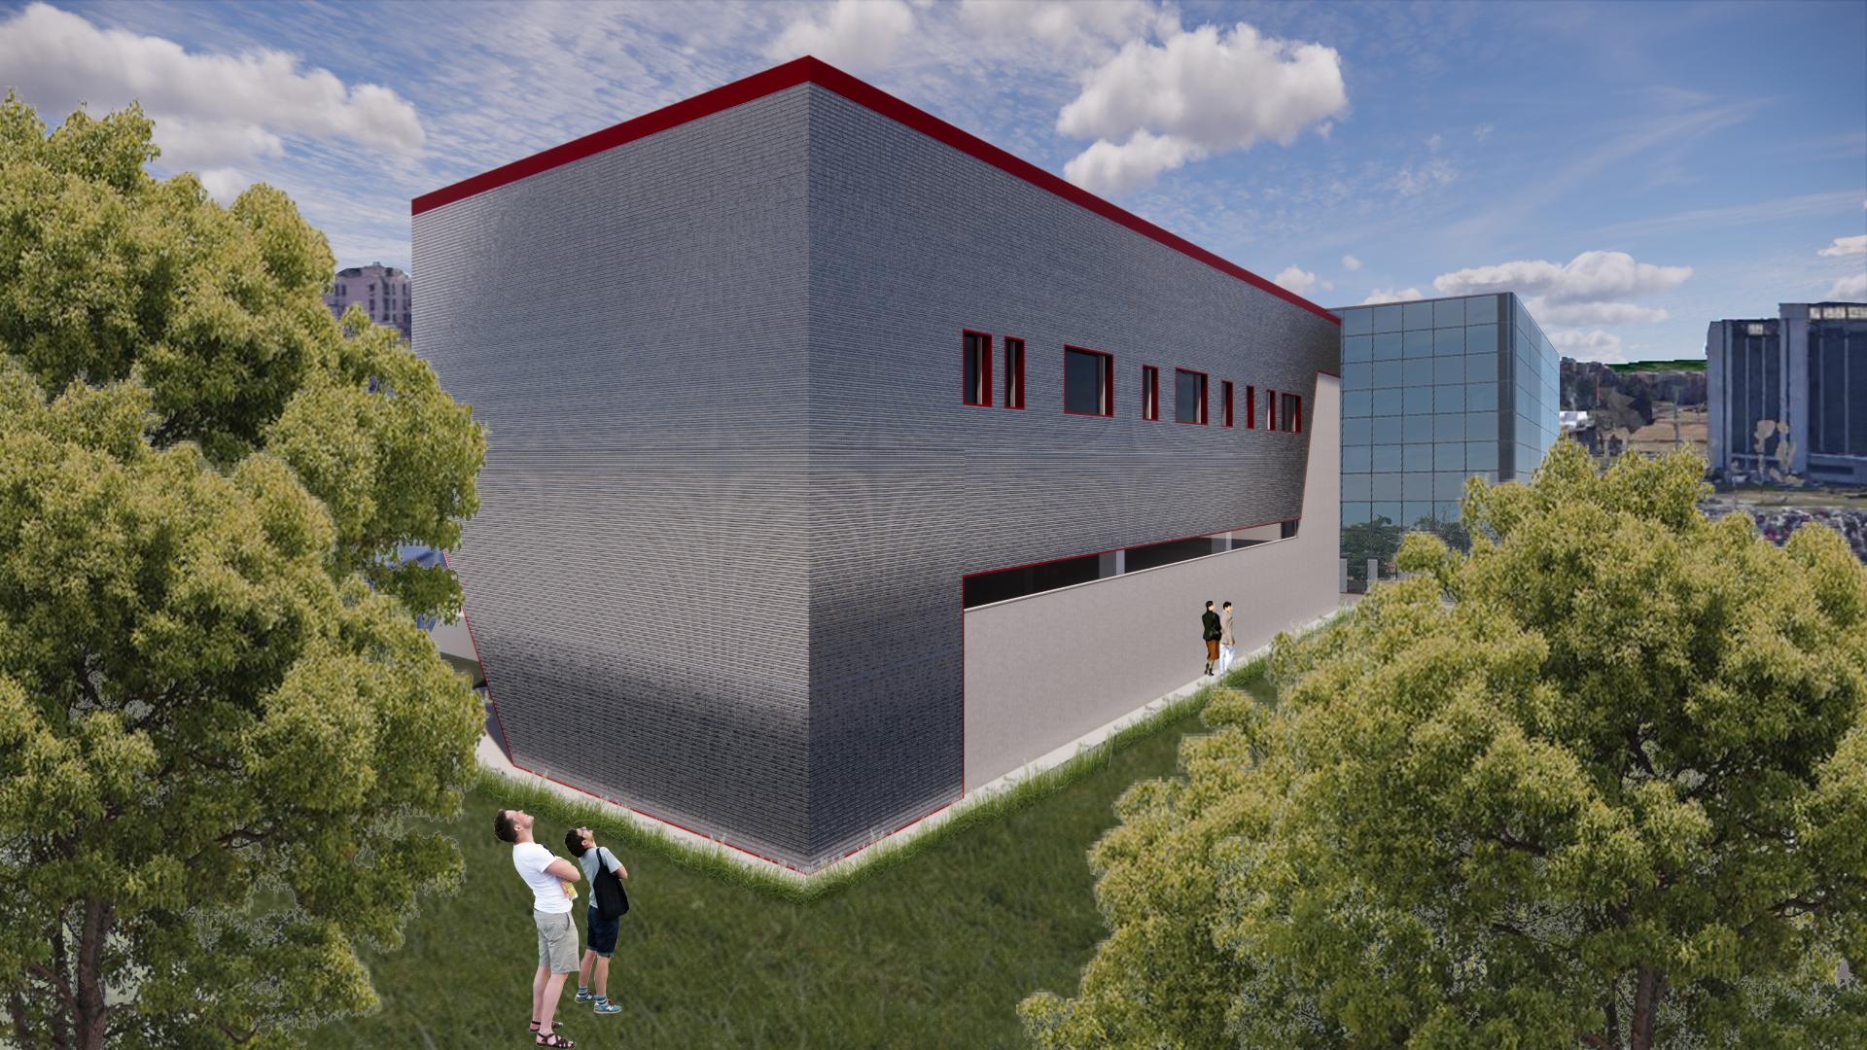

400 m² surface building - 2 floors
+ underground bunker by INFN
Develop technologies for HFM
Demostrators up to 2 m
RF and coherent beams in shielded underground
Technology Transfer

Slide 19

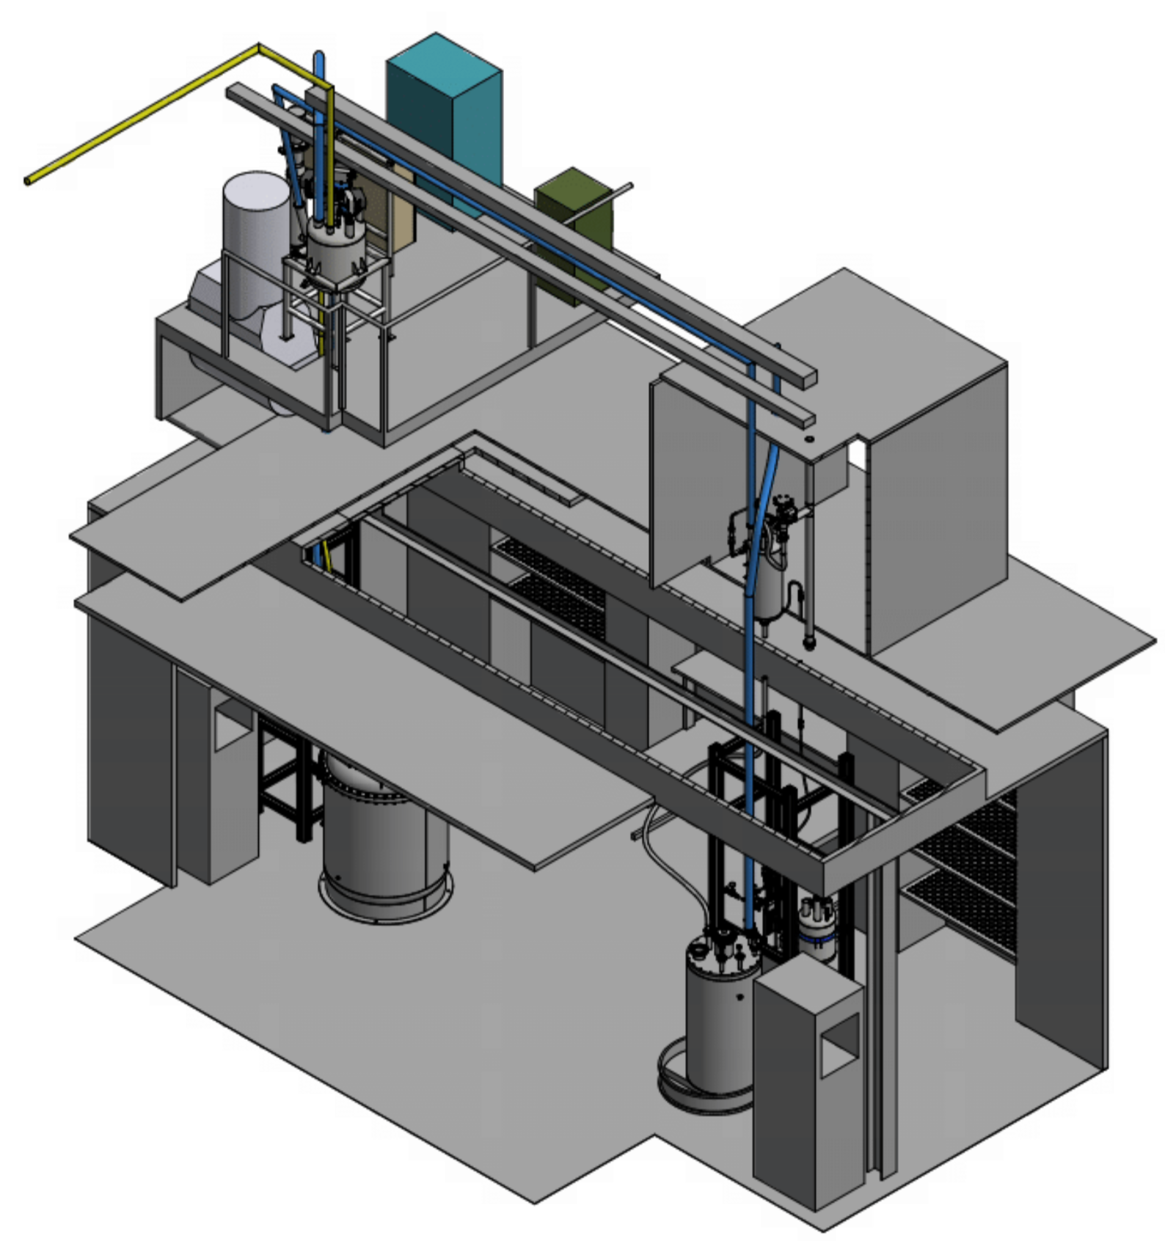

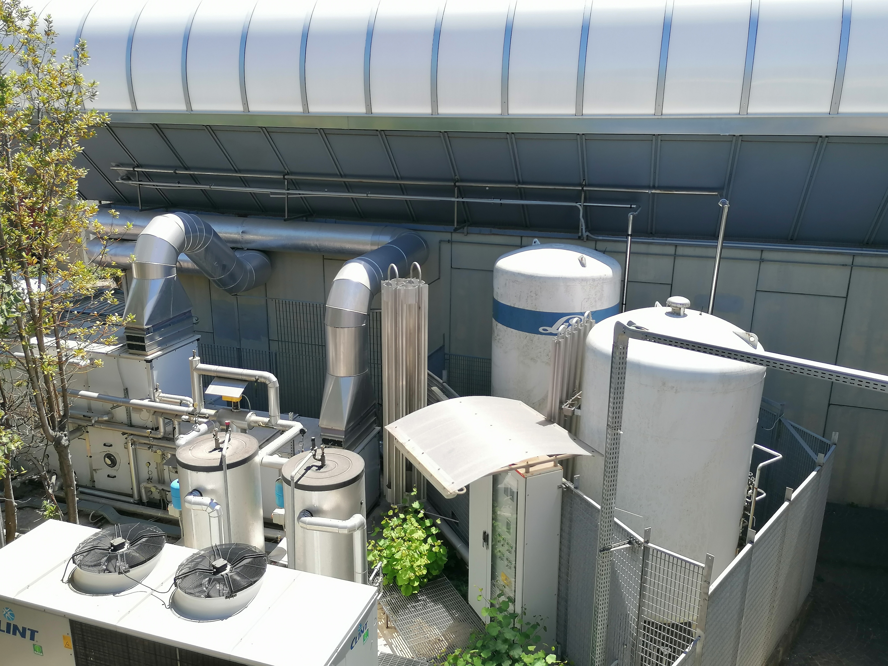
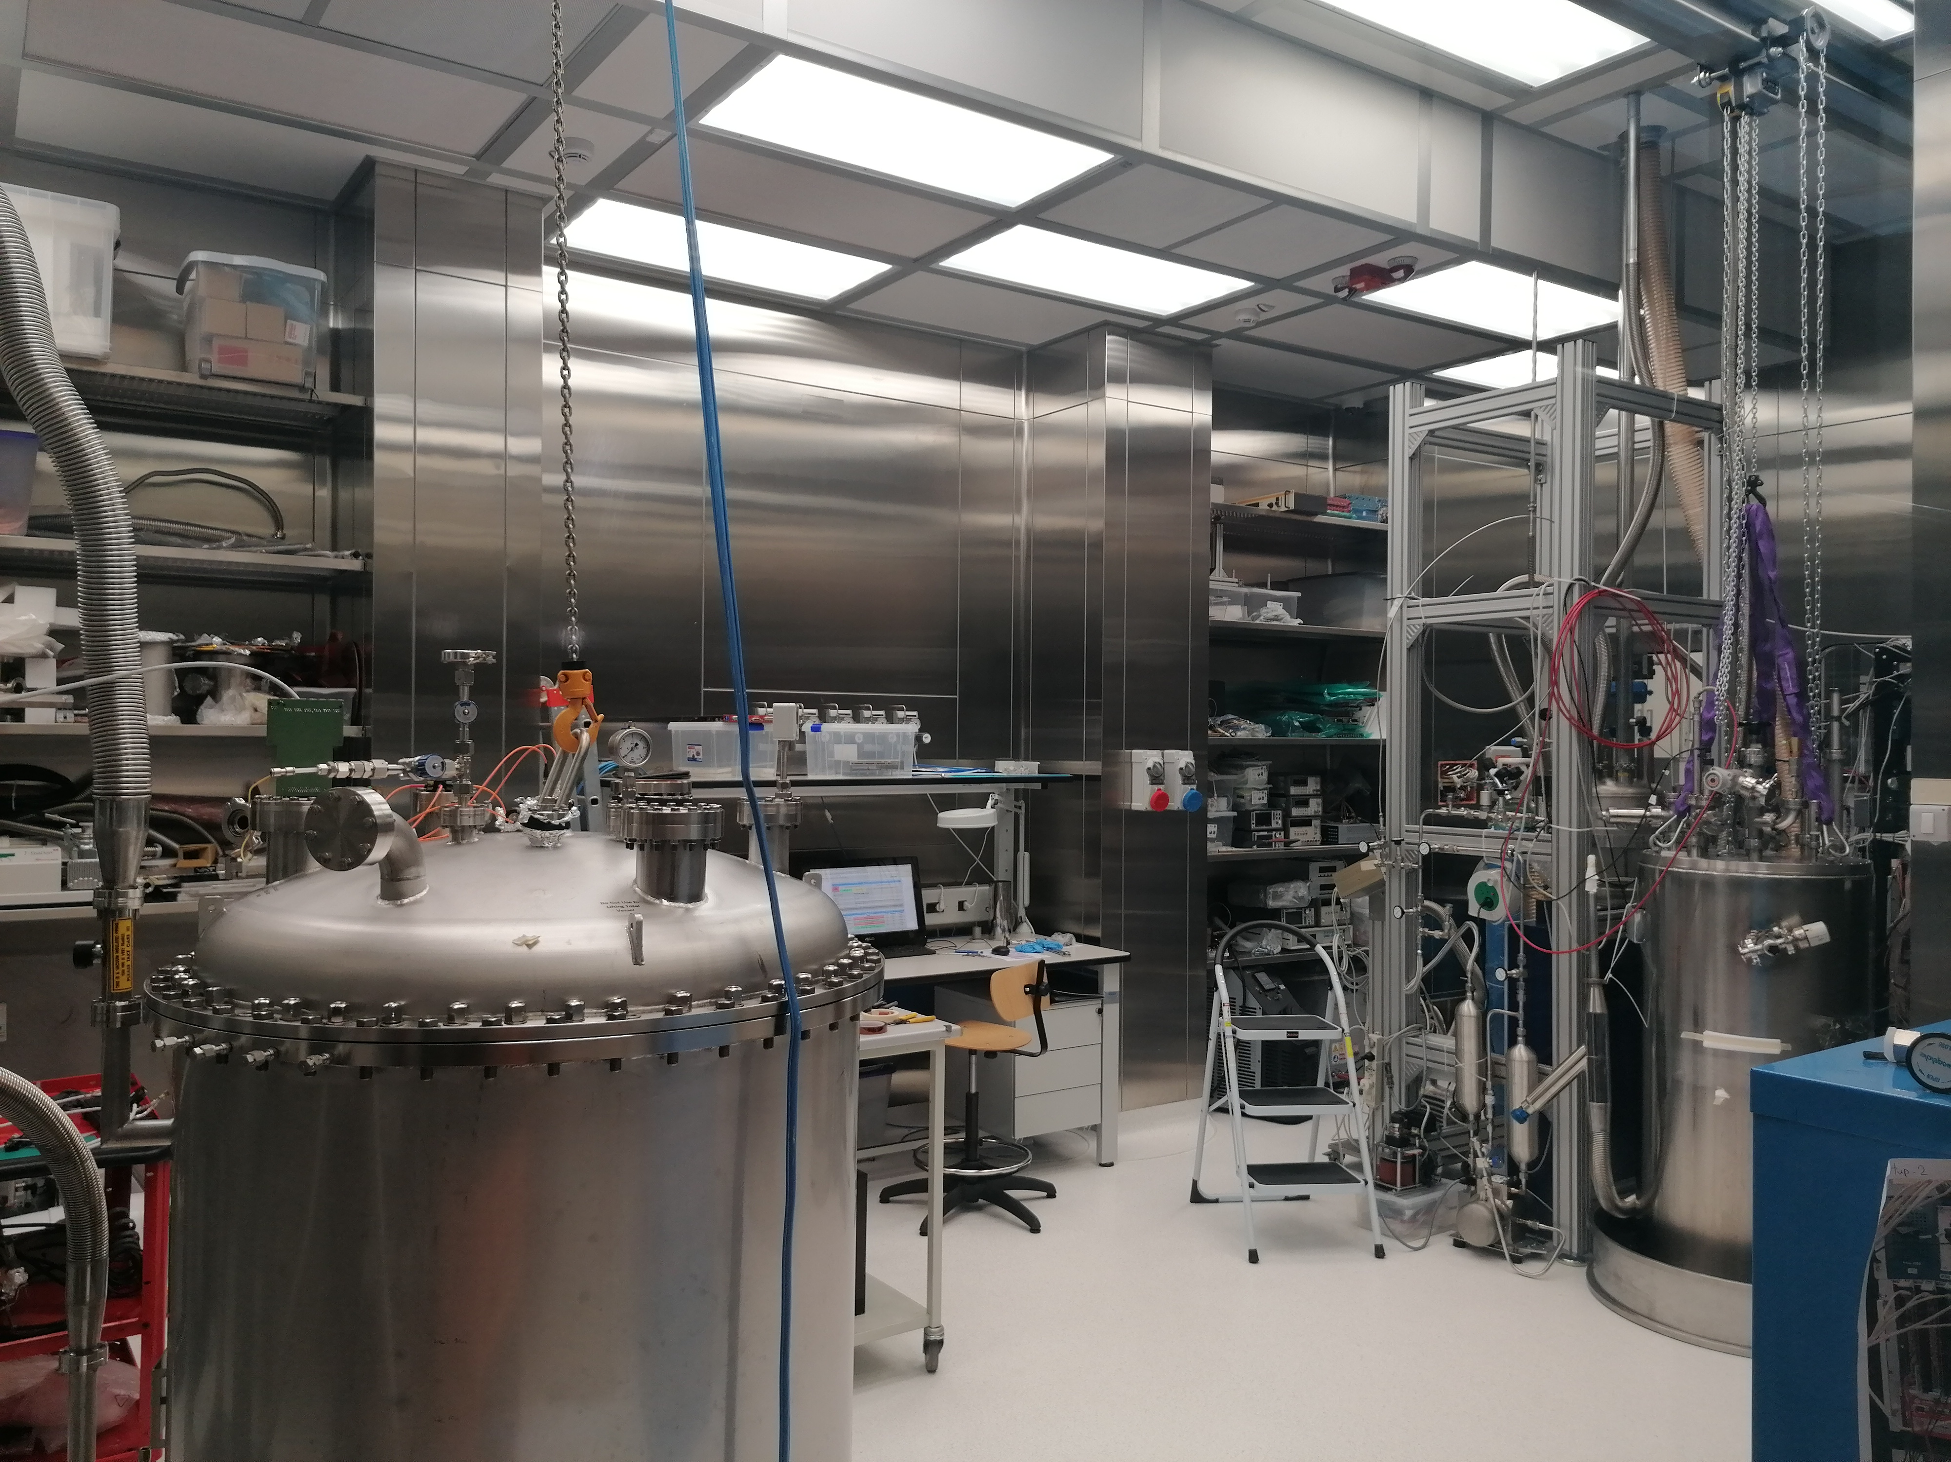
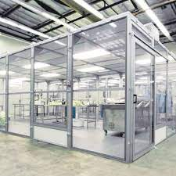
WP5 – Napoli - CRYOLAB
WP5 – Napoli – CIRMIS IMPALAB
Light Detectors Test
Stand alone cryo system
Vacuum and cryogenic equipment
Upgrade of cryogenics and instrumentation
Magnetic measurements
Measurements on superconducting cables
Cryogenics
Aims new lab (cryogenics and instrumentation)
        Extend the current instrumentation and measurement procedure for superconducting magnets and cable
        Improve metrological aspects of the measurements

Slide 20
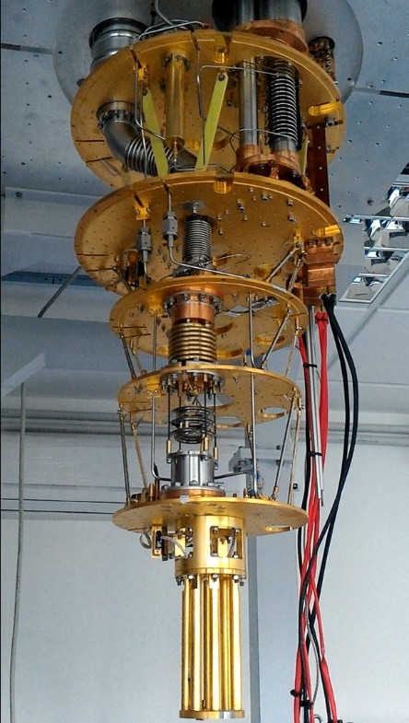
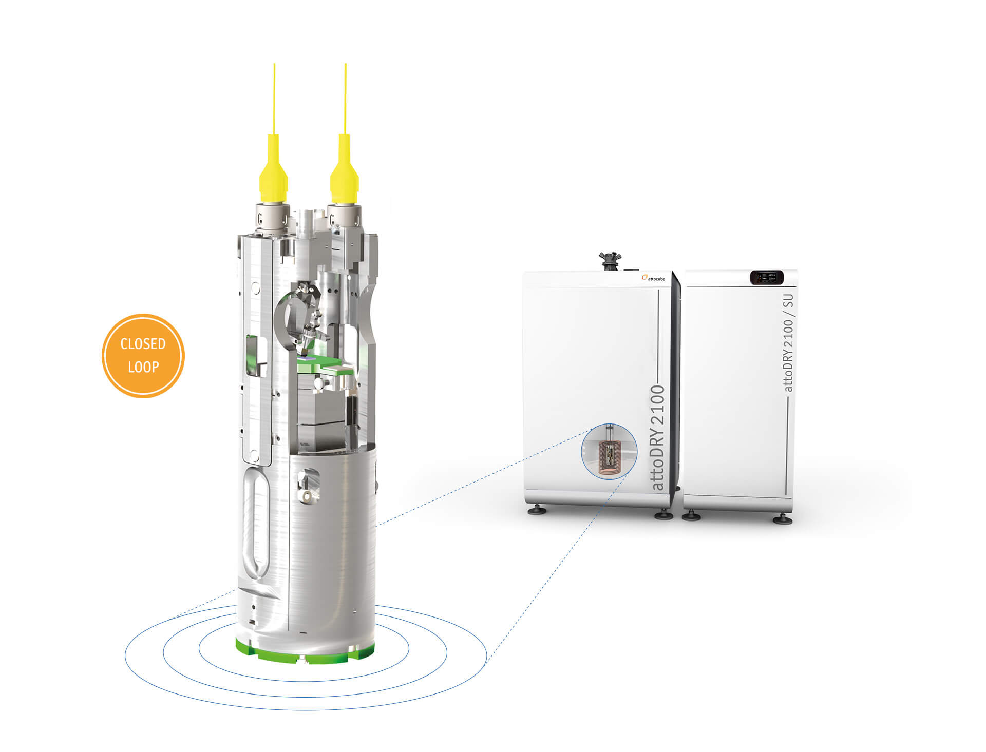

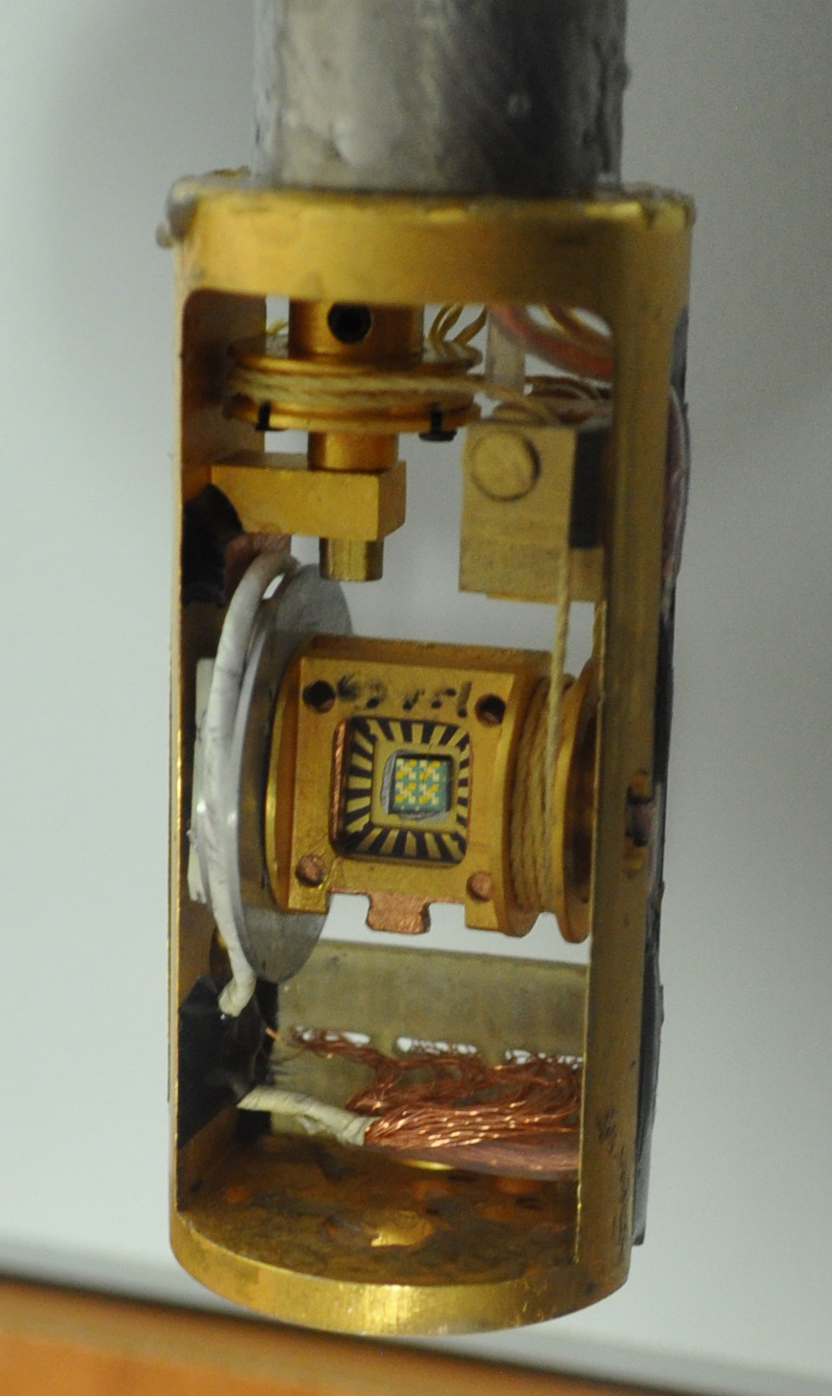
WP6 – UNISALENTO (Lecce) - Superconductivity and Magnetism Laboratory
scanning probe microscope for material characterization
Magnetic materials characterization
Cryogenic superconducting magnet (10.5 T, 0.3-300 K)
Oxford dilution refrigerator (down to 10 mK, vector magnet 6T/1T/1T)
Lakeshore Cryogenic RF probe station (down to 8 K and up to 0.5 T and 70 GHz).
Instrumentation upgrade
Italian node of the European Infrastructure on Magnetism EMFL-ISABEL (funded within ISABEL project, H2020-INFRADEV-2018-2020, Grant No. 871106).

Slide 21
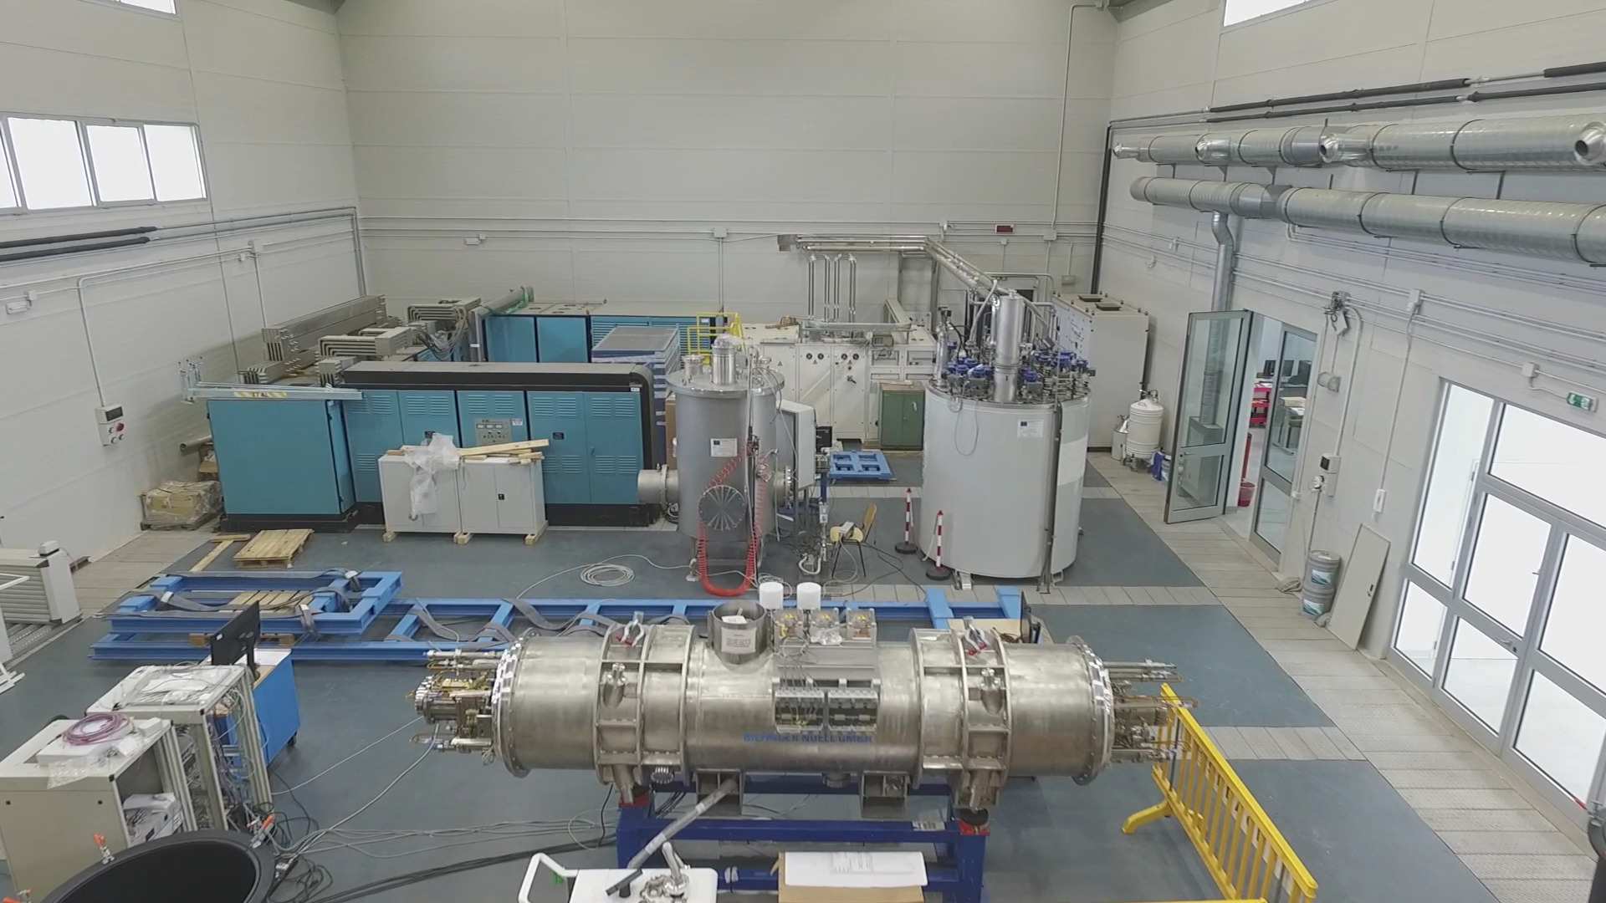
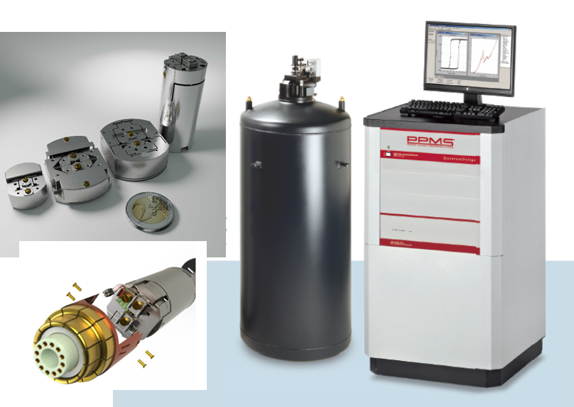
WP7 – Salerno
INFN-NA-G.C.Salerno, CNR-SPIN- UNISA
Courtesy of U. Gambardella
INFN-Salerno with UNISA has built and
commissioned a new SC Magnet test facility
in the last 5 year, THOR
It is used at present for testing GSI – SIS100 SC multiplets
With IRIS the INFN/Unisa facility will evolve by:
  Increasing the cryogenic power for SC magnets
  Ability to test magnets not only at Supercritical He flow and ability
  to test magnets of LHC/Hilumi/FCC size (however, no HEII at the moment)
  Adding a new test facility for Green SC Lines :
  up to 25 kV – 40 kA (1 GW),20 K He gas, with a dugout for cable as long as 140 m

Slide 22
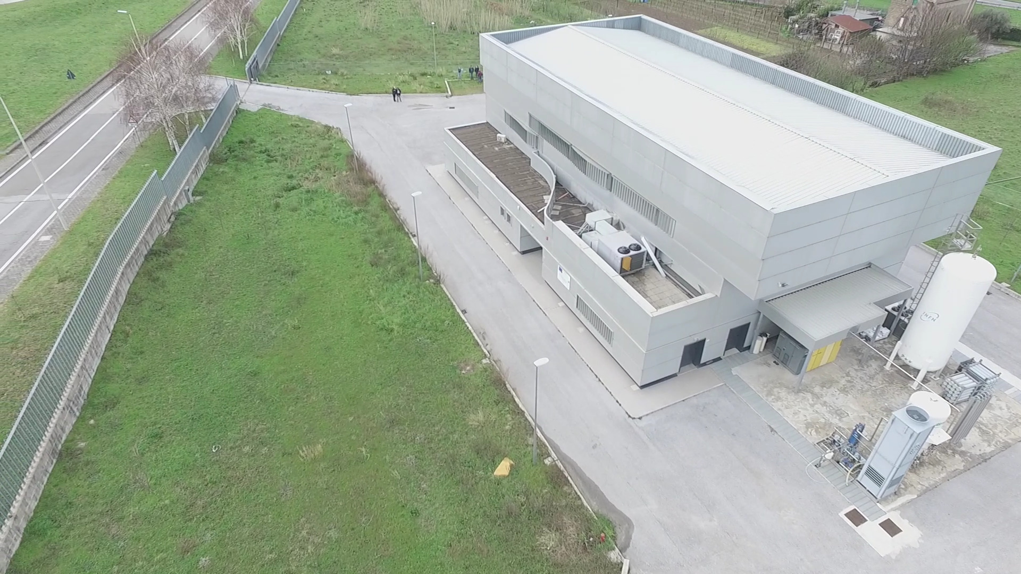
WP7 – Salerno – INFN & DIFI lab : present and IRIS extension
Present IRIS upgrade
50 kV – 40 kA - 20 K He gas – length 140 m
Open access for institutions and industry for all IRIS facilities

Slide 23
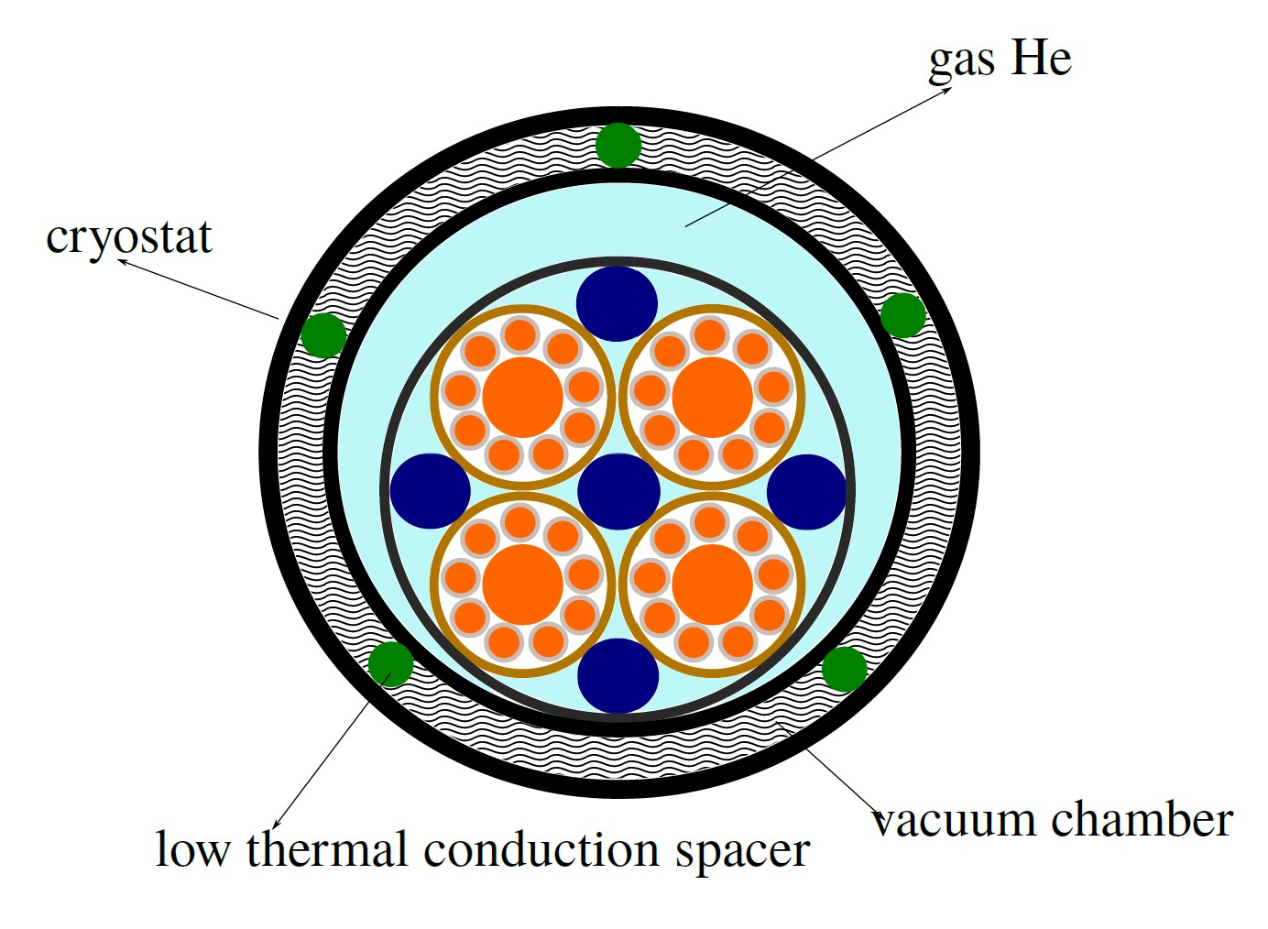
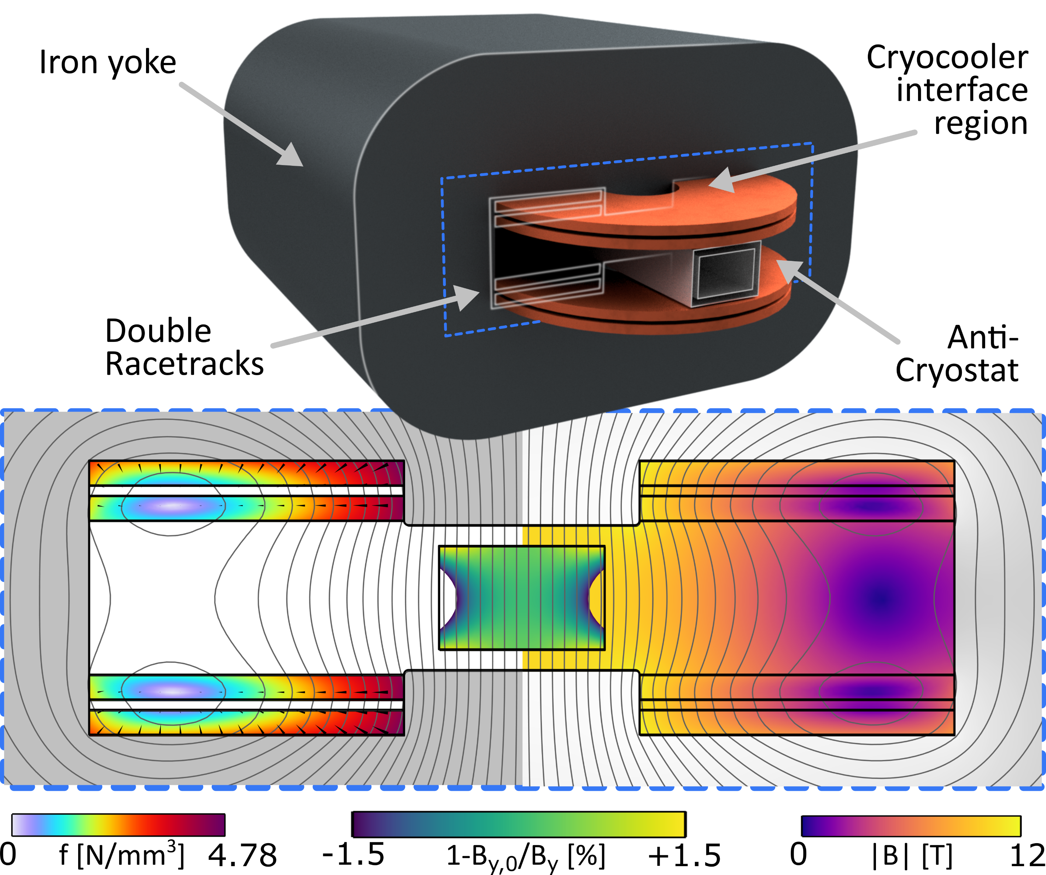
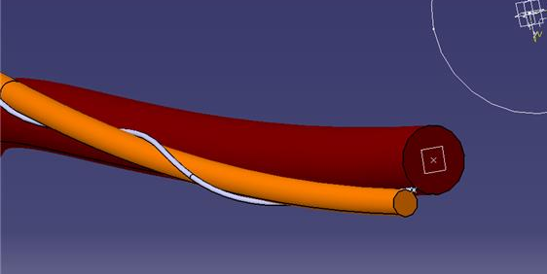
WP8 and WP9 - demonstrators
1GW SC line based on MgB₂
20 K GHe
40 kA – 25 kV
10 T dry magnet to test cables
50 mm x 70 mm warm bore
Good field region length >= 400 mm
Racetrack HTS coils
CERN superlink structure
Design started
Construction in industry
Tendering procedure ending soon

Slide 24
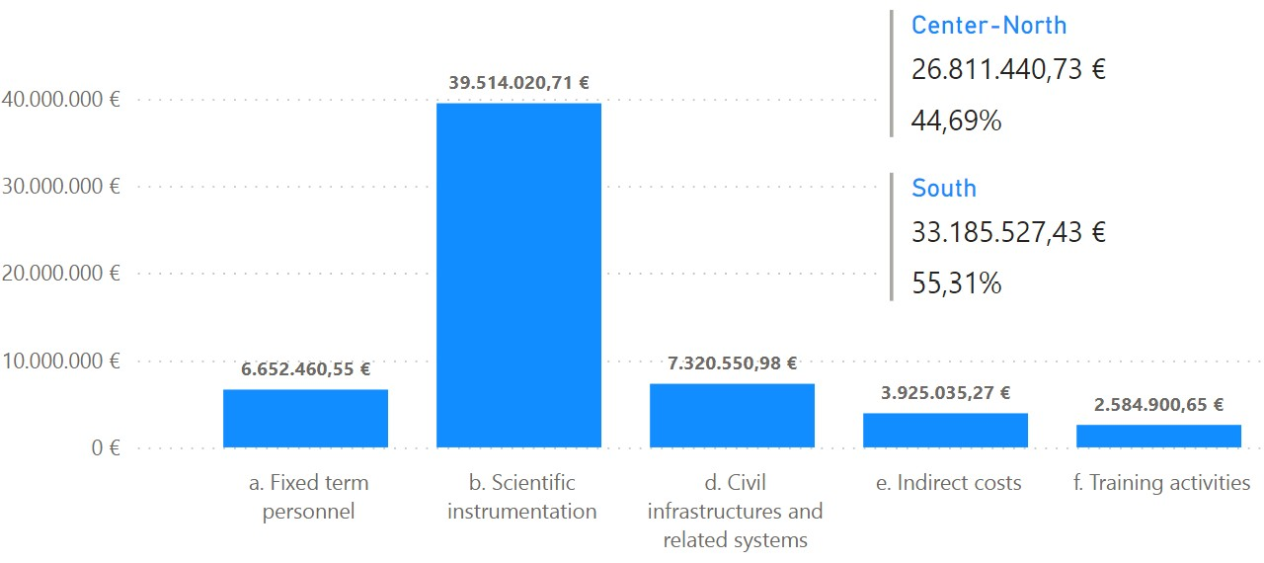
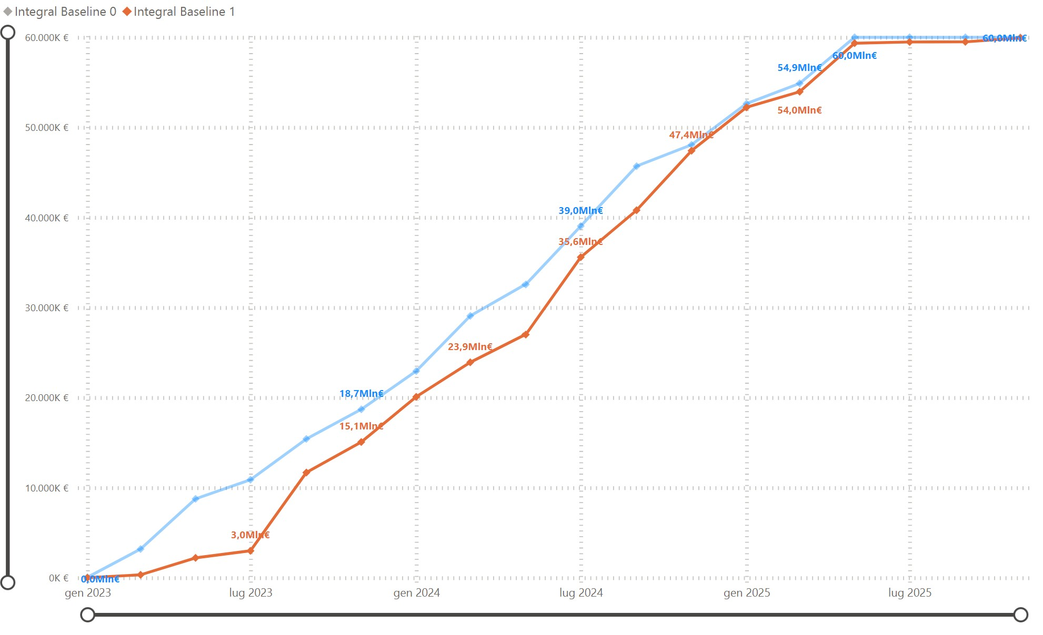
Planning and spending
39ME
7.3 ME
Tendering started for
  HTS tape
  SC prototypes
  Machines for magnet laboratory
  Scientific instrumentation
Specs in definition
  Cryogenic plants
  Civil infrastructures
Procurement rules:
More paper work than standard EU projects
Specific rules defined after IRIS KOM

Slide 25
Conclusion
The challenge started
The construction of a research infrastructure for applied superconductivity has started
Tight plan, we started the most critical activities including the civil engineering
open access facilities for
  SC material, conductor and short high field magnet construction and test
  SC line for power transmission test

