Slide 1
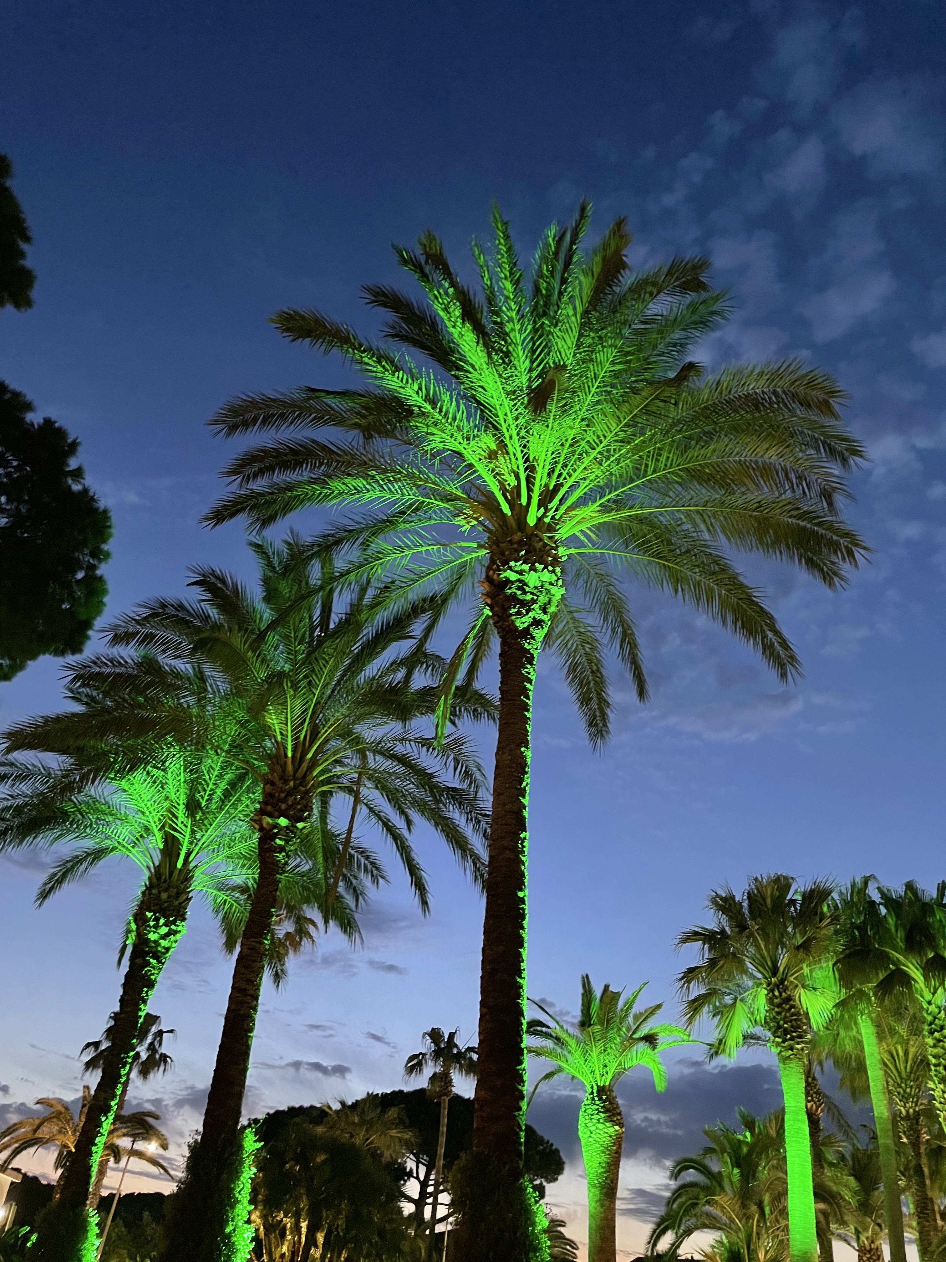
MARTA BAJKO, CERN
Chair of the SMTF Workshop
Joint organisation by CERN-HFM Program and INFN

Slide 2
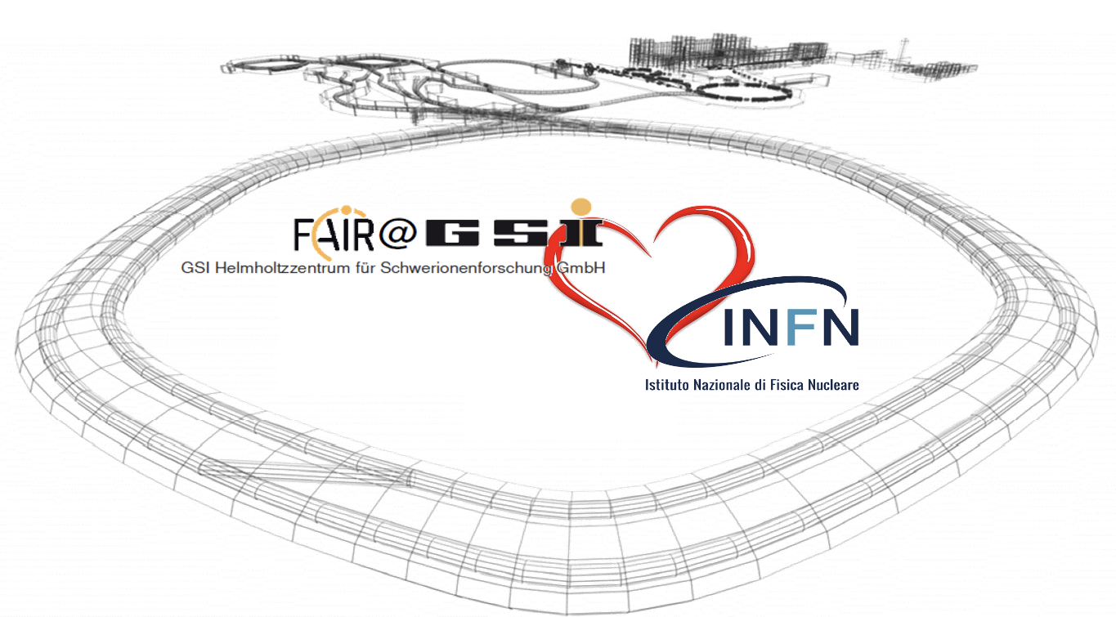
Why Paestum
Poseidonia ( called later by the romans Paestum) was a major ancient Greek city on the coast of the Tyrrhenian Sea in Magna Graecia. The ruins of Paestum dating from about 550 to 450 BC, are in an excellent state of preservation.
THor project is based on the collaboration with GSI and INFN.
It is devoted to the test Sc magnets for SIS-100 synchrotron of FAIR in
Salerno near Paestum.
Links to the past workshops:
SMTF 1, SMTF 2, SMTF 3, IDSM01

Slide 3
TWO workshops in ONE + a TRAINING
Following difficult years of pandemics, the Superconducting Magnet Test Facility Workshop (SMTF) is back now in a presential mode.
For this new edition, we propose a joint event with the Instrumentation and Diagnostics for Superconducting Magnets Workshop (IDSM), which had been initiated in 2019 by M. Marchevsky (LBNL) and G. Willering (CERN). The two workshops are held in Paestum close to INFN and University of Salerno (IT).
At this occasion, we propose to enlarge our activity with an online training with a series of 20 lectures on Superconducting Magnet test stands, Magnet protections and Diagnostics given by speakers from worldwide laboratories (BNL, CEA, CERN, EPFL, FNAL, HNINP, LBNL, Tampere). The lectures will be given from May the 30th to June the 12th via Zoom. We hope to see many of you joining!

Slide 4
A small, but efficient team of organisers
The scientific organization committee:
Marta Bajko CERN
Stoyan Stoynev FNAL
Roser Vallcorba CEA
Toru Ogitsu KEK
Hugo Bajas EPFL
Maxim Marchevsky LBNL
Gerard Willering CERN
The local organizing committee represented by:
Umberto Gambardella INFN and University of Salerno,
Domenico D'Agostino INFN & University of Salerno
Registered Participants
21 Institutes
20 talks
Links to the past workshops:
SMTF 1, SMTF 2, SMTF 3, IDSM01

Slide 5
SMTF Program
The SMTF Workshop will focus strictly on the status of the test facilities, their road map, interest in investing and getting developed for their participation in different projects. The topical part of the SMTF workshop will be reduced this time to give the floor to the workshop dedicated to novel diagnostics and instrumentation (IDSM). More standard measurements and systems – presented in the previous editions of the SMTF – will instead be part of an online training program that we had planned for a larger audience (separate from the workshop, however). The participants will deliver a presentation (typically a 20 min talk + 10 min discussion) on the following topics:
Status report on the test facility, regarding equipment and operational conditions.
List of relevant projects for the laboratory that are a motor for operation or further investment.
Plans for upgrading/development of the test facility.
Chair: M. Bajko (CERN)

Slide 6
IDSM Program
By having the two Workshops side by side, we aim to ease participation for those colleagues who may be interested in attending both events, and at the same time enrich the overall experience and foster new collaborations between the two communities. Please note, however, that the core agenda of the IDSM Workshop will focus strictly on novel instrumentation. Workshop participation is by invitation only, and most participants are asked to deliver a presentation (typically a 20 min talk + 10 min discussion) on the following topics:
Diagnostics for transient strain energy releases, quench precursors and sources of training in LTS magnets (acoustic emission, accelerometers, strain sensors, FBGs, etc.).
Diagnostic challenges for HTS magnets in HEP and Fusion: conductor defects, damage mechanisms, current sharing.
Novel quench detection and localisation methods (optical, ultrasonic, RF, etc.).
Magnetic measurement methods (harmonic field probes, quench antennas, other magnetic sensors).
Data analysis and management; processing diagnostic “big data” with ML/AI.
Innovative electronics and data acquisition solutions
Any innovative ideas for new kinds of diagnostic instrumentation, sensors, and data analysis techniques.
Chairs: M. Marchevsky (LBNL) and G. Willering (CERN)
See the welcome talk on Wednesday

Slide 7
ONLINE TRAINING
Lectures on Superconducting Magnet test stands, Magnet protections and Diagnostics
For this series of twenty lectures, speakers from worldwide laboratories (BNL, CEA, CERN, EPFL, FNAL, HNINP, LBNL, Tampere) will cover the main aspects of a superconducting magnet test stand (cryogenics systems, power supplies, current leads). A second part will then be dedicated to the design and use of magnet protection systems (high voltage electrical integrity checks, energy extraction, strip heaters, CLIQ, quench detection) with emphasis on the differences between LTS and HTS magnets. The third part will introduce the various measurement techniques related to magnet health monitoring (magnetic, thermal, mechanical behaviours and AC loss). At last, a dedicated talk will introduce the problematic of the protection of large fusion superconducting coils.
Organiser: Hugo Bajas (EPFL)
See the presentation of Hugo on this subject later today

Slide 8
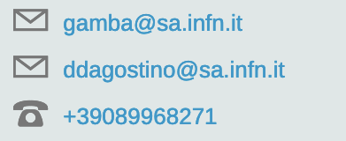
TIMETABLE and ACTIVITIES
TIME TABLE : https://agenda.infn.it/event/32061/timetable/#20230424
VISIT of THOR Facility Salerno: on Wednesday afternoon . Bus departure at 13h30; return at 17h https://agenda.infn.it/event/32061/timetable/#20230426
ROUND TABLE DISCUSSIONS: https://agenda.infn.it/event/32061/timetable/#20230425 , https://agenda.infn.it/event/32061/timetable/#20230426
TURISM in the area: https://agenda.infn.it/event/32061/page/7233-tourism-and-sightseen-in-the-area
GALA DINNER: Tuesday at 20h in this hotel
Practical info ask
Umberto and Domenico

Slide 9
I wish you nice and interesting workshop(s) ENJOY!

