Slide 1
The LHC Physics Case
(as for “Challenges for Anomaly Detection at the LHC”)
Marco Zanetti
University of Padova and INFN

Slide 2
Statistical Data Analysis in HEP
If your experiment needs statistics, you ought to have done a better experiment
Ernest Rutherford
A modern interpretation: data analysis just pulls things together, the obvious step that draws the conclusions
Is that (still) really the case?

Slide 3

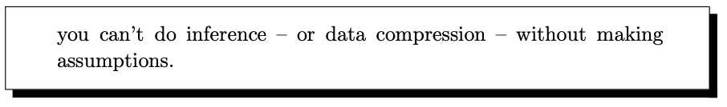
Inference and “unbiased” analysis
/reduction
/hypotheses
David MacKay
“Let the data speak for itself”: sure, but you still have to make a question
Disclaimer: CMS is used as reference in the following, but everything holds for ATLAS too

Slide 4
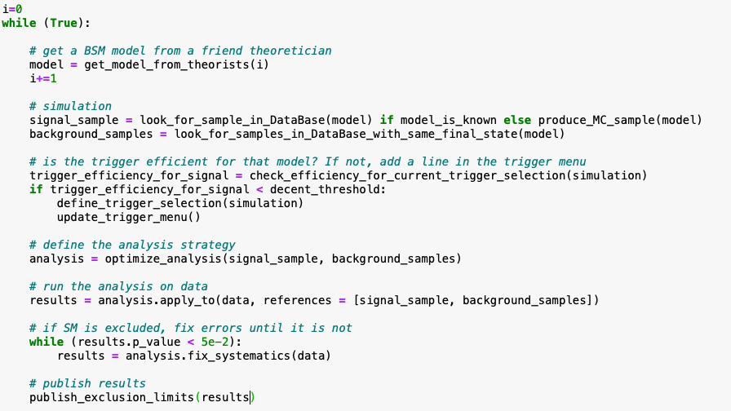
Searching for Alternatives to SM Hypotheses
(ML crucial at each step)

Slide 5
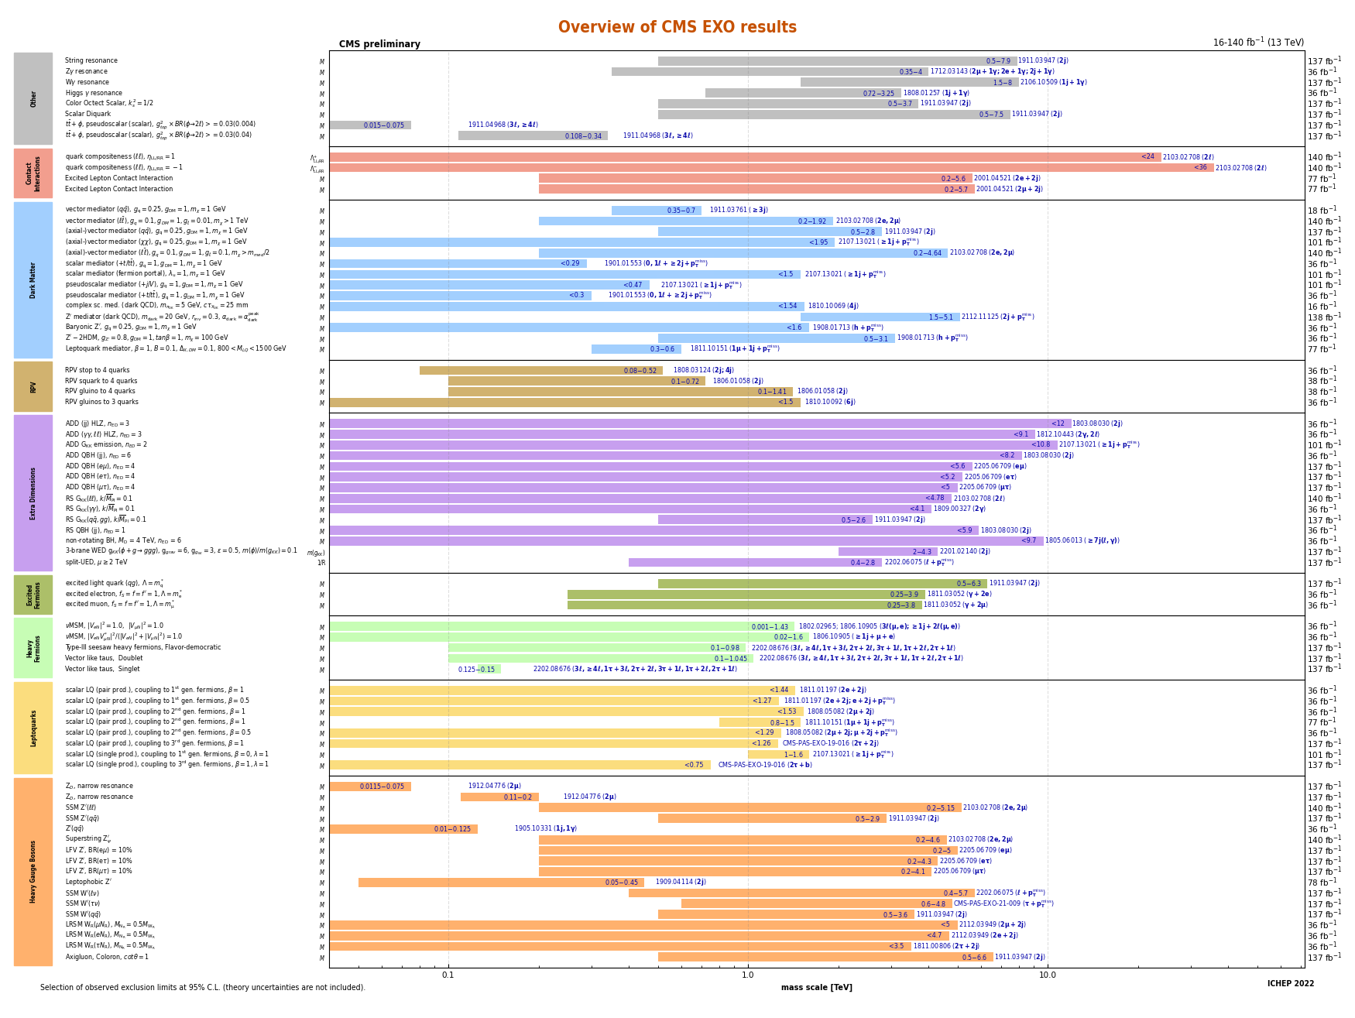
Results of the searches
Full list here

Slide 6
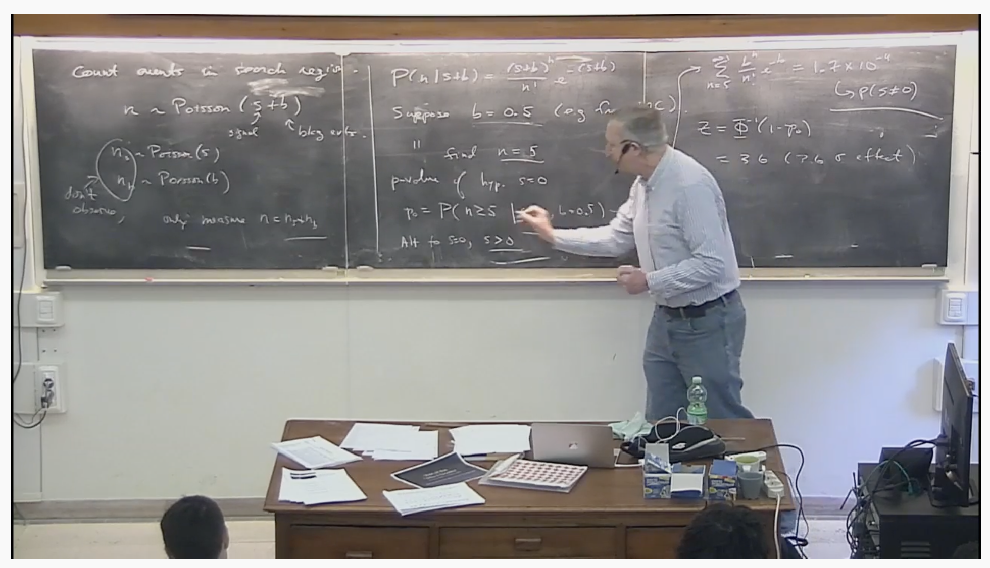
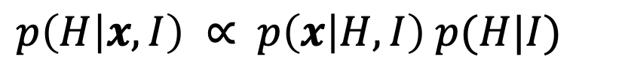
The attitude to answer relevant questions
$p\left(H | x,I\right) ∝$ $p\left(x | H,I\right) p(H|I)$
Our updated opinion about the hypothesis “I”
The measurement
Our subjective opinion on the hypothesis based on auxiliar information “I”
(not necessarily prior in time!)
One goal of this talk is to revise “I” for the next slide’s relevant questions, aiming at an improved p(H|I)
Frequentists use impeccable logic to deal with an issue of no interest to anyone.
Bayesians address the question everyone is interested in, by using assumptions no-one believes
not unanimously believed
check the end of G. Cowen lecture at GGI 2017
L. Lyon (as cited by K. Cranmer)
Notes:
The probability that, assuming the SM, the observe data as discrepant as we found or more so, is blah

Slide 7
The relevant question(s)
Are phenomena not described by the SM being produced at the LHC?
Are there plausible alternative models not tested so far at the LHC?
Could have some new phenomena gone undetected so far?
If the answer to any of those were “yes” there is job to do for us, which requires a new approach (and ML)

Slide 8
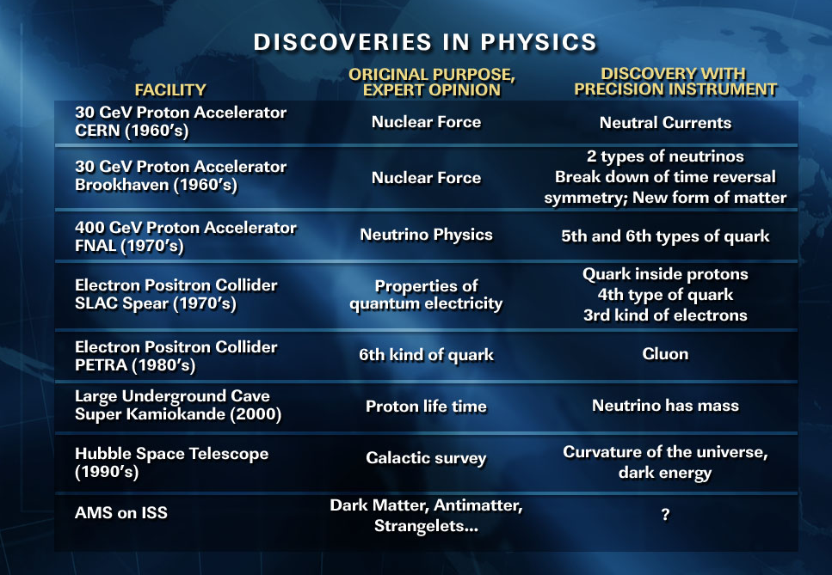
Always aiming at the right thing?
Sam Ting (J)

Slide 9
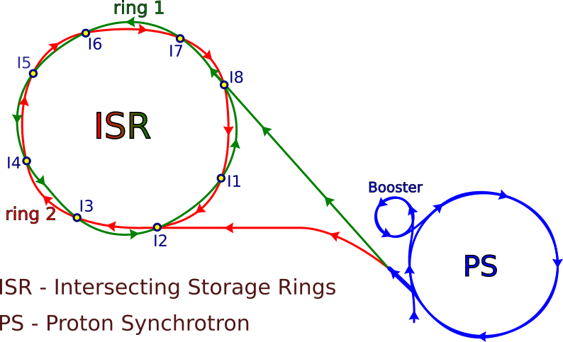
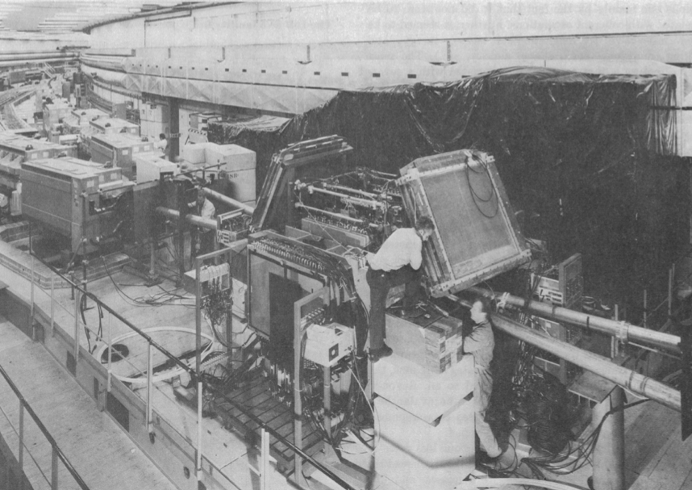
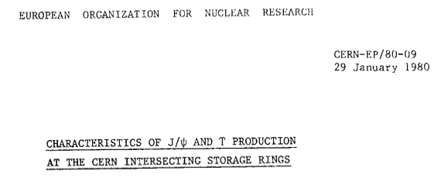
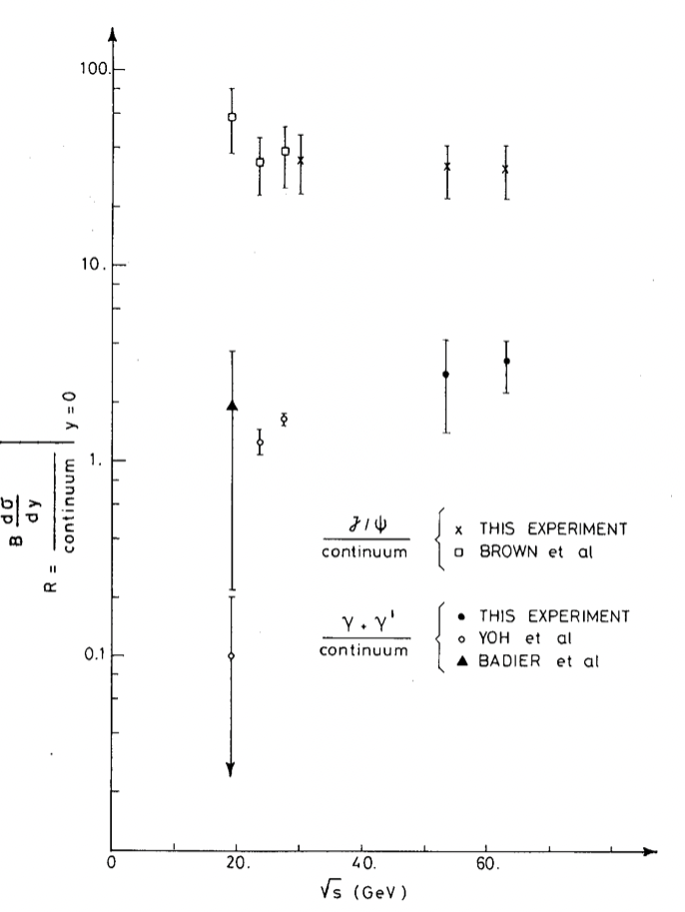
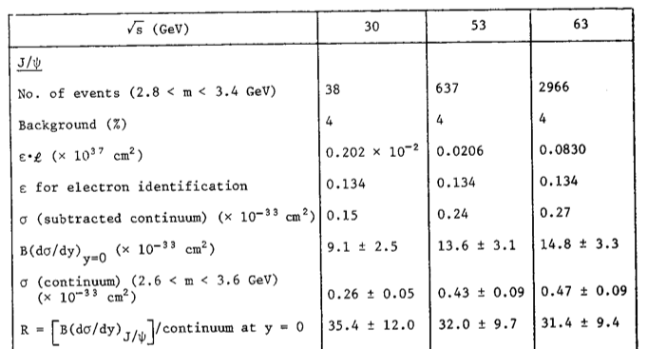
Intersecting Storage Rings
O(1000) J/ψ in 1971!!

Slide 10

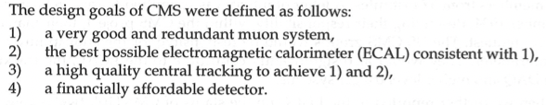
Omnipurpose experiments?
From the CMS Technical Proposal (1994):
Higgs to 4 muons (high mass)
Higgs to 2 photons
(low mass)
Onion-like structure assuming SM particles only in the final state
Hermiticity (4π) to “close the kinematic”, aiming at neutrinos (no mention of Dark Matter)
Trigger&DAQ designed on the basis of the electronics (projected to be) available in those times
Beyond the Higgs, a rather long list of NP model to be sought for

Slide 11
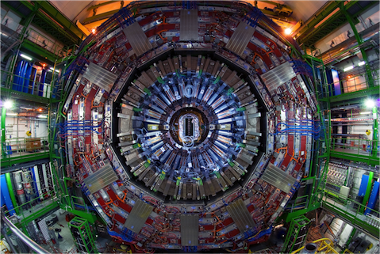
Data Acquisition and Selection
Data Throughput
8x10⁷ Front-End channels
2-5 MB per collision (zero suppression)
40 MHz of collision rate
O(100) TB of data bandwidth (comparable with the internet traffic worldwide in 2018)
Online processing and selection
(beyond the colossal issue of putting together fragments at that rate)
Regarded as not technically possible AND pointless to permanently store the whole data stream
Online reconstruction and selection of 0.002% of the collision data based on assumptions about what is relevant
Notes:
Numeri di CMS

Slide 12
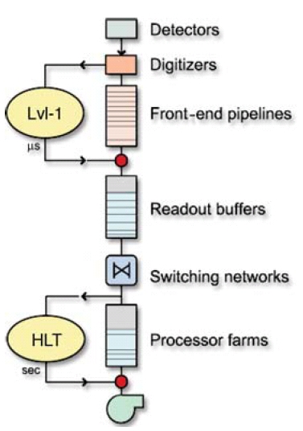
Trigger system
Online selection occurs in two steps:
L1 (40MHz→0.1MHz) and HLT (0.1MHz→ 0.8kHz)
L1
Based on dedicated, much coarser data from Calorimeters and Muon spectrometer
Implemented on custom electronics
~ 3μs available time per event (related to depth of FE buffers)
Poor resolution and identification
HLT
Based on full granularity data, ~offline quality reconstruction
Implemented on commercial computers
~ 200 ms available time per event (related to number of servers available)
A bit less than 1000 selection criteria (paths)!!

Slide 13
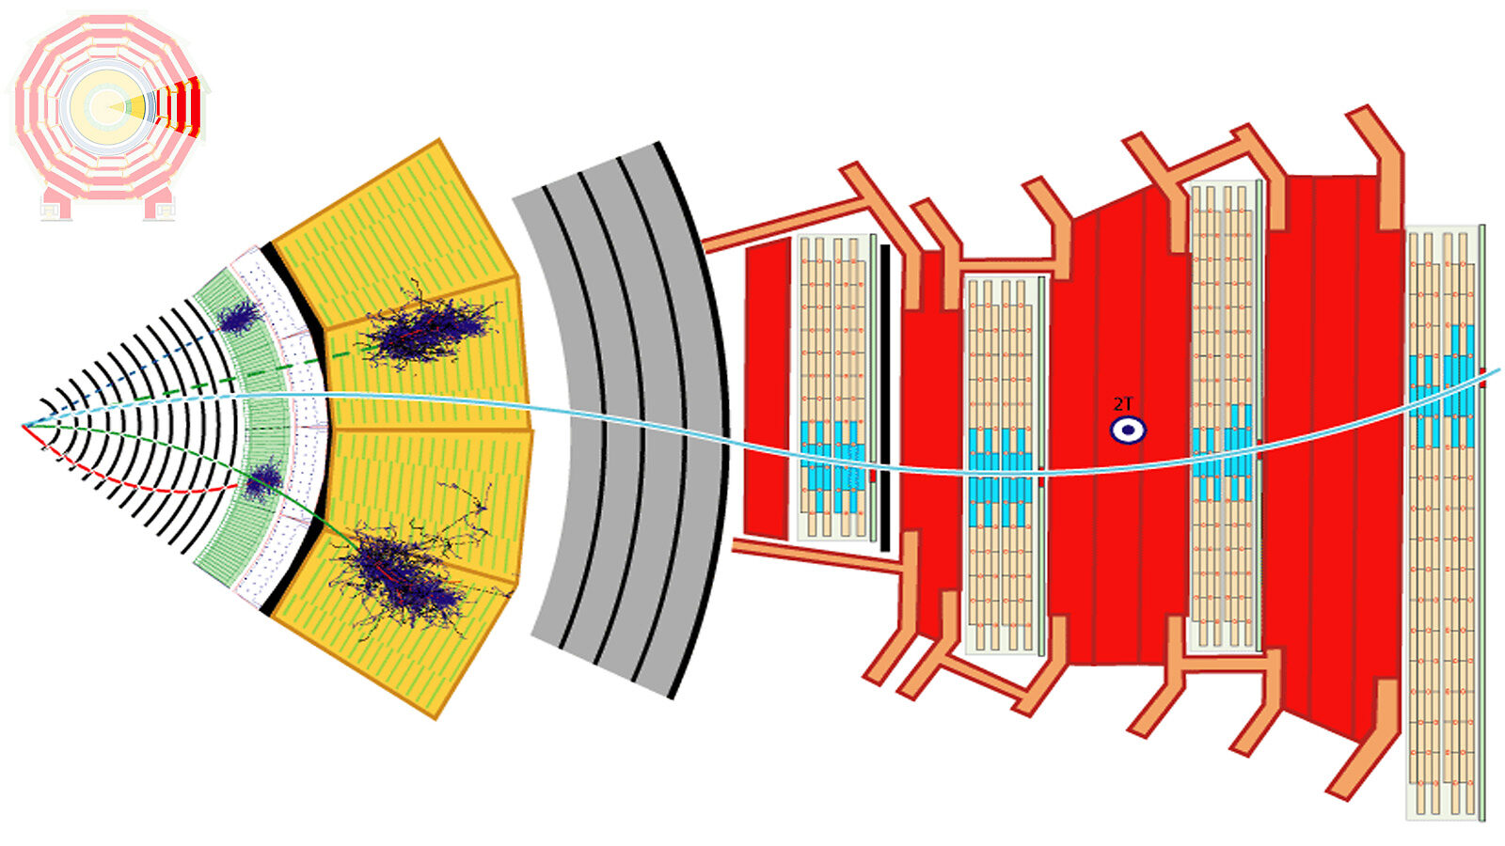

Slide 14
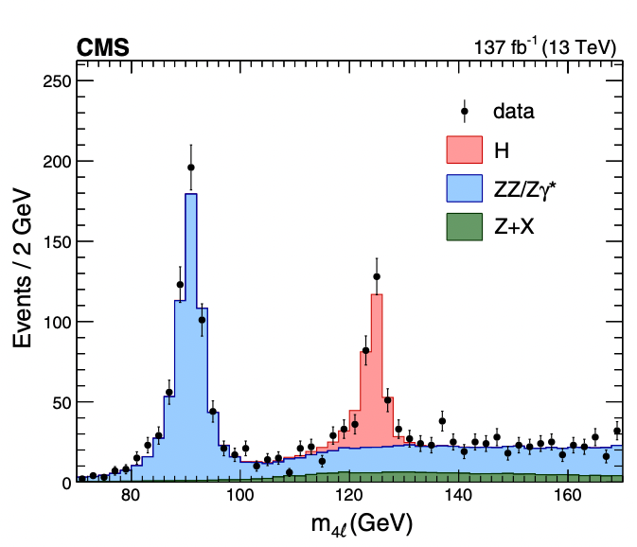
Data compression
Central production of datasets with predefined event-content
RAW
5MB/event
RECO
1MB/event
AOD
0.4MB/event
miniAOD
50kB/event
nanoAOD
1kB/event
Analysis specific
Analysis’ ntuple
<1kB/event
Format of the public data

Slide 15
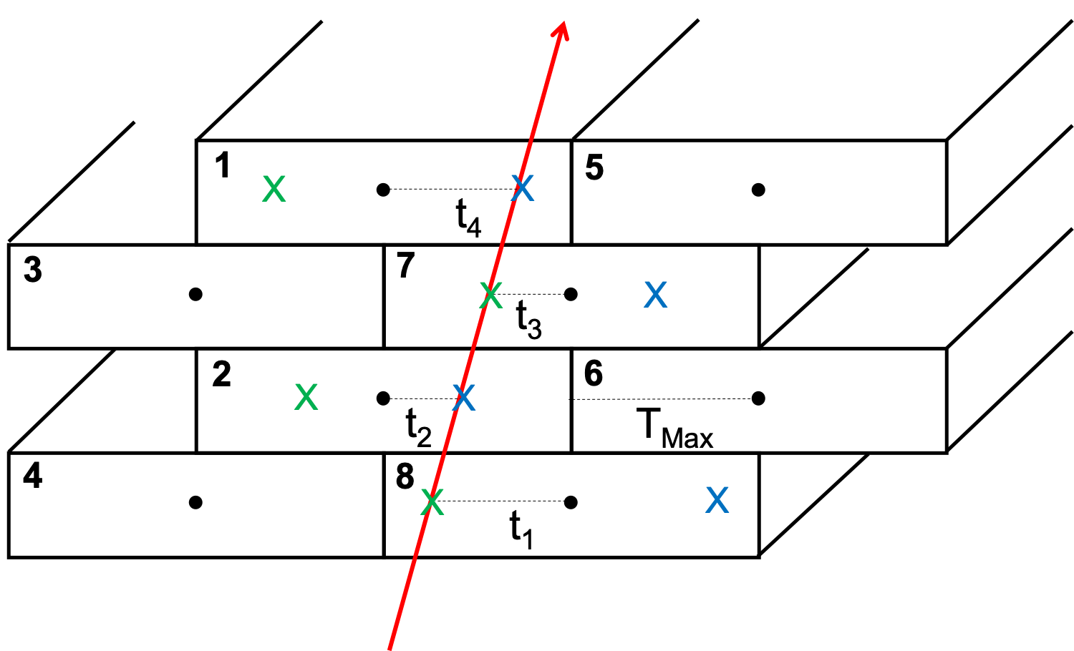
Many assumptions
At reconstruction level
Particles are helixes (bending only in the transverse plane)
Particles’ speed is about c
Only what is instantaneous with the corresponding bunch-crossing belongs to the event
..
At FE/trigger level
The way analog signals get integrated
How zero-suppression is applied
Local trigger “tricks”

Slide 16
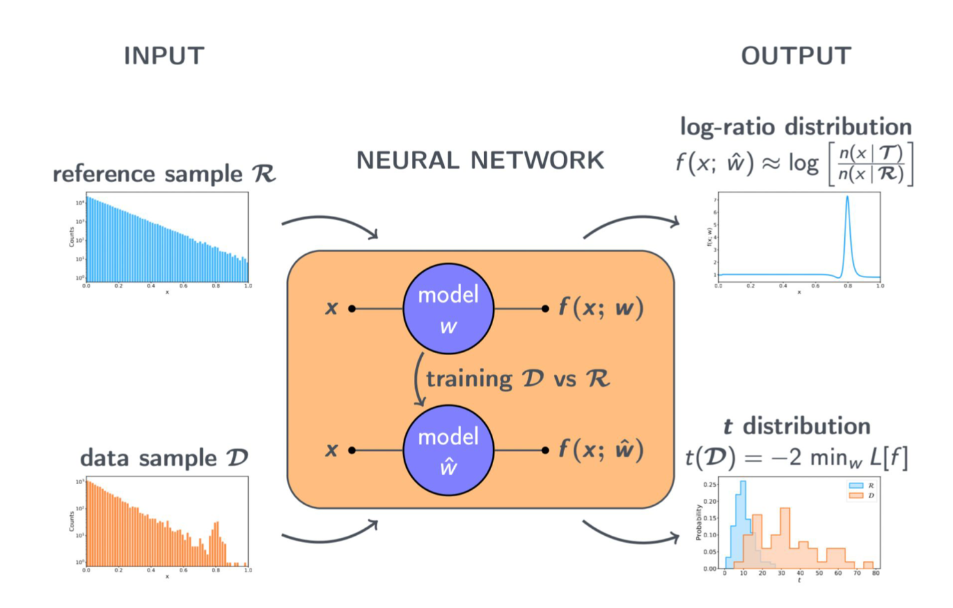
Anomaly Detection
Anomaly detection as a way out of the scheme with H₀ as the SM and H₁ as a theory motivated BSM model
Plethora of subclassification depending on how much one relies on theory for SM or how much empirical are the models being tested
Examples in next talks by G. Grosso and M. Letizia
N.B.: hypotheses are still made!
For a review check e.g. Karagiorgi et al.

Slide 17
Test the anomaly detection power
Can the machine discover (e.g.) the Higgs Boson, if no signal hypothesis is provided?
What kind of input (i.e. how much “domain knowledge”) is needed for such discovery?
  How many variables
  How large the dataset can be
  How sparse the variables could be
How does the machine’s performance compare with the by (physicist) hand search?
Can the machine be run online?
  Single anomalous event? Batches?
  Sufficiently low evaluation time?
Present implementations rather limited in several of these aspects

Slide 18
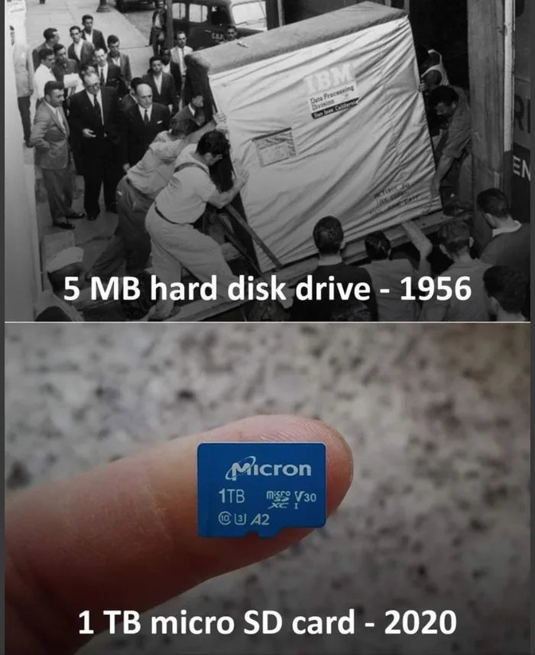
A Data Science Problem?
The long term solution: get the raw data from detector front-ends and feed them to an anomaly detection machine
Dataset would consist of O(10⁷) unlabelled features and O(10¹⁵) data points
Cannot be done now, both technically and algorithmically
Is that really the effective way to proceed?
Our domain knowledge is the most accurate ever gathered, pointless not to partly rely on that
But let’s rush with the technological advancements anyhow!

Slide 19
High-Luminosity LHC
← LHC →
← HL-LHC →
~ factor 2
couple of years of delay

Slide 20
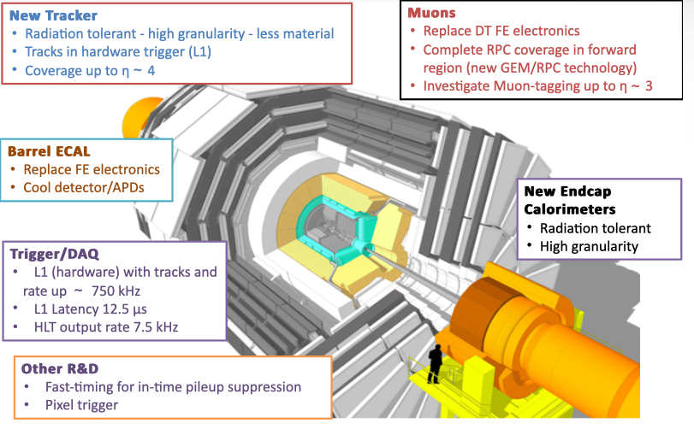
But “New” Experiments!
New, more performant detectors

Slide 21
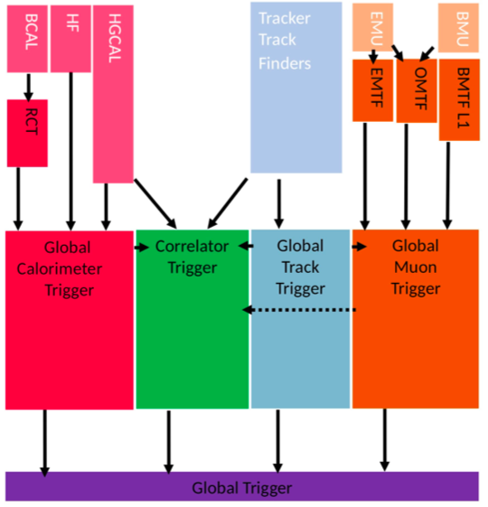
But “New” Experiments!
Re-thought, offline-quality Trigger systems
Deeper buffers, more latency (12 μs)
Advanced object reconstruction in firmware
  Tracker tracks, Vertex finding, high precision calorimetry, Particle Flow
Topological trigger algorithms at higher resolution
  Including invariant/transverse mass cuts
Inter-BX algorithms (up to ±3 bunch crossings)
ML reconstruction and particle ID
Critical task for current and future developments: port advanced ML algos to FPGAs

Slide 22
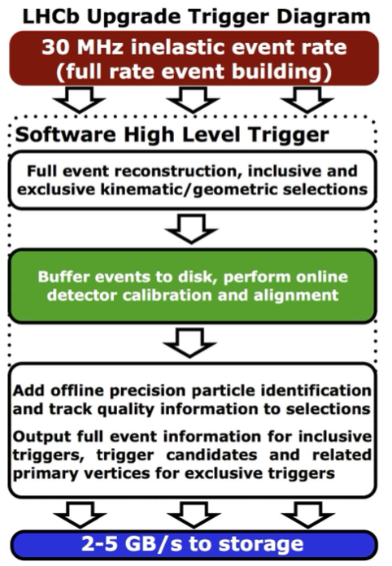
Current Trigger Level analyses
LHCb is already running an online triggerless processing:
but they know exactly what to do (i.e. they don’t question their hypothesis)
In CMS and ATLAS, “Scouting” at HLT level successfully exploited to produce otherwise not achievable physics measurements, e.g.:
Low-mass di-jets
Di-jet resonances in three-jet events
Di-muons

Slide 23
Triggerless analysis facility

Slide 24
Triggerless analysis facility
Trigger data from spare outputs of L1T boards
FPGAs (either on ATCA creates or on servers’ PCIe bus) receive and process trigger data (object candidates)
  Zero-suppression, local pre-processing (e.g. re-calibration using ML) in FPGA
  Data transmission to I/O nodes via TCP/IP
I/O nodes
  CPU, GPU, other accelerators
  Use distributed algorithms to extract features while data are buffered in the short-term memory
  Interesting features and/or full “events” (multi-bx possible) streamed over interconnect to processing farm
Distributed global stream processing and storage into “feature DB”
  Organizes features in “searchable” data structures for medium term storage
Analysis by query, analysis results to permanent storage
Under test already now!

Slide 25
Triggerless analysis facility
The whole processing pipeline requires advanced solutions
Commercial big-data tools become critical in the process, exploiting developments of other fields
especially if ML algorithms have to be deployed
M. Migliorini et al.

Slide 26
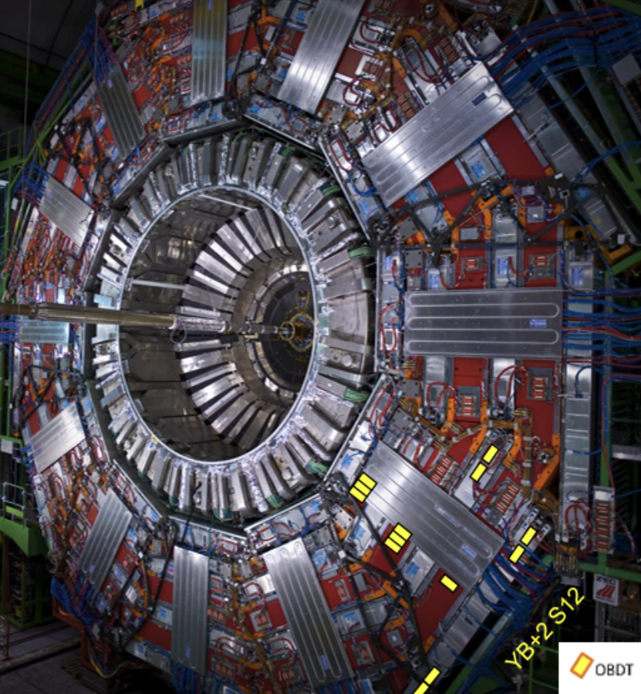
Even before in the data chain?
A sector of the muon spectrometer is equipped with HL-LHC electronics
I.e. offline quality information is achievable
Data is gathered continuously w/o a trigger
The same event statistics of the whole “Zero-Bias” dataset is integrated in a couple of minutes
Weird things observed that need careful studies..
Plan is to equip more sectors during the ongoing LHC run and the whole spectrometer at HL-LHC
Findings from this system may lead to enlarge the number of subdetectors read-out (also) triggerlessly

Slide 27
Take-home message and next steps
Even after all the null tests conducted so far, new, unexpected Physics may still be there to find at LHC
Many assumptions may be limiting our sensitivity. It is necessary to profit from all the current (and future) tech and scientific developments to move ahead w.r.t a 30 years old scheme
The HL-LHC detectors upgrades represent an opportunity worth exploiting, especially their triggerless analysis facilities
To-do list
Experimentalists and theorists sit together to think about which hypotheses can be lifted and what that implies experimentally
Work hard to improve the performance and scope of Anomaly Detection algorithms
Learn to program in VHDL (or at least HLS)

Slide 28
Courtesy of G. Grosso

Slide 29
Courtesy of G. Grosso

