Slide 1




GAMMA:
Struttura nucleare usando spettroscopia γ

Slide 2
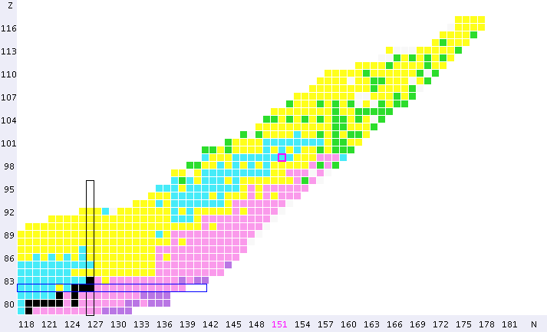
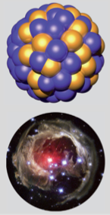
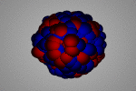
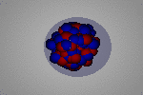
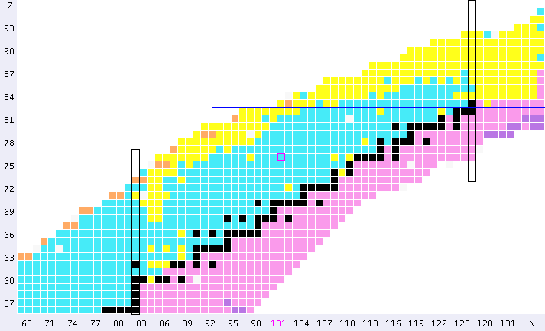
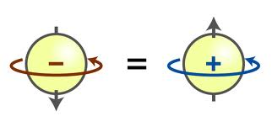
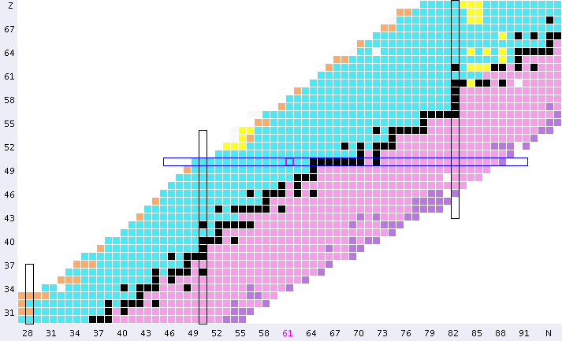
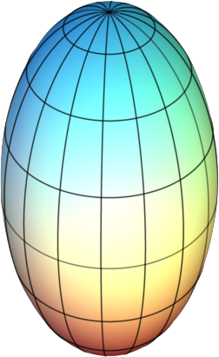
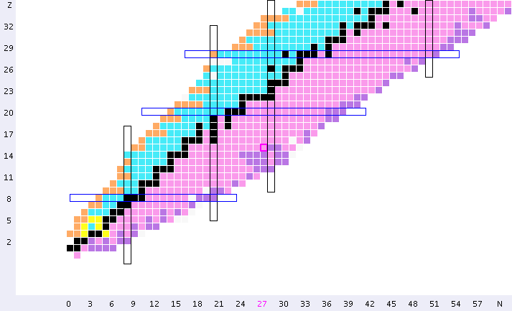
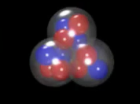
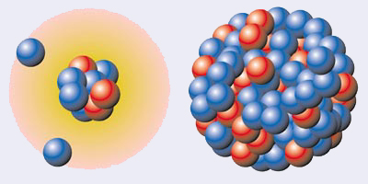
GAMMA: Struttura nucleare con spettroscopia γ
BASIC SCIENCE
THE CHALLENGE:
a UNIFIED Description of ALL Nuclei in the Universe
Many Body Quantum System
248 Stable
DIPOLE
n
p
Symmetry
Principle
Neutron SKIN OSCILLATION
82
²⁰⁸Pb
SHELL Structure
Magic Numbers
Excitations
126
Effective
Nuclear Force
126
Proton number Z
¹⁰⁰Sn
¹³²Sn
50
82
82
> 7000 estimated
to exist in the Universe
28
⁷⁸Ni
Shapes
⁴⁸Ca
50
20
50
Clusters
8
¹⁶O
28
20
28
2
20
Halos
Neutron number N
2
8

Slide 3
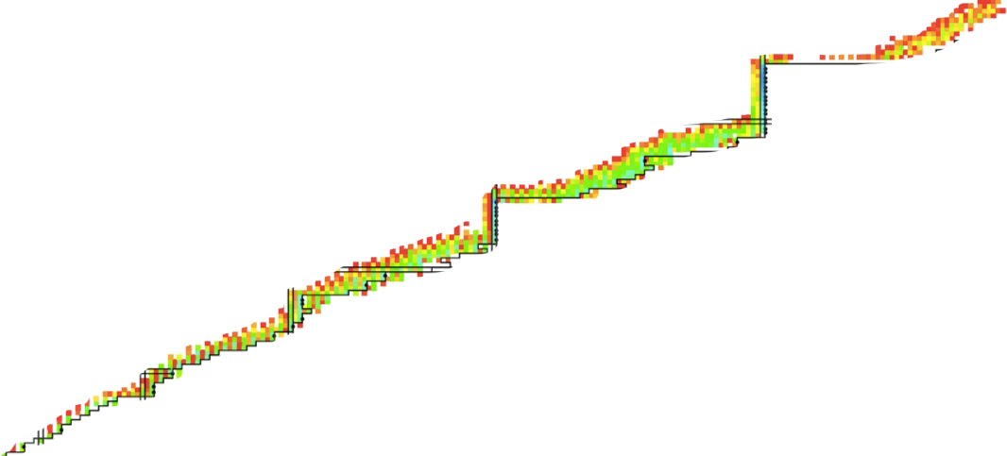
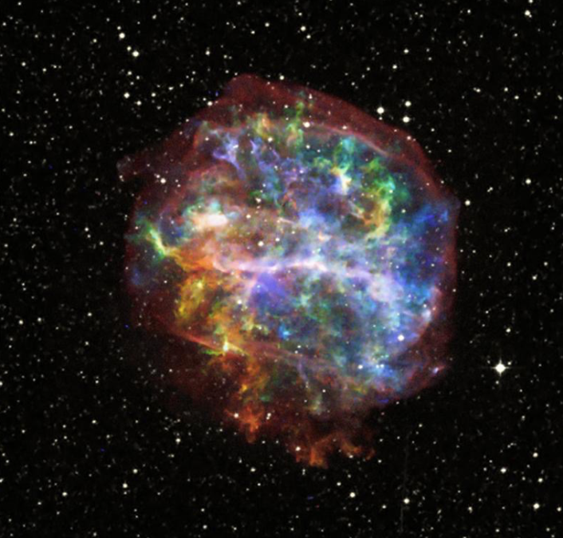
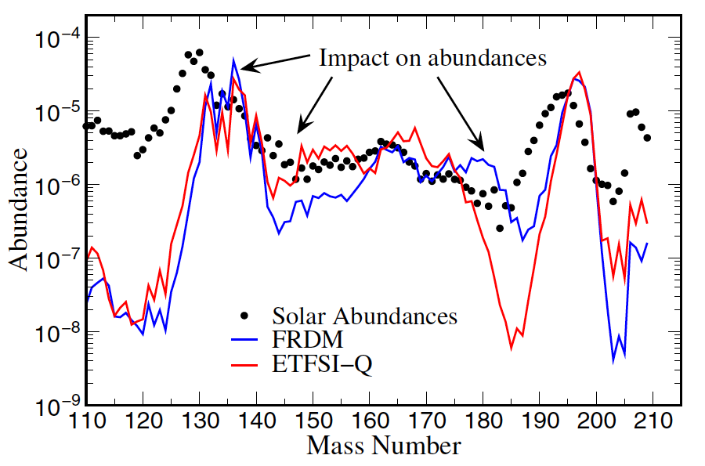
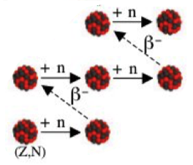
GAMMA: Struttura nucleare con spettroscopia γ
STRONG Interdisciplinary with ... ASTROPHYSICS
… in STAR explosions
248 Stable
82
126
126
Proton number Z
Rapid Capture
of FREE Neutrons
50
82
82
β-decay towards
stable Isotopes
28
50
50
20
8
28
2
20
Neutron number N
2
8

Slide 4

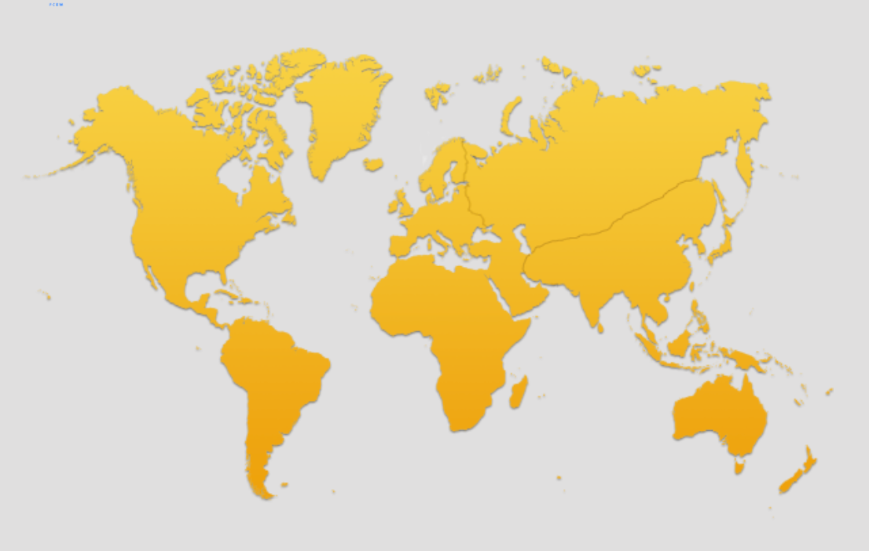
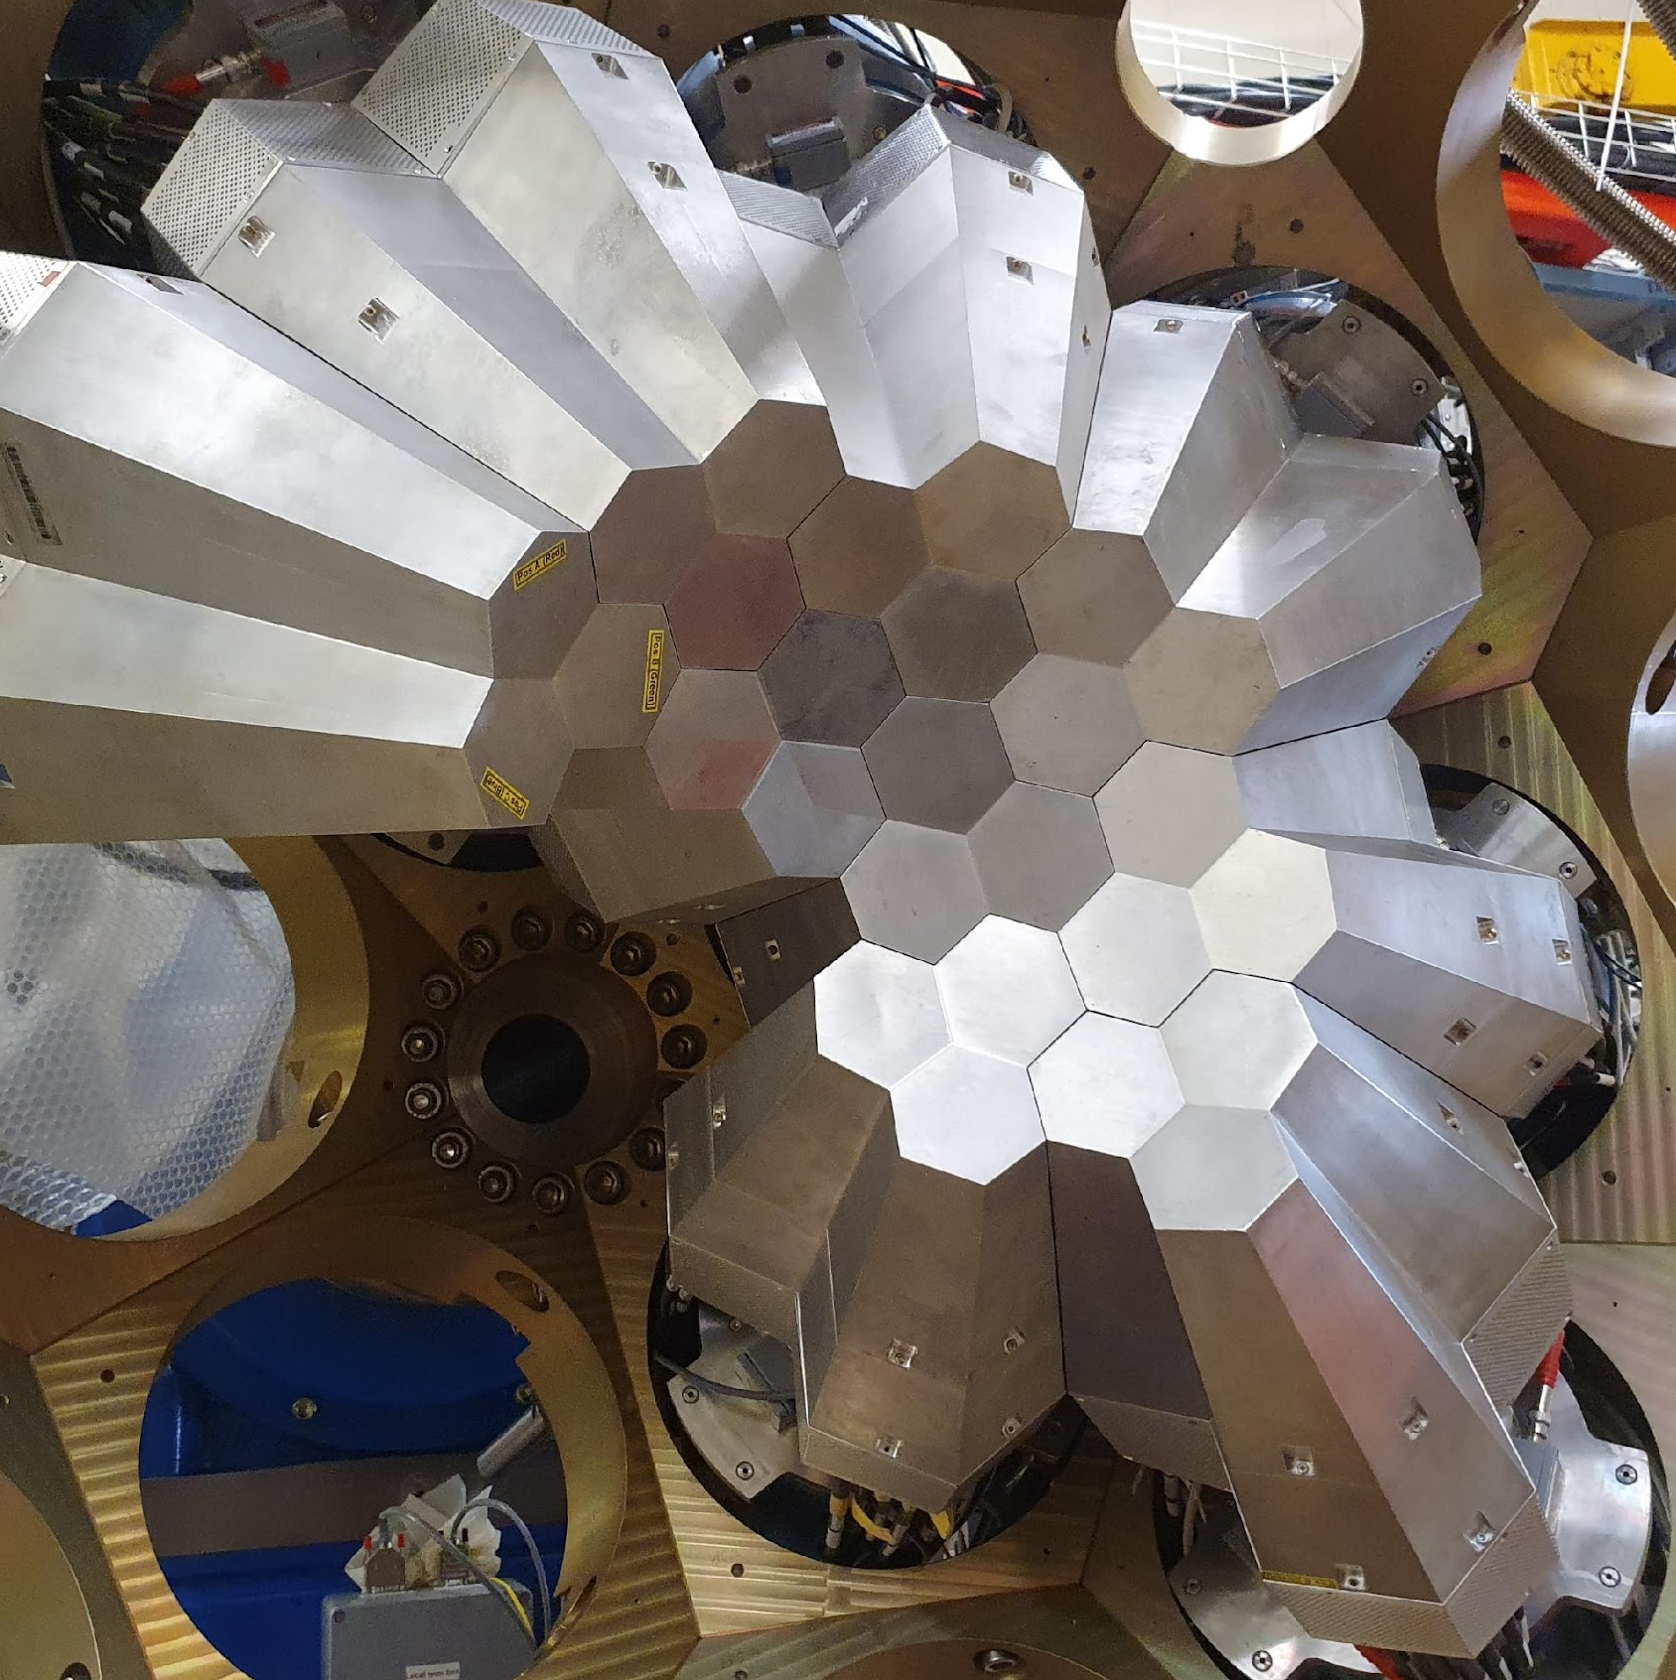

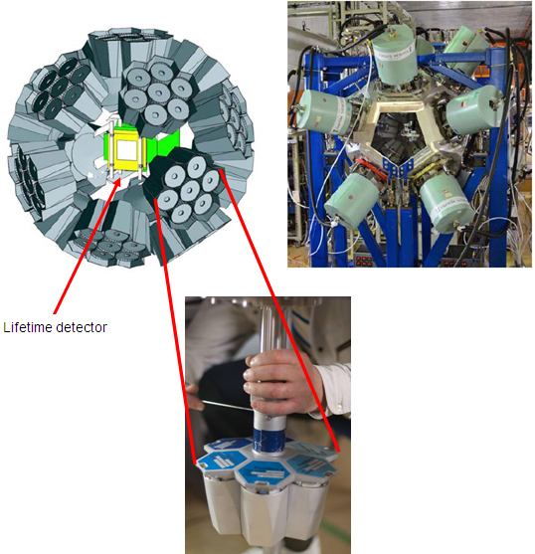
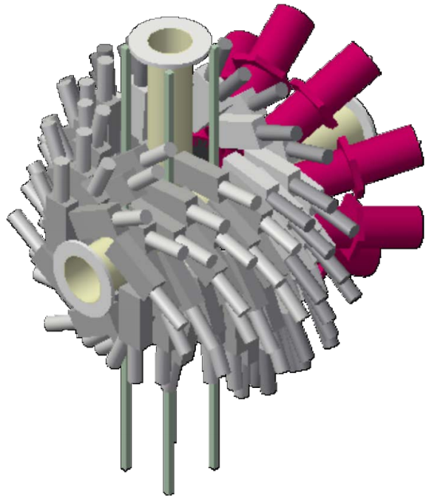

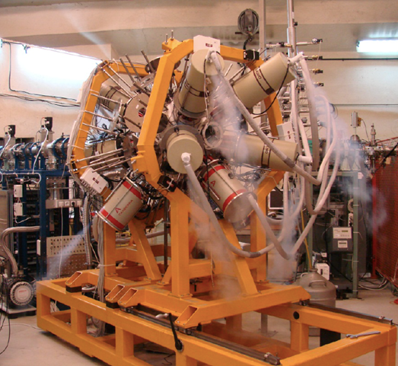



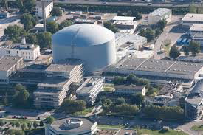
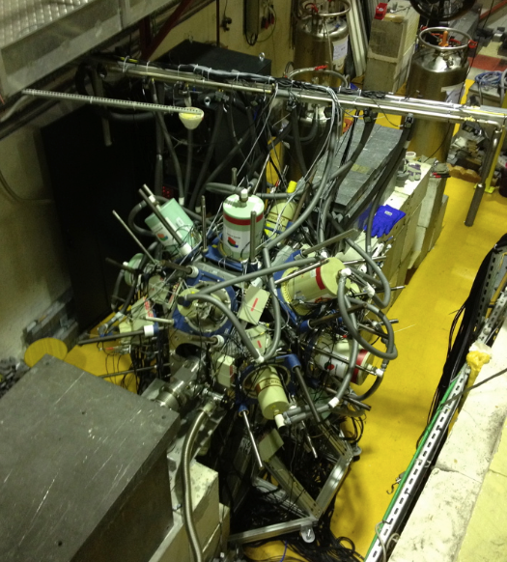

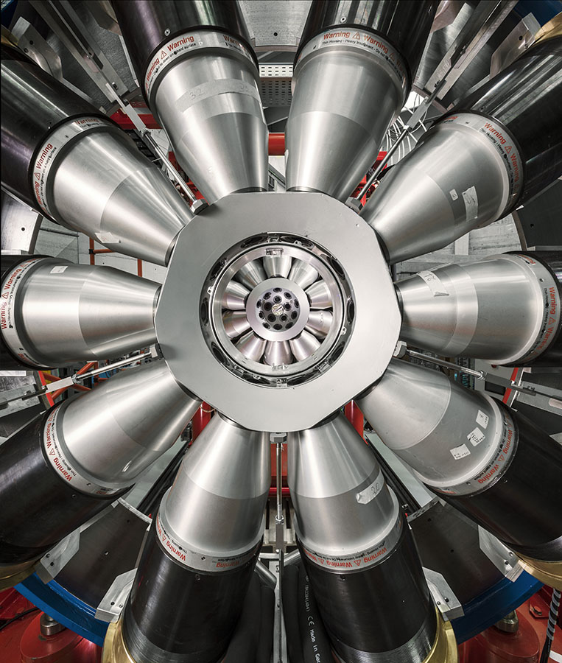


GAMMA: Struttura nucleare con spettroscopia γ
CAMPAGNE SPERIMENTALI COMPLEMENTARI
FASCI (stabili, radioattivi, neutroni) e APPARATI allo stato dell’arte, …
MARA
Separator
DUBNA
Oslo
JYFL
GANIL
Krakow
GSI
Orsay
Legnaro
ROSPHERE
ILL
ISOLDE
CERN
OSAKA
Bucharest
RIKEN
USA/CANADA
EXILL/FIPPS
LNS
TRIUMF
GALILEO Array at LNL
Working horse for

Slide 5
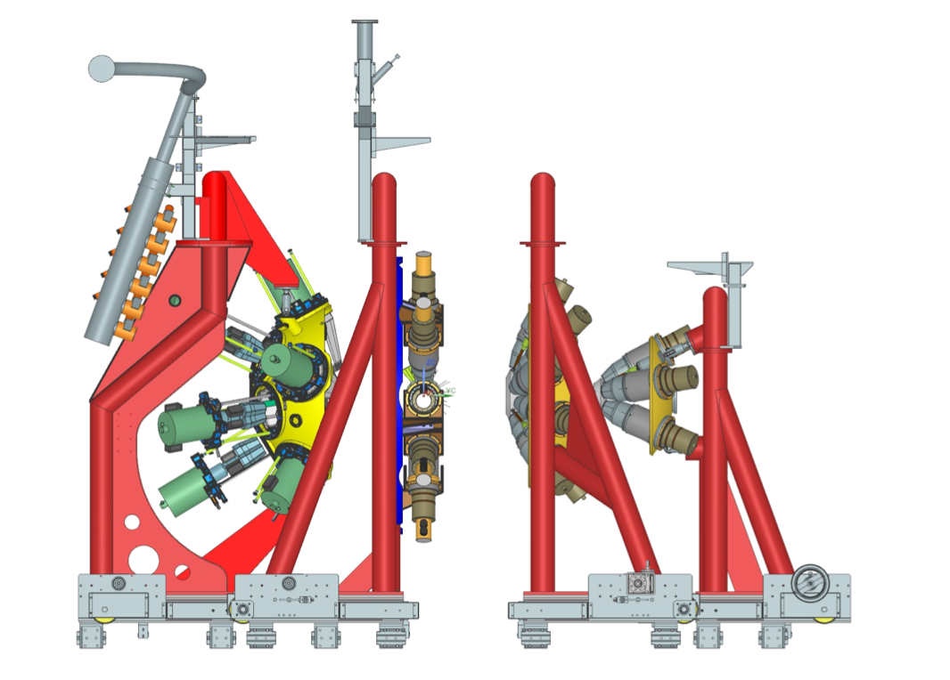
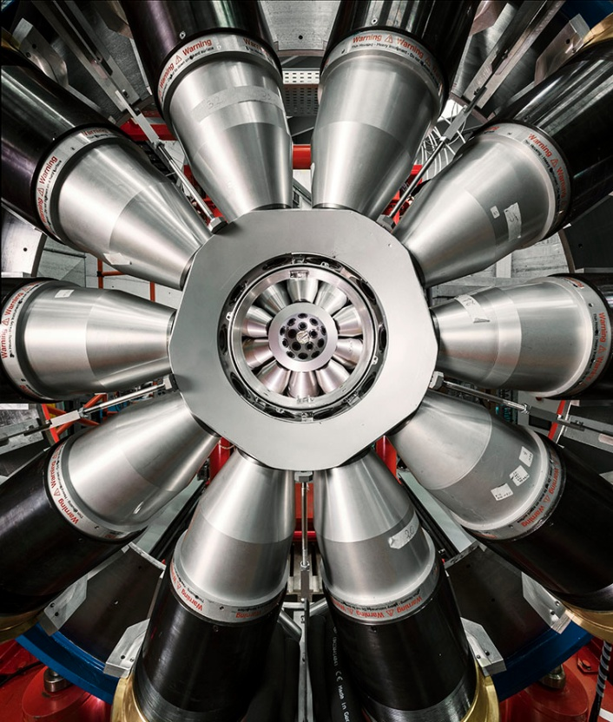
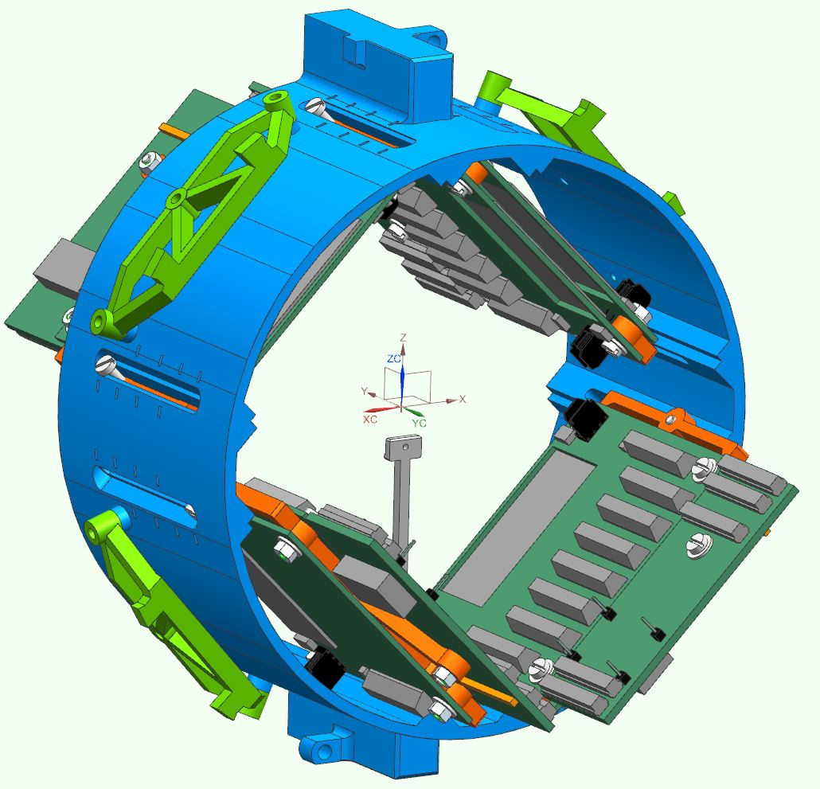
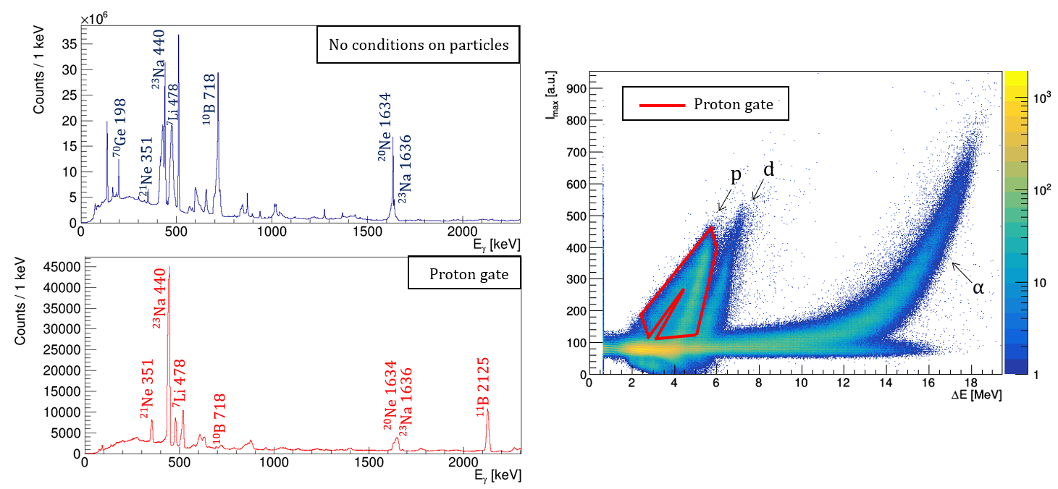
Highlights and flagship for GAMMA-Milano:
GALILEO, resident γ array @ LNL
Sez. Milano contributed to mechanics (2014-2019):
- Scattering chamber
remote handling target system
Holding structure for ancillary detectors
Electronics:
Pre-amplifiers by A.Pullia
Integrated ASIC preamplifiers for GAL-TRACE by S. Capra, A. Pullia
➔ development for AGATA with S.Brambilla and C.Boiano
⁶Li(⁶Li,p)¹¹B (S. Ziliani et al., Milano)
γ-decay from near-threshold resonance in light p-shell
GAL-TRACE to detect the proton at forward angles
(preparatory exp. for AGATA with stable beams)
Performed in Feb. 2021
large Remote participation

Slide 6
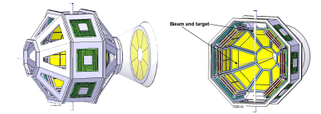
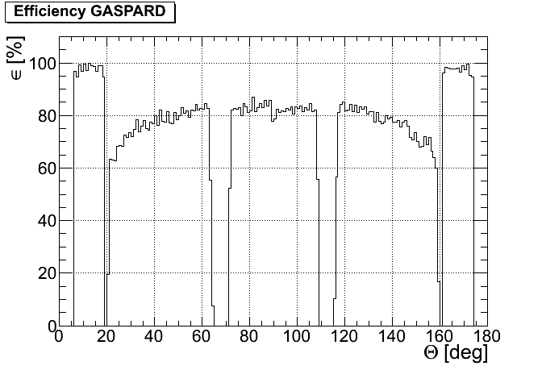
GRIT
State-of-the-art light particle detection setup
GAL-TRACE:
Part of a larger state-of-the-art light charged particle detector array based on Si telescopes with digital readout
- E-DE and PSA techniques
Development of pre-amplifiers by C.Boiano, S.Capra, A.Pullia, S.Brambilla
GRIT
Management Board : M.Assié(IJCLab), D.Beaumel (IJCLab), D.Mengoni (INFN, Padova), A.Pullia (INFN Milano)
Steering Committee : Y.Blumenfeld (IJCLab), G.de France (GANIL), W.Catford (Univ. of Surrey), G.De Angelis (LNL), S.Leoni (INFN, Milano, Italy), A. Shrivastava (BARC, India)
θ [deg]
D. Mengoni et al., TDR June 2018
LOIs @ GANIL SPIRAL1, LISE and SPES
GRIT MOU (2020-2024) Signed INFN: 74 kE/y

Slide 7
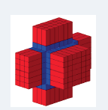

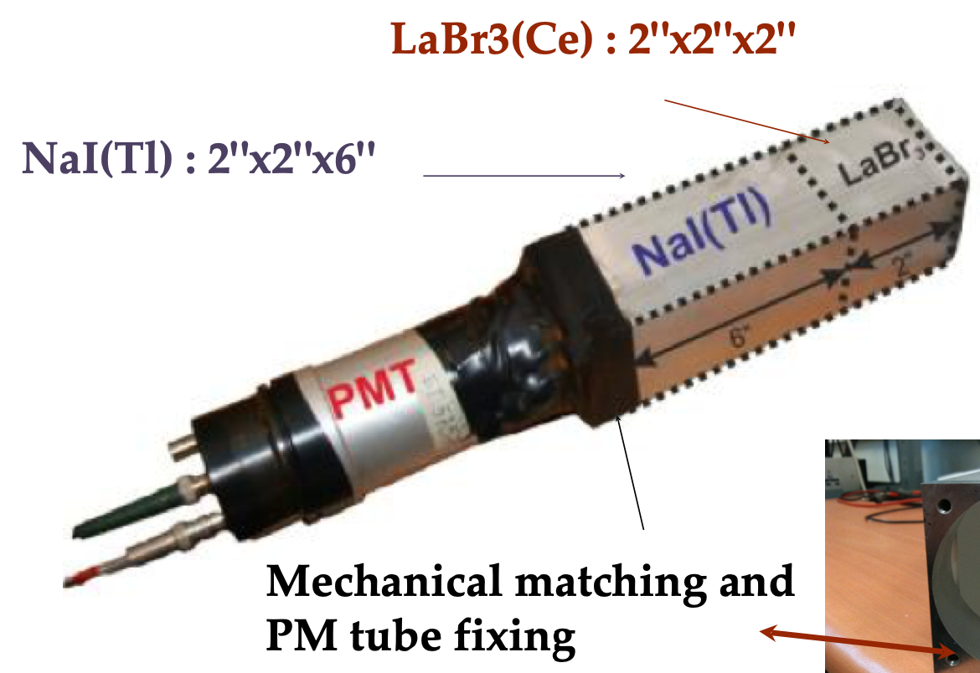
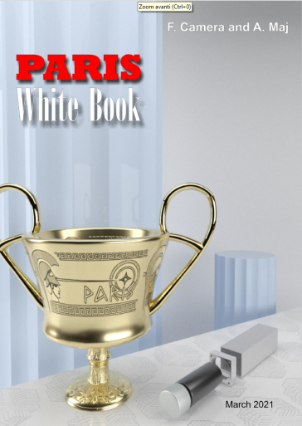
Highlights and flagship for GAMMA-Milano:
PARIS and high-energy detectors
Steering Committee
- Marek Lewitowicz (Chair)
- Member: Angela Bracco
Management Board
Adam Maj (Chair)
Member: Sergio Brambilla (electronic working group)
Collaboration Council
Chair: Franco Camera
‘PARIS White-Book’ completed in 2021
https://rifj.ifj.edu.pl/handle/item/333?locale-attribute=en
Introduction (PARIS performances)
PARIS at GANIL, IJC, LNL, TIFR, GSI, JINR
The path towards a minicube
MOU is expired in 2020, New MOU finalised and being signed
In 2022: GANIL Campaign (first half 2022)
IJC (ALTO) Campaign (second half 2022)

Slide 8

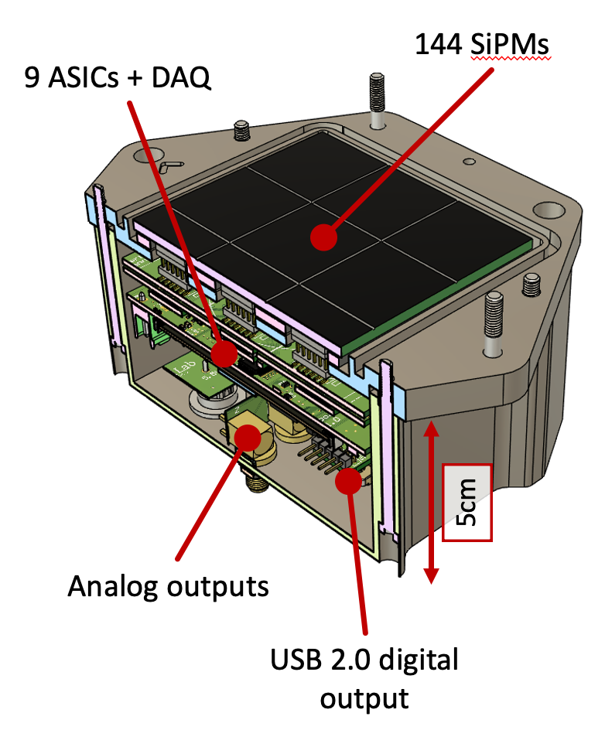
Carlo Fiorini (POLIMI)
Franco Camera (UNIMI/INFN-MI)
Development of SiPMs-based readout for large LaBr₃ scintillators
Full-scale range of 40 MeV (lowest ASIC gain)
< 3% resolution at 662 keV (highest ASIC gain)
state-of-the-art: similar performance of PMT
4 PREMI internazionali
interesse da altre collaborazioni
PMT
15-20 cm
SiPM
5 cm
Scintillator
9x16-ch GAMMA ASICs for a total of 144 readout channels
Each SiPM is read by an ASIC channel (no merging)
FPGA-based data processing and acquisition system
Temperature gain drift compensation
USB 2.0 communication for both control and data transfer
Analog outputs (trigger, signal amplitude, interaction position)
Sez. Milano contributes to realisation of detectors’ and SiPMs’ cases ➔new elements to be produced

Slide 9
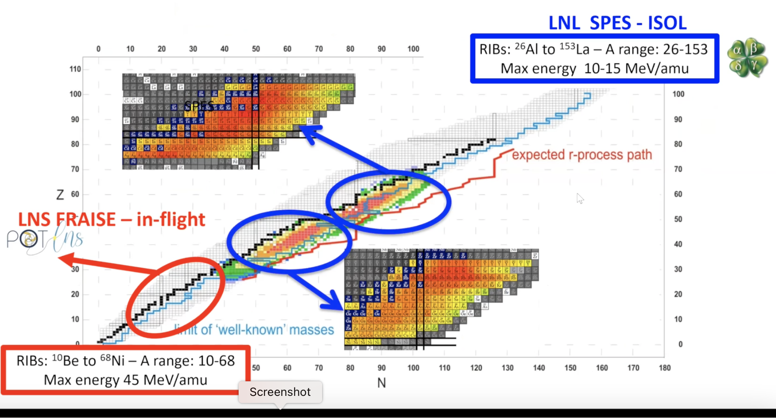
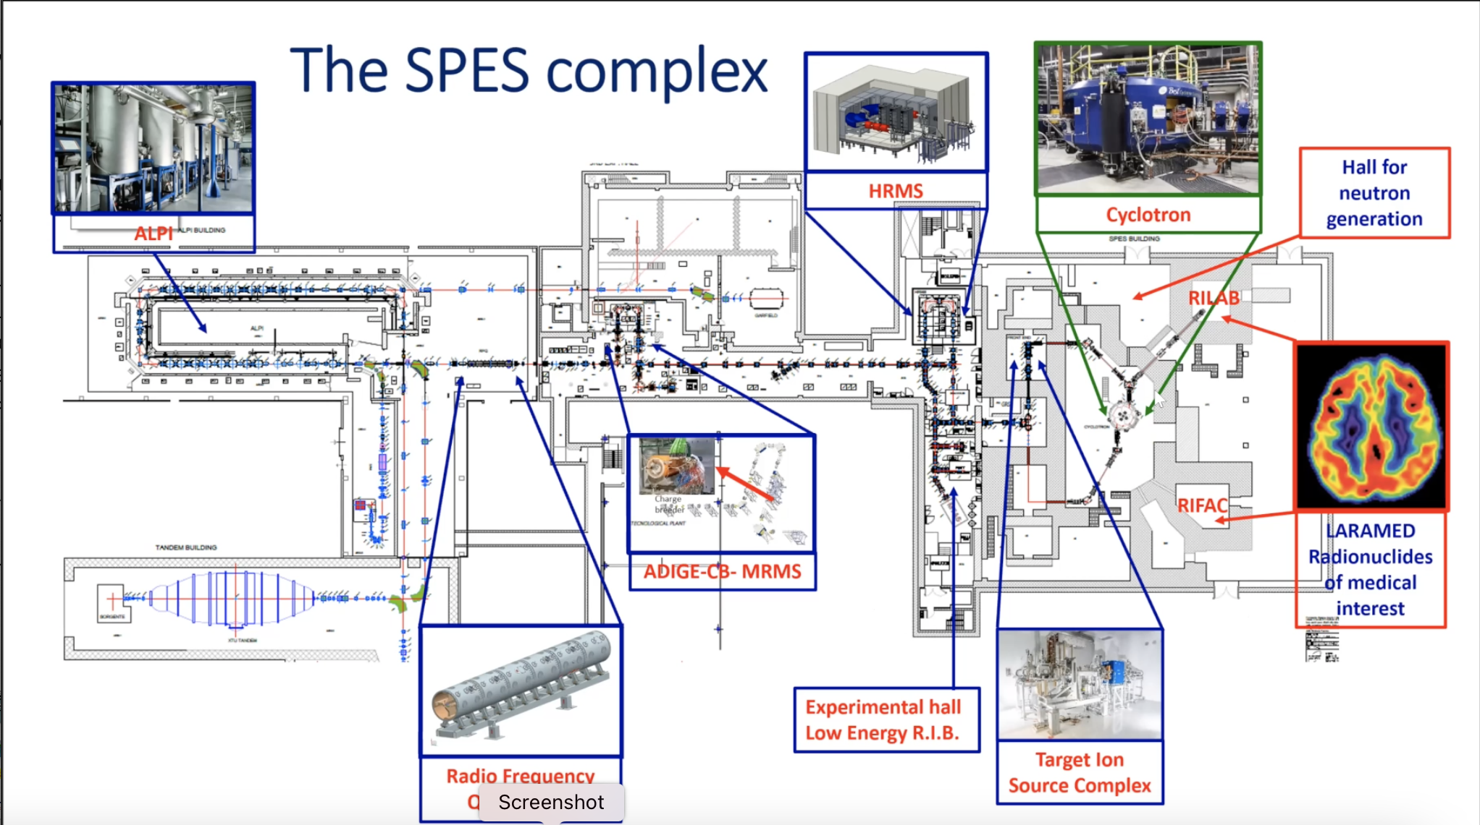
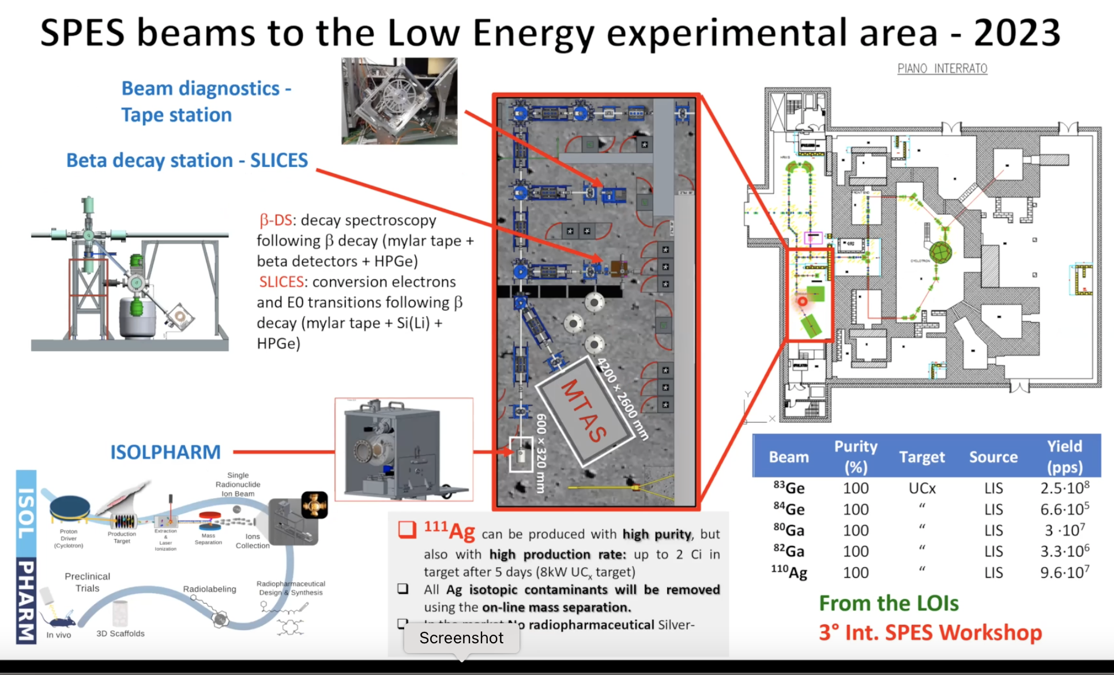
Facility per la produzione di fascio radioattivi basata su metodo ISOL

Slide 10
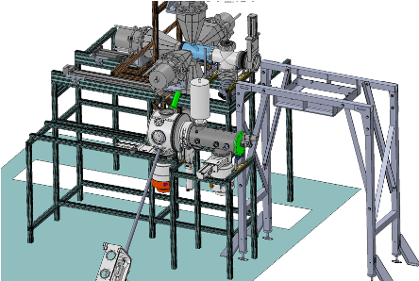
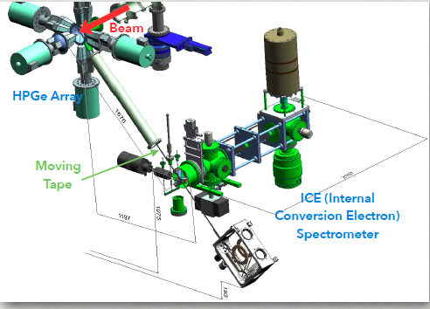
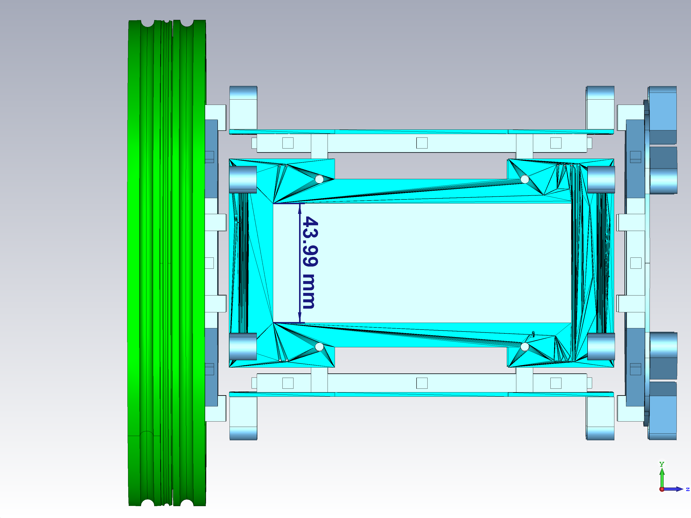
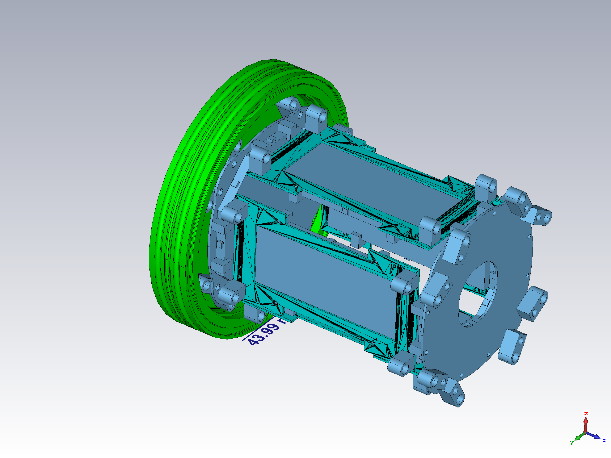
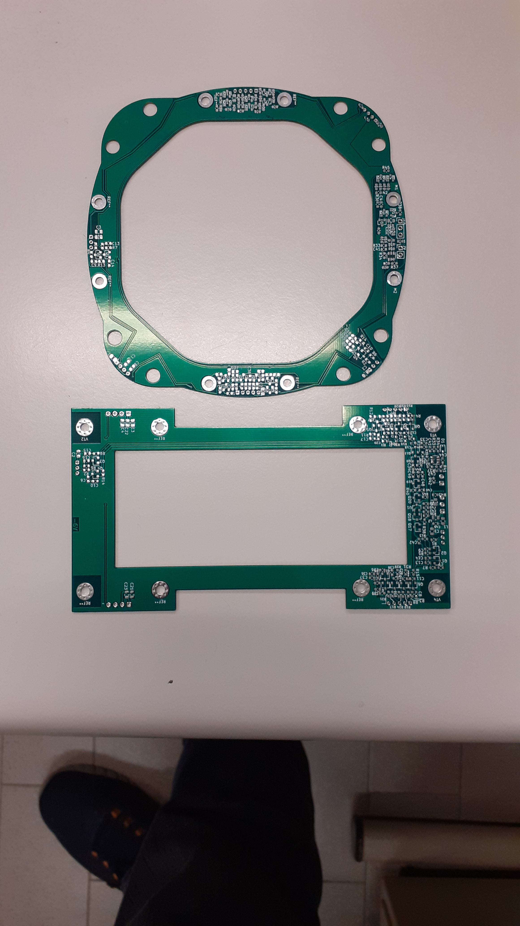
Highlights and flagship for GAMMA-Milano:
BETA TAPE DECAY STATION ed ELECTRON CONVERSION SETUP (@SPES-1+)
Punto Misura
Gamma e beta
Struttura di
sostegno progettata
ordini a breve
(2) Rivelatori da Installare:
Plastici e HPGE
Sez. Milano contributed to mechanics (2018) for the tape cassette
Holding structure designed at INFN-Fi
Electronics and Read-out:
PCB boards for SiPM readout of Plastic by C.Boiano
Implementation of signals from HPGe and Plastics into digital DAQ system S.Brambilla
Help to produce small mechanical holding elements foreseen
PRIMI FASCI SPES@LNL
2023

Slide 11
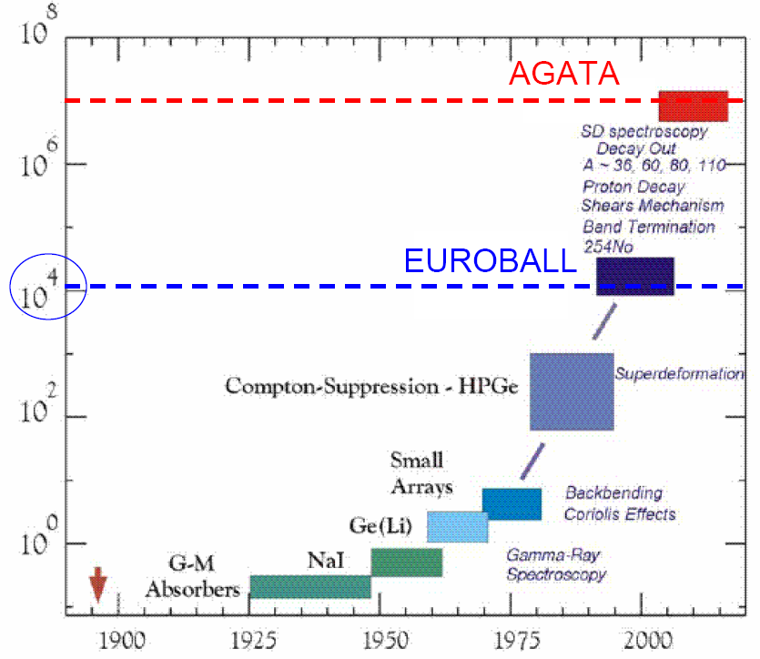
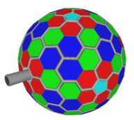
Highlights and flagship for GAMMA-Milano:
AGATA, γ-ray tracking array
Increase in sensitivity
for gamma-arrays
over the years
AGATA
the “Ultimate” Ge Array
EFFICIENCY:
43% M_{γ} = 1 and 28% Mγ = 30 (@ 1 MeV, FULL BALL)
COUNT RATE capabilities (100s KHz)
ANGULAR RESOLUTION
of the γ interaction point (θ~1º)
“PERFECT” DOPPLER CORRECTION
(6 keV @ 1 MeV, β=50%)

Slide 12
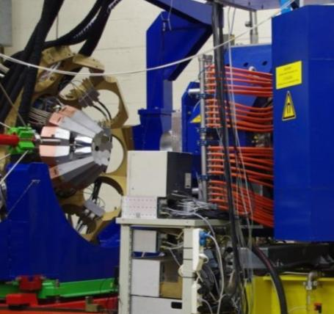
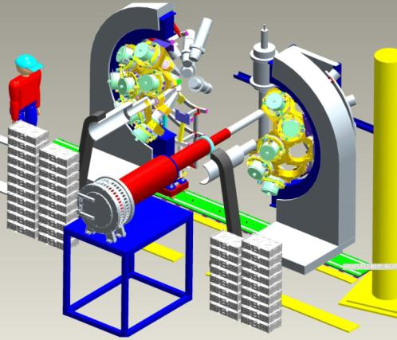
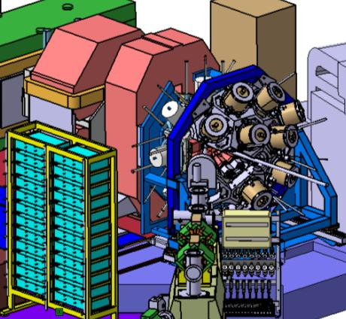
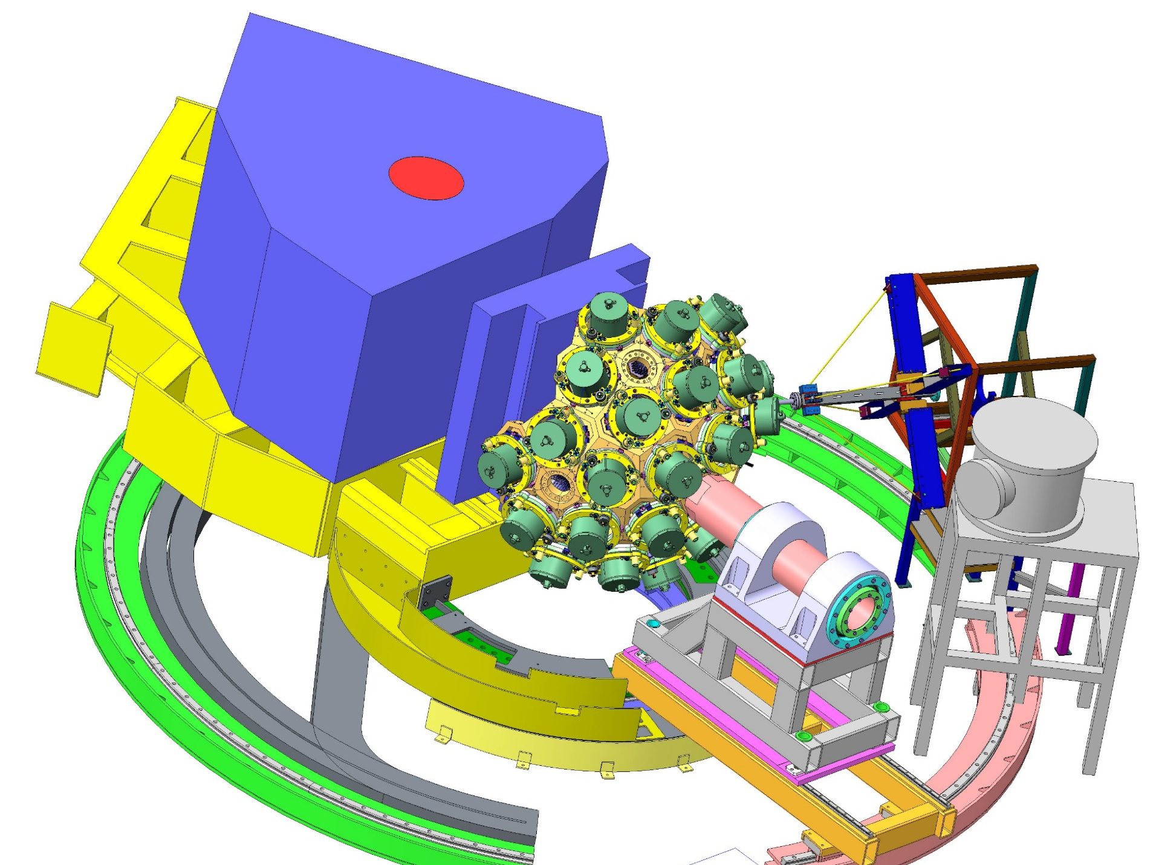
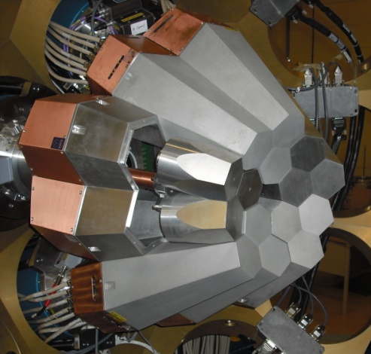
The AGATA Evolution Towards 2π
LNL
2009
9 crystals
Eff. ~3.5%
MAJOR UPGRADE
Ready for 4π
LNL: 2010-2011
15 crystals
Total Eff. ~6%
GSI: 2012-2014
22 crystals
Total Eff.~10%
GANIL: 2015 - 2021
up to 45 crystals
Total Eff. ~22%
LNL: 2022- 2025
up to 90 crystals (2π)
AGATA + PRISMA
“backward”
STABLE
BEAMS
20 experiments
AGATA + Hector⁺ + FRS
“forward”
RELATIVISTIC
EXOTIC BEAMS
7 experiments
AGATA+VAMOS+ …
AGATA+NEDA+...
AGATA+PARIS+...
STABLE BEAMS &
EXOTIC (ISOL)
30 experiments
AGATA+MUGAST in 2019-2021
AGATA+VAMOS in 2021
AGATA+PRISMA+ …
AGATA+NEDA+...
AGATA+PARIS+...
AGATA+MUGAST+...
STABLE BEAMS &
SPES BEAMS
AGATA “Demonstrator”

Slide 13
AGATA Management Board and Teams
AGATA Steering Committee Italian Members: A. Bracco, G. De Angelis → A. Bracco next CHAIR (April 22)
AGATA Collaboration Council Italian Members: S. Leoni (CHAIR), S. Lenzi, B. Million, A. Nannini, D. Napoli
Gadea (Project Manager), A. Boston, B. Million, A. Korichi, F. Recchia, H.Hess,
J. Simpson (ASC) and S. Leoni (ACC), J. Gerl (LCM-GSI), E. Clement (LCM-GANIL)
AGATA Working Groups
AGATA Teams
Detector
Module
H.Hess
Detector &
Cryostat
(tbd)
Detector
CAT &Testing
H. Boston
R & D on gamma
Detectors &
Applications
AMB Chairman
Project Manager
A.Gadea
Front-end
Electronics
A. Gadea
Pre-Amplifier
Digitizer
A. Pullia
Global Trigger &
Synchronization
M. Bellato
Pre-processing
I. Lazarus
Data
Processing
A.Korichi
Hard/Software DAQ Support
G. Lalaire
Slow Control
& FEE Monitoring
E. Legay
Data Analysis
& Tracking
O. Stezowski
A. Lopez-Martens
Data distribution and re-processing F.Crespi
J.Dudouet
PSA & Characterization
A.Boston
PSA Algorithm Development
L. J. Harkness
Detector Characterisation
J.Simpson
Infrastructure.
Comp. Det.
B.Million
Detector array
Infrastructure
R.Menegazzo
Complementary
Detectors
A.Goasduff
Mechanical
Infrastructure
A.Grant
Resource Manager
B.Million
Performance
and Simulation
F.Recchia
AGATA
Performance
J.Ljungvall
C.Michelagnoli
AGATA Commissioning
P.R. John
AGATA Physics & exp. Simulation
M. Labiche
Technical
Coordinator
Engineering Advi.
Compatibility
EMC, Interfacing
Specification
control
Quality
Control
Documentation
Local Campaign Managers (LCM)
INFN-LNL
Legnaro
J.J.Valiente-Dobón
GSI
Darmstadt
J.Gerl
GANIL-SPIRAL2
Caen
E.Clement
Status June 2022
AGATA MoU towards 3π configuration signed by INFN (September 2021)

Slide 14
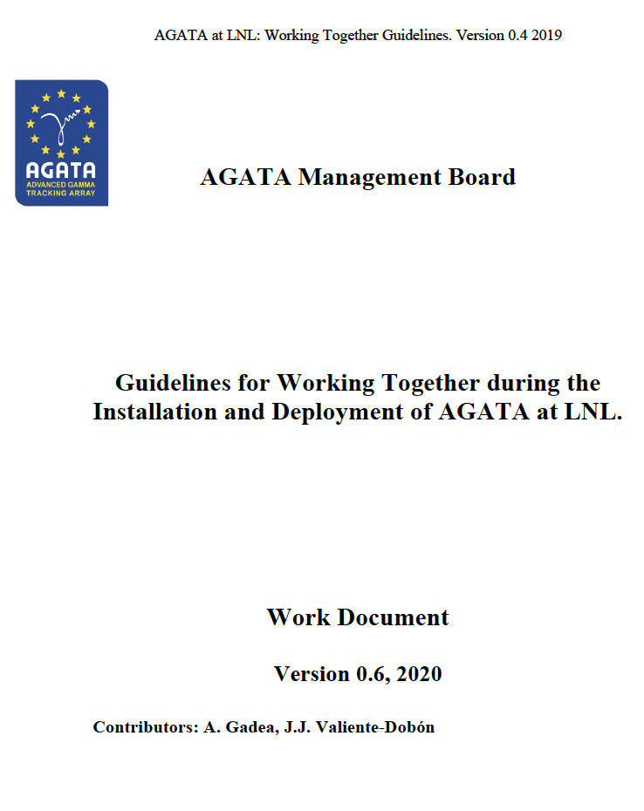
WG AGATA@LNL
Highlights and flagship for GAMMA-Milano:
AGATA, γ-ray tracking array
Task 1, Infrastructure: Roberto Menegazzo
Task 2, AGATA Mechanics: Nicola Bez, Loris Ramina, Mirco Rampazzo, Marco Scarcioffolo, Diego Giora
Task 3, Experimentation mechanics: Giovanna Benzoni
Task 4, Safety and Quality: Maria Luisa Allegrini, Daniela Benini, Luca de Ruvo
Task 5, Computing and network infrastructures: Michele Gulmini, Massimo Biasotto, Sergio Fantinel
Task 6, Surveyor: Daniele Scarpa
Task 7, Detectors: Walter Raniero, Davide Rosso
Task 8, DAQ-Electronics: Alain Goasduff, Nicola Toniolo
Task 9, Complementary instrumentation: Daniele Mengoni
Task 10, Performance: Fabio Crespi, Simone Bottoni, Eugenio Gamba, Rosa Perez
Task 11, Exploitation: Andrea Gottardo, Oliver Wieland
Task 12, Data Analysis: Francesco Recchia
Task 13, Logistics: Paolo Cocconi
Task 14, Documentation and data base: Vincenzo Volpe
Task 15, Public exposure of AGATA activities: Andrea Gozzelino

Slide 15
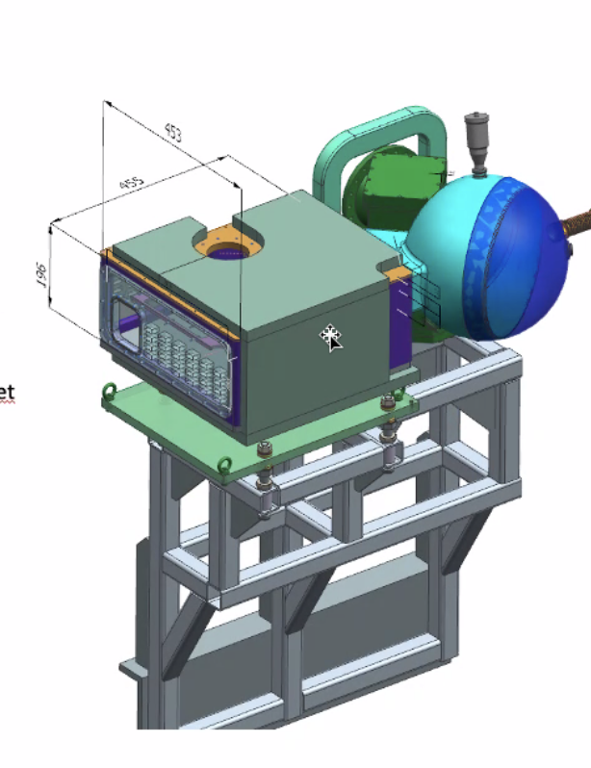




Highlights and flagship for GAMMA-Milano:
AGATA, γ-ray tracking array
Scattering chamber made of two shells
Outer radius 170 mm
Thickness 2 mm
3 removable shells help covering angles btw ~7-88 deg
Each shell can slide +/- 13 deg from central position
Sept 2020- June 2021: designing of scattering chamber+ service chamber + holding structure and aligning mechanisms
INFN-MI design office:
S.Coelli, F. Tomasi, E. Viscione, A. Capsoni, D. Vigano’, L.Manara
Installata e collaudata,
requirements perfettamente raggiunti

Slide 16






HIGHLIGHTS GAMMA 2022-2023: AGATA Physics Campaign @ LNL
Celebration of AGATA 10(+2) years
9th June
Physics Campaign in 2023
28 proposals submitted:
15 approved +3 commissioning
AGATA WEEK
LNL, June 6th-9th
03/2021 – Hall refurbishment started
10/2021 - First detectors installed
26/04/2022- Successfull Commissioning with beam
Start of the Experimental Campaign AGATA@PRISMA
130 participants
Full reconstruction
Event-by-event Doppler correction
Expected resolution achieved
Pre-PAC meeting
LNL 5th-7th Oct.
to prepare campaign in 2023
No Doppler

Slide 17


Slide 18



Highlights and flagship for GAMMA-Milano:
AGATA, γ-ray tracking array
I°Setup 2022-2023
Coupling with PRISMA
II°Setup 2024-2025
Configuration at 0°
Movimentazione struttura + rivelatori (5T)
Progettazione camera di scattering
Progettazione beamdump
Struttura di supporto
➔ Lavoro iniziato con L.Manara

Slide 19





HIGHLIGHTS GAMMA 2021-2022
Angular momentum generation
in nuclear fission
New narrow resonances observed in the unbound nucleus ¹⁵F
Pygmy Dipole Resonances in ^{90,94}Zr
Nature 590, 566 (2021)
PRC Letter 105, L051301 (2022) –
Editor Suggestion
PLB 816, 136210 (2021)
²³²Th(n,f)
NuBALL Campaign
IJCLab, Orsay
AGATA-MUGAST-VAMOS Campaign GANIL
¹⁴O radioactive beam on CH₂ target:
¹H(¹⁴O, p) ¹⁴O
²³⁸U(n,f)
extensive γ-spectroscopy
FISSION data
RCNP –Osaka Campaign with LaBr₃(Ce) det. From Milano
²⁵²Cf(SF)
Mixing of isoscalar and isovector components: degree of collectivity is not the same for all the 1− states below the particle binding energy.
NEW INSIGHT in COLLECTIVE RESPONSE BELOW BARRIER
NO “knowledge” of the partner spin:
UNCORRELATED POST-SCISSION
spin-generation
collectivization effects of near-threshold unbound states due to coupling to the continuum
The Nucleus is an OPEN QUANTUM SYSTEM
New insights important for the fundamental understanding and theoretical description of the fission process:
Workshop on Fission Fragment Angular Momentum Seattle – 21-24 June 2022: LINK
Near-Threshold states are a universal phenomenon: Strong impact on Nuclear Structure and Nuclear Astrophysics
Further investigation with AGATA-MUGAST at LNL
Further investigation with new experimental campaign at RNCP-Osaka employing our detectors

Slide 20






HIGHLIGHTS GAMMA 2023: Campaigns at International Labs.
International coll. of 270 people
Spokes: G.Benzoni (2nd mandate)
Experimental campaign in Osaka to be restarted in 2023
Use of our LaBr₃(Ce) detetcors as part of in-house array
HISPEC/DESPEC @ FAIR low-energy branch
Phase-0 Campaign started in 2020 (3 exps./year)
2 experiments Italian leadership (PhD projects)
September 2023, new G-PAC meeting:
  1 proposal by Italian Gamma Coll.
IDATEN new exp. Campaign in RIKEN (J) starting in 2023:
2 proposals with Italian Leadership

Slide 21
GAMMA collaboration
Struttura nucleare con spettroscopia γ
GAMMA - Nazionale
FTE: 39.95
Persone: 65
5 Sezioni: FI,LNL,PD,PG, MI
CONSUNTIVI 2021
64 pubblicazioni ISI
58 Talks
27 Tesi
92 Leadership Roles
Resp. Nazionali:
S. Leoni, A.Gottardo
GAMMA - MILANO
FTE: 19.6
Persone: 25 (78% impegno medio)
Resp. Locali:
A. Nannini (FI)
A. Goasduff (LNL)
G.Benzoni (MI)
R. Menegazzo (PD)
S. Simonucci (PG)
GAMMA: rinnovo sigla, estensione fino a 2030,
collegata a MOU attivi (AGATA in particolare)
AGATA MoU towards 3π configuration signed by INFN (September 2021)

Slide 22


Richieste per officina meccanica e ufficio progettazione | Ore progettazione | Ore officina
AGATA: Nuova camera di scattering + beam dump + struttura portante per configurazione stand-alone (2023-2024) Design simile a GALILEO, con possibilita’ di adattare targets criogenico | 12 mesi/uomo | 6 mesi/uomo
b-DS: Struttura di sostegno dei rivelatori plastici nella camera di decadimento; aiuto per costruire piccole parti: Aste e Adattatori (piccole L) |  | 1 mese/uomo
Housing per rivelatori
modifica e produzione seriale di housing per Labr3 3x3 inch con lettura da SiPm (Camera – Fiorini Politecnico) Totale di 4 moduli in due anni (2021-2023) |  | 3 mesi/uomo
Sviluppo di elettronica integrata di nuova generazione per AGATA-GRIT (Capra): | 1 mese/uomo | 1 mese/uomo
TOTALE | 13 | 11

Slide 23
Richieste per officina meccanica e ufficio progettazione | Ore progettazione | Ore officina
AGATA: Nuova camera di scattering + beam dump + struttura portante per configurazione stand-alone (2023-2024) Design simile a GALILEO, con possibilita’ di adattare targets criogenico | 12 mesi/uomo | 6 mesi/uomo
b-DS: Struttura di sostegno dei rivelatori plastici nella camera di decadimento; aiuto per costruire piccole parti: Aste e Adattatori (piccole L) |  | 1 mese/uomo
Housing per rivelatori
modifica e produzione seriale di housing per Labr3 3x3 inch con lettura da SiPm (Camera – Fiorini Politecnico) Totale di 4 moduli in due anni (2021-2023) |  | 3 mesi/uomo
Sviluppo di elettronica integrata di nuova generazione per AGATA-GRIT (Capra): | 1 mese/uomo | 1 mese/uomo
TOTALE | 13 | 11
Richieste per Servizio di Elettronica: Ciro Boiano 100%
continuazione dello sviluppo di read-out con SiPM dei rivelatori di PARIS
- sviluppo di preamplificatori e supporto alla sperimentazione di TRACE array di Silici
- supporto alla sperimentazione con AGATA, GALILEO e rivelatori ancillary
- supporto per readout con SiPM per scintillatori beta decay Tape Station
- supporto sperimentazione CRACOVIA e ILL
Richiesta di tempo su macchina bonding (Capra), 1-2 settimane

Slide 24
GAMMA 2023: Richieste finanziarie
Richieste economiche:
Preventivi 2023
Consumo 55 k€ di cui 10 k€ s.j.
Trasporti 4 k€ di cui 2 k€ s.j.
Inventariabile 11 k€ di cui 0 k€ s.j.
SPServizi 115 k € di cui 0 k€ s.j.
Apparati** 642 k€ di cui 0 k€ s.j.
Σ 826 k€ di cui 7 k€ s.j.
Missioni 179.5 k€
Rinnovo sigla fino a 2030
** su APPARATI Milano: PARIS MoU (40.5 k€), GRIT MoU (25 k€),
AGATA MoU 567 k€ 3π configuration in 10 years (total investment: 5.5 M€))

Slide 25
The Legnaro Accelerator Program 2020-2022
Proposals
con GALILEO
TRIPLI CLUSTERS
Fasci TANDEM
PAC
2020
COVID STOP
09/2021:
AGATA detector installation !
2021
shutdown x SPES
04/2022: AGATA with STABLE BEAMS !
2022
Proposals
con AGATA
PAC
Pre-PAC
AGATA WS

Slide 26

Highlights and flagship for GAMMA-Milano:
GALILEO, resident g array @ LNL
AGATA, last generation g-ray tracking array
PARIS and high-energy detectors
Ancillary detectors (Silicon-based/LaBr3(Ce)…)
b-DS for SPES
Chair Collaborazione: F. Camera
Elettronica: S. Brambilla, C. Boiano

