Slide 1
Laboratorio Acceleratori e Superconduttività Applicata
Dario Giove
on behalf of the LASA community
12 July 2022

Slide 2
What is LASA ?
The INFN laboratory LASA (short for Laboratorio Acceleratori e Superconduttività Applicata, i.e. Laboratory for Accelerators and Applied Superconductivity), in Segrate, at the outskirts of Milano, is an internationally Excellence Particle Accelerator technology center since nearly thirty years.
The LASA develops advanced technologies for superconductivity, cryogenics and the productions of high intensity DC and RF electromagnetic fields.
As the name suggests, the LASA laboratory is dedicated to the study and development of innovative acceleration schemes and applications of advanced superconductivity both to accelerators and to other fields of physics.
The activities carried out since the early 90s in different sectors of accelerator physics and cryogenics applied to both magnets and RF cavities, have allowed the establishment of unique skills, which result in the possibility for INFN to play an important rule in support of international projects of particle physics.
2

Slide 3
Where do we come from?
From an idea of Prof. Francesco Resmini (1938-1984), the third superconducting cyclotron ever realized worldwide (and first in Europe) was designed, assembled and tested by LASA. The cyclotron has been in regular operation at the INFN LNS in Catania for nuclear physics experiments and medical applications from 1994 to the recent shutdown and the POTLNS project will be the refurbishment of the machine.
The activities carried out in all these years has been benefiting from national (special projects and CSN5) and international funding and all have been by LASA in exploiting the commitment to the world of accelerators and applied physics.
Some research activities have been attenuated due to reduction in staff.
3

Slide 4
LASA in a nutshell
The LASA building is owned by the University of Milan and is in use governed by a long-standing bilateral agreement with INFN.
The University, to a good extent, provides for the routine maintenance of conventional facilities and basic laboratory infrastructures.
From a management point of view, LASA operates under the Director of the Milan Section.
He appoints a coordinator who:
  - coordinates all the activities related to the proper functioning of the laboratory
  - convenes the laboratory council at regular intervals
  - performs the role of "spoke person" towards the territory and towards the scientific community.
From a financial point of view, LASA still does not have a predefined budget but operates on the basis of both Section funds and of the eventual overhead of special projects.
4

Slide 5
LASA in a nutshell
The staff who works at LASA belongs to the University of Milan and to the INFN.
The situation, to date, can be summarized as follows:
University of Milan – Department of Physics
Associate Professors : 2
Full Professor : 1
Senior : 1
RTDA : 1
Grant for foreign people : 1
PHD : 1
INFN
Researchers TI (lev. 3) : 3
Technologists TI (lev. 3) : 4.5
Technologists TD (lev. 3) : 1
Technologist (lev. 2) : 1
ADR :6
CTER TI : 8 (1 will retire in 2023)
CTER TD : 3
if Brixsino is approved the following profiles would come to LASA for construction
Research Director :1
PA :1
Researcher/tecnologist :3
AR :2
5

Slide 6
LASA in a nutshell
The people involved seem significant but we have to consider few elements:
1) The age of a number of people is advanced and we have to consider that some of them may retire within a maximum of 5 years (1 PO, 1PA, 2 INFN Researchers, 1 Technologist, 3 CTER TI)
2) The ADR are really relevant for the research but we need to guarantee a base for all the activities that must rely on TI positions
3) The CTER profiles are more than relevant for the activities we carry out. The use of TD positions and the impossibility (so far experienced) to pass the experience will result in the impossibility to guarantee medium term know how.
During the last 10-15 years LASA lost a number of positions (some of them are in Via Celoria now) without any replacement. The same applies for the University component.
Career prospects have been very limited in the past (and also in the last competitions).
6

Slide 7
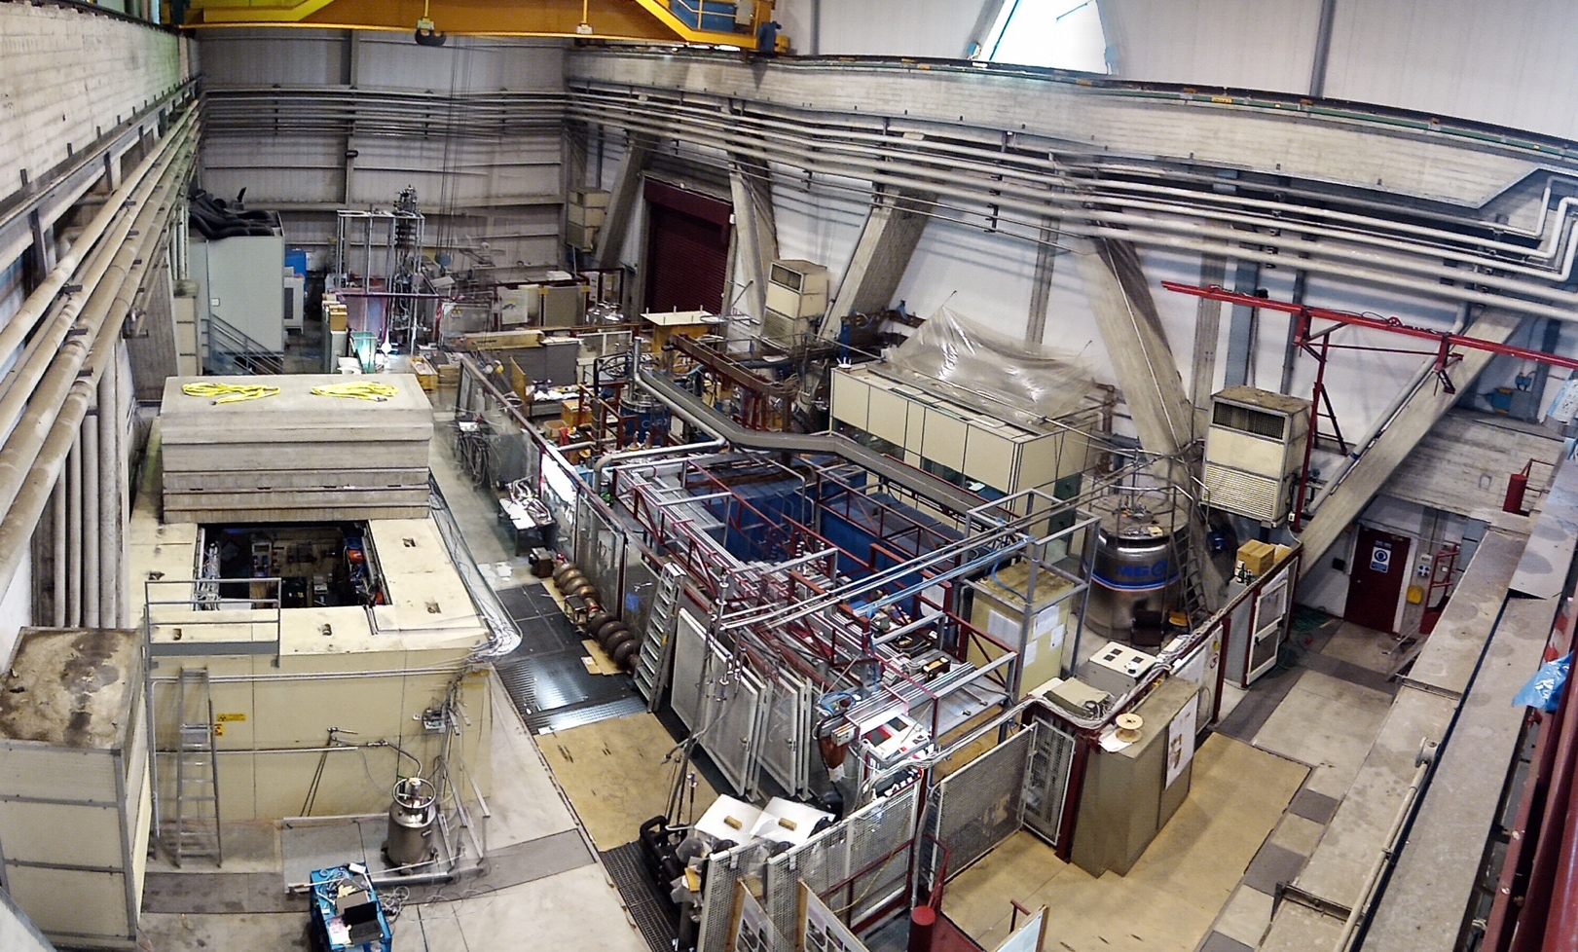
Main Experimental Hall
Clean room
class 100
& HPR
UPW production
Nuclear dosimetry area
High field solenoids
SC wire testing area
SCRF cavities
Vertical test area
High current PS
Test Station for long magnets & High Current
He pumping system for subatmospheric op. and
He Recovery balloons
7

Slide 8
A new strategy for the Laboratory
The strategy focused on a laboratory structure capable of supporting the activities considered essential to LASA:
• clear identification of research areas for which the LASA, for historical reasons, of existing skills, of available equipment, is a natural headquarters
• increase in scientific and technological R&D activities, to approach a balance between these and the activities requested and financed in a dedicated way by INFN
• strengthening of collaborations between our laboratory and national and international communities
• consolidation of the laboratory infrastructure
• upgrading of the main components of the cryogenic plant in view of the purchase of a new liquefier with performance suitable for the foreseen 10 years of activities
8

Slide 9
A new strategy for the Laboratory
• upgrading of laboratories and organizational structures (even if not immediately declinable as services)
• request for new staff, taking advantage of the different possibilities available, aimed at strengthening the structure of the laboratory as a whole both in terms of researchers, technologists and technical collaborators (the latter particularly necessary)
• training of young people hired on a fixed-term basis
• general staff training with regard to workplace safety issues and use of specific equipment (mechanical, electronic and laser)
• opening of the laboratory to local relations
9

Slide 10
Clear Identification of Research Areas
The research areas already funded at LASA and on which the laboratory has focused in recent years, cover the following topics:
• superconducting cavities
• superconducting magnets
• design of an ERL-type linear accelerator with 2 experimental stations to generate coherent X radiation, THz radiation and a beam line for applications in the medical field (BriXsino project)
• components for innovative accelerators for tumor therapy with electron, proton or X beams with applications in the field of flash therapy
components for new generation accelerators
• radioisotope study.
10

Slide 11
Consolidation of the general laboratory infrastructure
In the last year, LASA has undergone a profound renovation of its building and technological infrastructures which is still ongoing today.
This process was originated by an investment of over one million euros by the University of Milan triggered by the requirement to host laboratories of the Department of Earth Sciences at LASA (Departments of Excellence MIUR 2018-2022).
Rainwater effluvium system
The entire system of drains of rainwater that had always caused damage and made floor -1 of the laboratory nearly unusable was rebuild by the University of Milan (in July 2020 we had suffered a flooding with a spill of about 15,000 liters of water). The investment was approximately Euro 130,000 and today new laboratories are active in those premises.
11

Slide 12
Consolidation of the general laboratory infrastructure
Fire detection system
The laboratory was equipped with a new fire detection system that covers the entire experimental area and all offices and laboratories.
Air Handling System
Some outdated sections of the AHU (air handling units) have been overhauled, while the whole air handling system in the main experimental area is going to be replaced thanks to an investment by INFN of Euro 120,000 euros to make it compatible with COVID recommendations.
12

Slide 13
Consolidation of the general laboratory infrastructure
Diesel generator
A new 200 kW diesel generator (the previous one was 30 kW) has been installed in April 2021, again financed by the University of Milan, which will be used to guarantee basic plant services (approximately 70% of the capacity) and to keep in action or allow a controlled shutdown of vacuum equipment, lasers, power supplies in laboratories.
Computing services
The computing network was modernized and extended to cover the entire laboratory (both via cable and WiFi) with a 50% complete fiber optic infrastructure thanks to an investment from the University of Milan. INFN financed the replacement of all internal active systems (which dated back to at least 20 years ago).
A separate network from the main one was set up and dedicated to data acquisition from the main experiments active in the main experimental hall.
13

Slide 14
Upgrading of the main components of the cryogenic plant
The LASA cryogenics plant was the subject of an in-depth study which resulted in the financing by INFN in 2020 of a series of extraordinary maintenance on filters and purifiers and on an intervention plan that has been completed within December 2021).
14

Slide 15
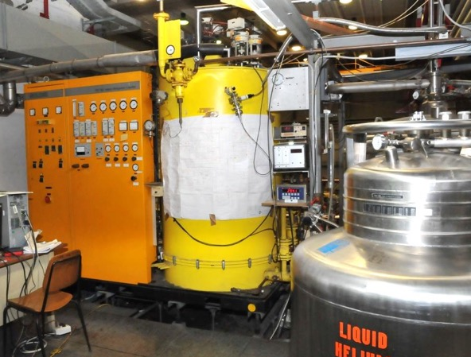
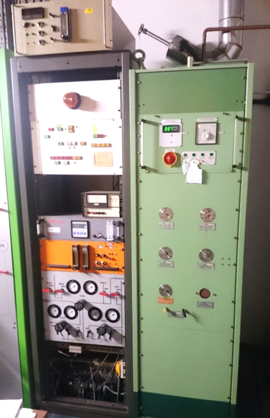
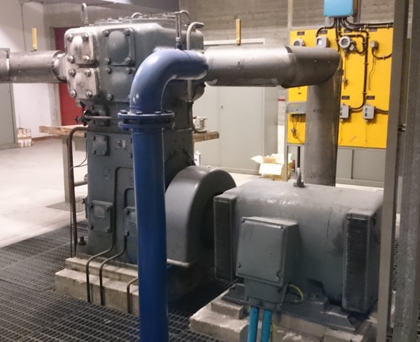
LASA cryogenic plant, as 2018
Liquefier
  LINDE TCF100 from 1981
  Up to 35 l/h with LN2 pre-cooling
  Buffer 2 m3
Liquefier compressor
  SULZER, dry, 4 pistons from 1969
  150 kW plug power
Cryogenic purifier
  LINDE, single column with LN2, 1985
  Throughput of 50 Nm3/h for hours
Liquid helum dewar and transfer lines
  D1000 e D3000 with dedicated lines
  2 D450 e 2 D500 movable
Recovery compressors
  60 + 20 Nm3/h from BAUER
  Recovery balloon from users, 100 m3
Gas helium storage
  Up to 4000 Nm3, vessel pressure 200 bar
  About 3000 Nm3 for purified gas
Support and analyses instruments
  O2 and H2O process analyzers

Slide 16
Upgrade of LASA cryogenic plant
From 2018, upgrade activity aims to the recovery and the improvement of LASA cryogenic plant that has today almost 40 years of functioning. All key activities have already started:
Heal long-running problems and performance limitations:​ Complete renewal of recovery compressors line-up with modern machines and recovery of nominal peak throughput of about 100 Nm3/h (60 + 20 + 20 Nm3/h).​ Automatic optimization of first filter stage return flow as a function of actual throughput ​ Replacement of old second filtering stage with a modern cartridge filter (Bauer P120)​ Additional RGA analyzer working at atmospheric pressure to monitor in real-time the contamination level of helium gas recovered from users, meant to protect the gas already stored. ​ Renewal of adsorbent material and extensive maintenance of LINDE cryogenic purifier​ P&ID and electrical scheme revision for the whole plant​ | ​ Lug. 2021​ ​ Lug. 2021​ Aug. 2021​ Dec. 2021 ​ Set. 2021​ Ott. 2021​
Increase the level of reliability, performance and automation of key plant elements up to a level that is coherent with a new liquefaction system:​ New central gas panel for the management of all gas processes (recovery, purification, liquefaction) based on PLC and fully compatible with the control system of a new liquefier.​ Inspection, recovery and instrumentation of all existing transfer lines and dewars, including the 3000 liter dewar that was unused since 2009.​ | ​ ​ Jul. 2022​ ​ March 2021​
Issue a complete technical proposal for a new liquefier taking into consideration LASA perspectives and potentialities in the next future and technical solutions available on the market. ​ | Sep. 2021​

Slide 17
Guide lines for a new liquefier for LASA
A modern liquefier, medium-sized and available on the market could be promptly inserted into the layout of existing LASA plant, granting moreover a significant reduction of electrical power consumption and space at the cold-box mezzanine. Such a machine would generate for LASA
several advantages, both technical and strategical:
State-of-the-art reliability, maintenance, industrial assistance, automation as well as remote operability
Removal of the cryogenic purifier and of the concurrent split gas management thanks to an optional internal purifier: a single storage is generated and the recovered gas is directly liquefied.
Preservation of nominal performances throughout the cold session thanks to dedicated cold-traps (10-20 K) capable of retaining low T condensing gases.
Increasing of liquid helium storage for users possible thanks to the higher liquefaction rate granted by modern screw-compressors, thus achieving an higher decoupling between users and plant schedule.
Opening toward new experimental users that make use of complex cryogenic schemes supported by an additional supercritical 3 bar helium line. Up to 150 W at 4.5 K could be delivered preserving a large liquefaction rate, provided that the liquefier is properly configured upon purchasing.
Portability to a different site is possible with reasonable effort and costs (LASA at MIND Campus option)

Slide 18
LASA cryogenic plant, 2023 (?)

Slide 19
Consolidation of the general laboratory infrastructure
New laser lab
The operation of advanced CW high brightness electron sources based on photocathodes requires their operation to very high repetition rate.
High-intensity X- and γ-ray beams are extremely useful in fundamental and applied physics as well as in the fields of medicine, material studies, cultural heritage preservation.
19

Slide 20
LASA participation to Euro-Labs
Lasa has been one of the 4 facilities that have been granted within the EuroLabs program WP3.
LASA will provide access to the following experimental facilities:
• Superconducting Magnets
• Superconducting RF Cavities
• High Brightness Photocathodes for Electron Sources
• Laser Applications to High Power Fabry Perot Cavities and Advanced Timing Systems.
The participation has been based on a total of 600 user days over a period of 4 years.
The funding is the order of 320 Keuro.
20

Slide 21
LASA organizational structure
The shortage of staff and the contraction due to the delay in replacing retired colleagues, led us to review the overall organization of the laboratory.
We have identified the areas that should benefit from the reorganization and we are trying to lay the foundation of a group of services to efficiently run the laboratory.
The services that have been foreseen may be so summarized :
  • cryogenics (liquid helium production)
  • general plant engineering services
  • workshop and mechanical design
  • distributed data acquisition and computing
  • specific administrative service for large orders and tenders
Moreover, we would like to add 2 more services by fixed-term positions for which calls are underway:
• electronics and electrical engineering
• Vacuum.
21

Slide 22
LASA requests for services in 2023
The situation described in the previous slide forced us to consider that for the second half of 2022 and for the next year we have urgent and significant requests in terms of support for:
Mechanical workshop
General Plant services
Administrative services.
Since the past year we are requesting to have people at LASA and satisfy these request in terms of the establishment of fixed services in consideration of the number, size and relevance of the projects that we will describe in the following slide.
The requests for 2023 (to be considered as a minimum) may be summarized as follows:
SRF: 8 months of mechanical workshop man power
SC Magnets: 6 months of mechanical workshop man power
CSN5 related experiments: 3 months of mechanical workshop man power
HB2TF: 6 months of mechanical workshop man power
2 months of electronic service man power
LASA: 2 months of mechanical workshop man power
12 months of general plant services
12 months of administrative services
22

Slide 23
Superconducting RF Cavities

Slide 24
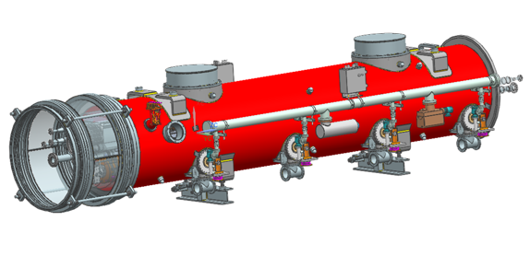
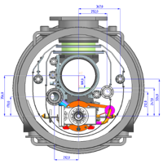
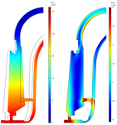
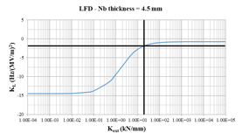
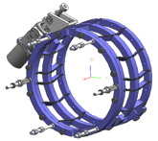
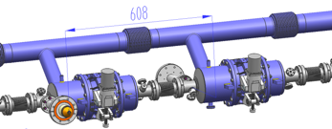
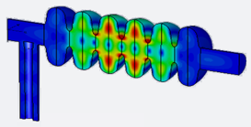
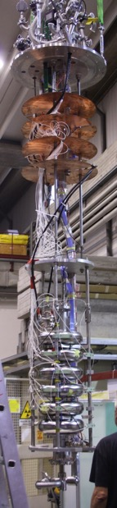
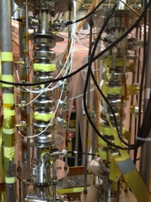
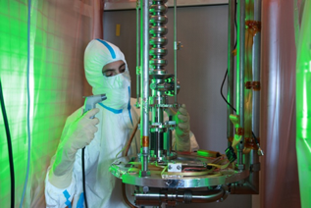
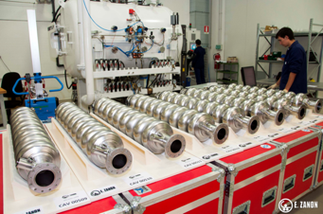
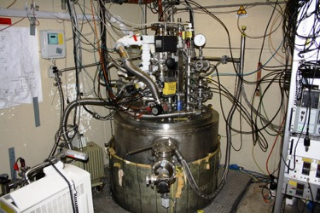
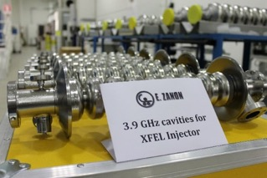
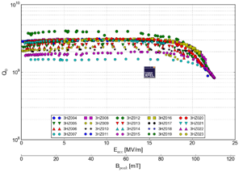
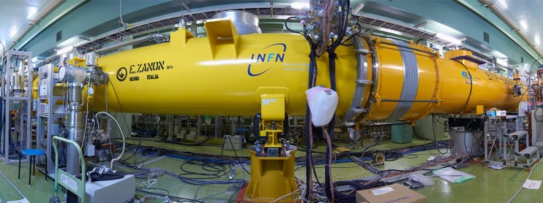
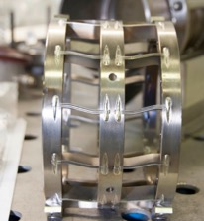
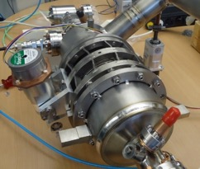
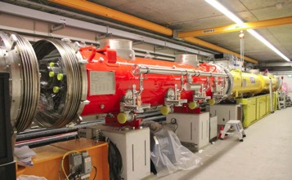
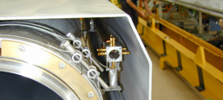
SRF@ INFN LASA
Design
  Cavities
  Cryomodules
  Ancillaries
Qualification
  Cavities
  SRF Ancillaries
Facilities
  RF Test Stand (500 to 3900 MHz)
  ISO4-7 Clean Room (HPR, UPW, etc.)
  Large Vertical Cryostat and advanced quench diagnostic
With Industry
  Fabrication of cavities and cryomodules
  Mass Production of European-XFEL cavities and cryomodules (1.3 and 3.9 GHz)
    QA/QC
    Technology transfer (within XFEL contract)
  Large Production of ESS Medium Beta Cavities
  Upcoming Production of PIP-II LB650 Cavities
Module 1
Module 2 & 3
Module 4+
HOM analyses.
Semi-trapped mode at 1742.7 MHz
FEM analysis of the spool transition ring exhibiting about 60 kN/mm stiffness

Slide 25
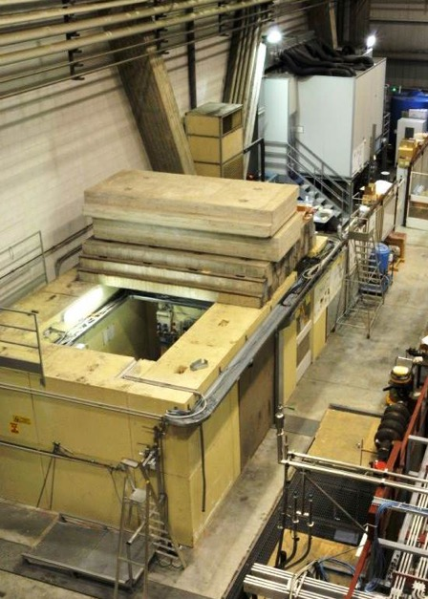
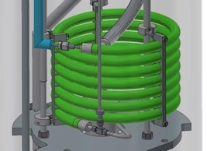
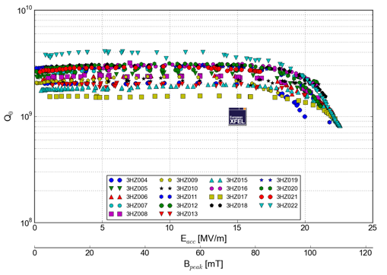
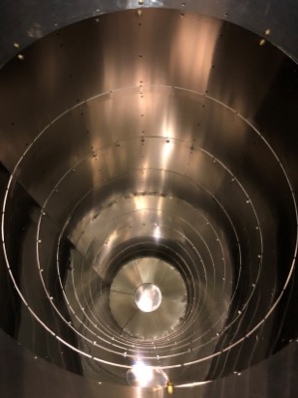
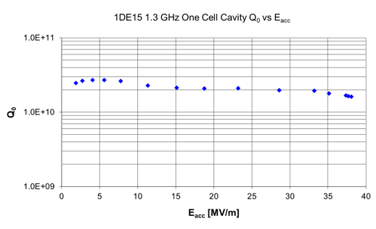
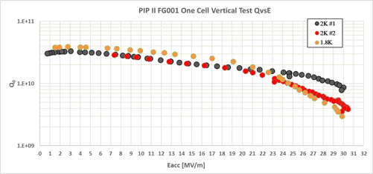
INFN - LASA Cold test facility
Clean Room and UPW
  Ultra Pure Water plant
  ISO4/7 clean room, HPR system
  Qualified Slow Pumping Slow Venting system
Cryostat: φ 700 mm, 4.5 m length, losses < 1 W @ 4 K
Residual magnetic field: < 8 mGauss (single shield). Single μmetal external shield, second cryogenic shield (Cryoperm) just installed and measurement in progress.
Sub-cooling system:
  Cooling power: ∼ 70 W @ 2 K
  Lowest temperature 1.5 K.
  Soon capability of direct filling at 2 K
RF capability (500 to 3900 MHz)
Dedicated inserts with several diagnostics: second sound detectors for quench localization, cryogenic photodiodes, fast thermometry, flux gate.
X-ray counter and X-ray NaI spectrometer available.
25

Slide 26
SRF Group FTE 2022
Massimo Bonezzi CTER TI Pensionamento fine 2022
Daniele Cardelli CTER TD Contratto in fase di estensione fino ad agosto 2023
Manuel Zaggia CTER TD Contratto in fase di estensione fino ad agosto 2023
Fabrizio Fiorina CTER TD Contratto in scadenza gennaio 2023
Daniele Sertore Ric – TI 30 % TRAMM – RN / 10 % Ethiopia
Michele Bertucci Tecnologo – TI 10 % SAMARA – RL
Angelo Bosotti Tecnologo – TI 15 % TRAMM
Giorgio Fornasier Tecnologo - TD
Tommaso Grimaldi Tecnologo - TI (50%)
Laura Monaco Tecnologo – TI 15 % TRAMM
Rocco Paparella Tecnologo – TI 10 % TRAMM
Alessio D’Ambros AdR Scadenza contratto dicembre 2022
Elisa del Core AdR Scadenza contratto gennaio 2024
Carlo Pagani Associato Senior
Servizi LASA

Slide 27

Progetti del Gruppo
European Spallation Source - 2022
MUR Italian In-Kind Contribution to ESS, managed by INFN through the LASA SRF Group.
  36 superconducting cavities at 704 MHz ready for the installation into the cryomodule at CEA (E_{acc}=16.7 MV/m, Q₀=5e9)
Project Value: 11150 k€
Duration: end 2023
Achievements:
  Delivery of 28 (75 %) of the
  requested cavities with
  performance above project
  specifications
28 cavities at CEA
ESS Acceptance Goal
E_{acc} = 16.7 MV/m
Q₀ = 5·10⁹

Slide 28
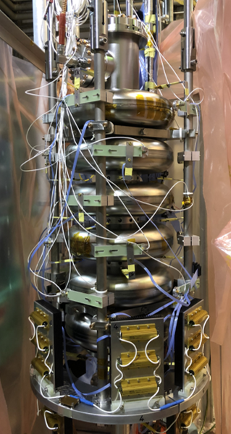
Progetti del Gruppo
European Spallation Source - 2023
Future plan
  Complete the ESS In-Kind contribution by
    Qualify cavities by new processing methods
    Qualify set of four new cavities
We have no plan for additional personnel
We plan few tests of cavities at LASA

Slide 29

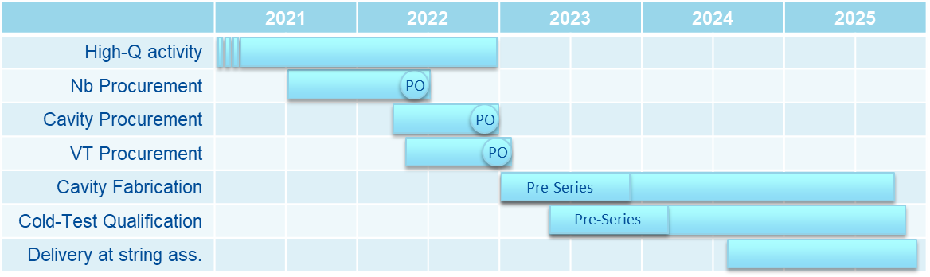
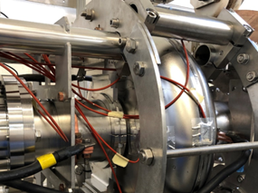
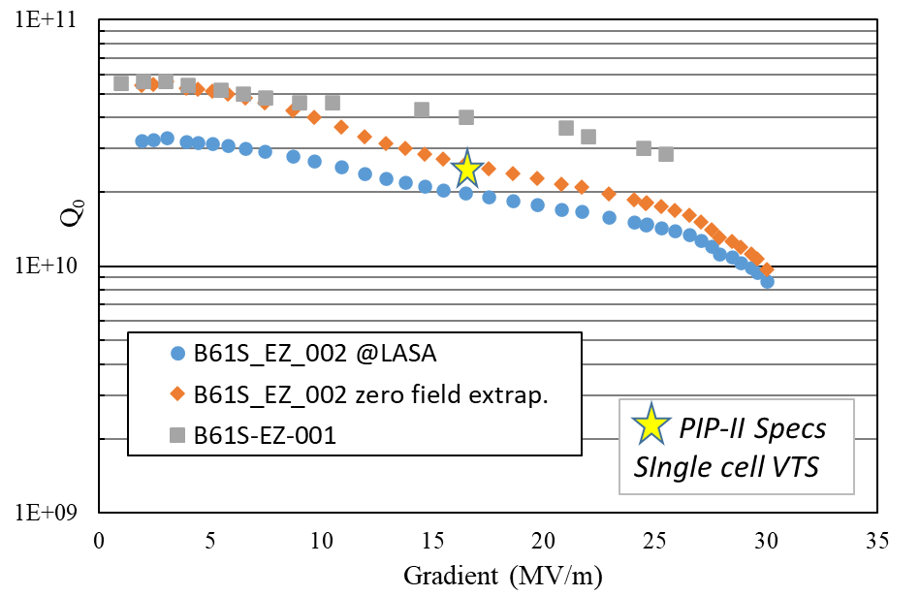
Progetti del Gruppo
PIP-II - 2022
MUR Italian In-Kind contribution to PIP-II (DoE), managed by INFN through the LASA SRF Group.
  38 superconduting cavities at 650
  MHz ready for installation into cryomodule
  (E_{acc} = 17 MV/m, Q₀ = 2.4e10)
Project Value: 21000 k€
End of the project: 2026
Achievements:
  Test of single and multicell cavities at
  LASA and at FNAL for R&D on high Q₀ cavities
  Achieved outstanding quality factor (Q₀)
  in single cell and, near to specs, in multicell

Slide 30
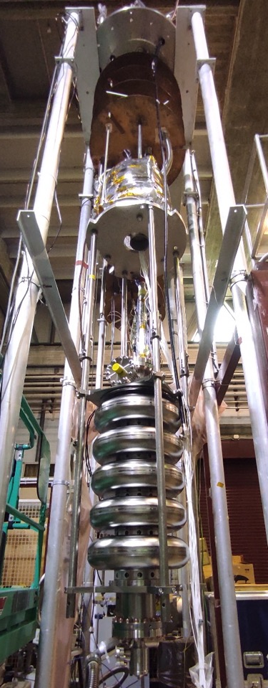
Progetti del Gruppo
PIP-II - 2022
Plan for 2022/2023
  Tender for Nb (5.4 M€ VAT included)
  Tender for SRF cavity (8.1 M€ VAT included)
  Joint development of a High Q₀ test equipment to be transferred
  to a partner qualified for series cavity vertical test validation.
  Procurements components for series
  Upgrade the reference test facility at LASA for high Q and
  high gradient
  R&D towards stable outstanding cavity performances
  producible in industry through an adequate QA/QC
  Qualification tests of cavities at LASA
  Start preparation for pre-series cavities with
  tender-winner cavity vendor

Slide 31
Progetti del Gruppo
PIP-II - 2023
Personnel 2023
  The experience of the group personnel learnt during the European XFEL and ESS projects is being transfer to PIP-II.
  However, the challenging requests of the PIP-II project ask for a further extension and knowledge transfer of the group expertise through one Tecnologo (RF instrumentation and SRF cavity measurement) and one AdR for Project Management Assistance.
  Clearly, we account on the existence of efficient LASA specific services, at least for mechanics (about 6/8 months) and cryogenics, to support our activities.

Slide 32
Near future possibilities
EAJADE Marie Curie Staff Exchange Program
  A staff exchange network for accelerator R&D within elementary particle physics.
  It passed, few days ago, the first examination.
  Duration: 4 years
  Proposed INFN budget (LASA + LNF): 147 k€
  INFN Main Contact Person: Laura Monaco
ILC pre-lab
  Japan decision expected by August. If positive, it will start an international effort for the development of the ILC SRF related activities.
  INFN LASA will be mainly involved in the R&D activities on 1.3 GHz SRF cavities.

Slide 33
Super Conducting Magnets

Slide 34
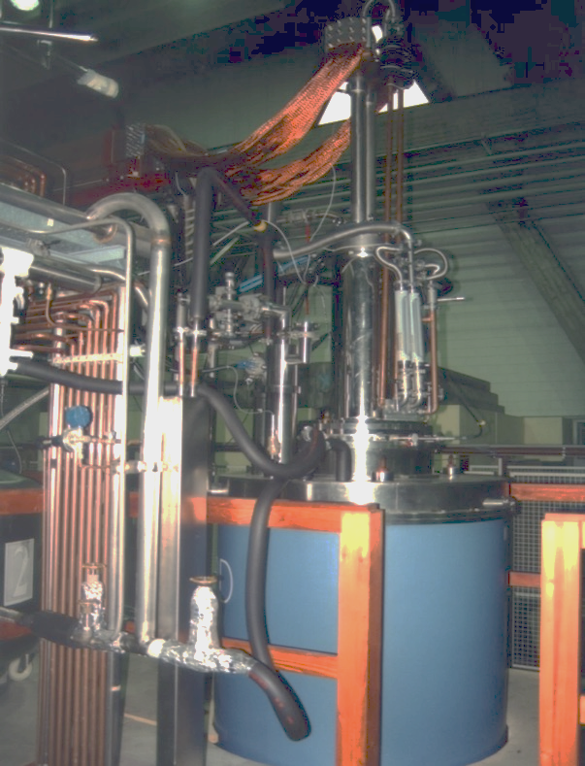
High Magnetic Field Laboratory
The High Magnetic Field Laboratory has the capability to provide magnetic field for research purposes, and to develop and test magnet prototypes
Research Magnets
SOLEMI 1: solenoid NbTi
8 T, 535 mm room temperature bore
SOLEMI 2+3: solenoid Nb₃Sn
15 T, 100 mm cold bore @ 4.2/2.2 K
75 mm cold bore in gas flow 2-300 K
Solenoid NbTi + Nb₃Sn
13.5 T, 50 mm cold bore @ 4.2/2.2 K
Cryocooler-operated magnet
8 T, 75 mm cold bore cryogen-free
Resistive Dipole
1 T, 120 mm room temperature gap
SOLEMI 1

Slide 35
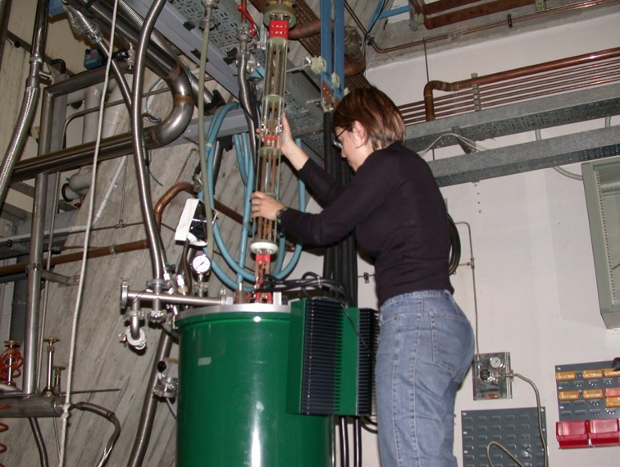
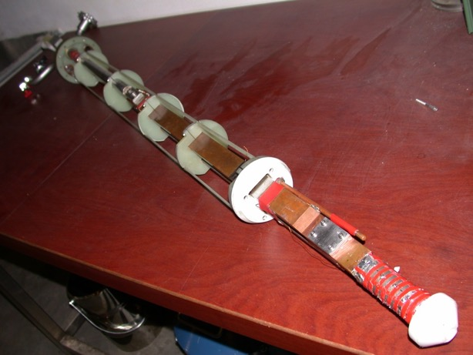
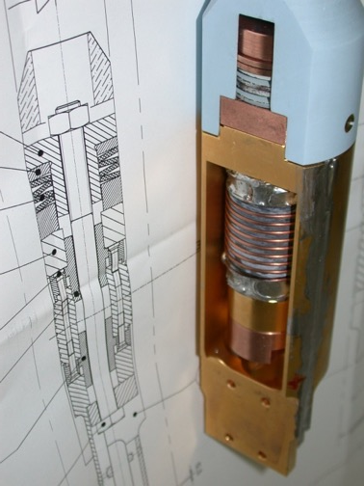
Test Station for Superconducting Wire Characterization
Critical current measurement of S.C. wires
  Facilities to test superconducting wires
  Back-ground magnetic field up 15 T
  Temperature variable from 1.9 K to 50 K
  Iper-stabilized power supply 3000 A, 6 V (battery bank to cancel ripple noise)
  Several supports for many types of conductor
  New impulse on the activity for Nb₃Sn with ABSTRACT experiment (CSN-V 2021-2023)
Notes:
New Impulse perché questa importante attività storica del LASA è stata ferma per 10 anni, e la si vuole rivitalizzare perché ritenuta strategica per i magneti superconduttori (la

Slide 36
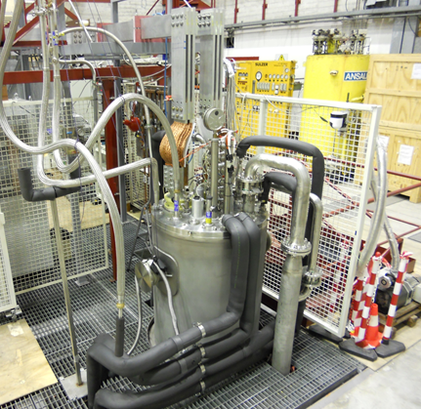
Test Station for long magnets LTS and HTS
LHe Cryostats
  φ 690 mm, 6500 mm depth a rather unique feature
  φ 515 mm, 3300 mm depth for medium-size
  φ 480 mm, 1200 mm depth for small-medium size
  other smaller cryostat
Power Supplies
  3 x Power supply up to 10 kA, 6 V
  (i.e. up 30 kA – 6 V or 10 kA – 18 V)
  2 x Power supply up to 1.2 kA, 36 V
  1 x Power supply up to 500 A, 125 V
  1 x Power supply up to 2 kA, 4 V
  (low noise, battery based)
Magnet Protection System including discharge resistor, switch, Quench Detection Electronics
  10kA IGBT fast switch <1 ms to open
Strategic tooling for high field programs

Slide 37
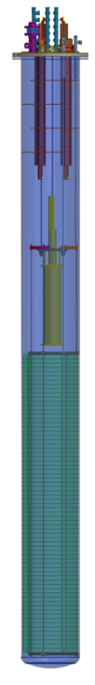
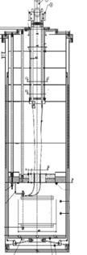
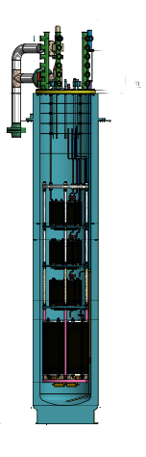

Cryogenic test availability
SMTT
D 480 mm
h 1200 mm
4.2 K and 2.17 K
500 A
Small Magnets Test Cryostat (SMTT)
  HO correctors protoypes
    6P MCSXFP
    8P MCOXFP
    10P MCDXFP
High Current Test Station (DISCORAP)
  DISCORAP and HTS magnets
HiLumi Correctors series (HOC)
  All HO correctors series
DISCORAP
D 695 mm
h 7200 mm
4.2 K
10 kA
HiLumi HOC
D 515 mm
H 2950 mm
4.2 K
500 A

Slide 38
Magnet Group FTE 2022
Technicians:
Augusto Leone
Antonio Paccalini
Danilo Pedrini
Maurizio Todero
Alessandro Pasini
Researcher:
Francesco Broggi (Ric.-INFN)
Lucio Rossi (PO-UNIMI)
Massimo Sorbi (PA-UNIMI)
Marco Statera (1°Tecnologo-INFN)
Marco Prioli (Tecnologo INFN)
Not permanent:
Samuele Mariotto (RTDA-UNIMI)
Ernesto De Matteis (A.R. Senior-INFN)
Riccardo Valente (A.R. INFN)
Stefano Sorti (A.R. INFN)
Magnus Dam (Borsa stranieri INFN)
Tiina Benso (A.R. for INFN-A)

Slide 39
Main Activities:
PNRR
IRIS
CSN5
Astract 0.2 FTE
SIG (Call CSN5, parzialmente finanziata fondi esterni) 2.6 FTE
HITRI+ (dimostratore magnete CCT, fondi europei) 1.65 FTE
IFAST (Studi di magneti adroterapia, fondi europei) 0.6 FTE
FALCOND (dimostratore per FCC-HH, Fondi CERN) 1.1 FTE
CSN1
HL_SHOC (magneti correttoti per HighLumi-LHC, fondi CERN) 0.2 FTE

Slide 40

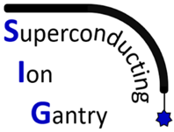
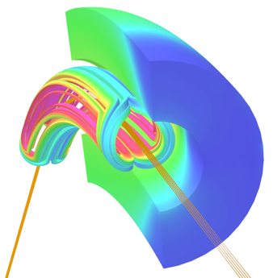
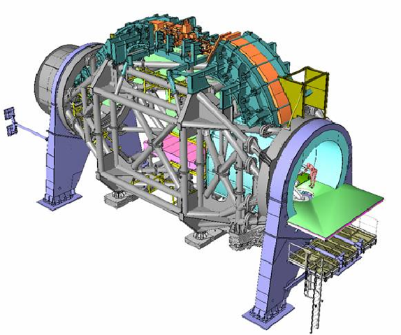
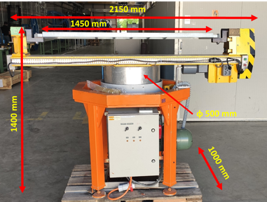
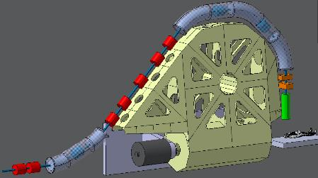
Il progetto SIG: scopo e sfide aperte
Call Gruppo V e accordo quadripartito: INFN – CERN – CNAO – MedAustron
Scopo generale: rendere più accessibile l’adroterapia con ioni pesanti
→ ridurre ingombro e peso dei gantry grazie alla superconduttività e alla tecnologia dei magneti da acceleratore
Obiettivo: costruzione di un magnete superconduttore dimostratore curvo
  4 T, apertura 80 mm, 45° (1.3 m)
Sfide aperte
  Avvolgimento con alta curvatura (ρ = 1.65 m)
  Raffreddamento indiretto (no elio liquido)
  Ramp-rate elevato (0.4 T/s) e minimizzazione delle perdite dinamiche
  Nuova magnet facility @LASA
Heidelberg Gantry ~600 tons
Bobinatrice @ LASA
Compact Gantry ~50 tons (L. Gentini)

Slide 41
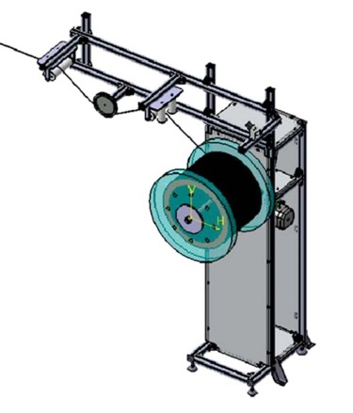


Il progetto SIG: stato 2022
Assegnazioni
144 k€ per le sezioni MI, GE, LNF, TO
Sezione di Milano
  1 AdR Junior → bandito
  53 k€ → impegnati per l’acquisto di un tenditore per la fase di avvolgimento
Milestones
MS1.1: Firma del framework agreement CERN-CNAO-MedAustron in febbraio
MS2.1: congelamento del design concettuale del magnete entro l’anno
→ A partire dal 2023 SIG non partecipa più alle assegnazioni di Gr. V poiché ha ricevuto fondi ministeriali dedicati. I referee assegnati continueranno a seguire le attività per conto della CSN5.
FTE 2022
 |  | SIG
1 | Lucio Rossi | 0.2
2 | Massimo Sorbi | 0.1
3 | Marco Statera | 0.1
4 | Francesco Broggi | 0.1
5 | Marco Prioli | 0.3
6 | Ernesto De Matteis (AR) | 0.3
7 | Samuele Mariotto (RTDA) | 0.2
8 | Riccardo Valente (AR) | 0.2
9 | Magnus Dam (Borsa x stranieri) | 0.1
10 | Nuovo AdR SIG | 1
 | TOT Ricercatori | 2.6

Slide 42

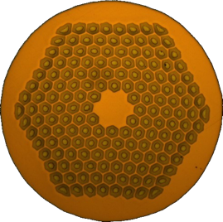
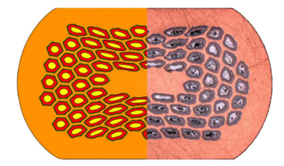
Progetto ASTRACT (2021-2023)
ASTRACT: Analysis of STRain Affected CharacTeristics of brittle SC cables
Attività di supporto ad altri progetti del gruppo magneti del LASA: magneti per alto campo e magneti curvi per acceleratori e gantry per adroterapia
Property | Value
d_{strand} | 1 mm
α=Cu/non-Cu | 0.9 ± 0.2
d_{fil.} | 58 µm
L_{tp-fil} | 19 ± 3 mm
RRR, rolled | 159 ± 14
T_{HT} | 665 K
J_{sc} @ 4.2 K, 16 T | 1200 A/mm²
Scopo: studiare gli effetti delle deformazioni meccaniche sulle caratteristiche di cavi/fili su superconduttori “fragili” prima e dopo il trattamento termico
  Prima del trattamento → Simulazione degradazione di cablaggio
  Dopo il trattamento → Simulazione effetti forze di Lorentz
Collaborazione tra INFN Genova (capofila), Milano-LASA e G.C. di Salerno
Resp. nazionale: Riccardo Musenich
Resp. Locale Milano: Marco Prioli
Referee: Cristina Vaccarezza, Giuseppe Cirrone
Nb3Sn RRP 162/169
Courtesy of S. Hopkins
Strand Nb3Sn
deformato

Slide 43


Progetto ASTRACT (2021-2023)
Obiettivo per Milano: misure di corrente critica (I_{C}) su campioni di Nb3Sn vergini e deformati meccanicamente prima del trattamento termico
Attività completate, prima metà 2022:
  1/2022: qualificazione del processo di trattamento termico di formazione del Nb3Sn (1) e della misura di corrente critica su fili di riferimento
  5/2022: caratterizzazione del comportamento meccanico del filo Nb3Sn di FalconD (2) → nessuna evidenza di degradazione, in accordo con le misure di magnetizzazione svolte a Salerno (3)
Piano 2023 → contributo di Milano in esaurimento
  Completamento misure I_{C} e modellazione numerica
  Misure di I_{C} su campioni deformati dopo il trattamento termico → @ Genova
  Richieste 250 litri LHe (6.5 k€, prezzo volatile) + 3 k€ missioni
 | FTE 2023
Marco Prioli | 0.1
Riccardo Valente (AR) | 0.1
Totale | 0.2
  (1)
  (2)
  (3)

Slide 44





FALCOND – A FCC 14T dipole demostrator
Resp. locale: M. Sorbi
Future Accelerator post-LHC
Cos-theta Optimised Nb₃Sn Dipole
I
n September 2018, a CERN-INFN agreement was signed for the construction of a high-field dipole model as part of the FCC studies.
An international tender awarded to ASG Superconductors the construction of the superconducting coils (6+2)
The mechanical structure will be assembled in LASA labs
A functional test of the magnet at 20 kA is foreseen at LASA
Final test at CERN
1.4 m
7 m
10⁴
1.67 m
Nb₃Sn
Critical current density A.mm⁻²
10³
LHC dipole
NbTi
FCC dipole
10²
Conventional iron yoke electromanets
10
Magnetic field (Tesla)

Slide 45




Activity with external contribution:
Total financial value of CERN's contribution: 3100 k€
  in kind contribution 1600 k€
  cash contribution of 1500 k€ (Genova & LASA)
The details of CERN in kind contribution are as follows:
Activity in 2023:
Upgrade LASA test station from 10 kA to 25 kA
Component | Value k€
Superconducting wire | 680
Cable production, controls, etc.* | 270
Insulation, preparation, tests | 50
Design of components | 50
Pads, Yoke, Shell | 300
Other mechanical components** | 100
Instrumentation (strain gages, optical fibres) | 50
Small parts for tests (winding, yoking tests) | 50
Magnet tests (Helium not included) | 50
Start the operation of magnet assembling
Personale Ric. | FTE
Massimo Sorbi | 20%
Marco Statera | 10%
Marco Prioli | 10%
Samuele Mariotto | 10%
Riccardo Valente | 60%
TOTALE | 110%
Richieste servizi 2023
Progettazione meccanica 3 mu
Officina meccanica 2 mu
Personale Tecn. | FTE
Danilo Pedrini | 20%
Arsenio Palmisano | 20%
Antonio Paccalini | 30%
Alessandro Pasini | 30%
TOTALE | 100%
Tooling necessary for assembly
(to be purchased)
Tooling to apply pressure
for prestress the magnet
(already purchaded)

Slide 46











HL_shoc : HL-LHC High Order Correctors
INFN LASA
In kind contribution
Series production of 54 High Order correctors. 6 families of magnets to compensate the field errors of focusing quadrupoles
CERN 2881 k€– INFN 2981 k€
3 new low beta sections:
Singola beampipe diametro 150 mm
Fascio ~ μm nel punto di interazione
~70 m
ATLAS
CMS
Magnets specification and challenges
NbTi superconducting coils
superferric design (first time in LHC)
Produzione di serie
54 magneti SAES Rial Vacuum – terminata Nov 2021
Fine test (100%) LASA Autunno 2022
Consegna CERN 2022
OD320
a2
OD460
a3 b3
MgB₂ demonstrator accelerator magnet Sextupole round coil
a4 b4
a6 b6
a5 b5

Slide 47
HL_shoc : HL-LHC High Order Correctors – FTE e richieste
FTE HL_shoc
Marco Statera (PT) 10%
Ernesto De Matteis (AR) 10%
Tecnici
Danilo Pedrini 10%
Arsenio Palmisano (TD) 30%
Antonio Paccalini 10%
Alessandro Pasini 20%
RICHIESTE HL_shoc
Fondi –
1 mese uomo di officina per lavorazioni meccaniche per aggiustaggi durante gli assemblaggi dei discendenti criogenici e movimentazione con muletto e carro ponte per trasporti.

Slide 48
European Funded Projects

Slide 49

EC-H2020 initiatives for Hadrontherapy
(parallel, but very linked, to the 4PCIG)
HITRIplus (Hitri+): approved, start on 1st April 2021
Study of a full new ion therapy facility: SEEIIST (but not oly!). Led by CNAO; Mi-LASA is the INFN coordinator
WP8 on Magnet Design: coordinated by INFN-Mi-LASA
overview and assessment of various conductors (LTS, HTS, various types of cables) and magnet layouts (cosθ, CCT, racetracks – split coils or flare ends – etc…). Both for Synchrotrons (main dipole and extraction channel) and Gantry. Probably in CCT.
Design construction and test of 1 dipole demonstrator ~500-700 mm long 5 T (either LTS or HTS). INFN-Mi-LASA in charge of general design and magnet structure (winding at CIEMAT). Test at CERN or Uppsala.
Very much oriented to CCT layout as required by the community!
I.FAST : approved, start on 1st of May 2021
Following CARE, Eucard, Eucard2, ARIES, it is the EU accelerator R&D program. Led by CERN; Mi-LASA is the INFN coordinator.
WP8 on Innovative Superconducting Magnets: coordinated by INFN-LASA.
scope is fostering technology innovation: exploring HTS conductor and new magnet layout for Hadrontherapy with Industry!
General consensus to go toward CCT: 2 dipoles of 5 T 500-700 mm long designed by labs, built by Industry. At least 1 demo in HTS. INFN-LASA in in charge of general design, define the mechanical structure and follow up one Industry.
The WP8 fosters also a panel among various lab to steer HTS for accelerator magnets in EU. INFN-LASA has a promoting role (see slide on future of HFM and EU strategy for PP.

Slide 50
Additional elements financed in i.FAST
WP9 Test of innovative superconducting accelerating cavities
WP6 (Novel particle accelerators concepts and technologies) Lasers for Plasma Acceleration (LASPLA) task 6.2 Lasers for Plasma Acceleration (LASPLA)
• Establish a roadmap to foster delivery of advanced industrial laser drivers with high-repetition rate and higher efficiency, for the first user plasma-based accelerator.
• Establish a coordination activity with networking and training of main laser labs, focused on laser-driver R&D.
The Task will identify strategies for the development of high-intensity lasers specifically as drivers of compact laserdriven plasma accelerators and novel radiation sources and applications to industrial, medical and biological sciences. Laser-drivers were identified as the main limitation to the societal exploitation of novel accelerator technologies. A comprehensive approach to the development of high-repetition rate lasers for plasma accelerators will tackle the key scientific issues currently limiting technological and industrial development

Slide 51
Physics applied to Medicine

Slide 52

Laboratories of Physics Applied to Health at LASA
The MAIN research activity is the study of the optimization of production of radionuclides not available on the market at very High Specific Activity, produced in No Carrier Added Form with non conventional techniques for Nuclear Medicine – diagnosys and methabolic radiotherapy, towards the new frontier of theranostic. The last studiies and the future are related to:
¹⁰³Pd produced in NCA form by ¹⁰³Rh (d,2n) nuclear reaction
The ¹⁰³Pd (T_{1/2} = 17 d) is an effective alternative to ¹²⁵I (T_{1/2} = 60 d) for brachytherapy of prostate cancer by implantation of seeds and now a day nano seeds into the gland.
⁸⁹Zr (T_{1/2} = 78.41 h) is one of the most promising radionuclide in Nuclear Medicine for labelling monoclonal antibodies for bio-distribution studies and for immuno-PET imaging. Furthermore Zr-89-labelled octreotide liposomes can be used for simultaneous PET and magnetic resonance tumor imaging in theranostics applications.
^{52g}Mn (T_{1/2} = 5,59 d) is the radioactive isotope with useful nuclear properties for PET imaging or ⁵¹Mn (T_{1/2} = 46.2 min) with higher β⁺ energy spectrum. The transition element Mn has moreover stable isotope (Mn²⁺), with useful paramagnetic properties to be used as MRI contrast agents.
^{193m}Pt, for metabolic radiotherapy applications.
and we start the study, using deuteron or alpha beams for
the production of:
For each of them are required the experimental determination of thin target yield, Thick Target Yield, RadioNuclidic purity, simulation of the cross section of primary and contaminats production with computer codes like EMPIRE and FLUKA

Slide 53



Collaboration
ARRONAX Cyclotron (Nantes)
Protons 35 – 70 Mev up to 750 mA
Deuterons 15 – 35 Mev
Alpha 70 MeV
Beam particles
LENA - Pavia
Nuclear Research Reactor TRIGA MARK II
Notes:
Here are reported the involved Laboratories. The irradiations are made at ARRONAX Cyclotron with these caracteristics suitable for radionuclide production for medical purpose.
All the other procedures like measurements and radiochemical separations are made at the Laboratories in LASA.
In particular a Radiochemical Laboratory that is a Laboratory ISO Class II and UNICEN 7815 classified Controlled (Restricted) Area for the Radioprotection Italian Law.
In it, Non Sealed sources of medium activities containing radionuclides of short and medium half life can be manipulated.
Physics Measurements Laboratory where are installed: eight HPGe gamma spectrometers, two alpha spectrometers with a Si surface barrier detector and two different liquid scintillation counting systems - Beckman LD5000 system and the high-resolution α-liquid scintillation with α/β pulse shape analysis (PSA) discrimination - TRIATHLER “multilabel tester”.
The HPGe detectors are filled with a LN₂ automatic system based on the reading of the weight of the detectors: the start and stop of filling is driven by the thresholds of maximum and minimum values set on the balances inserted under each dewar. A second alarm is controlled by strain gauges inserted in each cryostats. All the system can be monitored remotely also via internet.

Slide 54
Activities under-way

Slide 55
CALL
FRIDA
FLASH Radiotherapy with hIgh Dose-rate particle beAms
RL: Dario Giove
55

Slide 57


Stress Test
The operation of advanced CW high brightness
electron sources based on photocathodes requires
their operation to very high repetition rate.
Up to now, few facilities have run
photocathodes with such high repetition rate
  1 MHZ (LASA Cs₂Te) APEX, LCLS-II, etc.
  1.3 GHz (KCsSb) BerlinPRO, etc.
As part of the INFN activity preliminary to BriXSino,
we want to learn how to deal with
these operation modes
and how the photocathodes
behave. The photocathodes
will be operated with a UV
laser at 100 MHz in an
HV extractor (100 kV).
DC Gun
Photocathode
Manipulator
Connection
to suitcase
Laser
Power | 10 W
Wavelength | 1040 nm
Pulse length | 10 ps
Single Bunch Repetition Rate | 92.857 MHz
IR->UV Efficiency | 1 %
Cs₂Te
QE | 1-10 %

Slide 58
ETHIOPIA
Efficient THz generatIon fOr hypersPectral ImAging and broad-band spectroscopy
Durata proposta: 3 anni (inizio 2022)
Area di ricerca: Interdisciplinare
Responsabile nazionale: Gianluca Galzerano
Unità partecipanti: INFN-Milano (Resp. Locale G. Galzerano): 2.80 FTE
INFN-Napoli (Resp. Locale B. Piccirillo): 1.20 FTE

Slide 59

Scopo della proposta ETHIOPIA
L'obiettivo del progetto è la realizzazione di una sorgente coerente presso il laboratorio LASA operante nella regione spettrale da 0.5 a 5 THz con elevata frequenza di ripetizione (100 MHz) e potenze medie sino a 10 mW per la sensoristica per immagini non distruttiva e la biomedicina. Questo sfruttando la disponibilità di un avanzato sistema laser e di un laboratorio realizzati nell’ambito del progetto BriXsino.
Yb:fiber amplified ultrafast laser
100 W, 200 fs
92.86 MHz
Optical Rectification
GaP crystal
0.3 – 5 THz
1 mW
<1 ps
92.86 MHz
Obiettivo 1 - Sorgente THz
Realizzazione della sorgente THz ad elevata frequenza di ripetizione (~100 MHz) mediante il processo non-lineare della rettificazione ottica di un treno di impulsi generato da un sistema laser in fibra ottica drogata Yb
Obiettivo 2 - Imaging Iperspettrale
Sviluppo e validazione di un metodo innovativo che combina l'imaging iperspettrale nel dominio THz con la tecnica della termometria

Slide 60

CSN5
REMIX
Research on Emerging Medical radioIsotopes from the X-sections
Proposta sperimentale in CSN5 (2021 –2022 –2023)
  PI: Gaia Pupillo – LNL
  Sezioni partecipanti: FE, LNL, MI, PD, PV

Slide 61

Aim of the project
CSN5
Study the production of theranostic radionuclides for innovative radiopharmaceuticals.
⁴⁷Sc and Terbium isotopes
Determination of thin targets yield for the, ^{149,152,155,161}Tb by deuteron and alpha irradiation at ARRONAX
Determination, by integration of thin target yield, of Thick Target Yield for the involved radionuclides production
Comparison with the results obtained with simulation of computer codes: Alice; TENDEL 2017; Empire 3.2.2
Milano
FTE: 1.90 (da settembre 2.90)

Slide 62

ASTAROTH (All Sensitive crysTal ARray with lOw THreshold)
Dimostratore di rivelatore criogenico per ricerca diretta di Materia Oscura con cristalli scintillanti di NaI(Tl) letti da matrici di SiPM @LAr con soglia inferiore al keV.
Sigla approvata “in corso d’anno” CSN5 Febbraio 2020 – Richiesta estensione a 2023 per Covid/ritardi ditte produttrici
  2020 dedicato al design del rivelatore
  2021-22 dedicato a test a freddo di componenti:
    Cristalli (2, cubico e cilindrico)
    SiPM arrays (Hamamatsu, FBK)
    Elettronica di lettura
Sinergia con Progetto FELLINI LITE-SABRE (Zani)
Attività SiPM criogenici in sinergia con Dune (CSN2).
Esperimento al LASA
Test a Celoria e PoliMi

Slide 63
CSN5 projects that will close at the end of 2022

Slide 64
New acceleration schemes for protons and Flash-Therapy
During the past decade, important goals have been reached on laser-driven proton sources, making them a reliable possibility for in-vitro studies.
The biggest difference between laser-driven sources and conventional ones is the temporal structure of the irradiation. While conventional proton sources deliver a continuous beam at a dose-rate of several Gy/min, laser-driven particle beams are delivered as separate ultra-short bunches, typically in the range of nanoseconds, and dose rates as high as 10⁹ Gy/s.
Laser sources at Hz repetition rates are hence capable of delivering comparable average dose rates, whereas peak dose rate is 6 to 9 orders of magnitude higher.
While development of laser-driven proton sources is still ongoing, to reach energies relevant for clinical applications, it is crucial to characterize the radiobiological effects of pulsed ionizing radiation at high dose rate.
Although the biological effects of proton irradiation on living systems have been widely studied, much still has to be explored on the impact of protons delivered in such short pulses of ultra-high dose rates on living cells or tissues.

Slide 65








LPA2: First Radiobiology Test
First radiobiological test was carried out on LPA beam using the Micronucleus Assay on exposed blood cells
Method: samples from two donors were exposed to incresing dose obrained from 1, 2, 4 and 8 number of laser shots. Proton energy on the samples was between 5 and 6 MeV (tbc) and the dose per shot was approx. 0.6 Gy (tbc)
Samples after irradiation
Measured MN n. vs n. of shots
Samples on the beam
Test: MN assay, a standardized cytogenetic technique recommended by IAEA, provides a quantitative measurement of radiation induced-chromosome damage (whole chromosomes or chromosome fragments) expressed as small nucleus at the end of mitosis
Unexposed
Preliminary results: proton induced damage was measured at all dose levels explored; Damage increases with the number of shots (dose). The data are averaged on samples from two donors.
Measurement: for each exposed sample the test returns a number of MNs that is normally related to the imparted dose.
Preliminary observation on first radiobiology test on LPA2:
Beam delivery on biological sample completed successfully.
Microscopic image of
MN assay
Dose scaling measurement possible thanks to the shot to shot stability of the laser-plasma source. Full analysis in progress.

Slide 66



TRAnsverse Momentum Measurement for low energy electrons
TRAMM measurement principle is to transform the electron transverse momentum into a measurable shift in position by uniform acceleration.
TRAMM allows a prompt feedback on the thermal emittance of the photocathodes, possibly even during their growth.
It will allow exploring new production techniques and investigating new materials.
Major components have been ordered or will by order this year.
By end 2022, we expect to have the system assembled.
Spot size Φ = 3 mm
Virtual
Cathode
Cathode
Grid
Detector
V
L
-g
g
d
$$\frac{p_{x}}{mc}=\frac{L}{2g+d}\sqrt{\frac{2eV}{mc^{2}}}$$
kT = 25 meV

Slide 67



Status
3D CAD model of the TRAMM layout
Mechanical assembly of all components
FTE in 2022
  Dario Giove 20 %
  Giorgio Guerini Rocco 80 % (Giorgio left beginning of June)
  Daniele Sertore 30 %
  Angelo Bosotti 15 %
  Monaco Laura Silvia 15 %
  Rocco Paparella 10 %
MCP with Phosphor for electron detection

Slide 68
LASA Proposals for the Next Years

Slide 69

The BriXSinO Proposal
BriXSinO (the acronym for Brilliant source of X-rays based on Sustainable and innOvative accelerators) is a project for a small research infra-structure based on super-conductive accelerators with very high energy sustainability, oriented towards the frontier of high intensity in electron beams with high average power
69

Slide 70


The BriXSinO Proposal
BriXSinO is a demonstrator of a new acceleration mechanism – two way in the same Linac, pursuing at the same time research of beam and machine operation in E.R.L. (Energy Recovery Linac) mode, following the original Maury Tigner’s configuration of opposite way, dog-bone recirculation.
BriXSinO’s mission is the demonstration of high peak and average brightness beam generation, acceleration and manipulation with large energy sustainability, as requested by the high intensity frontier.
Besides such a primary mission, that is in the mainstream of future strategies for large scale particle accelerators, BriXSinO will offer unique radiation beams to users of X-rays and THz, thanks to the very large expected electron beam power/brightness.
70

Slide 71

The BriXSinO Proposal
Due to constraints in the footprint available at LASA’s site, and budget/resources limitations typical of a demonstrator, BriXSinO will be restricted to modest beam energy, below 50 MeV in ERL mode, and 90 MeV in two-way mode, a minimum requirement in order to conceive a machine set-up composed of multiple accelerating sections, operated with Super-conducting CW RF cavities, within a configuration capable to effectively test two-way and E.R.L. operation modes.
Nevertheless, the beam power achieved is expected to reach up to 250 kW, carried by a CW 5 mA - 50 MeV electron beam, that is recirculated by a proper arc-shaped beam transport line, and decelerated through the main SC Linac back down to the injector beam energy, at about 5 MeV. The challenge is to generate, accelerate, manipulate, characterize, deliver to users and recover back such a large beam power, at the same time reaching the high phase space density (i.e. peak brightness) requested by the Compton source and the THz FEL operation.
71

Slide 72

The BriXSinO Proposal
BriXSinO will reach beams with normalized transverse emittances below 1 mm.mrad, together with energy spreads below 0.1%, and time and pointing stabilities typical of high brightness Linacs.
These are in fact minimum requirements on beam quality requested to drive either I.C.S. (Inverse Comtpon Scattering sources) or Free Electron Lasers (FEL): the great advantage of ERLs, compared to storage rings, is the full accessibility to beam phase space for experiments, married to beam power levels typical of storage rings, that are not achievable in standard Linacs.
72

Slide 73

The BriXSinO Proposal
BriXSinO’s electron accelerator would not reach his missions without a photonic machine based on a very high phase-stability laser system, capable to pump the optical Fabry-Perot cavity of the Compton source and, at the same time, drive the injector photo-cathodes with CW beams with up to 100 MHz rep rate. An ultra-stable kW-class fiber laser is the core of the photonic machine, to drive the Fabry-Prot cavities up to MW-class stored power level and 10 mA-class electron beams delivered by photo-cathodes.
The integration between the two - electron and the photonic - machines is essential in BriXSinO.
73

Slide 74
The BriXSinO Proposal
Phase stabilities performances up to the level of the laser optical carrier will allow full synchronization of the electron beam with radiation beams delivered to users. This would allow experiments with fully synchronized mono-chromatic X-rays from the Compton source with THz beams from the Free Electron Laser oscillator.
Dual color X-rays up to 35 keV are also planned to be generated in the Compton source by a system of twin shiftable Fabry-Perot optical cavities, that was conceived, developed and succesfully tested for the first time in the context of the R&D activity associated to the preparation of this TDR. This innovative and new technique will allow two and three-dimensional breast radiography by exploiting dual-energy flashes and K-edge subtraction or speckle-based Phase Contrast Imaging.
Fully coherent kW-class THz beams generated by the FEL oscillator cavity will also be available, opening a new unexplored range of user experiments with imaging methods from 6 to 30 THz
74

Slide 75
The BriXSinO Proposal
A dedicated fixed target beam line, carrying an intense beam of up to 10 MeV energy and up to 2.5 mA average current, will enable experiments in the flash-therapy domain, as well as new positron source investigations in conjunction with Quplas experiments and scientific case, aiming the study of positronium (Ps) interferometry to test the fundamental physical laws, with special attention to the matter-antimatter gravitational symmetry law.
75

Slide 76

The HB2TF Proposal for a CALL
High-brightness electron beam source is a critical element in the path to the success of upcoming projects, such as linac-based light sources and industrial-scale UV lasers.
Disparate needs are driving injector design in different directions: high beam power for IR and UV FELs, low transverse emittances for linac-based x-ray light sources, and emittance aspect-ratio control for linear colliders.
There are elements common to most of these areas of application, however, which must be addressed regardless of the final application. They include:
Increasing the duty factor, for higher average performance figures;
Improving the beam quality, for higher single-bunch performance figures;
Improving the techniques used to build the guns;
Increasing the operational reliability of the entire injector system;
Improving the fundamental electron source, e.g., cathodes and cathode research;
Improving the basic tools (theory and simulation) used to understand and design injectors.
The present proposal is related to the development of a High Brightness Beams Test Facility (HB2TF) at the INFN-LASA laboratory.
76

Slide 77
The HB2TF Proposal for a CALL
The Test Facility setup will comprise a high-performance laser driven DC Gun followed by a normal conducting RF buncher-acceleration section to provide 1 MeV 5 mA CW electron beam.
The engineering design of a Superconducting RF booster linac able to increase the electron energies up to 5-10 MeV maintaining beam current up to 2.5 mA will be part of the proposal even if its financing and realization will be delegated to other requests.
The proposal is aimed to pool different experiences and capabilities so far available in research groups at the LASA laboratory along with the contribution from accelerator groups in other INFN sites and in foreign labs.
77

Slide 78
The HB2TF Proposal for a CALL
The HB2TF proposal aims to provide a high power and high brightness CW beam. The beam will provide different bunch charges at different repetition rate and energies, as summarized in the table below. This impressive flexibility is part of the originality of the facility and will allow the usage of the beam for some advanced experiments.
To achieve these parameters, we have done an extensive simulation activity to select optimal components and their characteristics to get the design goals.
Under these assumptions, the Facility is composed of different elements that can be grouped into the following sections:
• The DC gun with focusing solenoids.
• The two 650 MHz sub-harmonic bunchers.
• Transport optics.
78

Slide 79
The HB2TF Proposal for a CALL
The establishment of a Test Facility aimed to the development of high brightness electron beams that may be tuned to allow specific analysis opens the way to future applications in different areas.
Plasma Acceleration Tests
Preliminary simulations carried out on the electron beams produced at HB2TF show that it would be possible their use to verify emerging physical limits and to investigate specific behaviors in plasma acceleration.
Plasma relaxation times to investigate the minimum temporal distance between two successive acceleration processes in the same target: this may be referred as repetition rate limit.
Thermal load limits, due to the effect that any driver-plasma interaction deposes an amount of energy in the plasma itself (i.e. energy not extracted by the witness beam) and, subsequently, in the whole plasma target, increasing its temperature and requiring to correctly dimension a cooling device for avoiding damages.
Setting the HB2TF beam line to have a narrow beam envelope compatible with the plasma target transverse aperture and a bunch short enough to efficiently couple with the plasma wave, may result in the possibility to carry out plasma target stress tests.
keV Ultrafast Electron micro-Diffraction
Recently, a team at Cornell University has designed and commissioned an Ultrafast Electron micro Diffraction (UED) apparatus with sub-picosend temporal resolution. This apparatus is based on a 200 kV DC Gun, two solenoids and a 3 GHz buncher. Using a alkali antimonied photocathode, they generated beams with low intrinsic emittance allowing for micron scale probe size. The HB2TF accelerator is a natural place where the techniques developed at Cornell might have their natural implementation and evolution.
Positronium Beam Generation
The availability of an intense and high quality electron beam as the one specific of this experiment may be very beneficial to carry out tests for a Positronium beam generation as the one foreseen in the QUPLUS experiment
79

Slide 80
The HB2TF Proposal for a CALL
The financial request described below has been conceived taking into consideration various aspects:
•the upper boundary in the funding available for the proposal
•a strong reuse of components available at LASA, even though most of these are dated (they are reported in the plan at cost 0 Euros)
•the possibility to proceed with the consolidation of a solid base, even reduced with respect to the optimal one, which can evolve according to additional funding
•the possibility of accessing additional funding during the CALL to complete the structure (for example, the funding request shows only one buncher and the absence of a circulator to protect the power amplifier)
Funding Request
2023 Euro 333.100
2024 Euro 412.000
2025 Euro 254.600
Total Euro 999.700
80

Slide 81
New proposals submitted to CSN5
Fusion StudIes of prOton boron Neutronless reaction in laser-generated plasma)
CUPRUM-TTD 67/64CU PRoduction and Use in Medicine – Target Technology Development
Re-organization of the Mu-Coll proposal submitted to CSN1
The Milan group involved in the Mu-Coll Project has been modifyed and reflects new activities involved in the project. This has been the result of an effort finalized to submit a European proposal for a design study of the new scheme of the accelerator.
The main items that are at the center of the activities for the 2023 (but some of them have been already started) are related to SC cables and magnets and NC RF cavities for the Cooling Channel scheme.
RL: Dario Giove
Giove Dario | 20
Mariotto Samuele | 20
Paparella Rocco | 10
Rossi Lucio | 10
Sertore Daniele | 10
Sorbi Massimo | 20
Statera Marco | 10
Magnus Dam | 40
Valente Ricardo | 10

Slide 82
Other Activities at LASA

Slide 83
Laboratory of Natural Magnetism and of Geochmistry
The Department of Earth Sciences operates the Laboratory of Natural Magnetism and of Geochmistry, funded under the Departments of Excellence MIUR 2018-2022.
In the Lab of Natural Magnetism we perform measurements of the magnetic properties of the matter through hysteresis cycles at variable temperatures with a vibrating sample magnetometer; magnetic remanence measurements in natural and artificial samples with a SQUID cryogenic magnetometer; with applications in the field Earth system science and material science.
The laboratory of Geochemistry carries out the analysis of materials for their elemental, isotopic and chronological characterization. The lab consists of a multi collector ICP mass spectrometer (Neptune XR), a single collector-quadrupole ICP-MS, both connected to a laser ablation microprobe, and a gas chromatographer for environmental applications.

Slide 84

Laboratorio di Geochimica Isotopica e Geocronologia
Dipartimento di Scienze della Terra
Single Collector ICP-MS
Multi Collector ICP-MS
Autosampler
Ionic chromatograph
Laser Ablation Microprobe
84

Slide 85




Laboratorio di Geochimica Isotopica e Geocronologia
Dipartimento di Scienze della Terra
Multi Collector ICP-MS
Single Collector ICP-MS
Autosampler
Ionic chromatograph
Laser Ablation Microrobe
193 nm ArF excimer laser
In situ determination of isotope ratios
In situ determination of trace and ultra trace element concentrations
Determination of trace and ultra trace element concentrations (with element speciation e.g. Cr^{III}/Cr^{VI}) in solutions
Applied to: geology, environmental sciences,
material science
85

Slide 86


Laboratorio di Magnetismo Naturale
Magnetometro criogenico a superconduttori SQUID in stanza schermata da c.m.t. per la misura della rimanenza magnetica superdebole.
Magnetometro a campione vibrante MicroSense EZ7 per la misura delle proprietà magnetiche della materia.

Slide 87
Laboratorio per Spin-Resolved-Imaging
Si propone la creazione presso il dipartimento di Fisica della Università Statale di Milano di un laboratorio di spettroscopia e imaging di superfici di materiali quantistici capace di analizzare la polarizzazione di spin della corrente eccitata dal campione con tecniche a scansione di sonda e derivate dalla microscopia a effetto tunnel. La rilevante caratteristica di unicità di tale strumentazione è data dalla possibilità di misurare alla nanoscala la magnetometria di superfice in condizioni di ultra alto vuoto, 10-11 bar, cioè di estrema purezza, contestualmente ad altre proprietà come la
topografia, la foto corrente, la corrente di tunneling e quella degli elettroni secondari. La possibilità di usare una camera di interazione ben oltre 4 ordini di grandezza più pulita dello standard di vuoto attualmente disponibile per i microscopi SEM permetterà la misura di superfici in condizioni uniche, di estrema purezza, laddove con altri apparati la vita media delle superfici atomicamente pure non permette di completarne l’analisi.

Slide 88
Laboratorio per Spin-Resolved-Imaging

Slide 89
Young scientists @LASA

Slide 90

Previeni
Obiettivo: rivelazione preventiva di tumori e cisti tramite spettro-tomografia a microonde
Proponente: Nadim Conti – Responsabile CNTT Locale: Francesco Broggi
Missione: - Risolvere il problema della tarda o mancata diagnosi di patologie realizzando uno strumento poco costoso da acquistare e operare anticipando l’uso di TC e RMN.
- Sviluppare metodi di analisi delle immagini cliniche tramite machine learning accompagnando il personale nella diagnosi riducendo errori e premi assicurativi.
- Velocizzare le operazioni di diagnosi in situazioni di emergenza realizzando un dispositivo installabile in autoambulanze.
Stato:
- Ottobre 2020: ottenuto un mini-finanziamento dal CNTT da 12.000€ ca. per realizzare il primo dimostratore tecnologico focalizzato sull’area cranica.
- Dicembre 2020: Sottomessa domanda di brevetto.
- Aprile 2021: Inizio lavori di assemblaggio del dimostratore.
- Aprile 2022: Termine massimo lavori coperti dal finanziamento.
90

Slide 91

Previeni
91

Slide 92
Outreach activities

Slide 93
Dissemination activity inserted in CC3M INFN Commission
RADIOLAB Project: National Project that now a day involved 10 INFN Sections.
Only for the last two years and only for Regione Lombardia contribution the number of students working in the project are about 300. In the last years the project is carried out also by the students of Korce Liceum in Albania.
This activity has an impact also on the population through the involvement of students’ family and friend.
In this project the high school students are involved in the measurement of natural radioactivity with 2 scholastic years experience of experimental concentration meaurement of ²²²Rn activity.
Activity recognized by MUR ASL now PCTO.
First Edition of RADIOLAB Summer School.
Training for the High School teachers.
Partecipation in public events like:
  Bergamo Scienza
  MeetmeTonight – Notte dei Ricercatori – each year the last weekend of September (this year for COVID was moved in November)
  European Radon Day - 7 November of each year (birthday of Marie Curie)
Open days: UNIMI; Science Under 18; visits of LASA Labs previous of COVID-19 pandemic situation
Student participation in contests with prizes:
  Sponsored by Confindustria; FAST; INFN; e-learning week of Regione Lombardia
Masterclass “Particle Therapy”: event devoted to high school students of the last scholastic year.

Slide 94

Dissemination activity inserted in CC3M INFN Commission

Slide 95
Thanks for your attention !

