Slide 1
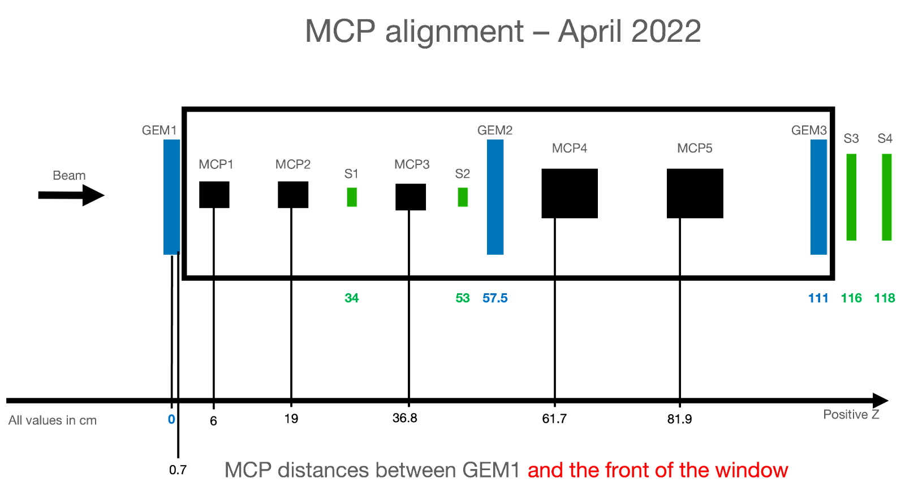
RD51 Test Beam Setup
Slots for DUTs
Picosec sketch
Standard configuration:
3mm MgF2 radiator
12nm CsI photocathode
200um drift gap
128um thick mesh
100um amplification stage
Gas→Ne/C2H6/CF4 (80/10/10)
MCP for time reference (σt≈5ps)

Slide 2
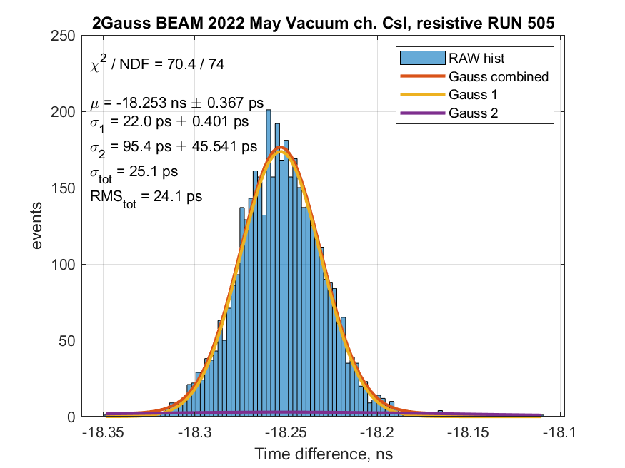
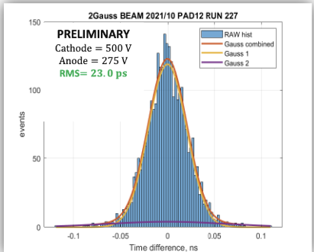
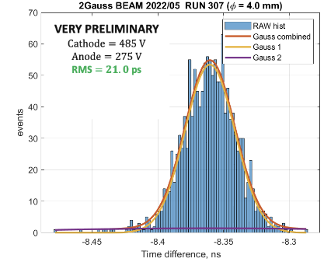
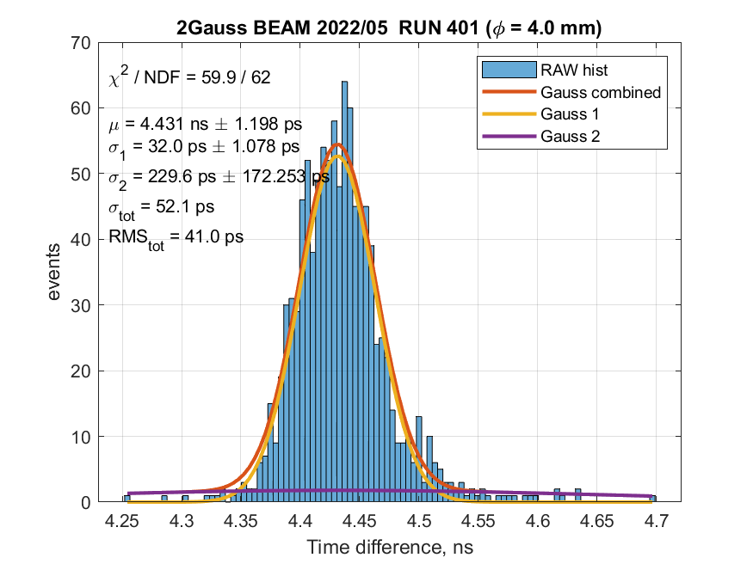
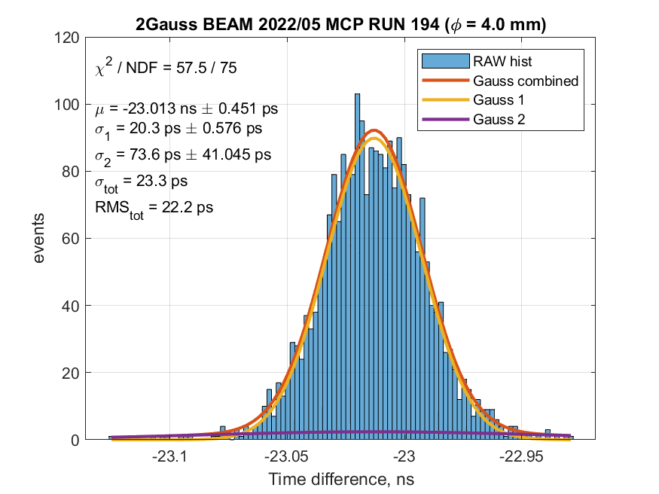
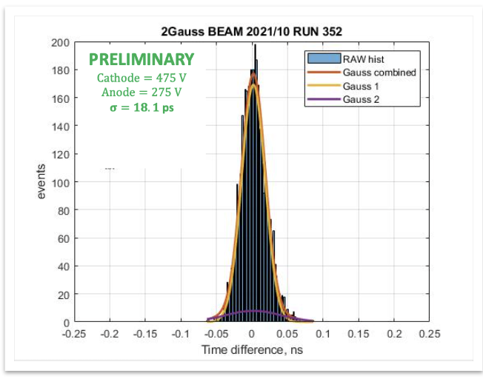
Preliminary results RD51 PicosecMM
We participated in the RD51 test beam in May/June 2022
RMS=24ps
Baseline detector
Resistive MM
RMS=23ps
RMS=21ps
10x10
Single-pad
New gap and mesh configurations
B4C photocathode
RMS=41ps
RMS=22ps
RMS=18ps
Thin-mesh
Thin-gap

Slide 3
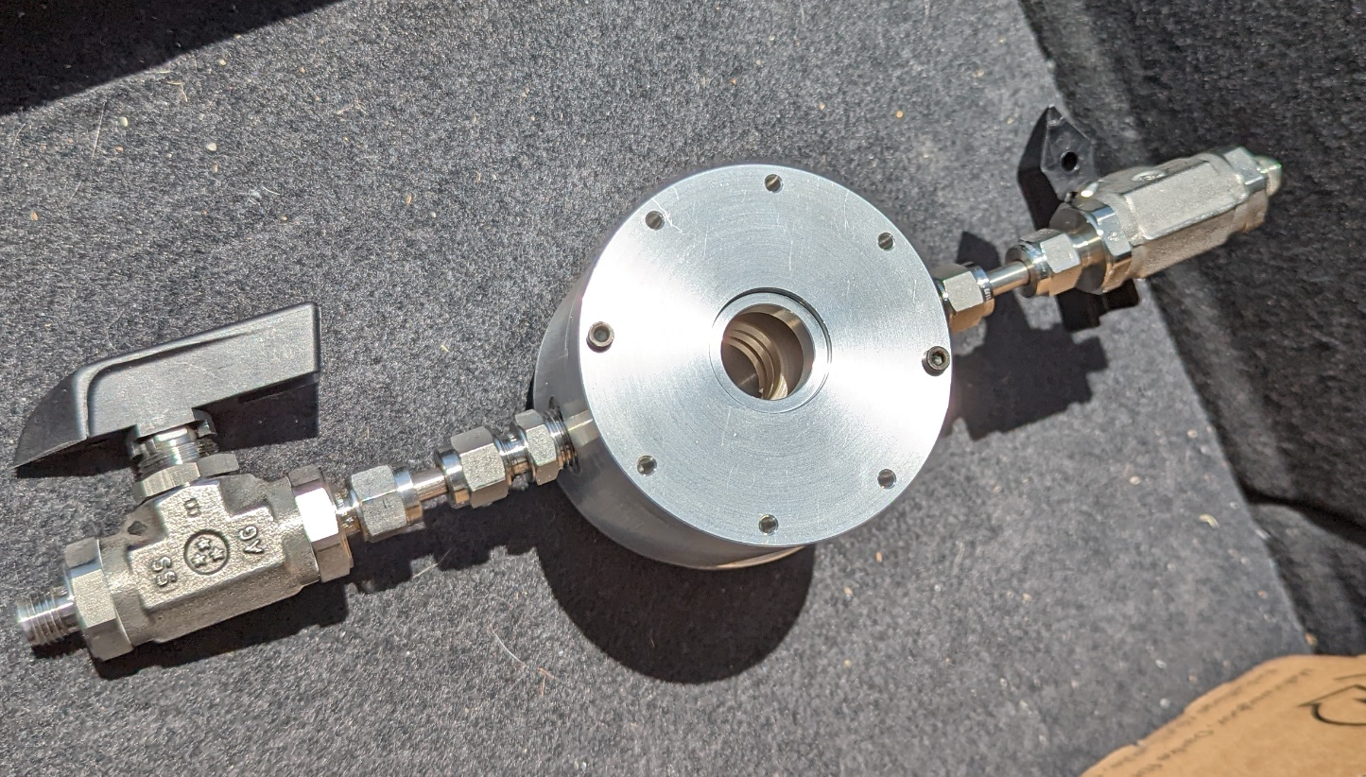
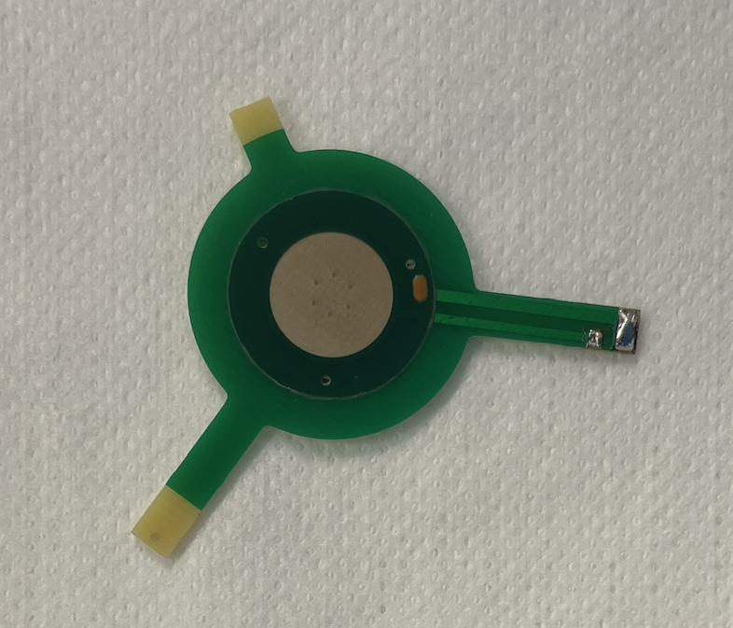
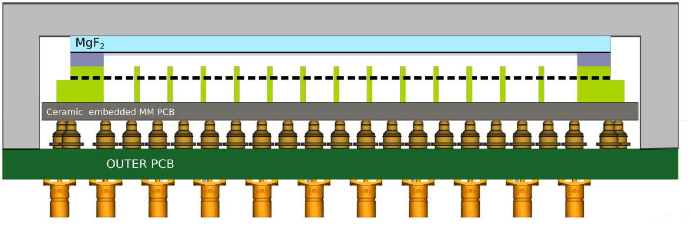
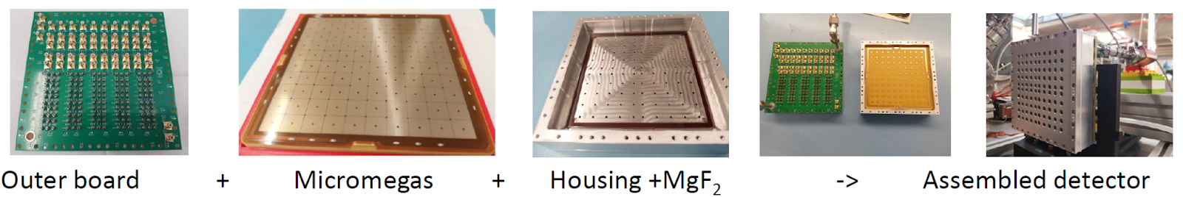
Status R&D PicosecMM
Pavia single-pad detector:
Micromegas from RD51
Still waiting for radiators (shipping before the end of July)
CsI deposition @ CERN in one/two days from arrival
Start of calibration in August @ GDD lab
Participate in RD51 October test beam as parasites
Pavia multi-pad detector:
Still waiting for radiators (shipping before the end of July)
Micromegas order placed @ Rui’s lab
  Should be ready before the end of September
Housing and readout board to be produced after the arrival of the components
Start of calibration expected in October/November

