Slide 1
CUPRUM-TTD ^{67/64}CU PRoduction and Use in Medicine – Target Technology Development
CSN5 INFN new research project proposal (2023-2025)
J. Esposito (RN e LNL) Sezioni partecipanti (FE, MI, PD) + UNIPD / UNIFE / SCDC (Negrar, VR) / IOV/ Padua Univ. Hospital /ICMATE CNR Padua )
P. Martini responsabile locale INFN-FE
New research project proposal to CSN5 INFN, July 1th , 2022

Slide 2
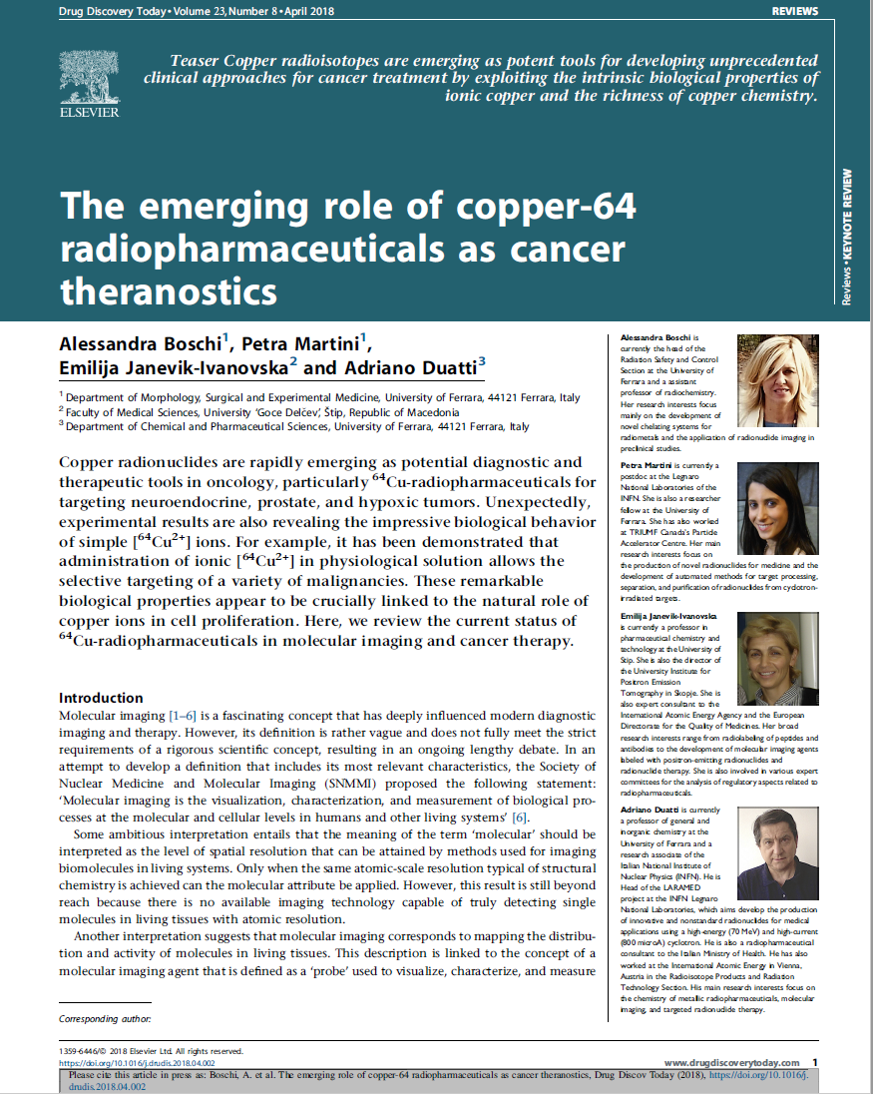
State of the art and background experience on emerging Cu radiometals
Cu-67 (T_{1/2} 62 hrs) promising radionuclide for Theranostic and Radio Immuno Therapy (RIT) applications, as single isotope, or in pair with ⁶⁴Cu (β^{+/-}emitter, T_{1/2} 12.7 h).
⁶⁴Cu is ALREADY used in nuclear medicine for PET diagnostic procedures
⁶⁴Cu seems to provide excellent results also in THERAPY (under simple ⁶⁴CuCl₂) for brain tumors
What will it happen by using ⁶⁷Cu ?
⁶⁷Cu‘s limiting factor: Still lacking a REGULAR availability worldwide
Only recently become available in US in enough quantities for medical research applications (DOE-IP)
Production capability upon request @ ANL-LEAF via ⁶⁸Zn(γ,p) nuclear reaction (BNL through the ⁶⁸Zn(p,2p)
→ ⁶⁷Cu future supply in Europe: Goal both for ARRONAX and LARAMED!!!
Theranostic = Therapy + Diagnostic
Notes:
Intro sui rami :
2 - spiegazione TERANOSTICA sia come isotopi singoli sia come miscela dei due

Slide 3
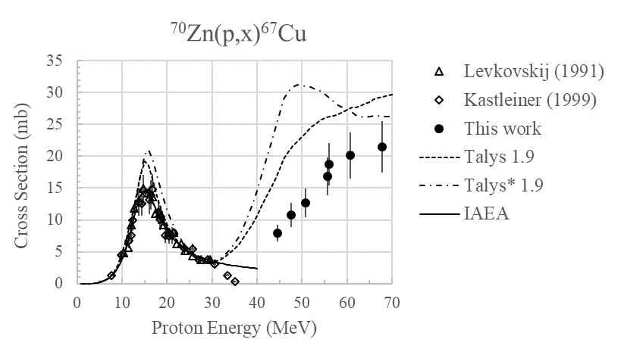
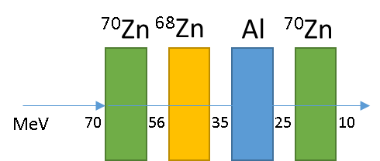
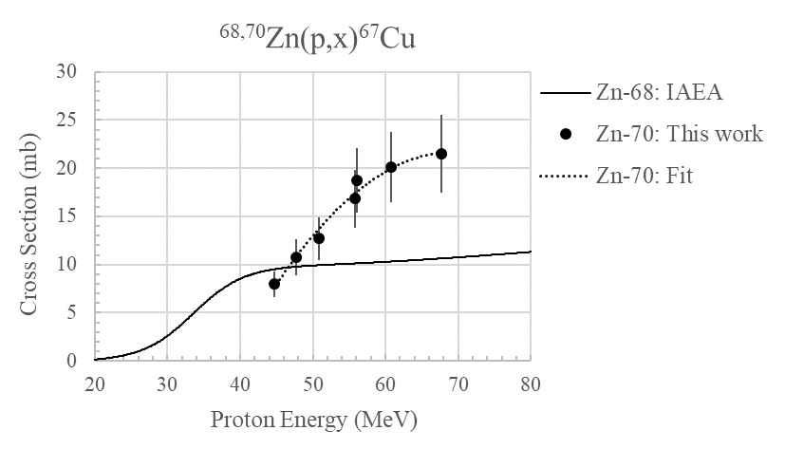
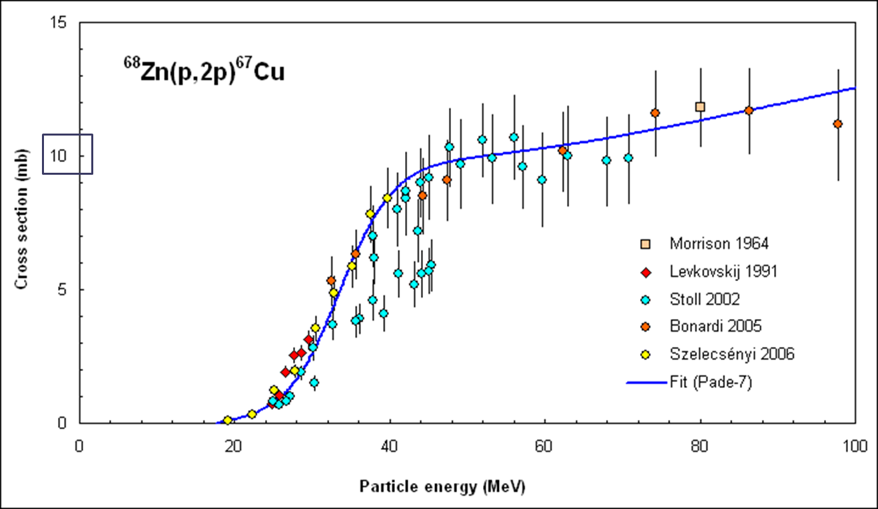
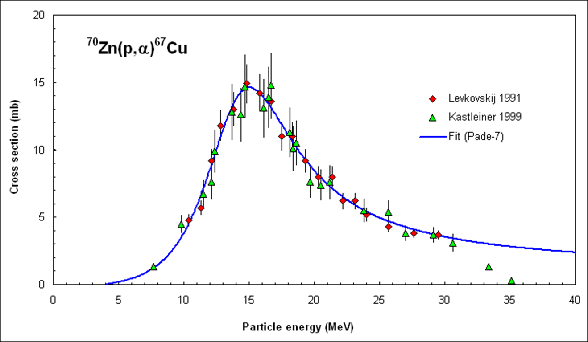
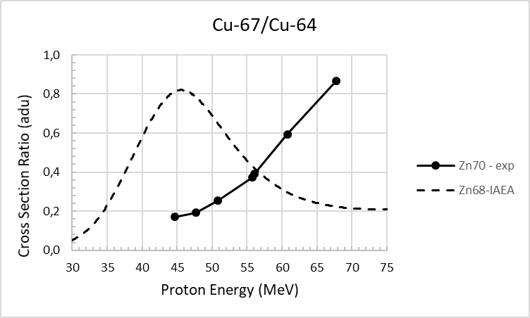
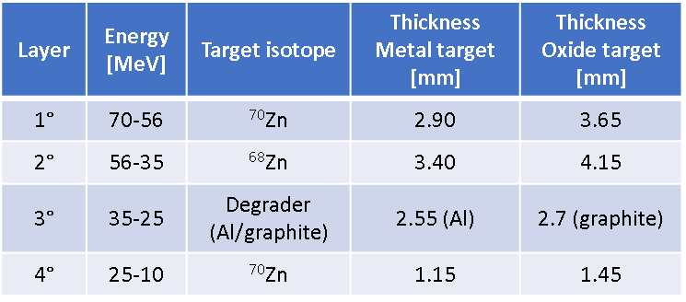
COME prj. Results and Patent:
No Cu-64 production
⁷⁰Zn(1)
⁶⁸Zn
⁷⁰Zn(2)
A multi-layer ⁷⁰Zn/⁶⁸Zn target produces about 45% more ⁶⁷Cu and 17% less ⁶⁴Cu in comparison with ⁶⁸Zn targets! (T_{irr} = 62h) in the range 70-35 MeV
⁶⁷Cu production yield ≈2 GBq/µA
(62 h irradiation)
L. Mou, G. Pupillo, P. Martini, M. Pasquali WO 2019/220224 A1, EP 3 794 615 B1

Slide 4
CUPRUM-TTD (2023-2025) research project development
In view of the next preclinical/clincal applications the goal of the current research proposal is therefore to develop beforehand a reliable technology aimed at producing clinical-grade batches of ⁶⁷Cu- ⁶⁴Cu, on a routine basis by small medical cyclotrons.
Main project GOALS:
to acquire a robust and reliable target manufacturing technology to produce ⁷⁰ZnO target (and ^{nat}Ni targets for first ⁶⁴Cu yield batches from ⁶⁴Ni(p,n)⁶⁴Cu at a later stage );
to design and construct proper targets, able to sustain beam power levels from medical cyclotrons (i.e. 18-20 MeV, 2/3 kW max);
to develop/optimize the radiochemistry separation/purification methods: Zn→Cu to achieve a clinical-grade ⁶⁷Cu radionuclide;
Implementation of in-vitro survival studies;
Pre-clinical and clinical phantom imaging;
to develop /optimize technology for the costly ⁷⁰Zn-enriched target material recovery.

Slide 5
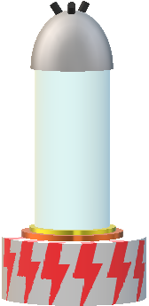
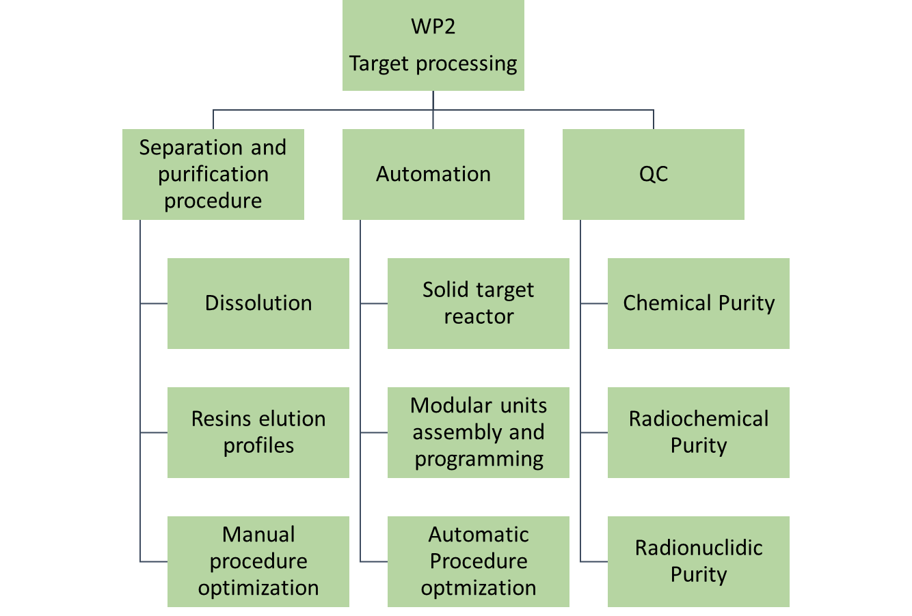
CUPRUM-TTD WP2: Target radiochemistry processing
Separation and purification procedure development:
cold tests nat ZnO
ICP(OES) characterization @UNIFE
Automated module prototype development
Purchase of modular units
Hot test natZnO
Quality Control (QC) assessment on RCP:
Hot tests 70ZnO
Milestones and deliveries planned
M5: development of separation and purification procedure using cold targets of ^{nat}ZnO M6: development of a semi-automatic system for the separation and purification of Zn/Cu M7: productions tests of ⁶⁷Cu by using enriched target and determination of the extraction yield and purity of the final product. M8: QC analysis on ⁶⁷Cuproduced and isolated for pharmaceutical studies
D7: Zn/Cu separation and purification procedure D8: semi-automatic module for the separation and purification of ⁶⁷Cu from ZnO target D9: ⁶⁷Cu radiochemistry product quality assessment

Slide 6
CUPRUM-TTD project 2023 Distribuzione FTE partecipanti al Progetto
LNL | FTE | INFN-Fe | FTE | INFN-Mi | FTE
Esposito J. (R.Naz.-Loc.) | 0.5 | Martini P. (R. Loc) | 0.55 | Groppi F. (Res. Loc) | 0.4
Pupillo G. | 0.2 | Di Domenico G. | 0.1 | Manenti S. | 0.3
Mou L. | 0.2 | Taibi A. | 0.1 | Cagnetta F. | 0.4
Sciacca G. | 0.5 | Boschi A. | 0.7 | Bolchini F.C.** | 1.0
Cisternino S. | 0.4 | Uccelli L. | 0.5 |  | 2.1
Melendez-Alafort L. | 0.4 | Marvelli L.* | 1.0
Bello M. | 0.8 | Carnevale A.* | 1.0
Kotliarenko A. | 0.5 |  | 3.95
Keppel G. | 0.1
Anselmi-Tamburini U. | 0.2 | INFN-Pd | FTE
Borsista*** | 1.0 | De Nardo L. (R. Loc) | 0.5
 | 4.8 | Canton L. | 0.1 | TOTALE FTE | 12.35
 |  | Zorz A. | 0.2
 |  | Paiusco M. | 0.2
 |  | Cecchin D. Bolzati C. | 0.2 0.2
 |  | Barbaro F. | 0.1
 |  |  | 1.5
* associazione INFN-Fe da settembre 2022
** associazione INFN-Mi da settembre 2022
*** contratto da firmare a ottobre 2022

Slide 7
Summary overall budget request CUPRUM FY2023
Sezioni / Lab | Missioni | Consumo/ Altri consumo | Trasporti | Manutenzione | Inventario | apparati | Sp- servizi | Tot. per sez/lab | FTE previsto
LNL | 10.0 | 27.0 |  |  |  | 26.0 |  | 63.0 | 4.8
Fe | 2.5 | 18.0 |  |  |  |  |  | 20.5 | 4.0
Pd | 0.5 | 4.0 |  |  | 7.5 |  |  | 12.0 | 1.5
Mi | 8.5 | 5.0 | 7.5 | 4.0 |  |  |  | 25.0 | 2.1
TOTALE | 16.5 | 52.0 | 15.0 | 4.0 |  | 18.0 |  | 120.5 | 12.4
Consumables: solvents, glassware, chemical products Materials to assess the QC of the product
Synthesis of the RPh
Chemical analyses: ICP(OES) characterization
Domestic travels for meetings and experimental activity at the SCDCH (Negrar –VR) cyclotron unit
Budget request outlook CUPRUM-TTD FY2024 ~ 180 kEuro (circa 110 kEuro modulo automatic WP2 INFN-FE)
FY2025 ~ 70 kEuro
TOTAL BUDGET request (3yrs) ~ 370 kEuro

Slide 8
GRAZIE

