Slide 1
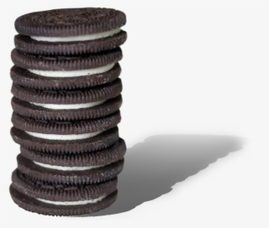

The OREO experiment
ORiEnted calOrimeter
2023-2024
L. Bandiera
National coordinator
INFN - Ferrara
D. De Salvador
local coordinator
INFN - Legnaro Lab
M. Prest
local coordinator
INFN - Milano Bicocca
01/07/2022 CDS Ferrara

Slide 2
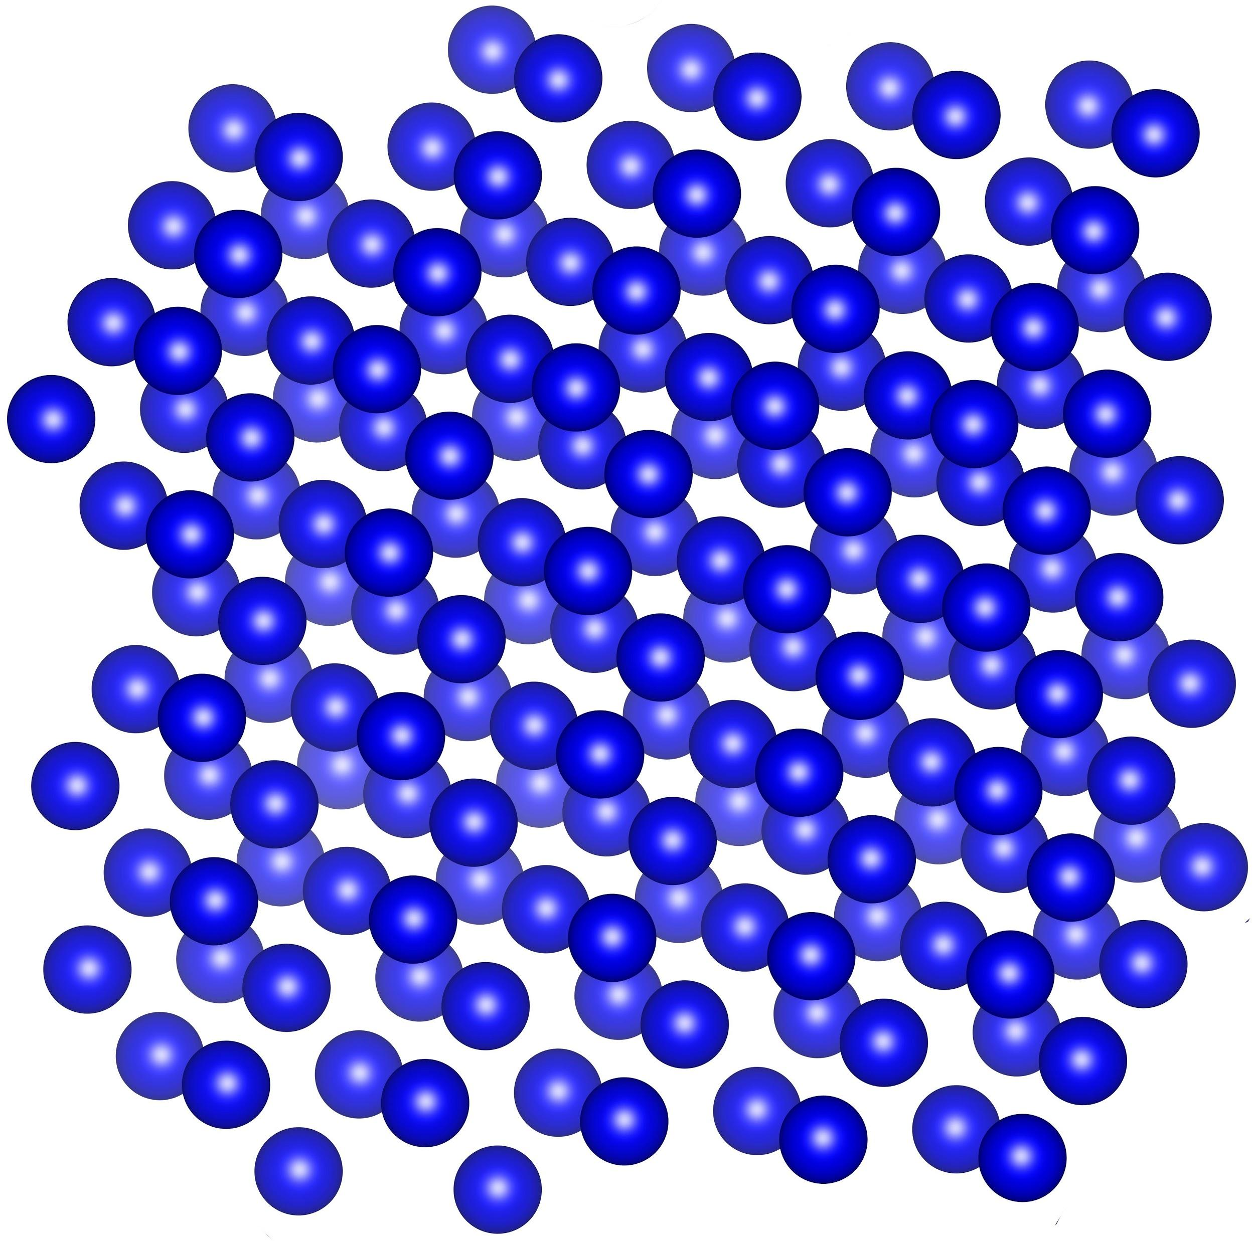

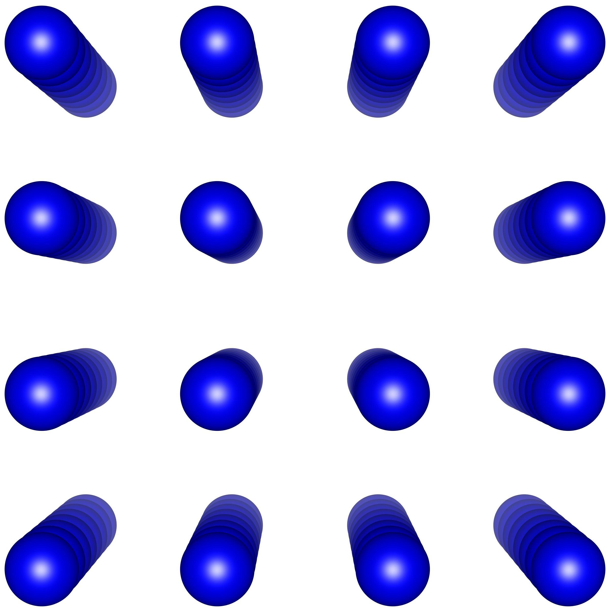
Electromagnetic shower acceleration in oriented crystals
The strong crystal field stimulate intense hard-photon emission by e±, as well as intense pair production by photons when the primary particle trajectory is aligned with a main crystallographic direction.
electromagnetic shower is way
more compact
or equivalently
effective radiation length X₀ is
much shorter
the modern electromagnetic calorimeters are designed for experiments at energies of hundreds of GeV/TeV and these enhancement effects are expected to be quite important in this energy range
the input photon or electron/positron showers can fully develop in a much lower thickness with respect to the current state-of-the-art detectors

Slide 3

OREO idea: realization of an ultra-compact crystal-based calorimeter
The main goal of the project will be the construction of a calorimeter prototype based on oriented crystals and its experimental test with e± or gamma beams in an energy range interesting for applications (from 1 to few hundreds GeV).
We expect to demonstrate the possibility to contain e.m. showers initiated by particles with energies even above 100 GeV in a reduced volume/weight (and cost!!) and the scalability of OREO technology to large calorimeters needed by realistic experiments.

Slide 4
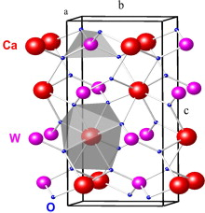
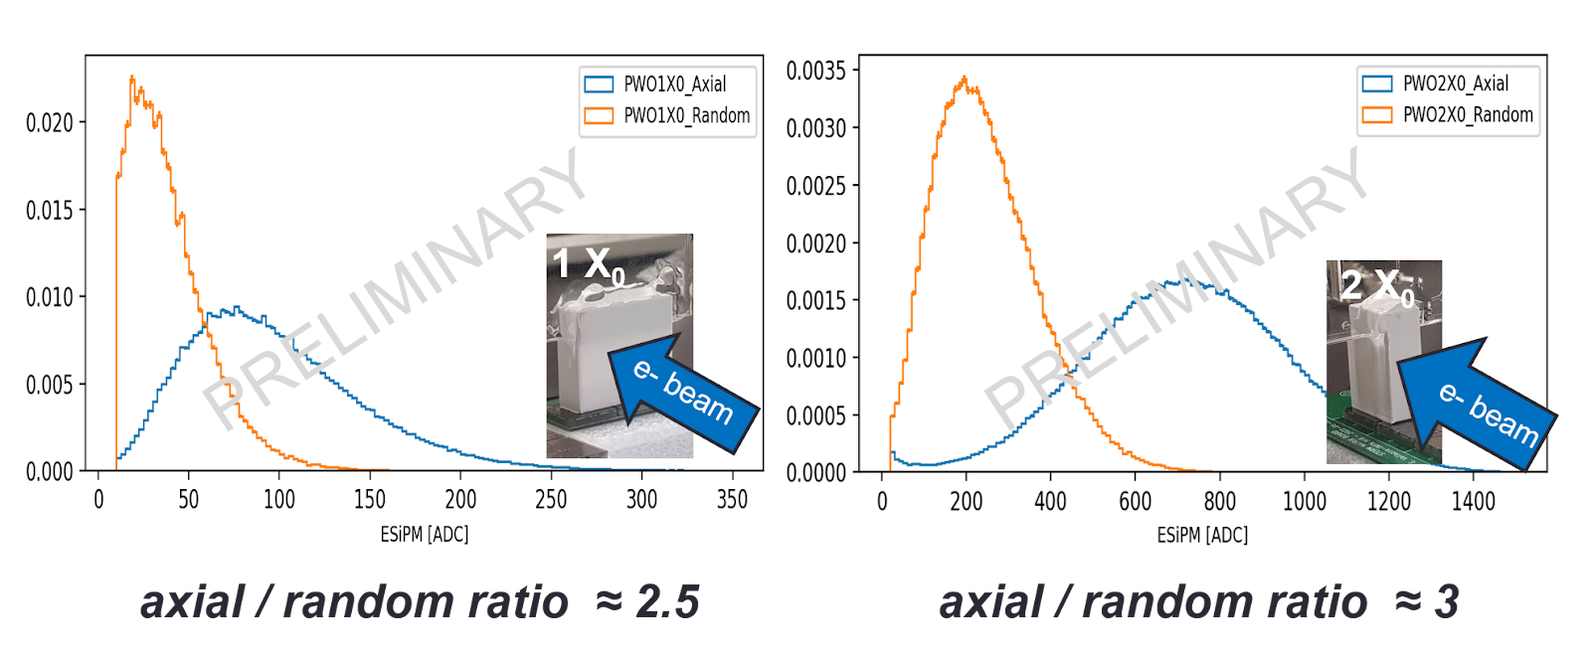
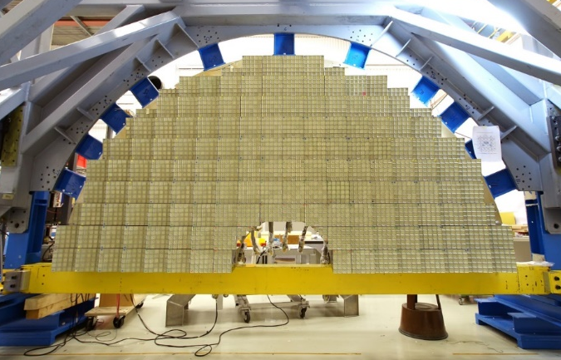
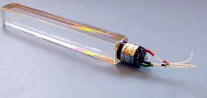
Starting point: the CSN5 STORM results with single crystalline samples
Scintillation light enhancement in axially oriented crystals
Pb
CMS ECAL endcap made of PWO crystals
  e⁻ at 120 GeV/c interacting with PWO crystals
PWO
N.B. Within ELIOT and STORM experiments, several scintillator (PWO, BGO, CsI, YAG) and a Cerenkov (PbF2) crystals. All the tests demonstrated an increase in the electromagnetic processes

Slide 5
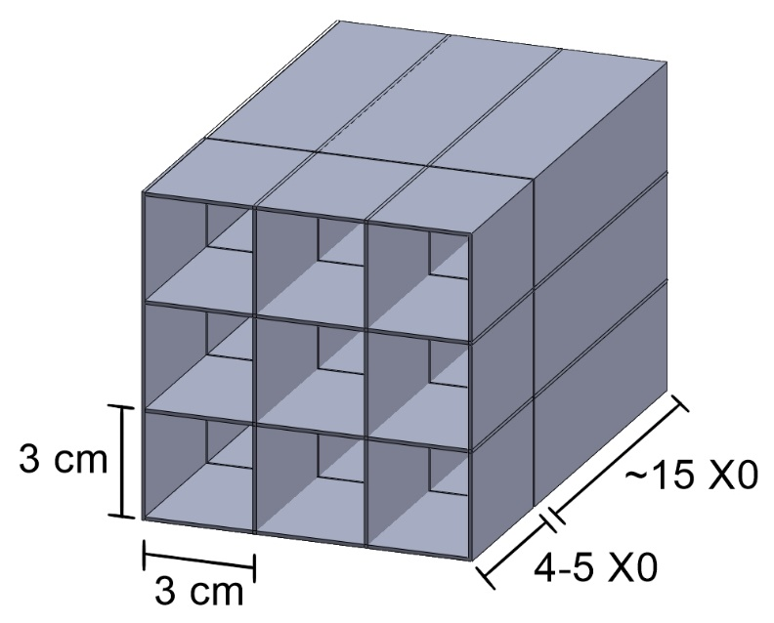
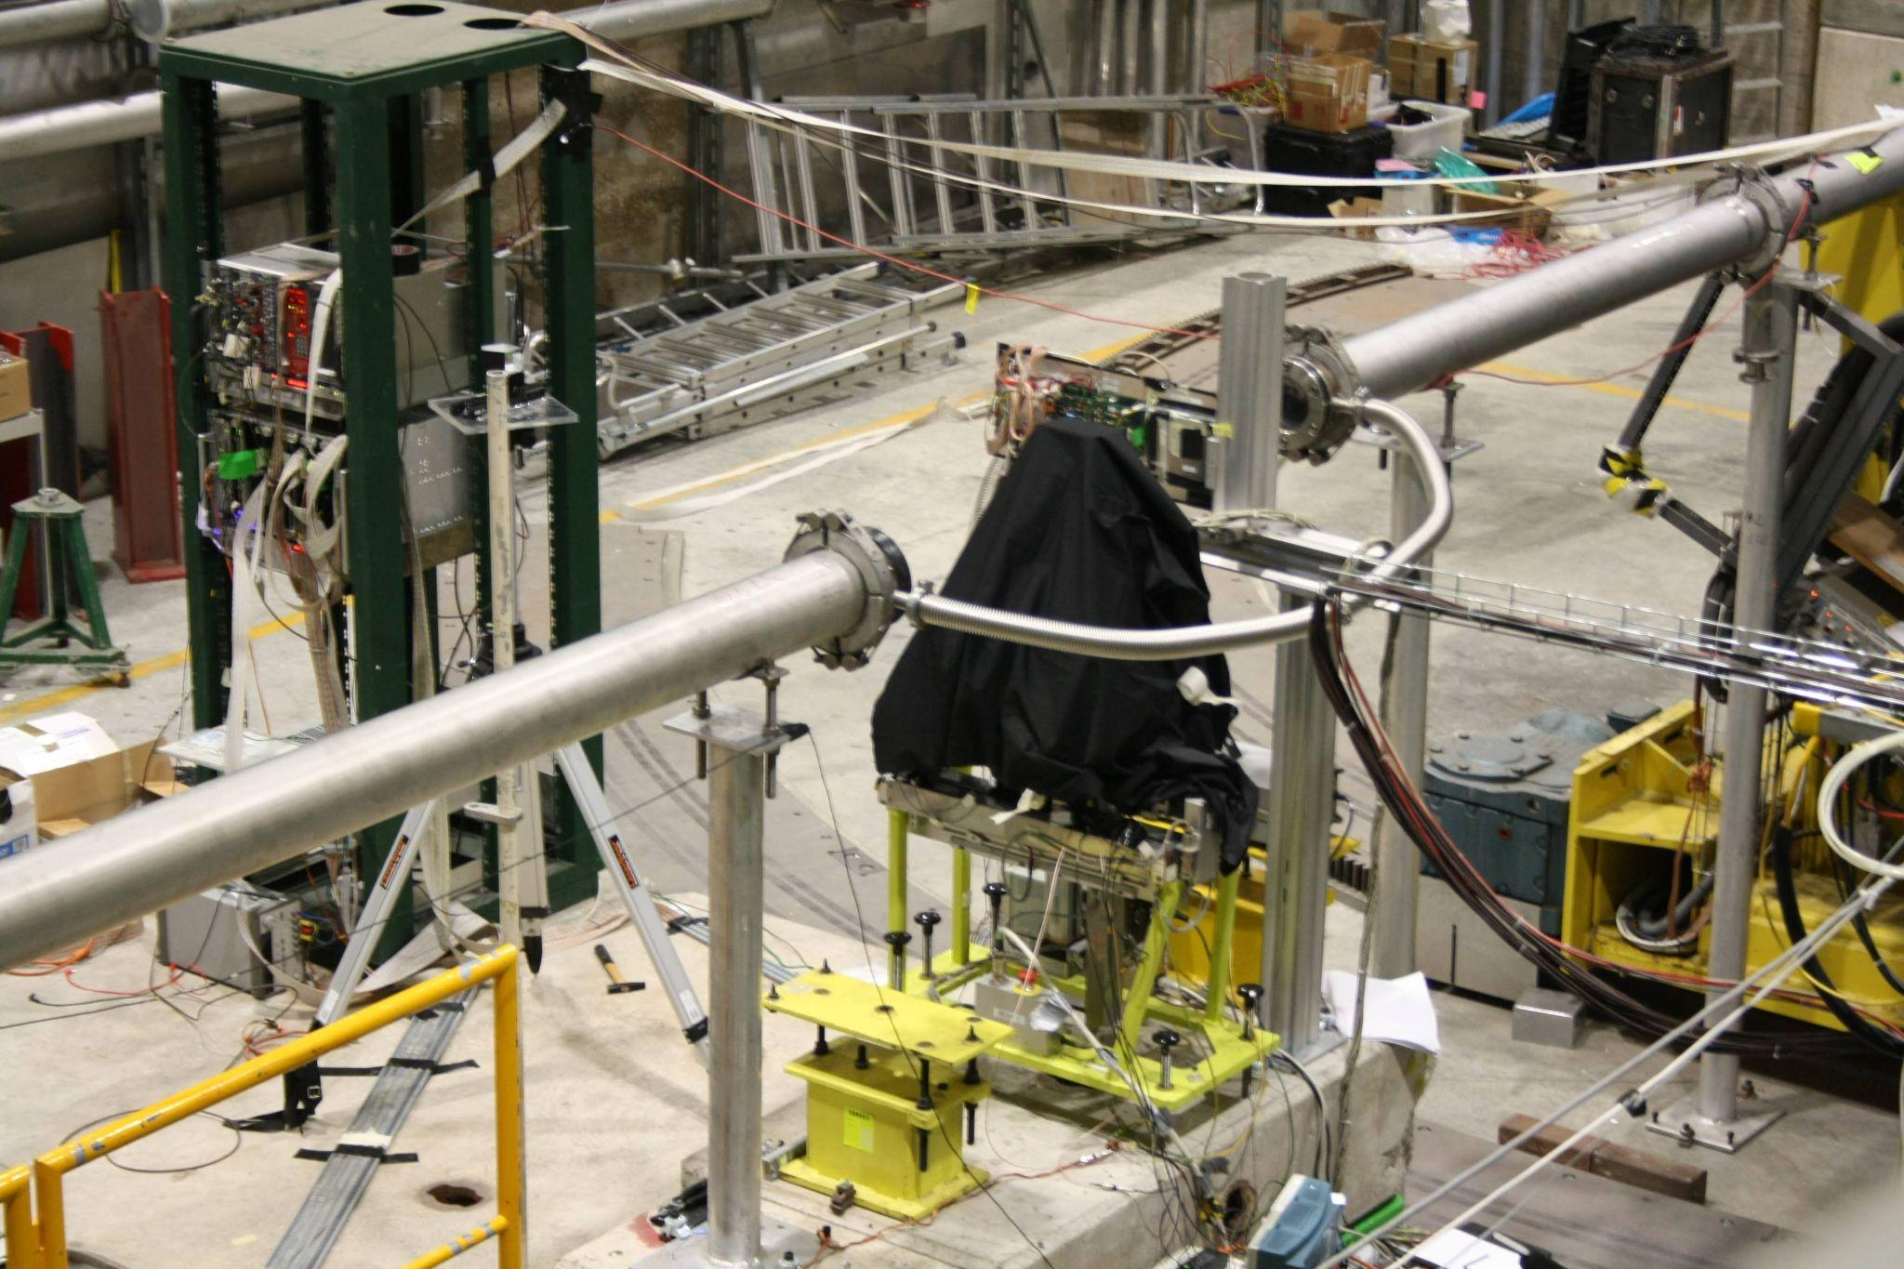
OREO methodology
Selection of materials: Ultrafast PWO scintillator (PWO-UF*): good crystallographic properties; scintillation decay with a time constant of 640 ps at a light yield of 7 phe/MeV and a high radiation tolerance to the electromagnetic component of ionizing radiation. It is considered a candidate for dual readout of scintillation and Cherenkov photons in electromagnetic calorimetry at future colliders.
Prototype construction: realization of a 3x3 matrix of oriented PWO-UF crystals and of the SiPM based readout system, with the development of a technology applicable to large calorimeters;
Experimental test: at CERN PS&SPS with 1-100 GeV electron beam, with the determination of all the crucial parameters:
  X₀ reduction vs. beam energy/crystal orientation and its reproducibility in different samples;
  Dependence of energy deposition, scintillation light, Moliere radius, vs. crystal-to-beam orientation;
Comparison with Monte Carlo simulation to demonstrate full control of the physical processes.
10
*M. Korjik et al., Ultrafast PWO scintillator for future high energy physics instrumentation, NIM A, 1034 (2022) 166781

Slide 6
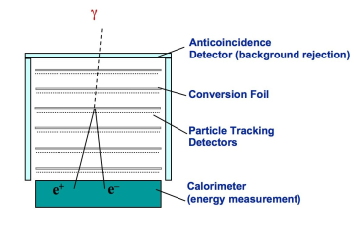
Possible application of an ultra-compact calorimeter made of oriented crystals
Particle Physics
Astroparticle
in fixed-target experiments, which are intrinsically forward, to realize compact electromagnetic calorimeters or preshower with reduced volume w.r.t. to the state-of-the-art (collaboration with the NA62/KLEVER experiment on rare kaons decay at CERN)
in dark matter search, to realize compact active beam dump with an increased sensitivity to light dark matter, such as dark photons etc…
pointing a telescope towards a source, thus measuring the spectrum of γ-rays with energy larger than 100 GeV can be completely contained in a quite compact volume, reducing the necessary weight and cost.
FERMI-LAT
tower
W
CsI crystals

Slide 7
Ferrara team
Nome | Qualifica | % FTE
Bandiera Laura | Ricercatore | 40
Guidi Vincenzo | Prof. Ordinario | 20
Soldani Mattia | Dottorando | 50
Zonta Giulia | Assegnista | 100
Rossi Arianna | Dottoranda | 50
Davì Fabrizio | Prof. Ordinario | 100
Sytov Alexei | Marie Curie fellow | 0*
% FTE Totale |  | 350
*sinergia con Progetto H2020-MSCA-IF TRILLION

Slide 8
Preliminary financial request
Capitolo | Richieste
Missioni interne | 1.5 k
Missione estere | 16 k
Consumo | 25 k
Trasporti | 3 k
Manutenzione | 5 k
Inventariabile | 19 k
Totale | 69.5 k
Richieste finanziarie in via di definizione – richieste offerte dettagliate

