Slide 1
NPQCD (Non Perturbative Quantum Chromodynamics)
Scopo del Progetto: The main purpose of our research program is to investigate the nonperturbative (NP) sector of Quantum Chromodynamics (QCD) and related theories using state-of-the-art numerical and analytic methods.
Sedi partecipanti: Bari, Cosenza, Ferrara, Pisa
Research activities and HPC in NPCD:
QCD in extreme conditions (finite temperature and density, phase diagram in strong magnetic backgrounds, color confinement and deconfinement, topological properties and axion phenomenology)
QCD-like theories (Large-N limit, universality)
Numerical approaches to quantum gravity (CDT)
Exploratory exercises in Quantum Computing
Attivita’ di Ferrara per il 2023:
ottimizzazione di codici lattice based per architetture multi-core e many-core
Experimenting with Quantum Computing

Slide 2
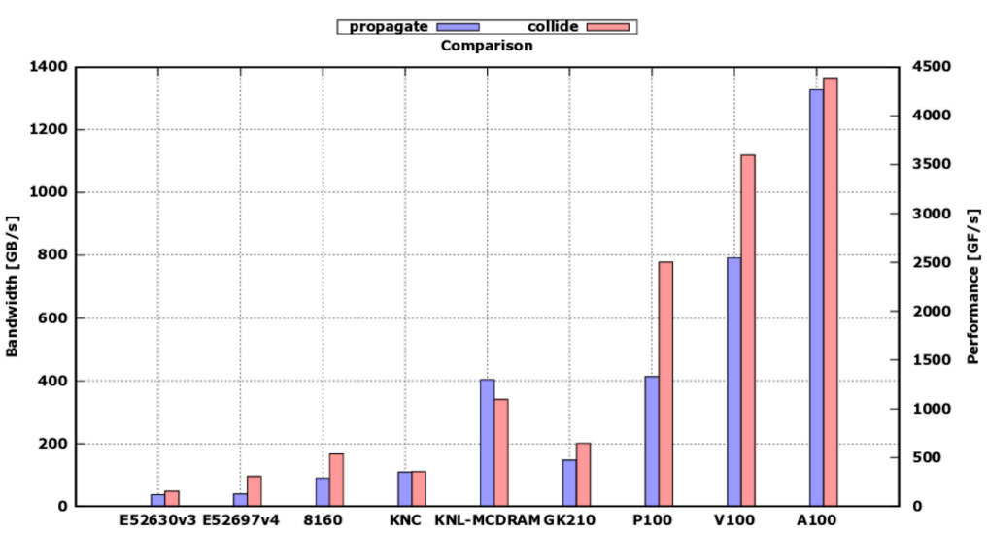
NPQCD

Slide 3
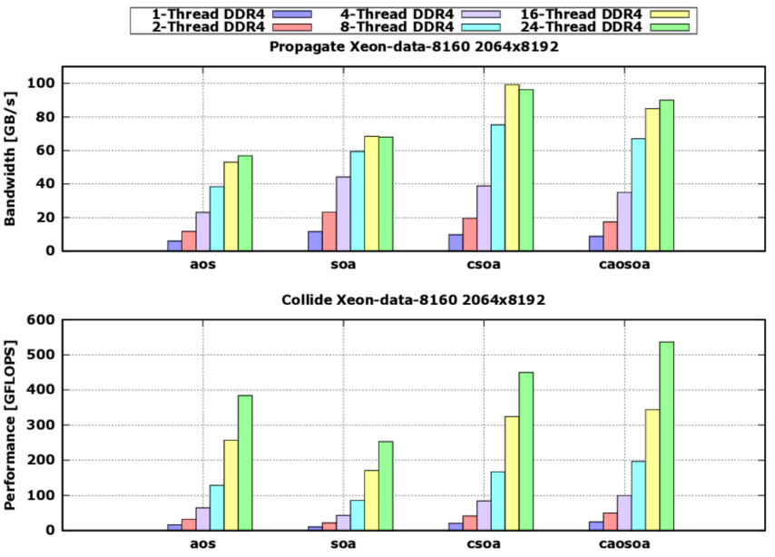
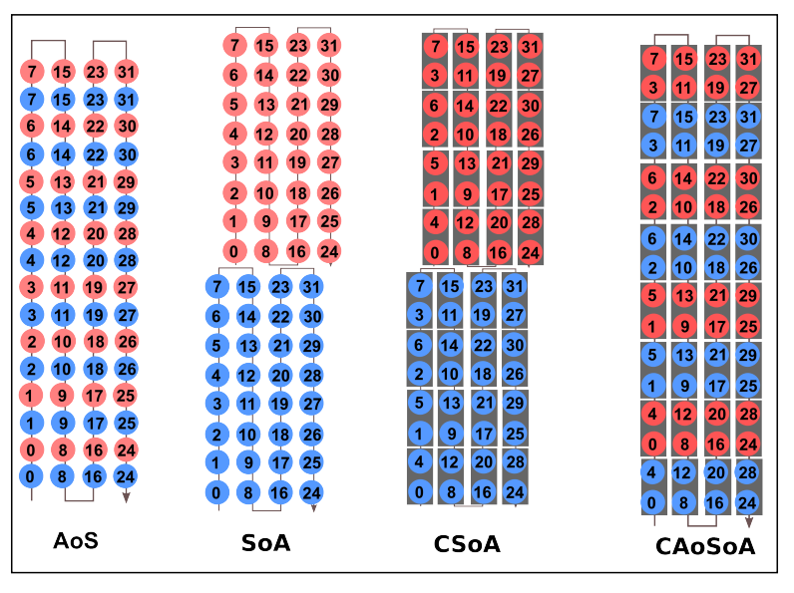
NPQCD

Slide 4
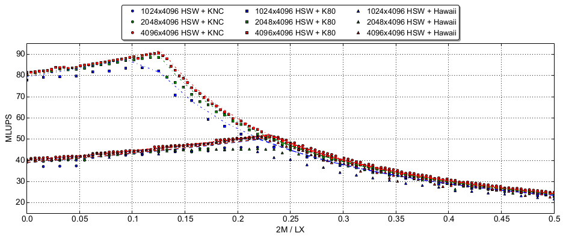
NPQCD

Slide 5
NPQCD
Anagrafica (da confermare):
Fabio Schifano (resp. locale) 0.4 FTE
Enrico Calore 0.2 FTE
Andrea Miola 0.8 FTE
Richieste per missioni (collaboration meeting, etc)

