Slide 1
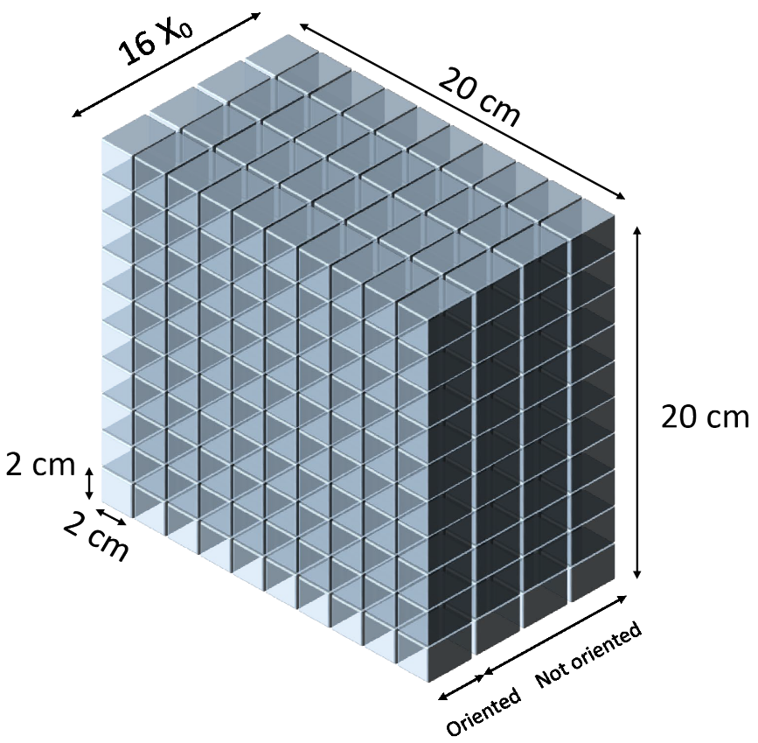
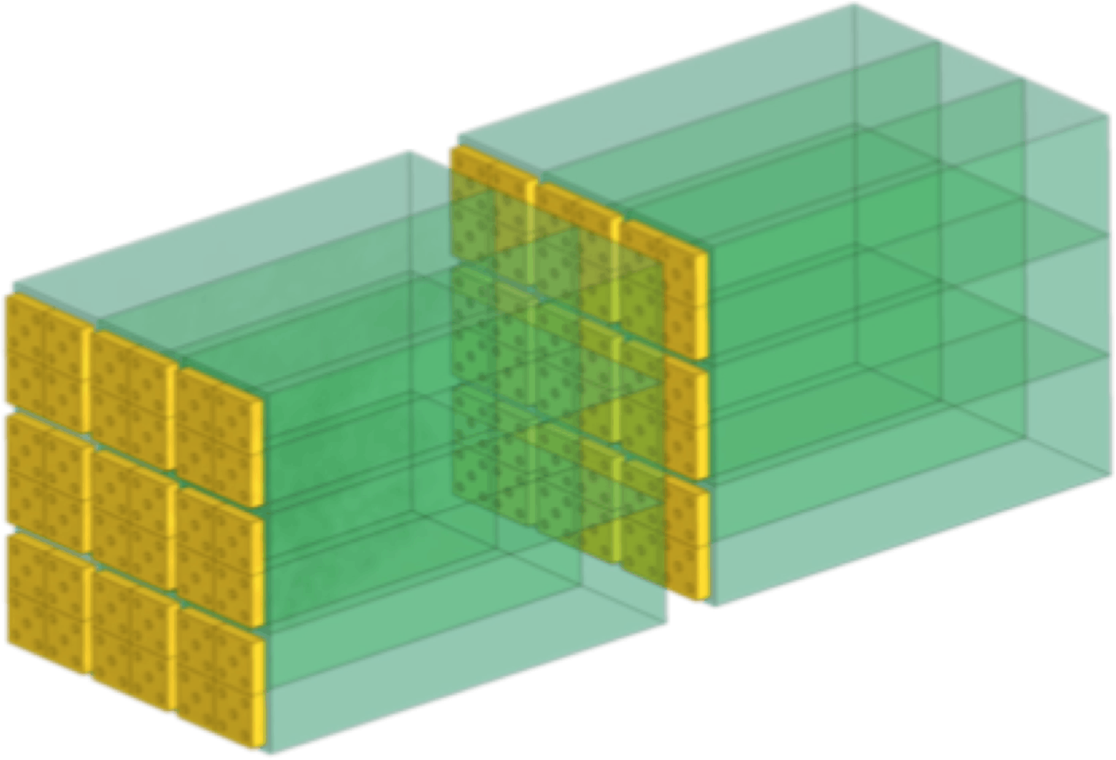
Crystals for forward calorimetry
Development of highly-compact, small-angle electromagnetic calorimeters for intensity-frontier experiments at fixed target
WP8 Calorimeters / PID
3.1 crystal detectors
Task coord. M. Moulson - LNF
  Resistance to > 100 MHz sustained rates
  Time resolution σ_{t} < 100 ps, 2-pulse separation at ~ 1 ns
  Good radiation resistance (10¹⁴ n/cm²)
  An experiment to measure K_{L} → π⁰νν at the CERN SPS (in the NA62 area)
    Good efficiency for detection of photons with E_{γ} > 5 GeV while operated in 500 MHz neutral hadron beam
Select Cerenkov radiator or ultrafast scintillator for use at high rates and radiation doses
Optimize design (e.g. choice of photodetector)
Evaluate performance gains from alignment of crystal axis to exploit effect of coherent interactions
CRYLIN
Sinergy with RD-MUCOL to test CRYLIN prototype
1 week of test beam at CERN SPS in August 2022 in collaboration with the CSN5 STORM team

Slide 2
Preventivi RD-MUCOL 2023
Ferrara

Slide 3
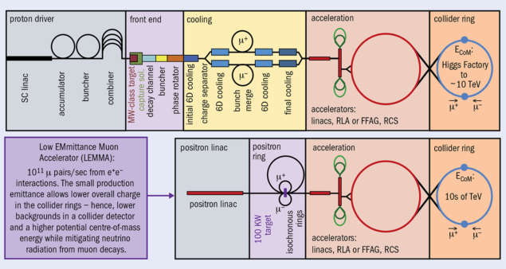

Slide 4
Hybrid crystal-based positron source
(in synergy with FCCee)
Option for FCCee
Option for LEMMA

Slide 5
Hybrid crystal based positron source for future colliders
Project in CHART: Collaboration between PSI and CERN with external partners: CNRS-IJCLab (Orsay), INFN-LNF (Frascati), SuperKEKB (interested in the P3 project) – observer, INFN-Ferrara – radiation from crystals
Attività in corso
Progettazione e realizzazione targette cristalline di tungsten;
Test di irragiamento a MAMI con fasci intensi di elettroni – contributo ad IPAC 2022;
Partecipazione a test calorimetro CRYLIN per Muon Collider in sinergia con AidaInnova e NA62/KLEVER.
Comparable e+ rate at the target exit, but energy deposited in the target and PEDD (Peak Energy Deposition Density), thus, are 34% and 63% respectively lower in the case of the hybrid scheme
L. Bandiera et al., minor revision on EPJC, Crystal-based pair production for a lepton collider positron source
Notes:
The main concern for all positron sources is not only the yield but also the energy deposition and the associated PEDD (Peak Energy Deposition Density). Recent investigations led to the concept of a hybrid source where the crystal-radiator and the amorphous converter were separated by some distance allowing the charged particles emitted in the crystal to be swept off [4]. Moreover, the replacement of the compact converter by a granular one, made of small spheres, seems very promising for the deposited power dissipation. https://www.sciencedirect.com/science/article/pii/S0168583X15001445

Slide 6
ATTIVITà previste per il 2023
  Continuazione ed ottimizzazione dei test di irragiamento delle targhette per valutarne la resistenza;
  Caratterizzazione cristallografica delle targhette prima e dopo l’irragiamento;
  Progettazione e test di altri materiali (Diamante e Iridio) come radiatori alternativi al tungsteno sui fasci di elettroni al CERN PS&SPS;
  Continuazione test del calorimetro CRYLIN in sinergia con le attività di AidaInnova e NA62, con studi di cristalli Cerenkov PbF2 orientati.

Slide 7
Anagrafica Ferrara 2022
 | Ruolo | FTE
Laura Bandiera (RL) | Ricercatrice | 10%
Vincenzo Guidi | PO | 20%
Richieste finanziarie ancora in via di definizione

