Slide 1


Status of MPGD Calorimeter Hardware
Piet Verwilligen

Slide 2
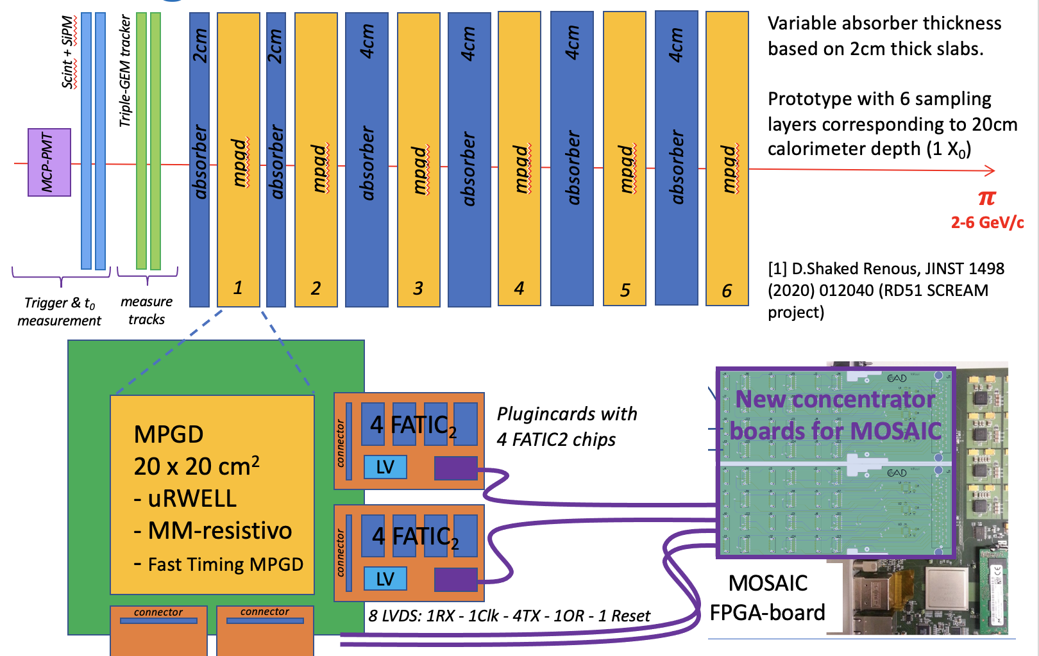
Reminder: MPGD-based HCAL cell
1TX/Fatic
1RX/board

Slide 3
Overview of the work
Design of the 20x20 uRWELL and resistive uMegas
  Design: Feb-May 2022
  Order of Readoutboard placed (ELTOS)
  Assembled detectors expected 15/09
Front-End Electronics
  Design: done in 2021
  Production: finished in 2022
  Wire-bounding of FATIC2 asic on plugin-cards: ongoing
  Order of SAMTEC Firefly Cables: done 2022
  Test FATIC plugin card with MOSAIC (G.De Robertis/F.Licciulli – to start)
Design & Construction of Mechanics
  Design ongoing (final version had to wait for final DET)
Test resistive uRWELL and resistive uMM Detectors
  Test in laboratory – gas leak test – Gain Test
  Test with beams – at SPS with MIPs = test of the DAQ
DAQ SW Development for MOSAIC board
  Need FW code to talk to FATIC chips (G.De Robertis – to start)
  Need SW code to make up entire DAQ for MOSAIC reading out several plugin cards (A.Pellechia – to start)

Slide 4
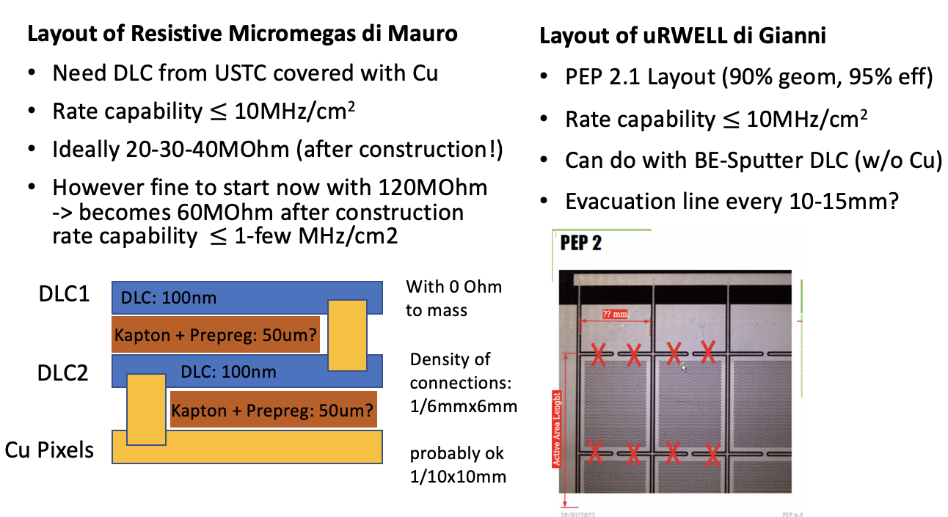
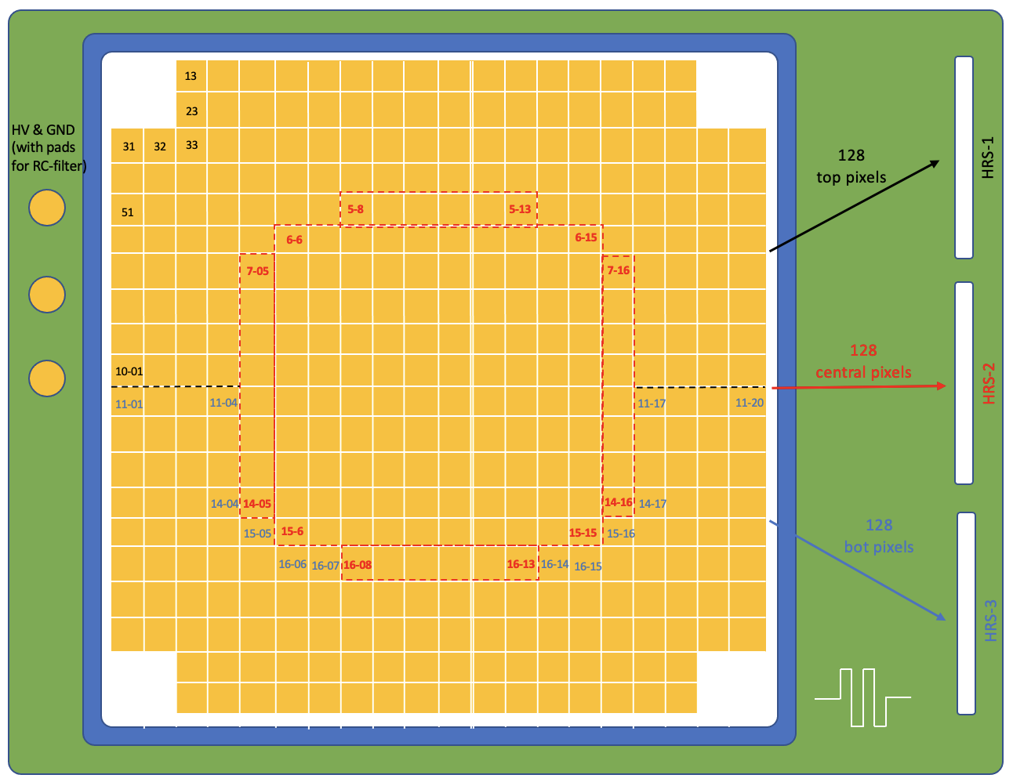
Design 20x20 uRWELL & uMegas
After discussion with RD51 Management we decided to design directly 20x20 detectors
1cm2 pixels: reduce from 400 to 384 (-16) allows to read all channels with 3 connectors
Common Readout board for uRWELL and uMEgas
Discussion on Detection technology for uMegas and uRWELL to adopt: Jan-Feb’22
Preliminar detector design Feb’22 – Discussing costs
Design by CERN MPT workshop March-June ’22
Discussing number of Detectors:
6-8 uRWELL – 3-4 uMegas – 4 RO PCB
Production ROB PCB ELTOS July ’22
Delivery detectors by Rui: 15/09

Slide 5
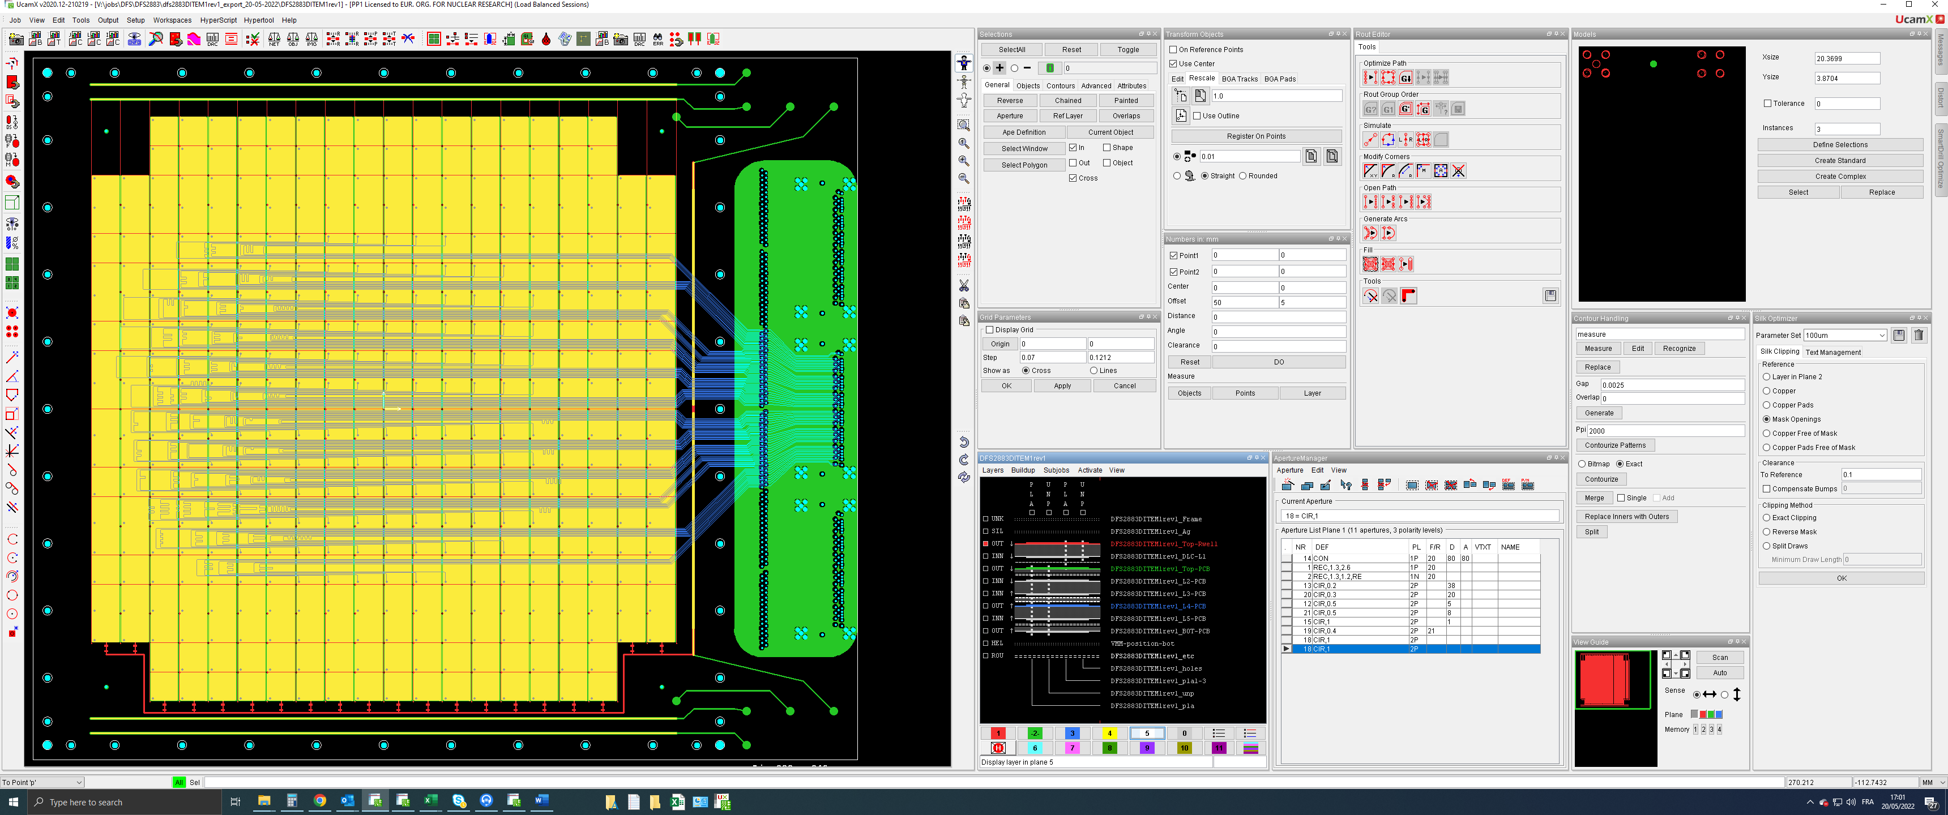
Design 20x20 Readout Board
Common RO board is 6-layer PCB
386 pixels – 3 HRS connectors
Equalized Tracelength
Bertrand Mehl – Rui De Oliveria – CERN MPT Workshop

Slide 6
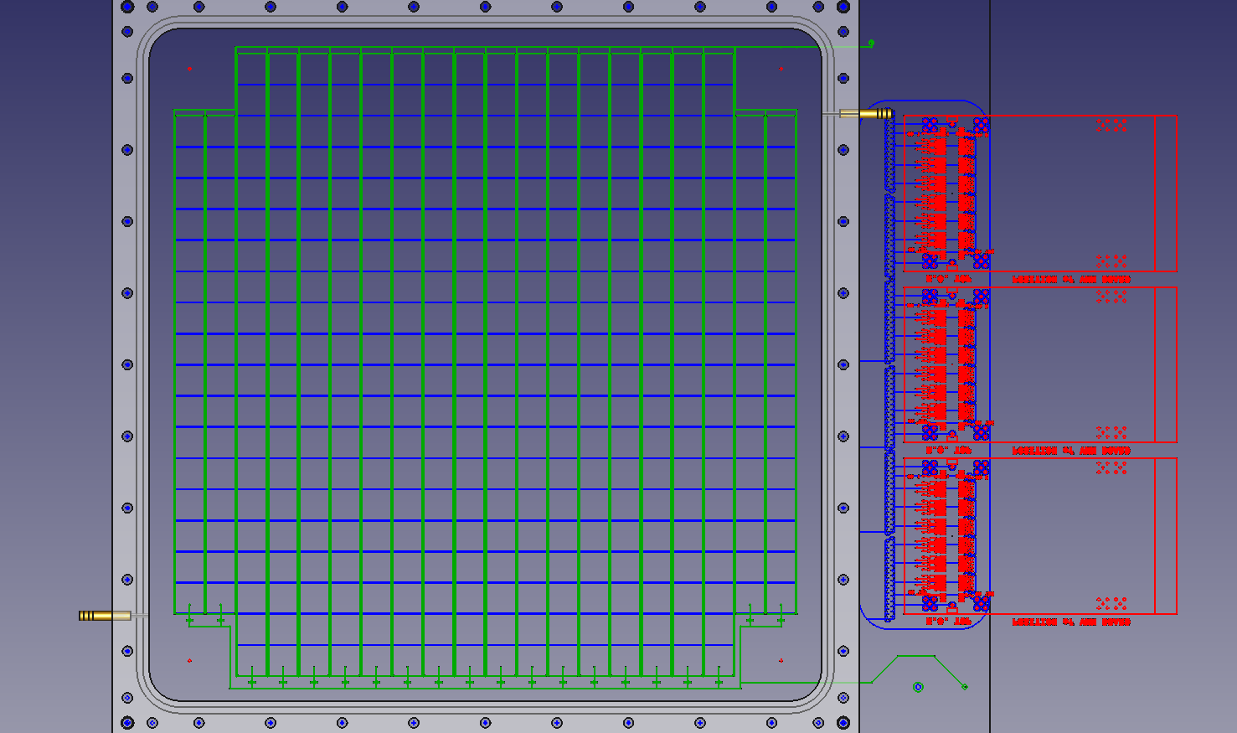
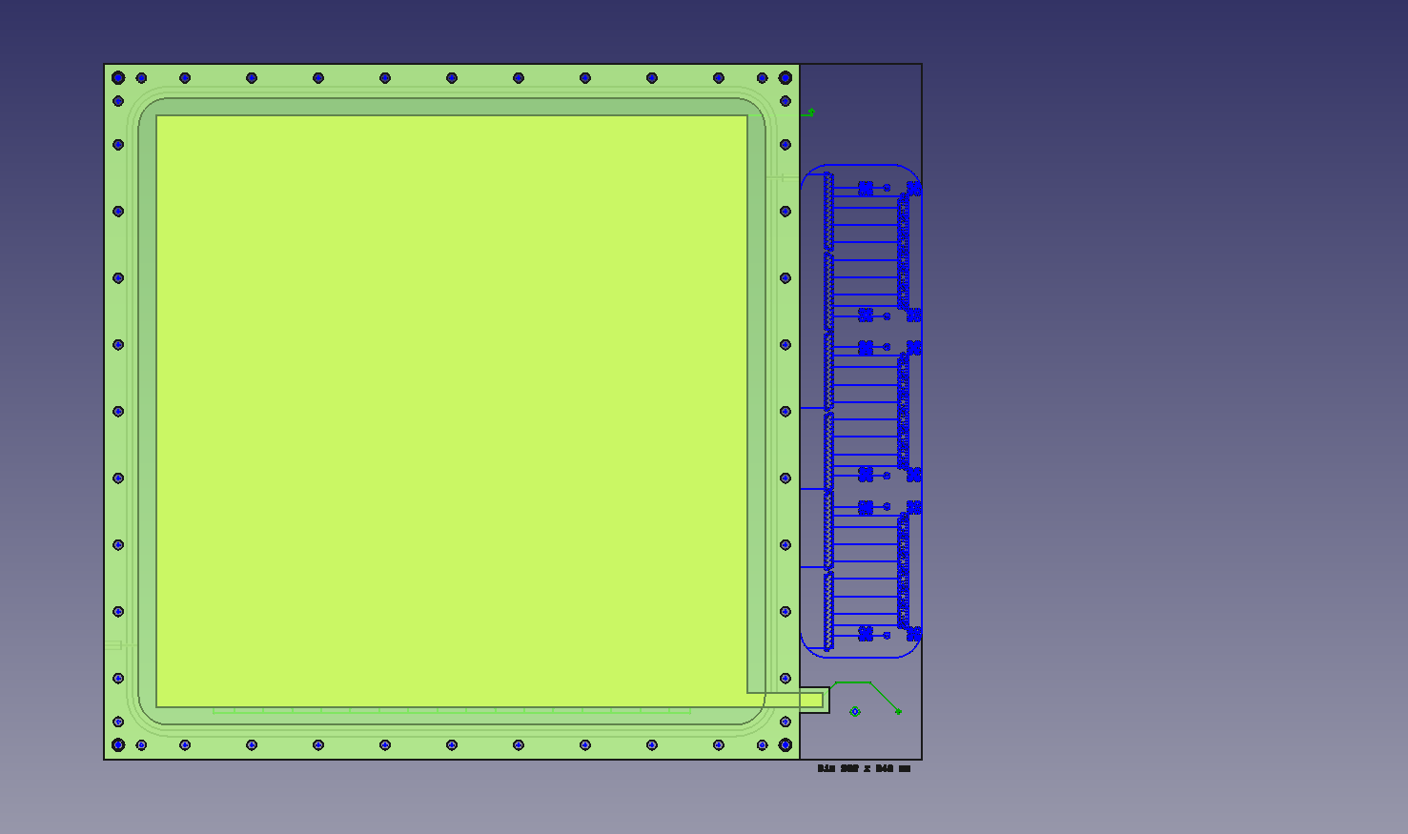
Design of Gas Frame and Cathode
Design delivered by CERN MPT Workshop contains:
  Common Readout board on which both uRWELL and uMegas can be constructed
  Design for uRWELL construction
  Design for uMegas construction
Our side: design of Gas Frame and Cathode board that closes the detector
Gas frame can be constructed at LNF workshop (Peek)
Cathode board designed. Need to ask offer from ELTOS and place order
GF Morello – INFN LNF - Design of Gas Frame
GF Morello – INFN LNF - Design of Cathode

Slide 7
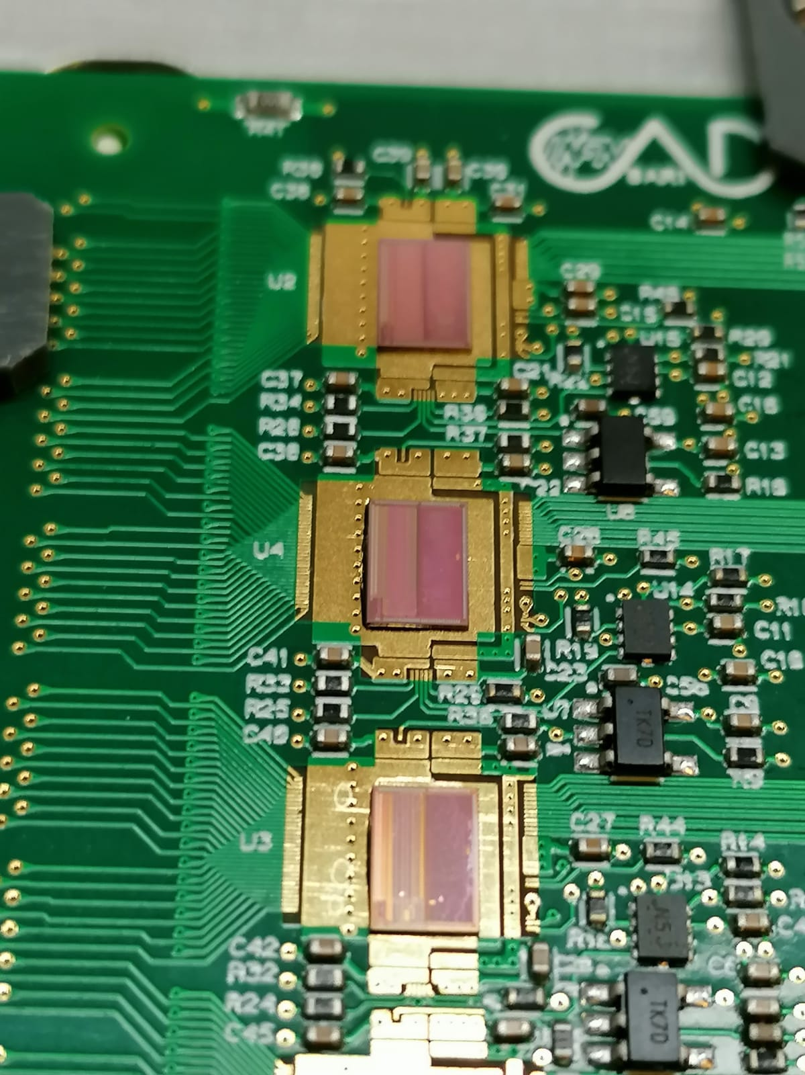
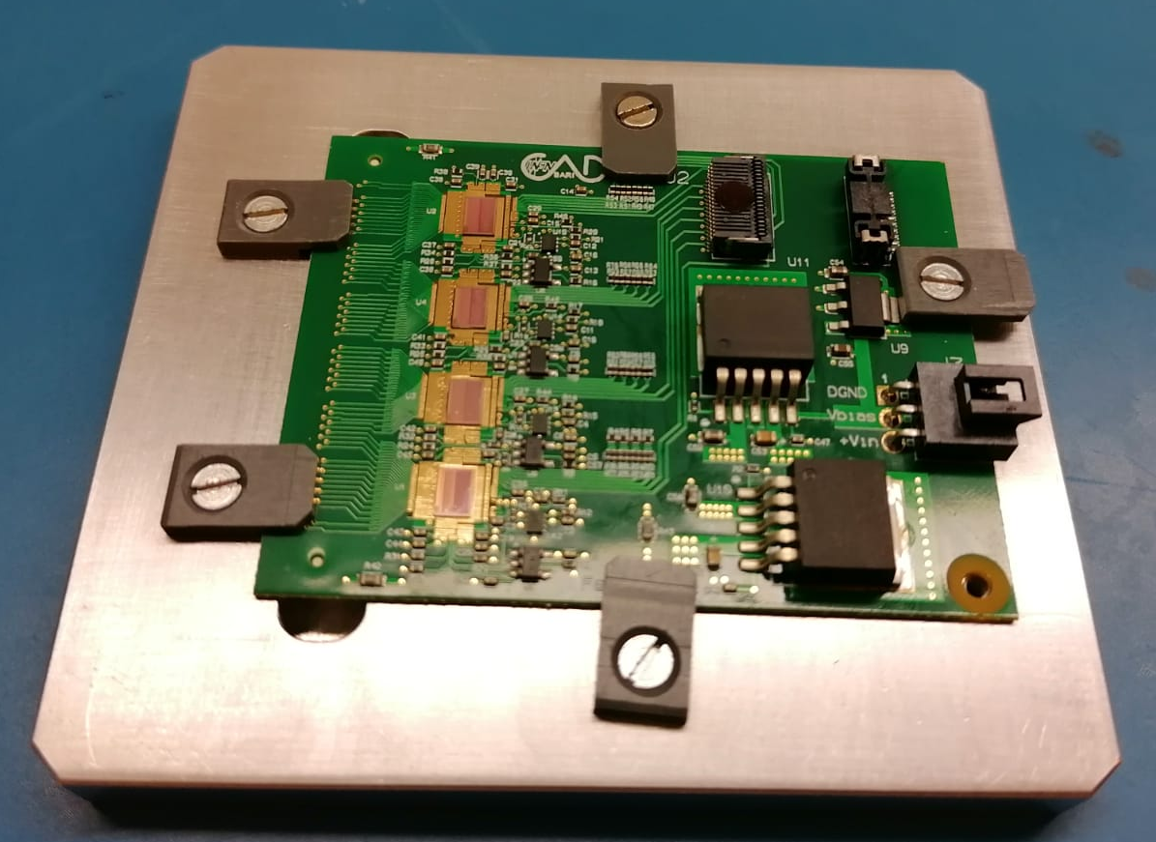
Front-End Electronics: Plugin-Card
Plugin card with HRS connector processes signals from 128 channels
4 FATIC2 asics (32 channels each)
Plugin-card board designed in 2021
Order in Febr’22 – PCB produced and components mounted Jun’22
Currently: chip glueing and wirebounding on 1 card (demonstrator)
In total 18 cards were produced
4 FATIC chips glued on the plugin card
ready for wirebounding

Slide 8
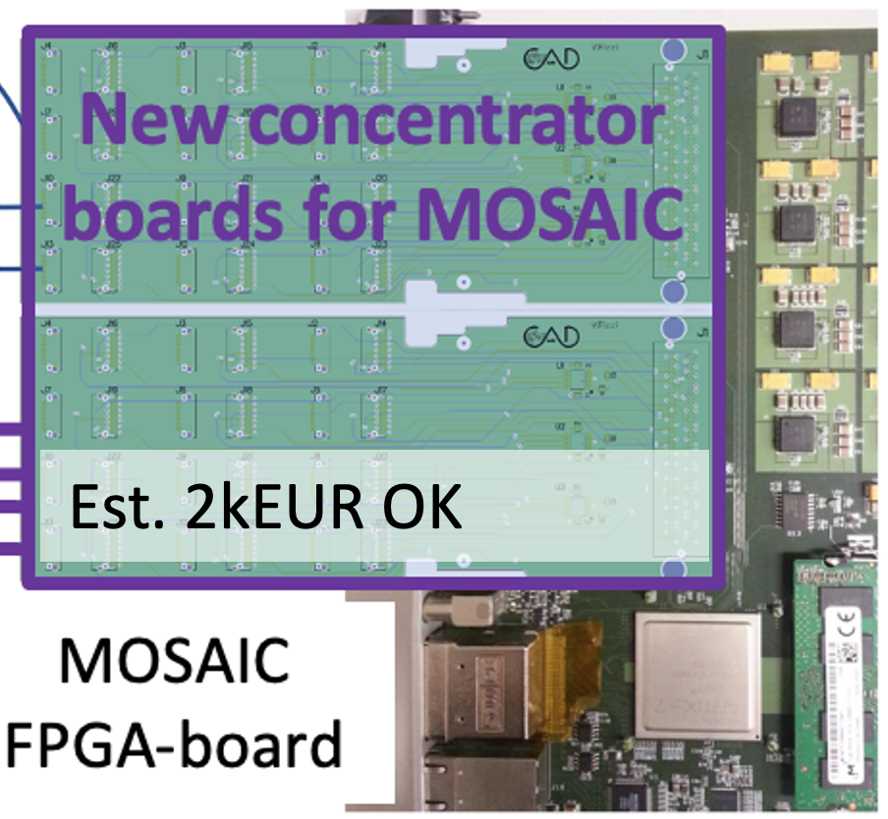
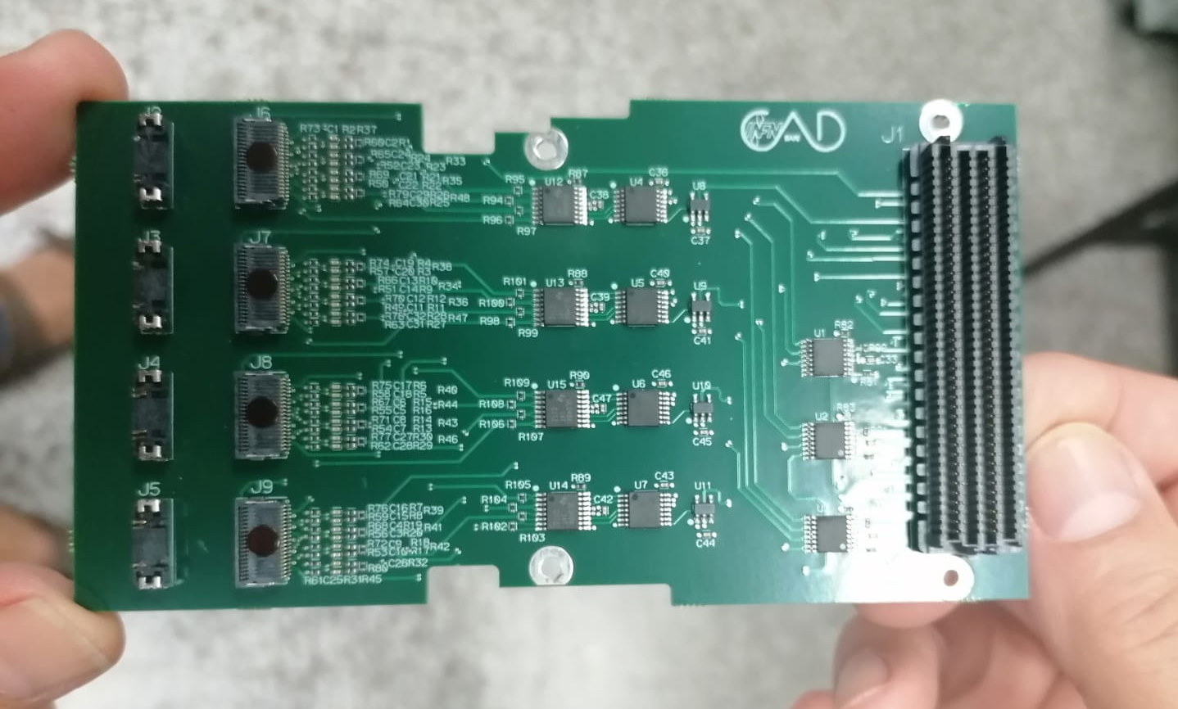
Front-End Electronics: Back-End
Each plugin card sends data from 4 FATIC asics to the concentrator board through a SAMTEC Fire-Fly Cable
Each Concentrator board receives signals from 4 plugin-cards (16 asics)
Each Mosaic can mount 2 Concentrator boards (32 asics) on FMC
Concentrator boards designed in 2021
Order in Feb’22 – PCB produced and components mounted Jun’22
In total 4 cards were produced
We have 2 MOSAIC boards available
They will work in Master-Slave config
4 Firefly connectors
Xilinx Virtex
FMC

Slide 9
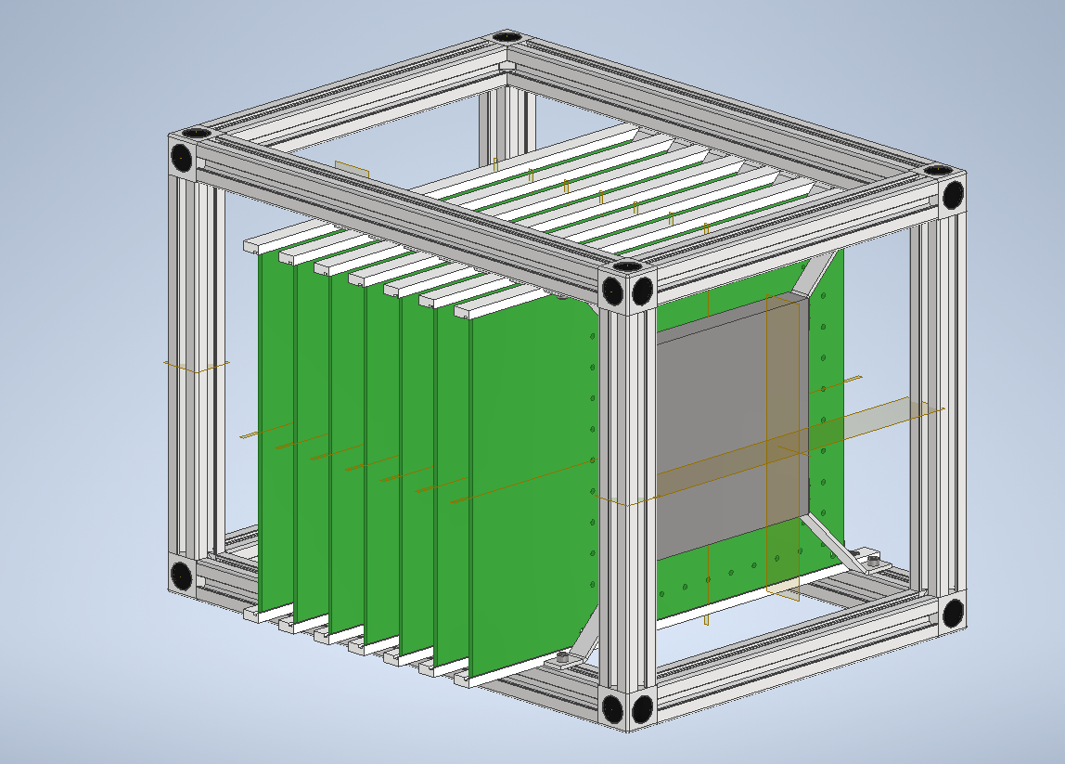
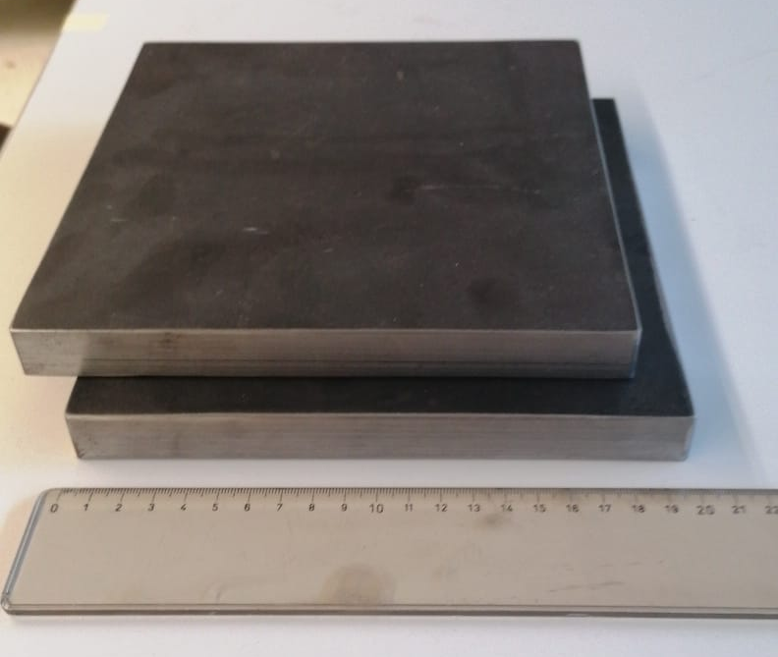
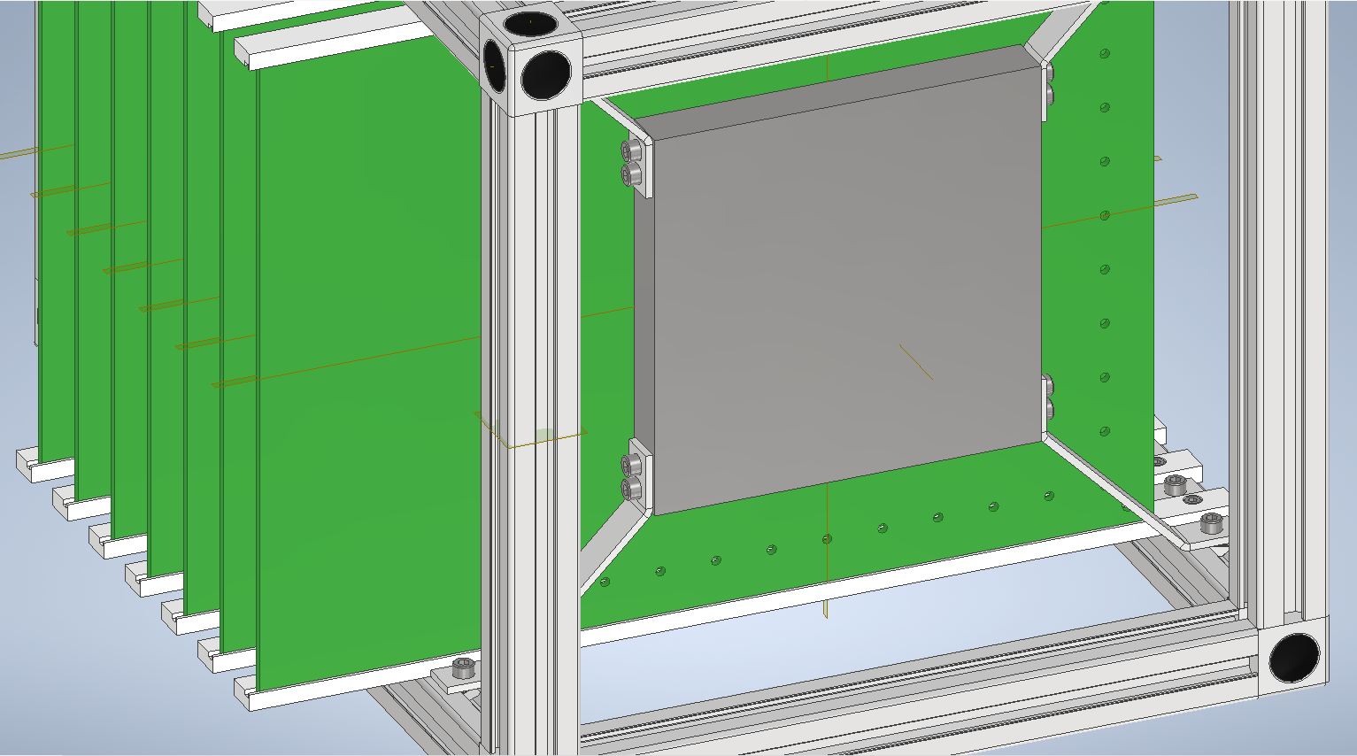
Mechanics & Absorbers
Stack 6 detectors & 6 absorbers (2cm)
First design made on preliminar
detector design (Apr’22)
Design update ongoing based on frozen detector design (Jun’22)
2 20x20 absorbers “recovered” by Michele Franco @ CERN
Design: R.Triggiani
Detail how to mount 20x20 stainless steel absorbers
2 stainless steel absorbers 20 x 20 x 2 cm³

Slide 10
MOSAIC Firmware & Software
Activity to start ~now
Soon we will have first plugin-card ready
  To be connected to concentrator board & MOSAIC
  FW to be written to communicate to FATICs
  Tests to be performed – F.Licciulli & G.De Robertis
DAQ Software to be developed – A.Pellecchia
  Read several plugin-cards together
  Features to be developed:
    Start / Stop Run
    Acquire date upon trigger externo; (busy logic?)
    Write Data
    S-curves FATIC
    Monitor Running conditions (errors)
    … ?
A lot of work to be done on this front before we are ready to go to testbeam !!!

Slide 11
Update CP Project timeline
2022
2023
Milestones 2022
  MS1: Design of 20x20 readout board Feb ’22 June ‘22
  MS2: Production uRWELL & MM dets Jun ’22 September ‘22
  MS3: Lab tests of produced detectors Sep ’22 October ‘22
  MS4: test in beam of individual dets Dec ’22 November ’22?
  In parallel: GEANT simulation of calorimeter stack to benchmark data
    Improvements for 2nd round of detector production early 2023
Milestones 2023
  MS5: 1st test with first calorimeter stack May ’23
  MS6: production of additional chambers Jun ‘23
  MS7: 2nd test with longer calorimeter stack Dec ’23
Performance measurements
  Single Chambers (testbeam Sep ‘22): efficiency, rate-cap, cls-size
  Calorimeter stack (testbeam May ‘23): timing, Energy-reconstruction

Slide 12
BACKUP
Online, February 10th 2022

Slide 13
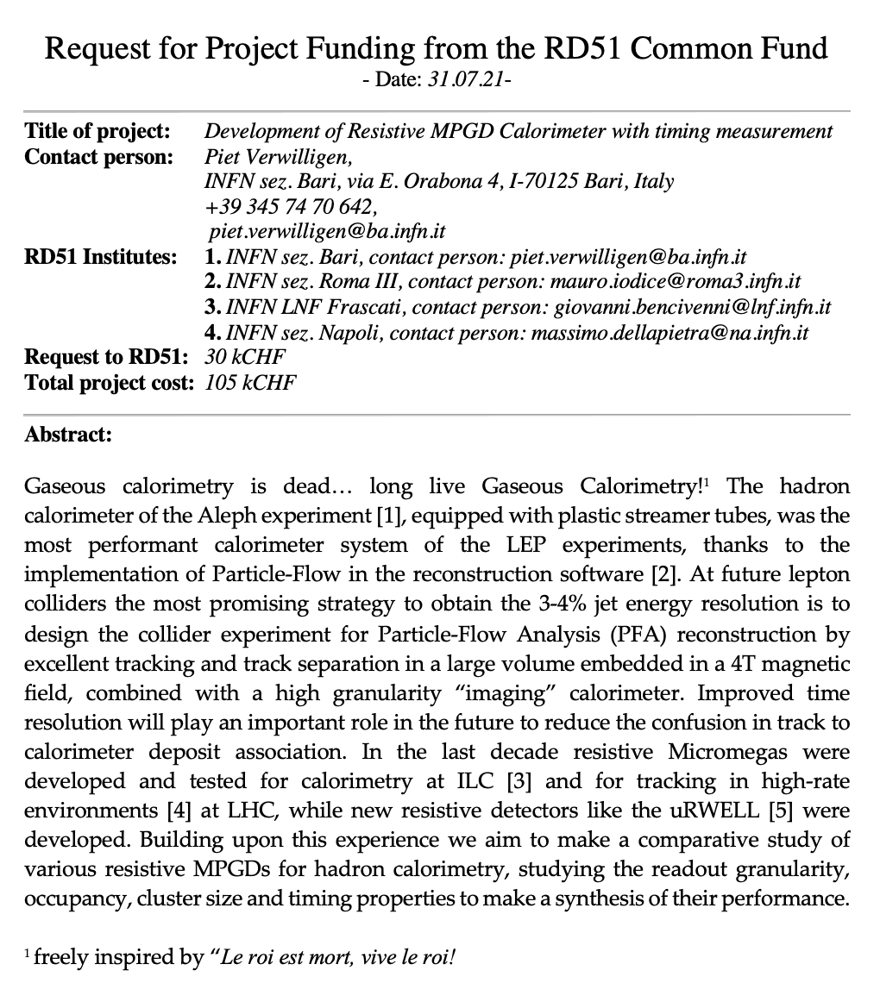
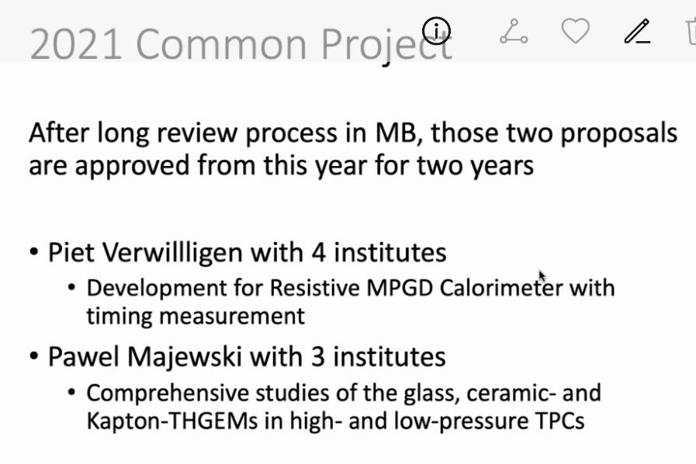
Common Project RD51
Unifies experience of:
INFN Na & RM3 >> Resistive MM
INFN LNF >> uRWELL, GEM
INFN Ba >> GEM,FTM
8 pages proposal funded for 2 years
Interesting discussion with RD51
Proposal triggered interest and Weissman Institute (ATLAS TGC) will collaborate
Approved!

Slide 14
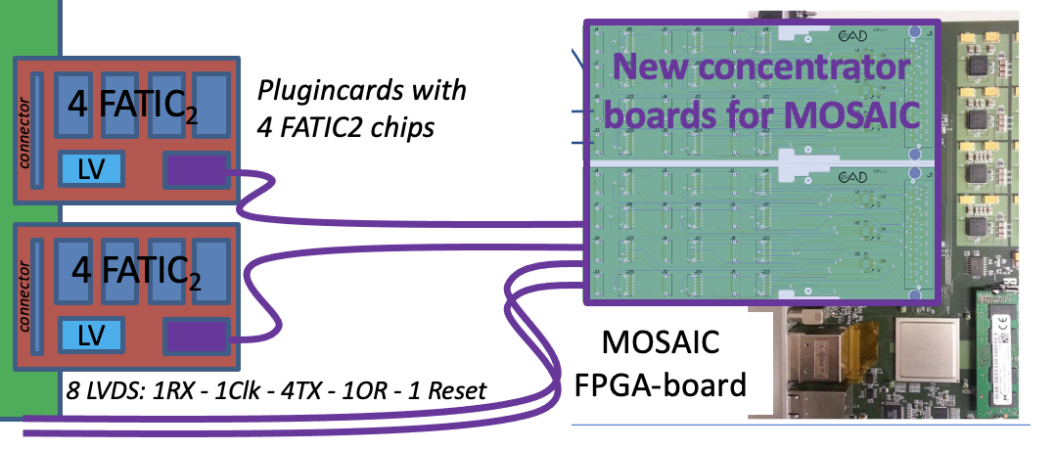
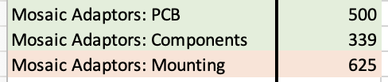
FATIC plugin card
FATIC chip:
  32channels; 1 CSA + Timing & Energy branch; 100ps on ~1.5fC: timing for small signals!
  can be used for any type of Micro-Pattern Gaseous Detector
64 FATIC chip available @ INFN Bari
  Chip development financed in Gr5 2018-2021 (3y) 30kEUR
  Activity in Gr5: Design – Production & Test on bench
  Not foreseen to test on detector due to time-scale project
64 chips can be mounted on 16 Plugin-Cards (128 channels each)
  Project requires 6 chambers x 3 connectors = 18 plugin cards
  We can read 5 detectors 20x20 + 1 detector 10x10 (only inner channels)
Interest from LHCb to test this chip for the uRWELL upgrade
  We share the resources @ INFN Ba for design & test
  Common order, but each experiment pays for the number of cards needed
Good results on Test Bench!
FATIC
Cost Estimate based on past plugin cards made
4-layer PCB
Mounting of Fire-Fly and Hirose connectors
Price does not include wire-bounding asic (will be done @ INFN)
Est. 400EUR/piece
Est. 2kEUR OK
Cables: 1kEUR OK
Past example:
Example 4 boards: 1464 EUR => 366EUR/board (comp cost++)

Slide 15
CP Project timeline & milestones
2022
2023
Milestones 2022
  MS1: Design of 20x20 readout board Feb ’22 On schedule!
  MS2: Production uRWELL & MM dets Jun ’22
  MS3: Lab tests of produced detectors Sep ‘22
  MS4: test in beam of individual dets Dec ’22
  In parallel: GEANT simulation of calorimeter stack to benchmark data
    Improvements for 2nd round of detector production early 2023
Milestones 2023
  MS5: 1st test with first calorimeter stack May ’23
  MS6: production of additional chambers Jun ‘23
  MS7: 2nd test with longer calorimeter stack Dec ’23
Performance measurements
  Single Chambers (testbeam Sep ‘22): efficiency, rate-cap, cls-size
  Calorimeter stack (testbeam May ‘23): timing, Energy-reconstruction

Slide 16
Financial Requests
Categoria | Motivazione | Richiesta | Assegnato | Note
Missioni | Test Beam | 8kEUR | 3kEUR | Sblocco Settembre
Consumi | 10 Cavi Samtec | 1kEUR | 1kEUR | Sblocco Febbraio
 | 10 FATIC plugin-card | 4kEUR | 0kEUR | Richiesta 6.5 kEUR ( we can use 2kEUR sj for Stainless Steel sheets that we will recuperate elsewhere)
 | DAQ concentr. card | 2kEUR | 2kEUR | Sblocco Febbraio
 | 2 Micromegas per Calorimetro | 10kEUR | 10kEUR | Sblocco Febbraio
 | Stainless Steel sheets | 2kEUR | 2kEUR | Sblocco Febbraio
 | Bosch profiles for mechanics | 1kEUR | 1kEUR | Sblocco Febbraio
* In Last meeting with referees (23/09) we told the referees that electronics need to be financed for the entire 7kEUR budget required. This cannot be justified to ask CSN5, neither can come from RD51 as these money have to be spend “in sede” and not at CERN. As far as I remember referees told us that they would review the situation w.r.t. what they proposed …. anyway would have gone under S.J. However in assegnazioni I see the situation unvaried w.r.t. earlier proposal … I would tend to believe that they forgot about it.

