Slide 1
Laboratori Nazionali del Sud
Università degli Studi di Sassari

Slide 2
INFN UNISS Role
VIRGO: Data analysis. Search for Burst Multi-messenger event candidates and application of Machine Learning to data analysis
ET: Sos Enattos Characterization and Candidature. R&D Sospensioni.

Slide 3
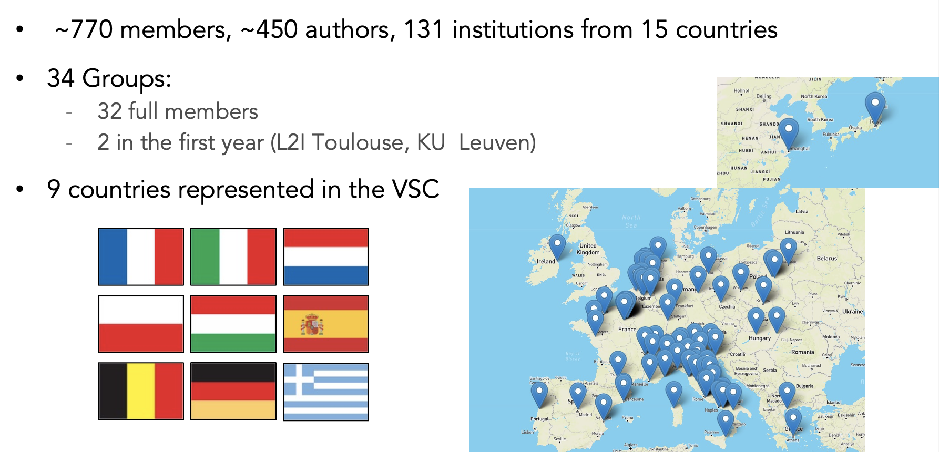
Virgo Collaboration

Slide 4
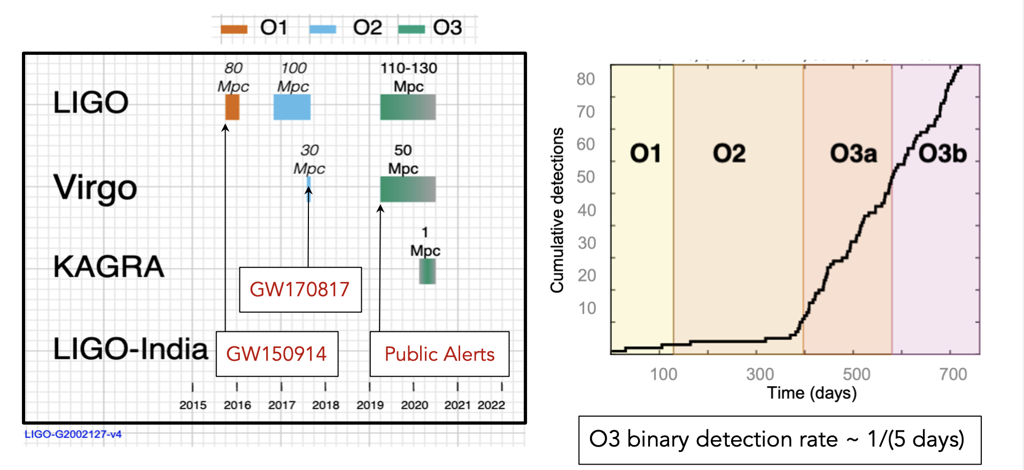
Past Obs. RUN

Slide 5
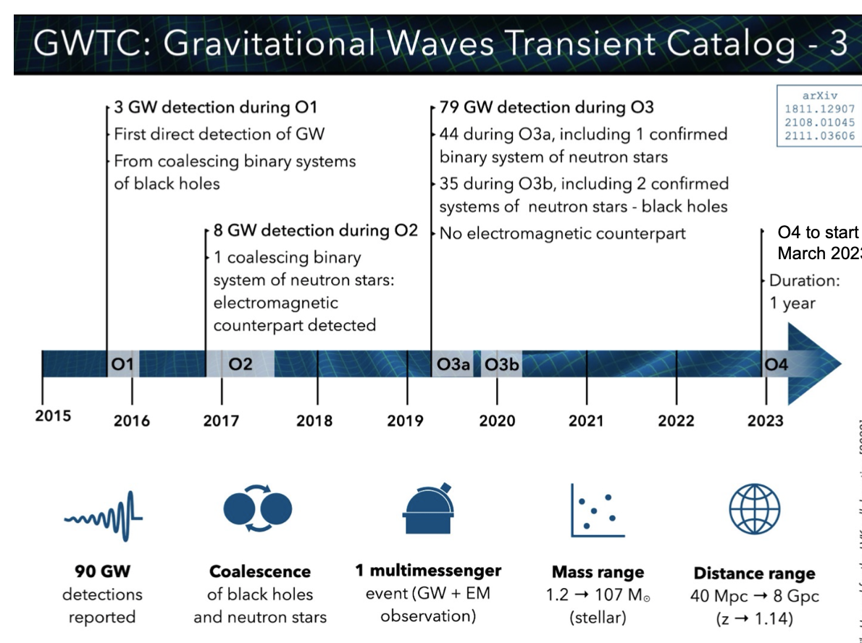

Slide 6
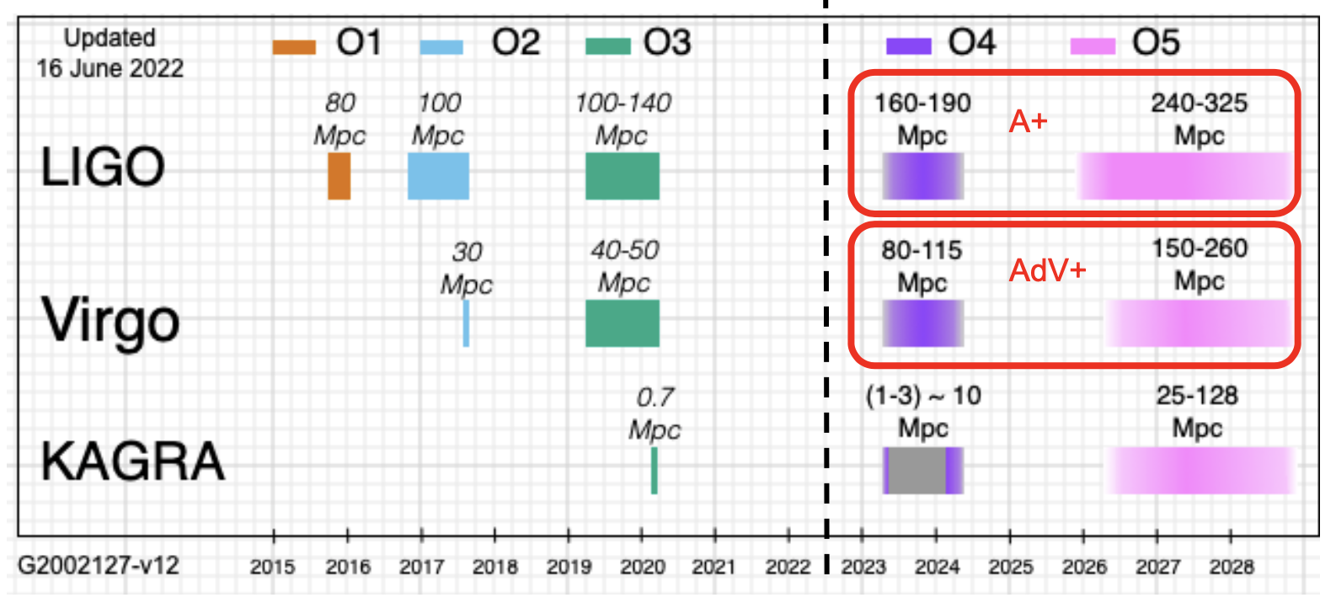
Future Obs. RUN

Slide 7
Advanced Virgo+
Two phases project
  Phase I (before O4 run/2023)
    Mainly an upgrade to reduce quantum noise: no mirrors change
    Reduction of technical noises
    Preparation of Phase II
  Phase II (before O5 run/2025)
    More invasive upgrade to reduce thermal noise: mirrors change
What Post –O5 ????

Slide 8
Towards O4
Installation of main interferometer completed in December 2020
=> Commissioning of main interferometer started in January 2021
Installation of quantum noise reduction system completed in April 2021
=> Commissioning of quantum noise reduction system started in May 2021
Great effort to complete the installation during the pandemic
Now working at the commissioning of the detector

Slide 9
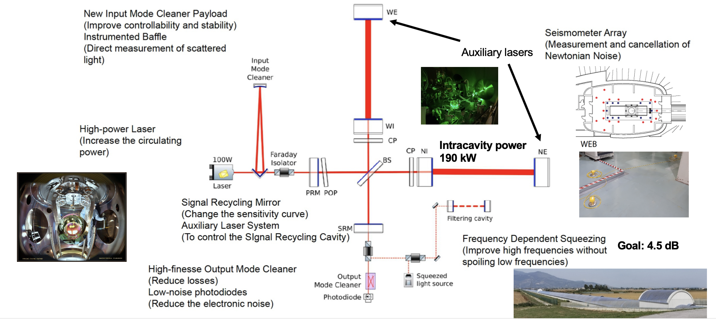
Towards O4
Reducing quantum noise – hit against thermal noise

Slide 10
VIRGO: UniSS/LNS Contribution
Burst Multi-messenger events: Search for transient GWs signals associated with GRB and FRB during LIGO-Virgo third observational run => paper “Search for Gravitational Waves Associated with Fast Radio Bursts Detected by CHIME/FRB During the LIGO–Virgo Observing Run O3a” e-Print: 2203.12038
Use of machine learning techniques to search for GW events
  Implementation of pre-filter trigger to distinguish event candidates by means of machine learning techniques
=> contribution to a review paper under preparation

Slide 11
VIRGO: Anagrafica/Richieste 2021
Personel | Virgo FTE
Massimo Carpinelli | 0.50
Domenico D’Urso | 0.50
Daniele Dell’Aquila | 0.40
Davide Rozza | 0.50
Valeria Sipala | 0.40
Iara Tosta e Melo | 0.50
Tot | 2.8
 |  |  |  | (kEuro)
Missioni | N. 6 Meeting Nazionali 1 fisico x 3 gg (meeting di gruppo) |  |  | 5
 | N. 3 Meeting Internazionali 1 fisico x 3 gg (meeting di gruppo e/o 1 conferenza) |  |  | 7
Tot |  |  |  | 12.0

Slide 12
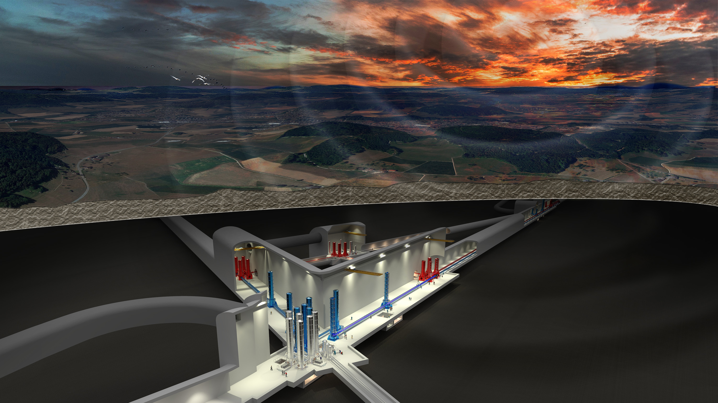
The Einstein Telescope

Slide 13
ET Science Case in a nutshell
ASTROPHYSICS
Black hole properties
  origin (stellar vs. primordial)
  evolution, demography
Neutron star properties
  interior structure (QCD at ultra-high densities,
  exotic states of matter)
  demography
Multi-band and -messenger astronomy
  joint GW/EM observations (GRB, kilonova,...)
  multiband GW detection (LISA)
  neutrinos
Detection of new astrophysical sources
  core collapse supernovae
  isolated neutron stars
  stochastic background of astrophysical origin
FUNDAMENTAL PHYSICS AND COSMOLOGY
The nature of compact objects
  near-horizon physics
  tests of no-hair theorem
  exotic compact objects
Tests of General Relativity
  post-Newtonian expansion
  strong field regime
Dark matter
  primordial BHs
  axion clouds, dark matter accreting on compact objects
Dark energy and modifications of gravity on cosmological scales
  dark energy equation of state
  modified GW propagation
Stochastic backgrounds of cosmological origin
  inflation, phase transitions, cosmic strings

Slide 14
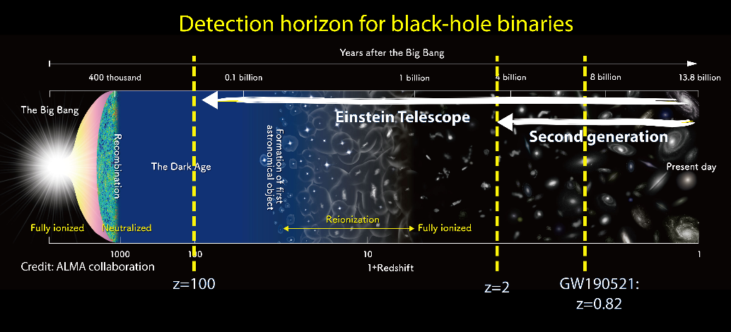
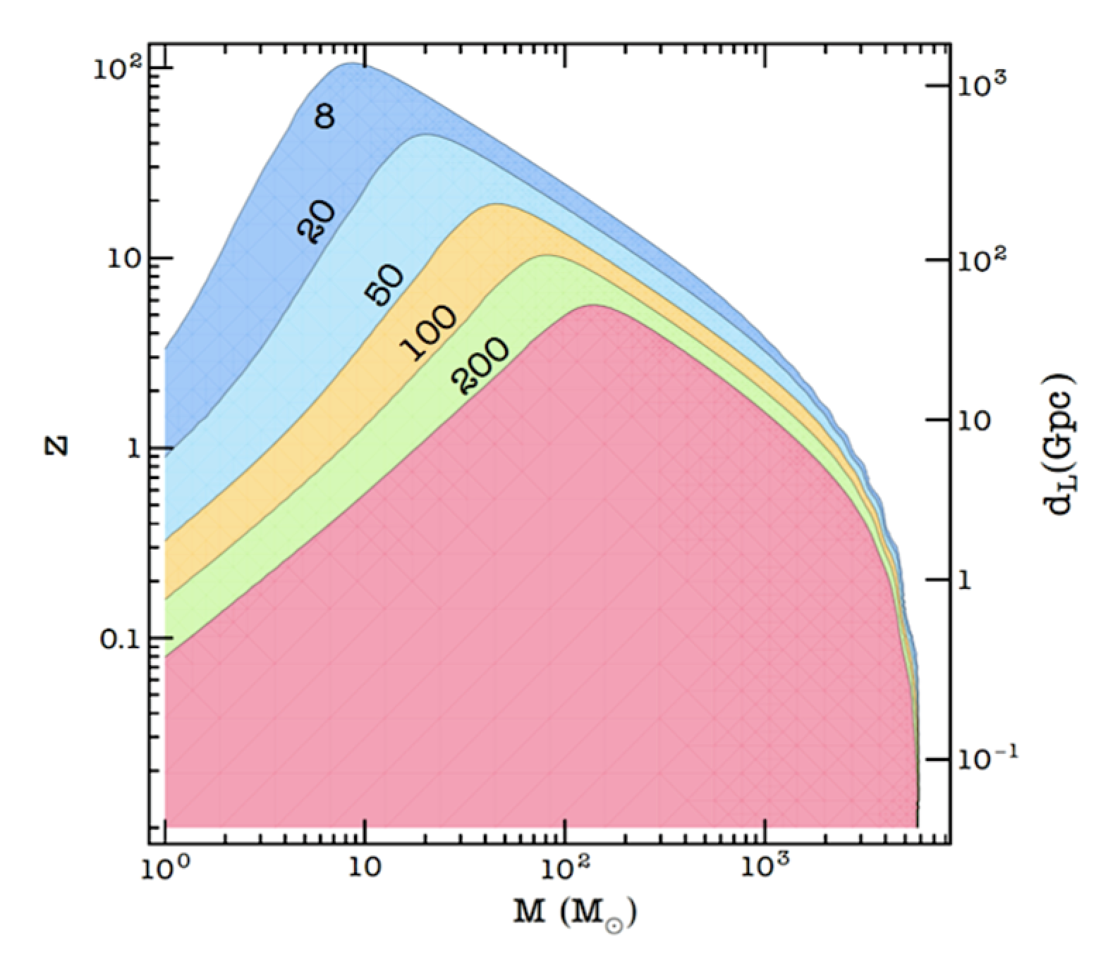
ET Science in a nutshell: double nature
ET will be a new discovery machine:
  ET will explore almost the entire Universe listening the gravitational waves emitted by black hole, back to the dark ages after the Big Bang
Years after the Big Bang
400 thousand
0.1 billion
1 billion
4 billion
8 billion
13.8 billion
Remote Universe
Cosmological redshift z
ET will be a precision measurement observatory:
  ET will detect, with high SNR, hundreds of thousands coalescences of binary systems of Neutron Stars per year, revealing the most intimate structure of the nuclear matter in their nuclei
SNR
Nearby Universe
Credit: M.Branchesi
Notes:
Marica

Slide 15
ET Science in a nutshell: double nature
GW science targets are almost equally distributed in the frequency range accessible by terrestrial GW detectors (but technical difficulties aren’t)
We want to have access both to low and high frequency targets
  ET will be a wide band observatory with a special focus on (intermediate) massive compact object:
    Low frequency!

Slide 16
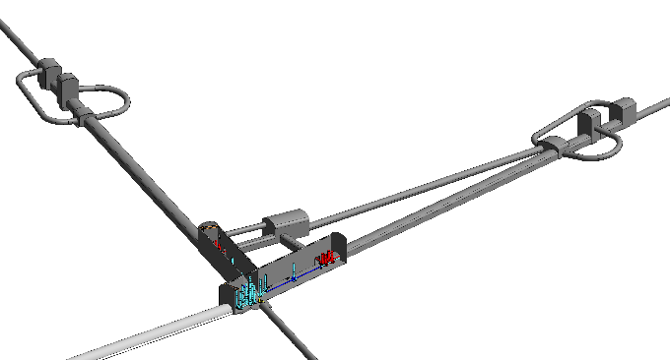

ET Design: key elements
Requirements
Design Specifications
Wide frequency range
Massive black holes (LF focus)
Localisation capability
(more) Uniform sky coverage
Polarisation disentanglement
High Reliability (high duty cycle)
High SNR
Xylophone (multi-interferometer) Design
Underground
Cryogenic
Triangular shape
Multi-detector design
Longer arms

Slide 17
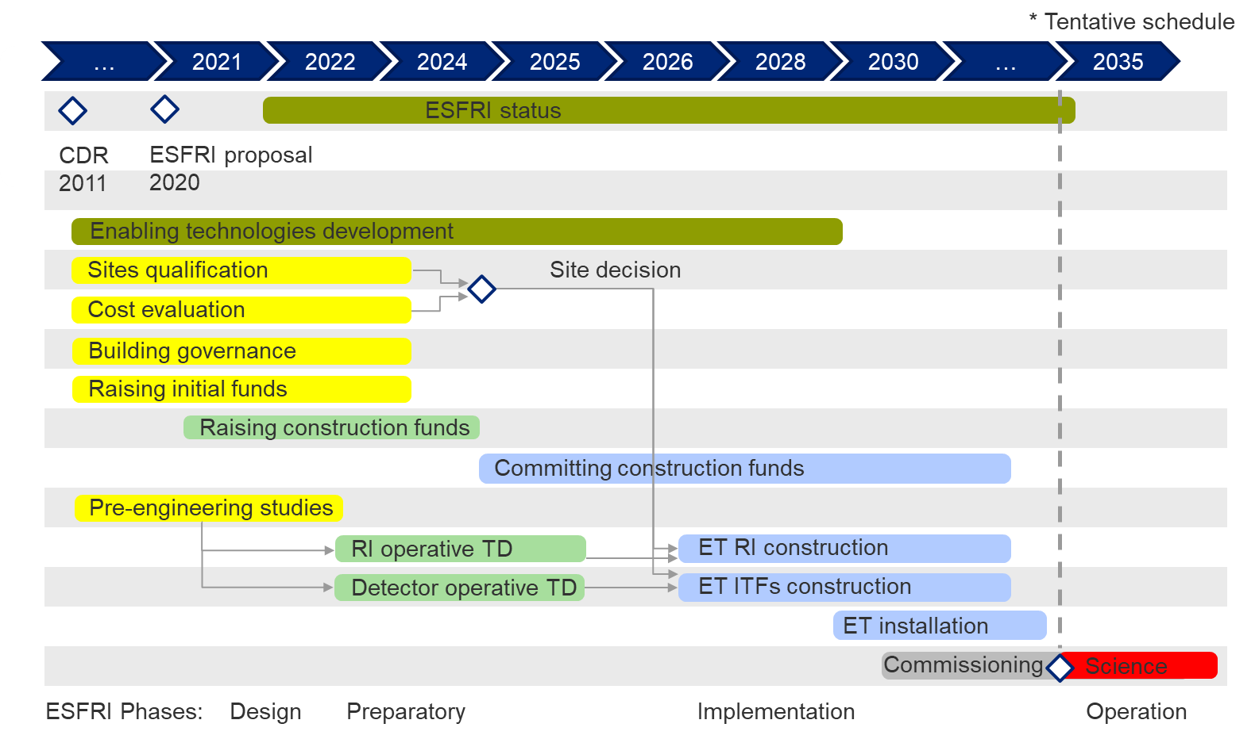
ET time scale (ESFRI proposal)

Slide 18
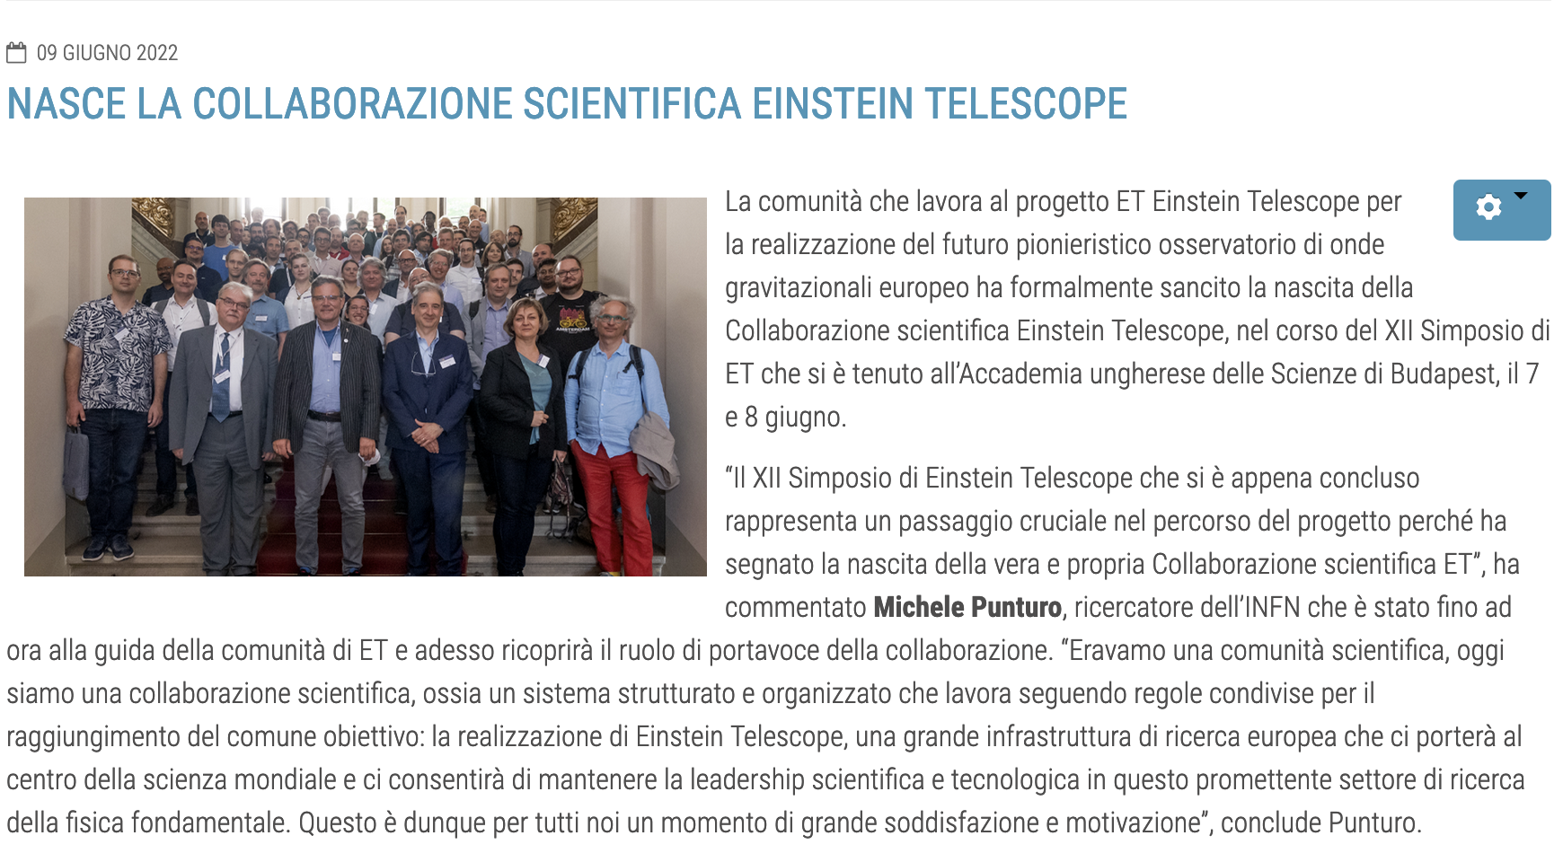
Birth of ET Collaboration
More then 1200 researchers from Europe, USA and Japan

Slide 19
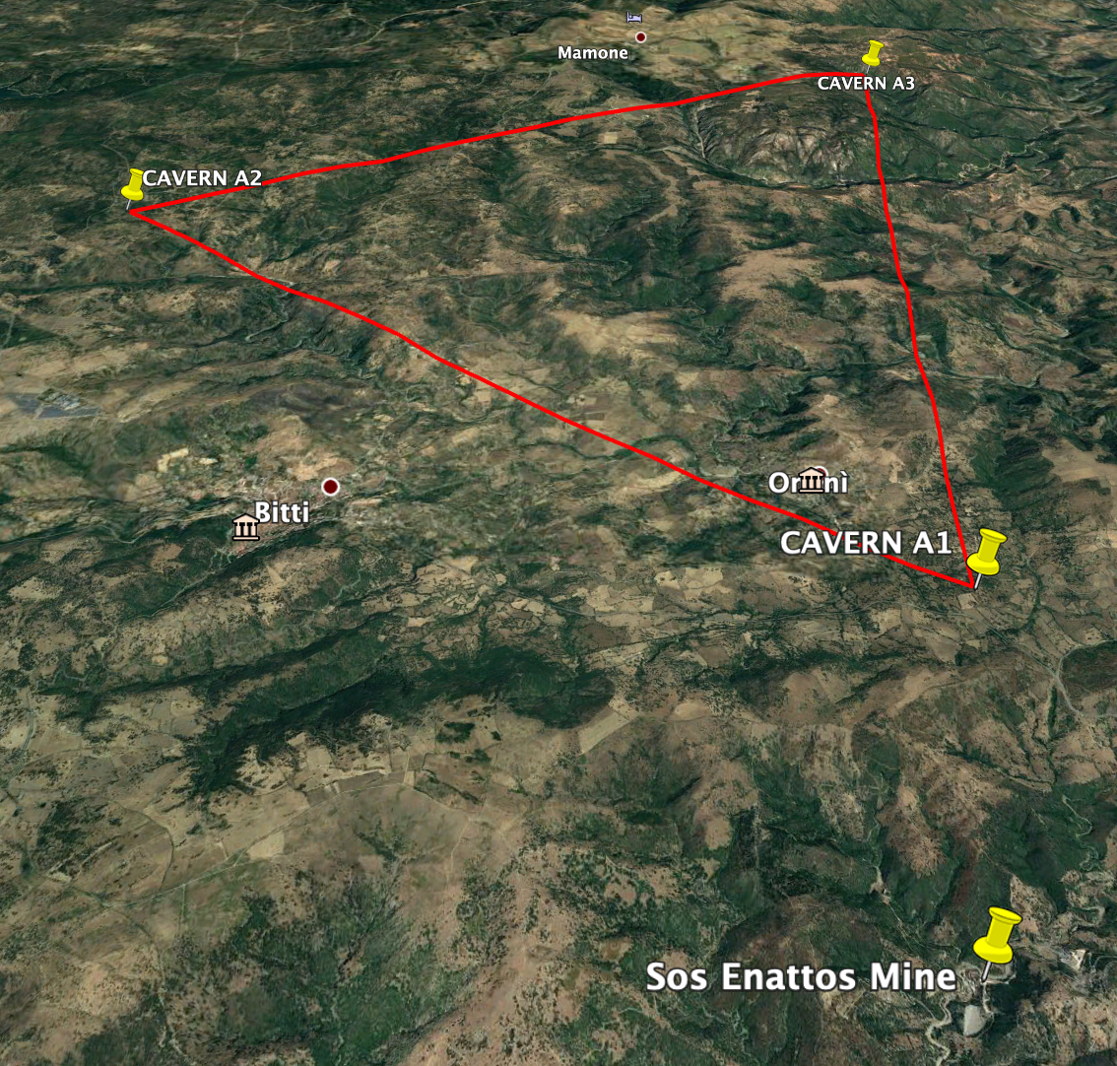
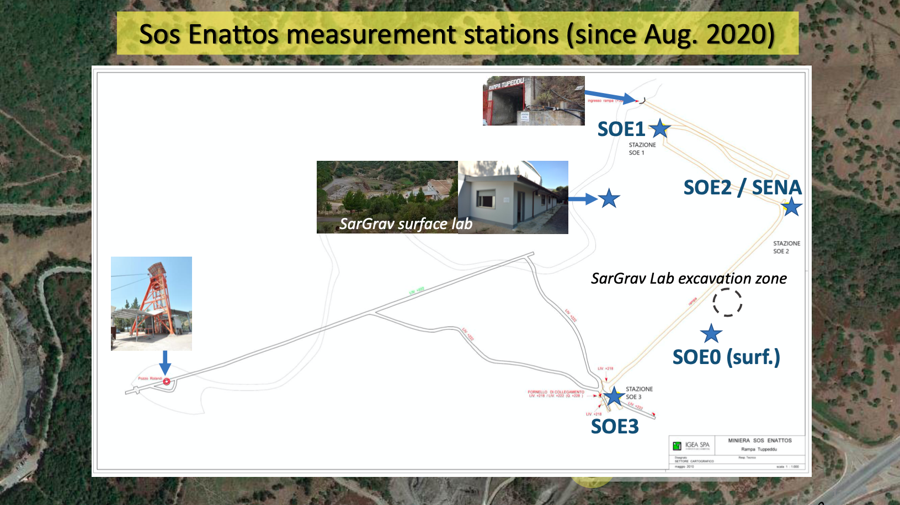
Sardinia one of Candidate Site: Measurement on going
Characterization of the Bitti and Onanì corners:
Surface and underground seismic and environmental measurements
SarGrav surface lab
SOE0 (surface)
SOE1, SOE2, SOE3
(-84m, -111m, -160m)
integrated into the INGV seismometer network
http://cnt.rm.ingv.it/en/instruments/station/SENA
4 broadband seismometers, 3 short-period seismometers, 2 magnetometers, 1 tiltmeter distributed over underground and surface stations, 1 infrasound station
Credits to L. Naticchioni

Slide 20
Courtesy of G.L. Cardello et al.
Notes:
Higher quality definition of lithologies involved and their distribution.
Tectonic contacts are also better mapped, thus allowing to predict the distribution of structures at depth.
Faults were mapped by using crossed field and satellite evidence.
A first attempt of location and distinction of permanent and seasonal water springs was also performed on the map by means of initial field checks.
Springs (preferentially permanent) are located near larger faults and intrusive contacts

Slide 21
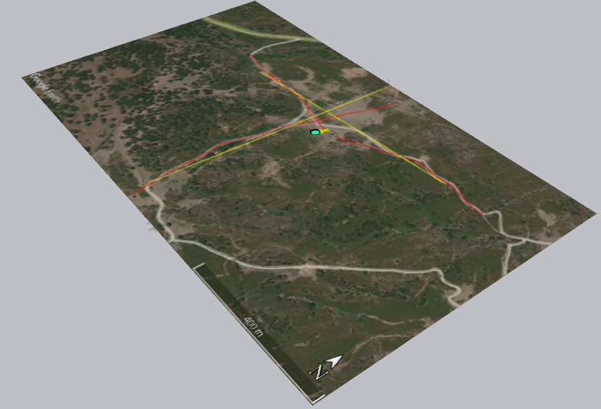
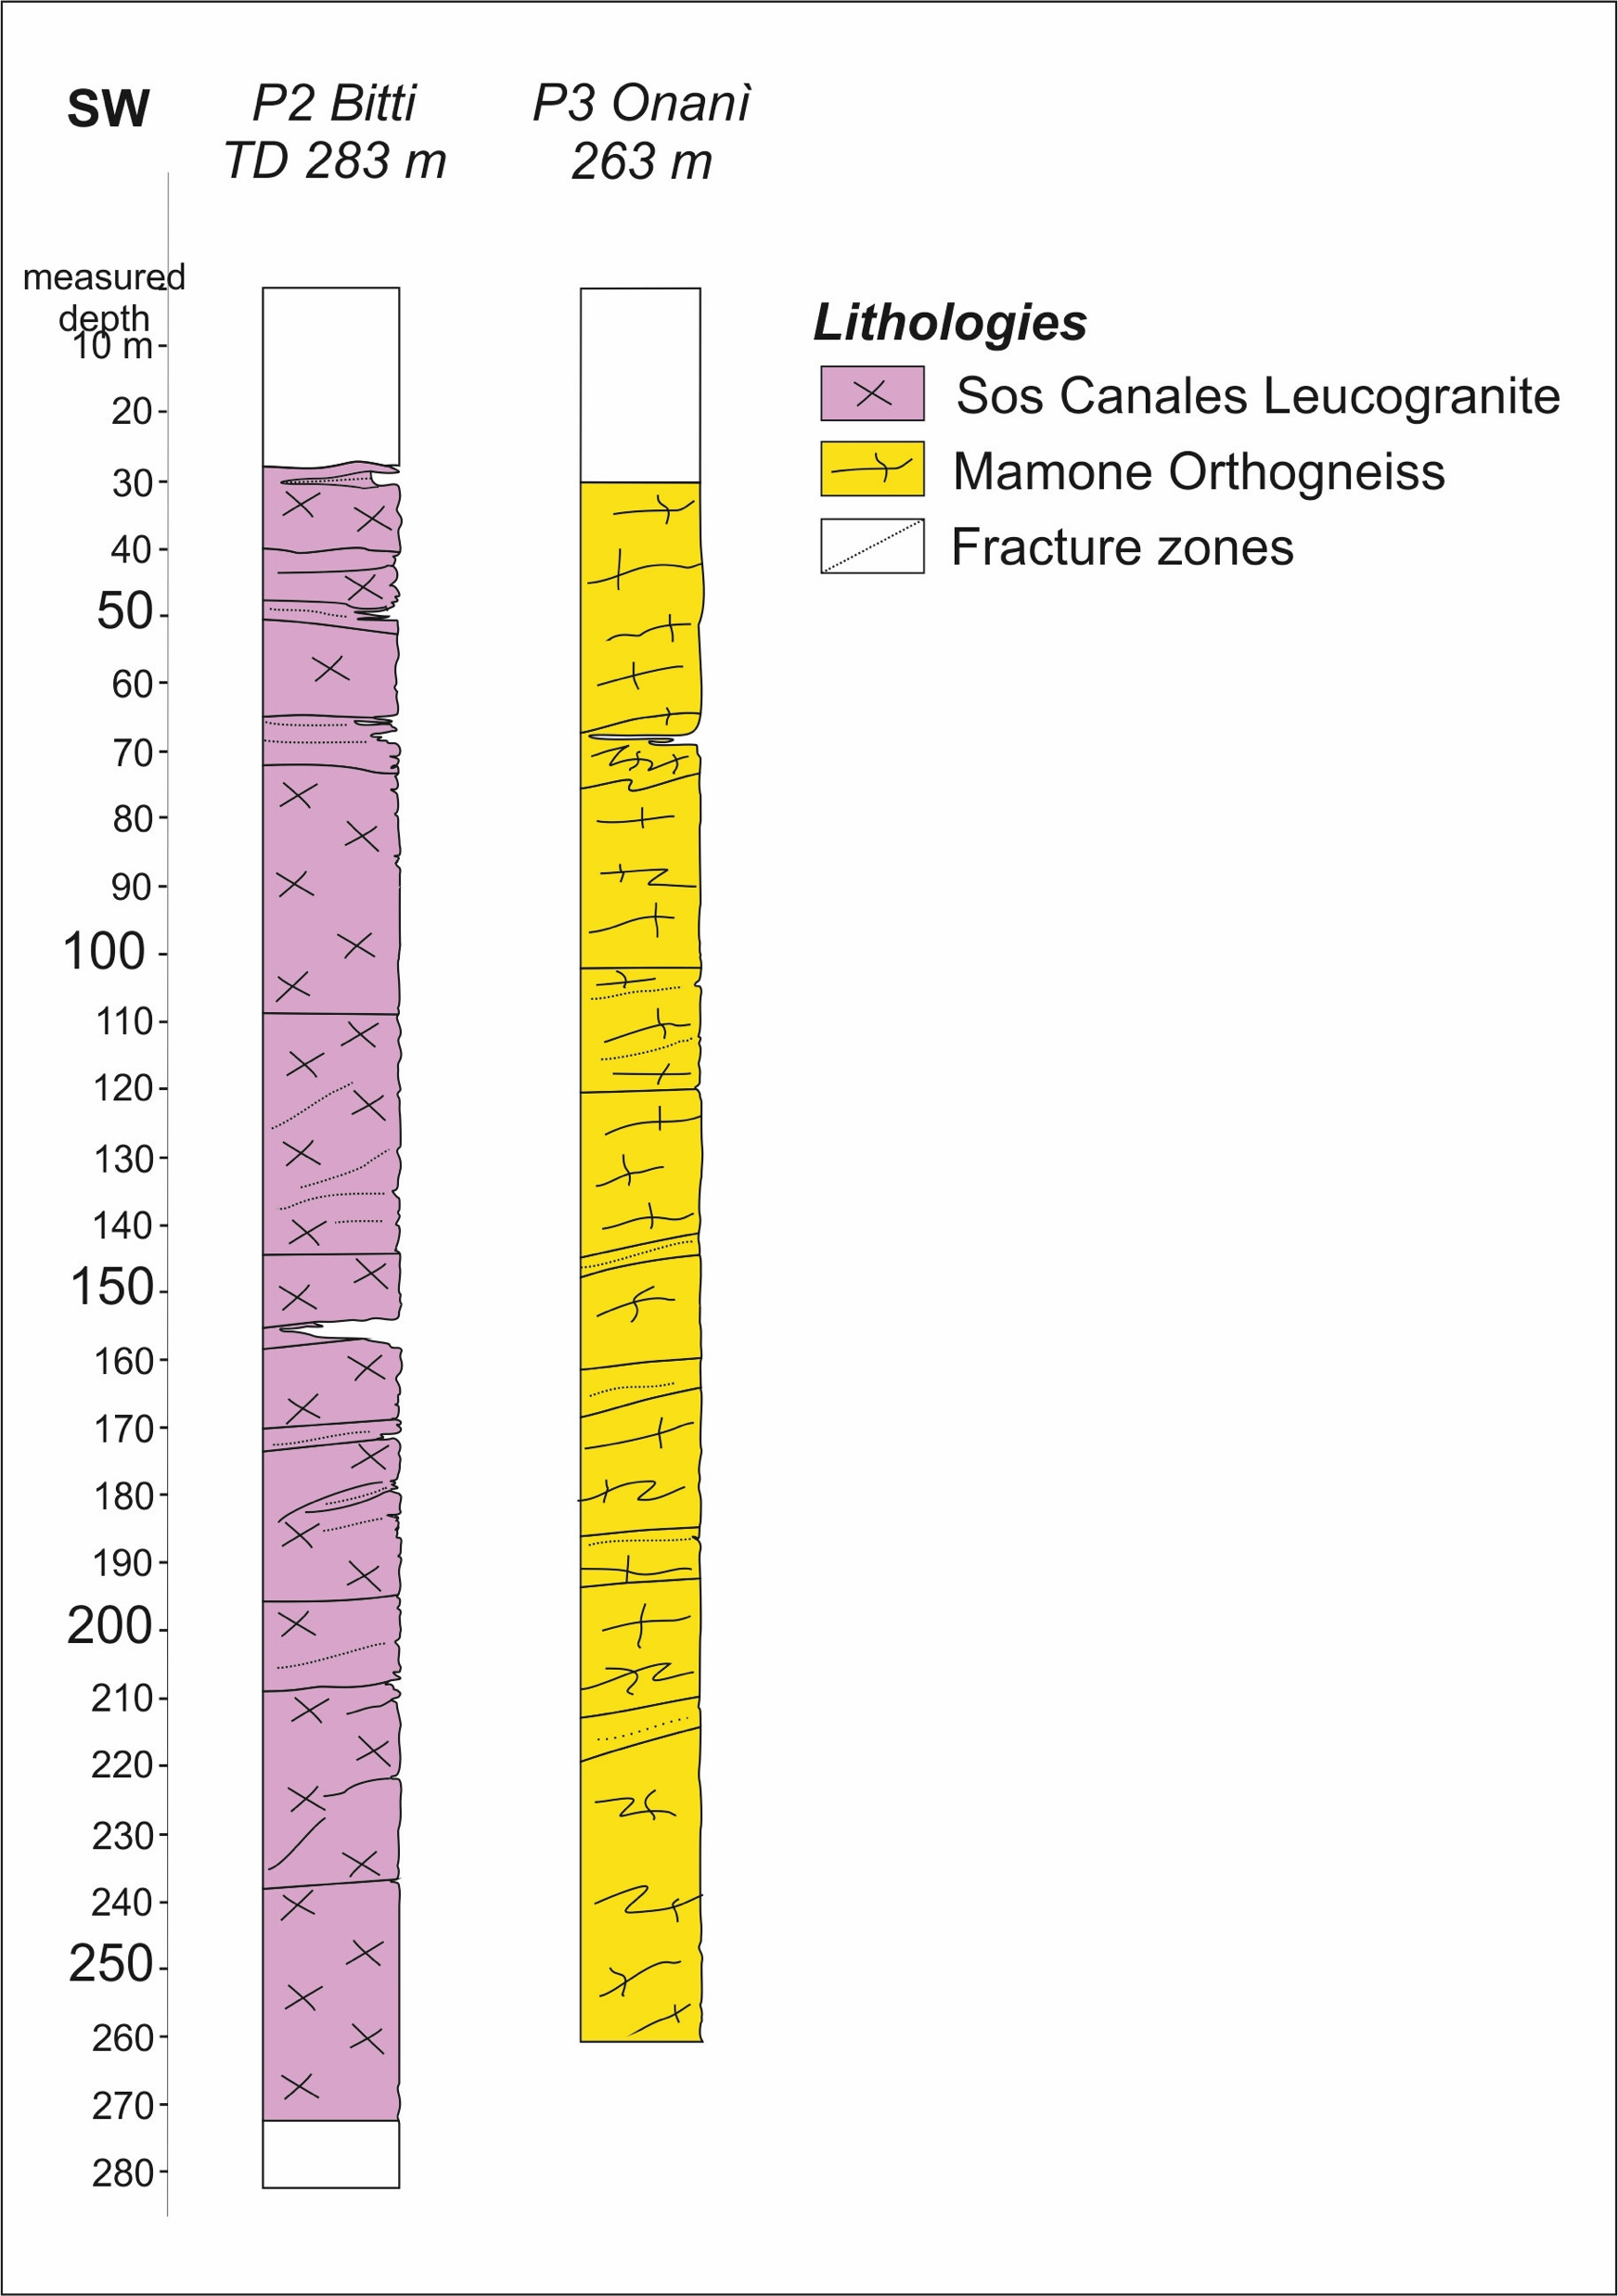
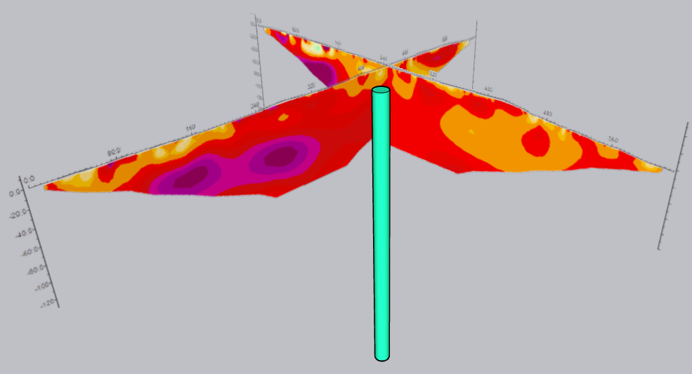

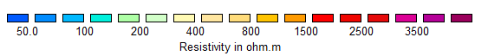
ERT RESULTS AT ONANI’ BOREHOLE
On1
conductive layer occurs either as:
a discontinuous and well-localized layer near the surface (up to 20 m thick), or as
a broader anomaly zone of values around 1000 Ωm that locally occurs at a depth of 30-90 meters.
P3
On2
On1
Fractured area
On2
P3
Courtesy of G.L. Cardello et al.
Notes:
The tomographies of the Onanì vertex,
show that the conductive layer occurs either as:
a discontinuous and well-localized layer near the surface (up to 20 m thick), or as
a broader anomaly zone of values around 1000 Ωm that locally occurs at a depth of 30-90 meters.

Slide 22
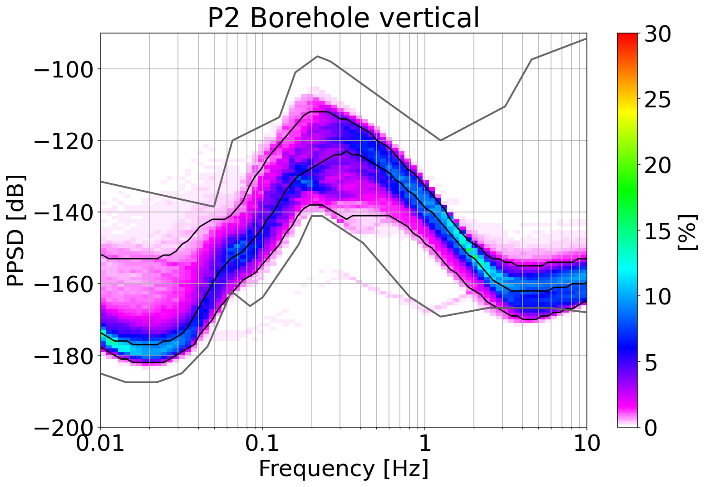
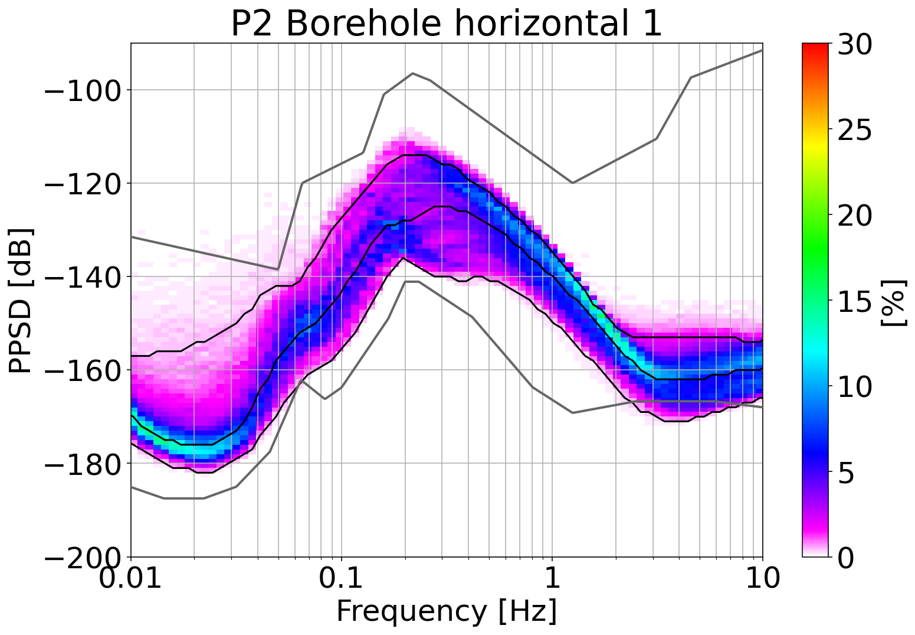
Updates from P2 and P3
About half-year of continuous underground seismic measurements from the P2 and P3 boreholes, e.g.:
Seismic noise
Peterson’s limit
Area of interest for ET
Area of interest for ET
P2 (-264m) : 01 October 2021 – 20 March 2022
Courtesy of L. Naticchioni et al.

Slide 23
ET: LNS-UNISS Role
Site Characterization Activity Coordination
Infrastructure design and feasibility study
Sensor Instrumentation and maintenance
Acquisition system and mechanics of the Archimedes tiltmeter
Data analysis and ET sensitivity estimation

Slide 24
ET: Sos Enattos Candidature
Next Steps
Geology:
  Geophysical campaign (geoelectrics and seismic lines along roads)
  Complete the structural review of the area => Field survey
  Hydrogeological model
  Characterize fracture system => from LIDAR images
  Perform microstructural studies => thin sections
  Collect new samples for dating and chemical characterization
  3D geological modellin
Site Measurements
  Complete the long-term measurements
  two additional magnetometer stations: SOE3 and P3
  Interaction with windmills
PNRR projects supporting ET in Sardinia:
  INFN: a Reference System Network for geodetic survey (in coll. with ASI), strainmeter, Environmental Impact Assessment, Feasibility Design for surface works, Feasibility Design for technological systems, Feasibility Design of the Underground works
  INGV: realization of a geophysical lab in the Sos Enattos area

Slide 25
ET Anagrafica/Richieste 2022
Personel | ET FTE
Giovanni Luca Cardello | 1.00
Leonardo Casini | 0.50
Domenico D’Urso | 0.20 (+0.2 NGSA)
Luca Deidda | 0.50 (ass. in corso)
Luca Pesenti | 0.70 (+0.3 NGSA)
Davide Rozza | 0.10 (+0.1 NGSA)
Valeria Sipala | 0.00 (+0.1 NGSA)
Iara Tosta e Melo | 0.20 (+0.3 NGSA)
Gaetano Schillaci | 0.5
Daniele Cittadino | 0.5
Tot | 4.2 (+1 NGSA)

Slide 26
Richieste
 |  |  |  | (kEuro) | S.J. PNRR
Missioni | Missioni sul sito per installazioni manutenzione sensori e misure in loco (commissioning, montaggi e misure) |  |  | 30 | +10
 | Missioni sul sito per la definizione e la valutazione della localizzazione delle infrastrutture |  |  | 20 | +30
 | Partecipazione a Meeting di Coordinamento, di Collaborazione e working group |  |  | 10
Apparati | Stazione sismometrica |  |  | 20
Consumi | Materiale di consumo per I sismometri di superficie |  |  | 20
Servizi | Servizio di sorveglianza (dal 2022) |  |  | 20
Tot |  |  |  | 120.0 | +40
Def. Preventivi in Corso
R&D, first meeting on June 30th 11am
Site Characterization, first meeting on July 1st 12pm

