Slide 1
One-day meeting on (n,cp) reactions at n_TOF Timepix and GEM detectors
Gempix 1 with internal target
Gempix 3 evolution
Timepix (silicon ) QUAD
Light Timepix 3 (silicon) QUAD
Diamondpix (Timepix3 with diamond sensor)
Multiboron GEM Detector

Slide 2
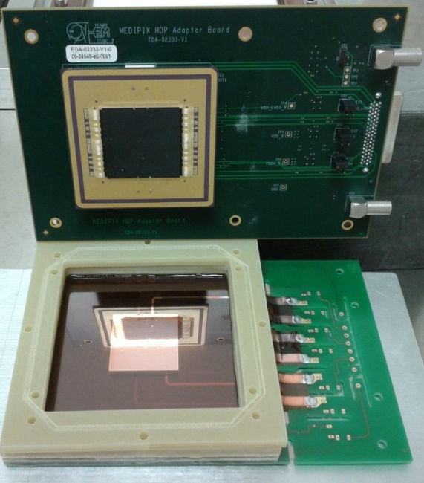
GEMPix detector: studies with internal target
Neutron
Target
Mylar window
Triple GEM
Gas flux AR CO₂ or AR CO₂ CF₄
Atmospheric pressure
Active Area : 3x3 cm²
Time resolution : 5 ns
Space resolution : 200 um
Particle id capability (dE/dX)
The target doesn’t have to produce oxygen inside the gas

Slide 3
Alumina strips as target
neutrons
Drift volume
Mylar window
HV
The alumina strips have dimension : 0.4 x 10 x 50 mm
FITPIX
Triple GEM
Gas flux AR CO₂ or AR CO₂ CF₄
Openable 12 um aluminized mylar
1.6 mm
The mesh and the aluminized mylar
are at the same potential
Allumina target
Copper mesh

Slide 4
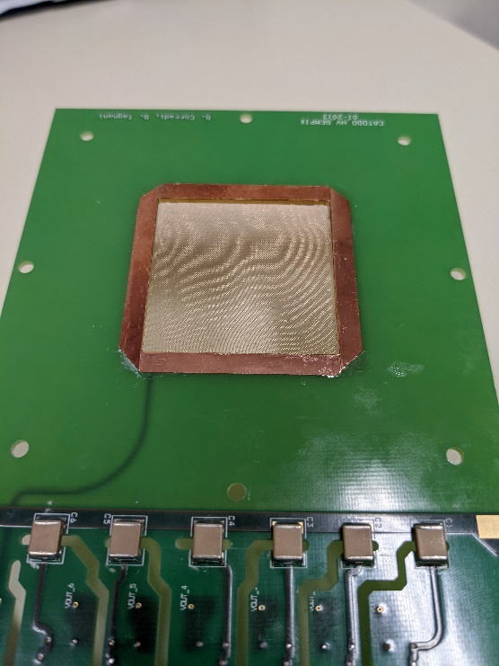
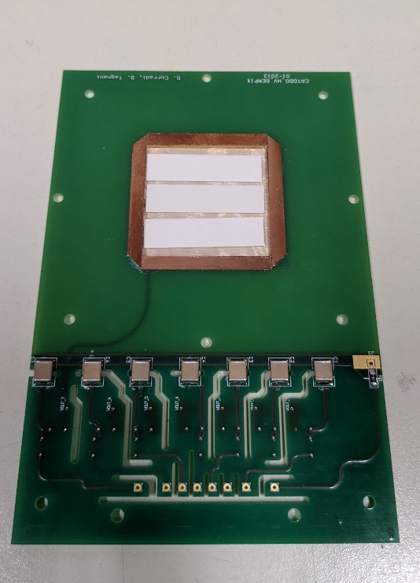
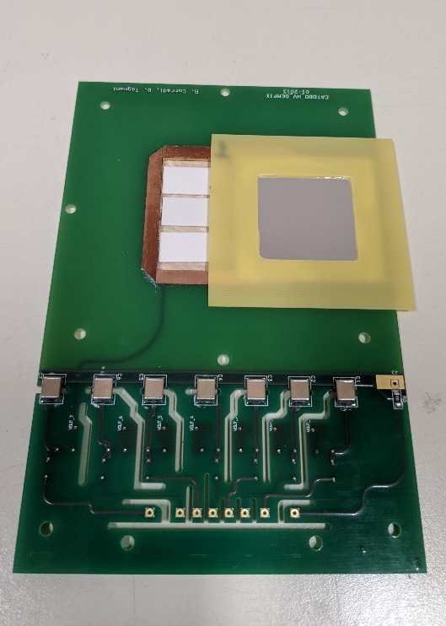
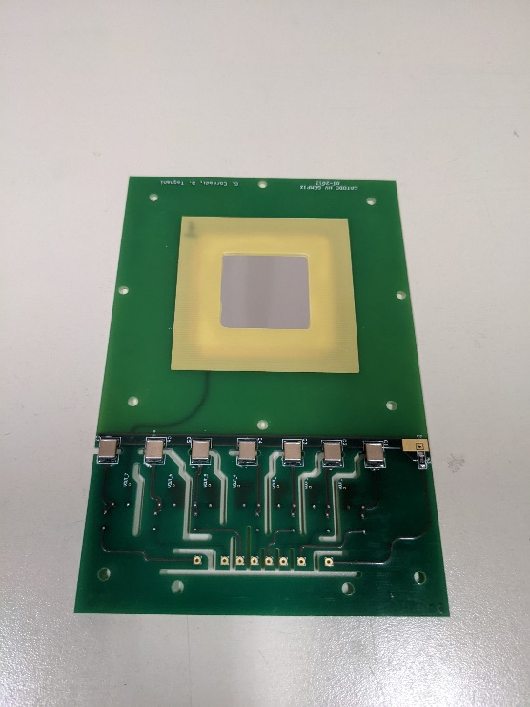
Prototype of the mesh window & alumina strips
Copper Mesh windows
A mouse in transparency
Alumina strips
Mylar window
Final target setup
The target can be changed removing the mylar window
The detector should be completed next week and ready to be tested on the dump area

Slide 5
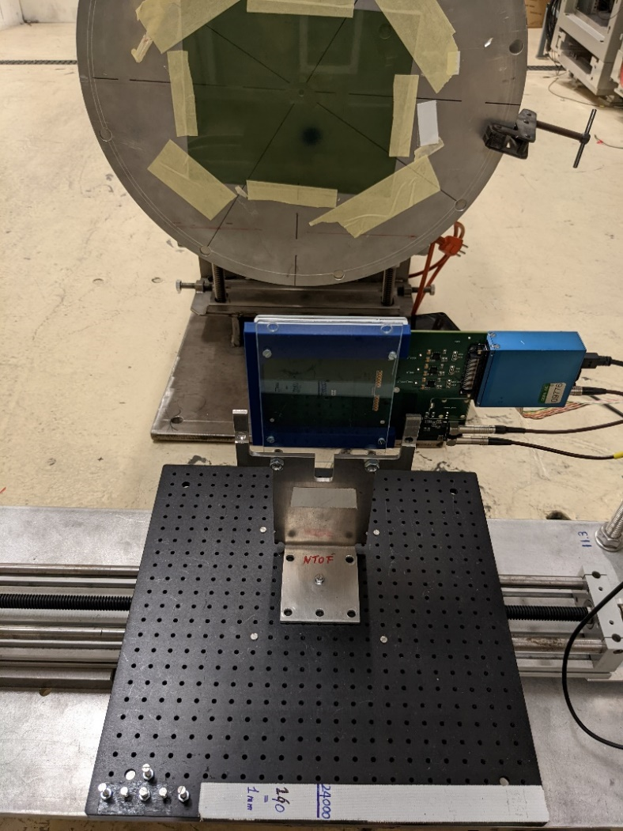
Next GEMPix Installation in Dump Area
3x3 cm²
Vertical (pxl)
Horizontal (pxl)
X
Beam image from silicon sensor

Slide 6
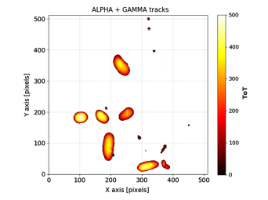
Particle identification
The detector can perform particle id using the cluster parameters : alfas from protons and from gammas
The calorimetric measurements depends on the dimension of the drift space (with this version only 3mm)
Future : with Timepix3 technology it is possible to implement 3D reconstruction of the products tracks

Slide 7
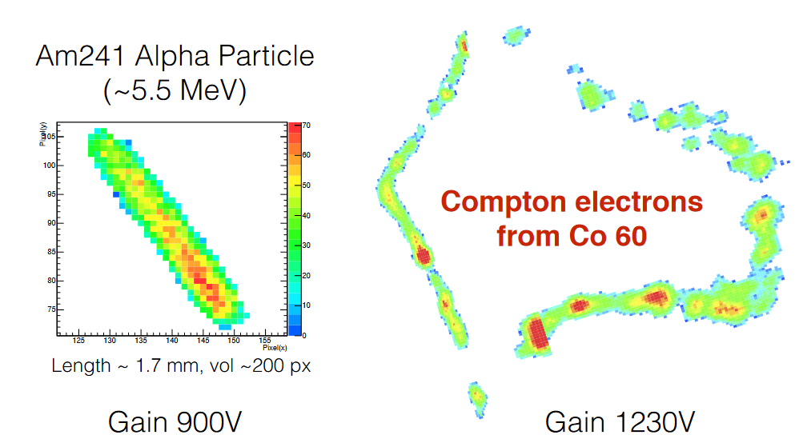
Particle ID with GEMPix detector

Slide 8
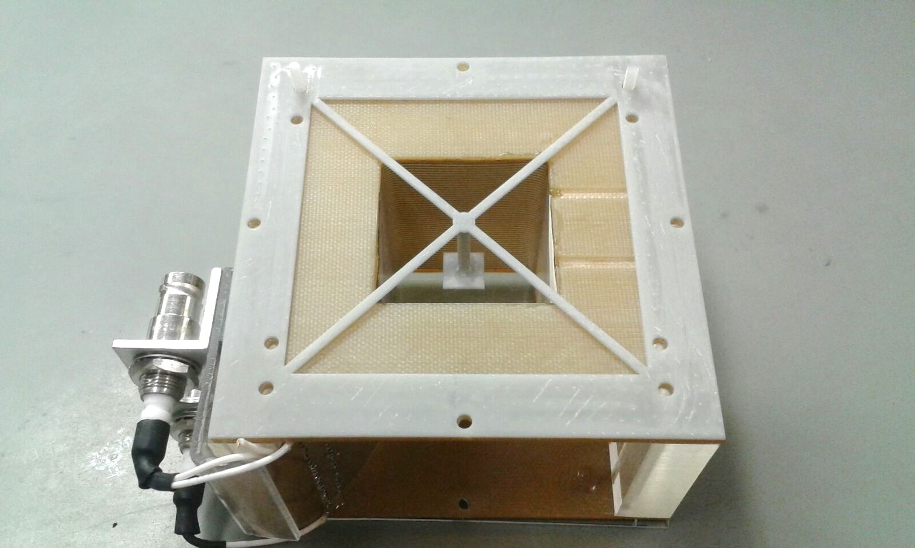
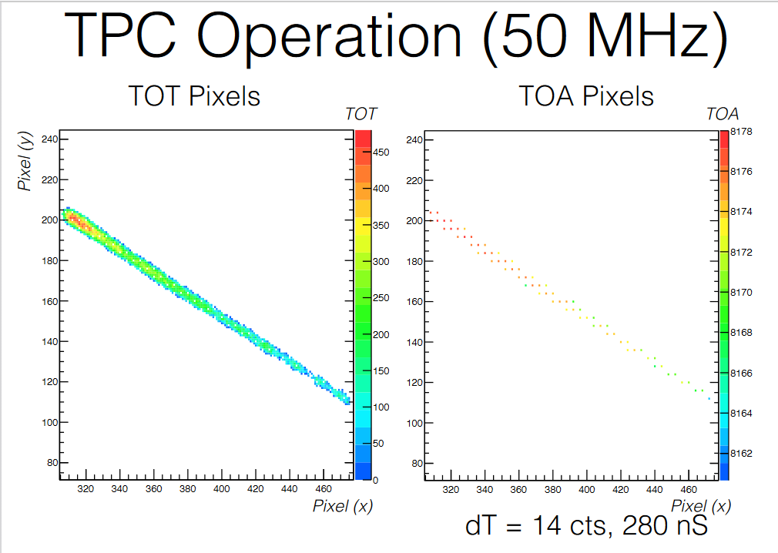
GEMPix as small TPC
5 cm drift space

Slide 9
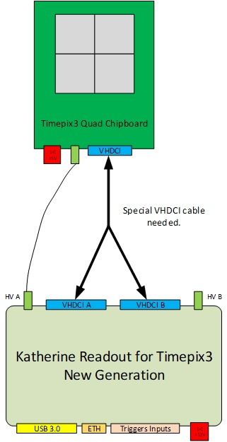
GEMpix vs GEMPix3
Up to now we always used GEMPix detector with
10 ns resolution
50 um spatial resolution
Big dead time (few time frame per second)
Information on Charge OR Time
Improvement with GEMPix3 detector are:
1 ns resolution
50 um spatial resolution
NO dead time (data drive mode)
Information on Charge AND Time
Online Clustering

Slide 10
Silicon sensor QUAD
BNCT studies

Slide 11
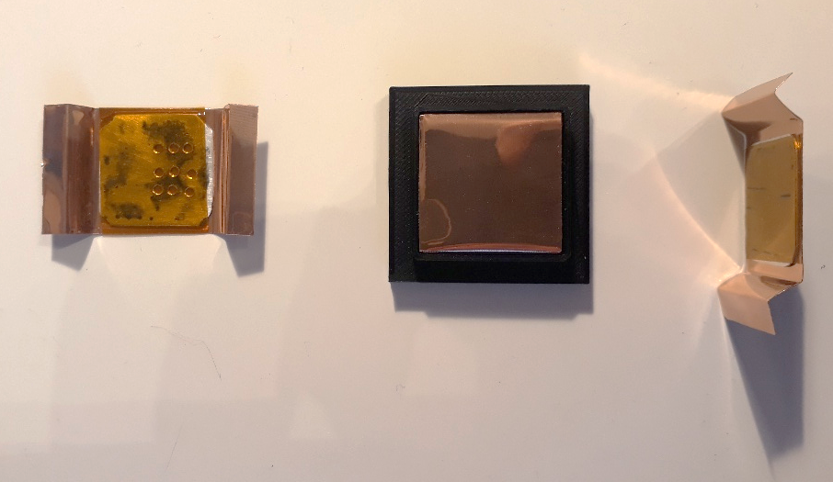
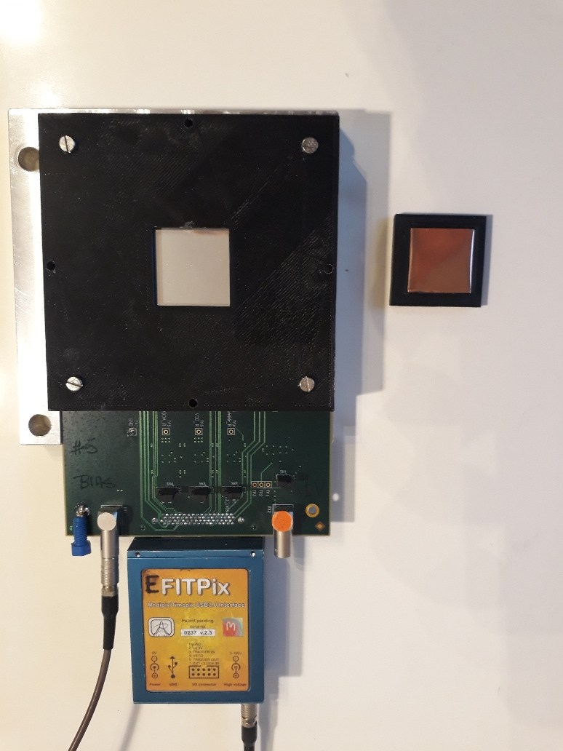
Silcon sensor Timepix QUAD and target holder

Slide 12
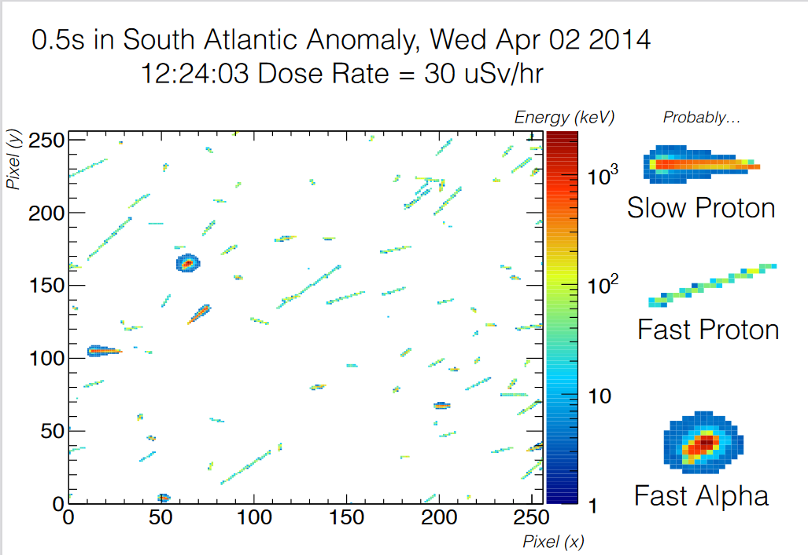
Particle ID using Timepix cluster analysis

Slide 13
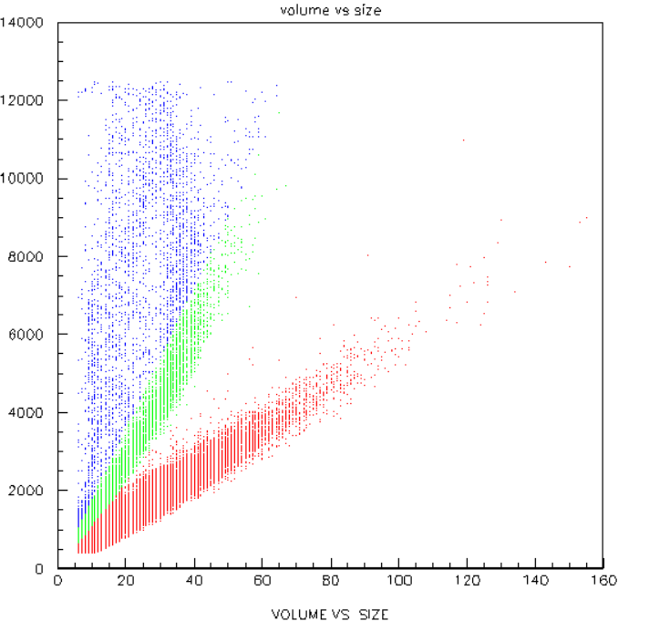
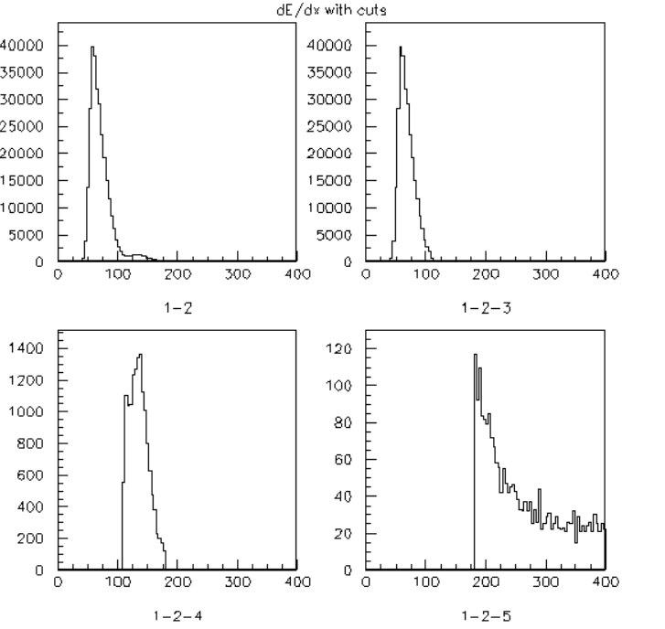
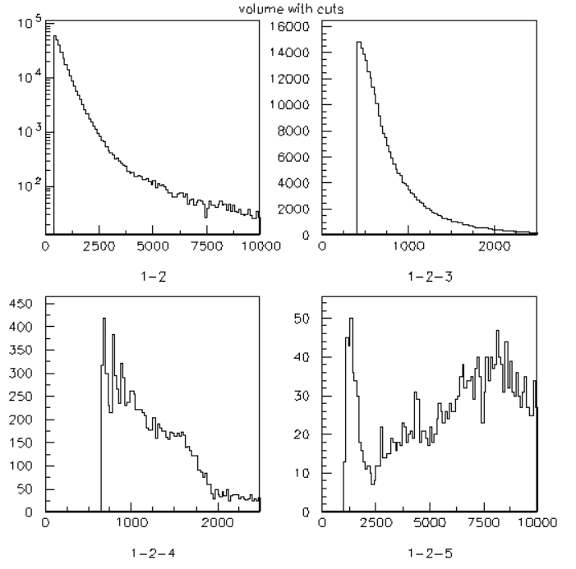
Measurements at Callab @ CERN
Cluster Charge vs Cluster size
Charge/Size (dE/dX)
Charge
Gamma
Gamma
Neutron
Neutron
Neutron
Gamma

Slide 14
How to put a target in front of a silicon sensor
Target
GEM foil
as collimator

Slide 15
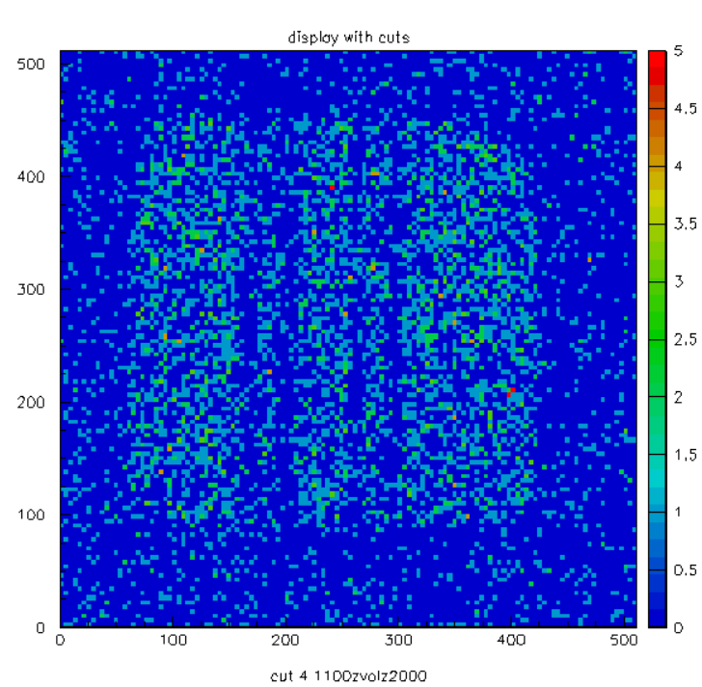
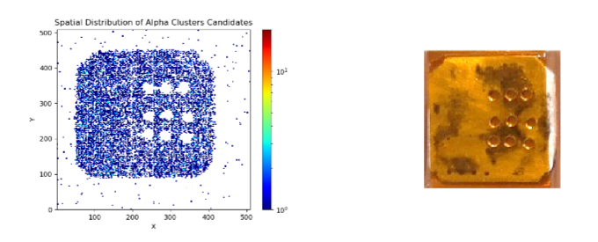
¹⁰B₄C target on silicon sensor detector
20mm
Cuts in dE/dx &
1100 < volume < 2000
(1.1 < E < 2 MeV)

Slide 16
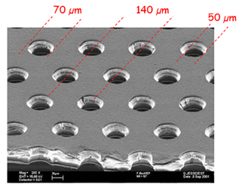
Timepix Quad detector cross section
target
< 400 um air (?)
0.5 um Alu
300 um silicon sensor
700 um Timepix
0.1 um Gold
1.6 mm Ceramic
70 um
Copper 5 um
1.6 mm PCB
Kapton 50 um
50 um
Copper 5 um
4 mm Alu

Slide 17
Light Timepix3 Quad detector cross section
tissue
< 400 um air (?)
0.5 um Alu
100 um silicon sensor
200 um Timepix
70 um
Copper 5 um
Kapton 50 um
50 um
Copper 5 um

Slide 18
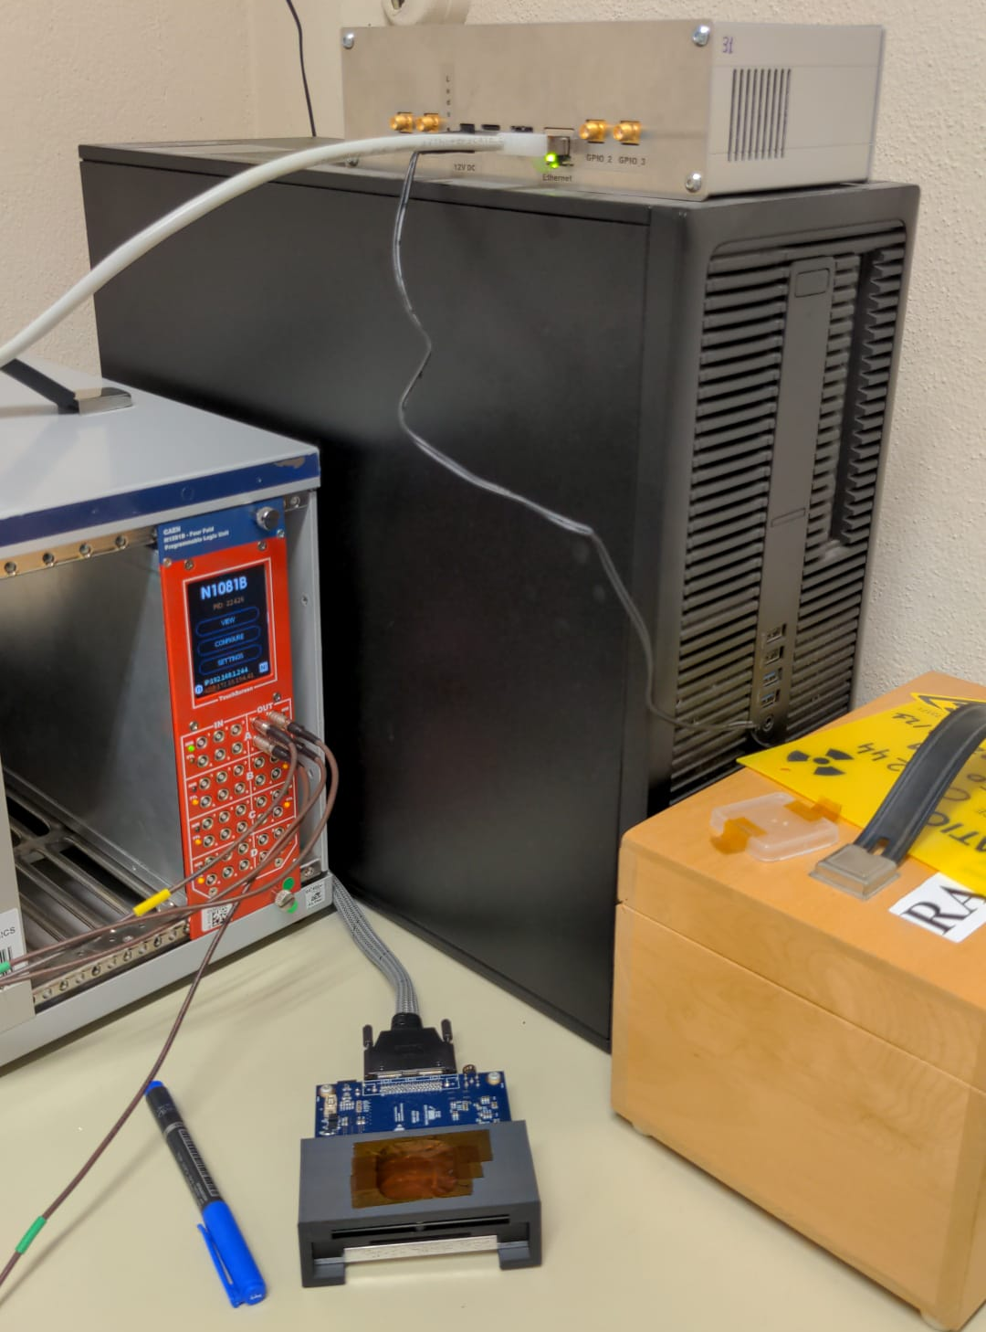
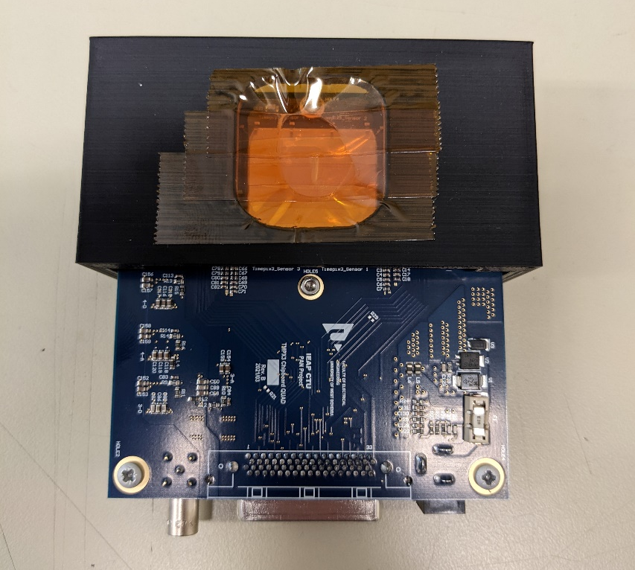
Light Timepix3 QUAD detector at CERN
Calibration ongoing …

Slide 19
Diamondpix

Slide 20
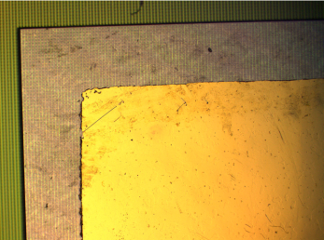
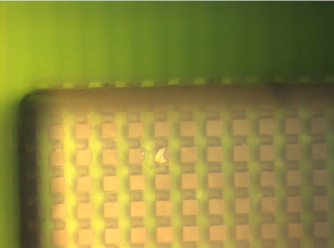
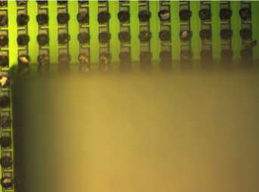
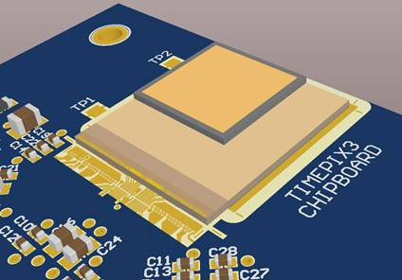
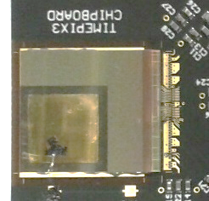
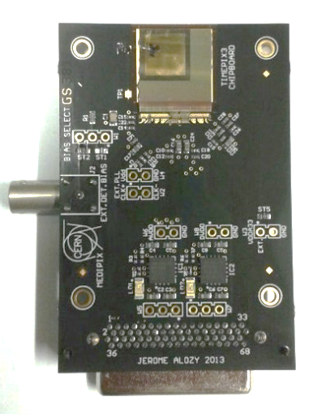
Diamondpix : a radiation tollerant detector
Made by Element6 and Fraunhofer IZM
Gold cathode on diamond
upward surface
Pads on diamond
downward surface
Timepix3 Pads
Diamond bump bonded on Timepix3
Two Diamondpix have been tested on
charged and neutron beam for future applications.

Slide 21
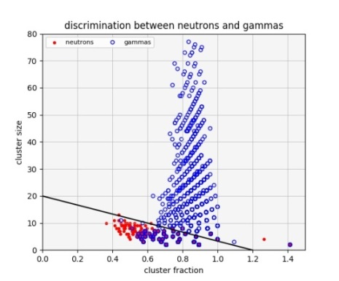
Diamondpix : a radiation hardness detector
Beam image
Neutrons
Gammas
Neutron / Gamma discrimination
Details on :
Diamondpix: a CVD diamond detector with Timepix3 chip interface TNS 00581-2018-R1

Slide 22
MultiBoron layer GEM detector

Slide 23
MBGEM Detector Layout
3GEM
GAIN
DRIFT
α
α
Thermal Neutron
12 layers of
1 um ¹⁰B₄C
pad readoout
pad readoout
α
Triple GEM
Multiborate
cathode
Triple GEM
BGEMs
50 um

Slide 24
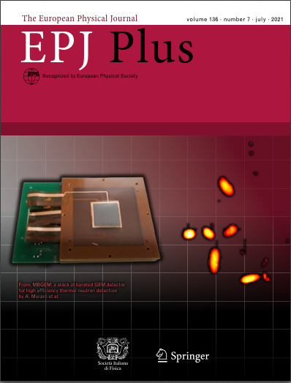
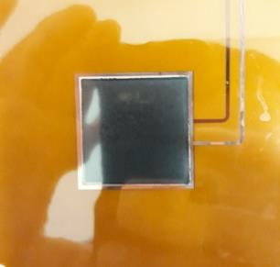
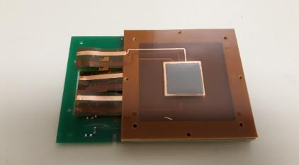
BGEMs with GEMPix : 3x3 cm² active area

Slide 25
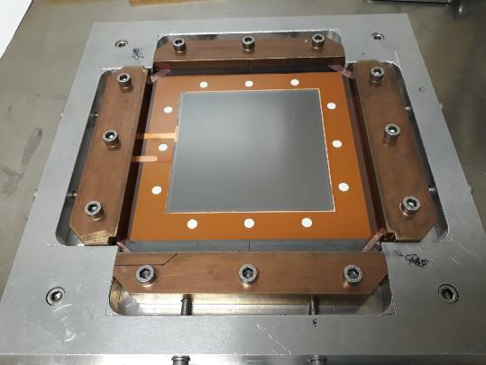
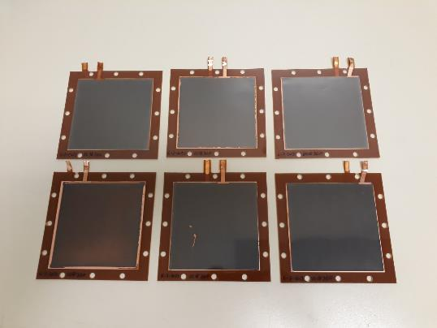
BGEMs foils after Boron Carbide deposition 10x10 cm²

Slide 26
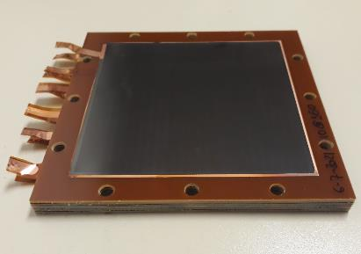
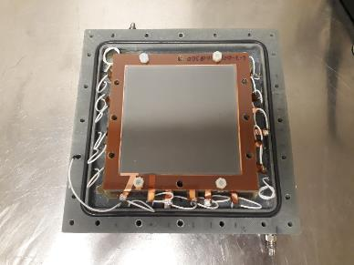
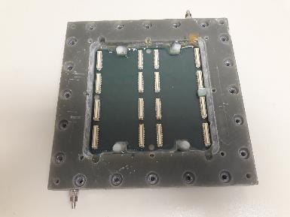
BGEMs foils after Boron Carbide deposition 10x10 cm²

Slide 27
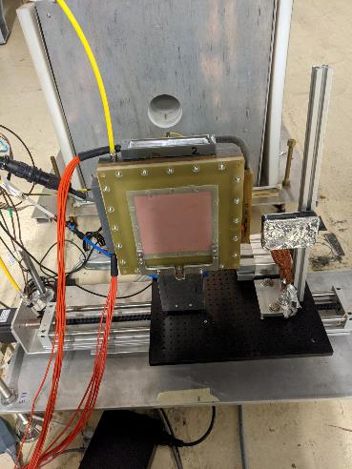
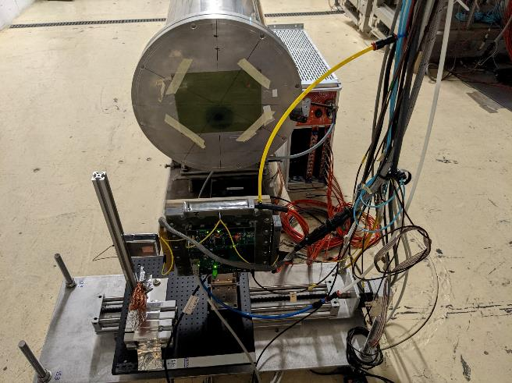
MBGEM 10x10 cm² detector at nToF
The detector has been placed on the optical table inside the dump area of EAR1

Slide 28
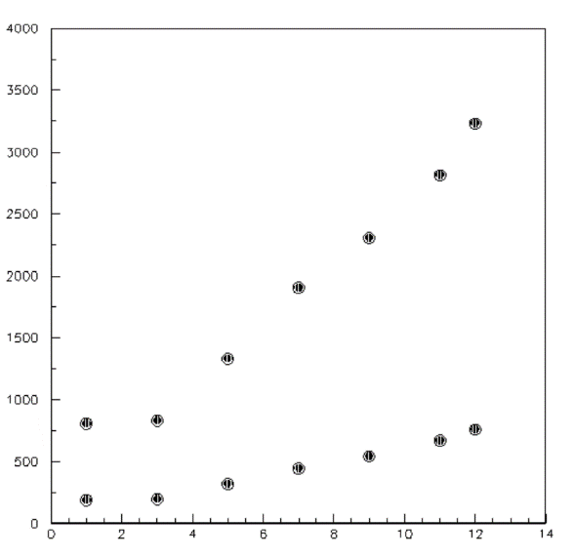
MBGEM detector : boron layers contribution
# Hits
BGEM
Layers

Slide 29
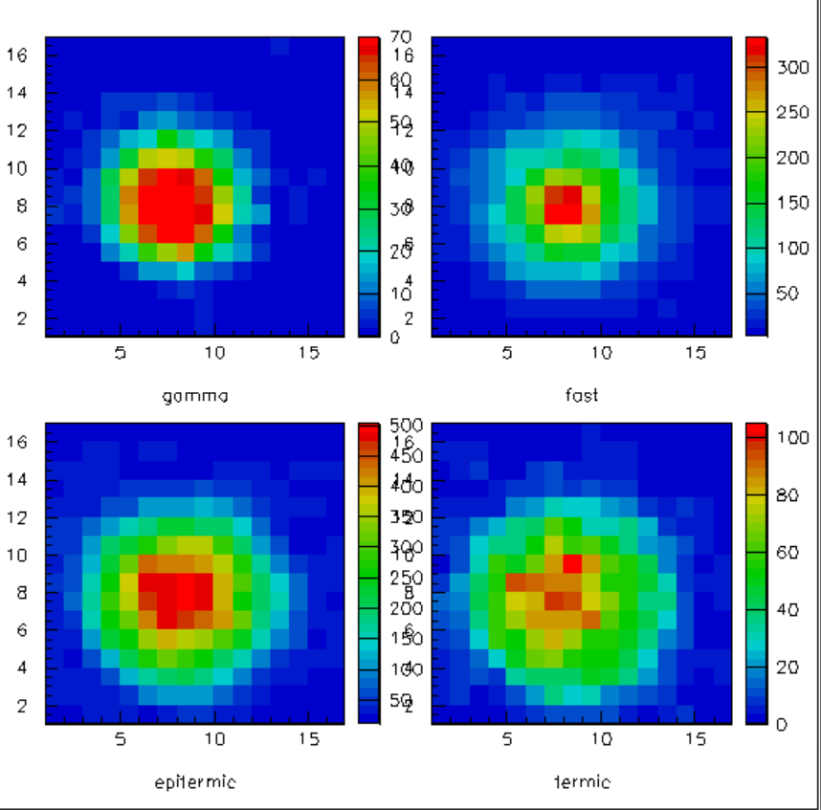
MBGEM detector : 2D image of the beam vs energy
Active area 10x10 cm²
Fast
neutrons
Gammas
Epitermic
Neutrons
Termal
Neutrons

Slide 30
MBGEM detector : to be done
Cluster analysis
Energy reconstructions
Efficiency measurements
Passive divider

Slide 31
SPARE

Slide 32
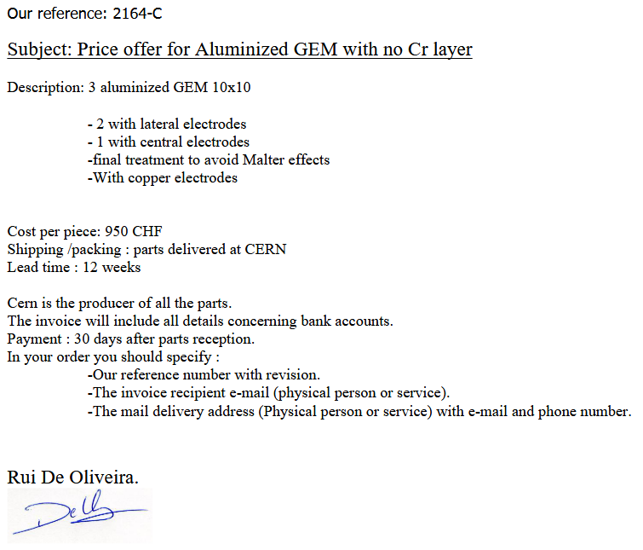
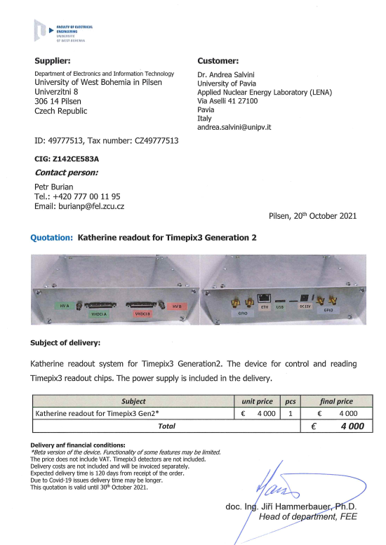
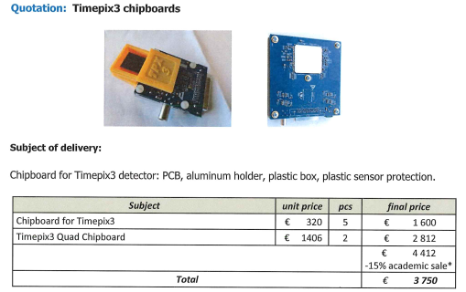
GEMPix3 prototype costs
Katherine readout for a TIMEPix3 quad . : 4000
Timepix3 quad board . . . . . . . . . . . . . . . : 1400
Timepix wirebonding . . . . . . . . . . . . . . . . : 600
4 Timpix3 chips . . . . . . . . . . . . . . . . . . . . . : 1000
6 Alluminized GEM . . . . . . . . . . . . . . . . . . : 2000
2 cables VHDCI high speed . . . . . . . . . . . : 1000
Total . . . . . . . . . . . . . . . . . . . . . . . . . . . . . : 10000

