Slide 1
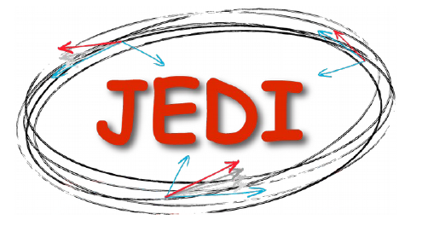
Jülich Electric Dipole Investigation

Slide 2
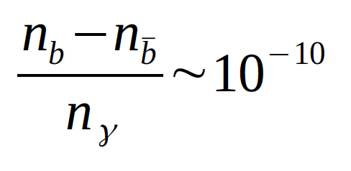
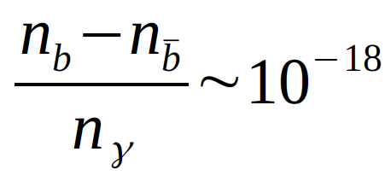
Matter-Antimatter Assimetry
Why current universe is mater dominated?
Big Bang produced the same amount of matter – antimatter
Comparing the experiment:
expectation from SCM :
Preponderance of matter over antimatter
C, CP violation
There is CP violation in SM, but not of sufficient magnitude EDM

Slide 3
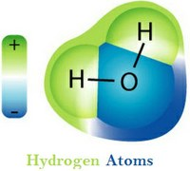
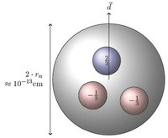
Electric Dipole Moment
The Electric Dipole Moment (EDM) of a particle is determined by the separation of positive and negative charge distributions within the particle itself
The water molecule can have an electric dipole moment because it does not violate any fundamental symmetry of nature.
Fundamental particle has a well defined parity state and cannot have an electric dipole moment because it would violate one of the nature fundamental symmetries: parity. This symmetry is conserved by three of the nature fundamental interactions.

Slide 4
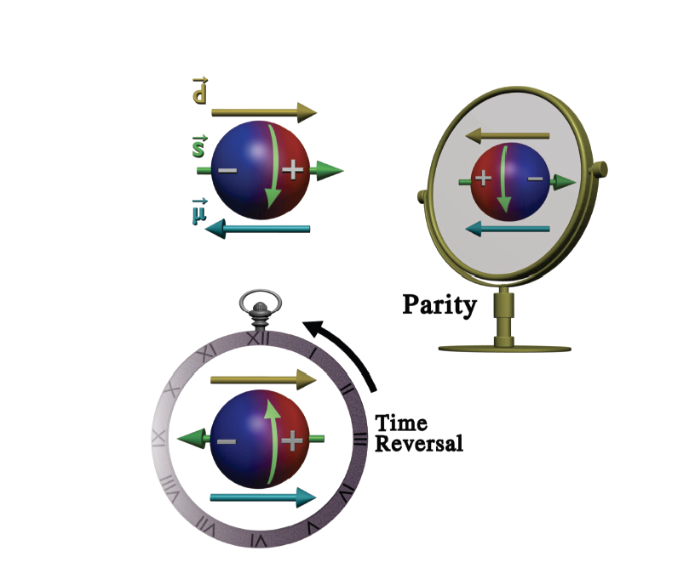
EDM of fundamental particle
EDM violates both T, P symmetries
EDM violates CP symmetry (if CPT conserved)
EDM is a probe for CP violation beyond the SM

Slide 5
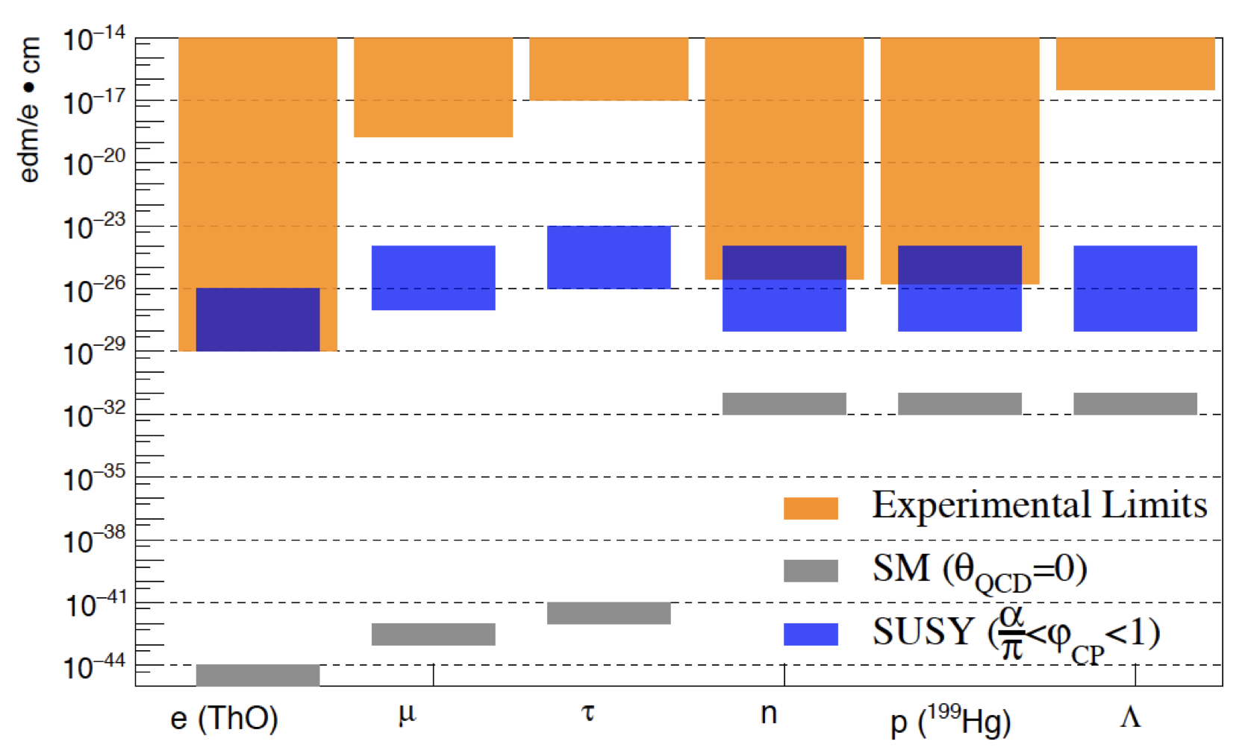
Static EDM: Current upper limits

Slide 6
Charge Particle EDM – CPEDM
No direct measurement for charged hadron EDMs
Potentially higher sensitivity for charged hadrons (compared to neutrons):
longer lifetime
more stored polarazied protons/deuteron
possibility to apply larger electric fields in storage rings
EDM of single particle type not sufficient to identify CP violation

Slide 7
EDM AT STORAGE RINGS
$$\frac{d\vec{S}}{dt}=[{\vec{Ω}}_{MDM}−{\vec{Ω}}_{cycl}+{\vec{Ω}}_{EDM}]$$
THOMAS - BMT EQUATION:
${\vec{Ω}}_{MDM}−{\vec{Ω}}_{cycl}=−\frac{q}{m}[G\vec{B}−(G−\frac{1}{γ^{2}−1})\frac{\vec{β}×\vec{E}}{c}$]
$${\vec{Ω}}_{EDM}=−\frac{ηq}{2mc}[\vec{E}+c\vec{β}×\vec{B}]$$
$${\vec{Ω}}_{MDM}−{\vec{Ω}}_{cycl}=0$$
Frozen spin case
Momentum and spin in the absence of EDM would stay aligned.

Slide 8
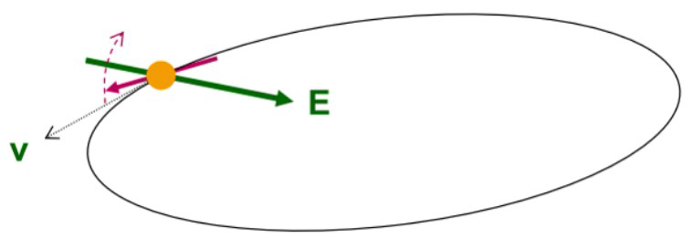
EDM AT STORAGE RINGS
In case of purely electric ring:
$${\vec{Ω}}_{MDM}−{\vec{Ω}}_{cycl}=−\frac{q}{m}[G\vec{B}−\left(G−\frac{1}{γ^{2}−1}\right)\frac{\vec{β}×\vec{E}}{c}]$$
X
X
$${\vec{Ω}}_{EDM}=−\frac{ηq}{2mc}[\vec{E}+c\vec{β}×\vec{B}]$$
$$\left(G−\frac{1}{γ^{2}−1}\right)=0$$
Frozen spin case
works only for G > 0, e.g. proton

Slide 9
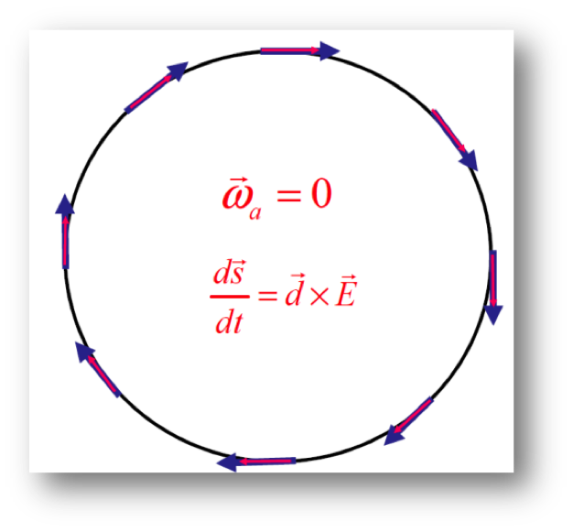
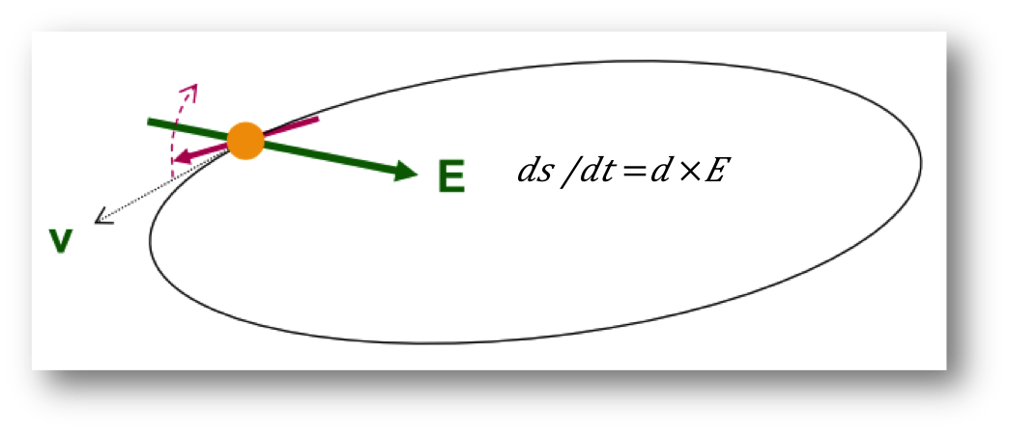
EDM AT STORAGE RINGS
Measurement concept
Inject particles in storage ring
Align spin along momentum (-> freeze horiz. Spin procession)
Search for time development of vertical polarization
Frozen-spin condition:
For pure E ring for p
Combined E/B ring: special combination of E, B fields and γ for d and ³He

Slide 10
CPEDM: Strategy

Slide 11
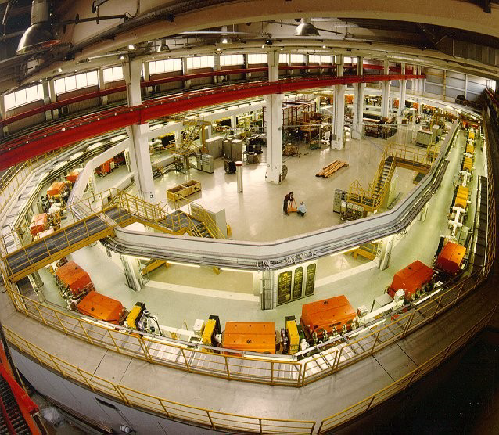
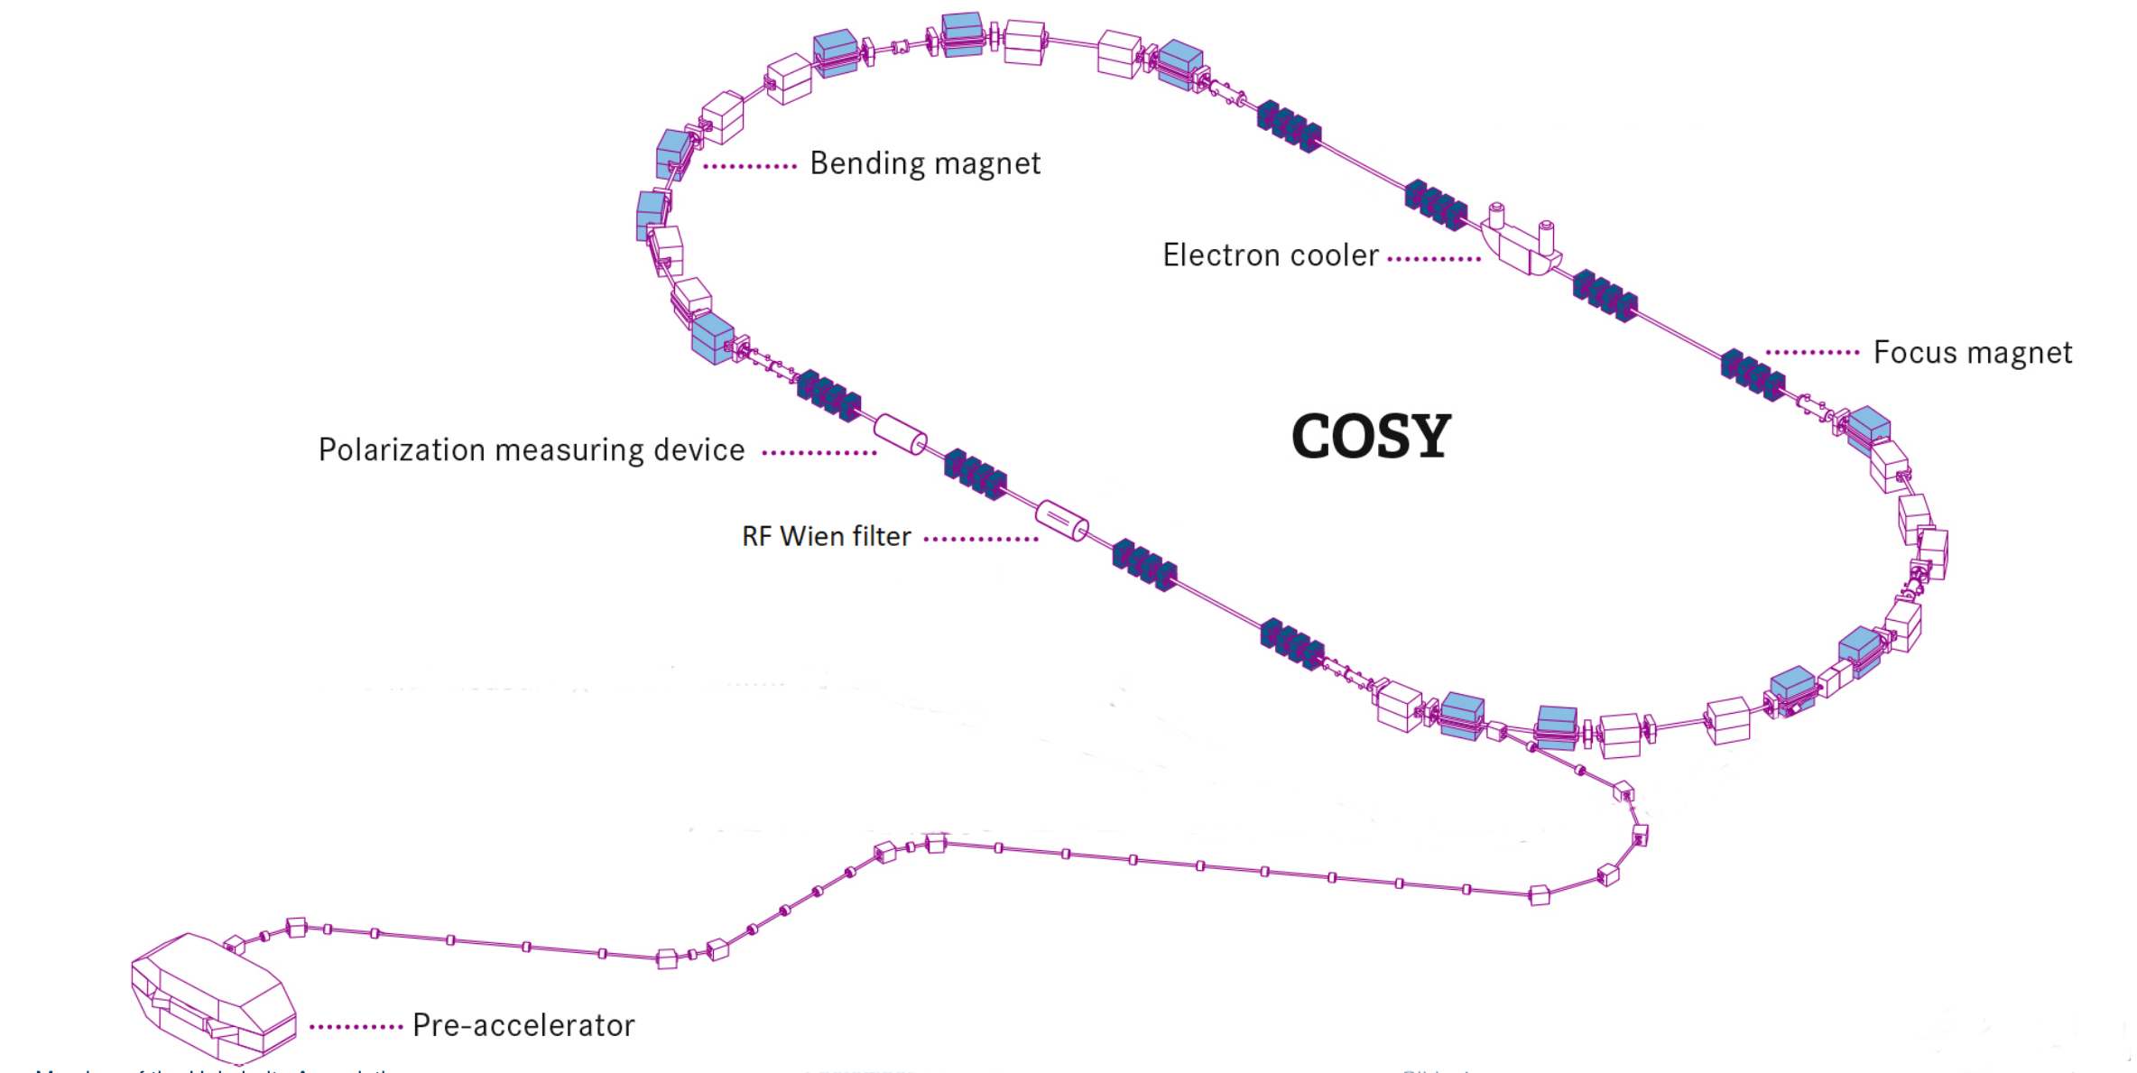
Precursor Experiment at COSY
COSY (Jülich, Germany)
● magnetic storage ring
● polarized protons and deuterons
● Momenta p = 0.3 – 3.7 GeV/c

Slide 12
EDM AT MAGNETIC RING
In case of purely magnetic ring:
$${\vec{Ω}}_{MDM}−{\vec{Ω}}_{cycl}=−\frac{q}{m}[G\vec{B}−\left(G−\frac{1}{γ^{2}−1}\right)\frac{\vec{β}×\vec{E}}{c}]$$
X
$${\vec{Ω}}_{EDM}=−\frac{ηq}{2mc}[\vec{E}+c\vec{β}×\vec{B}]$$
X
At storage rings: vertical B field, radial E field
MDM causes fast spin precession in horizontal plane
$$c\vec{β}×\vec{B}$$
In pure magnetic ring motional electric field term
access to EDM

Slide 13
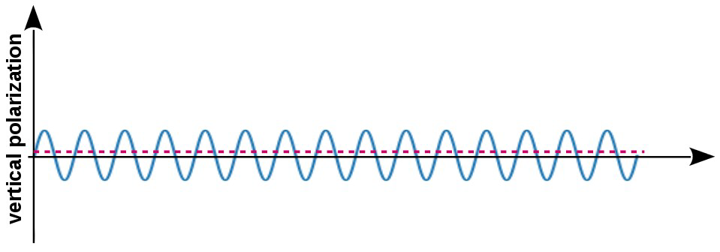
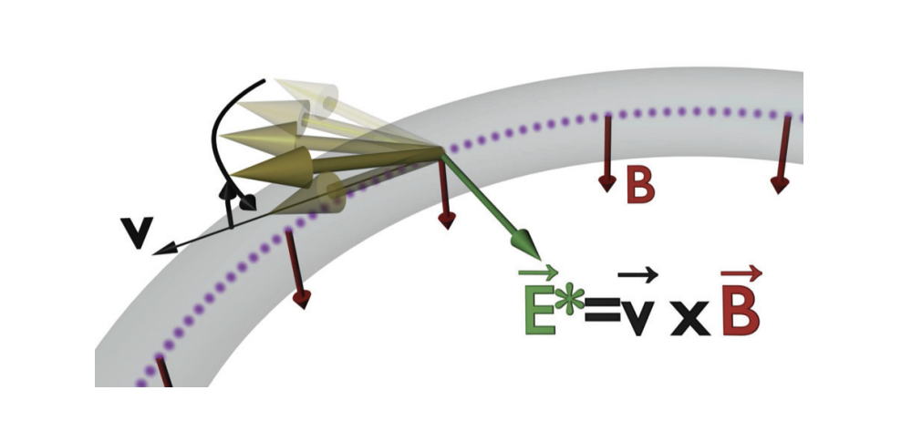
EDM AT MAGNETIC RING
tiny oscillations of vertical polarization
In the magnetic ring
momentum ↑↑ spin spin kicked up
momentum ↑↓ spin spin kicked down
no accumulation of vertical asymmetry
A radiofrequency system synchronized with the spin precession frequency, restores the parallelism between spin and momentum

Slide 14
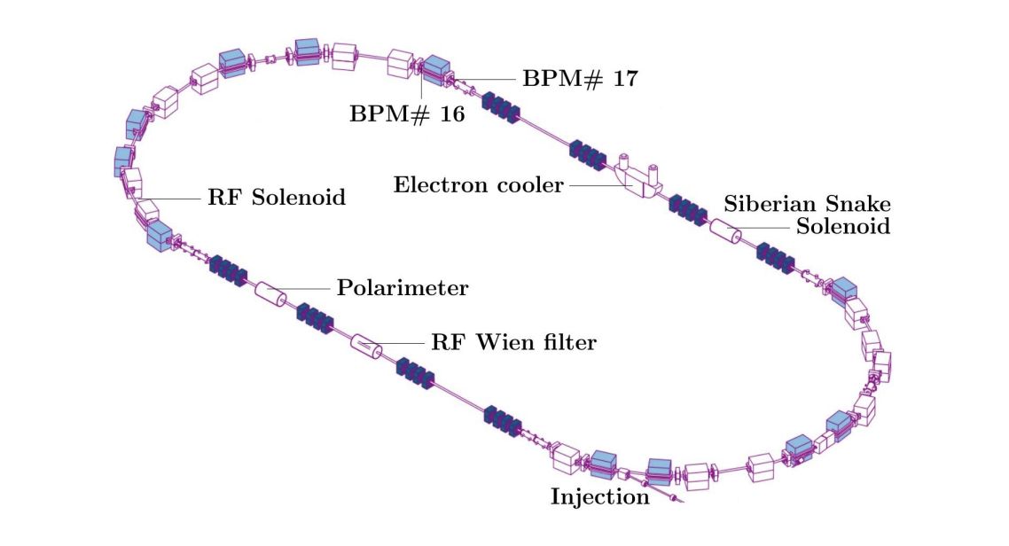
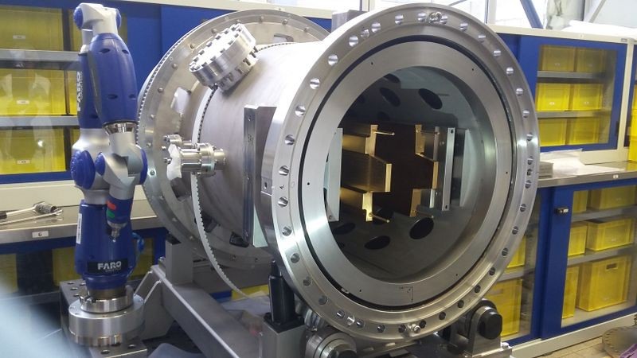
RF WIEN FILTER
● Lorentz force ${\vec{F}}_{L}=q\left(\vec{E}+\vec{v}×\vec{B}\right)=0$
● $\vec{B}=\left(0,B_{y},0\right) and \vec{E}=(E_{x},0,0)$

Slide 15
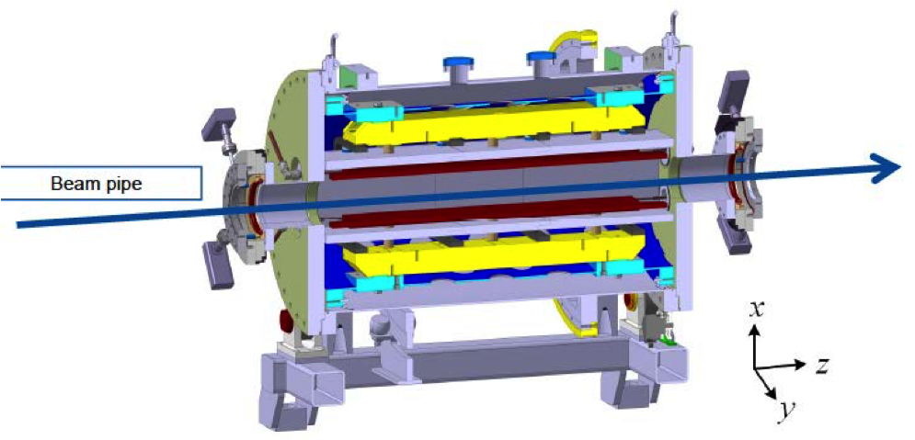
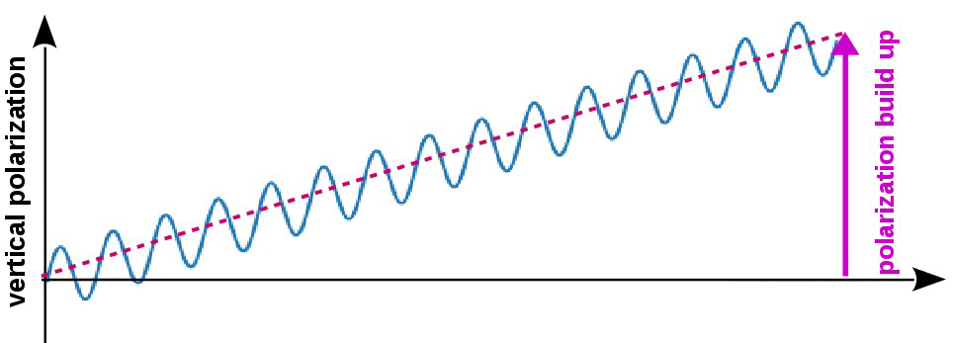
EDM AT MAGNETIC RING
tiny oscillations of vertical polarization
In the magnetic ring
momentum ↑↑ spin spin kicked up
momentum ↑↓ spin spin kicked down
no accumulation of vertical asymmetry
phase lock between spin
precession and RF Wien filter

Slide 16
Precursor Experiment at COSY
The precursor experiment requires several additional prerequisites:
a long spin-coherence time
precise monitoring of the precession in the horizontal plane
a feedback system controlling the relative phase of the polarization vector and the RF Wien filters fields
a good understanding of the effects other than EDM that may lead to a tilt of the invariant spin axis

Slide 17
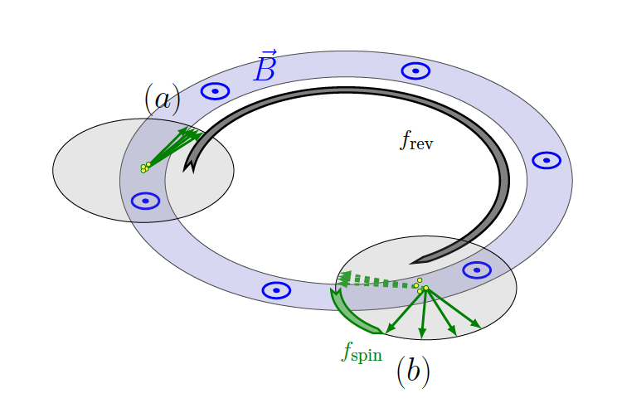
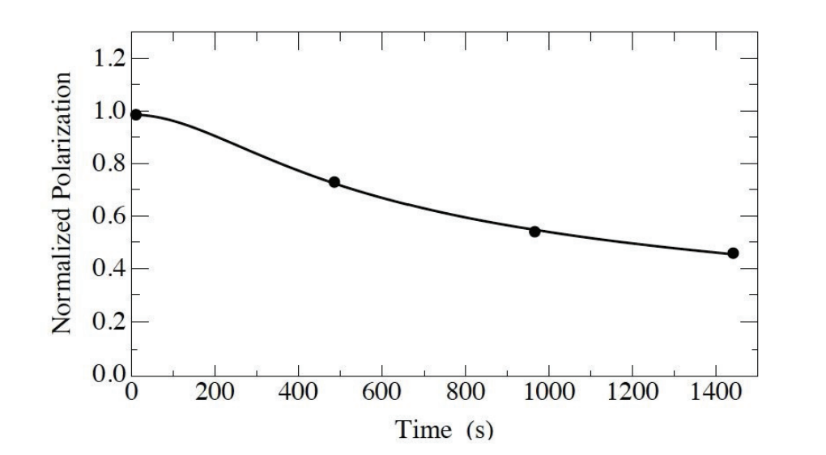
Spin-coherence time
One of the longest polarization lifetimes recorded for the COSY ring.
The half-life of the polarization is 1173 ± 172 s, which is three orders of magnitude longer than previous results using electron beams.

Slide 18
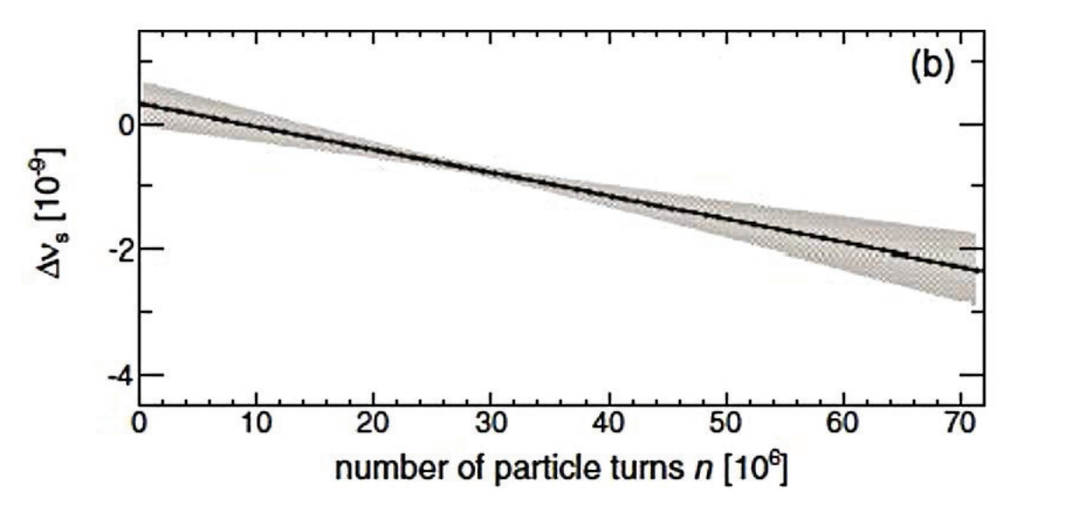
Measurement of the spin-tune
It was possible to unfold for the first time the rapid rotation of the polarization in the ring plane (≈ 120 kHz) arising from the gyromagnetic anomaly. The spin tune (i.e. the number of spin precessions per turn) has been measured with a precision better than 10⁻¹⁰ in a cycle of 10 seconds
It represents the most precise measurement ever performed in a storage ring

Slide 19
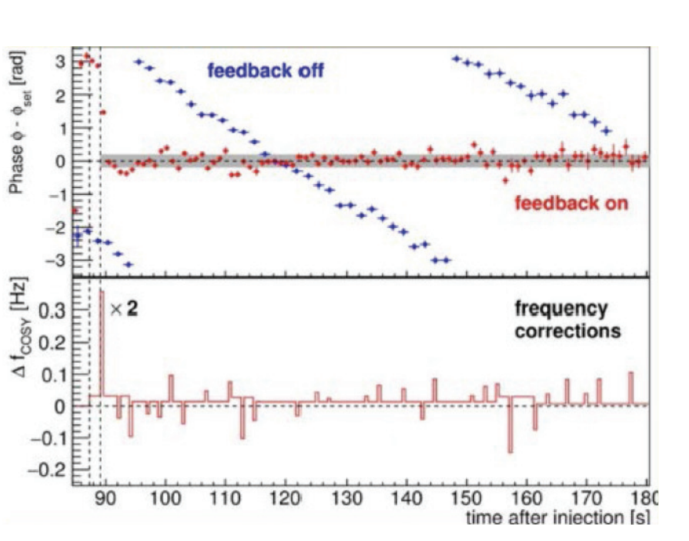
Phase-locking the spin precession
Phase-locking is necessary, making sure that phase between the spin precession and the device RF is maintained throughout the measurement. To this end, a feedback system has been developed that stabilizes the phase of the spin precession relative to the phase of an RF devices, providing a so-called phase-lock.

Slide 20
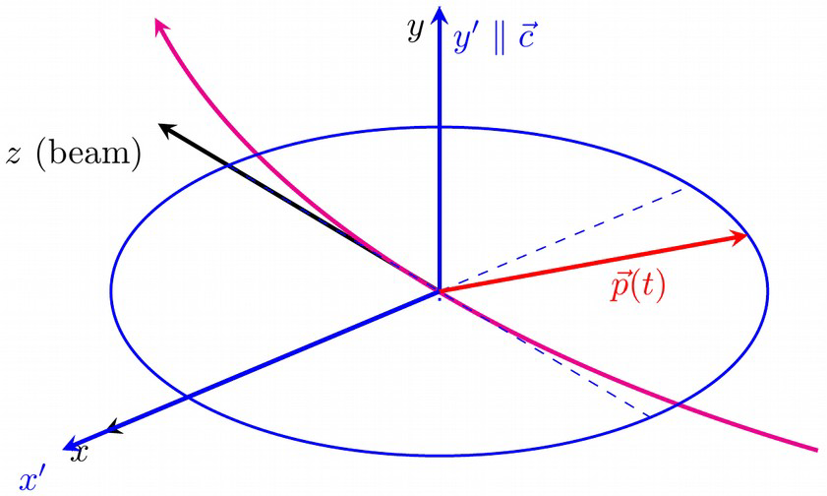
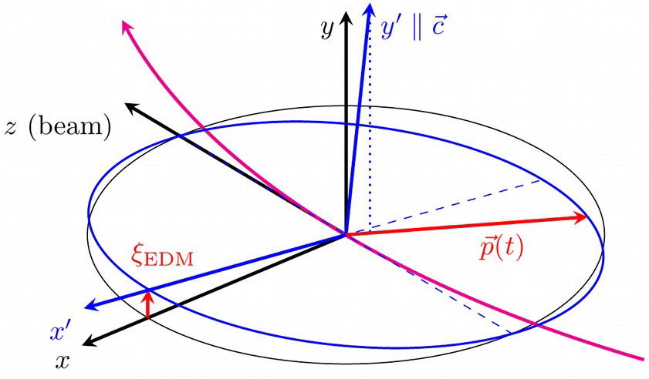
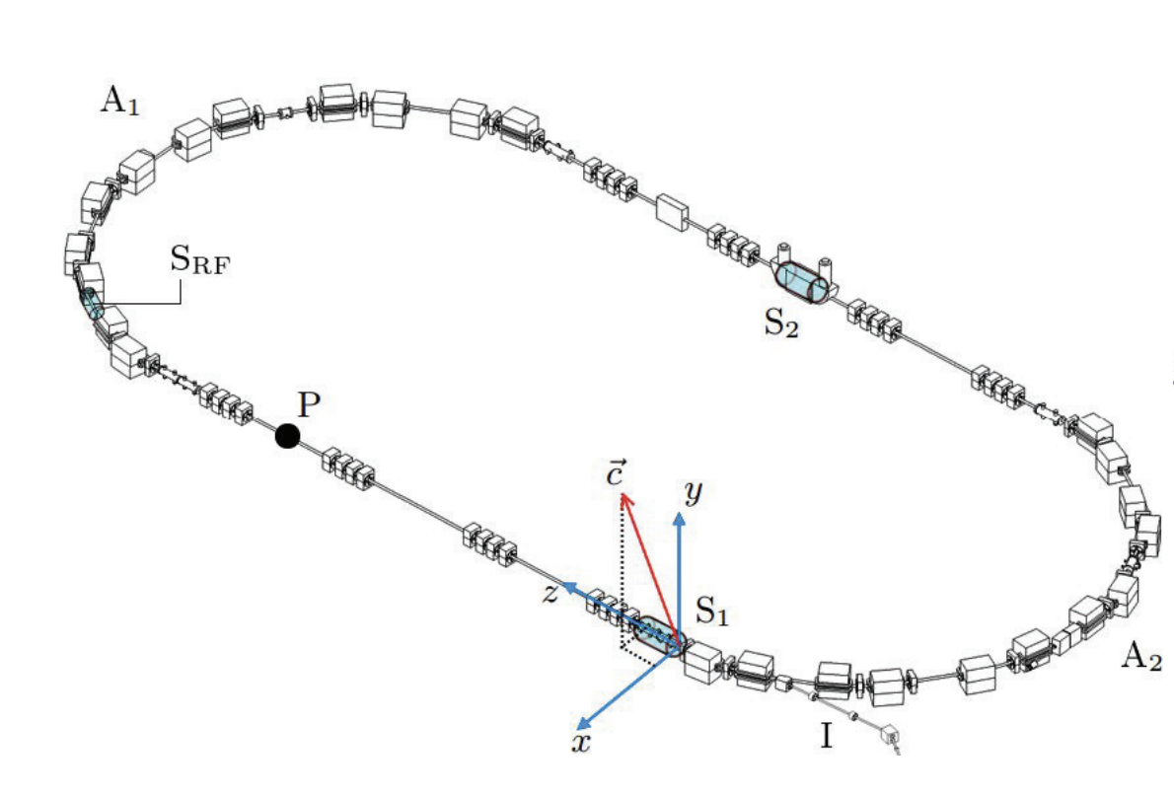
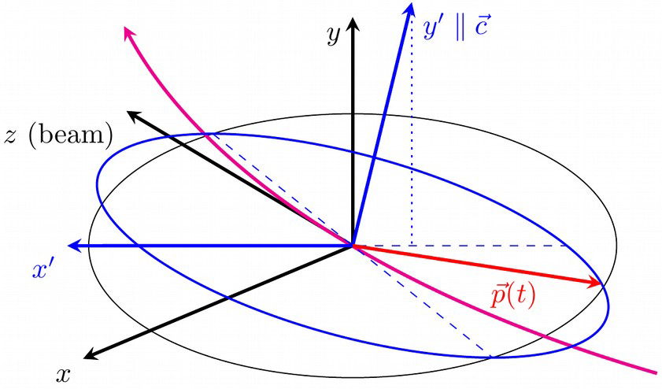
Spin-tune mapping
JEDI developed a new method to investigate magnetic machine imperfections based on the highly accurate determination of the spin-tune
EDM absence case
EDM effect
Magnetic misalignment effect

Slide 21
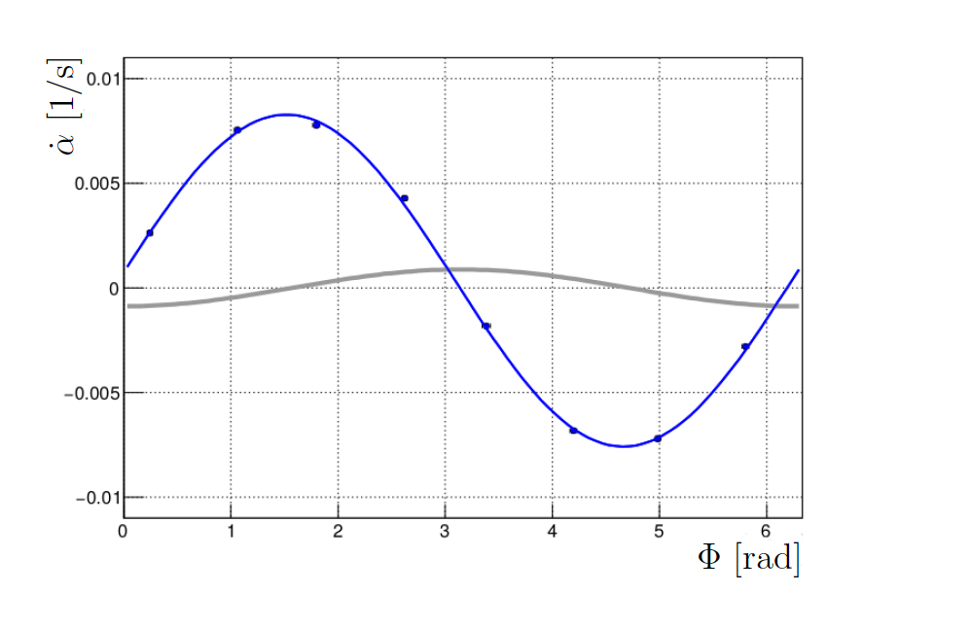
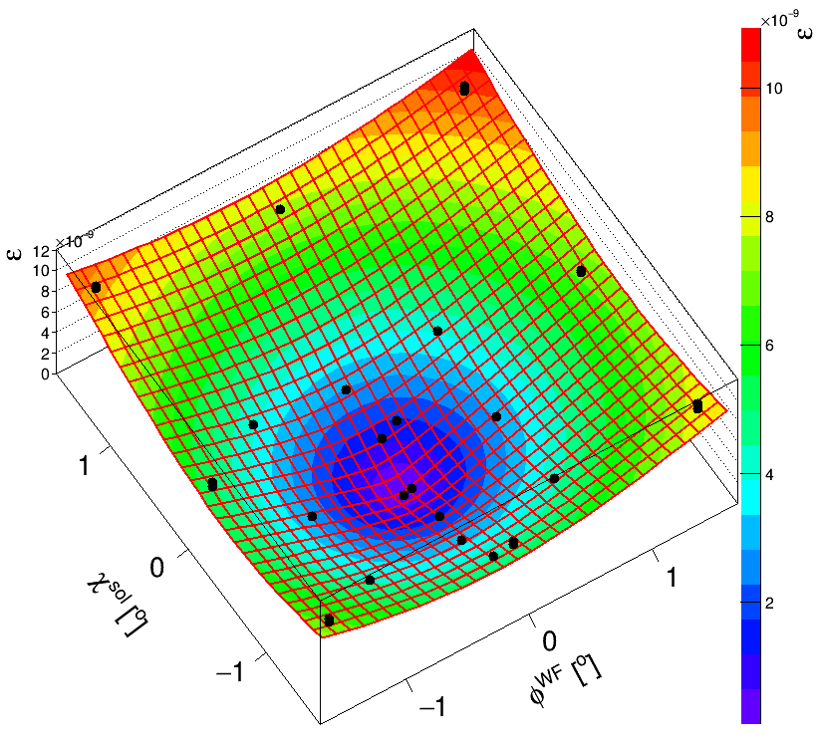
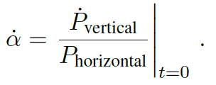
First Results
$$Φ_{0}^{WF}=−3.80 ±0.05 mrad$$
$$Χ_{0}^{SOL}=−5.51 ±0.05 mrad$$

Slide 22
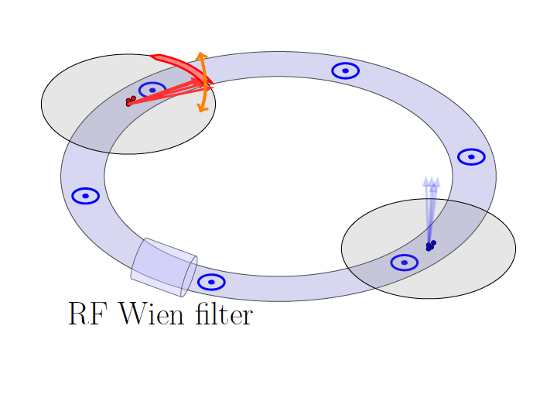
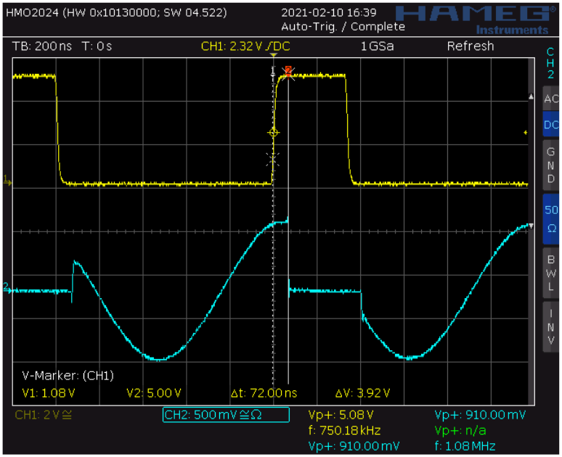
First Results
Pilot bunch method:
● 8 high-speed RF switchers to gate the WF power for one of two bunches
● Capable of short switch time ~ few ns
● Bunch 2 feels the power and oscillate
● Bunch 1 is used as pilot bunch for phase locking

Slide 23
First Results
Tools developed to manipulate and measure beam polarization:
Spin coherence time > 1000 s
Measure spin tune precession in horizontal plane with a precision of 10⁻¹⁰
Polarization feed back system
Single bunch spin manipulation

Slide 24
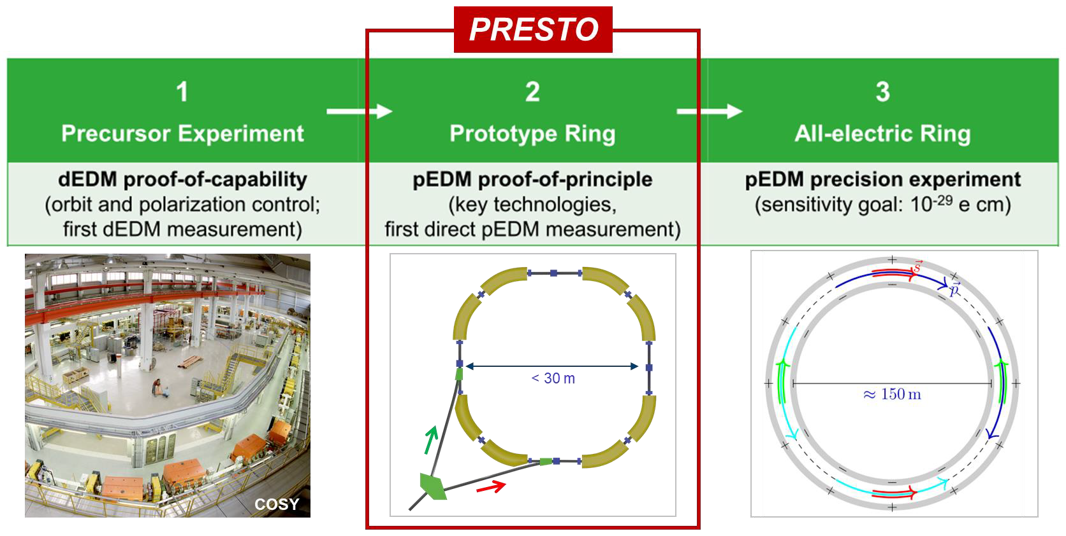

Slide 25
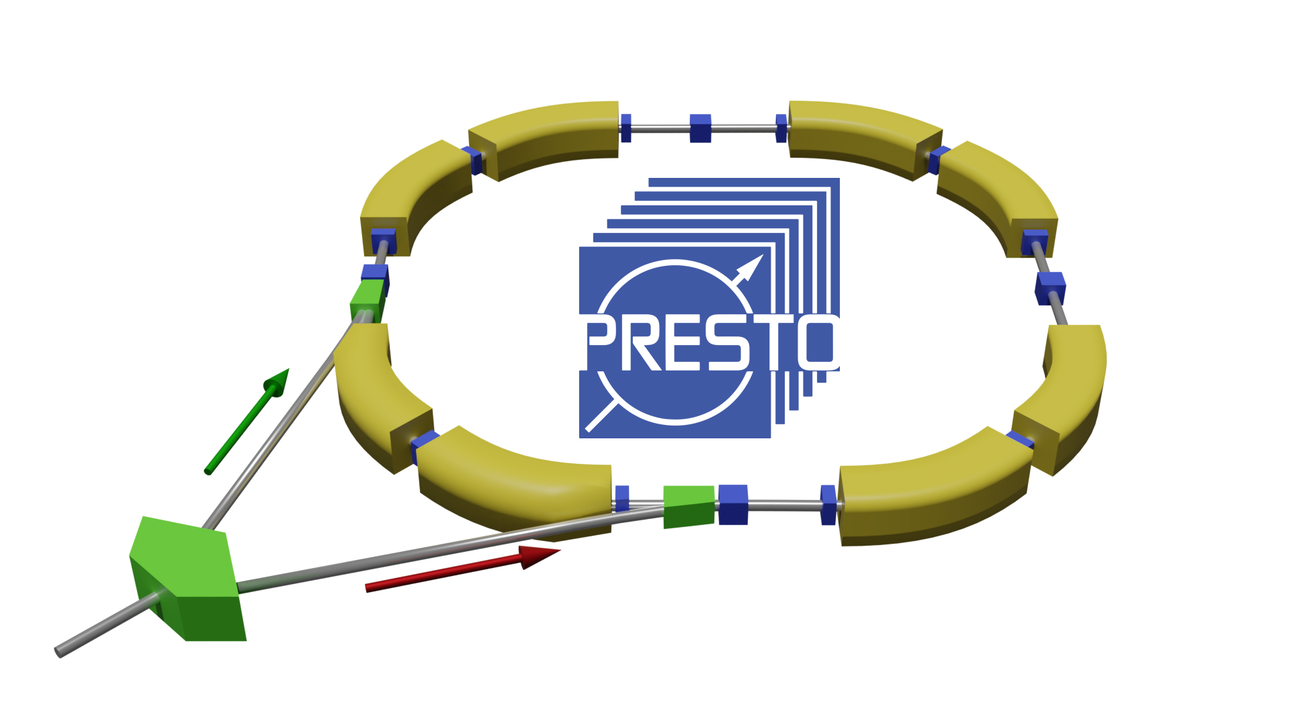
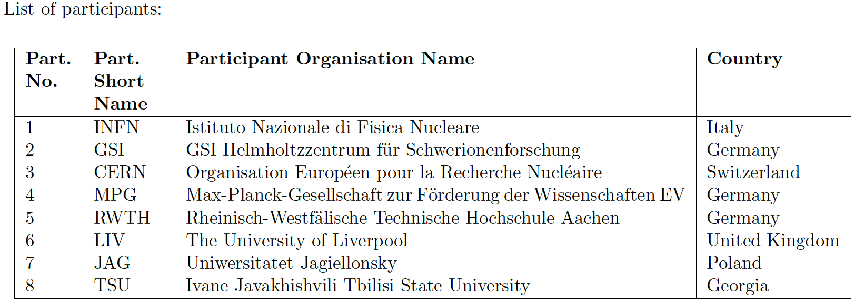
HORIZON-INFRA-2022
Research Infrastructure Concept Development

Slide 26
2023
All was done for the deuterium has to be done for the :
Spin coherence time (started in 2022)
Measure spin tune precession in horizontal plane
Polarization feed back system
Single bunch spin manipulation

Slide 27
Pubblicazioni 2021-2022
First detection of collective oscillations of a stored deuteron beam with an amplitude close to the quantum limit PHYSICAL REVIEW ACCELERATORS AND BEAMS 24 (12) 2022
Beam-based alignment at the Cooler Synchrotron COSY as a prerequisite for an electric dipole moment measurement JOURNAL OF INSTRUMENTATION 16 (2) 2021

Slide 28
Richieste finanziarie e Manpower 2023
G. Tagliente 30%
Missioni | 4 k€
Consumi | 0 k€
Apparati | 0 k€
TOTALE | 4 k€

