Slide 1
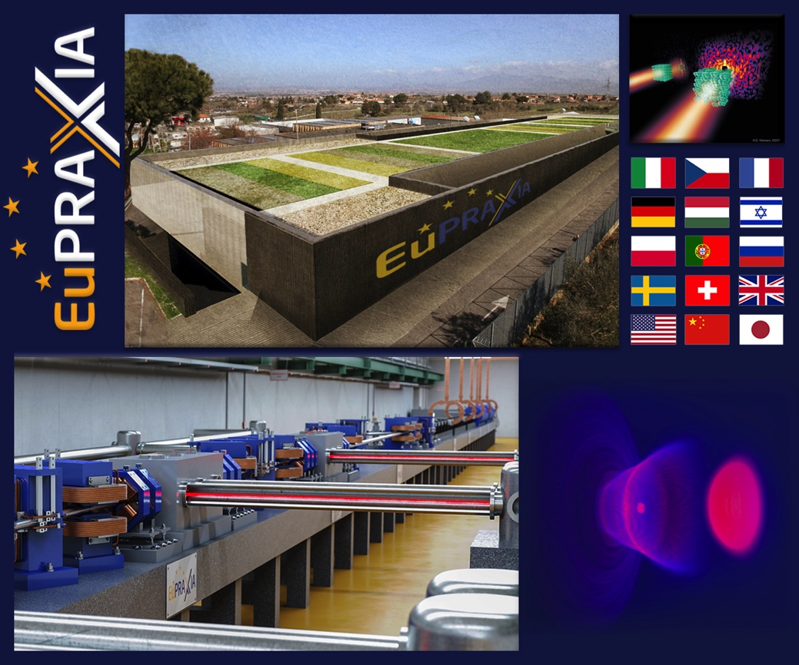
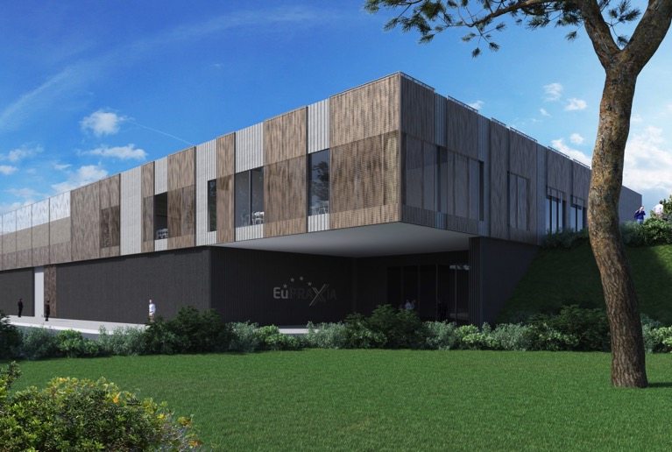
EuPRAXIA Advanced Photon
Sources
Massimo Ferrario
EuAPS First Day Meeting -27.06.2022
Notes:
Ralph

Slide 2

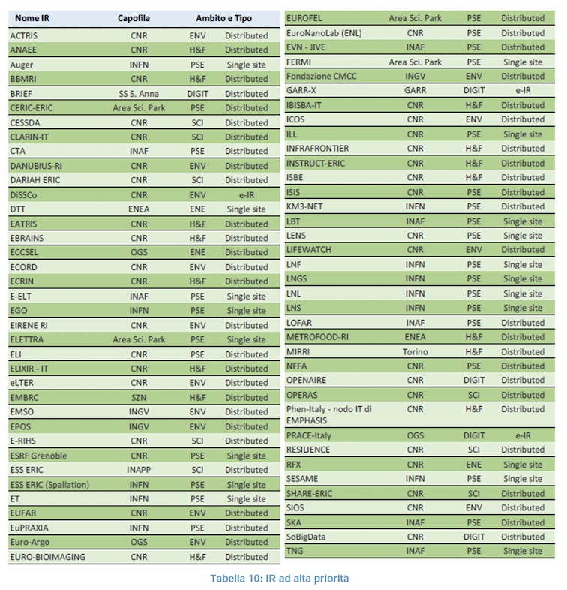


Bando PNRR
Published on December 28th, 2021
Total available funds 400 M$∈$
Minimal request 15 M$∈$ of which 40% to the Southern Regions
Personell funding allowed provided that 40% is reserved to women
To be completed no later than December 31^{rst} 2025

Slide 3
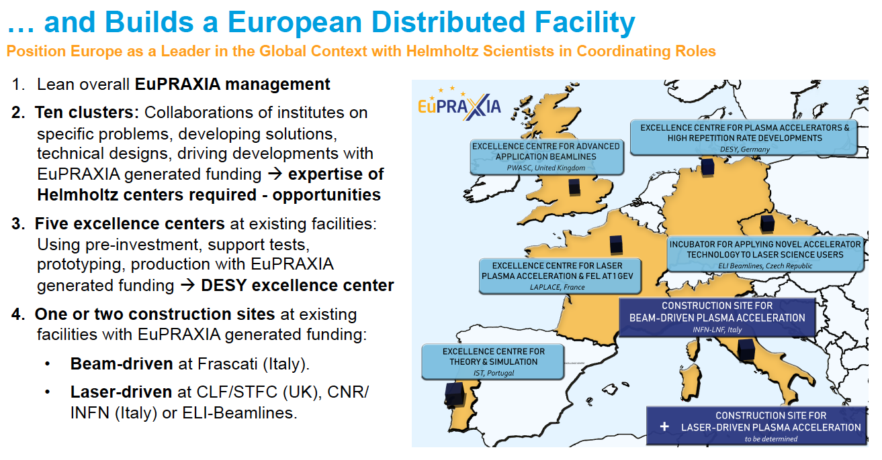
EuPRAXIA is an ESFRI Distributed Facility

Slide 4
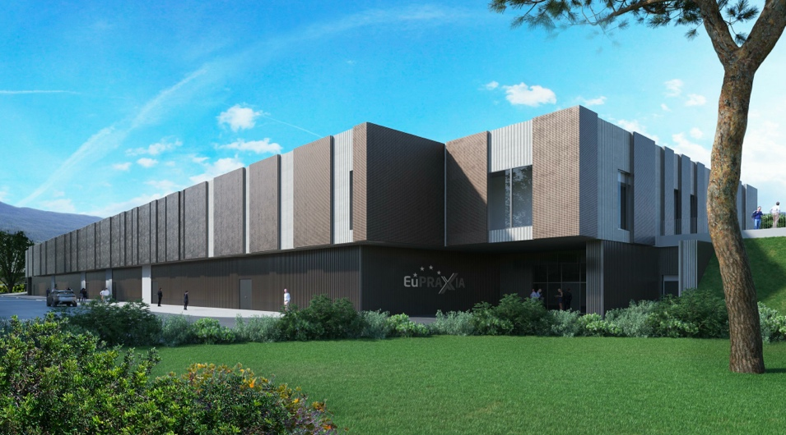
Headquarter and Site 1: EuPRAXIA@SPARC_LAB
Frascati`s future facility
> 108 M€ invest funding
Beam-driven plasma accelerator
Europe`s most compact and most southern FEL
The world`s most compact RF accelerator (X band with CERN)

Slide 5
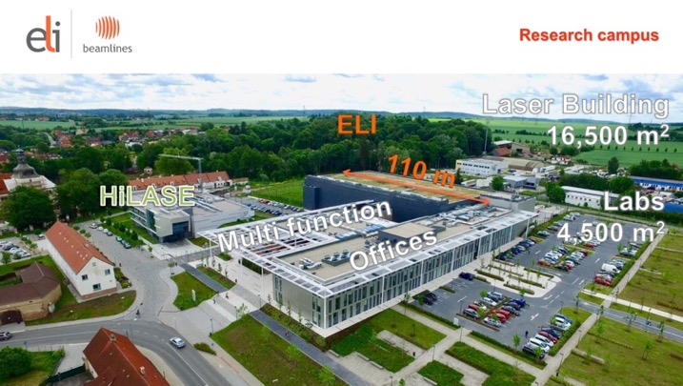
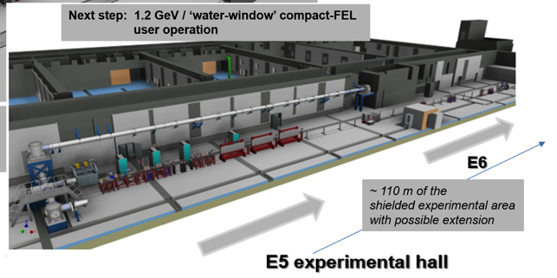







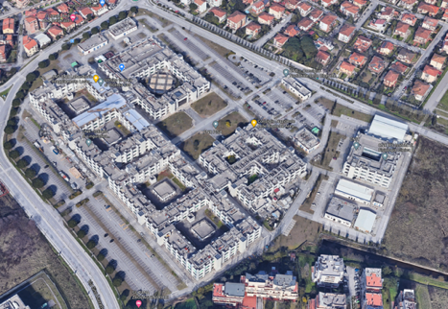


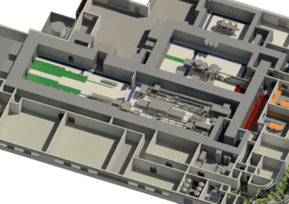









Candidate 2nd Sites from CDR
Prague, Czech Republic
@ EPAC
Rutherford, STFC, UK
PWASC
CNR Campus Pisa
Notes:
Maria

Slide 6

From the EuPRAXIA CDR
The EuAPS proposal benefits from the preparatory work done in the conceptual design phase of EuPRAXIA, both for the scientific case and the technology. It focuses on an ambitious but technically achievable goal and builds on the pre-existing investments at the SPARC_LAB facilities. As stated in the EuPRAXIA CDR the following EuPRAXIA Flagship Goals will be addressed by the EuAPS Project:
Flagship Innovation Goal 2: EuPRAXIA will develop together with laser industry a new generation of high peak power lasers, advancing the presently leading technology into the regime of 20 - 100 Hz repetition rate […].
Flagship Science Goal 2: EuPRAXIA will deliver betatron X rays with up to 10¹⁰ photons per pulse, up to 100 Hz repetition rate and an energy of 5-18 keV to users from the medical area. […].
Flagship Science Goal 7: EuPRAXIA will provide access to cutting edge laser technology with short pulse length in combination with high energy photon pulses […].
We expect that the focus on a mature part of the EuPRAXIA project strongly supports project completion on the timescales that are required by PNRR.

Slide 7
Phased Implementation of Construction Sites
 | Laser-driven | Beam-driven
Phase 1 | FEL beamline to 1 GeV + user area 1 Ultracompact positron source beamline + positron user area | FEL beamline to 1 GeV + user area 1 GeV-class positrons beamline + positron user area
Phase 2 | X-ray imaging beamline + user area Table-top test beams user area FEL user area 2 FEL to 5 GeV | ICS source beamline + user area HEP detector tests user area FEL user area 2 FEL to 5 GeV
Phase 3 | High-field physics beamline / user area Other future developments | Medical imaging beamline / user area Other future developments
INFN (Italy):
Facility for beam-driven plasma accelerators
Beamline BB-A: Radiation sources
FEL user area 1
Undulator
Undulator
1
Plasma Accelerator
FEL user area 2
RF Injector
RF Accelerator
ICS X-ray source user area (BU3)
HEP detector test user area
laser
Plasma Accelerator
Conversion & conditioning
2
GeV-class positron user area
electrons
positrons
Beamline BB-B: GeV-class positrons & HEP detector test stand
Beamline LB-C: X-ray imaging – life sciences & materials
Facility for laser-driven plasma accelerators
Plasma Injector
Life-science & materials X-ray imaging user area
Beamline LB-B: Positron beam source & table-top test beam
Table-top test beam user area
Plasma Injector
Plasma Accelerator
Conversion & conditioning
Ultracompact positron source user area
1: INFN-LNF construction funding 108 M€
2: INFN/CNR/TorVer demo facility 22 M€ (PNRR)
Laser
Plasma Accelerator
FEL user area 1
Undulator
Undulator
RF Injector
Beamline LB-A: FEL
FEL user area 2

Slide 8
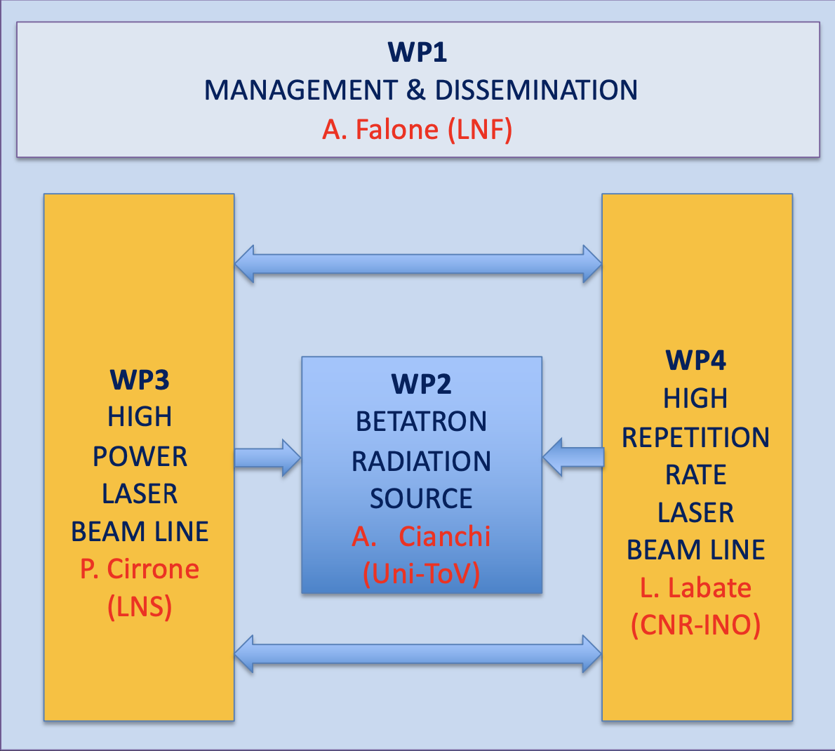



EuPRAXIA Advanced Photon Sources Proposal
Started on February 13th, 2022 - Submitted on February 28th , 2022
EuAPS Scientific Coordinator: M. Ferrario (INFN-LNF)
EuPRAXIA/EuAPS Integration: R. Assmann (DESY & INFN)
Scientific Advisory Committee
Operating Units Board
Scientific and Technical Board
LNF-LNS-MI
INO-ISM

Slide 9
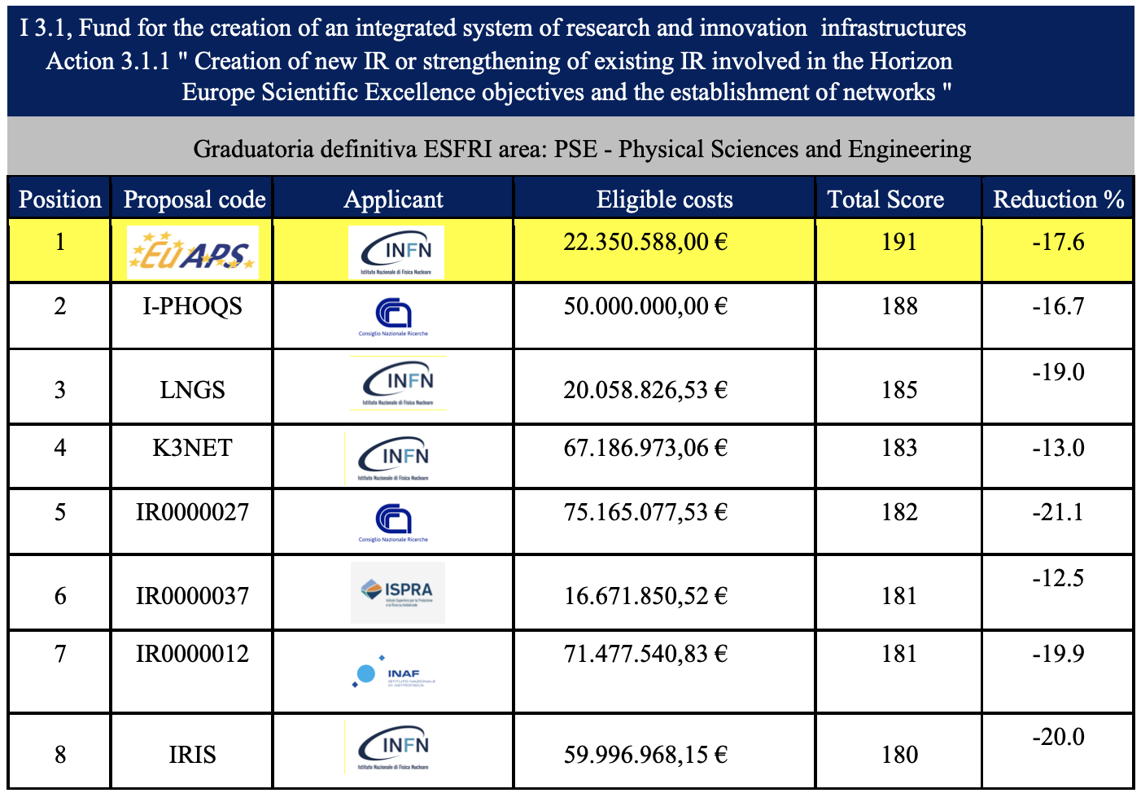
Graduatoria Definitiva
Published on June 20th, 2022

Slide 10


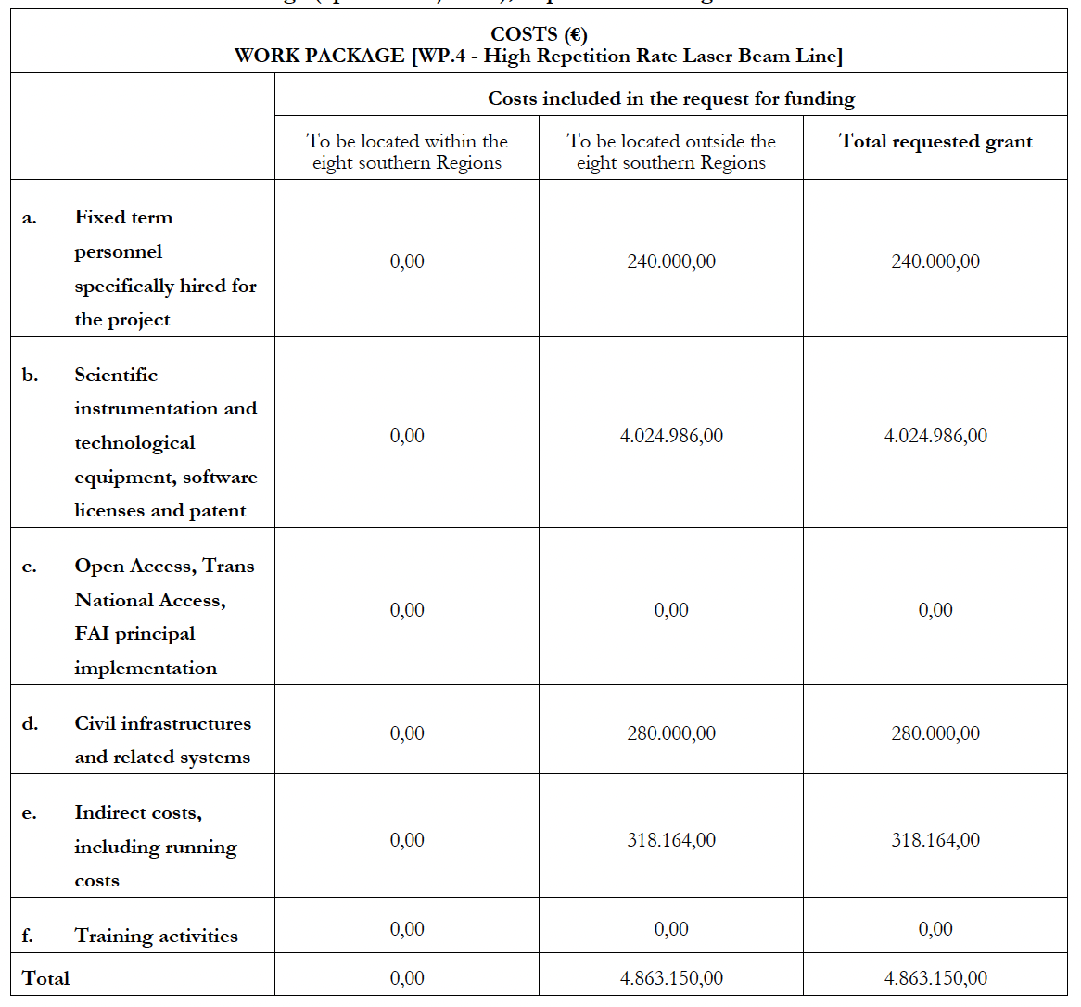
Budget Distribution among WPs
LNF-MI
ISM
LNS
INO

Slide 11
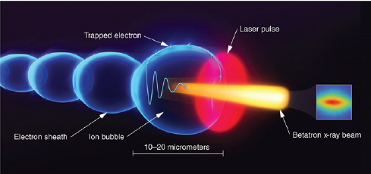
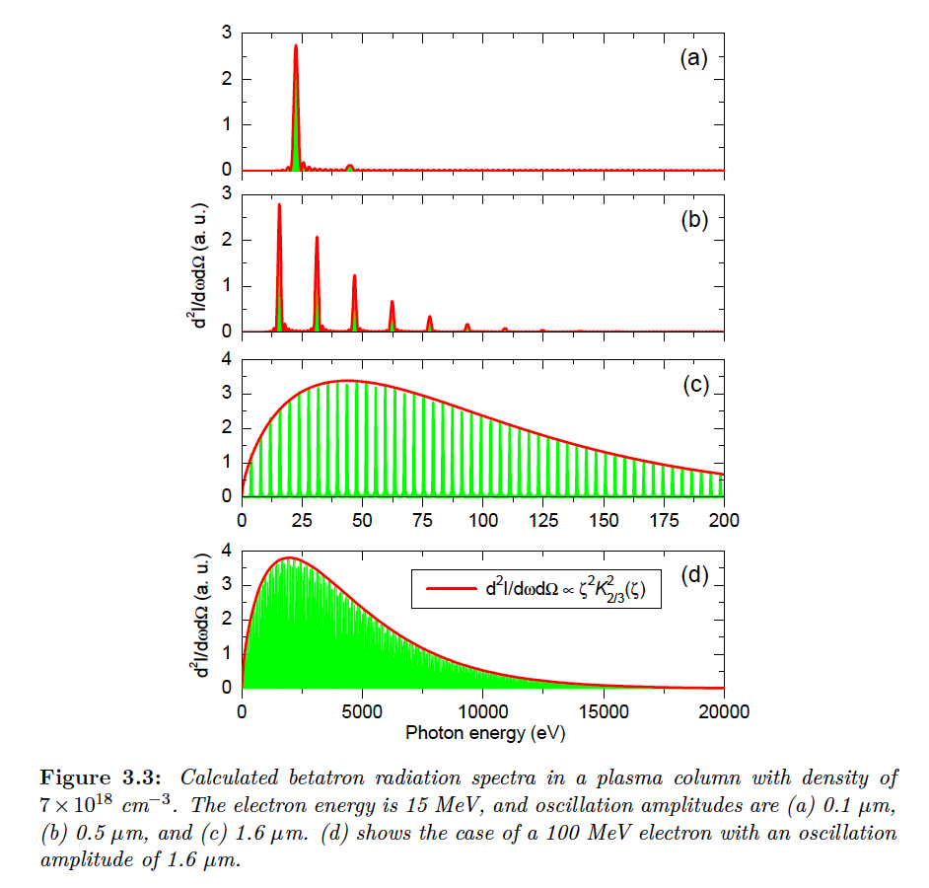
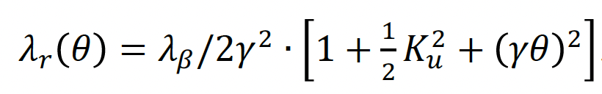





Betatron Radiation Source
K_{u}<1
$$λ_{β}=\sqrt{2γ}λ_{p}$$
K_{u}>1
$$ω_{c}=3K_{u}γ^{2}ω_{β}$$
K_{u}>>1
$$N_{ph}∝N_{e}N_{β}K_{u}$$
$$K_{u}=γk_{β}r_{β}$$
$$r_{β}^{}=\frac{2\sqrt{a_{0}}c}{ω_{p}}$$

Slide 12
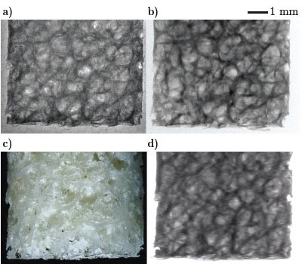
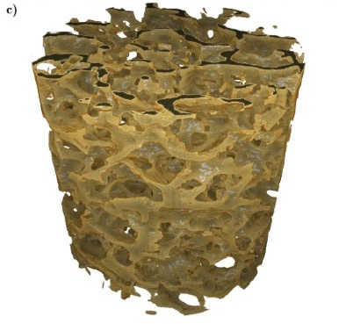
Betatron X Rays: Compact Medical Imaging
J.M. Cole et al, “Laser-wakefield accelerators as hard x-ray sources for 3D medical imaging of human bone”. Nature Scientific Reports 5, 13244 (2015)
Physics & Technology Background:
Small EuPRAXIA accelerator → small emission volume for betatron X rays.
Quasi-pointlike emission of X rays.
Sharper image from base optical principle.
Quality demonstrated and published, but takes a few hours for one image.
Advancing flux rate with EuPRAXIA laser by factor > 1,000!
EuPRAXIA technology
μCT Scanner
Added value
Sharper images with outstanding contrast
Identify smaller features (e.g. early detection of cancer at micron-scale – calcification)
Laser advance in EuPRAXIA → fast imaging (e.g. following moving organs during surgery)
3D tomography of human bone
EuPRAXIA laser advance (industry)
will push rate from 1/min to 100 Hz.
Ultra-compact source of hard X rays → exposing from various directions simultaneously is possible in upgrades
Macro-photography
Radioactive source
Notes:
Massimo

Slide 13
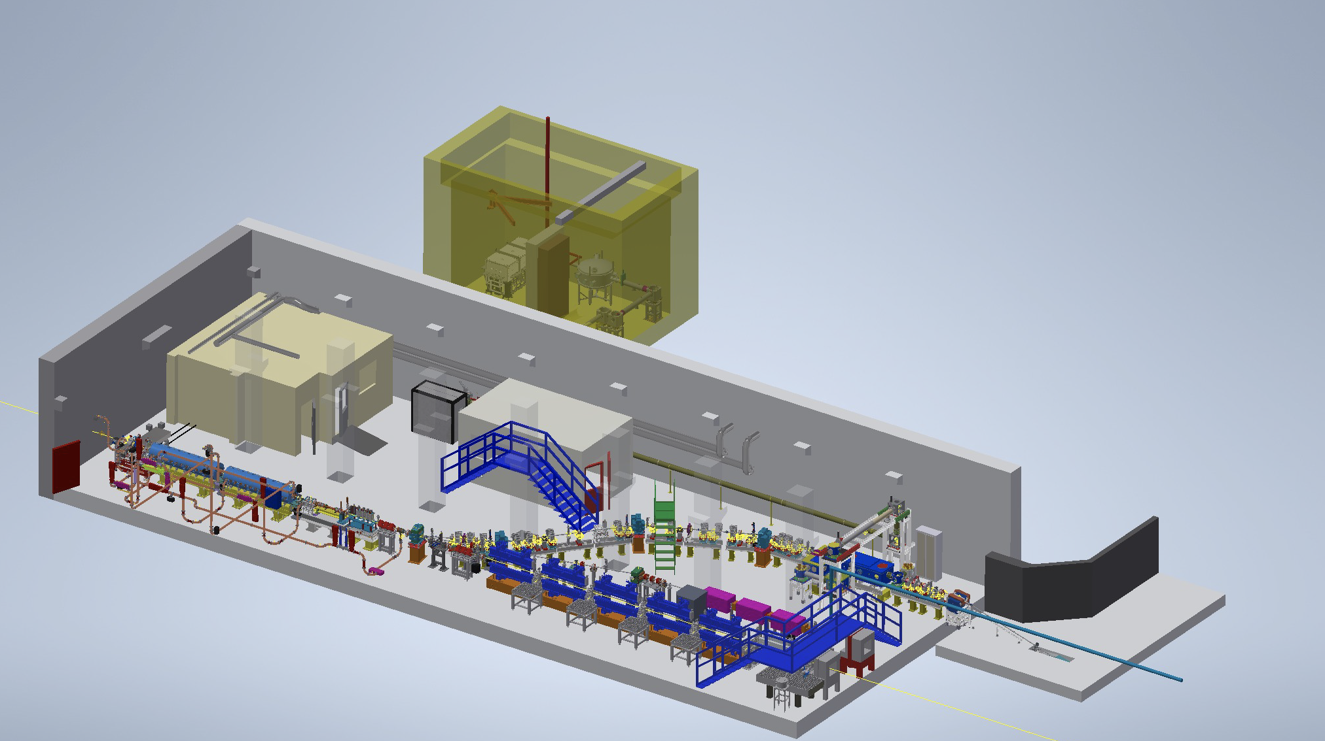
WP2 - Betaron Radiation Source at SPARC_LAB
LWFA
TNSA
LNF-MI
Betatron
ISM
PWFA
LWFA
FEL
THz

Slide 14
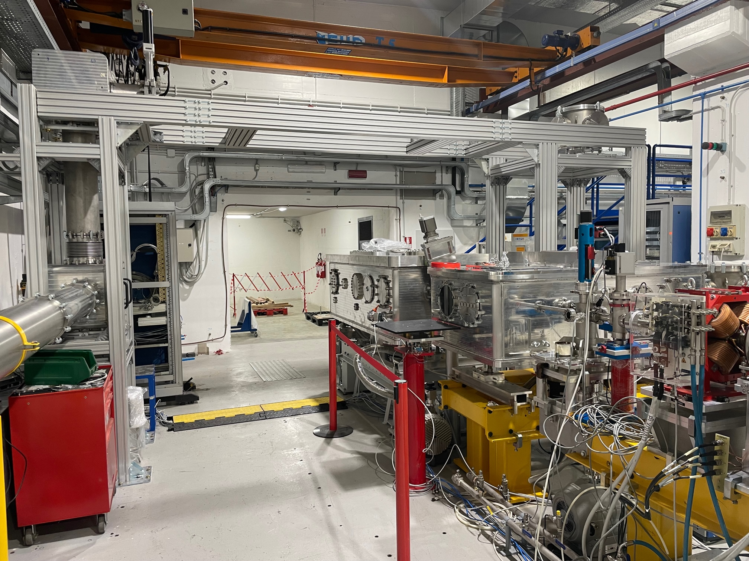
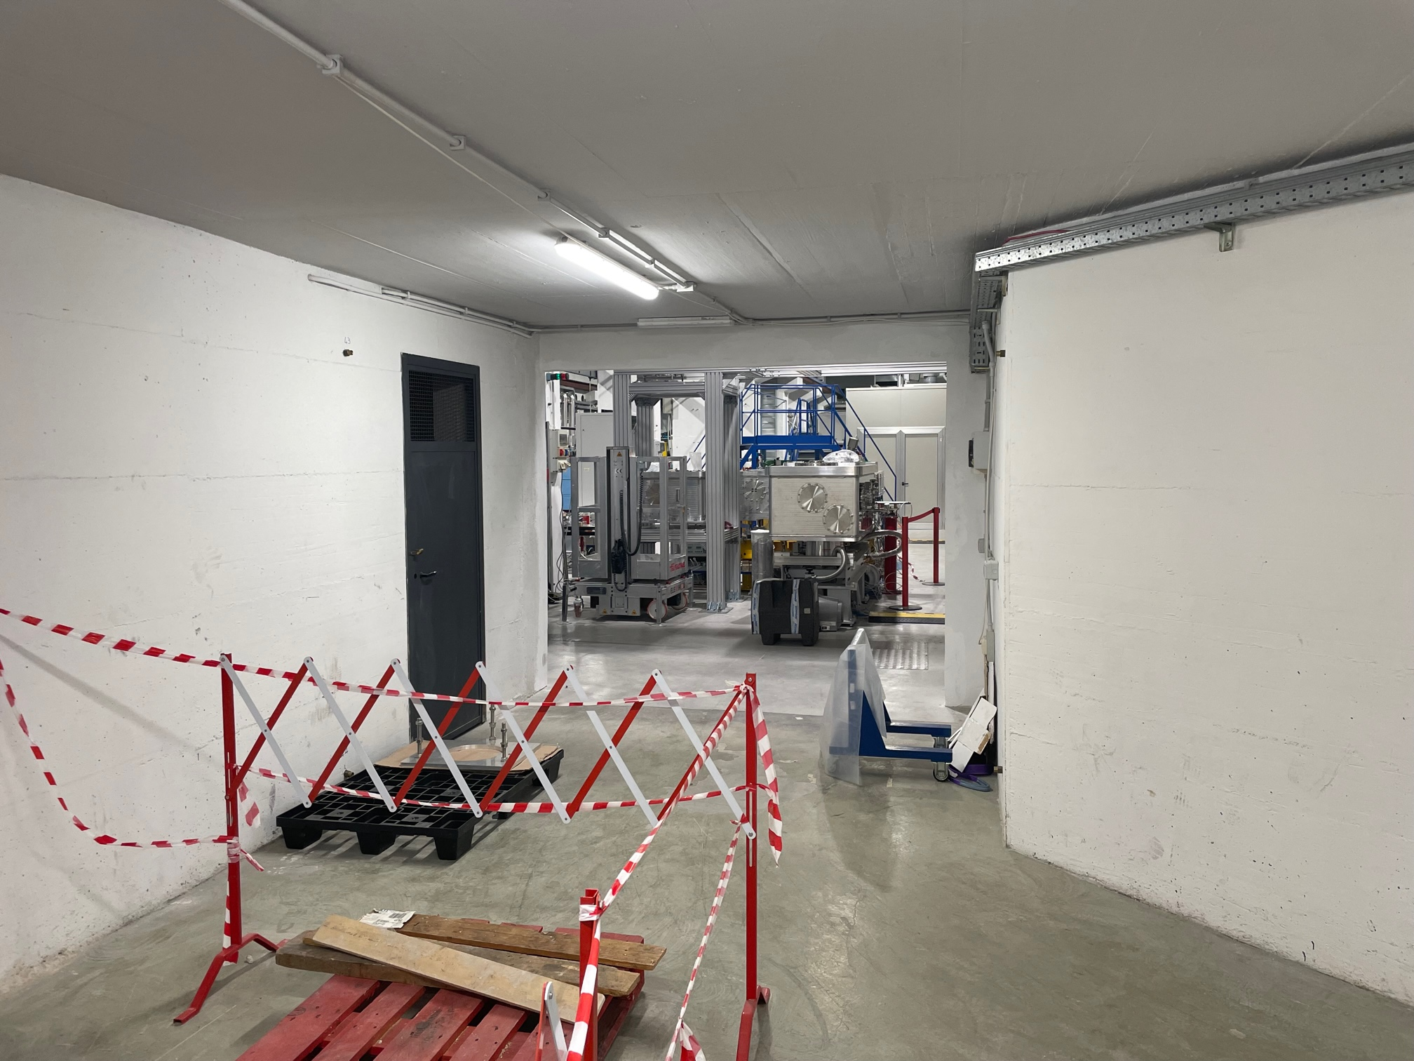
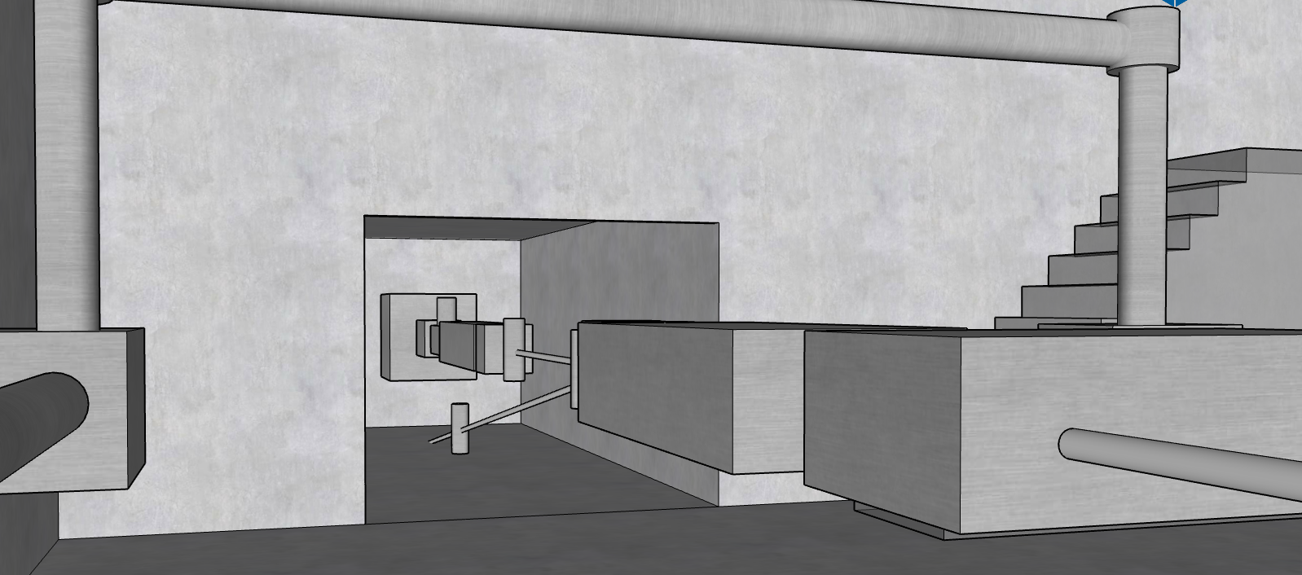
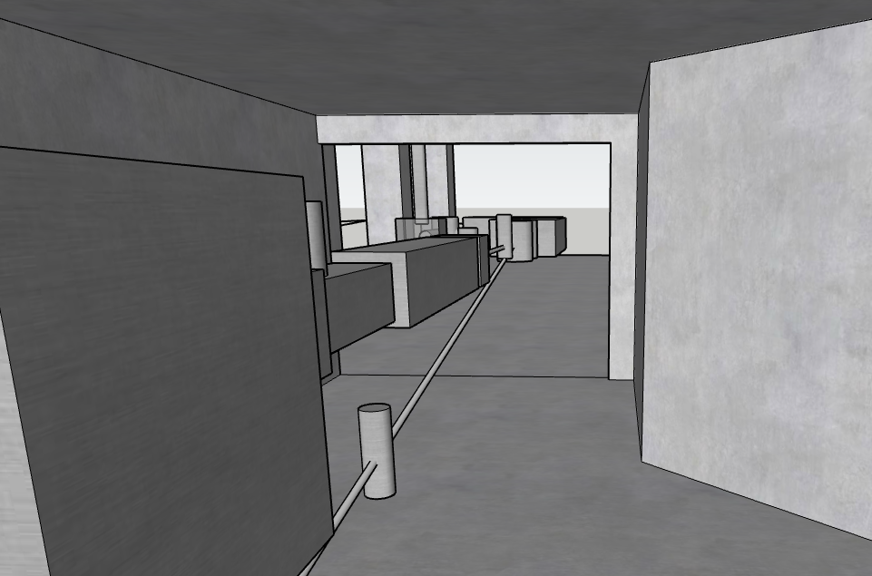
WP2 - Betaron Radiation Source at SPARC_LAB
Laser/Plasma interaction chamber at SPARC_LAB just intalled and possible betatron radition user’s beam line

Slide 15
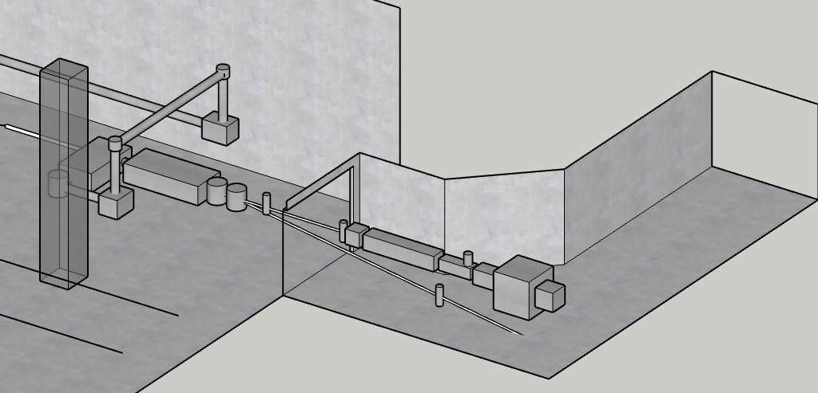

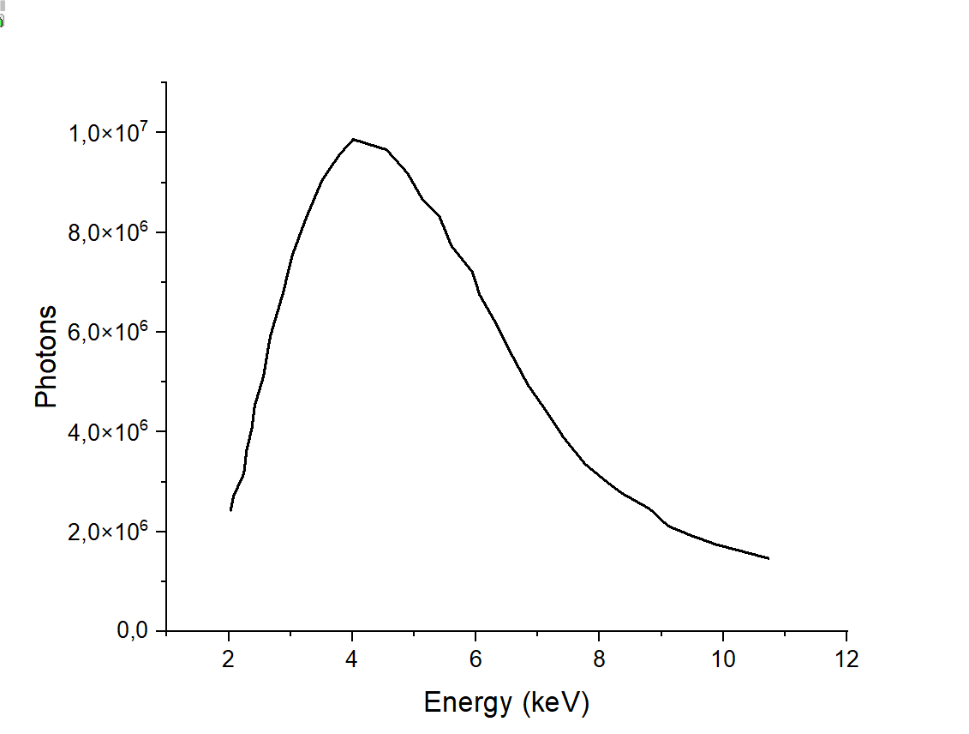
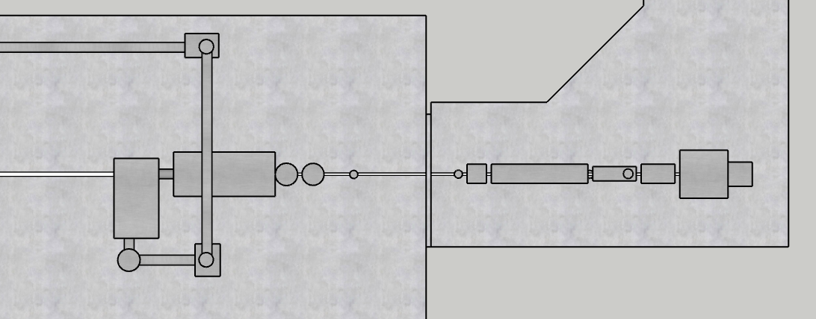
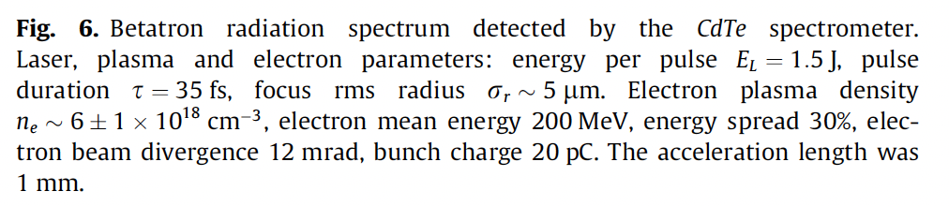
WP2 - Betaron Radiation Source at SPARC_LAB
1 m
Plasma chamber
Perm. mag.
dipole
BPM
Ion. chamber
Monochrom..
Focusing chamber
High res.
cameras
HP laser in
YAG Screen
Exp. chamber
HP laser out

Slide 16
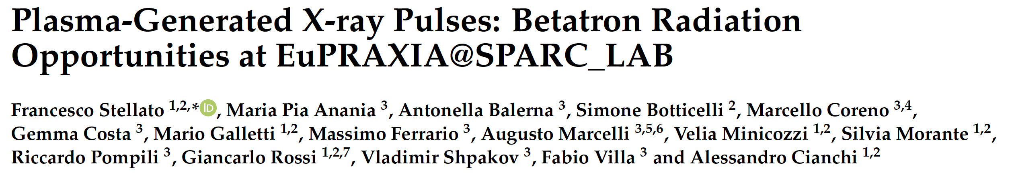
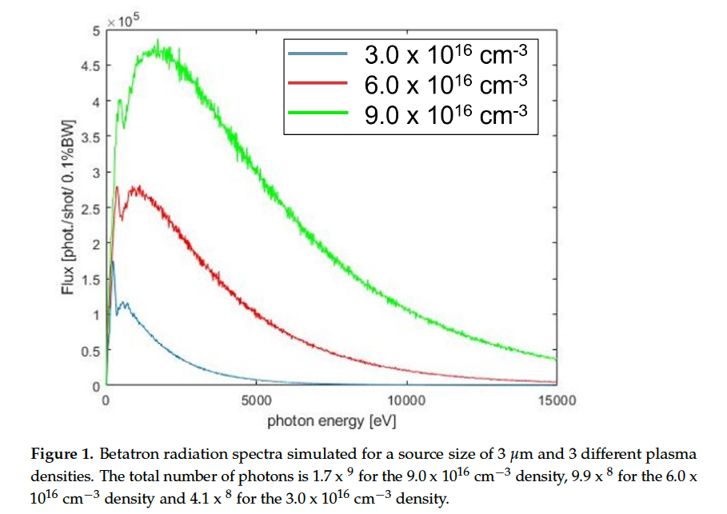
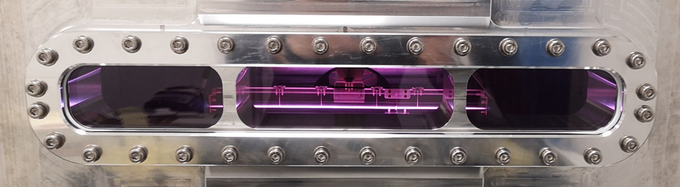
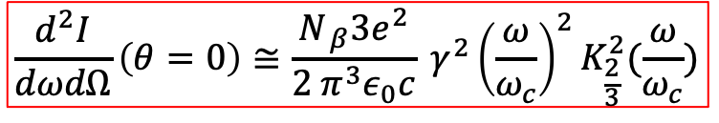
WP1 - Betaron Radiation Source at EuPRAXIA@SPARC_LAB
$$\frac{d^{2}I}{dωdΩ}\left(θ=0\right)≅\frac{N_{ β}3e^{2}}{2 π^{3}ε_{0}c} γ^{2}{\left(\frac{ω}{ω_{c}}\right)}^{2}K_{\frac{2}{3}}^{2}(\frac{ω}{ω_{c}})$$
According to this simulations, the expected EuPRAXIA betatron radiation spectrum will range from about 1 nm down to the hard X-ray region (less than 1 Å).
Some degree of tunability is possible

Slide 17
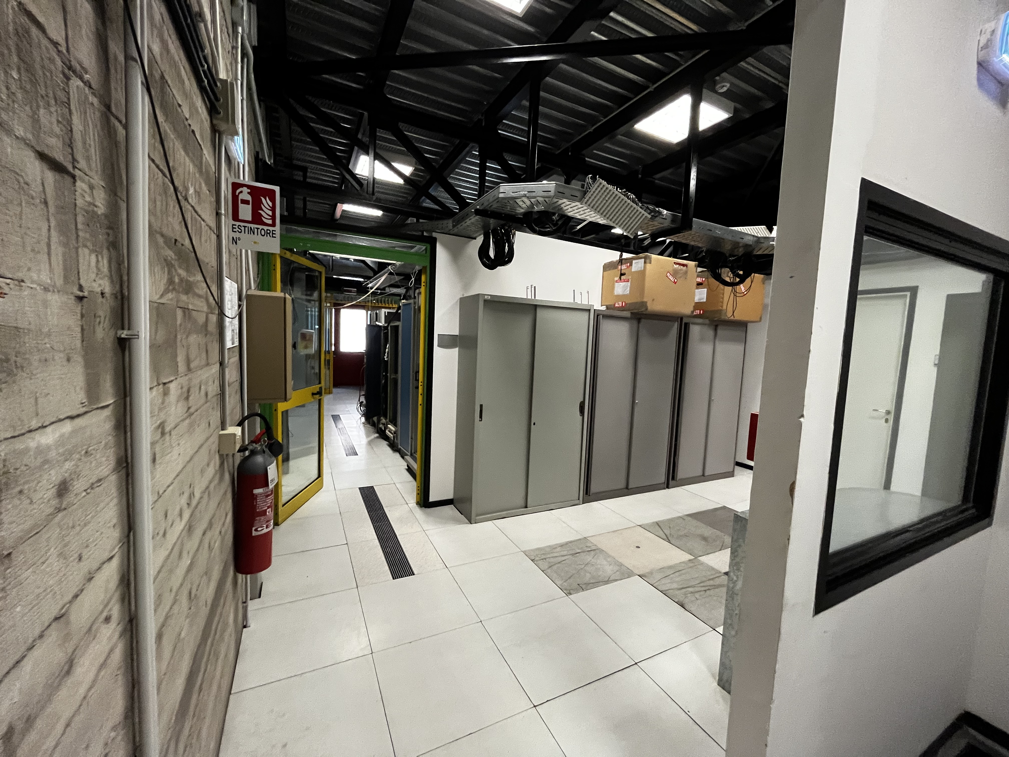
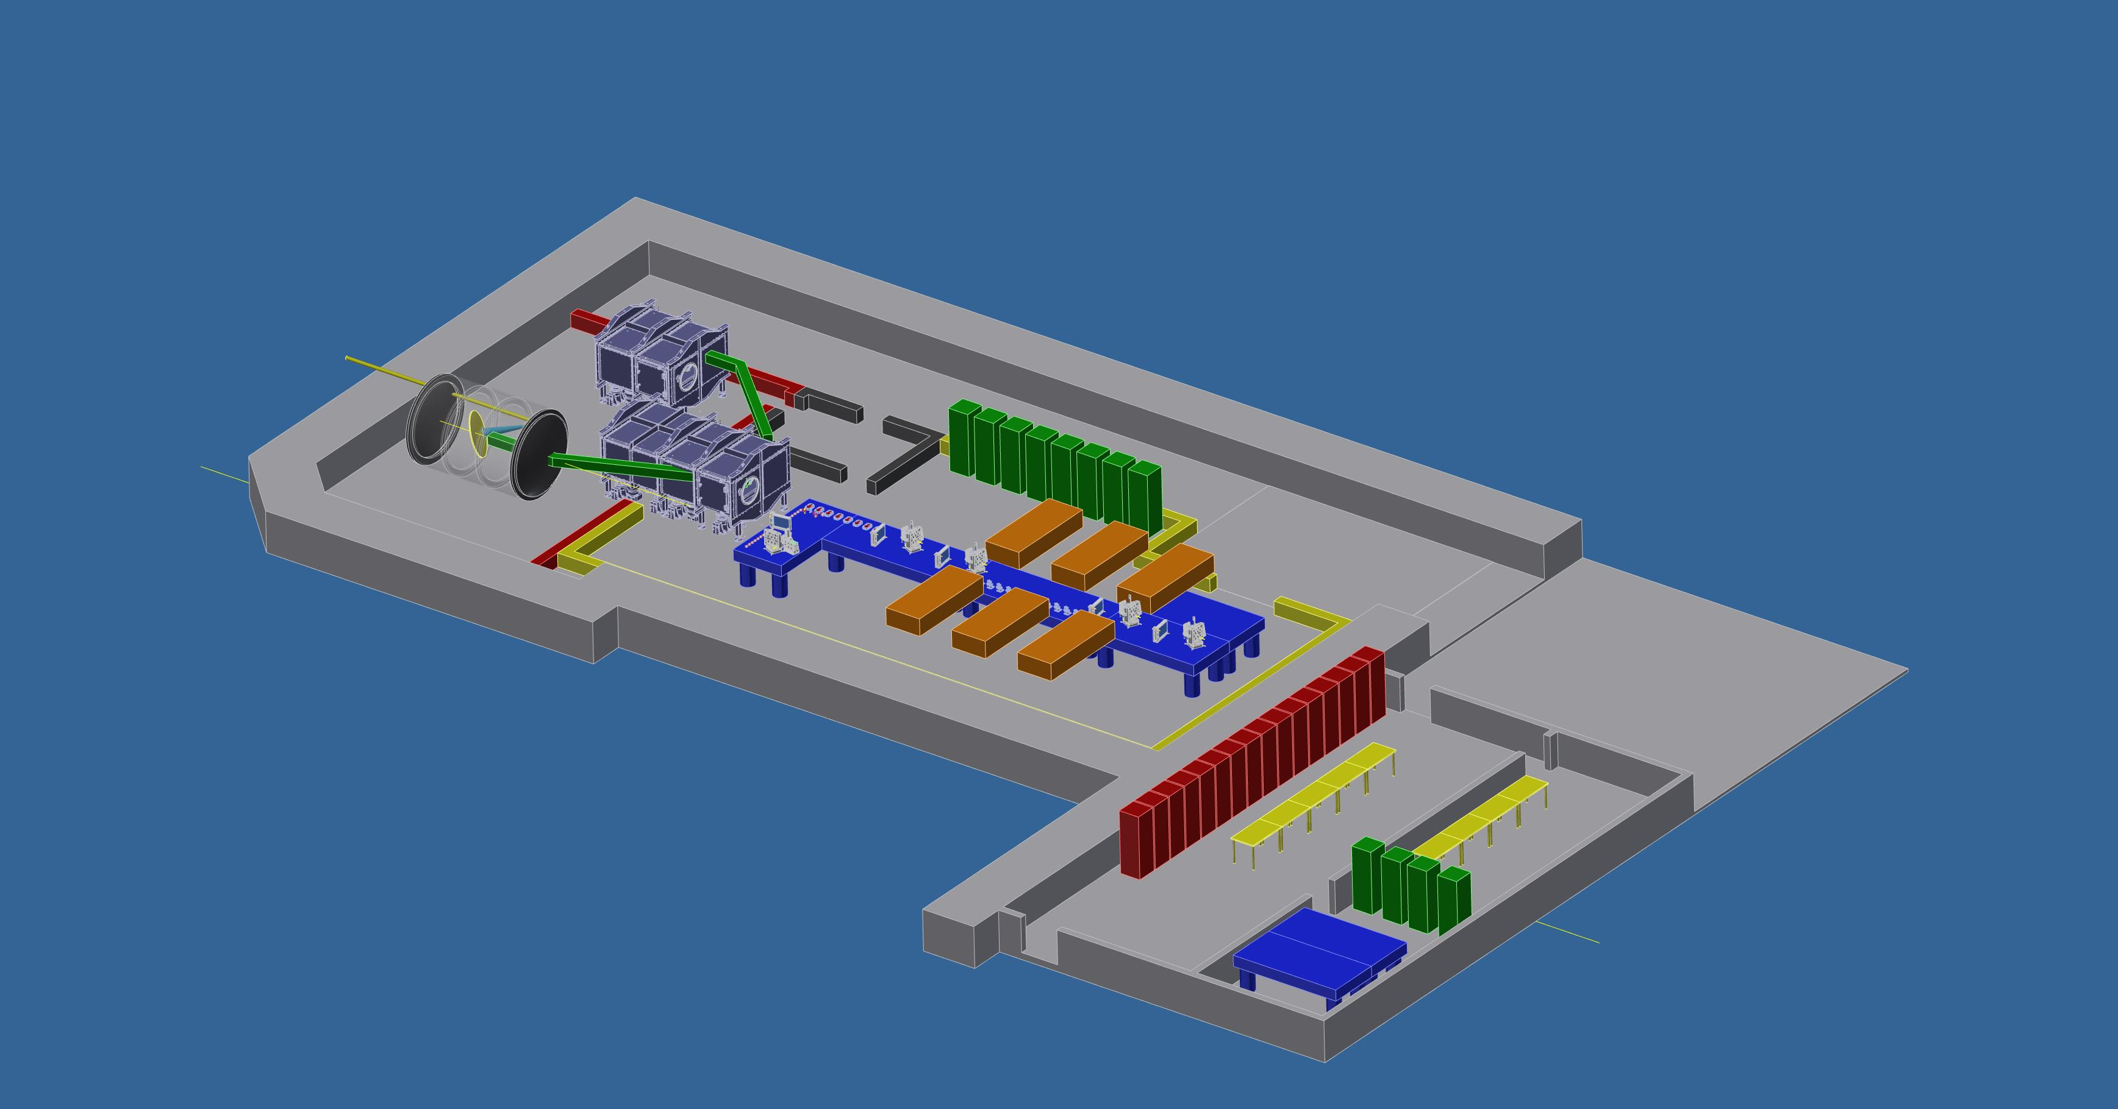
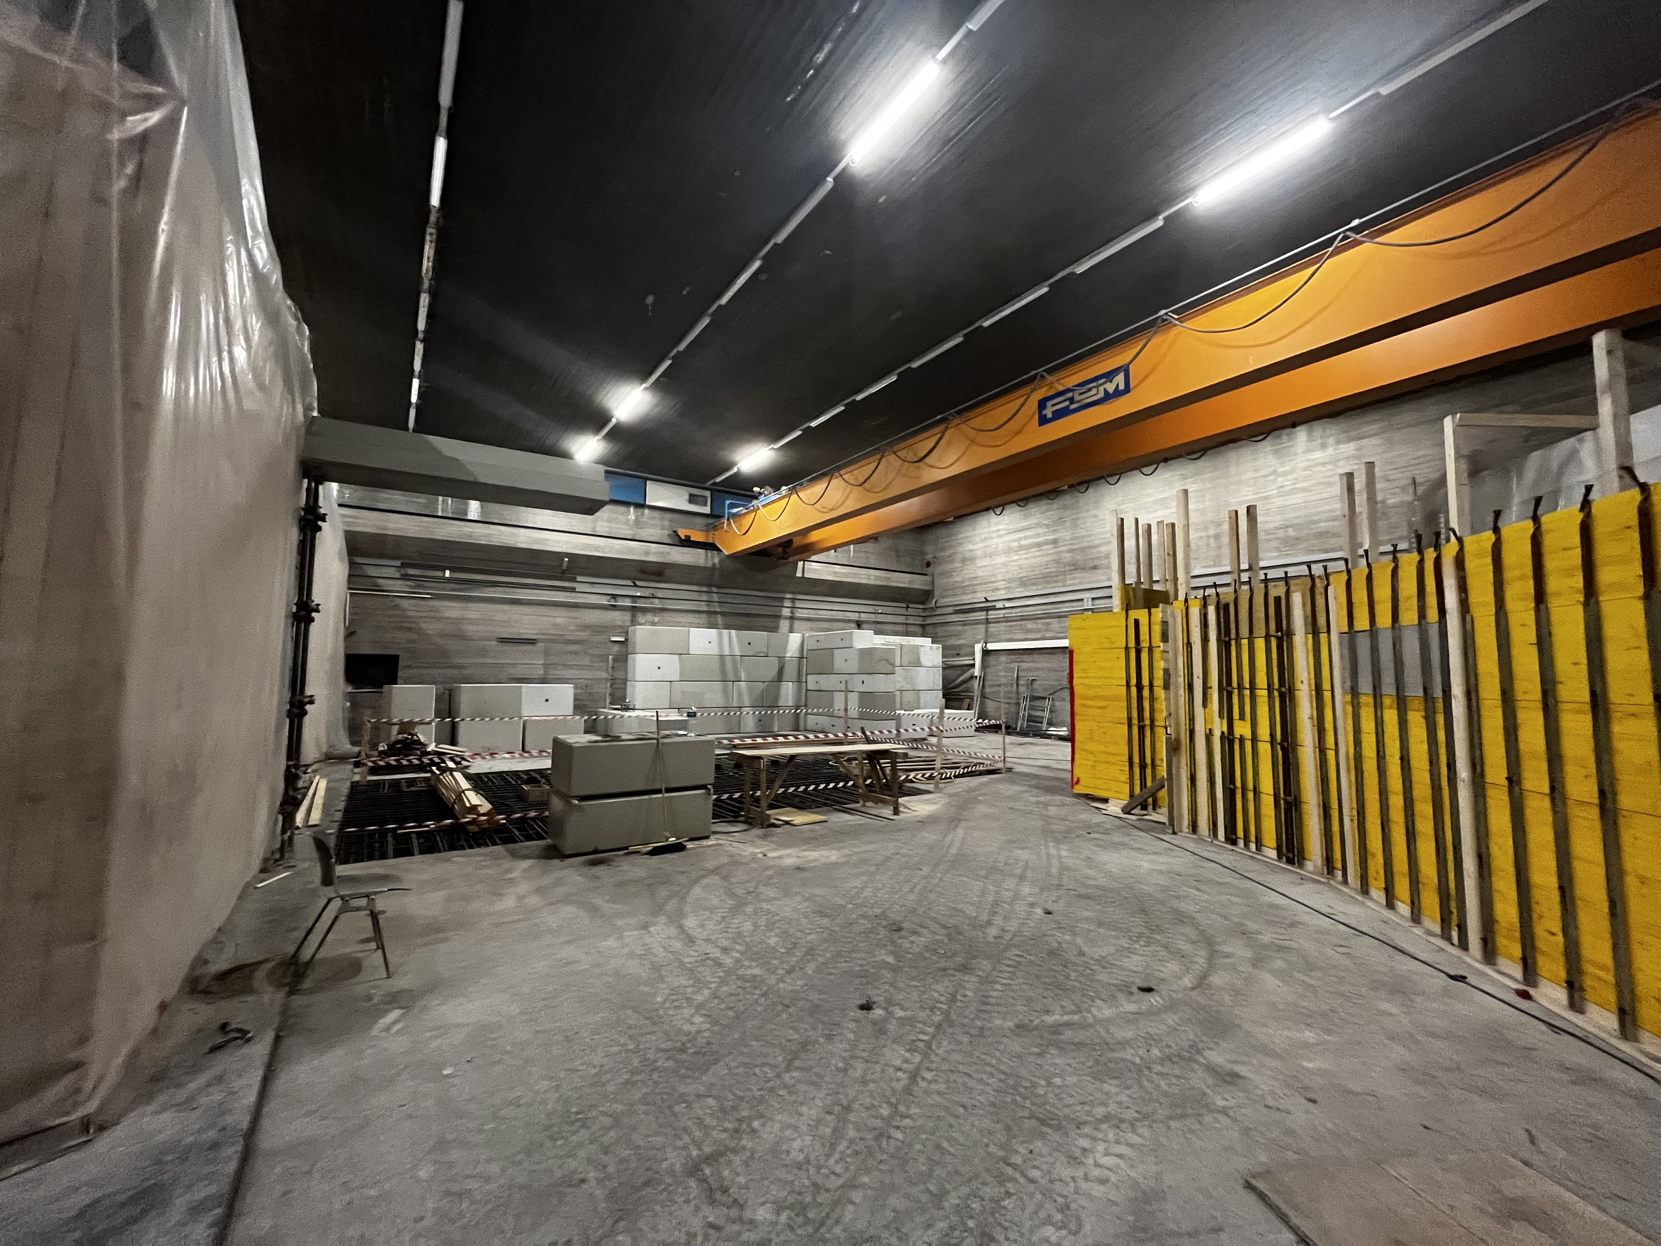
WP3 - I-LUCE INFN-Laser indUced radiation acCEleration
LNS

Slide 18
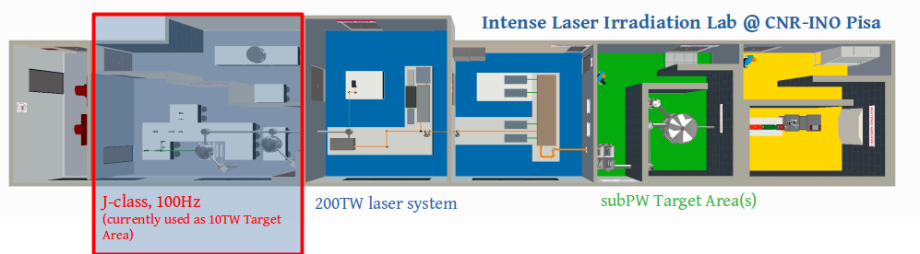
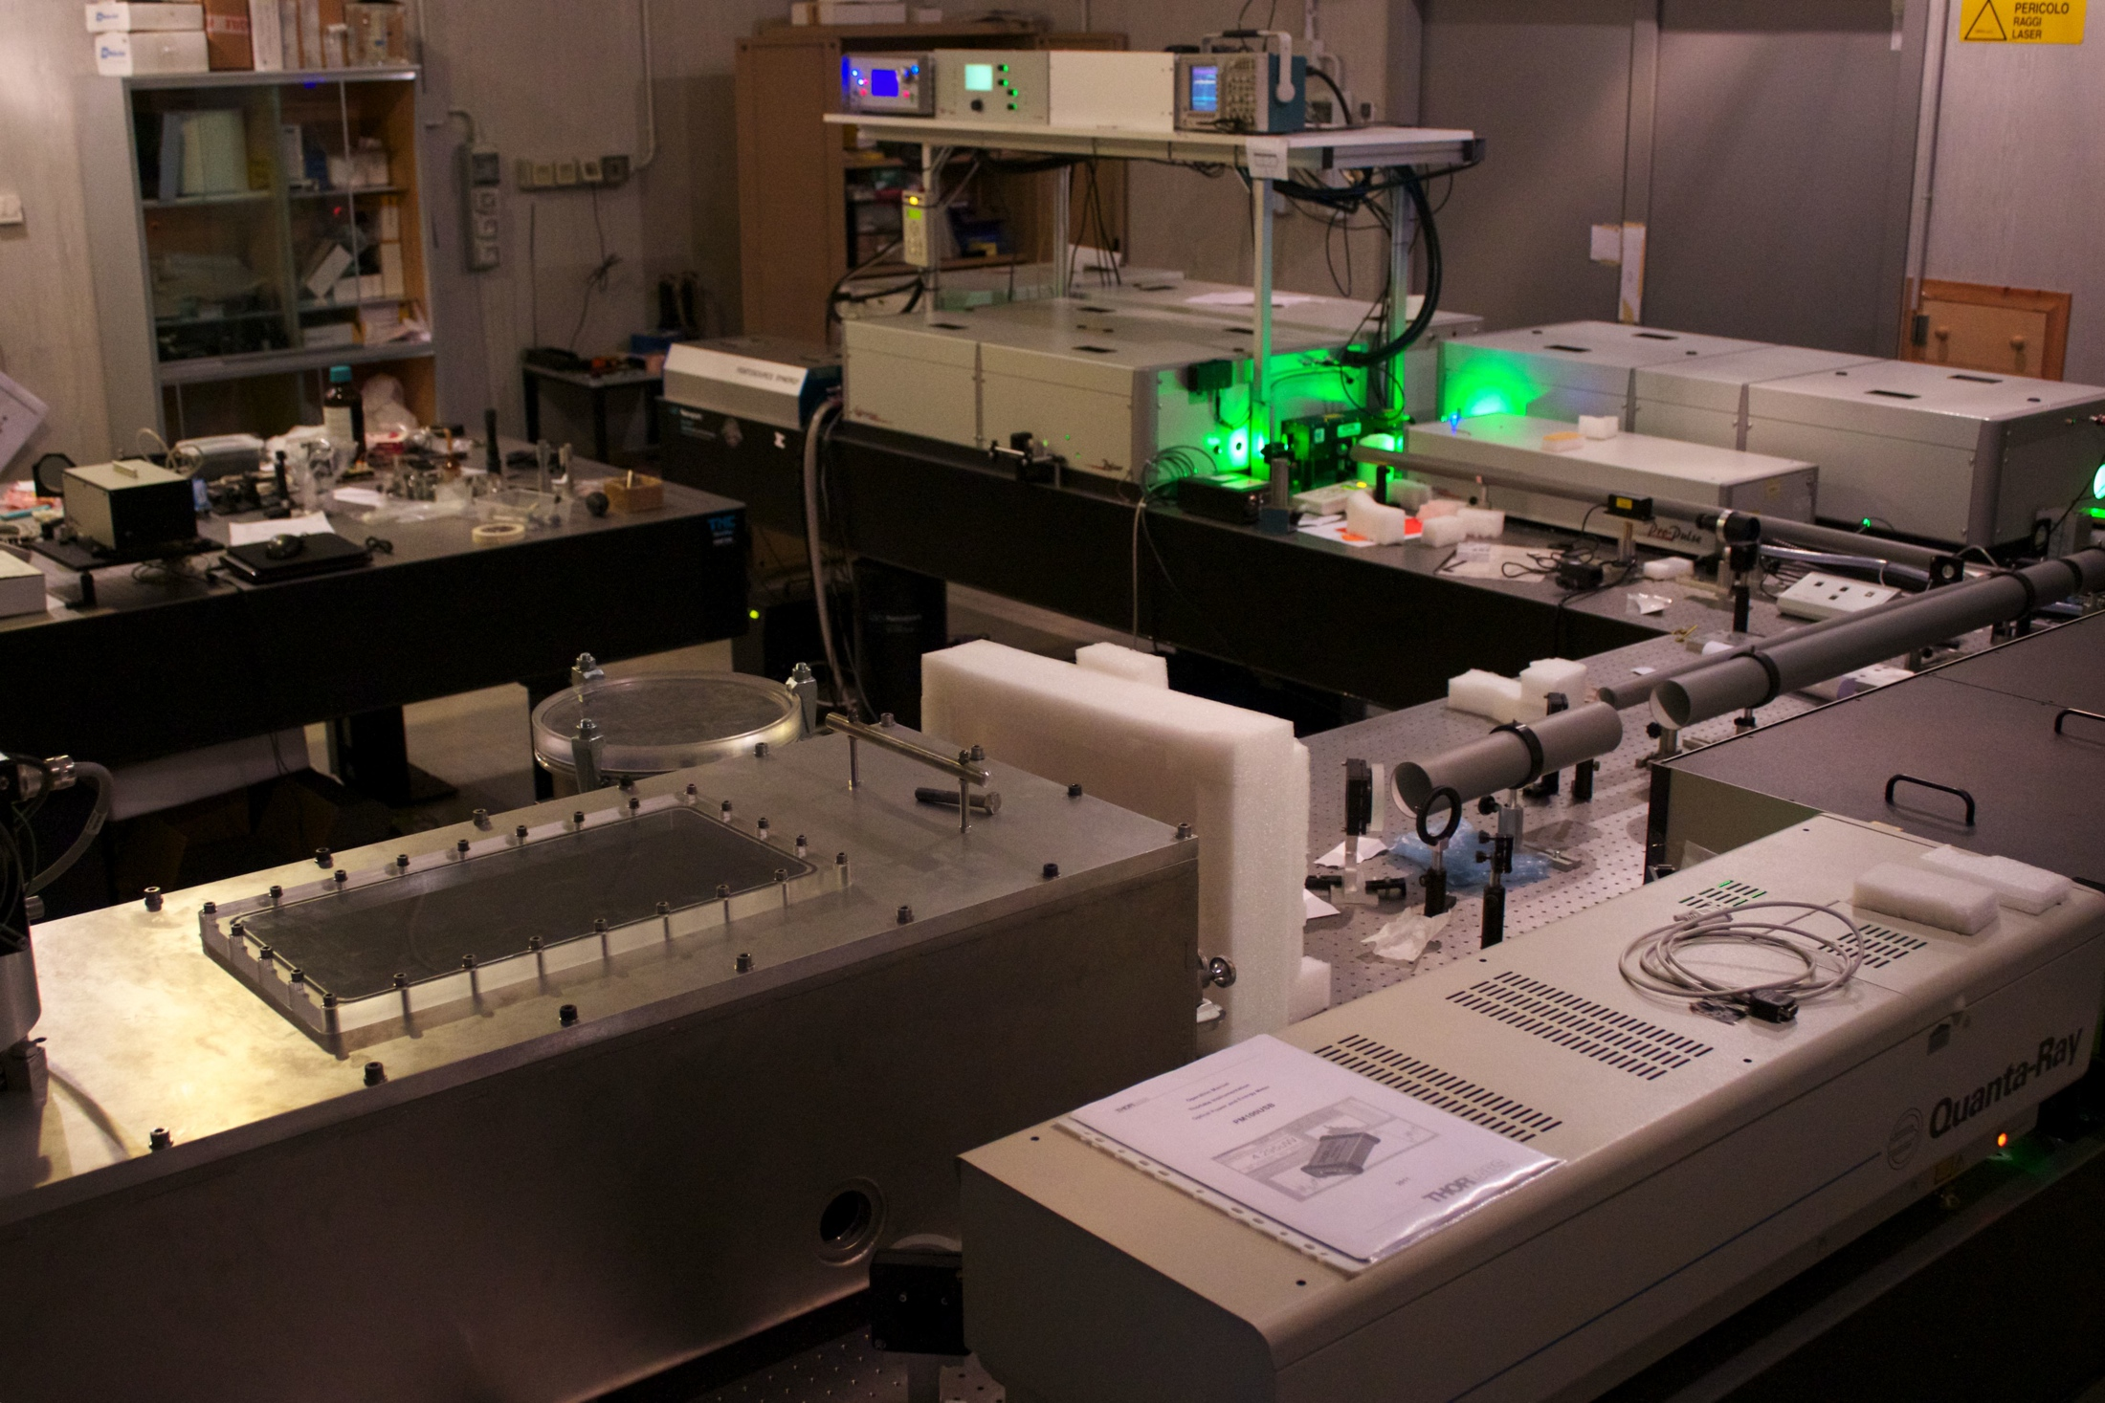
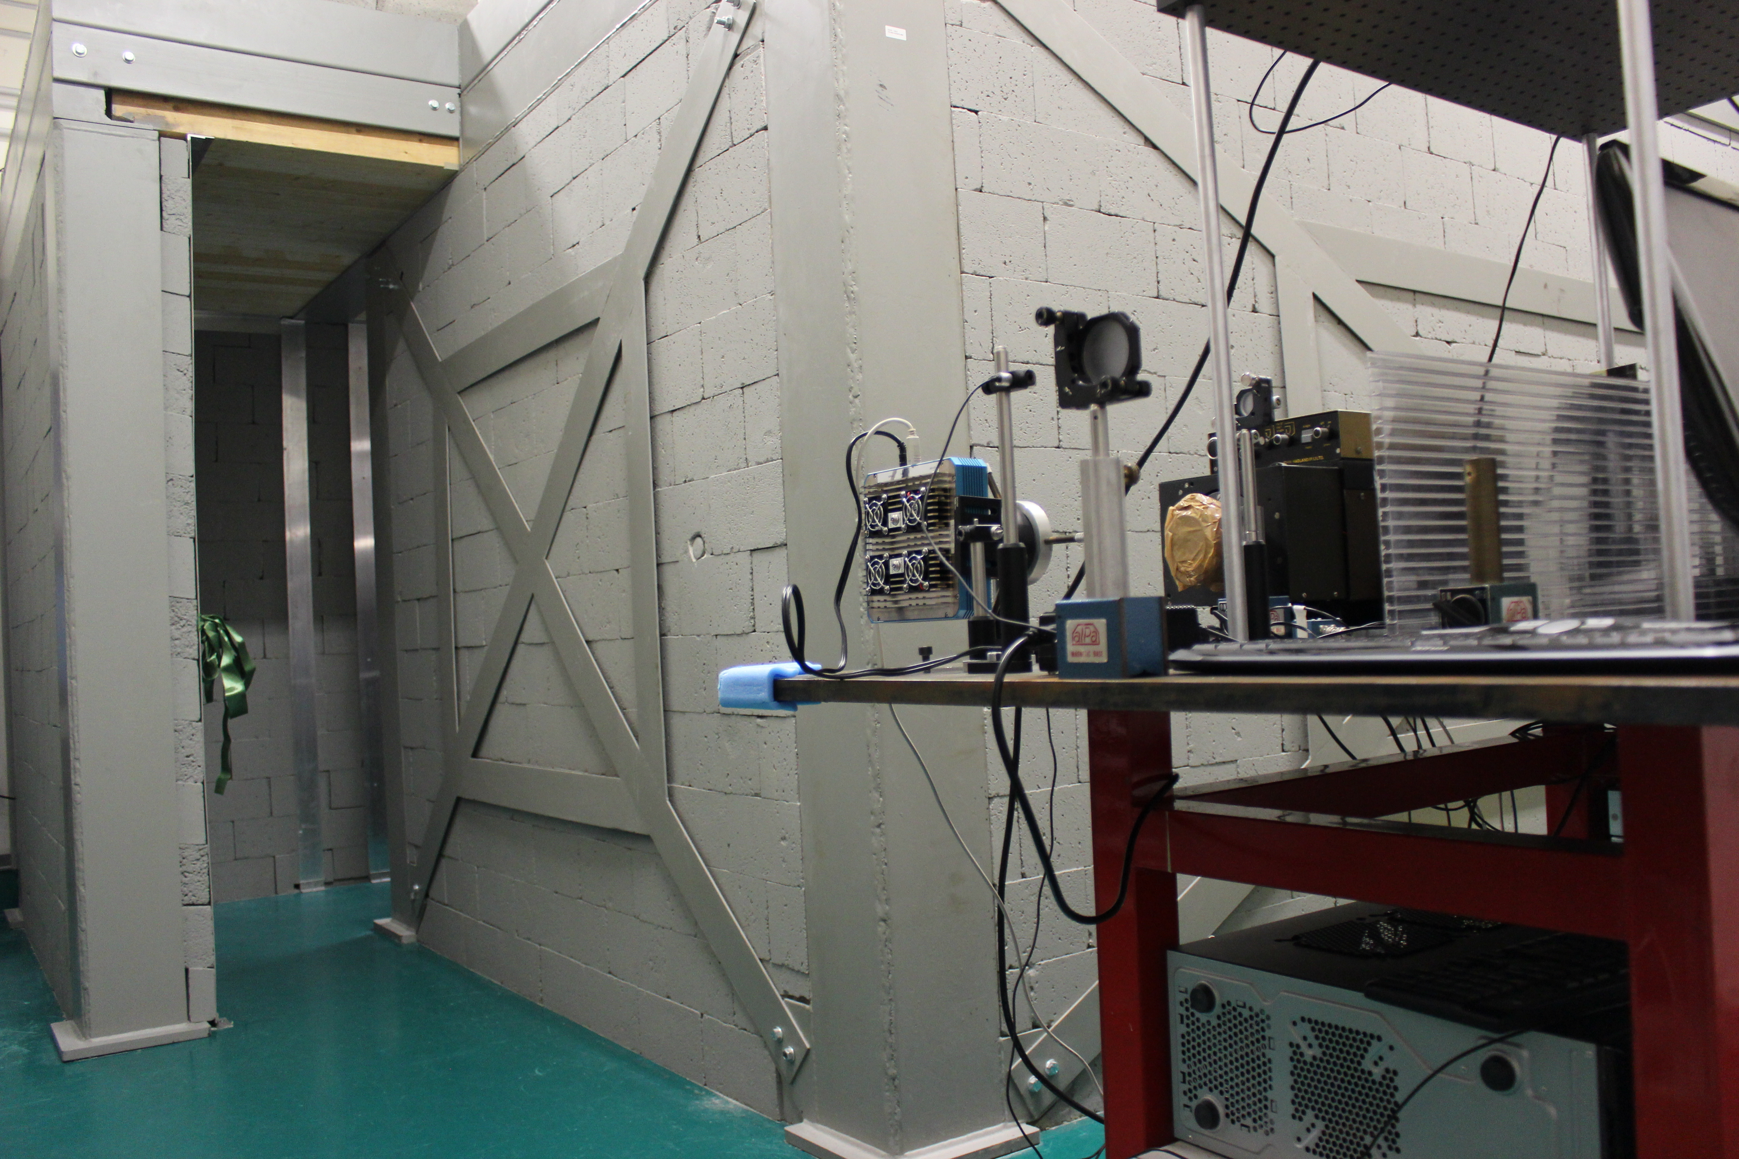
WP4 - J-class, 100Hz laser infrastructure @CNR-INO Pisa
The new ultrashort, J-class, high rep rate laser facility is expected to be hosted in the 10TW Target Area (~100m2 excluding room for ancillaries) currently available.
INO

Slide 19
Conclusions
One of the ambitions of EuAPS is to be the first operating brick of the EuPRAXIA project well in advance compared to the EuPRAXIA time scale.
Thus bringing together laser, plasma and advanced accelerator scientists with radiation user’s experts to promote the blooming of a new scientific community well prepared to efficiently exploit the scientific opportunities of EuPRAXIA.
Significant advancement in Laser Technology for EuPRAXIA
X-ray users beam line scientific case in preparation, medical applications
A lot of new interesting beam physics still possible (various plasma configurations, plasma undulator and FEL, beam diagnostics, limitation for LC)

Slide 20
Thank you for your attention

