Slide 1


LASER DEVELOPMENT STRATEGY TOWARDS THE EUPRAXIA 2nd SITE
EuPRAXIA Advanced Photon Sources Introductory Meeting
Monday Jun 27, 2022, 9:15 AM → 5:00 PM, LNF, Frascati, Italy
Leonida Antonio GIZZI (CNR, Pisa, Italy)
http://eupraxia-project.eu

Slide 2
Outline
EuPRAXIA laser requirements
Overall layout
Thermal management options
Modelling
Pump lasers
Summary

Slide 3

Overview
Eupraxia laser development is aimed at delivering more efficient, kW class PW laser driver for plasma acceleration at >100 Hz rate
EuPRAXIA
PW class,
100 Hz repetition rate,
multi kW average power,
diode pumped
Full therma load transport
EuAPS
30 TW peak power
100 Hz repetition rate
100 W average power
Diode pumped
Thermal load effects
CURRENT
PW class,
Hz repetition rate,
≈10 W average power
flashlamp pumped
No thermal load transport

Slide 4

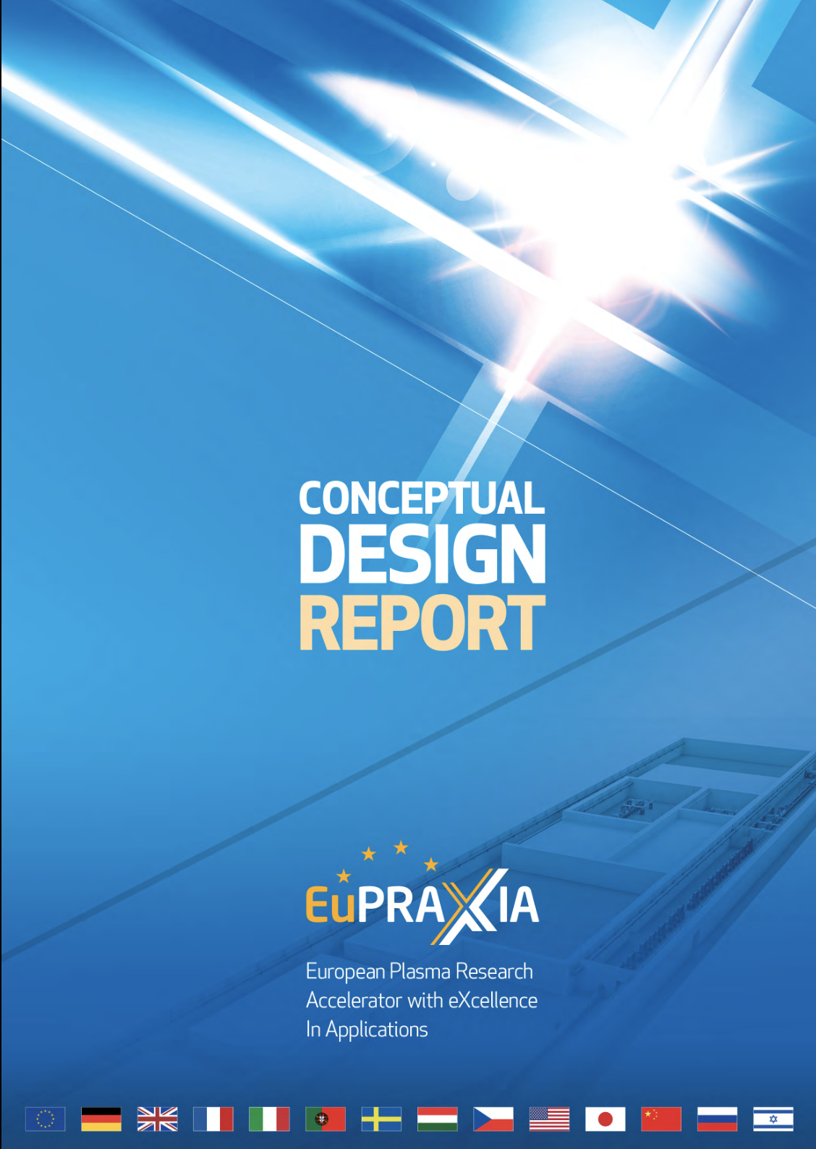
The EuPRAXIA Project
With the inclusion in ESFRI and the approval of the Preparatory Phase Project, EuPRAXIA must rapidly move from the conceptual design to a viable technical design of the laser driver.
R. W. Assmann, M. K. Weikum, T. Akhter, D. Alesini, A. S. Alexandrova, M. P. Anania, N. E. Andreev, I. Andriyash, M. Artioli, A. Aschikhin, T. Audet, A. Bacci, I. F. Barna, S. Bartocci, A. Bayramian, A. Beaton, A. Beck, M. Bellaveglia, A. Beluze, A. Bernhard, A. Biagioni, S. Bielawski, F. G. Bisesto, A. Bonatto, L. Boulton, F. Brandi, R. Brinkmann, F. Briquez, F. Brottier, E. Bründermann, M. Büscher, B. Buonomo, M. H. Bussmann, G. Bussolino, P. Campana, S. Cantarella, K. Cassou, A. Chancé, M. Chen, E. Chiadroni, A. Cianchi, F. Cioeta, J. A. Clarke, J. M. Cole, G. Costa, M. -E. Couprie, J. Cowley, M. Croia, B. Cros, P. A. Crump, R. D’Arcy, G. Dattoli, A. Del Dotto, N. Delerue, M. Del Franco, P. Delinikolas, S. De Nicola, J. M. Dias, D. Di Giovenale, M. Diomede, E. Di Pasquale, G. Di Pirro, G. Di Raddo, U. Dorda, A. C. Erlandson, K. Ertel, A. Esposito, F. Falcoz, A. Falone, R. Fedele, A. Ferran Pousa, M. Ferrario, F. Filippi, J. Fils, G. Fiore, R. Fiorito, R. A. Fonseca, G. Franzini, M. Galimberti, A. Gallo, T. C. Galvin, A. Ghaith, A. Ghigo, D. Giove, A. Giribono, L. A. Gizzi, F. J. Grüner, A. F. Habib, C. Haefner, T. Heinemann, A. Helm, B. Hidding, B. J. Holzer, S. M. Hooker, T. Hosokai, M. Hübner, M. Ibison, S. Incremona, A. Irman, F. Iungo, F. J. Jafarinia, O. Jakobsson, D. A. Jaroszynski, S. Jaster-Merz, C. Joshi, M. Kaluza, M. Kando, O. S. Karger, S. Karsch, E. Khazanov, D. Khikhlukha, M. Kirchen, G. Kirwan, C. Kitégi, A. Knetsch, D. Kocon, P. Koester, O. S. Kononenko, G. Korn, I. Kostyukov, K. O. Kruchinin, L. Labate, C. Le Blanc, C. Lechner, P. Lee, W. Leemans, A. Lehrach, X. Li, Y. Li, V. Libov, A. Lifschitz, C. A. Lindstrøm, V. Litvinenko, W. Lu, O. Lundh, A. R. Maier, V. Malka, G. G. Manahan, S. P. D. Mangles, A. Marcelli, B. Marchetti, O. Marcouillé, A. Marocchino, F. Marteau, A. Martinez de la Ossa, J. L. Martins, P. D. Mason, F. Massimo, F. Mathieu, G. Maynard, Z. Mazzotta, S. Mironov, A. Y. Molodozhentsev, S. Morante, A. Mosnier, A. Mostacci, A. -S. Müller, C. D. Murphy, Z. Najmudin, P. A. P. Nghiem, F. Nguyen, P. Niknejadi, A. Nutter, J. Osterhoff, D. Oumbarek Espinos, J. -L. Paillard, D. N. Papadopoulos, B. Patrizi, R. Pattathil, L. Pellegrino, A. Petralia, V. Petrillo, L. Piersanti, M. A. Pocsai, K. Poder, R. Pompili, L. Pribyl, D. Pugacheva, B. A. Reagan, J. Resta-Lopez, R. Ricci, S. Romeo, M. Rossetti Conti, A. R. Rossi, R. Rossmanith, U. Rotundo, E. Roussel, L. Sabbatini, P. Santangelo, G. Sarri, L. Schaper, P. Scherkl, U. Schramm, C. B. Schroeder, J. Scifo, L. Serafini, G. Sharma, Z. M. Sheng, V. Shpakov, C. W. Siders, L. O. Silva, T. Silva, C. Simon, C. Simon-Boisson, U. Sinha, E. Sistrunk, A. Specka, T. M. Spinka, A. Stecchi, A. Stella, F. Stellato, M. J. V. Streeter, A. Sutherland, E. N. Svystun, D. Symes, C. Szwaj, G. E. Tauscher, D. Terzani, G. Toci, P. Tomassini, R. Torres, D. Ullmann, C. Vaccarezza, M. Valléau, M. Vannini, A. Vannozzi, S. Vescovi, J. M. Vieira, F. Villa, C. -G. Wahlström, R. Walczak, P. A. Walker, K. Wang, A. Welsch, C. P. Welsch, S. M. Weng, S. M. Wiggins, J. Wolfenden, G. Xia, M. Yabashi, H. Zhang, Y. Zhao, J. Zhu & A. Zigler
EuPRAXIA Conceptual Design Report
The European Physical Journal Special Topics 229, 3675–4284 (2020); https://doi.org/10.1140/epjst/e2020-000127-8

Slide 5
What laser driver specs for future LPA
Rapidly evolving scenario for laser technologies relevant for plasma acceleration towards multi-stage accelerators design:
Pillars for a STRATEGY for laser drivers for plasma accelerators:
Ultrashort pulses (large bandwidth <50 fs)
High Repetition rate (20/100 Hz – 15 kHz)
High average power (kW -10 kW)
High wall-plug efficiency (>1%-30%)
L.A Gizzi, F. Mathieu, P. Mason, P P Rajeev, Laser drivers for Plasma Accelerators, in Félicie Albert et al, 2020 roadmap on plasma accelerators, 2021 New J. Phys. 23 031101, https://doi.org/10.1088/1367-2630/abcc62

Slide 6
EuPRAXIA in a nutshell
The EuPRAXIA project aims at the construction of an innovative compact electron accelerator using laser- and electron-beam-driven plasma wakefield acceleration;
EuPRAXIA foresees the implementation of a laser wakefield accelerator (LWFA) at the 1-5 GeV target energy and a repetition rate of 20-100 Hz, requiring the most advanced and robust ultrashort pulse laser technologies available to date;
The Design Study project was carried out initially by 16 laboratories and universities from 5 EU member states within the European Union’s Horizon 2020 programme;
A Conceptual Design Study has addressed the development of a ultrashort pulse laser system (pulse durations in the range of tens of fs) and energies up to 100 joules, yielding a PW scale peak power, targeting a repetition rate of up to 100 Hz, a performance never achieved so far
EuPRAXIA was included in the ESFRI Roadmap (2021); the Preparatory Phase project was recently approved (2022); a MSCA project for PhD was

Slide 7
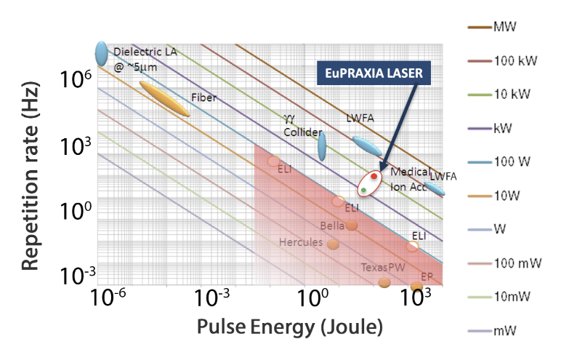

Roadmap on LPA Laser Driver tech for EuPRAXIA 2nd SIte
Laser-driven plasma acceleration needs ultrashort, high power lasers with high average power
Current technology: ≈ Ti:Sa technology, pumped by flash-lamp pumped lasers
  Robust, reliable industrial technology
Mature technology: ≈ Ti:Sa technology, pumped by diode-pumped lasers
  Strong R&D effort in place (e.g HAPLS@ELI)
  ≈ 3-5 years to go to first industrial LWFA demonstrator (e.g. Eupraxia) [1]
Beyond TiSA: targeting higher wall-plug efficiency and rep. rate, kHz and beyond, stability, control (space, time, spectral);
  5-10 yrs for first efficient, multi-kW-scale demonstrator,
  A strategy is needed to steer effort in the LPA laser driver direction: LASPLA
Addressed by EuAPS 100 Hz laser system
[1] R. Assmann et al., EuPRAXIA Conceptual Design Report, The European Physical Journal Special Topics 229, 3675–4284 (2020)
[2] C. Danson et al., Petawatt and exawatt class lasers worldwide High Power Laser Sci. and Eng. 7, e54 (2019)

Slide 8
Other options under development for high efficiency
Fiber laser technology offers the best WPE >50% in CW mode and coherent combination is being developed (FSU Jena-Fraunhofer IOF and Ecole Polytechnique-Thales in France).
  Suited for moderate energy per pulse/high rep-rate (10s of kHz);
  Now 96 fibers delivering 23 mJ and 674 W in a 235 fs pulse
Direct Chirped Pulse Amplification with lasing media pumped directly by diodes is ideal for higher efficiency and higher rep-rate;
  several materials under consideration, Yb:CaF2, Tm:YLF, Tm:Lu2O3 (Pisa) …
  PENELOPE (Jena) 150 J, 1 Hz, at 1030 nm
  Available ps kW thin disk lasers using plasma modulation (Oxford²)
OPCPA optical parametric amplification within large-aperture (LBO) crystals;
  ELI-Beamlines facility, L1 ALLEGRA (100 mJ at 1 kHz) and L2 AMOS (100 TW, 2 to 5 J between 10 and 50 Hz), and the Shenguang II Multi-PW beamline(SIOM, China) …
Addressed by “CREATE” proposal (H2020)
L.A Gizzi, F. Mathieu, P. Mason, P P Rajeev, Laser drivers for Plasma Accelerators, in Félicie Albert et al, 2020 roadmap on plasma accelerators, 2021 New J. Phys. 23 031101, https://doi.org/10.1088/1367-2630/abcc62;
O. Jakobsson, S. M. Hooker and R. Walczak, PRL, 2021

Slide 9
RATIONALE OF LASER DRIVER DESIGN STUDY
In the EuPRAXIA project, several alternative technological approaches were considered and down-selected, to provide the required laser driver performances.
We based the design primarily on Chirped Pulse Amplification (CPA) in Ti:Sapphire, pumped by all-solid state green lasers (i.e. diode pumped, frequency doubled Yb or Nd lasers)
Thermal management related to the handling of high pump average power was the most complex aspect in the design, requiring out-of-the-box thinking and original solutions
Optimization of energy extraction was also an issue, aimed to reduce pump energy requirements and waste heat production.
Three laser systems envisaged, to drive three stages:
Laser Plasma Injector at 150 MeV (LPI 150MeV)
- Laser Plasma Injector/Accelerator at 1 GeV (LPI 1GeV)
- Laser Plasma Accelerator at 5 GeV (LPA 5GeV)
For each system, two levels of performances considered:
P0: low energy, 20 Hz rep rate
P1: high energy, 100 Hz rep rate

Slide 10
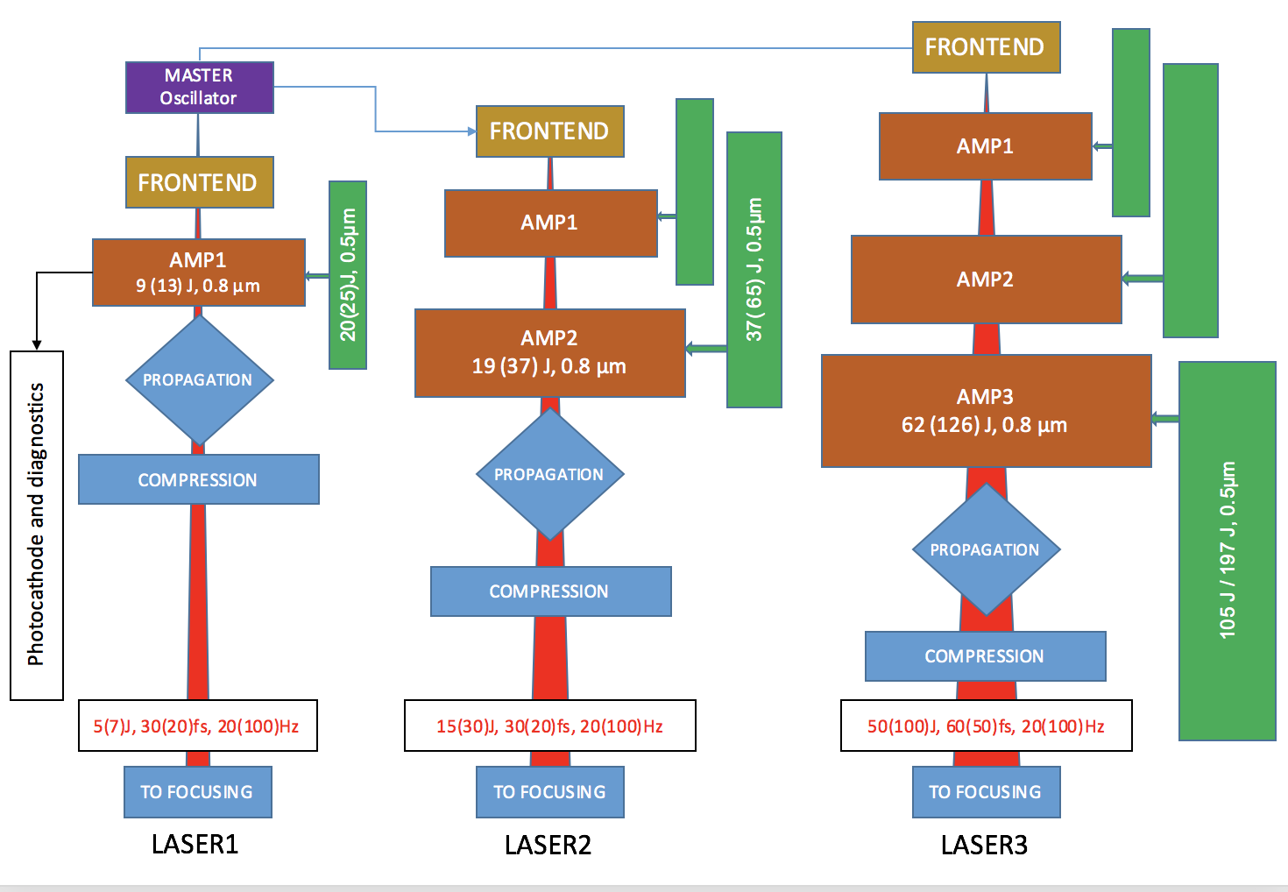
GENERAL ARCHITECTURE
Laser 1
Laser 1
Modularity of amplification stages:
LPI 150 MeV ⇒ Laser1
LPI 1 GeV ⇒ Laser1 + Laser2
LPA 5 GeV ⇒ Laser1 + Laser2 + Laser3
adjustments on pulse duration/bandwidth
Synchronization: common master oscillator
Pulse duration/wavelength tailoring : separate front end
Scalability: possibility to upgrade from P0 to P1 performance levels without a major changes
Laser 1
Laser 2
Laser 2
Laser 3
LPI 150 MeV
LPI 1 GeV
LPA 5 GeV

Slide 11
AMPLIFIERS MODULAR ARCHITECTURE
Foreseen I/O energy and pump requirements
LPI 150 MeV
From the
front end
LASER1
E_{out} 8.8 J (P0) / 12.5 J (P1)
To the
compressor
E_{pump}: 19.2J (P0)/ 25.7 J (P1)
From the
front end
LPI 1GeV
LASER1
E_{out} 8.8 J (P0) / 12.5 J (P1
LASER2
E_{out} 18.8 J (P0) / 37.5 J (P1)
To the
compressor
E_{pump}: 37.2J (P0)/ 65.2 J (P1)
LPA 5GeV
From the
front end
LASER1
E_{out} 8.8 J (P0) / 12.5 J (P1)
LASER2
E_{out} 18.8 J (P0) / 37.5 J (P1)
LASER3
E_{out} 62.5 J (P0) / 125 J (P1)
To the
compressor
E_{pump}: 105J (P0)/ 197 J (P1)
Three main modules: LASER1, LASER2, LASER3
LASER1: stand-alone for LPI 150 MeV
LASER2: output stage for LPI 1 GeV, second stage for LPA 5GeV
LASER3: high energy stage for LPA 5GeV
Two levels of performance : P0 and P1

Slide 12
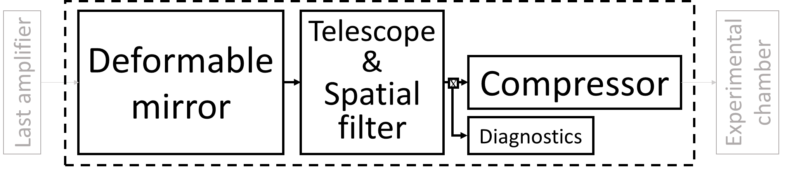
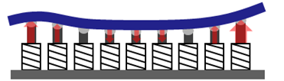
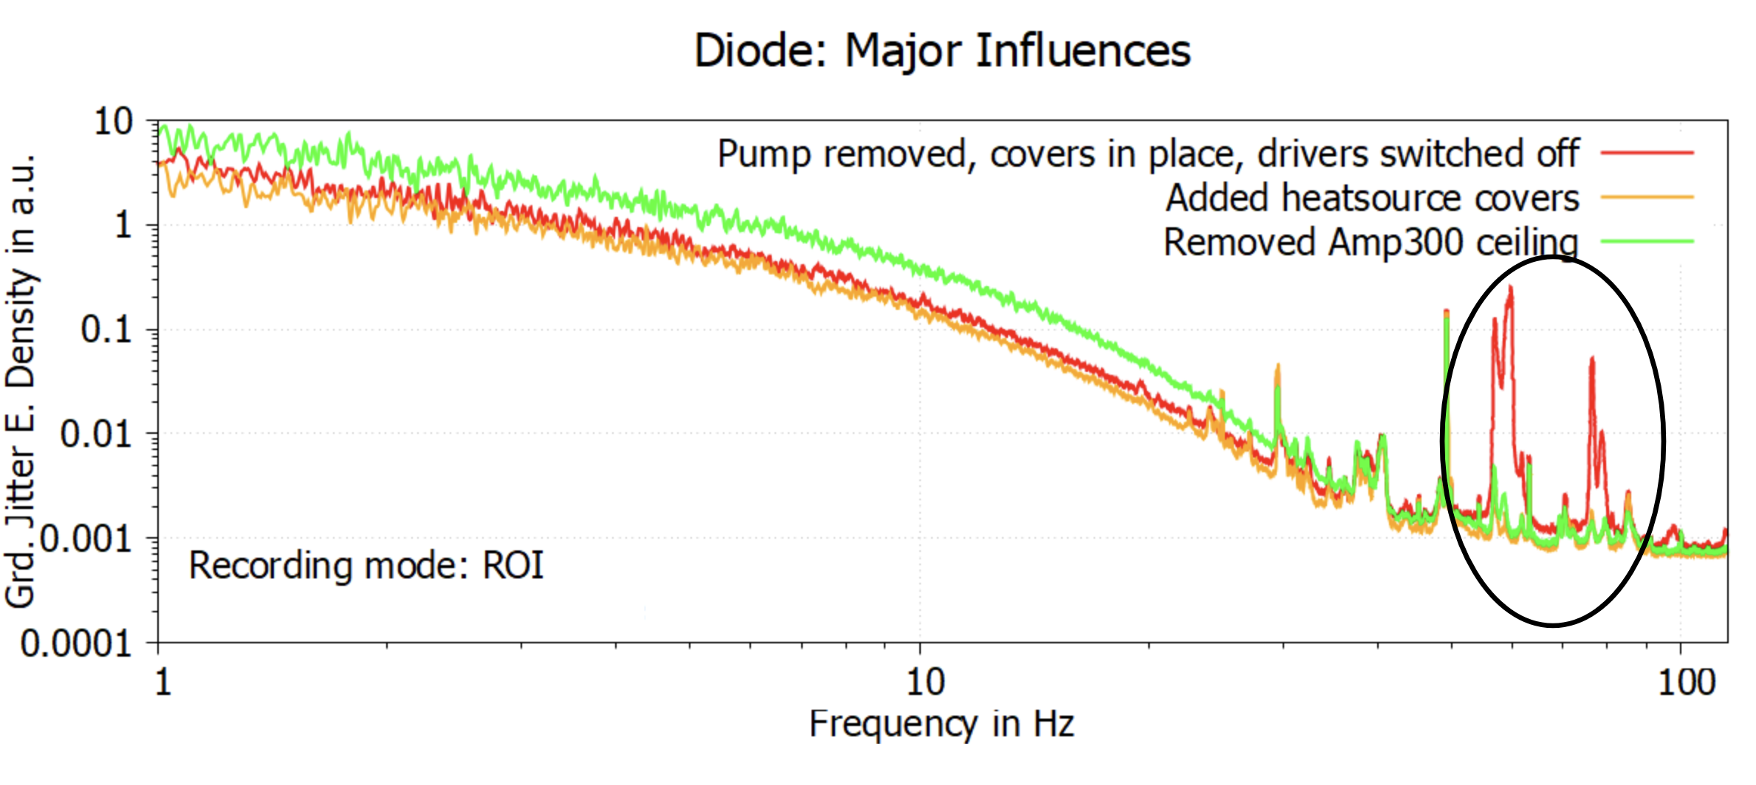
Open issue 1: Transport to target
Main challenges: large optics, mechanical stability, beam quality control, pointing stability
Currently under investigation at Apollon
(F. Mathieu)
Addressed in the “CREATE” development project

Slide 13
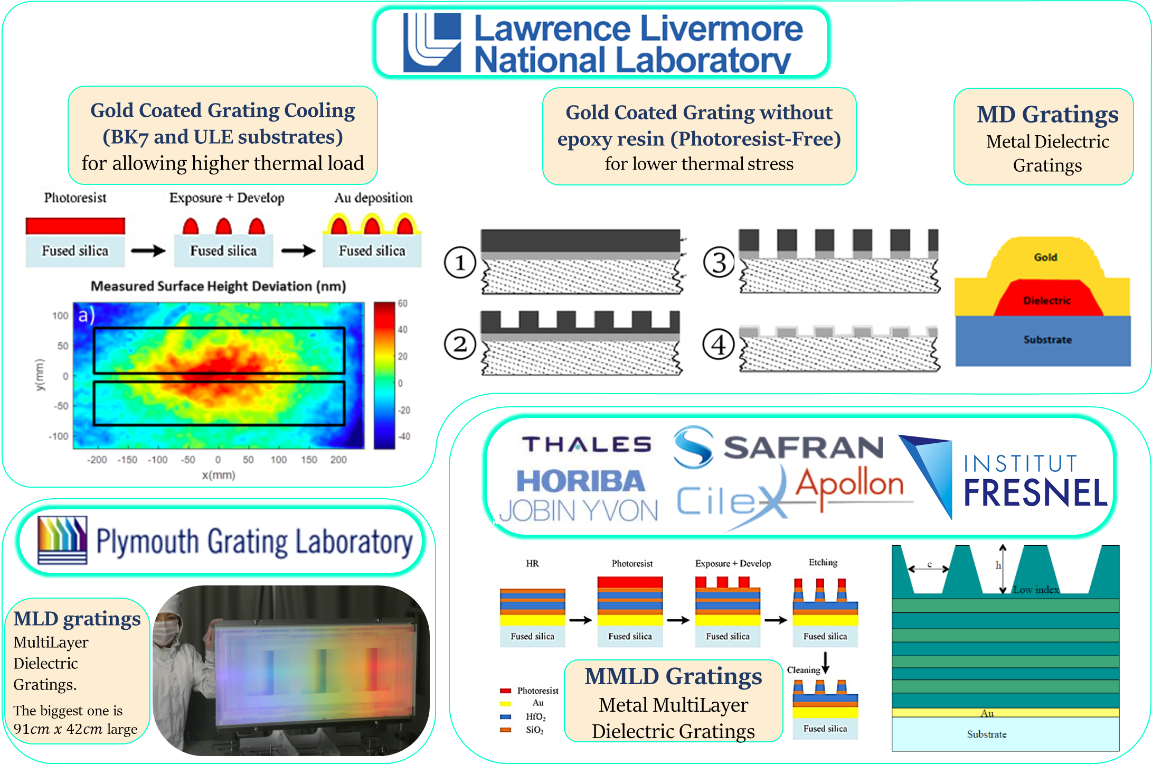
Open Issue 2: Compressor grating technology
Different technologies under evaluation to address main issues with higher repetition rate
Strategy includes:
reduction of the thermal load at high average power
cooling of residual heat and
control of thermal effects on compression quality.
Addressed in the “CREATE” development project

Slide 14
Open issue 3: THERMAL MANAGEMENT iN AMPLIFIER HEADS
Critical design crossroad
Multipass reflection
Multipass transmission
Input beam
Ouput beam
Input beam
Water flow
Steering mirror
Pump
recycling
mirrors
Pump beam
Ti:Sapphire
crystals
Pump
beam
Steering mirror
Absorber
Ouput beam
Ti:Sapphire
crystal
Window
Window
Pump recycling
mirror
Steering mirror
Water flow
Water flow
Steering mirror
Pump
recycling mirror
Cooling flow
Cooling flow
Reflective coating
(cooled side)
Pro’s
Simpler scheme (up to 2 sub-crystals, single pump path)
Broader cooling surface available
Less sensitive to mechanical vibrations
Less sensitive to parasitic reflections (contrast issues)
Con’s
Aberrations from fluid turbulences
Very critical design of the fluid ducts
Pro’s
No aberration from cooling fluid
Modularity
Con’s
Less cooling capability
More complex set-up (up to 3 units required , pump splitting)
More sensitive to mechanical vibrations
Possible issues from parasitic reflections (pulse contrast)
Preliminary design: equivalent perfomances from simulations
Critical aspects (i.e. optical aberrations from cooling fluid) beyond numerical simulations capabilities
Dedicated experimental development (i.e. realization and testing of small scale pilot devices) is required to address this design choice
Addressed in the “CREATE” development project

Slide 15
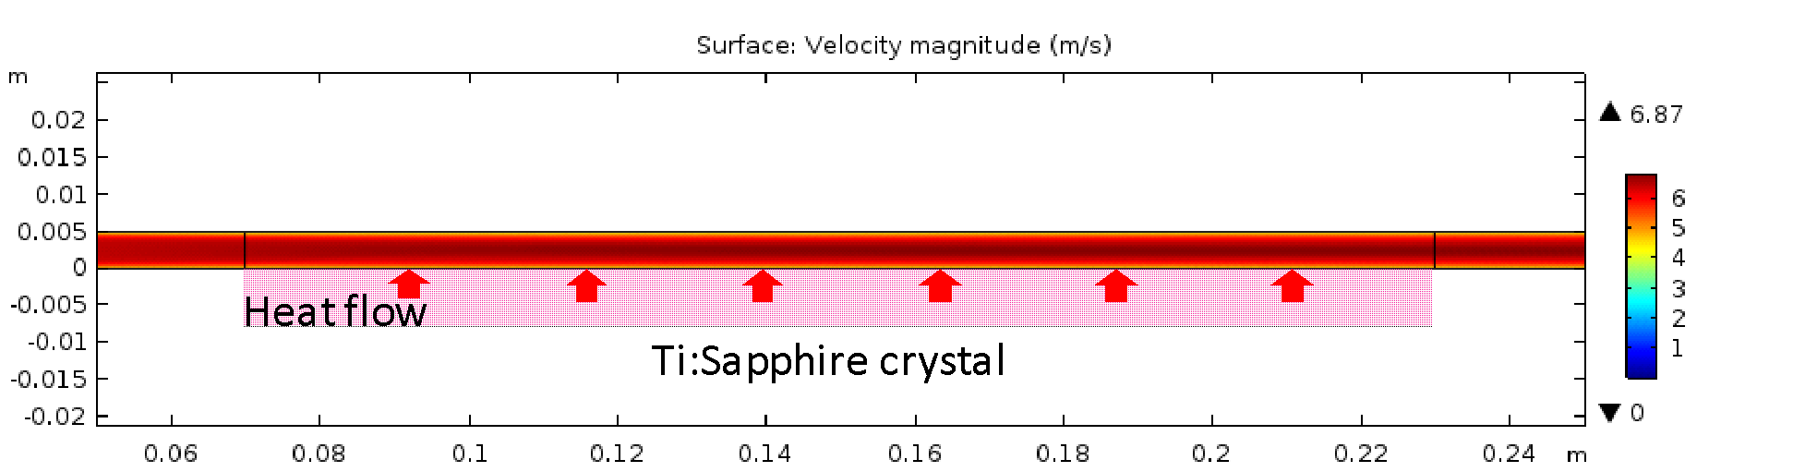
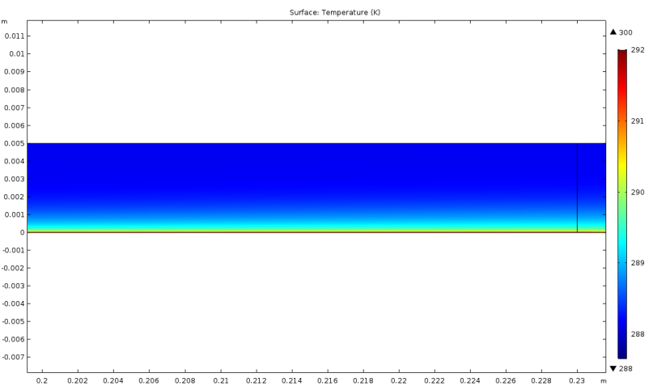
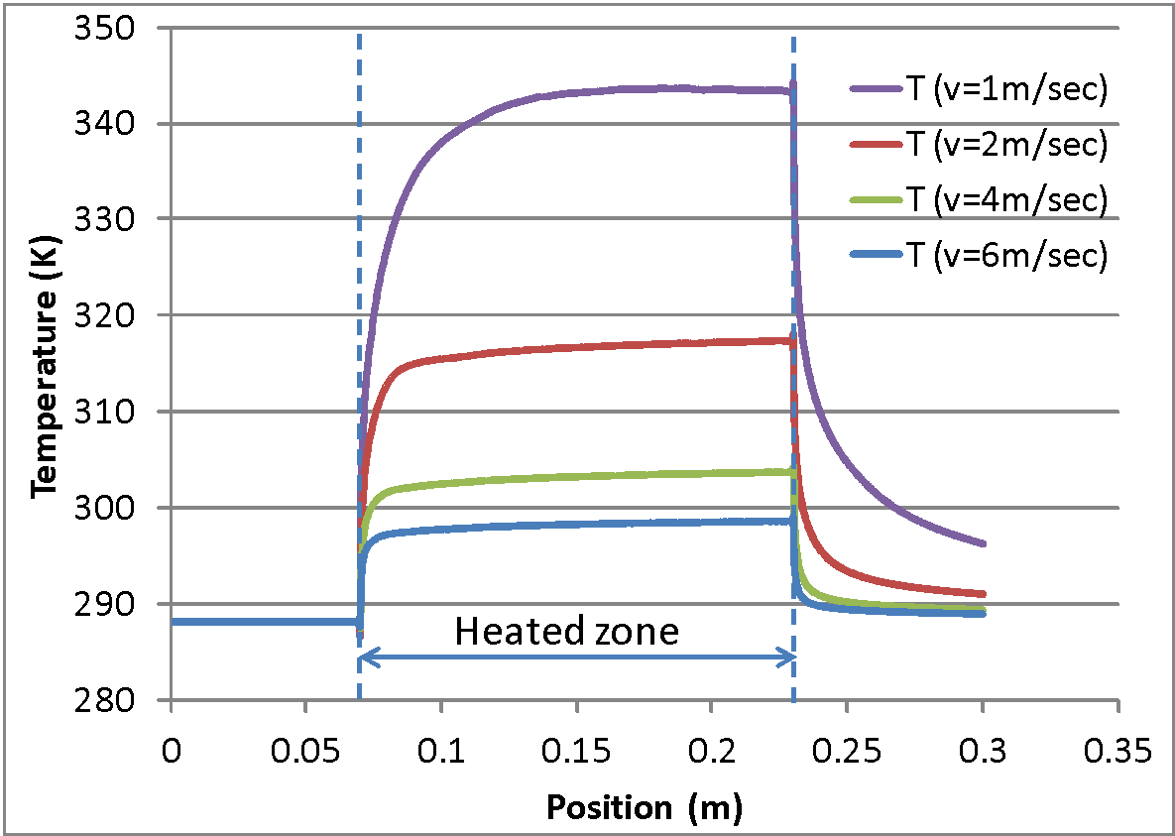
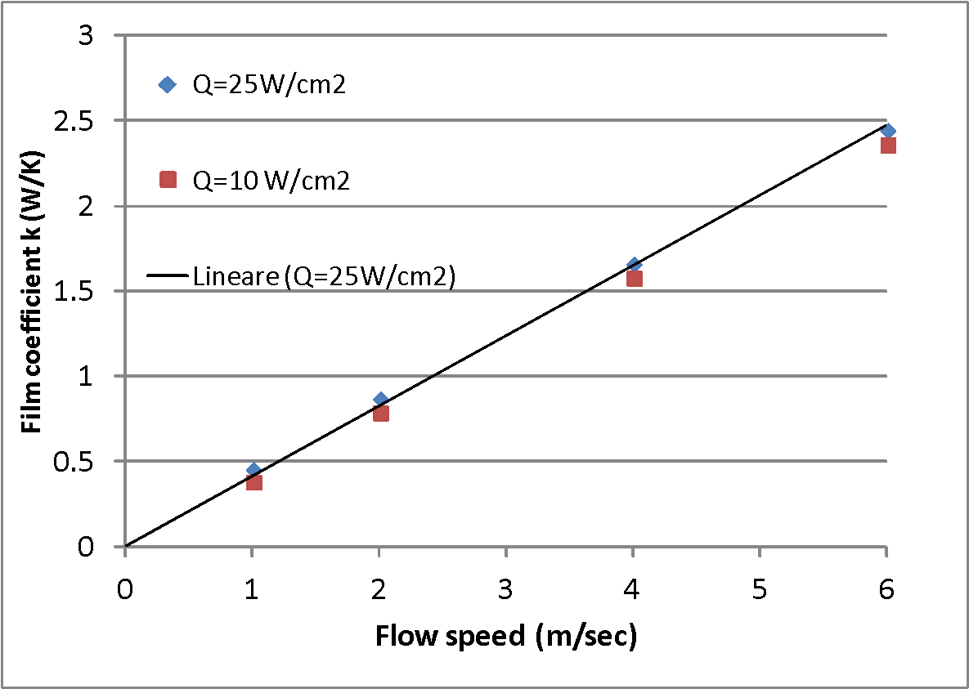
TDR issue: FLUID-DYNAMICS SIMULATIONS
Water cooling of disk amplifiers: modelling physics
Simulation software: COMSOL multiphysics (ver. 4.2 and 5.2)
Finite Element Analysis approach
Numerical solution of the Navier-Stokes equations for mass and energy transport
Low Reynolds k-ε solution method
Thermal coupling with boundary layer at the channel walls (heated Ti:Sa crystal)
Time-averaged simulation (i.e. time-dependent turbulences not modelled)
Velocity magnitude distribution
Temperature distribution
Example:
channel thickness 5 mm, flat channel walls
inlet flow speed 6 m/sec,
heat input 25 W/cm² (AMP3 at P1 performance level)
heated length 160 mm (AMP3 pump beam ∅);
temperature dependence of water properties
water input temperature 15 °C
mesh ∼ 128000 elements
292
Water flow direction
291
290
289
288
Temperature of Ti:Sa surface at different inlet flow speed
Water inlet temperature 15°C (288.15 K)
Heat input 25 W/cm2, Channel heigth 5 mm
Effective film coefficient (heat exchange coefficient between water and heated wall for different flow speed and heat input levels

Slide 16
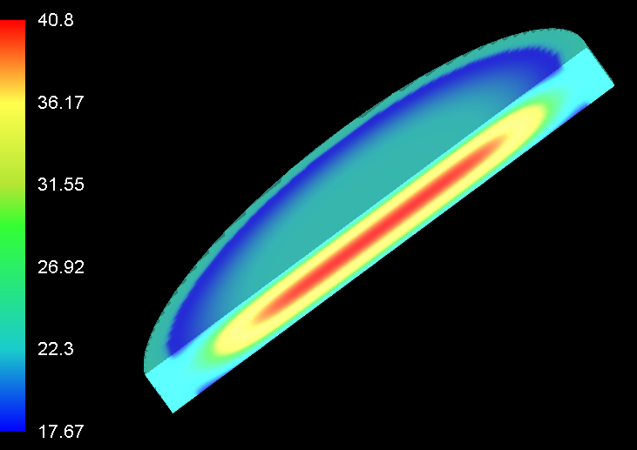
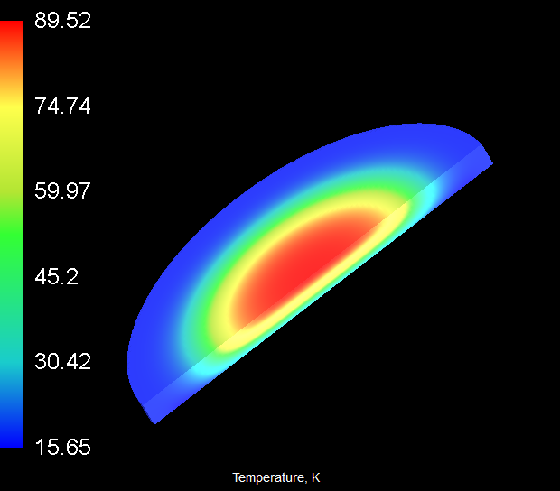
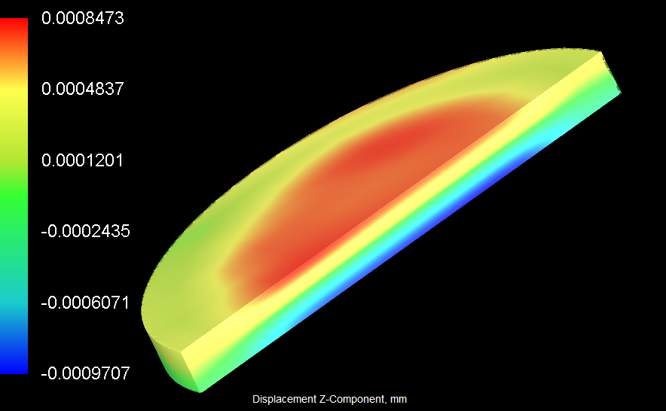
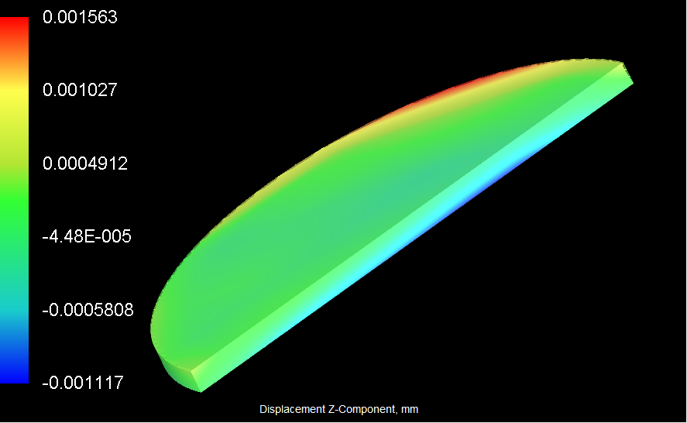
TDR issue: THERMOMECHANICAL SIMULATIONS
Temperature distribution
Temperature distribution for AMP3 transmission disk (left, 1.6 cm thickness) and AMP3 reflection disk (right 1.3 cm thickness) at P1 pump level
Peak T: 40.8 °C
Peak T: 89.5 °C
Deformation distribution
Phase modification requires Adaptive Optics compensation
Axial displacement distribution (mm) for AMP3 transmission disk (left, 1.6 cm thickness) and AMP3 reflection disk (right 0.8 cm thickness) at P1 pump level
Modelling: Finite Element Analysis (FEA)
Optical path difference (OPD)
OPD in microns resulting from thermal expansion and thermooptic effect. Parabolic fit and higher order aberrations also shown. Left: AMP3 transmission disk; right AMP3 reflection disk at P1 pump level

Slide 17
TDR Issue: PUMP SOURCES TECHNOLOGY
P0 performance level
Issue: P0 operation regime has a pulse repetition rate of 20 Hz.
The two available pump sources have a repetition rate of only 10 Hz.
To circumvent this problem (until higher rep rate devices are developed) we considered to use two (or two sets) of pump sources and shot them interleaved, so that repetition rate of the pump pulses arriving to the amplifiers id effectively doubled.
Issue: Pump energies higher than about 60 J (as needed by the AMP3 module) require more than a single pump source.
This calls for specific arrangements to multiplex the input from several pump units to the amplification crystals.
PUMP SOURCE DIMENSIONING
P1 performance level
Issue: P1 operation regime considers a pulse repetition rate of 100 Hz, along with higher energies than P0. Currently no solutions for pump sources are available to meet these requirements.
Speculatively, we have considered the availability of a system similar to Amplitude P60 but operating at 50 Hz (conversion to diode laser pumping of the flashlamp pumped P60) with the same output energy of 60 J/pulse in the green.
Again, reaching 100 Hz requires the time interleaving of a pair of twin sources. This analysis did not include the DiPOLE 100 system, as no developments are currently planned toward a high energy, high rep rate system.

Slide 18
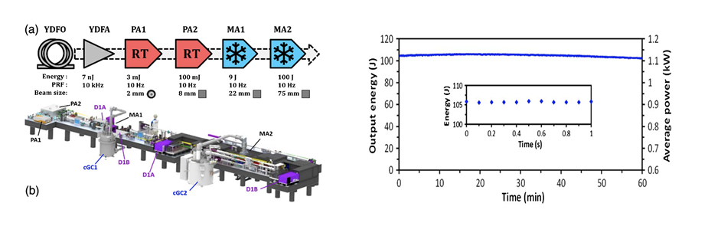
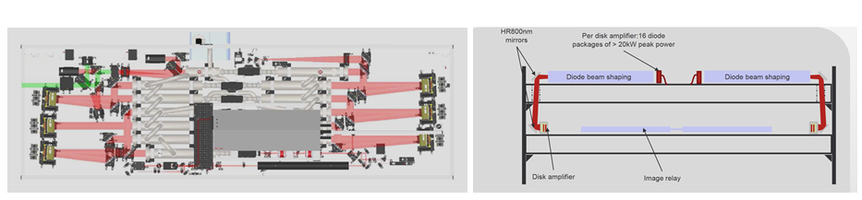
TDR Issue: PUMP SOURCES TECHNOLOGY
DiPOLE 100 (STCF)
Cryogenically operated Yb:YAG, diode pumped
100J @1030 nm , 10 Hz demonstrated
Energy stabilty 1% RMS (few hours of operation)
60 J SHG @ 515 nm, 10 Hz expected
Possible upgrades include:
IR Output energy 150 J
SHG output > 100 J
PRF 100 Hz @ 10 J
P-60 technology (Amplitude)
Nd:YAG Disk Amplifier Heads (DAH), liquid cooled.
Current design: flashlamp pumping
Scalable design (n. of DAH units): P20, P30…
Design specificatons (6 DAH):
~80 J @ 1064 nm, 10 Hz
60 J @ 532 nm, 10 Hz
Possible developments
- Diode pumping
- 50 Hz rep rate

Slide 19
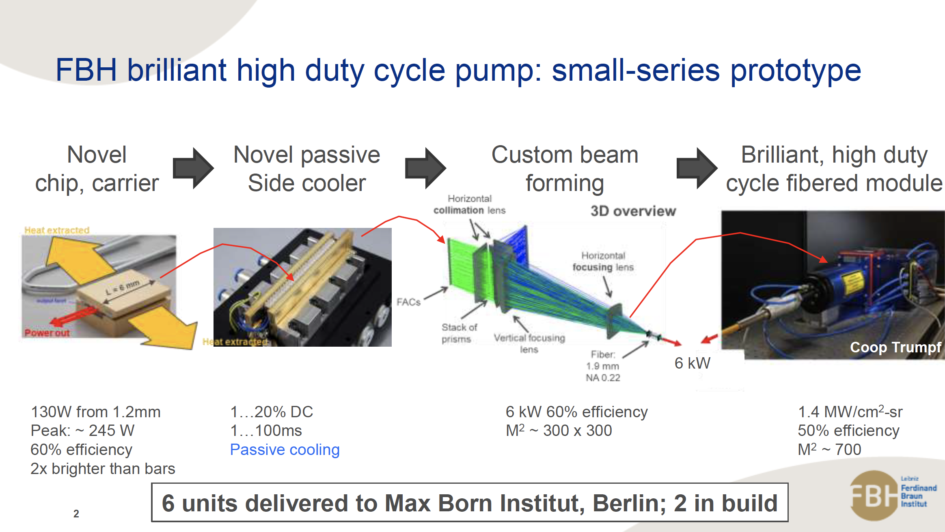
Needed Development: Diode lasers
Addressed in the “CREATE” development project

Slide 20
MAIN OUTPUTS OF THE EUPRAXIA DESIGN STUDY FOR PP&TDR
Requirements on energy, pulse duration, stability etc set by the LPA working point
Design based on CPA in Ti:Sapphire, dictated by requirements vs. time scale
Thermal management issues to be addressed by means of liquid cooling
Main developments required:
  Prototyping of Ti:Sa amplifiers: fluid cooling (choice between reflection/transmission amplifier): possibly by means of pilot devices
Addressing 100 Hz pump lasers developments
Thermal management of compressor gratings
Stability (pointing & more) and active control
Driver pulse temporal shaping and synchronization
Construction
Integration Issues
Workpackage 12 of Preparatory Phase project:
WP12 - Laser Technology and Liaison to Industry 2 - CNR

Slide 21
The end
Thank you!

