Slide 1
WP1 Status
Perugia 22/06/2022

Slide 2
General News
P-i-n devices on Kapton from Nicolas arrived both in Perugia and in Wollongong in two batches
  First batch tested for I/V had no direct current, some channel did not passed the “photovoltaic test”
  Second batch ok from I/V and PV test
  The devices were also tested for bondability yielding negative results.
Good news from the sputtering deposition tests some samples reached 10¹⁰ Ω cm resistivity

Slide 3
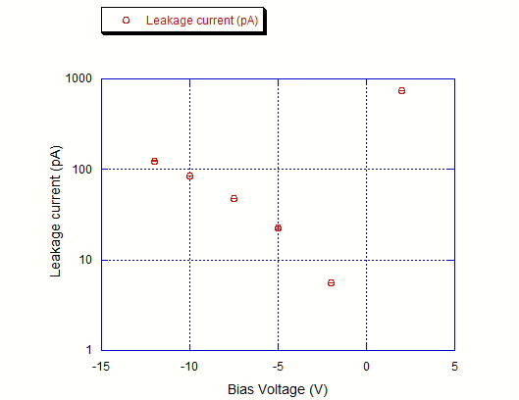
I/V characteristics of a p-i-n diode

Slide 4
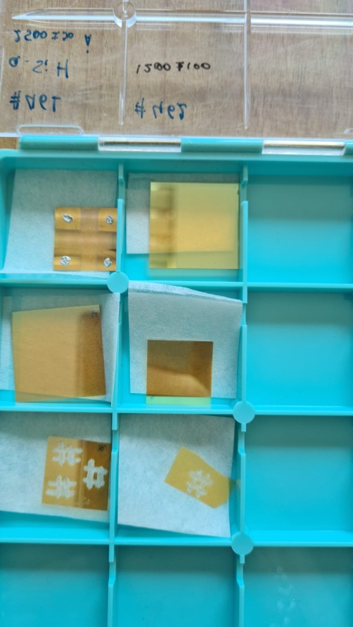
June 2022
Preliminary sputtering deposition of a-Si:H
Sample | H₂ (%) | Ar (%) | P_{sputtering} (mTorr) | Power (W) | Thickness (nm) | Resistivity (Ωcm)
# 461 | 5 | 95 | 10 | 500 | 240 | 10⁸
# 463 | 5 | 95 | 10 | 500 | 750 | 10⁷
# 464 | 5 | 95 | 15 | - | - | -
# 465 | 5 | 95 | 7.5 | 500 | 370 | 10¹⁰
First Trial

Slide 5
10 mTorr
10 mTorr
7,5 mTorr

Slide 6
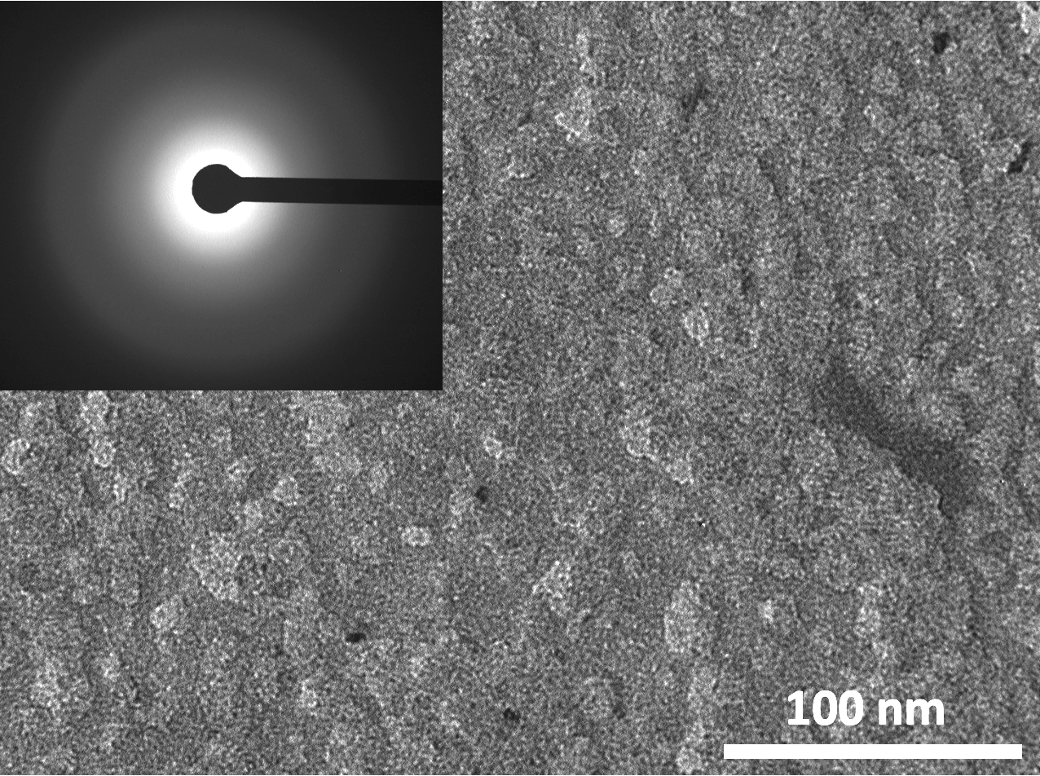
Transmission Electron Microscopy Investigation
# 465

