Slide 1

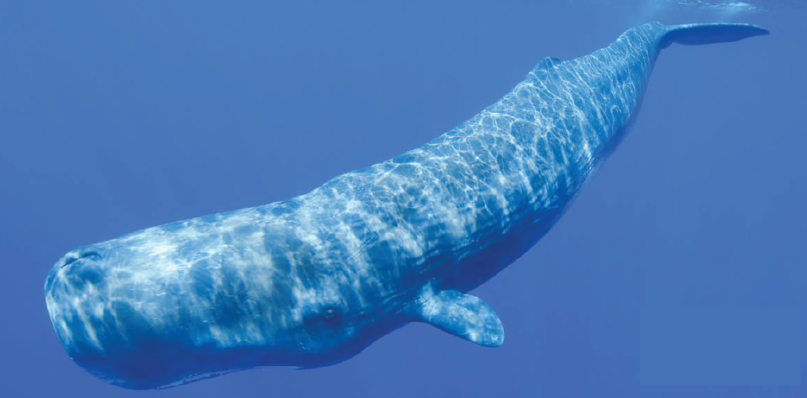

Towards acoustic
UHE neutrino detection
in the Mediterranean Sea
Giorgio Riccobene INFN-LNS

Slide 2
Large Area Detectors for HE neutrinos
1 TeV 100 PeV 1000 ZeV
Optical Detection
(ICECUBE-KM3NeT)
Radio Detection
(RICE, ARIANNA, ARA)
Acoustic Detection
(Prototypes)
em cascade
ν
μ
ν_{μ}
ν_{e}
hadron
cascade
em cascade
Medium: Seawater, Polar Ice
ν_{μ} (throughgoing and contained)
ν_{e,τ} (contained cascades)
Carrier: Cherenkov Light (UV-visible)
Attenuation length: 100 m
Sensor: PMTs
Instrumented Volume: 1 km³
Medium: Salt domes, Polar Ice
ν (cascades)
Carrier: Cherenkov Radio
Attenuation length: 1 km
Sensors: Antennas
Instrumented Volume: >1 km³
Medium: Seawater, Polar Ice, Salt Domes
ν (cascades)
Carrier: Sound waves (tens kHz)
Attenuation length: ∼ 10 km
Hydro-phones
Instrumented Volume: >100 km³

Slide 3
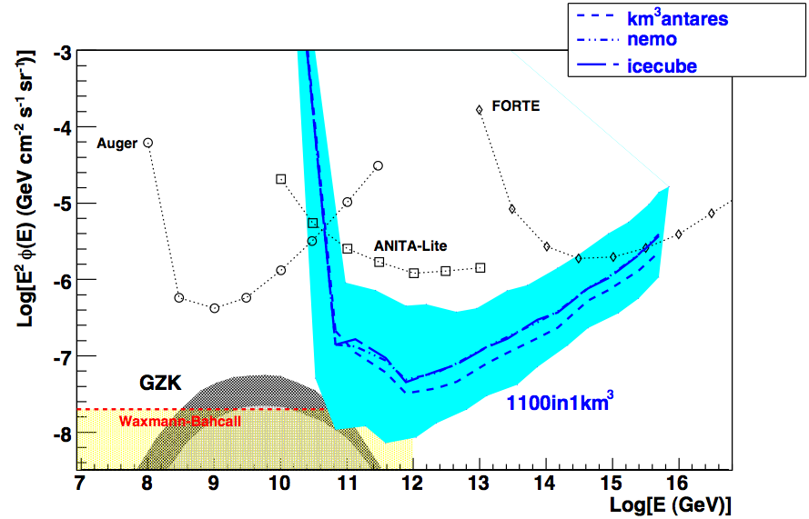
Acoustic detectors expected sensitivity
Standard approach
Possible KM3 complementarity
Largely spaced detectors for UHE neutrino detection
1100 hydros in 1 km³
Vertical arrays of hydrophones
1 year, threshold 35 mPa
Acoustics
.. with cuts
- No cuts
5 years, 15 mPa, 95% CL
1500 km³, 200 hydros per km³
5 years
threshold 5 mPa
10 years, threshold 5 mPa
See Rolf Nahnhauer’s talk tomorrow
A “complementary” km³-scale detector ?

Slide 4

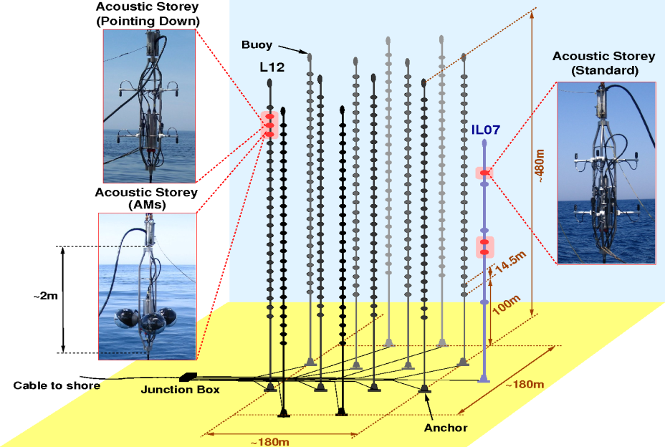


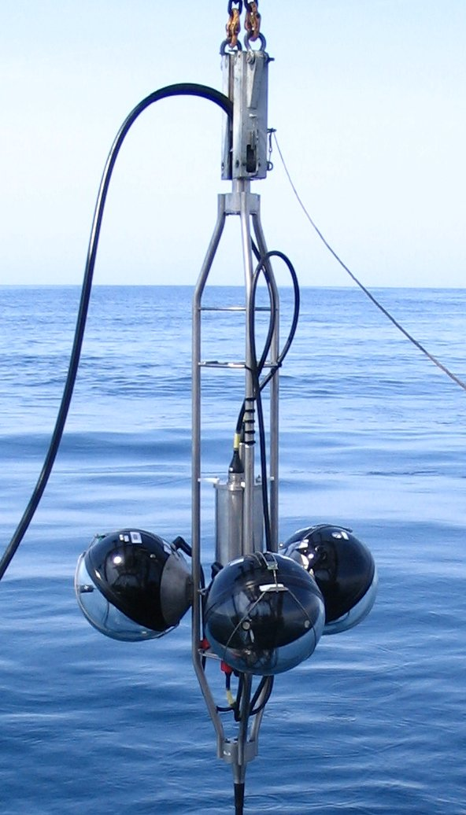

R&D on acoustic detection in ANTARES: AMADEUS
AMADEUS comprises 36 hydrophones on two lines of ANTARES
A test bench to study the feasibility of a large acoustic UHE neutrino detector
Study of acoustic environment and backgrounds
Methods to reconstruct direction

Slide 5
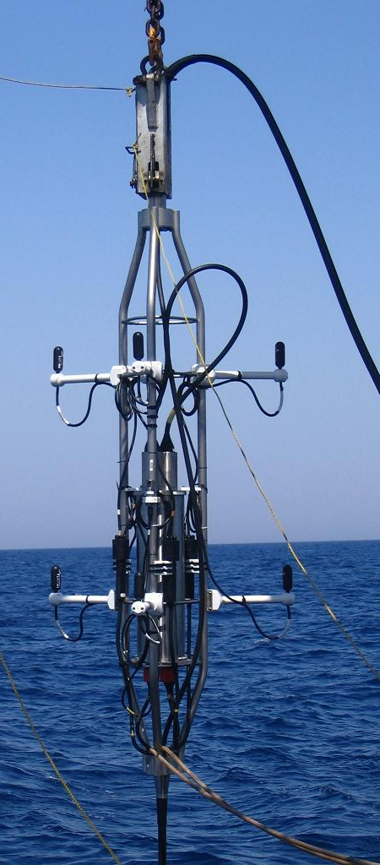
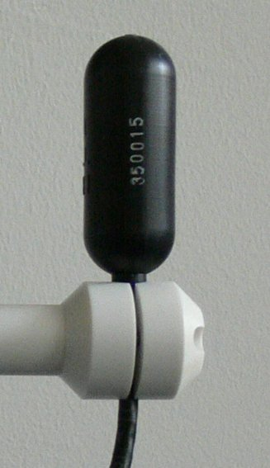
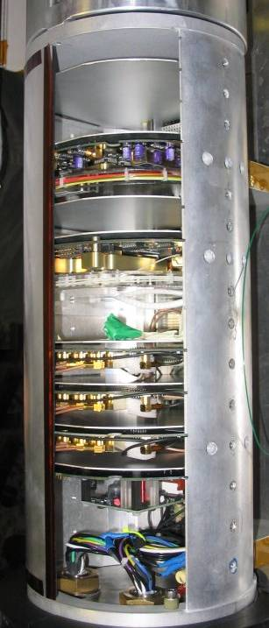
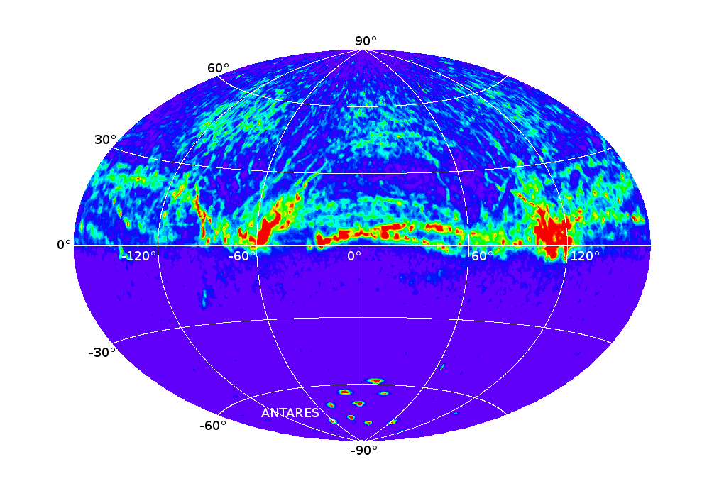
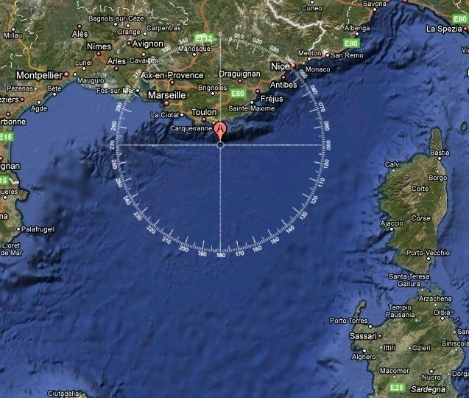
R&D on acoustic detection in ANTARES: AMADEUS
Setup of Acoustic Storey with Hydrophones
Hydrophone:
Piezo sensor
with pre-amplifier
and band pass filter in PU coating
Typical sensitivity:
-145 dB re 1V/μPa
3 custom designed Acoustic ADC boards 16bit @ 250kHz
~10cm
Titanium cylinder
with electronics
Reconstruted acoustic pulses directions
0º
-60º
-90º
90º
120º
Ferry routes

Slide 6
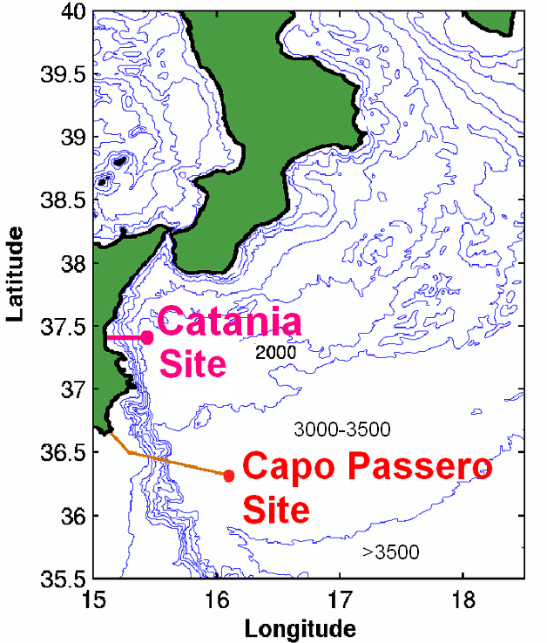
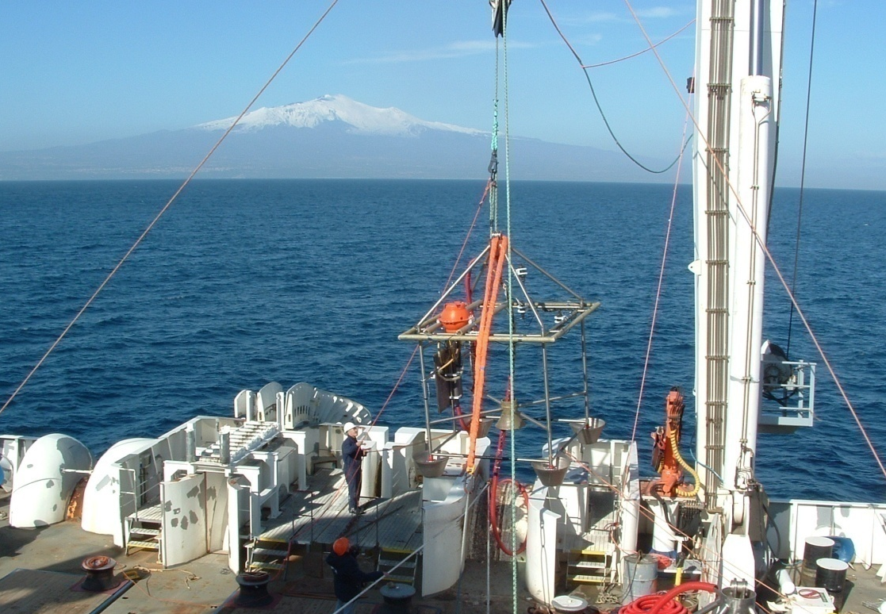
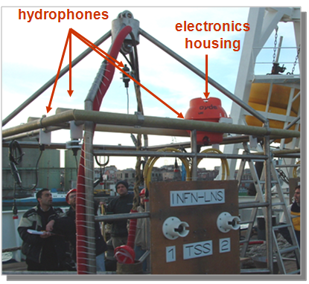




NEMO-OνDE: Ocean noise Detection Experiment
First experiment to perform long-term measurement and monitoring of the acoustic background @ 2000 m depth
Thetrahedral antenna (1m size):
4 Reson TC4042 hydrophones (special production for 2500 m depth).
Low cost professional audio electronics (96 kHz, 24 bit sampling, ΔΣ)
Hydrophones synchronised and phased.
On-line monitoring and recording on shore. Recording 5’ every hour
Data taking from Jan. 2005 to Nov. 2006 (when NEMO Phase 1 was deployed).
Sea Noise measurement and modelling (presently under study)
Bioacoustics: study of sperm whales population in the East Med Sea
CIBRA

Slide 7
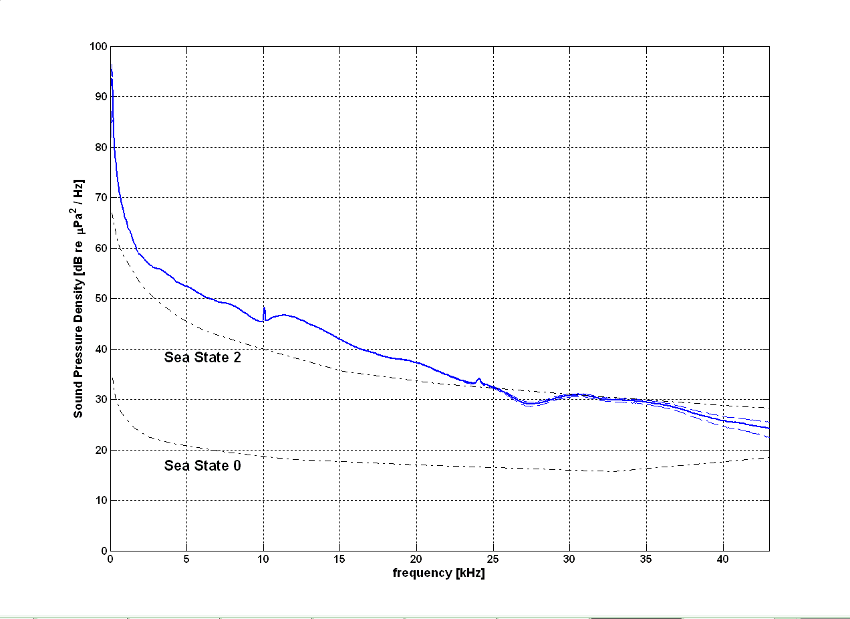
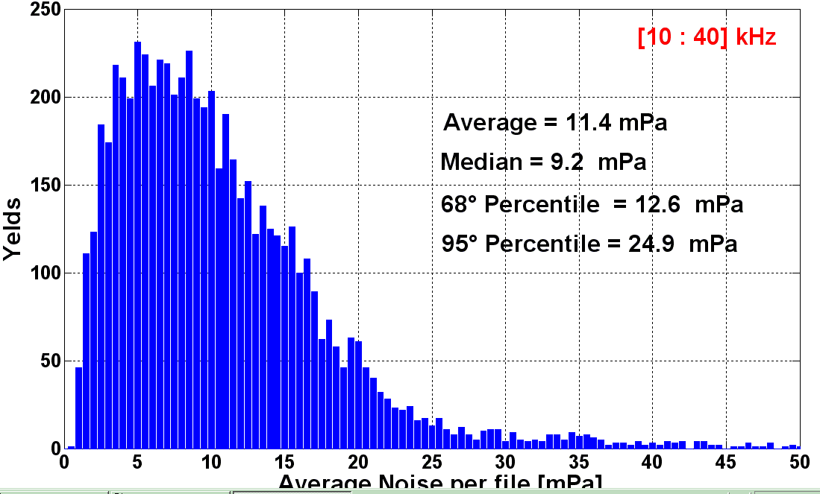
NEMO-OνDE: acoustic noise spectrum in deep-sea
Study of acoustic background level and its variation as a function of time (due to weather, seismic, biological and anthopogenic sources).
The average SPD is close to SS2, with increase at low frequency probably due to diffuse anthropogenic noise.
Peaks are due to pingers and shipping instrumentations continuosly present in the area.
Average acoustic noise 2005-2006
Sea State 2
Sea State 0
The average noise in the [20:43] kHz band is
5.4 ± 2.2_{stat} ± 0.3_{syst} mPa
G. Riccobene et al., NIM-A 604 (2009), S149

Slide 8
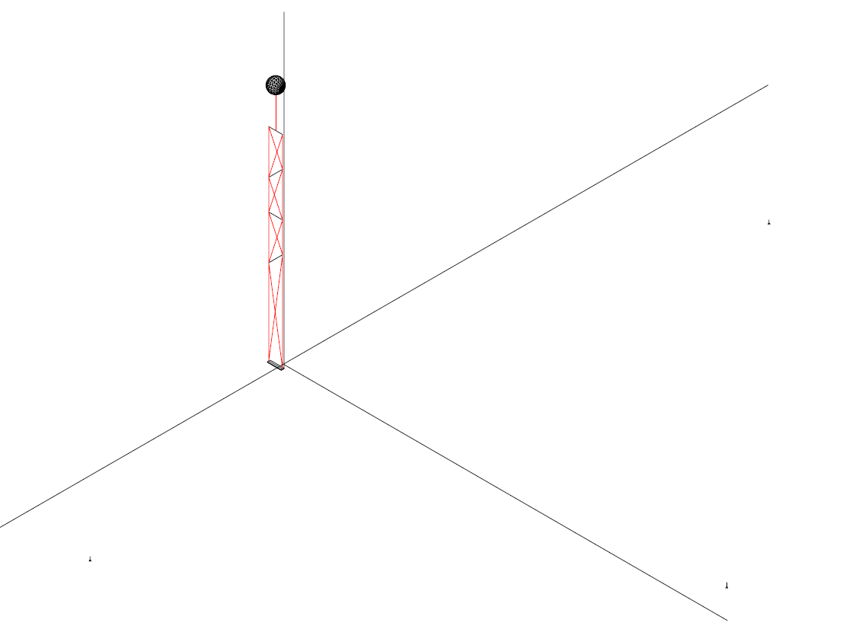
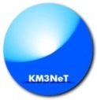

Acoustic positioning for KM3NeT: an opportinity for acoustics detection
The detector positioning system is a mandatory subsystem for the detector providing:
Guide during the deployment of the telescope structures and infrastructures
Optical module position during the telescope operation for muon track reconstruction
  Requirements:
  relative positioning accuracy: <20 cm (less than PMT diametre)
  absolute positioning accuracy: <1 m to optimize pointing resolution
  no interference with the optical detectors
  easy installation
  data acquisition/transmission system compliant with KM3NeT electronics
Use acoustic positioning systems
Key elements
Auto-calibrating Long Baseline of acoustic transceivers anchored in known and fixed positions.
Array of acoustic sensors (hydrophones) moving with the Detection Unit mechanical structure
Auxiliary devices: compasses, CTD , sound celerimeters, current metres
Data analysis system on-shore
Detection Unit
Hydrophone position calculation
TDoA (Time Difference of Arrival)
T^{Emit}(LBL) – T^{Receive}(Hydrophone)
Geometrical Triangulation
Hydrophone
LBL
transceivers

Slide 9




Acoustic detectors on the NEMO phase 2 tower
Installation and operation of a NEMO tower in Capo Passero
8 floors: 32 Optical Modules. Bar length 8 m.
Deployment 2011
2 PMTs
1 hydrophone
18 hydrophones for acoustic positioning (NEMO phase II)
and multidisciplinary science (SMO – FIRB MIUR)
  New technology:
  New high pressure-calibrated hydrophones
  (in collaboration with SMID and NATO)
  New front-end electronics
  Syncronization with the detector Master clock
  Underwater GPS time stamp
  2 Opto-Acoustic modules (ECAP)
  2 Free Flooded Ring hydrophones (UPV-CPPM)
  All data to shore
  Expected overall resolution for positioning few cm
  Multidisciplinary science (SMO)
  Tests for neutrino acoustic detection (SMO)
40 m

Slide 10
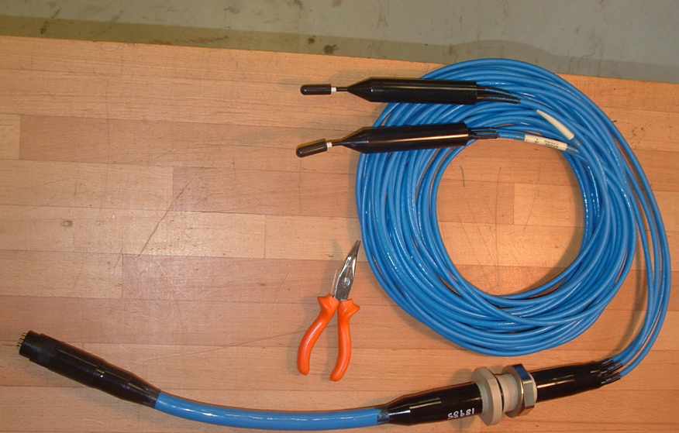
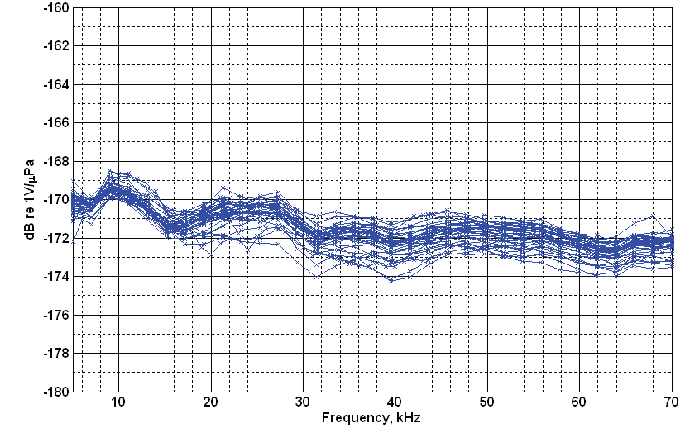
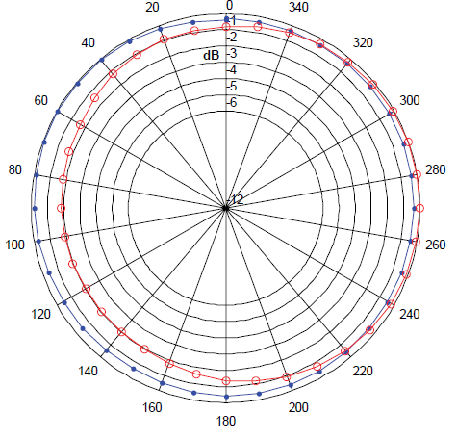
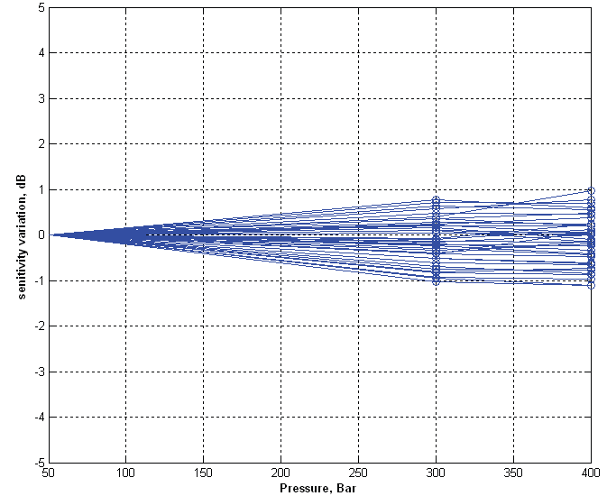
Novel deep sea calibrated hydrophones
SMID hydrophones and preamps (+ 38 dB gain)
Sensitivity and pressure calibration measured and certified by NATO – URC (La Spezia)
Hydrophone sensitivity calibrated at NATO - URC (40 hydrophones)
Hydrophone + preamplifier moulded in deep sea cable 7.5 m length
Measured differences ≤ ±2 dB
Relative Hydrophone sensitivity
variation with hydrostatic
pressure at 20 kHz
300 Bar
400 Bar
Radiation lobe
30 kHz
50 kHz
Measured variations ≤ ±1 dB

Slide 11





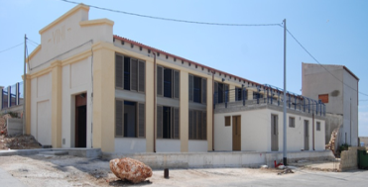
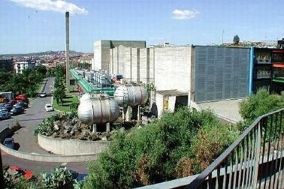
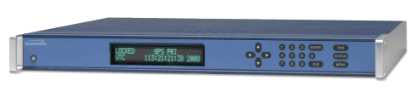
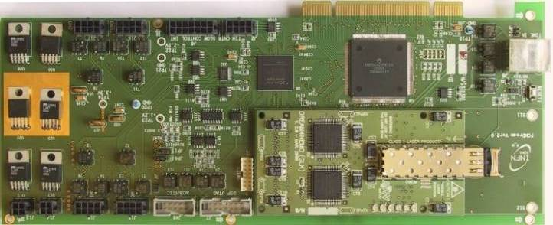
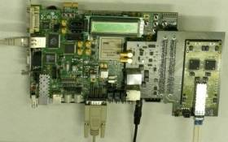
Acoustic data chain onboard NEMO phase II
Point to point storey connection , “All data to shore” , underwater GPS synchronisation
Hydros +
preamps
GPS
ADC
192 kHz
24 bits
Storey Control Module
Adds GPS Time
Sends Acou-data to shore
Ethernet
Optical data
On-Shore
Storey Control Module
Data Parsing
Acoustic data
optical
fiber link
OMs
Acoustic positioning
and bio-acoustics
Deep Sea Detetcor
INFN Shore Laboratory
INFN-LNS
Capo Passero
Sensor data acquistion
GPS time stamping
Data transmission
- fixed latency
- known optical walk
Trigger
Storage
GPS receiver
GPS clock transmission
Data parsing/distribution
Main storage
Analysis
F. Ameli et al, NIM A doi:10.1016/j.nima.2010.04.130

Slide 12
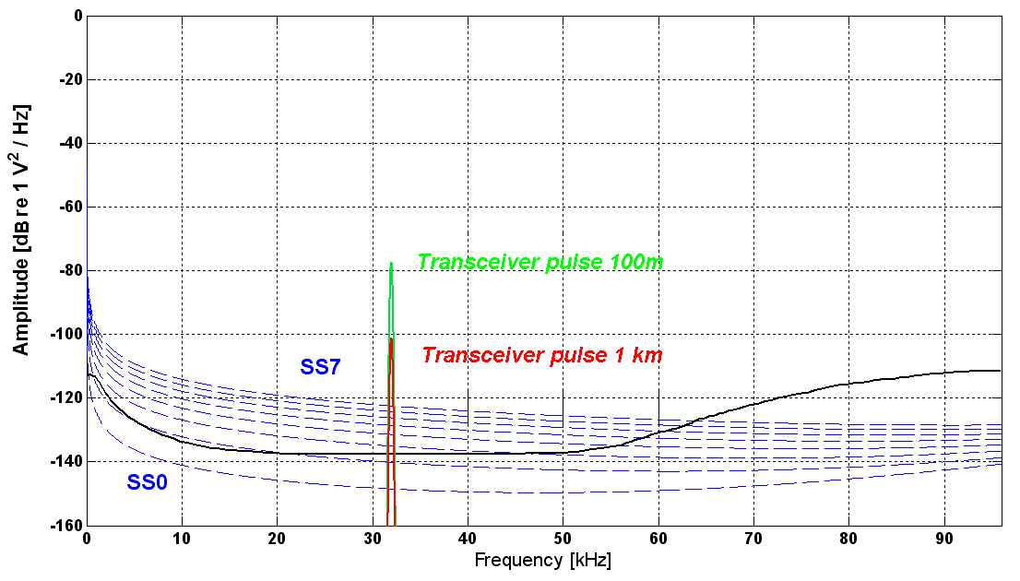
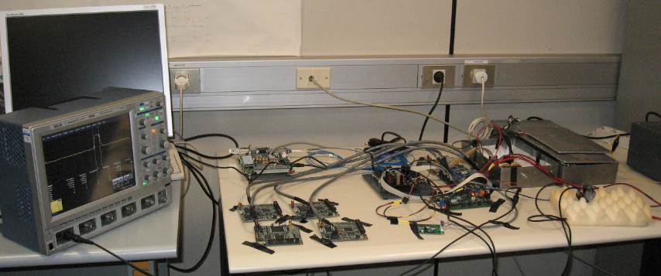
Test bench performances
Assuming transceiver pulse:
f= 32 kHz A=180 dB re 1 µPa @ 1m
See F. Simeone’s talk
friday
Measured system Latency = 166.1 µs
Measured electronics noise spectrum
σ < 100 ns
1 µs →1.5 mm in water
Preliminary
10 kHz < f < 80 kHz

Slide 13

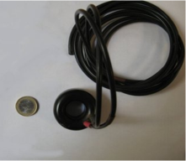
Towards the synchronised acoustic Long Base-Line
SCM
on-shore
SCM on-shore
Transmits GPS time
Sends user trigger
Sends user commands and settings
SCM off-shore
Inserts time in acoustics data
Interfaces commands and trigger to SEB
Signal Emission Board
RS-232 connection from shore allows to:
Set amplitude to emit
Set frequency to emit
Set repetition rate
Time of trigger known
(accuracy < ns )
SCM off-shore
Optical link
Trigger
Digitized
Data
Slow
Control
Board
Acou
Board
Signal
Emission
Board
RS232
UPV (Spain)
CPPM (France)
Signal to
transmitters
preamp
preamp
Transceivers: Sensor X30
TVR (transmission) 133 dB re uPa/V @ 1m
RVR (reception) -193 dB re V/uPa @1 m
Frequency range 20 kHz – 40 kHz
Beam pattern Radial: Omni
Axial: Toroidal (60°)
Operating Depth unlimited
FFR

Slide 14
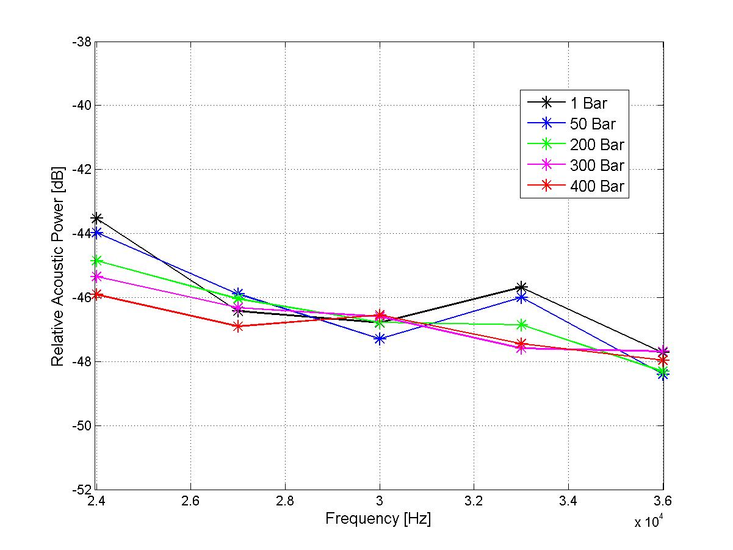
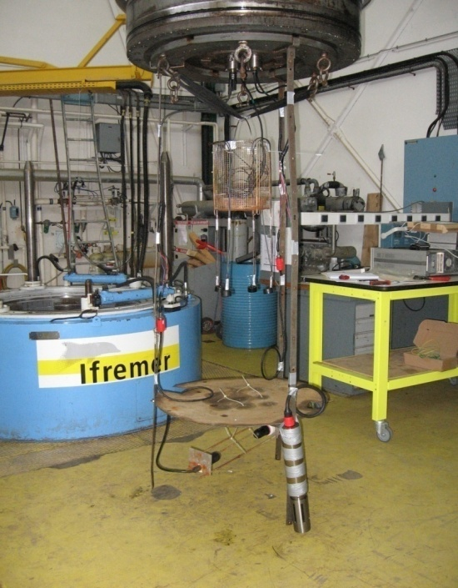
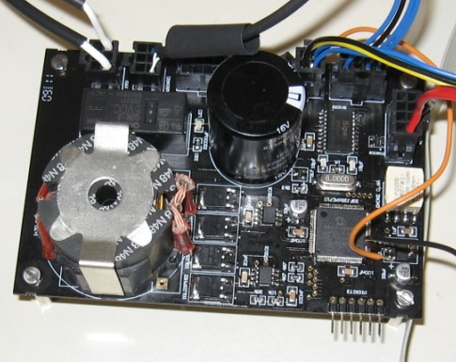
Tests of the acoustic transceivers and electronics
Preliminary
Test of sound emission:
FFR +Sound emission board
Transceiver pressure test at IFREMER Brest
The sound emission board

Slide 15
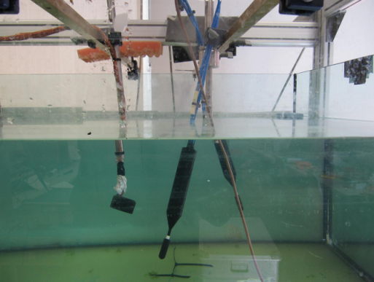
Joint tests: transceivers and hydrophones
Water tank tests at university of Valencia (Gandia):
Hydrophones SMID, Transceiver FFR
Signal emitted by the Sound emission board: 30 µs (1 cycle) | f= 32 kHz |A ∼ 10 V_{p}
trigger time
acoustic pulse on H1
(about 15 cm)
Preliminary
e.m. pulse
on H1 and on H2 at
166.1 +7.5 = 173.6 µs
acoustic pulse on H2
(about 30 cm)

Slide 16
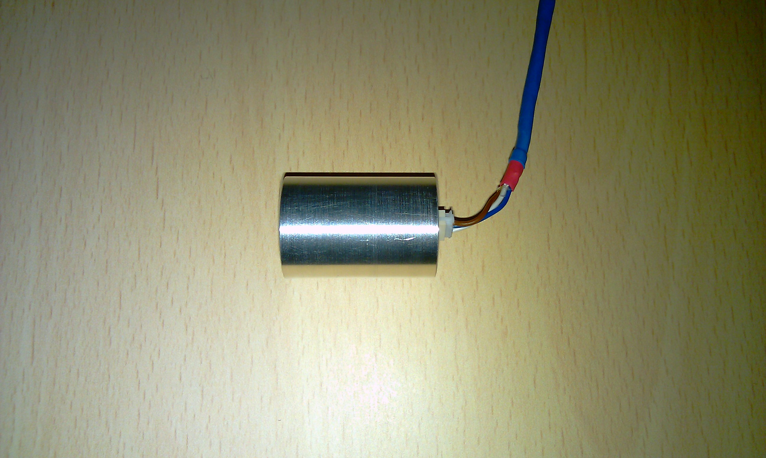
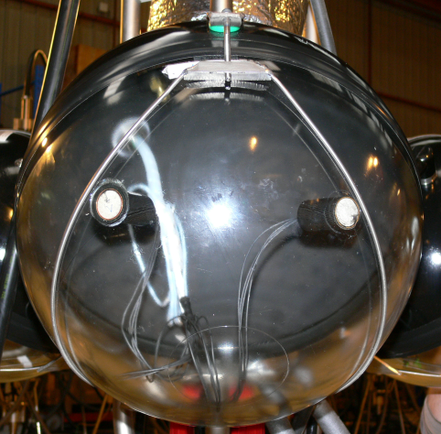
Opto Acoustic modules for NEMO phase II and KM3NeT
Adopt design of Acoustic Modules (AMs), used successfully in AMADEUS as part of ANTARES
Design allows for integration of acoustic sensors into pressure housing of photo sensors to form Opto-Acoustical Modules (OAMs)
ECAP Piezo
Aluminum tube:
Piezo + preamplifier
Mechanical container
shielding
30mm
Piezo sensor + preamplifier
21mm

Slide 17
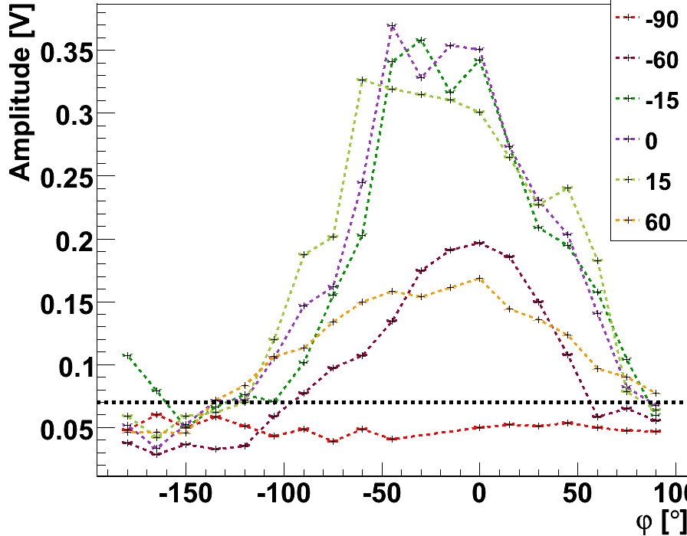
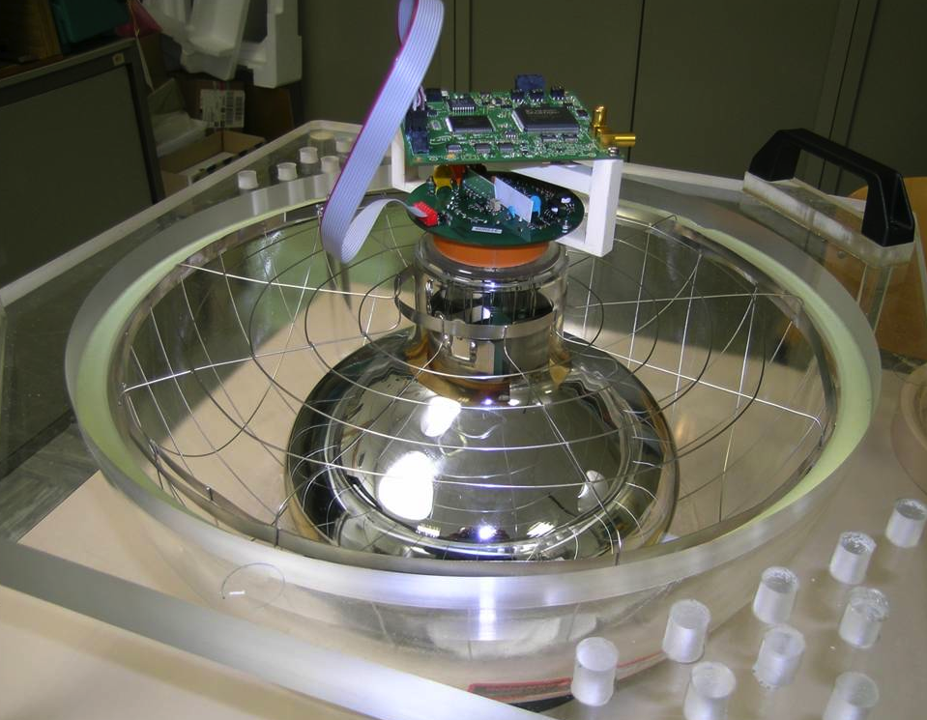
Opto Acoustic modules for NEMO phase II
OAM layout for the tower
Noise floor spectrum
Piezo inside OAM
Acceptance: ± 70°
hydrophone
Test with empty glass sphere

Slide 18

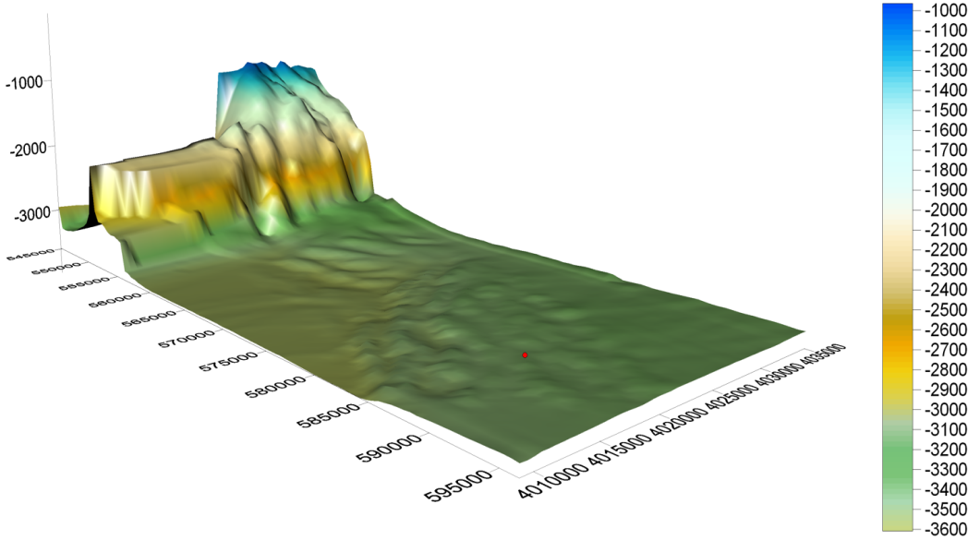
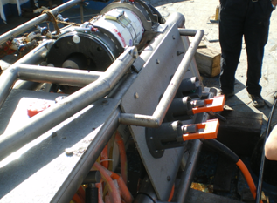
The Capo Passero Infrastructure
Suitable for KM3NeT and EMSO
Shore laboratory
Power supplier 10 kV - 50 kW
Optical fibre link to LNS (end 2011)
Submarine cable:
100 km - 20 fibres, DC-sea return
DC/DC Converter 10 kV-375 V 10 kW
3 ROV e.o. output connectors
Shore Laboratory in Capo Passero harbour
CP Site
The Capo Passero Site lies on a flat and wide plateau
Will host: ANTARES mini-line, NEMO Phase II - SMO, KM3NeT Prototype

Slide 19
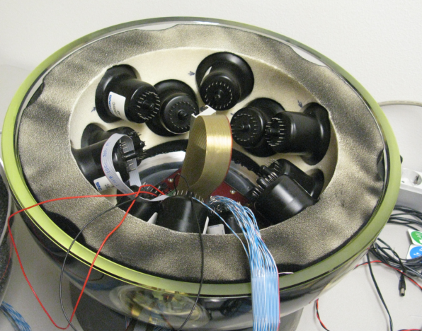
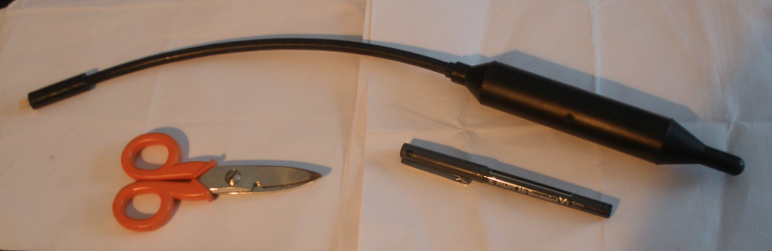
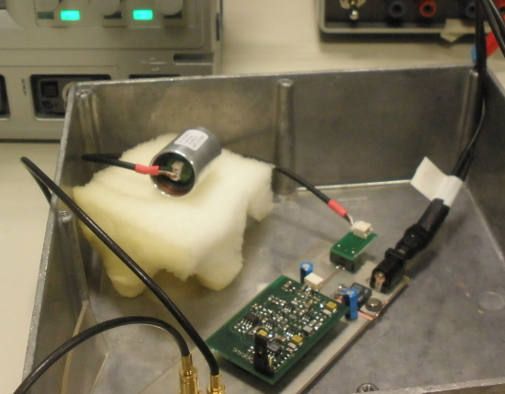
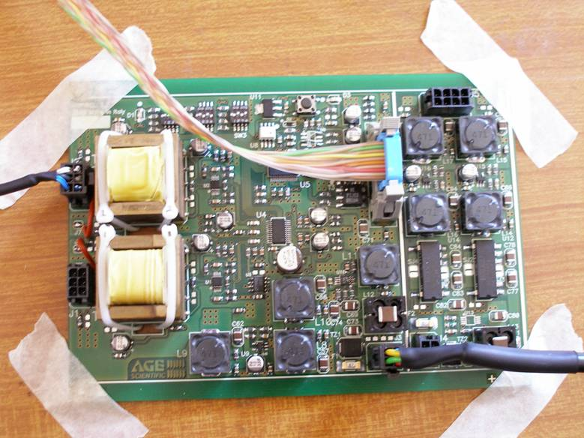
Design of acoustic sensors and electronics for KM3NeT
Multi PMT option adopted for KM3NeT: DOM (Digital Optical Module)
DOM:Multi PMT
Central Logic Board
Acoustic Mezzanine
Piezo inside the DOM
Hydrophone outside
the DOM

Slide 20
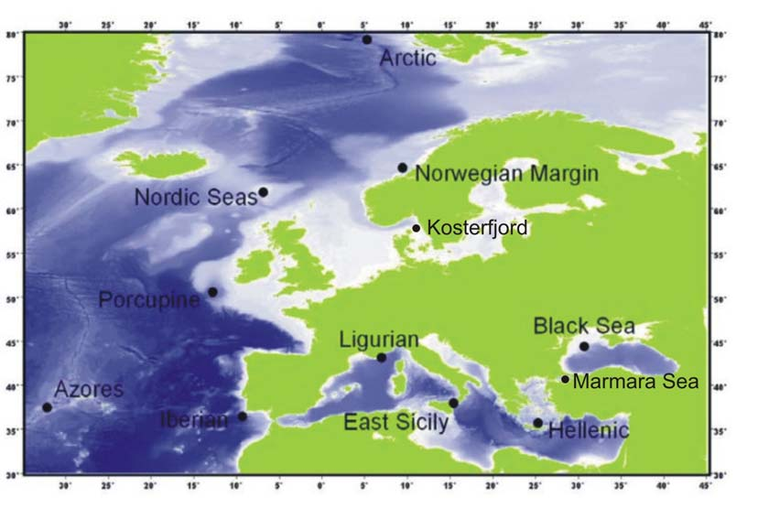
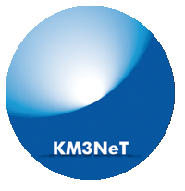

KM3NeT and EMSO

Slide 21
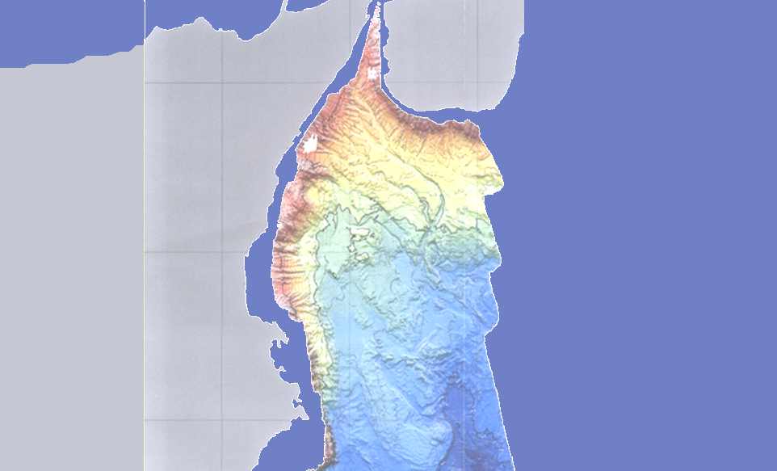
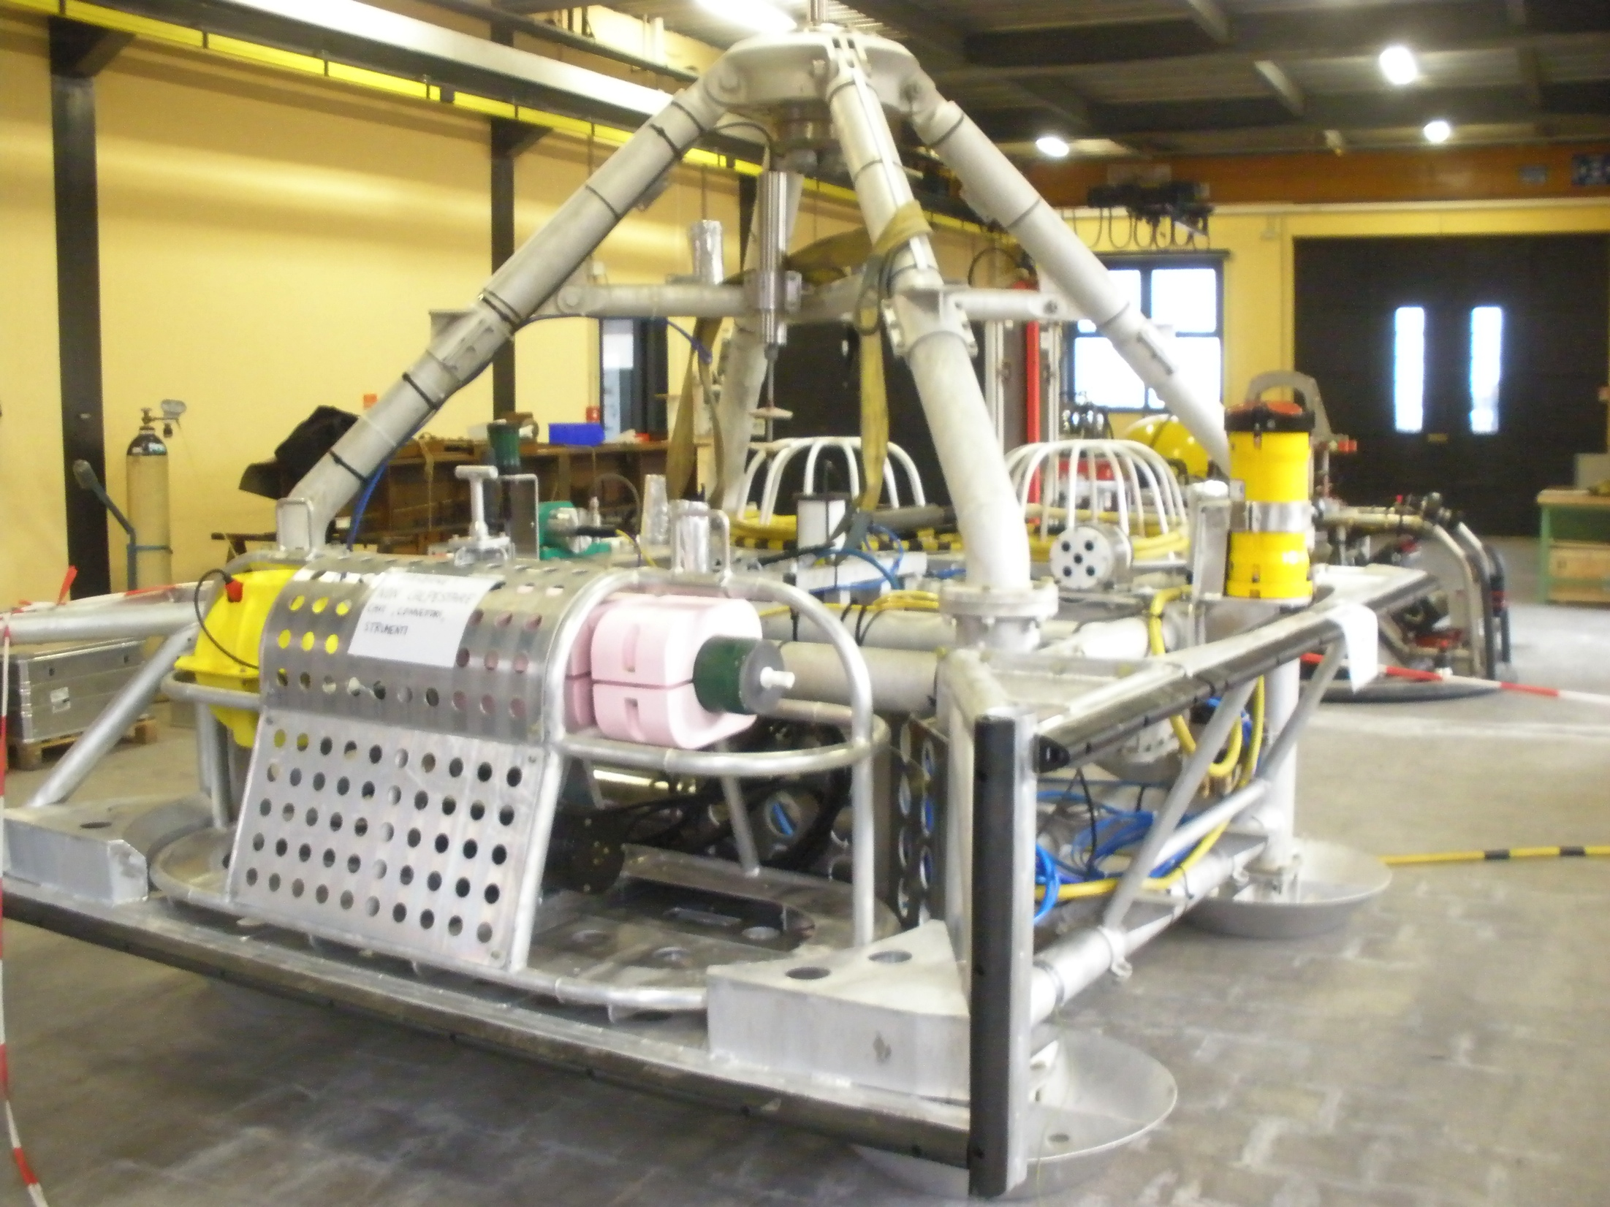
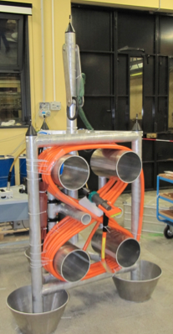
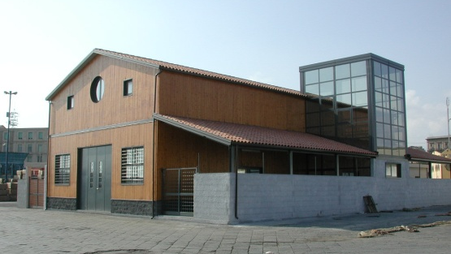
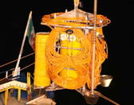


Acoustic detectors at the INFN-LNS Catania Infrastructure
Two observatories with sensors for bioacoustics, ocean monitoring, geohazards re ready for deployment
LNS-INFN Catania
Test Site North
4 hydrophones
CTD
Seismometer
Magnetometers
ADCP
pressure gauge
5 km
Internet Radio Link
20 km
5 km
NEMO JB
LNS Test Site Laboratory
at the port of Catania
4 hydrophones
GPS
time- stamp
Test Site South

Slide 22
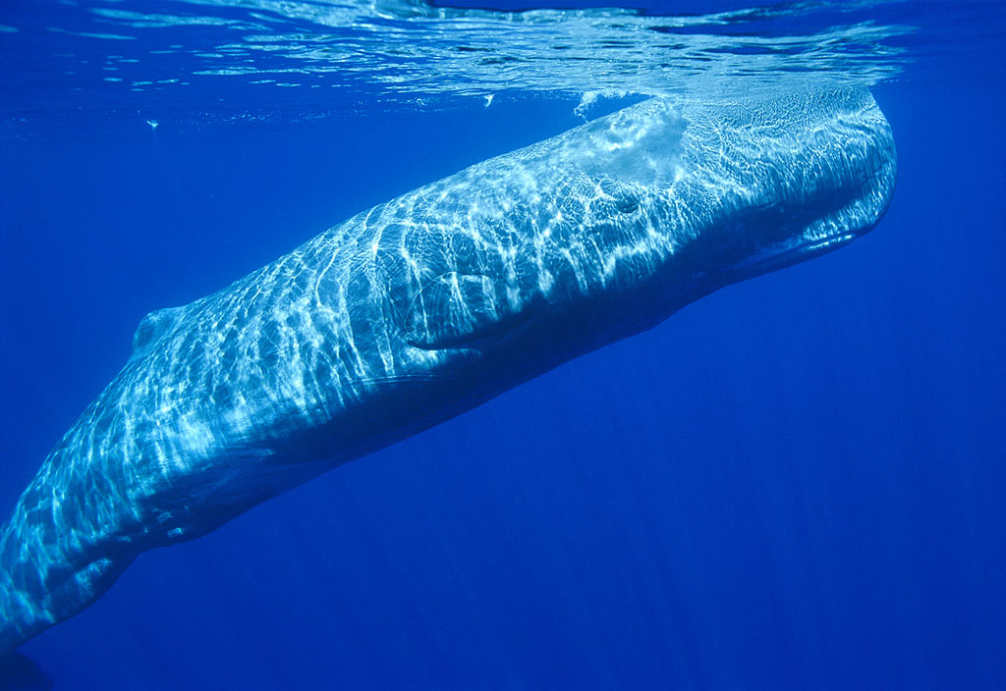
NEMO-OνDE hydrophones the sperm-whales !
Dolphins and sperm-whales’ sounds detected almost daily.
Optimal SNR in deep sea. Optimal sampling frequency and sensitivity.
Very good news from OνDE:
Almost daily detection of
sperm-whales
The major environmental agencies declared that sperm-whales were declining in the area
N. Nosengo, G. Pavan and G. Riccobene, Nature 462 (2009), 560
Estimated population of sperm-whales (units of 1000) from 1700 to 2000

Slide 23





Sperm-whales’ tracking
Sperm-whale click
Wave direction reconstruction through TDoA on 4 hydrophones → source tracking
Limited size of the OνDE detector permits to measure wave source direction in plane wave approximation.
Surface reflection permits determination of source position.

Slide 24





Improved algorithms for tracking sperm-whales
Dive profile
Depth (m)
F. Bénard, H.Glotin and P. Giraudet, Appl. Acoust. 71 (2010), 994
Correct speed ∼ 10 km/h
F. Bénard et al., J. Appl, Aco. 71 (2010), 994
Time (s)
F. Bénard, H. Glotin and P. Giraudet
UMR CNRS LSIS – Univ. du Sud Toulon Var

Slide 25


Improved algorithms for tracking sperm-whales
15th august 2005 15:00, two sperm whales are diving together at -1000 m depth
Demo available at http://glotin.univ-tln.fr
Depth (m)
F. Bénard, H.Glotin and P. Giraudet
UMR CNRS LSIS – Univ. du Sud Toulon Var

Slide 26




Sperm-whales’ click analysis: size of the animals
Measurement of Inter-Pulse-Interval permits to determine of the size of the sperm whale
P1
P2
IPI = head(m) * c_{s} / 2
Head = 3.41 ± 0.05 m → Total length = 9.72÷10.50 m
Young male or female
About 50 animals identified
males
Total Length (m)
females
youngs
P2-P1 (ms)

Slide 27




Sperm-whales’ typical sounds and population
G. Pavan et al., Proc. IE meeting on IT-based detection of bioacoustical patterns (2008), 7
“regular clicks” (3 sperm whales)
Seasonal presence
Hunting, exploration, communication
CIBRA
Sperm-whales’ groups dimensions
coda (1 sperm whale)
communication
“3+1” Mediterranean dialect ? (54%)
“2+1” Atlantic ? (43%)
Most of the detected sperm-whales transit the area of the Gulf of Catania towards or from the Messina Strait.

Slide 28


Noise spectrum correlation with ships and biological sources
September 2005
In the spectral region between 20 and 40 kHz we observe a day-night effect with upto 50% variations.
In this region dolphins give a strong contribution to noise
kHz
dB
Catania-Naples
ferry
Preliminary
00/06
19/23
Independent CIBRA analysis:
Number of dolphins detected during day and night.
Night is the hunting time for dolphins
They emit both echolocalization clicks (>20 kHz) and whistles.
Dolphin detection rate
07/12
13/18

Slide 29








Geo-hazard: towards tsunami early warning systems
- Monitoring of volcanic and seismic activity in Sicily
- Development of Tsunami early warning systems
3-axis broadband seismometer
Low frequency hydrophone
3 axis accelerometer and gyro
Absolute pressure gauge
Differential pressure gauge
Scalar and vectoria magnetometer
Single point 3-axis current meters
Acoustic doppler current profiler
Conductivity, temperature and depth meter
4 large bandwidth hydrophones
SN1 Connection

Slide 30




Acoustic waves: towards tsunami early warning systems
MW=6.6
MW=6.9
MW=6.2
Papua New Guinea (Nov. 7, 2006)
Peloponnesus (Greece, Feb. 14, 2008)
Multiparameteric observatory for early detection of tsunamigenic events:
- Seismic waves
- Magnetic field change
- Low f sound waves
MW=8.6
Tsunamy early warning
Sumatra (March 28, 2005)

Slide 31

Conlcusions
Mediterranean groups have run experimental test towards acoustic neutrino detection
Technological R&D is in advanced state. Deep sea tests will run soon.
Efforts are converging in the framework of KM3NeT: acoustic positioning, neutrino detection tests, Earth and Sea science
Dedicated Acoustic JRA have been submitted within the HEAP-MM request to EU
(thanks to L. Thompson and K. Graf for coordination!)
Strong interaction with EMSO and other multidisciplinary science groups

