Slide 1
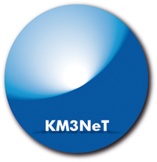
Overview of the KM3NeT project: an underwater multi‐km³ ν detector
M. Spurio
University of Bologna and INFN
RICAP 2011 - Roma, May 26 2011

Slide 2
A brief history of KM3NeT
Objective: design and build a deep-sea research infrastructure in the Mediterranean Sea hosting a multi-km³ neutrino telescope and scientific nodes for long- term, continuous measurements in earth and marine scientific research
KM3NeT consortium consists of 40 European institutes and 10 countries, including those in Antares, Nemo and Nestor.
Started in 2006 with the Design Study project co-funded under the 6th EC Framework Programme (concluded in 2009)
  Technical Design Report http://www.km3net.org/KM3NeT-TDR.pdf
KM3NeT Research Infrastructure was included in the roadmap of the European Strategy Forum of Research Infrastructures (ESFRI)
Preparatory Phase, co-funded under the 7th EC Framework Programme, started in march 2008 and will conclude in february 2012

Slide 3
Physics Case and Main objectives
Origin of Cosmic Rays and Astrophysical ν sources
  Galactic Candidate ν Sources (SNRs, microquasar, Fermi Bubbles,…)
  Extragalactic Candidate ν Sources (AGN, GRB, …)
  Telescope optimisation→ “point sources” energy range 1 TeV-1 PeV
Diffuse neutrino fluxes
Other items: Dark Matter, Neutrino particle physics, Exotics (Magnetic Monopoles, Lorentz invariance violation, …)
Cabled platform for deep-sea research, marine sciences (not covered in the talk)
Implementation requirements
  Construction time ≤5 years
  Operation over at least 10 years without “major maintenance”

Slide 4
The KM3NeT sky view
γ-ray sky
Up-going neutrinos :
100% visibility up to
about δ= -50° in the
Mediterranean Sea
>25%
>75%
KM3NeT observes a large part of the sky (~3.5π)
KM3NeT complements the IceCube field of view

Slide 5
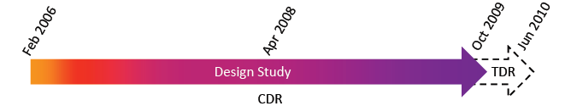
Design Study conclusions: the TDR
Construction is possible with viable technologies: experience gained with ANTARES, NEMO and NESTOR
~300 detection units needed to achieve the required sensitivity
Full KM3NeT can be built in independent “building blocks”
Overall investment ~200-250 M€
Operational costs 4-6 M€ per year including electricity, maintenance, computing, data centre and management
Simulations indicate that local 3D OM arrangement resolve ambiguities in the reconstruction of the azimuthal angle

Slide 6
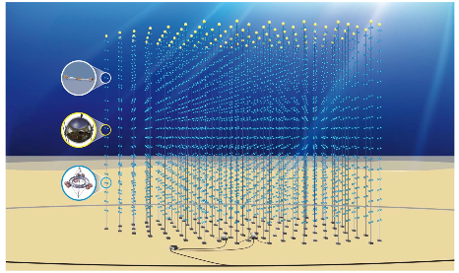
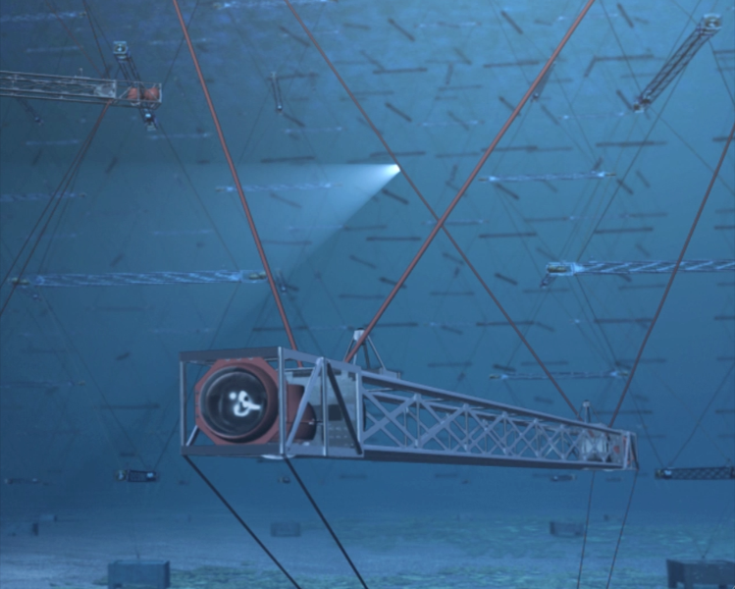
Schematic view of KM3NeT
KM3NeT in numbers
(full detector)
~300 DU
20 storey/DU
~ 40m storey spacing
~1 km DU height
~180m DU distance
~ 5 km³ volume
Detection Units
Primary Junction box
Secondary Junction boxes
Electro-optical cable
Optical Module (OM) = pressure resistant/tight sphere containing PMTs
Detection Unit (DU) = mechanical structure holding OMs, environmental sensors,
electronics,… DU is the building block of the telescope

Slide 7
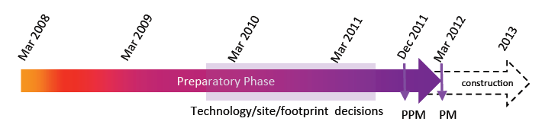
From the Design Study to the Preparatory Phase
After the Design Study the process towards technological convergence and definition of a common solution started with the Preparatory Phase project:
  to facilitate the political convergence process in matters of site selection, legal and governance issues and financial arrangements
  to choose the appropriate legal form and governance model
  to compare the physics performance, technological implications and time-scale issues related to different options for the construction
Now a unique design defined in almost all its aspects
→description of production‐models (PM) preparation

Slide 8
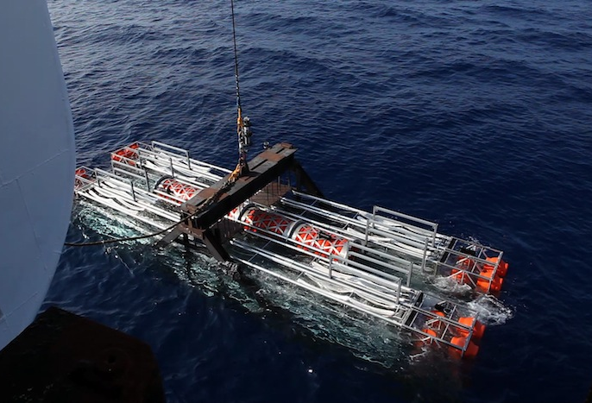
Detection Unit- Flexible Mechanical Tower Prototype and validation
Compact package – deployment – self-unfurling
  Eases logistics (in particular in case of several assembly lines)
  Speeds up and eases deployment;
  Self-unfurling concepts need to be thoroughly tested and verified
Connection to seabed network by Remotely Operated Vehicle (ROV)
The packed flexible tower
Spherical deployment structure for string with multi-PMT OM
Successful deployment test in Feb 2010
Successful deployment test in Dec 2009

Slide 9
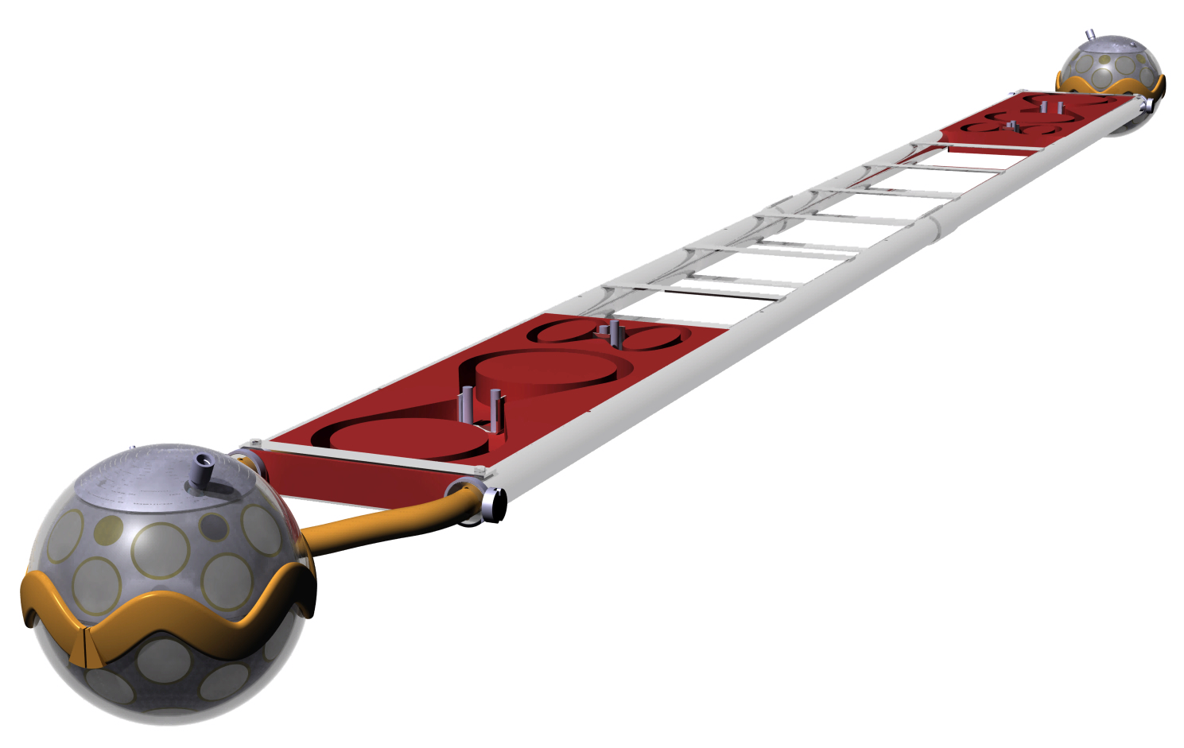
DOMBAR Prototype–Storey -
  DOMTOWER: 20 storey (DOMBAR), 40 m spacing
  DOMBAR 6 m long with 2 multi-PMT OM (DOM)
Bar Frame
Rope Storage
Rope & Cable Storage
Mechanical Cable Connection
Optical Module
6 m
Mechanical Interface

Slide 10

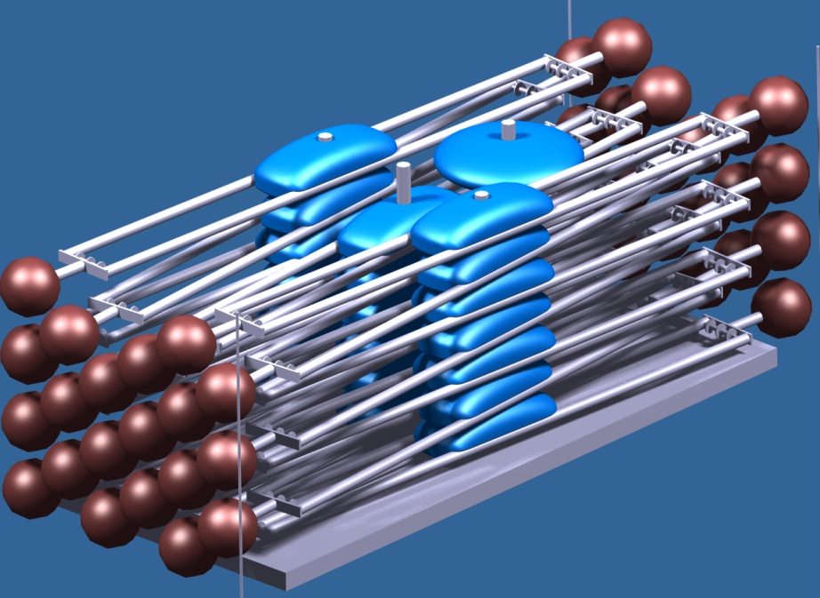


DOMTOWER - Prototype– Packaging -
Storey
6 m long
Very compact packaging →integration in several production sites and transport on trucks, “easy” to be deployed
DU
Backbone
20 storeys @ 40 m
Anchor

Slide 11
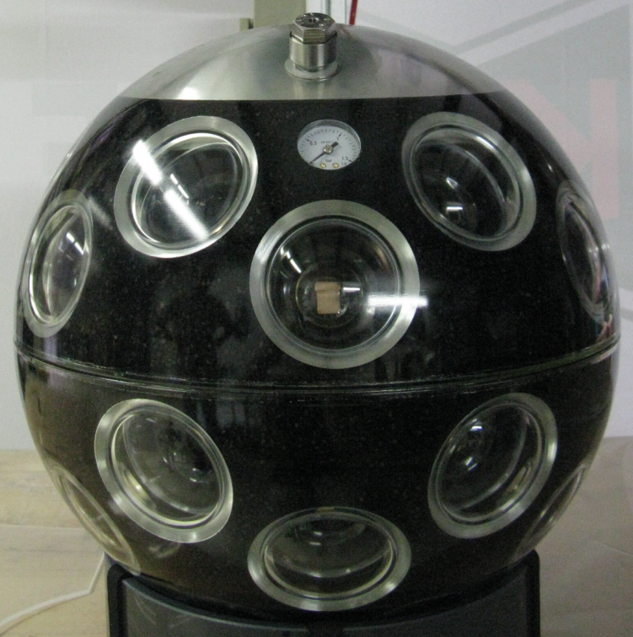
OpticalModule - Multi-PMT
31 x 3” PMTs inside a 17” glass sphere with 31 bases (total ~140 mW)
First full prototype under test
Single vs multi-photon hit separation
  Multi-PMT Optical Module
    PRO→ Single vs multi-photon hit separation, better background rejection
    Larger photocatode area per OM
    Test plan for validation of technology ongoing
  Deployment of first DU prototype planned beginning 2012
11

Slide 12
Data Network and data transmission
“All data to shore” concept (no trigger undersea)
Data transport on optical fibers (data, slow control)
  Optical point-to-point connection to shore
  DWDM technique → minimize numbers of fibers
Structure
  Hierarchical topology
  Primary and Secondary Junction Boxes
  Commercial electro-optical data cables and connectors
  Intallation with ROV
Star-like geometry for 127 DU
1 detector “building block”

Slide 13
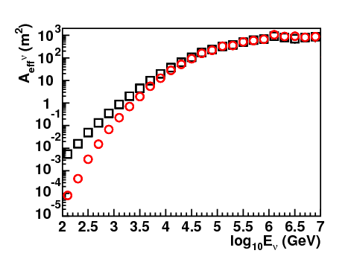
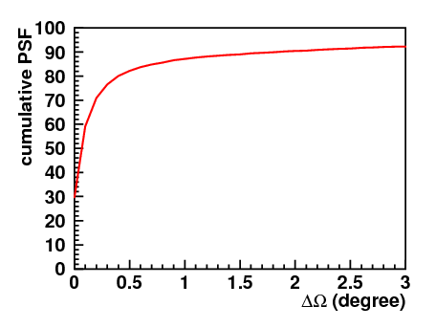
KM3NeT performance
Results for “full detector” i.e. 310 DU (154x2 blocks), each DU made of 20 storeys
Total budget about 220M€
Up-going neutrinos
Quality Cuts applied (median 0.2°@30TeV)
Quality Cuts optimized for
Point-like sensitivity E⁻²
ΔΩ_{ν−μrec}
μ
θ _{ν−μ}
ν

Slide 14
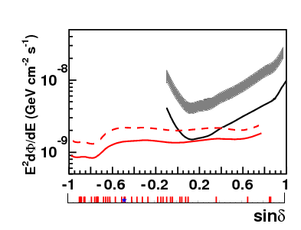
Sensitivity and discovery potential
Sensitivity and discovery fluxes for point like sources with E⁻² spectrum for 1 year of observation time
KM3NeT sensitivity 90%CL
KM3NeT discovery 5σ 50%
IceCube sensitivity 90%CL
IceCube discovery 5σ 50% 2.5÷3.5 above sensitivity flux. (extrapolation from IceCube 40 string)
unbinned method
binned method
| = Observed Galactic TeV-g sources (SNR, unidentified, microquazars)
F. Aharonian et al. Rep. Prog. Phys. (2008)
Abdo et al., MILAGRO, Astrophys. J. 658 L33-L36 (2007)
★ Galactic Centre
Sensitivity and discovery potential will improve with unbinned analysis

Slide 15
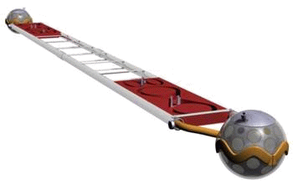
What after the Preparatory Phase?
Following the convergence on the technology for the detection unit the collaboration is presently strongly engaged in the construction of a pre-production model of the detection unit
One mechanically complete DU with some active OMs and related electronics
Need for an organizational structure to manage the post-PP phase
A Memorandum of Understanding (MoU) is in preparation
MoU must be a step further in the collaboration building process and not just a way to continue R&D activities

Slide 16
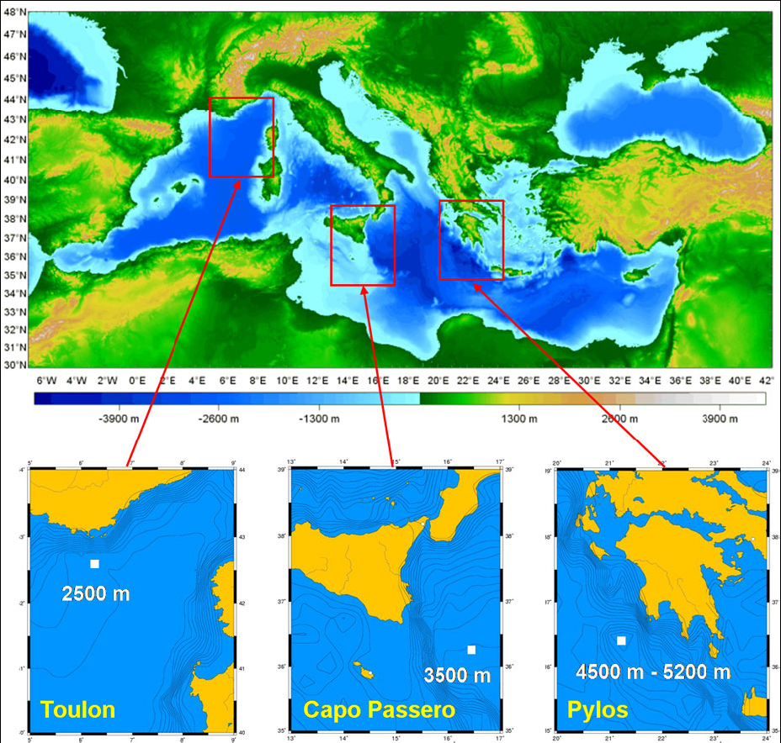
Candidate sites
Three candidate sites
  Toulon (France)
  Capo Passero (Italy)
  Pylos (Greece)
Long-term site characterization measurements performed
Site decision requires scientific, technological and political input
Connection with funding opportunities

Slide 17
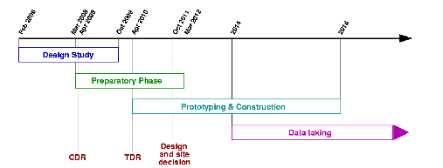
Project Timeline
Construction Phase can start in 2012 depending on funding…

Slide 18
Conclusions
KM3NeT will cover most of ν sky with unprecedented sensitivity → Promising Galactic Candidate ν Sources
KM3NeT-Preparatory Phase ongoing →Final design and prototyping activities in progress
The essential stage with the definition of the technology reached
Major impact also on the deep-sea sciences
  Technological solutions developed by KM3NeT provide a unique opportunity for deep-sea sciences allowing long-term, realtime data taking.
  Collaboration with INGV, IFREMER and HCMR already active at the Catania, Toulon and Pylos sites respectively
MOU after KM3NeT-Preparatory Phase with Prototype Implementation Experiment program

Slide 19
Spares

Slide 20
The KM3NeT Technical Design Report
Technical design
Objective: Support 3D-array of photodetectors and
connect them to shore (data, power, slow control)
  Optical Modules
  Front-end electronics & readout
  Readout, data acquisition, data transport
  Mechanical structures, backbone cable
  General deployment strategy
  Sea-bed network: cables, junction boxes
  Calibration devices
  Shore infrastructure
  Assembly, transport, logistics
  Risk analysis and quality control
Design rationale:
Cost-effective
Reliable
Producible
Easy to deploy
Builds on the experience gained with ANTARES, NEMO and NESTOR
Described in the KM3NeT Technical Design Report
http://www.km3net.org/KM3NeT-TDR.pdf

Slide 21
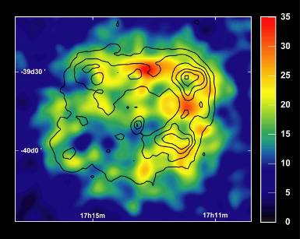
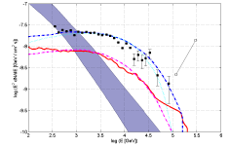
Galactic Candidate ν Sources – SNRs -
Origin of CosmicRays => SNR paradigm, hints from VHE γ but no conclusive evidence about CR acceleration RXJ1713-39.43 and Vela JR best candidates
RXJ1713-39.43
IF hadronic mechanisms =>ν spectrum can be calculated from VHE γ spectrum (solid red line Vissani)
Observation at 5σ within about 5ys with KM3NeT
Hess RXJ1713-39.43

Slide 22
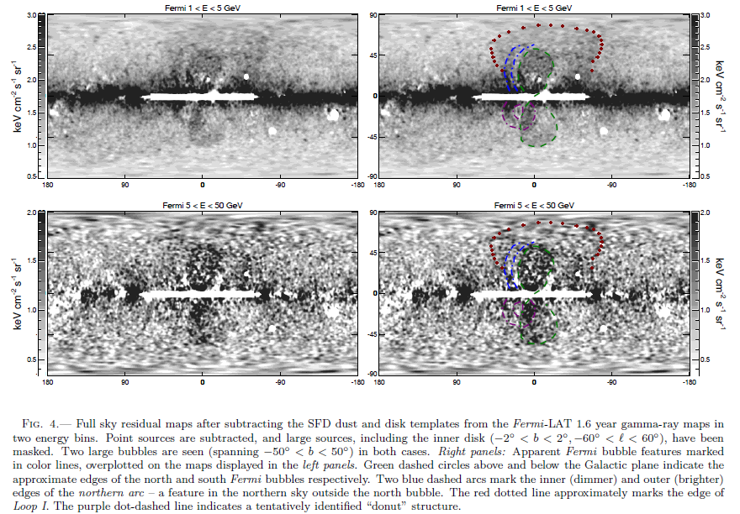
Fermi LAT Observation – Fermi Bubbles -
From Meng Su, Tracy R. Slatyer, Douglas P. Finkbeiner Astrophys.J.724:1044-1082,2010
Large extension (50°lat. 40° long.)
no spatial variation in the γ spectrum

Slide 23
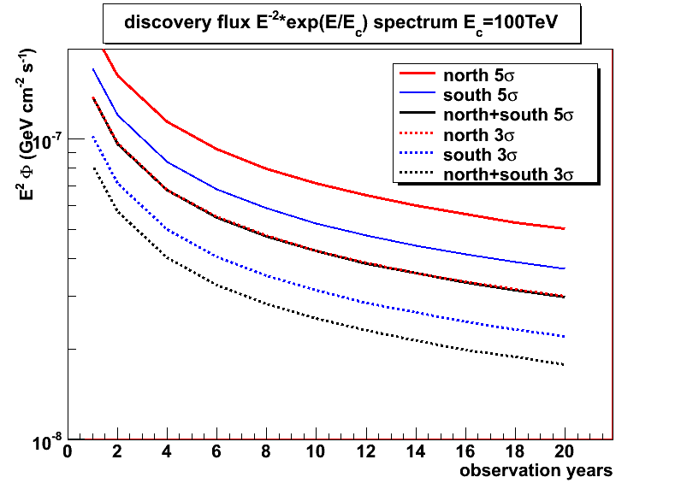
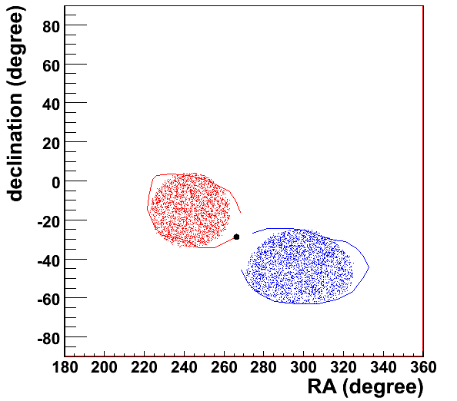
Fermi Bubbles Discovery potential Preliminary calculations (154 DU)
“… extended TeV γ radiation surrounding the Galactic nucleus on similar size scales to the bubbles up to φ = E⁻²F_{γ}(TeV) ~10⁻⁹TeV cm⁻¹ s⁻¹ sr⁻¹...” M. Crocker and F. Haronian PRL106(2011)11102
“back envelope” estimate of ν flux if γ=2 proton spectrum and 1 PeV cut-off assumed

Slide 24
Funding opportunities
Funding is presently the major problem
The issue is followed by the ASC
Some funds for KM3NeT have been allocated in France (15 M€ with a possibility of other 8 M€) and The Netherlands (8.8 M€)
Some funds may also come from other countries: Romania (2.5 M€), Spain (1 M€)
Major funding may come from EU structural funds
  An action to access these funds is under way in Italy for a total of approximately 45 M€
  50 M€ allocated in Greece
These structural funds are “site”-linked

