Slide 1
Astrophysical neutrino results
--overview and comments
(Neutrino telescope session tomorrow includes
IceCube, Antares, Baikal-GVD, KM3NeT)

Slide 2
Outline
Motivation and history (since 1960)
Effective area and event reconstruction
Atmospheric neutrinos
New limits on astrophysical neutrinos
Implications for models of sources
Search for cosmogenic neutrinos
Status and future

Slide 3
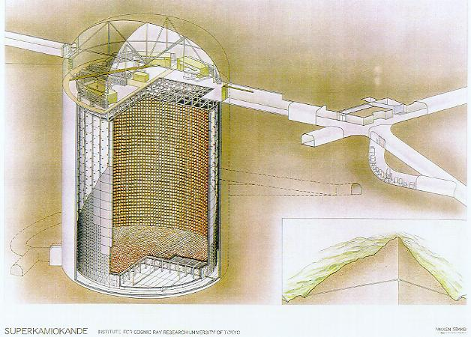
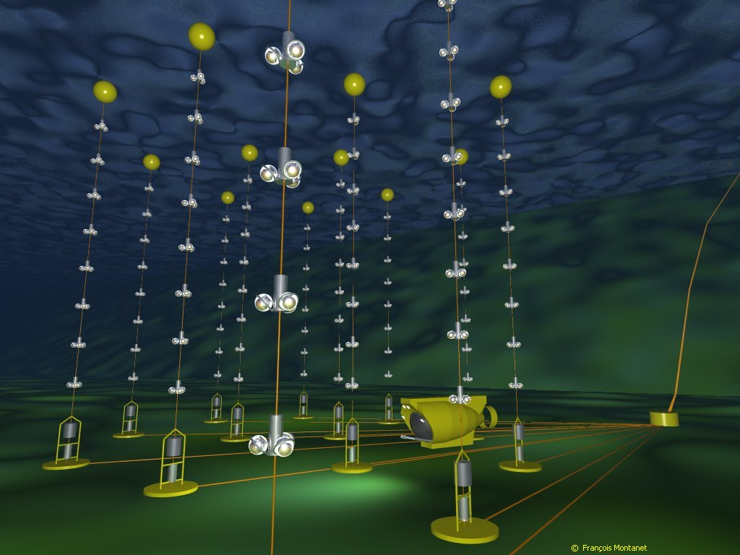
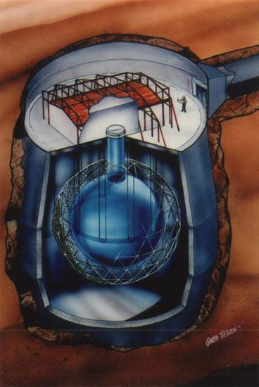
Detecting neutrinos in H₂0
Proposed by Greisen, Reines, Markov in 1960
Heritage:
DUMAND
IMB
Kamiokande
Baikal
AMANDA
IceTop
Super-K
AMANDA
SNO
ANTARES
IceCube in 2008-09
with 40 strings &
40 IceTop stations
All use Cherenkov light from charged products of ν interactions

Slide 4
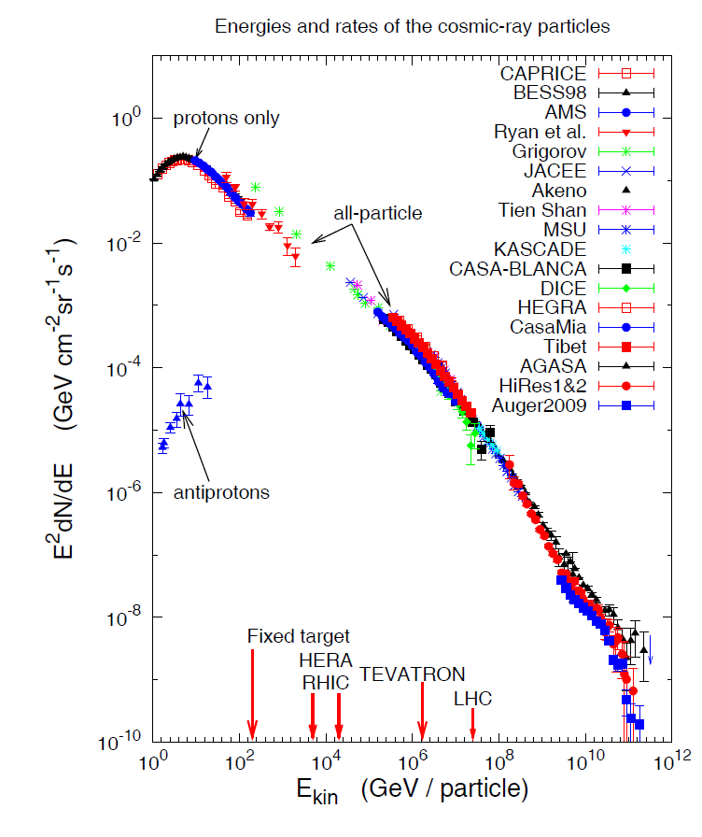
Cosmic-ray connection
Galactic SNR can accelerate particles into nearby molecular clouds
Extra-galactic jets (in AGN or GRB) may share power between c.r. & ν
Expect a few TeV ν/yr in a gigaton detector in hadronic scenarios
Sets km³ scale for HE neutrino astronomy
Galactic
Extra-Galactic

Slide 5
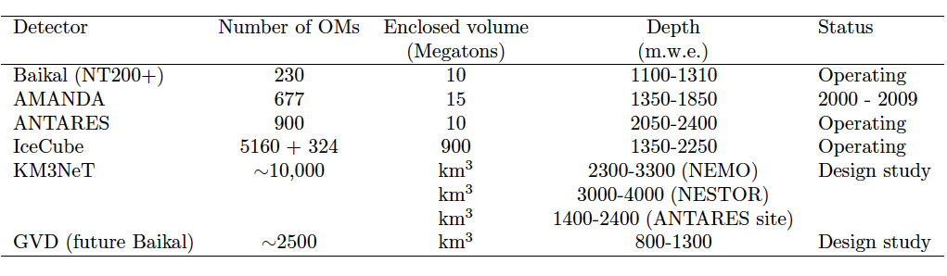
High-energy Neutrino telescopes
Large volume--coarse instrumentation--high energy (> TeV)
as compared to Super-K with 40% photo-cathode over 0.05 Mton
= 4 x 10⁵ cm² / kT compared to 50 for Antares & 2 for IceCube

Slide 6
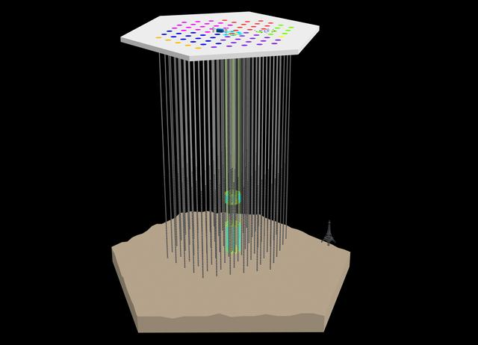
IceTop
81 stations, 324 DOMs
2004-05 1 1
2005-06 8 9
2006-07 13 22
2007-08 18 40
2008-09 19 59
2009-10 20 79
2010 11 7 86
DeepCore
8 strings
IceCube
86 strings, 5160 DOMS
IceCube construction complete !

Slide 7
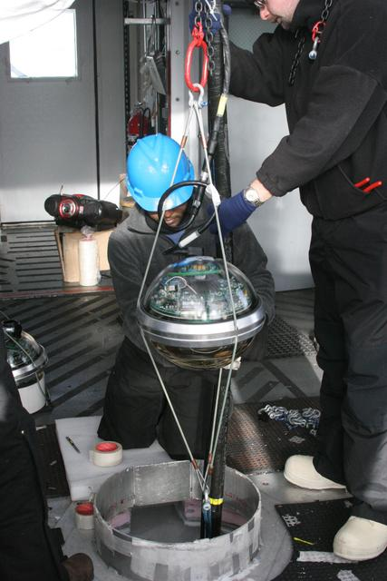
IceCube Digital Optical Module and deployment
LED Flasher board
HV board
Main board for digitizing & time stamping

Slide 8
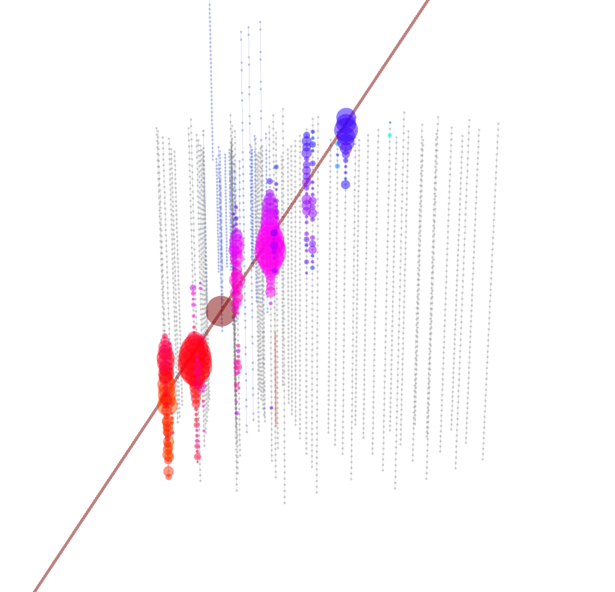
High-energy events in IceCube-40
~ EeV air shower
~100 TeV ν_{μ} induced muon

Slide 9
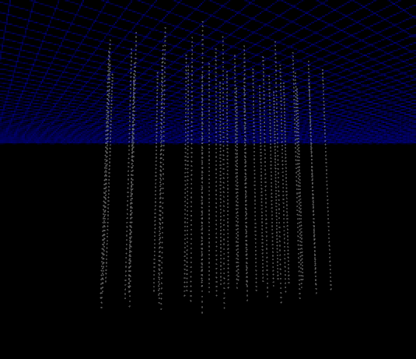
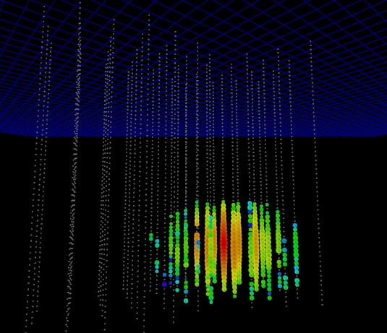
More events
A cascade event, candidate for
a high energy ν_{e} ~50 TeV

Slide 10
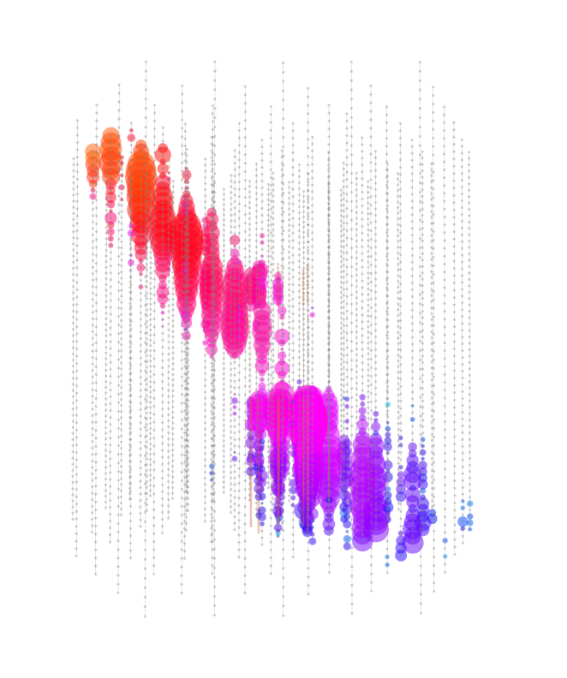
IC-79 events illuminate deep core
~100 PeV primary cosmic ray
~ 300 muons in deep IceCube
IceCube Deep Core talk by Ty DeYoung in afternoon session

Slide 11
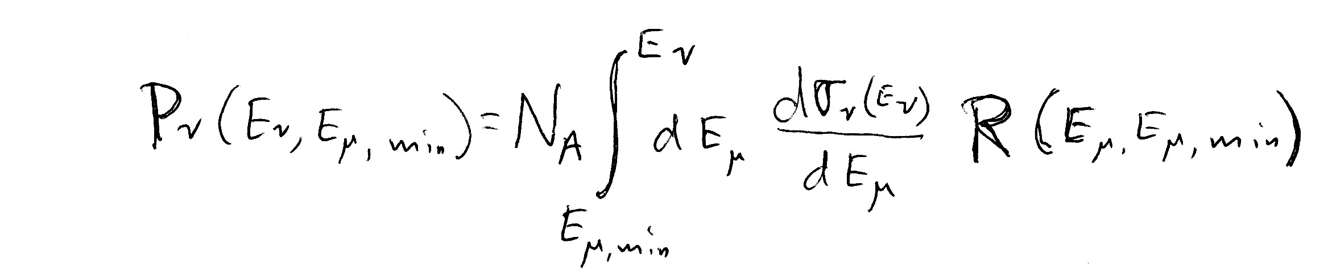
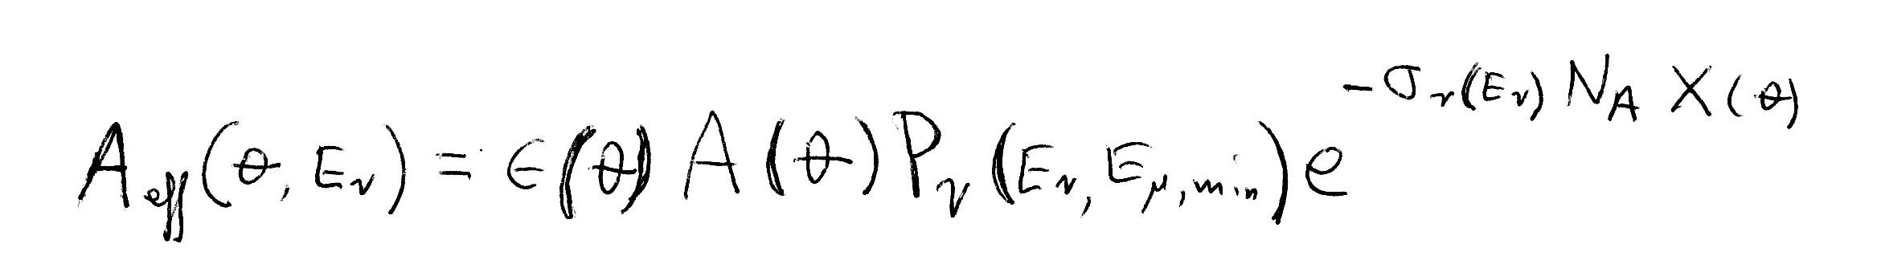
Detecting neutrinos
Rate = Neutrino flux
  x Absorption in Earth
  x Neutrino cross section
  x Size of detector
  x Range of muon (for ν_{μ})
Range favors ν_{μ}
  ~4 to 15 km.w.e. for
  E_{ν} ~ 10 to 1000 TeV
For threshold
E_{μ} > 1 TeV
Probability to detect ν_{μ}-induced μ

Slide 12
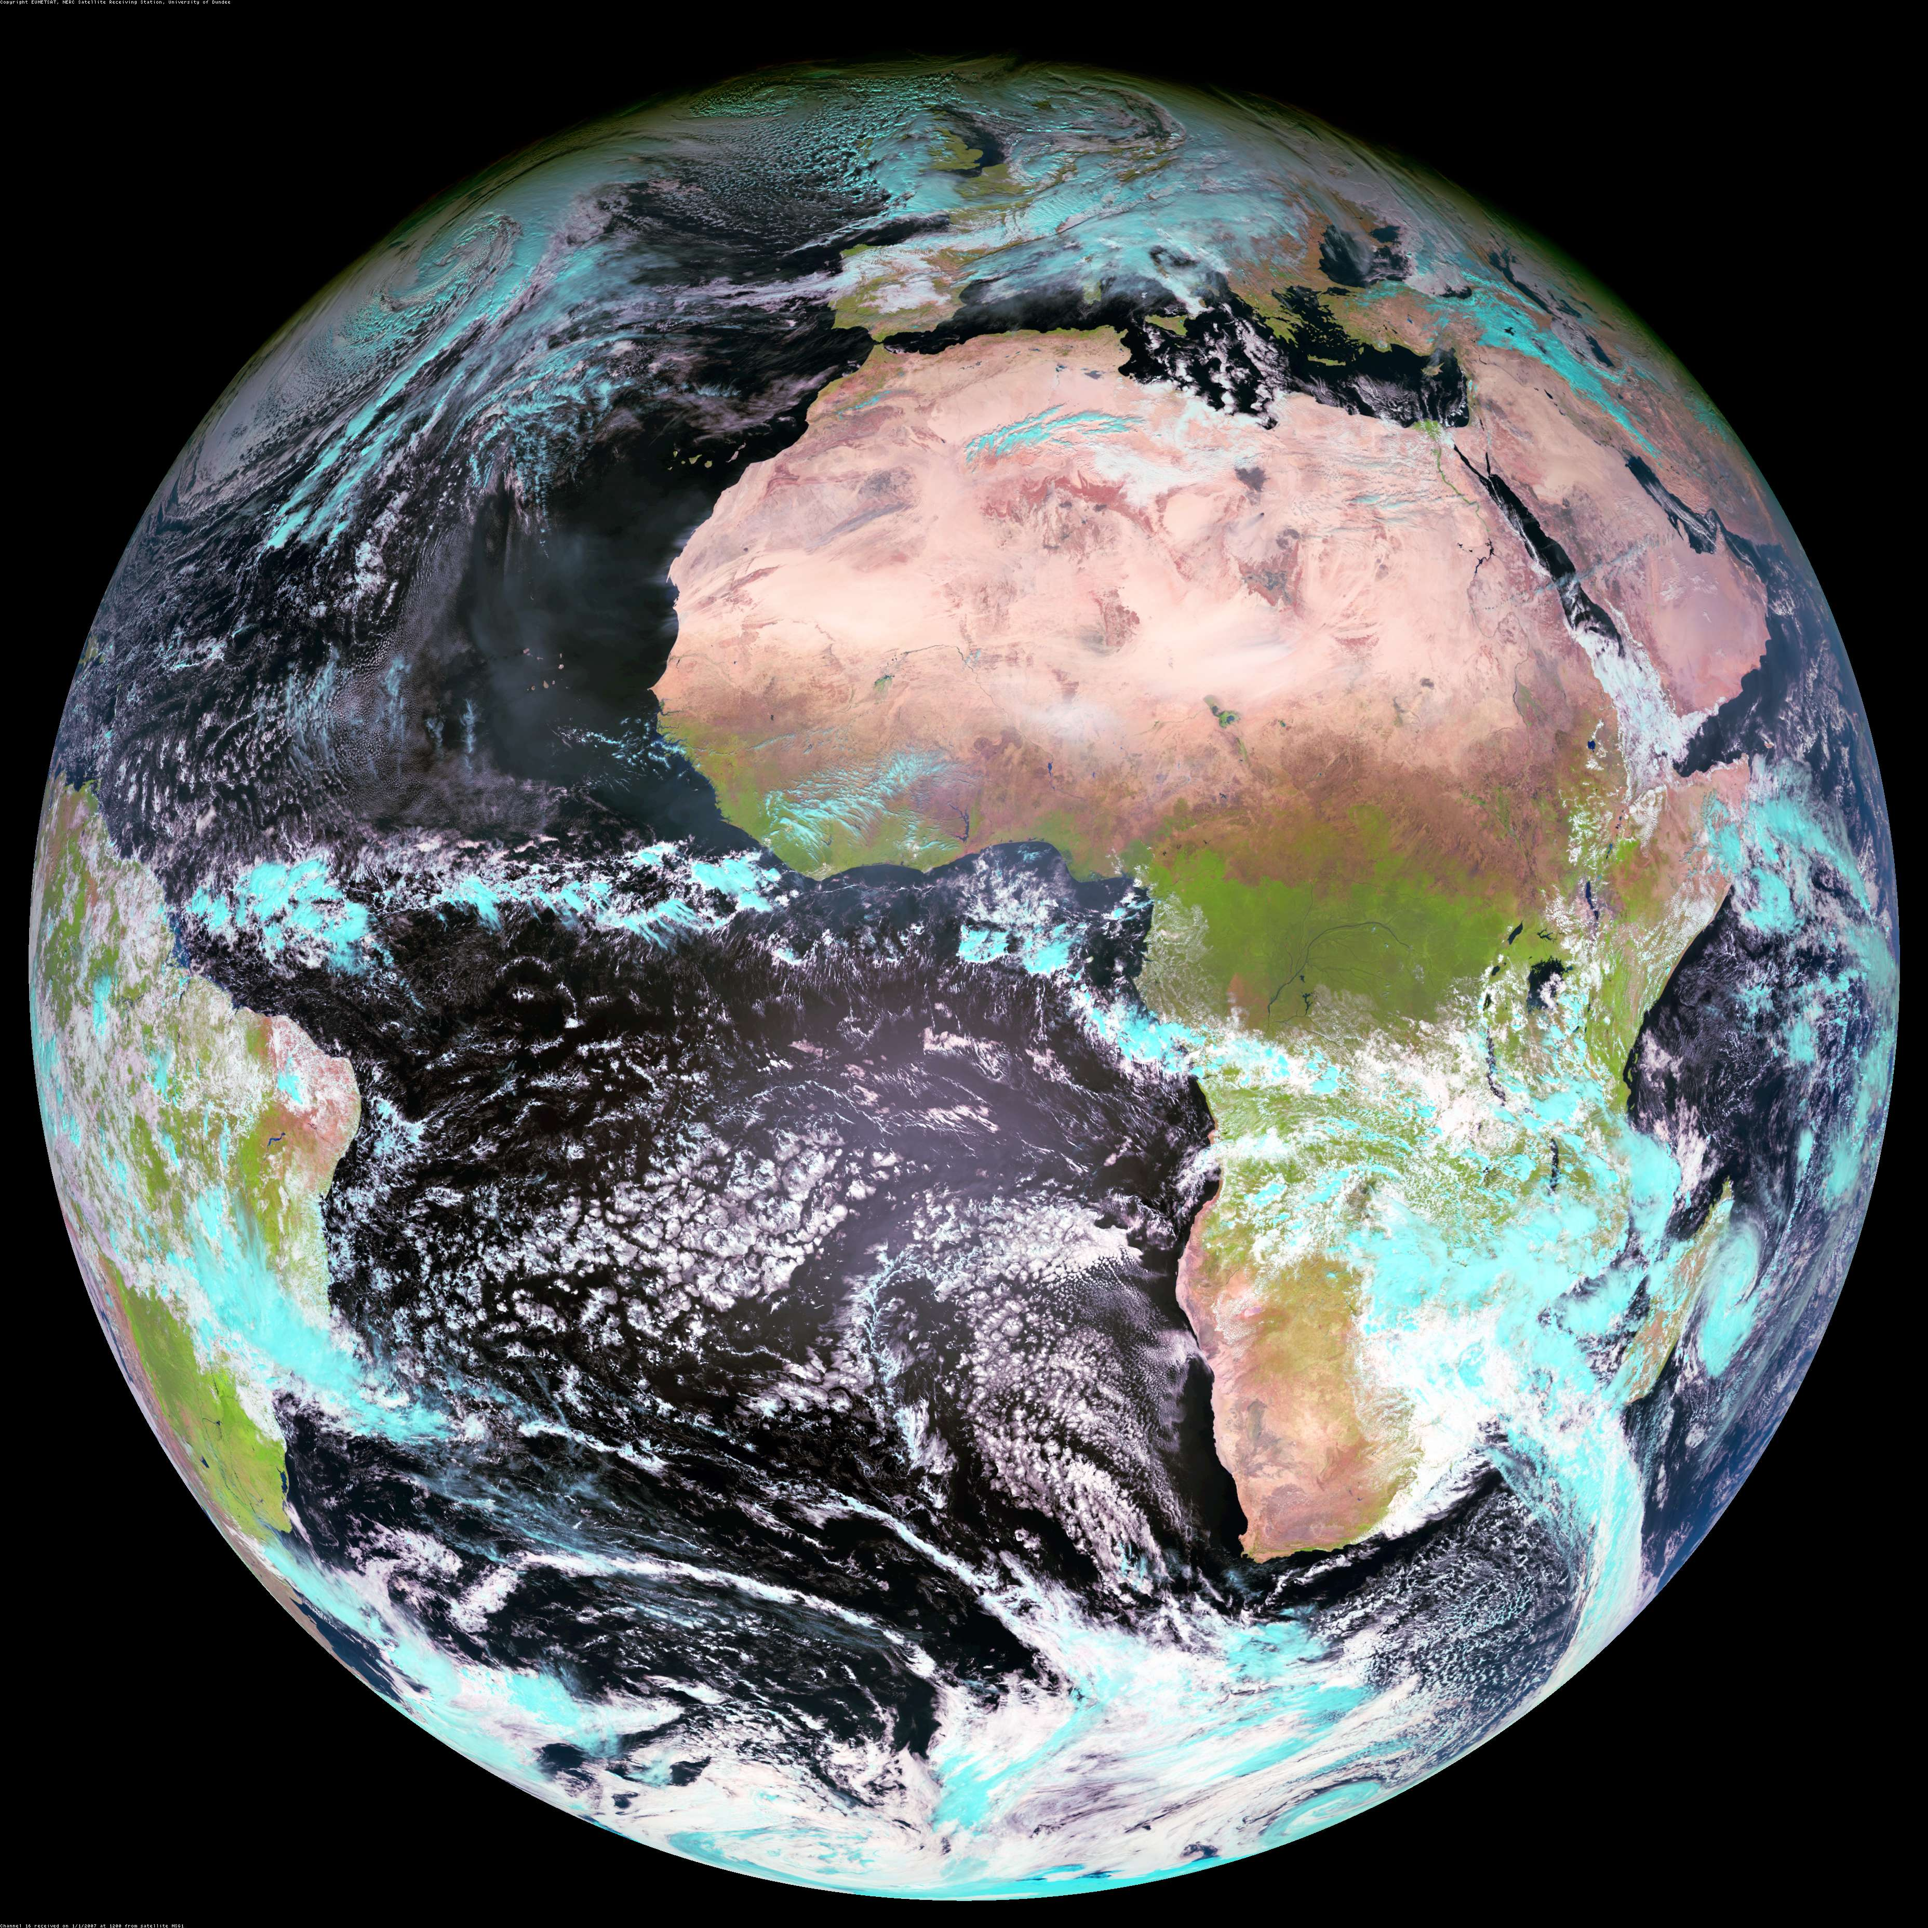
Atmospheric ν in IceCube
S.P.
Zone 1, l: -30 to -90 ; 3.14 sr
Zenith: 90 < θ < 120º
(40% of Zone 1 is over the
Antarctic continent)
Zone 2, l: -30 to +30; 2.30 sr
Zenith 120 < θ < 150º
Note: 43% of Zone 1 is in declination -65º < δ < -90º --over Antarctica. Contains
~25% of IceCube ν_{μ}.
Seasonal temperature like
South Pole: δT ~ ± 7.5%,
α_{T} ~ 0.54 → δRate ~ ± 4%
Zone 3, l: +30 to +90, 0.84 sr
Zenith: 150 < θ < 180º
Cosmic ray produces ν in atmosphere that puts a muon into the detector

Slide 13
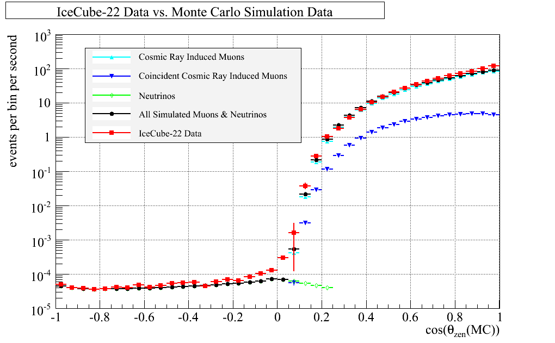
Cuts and event reconstruction
40-string IceCube:
  375 days livetime in 08/09 @ 1 kHz =3.3x10¹⁰ triggers, 99.9999% muons
  8 x 10⁸ filtered & sent over satellite from S.P.
  Quality cuts applied to get ~14,000 upward ν_{μ} induced muons
Upward
ν_{μ} → μ
Downward atmos. μ
All-sky plot of muons in IceCube-22 from 2007 (P. Berghaus, IceCube, ISVHECRI-2008 arxiv.org/abs/0902.0021)

Slide 14
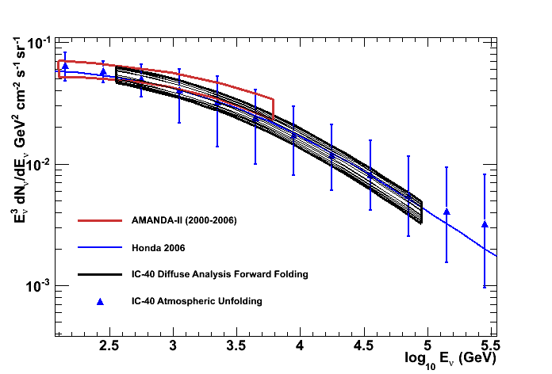
Atmospheric ν_{μ} with IceCube-40
Two analyses:
Unfolding
Forward folding as a by-product of a search for diffuse astrophysical ν
Look in detail at 2
Phys. Rev. D 79, 102005 (2009)
arXiv:1104.5187
PHYSICAL REVIEW D 83, 012001 (2011)

Slide 15
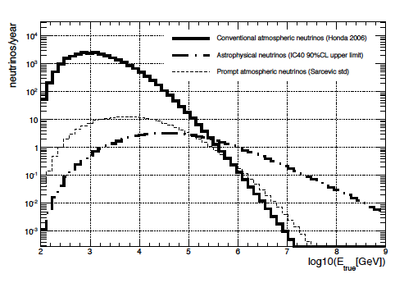
Measurement of ν_{μ}-induced μ
Fit 3 components:
  Atmospheric ν from K± and π± (0.3 – 85 TeV)
    Use Honda 2007 to 10 TeV
    + power-law extrapolation
    ~ cos⁻¹ (θ)
  Prompt ν ( 10 – 600 TeV )
    Harder spectrum to > 10⁷ GeV (~E^{-2.7}), isotropic
  Astrophysical ν
    Isotropic, with E⁻² spectrum assumed (35 – 7000 TeV)
  Note different response for astro. ν vs atmos. ν
π and K-decay
Astrophysical
Prompt
Neutrino energy at production
Measured dE/dX

Slide 16
Results of likelihood fit
IceCube preliminary
Consistent with only K, π atmospheric ν to 100 TeV
Charm component not yet seen; “intrinsic” charm in doubt?
No astrophysical neutrinos seen yet

Slide 17
IceCube ν_{μ}: measurements & limits
Waxman
-Bahcall Limit
IceCube 40
arXiv:1104.5187
Plot: Sean Grullon, UW

Slide 18
Comments on diffuse ν results
Input to analysis
  Specific spectrum assumed for atmospheric ν from decay of π and K (Honda et al., PR D75:043006,2007)
    Extrapolate with power law for E_{ν} > 10 TeV up to 10 PeV
  For prompt ν use Enberg et al.. PR D 78, 043005, 2008
  Overall normalization fitted for each component with a single fitted slope for both components
Limitations of this analysis
  Limits depend on simple power-law extension of conventional atmospheric ν_{μ} to E_{ν} > PeV
  Neutrino spectrum must steepen to some extent above 100 TeV to reflect the knee in the primary spectrum
  Bounds on prompt and astrophysical ν will be relaxed to some extent with a more realistic assumption for shape of atmospheric ν
  Recent calculation extends calculation of ν_{μ} to > PeV
    Illana, Lipari, Masip, Meloni, Astropart. Phys. 34 (2011) 663

Slide 19
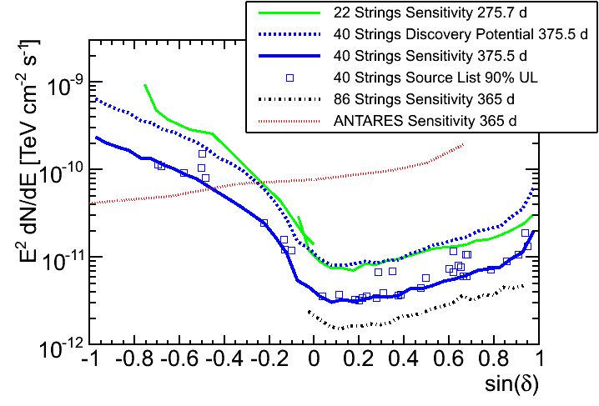
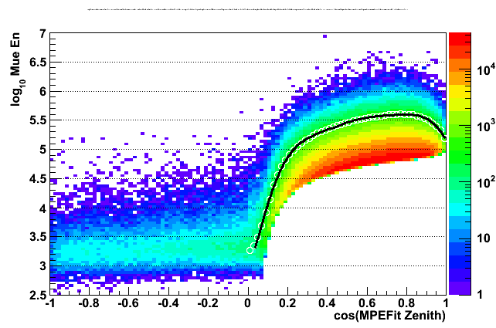
Limits from point src searches
IceCube 40, Ap.J. 732 (2011) 18
For IceCube-59
add IceTop veto
preliminary
MGRO J1908+06
Note: IceCube energy threshold is set very high for Southern sources
to reduce background of atmospheric muons. Antares is complementary.

Slide 20
in Galactic coordinates (Gisela Anton, ν-2010)
Northern detector has more
Galactic sources in F.O.V.

Slide 21
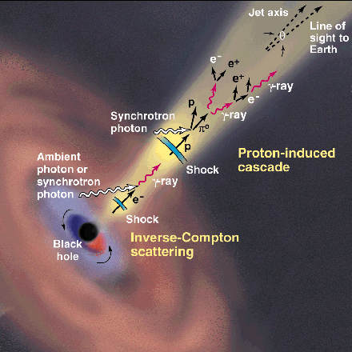
Generic model I
CR acceleration occurs in jets
  AGN or GRB
Abundant target material
  Most models assume photo-production:
    p + γ → Δ⁺ → p + π⁰ → p + γ γ
    p + γ → Δ⁺ → n + π⁺ → n + μ + ν
Ideal case ( ~ “Waxman-Bahcall limit”)
  Strong magnetic fields retain protons in jets
  Neutrons escape, decay to protons & become UHECR
  Extra-galactic cosmic rays observed as protons
  Energy content in neutrinos ≈ energy in UHECR
This picture disfavored as limits go below W-B
http://www.ucd.ie/math-phy
/rieger/science.gif
Waxman, Bahcall, PRD 59,
023002 (1998). Also
TKG astro-ph/9707283v1

Slide 22
Generic model II
UHECR are accelerated in external shocks analogous to SNR
  See E.G. Berezhko, 0809.0734 & 0905.4785
  mixed composition (accelerate whatever is there)
  Low density of target material
  → lower level of neutrino production
Diagram from A.Ferrari, Ann Revs A&A 36 (1998) 539

Slide 23
Primary spectrum
& composition: expectations for
> 100 TeV ν
All-particle spectrum modeled with 3 populations & 5 groups of nuclei
Mixed composition
→ Fewer ν
Extra-galactic = p
→ More ν

Slide 24
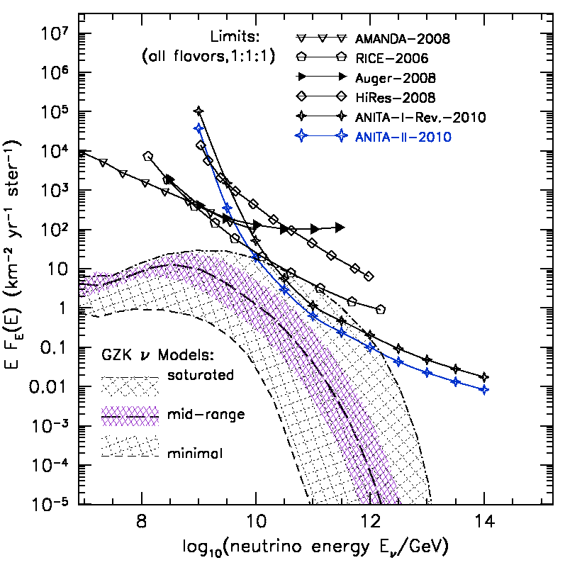
Cosmogenic (GZK) neutrinos
Cosmogenic ν from
Intensity depends on
  Spectrum at sources
  Evolution of sources
  Composition of UHECR (Heavy nuclei give less ν)
Third flight of ANITA
  Optimized for UHECR as well as GZK ν, 2011/12 ?
ANITA
arXiv:1011.5004

Slide 25
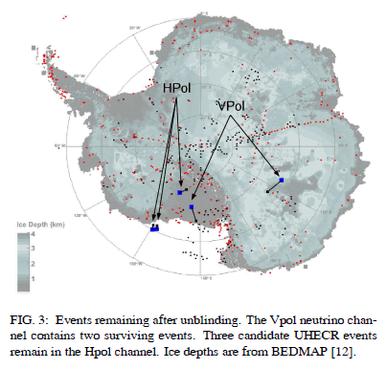
Radio Detection of neutrinos
ANITA-II over Antarctica
Vpol:1 neutrino candidate;
HPol:3 > 10¹⁹ eV cosmics
http://arxiv.org/abs/1003.2961

Slide 26
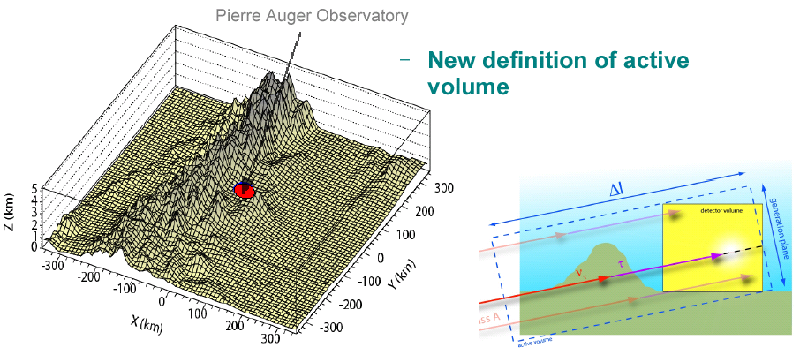
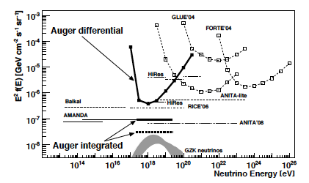
EeV ν_{τ} detection with Auger et al.
PRD 79 (2009) 102001
D. Gora
<~ 1 GZK ν_{τ} / year in Auger
Γcτ ~ 100 km for E_{τ} ~ 2 x 10¹⁸ eV followed by τ-decay shower
T. Weiler, D. Fargion

Slide 27
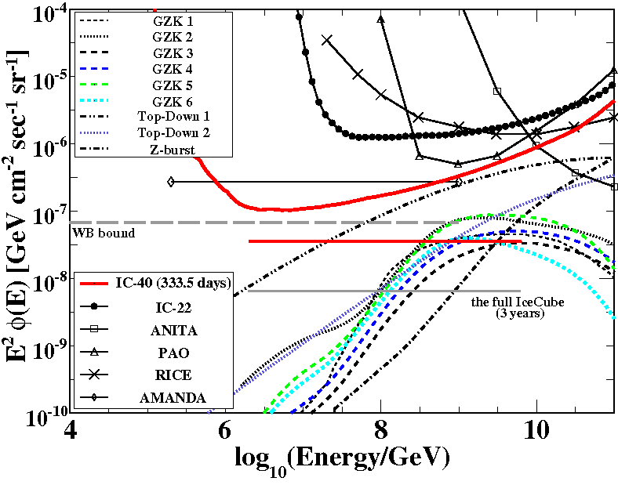
IceCube limits on cosmogenic ν
GZK search looks for
  Very bright events
  Near the horizon
  with compact initial burst of light
Range of sensitivity
  PeV – EeV
  Complementary to diffuse ν_{μ} search that starts by measuring atmospheric ν_{μ}
  Model 6 (Fermi max): expect 0.4 events
IceCube-40 arXiv:1103.4250
All-flavor limits assuming ν_{μ} ~ ν_{τ} ~ ν_{e}

Slide 28
Related science with IceCube
Cosmic-ray physics
  Composition/spectrum with IceCube/IceTop
  Cosmic-ray anisotropy with 5 x 10¹⁰ μ/yr (arXiv:1005.2960 Ap. J. Letters in press)
Monitoring stream
  Galactic SN ν will manifest as sharp increase in background counting rate of 5000 DOMs
  Detect solar particle events as increase in IceTop DOM rates (2008 ApJ 689 L65 )
Neutrino alerts to optical follow-up (ROTSE, et al.)

Slide 29
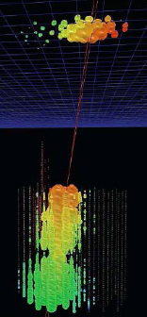
Cosmic-ray physics with IceCube
IceCube sees cosmic ray events from all directions
  30,000 atmospheric ν/year
  100 billion atmospheric μ/year
  1 billion air showers/yr in IceTop
  ~10% in coincidence with deep IceCube
Spectrum/composition:
  TeV to EeV

Slide 30
Status
Atmos. ν spectrum extended to 100 TeV
  Models with intrinsic charm (e.g. RQPM) disfavored
  New analysis underway with bigger detector
    Will use more realistic shape for atmospheric ν
    Will look at angular dependence to discriminate prompt ν
Limit on an isotropic contribution of high-energy neutrinos are testing the W-B “bound”
  Models with energy parity between UHECR and neutrinos are disfavored (e.g. Ahlers et al., PR D79, 083009, 2009)
  Or IceCube should see the signal soon!
No point sources yet with 0.5 km³yr data

Slide 31
Future projects at South Pole
Acceptance and sensitivity of IceCube will increase rapidly as new analyses use full detector
Larger acceptance needed to measure cosmogenic (GZK) neutrinos in EeV range
ARA (Askaryan Radio Array) for higher energy
  First test deployment next to IceCube in January, 2011
  Aims for greater sensitivity than ANITA
Beyond Deep Core for lower energy (~GeV)
  Proposed expansion of present Deep Core
  Talk by Ty DeYoung, May 25 afternoon session
Dark Matter Ice – two pilot scintillators deployed at 2500 m in IceCube holes in December, 2010
  Seasonal variation of background opposite to DAMA,
  Seasonal vatriation of DM signal universal

Slide 32
DM-Ice

Slide 33
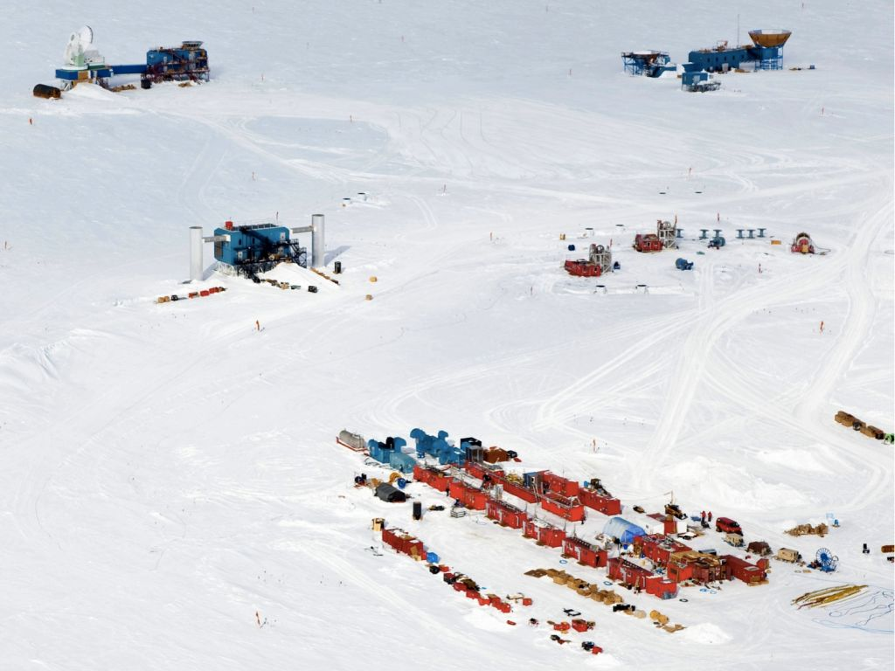
IceCube drill in action
December, 2010

Slide 34
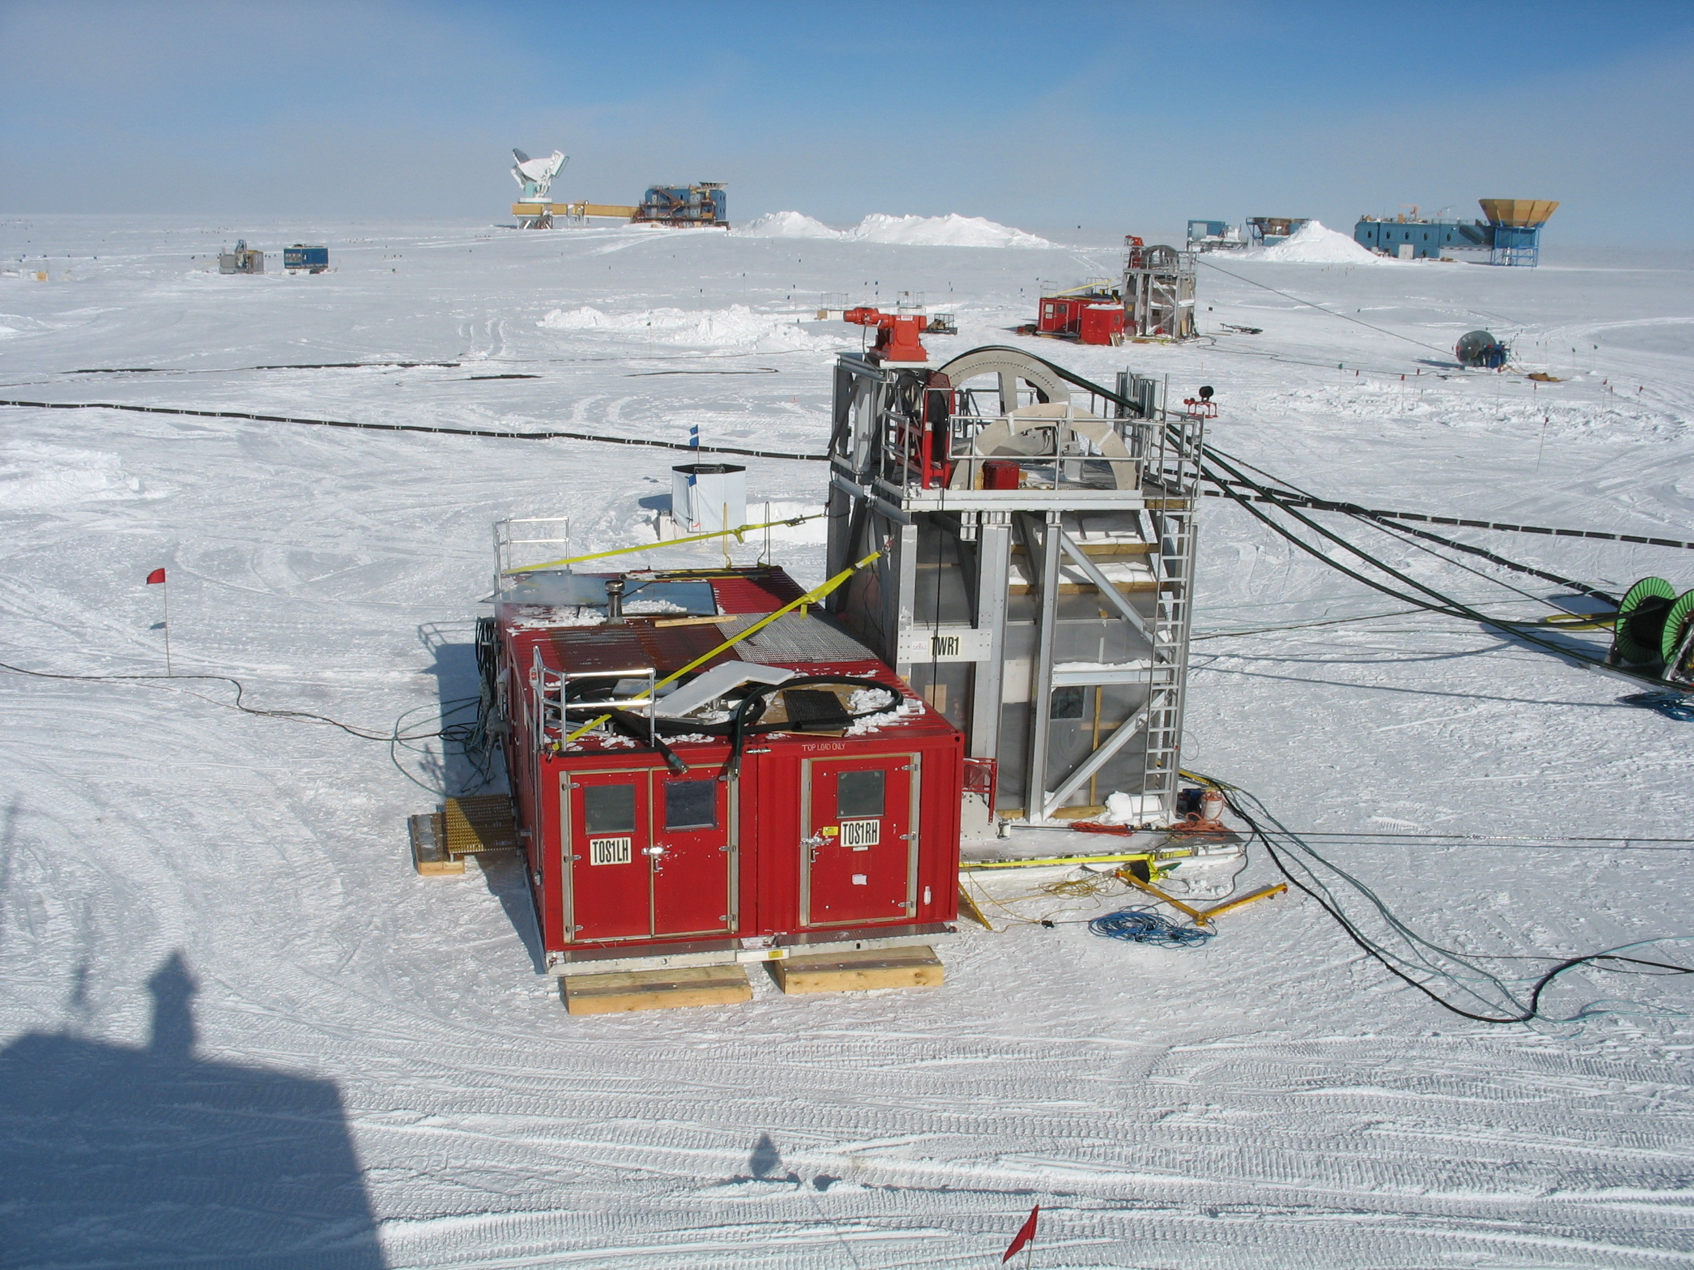

Slide 35
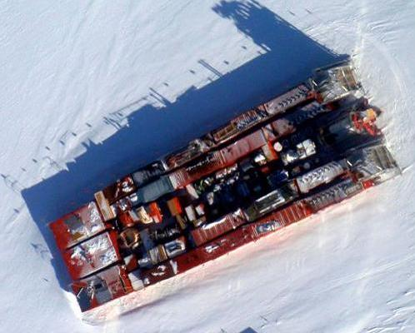
IceCube drill in storage
January, 2011

