Slide 1
Acoustic detection
of ultra-high energetic neutrinos
- a snap-shot -
R. Nahnhauer
DESY

Slide 2
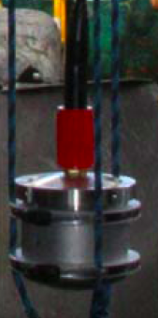
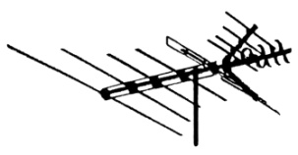
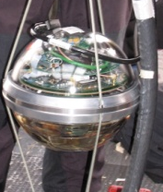
~ km
The Vision
p
t
Build ~100 km³ hybrid detector to:
Confirm GZK cutoff !
Do physics with extremely
high energy cosmic neutrinos^{*)}
- astrophysics - E > 10¹⁶eV :
study origin of cosmic rays -
(AGN’s, black holes, GZK cutoff, …)
- particle physics - E > 10¹⁸eV :
study neutrino cross section
(sphalerons, mini BH, ν_{strong},…)
- cosmology - E > 10²¹eV :
study relic neutrino
background radiation
(ν_{UHE} absorption at ν_{CBR} )
sound disk
ν_{μ}
radio lobe
optical light cone
μ
*) see e.g.
R. Nahnhauer ,ARENA 2010

Slide 3
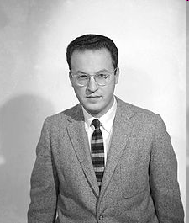
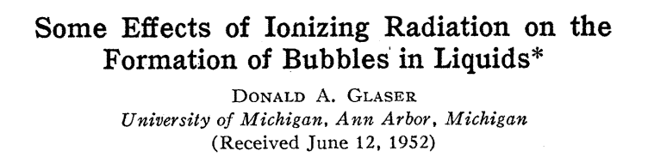

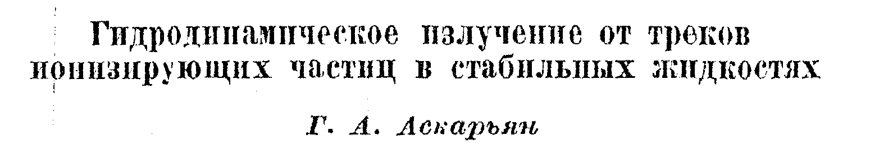
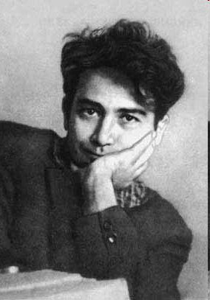

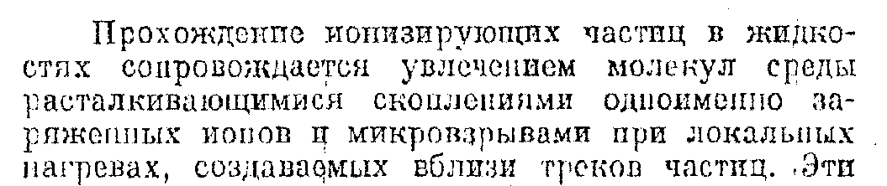
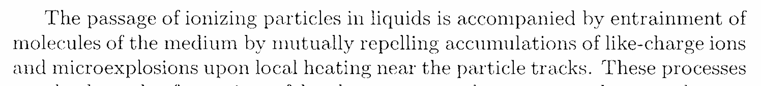
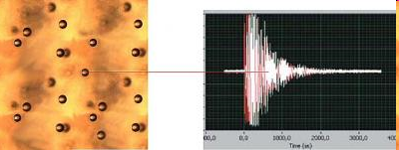
Nobel price 1960:
"for the invention of the bubble chamber"
Hydrodynamic radiation from tracks of ionizing particles in stable liquids
First mentioning of an acoustic particle detection possibility
A modern application:
PICASSO - searching for Dark Matter
If a dark matter particle hits a nucleus in a tiny superheated droplet, the atom recoils and deposits its energy in a heat spike, which in turn triggers a phase transition.

Slide 4
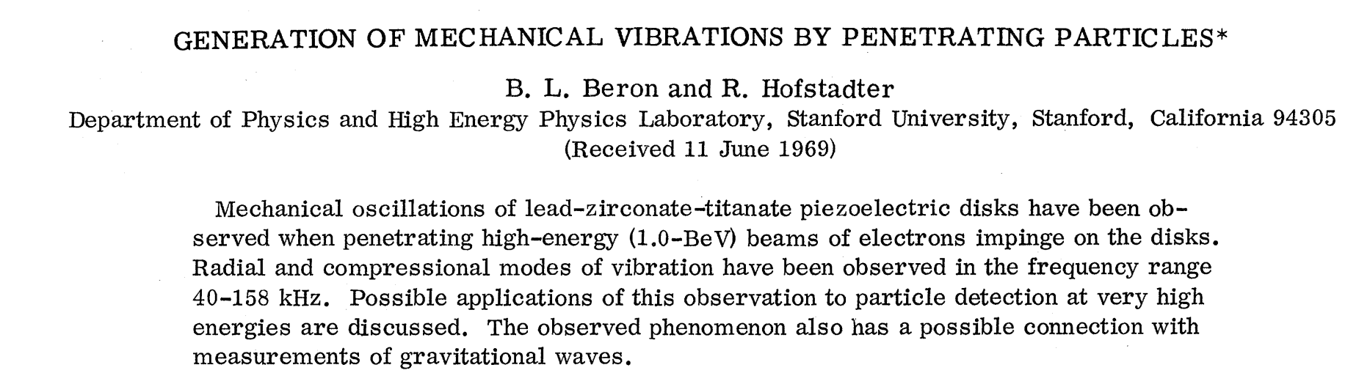
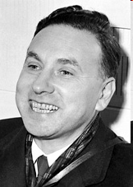
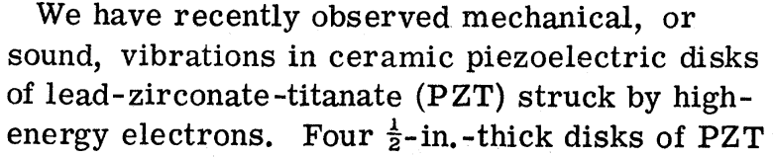
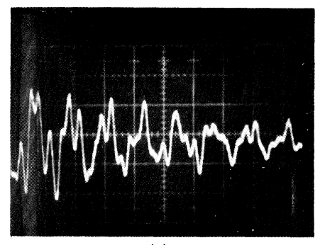
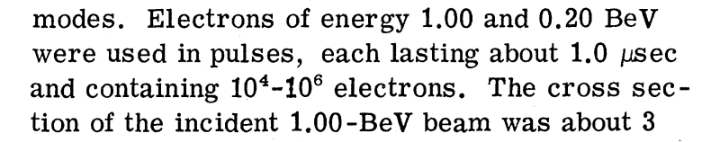
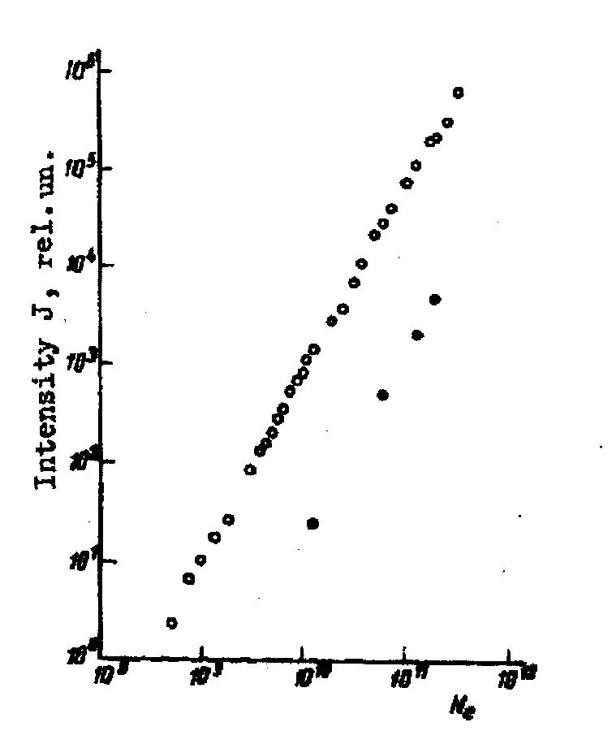
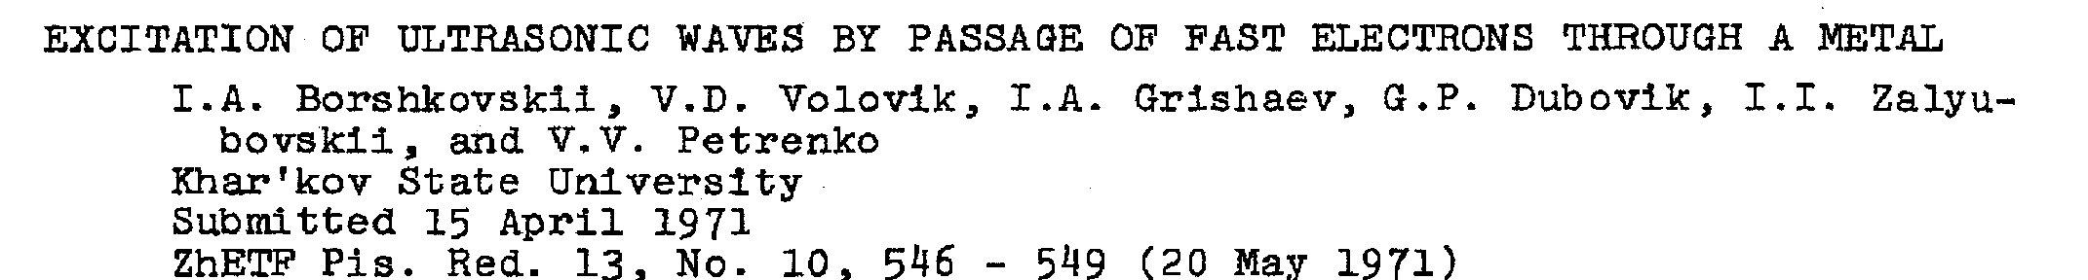
First experimental detection of acoustic particle signals ?
Phys. Rev. Lett. 23, V4 (1969)184
9 mm²
acoustic intensity
V. D. Volovik et al., Sov. JETP Lett. 13 (1971) 390
N_{e}

Slide 5
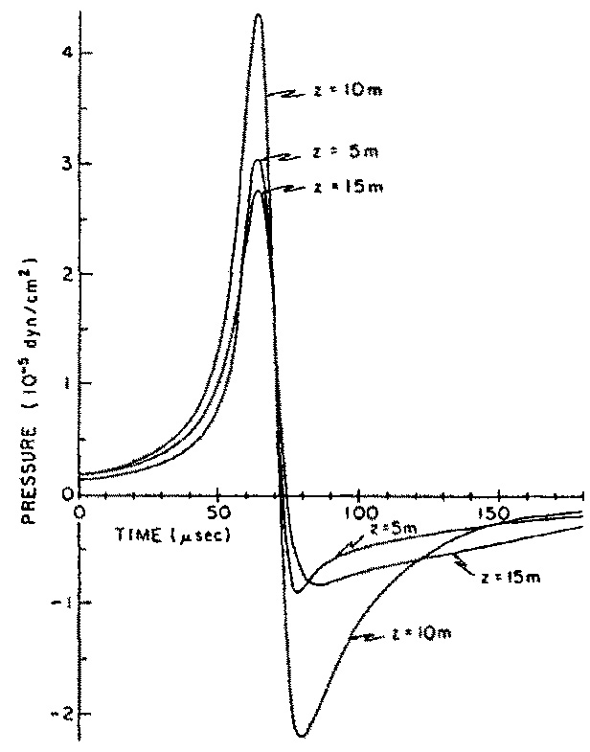
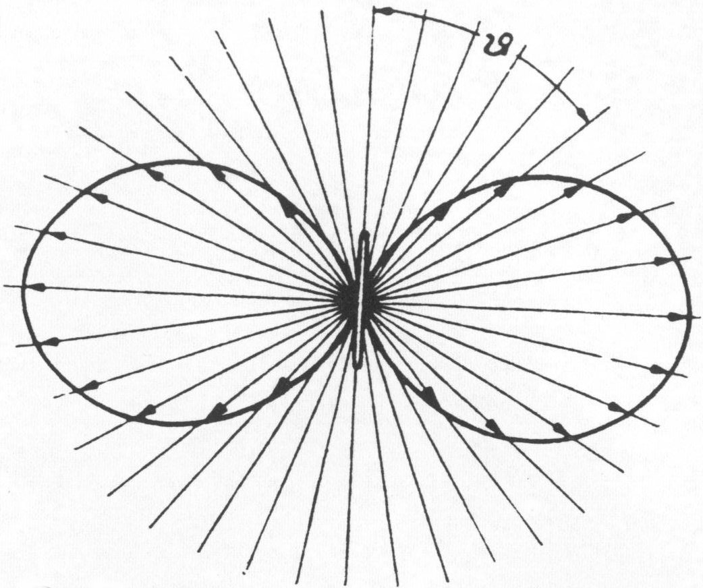
The Thermo-acoustic Model
First ideas presented at the 1976 DUMAND workshop independently
by T. Bowen and B.A. Dolgoshein,
Proceedings not accessible (to me) but see:
G. A. Askaryan and B.Dolgoshein, JETP Lett. 25 (1977) 213
T.Bowen, Proc. 15th ICRC, Plovdiv, 1977, V6, p. 277
d
G.A. Askaryan et al.
NIM 164(1979) 267
In frequency domain :
P = (k/c_{p}) (E/R) M
M=(f²/2) (sinx/x)
f=v_{s}/(2d), x=(πL/2d)sin δ
k : vol. expans. coefficient
c_{p}: specific heat
signal shape:
flat disk, width ~L
T. Bowen:
In time domain :
P = (1/4π)(k/c_{p}) (E/R)
J. Learned,
Phys.Rew. D 19
(1979) 3293
P = (1/√(5.4π) (1/4π)(k/c_{p}) (E/R) (v_{s}/σ)²
σ: Gaussian width of ionization distr.
E=10¹⁶ eV
R=400 m

Slide 6
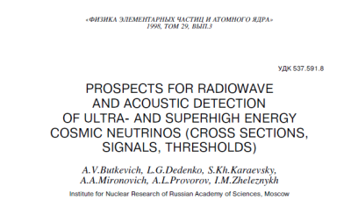
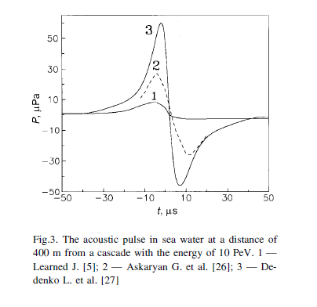
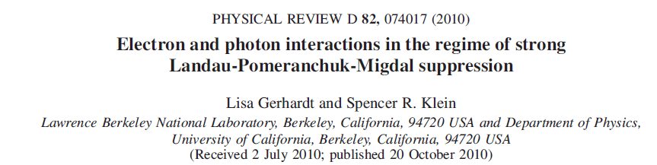
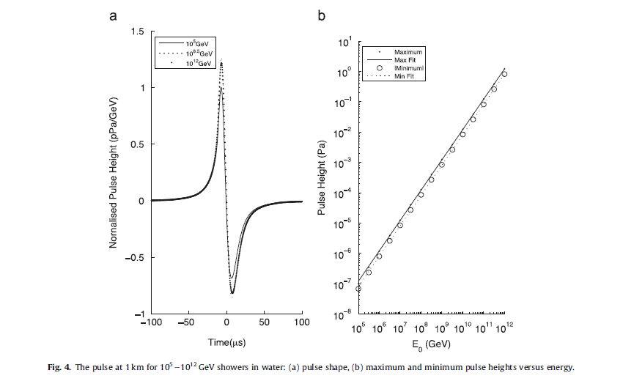
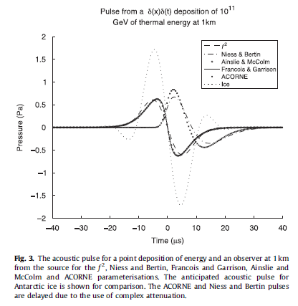
Signal strength :
Strongly dependent on:
- cascade simulation
- inclusion of LPM-effect
and photo-nuclear reactions
- attenuation model
- matter effects
For a recent 3D CORSIKA simulation see:
S. Bevan et al. NIMA 607(2009)398

Slide 7
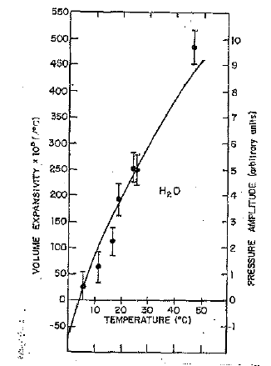
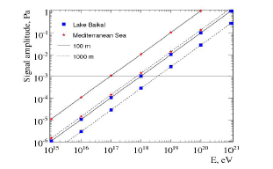
Target material influence on signal strength :
signal strength ~ Gruneisen parameter γ
 | water | South Pole ice | salt
c (m/s) | 1530 | 3880 | 4560
k (/K) | 25.5e-5 | 12.5e-5 | 11.6e-5
C_{P} (J/kg/K) | 3900 | 1720 | 839
γ = c²k/C_{P} | 0.153 | 1.12 | 2.87
f_{max} (kHz) | 7.7 | 20 | 42
refraction | moderate | very small | small?
λ_{att} | > 1000 m | ~300 m | > 100 m
noise | variable | stable, < 14 mPa | small?
adapted from B. Price, ARENA2005
using SPATS results
Ice is the only medium where optical, radio and acoustic signals can be used simultaneously
What about permafrost?
R. Nahnhauer et al.,
NIMA 587 (2008) 29
BUT
G.Sulak et al.
NIMA 161(1979)203
Real signal strength depends strongly on local conditions
T_{ANTARES} = 13°C
T_{Baikal} = 3°C
→
Baikal,
ICRC 2007

Slide 8
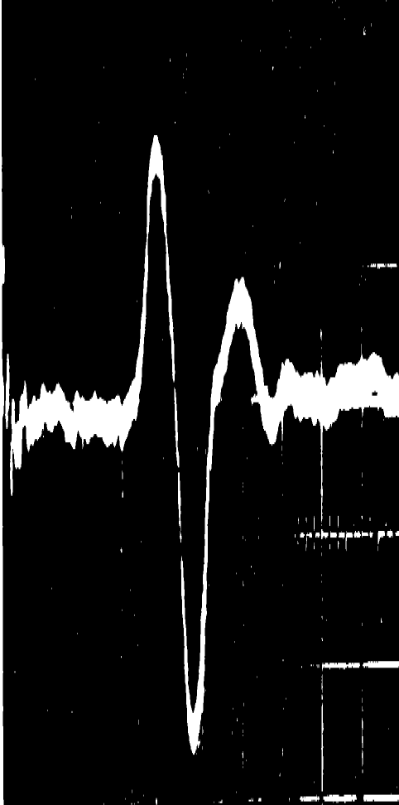
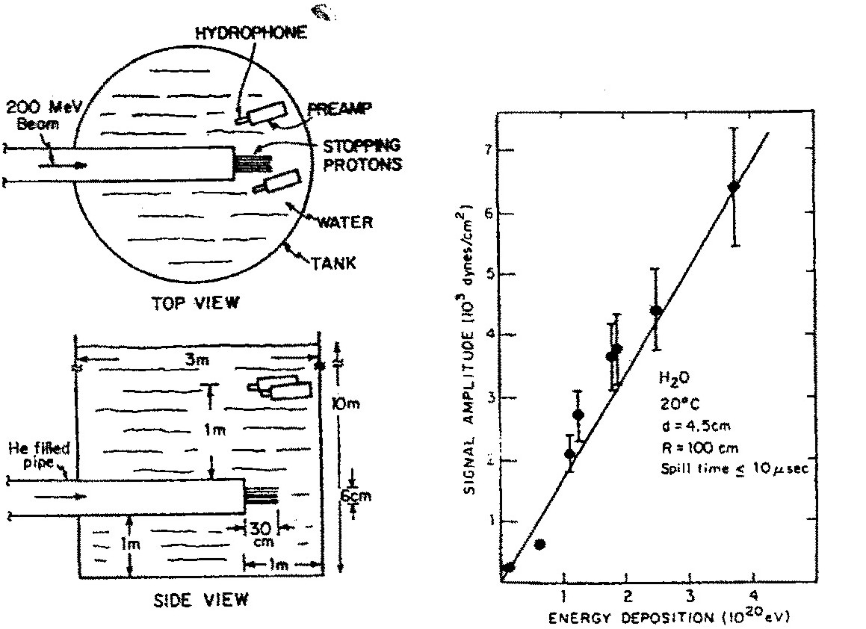
What do measurements say?
Early experimental checks 1979-80
Similar studies from the last decade
Sulak et al. NIM 161(1979) 203
BNL: 200 MeV and 28 GeV protons, E_{min} = 10²⁰ eV Harvard: 158 MeV Protons, E_{min} = 10¹⁵eV
V.I. Albul et al. Instr. and Exp. Techn. 44 (2001)327
125 Mev+200 MeV, p,H2O, ITEP Moscow
S. Böser et al. unpublished
(Dipl.-Thesis J.Stegmaier, Mainz2004)
177 MeV, p, ice, TSL Uppsala
K.Graf et al., Int.J.Mod.Phys. A21(2006)127
177 MeV , p, H₂O, TSL Uppsala
Laser, 1064 nm, H₂O, Erlangen
R. Nahnhauer et al., NIMA 587 (2008) 29
Laser, 1064 nm, “permafrost”, Zeuthen
G.De Bonis et al.NIMA 604 (2009) 199
100 MeV+200 MeV, p, H₂O, ITEP
P.I. Golubnichy et al. Proc. DUMAND-1979, 148
Laser , λ= 1060 μm
Conclusions
→ many Thermo-acoustic Model
predictions confirmed
→ dominant mechanism is thermal expansion
→ other contributions (microbubbles, ???)
can not be completely excluded
No comparison of absolute amplitude strength between data and model(s) available up to now
Other questions studied
A= f(d), varying beam diameter
A= f(K/c_{p}), varying liquids
A=f(R), varying distance
A=f(p), varying static pressure

Slide 9
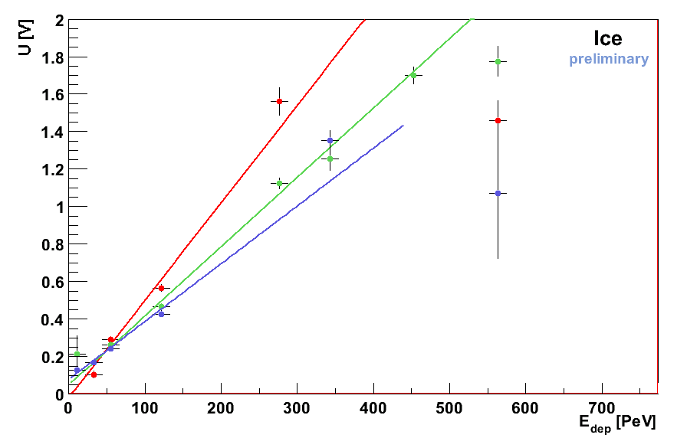
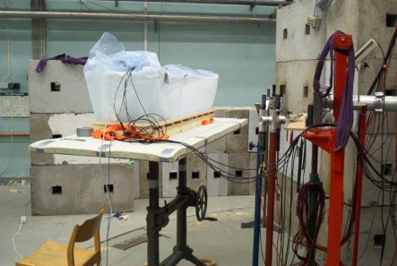
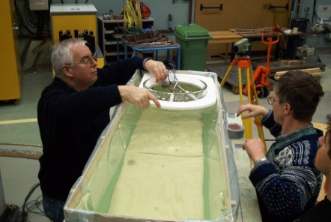
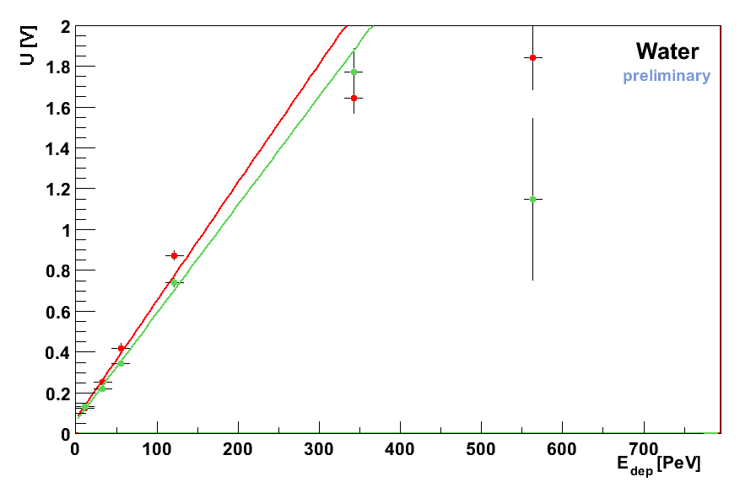
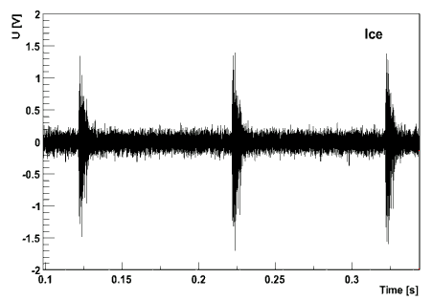

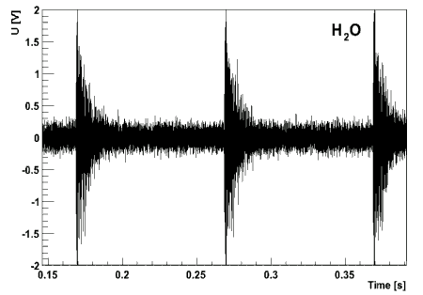
A first relative comparison
TSL Uppsala 2003
S. Böser et al. unpublished
Ice
H₂O
• R = 42.5 cm ⊥
• R = 77.6 cm ⊥
• R = 90 cm ⏐⏐
LxBxH = 130x40x27 cm³
LxBxH = 135x45x27 cm³
• R = 43.5 cm ⊥
• R = 74.6 cm ⊥
unexpected:
S_{H2O} ≥ S_{ice}
But several experimental uncertainties, measurement needs to be repeated
Beam: p, φ = 2cm, E = 110 PeV R = 40cm
Detectors: First generation glaciophones
mounted to 13 inch IceCube glass half-spheres

Slide 10
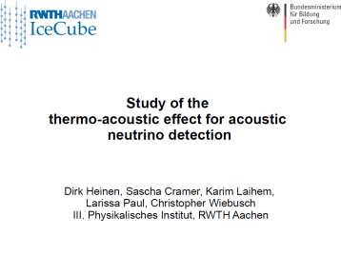
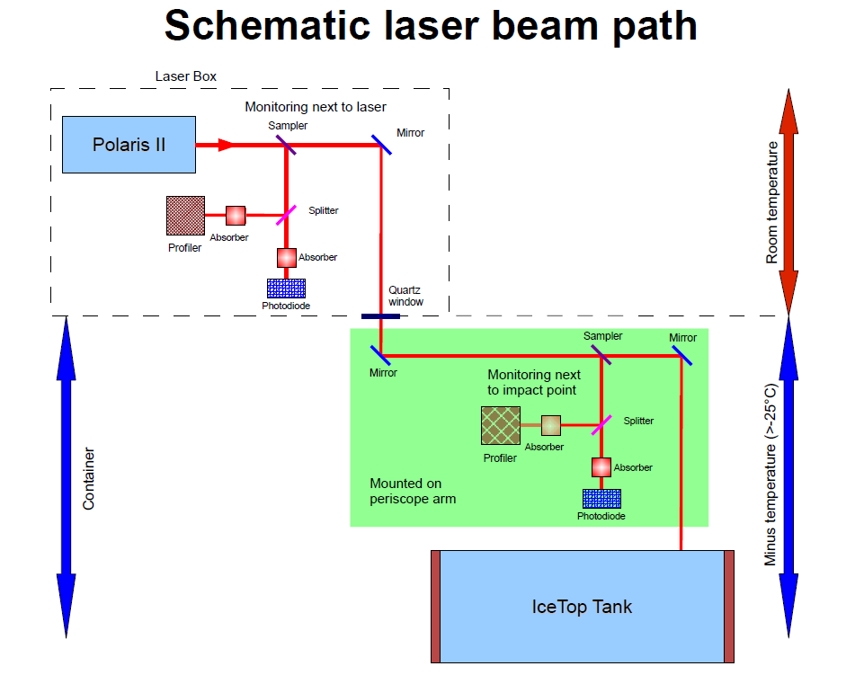
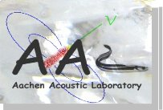
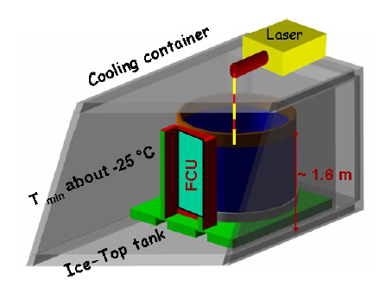
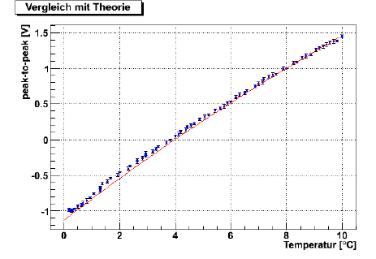
Soon new data from AAL ?
D. Heinen,
talk at German DPG ,April 2011
excellent laser monitoring
preliminary
water measurements done
tank freezing started end of March, needs about 60 days

Slide 11
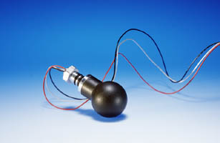
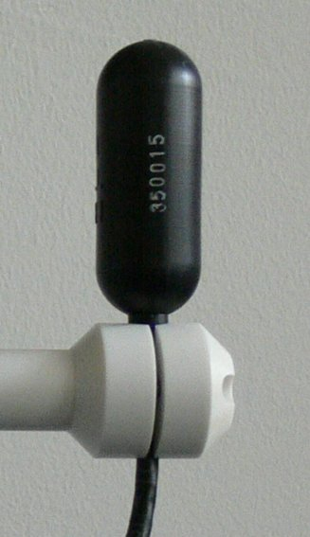
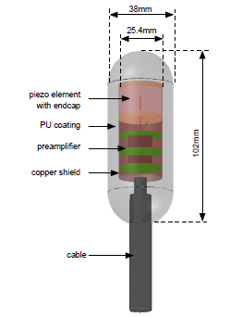
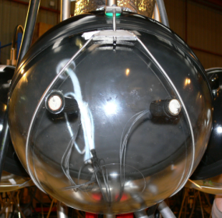
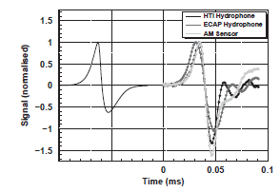
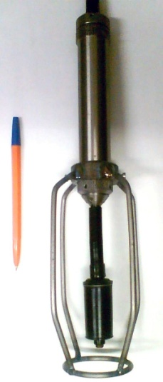
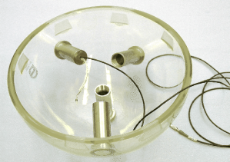
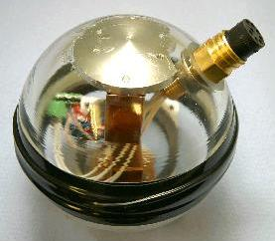
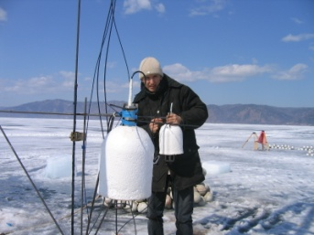
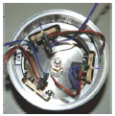
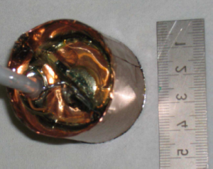


Piezo-ceramic based acoustic sensors
commercial production
home made
ONDE: RESON
~10cm
G. Riccobene
talk at ARENA2005,
AMADEUS: Erlangen
J.A.Aguilar et al.,
NIMA 626-627(2011) 128
AMADEUS: HTI
BAIKAL: H2020C
SPATS: DESY
N. Budnev talk at ARENA2010,
Typical sensitivity:
-190 → -110 dB re 1V/μPa
S. Böser talk at ARENA2005,
Sound
absorb. hats
Special cases: military applications
RONA – ACORNE
AUTEC - SAUND
Y. Abdou et al.,
arXiv: 1105.4339
submitted to NIMA
HADES: Wuppertal

Slide 12



“New“ sensor ideas
fibre acoustic sensors – first ideas go back more than 30 years
C.Trono talk at ARENA2005
pressure wave on fibre :
➔ modulation of cavity size, leading to modulation
of laser wavelength detectable by interferometer
Proven to work at static pressure of 35 MPa (3500 m depth) with higher sensitivity then PZT devices
P.E. Bagnoli et al., NIMA 567(2006) 515, E. Maccione et al.,NIMA 572 (2007) 490,
A.Cotrufo et al. NIMA 604 (2009) 219 (fiber wrapped on a mandrel)
For other recent publications see e.g.:
J. Wang et al., Optoelectronic letters V3 No 4 (2007) doi: 10.1007/s11801-007-6169-1
S. Goodman et al., Proc. SPIE V 7004 (2008), doi: 10.1117/12.785937
B.Guan et al. , Optics Express Vol 17 No.22 (2009)19544 and references therein
Another approach: use intensity variations instead of phase modulation

Slide 13





Piezo-foils as acoustic sensors
a- PVDF foil
b- Electrical contact
(Copper tape +
Silver glue)
c- Preamplifier
d & e - PVC Support
Thermo-acoustic signal
Test with laser
in water tank →
Will be tested
in ice next
preliminary
Reflections
Clean bipolar signal (thermo-acoustic)
Nice separation between direct signal and reflections
Frequency of the bipolar signal related to the laser beam width

Slide 14











Acoustic transmitter
Saund I calibration sources
J.Vandenbroucke at Stanford Acoustic Miniworkshop ,2003
21 events per light bulb
measure energy and location
Position monitoring
SPATS transmitter:
measure sound speed,
sound attenuation length,
produced shear waves
Problem for all deep water optical neutrino telescopes
Solution : fix strong acoustic transmitters at known positions of the sea bed, add hydrophones to optical strings, ping every 1-2 minutes, triangulate pulses
Example: ANTARES
precision < 10 cm
M. Ardid,
NIMA 602(2009)174
own production
used in ice
commercial ITC1001
use in water filled holes
R&D for KM3NeT →
F.Ameli et al.,
NIMA 626(2011)211
R. Abbasi et al., APP 33(2010)277
R. Abbasi et al., APP 34(2011)382

Slide 15









Acoustic transmitters for bipolar signals
ACORNE
S.Danaher, ARENA2010,
doi:10.1016/j.nima2010.11.142
M
E
T
H
O
D
1
Take into account transfer
function between emitted
and received signal
For a bipolar pancake
> 5 hydrophones needed
M
E
T
H
O
D
2
Valencia
M.Bou-Cabo, ARENA2010,
doi:10.1016/j.nima2010.11.139
At distances
> O(100 m) the
bipolar pulse
is dominant
Use parametric acoustic sources (non-linear effect)
build 1° pancake:
3 transducers with 20 cm separation

Slide 16







Sensor calibration for use in water
Example: AMADEUS sensors lab calibration
Sensitivity measured with calibrated hydrophone,
confirmed with reciprocity method
In-situ calibrations and application of “fake
neutrino source” planned for September 2011
φ - freq sensitivity
ϕ - freq sensitivity
10
10
R. Lahmann,
talk at ARENA2008
φ/deg
ϕ/deg
100
f/kHz
100
f/kHz
J.A.Aguilar et al.,
NIMA 626-627(2011) 128
B
U
T
2
Sensitvity variation, dB
-2
100
300
G. Riccobene, talk at DESY 2009
Pressure,Bar

Slide 17








Sensor calibration for use in ice
For real application: calibrate at -50° C, at 50 MPa, in ice → hard to achieve
A
PPROX
1
Calbrate in water at 0 ° C
Study pressure dep.
at room temp.
Study in air
temperature dep.
<S_{H2O}>^{SPATS(10-50kHz)} = 2.8 ±0.8 V/Pa
Y. Abdou et al., arXiv: 1105.4339,
subm. to NIMA
<S_{ice}>^{SPATS(15-50kHz)} = 4.2 ±1.6 V/Pa
A
PPROX
2
Perform reciprocity calibration for AAL transmitters
Do for SPATS3
- reciprocity cal.
- hybrid cal.
(use calibrated
transmitter)
PRELIMINARY
SPATS3
Preliminary results consistent with approx1

Slide 18











Recent experimental test sites
x

Slide 19





AUTEC - SAUND
Study of Acoustic Ultrahigh-energy Neutrino Detection
SAUND I
15 km³
→
first flux limit
from acoustics
J. Vandenbroucke et al.,
Astrophys.J. 621 (2005) 301
Data taking:
65 *10⁶ trigger
in 195 days
Data taking:
328 *10⁶ trigger
in ~130 days
N. Kurahashi, G. Gratta
Phys. Rev. D 78, 092001 (2008)
Two events after all cuts (one example below)
N. Kurahashi et al.,
Phys. Rev. D 82, 073006 (2010)
SAUND II
1500 km³

Slide 20







RONA - ACoRNE
Use 8 hydrophones
at sea bed
Search for primordial black holes
In 50 TB of data
81 trigger survived cuts
Only two events with
“bipolar” waveform
(excluded by other reasons)
L. Thompson,
ARENA2008
and S. Bevan, Theses
S. Danaher, ARENA2010,
doi:10.1016/j.nima.2010.11.075

Slide 21





OνDE
Long term measurements of acoustic
background noise in very deep sea
4 hydrophones (10 Hz-40 kHz bandwidth) synchronized.
Acoustic signal digitization (24bit@96 kHz) at 2000m depth.
Data transmission on optical fibers over 28 km.
On-line monitoring and data recording on shore.
Recording 5’ every hour.
Data taking from Jan. 2005 to Nov. 2006 (NEMO Phase 1 deployed).
The average noise in the [20:43] kHz band is
5.4 ± 2.2_{stat} ± 0.3_{syst} mPa
From G. Riccobene:
ARENA2008, VLVNT2009
also: arXiv: 0804.2913
Next step:
See also G. Riccobenes talk at this conference

Slide 22




An acoustic detector for background studies
BAIKAL
Listening from top to down,
prototype device at
150m depth
March 2011 :
prototype acoustic string deployed
tetrahedral antenna 1.5m
4 hydrophones H2020C
4-ch, 195kHz, 16-bit ADC
one-plate computer
2 Mbit DSL modem
NT-200
From N. Budnev,
ARENA 2010,
doi:10.1016/j.nima.2010.11.153
One signal from the
deep layer of the Lake
Antenna with
4 waveguide
hydrophones
made in Vladivostok State University
Most of time RMS
of noise is a few mPa
Data taking ongoing,
first results soon

Slide 23






AMADEUS
Power Spectral Density of Noise
Noise strongly correlated with weather conditions
J.A.Aguilar et al., NIMA 626-627(2011) 128
36 sensors at 6 storeys
(1 – 350m distance, 34 active)
16bit @ 250kSps sampling
~ -125dB re 1V/μPa sensitivity
~85-90% uptime
Beam forming or time difference
algorithms used, uncertainty < 1 degree
R.Lahmann, ARENA2010
doi:10.1016/j.nima.2010.11.157

Slide 24









SPATS
4 strings in IceCube holes
instrumented depth:
80 m - 500 m
per string:
7 stations with
sensors + transmitters
pinger
T. Karg, ARENA2010, doi:10.1016/j.nima.2010.10.22
D.Tosi, TEVPA 2009
See also talk of K. Laihem at this conference
Noise conditions: ~ 2 years monitoring
Sound speed:
- two combinations
at 125 m distance
- accuracy < 1%
- first in situ measurements
for P and S waves at SP
Attenuation length:
5 methods:λ=300$60 m$
No evidence for depth or frequency dep.
Transient events
Only from identified sources, connected to IceCube detector construction
Gaussian, Stable,
Below 200 m
≤ 14 mPa

Slide 25
Acoustic neutrino flux limits
SPATS
ACORNE
SAUND2
R. Abbasi et al.,arXiv:astro-ph/1103.1216

Slide 26
Future: Water
Near term:
  completion of the various feasibility studies
  close cooperation with marine science
  prototyping for next step, e.g. sensors, calibration
  In-situ calibration and “fake neutrino source”
  (e.g. ACoRNE and ANTARES, BAIKAL)
Intermediate term:
  scalability and design studies towards a
  km³-sized hybrid (acousto-optic) detector
  convergence of European acoustic activities
Long term challenges:
  handling of varying background levels
  to achieve low energy threshold (<10¹⁸ eV)
  large distance deployment
  hybrid option for large scale (> 100 km³) detector

Slide 27
Future: Ice
Near term:
  completion of the SPATS feasibility study
  explanation of “low” attenuation length at the South Pole
  prototyping for next step, e.g. sensors, calibration
  check other locations than South Pole
Intermediate term:
− development of “robotic” drilling and deployment
(example : IceMole [K. Laihem at this conference])
  build an intermediate size detector in cooperation
  with a similar size radio detector project
  (ARA, ARIANNA, new)
  check offline hybrid detection possibilities
Long term challenges:
  handling of background to achieve low energy threshold (<10¹⁸ eV)
  drilling and deployment of/in > 100 deep holes per season
  power and communication for a > 100 km³ detector in Antarctica

Slide 28
Final Remarks
TeV-PeV neutrinos:
Should exist → possible sources : SN remnants, GRB’s, AGN’s, …
Have not been observed until now, why?
- Present detectors too small? But what is the right size?
- Have only optical detection technology working in this energy range
- May increase present projects in maximum by factor ~10
- What, if there are no such neutrinos?
- Would this be a catastrophe for our basics?
EeV neutrinos:
Must exist, otherwise basic physics knowledge has to be revised
→ possible sources : GZK-effect, AGN’s, others
→ have observed >10^{19.5} eV protons and CMB-photons
Don’t know frequency of occurrence vs. energy
Measured limits require 100-1000 km³ detectors to observe a few such neutrinos
Presently only radio and acoustic technologies allow to build such detectors
My conclusion:
- UHE neutrino search is a top priority topic
independent of the results achieved at lower energies
- Go for a hybrid detection concept to get convincing results

Slide 29
The End

