Slide 1
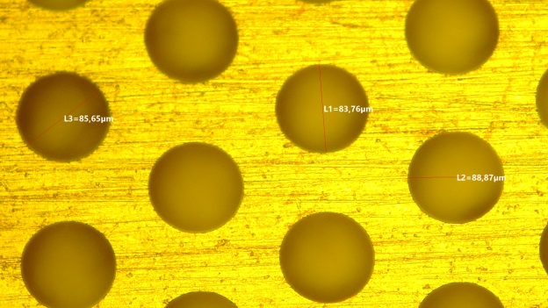
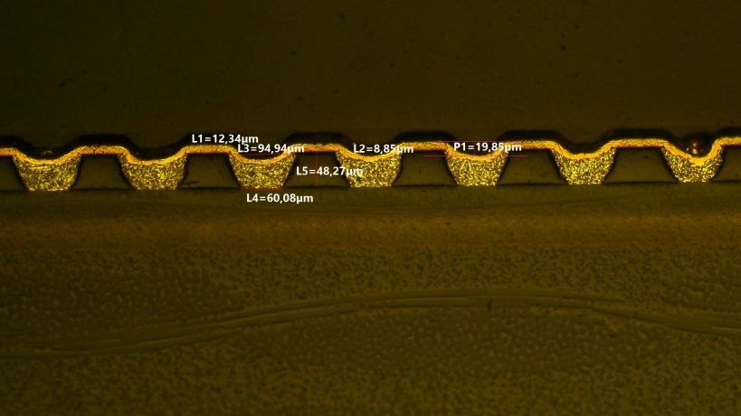

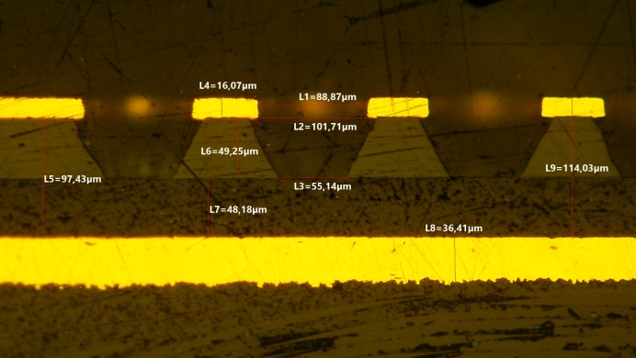

𝜇-RWELLs in LHCb & Nuclear experiments
G. Bencivenni
DDG – LNF - INFN
µ-RWELL GM 21-22 June 2022

Slide 2
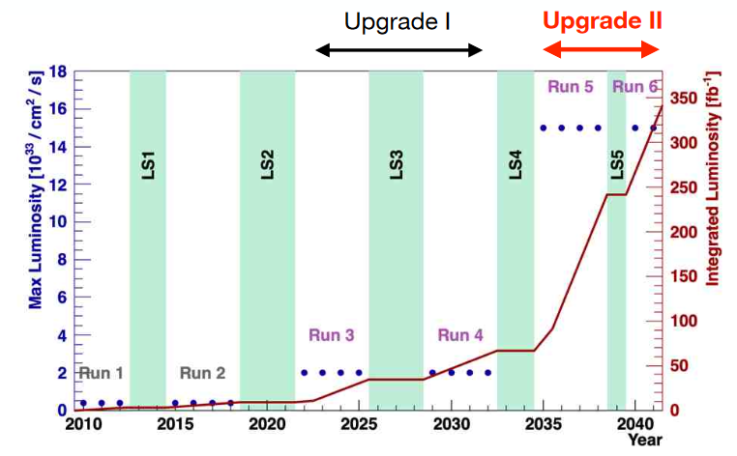
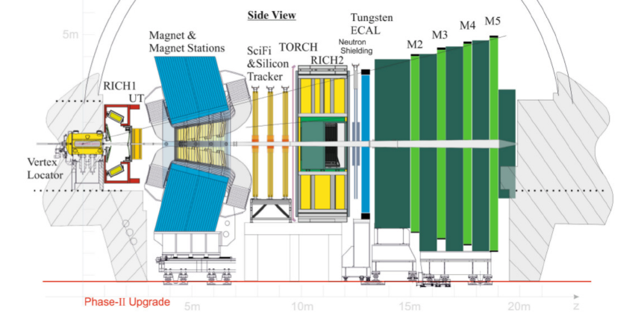
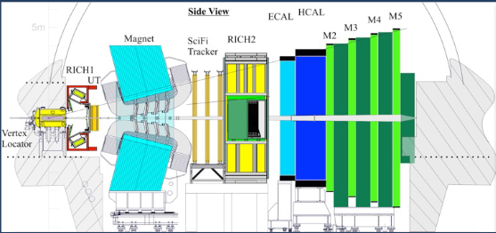
LHCb upgrade II (Run5 – Run6)
Current LHCb apparatus
Phase-2 upgrade apparatus

Slide 3
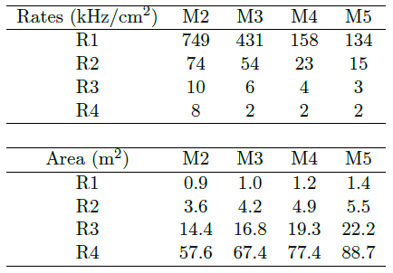
LHCb upgrade II (Run5 – Run6)
The Muon system (MWPC+GEM) during Run1 & Run2 (1÷4 x 10³² cm⁻² s⁻¹)
exhibited tracking inefficiency, from dead time, at level of 1% in Run1
and 2% in Run2
Detector requirements Run5 – Run6
Rate up to 1 MHz/cm² on detector single gap
Rate up to 700 kHz per electronic channel
Max input capacitance (double gap) ≤ 100 pF
Efficiency (double gap) > 95% within a BX (25 ns)
Long stability up to 1C/cm² accumulated charge in 10 y of operation (M2R1, G=4000)
Pad cluster size < 1.2
Detector size & quantity (4 gaps/chamber - redundancy)
R1÷R2: 576 detectors, size 30x25 to 74x31 cm², 90 m² det.
R3: 768 detectors, siz 120x25 to 149x31 cm², 290m² det.
R4 : 3072 detectors, size 120x25 to 149x31 cm², 1164 m² det.
Proposed solution:
µ-RWELL technology
Under discussion the replacing of part of R3

Slide 4
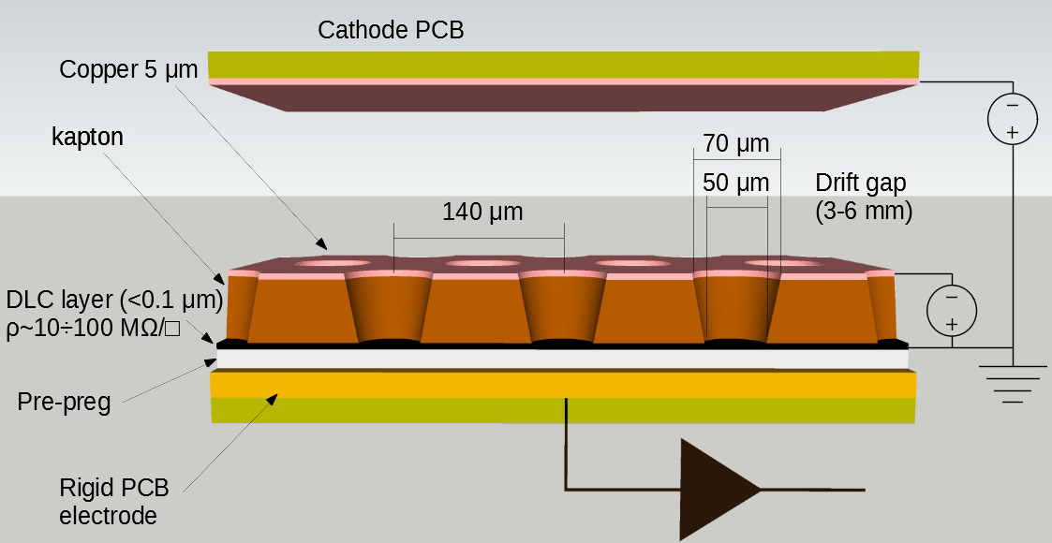
The μ-RWELL
The μ-RWELL is a resistive MPGD composed of two elements:
μ-RWELL_PCB
Cathode
The μRWELL_PCB is realized by coupling the resistive (grounded) amplification stage with the readout PCB through a thin prepreg foil
1
2
3
1
a WELL patterned kapton foil (with a Cu-layer on the top) acts as amplification stage
2
a resisitive DLC layer^{(*)} (Diamond-Like-Carbon), with ρ~40÷100 MΩ/□
3
a standard readout PCB with pad/strip segmentation
$C= ε_{0}×ε_{r}×\frac{S_{pad}}{t}$ $≈36 pF×S\left({cm}^{2}\right) | t≅0.1 mm$
^{(*)} DLC foils are currently provided by the Japan Company – BeSputter

Slide 5
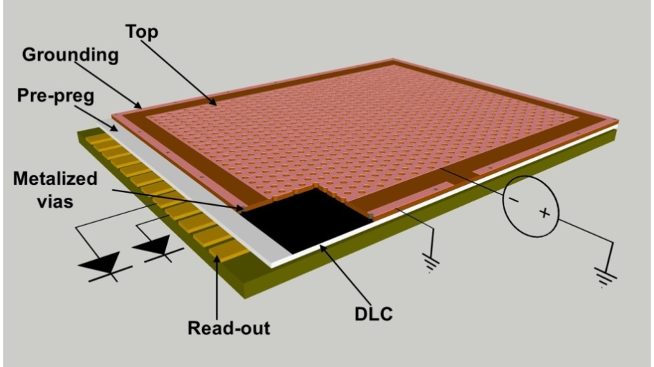
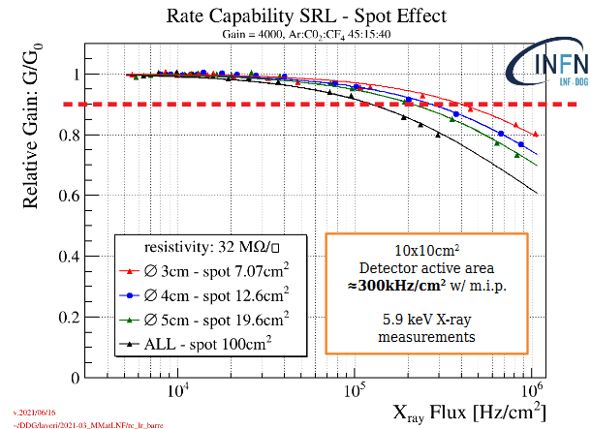
The low-rate layout
Single Resistive Layer (SRL)
2-D current evacuation scheme based on a single resistive layer
grounding around the perimeter of the active area
limitation for large area: the path of the current towards ground connection depends on the particle incidence point → detector response inhomogeneity → limited rate capability <100 kHz/cm²

Slide 6
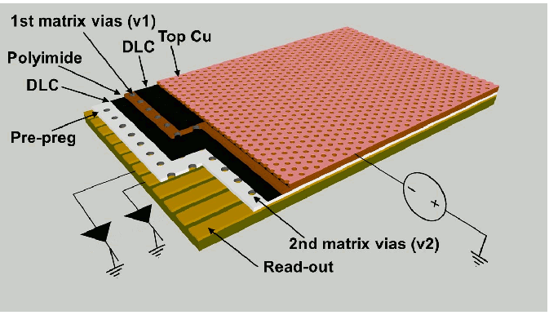
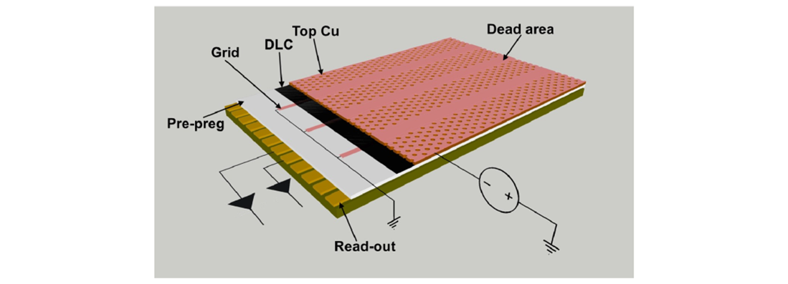
High-rate layouts
Double Resistive Layer
3-D current evacuation scheme
two stacked resistive layers connected through a matrix of conductive vias
Resistive stage grounding through a further matrix of vias to the underlying readout electrodes
pitch of the vias with a density less than 1/cm²
The Silver Grid
simplified HR scheme based on a SRL
2-D evacuation scheme by means a conductive grid realized on the DLC layer
grid lines can be screen-printed or etched by photo-lithography
pitch of the grid lines of the order of 1/cm

Slide 7
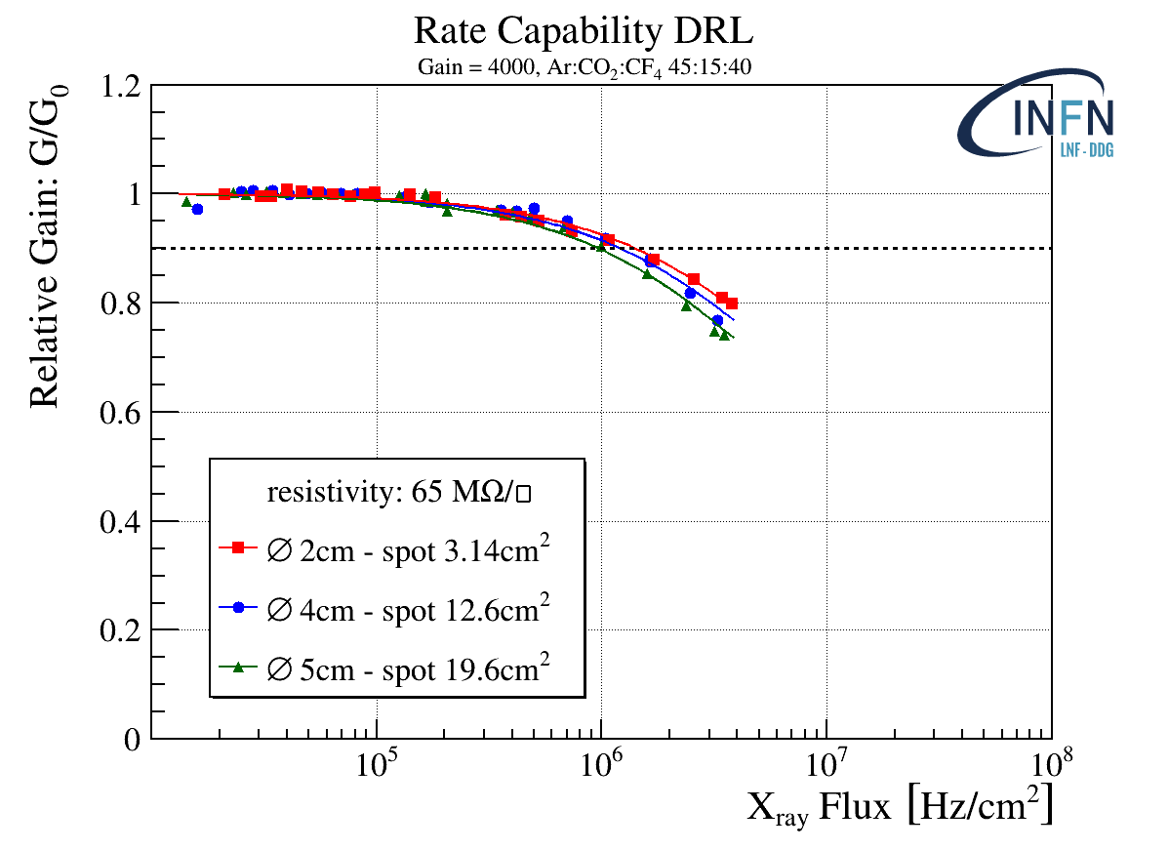
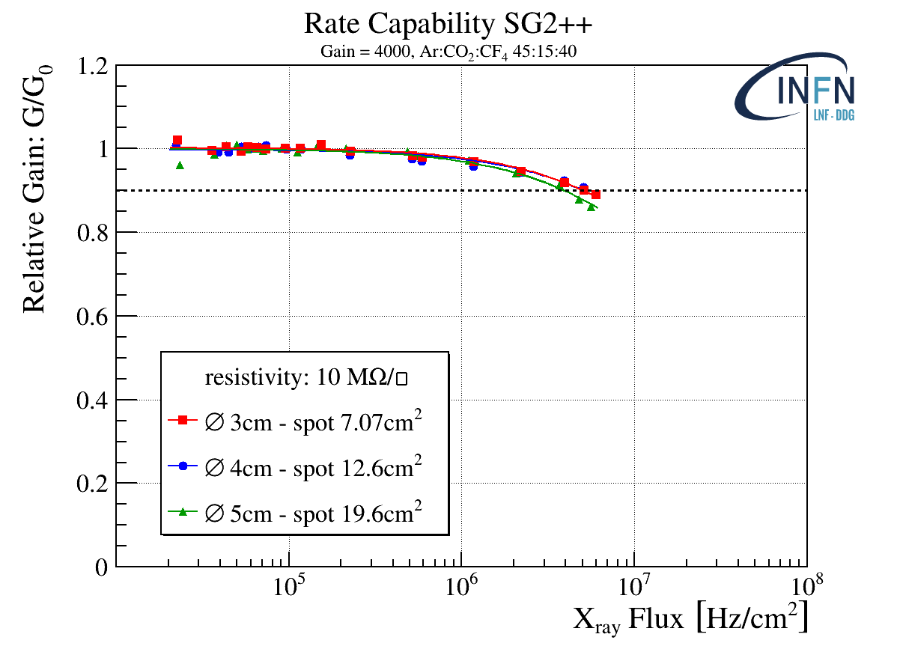
High-rate layouts: performance w/X-rays
3·10⁵
3·10⁶
3·10⁷
3·10⁸
3·10⁵
3·10⁶
3·10⁷
3·10⁸
Mip Flux[Hz/cm²]
Mip Flux[Hz/cm²]
Rate capability w/m.i.p. ∼ 3 times X-rays

Slide 8
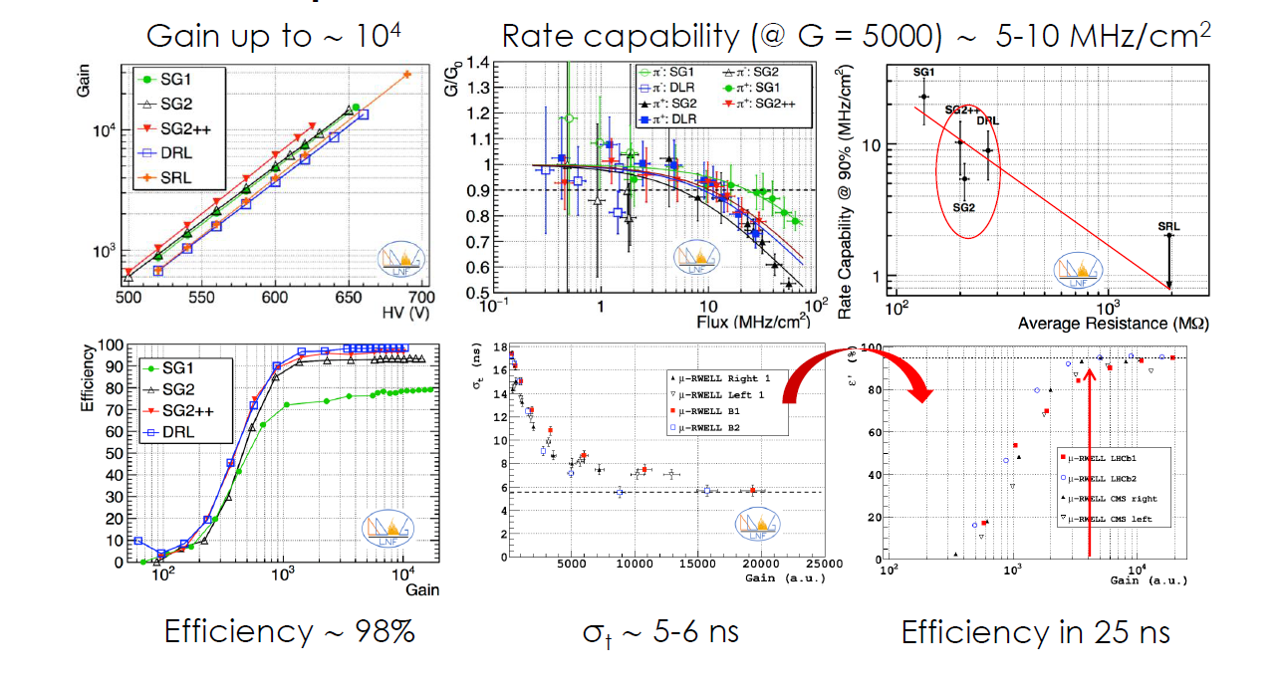
High-rate layouts: performance w/m.i.p.

Slide 9
Limitations of DRL/SG layouts
Both DRL and SG show very good performance, but some practical limitations:
both layouts require for DLC+Cu sputtering technology
The DRL based on double matrix of vias require complex manufacturing
The SG layout is more simple than DRL, BUT a bit critical for the alignment of the conductive grid pattern on DLC wrt the amplification pattern on the top (the well-pattern)
New layouts have been proposed in the last year in order to overcome such limitations, further simplifying the PCB manufacturing of the HR layouts.

Slide 10
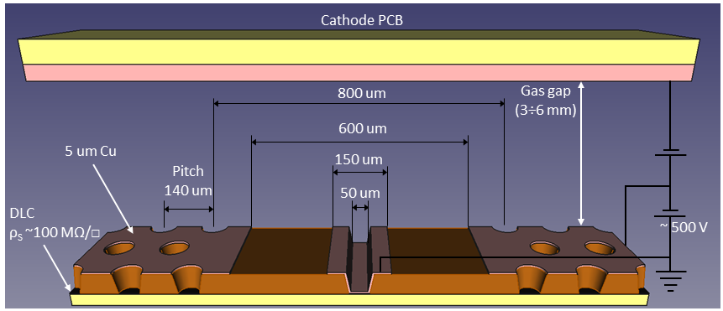

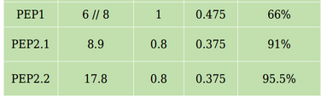
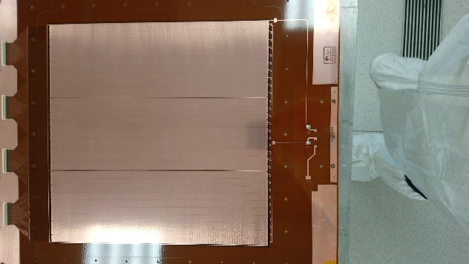
The new PEP HR layout
Cathode PCB
DOCA (Distance of Closest Approach): minimum distance between a grounding line and an amplification channel
PEP: Patterning – Etching – Plating
Single DLC layer
Grounding from top by kapton etching and plating
No alignment problems
Scalable to large size
ACTIVE AREA 30 x 30 cm²

Slide 11
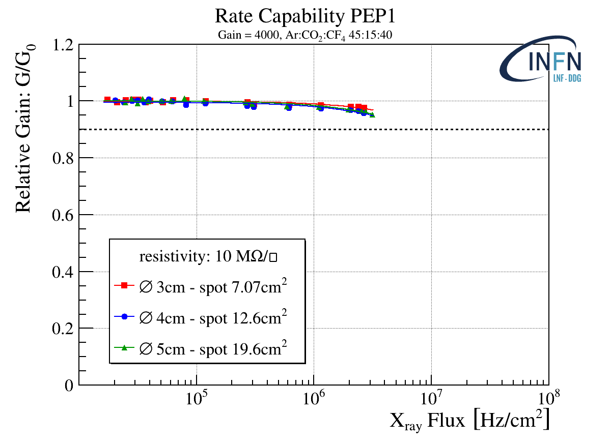
The PEP performance
Rate capability defined as the rate where a 10% of gain drop is observed.
It shoudn’t affect the detection efficiency once chosen a working point well above the efficiency knee
3·10⁵
3·10⁶
3·10⁷
3·10⁸
Mip Flux [Hz/cm²]
Because of the common effort in the scientific community to reduce the F-based components, we are changing the gas mixture to Ar:CO₂:iC₄H₁₀ 68:30:2 and starting the stability measurement

Slide 12
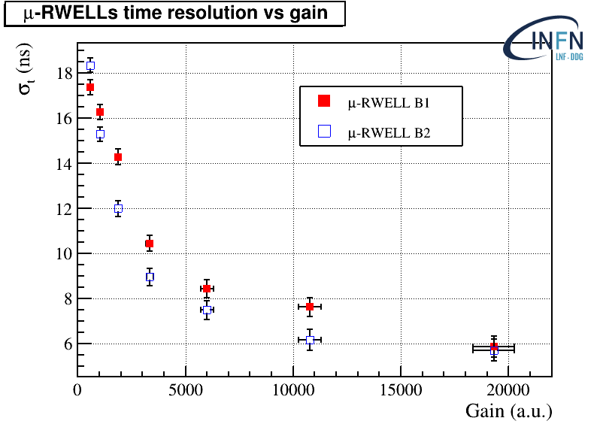
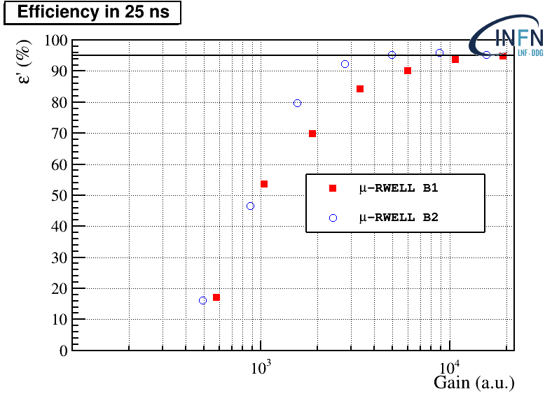
Time performance (old measurement)
A first measurement of the time resolution has been done at H8C CERN - NA
The detectors were operated with Ar:CO₂:CF₄ 45:15:40 gas mixture (the same used by GEM @LHCb) and equipped with VFAT2. A saturation due to FEE is visible at high gain
There is room to improve the resolution, improving the FEE

Slide 13
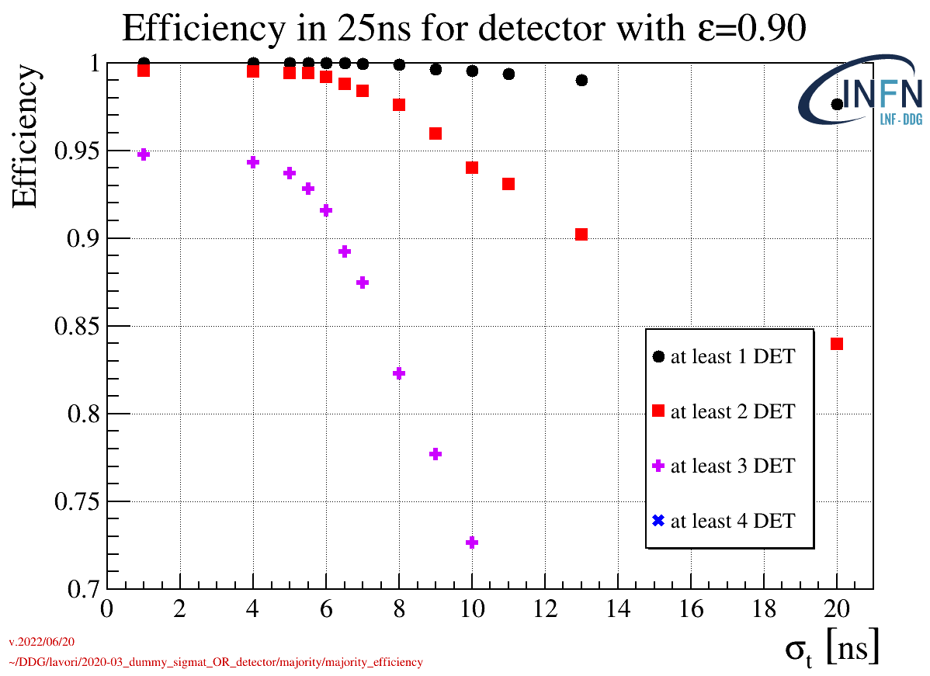
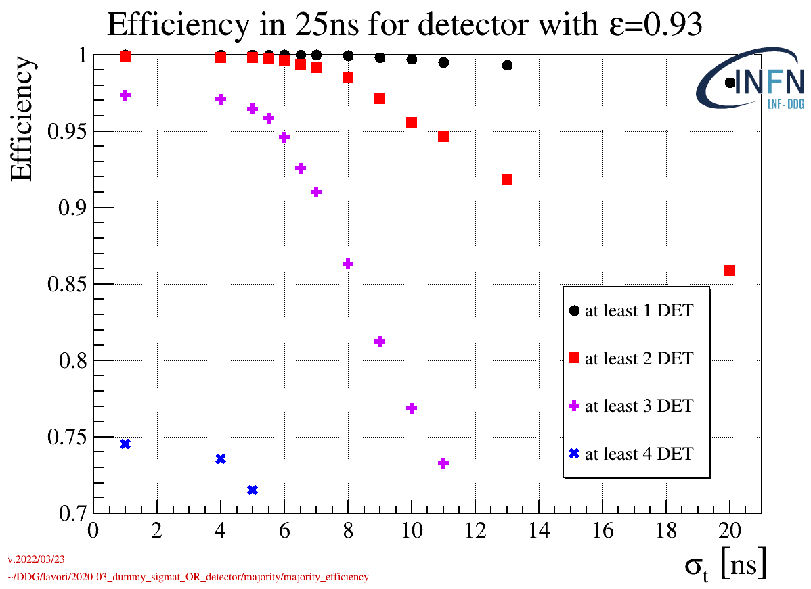
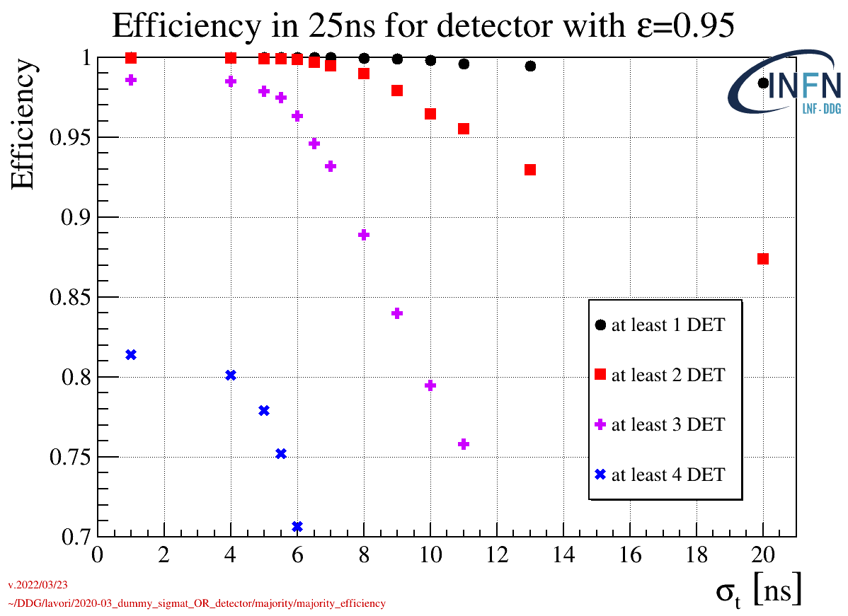
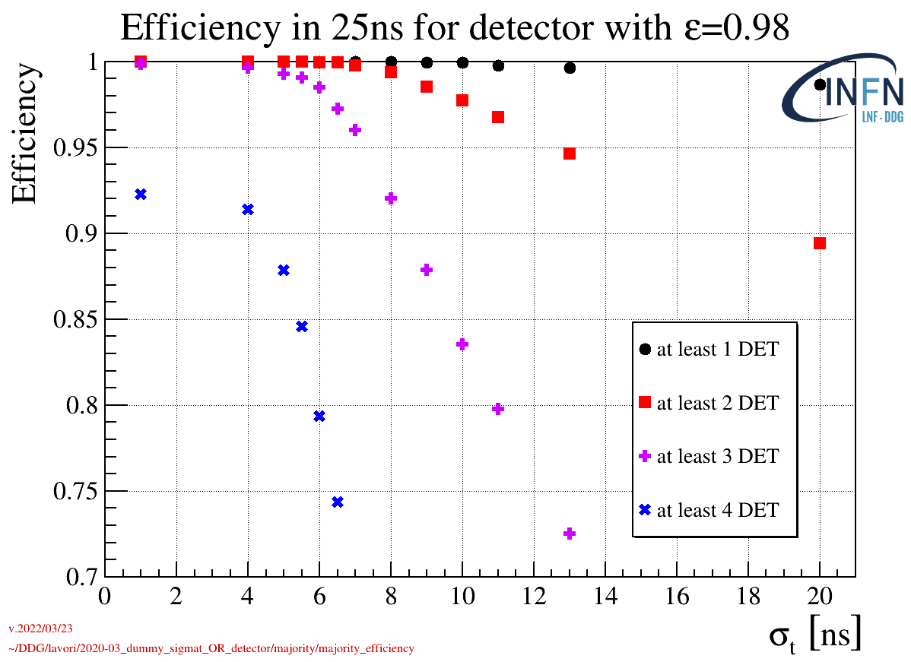
Time performance

Slide 14




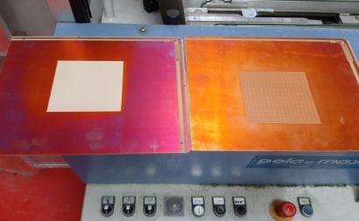
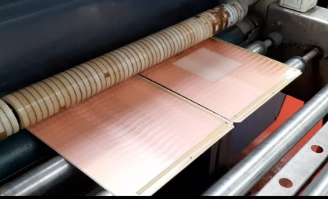


Technology transfer
Start
EU-project
μ-RWELL technology transfer
PCB production
DCL foil production
DLC sputtering know-how
Completed μ-RWELL_PCB
shipping
PCB shipping
*DLC Magnetron Sputtering machine
co-funded by INFN-CSN1
Detector manufacturing

Slide 15
2022 – 2023 tentative plans
2022
  9/2022 – delivery 10x10 cm2 PEP-RWELL pad layout (LNF)
  11/2022 – assembly, characterization w/X-ray, long-term test w/Xrays (LNF)
  11-12/2022 – FATIC integration & preliminary test w/cosmics (Bari + LNF)
  7/2022 – discussion about eco-gas mix test with Gas – CERN group (B. Mandelli)
  > 9-10/2022 – start eco-gas mix search/test (CERN + ???)
2023
  10/2022 (or 6/2022) Test Beam of 10x10 cm2 PEP-RWELL pad layout (LNF + Bari)
  Design/production of the M2R1 (20x25cm2) PEP-RWELL pad layout following results on 10x10 cm2 (LNF)
  Electronics … (Bari)
  GIF++ (? CERN + ???)

Slide 16
Open Problems/possible solutions (?)
CF4 is not an eco-gas, responsible of strong kapton etching observed on GEM detectors (STUDY OF ETCHING EFFECTS ON TRIPLE-GEM DETECTORS OPERATED WITH CF₄-BASED GAS MIXTURES, M. Alfonsi et al., IEEE Trans.Nucl.Sci.52 (2005) 2872-2878.)
Old GEM detectors at LHCb will be analysed to check for CF4 etching effects (we can learn from this study)
PEP µ-RWELL irradiated with X-Rays at LNF will be analysed to check for CF4 etching effects
Eco-gas mix for GEM/RWELL (?)
RWELL in LHCb (in principle) needs for fast gas mix (?)
Long-term test of a PEP µ-RWELL irradiated with X-Rays will be started soon with Ar/Co2 gas mix (no CF4)
Defining a safe assembly/testing procedure: DI-washing+electrical hot-cleaning, humidity control in the gas line, detector conditioning (in strict collaboration with Rui)
Replacing FR4 frames with PEEK frames, more expensive BUT not hygroscopic and then compatible with CF4 (eventually only in closed mode)
2D readout still to be investigated: 2x1D or 2D w/top readout … capacitive sharing (by Kondo)
Apart APV25 there is no other user-friendly electronics for testing MPGD (not only RWELL).
For LHCb the Bari group is developing a new ASIC, FATIC (still to be tested)
Other ASIC: VMM3 (?)

Slide 17
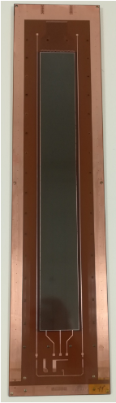

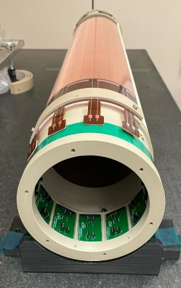
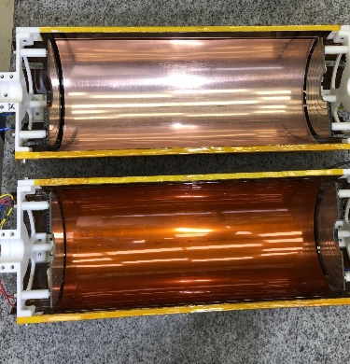
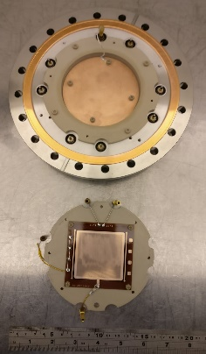
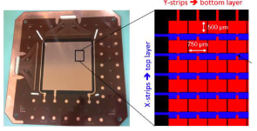
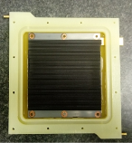
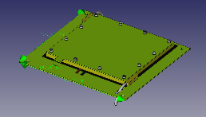
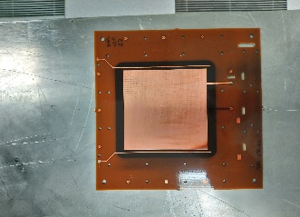
µ-RWELL in HEP/NP & beyond
FCC-ee: the muon system of the IDEA apparatus for a Future Collider
CLASS12 @ JLAB: the upgrade of the muon spectrometer
EURIZON: R&D on IT based on cylindrical micro-RWELL for a SCTF
X17 @ n_TOF EAR2: small -TPC for the detection of the X17 boson
UKRI: thermal neutron detection with pressurized ³He-CF4 gas mixtures
TACTIC @ YORK Univ.: radial TPC for detection of nuclear reactions with astrophysical significnace
URANIA-V: funded by CSN5 for neutron detection
Muon collider: HCAL R&D
2, 4
3
40 cm
1
6
2
5
7
5 cm

Slide 18

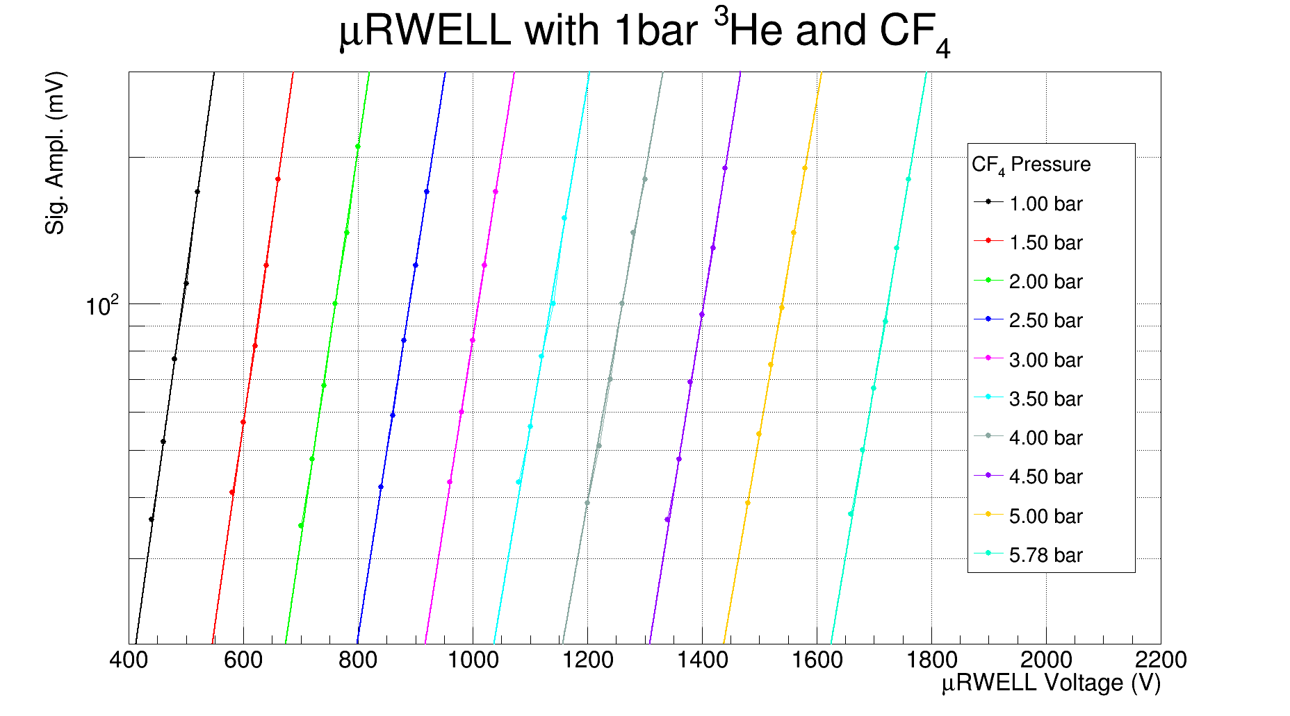

³He operated µ-RWELL for thermal neutron detection
Aim
Neutron scattering applications
Small area (100x100mm²)
High Efficiency(>70% at 25meV)
High Position resolution (<0.5mm FWHM)
Stopping gas to stop the range of the proton and triton of the reaction
n + ³He → ¹H + ³H + 770 keV
Measurements of the gain with a gas mixture containing 1 bar of ³He and 1 to 6 bar of CF₄
To date only MWPC and MSGC could operate at those gas pressures
Setup
50x50 mm2 active area
Active volume 16mm thick
Sealed vessel
(up to 7bar pressure)
Neutrons from AmBe Source
R. Hafeji
D. Raspino
E.M. Schooneveld
N.J. Rhodes

Slide 19


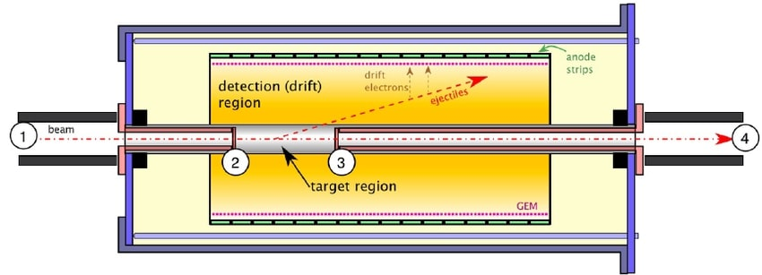
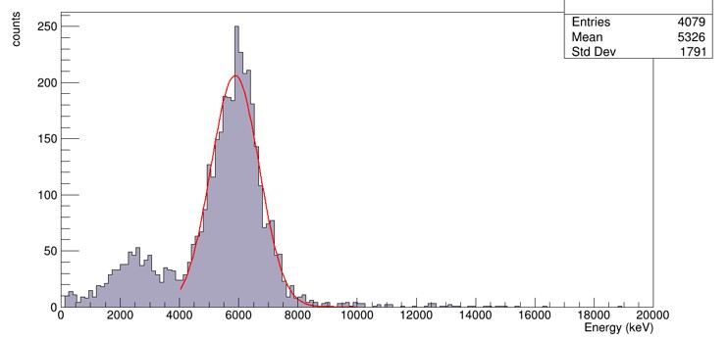
μ-RWELL for TACTIC (TRIUMF)
TRIUMF Anular Chamber for Tracking and Identification of Charged particles
Active-target detector with cylindrical geometry to study nuclear reactions with astrophysical significance
Aims at efficient small reaction cross-section measurements at low E
Exploiting μ-RWELLs in a curved cylindrical geometry for detection of various reactions of interest with a range of energies (tens keV to few MeV)
Length of detection region (shaded yellow): 251.9 mm
Radius: 53 mm
μ-RWELLs are currently installed inside the apparatus and first alpha signals were seen. Future tests with reference sources and with a stable beam planned
TEST
TPC with planar geometry
Test chamber size: 150 mm x 480 mm x 120 mm
Drift drift gap: 30 mm
μ-RWELL active area dimensions: 35 mm x 251.85 mm; μ-RWELL overall dimensions: 336 mm x 80 mm; Foil thickness: 0.2 mm
Anode is segmented into 60 pads of width 4.2 mm
Designed to test MPGDs and electronics for TACTIC
Ar:CO₂; ~10³ energy resolution

Slide 20
Clas12 upgrade @ JLAB
Upgrade phase I: increase luminosity by a factor 2 and improve tracking reconstruction efficiency
  Require additional fast tracking precision layer in the forward region to compensate for drift chamber limitation
Upgrade phase II: Increase luminosity by a factor 10
  Adding several layers to the forward trackers / or replacing drift chambers by fast trackers ➔ MPGD candidate for large area cost effective capabilities
R1
R2
R3
Main efficiency limitation is due to DC occupancy in R1 (up to 3% at high luminosity)

Slide 21
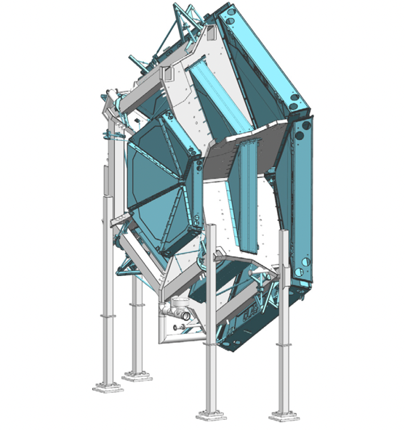
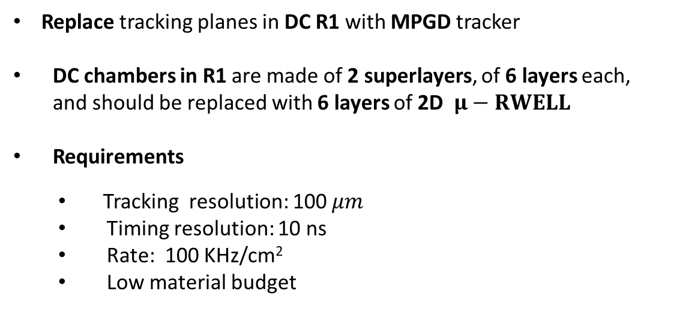
Clas12 upgrade @ JLAB
R1
R2
R3
Replace tracking planes in DC R1 with MPGD tracker
DC chambers in R1 are made of 2 superlayers, of 6 layers each, and should be replaced with 6 layers of 2D $μ−RWELL$
Requirements
  Tracking resolution: 100 $μm$
  Timing resolution: 10 ns
  Rate: 100 KHz/cm²
  Low material budget

Slide 22
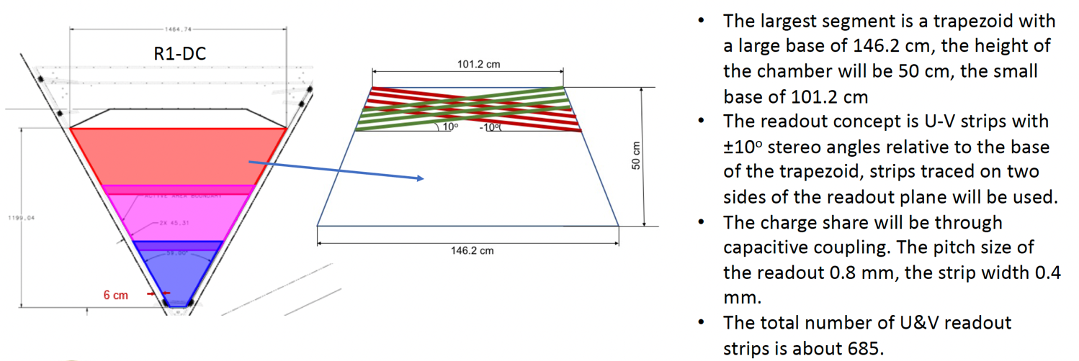
Clas12 upgrade @ JLAB
R1 – detector geometry

Slide 23
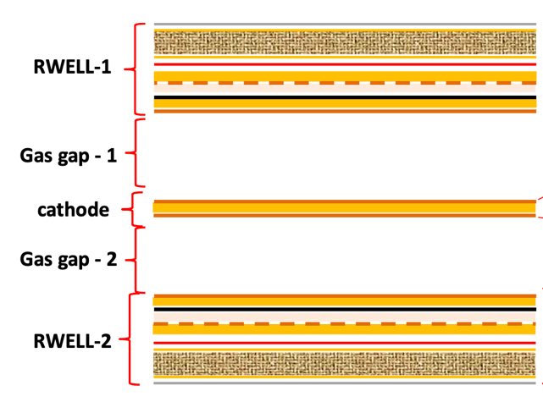
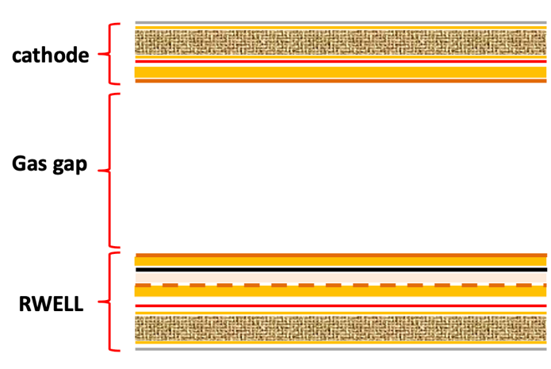
Clas12 upgrade @ JLAB
2D – readout schemes are being studied in LNF/Rome (synergy w/RDFCC studies)
2 x 1D with common cathode
2D readout: standard X strips on the bottom layer
Y strips on the top layer
Detectors prototypes will be tested @ CERN test beam run in fall 2022

Slide 24
2022 – 2023 CLAS12- RM2 tentative plans
2022
  7-8/2022 – delivery 10x10 cm2 PEP-RWELL 1D & 2D w/top readout (RM2 + LNF+ Ferrara)
  9/2022 – assembly, fast characterization w/X-ray (RM2 + LNF + Ferrara)
  10/2022 – joint test beam at CERN (RM2 + LNF + Ferrara)
  > 7/2022 – low mass mechanics simulation and mock-up construction (Ferrara + RM2 + LNF)
  > 7/2022 – 0.8 mm pitch strip simulation w/2021 data set (RM2 + …)
2023
  Design/production of the 50x50cm2 PEP-RWELL 2D layout following results from 2022 TB
  Test beam (?)

Slide 25
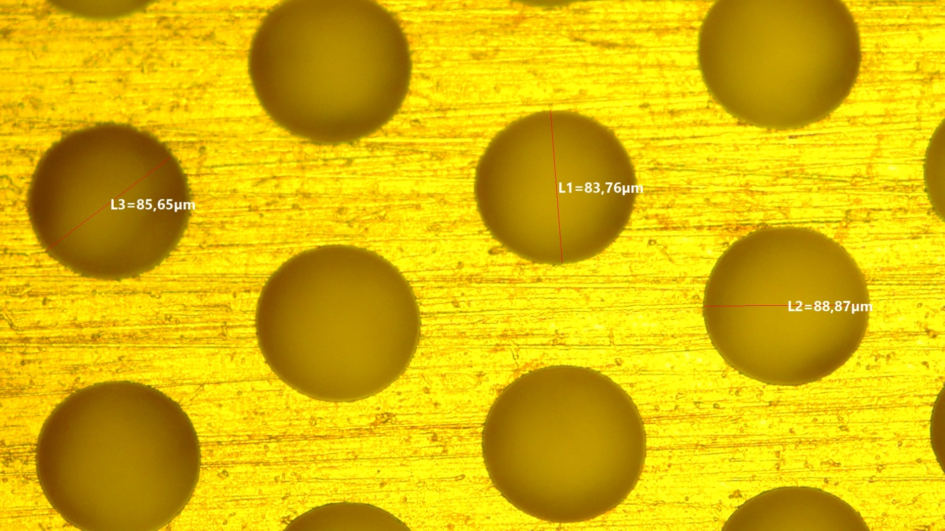
Spare Slides

Slide 26
LHCb upgrade II (Run5 – Run6)
Detector size & quantity (4 gaps/chamber - redundancy)
R1÷R2: 576 detectors, size 30x25 to 74x31 cm², 90 m² det. - 130 m² DLC
R3: 768 detectors, size 120x25 to 149x31 cm², 290m² det. - 414 m² DLC
R4 : 3072 detectors, size 120x25 to 149x31 cm², 1164 m² det. - 1662 m² DLC

Slide 27
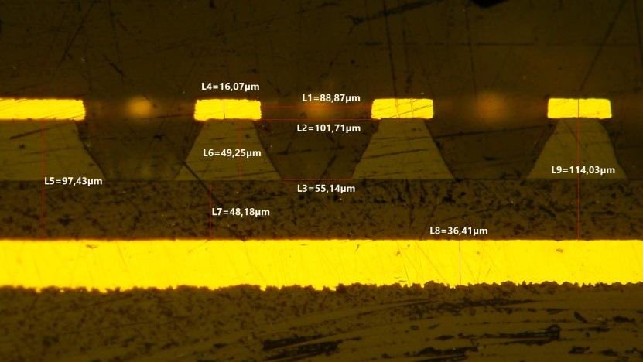
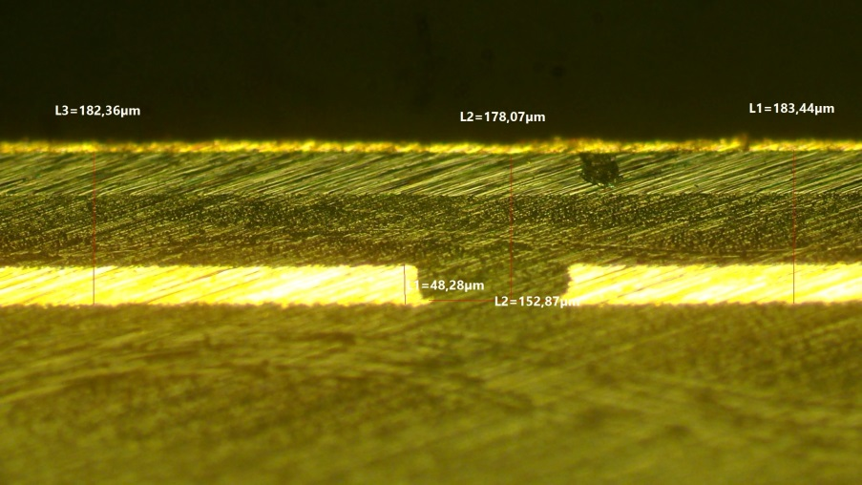
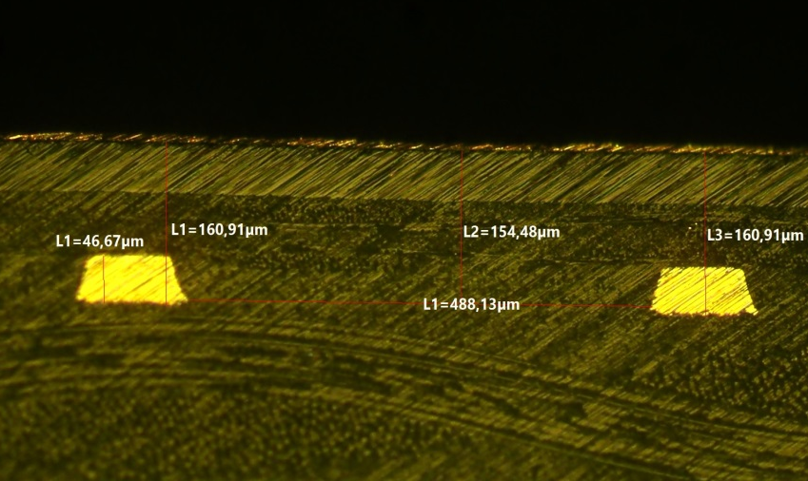
Starting point (2017-2020): ELTOS vs CERN
Standard CERN stacking
reference
DLCed Kapton foil gluing on PCB
The coupling/gluing is performed through a 106-prepreg foil. Main requirements:
good planarity
minimizing the DLC–readout distance (to maximize the signal amplitude):
  preliminary PCB planarizing at CERN + prepreg-106
  different approach implemented in the past in ELTOS with a double prepreg-106
16 um Cu
50 um Kapton
48 um 1xprepreg-106
36 um Cu readout pad
pad
Standard ELTOS stacking
to be optimized
Standard ELTOS stacking
almost OK
5 um Cu
5 um Cu
50 um Kapton
50 um
80 um 2xprepreg-106
58 um 2xpre-preg
48 um Cu readout
47 um Cu
pad
strip

Slide 28
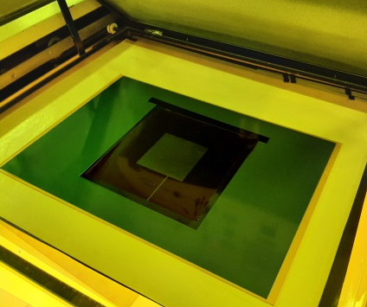
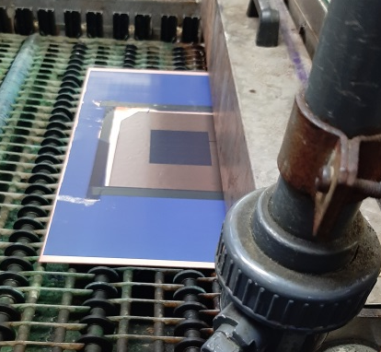
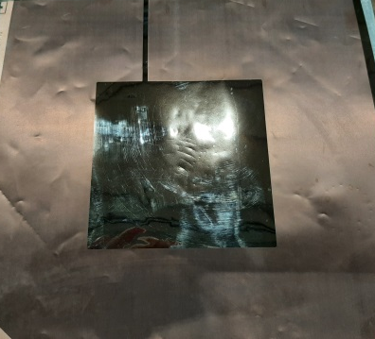



Tests in ELTOS (I)
1
  DLC patterning
photo-resist application/developing ⊕ patterning with brushing-machine
while at CERN a different approach, based on a JET-SCRUBBING-machine, is implemented
2
3
PCB planarizing
PCB planarizing by filling the gap between pads with epoxy resin Taiyo THP-100DX1 VF (screen printing) ⊕ PEM planarizer (POLA&MASSA)
  While at CERN a PCB planarizing w/early-stripping of suitable prepreg (115°C/15min)
1
2
28um
24um
29um
gap filling 24 um
pad 29 um

Slide 29




Tests in ELTOS (II)
DLCed Kapton foil gluing on PCB w/pressing machine
Press-top
pacothane
DLC-Kapton foil
Stainless steel plates
n.1 PANASONIC R-1551W tipo106
PCB-1.6mm
n.1 Pacoflex(1000)–250 um
Press-down
Main parameters:
pressure 180 N/cm²
temperature 210°C
5 um Cu
50 um Kapton
55 um 1xprepreg-106
18 um Cu readout
Good uniformity & DLC–readout distance close to CERN stackout

Slide 30



R&D on the PEP high rate layout
In the framework of the LHCb phase-2 upgrade, in strict collaboration with CERN (Rui), we are developing the PEP (Patterning-Etching-Plating) high-rate layout.
Similarly to the previous SG layout the PEP is based on a grid-like DLC grounding:
in the SG layout the conductive grid was patterned by etching a Cu-layer deposited onto the DLC film
in the PEP the conductive grid is Patterned on the Cu top layer of the kapton foil, connected with the underlying DLC by means a dense blind-vias first Etched then Plated. In this way the DLC is grounded from the top
Advantages:
no Cu deposition on DLC is required
No fine alignment problem between bottom and top
is required
PEP – Patterning-Etching-Plating
grid-like DLC grounding from Cu-top

Slide 31


PEP-1 layout
A first high rate PEP prototype, developed for LHCb, has been realized and it has been extensively tested (layout optmization in progress)
6 mm
8 mm

Slide 32


PEP-1 layout performance
The rate capability has been measured by irradiating the detector with 5,9 X-ray with Pb collimators with different spot size. The diameter of collimators was larger than the DLC ground pitch. RC_{mip} > 10 MHz/cm².
A long-term X-ray irradiation is on-going: the current of the detector electrodes (Itop, Icat) as well as ambient parameters (T, P, RH) are constantly monitored.
Q_{int.} ∼ 100mC over all the test period.

Slide 33




PEP-2 layout (geometry optimization)

Slide 34



2D – readout layouts
2-stacked 1D-RWELL
common light cathode
easy PCB construction
No high gain required
relatively small increase of material budget (0.6% wrt 0.5% X0)
PCB_RWELL w/2D readout
X-Y signal pick-up equalization
DLC-readout distance to be minimized
higher gain (2x) wrt 1D-RWELL
more complex PCB manufacturing
PCB_RWELL w/segmented top
HV on DLC, safer insulation required
TOP to ground
No high gain required
y strip
y strip
x strip y strip
x strip
x strip

Slide 35
2D – readout layouts study
2-stacked 1D-RWELL
common light cathode
easy PCB construction
No high gain required
small increase of material budget
PCB_RWELL w/2D readout
higher gain (2x) wrt 1D-RWELL
more complex PCB manufacturing
X-Y signal pick-up equalization
DLC-readout distance to be minimized
PCB_RWELL w/segmented top
HV on DLC, safer insulation required
TOP to ground
No high gain required
y strip
y strip
x strip y strip
x strip
x strip
Options investigated for RDFCC & CLAS_12-JLAB

Slide 36




Comparison single/double press (LR w/pad readout – 2017 batch)
77 um
5 um Cu
5 um Cu
70 um
53 um
32 um
108 um
108 um
Single press. Ampl. Hole (ELTOS + CERN)
Double press. Ampl. Hole (ELTOS + CERN)
Single press. stackout (ELTOS + CERN)
Double press. stackout (ELTOS + CERN)

Slide 37




Low-rate (RDFCC) vs PEP -1 (LHCb)
80 um
100 um
15 um Cu
15 um Cu
87 um
40 um
66 um
50 um
52 um
RDFCC Low-rate Ampl. Hole (CERN)
PEP - 1 Ampl. Hole (CERN)
RDFCC Low-rate stackout (CERN)
PEP -1 stackout (CERN)

Slide 38



PEP-0 vs PEP-1
15 um Cu
88 um
102 um
80 um
100 um
15 um Cu
55 um
48 um
50 um
52 um
PEP–0 Ampl. Hole (CERN)
PEP-1 Ampl. Hole (CERN)
DLC grounding vias
DLC grounding vias
PEP–0 stackout (CERN)
PEP-1 stackout (CERN)

Slide 39
PEP-1 details
PEP-1 Ampl. Hole (CERN)
PEP-1 DLC grounding-hole plating (CERN)
PEP-1 stackout (CERN)

Slide 40
The High Rate μ-RWELL concept
Ground
Ground
Low Rate
High Rate
spot size: r
half active area: d
A sort of tassellation with little low rate schemes.

Slide 41


PCB-RWELL w/2D-readout (stackout optimization)
X-Y equal sharing + signal collection optimization → study by Zhou Yi (USTC) w/Rui (CERN)
2D-strip μRWELL
Sector 1能谱
Top layer
Bottom layer
Copper
Top strips: 60um (80)
Bottom strips: 350um (350)
Pitch: 400um (400)
strip width geometry
X-Y equal sharing
Insulator layer between Top & Bottom readout strips: 25um (50)
DLC resistivity: R_{AB}=40MΩ
top/bottom
thickness
Insulating layer between DLC and readout strip:
50um Prepreg+12um Kapton+10um epoxy glue
DLC-readout distance → can be reduced down to 28um for signal optimization

Slide 42
Tentative schedule µ-RWELL in LHCb

Slide 43
Open Problems/possible solutions (?)
CF4 is not an eco-gas, responsible of strong kapton etching observed on GEM detectors (STUDY OF ETCHING EFFECTS ON TRIPLE-GEM DETECTORS OPERATED WITH CF₄-BASED GAS MIXTURES, M. Alfonsi et al., IEEE Trans.Nucl.Sci.52 (2005) 2872-2878.)
Old GEM detectors at LHCb will be analysed to check for CF4 etching effects (we can learn from this study)
PEP µ-RWELL irradiated with X-Rays at LNF will be analysed to check for CF4 etching effects
Eco-gas mix for GEM/RWELL (?)
RWELL in LHCb (in principle) needs for fast gas mix (?)
Long-term test of a PEP µ-RWELL irradiated with X-Rays will be started soon with Ar/Co2 gas mix (no CF4)
Defining a safe assembly/testing procedure: DI-washing+electrical hot-cleaning, humidity control in the gas line, detector conditioning (in strict collaboration with Rui)
Replacing FR4 frames with PEEK frames, more expensive BUT not hygroscopic and then compatible with CF4 (eventually only in closed mode)
2D readout still to be investigated: 2x1D or 2D w/top readout … capacitive sharing (by Kondo)
Low-mass mechanics (Jlab, Eurizon): to be tuned, looking for materials compatible with RWELL DI-washing/hot-cleaning
Apart APV25 there is no other user-friendly electronics for testing MPGD (not only RWELL).
For LHCb the Bari group is developing a new ASIC, FATIC (still to be tested)
Other ASIC: VMM3 (?)

