Slide 1
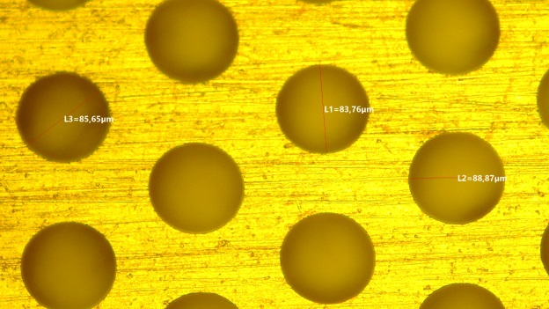
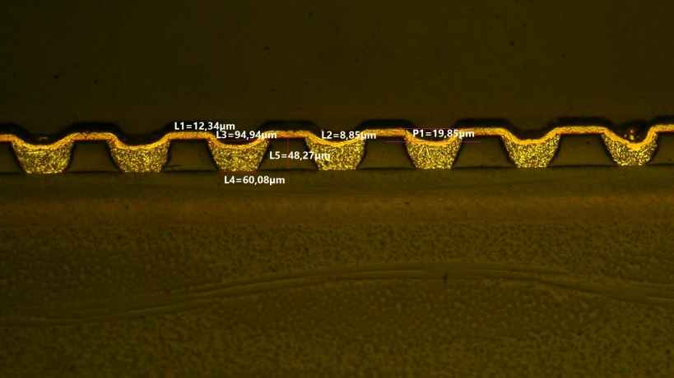
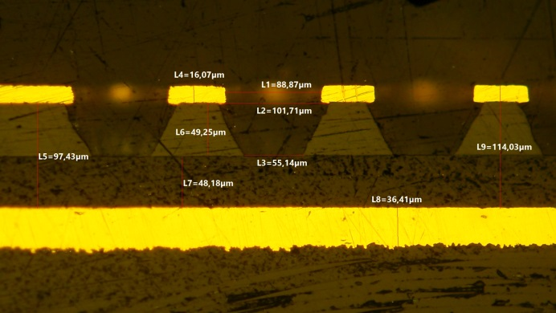
AIDAInnova-WP7.3.2
Industrial engineering of high rate 𝜇-RWELLs
G. Bencivenni (LNF-INFN)
on behalf of Bologna-Ferrara-Frascati INFN teams
R. De Oliveira - CERN-EP-DT-MPT Workshop
R. Pinamonti, M. Pinamonti - ELTOS SpA
AIDA-Innova General Meeting, CERN - 29th March 2022

Slide 2
Task objectives
Deliverable
D7.3: μ-RWELL prototypes co-produced by industry under the guidance and supervision of the research team. A complete report will be provided (Task 7.3)
Milestone
MS27: Build a 0.3×0.3 m² prototype and the readout plane with the new structure

Slide 3
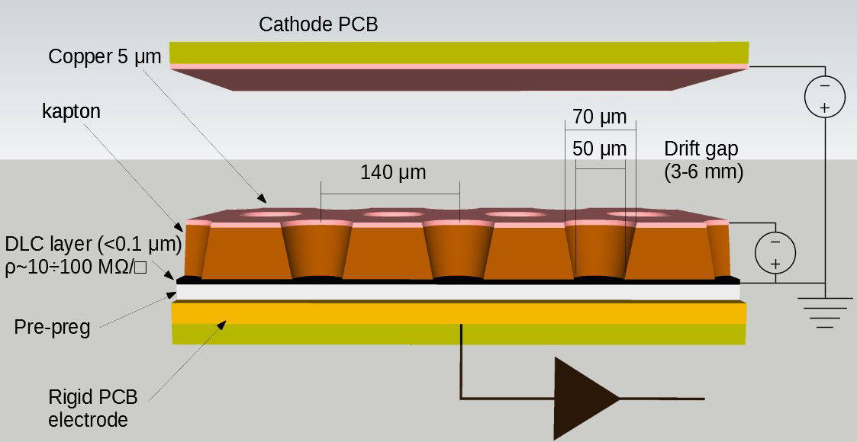
The μ-RWELL (reminder)
The μ-RWELL is a resistive MPGD composed of only two elements:
μ-RWELL_PCB
Cathode
The μRWELL_PCB realized by coupling the resistive grounded amplification stage with the readout PCB through a thin prepreg foil
1
2
3
1
a WELL patterned kapton foil (with a Cu-layer on the top) acts as amplification stage
2
a resisitive DLC layer^{(*)} (Diamond-Like-Carbon), with ρ~10÷100 MΩ/□
3
a standard readout PCB with pad/strip segmentation
^{(*)} DLC foils are currently provided by the Japan Company – BeSputter

Slide 4
The road-map: R&D + Engineering
R&D loop
Layout design
CERN prototyping
LNF validation tests
Layout adj.
IDEA
Manufacturing readiness
Engineering
Pilot-run
QA/QC
Process adj.
Engineering loop

Slide 5
Operative meetings
21 Sept. 2021 - joint INFN-ELTOS-CERN meeting
standardizing manufacturing procedures of μ-RWELL layout
1-3 Dec. 2021 - CERN-INFN meeting
status of the R&D on the High Rate layout
measurement with high intensity X-ray beam
2D layout based on the readout of a segmented amplification stage
7–10 Dec. 2021 – 1st test batch in ELTOS
DLC patterning
PCB planarizing tests
7–8 Mar. 2022 - 2nd test batch in ELTOS
PCB planarizing tests
Kapton DLCed foil coupling with PCB-readout
Mar. 2022 - joint INFN-ELTOS-CERN meeting
discussion with Rui about the results obtained

Slide 6
Manufacturing steps
Step 0 - CERN_INFN DLC sputtering machine @ CERN
bid concluded
delivery foreseen end of July 2022 – operational within end of 2022
Step 1 - producing PCB readout for μ-RWELL (pad/strip readout) @ ELTOS
with top patterned (pad/strip side)
without patterning bottom layer (connector side)
Step 2 - DLC patterning → two options under investigation:
photo-resist ⊕ patterning with BRUSHING-machine (ELTOS)
photo-resist ⊕ patterning with JET-SCRUBBING-machine (CERN)
Step 3 - DLC foil gluing on PCB → three options under investigation:
double 106-prepreg, ~2x50μm thick (by ELTOS - before 2021)
PCB planarizing w/early-stripping of suitable prepreg (115°C/15min) ⊕ single 106-prepreg (by CERN)
PCB planarizing w/gap filling with epoxy Taiyo THP-100DX1 VF (screen printing) ⊕ single 106-prepreg (by ELTOS - NOW)
Step 4 - Top copper patterning for successive kapton etching to create evacuation vias (by CERN and/or ELTOS)
Step 5 - Amplification stage patterning: kapton etching ⊕ plating ⊕ ampl-holes (by CERN)

Slide 7
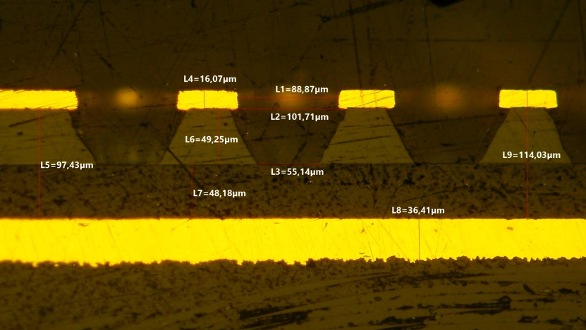
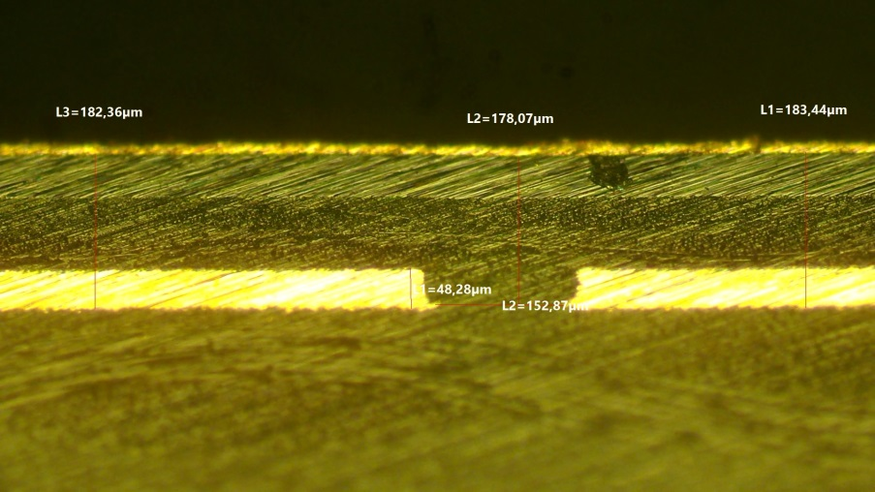
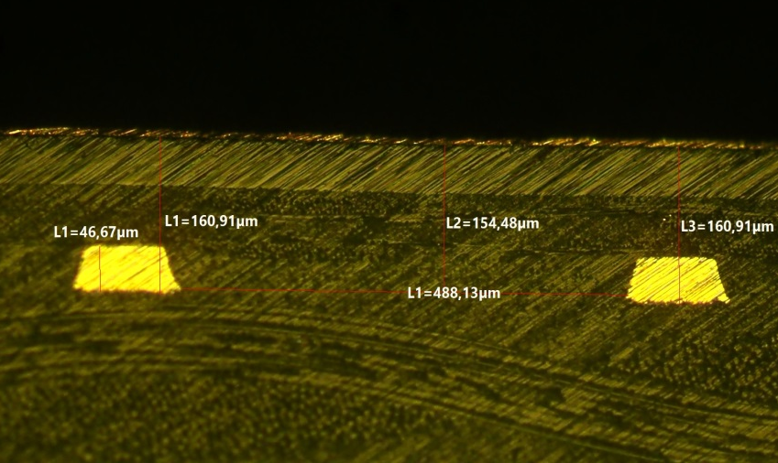
Starting point (2017-2020): ELTOS vs CERN
Standard CERN stacking
CERN reference
DLCed Kapton foil gluing on PCB
The coupling/gluing is performed through a 106-prepreg foil. Main requirements:
good planarity
minimizing the DLC–readout distance (to maximize the signal amplitude):
PCB planarizing at CERN + prepreg-106
different approach implemented in the past in ELTOS with a double prepreg-106
16 um Cu
50 um Kapton
48 um 1xprepreg-106
36 um Cu readout pad
pad
Standard ELTOS stacking
to be optimized
Standard ELTOS stacking
almost OK
5 um Cu
5 um Cu
50 um Kapton
50 um
80 um 2xprepreg-106
58 um 2xpre-preg
48 um Cu readout
47 um Cu
pad
strip

Slide 8
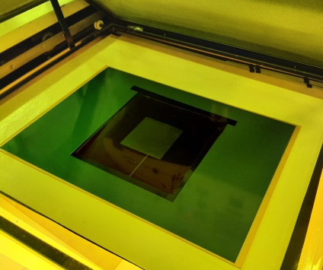
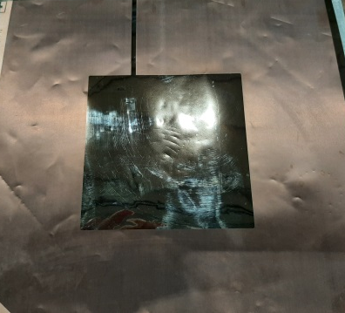
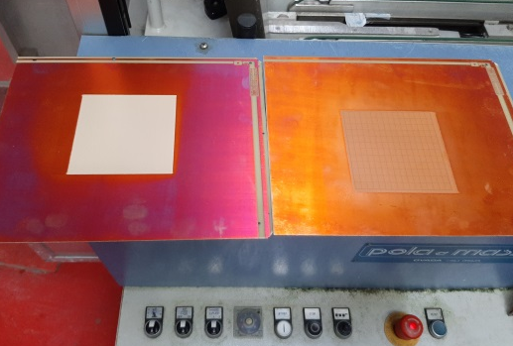
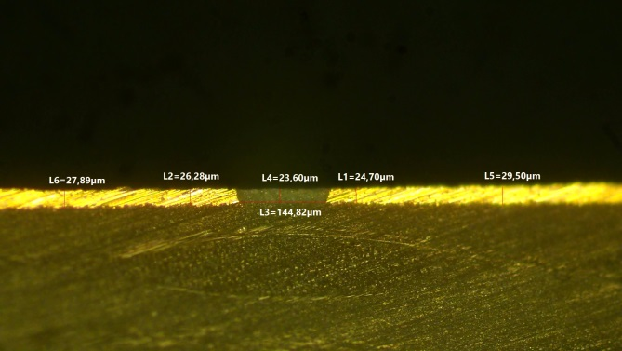
Tests in ELTOS (I)
1
DLC patterning
photo-resist application/developing ⊕ patterning with brushing-machine
while at CERN a different approach, based on a JET-SCRUBBING-machine, is implemented
2
3
PCB planarizing
PCB planarizing by filling the gap between pads with epoxy resin Taiyo THP-100DX1 VF (screen printing) ⊕ PEM planarizer (POLA&MASSA)
While at CERN a PCB planarizing w/early-stripping of suitable prepreg (115°C/15min)
1
2
28um
24um
29um
gap filling 24 um
pad 29 um

Slide 9
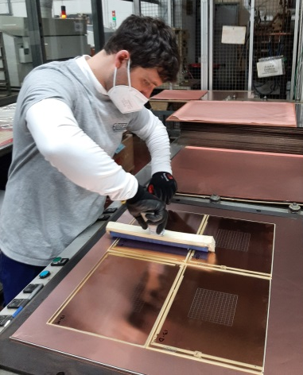
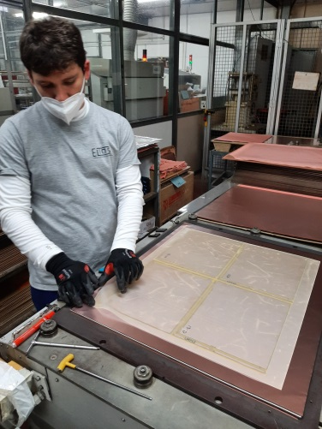
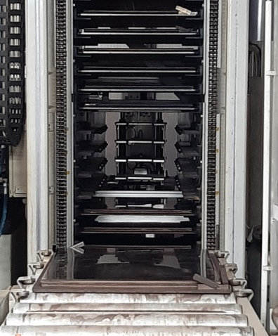
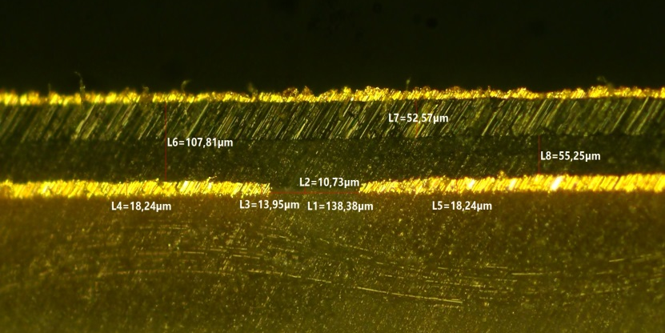
Tests in ELTOS (II)
DLCed Kapton foil gluing on PCB w/pressing machine
Press-top
pacothane
DLC-Kapton foil
Stainless steel plates
n.1 PANASONIC R-1551W tipo106
PCB-1.6mm
n.1 Pacoflex(1000)–250 um
Press-down
Main parameters:
pressure 180 N/cm²
temperature 210°C
5 um Cu
50 um Kapton
55 um 1xprepreg-106
18 um Cu readout
Good uniformity & DLC–readout distance close to CERN stackout

Slide 10
NEXT steps
Production of real μ-RWELL_ PCBs (PEP layout w/pad-readout) in ELTOS
PCB with pad readout
PCB planarizing
DLC patterning
DLCed kapton foil gluing on PCB
Finalizing μ-RWELL_ PCB at CERN
Top Cu patterning for DLC grounding vias
Well patterning by Kapton etching
Comparison of joint ELTOS-CERN PCB _RWELL with one manufactured only at CERN
Start operation of the DLC sputtering facility at CERN (techn. Staff to be trained …)

Slide 11
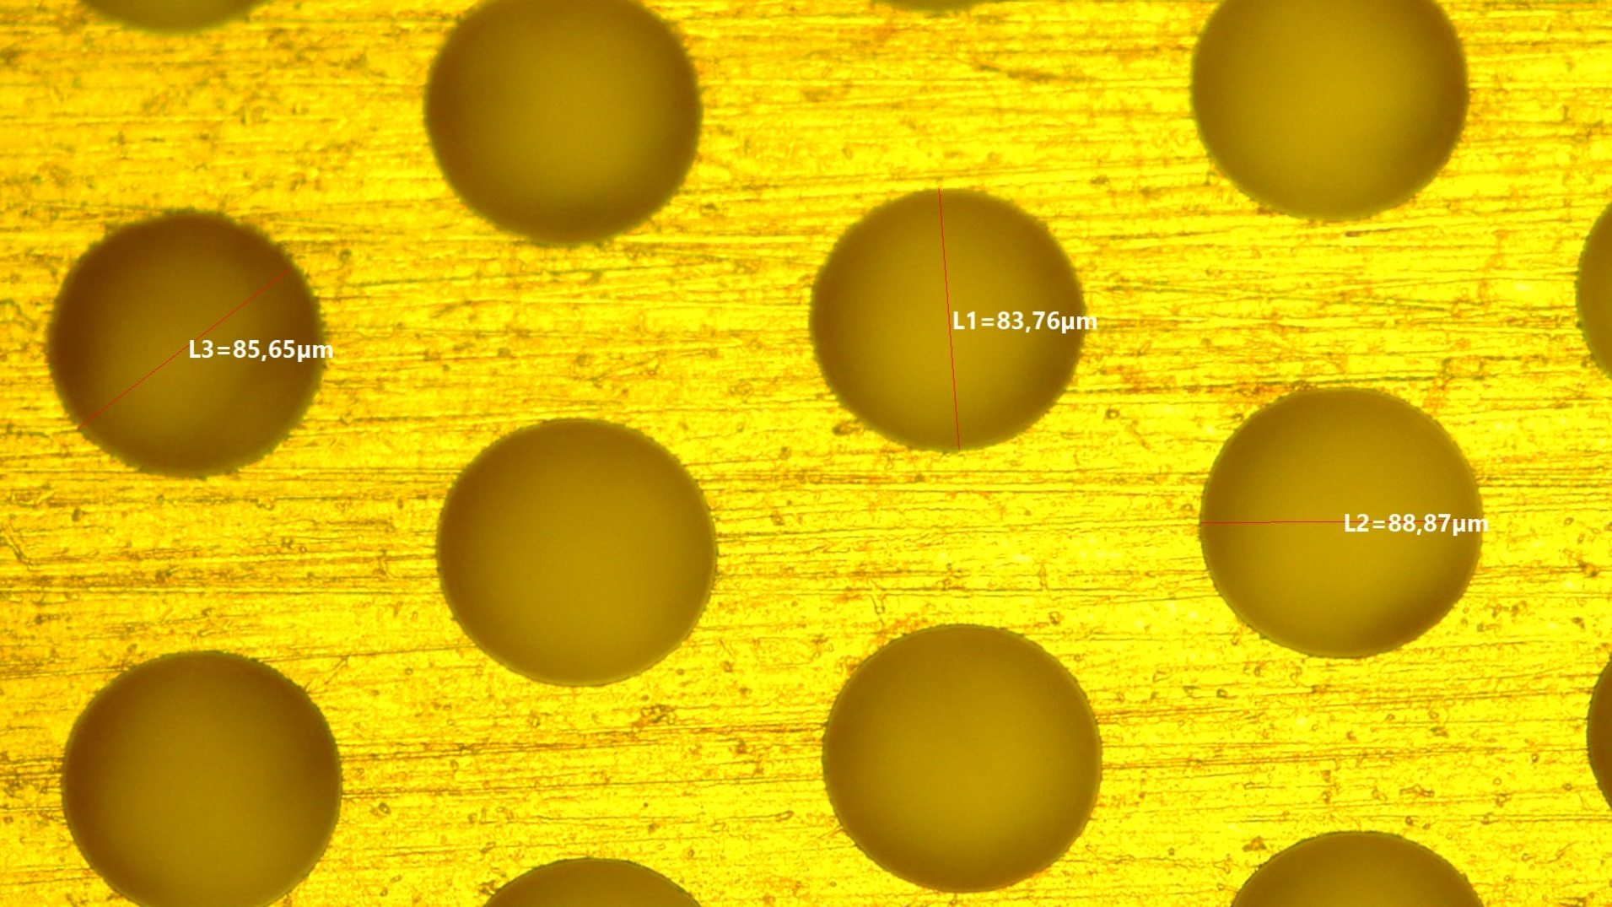
Spare Slides

Slide 12
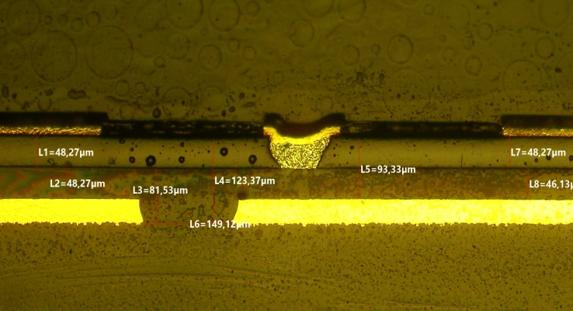
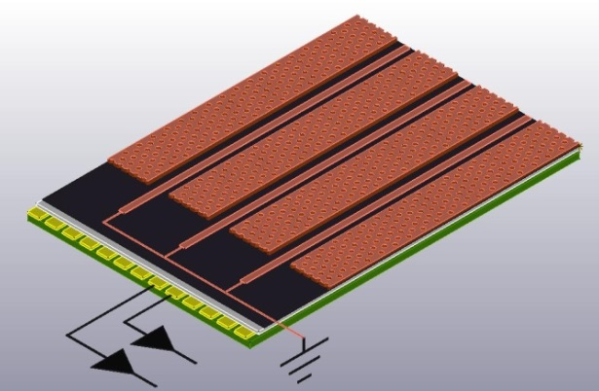
R&D on the PEP high rate layout
In the framework of the LHCb phase-2 upgrade, in strict collaboration with CERN (Rui), we are developing the PEP (Patterning-Etching-Plating) high-rate layout.
Similarly to the previous SG layout the PEP is based on a grid-like DLC grounding:
in the SG layout the conductive grid was patterned by etching a Cu-layer deposited onto the DLC film
in the PEP the conductive grid is Patterned on the Cu top layer of the kapton foil, connected with the underlying DLC by means a dense blind-vias first Etched then Plated. In this way the DLC is grounded from the top
Advantages:
no Cu deposition on DLC is required
No fine alignment problem between bottom and top
is required
PEP – Patterning-Etching-Plating
grid-like DLC grounding from Cu-top

Slide 13
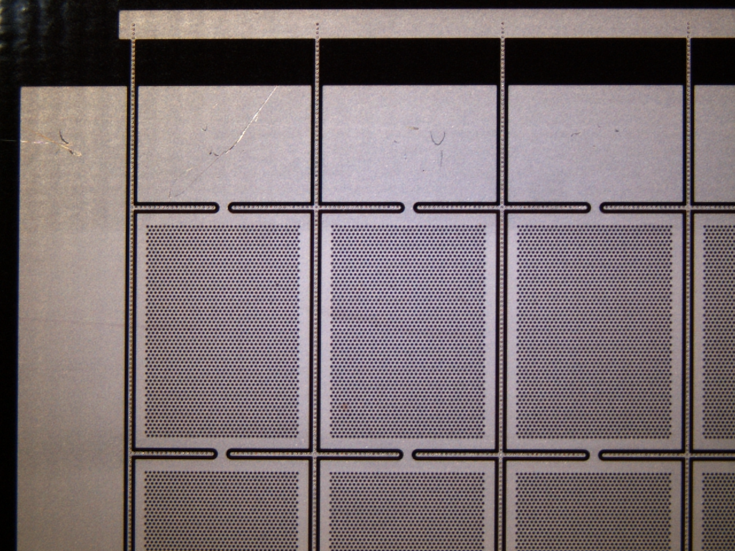
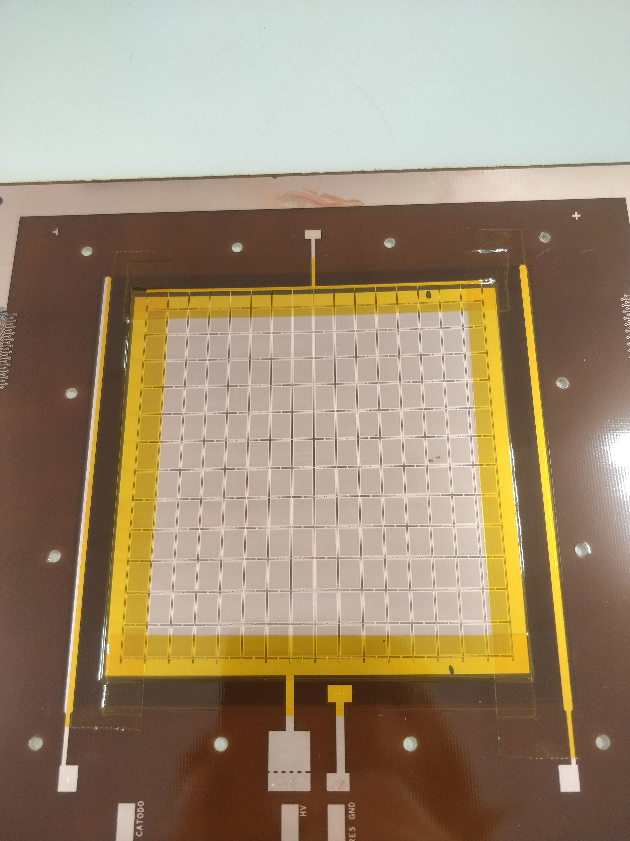
PEP-1 layout
A first high rate PEP prototype, developed for LHCb, has been realized and it has been extensively tested (layout optmization in progress)
6 mm
8 mm

Slide 14
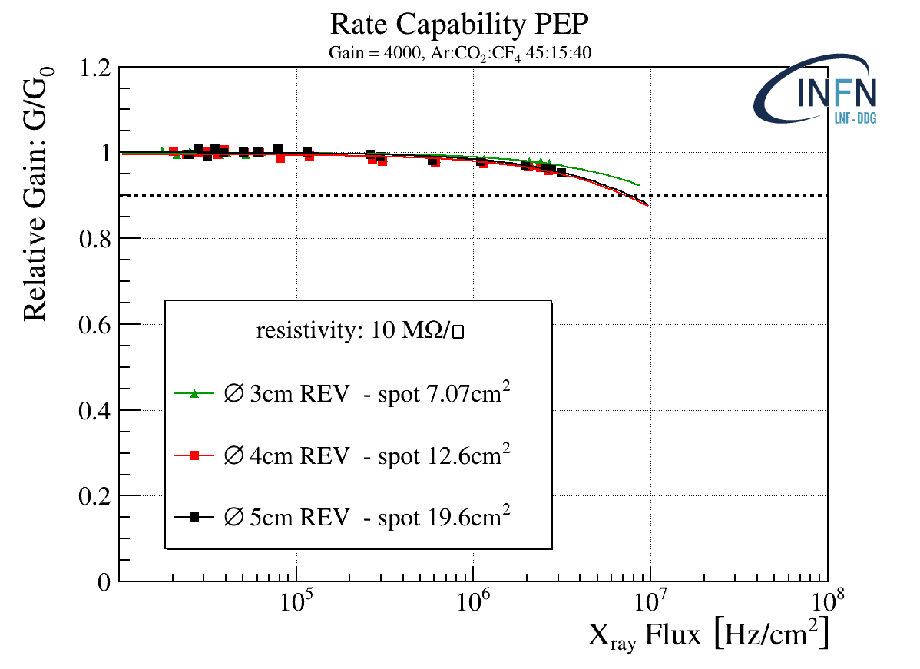
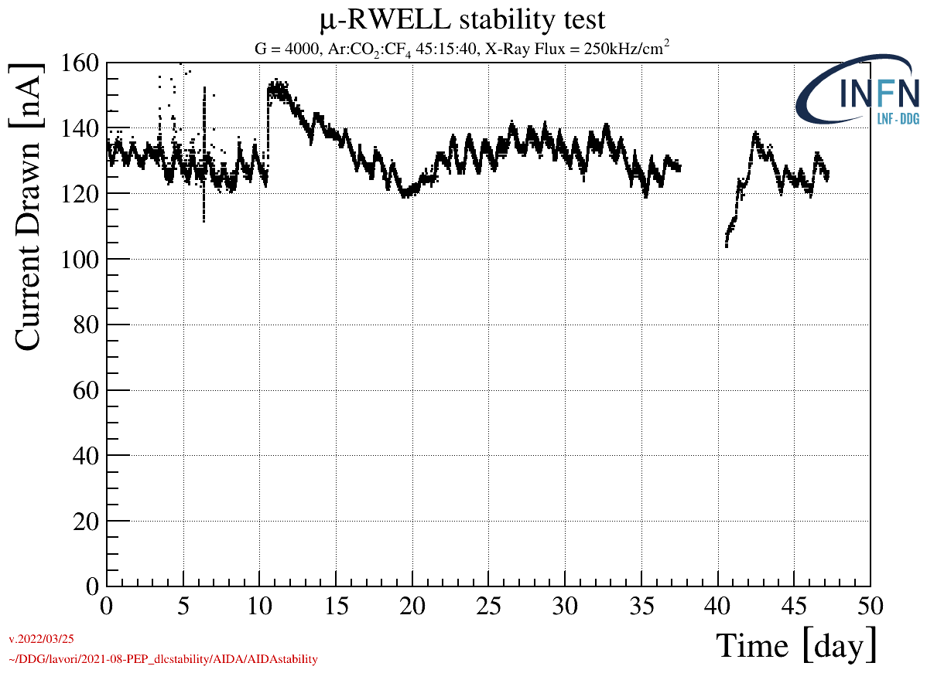
PEP-1 layout performance
The rate capability has been measured by irradiating the detector with 5,9 X-ray with Pb collimators with different spot size. The diameter of collimators was larger than the DLC ground pitch. RC_{mip} > 10 MHz/cm².
A long-term X-ray irradiation is on-going: the current of the detector electrodes (Itop, Icat) as well as ambient parameters (T, P, RH) are constantly monitored.
Q_{int.} ∼ 100mC over all the test period.

Slide 15
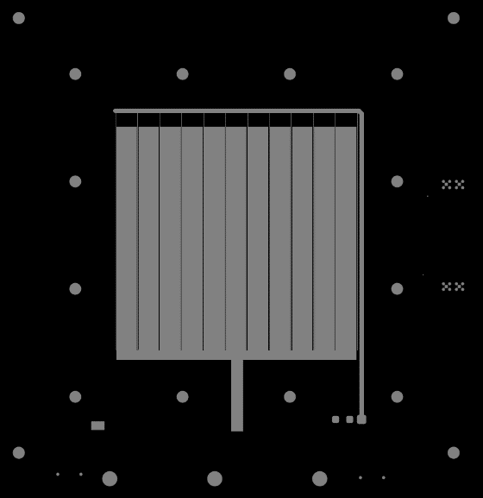
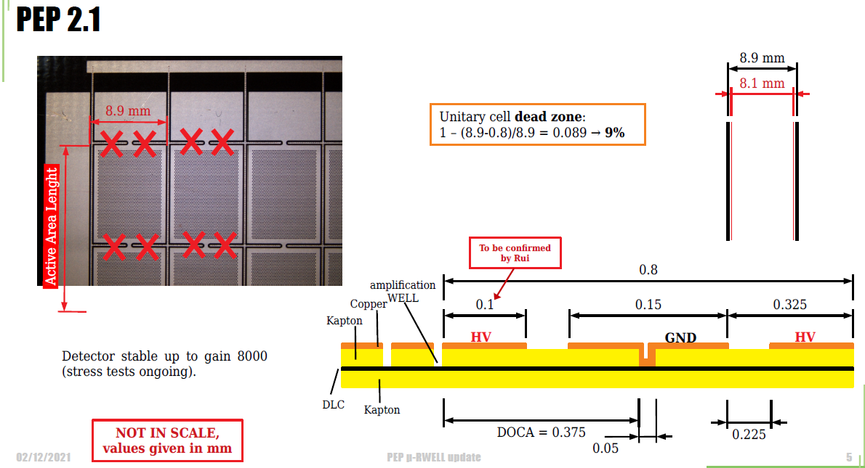
PEP-2 layout (geometry optimization)

Slide 16
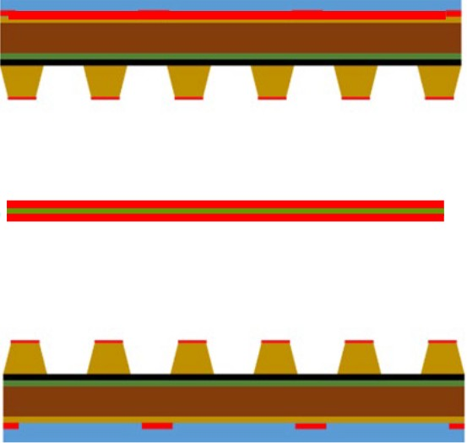
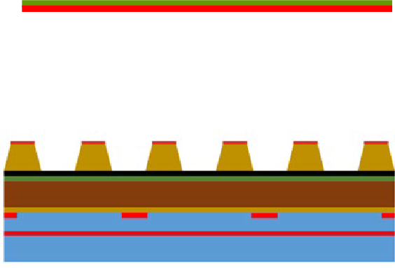
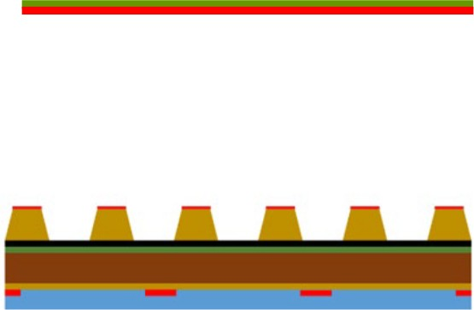
2D – readout layouts
2-stacked 1D-RWELL
common light cathode
easy PCB construction
No high gain required
relatively small increase of material budget (0.6% wrt 0.5% X0)
PCB_RWELL w/2D readout
X-Y signal pick-up equalization
DLC-readout distance to be minimized
higher gain (2x) wrt 1D-RWELL
more complex PCB manufacturing
PCB_RWELL w/segmented top
HV on DLC, safer insulation required
TOP to ground
No high gain required
y strip
y strip
x strip y strip
x strip
x strip

Slide 17
2D – readout layouts study
2-stacked 1D-RWELL
common light cathode
easy PCB construction
No high gain required
small increase of material budget
PCB_RWELL w/2D readout
higher gain (2x) wrt 1D-RWELL
more complex PCB manufacturing
X-Y signal pick-up equalization
DLC-readout distance to be minimized
PCB_RWELL w/segmented top
HV on DLC, safer insulation required
TOP to ground
No high gain required
y strip
y strip
x strip y strip
x strip
x strip
Options investigated for RDFCC & CLAS_12-JLAB

Slide 18
Summary and Outlook
The activity of WP7.3.2 task proceeds on two parallel paths:
the industrialization of some construction procedures of the µ-RWELLs at the ELTOS company (Arezzo - IT), in close collaboration with the CERN-EP-DT-MPT Workshop (Rui):
good results obtained on several manufacturing steps
planning the production of high-rate PCB-RWELLs with some construction steps carried out by ELTOS
kapton etching (+ …) performed at CERN
the R&D with CERN on the high-rate layouts is focusing on different items:
Design/optimization of the new PEP layout
prototypes characterization at LNF (gain, rate capability)
long-term stability test with high intensity X-rays
test beam at high rate (PSI) for efficiency in 25 ns time window

Slide 19
Spare Slides

Slide 20
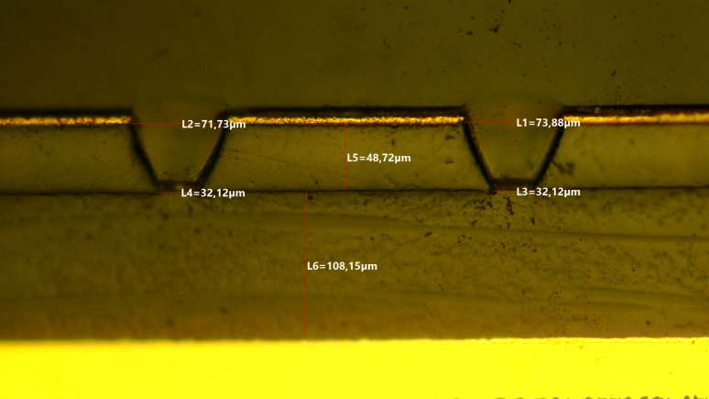
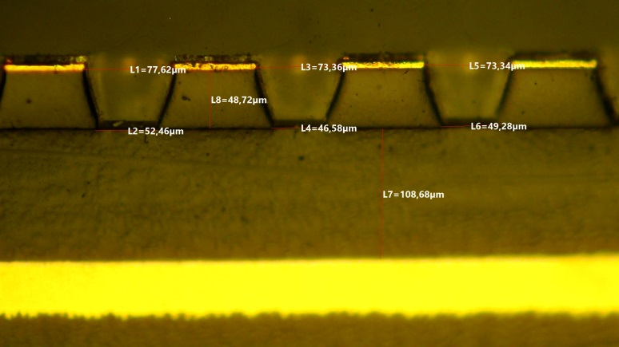
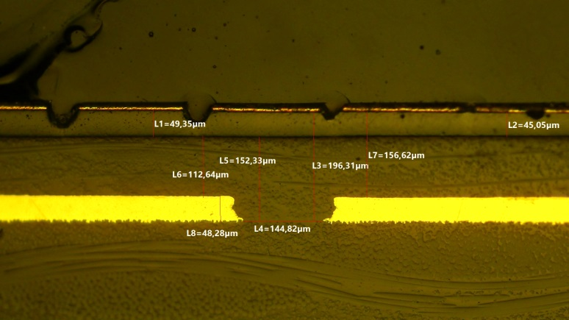
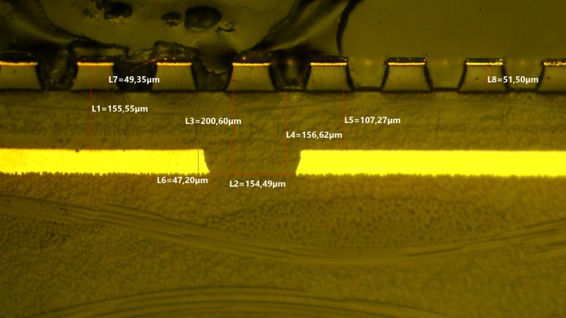
Comparison single/double press (LR w/pad readout – 2017 batch)
77 um
5 um Cu
5 um Cu
70 um
53 um
32 um
108 um
108 um
Single press. Ampl. Hole (ELTOS + CERN)
Double press. Ampl. Hole (ELTOS + CERN)
Single press. stackout (ELTOS + CERN)
Double press. stackout (ELTOS + CERN)

Slide 21
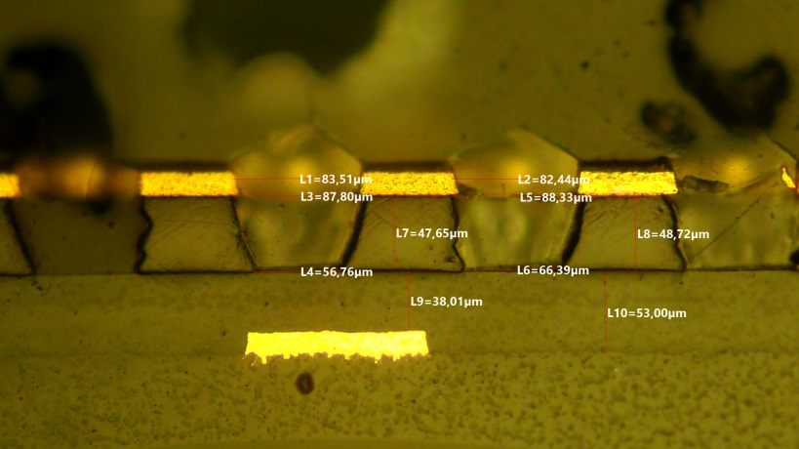
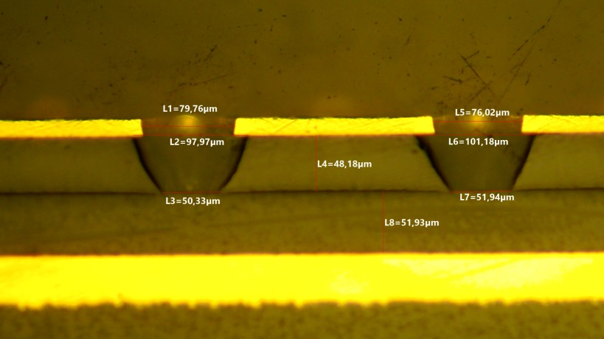
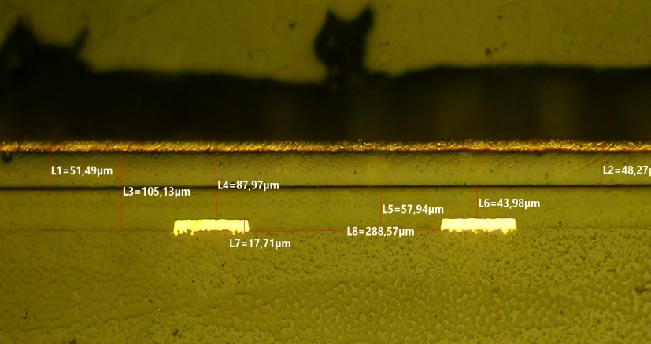
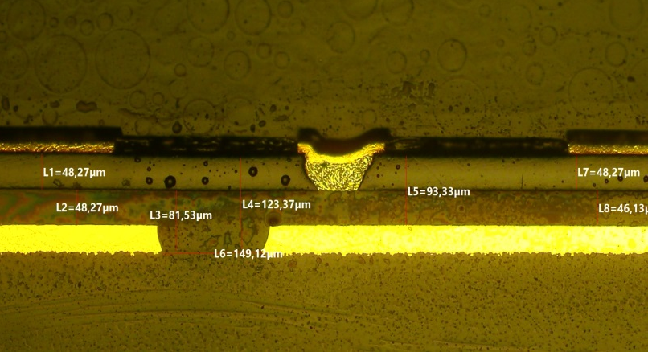
Low-rate (RDFCC) vs PEP -1 (LHCb)
80 um
100 um
15 um Cu
15 um Cu
87 um
40 um
66 um
50 um
52 um
RDFCC Low-rate Ampl. Hole (CERN)
PEP - 1 Ampl. Hole (CERN)
RDFCC Low-rate stackout (CERN)
PEP -1 stackout (CERN)

Slide 22
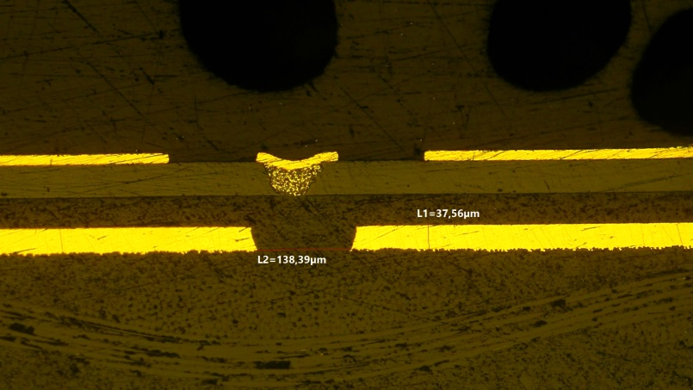
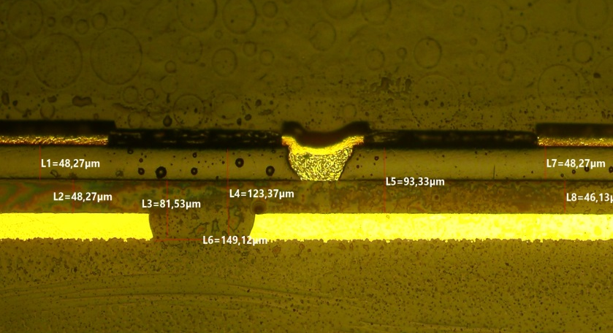
PEP-0 vs PEP-1
15 um Cu
88 um
102 um
80 um
100 um
15 um Cu
55 um
48 um
50 um
52 um
PEP–0 Ampl. Hole (CERN)
PEP-1 Ampl. Hole (CERN)
DLC grounding vias
DLC grounding vias
PEP–0 stackout (CERN)
PEP-1 stackout (CERN)

Slide 23
PEP-1 details
PEP-1 Ampl. Hole (CERN)
PEP-1 DLC grounding-hole plating (CERN)
PEP-1 stackout (CERN)

Slide 24
The High Rate μ-RWELL concept
Ground
Ground
Low Rate
High Rate
spot size: r
half active area: d
A sort of tassellation with little low rate schemes.

Slide 25
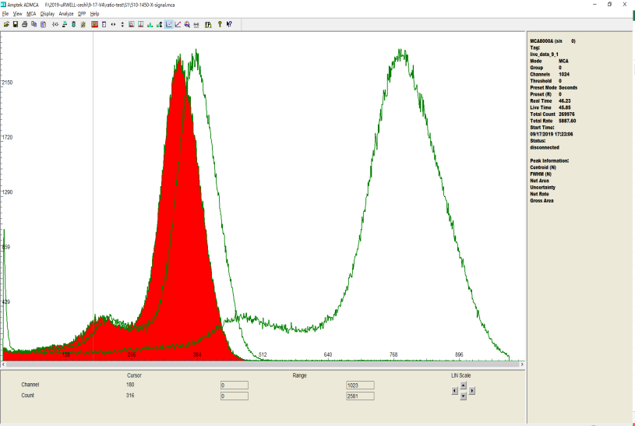
PCB-RWELL w/2D-readout (stackout optimization)
X-Y equal sharing + signal collection optimization → study by Zhou Yi (USTC) w/Rui (CERN)
2D-strip μRWELL
Sector 1能谱
Top layer
Bottom layer
Copper
Top strips: 60um (80)
Bottom strips: 350um (350)
Pitch: 400um (400)
strip width geometry
X-Y equal sharing
Insulator layer between Top & Bottom readout strips: 25um (50)
DLC resistivity: R_{AB}=40MΩ
top/bottom
thickness
Insulating layer between DLC and readout strip:
50um Prepreg+12um Kapton+10um epoxy glue
DLC-readout distance → can be reduced down to 28um for signal optimization

