Slide 1
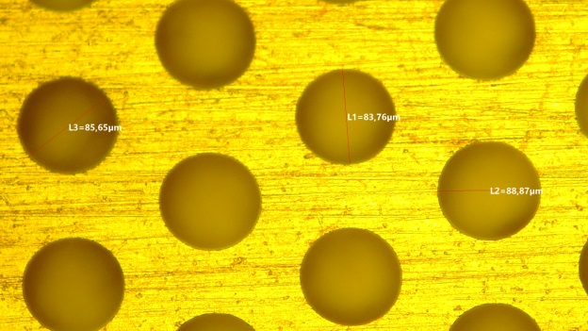
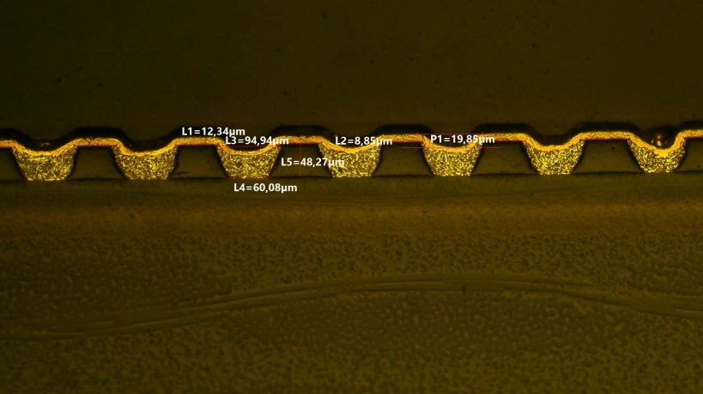
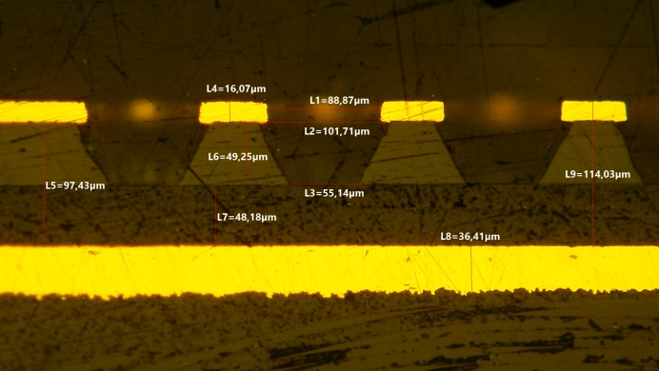

uRANIA-V: development of RGD for thermal neutron detection
G. Bencivenni
DDG – LNF - INFN
µ-RWELL GM 21-22 June 2022

Slide 2
uRANIA-V
GOAL: development of thermal neutron detectors based on Resistive-Gaseous Detectors (uRWELL + sRPC ) for applications in homeland security & radioactive waste monitoring
Project duration: 2021 - 2023
u
R
A
N
I
A
micro
INFN - Ferrara (1.1 - FTE) - tbc
G. Cibinetto (resp.loc) 0.15
I. Balossino 0.2
R. Farinelli 0.1
I. Garzia 0.25
M. Scodeggio Marco 0.2
A. Cotta Ramusino 0.1
+ 0.1 FTE dal servizio meccanico
INFN – LNF (1.15 FTE)
G. Bencivenni (resp. Naz) 0.4
G. Felici 0.2
G. Morello 0.2
M. Poli Lener 0.2
M. Giovannetti 0.15
esistive
dvanced
eutron
maging
pparatus

Slide 3
2022 plans
The GOAL was the construction and test of the first prototype of the detector-tile based on µ-RWELL technology with suitable converters & integrated counting-mode electronics
Finalizing the design of the detector PCB-RWELL (10x10cm²)
Finalizing converters design (planar/grooved cathodes – metallic mesh …)
Finalizing electronics based on CREMAT CR110 (+ discrimination + counting + … display + buzzer)
In parallel preliminary test of a neutron device based on mono-gap sRPC technology in hybrid configuration (DLC + ¹⁰B4C electrodes):
Design/construction of kapton electrodes w/DLC coating and ¹⁰B4C
Design/construction of detector mechanics
PCB readout
Electronics readout board based on CREMAT CR110
Three config.:
DLC(cat)+B4C(an)
B4C(cat)+DLC(an)
B4C(cat)+B4C(an)

Slide 4
Milestones
2021
M1: realizzazione dei convertitori a mesh e grooved-cathode e costruzione rivelatori piccoli dimensioni [m9]
M2: analisi dati del test beam di HOTNES con prototipi di piccole dimensioni equipaggiati con convertitori a mesh e grooved-cathode e instrumentati con elettronica commerciale [m12]
M3: costruzione e test del primo prototipo di detector-tile (10x10cm²) su tecnologia uRWELL, tipo head-on, con convertitori a mesh e grooved-cathode ed elettronica counting integrata [m24]
M4: costruzione e test di prototipi basati su tecnologia sRPC [m24]
M5: costruzione e full characterization di prototipo µ-RWELL di grande area strumentato con elettronica finale [m36]
DONE
2022
DONE
to be done?
2023
to be adjusted

Slide 5
2023 plans
In agreement with milestones, on the µ-RWELL side, plans can be the following:
Design & construction of large size tile (20x20 cm²) w/pad & top r/out
Choose the converter (planar/grooved cathodes – metallic mesh ???)
Design final fee board based on CREMAT CR110
HV ? We would like to do something ?
Assuming that the 2nd HOTNES (for sRPC) test will give good results:
Design/construction of 10x10 cm² sRPC tiles (electrode sputtering & assembly, mechanics …)
Design/construction of the PCB readout (for both anode/cathode)
Exploiting existing fee boards (?) already used for µ-RWELL

Slide 6
Funds request – 2023 (very preliminary)
???
We should start asap to collect offers (within Friday 24° June)

Slide 7
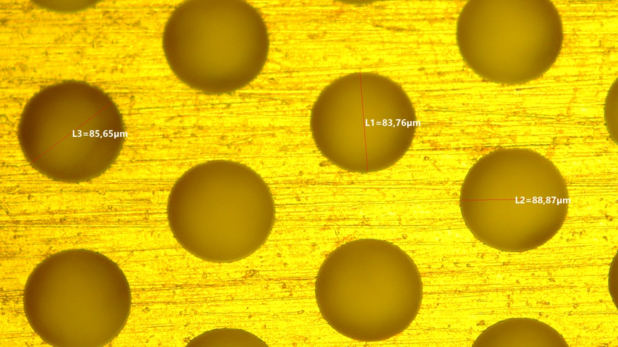
Spare Slides

Slide 8
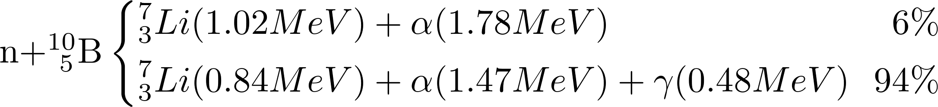
The pillars
Resistive Gaseous Detectors (μ-RWELL + sRPC)
Neutron Boron-Converters:
  Boron coated planar cathodes
  Boron coated metallic meshes
  Boron coated grooved-cathodes
detection of thermal neutrons (E_{k} ~ 25meV) with ¹⁰B₄C deposition on detector electrodes/cathodes
neutron conversion in ionizing particles (α/⁷Li back to back → mutually exclusive events)
not negligible α/⁷Li cross-section with ¹⁰B₄C → thickness optimization.
Counting-mode electronics - read-out of the induced signals on HV electrodes or external pick-up pads

Slide 9
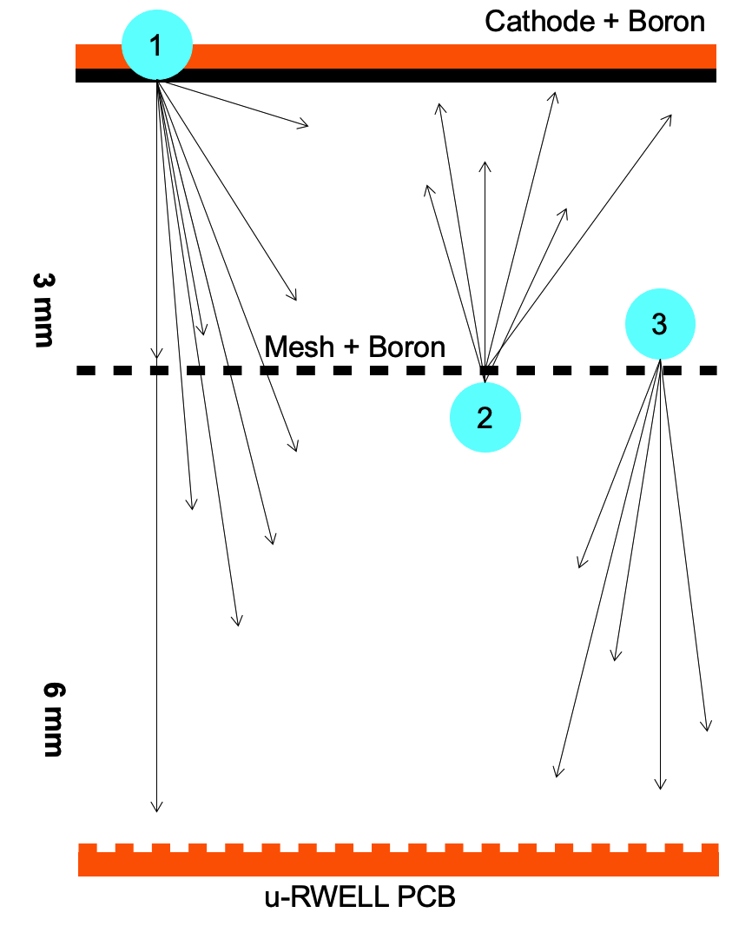
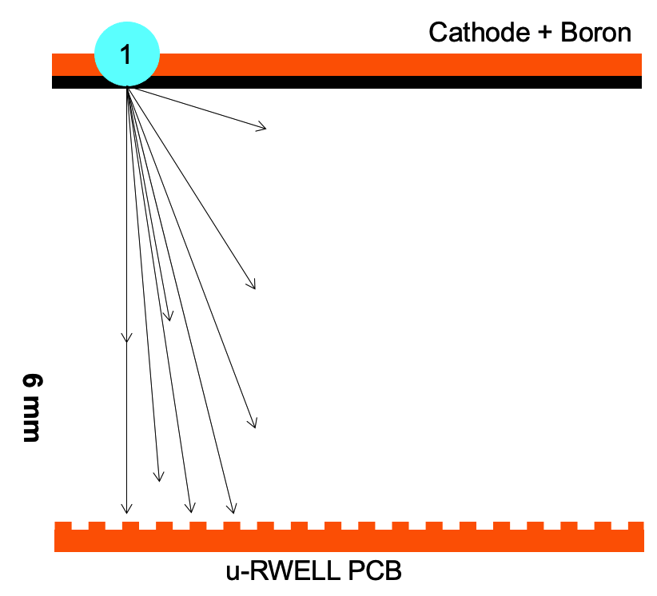
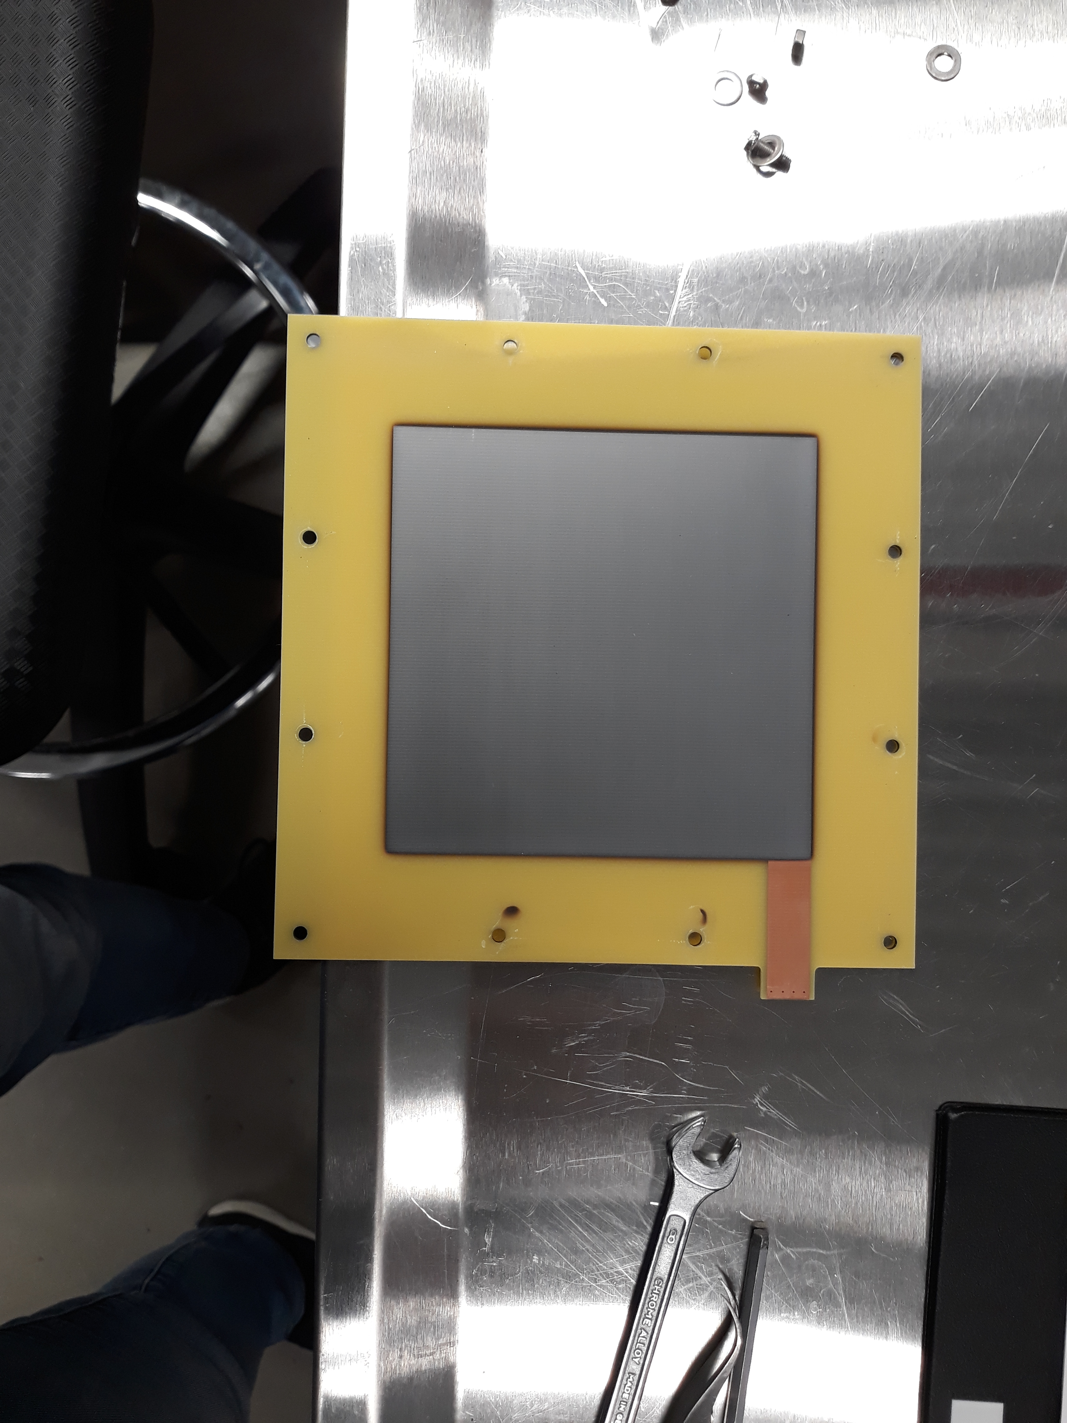
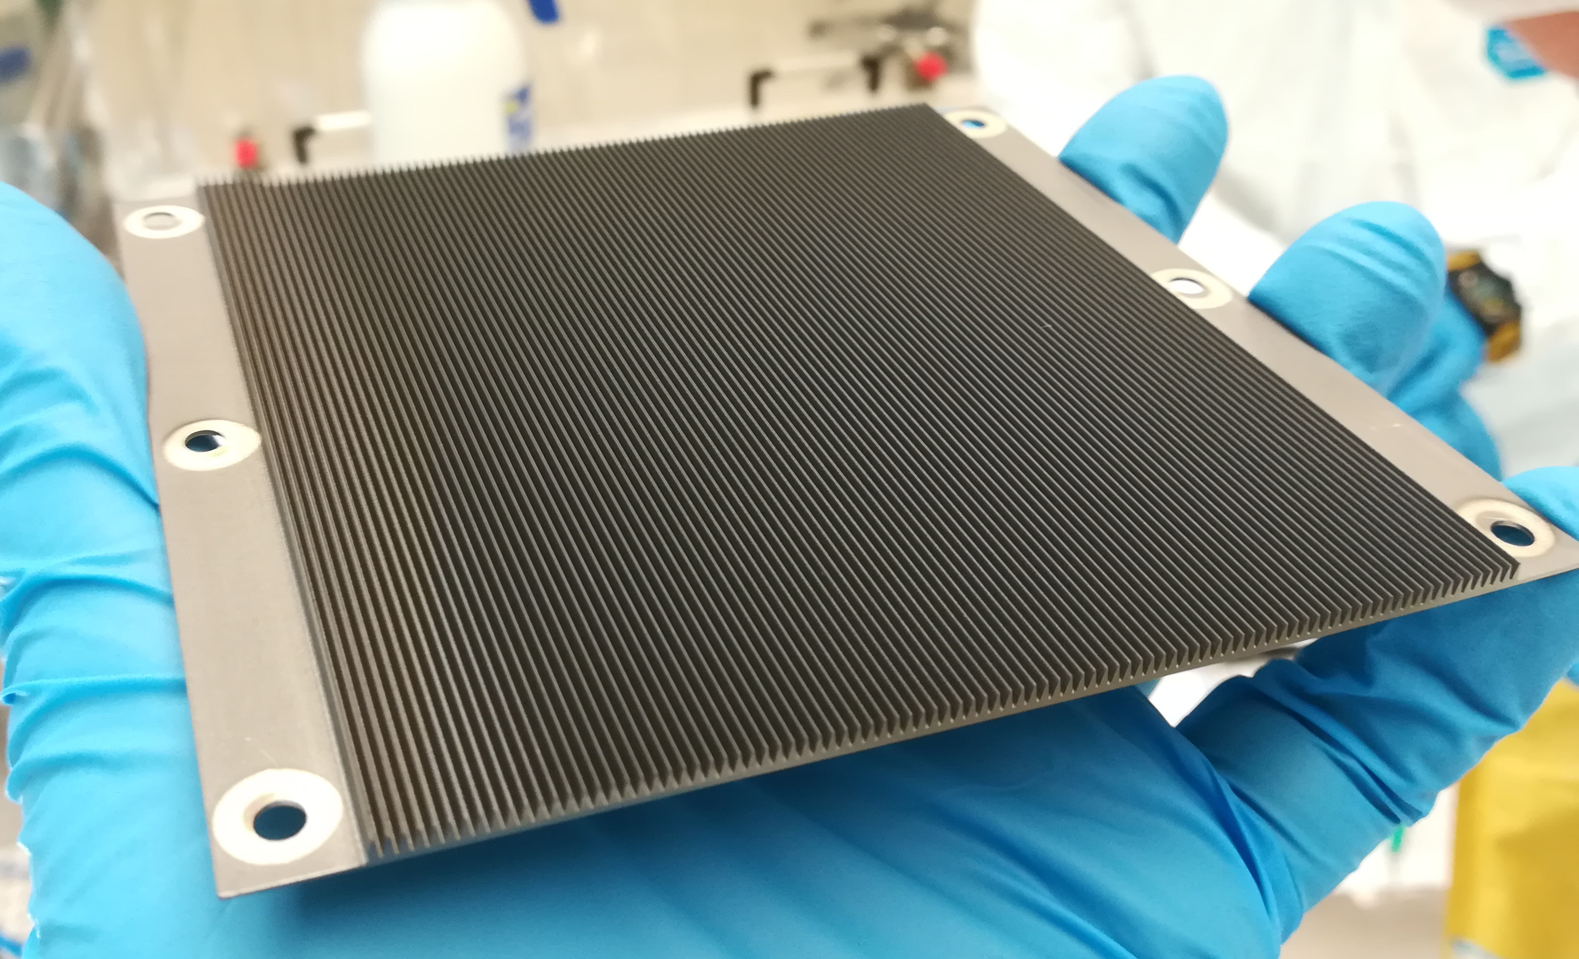
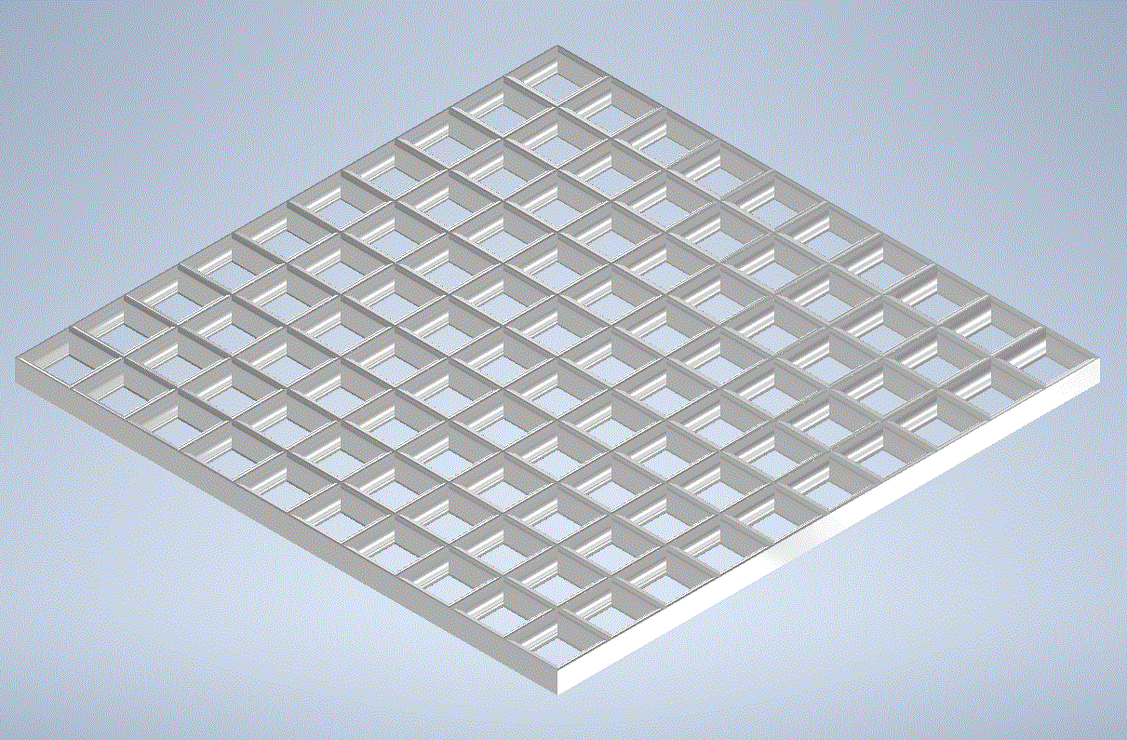
Converter geometries
planar B-cathode + B-coated mesh
planar B-cathode
B-grooved cathode
9

Slide 10
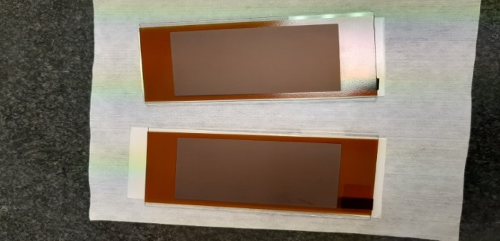
sRPC for Thermal Neutron Detection
The sRPC is based on a new concept of surface resistivity thin electrodes (0.1 – 1 GOhm/square)
manufactured with industrial DLC coating techniques on flexible or semi-rigid supports
gas box
¹⁰B4C kapton foil
2 mm gas gap
2 mm float glass support
readout board
DLC Kapton foil → ρ ~ 0.1 - 1 GΩ/□
Hybrid sRPC
the cathode, with high resistivity DLC coated kapton foil, acts as “voltage-quencher”, ensuring the correct operation of the detector
the anode, with low resistivity ¹⁰B4C coated kapton foil, acts as “neutron-converter”

