Slide 1
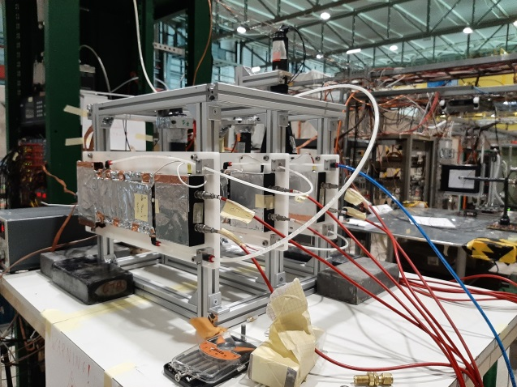
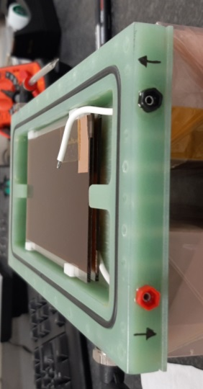
sRPC: an RPC based on resistive MPGD technology
G. Bencivenni
R. De Oliveira², G. Felici¹, M. Gatta¹, M. Giovannetti¹
G. Morello¹, G. Papalino¹, M. Poli Lener¹
¹ LNF– INFN
² CERN

Slide 2
sRPC vs RPC
Classical RPC
bulk resistivity electrodes (bakelite or float-glass)
recovery time proportional to volume resistivity and electrode thickness
low volume resistivity and thin electrodes, together with the reduction of the gas gain is the standard recipe to increase the detector rate capability
Surface - RPC
surface resistivity electrodes manufactured with industrial sputtering techniques of DLC on flexible supports (scalable and cost-effective technology)
the technology allows to realize electrodes with a surface resistivity in a very wide range, 0.001 ÷ 10 GΩ/□
high density current evacuation schemes, similar to those used for resistive MPGD (i.e.
μ-RWELL) can be implemented to improve the rate capability of the detector

Slide 3
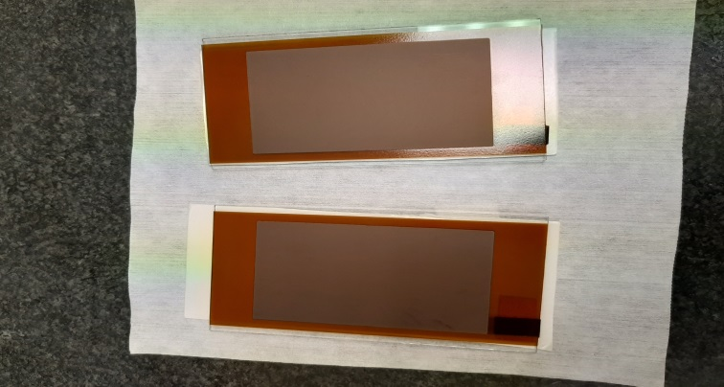
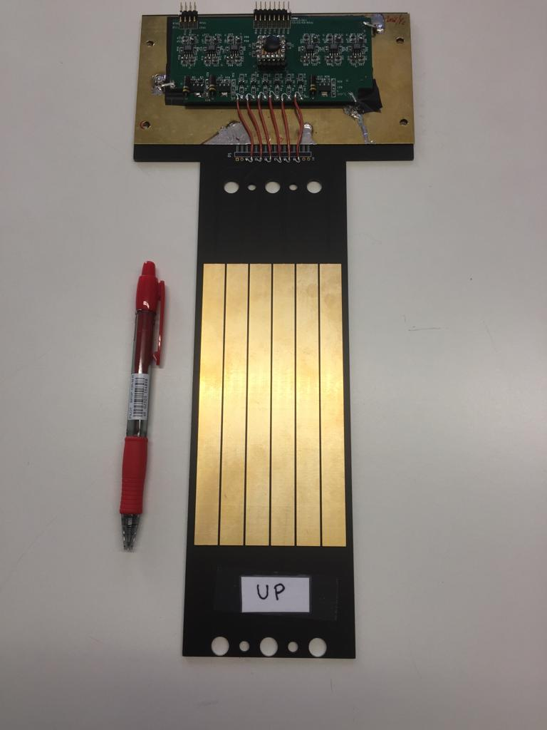
Prototype layouts
Two layouts
a symmetrical version with both electrodes made of patterned DLC sputtered on kapton foil then glued on float-glass substrates
a hybrid version in which one electrode is realized with DLC kapton foil on glass and the second one made of float-glass powered by means a copper tape on the external side
The 2 mm gas gap between the two electrodes is ensured by E-shaped spacers made of Delrin. The electrodes stack is inserted in a FR4 box that acts as gas volume container.

Slide 4
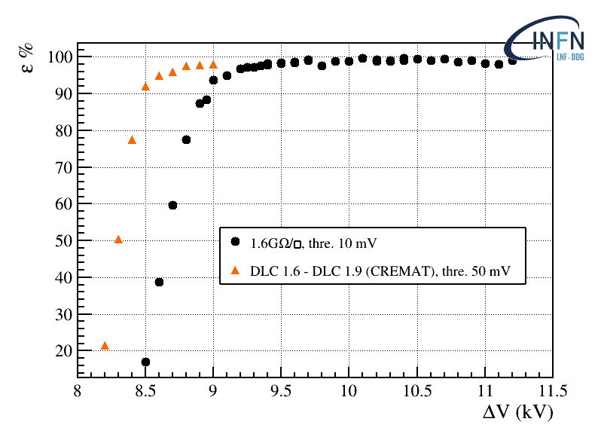
Simmetrical vs Hybrid layout
onset of the DLC-cathode instability
Symmetrical
DLC (anode) – DLC (cathode) electrodes shows instability at high voltage
possible photon-feedback or/and field emission effects on the DLC surface of the cathode
with more sensitive electronics few hundreds of Volts of stable operation can be found
Hybrid
DLC (anode) – float glass (cathode) electrodes shows high stability (plateau larger than to 2 kV)
glass cathode does not suffer of photon-feedback or field emission effects
not a solution for high-rate because limited by the relatively high resistivity of the float-glass
CREMAT 110 fee lowering the operating point
Exploited as a lock-pick for the study of the DLC as SRPC electrodes

Slide 5
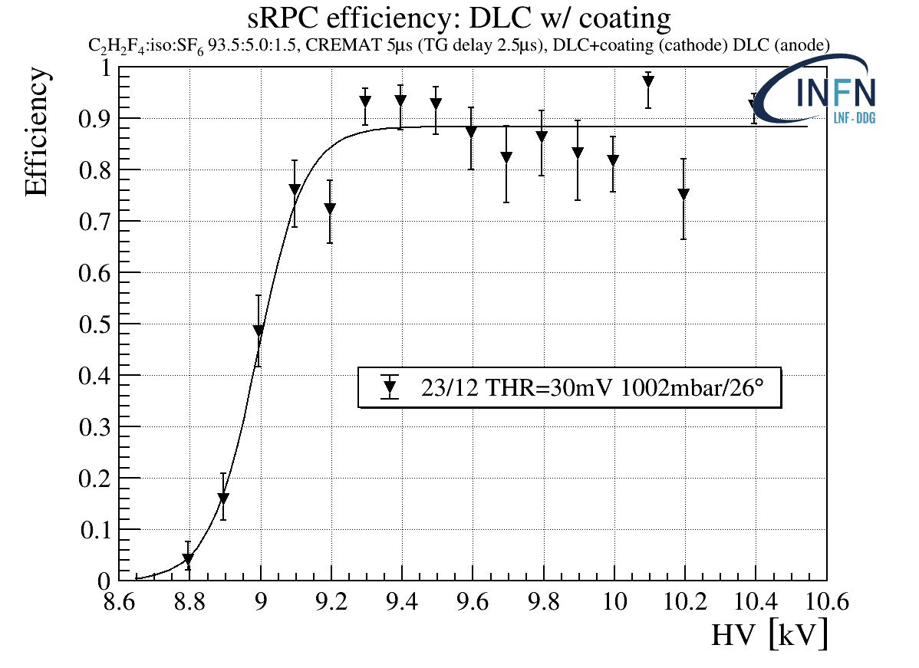
Symmetrical layout: the cathode puzzle
Tests indicate that the instability at highest voltages is due to some physics occurring at the cathode surface (photon-feedback or/and field emission effects on the DLC).
Besides replacing the DLC cathode with the float glass electrode (Hybrid layout), we tested several cathode configurations, leaving the anode unchanged.
The idea is to create a barrier in order to suppress the electron extraction from the cathode DLC surface (cathode passivation).
High stability (>1kV wide operating voltage) achieved with suitable cathode passivation
DLC(anode) ⊕ DLC-coated(cathode)

Slide 6
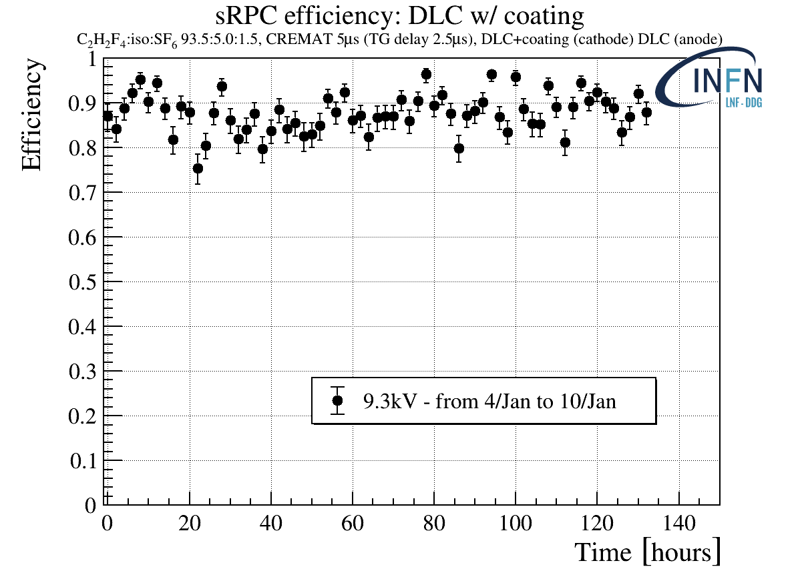
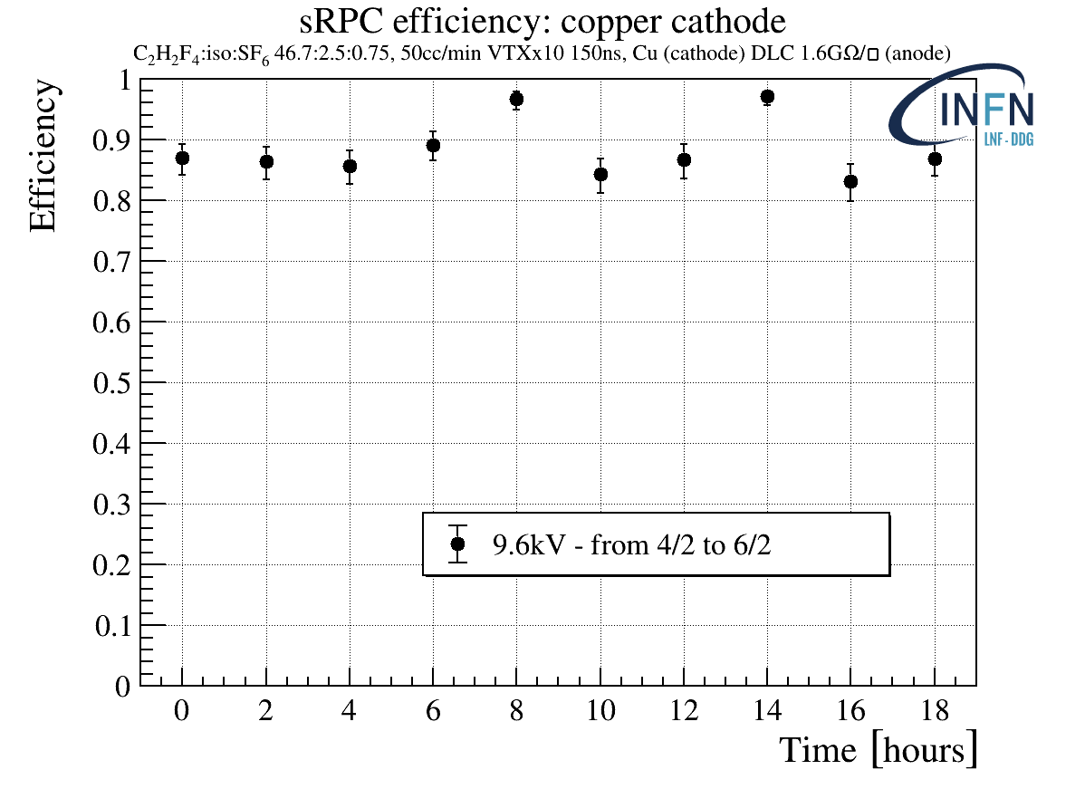
Symmetric layout: preliminary stability tests
DLC(anode) ⊕ DLC-coated(cathode) DLC(anode) ⊕ Cu(cathode)
Poliuretano

Slide 7
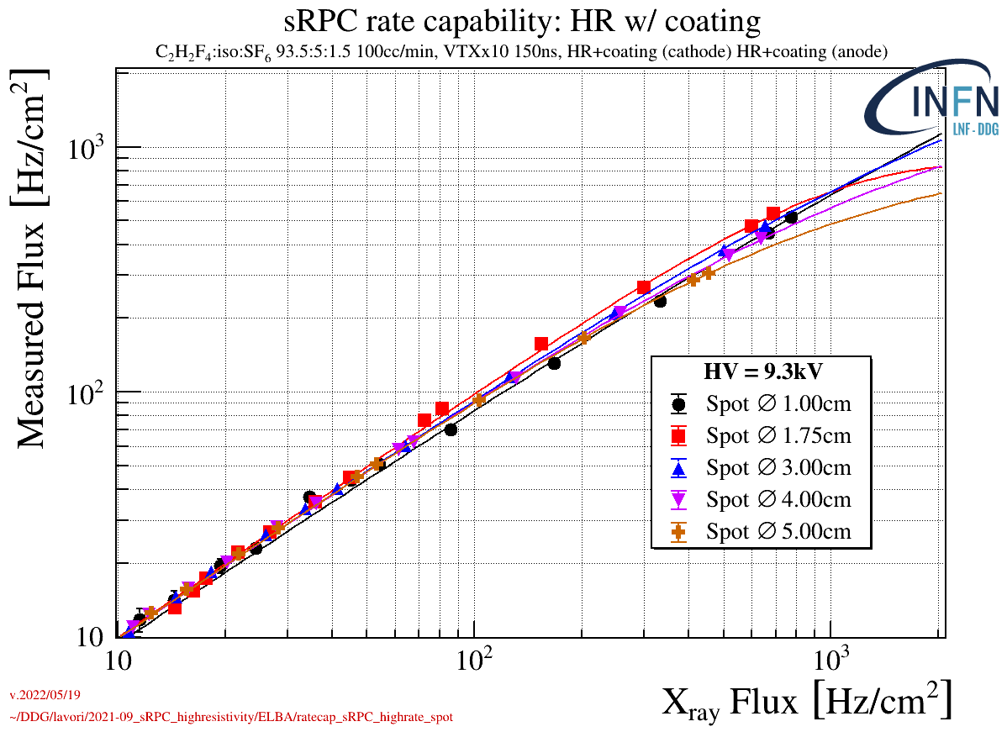
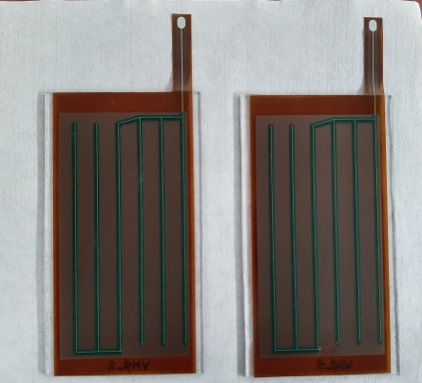
High-rate layout : rate capability
The rate capability of a symmetric high-rate layout has been measured irradiating the detector with a high intensity 5.9 keV X-ray gun with different spot size (1÷5 cm diameter) larger than the pitch (1 cm) of the current evacuation conductive grid realized on the DLC surface electrode.
High-rate layout with conductive grid acting as fast current evacuation scheme. Grid-pitch ~1 cm, DLC resistivity ~ 7GΩ/□
Rate capability of ~1 kHz/cm² with X-ray, corresponding to ~ 3 kHz/cm² m.i.p.

Slide 8
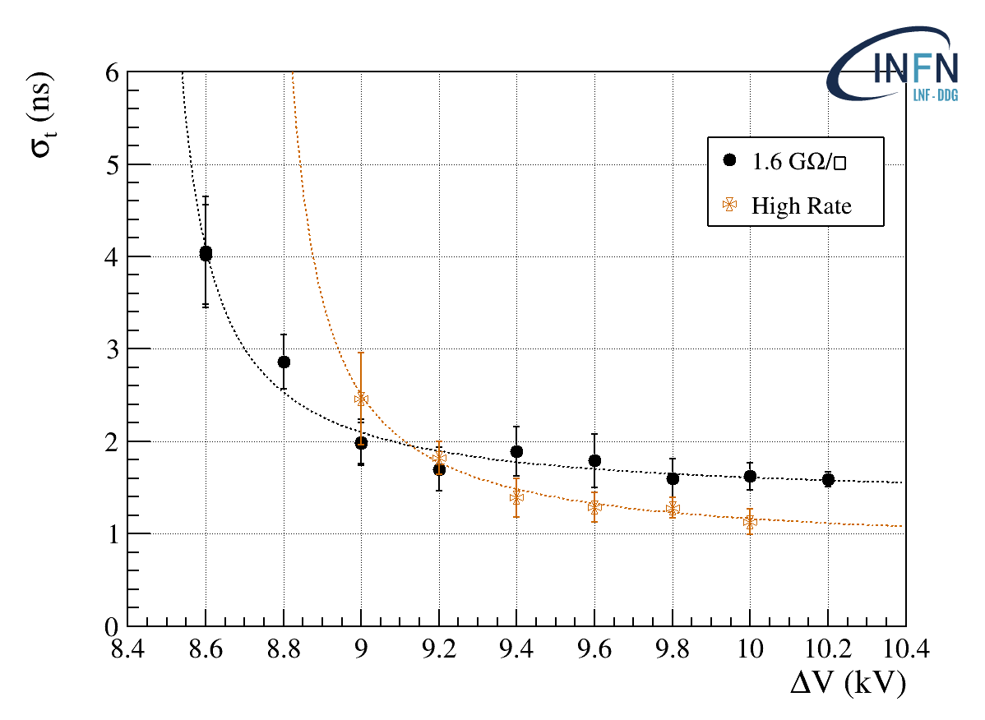
Time resolution
O(1 ns) time resolution obtained with different sRPC prototypes

Slide 9
Summary and Outlook
By exploiting the DLC sputtering technology developed for resistive MPGDs we realized surface resistive electrodes for a new generation of RPCs
Detector layouts with electrode resistivity ρ_{S} >1GΩ/□ have been tested, exhibiting high stability and good performance in terms of efficiency ∼95% and time resolution ∼1 ns
A first high-rate layout with ρ_{S} ∼7GΩ/□ & ground-pitch 1 cm showed a rate capability of ∼3 kHz/cm² with m.i.p
Optimizing the ground-pitch and reducing the surface resistivity (down to ∼100 MΩ/□) a rate capability of the detector hundreds kHz/cm² could be achieved
The DLC technology allows to realize large area electrodes: the CERN-INFN DLC sputtering facility can easily produce 2x0.5 m DLC foils
Cost-effective technology suitable for applications in large HEP experiments for future high luminosity colliders (FCC-ee, CepC)

Slide 10
Spare slides

Slide 11
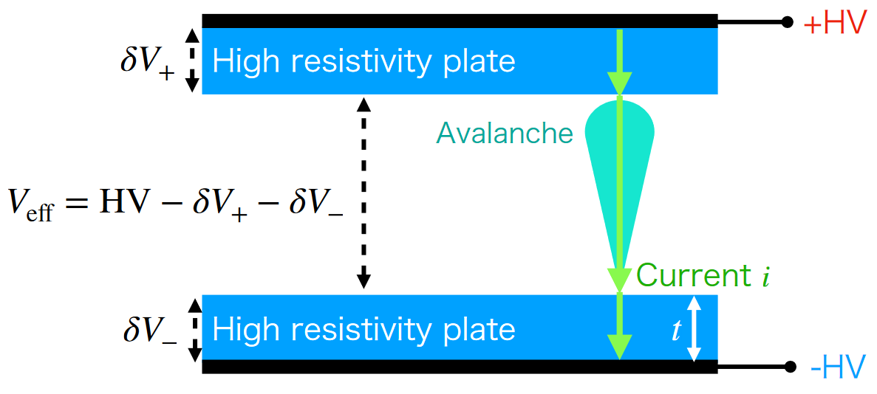
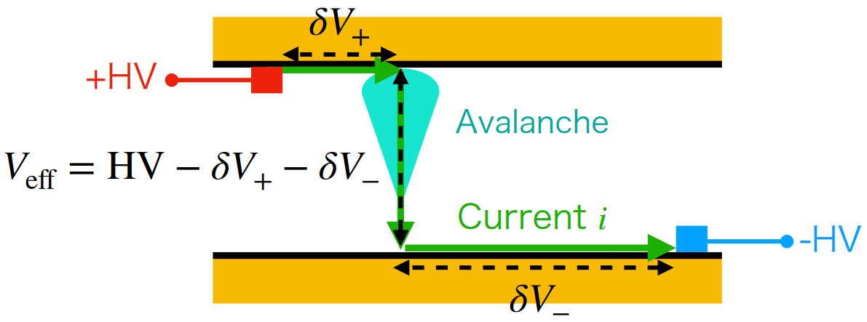
sRPC vs RPC
(Conventional) bulk RPC
sRPC

Slide 12
The cathode passivation
Cathode passivation with different features (resistivity/film thickness) have been considered.
Simple arguments based on Ohm's law can be used in order to understand the characteristics
of possible coatings. Stability tests are clearly required.
R_{pass}
passivation film (h)
DLC film (0.1 μm)
R_{DLC}
R_{DLC}
R_{pass} < R_{DLC} ≈ 1GOhm
h = 1 μm --> ρ_{pass} < 10¹¹ Ohm.cm h = 0.1 μm --> ρ_{pass} < 10¹² Ohm.cm h = 0.01 μm --> ρ_{pass} < 10¹³ Ohm.cm
R_{pass} = (ρ_{pass} x h)/S < 1x10⁹ Ohm
S ∼ O(1 mm²) → ρ_{pass} < 10⁷/h(cm) Ohm.cm

