Slide 1
HERD-SCD
Readout Electronic
-20220704
Gongke, Qiaorui, Peng wenxi

Slide 2
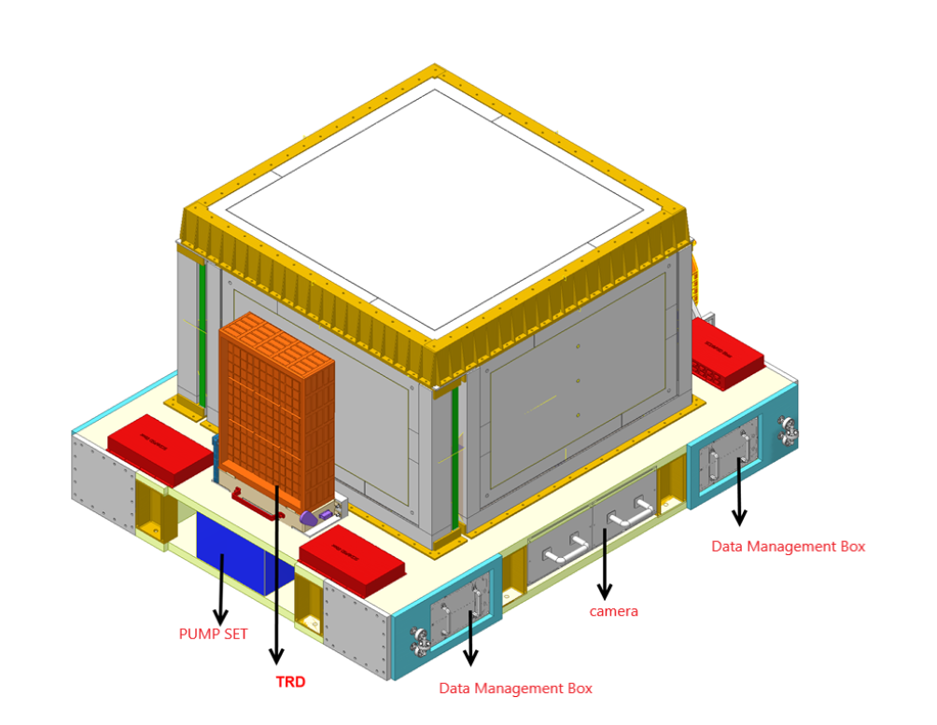
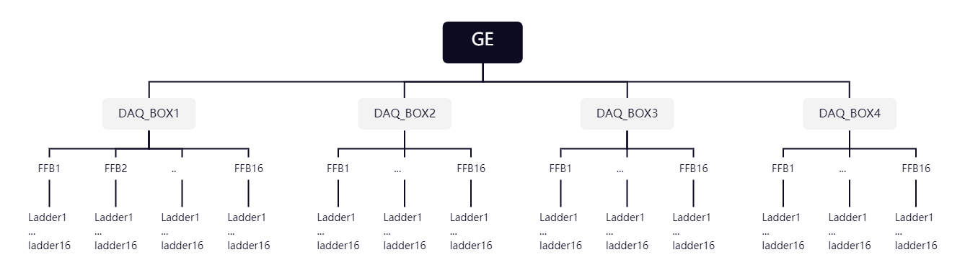
SCD Readout Electronic
Architecture
Submodule | function
DAQ_BOX | DC/DC, data compression & transmission
Front Fanout board(FFB) | RAW Data packing, Level shift，ASIC ctrl fanout
Ladder | Front end preamp , ADC
SCD&PSD DAQ

Slide 3
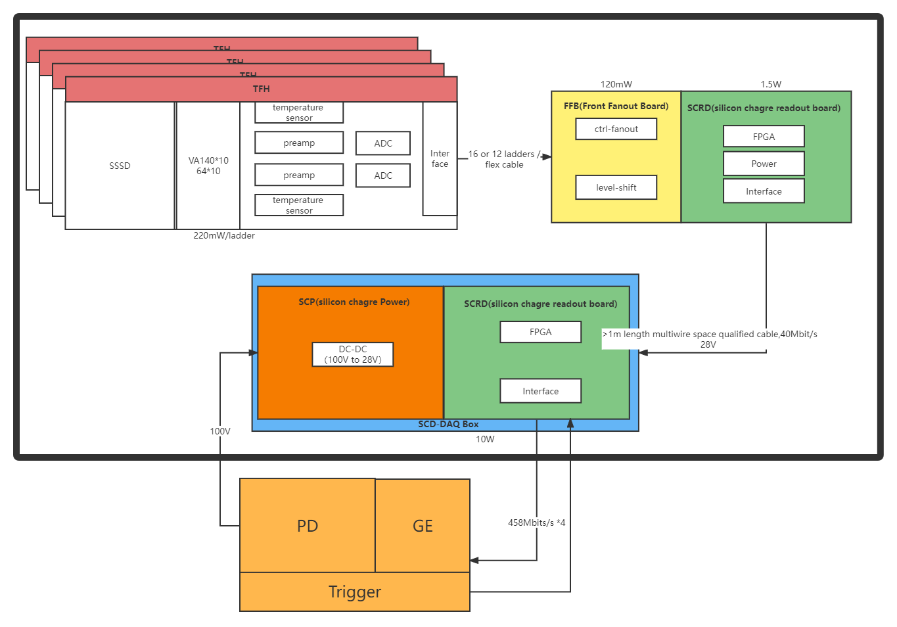
SCD Readout Electronic Architecture

Slide 4
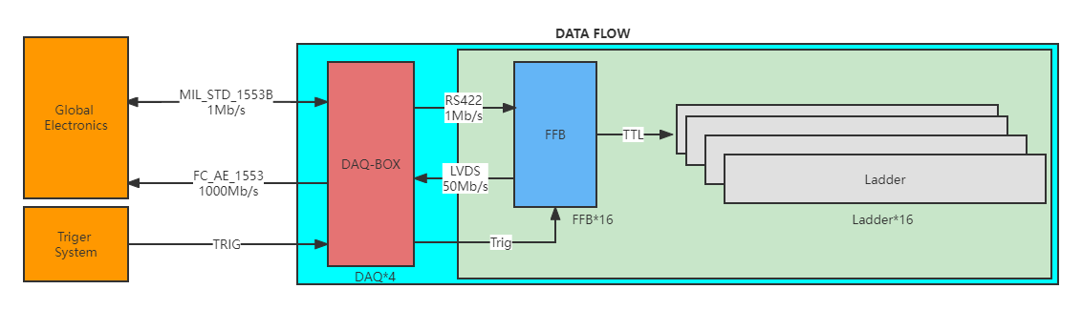
DATA FLOW

Slide 5
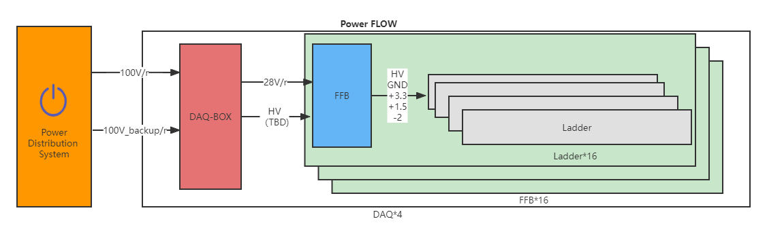
Power Supply Flow

Slide 6
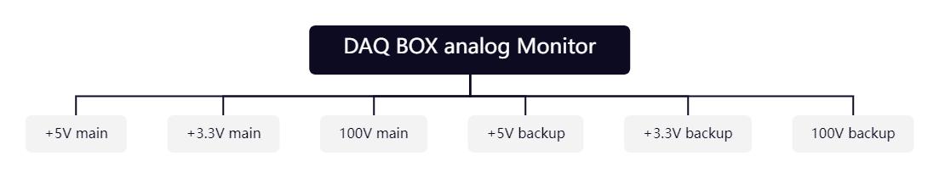
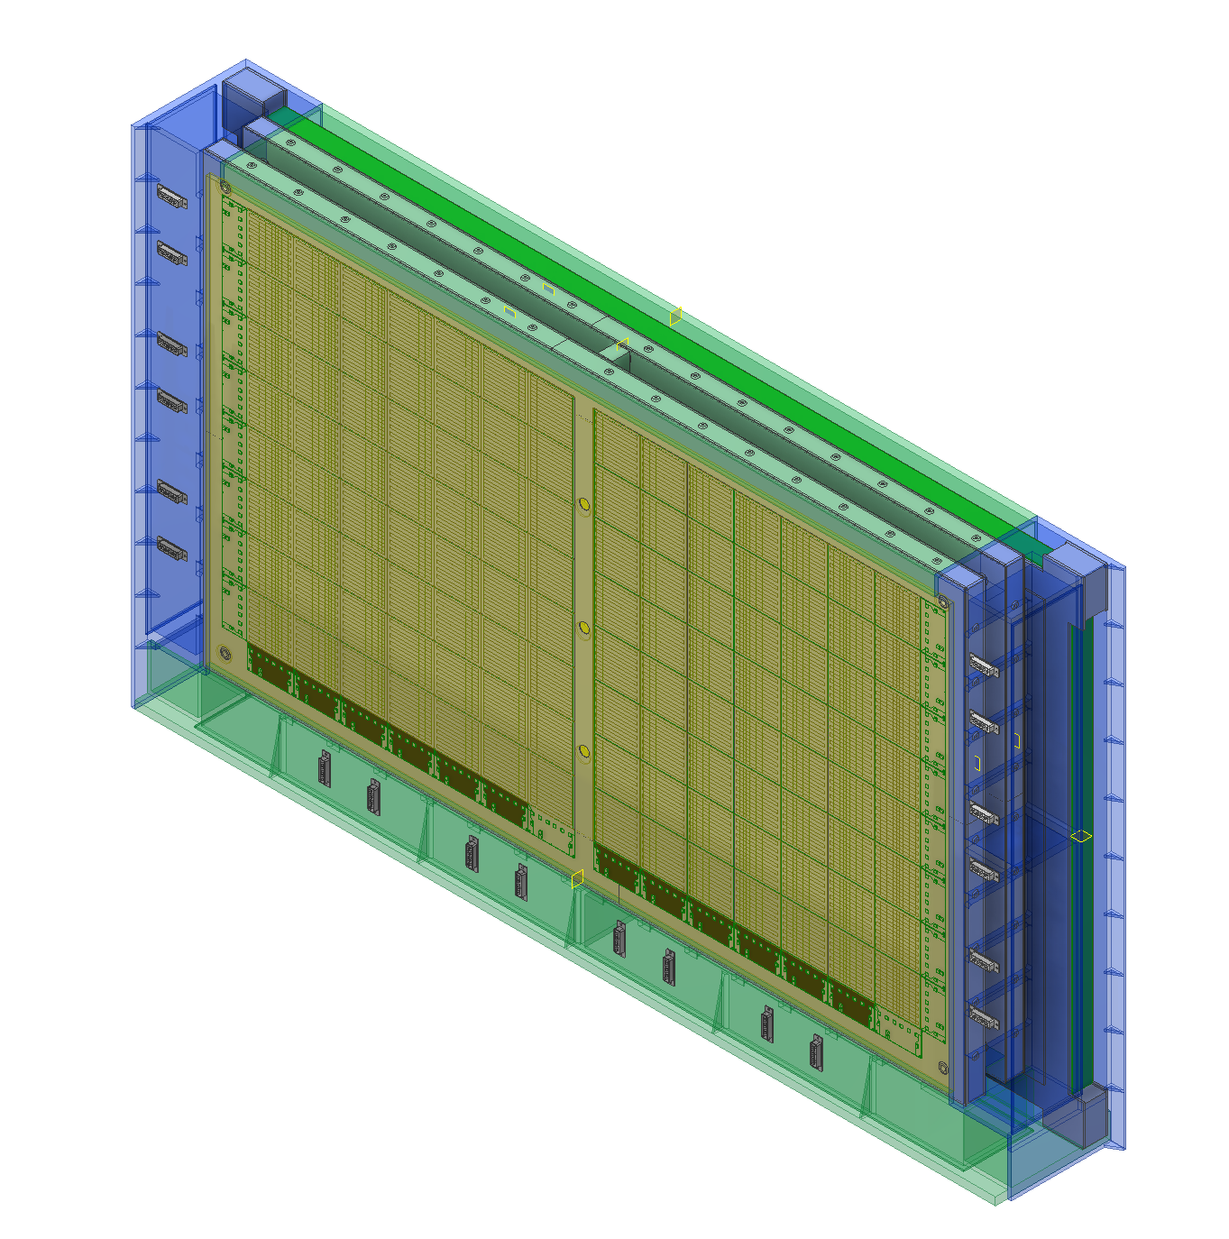
Key Telemetry parameters
1.Key Analog parameters
The key analog telemetry is used to check the working state of SCD.
The analog parameters is collected by GE.
GE will also collect the 100V current for 4 DAQ BOX.
2.Temperature sensors for thermal control
The temperature sensors for thermal control is collected by GE.
4 temperature sensors on each side, totally 64.

