Slide 1
News from IHEP
Rui Qiao; WenXi Peng; Ke Gong

Slide 2
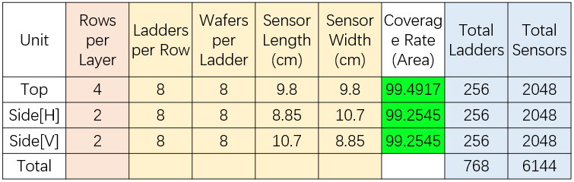
The ASIC counts based on new sensor
Roles to calculate ASIC counts:
Dead area (1mm each side)
Each ASIC has 64 channels
Each ladder has two group of ASISs (One amplifier & ADC each group)
Each group contain maximum 5 ASIC, or dead time is too long.
Readout pitch close to baseline (150 um)

Slide 3
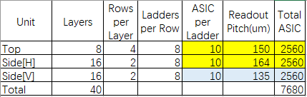
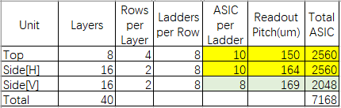
The ASIC counts based on new sensor
There are two solutions, with totally 7k~8k ASICs.
The two solutions for top & side(H) are the same, but different for Side(V).
Solution 1: smaller readout pitch for Side(V)
Solution 2: larger readout pitch for Side(V)

Slide 4
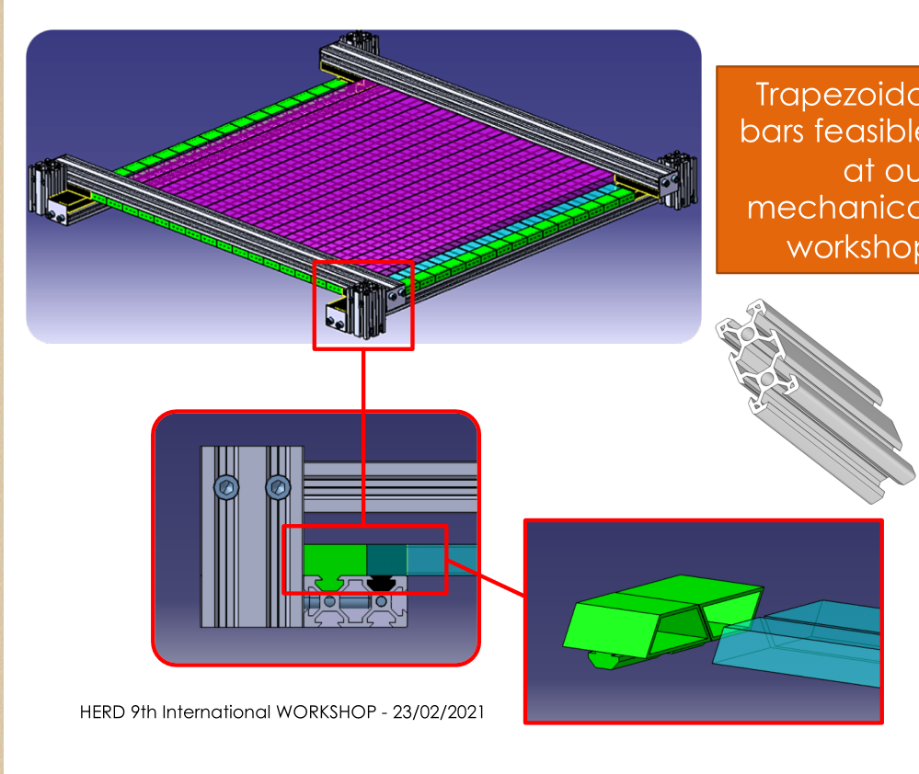
Support for test beam 2022

