Slide 1
Verification of TCAD & SPICE simulation with AMS02
Rui Qiao; WenXi Peng; Ke Gong

Slide 2
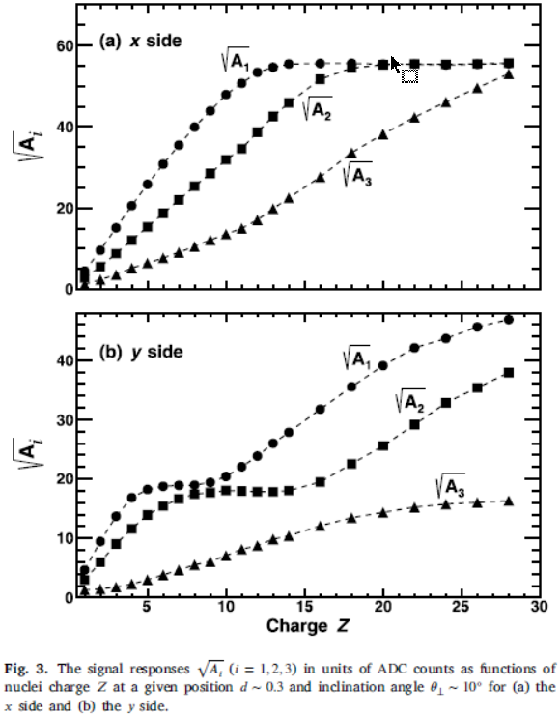
Background: SCD specification
Specification | Value
Charge range | Z=1~28
Coverage | >80%
Charge resolution | <0.1 c.u. @ Z=1 <0.2 c.u. @ Z=6
Dead time | <2ms
Charge response of AMS02
Requirement:
Charge sharing to neighboring strips for High-Z
Tools:
Simulation of charge sharing with given sensor specification
Objective:
The best sensor specification

Slide 3
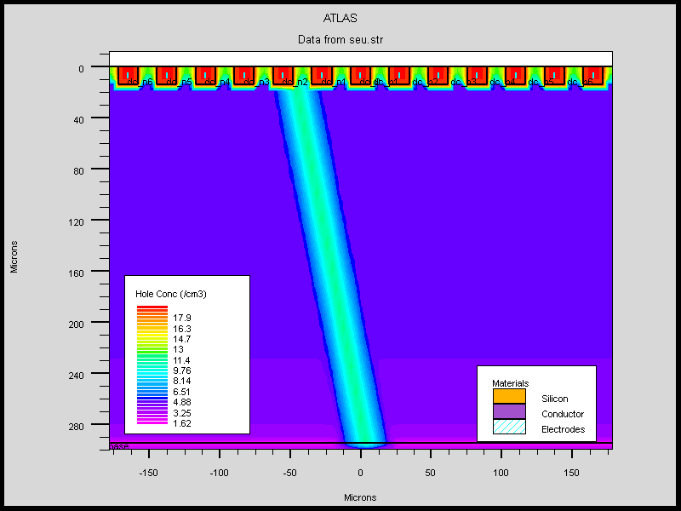
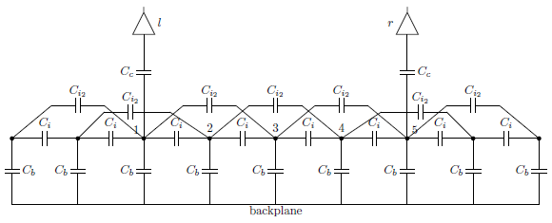
Two simulation tools
Tool 1:
TCAD charge injection
Tool 2:
TCAD for capacitance SPICE charge injection
Advantages: More Physics
Disadvantages: Slow! Sensitive to mesh & step!
Advantages: Fast! Reliable!
Disadvantages: Less physics
TCAD charge injection
SPICE Equivalent circuit
Notes:
来源：G:\keyan\科研任务\211212_硅微条模拟\MyTCAD\220416——SEU复现AMS02文章\Step4_无AC条SEU\700pF\AMS斜入射SEU示意图.png
菲利普博士论文

Slide 4
Two simulation procedures
Structure definition
Contact (Bias resistor, coupling capacitance)
NO Contact
Bias
Bias
TCAD
Charge injection; Get current.
AC analysis; Get cap.
Python analysis; Get CCE
SPICE simulation; Get CCE

Slide 5
Validation of the two simulation tools
Tool 1:
TCAD charge injection
Verification
AMS02 result
Tool 2:
TCAD for cap.
SPICE charge injection
Charge response of AMS02
A1: 65.66%
A2: 29.18%
A3: 5.16%

Slide 6
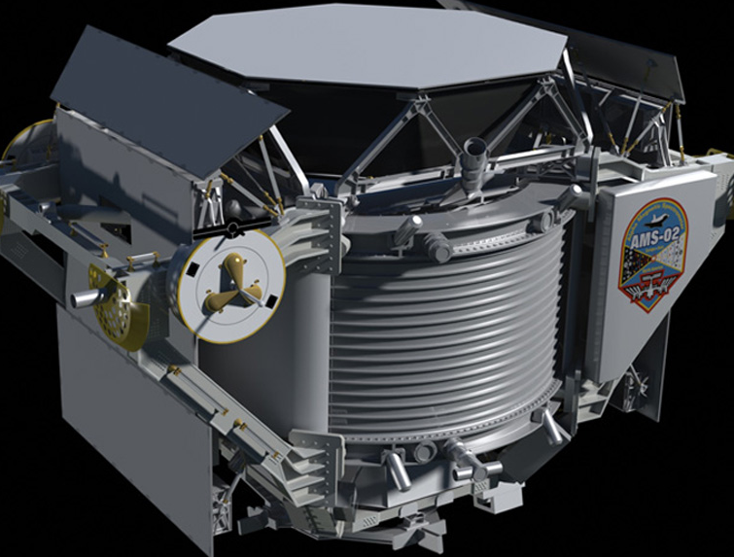
AMS02 specification
Known Parameter | Value
Thickness [um] | 300
Sensor num in ladder | 7~15
P+ Length [cm/sensor] | 4.136
P+ Implant Pitch [um] | 27.5
P+ Implant Width [um] | 14
P+ Readout Pitch [um] | 110
Coupling | DC
External capacitance [pF] | 700
Interstrip capacitance [pF/cm] | 2
IP~0.3， Angle~10
Solved Parameter | Value
Implant Depth [um] | 14
The IP, angle, sensor number are not precise!
Notes:
来源：Y. Jia et al., NIMA 972 (2020) 164169
G:\keyan\科研任务\211212_硅微条模拟\资料\AMS\AMS02的参数.docx

Slide 7
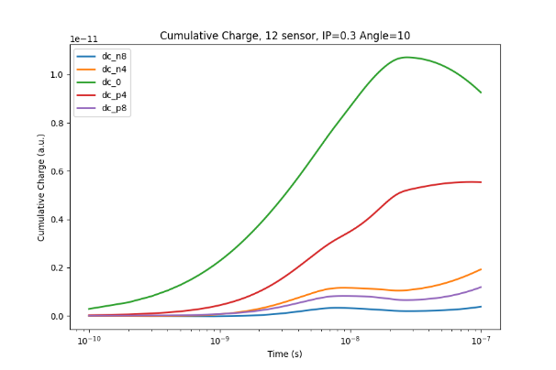
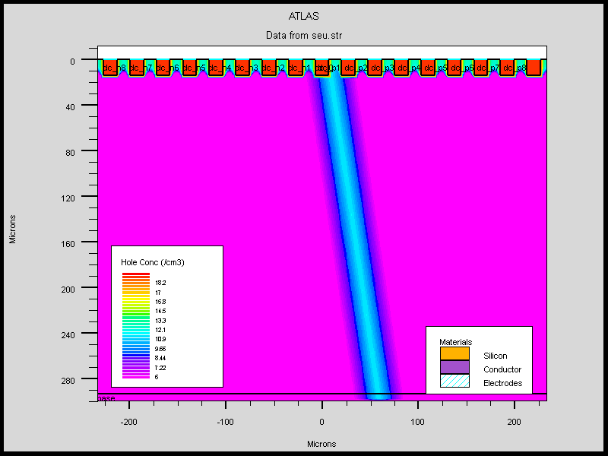
Solving the charge equalization in TCAD
Readout Channels
TCAD charge injection of AMS02
Cumulative charge(Y) vs Time(X)
Notes:
来源：G:\keyan\科研任务\211212_硅微条模拟\MyTCAD\220618——再次复现AMS02文章\Step3_17根条SEU_old_80V\SEU_str_PNG\SEU_IP0.3_Angle10.png
来源：G:\keyan\科研任务\211212_硅微条模拟\MyTCAD\220618——再次复现AMS02文章\png\Step3_17strips_80V\瞬态累积电量曲线_12sensor_IP0.3_Angle10.png

Slide 8
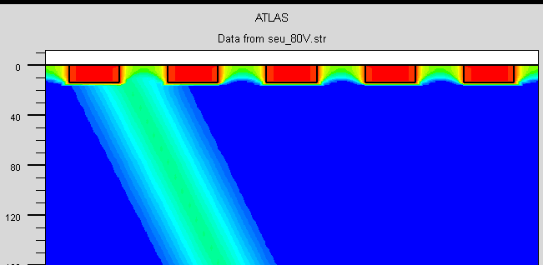
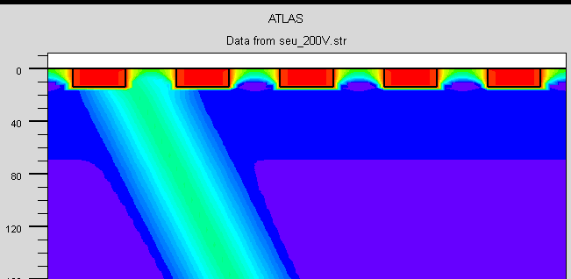
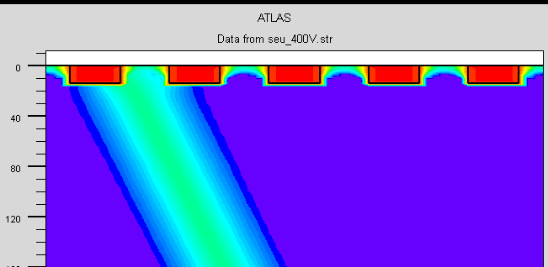
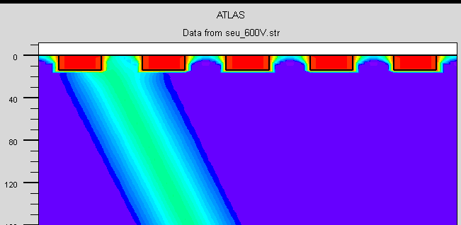
Possible reason for charge equalization
There are high hole-concentration region between strips with lower bias voltage.
This region become narrow with higher bias voltage.
Hole concentration. 80V
Hole concentration. 200V
Hole concentration. 400V
Hole concentration. 600V
Notes:
来源：G:\keyan\科研任务\211212_硅微条模拟\MyTCAD\220618——再次复现AMS02文章\Step5_5根条SEU_测试偏压的影响\

Slide 9
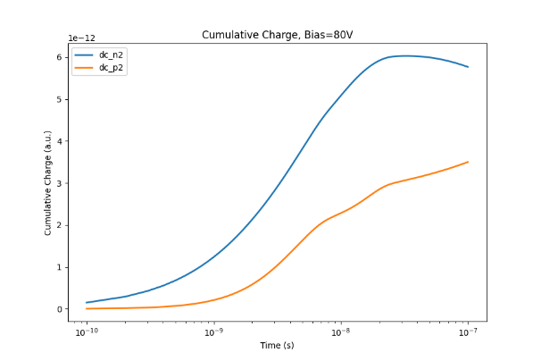
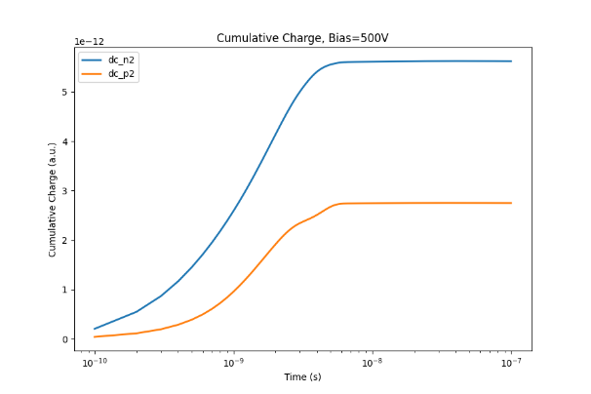
Possible reason for charge equalization
Cumulative charge(Y) vs Time(X), 80V
Cumulative charge(Y) vs Time(X), 500V
Charge Equalization disappear with 500V bias
Notes:
来源：G:\keyan\科研任务\211212_硅微条模拟\MyTCAD\220618——再次复现AMS02文章\png\Step5_5strip_ChangeBias\瞬态累积电量曲线_80V.png
G:\keyan\科研任务\211212_硅微条模拟\MyTCAD\220618——再次复现AMS02文章\png\Step5_5strip_ChangeBias\瞬态累积电量曲线_500V.png

Slide 10
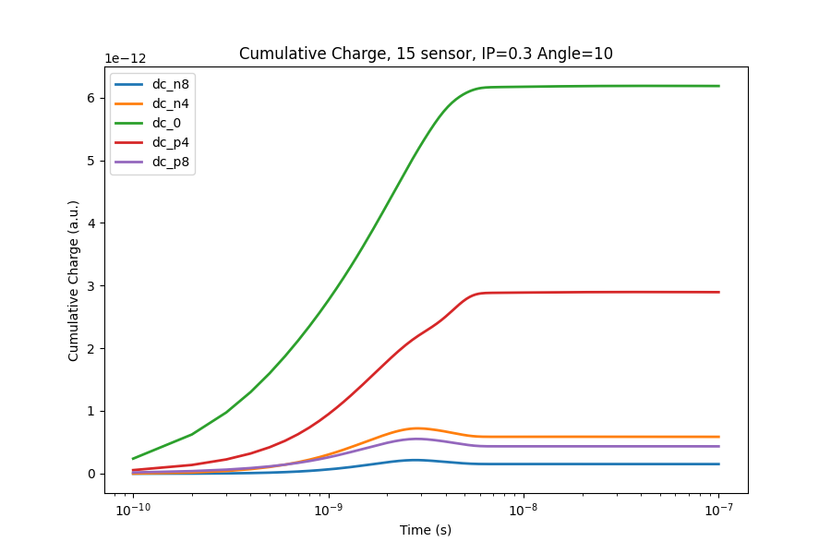
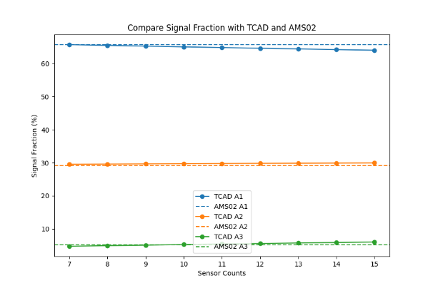
TCAD vs AMS02
The coupling cap. is 700pF/counts for each sensor.
If a ladder consist of 7~10 sensors, the TCAD match AMS02.
Amplitude fraction of 3 channels(Y) on sensor counts(X)
TCAD vs AMS02
Notes:
来源：G:\keyan\科研任务\211212_硅微条模拟\MyTCAD\220618——再次复现AMS02文章\png\Step8_17strips_500V\比较通道占比_AMS02_vs_TCAD_vs_SPICE_***.png
G:\keyan\科研任务\211212_硅微条模拟\MyTCAD\220618——再次复现AMS02文章\png\Step8_17strips_500V\瞬态累积电量曲线_15sensor_IP0.3_Angle10.png

Slide 11
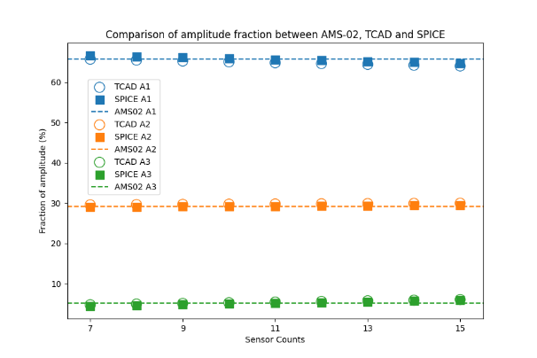
SPICE
Parameter | Value
Implant strips num. | 17
Readout channels | 0/4/8/12/16
Charge fractions | [13.6%, 52.0%, 34.4%] IP=0.3, Angle=10
Bulk cap. [pF/cm] | 0.102
Interstrip1 cap. [pF/cm] | 1.687
Interstrip2 cap. [pF/cm] | 0.093
Interstrip3 cap. [pF/cm] | 0.037
Interstrip4 cap. [pF/cm] | 0.019
Interstrip5 cap. [pF/cm] | 0.012
Coupling cap. [pF/cm] | 700/4.136/n_sensor
Amplitude fraction of 3 channels(Y) on sensor counts(X)
TCAD vs SPICE vs AMS02
Notes:
来源：G:\keyan\科研任务\211212_硅微条模拟\MyTCAD\220618——再次复现AMS02文章\Step8_17根条SEU_500V\所有电容.txt
G:\keyan\科研任务\211212_硅微条模拟\MyTCAD\220618——再次复现AMS02文章\png\Step8_17strips_500V\比较通道占比_AMS02_vs_TCAD_vs_SPICE_16inter.png

Slide 12
Conclusion
The charge equalization may be attributed to the high hole-concentration region between strips at low bias (80V).
High bias voltage (500V) can eliminate charge equalization
Two simulation tools (TCAD injection; SPICE injection) are introduced. Both tools reproduced AMS02 results.
In future, we use SPICE injection to find the best sensor specification, and then use TCAD injection to cross-check.

