Slide 1


Observation of pentaquarks at the LHCb experiment
20/06/2022
Mengzhen Wang

Slide 2
Outlines
History of pentaquarks
Pentaquarks @ LHCb
  First observation
  Validations
  Latest result with enlarged sample size
Conclusions

Slide 3
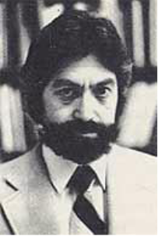
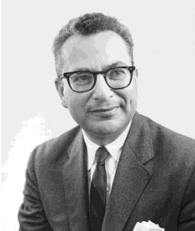
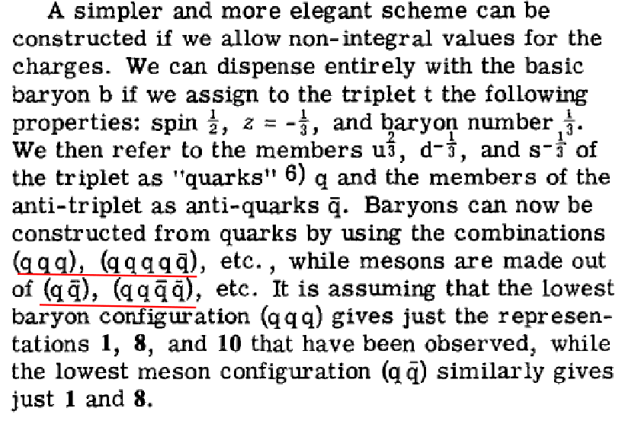
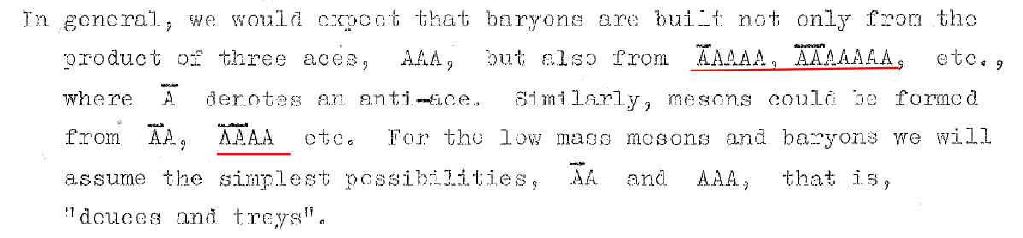
Quark Model and pentaquark
Pentaquark discussed in 1964 when Gell-Mann and Zweig proposed the Quark Model
http://cds.cern.ch/record/352337/files/CERN-TH-401.pdf
Phys.Lett.8 (1964) 214-215

Slide 4
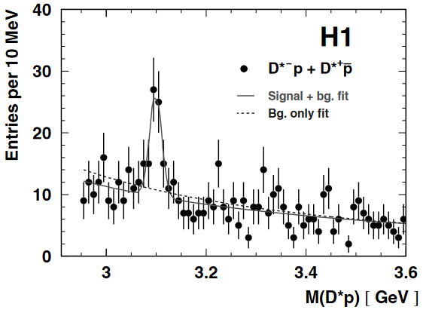
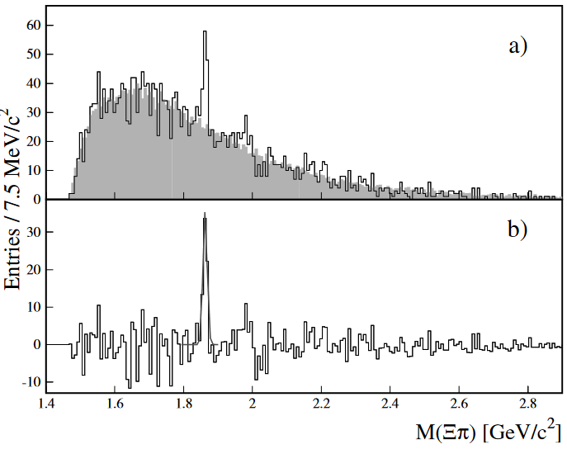
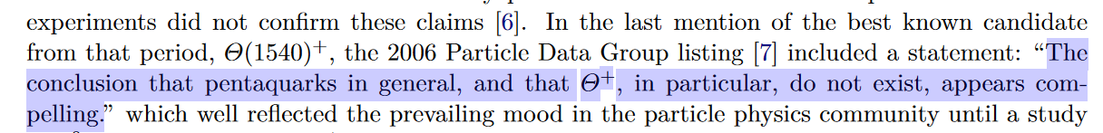



Previous “observations”
Summarized in Eur.Phys.J.H 37 (2012) 1-31
In the 50 years after the proposal of $q\overline{q}qqq$, several “observation” of pentaquarks made but later refuted
$$Ξ^{−−}→Ξ^{−}π^{−}$$
$$udud\overline{c}→D^{∗−}p$$
PLB 588 (2004) 17-28
PRL 92 (2004) 042003
not seen by companion experiments or further studies with larger sample size

Slide 5
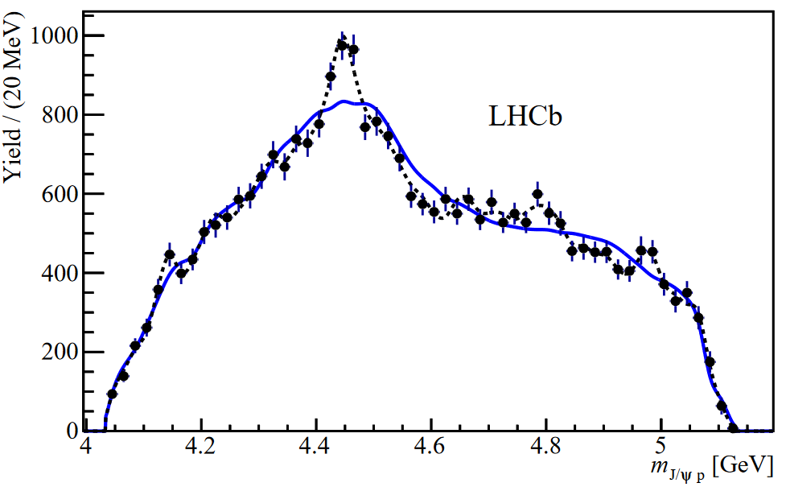
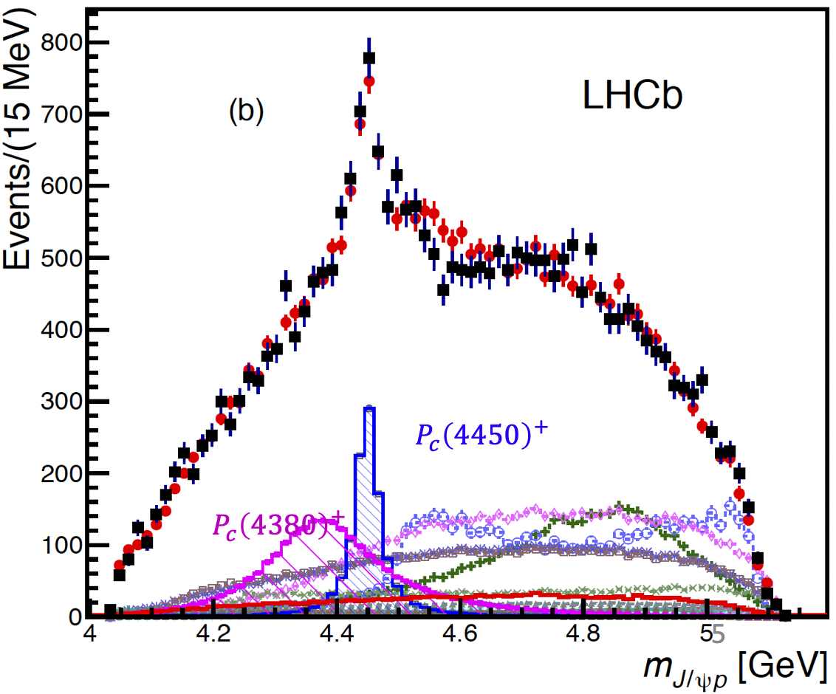
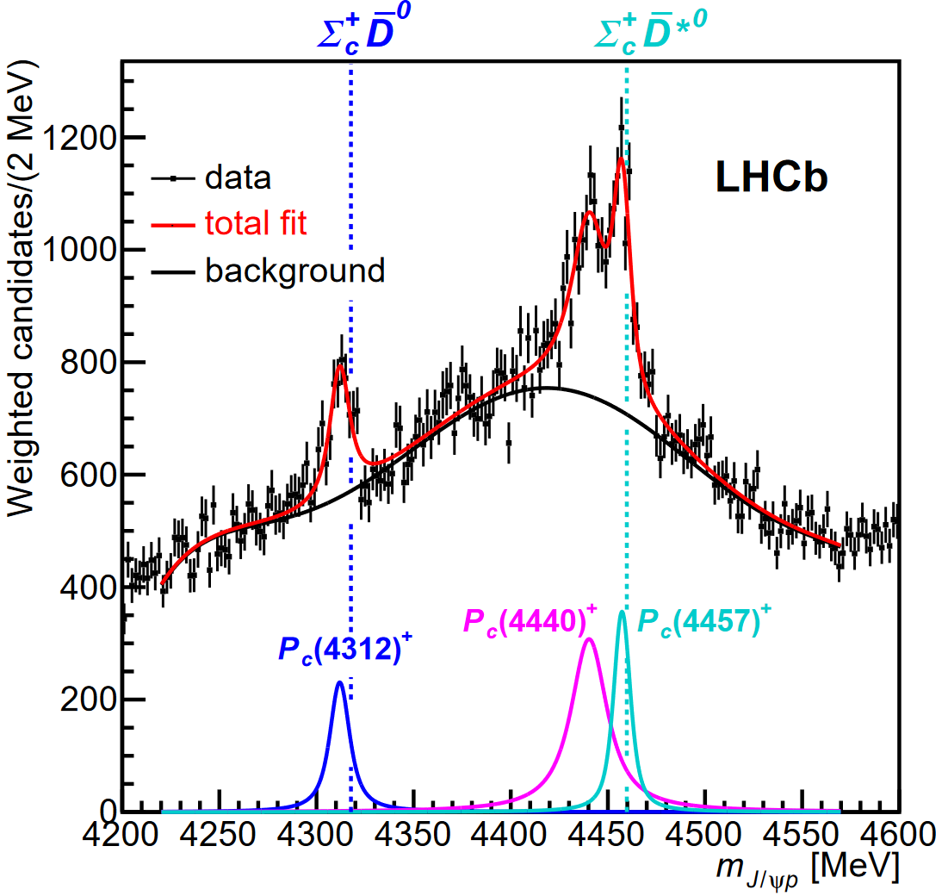
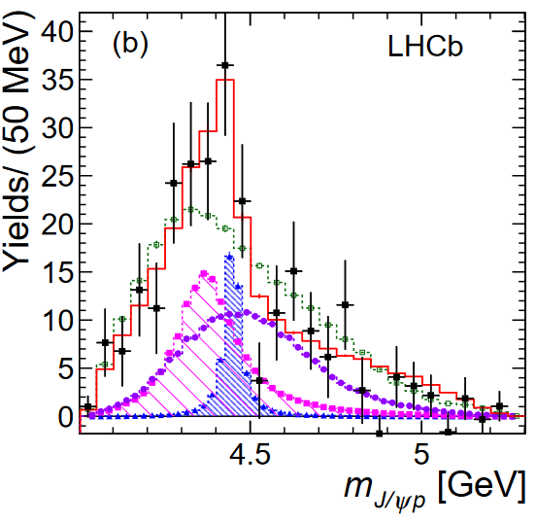
Today’s menus
Follow-up cross checks @ 2016
PRL 117(2016)082002
New analysis with X10 statistic @ 2019
Observation @ 2015
Same dataset & different approach
PRL 115(2015)072001
PRL 122 (2019) 222001
PRL 117(2016)082003
Same approach & different dataset

Slide 6
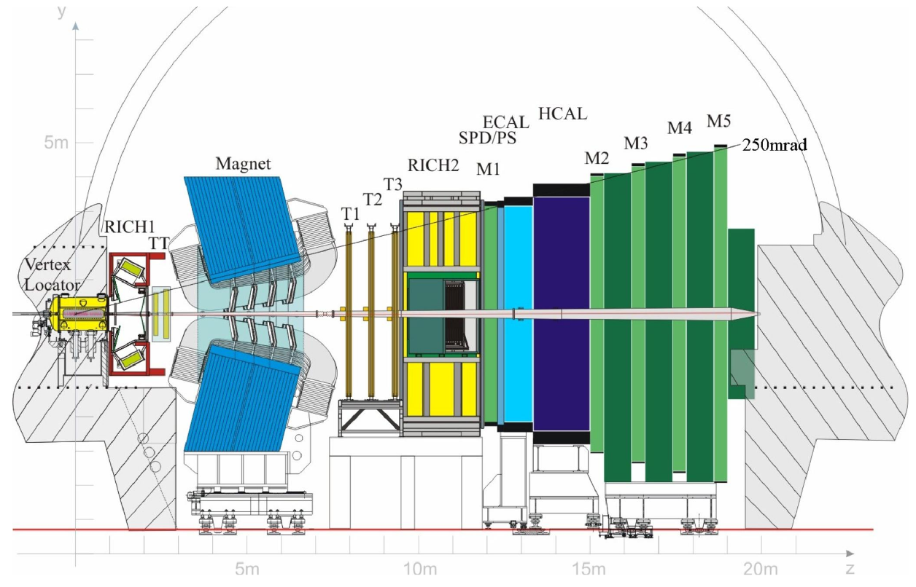


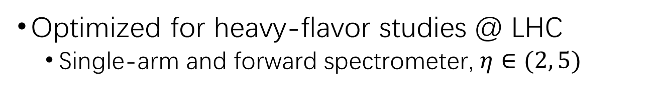
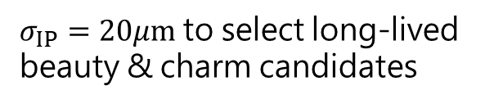
The LHCb detector
Optimized for heavy-flavor studies @ LHC
  Single-arm and forward spectrometer, $η∈(2, 5)$
Powerful particle identification
Good momentum resolution
Precise vertex resolution
$σ_{IP}=20μm$ to select long-lived beauty & charm candidates
JINST 3 (2008) S08005, IJMPA 30 (2015) 1530022

Slide 7
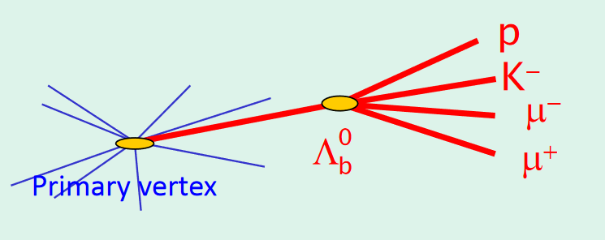
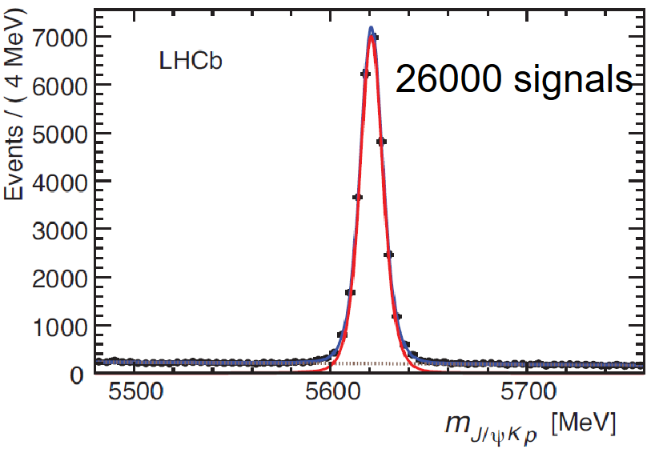
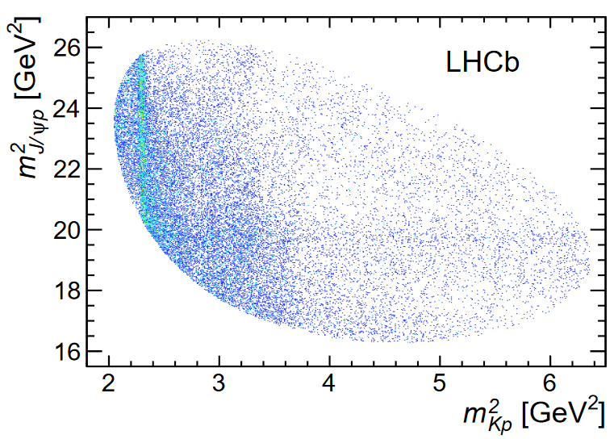
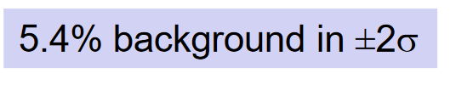




Data sample of $Λ_{b}^{0}→J/ψpK^{−}$ decay
$Λ_{b}^{0}→J/ψpK^{−}$ was observed by LHCb and used for $Λ_{b}^{0}$ lifetime measurement
PRL 111 (2013) 102003
LHCb Run1 $pp$ collision data, $L\sim 3 {fb}^{−1}$, $J/ψ→μ^{+}μ^{−}$
Loose preselection + further MVA-based selection
$J/ψp$ resonance ?

Slide 8
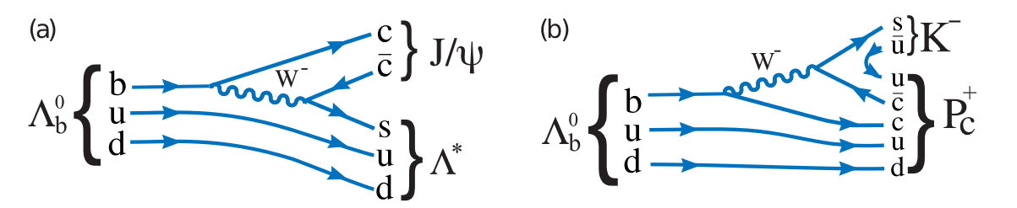
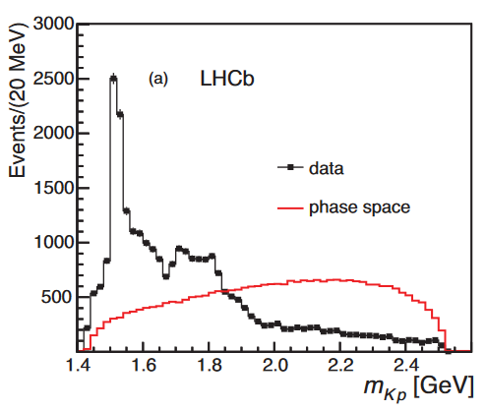
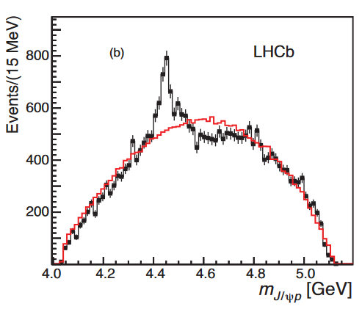



Intermediate states in $Λ_{b}^{0}→J/ψpK^{−}$
This state exist, or reflections from $Λ^{∗}$？
Known contributions
Need a technique to describe pentaquark contributions in data & reflections from $Λ^{∗}$ spontaneously involved

Slide 9
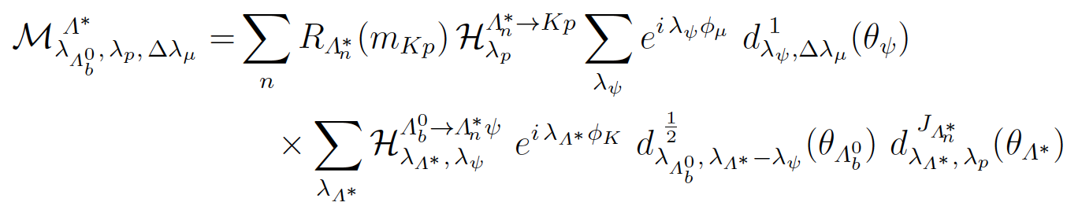
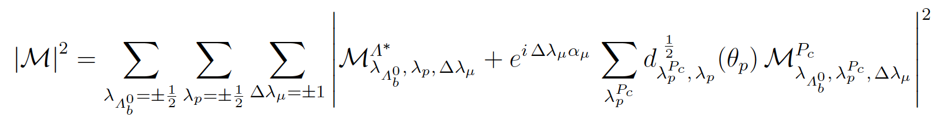


Full amplitude analysis
$Λ^{∗}$ decay chain (reference chain):
  $Λ_{b}^{0}→J/ψ\left(→μ^{+}μ^{−}\right)Λ^{∗}(→pK)$
$P_{c}^{+}$ decay chain:
  $Λ_{b}^{0}→P_{c}^{+}(→J/ψ\left(→μ^{+}μ^{−}\right)p)K$
For single decay chain:
Mass term
Wigner-D functions + constant couplings for angular terms
Two chains combined to get total amplitude:
Final state alignment

Slide 10
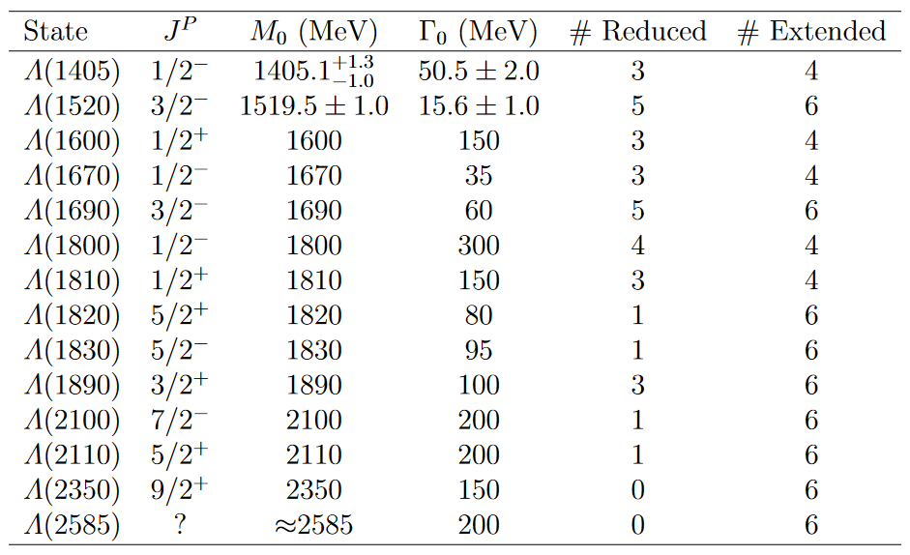
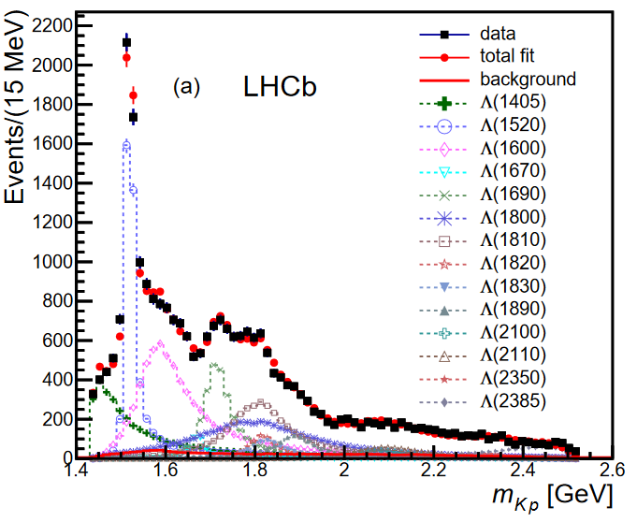
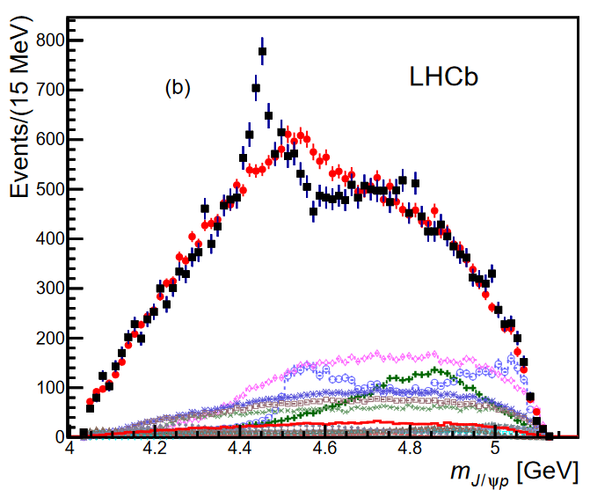


$Λ^{∗}$ resonances
$Λ^{∗}−only$ model cannot well describe data
Still fails even when
  Consider $Σ^{∗}$ resonance (isospin violating)
  Add unobserved $Λ^{∗}$
  Add non-resonant $pK^{−}$

Slide 11
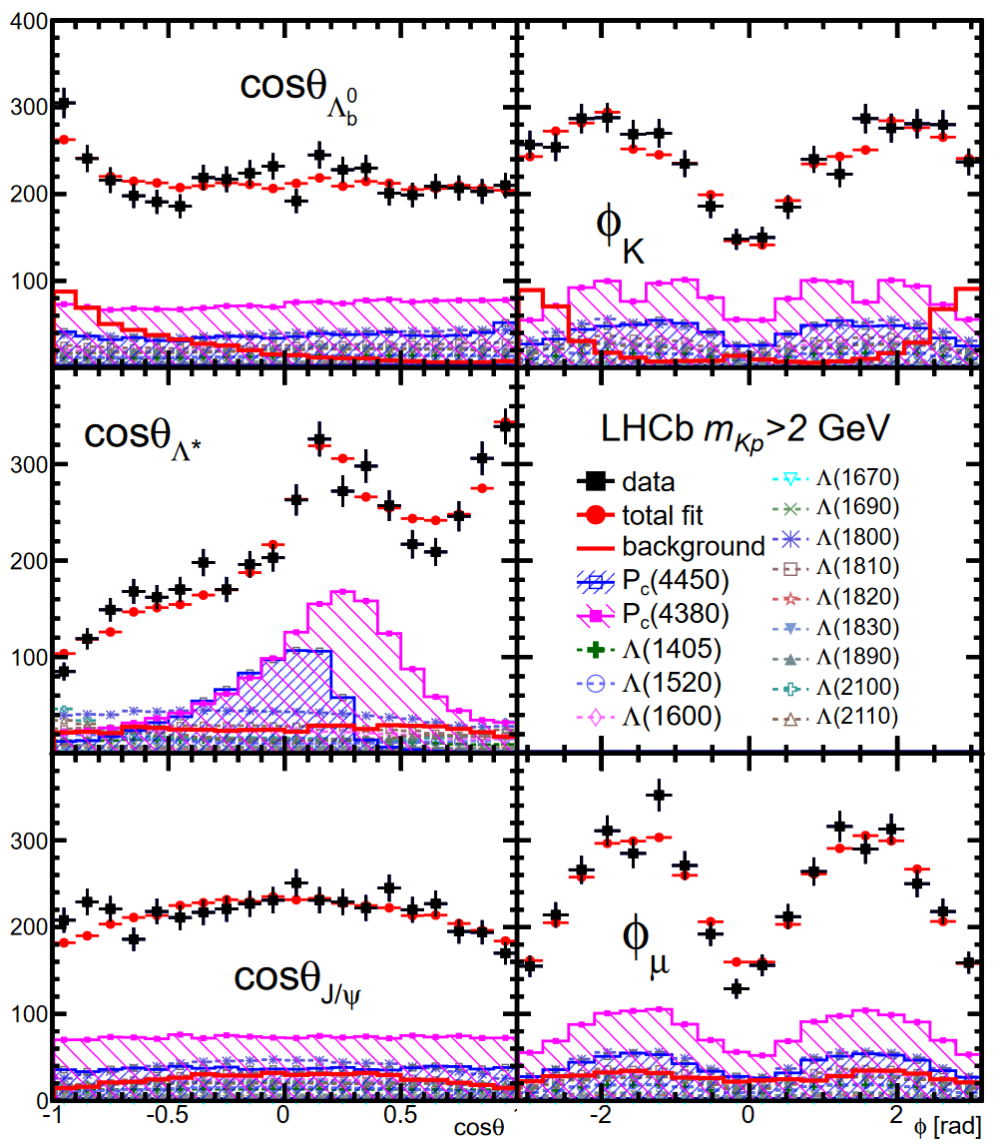
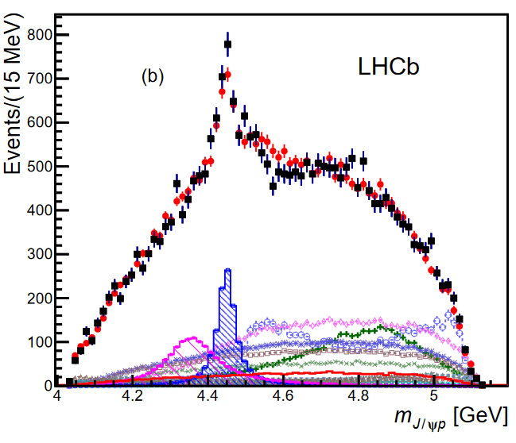
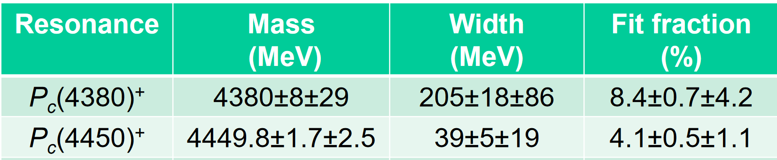
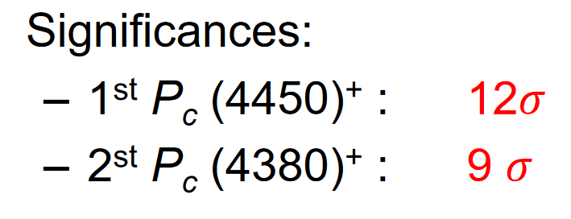



Fit with pentaquark ($P_{c}$)
Much better description in $m(J/ψp)$ spectrum when two pentaquarks involved
Angular spectra also well modeled
Major syst. uncertainties: $Λ^{∗}$ model, parameterization of $P_{c}$ mass shapes
Observation of intermediate states consistent with pentaquarks ($c\overline{c}uud$)

Slide 12
Previous “observations”
Summarized in Eur.Phys.J.H 37 (2012) 1-31
In the 50 years after the proposal of $q\overline{q}qqq$, several “observation” of pentaquarks made but later refuted
$$Ξ^{−−}→Ξ^{−}π^{−}$$
$$udud\overline{c}→D^{∗−}p$$
PLB 588 (2004) 17-28
PRL 92 (2004) 042003
not seen by companion experiments or further studies with larger sample size

Slide 13






$P_{c}$ search in $Λ_{b}^{0}→J/ψpπ^{−}$
$Λ_{b}^{0}→J/ψpπ^{−}$
  Expect similar intermediate states as $Λ_{b}^{0}→J/ψpK^{−}$
  Cabibbo-suppressed, stat. X ~0.1
  $P_{c}$ states found in $Λ_{b}^{0}→J/ψpK^{−}$ should also contribute to $Λ_{b}^{0}→J/ψpπ^{−}$
$$d$$
$$π^{−}$$
$$d$$
$$N$$

Slide 14
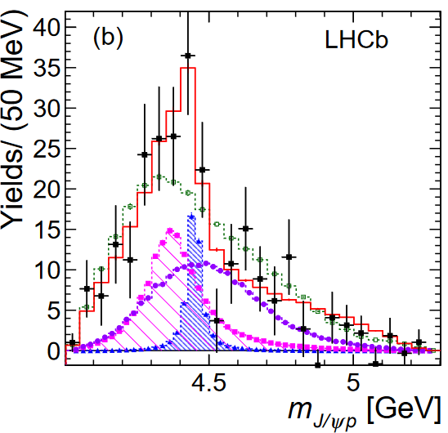
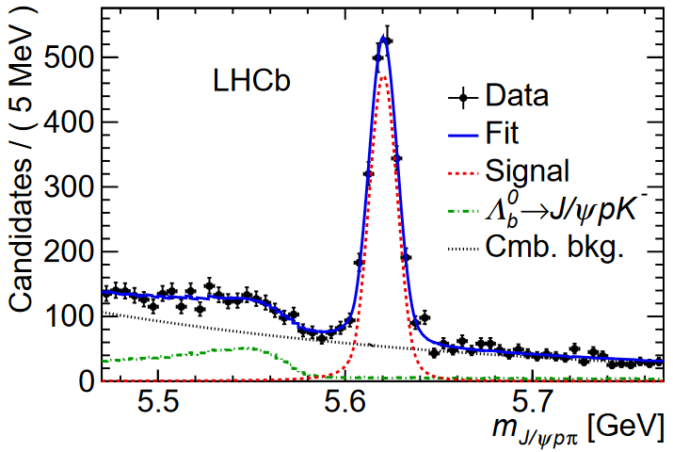
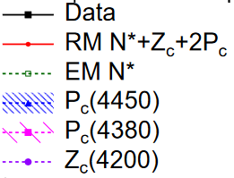

$P_{c}$ search in $Λ_{b}^{0}→J/ψpπ^{−}$
Amplitude analysis on $Λ_{b}^{0}→J/ψpπ^{−}$, following similar strategy as $Λ_{b}^{0}→J/ψpK^{−}$ study
Joint significance of $P_{c}\left(4380\right)+P_{c}\left(4450\right)$ larger than 3$σ$
Mass & width parameters consistent with results from $Λ_{b}^{0}→J/ψpK^{−}$study

Slide 15
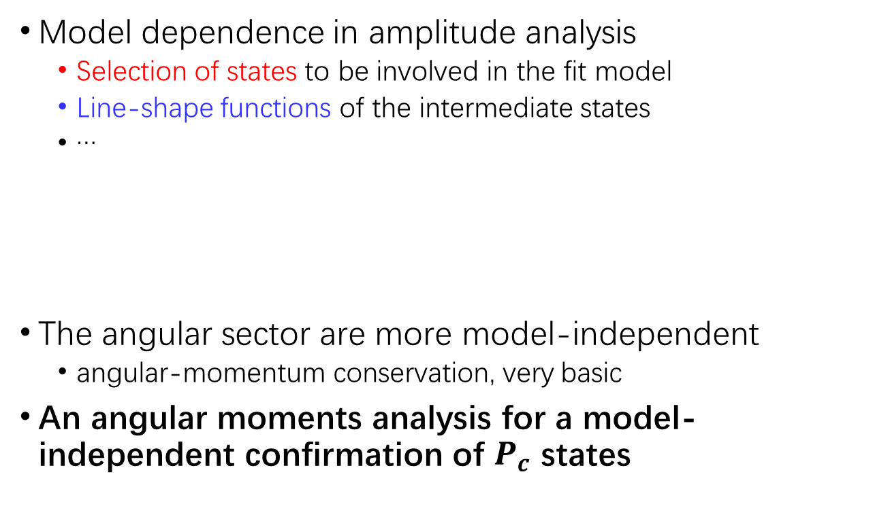

Model-independent $P_{c}$ search in $Λ_{b}^{0}→J/ψpK^{−}$
Model dependence in amplitude analysis
  Selection of states to be involved in the fit model
  Line-shape functions of the intermediate states
  …
The angular sector are more model-independent
  angular-momentum conservation, very basic
An angular moments analysis for a model-independent confirmation of $P_{c}$ states

Slide 16
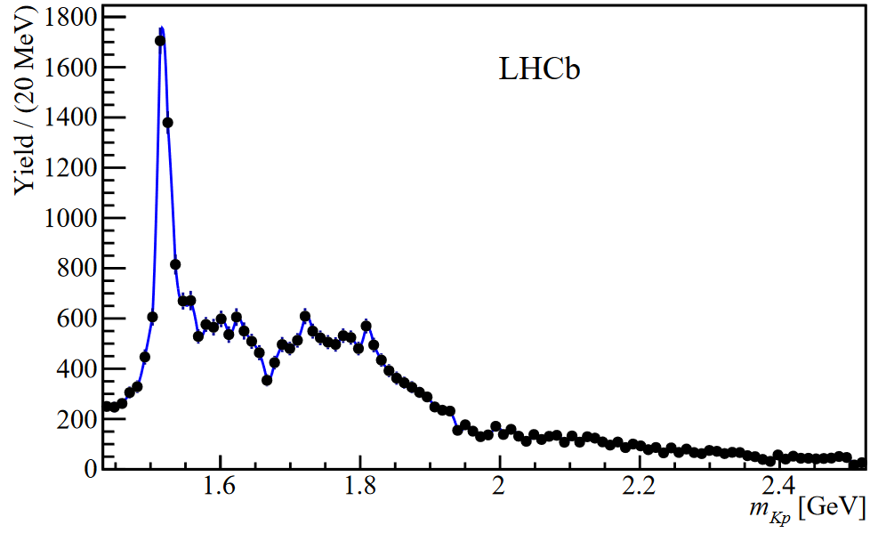







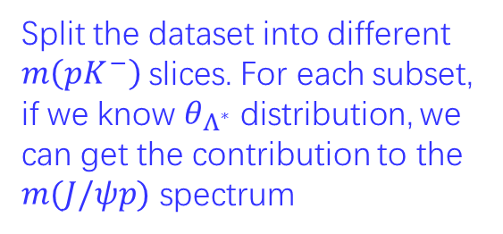

The moments analysis
$Λ^{∗}$ rest frame
$$K^{−}$$
$$J/ψ$$
$$θ_{Λ^{∗}}$$
A fixed $m\left(pK^{−}\right)$ and $θ_{Λ^{∗}}$ lead to a fixed $m(J/ψp)$
$$Λ^{∗}(→pK^{−})$$
$$p$$
Split the dataset into different $m\left(pK^{−}\right)$slices. For each subset, if we know $θ_{Λ^{∗}}$ distribution, we can get the contribution to the $m(J/ψp)$ spectrum
Features of angular spectrum $→$ mass spectrum

Slide 17
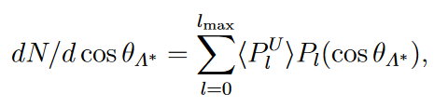
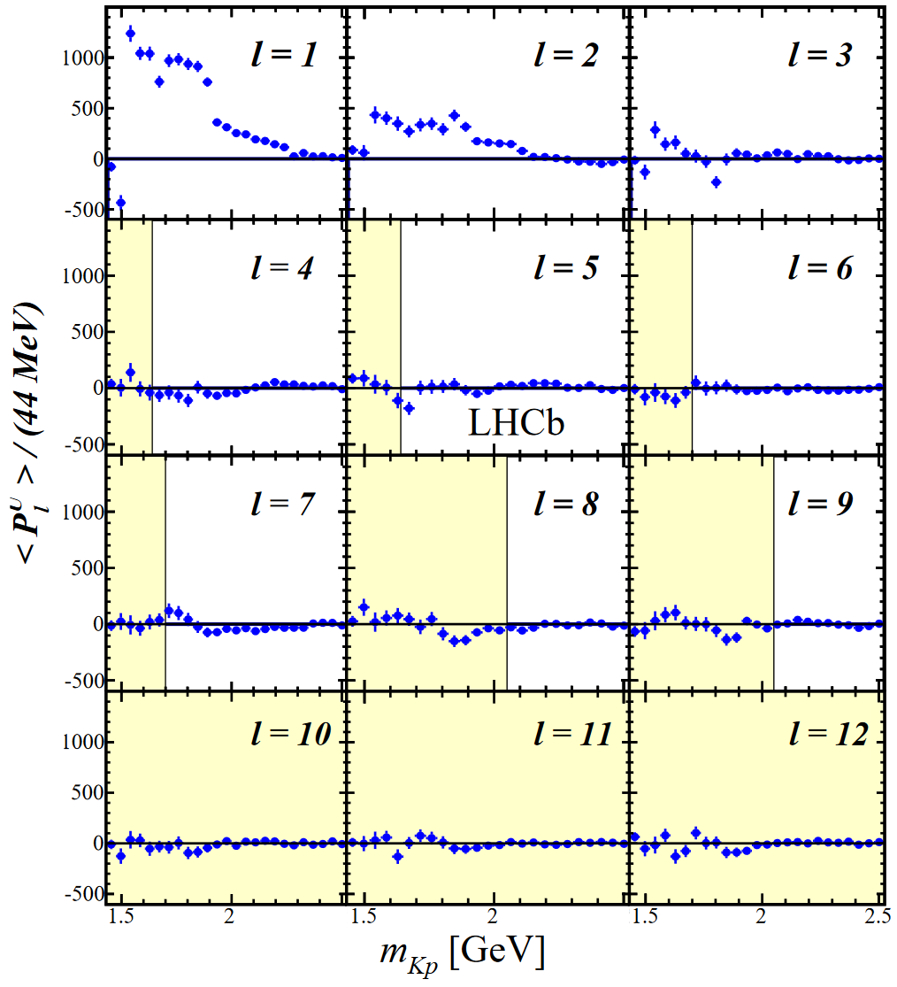
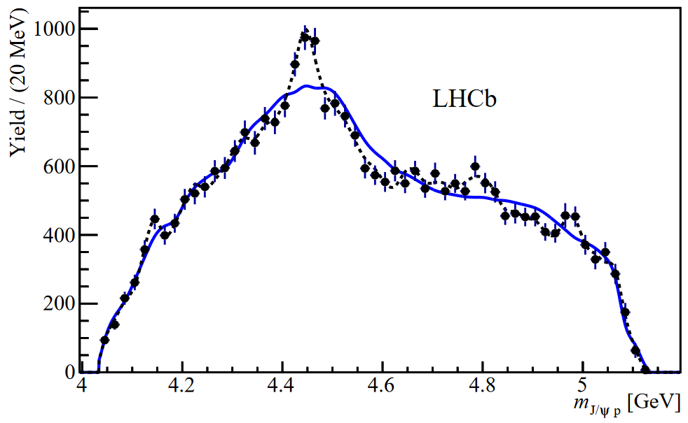
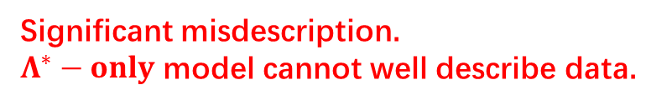


The moments analysis
If consider only $Λ^{∗}$ chain
Use $cosθ_{Λ^{∗}}$ distribution in data to obtain all $<P_{l}^{U}>$, assign a reasonable $J_{Λ^{∗}, max}$, remove higher order terms
$$l_{max}=2J_{Λ^{∗}, max}$$
Significant misdescription.
$Λ^{∗}−only$ model cannot well describe data.

Slide 18
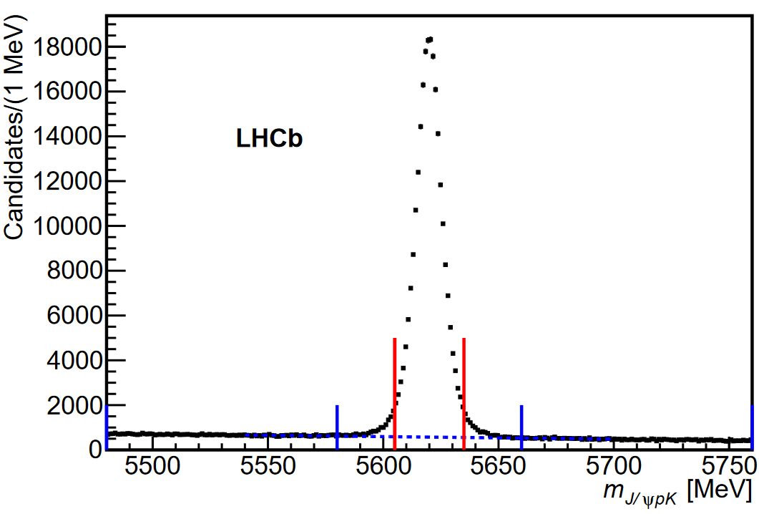



$Λ_{b}^{0}→J/ψpK^{−}$re-study using X10 data
First pentaquark observation @ LHCb is based on Run1 data, $L\sim 3 {fb}^{−1} @ 7,8 TeV$
More data available in 2019 after Run2 operation
  $L\sim 6 {fb}^{−1}, \sqrt{s}=13 TeV$ ($×4$ b-production than Run1)
Updated event selection:
  Use particle-identification info as input of MVA training
  Efficiency X 2 at the same BKG level
$>200k$ signals
Run1
Run1+2

Slide 19


Finer structures in $m(J/ψp)$ spectrum
Run1
Run1+2
Looks like 1 broad peak
Two narrower peaks
Clear peak
Just a hint

Slide 20




Properties of the new pentaquarks
A 1D mass fit to subtract properties of peaking signals
  $m(pK^{−})$-dependent weight assigned to subtract $Λ^{∗}$ contribution
  Breit-Wigner for $P_{c}$ shapes
  High-order polynomial for flat background
Significance of $P_{c}{\left(4312\right)}^{+}$: 7.3 $σ$
Significance of $P_{c}{\left(4440\right)}^{+}, P_{c}{\left(4457\right)}^{+}$ two-peak structure: 5.4$σ$

Slide 21

Conclusion
Intermediate states consistent with pentaquarks observed by LHCb in 2015, using the $Λ_{b}^{0}→J/ψpK^{−}$ decay
Evidence of the same states seen in $Λ_{b}^{0}→J/ψpπ^{−}$ in 2016
Model-independent studies prove the existence of exotic structures in $Λ_{b}^{0}→J/ψpK^{−}$ process in 2016
With LHCb Run2 data available, peaking structures in the $J/ψp$ mass spectrum are further investigated. Three new $P_{c}$ states announced in 2019

Slide 22



Open questions
Pentaquarks observed in experiment, but the nature still unclear
Compact ?
Hadronic molecule ?
Near-threshold kinematic effects ?
PRL115(2015)122001, PLB753(2016)547–551, PRC85(2012)044002…
PRD92(2015)071502(R)…
JHEP12(2015)128, PLB749(2015)289–291, PLB793(2019)365-371, PRD95(2017)5…

Slide 23







What we can do in experiment ?
Spin-parity measurement
Search for new pentaquarks
 | Compact | Molecule | Triangle
$$P_{c}{\left(4312\right)}^{+}$$ | $${\frac{3}{2}}^{−}$$ | $${\frac{1}{2}}^{−}$$ | $${\frac{1}{2}}^{−}$$
$$P_{c}{\left(4440\right)}^{+}$$ | $${\frac{3}{2}}^{+}$$ | $${\frac{1}{2}}^{−}( {\frac{3}{2}}^{−})$$ | $${\frac{1}{2}}^{+}$$
$$P_{c}{\left(4457\right)}^{+}$$ | $${\frac{5}{2}}^{+}$$ | $${\frac{3}{2}}^{−}( {\frac{1}{2}}^{−})$$ | $${\frac{1}{2}}^{+}$$
Compact model
PLB793(2019)365-371
Molecule
$$J^{P}$$
Mass(MeV)
PRL122(2019)242001
$$J^{P}$$
Width(MeV)
Mass(MeV)
Amplitude analysis would be a powerful tool for these targets !

Slide 24
Thank you for your attention !
Any questions or comments ?

