Slide 1
Development in dipole magnet technology
Massimo Sorbi
Università degli Studi di Milano – Dip. di Fisica
LASA - INFN – Sez. di Milano

Slide 2
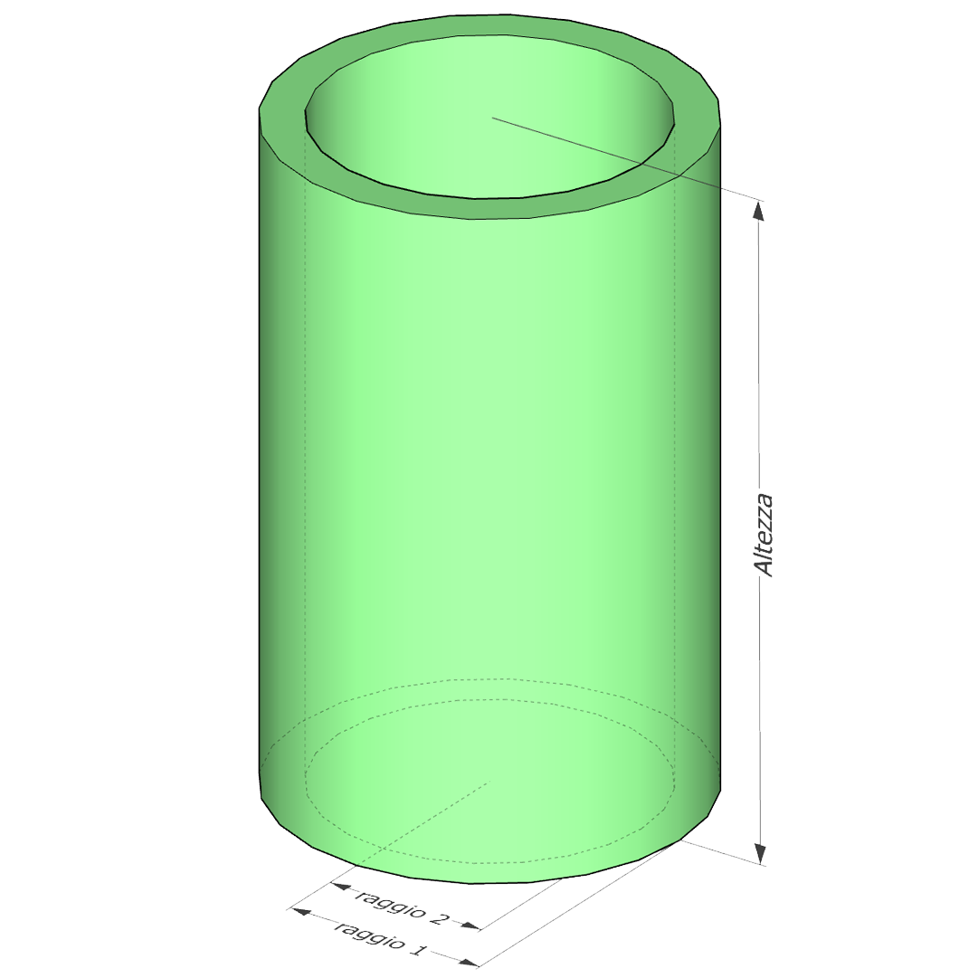
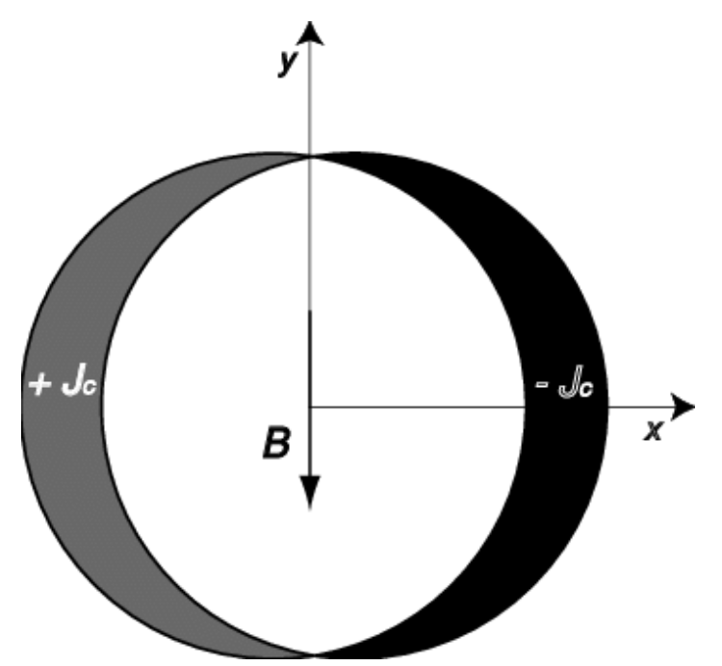
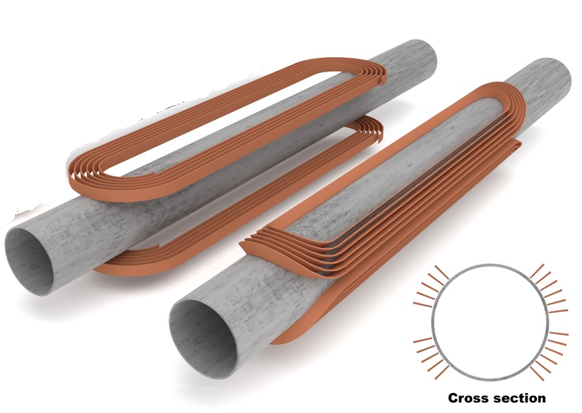
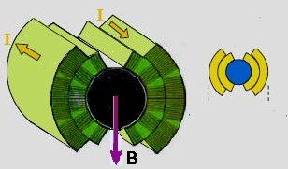
A few of basic considerations…
Magnetic field generated by conducting current
B = μ₀⋅J ⋅d
B = ½ μ₀⋅J ⋅d
B ≈0.5 ⋅ μ₀⋅J ⋅d
B =α ⋅ μ₀⋅J ⋅d
d
α ≈ 0.2÷0.4
d
CONCLUSION:
Superconducting dipole: less field respect solenoid with same current...
Removing the current in midplane is paid with less field
Other difficulties should be considered (mechanics, thermal design, …)

Slide 3
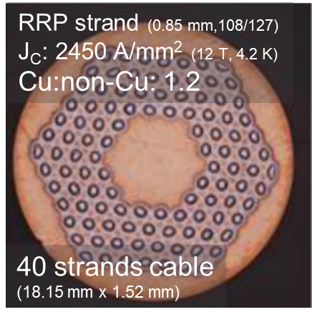
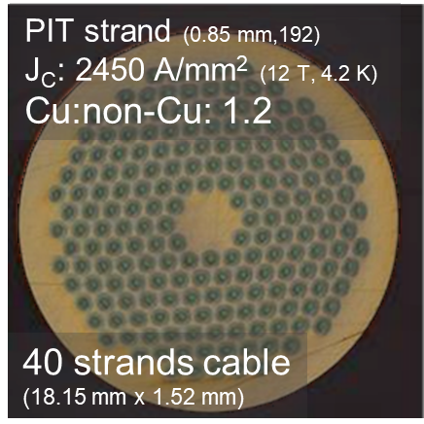
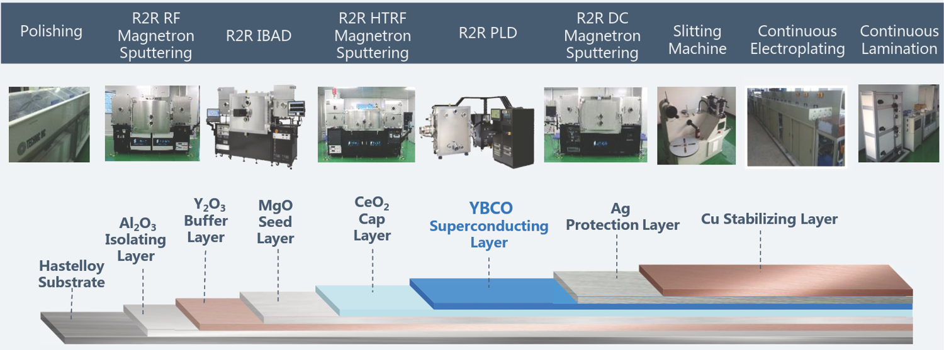
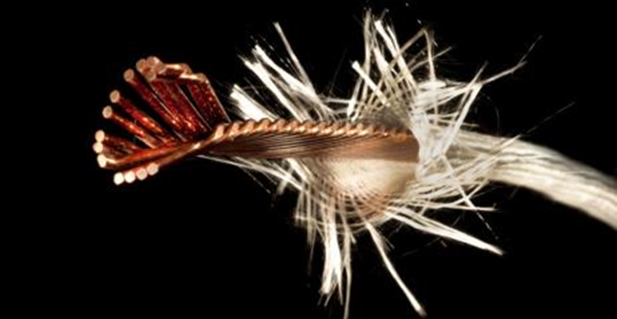
The conductor: not superconductor only
When we talk of J, we have to consider the overall density in metal part ---> J_{eng}
J_{eng} can be between 2 to 10 lower than J_{sup}
For the cable insulation, J_{eng} is additionally reduced of k_{ins} ≈ 0.7 → J_{eff} = k_{ins} ⋅ J_{eng}

Slide 4
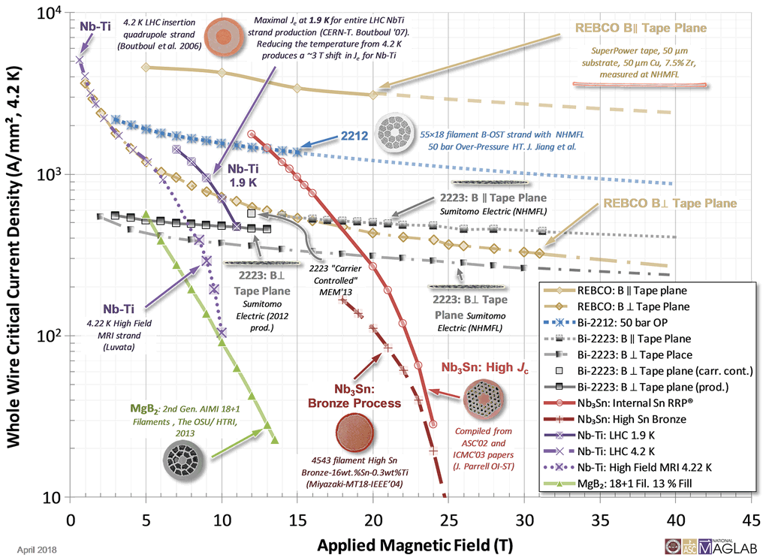
Where are we today?
B =α ⋅ μ₀⋅k_{ins} ⋅ J_{eng}⋅d
with
α≈0.5
d=100 mm
k_{ins} = 0.7
B=4.4 ⋅10⁻² ⋅J_{eng}
[J] = A/mm²
[B] = T
This means:
10 T -> 230 A/mm²
20 T -> 460 A/mm²
40 T -> 920 A/mm²
Engineering Critical Current Density vs. Applied Field for Superconductors Available in Long Lengths

Slide 5
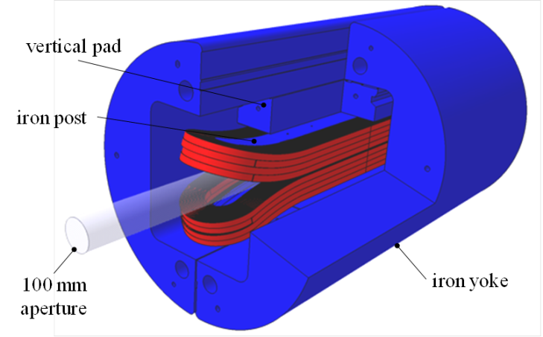
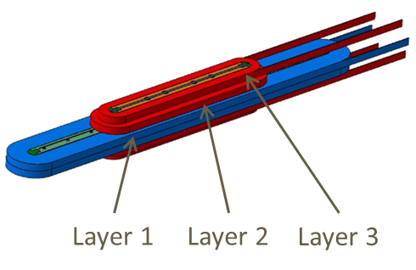
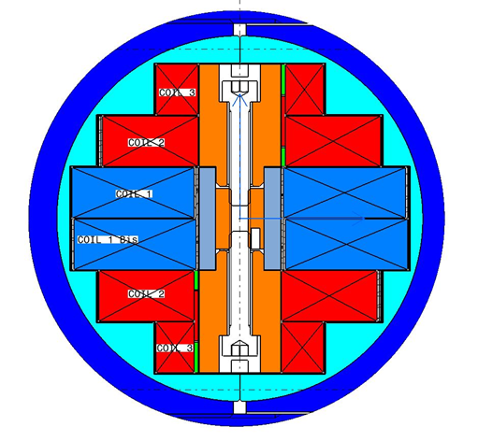
Recent achievement in Magnet Community
FP7 EuCARD – WP7
technology R&D 2008-2013
  FRESCA2 dipole
  13 T, ∅ 100 mm facility
  Tested in July 2017: 13 T!
  HTS insert + 6 T (no bore)
  Tested in Juy 2017: 4.52 T @4.2K (power supply limit, no quench)
In 2011 we set the goal for a new EU program FP7-EuCARD2 for enabling HTS in accelerator dipoles.
  Develop a CONDUCTOR of accelerator quality
  Develop a Dipole demo with accelerator characteristics
Fresca2
G. Willering et al. this session
EuCARD HTS Insert
M. Durante et al. Wed-Af.P03

Slide 6

Conductor cont.
Choice in favor of REBCO tapes assembled in Roebel cable
  REBCO: continuing the route of EuCARD
  EU Industry. Other EU programs (FP7-Eurotapes)
  High current density (use// orientation) & Transposition!
  “Easy” start: conductor in final form, no need high temperature heat treatment of whole coil.
Other types of cable like stacked tape cable with twist on the curvature ends have been investigated. Eyes on CORC®!
Activity on Bi-2212 have been pursued in the collaboration CERN-ASC(Fl) on advanced powder from Nexans with mesurements by Univ. of Geneva on strand and in future U.Twente on cable
W. Goldacker et al., 2006 J Phys. Conf. Ser. 43 901

Slide 7
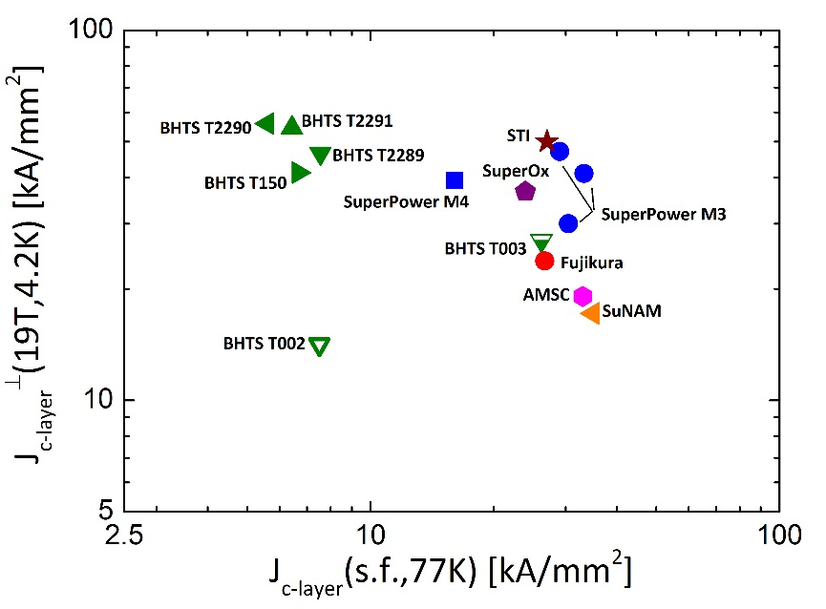
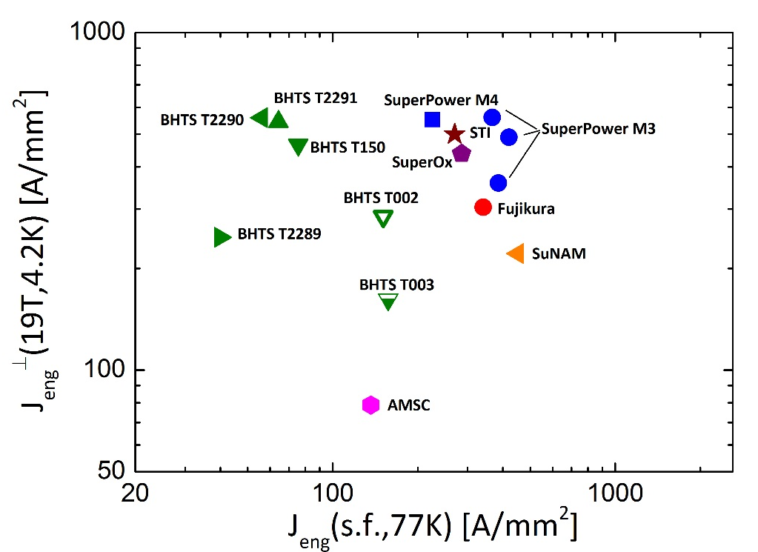

Characterization: full campaign @ UniGe
C. Senatore & C.Barth

Slide 8
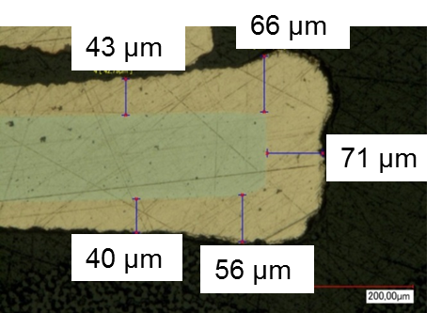
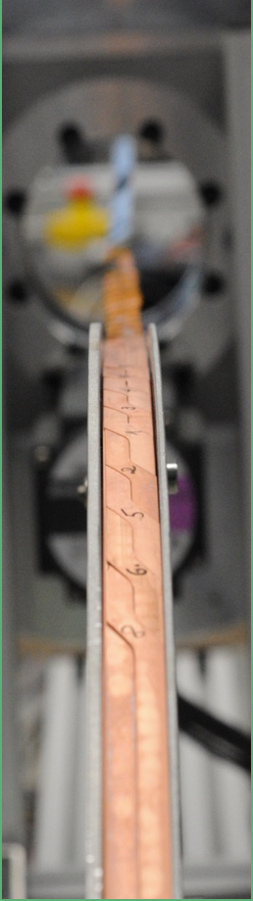
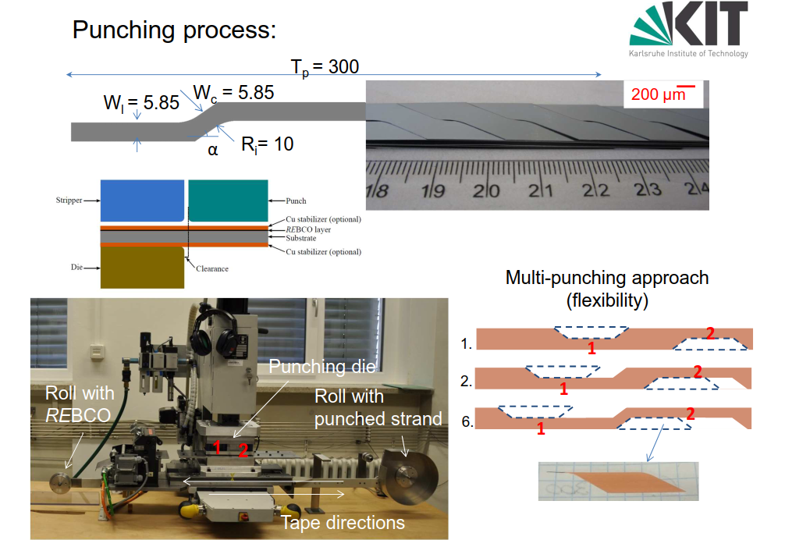
From tape to cable
A. Kario & W. Goldacker

Slide 9
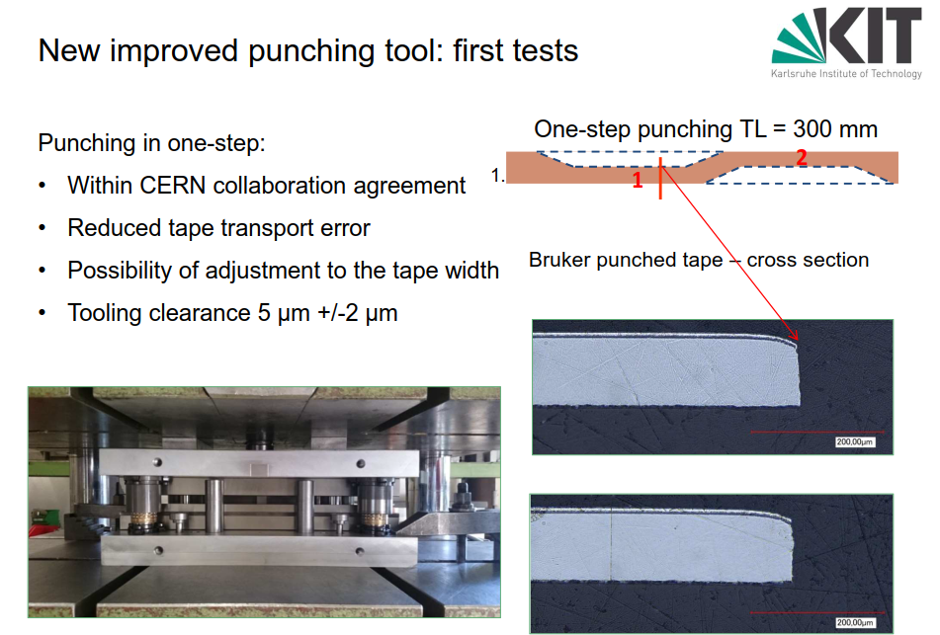

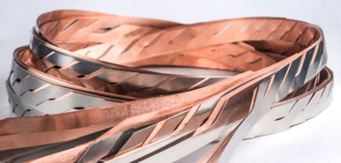
New line for the Roebel
Anna Kario, Simon Otten, Andrea Kling, et al., Wed-Mo-Or21-01

Slide 10
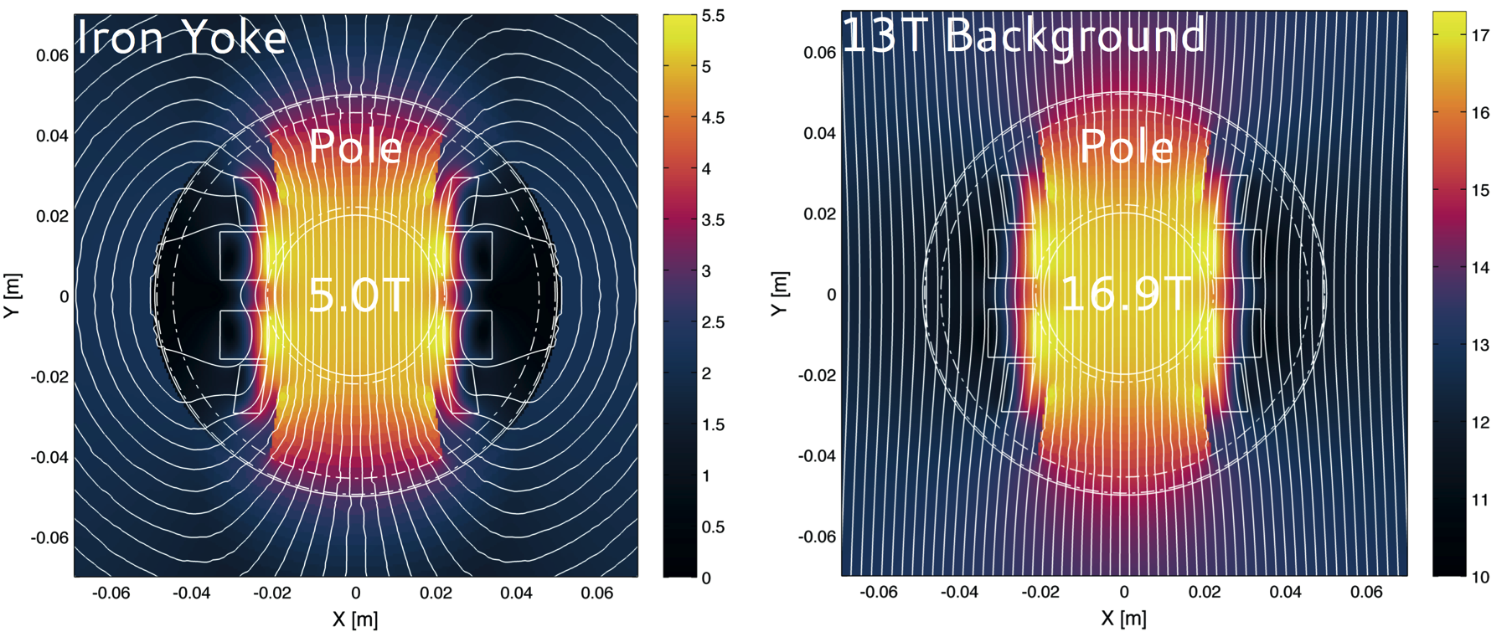
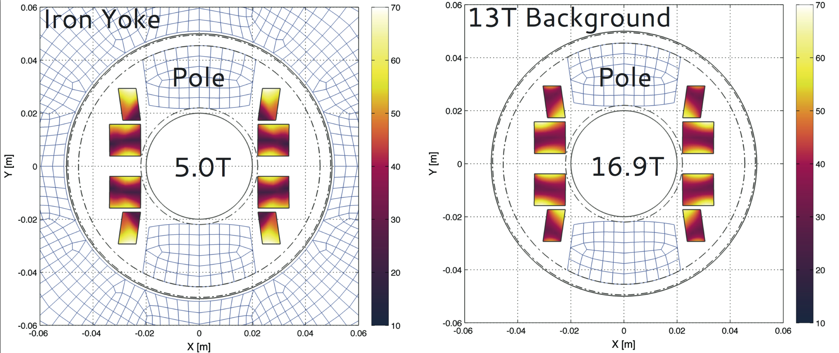
Aligned Block lay-out
The two plots present flux path variation for insert magnet:
(left) standalone in Iron ,
(right) in 13T ideal background field
Magnetic Field [T]
e.m. model and e.m. design by J. Van Nugteren @ CERN
Yellow area is the region more near to short sample.
Very different from std. LTS magnets.
Percentage on Loadline [%]

Slide 11
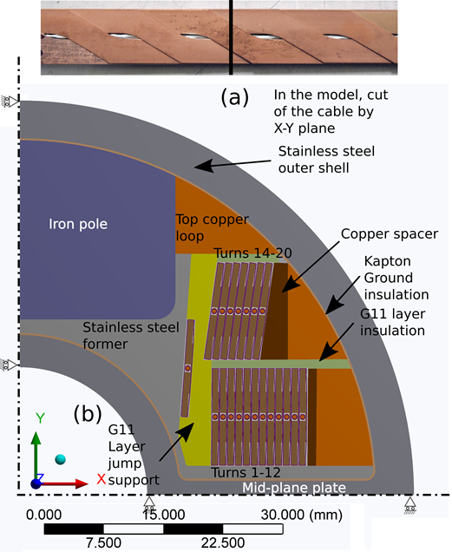
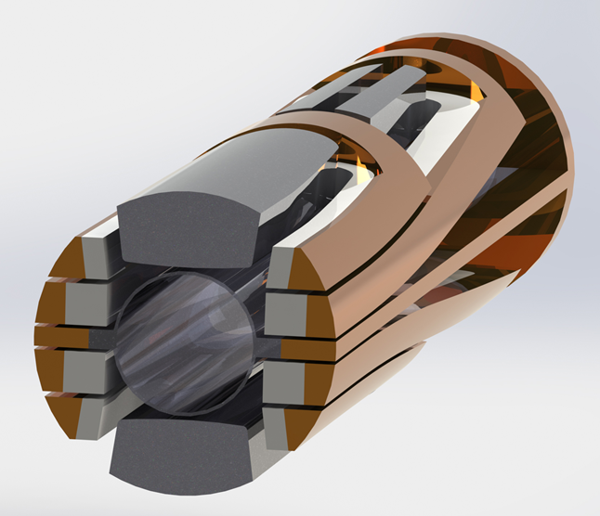
AB dipole magnet
Quench CU bars
G. Kirby, CERN
J. Murtomaki, CERN

Slide 12
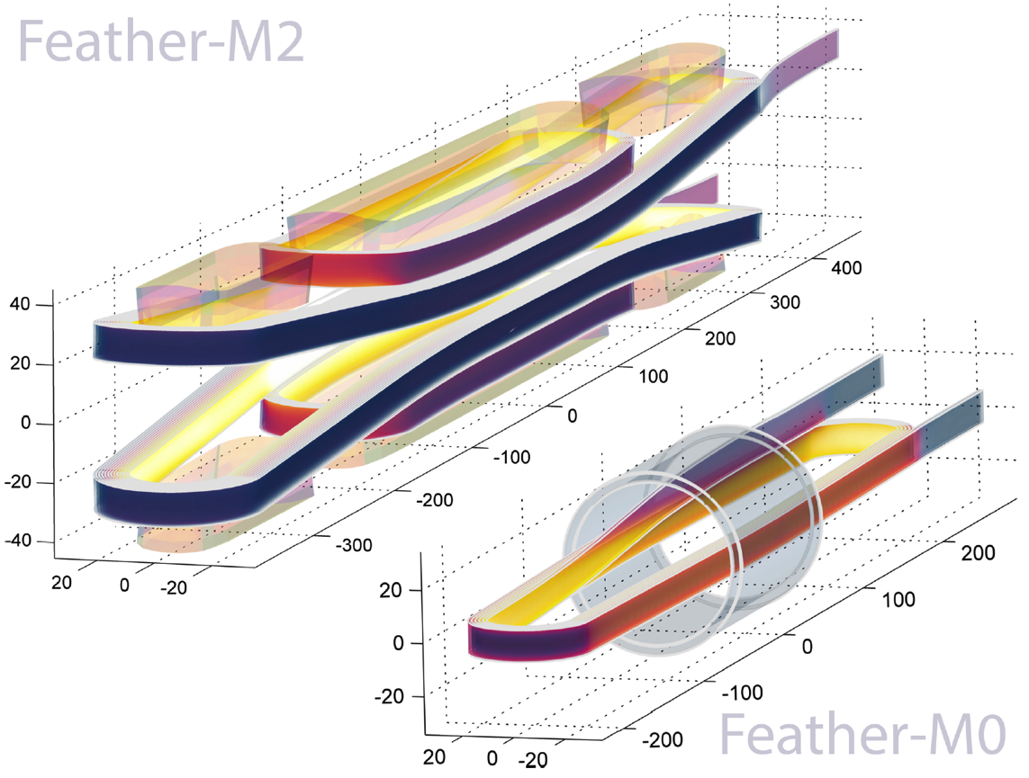
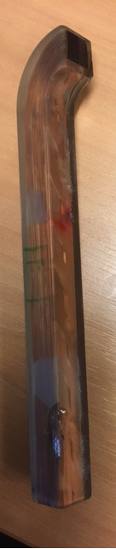
Going in steps:FeatherM0 flat racetrack, 5 m cable

Slide 13
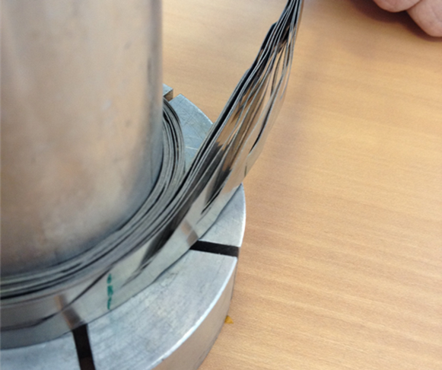
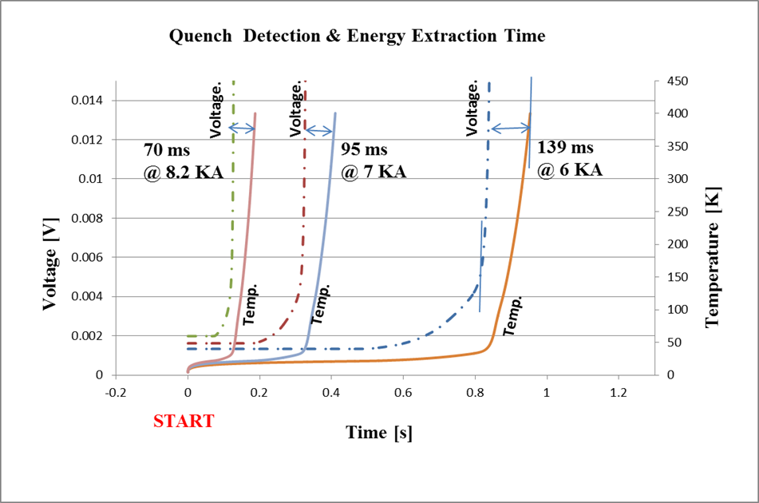
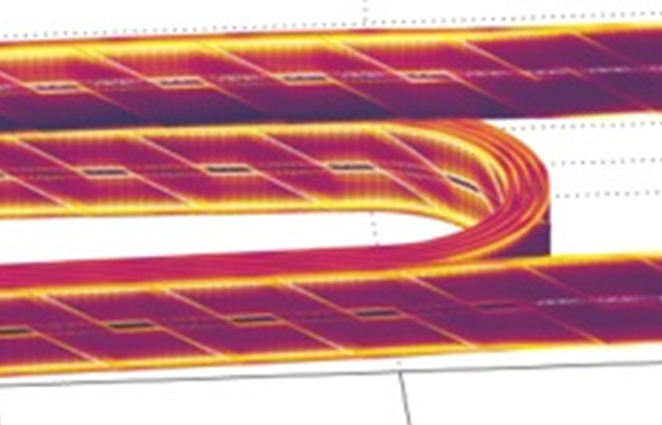

Magnet technology issues… design & protection issues…
Winding (un)stability : small tension
Impregnation → delamination
QD & QP Studies with strongly anistotropic th. Cond.
and with strong TCS variation inside tape/cable
Current redistribution
Tampere TUT. J. Ruuskannen
Thu-Af-Po4.09-09,
e.m. model of J. Van Nugteren, U.T. & CERN

Slide 14
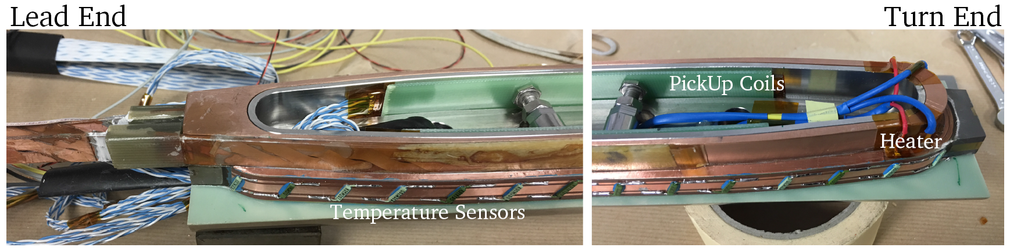
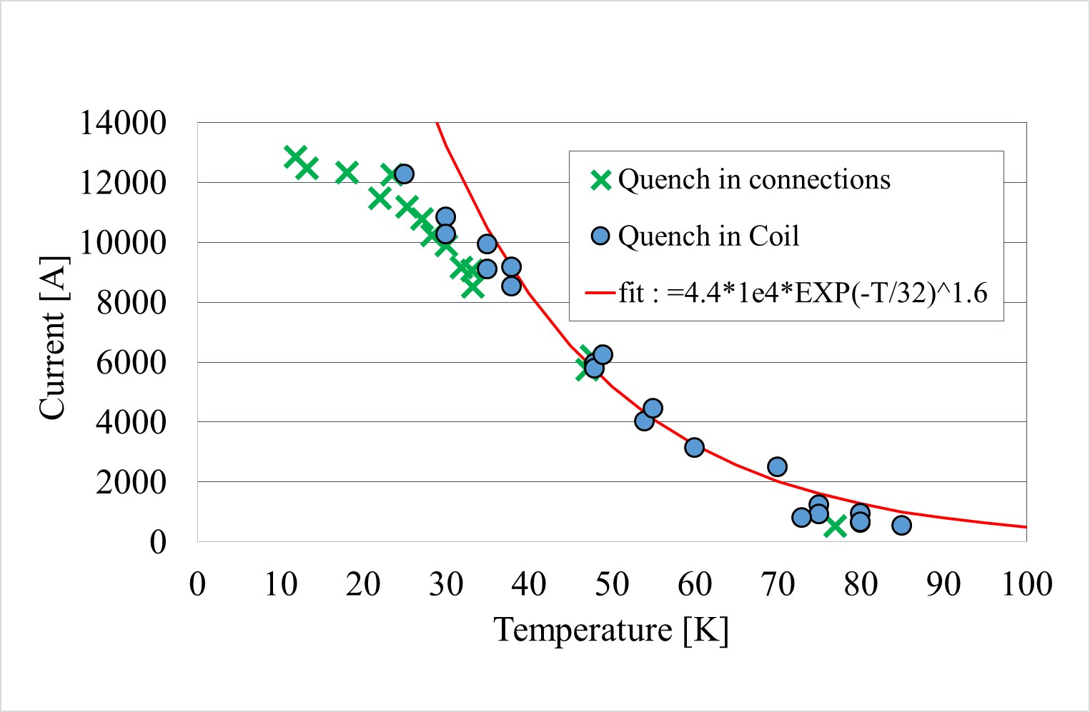
FeatherM0.4
Computation showed little time to react to a quench: 20-30 ms:
Quench detection.
Improved voltage taps
(≈ 1 mV)
Array of temp. sensors
Pick-up coil array
Fiberglass in Bragg grating
12.8 kA, cable qualified

Slide 15
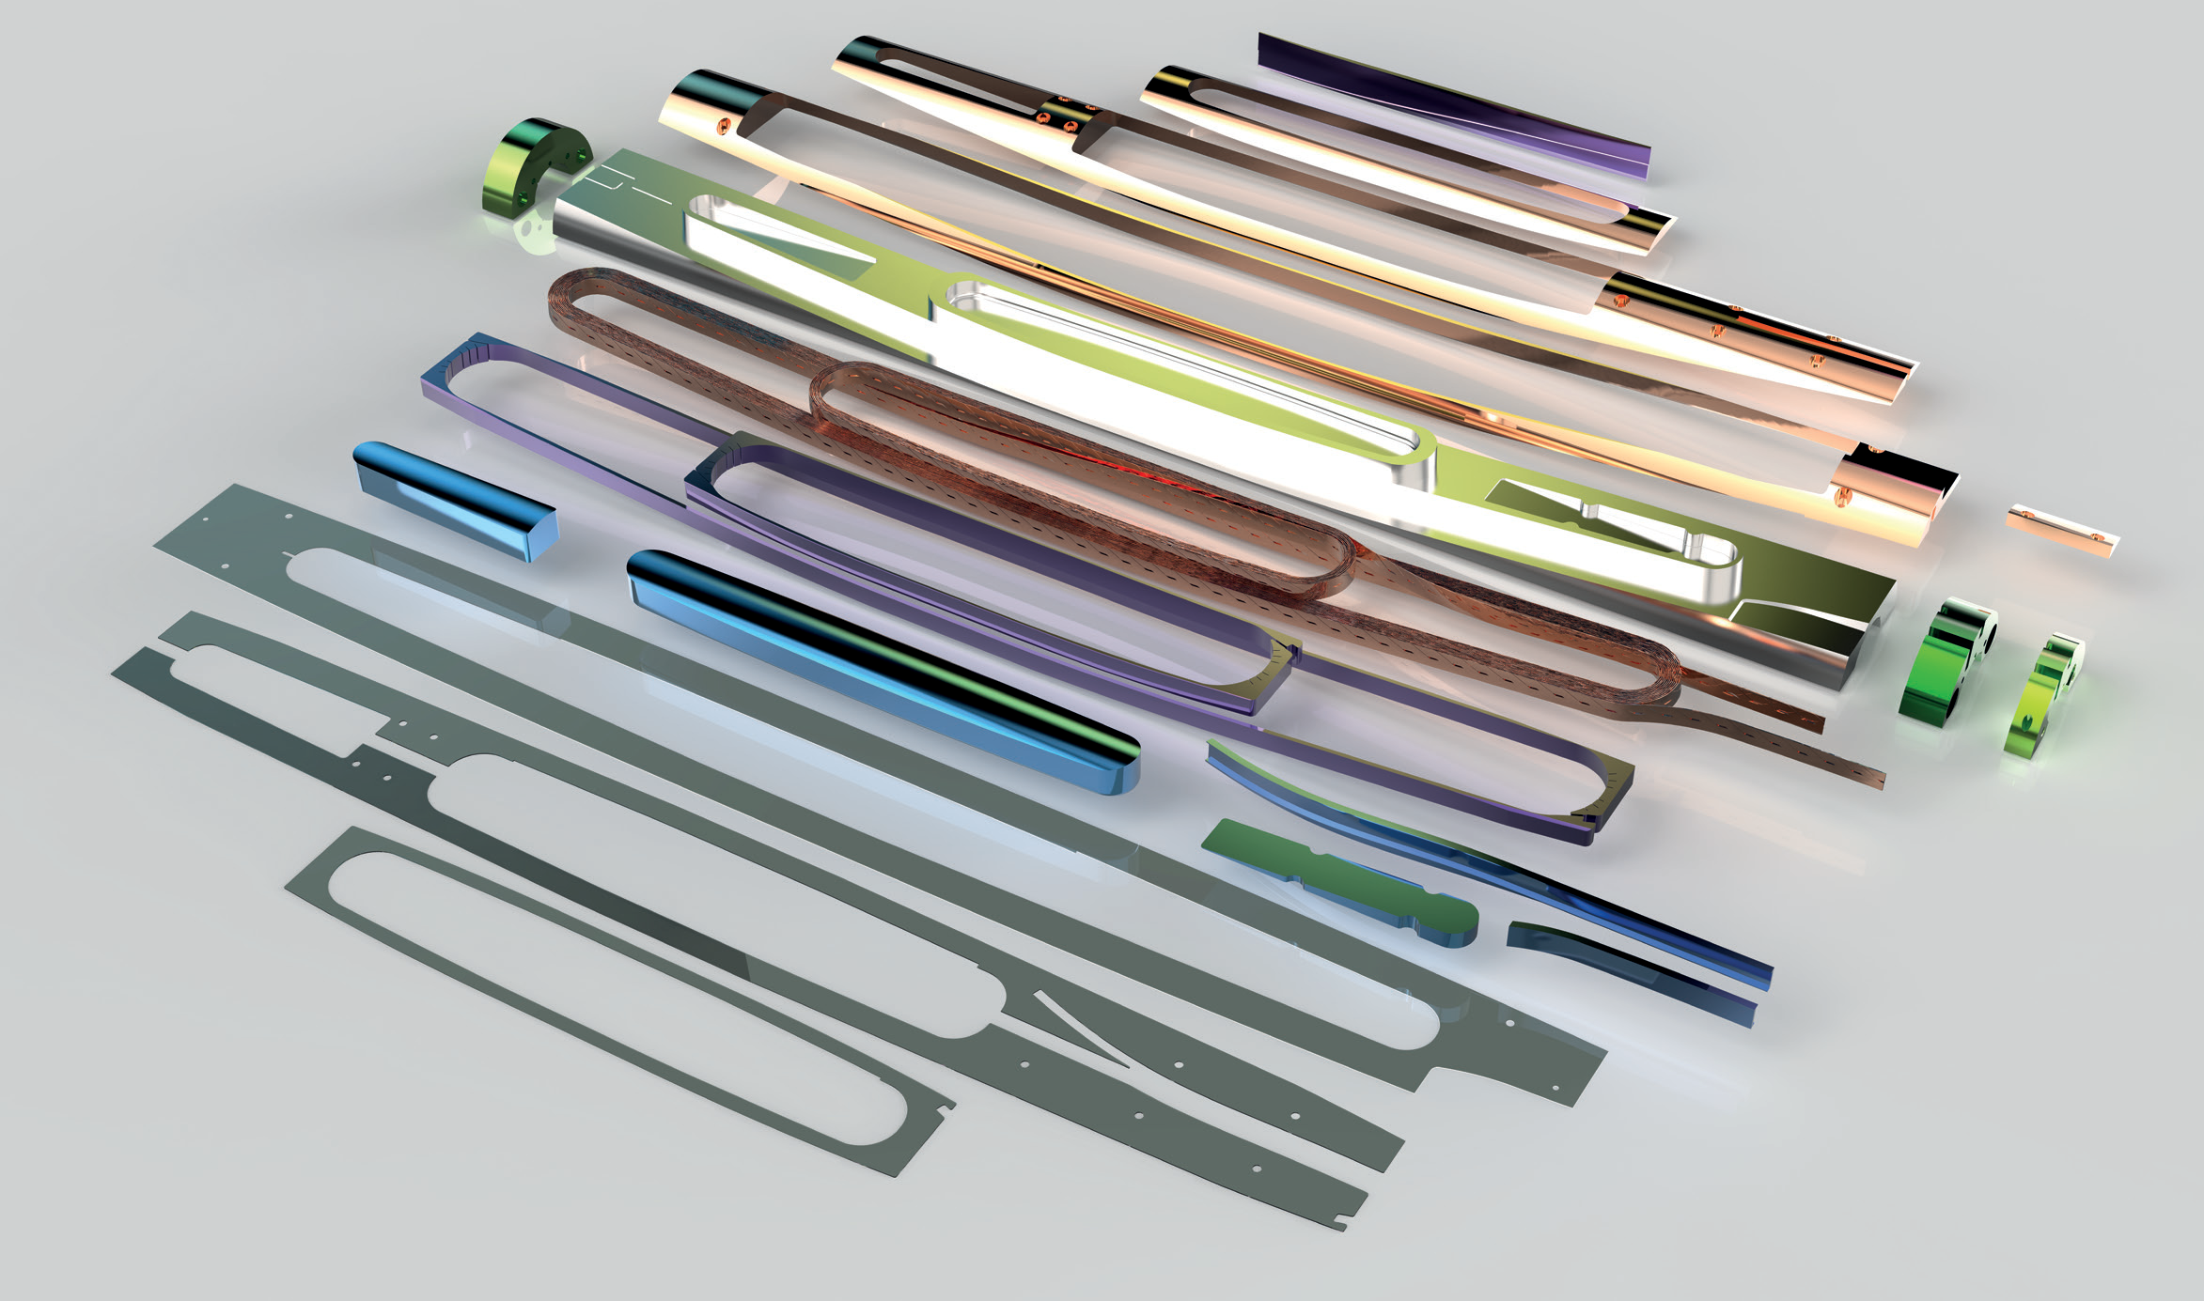
FeatherM2 construction: a complex assembly

Slide 16
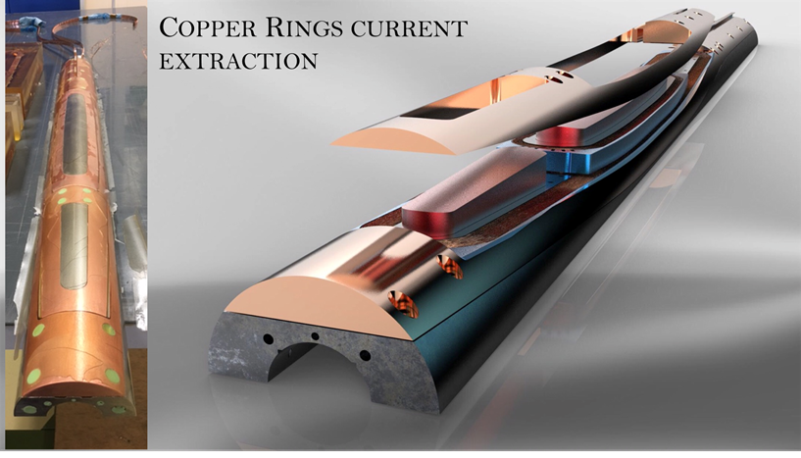
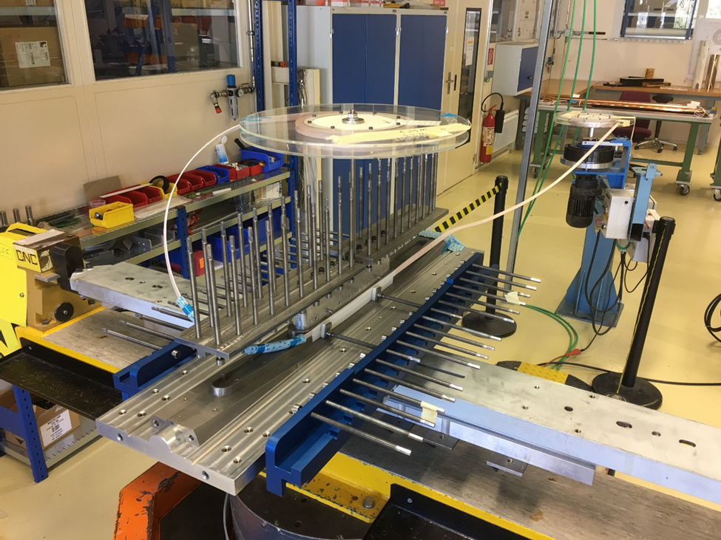
Manufacturing the Eucard2 first dipole FeatherM2
Courtesy of Glyn Kirby

Slide 17
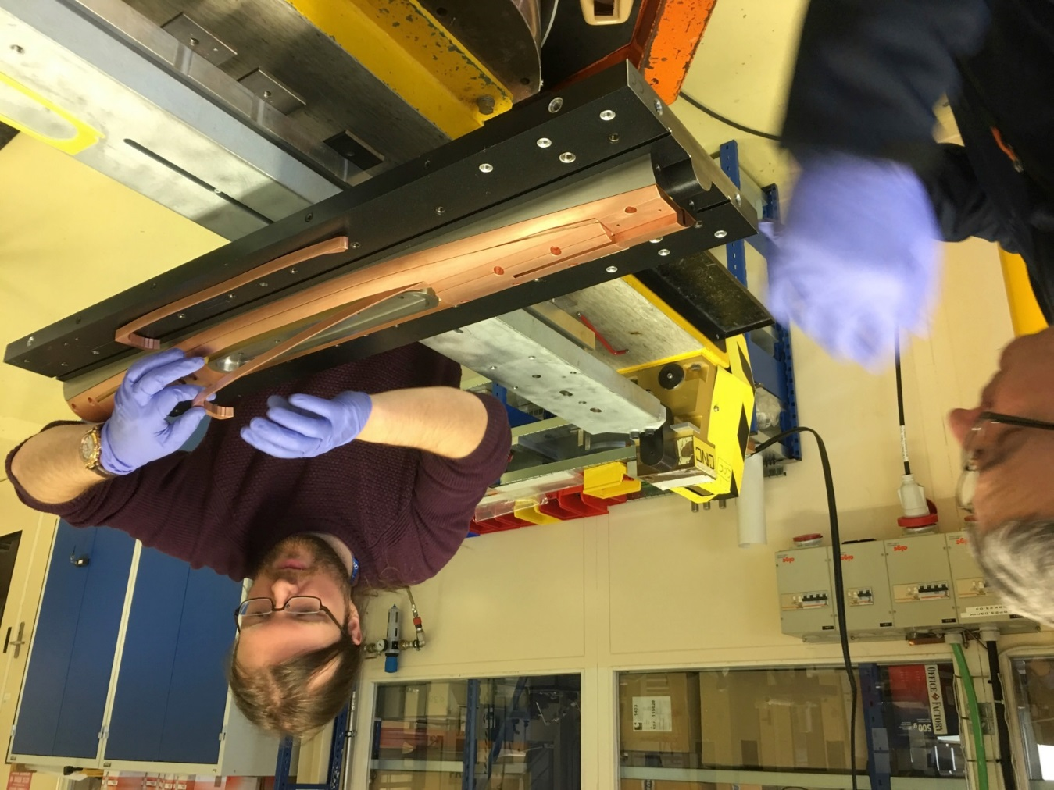
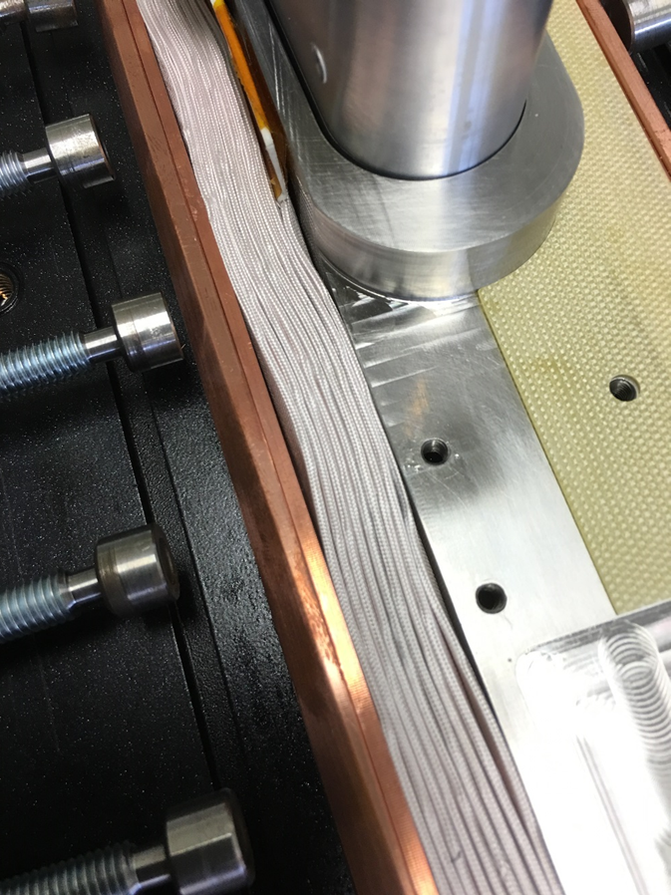
FeatherM2 AB block dipole construction

Slide 18
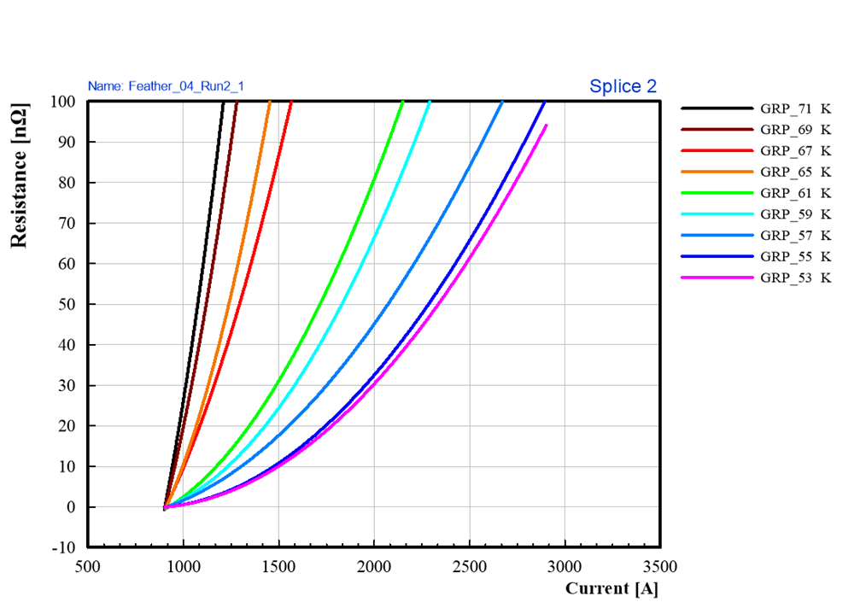
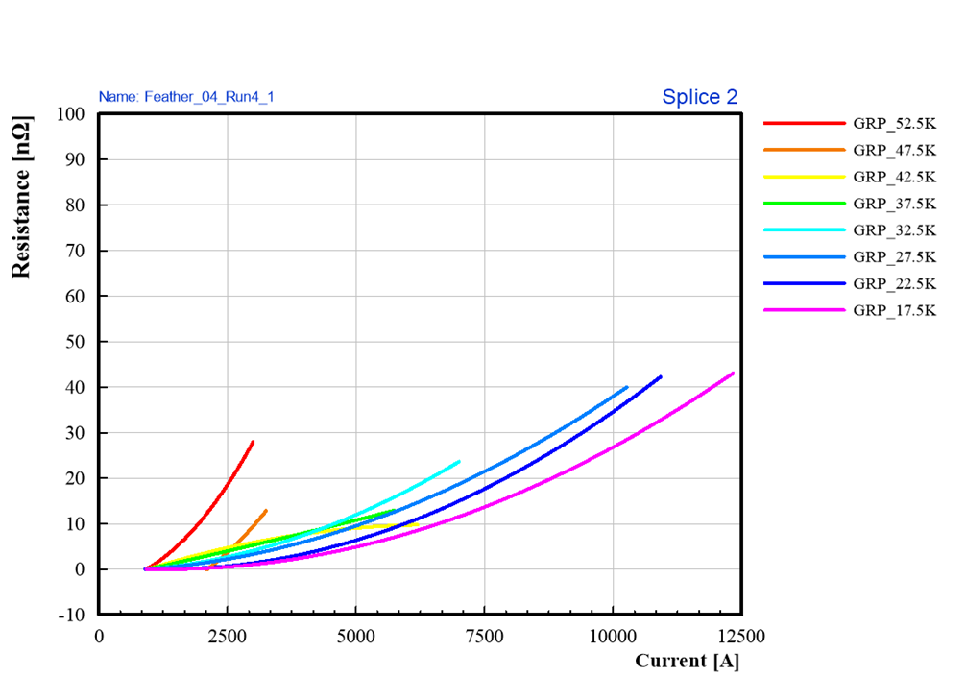
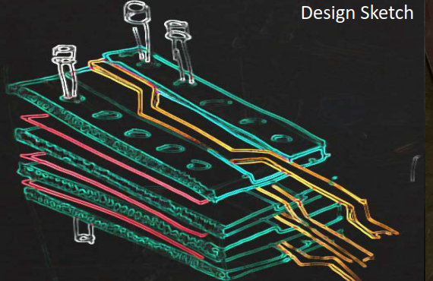
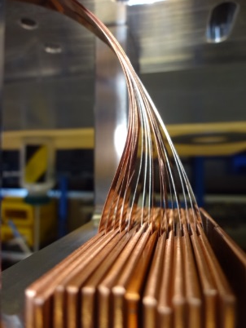
Joints
Classical butlap joint in FM0.4:
>100 nΩ! ⇒ 40 nΩ
New design, called Fin block joint
(G. Kirby).
Improvement by a factor 2, no need of overcooling: do we need it? Certainly it helps to transfer current more uniformly…

Slide 19
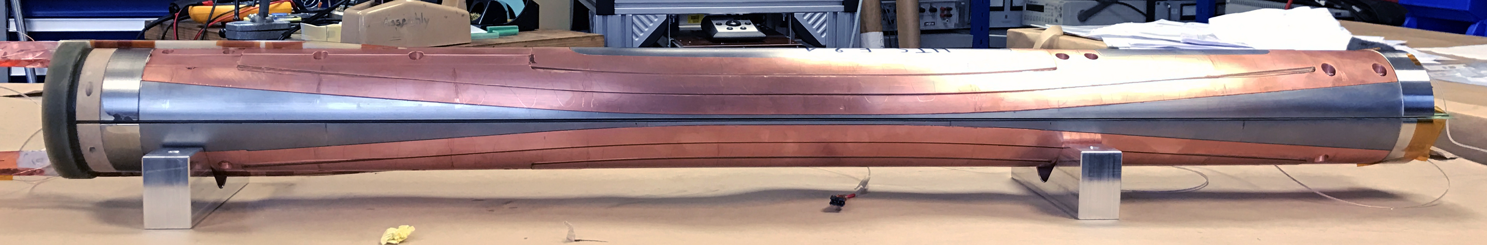
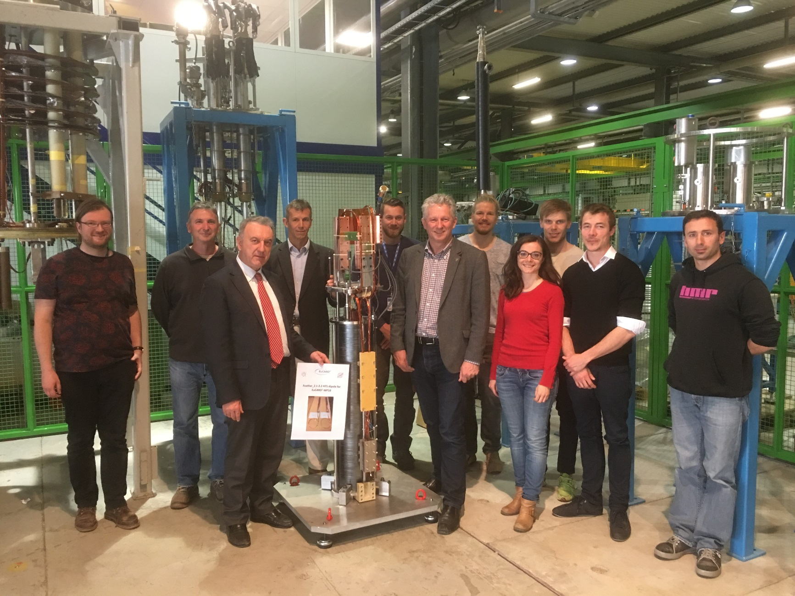
First accelerator-class magnet before going to test:
The Eucard2 FeatherM2.1-2 dipole
April 2017.

Slide 20
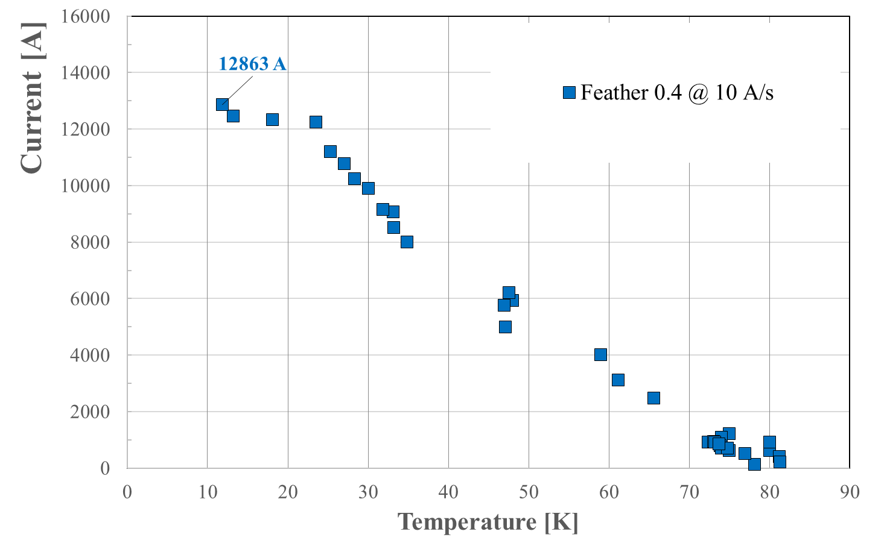

Slide 21

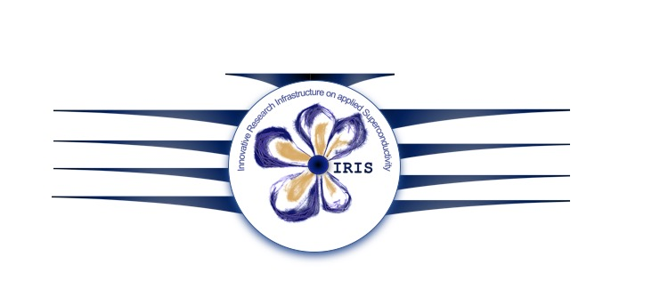
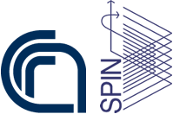





The IRIS program of the Italian PNRR
WP1
Project Management and Technical Coordination
WP2 Frascati – Magnetic Measurement Laboratory
WP6 Salento – Laboratory for Superconductivity and Magnetism
WP3 Genova – Superconducting Cables and Material Laboratory
WP7 Salerno – Test facility for large magnet and superconducting line
WP4 Milano LASA – Superconducting Magnets Laboratory
WP8 Green Superconducting Line at zero emission
WP5 Napoli – Advanced Instrumentation Laboratory
WP9 Energy Saving HTS Magnets for Sustainable Accelerators

Slide 22

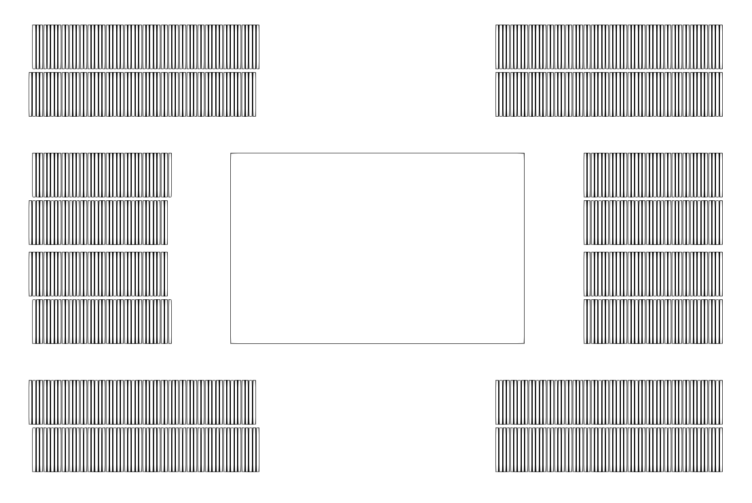
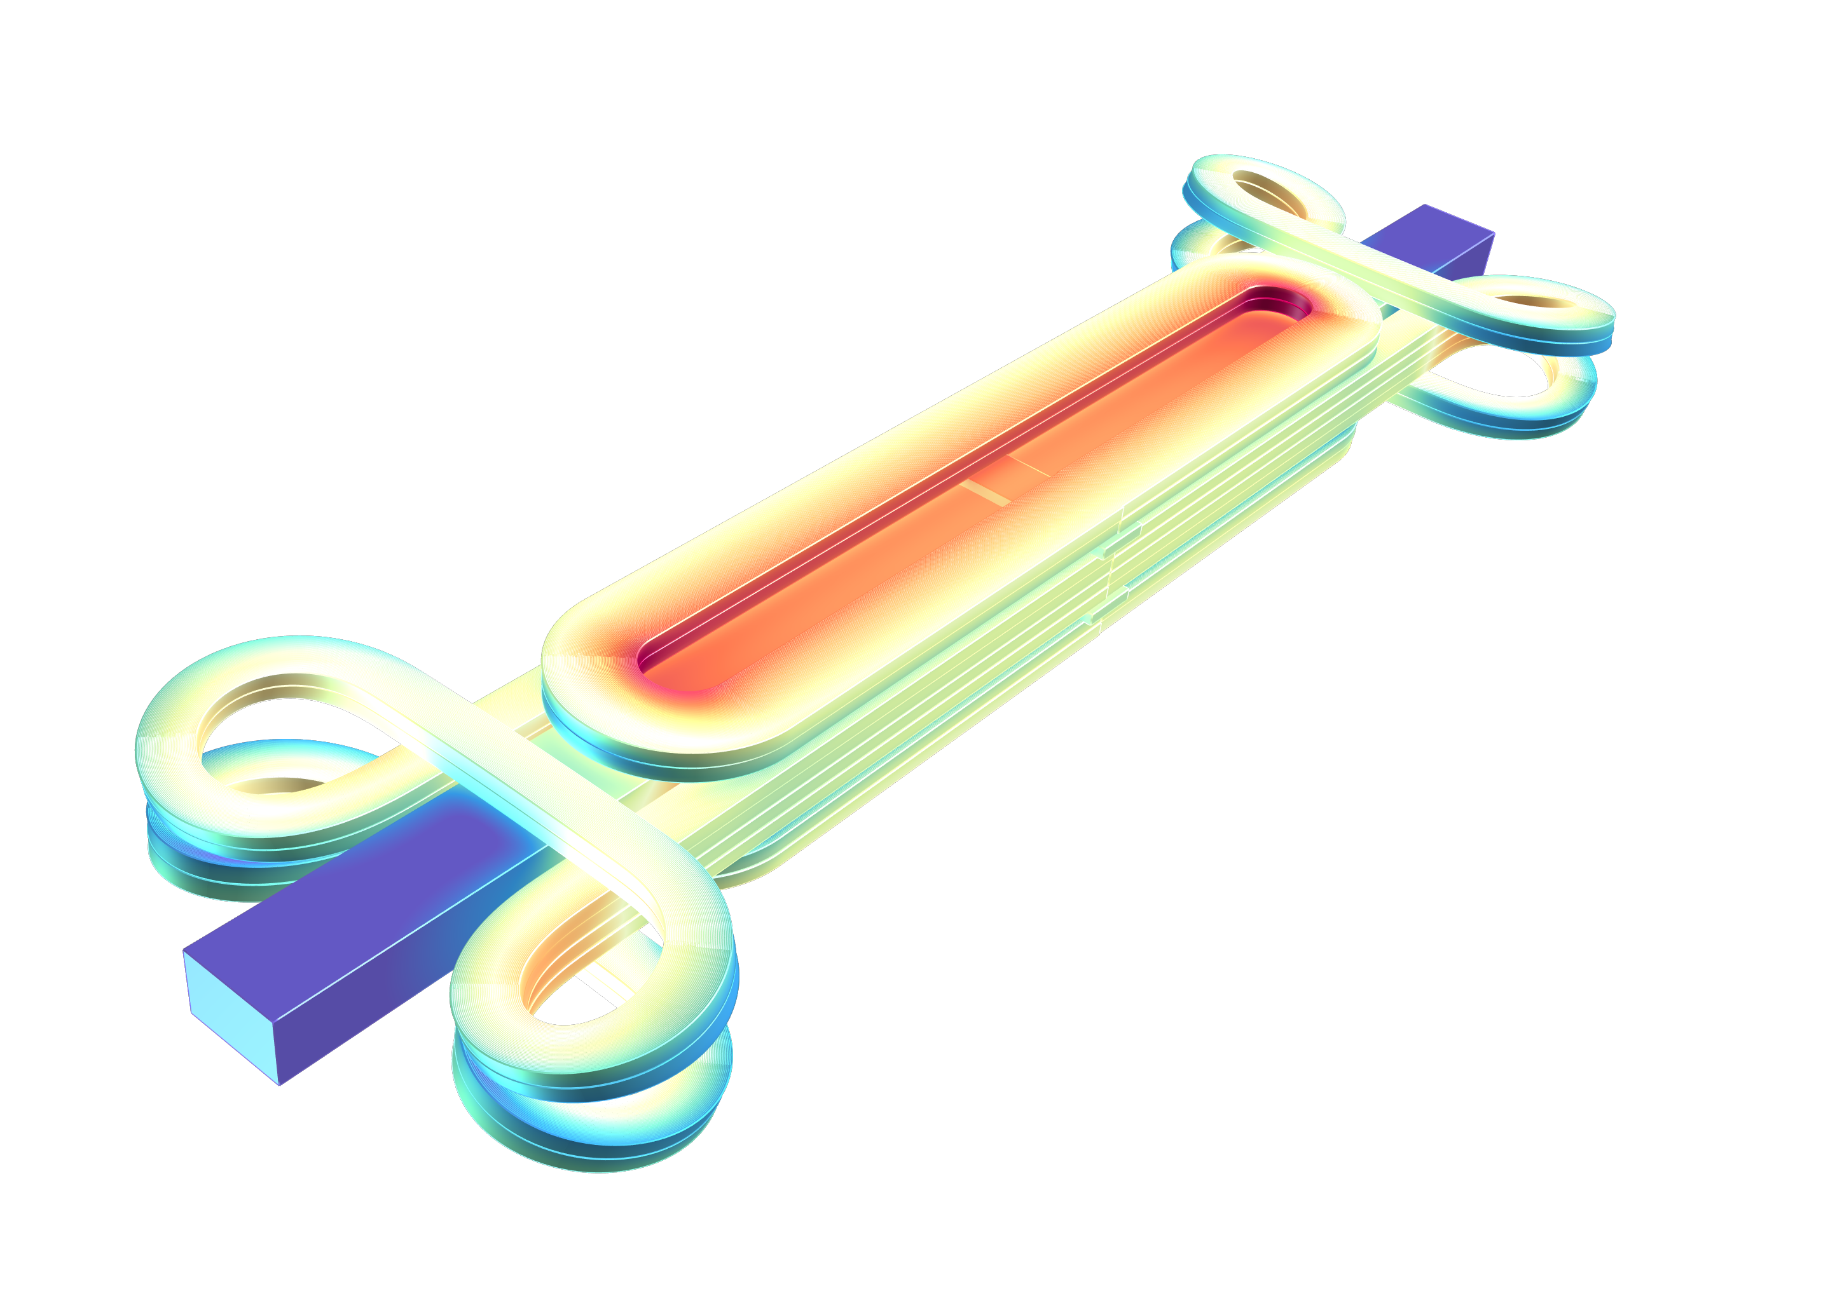
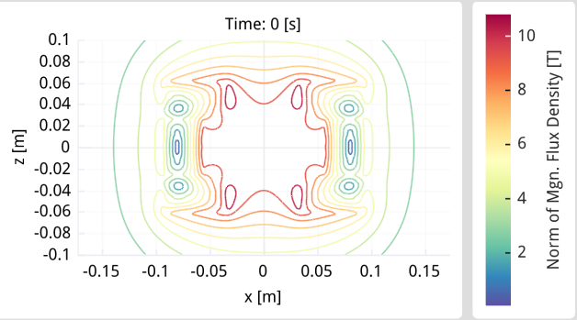
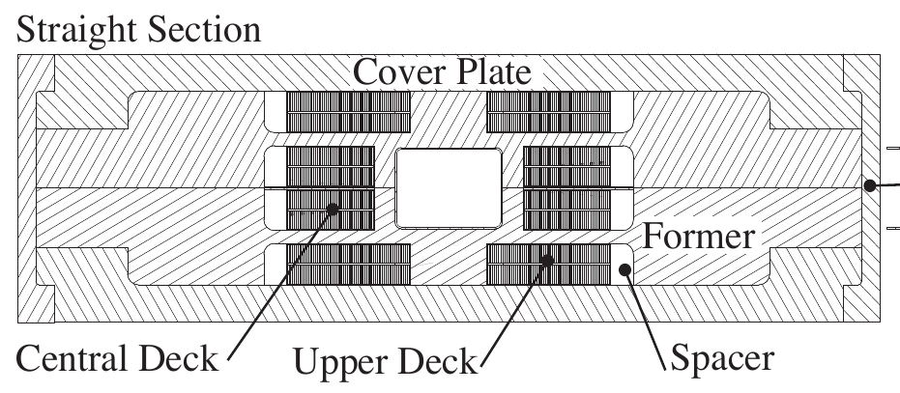
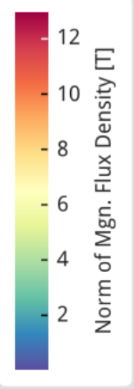
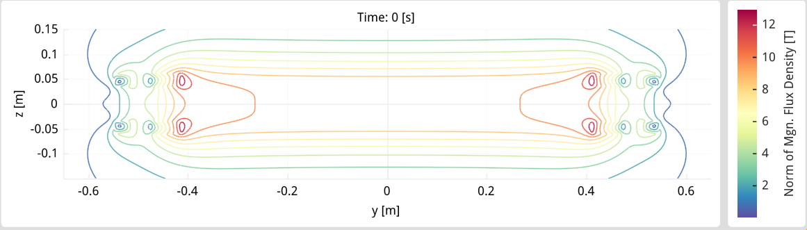
WP9: 10T 20K Test Station Magnet with Cloverleaf-End Design Sketch
Aperture 80X50 mm
700 mm straight section
B3 B5 geometric field quality
12 mm wide REBCO tape (stack)
1.2 MJ stored energy
10 K temperature margin
11 km of HTS tape (~1 M$)
550 A/mm² cable current density

Slide 23

what is the limit of our dream of J?
Changing paradigma:
B =α ⋅ μ₀⋅k_{ins} ⋅ J_{sup}⋅d
with
α≈0.5
d=100 mm
k_{ins} = 1
B=6.3 ⋅10⁻² ⋅J
[J] = A/mm²
[B] = T
This means:
10 T -> 160 A/mm²
20 T -> 320 A/mm²
40 T -> 640 A/mm²
Non-stabilizer Critical Current Density vs. Applied Field for Superconductors Available in Long Lengths

Slide 24

No-insulation (NI) coils
No turn-to-turn insulation
Self-protection: The current can bypass a local quenched part and avoid a local burning
Figure: NI test solenoid produced at CERN;
T H Nes et al. 2022 IEEE Trans. Appl. Superconduc. 32 1-6
Advantages:
Self-protection
Higher Young’s modulus (Lorentz forces cause less movement)
Higher overall engineering current density (no insulation and less stabilizer)
Disadvantages:
Long charging times
Requires more cooling power during ramping since the radial current generates heat
After a quench, the radial current generates new types of forces that can damage the HTS tape

Slide 25



Modeling no-insulation coils
Based on electrical circuit models that considers either 0, 1 or 2 physical dimensions
Couples with models for the temperature and magnetic B-field
Can be expanded to model multi-coil magnets
Course network circuit model: One physical dimension is considered (rotational symmetry assumed)
Network circuit model: Two physical dimensions are considered
Lumped circuit model: No physical dimensions are considered

Slide 26

Variations of the no-insulation winding technique
Aims to control the turn-to-turn resistance and increase mechanical strength
Partial insulation (Insulation between selected turns)
Metal insulation (cowound metal tape)
Metal cladding insulation (metal cladding applied to HTS tape surface)
Solder impregnation
Conductive epoxy impregnation
Smart insulation (utilizes the metal–insulator transition of Vanadium(III) oxide)
Varistor insulation (utilizes voltage dependent resistors)
Diffusion bonding (removes contact resistance to obtain predictable turn-to turn resistance)

Slide 27


The HTS Demonstrator Magnet for Space (HDMS) project
Conceptual design of a HTS magnet for the magnetic spectrometer in space ARCOS
Design and manufacture a demonstrator coil AMaSED-2 for the ARCOS magnet
Project webpage: https://knowledgetransfer.web.cern.ch/aerospace/hdms

Slide 28
AMaSED-2 coil design
Racetrack-like shape, outer dimensions: 480 mm x 256 mm
No-insulation coil
Two cowound HTS tapes (face-to-face)
724 m of 12 mm wide SuperPower HTS tape
Inductance: 46.6 mH
Magnet parameters at T_{op} = 10 K:
Operating current: 2.40 kA
Peak B-field on coil: 9.0 T
Central B-field: 2.7 T
Stored energy: 133 kJ
Notes:
AMaSED-2 has a racetrack-like shape and is a small-scale version of a coil from the ARCOS magnet.
The cable will be a tape stack of two HTS tapes. AMaSED-2 requires a total of 750 m of SuperPower HTS tape.
The theoretical maximum engineering operating current density is 2480 A/mm² at 4.2 K with a peak magnetic B-field of 9.3 T. The coil will be tested at a several different temperatures in the range from 4.2 K to 77 K.
28

Slide 29


Slide 30


AMaSED-2 completed in October 2021

Slide 31


AMaSED-2 tested in February 2022
Tested in helium gas at 77 K, 60 K, 40 K, 20 K, and 10 K
Characteristic magnet parameters determined at each temperature
Time constant, radial resistance, and magnet critical current versus temperature.
Maximum achieved B-field in the center (max B₀) and on the coil (max B_{m}) versus temperature

Slide 32
Conclusion
Dipole field in range of 12-13 T already reached with LTS superconductor. They are heavy magnets (in case of large aperture)
For a spectrometer with 4-5 T·m and 1000-1500 mm length, the actual LTS technology is suitable. Some concerns may be afforded in case of radiation depositions, losses depositions, large forces for large magnet, reduced space availability. Dedicated studies can give reliable solutions.
HTS technology may be a plus for the spectrometer, for energy saving (higher temperature, less consumptions), but strictly is not necessary.
Special dipole dedicated to spin precession in the range of 20 T and bore diameter 20-50 mm for sure requires HTS technology
Now we have HTS program financied for the use of HTS superconductors in dipole for field of 10 T (with insulated cable)
The new technology of non-insulated HTS coil has incredibles potentiability, theoretically with field up to 30 T – 40 T
We hope that this new starting programs will allow to pave the road of HTS, with the possibility to increase the field -> 20 T

