Slide 1
Goniometers for precision positioning of bent crystals in the LHC
Quentin Demassieux, on behalf of CERN SY-STI-TCD
27/09/2022

Slide 2
Summary
Principle and set-up of crystal collimators in the LHC
From requirements to operational designs
Toward a new generation of goniometers at CERN

Slide 3
Principle of crystal collimators (TCPCs)
Standard Collimation multi-stage cleaning
Crystal-based collimation cleaning
TCPPs
TCSPs
Absorbers
Beam
Crystal
Absorbers

Slide 4
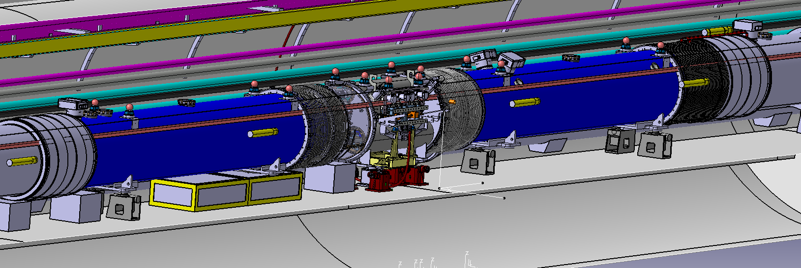
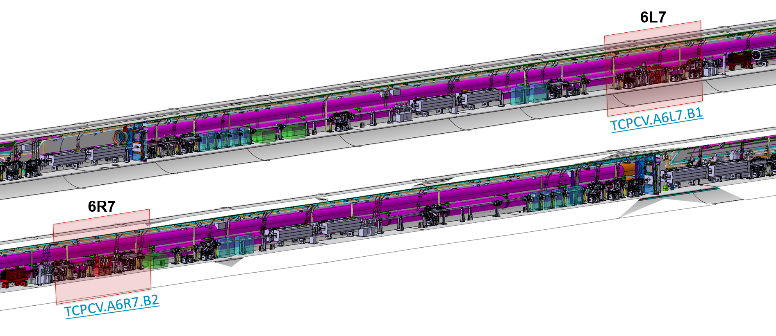
Set up of crystal collimators (TCPCs) in the LHC (IR7)
TCLD
Motivations
Cleaning upgrade required to prevent quenches in DS magnets at IR7
11T dipoles not available for TCLD cleaning
New baseline Nov.2020 using TCPC crystal collimators for ion runs cleaning
Set-up
4 TCPCs installed at IR7
2 verticals installed during YETS21-22 (figure on the right)
2 horizontals to be replaced during YETS 22-23
2 spares are being produced (2022-2023)
Operational only for ion-runs. HL-LHC protons runs would require additional absorbers
11T Magnet
11T Magnet

Slide 5
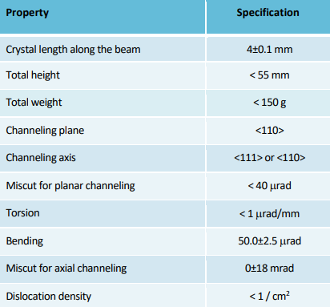
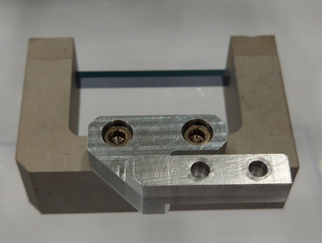
Requirement for TCPCs (Gonimeters) devices Bent crystal characteristics

Slide 6
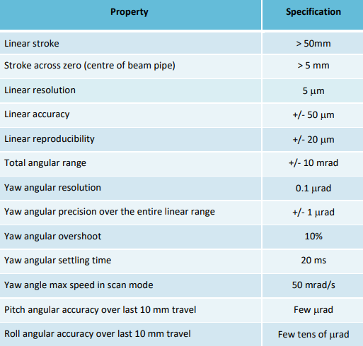
Requirement for TCPCs (Gonimeters) devices Device requirements
Impedance of device shall be compatible with operating crystal position for ion runs
Impedance of device shall be compatible with parking crystal position for proton runs
Device shall be compatible with UHV requirements and bakeable
Position of crystal and device temperature shall be monitored

Slide 7
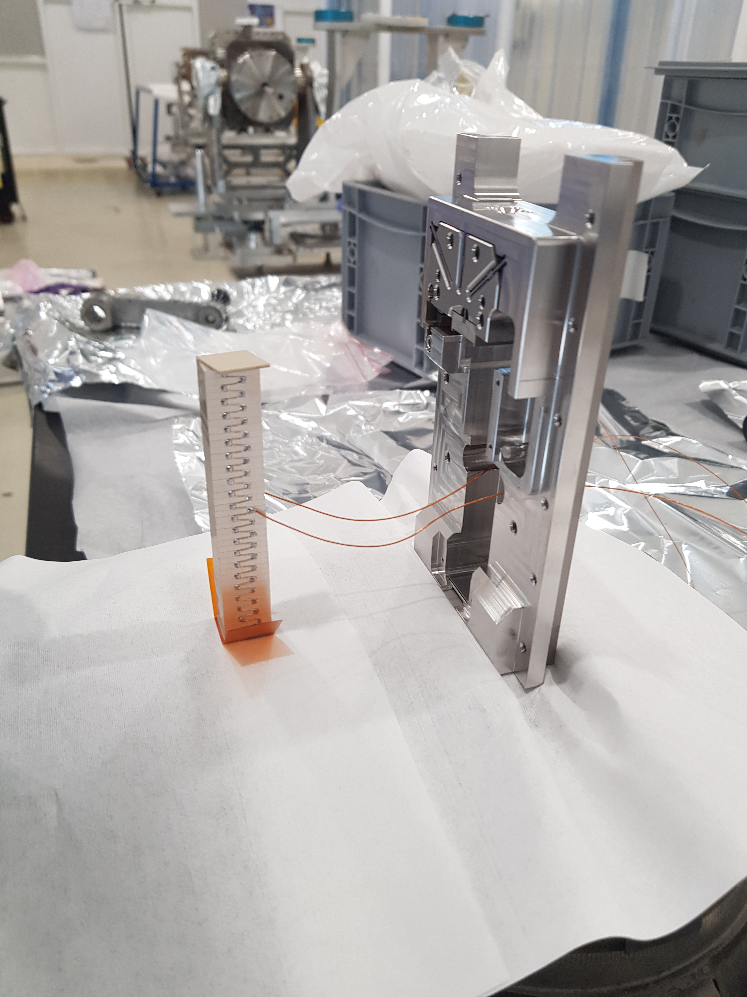
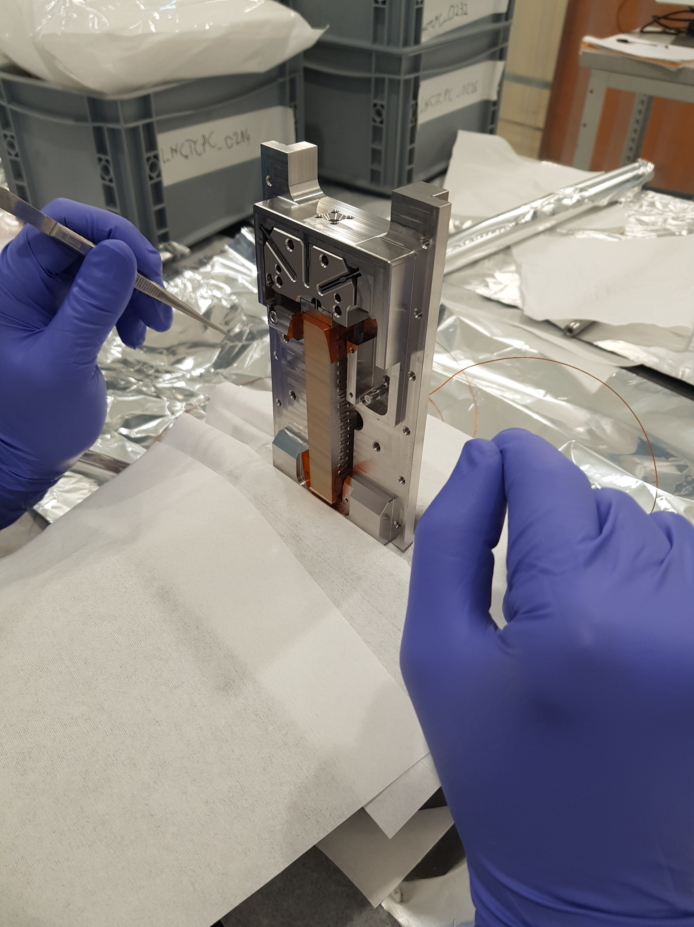
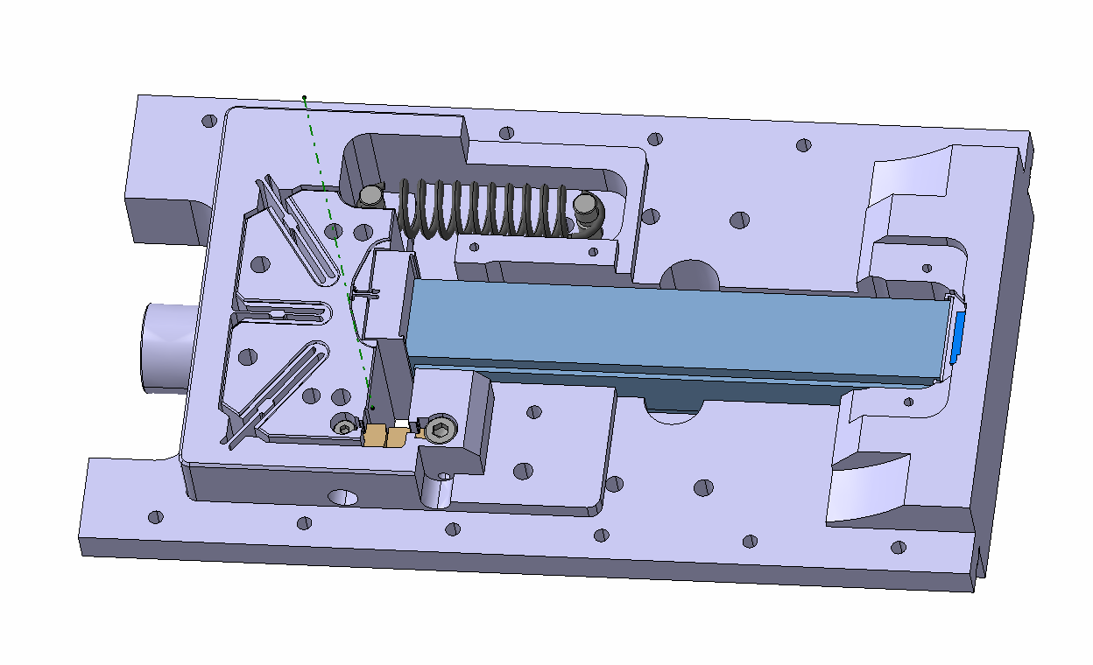
Design to requirement Rotation actuator
Pre-load spring
Piezoelectric material
Rotor
blades
Piston
Stopper
Wedge

Slide 8
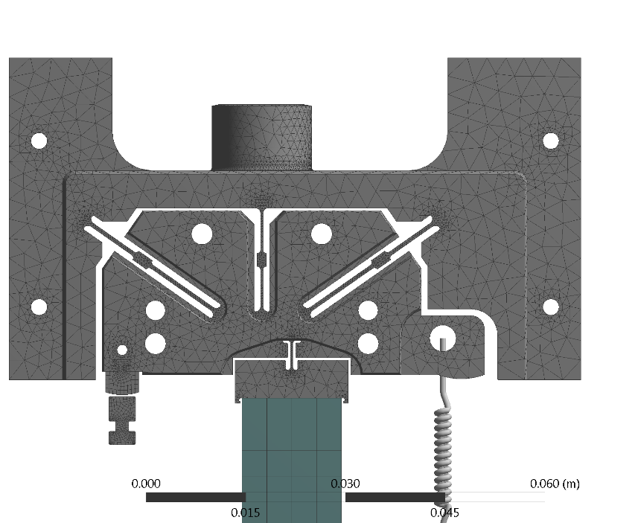
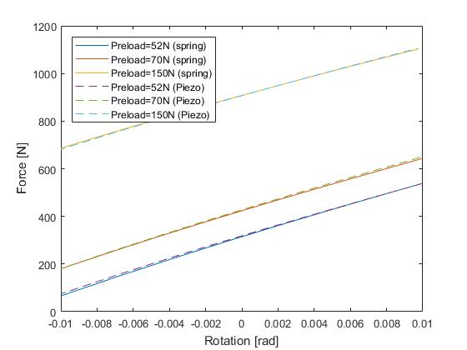
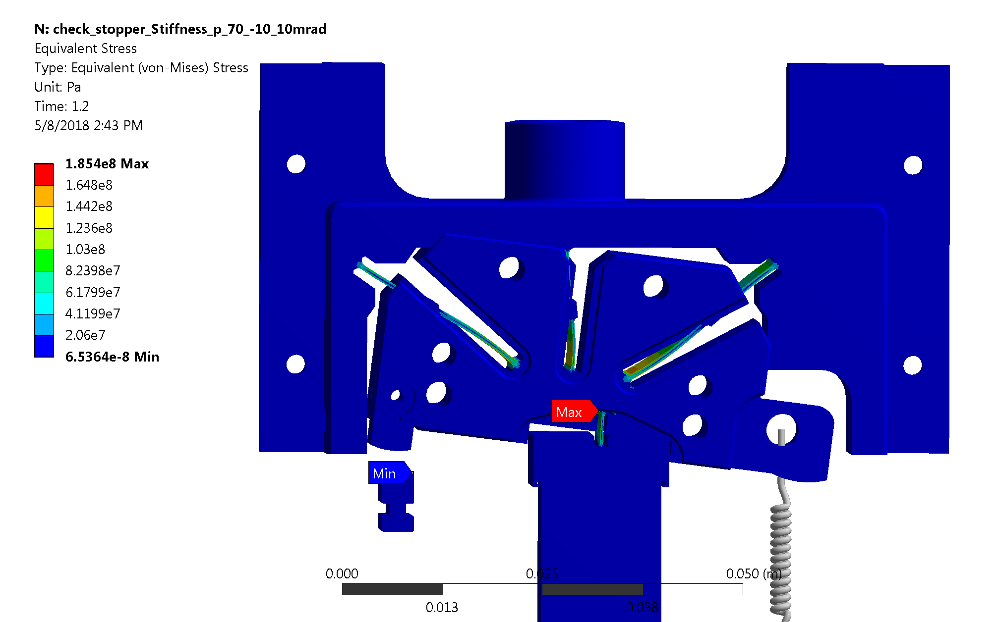
Design to requirement Mechanical Analysis
Force
Von-Mises stress at -10.5 mrad (Pre-load 70N)
Pre-loaded spring

Slide 9
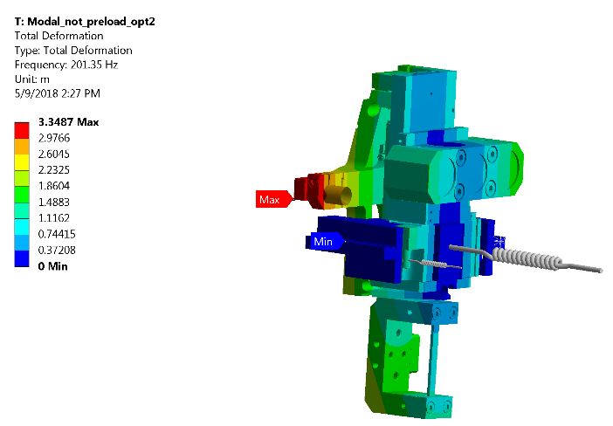
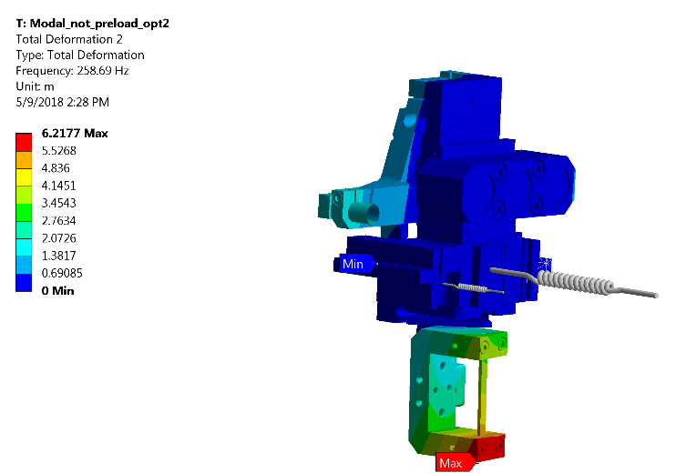
Design to requirement Vibration studies
Table 1 Natural frequencies
 | Al model | Ti6Al4V model
1 | 201.35 | 181.73
2 | 258.69 | 298.8
3 | 350.6 | 408.94
4 | 491.78 | 536.04
5 | 668.41 | 674.05
6 | 744.87 | 713.14
The first mode is related to rotation around the pivot
The second mode is related to torsion of the support arm
First two modes of vibration for the Al. model

Slide 10
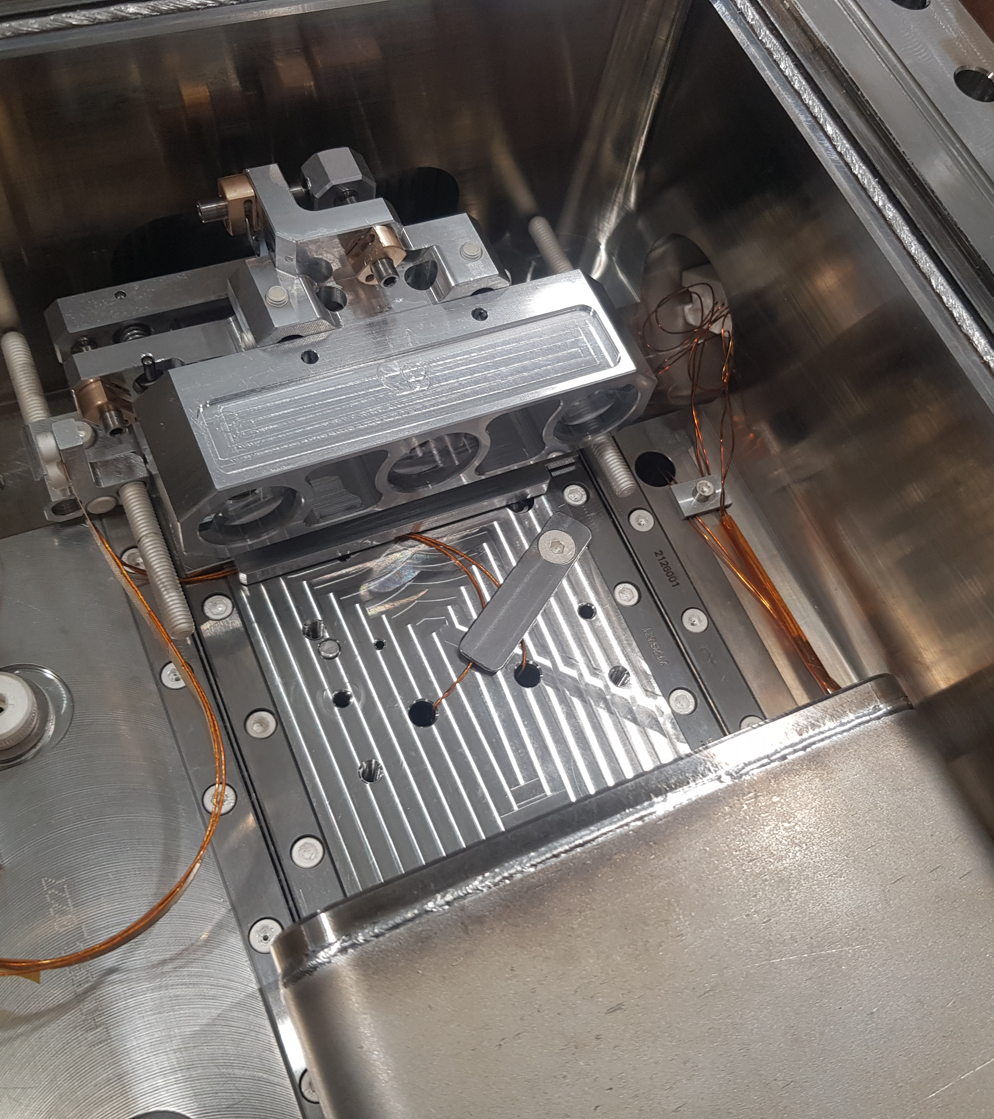
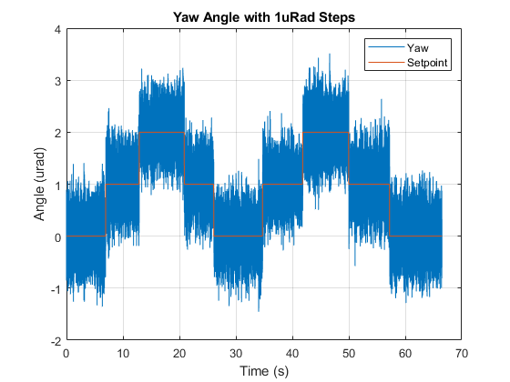
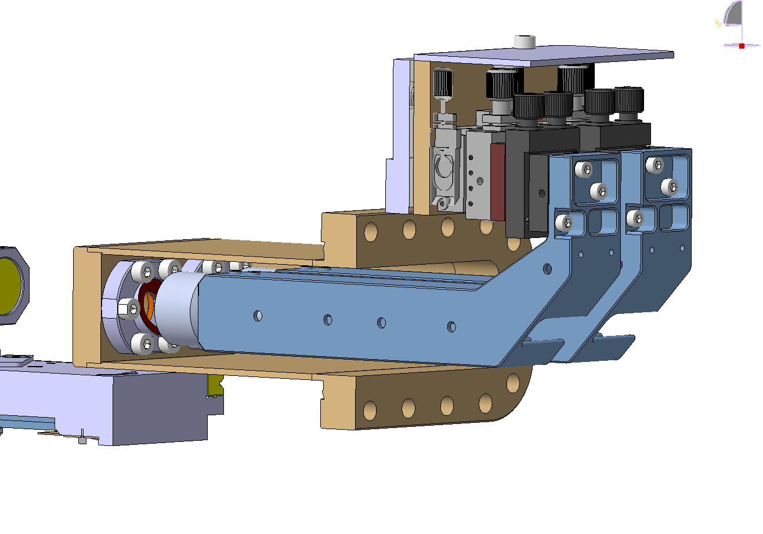
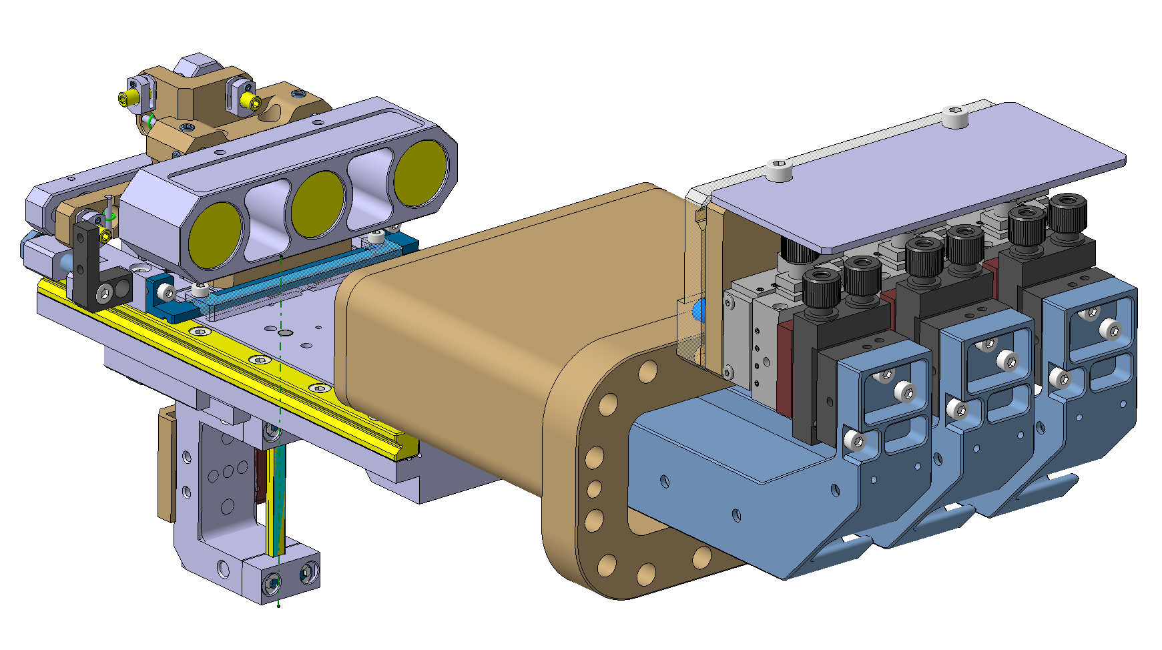
Design to requirement Rotation Control
Optical heads
Retroreflectors
Heads adjustments

Slide 11
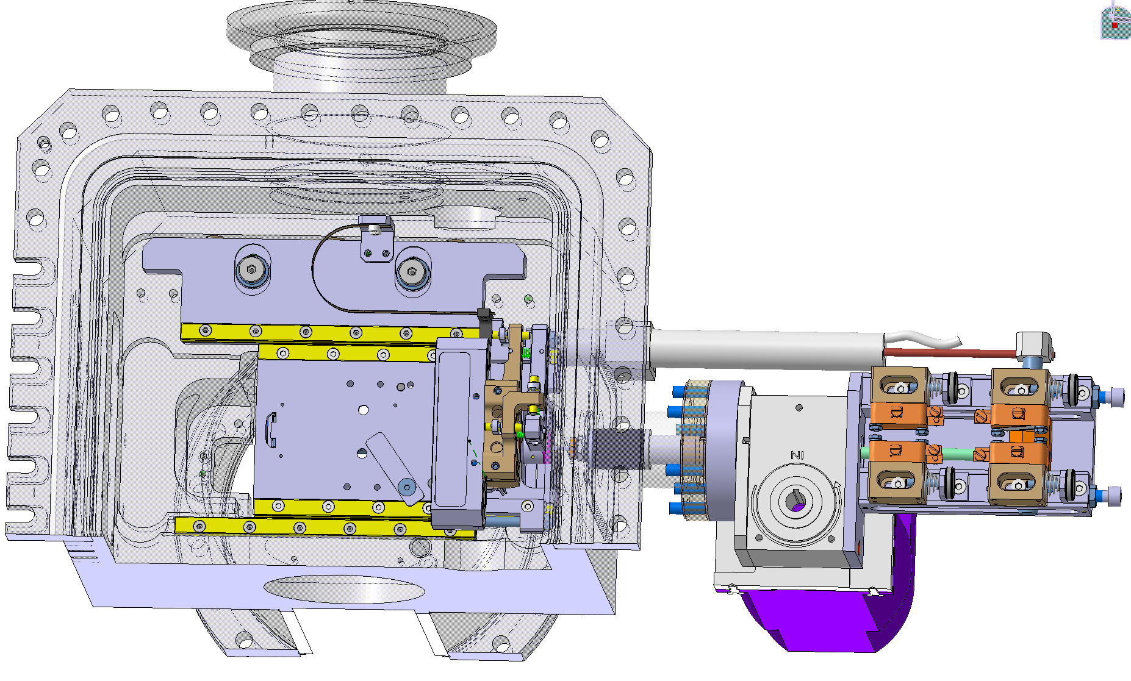
Design to requirement Linear Motion
Bellow & Cable link
UHV Linear bearings
LVDT probe
2 x 2 switches in/out
Gearbox
Steppermotor

Slide 12
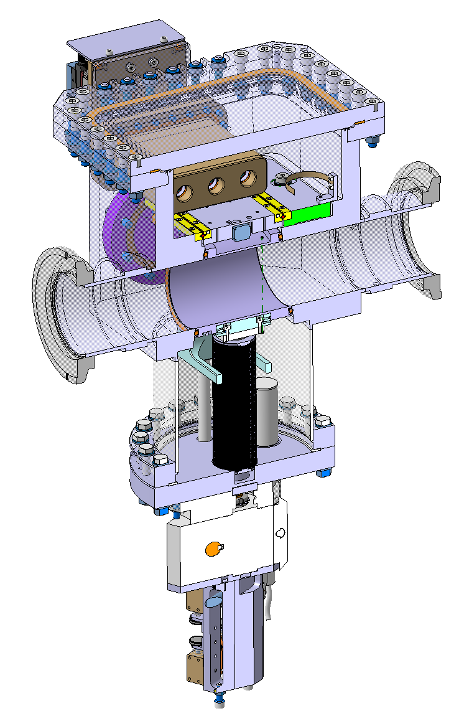
Design to requirement Replacement chamber for proton runs
RF contacts
Replacement Chamber
Column guide
Gearbox & motor
2 x 2 switches in/out

Slide 13
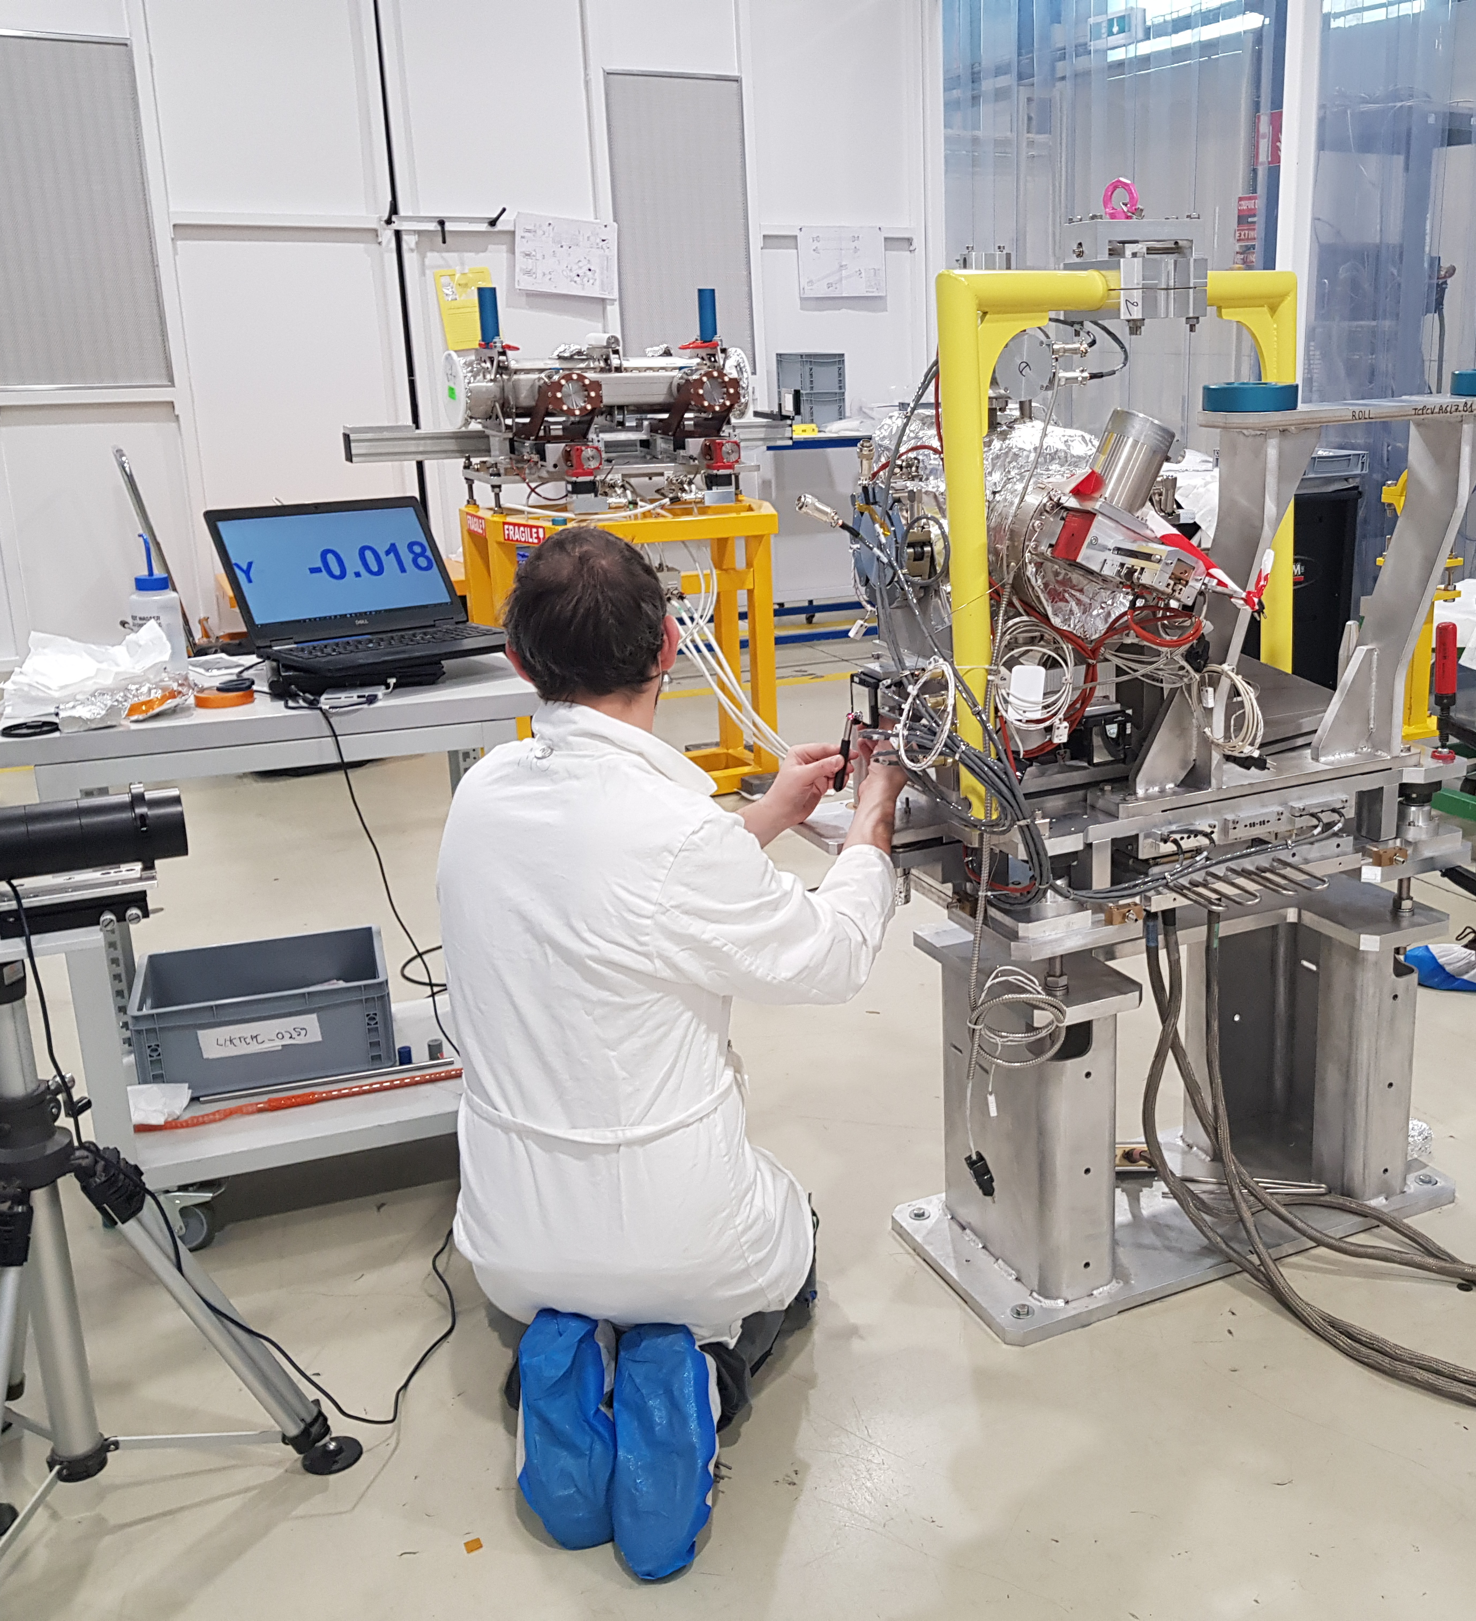
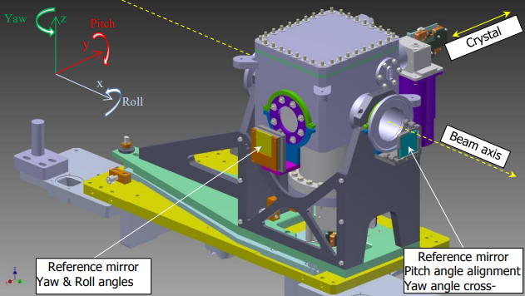
From assembly to operations Crystal alignment
Beam expected position
Device fiducials
Tank
Alignment mirrors
Crystal

Slide 14
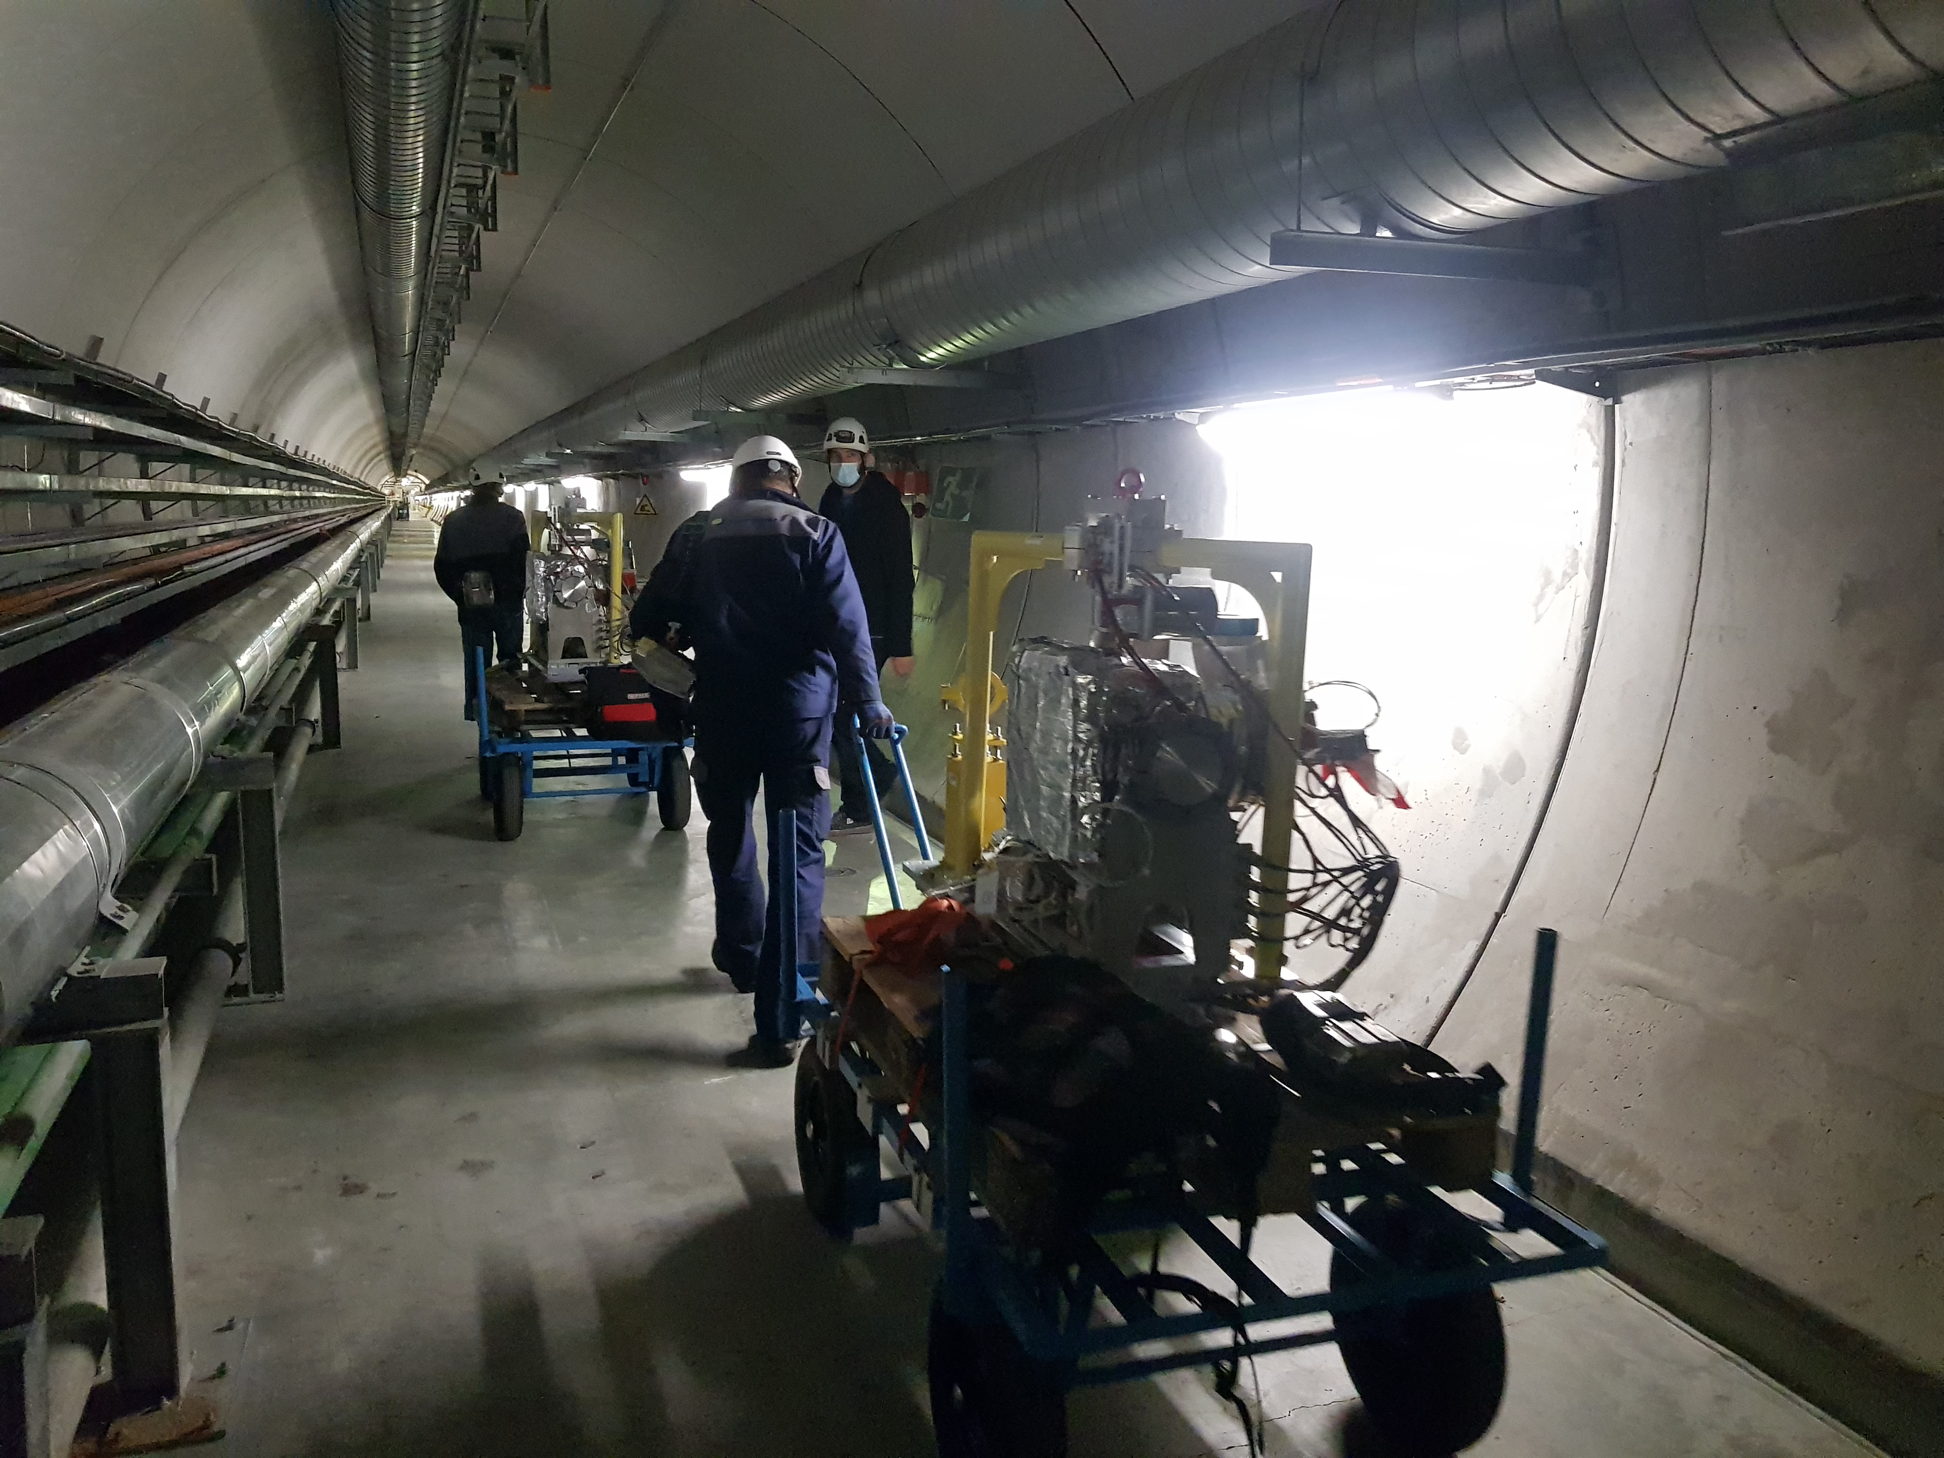
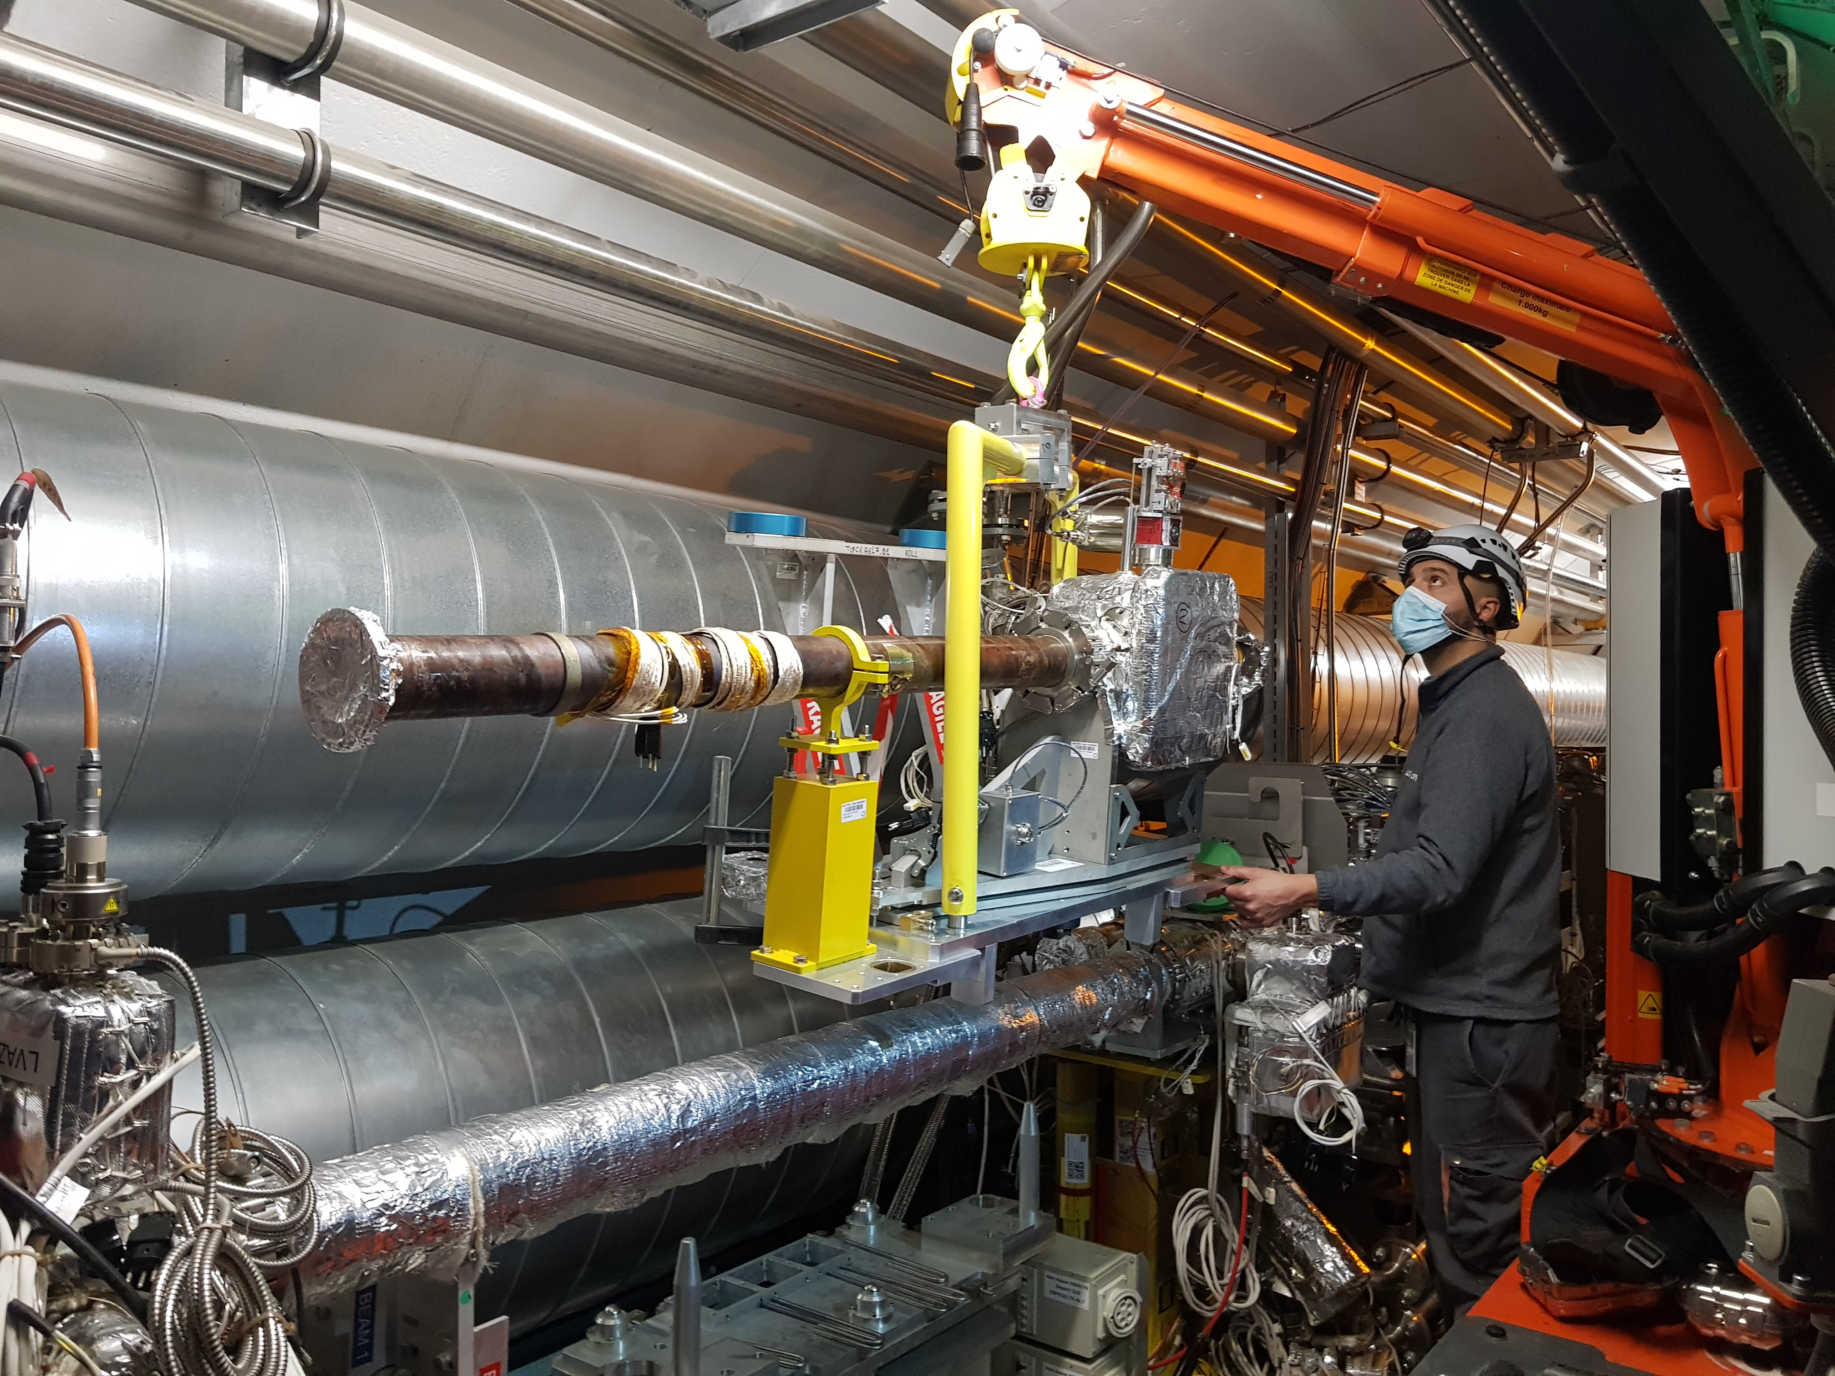
From assembly to operations LHC installation

Slide 15
Toward a new generation of bended crystal devices Limitations of current TCPC design
Crystal cannot be re-aligned without opening the vacuum tank
Device not designed for larger/heavier crystals
Actuator system is very sensitive (loss of range and temporal drift have been observed on previous generations)
Impedance losses of current design would exclude any use for HL-proton runs

Slide 16
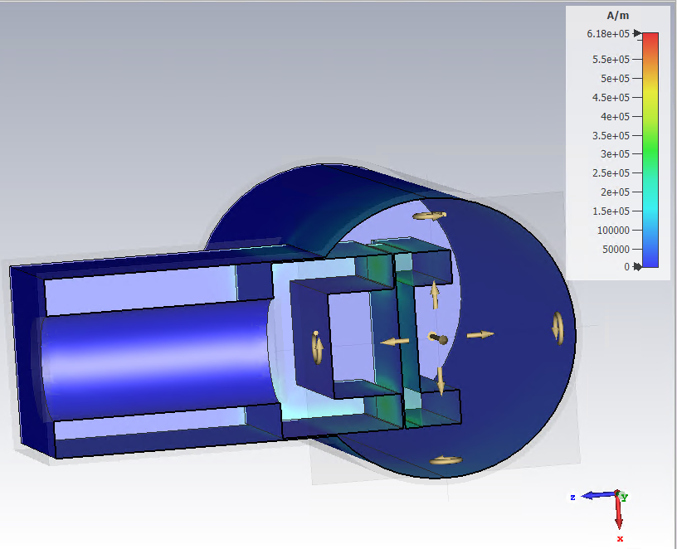
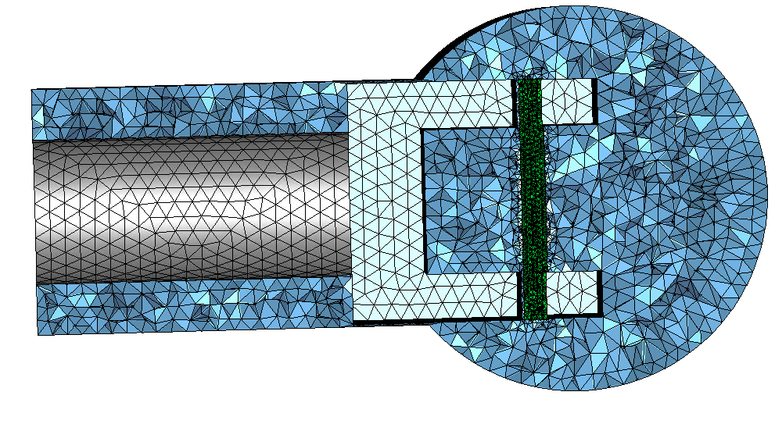
Toward a new generation of bended crystal devices Impedance and power loss of “ideal” devices
Ions runs with crystal in operating position : up to 10W
HL protons runs : up to 900W with crystal retracted
Quartullo, Danilo et al. “Electromagnetic characterization of the crystal primary collimators for the HL-LHC.” Nuclear Instruments & Methods in Physics Research Section A-accelerators Spectrometers Detectors and Associated Equipment 1010 (2021): 165465.
IR7 type crystal in operating position for HL protons runs: up to 9W
IR3 long crystal in operating position for HL protons runs: up to 570W
Courtesy of Chiara Antuono, BE/ABP

Slide 17
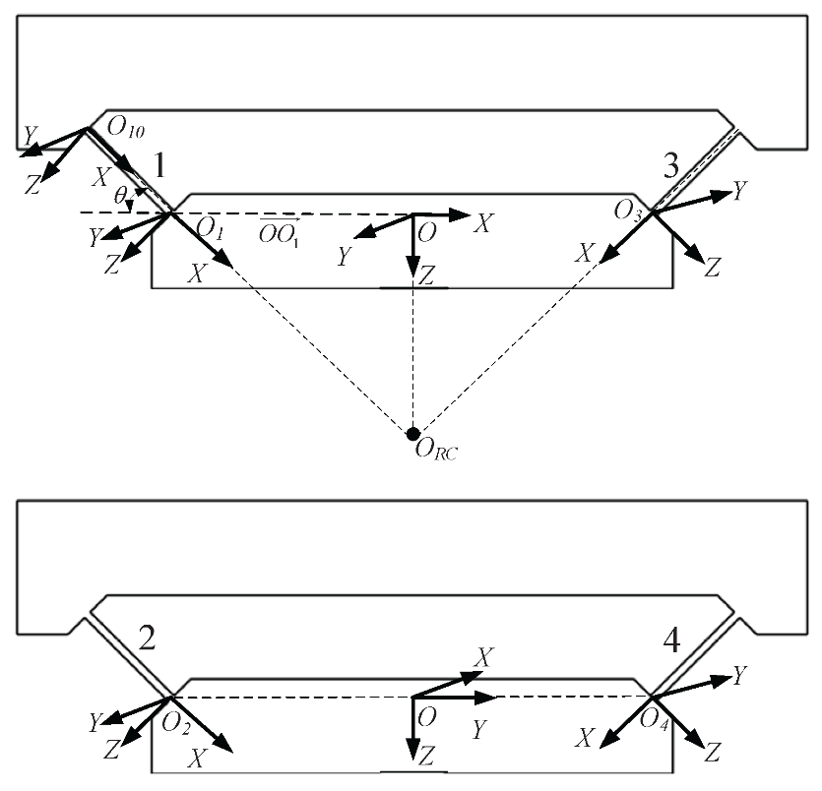
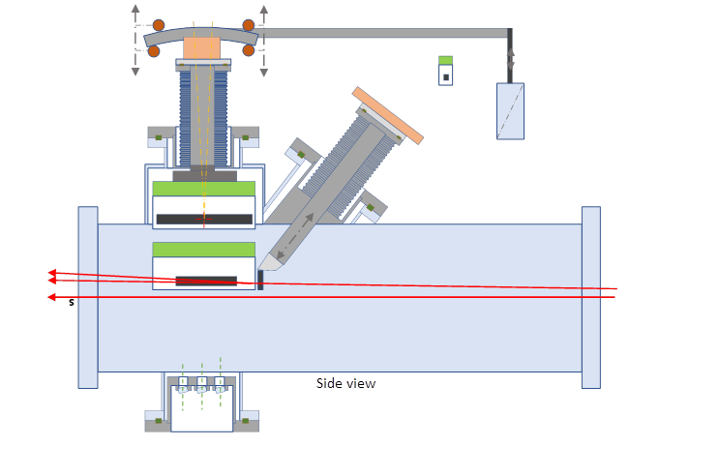
Toward a new generation of bended crystal devices Pre-design of motion systems for IR3 set-up

Slide 18
Conclusion
By the end of YETS 22-23, the baseline 4 TCPC set-up at IR7 will be completed
Ongoing project of PBC set-up at IR3 offers the chance to develop a new design compatible with high luminosity proton runs

