Slide 1
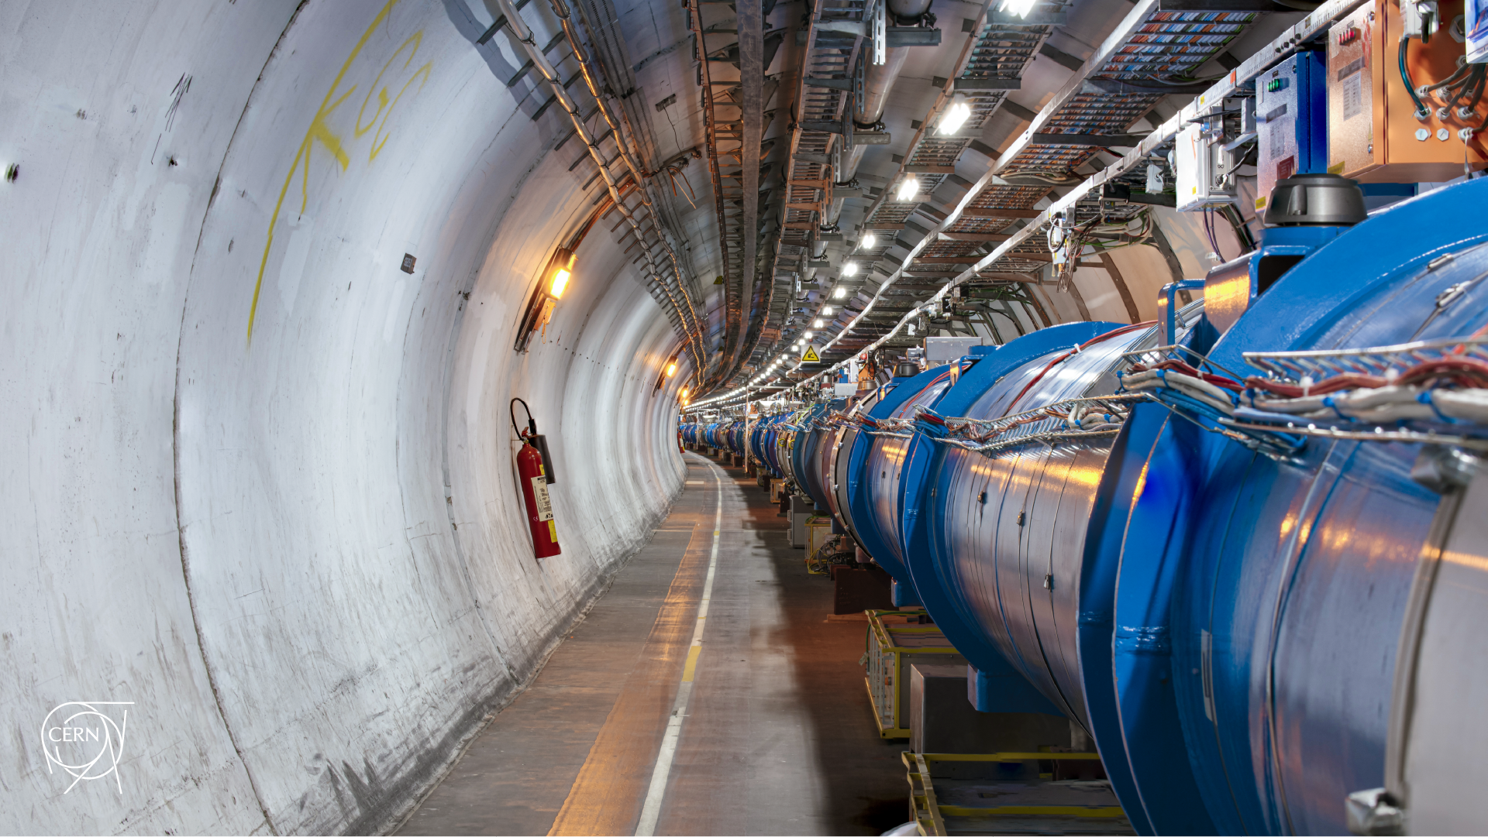
Machine Development scenarios and operational considerations
D. Mirarchi, P. Hermes, S. Redaelli, M. Solfaroli Camillocci, J. Wenninger
Acknowledgments: C. Antuono, Q. J. Demassieux
2nd Workshop on electromagnetic dipole moments of unstable particles

Slide 2
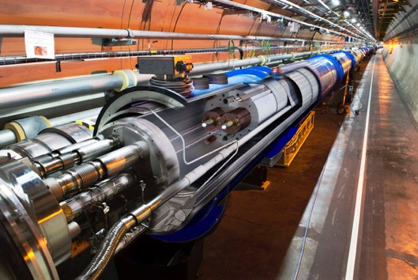


Introduction
The LHC: biggest and most powerful particle accelerator ever built
What does it mean?
Stored energy
Quench limit
LHC design 360 MJ
15-50mJ/cm³
And in HL-LHC stored energy
increased to ~ 700 MJ
Ladybug at 10 km/h
Airbus A320 at ~100 km/h
Very sensitive machine, several constrains for operations with high intensity beams!
Highly efficient collimation system needed for a safe beam disposal at any time!

Slide 3
Outline
Setting the scene
Handling movable objects in the LHC
Operating with beams
Conclusions

Slide 4
Outline
Setting the scene
Handling movable objects in the LHC
Operating with beams
Conclusions

Slide 5
Schematic layout
TCCS
TCCP
Secondary halo deflected by a bent crystal (Target Collimator Crystal Splitting) at larger aperture than TCP
Deflected halo impacts on a target
Interaction products channelled by a second bent crystal (Target Collimator Crystal Precession)
Dedicated absorber to intercept deflected halo that did not interact with target
More details in design principles in EPJC 80, 929 (2020)
Latest development in layout for proof of priciple studied in Pascal’s talk

Slide 6
Operational scenarios at 6.8 TeV
Machine Development
Nominal operations
Aim
Dedicated beam time for
proof of principle
Physics production
Beams
Setup beams
(up to 3 x 10¹¹ p)
Full machine
(>3 x 10¹⁴ p)
Machine Protection
Possible to mask
some interlocks
All protections active
Operations
Flexibility
for expert handling
Fully automated
handling

Slide 7
Aim of the project
Perform a proof of principle, being ready for nominal operations
Devices must be compatible
with high-intensity beams
To be done during
Machine Development
What can be re-used from present experience with handling crystals and other movable objects in LHC?
Knowhow
HW control architecture
What needs to be reviewed?
Goniometer design to be compatible with high-intensity proton beams

Slide 8
Basic needs to operate into the LHC
Movable devices into the LHC primary vacuum:
Extreme safety, reliability, control of their status and positions are a paramount
Beam based setup required (very important for crystals)
Do not jeopardize machine performance:
Aperture restriction
Impedance
Electron cloud
Vacuum
Avoid to introduce an aperture bottleneck
Avoid local heating due to impedance,
do not induce beam instability
No issues for beam instability expected,
material with low secondary electron yield to avoid local heating
Bakeout to avoid outgassing,
vacuum acceptance test to be compatible with LHC UHV of 10⁻⁹ mbar

Slide 9
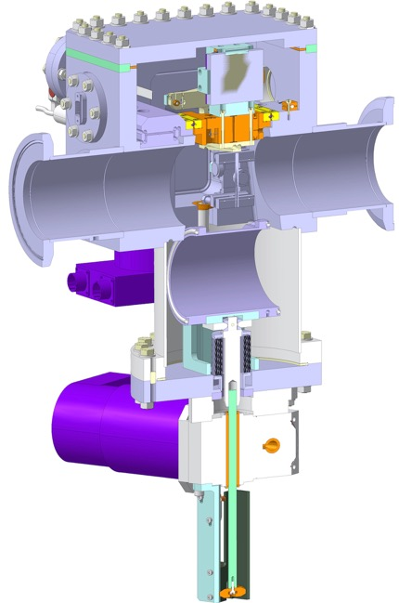
Present goniometer to handle crystals in the LHC
Four goniometers are installed in the LHC for crystal collimation purposes:
Developed for feasibility studies, upgraded along the years while gaining operational experience
Main features:
Crystal
Stepper motor with 5 μm resolution for linear stage
(same actuator as for standard collimators)
Piezo actuator with <1μrad resolution for angular stage
Replacement pipe to ensure electrical conductivity
and hide the crystal during nominal operations with protons

Slide 10
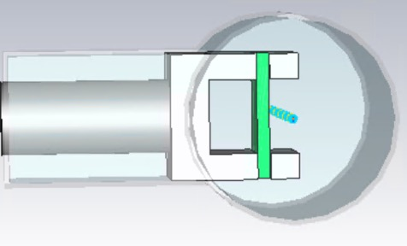
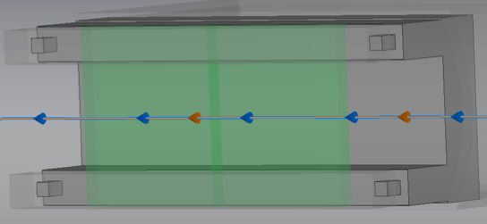
Goniometer needs for nominal operations with p
Linear stage:
  Present stepper motors can be used for both TCCS and TCCP
Angular stage:
  Same accuracy as present goniometer for both TCCS and TCCP (may be relaxed for TCCP)
Replacement pipe:
  To be removed, feasibility studies ongoing for the development of a design
  compliant with impedance requirements
More details in Quentin’s talk
C. Antuono

Slide 11
Outline
Setting the scene
Handling movable objects in the LHC
Operating with beams
Conclusions

Slide 12
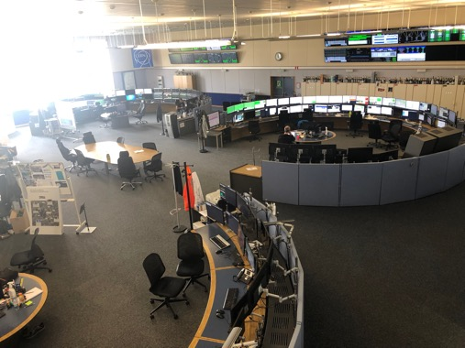
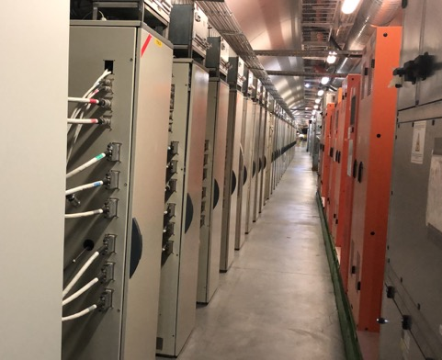
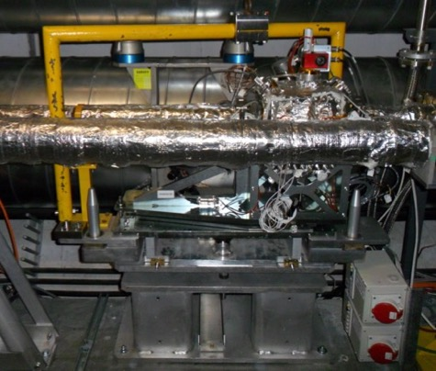



Controls in a nutshell
CCC
(CERN Control Centre)
FEC
(Front-End Card)
Device
FESA
(Front-End
Software
Architecture)
FPGA

Slide 13

Low level control & Machine protection
All movable object in LHC have several layers of
control and protection:
Motor Drive Control (MDC)
  Receives the commands
  Verifies the consistency of the order
  Performs the movement
Position Readout & Survey (PRS)
  Read actual position via LVDT (Linear Variable Differential Transformer)
  Checks that the actual position is within a well defined tolerance with 100 Hz rate
  A beam dump is triggered if outside tolerances
Environmental Survey System (ESS)
  Reads all environmental parameters, e.g. temperatures
  A beam dump is triggered if above threshold

Slide 14
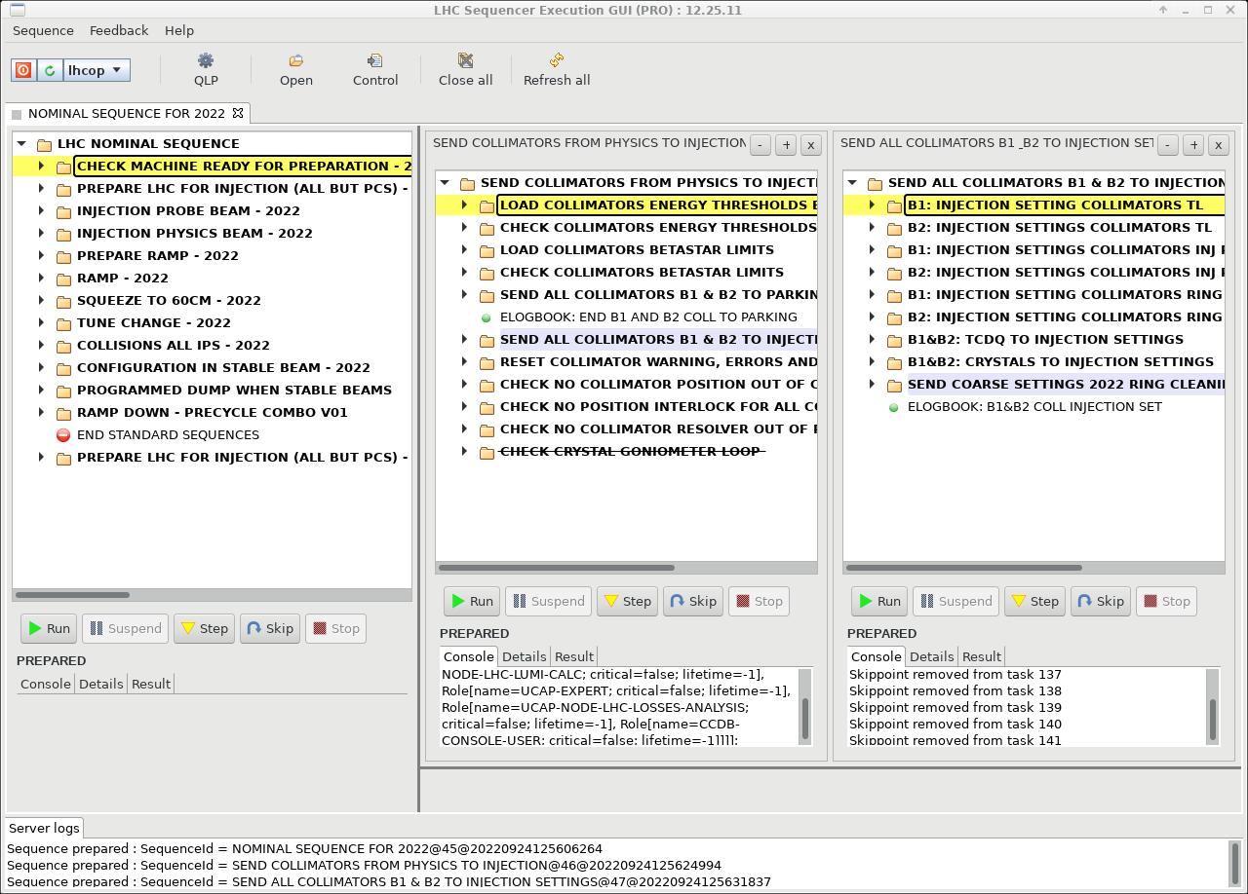
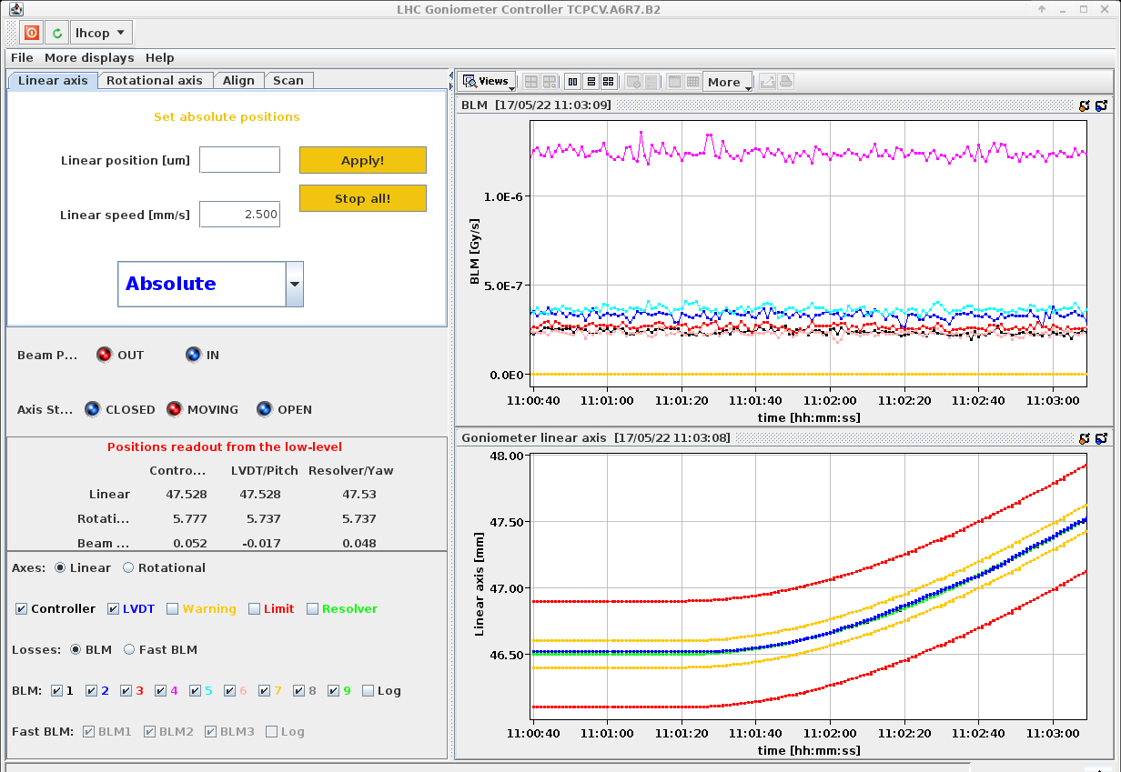
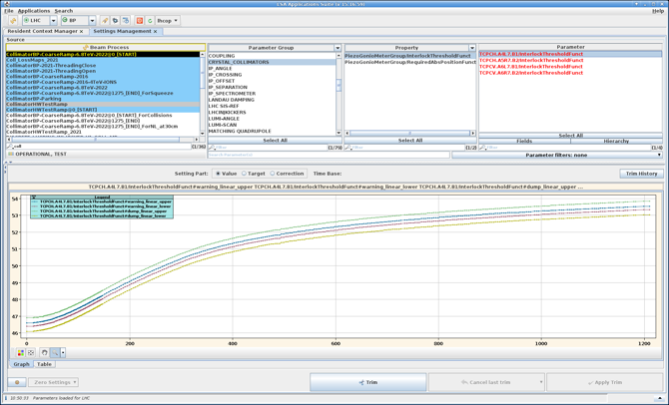
Actual handling from the CCC
Nominal operations
Machine Development
Fully automated handling via sequencer
Settings stored in
LHC Software
Architecture (LSA)
database
Manual handling
via dedicated GUI
Critical settings (like limits) protected by digital signature!

Slide 15
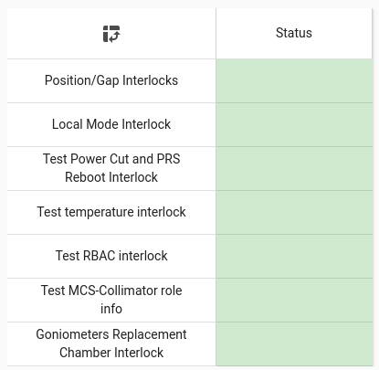
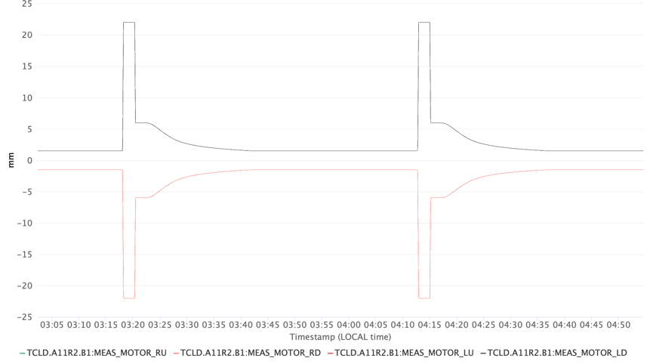
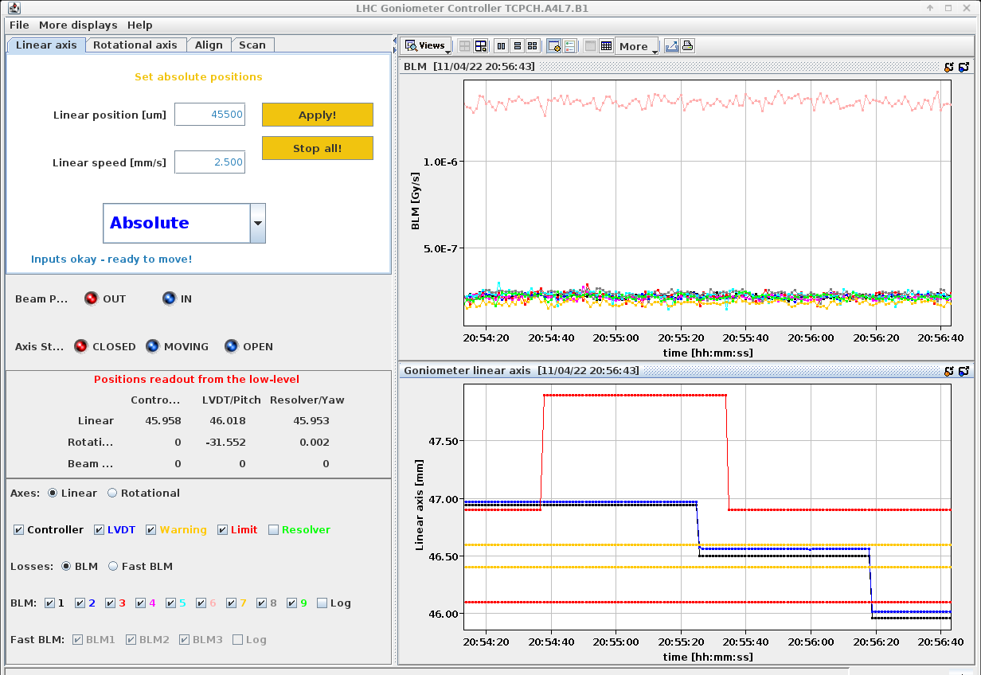
HW commissioning
Complete performance validation carried out between machine closure and first beam injection
Machine Protection validation
Stress test
Repeated cycles to simulate operational use
and check faults/stability/reproducibility
Full set of checks to confirm that interlocks
trigger beam dump request correctly

Slide 16
Outline
Setting the scene
Handling movable objects in the LHC
Operating with beams
Conclusions

Slide 17
How do I get allocated beam time?
Very sensitive, expensive, and unique machine: many requests and each choice must be well justified
Submit a Machine Development (MD) request
Get approved based on physics motivations and feasibility (LHC Studies Working Group, LSWG)
Get in touch with involved team from which support is required:
Do you need to change machine configuration? LHC Beam Operation Committee (LBOC)
Do you need to move collimators? Collimation Working Group (CWG)
Do you need to change optics? Optics Measurements and Correction (OMC)
Do you risk to make beams unstable? Instability Working Group (IWG)
Are your studies considered potentially dangerous? Machine Protection Panel (MPP)
Prepare a detailed MD procedure and step to be followed to prepare and recover the machine,
to be prepared with the LHC Operation team
Prepare a detailed MD note with main highlights and key results achieved

Slide 18
What and how can we learn?
Proof of principle focused on probing basics crystal features in a circular accelerator
Step 0: beam based alignment of all devices
Optimal channeling orientation and quality of crystalline lattice
Multi-turn channeling efficiency and geometrical crystal bending
Main observable: hadronic showers developed when beam interacts with obstacles
The LHC is a very stable machine!
Beam loss artificially increased introducing transverse white noise
Intensity limited to a maximum of 3 x 10¹¹ p,
i.e. 30 bunches of 1 x 10¹⁰ p
Sustained and uniform losses for long time needed
(up to 20-30min): gentle excitation of 3 bunches required
A limited number of measurements can be performed in each fill!
Each test must be carefully planned:
a not optimal manipulation at top energy can lead to several hours lost, deep knowledge of the LHC necessary

Slide 19


Angular scan
Monitoring of losses at the crystal location as a function of its angle
R. Rossi
Massive Absorber
Bent crystal
Deflected halo
First channeling
at 6.5 TeV!
➛ ➛ Beam ➛ ➛
AM
VR
AM
CH
Main outcomes:
  Optimal channeling orientation as a function of transverse crystal position (minimum of losses)
  Crystalline lattice quality (depth of well due to reduction of nuclear interaction rate)
  Qualitative evaluation of geometrical bending (well extension)

Slide 20
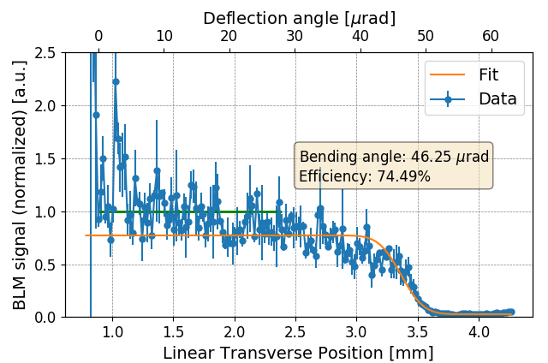
Absorber scan
Monitoring of losses at absorber as a function of its position, while crystal in channeling
Massive Absorber
First efficiencies
at 6.8 TeV!
Deflected halo
Bent crystal
➛ ➛ Beam ➛ ➛
M. D’Andrea
Main outcomes:
  Multi-turn channeling efficiency as a function of transverse crystal position (error function plateau)
  Geometrical crystal bending (displacement of channeled halo)

Slide 21

Looking further - learning from past
Pixel
detector
Static conditions
Massive Absorber
TCCP
TCCS
Deflected halo
➛ ➛ Beam ➛ ➛
TCCP angular scan
It will be like being on
SPS extraction line…
Proof of principle done in SPS
Data from “NIM A 1015 (2021) 165747”
…but with beam up 6.8 TeV!
Key requirement: beam based alignment for precise knowledge of relative position to circulating beam

Slide 22

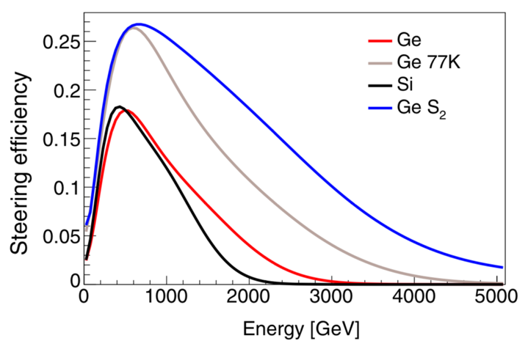
Wish list
Can we stop LHC ramp at intermediate energies?
  Technically possible, non trivial preparation
  Synergies with other experiments may be found
PRD 103, 072003
Main outcomes:
  Measure single-pass TCCP channeling efficiency
  Validation of simulation tools
  Improved prediction of Λ_{c} yield in nominal operations

Slide 23
Outline
Setting the scene
Handling movable objects in the LHC
Operating with beams
Conclusions

Slide 24
Conclusions
Very interesting and ambitious project
Knowledge acquired in the past decade of operations in SPS and LHC crucial to steer feasibility studies
Massive “hidden” work necessary to get approved to install movable objects in the LHC,
and to make them working properly
Rich program for proof of principle
Required expertise to make it happen acquired along the years
Further ideas on how to reach milestones for physics operations

Slide 25
Outline
BACKUP

Slide 26
Using scraper
NIM A 1015 (2021) 165747
Possible to measure:
multi-turn single channeling efficiency
multi-turn double channeling efficiency
Single-pass channeling efficiency of TCCP

