Slide 1
INFN Milano LASA
Vendor Management
T. Grimaldi & the INFN PIP-II group
30 June 2022

Slide 2
Vendors Management (XFEL & ESS cases)
Based on past and on-going cavities production:
  European XFEL: 1.3 GHz jacket cavities (400 + 400), two vendors
  European XFEL: 3.9 GHz jacket cavities (10 + 10), one vendor
  ESS: 704.42 MHz jacket cavities (36 + 2), one vendor

Slide 3
Vendor Management
INFN-LASA conducts procurements via the Italian public procurement code (Codice degli Appalti Pubblici) at its latest issue. This code regulates:
  Preconditions for a vendor to apply to the call-for-tenders
  Criteria for the submission and evaluation of offers
  Criteria for the final awarding and issuing of the contract
Vendors will be audited to ensure that appropriate QA and QC plans are developed, implemented and followed. In addition vendors will be required to write and deliver formal reports and documentation to INFN-LASA including:
  Technical analysis
  Quality Control Plans (QCPs)
  Materials analysis data and traceability reports
  Inspection reports
  Detailed time planning

Slide 4
Vendor Management
INFN-LASA conducts procurements via the Italian public procurement code (Codice degli Appalti Pubblici) at its latest issue. This code regulates:
  Preconditions for a vendor to apply to the call-for-tenders
  Criteria for the submission and evaluation of offers
  Criteria for the final awarding and issuing of the contract
Vendors will be audited to ensure that appropriate QA and QC plans are developed, implemented and followed. In addition vendors will be required to write and deliver formal reports and documentation to INFN-LASA including:
  Technical analysis
  Quality Control Plans (QCPs)
  Materials analysis data and traceability reports
  Inspection reports
  Detailed time planning

Slide 5
Vendor Management
INFN-LASA conducts procurements via the Italian public procurement code (Codice degli Appalti Pubblici) at its latest issue. This code regulates:
  Preconditions for a vendor to apply to the call-for-tenders
  Criteria for the submission and evaluation of offers
  Criteria for the final awarding and issuing of the contract
Vendors will be audited to ensure that appropriate QA and QC plans are developed, implemented and followed. In addition vendors will be required to write and deliver formal reports and documentation to INFN-LASA including:
  Technical analysis
  Quality Control Plans (QCPs) & Manufacturing and Inspection Plan
  Materials analysis data and traceability reports
  Inspection reports
  Detailed time planning

Slide 6
The 5 Acceptance Levels (ESS case)
As for ESS, PIP-II QA will be based on 5 Acceptance levels (Als):
  Al1-Al2-Al3: cavity production (industry)
  Al4: cavity performance (qualification test partner)
  Al5: cavity ready for string assembly (CEA) -> cavity handover to FNAL

Slide 7




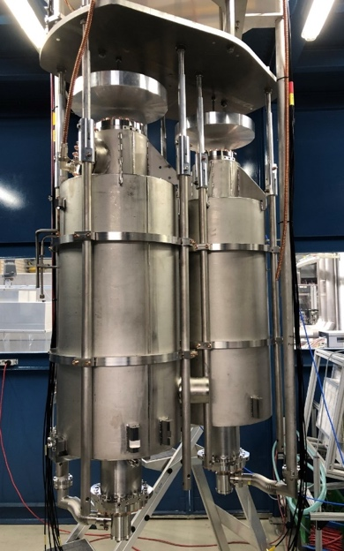
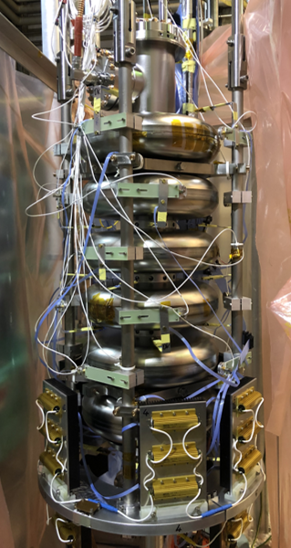
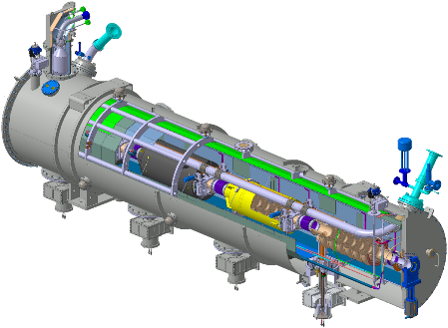

INFN-LASA ESS cavities production workflow
Eddy current
Scanning (DESY)
OTIC
Ningxia
Rejected
INDUSTRY
INFN LASA
Accepted
R300
Sheets
Semifinished parts
Special
diagnostic
Rs vs. T, etc.
Series
Vertical TEST @
DESY
Vertical TEST @
LASA
Cryomodule test at ESS
CEA
Cavities Assembly in criomodules
Not qualified
Qualified

Slide 8
The 5 Acceptance Levels (ESS case)
Level | Cavity status | Needed documents | If Level reached
Al1 | Cavity after mechanical fabrication | Mechanical, RF, vacuum, visual documents | Proceed to Level Two
Al2 | Cavity before He-tank integration | Mechanical, RF, vacuum, Treatment documents (bulk BCP, annealing) | Proceed to Level Three
Al3 | Cavity jacketing, Final BCP and surface treatments, assembly of accessories for the cold RF test | Cavity jacketing and pressure tests (mechanical, RF, vacuum, visual documents, transfer measurements), final surface treatments, final vacuum and RF checks, outgoing inspection | Jacketed cavity ready to be cold RF tested
Al4 | Cavity cold RF tested | Documents of the cold RF test, incoming/outgoing checks | Cavity can be sent to CEA for string assembly
Al5 | Cavity accepted for string assembly | Documents with incoming inspection at CEA | Cavity final approval (ESS)

Slide 9
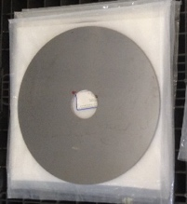



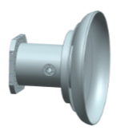


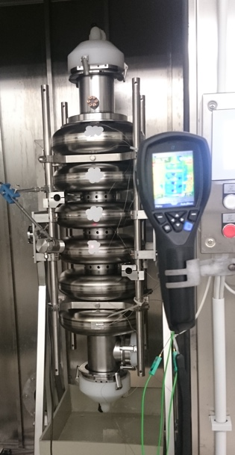
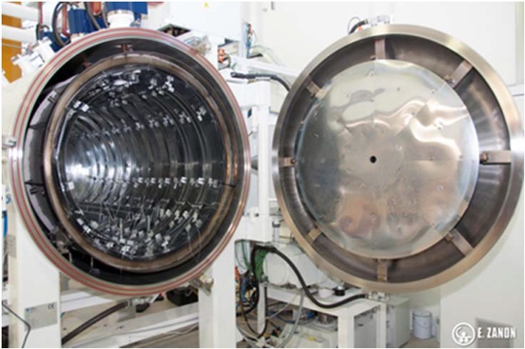
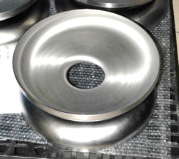
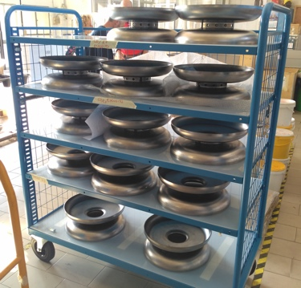
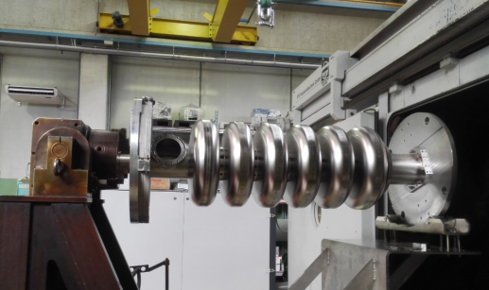
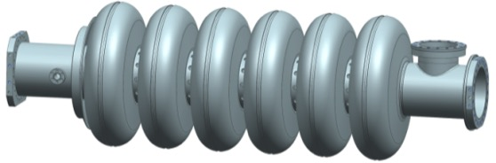
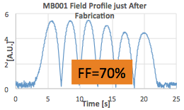
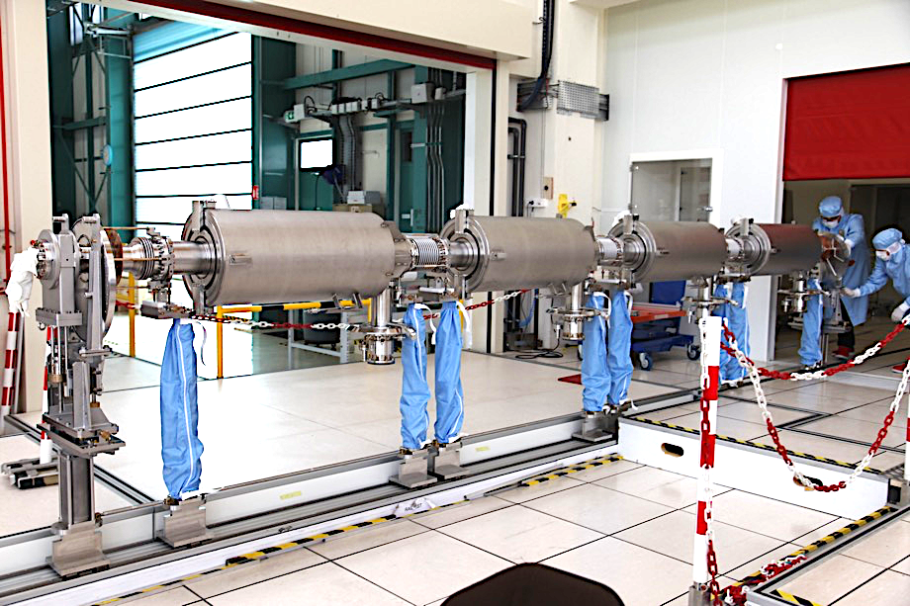




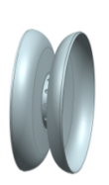
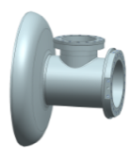
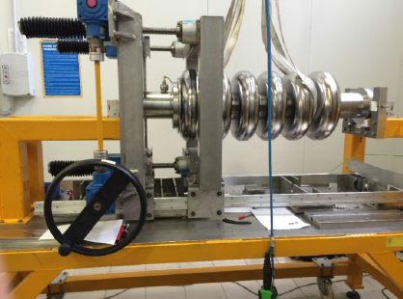
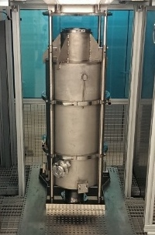
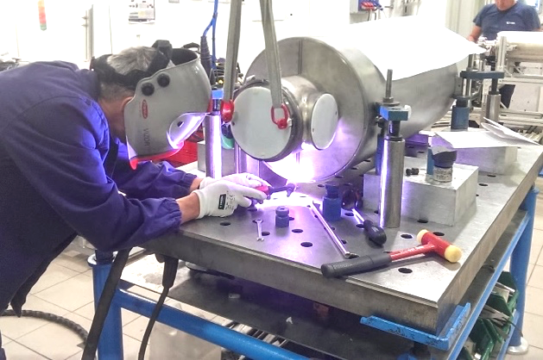
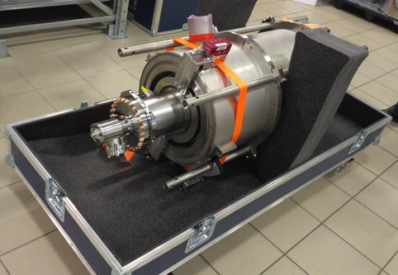
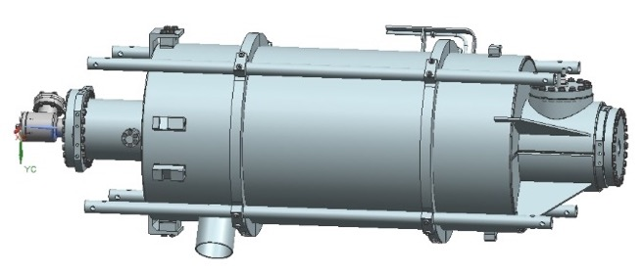
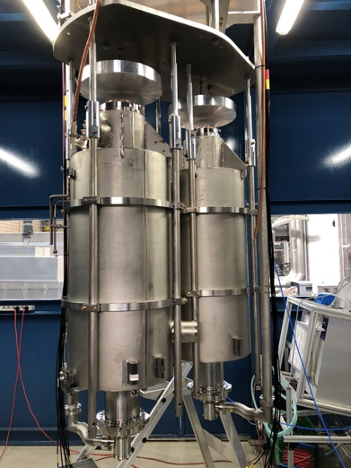
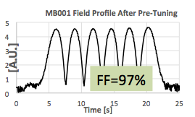
MB Cavity 5-Acceptance Levels (ESS case)
Nb sheets and raw materials
Subcomponents preparation
Cavity EBW
Bulk BCP
180 μm
Annealing
de Hydrog.
Al1
EC
PC
IC
PC
EC
EGP
PD
ID
CD
EGC
Tuning
Al2
Al3
CEA
Al5
DESY
Final Check and delivery
Accessories installation
Final BCP:
20 μm + HPR
Cavity integration
(He tank)
Al4

Slide 10
MB Cavity 5-Acceptance Levels (ESS case)
Nb sheets and raw materials
Subcomponents preparation
Cavity EBW
Bulk BCP
180 μm
Annealing
de Hydrog.
Al1
EC
PC
IC
PC
EC
EGP
PD
ID
CD
EGC
Tuning
Al2
Al3
CEA
Al5
DESY
Final Check and delivery
Accessories installation
Final BCP:
20 μm + HPR
Cavity integration
(He tank)
Al4

Slide 11


QA/QC and document flow
INFN Alfresco CMS
NCR
INFN Experts Check
Industry
Cavity Production Data
Database:
Parameter Analysis
Process Control
Managing System
Quality Control
INFN Managing system
Cavity
with Tank
NCR
Cold RF Test
Cavity Assembly
NCR
NCR
Cavity Acceptance
QUALIFICATION TEST
Cavity
with Tank
Module
Q₀ vs E_{acc}
RF at Cold
Incoming
RF check

Slide 12
Thanks for your attention

