Slide 1
INFN Milano LASA
Non-conformance Process
T. Grimaldi & the INFN PIP-II group
30 June 2022

Slide 2
Our General Scheme for PIP-II
Based on past and on-going cavities production:
  European XFEL: 1.3 GHz jacket cavities (400 + 400), two vendors
  European XFEL: 3.9 GHz jacket cavities (10 + 10), one vendor
  ESS: 704.42 MHz jacket cavities (36 + 2), one vendor
As for ESS, PIP-II QA will be based on 5 Acceptance levels (Als):
  Al1-Al2-Al3: cavity production (industry)
  Al4: cavity performance (DESY)
  Al5: cavity ready for string assembly (CEA) -> cavity handover to FNAL
If deviation occurs, NCR (Non Conformity Report) is emitted

Slide 3
The 5 Acceptance Levels (ESS)
Level | Cavity status | Needed documents | If Level reached
Al1 | Cavity after mechanical fabrication | Mechanical, RF, vacuum, visual documents | Proceed to Level Two
Al2 | Cavity before He-tank integration | Mechanical, RF, vacuum, Treatment documents (bulk BCP, annealing) | Proceed to Level Three
Al3 | Cavity jacketing, Final BCP and surface treatments, assembly of accessories for the cold RF test | Cavity jacketing and pressure tests (mechanical, RF, vacuum, visual documents, transfer measurements), final surface treatments, final vacuum and RF checks, outgoing inspection | Jacketed cavity ready to be cold RF tested
Al4 | Cavity cold RF tested | Documents of the cold RF test, incoming/outgoing checks | Cavity can be sent to CEA for string assembly
Al5 | Cavity accepted for string assembly | Documents with incoming inspection at CEA | Cavity final approval (ESS)

Slide 4


QA/QC and document flow
INFN Alfresco CMS
INFN Experts Check
Industry
Cavity Production Data
Database:
Parameter Analysis
Process Control
Managing System
Quality Control
INFN Managing system
Cavity
with Tank
Cold RF Test
Cavity Assembly
Cavity Acceptance
Qualification Test
Cavity
with Tank
Module
Q₀ vs E_{acc}
RF at Cold
Incoming
RF check

Slide 5
QA/QC and document flow
INFN Alfresco CMS
NCR
INFN Experts Check
Industry
Cavity Production Data
Database:
Parameter Analysis
Process Control
Managing System
Quality Control
INFN Managing system
Cavity
with Tank
NCR
Cold RF Test
Cavity Assembly
NCR
NCR
Cavity Acceptance
Qualification Test
Cavity
with Tank
Module
Q₀ vs E_{acc}
RF at Cold
Incoming
RF check

Slide 6
Non Conformances Process
Each deviation from the standard production cycle implies the emission of a Non Conformity Reports:
  NC of a part
  NC of a production process
  NC on the established production cycle (production steps)
Content of the Non Conformance Report:
  Description on the non conformance
  Proposal of its resolution (corrective action)
  Preventive action (to prevent the occurrence of the same problem)
Who issues a Non Conformance :
  Industry/subcontractor/partner (with their own template)
  INFN (if related with interfaces)
Once NCRs are closed they are all stored in the LASA_DMS repository system

Slide 7
Non Conformances Levels: ESS case
For ESS Project two priority levels are used:
  NCRs that do not impact technical interfaces toward ESS are managed and approved internally by INFN
  NCRs that impact technical interfaces toward ESS are managed together by INFN and ESS and submitted to ESS for the final approval
The NC communication time-scale:
  It must be fast: some action must be undertaken immediately to avoid further problems (also by phone call)
  It must be tracked easily: ticketing system used between INFN and Industry
  It must be tracked completely: NCR document contains the description of the NC, the repair action applied, all info relative to tickets used for the “fast resolution” of the NC
  It must be clearly associated to the affected part: Cavity Certificate of Conformity contains the list of occurred NCRs
Formal NCR emission postponed (obviously safely tracking all actions): we are a small group!

Slide 8
Non Conformances Levels: PIP-II case
For PIP-II:
  INFN proposes to have the two priority level scheme (as for ESS)
  Interfaces: Geometry (Dimensions, Frequency) + Performances + Scheduling (time)
Level | Description | Responsibility
Minor (L1) | NC with no impact on interfaces | INFN management All closed NCs will be stored in the LASA_DMS and listed in the Cavity Certificate of Conformity issued by the industry
Moderate (L2) | NC with impact on interfaces, completely resolved after corrective action | INFN management FNAL is informed on NC and corrective action FNAL may request reclassification to L3
Critical (L3) | NC with impact on interfaces, but with effect also on FNAL level | INFN-FNAL management FNAL is informed on NC, is invited to partake to the corrective action plan and is requested for the approval of the NCR
ESS (L1)
ESS (L2)
If three levels:
  How fast will be the communication INFN-FNAL (L2->L3)? Production at the industry is running fast!
  An example: in case of low performance cavity due to FE (thus an interface), we typically do a “standard” retreatment (HPR) … (L1 or L2)?
  Formal NCR emission postponed (as done for ESS)

Slide 9
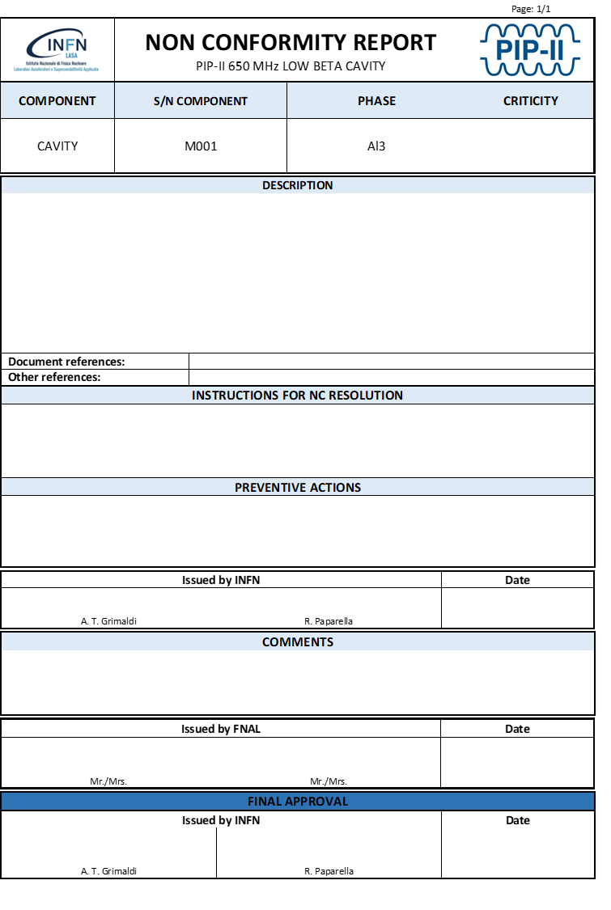
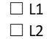
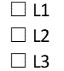
The NCR Template for PIP-II (draft)
Classification (criticity):
  Our proposal is L1/L2 (like for ESS scheme)
  L1/L2/L3
In the first page, a description of the NC and of the Instruction for resolution (corrective actions)
Detailed description of the NC in the following pages (drawings, photos, list of steps needed for the recovery, tickets, etc.)

Slide 10
Thanks for your attention

