Slide 1
Introduction from INFN
INFN PIP-II Quality Planning Workshop
June 30th, 2022

Slide 2
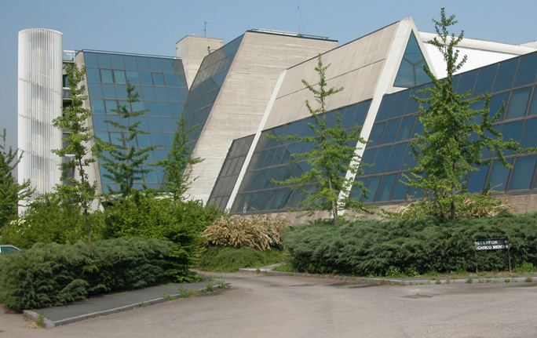
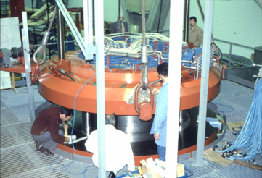
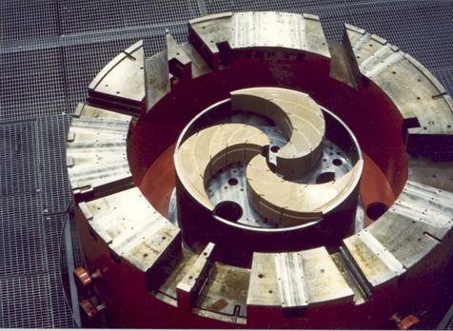
LASA is hosted by Universita’ degli Studi di Milano and by INFN, the Italian Institute of Nuclear Physics, Milano dpt.
LASA (Laboratorio Acceleratori e Superconduttività Applicata) was built in the ‘80 close to Milano to realize a K800 SC Cyclotron, the first in Europe and the third worldwide.
Designed, built and tested in Milano, in operation since 1994 at INFN-LNS in Catania
It is now is a center of excellence at an international level in the field of advanced technology for particle accelerators.
The main missions of LASA currently are:
Radiofrequency superconducting resonators for particle beam acceleration
Photocathodes for laser driven beam sources
Superconducting magnets for particle beam orbit and focusing.

Slide 3
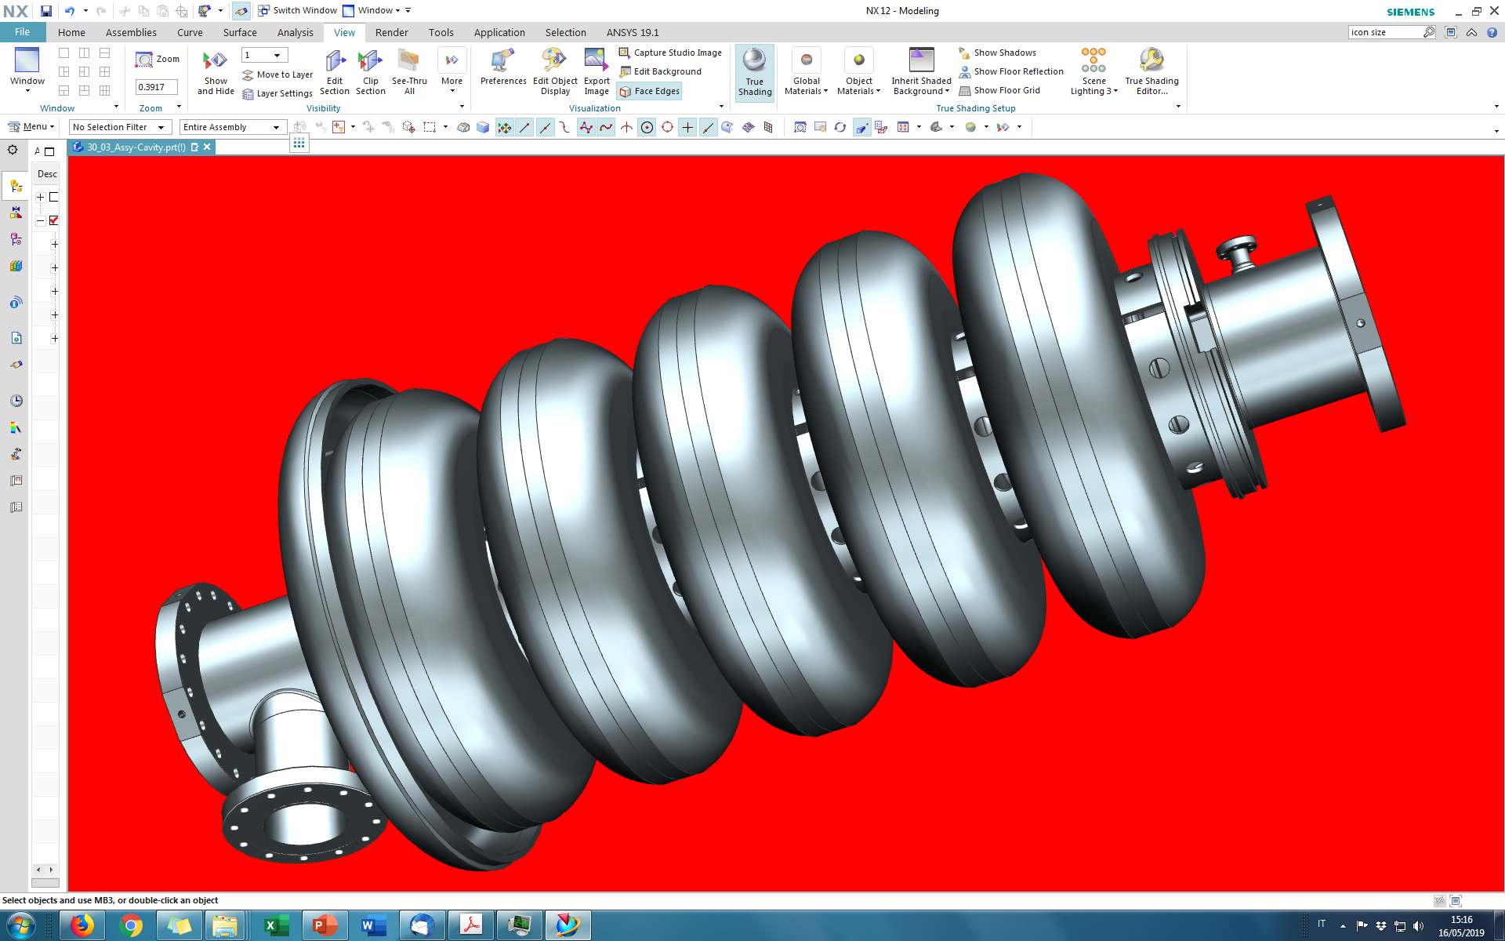
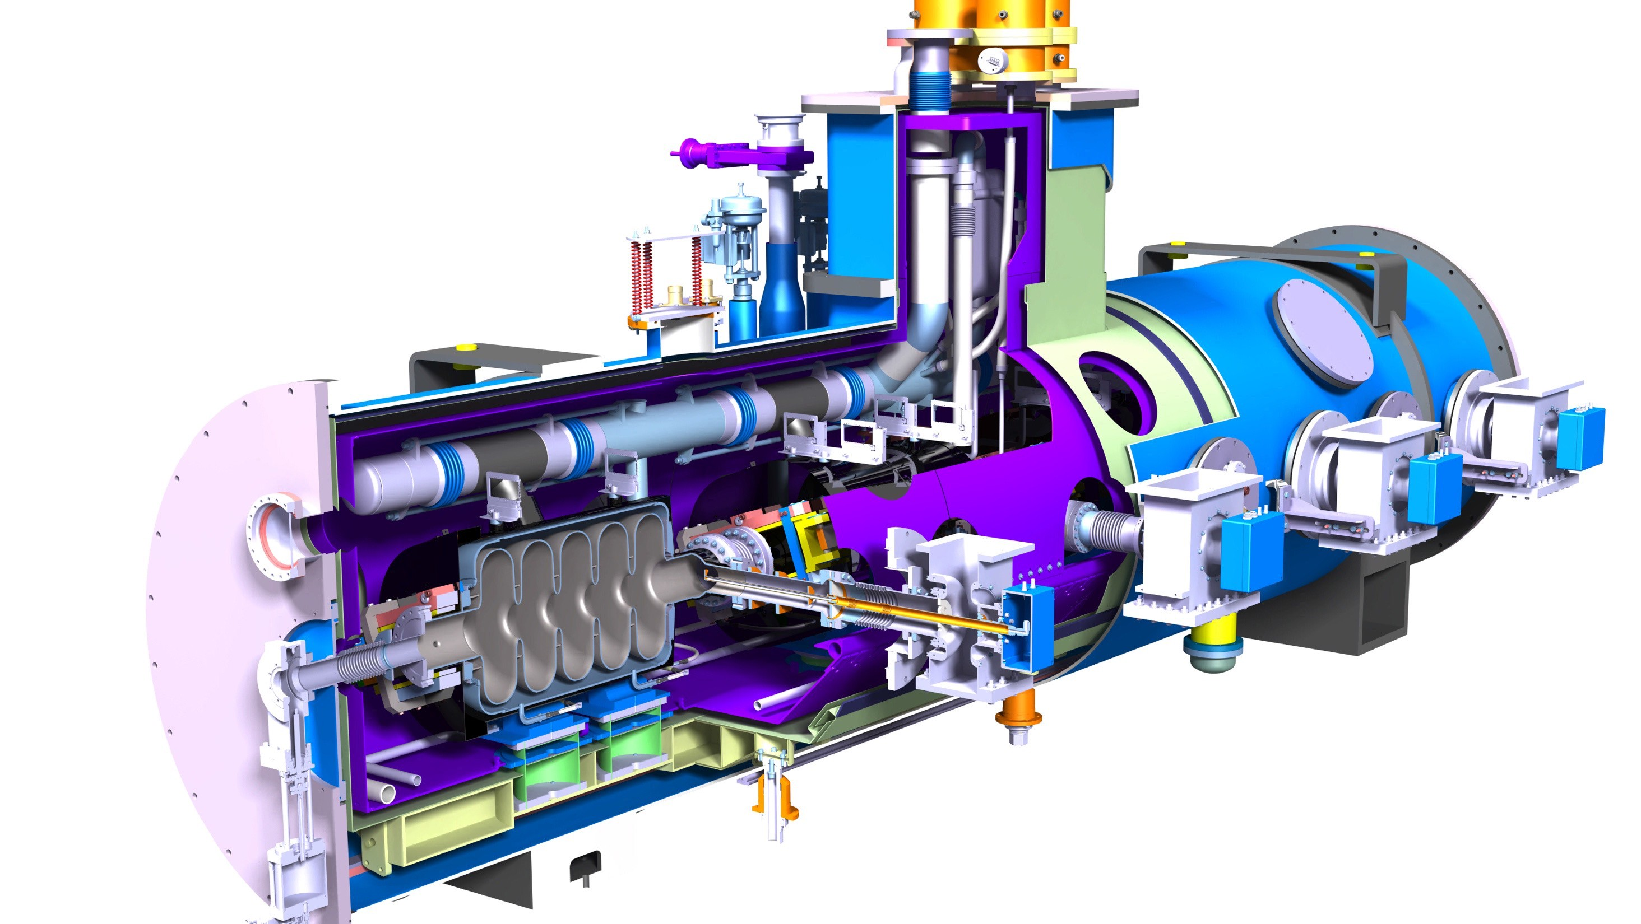
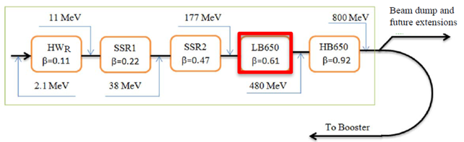
INFN LASA contribution to PIP-II
INFN firstly provided a novel RF design for the LB650 cavities, fully plug compatible with the Fermilab technical interfaces and performances specifications.
Cavity design meets the CW RF performance requirements
INFN contribution aims to cover the needs of LB650 section, and this includes:
38 SC cavities required to equip 9 cryomodules with 2 spares, delivered as ready for string assembly.
Qualification via vertical cold-test provided by INFN through a qualified cold-testing infrastructure acting as a subcontractor
Compliance to the PIP-II technical management plans and interfaces: System Engineering, Project Review, Quality Assurance and Risk Management.
PIP-II LB650 Project Specifications
Acc. Gradient | 16.9 MV/m
Q₀ | > 2 10¹⁰
RF rep rate | 20 Hz to CW
Beta | 0.61
Low-Beta (LB650, b=0.61) cryomodule
RT
SC

Slide 4
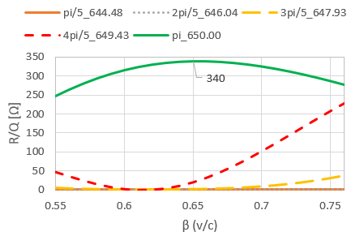
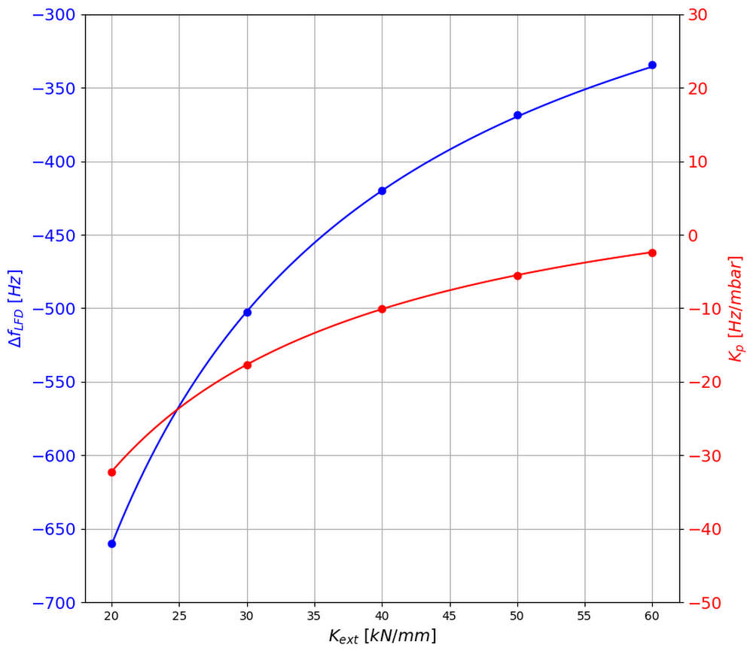
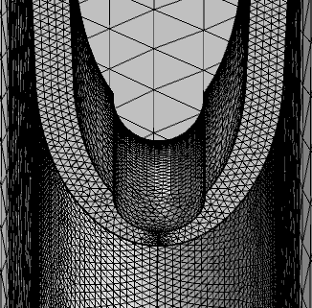
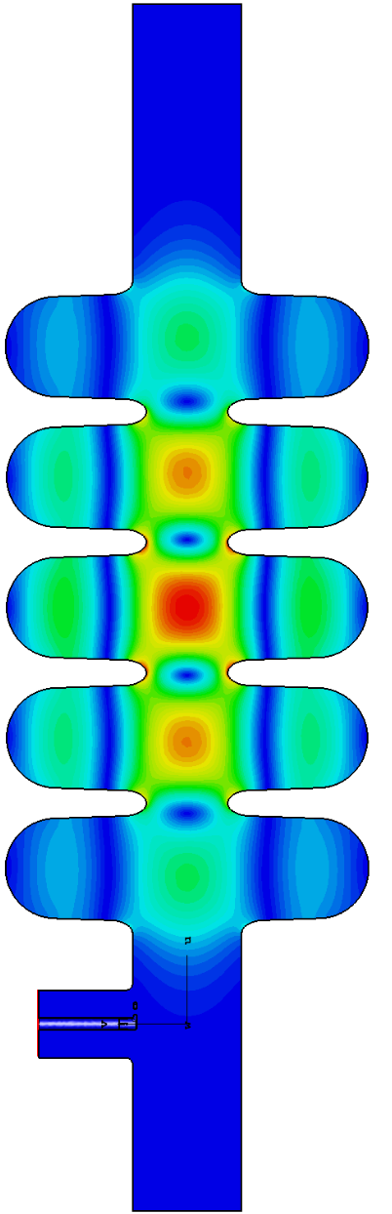
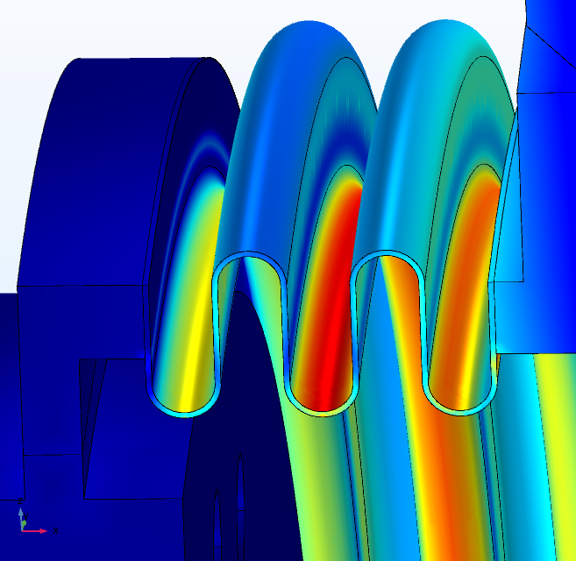
PIP-II LB650 challenges
The successful cavity design from INFN-LASA is the result of an interplay of multiple, state-of-the-art competences in electromagnetic, mechanical and technical domains.
PIP-II LB650 cavities are among the key scientifical challenges of the project, requiring:
an unprecedented quality factor for these resonators.
Besides accelerating mode and passband, High-Order
Modes risks have been assessed so that neither
instabilities nor additional cryogenic losses are
posing critical issues.
PIP-II operational scenario is an uncharted territory
in terms of detuning control, and this requires deep
understanding of Lorentz Force detuning, pressure
sensitivity and mechanical leading parameters as
rigidities, yield limits, stresses.
Extensive finite element analysis to evaluate the
challenging mutual compliancy to both PED and
ASME codes, a first-time for an accelerator project.
Last mode in 2nd monopole passband, +8 MHz away from 9th ML
R/Q of modes in the beta range
FEM mesh and internal stress analyses
LFD frequency shift (blue) and pressure coefficient (red) as a function of external cavity stiffness for a cold cavity.

Slide 5
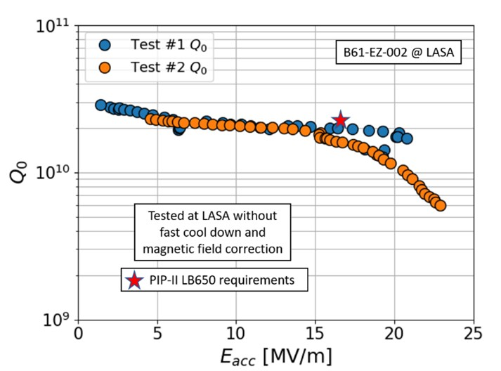
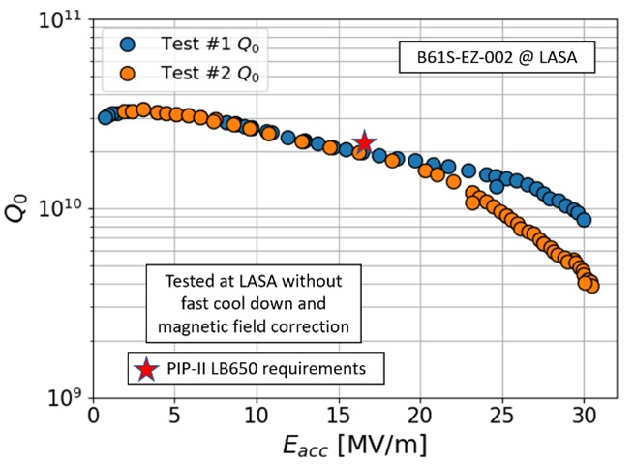
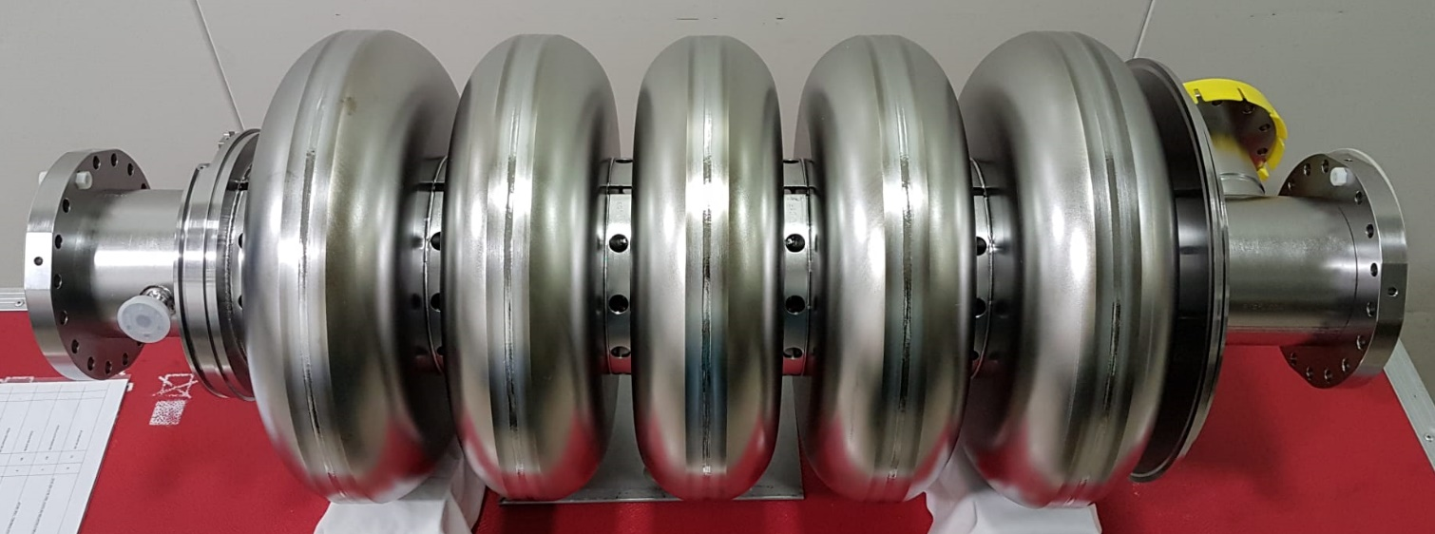
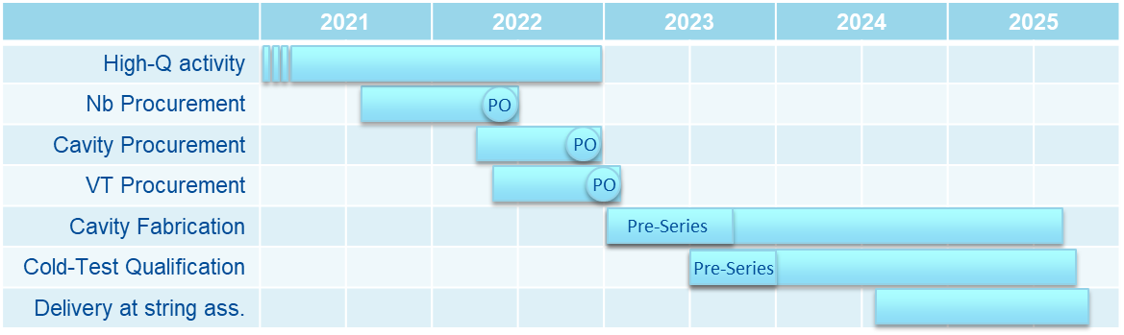
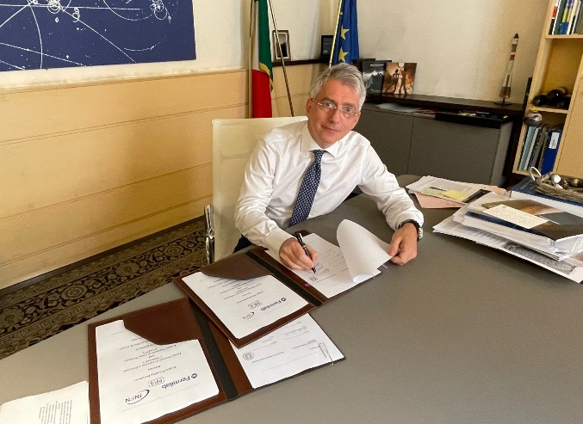
INFN LASA contribution to PIP-II
Successful prototyping activity ongoing on single and multicell LB650 cavities
PPD - Project Planning Document
  Setup starting from 2019
  Signed by INFN President on June 28, 2021
Timeline key points:
  Major procurements from 2022
  2 pre-series cavity
  First acceptance level from INFN after experimental qualification
  Second acceptance level by Fermilab at assembly site.
  Delivery through 2024 and 2025

Slide 6
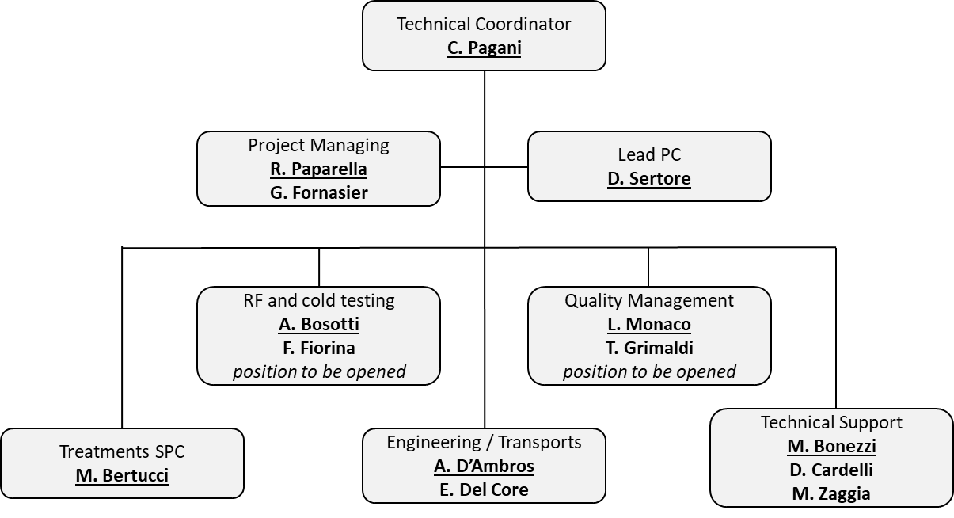
The INFN LASA team for the PIP-II
Technical Coordinator (TC): provides senior INFN LASA management ownership of the project and ensures that all agreed contract conditions are met, and liabilities managed.
Project Manager (PM): delivers the project to specification, in time, and on budget within the project constraints.
Project Coordinators: provides technical and scientific oversight for the whole project
(Lead PC) or for a sub-system (SPC), whilst also providing relevant expertise and guidance as to how to solve technical issues.
Quality Assurance (QA): primary responsibility for development and maintenance of quality documentation and systems, such as the change control system.
This includes, but is not limited to:
  defining quality requirements for procurement, manufacture, assembly and testing processes
  preparing/maintaining necessary documentation, monitoring of production quality performance
  identify opportunities for improvement, review and maintenance of quality procedures.

Slide 7
Resources within INFN
Limited resources are today “centrally” available within INFN for:
Professional managing of scientifical projects
Quality assurance and quality control for scientifical projects
… the need for professionals and professional tools in both fields is not yet recognized as much as it should.
As of today, these profiles are covered “locally” in each project by technical staff learning on the field!
as for Laura and Tommaso that developed and successfully managed QA/QC for INFN LASA contributions to European-XFEL and European Spallation Source.

