Slide 1


WP 4
06.06.2022
WP4 Photon & User beamlines
Last review meeting summary
Previous RC comments:
“The RC notes that most topics directly related to the photon beam line and user facility were not discussed at this meeting. […] These topics thus are also mostly not discussed in the report.”
1.8: “Considering the importance of these topics, the RC would like to see the development of all diagnostics along the FEL electron beam line, but also along the photon line to be pushed forward and presented at future meetings”

Slide 2
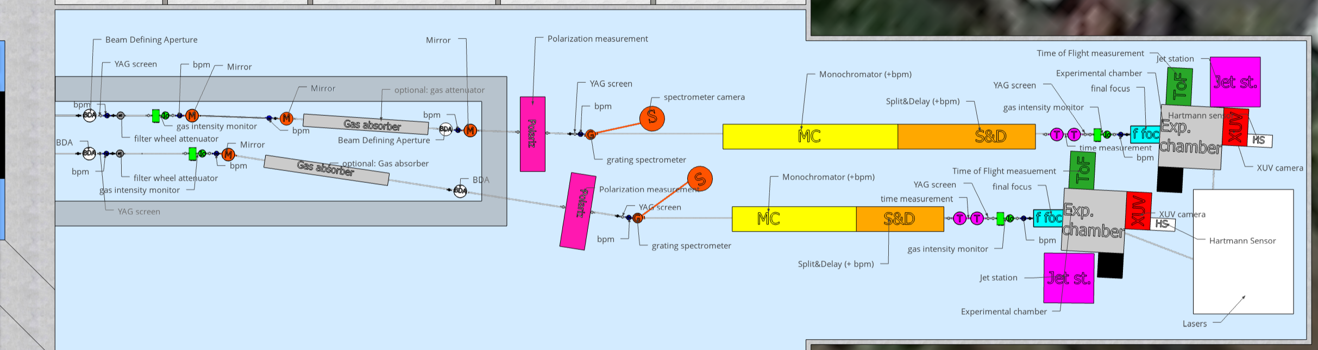
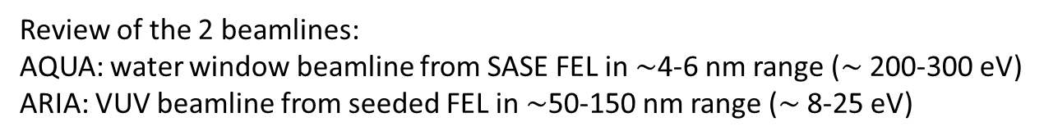
WP 4
06.06.2022
WP4 Photon & User beamlines
Last review meeting answers
Review of the 2 beamlines:
AQUA: water window beamline from SASE FEL in $∼$4-6 nm range ($∼$200-300 eV)
ARIA: VUV beamline from seeded FEL in $∼$50-150 nm range ($∼$8-25 eV)
50 m
AQUA beamline
ARIA beamline

Slide 3
WP 4
06.06.2022
WP4 Photon & User beamlines
Beamlines components
  Spectrometer: standard grating spectrometer
  Beam position monitor: photocurrent from metallic blades
  Beam dimensions: Ce:YAG screen
  Intensity monitor: ionization chambers
  Polarization measure: radial ToF ionization chamber
  Longitudinal dimension and Time of arrival: ionization streaking with laser or THz /
  nonlinear transient reflectivity or xuv autocorr. in gas (inside the exp. chamber)
  Coherence measure: interferometry using S&D and double slit with a screen
  Wavefront measure: commercial Hartmann sensor
  Beam defining apertures: the first is a moveable aperture and the second is a set of moveable pin holes
  Attenuators: solid thin filters, with optional gas attenuator
  Mirrors and focusing: near grazing incidence, final focus with K-B
  Split&delay line: geometrical split, tens ps range
  Monochromator: with gratings in dispersion compensation config.

Slide 4
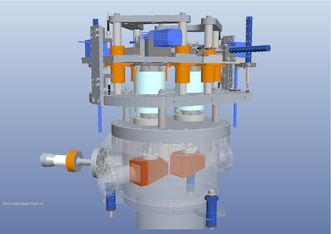

Beam defining apertures
Double rectangular aperture to select the beam from background and for radiation safety at the beginning of the beamline
Second aperture (as a set of moveable pin holes with different diameters) further down in the beamline for alignment/equipment protection and for radiation safety

Slide 5
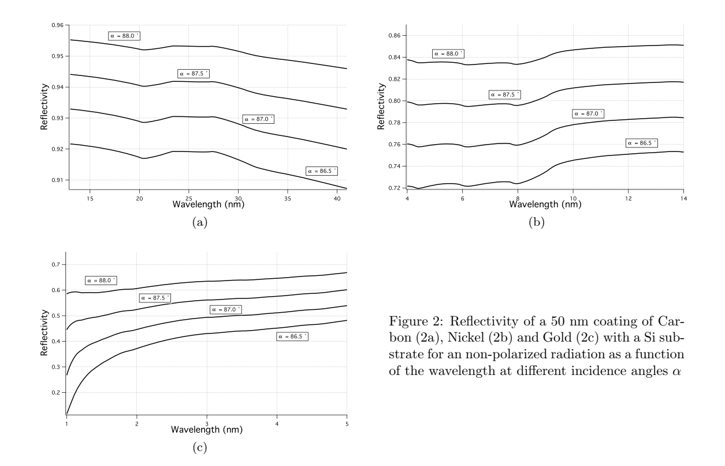
Mirrors
Near grazing angle mirrors (2° for AQUA, 5-9° for ARIA)
Coating:
  Water window: Ni (care for C contamination), Au
  VUV: C, Au
From FERMI
SPIE 74480O (2009)

Slide 6
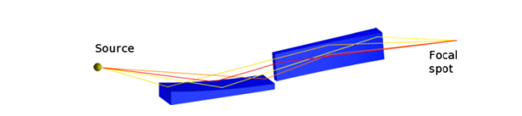
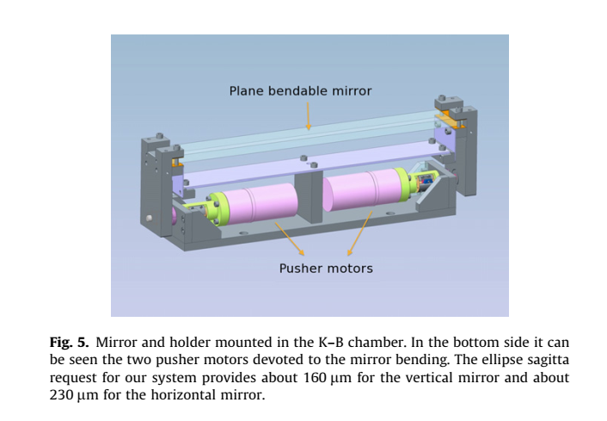
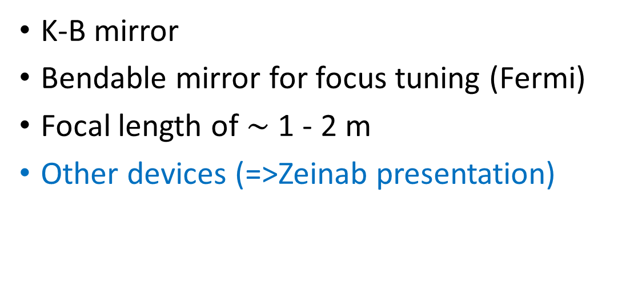
Focusing optics
K-B mirror
Bendable mirror for focus tuning (Fermi)
Focal length of $∼$ 1 - 2 m
Other devices (=>Zeinab presentation)
from FERMI
NIMA 710, 131 (2013)

Slide 7
Monochromator
Grating monochromators
Temporal dispersion compensation configuration
(larger losses but preserve temporal duration)
Grating diffraction coating: same as mirrors
Plane-elliptical
Double-grating monochromator for ultrafast free-electron-laser beamlines (FLASH II), F. Frassetto et al., proc. FEL2014

Slide 8
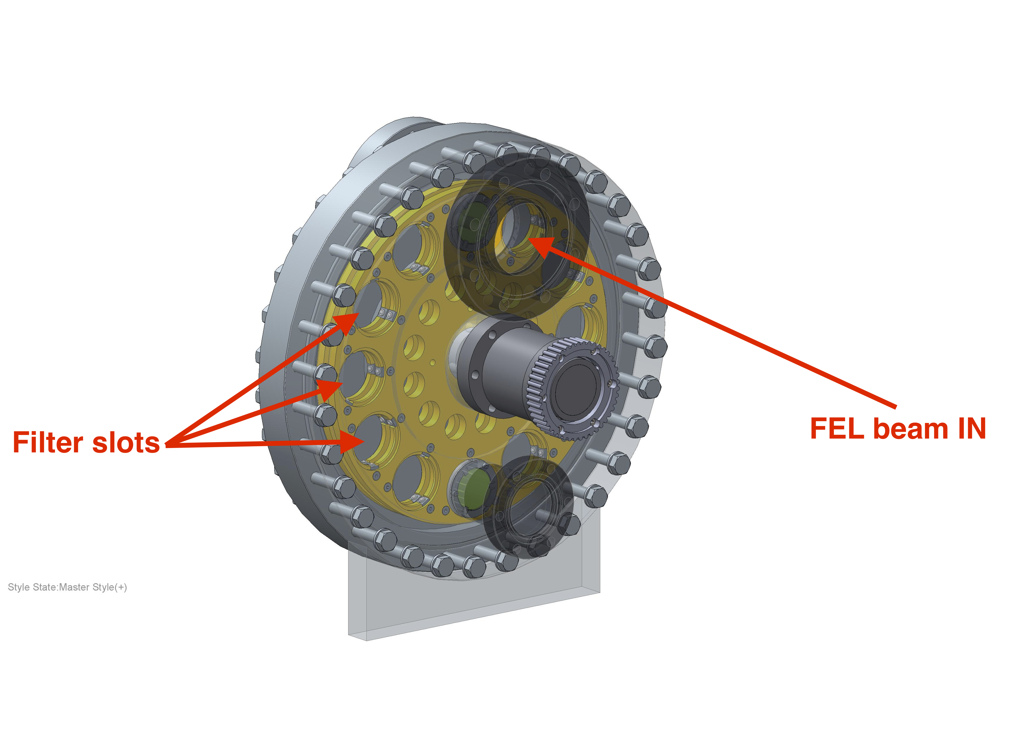
Filter and attenuators
Thin film filter wheel for attenuation
  Ongoing studies on materials, thickness and contamination cleaning
Optional: gas attenuators (larger, more costly but continuously tunable, not in the cost baseline)
From FERMI

Slide 9
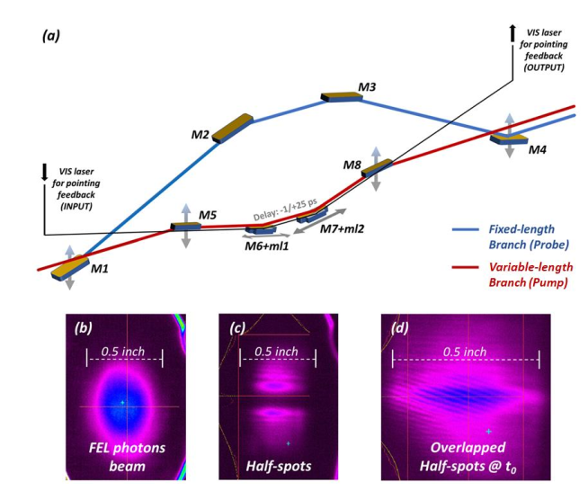
Split & delay line
For pump-probe experiments,
also useful for interferometric longitudinal coherence measure
Simple geometrical split/recombination on the target
from FERMI, Photonics 9(5), 314 (2022)

Slide 10
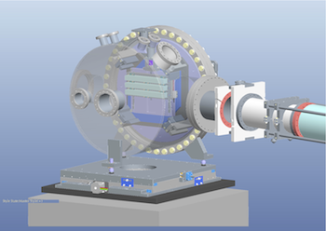
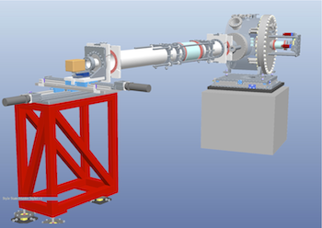
Spectrometer
Grating spectrometer:
reflection (0th order) to the beamline and diffraction to CCD for online acquisition
Grating coating:
Au, Ni for water window
Au, C for VUV
Images from PRESTO spectrometer (@FERMI)
https://doi.org/10.1016/j.nima.2008.04.031

Slide 11
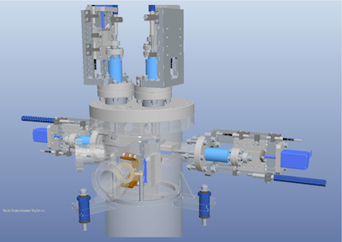
Beam position monitors
Standard item
Collected photocurrent from tail-intercepting metallic blades
Other devices may be used
(ToF form ionization chamber)
Expertise in LNF (at DAΦNE Light synchrotron VUV beamline)

Slide 12
Beam transverse size measurements
Ce:YAG screen (similar to the ones used for electrons), other scintillators may be envisaged (synthetic diamond,…)
Knife-edge or wire measurements (multishot) also available

Slide 13
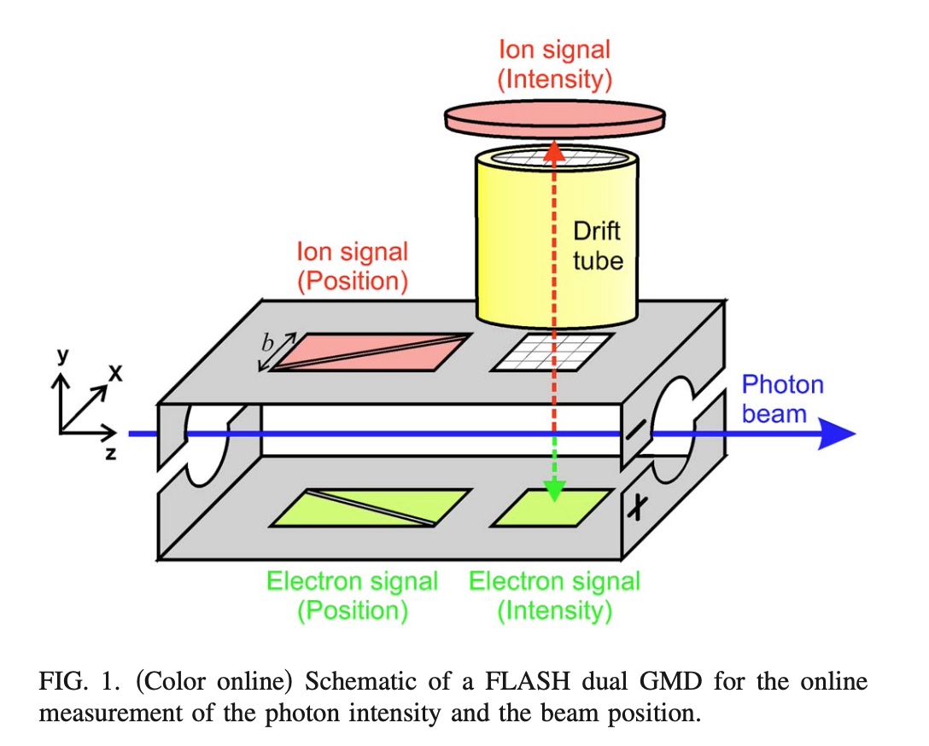
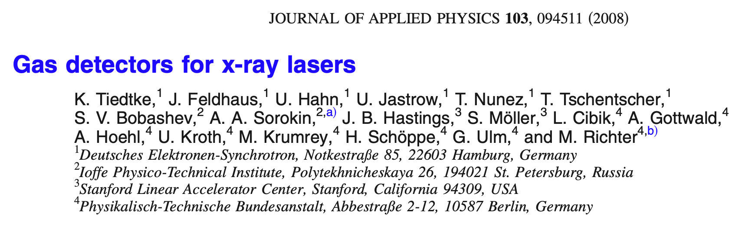
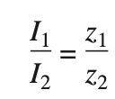


Gas Detector
Courtesy of Avaldi
An example from the literature at FLASH
Split electrodes are used for ion and electron detection.
With a homogeneous extraction field, the charged particles created within a single photon pulse represent, in the plane of the respective split electrode, a projection of the photon beam.
Ion time-of-flight mass/ charge spectrometers: the wavelength can be derived from intensity ratios of differently charged photo-ions
Currents on
Eletrodes
lengths of
projections
SEVERAL CALIBRATIONS NEEDED !
one of the limiting factors is the ability to read very low current with high precision, stability, and sensibility.
Consiglio Nazionale delle Ricerche

Slide 14
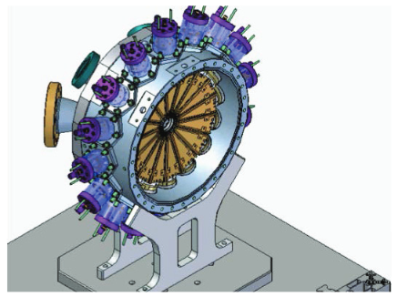
Gas monitors for polarization measure
Use an array of many ToF gas monitors to determines the photoelectron angular distribution
From this (and knowing the gas used) we can reconstruct the FEL pulse polarization
From FERMI (Proceedings of FEL2014 THA02)

Slide 15
Pulse duration
Courtesy of Avaldi
Indirect methods :
These methods extract the pulse information from some machine parameters (longitudinal electron phase space, fluctuation of the radiated spectrum, number of observed spikes) linked to the pulse duration by means of theoretical models of FEL emission
- C. Behrens et al. , Constraints on Photon Pulse Duration from Longitudinal Electron Beam Diagnostics at a Soft X-Ray Free-Electron Laser, Phys. Rev. ST Accel. Beams 15, 030707 (2012).
- C. Behrens et al. , Few-Femtosecond Time-Resolved Measurements of X-Ray Free-Electron Lasers, Nat. Commun. 5, 3762 (2014).
- A. A.Lutman et al. , Femtosecond X-Ray Free Electron
Laser Pulse Duration Measurement from Spectral Correlation Function, Phys. Rev. ST Accel. Beams 15, 030705 (2012).
- Y. Inubushi et al. , Determination of the Pulse
Duration of an X-Ray Free Electron Laser Using Highly
Resolved Single-Shot Spectra, Phys. Rev. Lett. 109,
144801 (2012).
Direct methods :
These methods (XUV autocorrelation in the gas phase, cross-correlation in solid state or in gas phase, and optical laser-driven Terahertz streaking) provide temporal information directly by means of the response of an ultrafast physical process to FEL radiation
- R. Mitzner et al. Phys. Rev. A 80, 025402 (2009).
- R. Riedel et al., Nat. Commun. 4, 1731 (2013).
- U. Fruhling et al. , Nat. Photonics 3, 523 (2009).
- I. Grguraš et al., Nat. Photonics 6, 852 (2012).
- F. Tavella et al., Nat. Photonics 5, 162 (2011).
- S. Dusterer et al., New J. Phys. 13, 093024 (2011).
- W. Helml et al., Nat. Photonics 8, 950 (2014).
- G. De Ninno et al., Nat. Commun. 6, 8075 (2015).
Consiglio Nazionale delle Ricerche

Slide 16
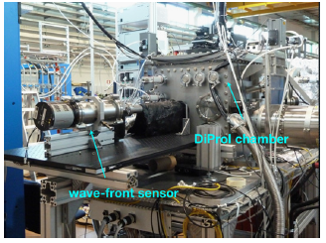
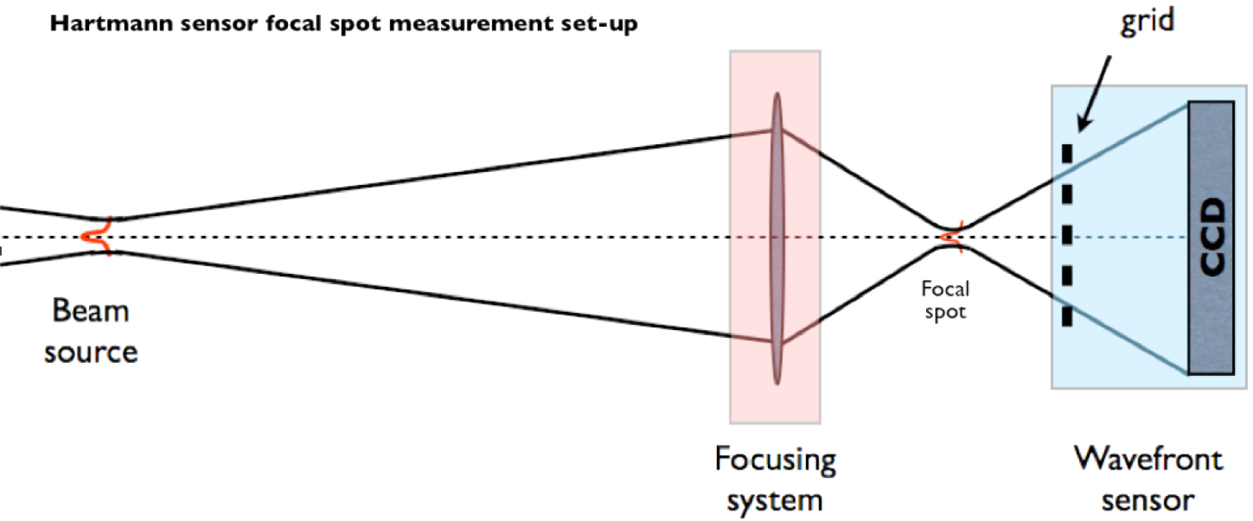
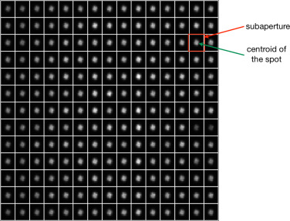
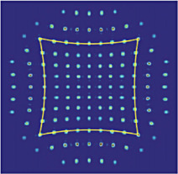
Wavefront measurement
Hartman sensor (commercial)
Needed to check the tilt due to gratings (spectrometer & monochr.)
Good wavefront
Wavefront with spherical aberration
https://doi.org/10.1016/j.nima.2012.11.039
from FERMI
https://doi.org/10.1016/j.nima.2018.03.026

Slide 17
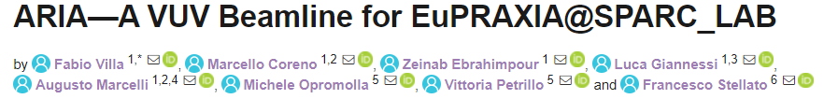
WP 4
06.06.2022
WP4 Photon & User beamlines
Ongoing actions
Outcome closed actions & Decisions
To Do
Preliminary beam parameters (with WA6) and user’s requests (with WA8) collection (by the end of June)
Zemax optical simulation of the beamlines
Experiment on the development and characterization of novel optics for focusing X-rays @Elettra
Increase in manpower:
2 people form DAΦNE synchrotron beamlines will join WP4, other agreement with CNR and LNF (DAΦNE) are still in progress
Conference paper for VUV beamline presented at High Precision X-ray Measurements 2021
Beamline elements multi-physic simulations (thermal load, damage, contamination, …)
Technical design: instruments, CAD, services (vacuum, laser, synch., CS,…)
Presentations at FEL conference (08/2022)
A new betatron source project (EuAPS) at SPARC_LAB in EUV/x-ray useful for EuPRAXIA@SPARC_LAB R&D tests on optics and diagnostics
R&D of diagnostics and optics at or above state-of-the-art

Slide 18
WP 4
06.06.2022
WP4 Photon & User beamlines
Upcoming milestones
Potential risks
General Status
30/06/22 Preliminary beam parameters collection for AQUA and ARIA beamlines (achievable)
Changes in the FEL parameters
(mitigation: sharing of preliminary simulations and achievable parameters)
It’s all ok!
31/12/22 Preliminary optical simulation of the beamlines (critical)
Low scientific FTE;
Change in beamlines layout
(mitigation: more manpower, expertise in beamline design)
Business as usual but some issues might become critical
30/06/24 Preliminary Technical Design of the beamlines (critical)
Low scientific and technical FTE;
oversights in conceptual design phase (mitigation: increasing the number of people and competence involved)
Business as usual but some issues might become critical
30/06/25 Beamline element R&D (achievable if pTD is ready)
Incomplete definition of the elements;
beamtime availability in other facilities;
higher failure/maintenance time
(mitigation: less performing on-shelf items, early agreement with other facilities for elements co-developing)
Business as usual but some issues might become critical

