Slide 1
WA6 Report APPLE-X Undulator for the AQUA line at EuPRAXIA@SPARC_LAB
Alberto Petralia, ENEA FSN, C. R. Frascati
on behalf of the WP6 collaboration team
EuPRAXIA@SPARC_LAB TDR Review Committee, Monday 6 June 2022 – Frascati

Slide 2
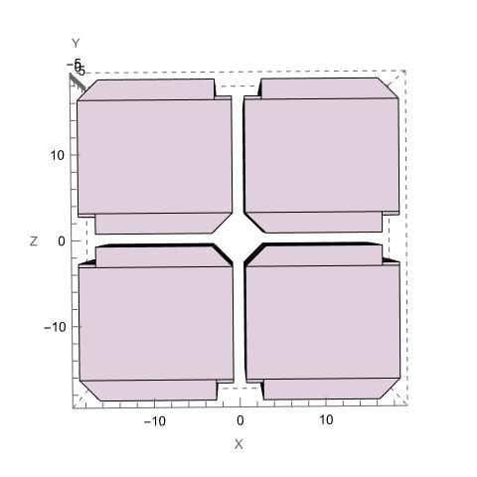
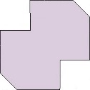
Apple-X Undulator structure
pipe support 1 mm
Remanent field Br = 1.35 T
Undulator period λu = 18 mm
4 blocks / period, NdFeB
Min. gap = 1.5 mm
# of periods N = 110 (Lu=2m)
φ hole 5.5 mm
φ ext pipe 5 mm
G2
G1
Gap 1.5 mm
G3
G4
y
Transverse plane
view
Simulation with RADIA
z
x
Longitudinal view
Ingoing field
Transverse view
y
x
Halbach array
y
λu
Outgoing field
z=0
z=λu/4
z=λu/2
z=3/4 λu
-Lu/2
Lu/2
0
z
Change of polarization by longitudinal shift (Δz) of G2 and G4

Slide 3
Why an Apple-X for AQUA?
Requirements on radiation and constraints on the beam parameters give:
E_{max} = 1 GeV
K_{rms} ≈ 1
$$λ=\frac{λu}{2γ^{2}}\left(1+{K_{rms}}^{2}\right)$$
λ = 4 nm
λ_{u} = 18 mm
Apple type undulator: Variable polarization, Linear/Circular
Apple-X geometry allows K>1 with a 5 mm round vacuum pipe
Minimum gap 1.5 mm (not less for mechanical issues) to have K>1

Slide 4
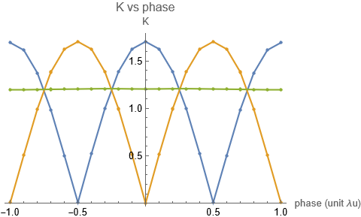
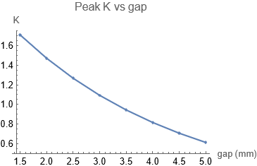
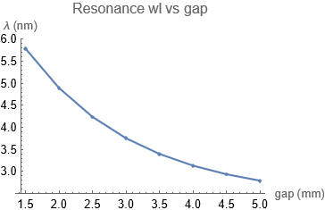
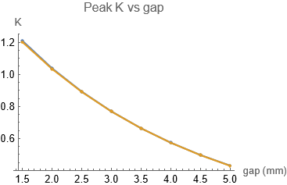
Wavelength Tunability
$$λ=\frac{λu}{2γ^{2}}\left(1+{K_{rms}}^{2}\right)$$
K vs phase
$$K_{rms}=\sqrt{\frac{{K_{x}}^{2}}{2}\text{+}\frac{{K_{y}}^{2}}{2} }$$
Ky
Linear Pol.
Krms
Ky
Kx
0.9 < Ky < 1.7
Δz/λu
3.5 nm < λ < 5.8 nm
$$K_{rms}=\sqrt{\frac{{K_{x}}^{2}}{2}\text{+}\frac{{K_{y}}^{2}}{2} }$$
@ E = 1 GeV
Circular Pol.
Ky
Kx
0.7 < Kx,Ky < 1.2
Same range of tunability for LP and CP, intrinsically due to the Apple-X symmetry
Parameters optimized for operation at 4 nm

Slide 5
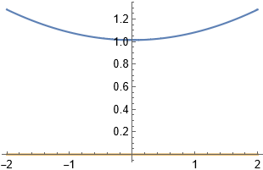
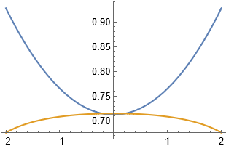
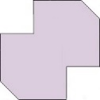
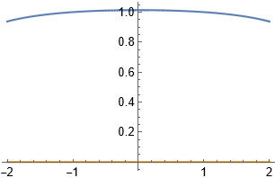
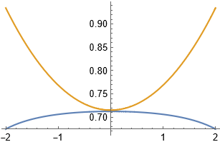
Transverse Field profile and homogeneity
By
Linear Pol.
Circular Pol.
Bx
By @ z=0
@ y=0
By @ z=0
@ y=0
x
Bx @ z=$λ_{u}$/4
x
Bx @ z=$λ_{u}$/4
@ x=0
By @ z=0
@ x=0
By @ z=0
y
y
@ 0.2 mm - dBy/dy < 0.05%, dBy/dx < 0.3%, dBx/x < 0.03%, dBx/dy < 0.3%
@ 0.4 mm - dBy/dy < 0.2%, dBy/dx <1.18%, dBx/x < 0.15%, dBx/dy < 1.18%

Slide 6
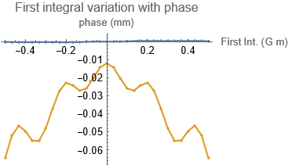
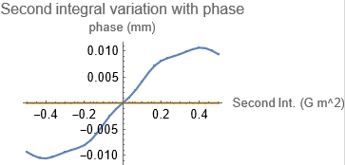
End magnets design and field integrals
Standard block size lz = $λ_{u}$/4
Symmetric
Zero-displacement orbit
¼ ½ ¾
Z=0
¾ ½ ¼
Variation of Field Integrals with phase (Δz/λu) at minimum gap
I1 (G m)
I2 (G m²)
Δz/λu
Iy
Ix
Δz/λu
within typical values (I_{x,y} <0.5 G m, II_{x,y} <0.5 G m²)
ending magnets distance/width optimized for LP operation

Slide 7
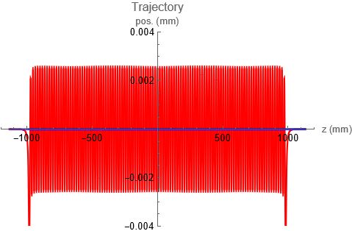
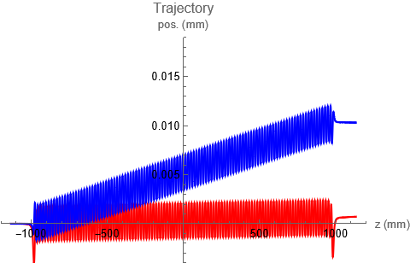
Trajectory
hor
LP (H)
CP
vert
For a 2 m long undulator (Nper=110)
Exit position and angle must be close to 0 for an electron moving on axis
Optimized for the LP operation
> 0 value in CP due to the magnetic properties of NdFeB
Can be managed by correctors and/or correction coils

Slide 8
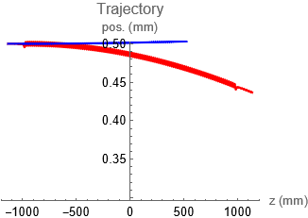
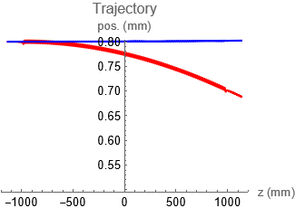
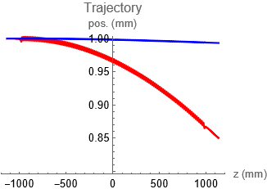
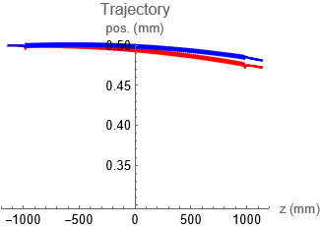
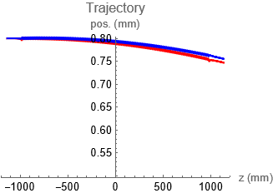
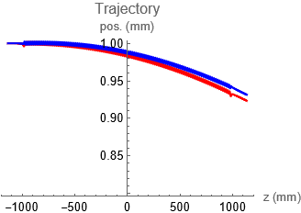
Focusing properties
hor
Looking at the Trajectory:
vert
LP
off: 0.5 mm
off: 0.8 mm
off: 1 mm
CP
off: 0.5 mm
off: 0.8 mm
off: 1 mm
LP - Focusing in X, def. In Y
CP - Focusing in both planes with equal strength
Focusing map can be evaluated numerically (Kick maps = Kick angle vs entrance position)
Linear variation of Kick angles with the off-axis displacement for entrance offset < 0.8 mm

Slide 9
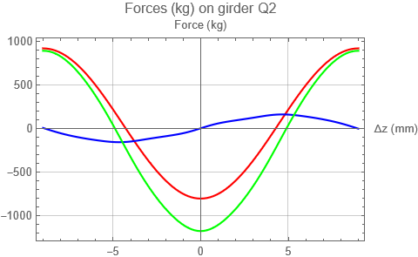
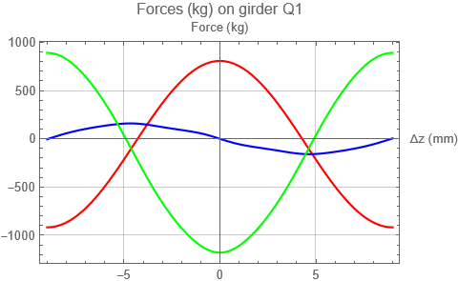
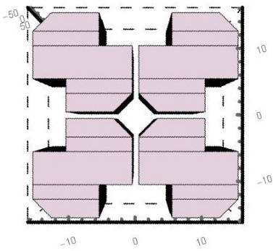
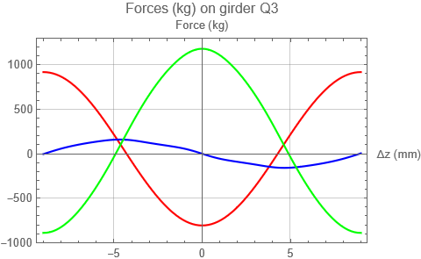
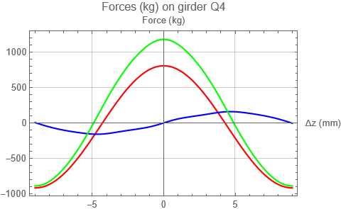
Magnetic Forces on girders
@ minimum gap = 1.5 mm
G2
G1
G2
G1
G3
G4
y
z
G3
G4
x
Max Fx = ± 920 kg Max Fy = ± 1200 kg Max Fz = ± 160 kg
Can be managed by conventional motors

Slide 10
Conclusion and remarks
Chosen geometry: Apple-X
Settled parameters, optimized for operation @ 4 nm – 1 GeV
K_{rms} constant for any setting of polarization, same tunability in LP and CP
Transverse fields in CP show a full symmetry between X and Y coordinates
Field integrals values within typical limits with conventional ends design
Focusing properties solved numerically (Kick maps)
X,Y acceptable region of operation < 0.2 mm (to be improved)
Estimation of forces acting on girders, no compensating magnets required
Design tolerances study
Mechanical design (based on the SABINA Apple-X)
Correction coils design
Phase shifters
Next steps

