Slide 1





WA6 Status Report – FEL Integration & Performance
TDR Review Committee Meeting, June 6th 2022
Federico Nguyen on behalf of the WA6 Working Group

Slide 2
Workflow
Undulator specifications (→ see A. Petralia’s talk)
FEL Layout definition (→ see A. Ghigo’s talk)
Beam optics analysis (→ this talk)
Baseline parameters simulation (→ this talk)
Tolerance analysis (→ to-do list)
Start to end simulation (→ to-do list)

Slide 3
FEL Layout definition
From the baseline electron beam parameters and the frozen undulator specifics
Design of the undulator section, intra-module distance and FODO properties
Focus on the red rectangle beam parameters (see WA1 C. Vaccarezza’s talk)
LINAC
LINAC + PWA
Parameter | Symbol | Units | A | B | C | D (CDR) | E
Charge | Q | pC | 200 | 200 | 30 | 30 | 30
Energy | E | GeV | 0.996 | 1 | 1 | 1 | 1
Peak current | I_{peak} | kA | 1.6 | 0.7 | ? | 1.8 | 800
Bunch length | 𝝈_{z} | μm | 18.3 | 100 | ? | 2 | 5
Proj. norm. emittances (x/y) | 𝜺_{n,x,y} | mm-mrad | 1.85 | ? | ? | 1.7 | 3/4
Slice, norm. emittances (x/y) | 𝜺_{n,x,y} | mm-mrad | 0.5 | 0.5 | ? | 0.8 | 3/4 (1/1.2 at linac)
Proj. energy spread | 𝝈_{𝜹p} | % | 0.09 | ? | ? | 0.95 | 1.5
Slice Energy spread | 𝝈_{𝜹s} | % | 0.02 | 0.01 | ? | 0.05 | 0.06
AQUA
ARIA
AQUA/ARIA

Slide 4
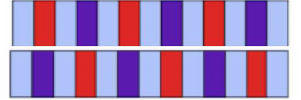
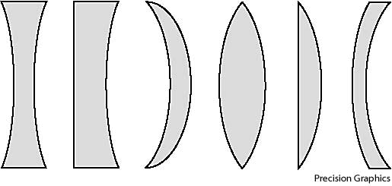
AQUA undulator magnetic lattice
~ 25 m whole section
Apple-X
undulators
Quad magn.
length ~ 10cm
198cm 18cm |!| 31cm
~ 60cm

Slide 5
AQUA @4nm with Apple-X: selectable polarization
Slightly asymmetric Quad field strengths in Linear
Twiss values at und. entrance for the electron beam to match → constrain the upstream transfer line

Slide 6
Quadrupole integral fields vs. E_{beam}
Quad integral field gradients should be such to sustain even higher beam energies →
Possible to reach for 3nm with the same undulator and quadrupole devices, if E_{beam} ~ 1.2 GeV

Slide 7
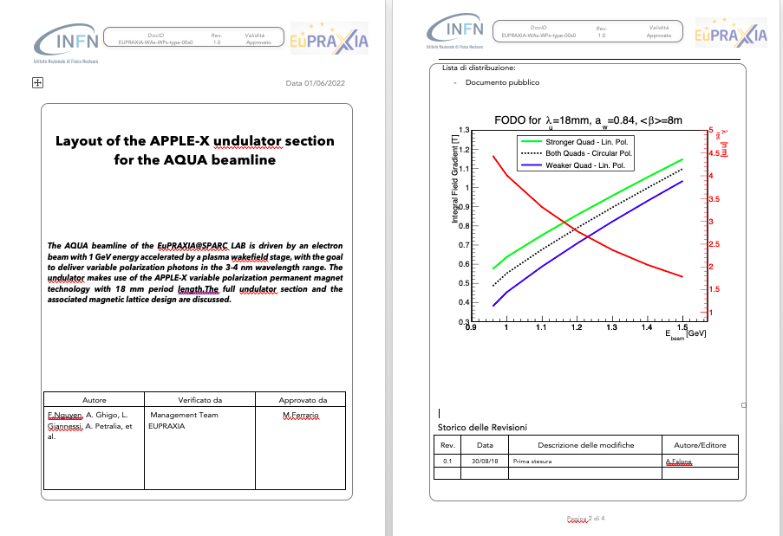
Towards approval of the adopted solution
The process towards Blessing of the chosen configuration
has started
(see A. Falone’s talk)
Draft of the Physics Interface Document will be circulated soon, to be scrutinized for approval

Slide 8
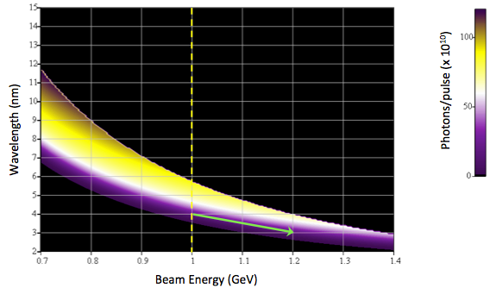
Linear Pol. Apple-X overall FEL performance
Tunability both in beam energy γm_{e}c² and
in undulator gap g_{u} weighted for N_{γ}/pulse
Undulator gap gives limited lever arm:
shorter λ_{res} ⬅➔ lower K values ⬅➔ lower
N_{γ}/pulse
By increasing beam energy
(other parameters constant) →
chance to reach for 4nm with performance similar to longer wavelengths
Courtesy of L. Giannessi

Slide 9
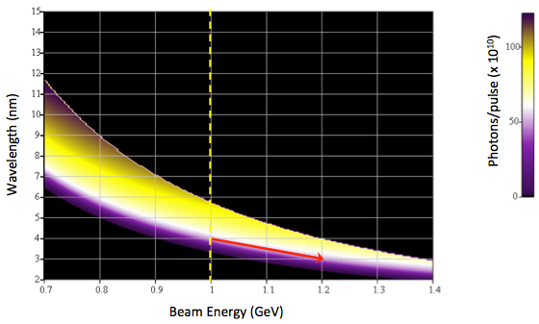
Circular Pol. Apple-X overall FEL performance
Tunability both in beam energy γm_{e}c² and
in undulator gap g_{u} weighted for N_{γ}/pulse
Circular Polariz.: wider undulator
gap tunability
than Linear →
“water window”
wavelengths
probed with
higher N_{γ} yield
By increasing beam energy
(other parameters constant) →
chance to reach for 3nm with performance similar to longer wavelengths
Courtesy of L. Giannessi

Slide 10
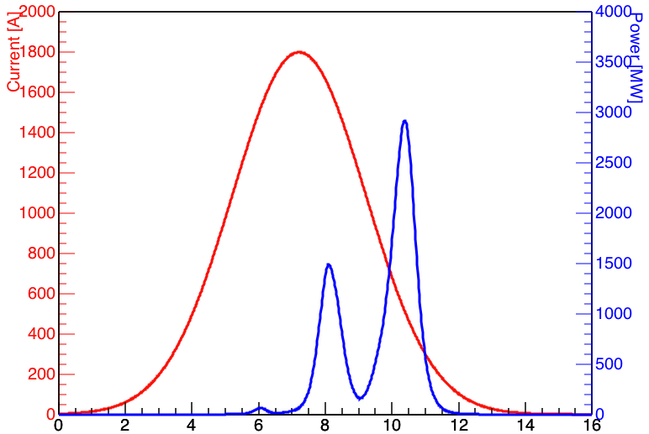
Electron beam used for FEL performance
Average electron beam slice parameters are used to perform 3D time dependent simulations with the Genesis1.3_V2 code in 4 undulator + related magnetic lattice configurations: Linear & Circular polarizations, targeting 4nm & 5.75nm (K_{max})
An ideal Gaussian current profile is assumed with I_{peak} = 1.8kA and Q = 30pC
beam current profile
CP 4nm exit power

Slide 11
AQUA FEL results with average beam parameters

Slide 12
Conclusions & outlook
AQUA undulator line is designed, featuring the magnetic lattice, intra-module distance and FODO quadrupole integral strengths → same line is able to sustain E > 1 GeV beam energies
Design of the full undulator line is going through the approval/blessing certification process
Ideal reference electron beam values are used to perform 3D time dependent simulations: both LP and CP APPLE-X, at 4nm and at 5.75nm K_{max} → CP at 5.75nm allows to enter the realm of O(10¹²) N_{γ}/pulse → to be achieved at shorter λ with higher E_{beam} (or improved parameters → WA1)
Now focus on the tolerance study and on the full S2E with electron macroparticles (V. Petrillo, N. Mirian, M. Opromolla & A. Selce will contribute on these)
Please, stay FEL-tuned!
Thank you!

